Slide 1

Warm-up as You Log In
Answer any query from the joint distribution
P(Weather)?
P(Weather | winter)?
P(Weather | winter, hot)?
Season | Temp | Weather | P(S, T, W)
summer | hot | sun | 0.30
summer | hot | rain | 0.05
summer | cold | sun | 0.10
summer | cold | rain | 0.05
winter | hot | sun | 0.10
winter | hot | rain | 0.05
winter | cold | sun | 0.15
winter | cold | rain | 0.20

Slide 2
Announcements
Midterm 2
Mon, 11/9, during lecture
See Piazza for details

Slide 3

Introduction to Machine Learning Hidden Markov Models
Instructor: Pat Virtue

Slide 4

Warm-up as You Log In
Answer any query from the joint distribution
P(Weather)?
P(Weather | winter)?
P(Weather | winter, hot)?
Season | Temp | Weather | P(S, T, W)
summer | hot | sun | 0.30
summer | hot | rain | 0.05
summer | cold | sun | 0.10
summer | cold | rain | 0.05
winter | hot | sun | 0.10
winter | hot | rain | 0.05
winter | cold | sun | 0.15
winter | cold | rain | 0.20

Slide 5

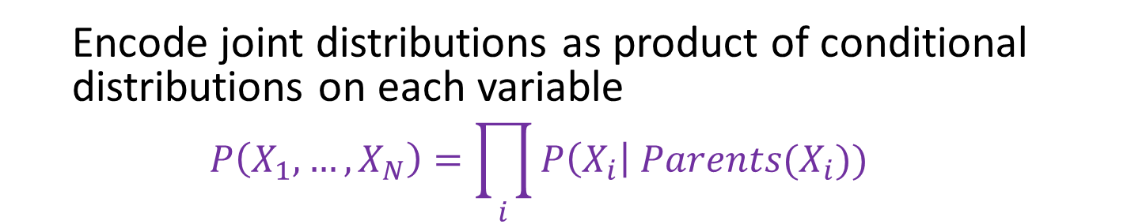



Bayesian Networks
Bayes net
One node per random variable
Directed-Acyclic-Graph
One CPT per node: P(node | Parents(node) )
$$A$$
$$B$$
$$C$$
$$D$$
$$P\left(A, B, C, D\right)=P\left(A\right) P\left(B | A\right) P\left(C | A,B\right) P\left(D | A,B,C\right)$$
Encode joint distributions as product of conditional distributions on each variable
$$P\left(X_{1},…,X_{N}\right)=\prod_{i}{P\left(X_{i}\right| Parents(X_{i})) }$$

Slide 6
Bayesian Networks
Bayes net
One node per random variable
Directed-Acyclic-Graph
One CPT per node: P(node | Parents(node) )
$$A$$
$$B$$
$$C$$
$$D$$
$P\left(A, B, C, D\right)=P\left(A\right) P\left(B | A\right) P\left(C | A,B\right) P\left(D | C\right)$
Encode joint distributions as product of conditional distributions on each variable
$$P\left(X_{1},…,X_{N}\right)=\prod_{i}{P\left(X_{i}\right| Parents(X_{i})) }$$

Slide 7
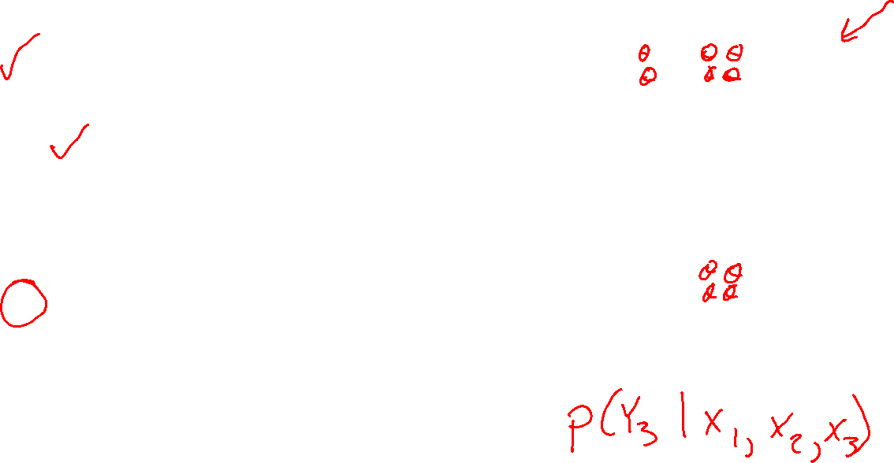
Outline
Probability primer
Generative stories and Bayes nets
Bayes nets definition
Naïve Bayes
Markov chains
Hidden Markov models
Learning HMM parameters
MLE for categorical distribution
Inference in Bayes Nets and HMMs
Y₁
Y₂
Y₃
X₁
X₂
X₃

Slide 8
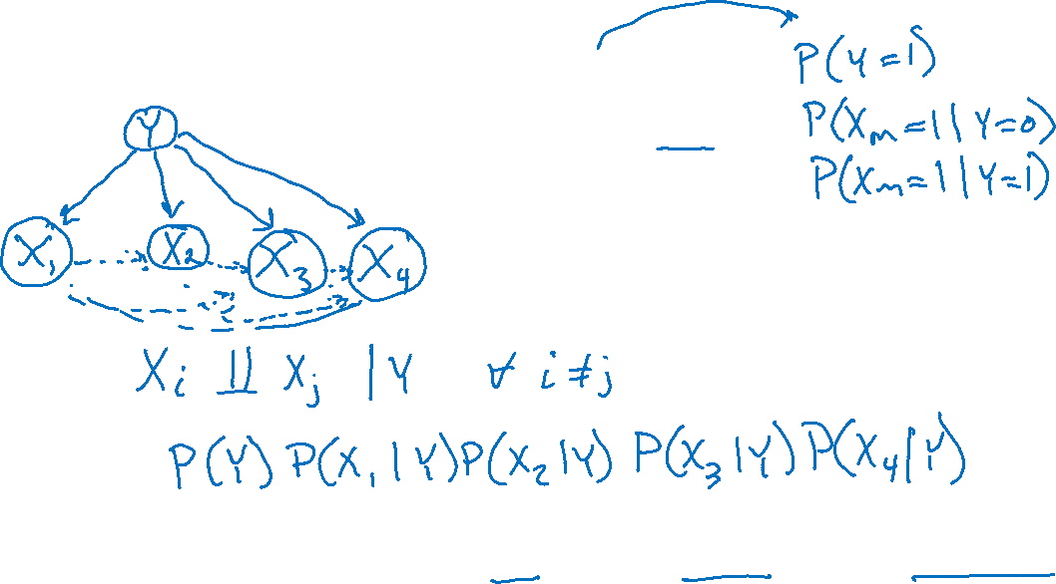



Generative Stories and Bayes Nets
SPAM: Bag of words, naïve Bayes
Generative story and Bayes net
Assumptions
Joint distribution
$$Y∼Bern(φ)$$
$$X_{m,y=0}∼Bern(θ_{m,y=0})$$
$$X_{m,y=1}∼Bern(θ_{m,y=1})$$
No assumptions:
$$P\left(Y, X_{1}, X_{2}, X_{3},X_{4}\right)=P\left(Y\right)P\left(X_{1} ∣ Y\right)P\left(X_{2} ∣ Y, X_{1}\right)P\left(X_{3} ∣ Y, X_{1}, X_{2}\right)P\left(X_{4} ∣ Y, X_{1}, X_{2}, X_{3}\right)$$

Slide 9
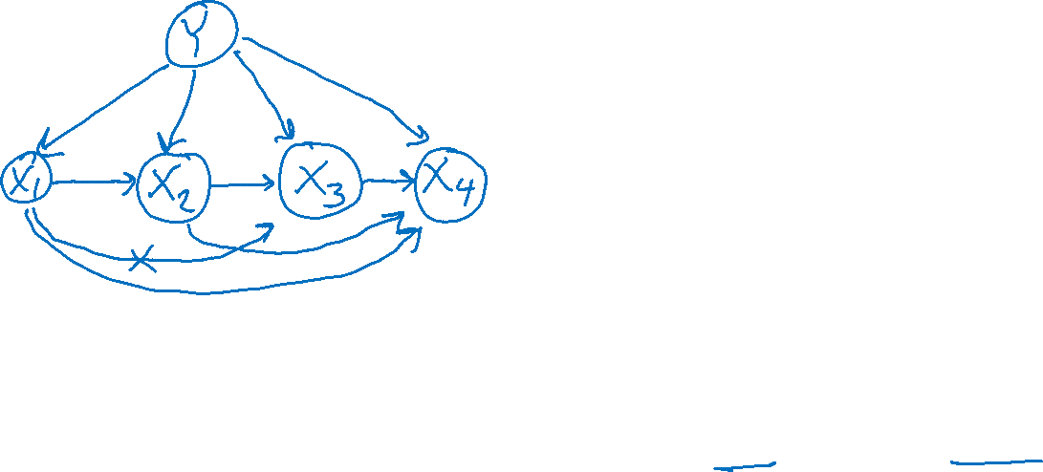



Generative Stories and Bayes Nets
News article: Bigram
Generative story and Bayes net
Joint distribution
$$Y∼Categorical(φ)$$
$$X_{m,y=0}∼Categorical(φ_{m,y=0})$$
$$X_{m,y=1}∼Categorical(φ_{m,y=1})$$
$$P\left(Y\right)P\left(X_{1} ∣ Y\right)P\left(X_{2} ∣ Y,X_{1}\right)P\left(X_{3} ∣ Y,X_{2} \right)P\left(X_{4} ∣ Y ,X_{3}\right)$$
No assumptions:
$$P\left(Y, X_{1}, X_{2}, X_{3},X_{4}\right)=P\left(Y\right)P\left(X_{1} ∣ Y\right)P\left(X_{2} ∣ Y, X_{1}\right)P\left(X_{3} ∣ Y, X_{1}, X_{2}\right)P\left(X_{4} ∣ Y, X_{1}, X_{2}{,X}_{3}\right)$$

Slide 10

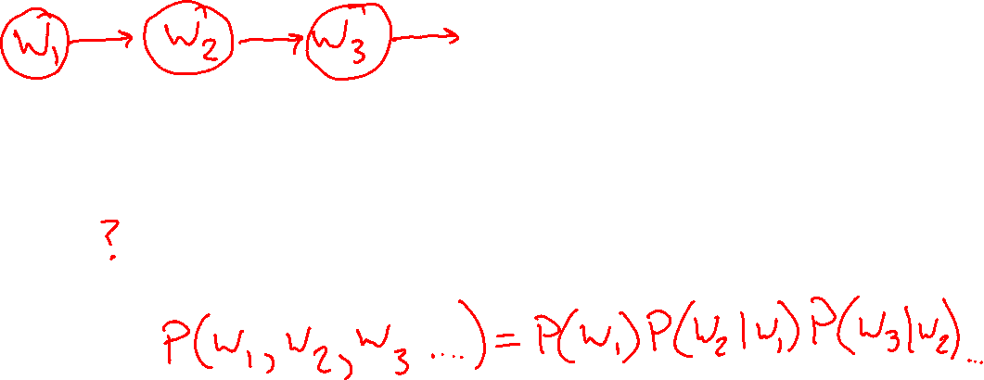
Generative Stories and Bayes Nets
Weather
Generative story and Bayes net
Assumptions
Joint distribution
Image: http://ai.berkeley.edu/

Slide 11



Markov Models
Value of Y at a given time is called the state
Parameters: called transition probabilities or dynamics, specify how the state evolves over time (also, initial state probabilities)
Stationarity assumption: transition probabilities the same at all times
Y₁
Y₂
Y₃
Y₄
$$P(Y_{1})$$
$$P(Y_{t+1}∣Y_{t})$$

Slide 12
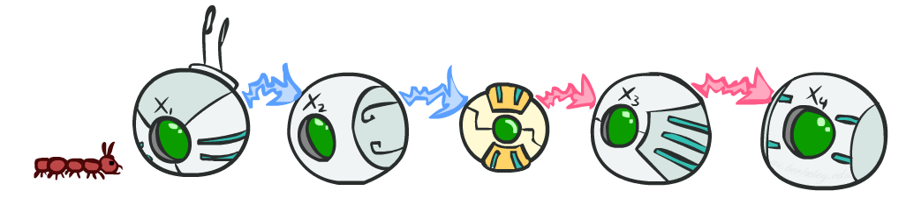
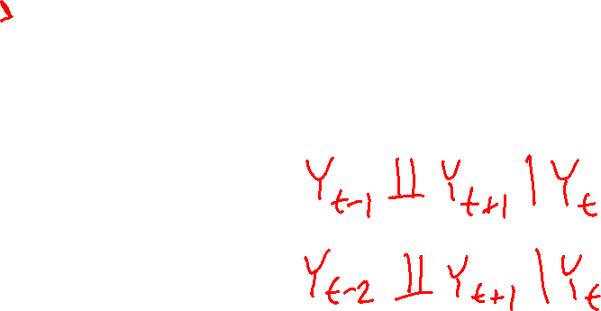
Markov Model Conditional Independence
Basic conditional independence:
Past and future independent given the present
Each time step only depends on the previous
This is called the (first order) Markov property
Image: http://ai.berkeley.edu/

Slide 13
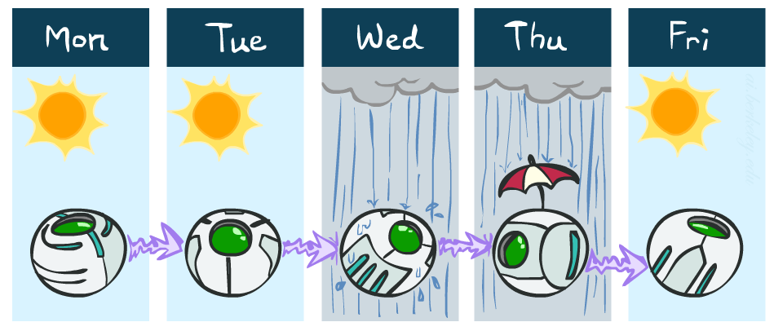

Example: Markov Chain Weather
States: Y = {rain, sun}
Initial distribution: 1.0 sun
Conditional probability table (CPT) P(Y_{t} | Y_{t-1}):
Two other ways of representing the same CPT
Y_{t-1} | Y_{t} | P(Y_{t}|Y_{t-1})
sun | sun | 0.9
sun | rain | 0.1
rain | sun | 0.3
rain | rain | 0.7
0.9
0.3
0.9
rain
sun
sun
sun
0.1
0.3
rain
rain
0.7
0.7
0.1
Image: http://ai.berkeley.edu/

Slide 14
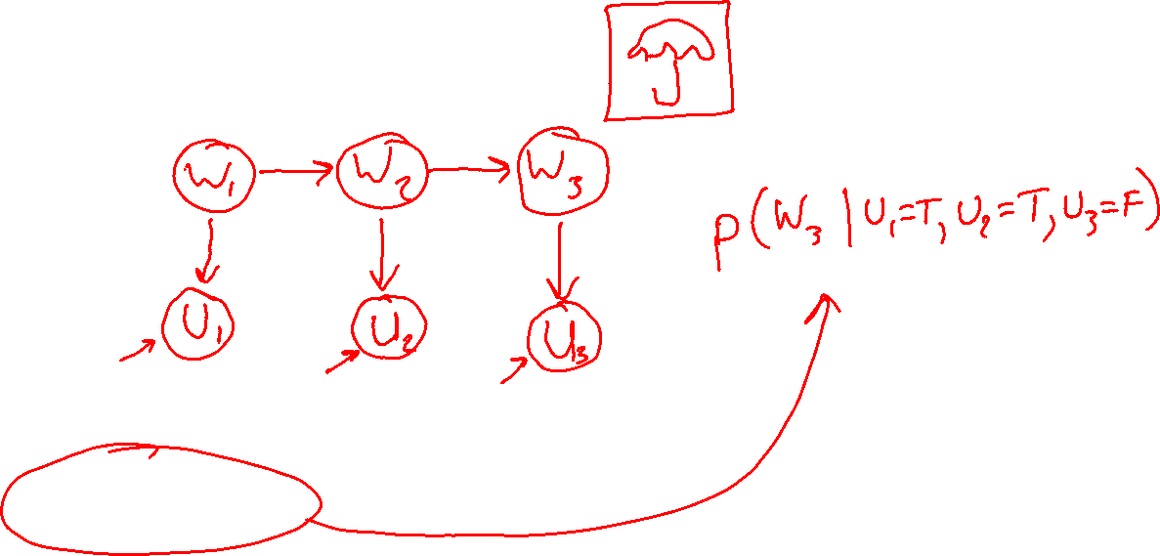
Generative Stories and Bayes Nets
Weather, Umbrella
Generative story and Bayes net
Assumptions
Joint distribution
Image: http://ai.berkeley.edu/

Slide 15

Hidden Markov Models
Image: http://ai.berkeley.edu/

Slide 16
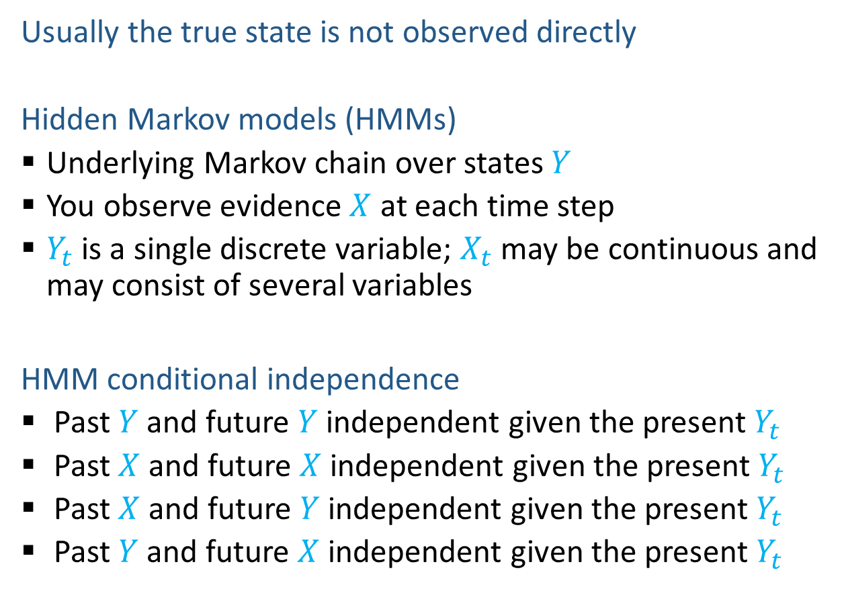
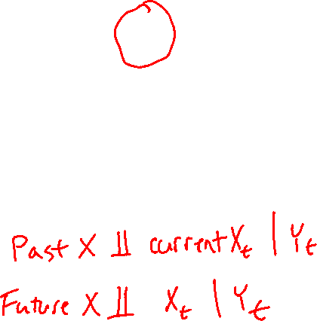
Hidden Markov Models
Usually the true state is not observed directly
Hidden Markov models (HMMs)
Underlying Markov chain over states $Y$
You observe evidence $X$ at each time step
$Y_{t}$ is a single discrete variable; $X_{t}$ may be continuous and may consist of several variables
HMM conditional independence
Past $Y$ and future $Y$ independent given the present $Y_{t}$
Past $X$ and future $X$ independent given the present $Y_{t}$
Past $X$ and future $Y$ independent given the present $Y_{t}$
Past $Y$ and future $X$ independent given the present $Y_{t}$
Y₀
Y₁
Y₂
Y₃
X₁
X₂
X₃

Slide 17
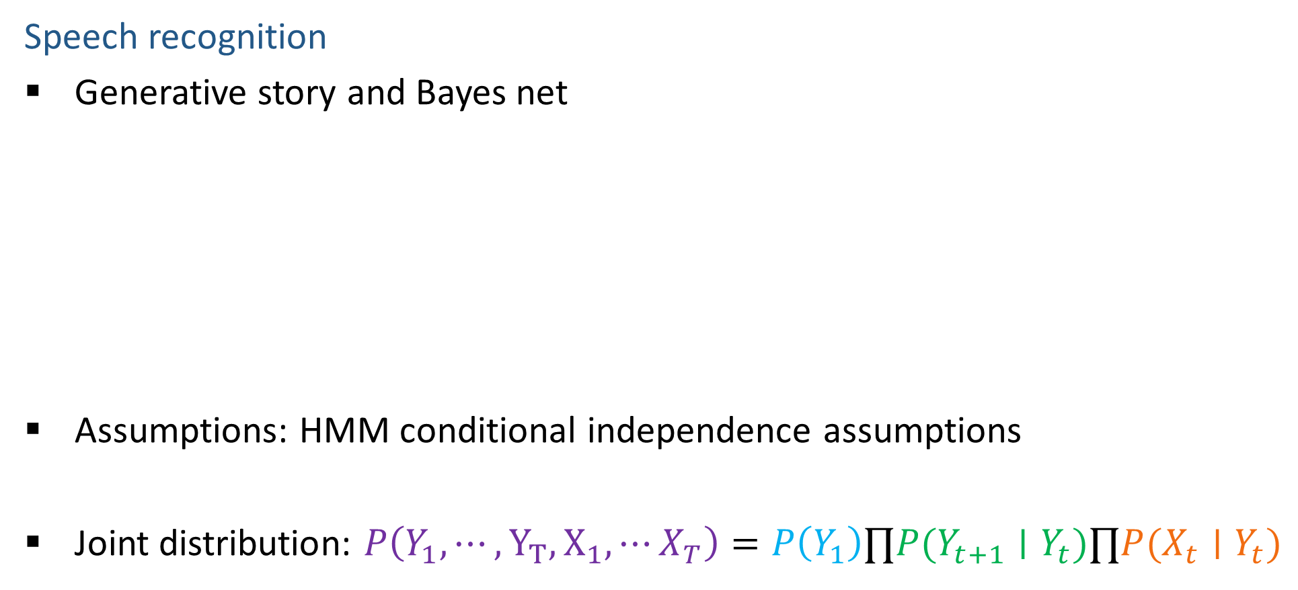
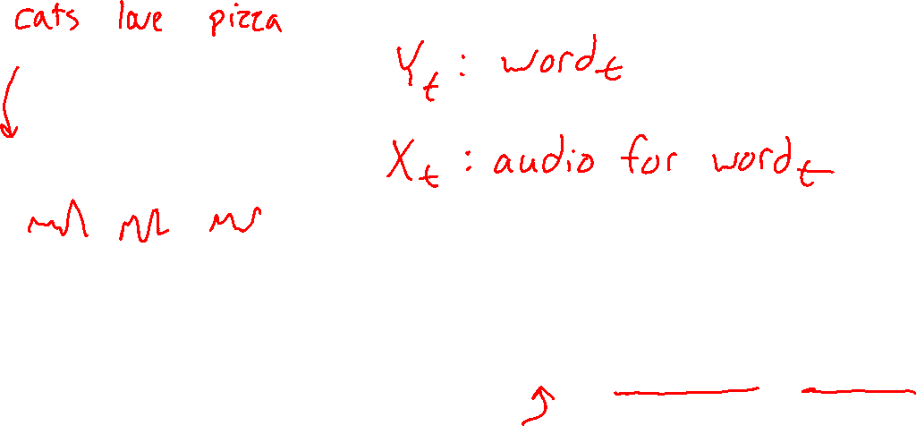
Generative Stories and Bayes Nets
Speech recognition
Generative story and Bayes net
Assumptions: HMM conditional independence assumptions
Joint distribution: $P\left(Y_{1},⋯,Y_{T}, X_{1},⋯X_{T}\right)=P\left(Y_{1}\right)∏P(Y_{t+1}∣Y_{t})∏P(X_{t}∣Y_{t})$
Y₁
Y₂
Y₃
X₁
X₂
X₃
Image: http://ai.berkeley.edu/

Slide 18
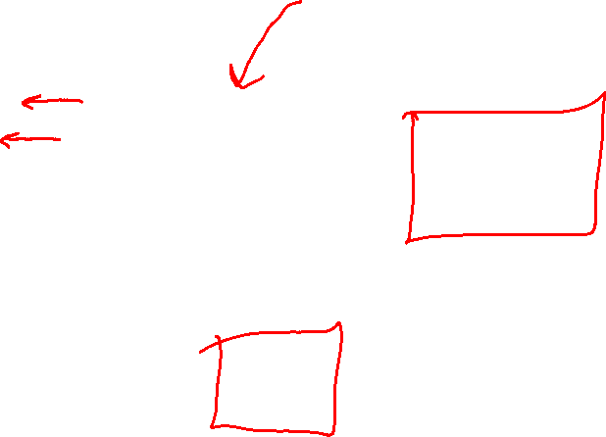
Example: Weather HMM
An HMM is defined by:
Initial distribution: P(W₀)
Transition model: P(W_{t} | W_{t-1})
Emission model: P(U_{t} | W_{t})
W_{t-1} | P(W_{t}|W_{t-1})
 | sun | rain
sun | 0.9 | 0.1
rain | 0.3 | 0.7
Weather _{t-1}
Weather _{t}
Weather _{t+1}
W_{t} | P(U_{t}|W_{t})
 | true | false
sun | 0.2 | 0.8
rain | 0.9 | 0.1
Umbrella _{t-1}
Umbrella _{t}
Umbrella _{t+1}
Image: http://ai.berkeley.edu/
Notes:
demo

Slide 19
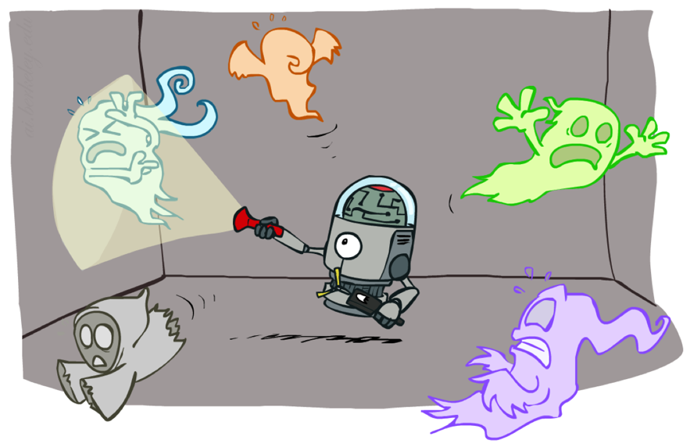
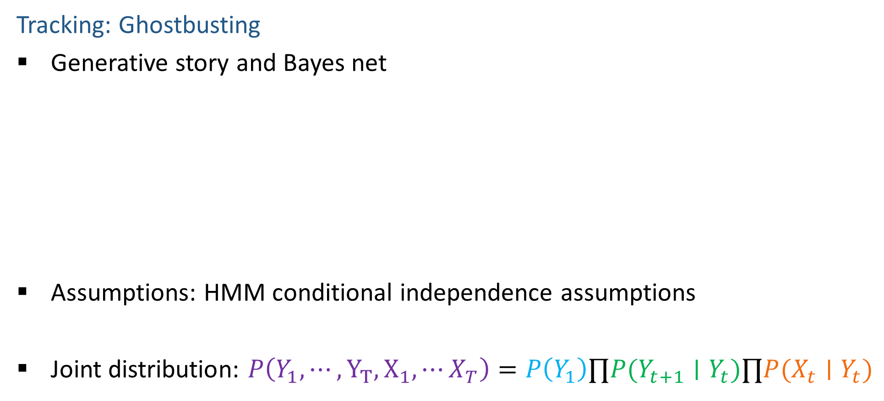

Generative Stories and Bayes Nets
Tracking: Ghostbusting
Generative story and Bayes net
Assumptions: HMM conditional independence assumptions
Joint distribution: $P\left(Y_{1},⋯,Y_{T}, X_{1},⋯X_{T}\right)=P\left(Y_{1}\right)∏P(Y_{t+1}∣Y_{t})∏P(X_{t}∣Y_{t})$
Y₁
Y₂
Y₃
X₁
X₂
X₃
Image: http://ai.berkeley.edu/

Slide 20


Example: Ghostbusters HMM
State: location of moving ghost
Observations: Color recorded by ghost sensor at clicked squares
P(Y₀) = uniform
P(Y_{t} | Y_{t-1}) = usually move clockwise, but sometimes move randomly or stay in place
P(C_{t} | Y_{t}) = sensor model: red means close, green means far away.
1/6
1/6
1/2
0
1/6
0
0
0
0
1/9
1/9
1/9
1/9
1/9
1/9
P( Y₂ | Y₁=(2,3) )
1/9
1/9
1/9
P(Y₁)
Y₀
Y₁
Y₂
Y₃
X₅
C₁
C₂
C₃
Image: http://ai.berkeley.edu/
Notes:
Dan has some demo for this.

Slide 21
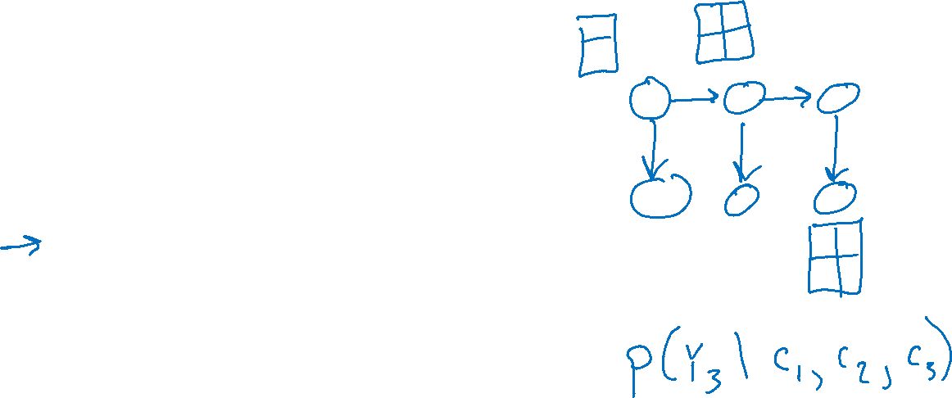
Outline
Probability primer
Generative stories and Bayes nets
Bayes nets definition
Naïve Bayes
Markov chains
Hidden Markov models
Learning HMM parameters
MLE for categorical distribution
Inference in Bayes Nets and HMMs

Slide 22
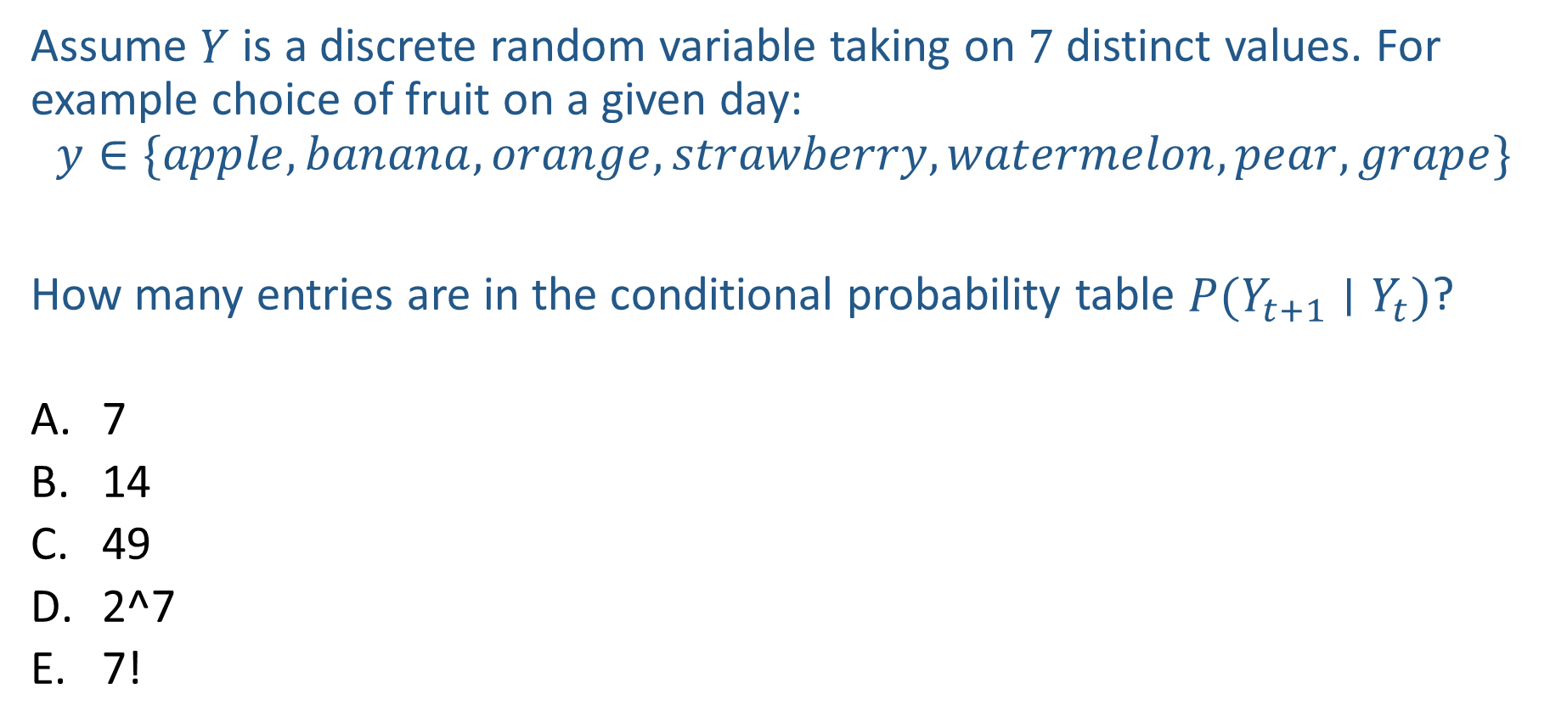
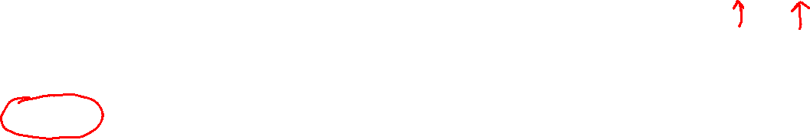
Piazza Poll 1
Assume $Y$ is a discrete random variable taking on $7$ distinct values. For example choice of fruit on a given day:
$$y∈\{apple, banana, orange, strawberry, watermelon,pear,grape\}$$
How many entries are in the conditional probability table $P(Y_{t+1}∣Y_{t})$?
7
14
49
2^7
7!

Slide 23
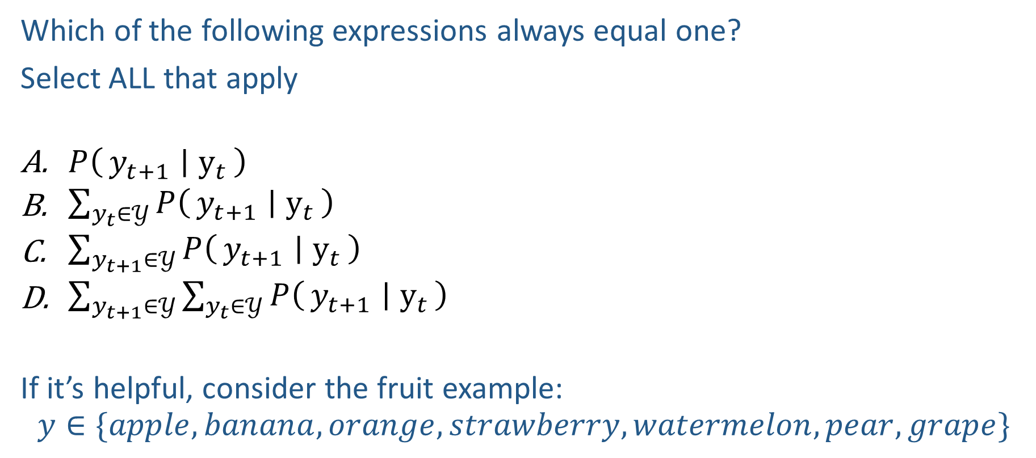

Piazza Poll 2
Which of the following expressions always equal one?
Select ALL that apply
$P\left(y_{t+1} ∣ y_{t}\right)$
$\sum_{y_{t}∈𝒴}{P\left(y_{t+1} ∣ y_{t}\right)}$
$\sum_{y_{t+1}∈𝒴}{P\left(y_{t+1} ∣ y_{t}\right)}$
$\sum_{y_{t+1}∈𝒴}{\sum_{y_{t}∈𝒴}{P\left(y_{t+1} ∣ y_{t}\right)}}$
If it’s helpful, consider the fruit example:
$$y∈\{apple, banana, orange, strawberry, watermelon,pear,grape\}$$

Slide 24
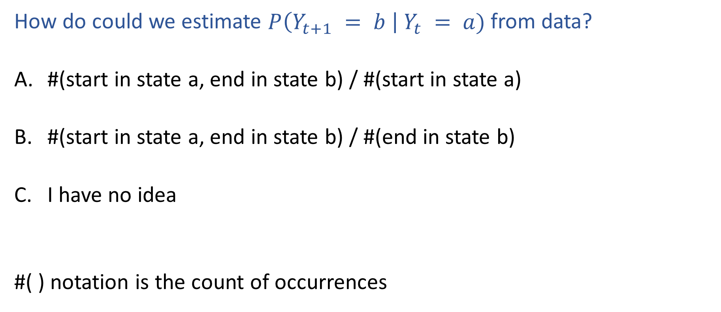

Piazza Poll 3
How do could we estimate $P\left(Y_{t+1} = b \right| Y_{t} = a)$ from data?
#(start in state a, end in state b) / #(start in state a)
#(start in state a, end in state b) / #(end in state b)
I have no idea
#( ) notation is the count of occurrences

Slide 25
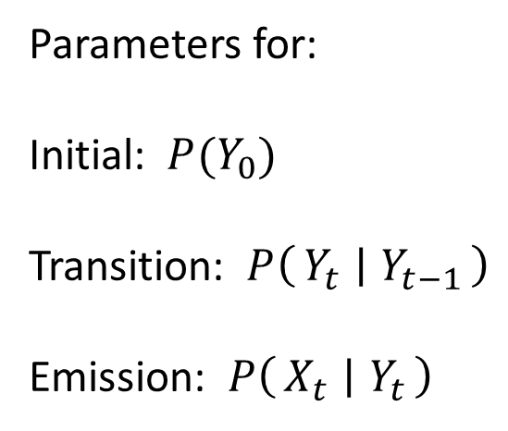
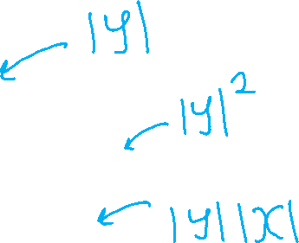
HMM MLE
Estimate probabilities of categorical distributions
Y₀
Y₁
Y₂
Y₃
Parameters for:
Initial: $P(Y_{0})$
Transition: $P\left(Y_{t} ∣ Y_{t−1}\right)$
Emission: $P\left(X_{t} ∣ Y_{t}\right)$
X₁
X₂
X₃

Slide 26
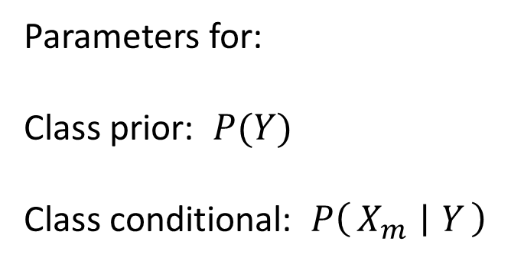
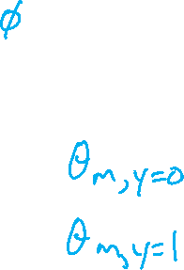
Reminder: Naïve Bayes MLE
SPAM: Bag of words, naïve Bayes
Y
Parameters for:
Class prior: $P(Y)$
Class conditional: $P\left(X_{m} ∣ Y\right)$
X₁
X₂
X₃

Slide 27

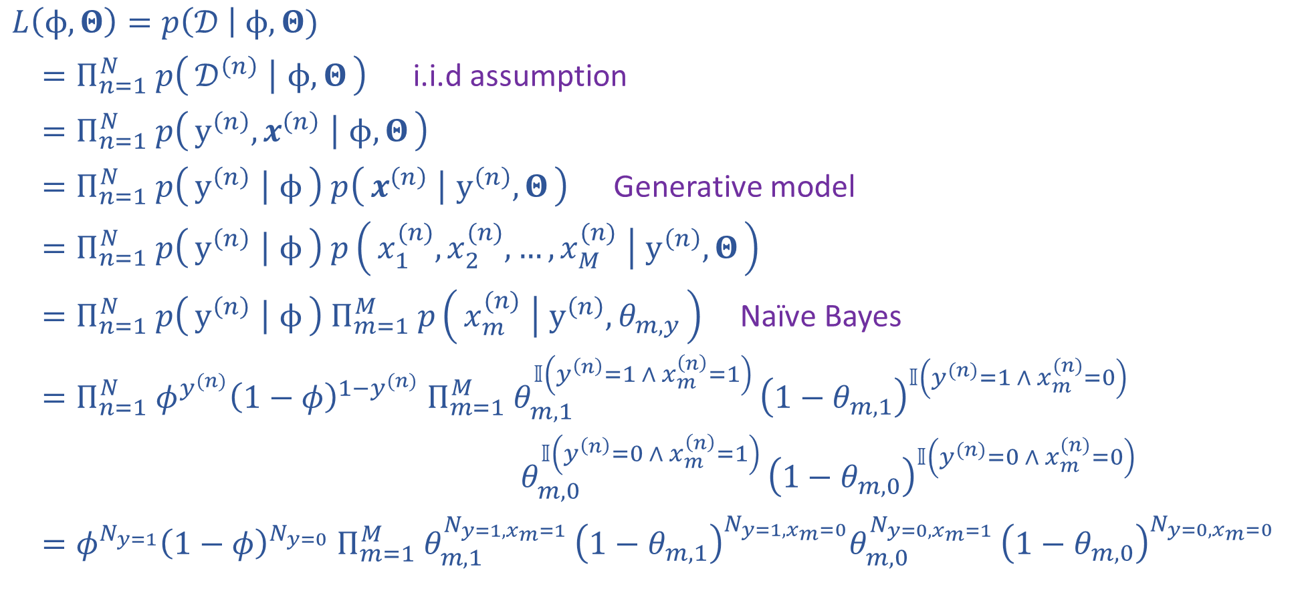
Reminder: Naïve Bayes MLE
$𝒟={\left\{y^{\left(n\right)}, x^{(n)}\right\}}_{n=1}^{N}$
$y^{(n)}∈\{0,1\}$
$x^{(n)}∈{\left\{0,1\right\}}^{M}$
$φ∈[0,1]$
$Θ∈{\left[0,1\right]}^{Mx2}$
$L\left(ϕ, Θ\right)=p\left(𝒟 \right| ϕ, Θ)$
$=Π_{n=1}^{N} p\left(𝒟^{\left(n\right)} ∣ ϕ, Θ\right)$ i.i.d assumption
$=Π_{n=1}^{N} p\left(y^{\left(n\right)}, x^{\left(n\right)} ∣ ϕ, Θ\right)$
$=Π_{n=1}^{N} p\left(y^{\left(n\right)} ∣ ϕ\right) p\left(x^{\left(n\right)} ∣ y^{\left(n\right)}, Θ\right)$ Generative model
$=Π_{n=1}^{N} p\left(y^{\left(n\right)} ∣ ϕ\right) p\left(x_{1}^{(n)},x_{2}^{(n)},…,x_{M}^{(n)} ∣ y^{\left(n\right)}, Θ\right)$
$=Π_{n=1}^{N} p\left(y^{\left(n\right)} ∣ ϕ\right) Π_{m=1}^{M} p\left(x_{m}^{(n)} ∣ y^{\left(n\right)}, θ_{m,y}\right)$ Naïve Bayes
$=Π_{n=1}^{N} φ^{y^{(n)}}{\left(1−φ\right)}^{1−y^{(n)}} Π_{m=1}^{M} θ_{m,1}^{𝕀\left(y^{\left(n\right)}=1 ∧ x_{m}^{\left(n\right)}=1\right) }{\left(1−θ_{m,1}\right)}^{𝕀\left(y^{(n)}=1 ∧ x_{m}^{(n)}=0\right)}$
$θ_{m,0}^{𝕀\left(y^{\left(n\right)}=0 ∧ x_{m}^{\left(n\right)}=1\right) }{\left(1−θ_{m,0}\right)}^{𝕀\left(y^{(n)}=0 ∧ x_{m}^{(n)}=0\right)}$
$=φ^{N_{y=1}}{\left(1−φ\right)}^{N_{y=0}} Π_{m=1}^{M} θ_{m,1}^{N_{y=1,x_{m}=1} }{\left(1−θ_{m,1}\right)}^{N_{y=1,x_{m}=0}}θ_{m,0}^{N_{y=0,x_{m}=1} }{\left(1−θ_{m,0}\right)}^{N_{y=0,x_{m}=0}}$

Slide 28
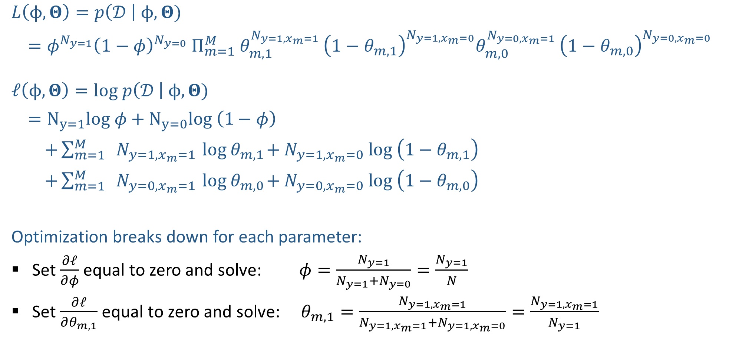

Reminder: Naïve Bayes MLE
$L\left(ϕ, Θ\right)=p\left(𝒟 \right| ϕ, Θ)$
$=φ^{N_{y=1}}{\left(1−φ\right)}^{N_{y=0}} Π_{m=1}^{M} θ_{m,1}^{N_{y=1,x_{m}=1} }{\left(1−θ_{m,1}\right)}^{N_{y=1,x_{m}=0}}θ_{m,0}^{N_{y=0,x_{m}=1} }{\left(1−θ_{m,0}\right)}^{N_{y=0,x_{m}=0}}$
$ℓ\left(ϕ, Θ\right)=log p\left(𝒟 \right| ϕ, Θ)$
$=N_{y=1}log φ+N_{y=0}log \left(1−φ\right)$
$+\sum_{m=1}^{M}{ N_{y=1,x_{m}=1}{ log θ}_{m,1}+N_{y=1,x_{m}=0} log \left(1−θ_{m,1}\right)}$
$+\sum_{m=1}^{M}{ N_{y=0,x_{m}=1}{ log θ}_{m,0}+N_{y=0,x_{m}=0} log \left(1−θ_{m,0}\right)}$
Optimization breaks down for each parameter:
Set $\frac{∂ℓ}{∂φ}$ equal to zero and solve: $φ=\frac{N_{y=1}}{N_{y=1}+N_{y=0}}=\frac{N_{y=1}}{N}$
Set $\frac{∂ℓ}{∂θ_{m,1}}$ equal to zero and solve: $θ_{m,1}=\frac{N_{y=1,x_{m}=1}}{N_{y=1,x_{m}=1}+N_{y=1,x_{m}=0}}=\frac{N_{y=1,x_{m}=1}}{N_{y=1}}$

Slide 29
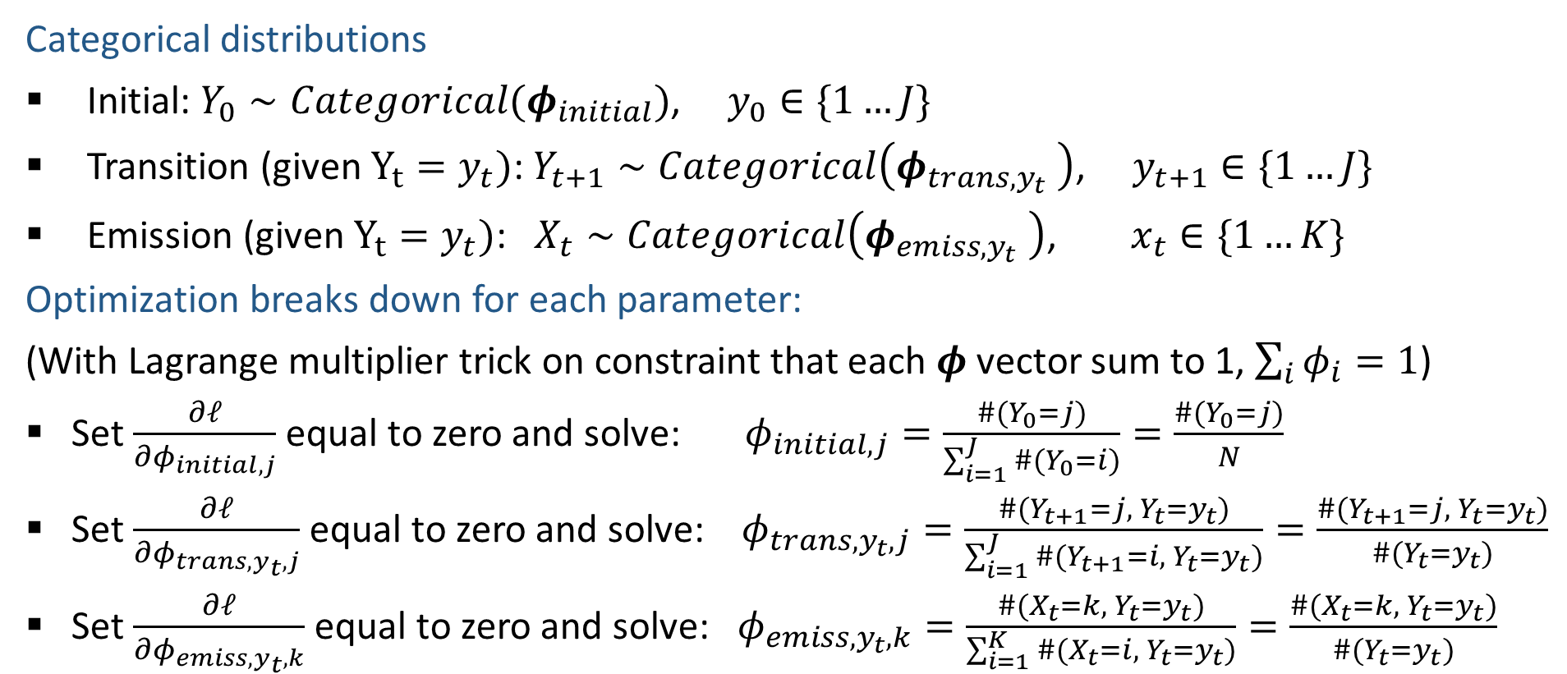
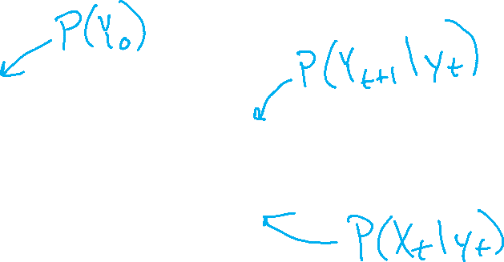
HMM MLE
Categorical distributions
Initial: $Y_{0}∼Categorical(φ_{initial})$, $y_{0}∈\{1…J\}$
Transition (given $Y_{t}=y_{t})$: $Y_{t+1}∼Categorical\left(φ_{trans,y_{t}} \right)$, $y_{t+1}∈\{1…J\}$
Emission (given $Y_{t}=y_{t})$: $X_{t}∼Categorical\left(φ_{emiss,y_{t}} \right)$, $x_{t}∈\{1…K\}$
Optimization breaks down for each parameter:
(With Lagrange multiplier trick on constraint that each $φ$ vector sum to 1, $\sum_{i}{φ_{i}}=1$)
Set $\frac{∂ℓ}{∂φ_{initial, j}}$ equal to zero and solve: $φ_{initial,j}=\frac{\#(Y_{0}=j)}{\sum_{i=1}^{J}{\#(Y_{0}=i)}}=\frac{\#(Y_{0}=j)}{N}$
Set $\frac{∂ℓ}{∂φ_{trans,y_{t}, j}}$ equal to zero and solve: $φ_{trans,y_{t},j}=\frac{\#(Y_{t+1}=j, { Y}_{t}=y_{t})}{\sum_{i=1}^{J}{\#(Y_{t+1}=i, { Y}_{t}=y_{t})}}=\frac{\#(Y_{t+1}=j, { Y}_{t}=y_{t})}{\#(Y_{t}=y_{t})}$
Set $\frac{∂ℓ}{∂φ_{emiss,y_{t}, k}}$ equal to zero and solve: $φ_{emiss,y_{t},k}=\frac{\#(X_{t}=k, { Y}_{t}=y_{t})}{\sum_{i=1}^{K}{\#(X_{t}=i, { Y}_{t}=y_{t})}}=\frac{\#(X_{t}=k, { Y}_{t}=y_{t})}{\#(Y_{t}=y_{t})}$

Slide 30

Outline
Probability primer
Generative stories and Bayes nets
Bayes nets definition
Naïve Bayes
Markov chains
Hidden Markov models
Learning HMM parameters
MLE for categorical distribution
Inference in Bayes Nets and HMMs

Slide 31
Outline
Probability primer
Generative stories and Bayes nets
Bayes nets definition
Naïve Bayes
Markov chains
Hidden Markov models
Learning HMM parameters
MLE for categorical distribution
Inference in Bayes Nets and HMMs

Slide 32
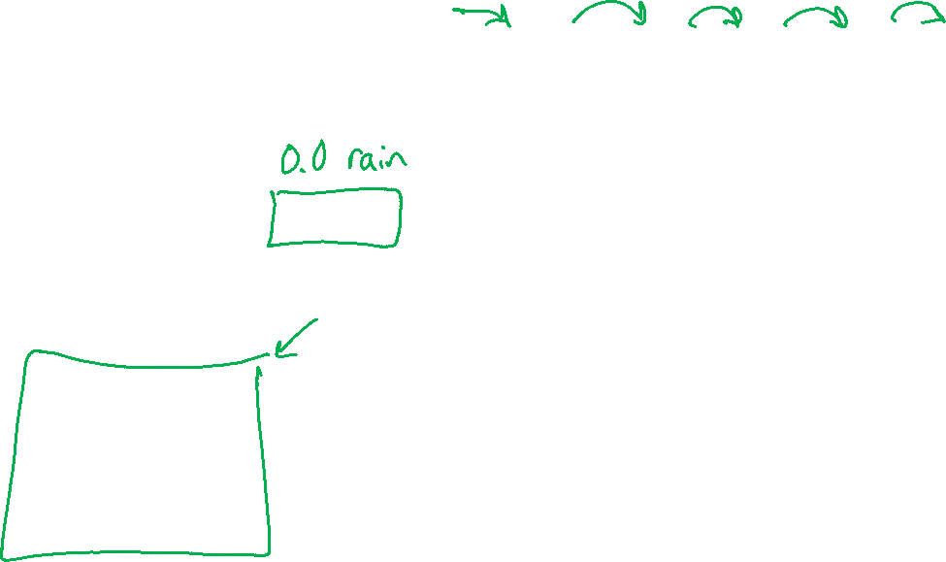
Example: Markov Chain Weather
States: Y = {rain, sun}
Initial distribution: 1.0 sun
Conditional probability table (CPT) P(Y_{t} | Y_{t-1}):
Two other ways of representing the same CPT
Y_{t-1} | Y_{t} | P(Y_{t}|Y_{t-1})
sun | sun | 0.9
sun | rain | 0.1
rain | sun | 0.3
rain | rain | 0.7
0.9
0.3
0.9
rain
sun
sun
sun
0.1
0.3
rain
rain
0.7
0.7
0.1
Image: http://ai.berkeley.edu/

Slide 33
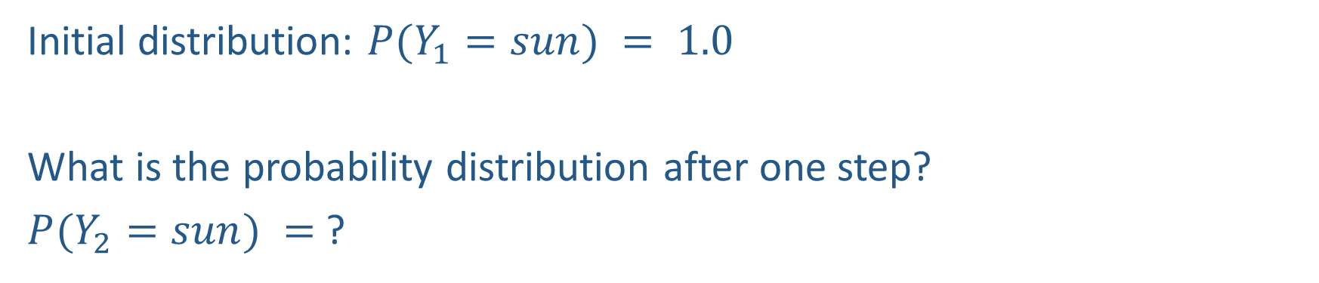
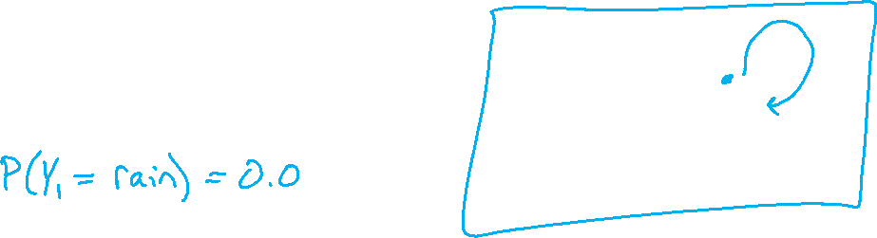
Example: Markov Chain Weather
0.9
0.3
rain
sun
Initial distribution: $P(Y_{1}=sun) = 1.0$
What is the probability distribution after one step?
$P(Y_{2}=sun) =$ ?
0.7
0.1

Slide 34
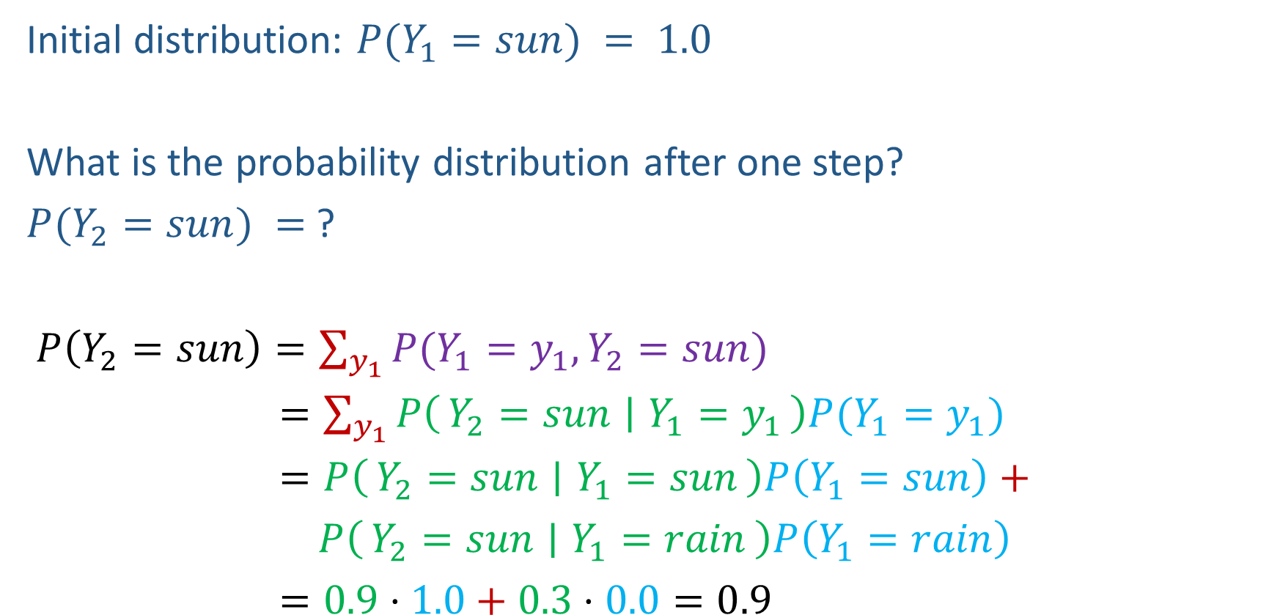
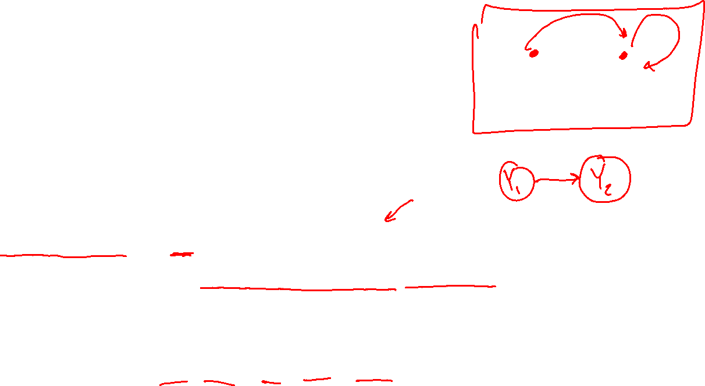
Example: Markov Chain Weather
0.9
0.3
rain
sun
Initial distribution: $P(Y_{1}=sun) = 1.0$
What is the probability distribution after one step?
$P(Y_{2}=sun) =$ ?
$P\left(Y_{2}=sun\right)=\sum_{y_{1}}{P(Y_{1}=y_{1}, Y_{2}=sun})$
$=\sum_{y_{1}}{P\left(Y_{2}=sun ∣ Y_{1}=y_{1}\right)P(Y_{1}=y_{1}})$
$=P\left(Y_{2}=sun ∣ Y_{1}=sun\right)P\left(Y_{1}=sun\right)+$
$P\left(Y_{2}=sun ∣ Y_{1}=rain\right)P\left(Y_{1}=rain\right)$
$=0.9⋅1.0+0.3⋅0.0=0.9$
0.7
0.1

Slide 35
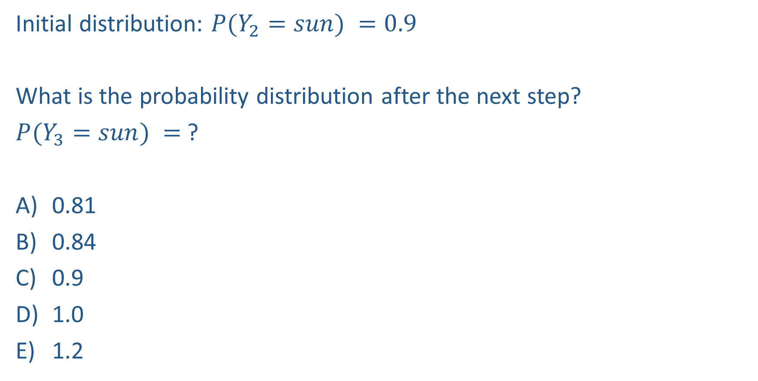
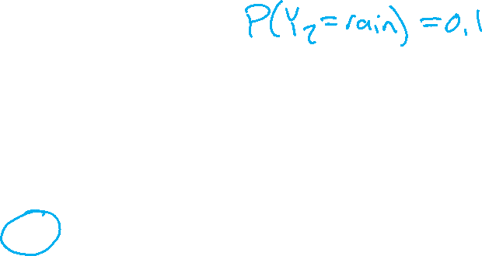
Piazza Poll 4
0.9
0.3
rain
sun
Initial distribution: $P(Y_{2}=sun) =0.9$
What is the probability distribution after the next step?
$P(Y_{3}=sun) =$ ?
0.81
0.84
0.9
1.0
1.2
0.7
0.1

Slide 36
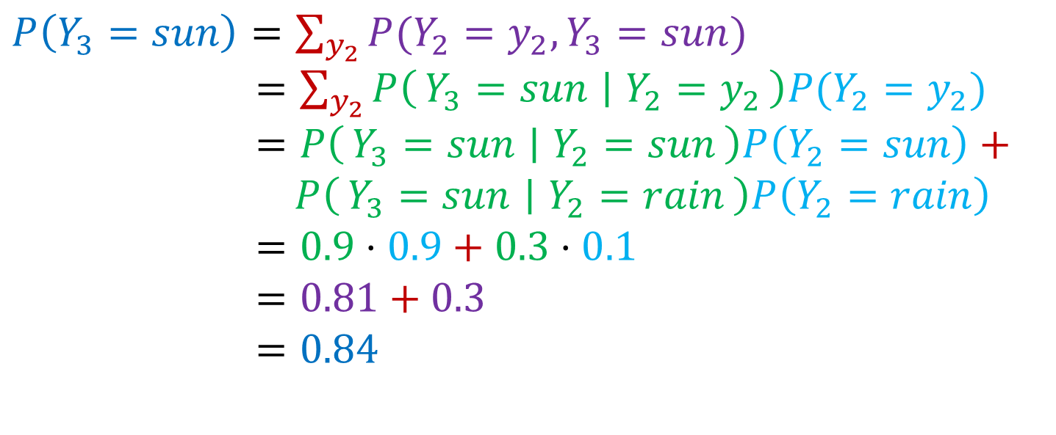
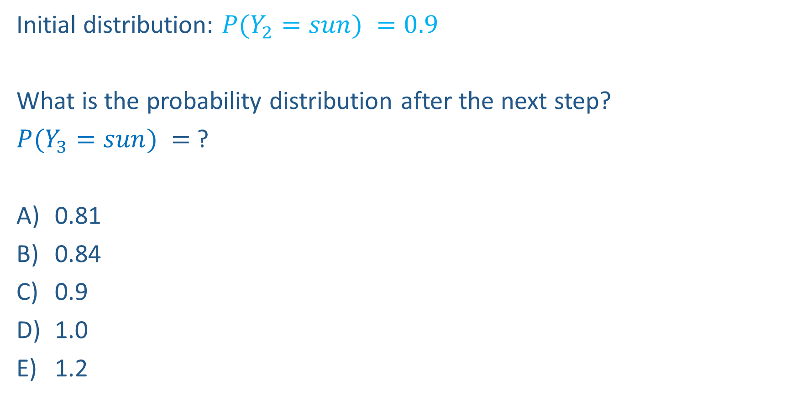
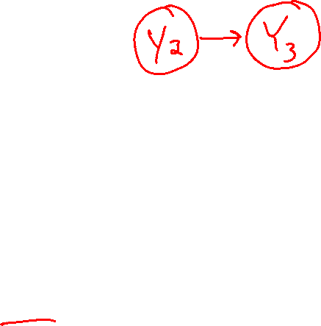
Piazza Poll 4
0.9
0.3
rain
sun
Initial distribution: $P(Y_{2}=sun) =0.9$
What is the probability distribution after the next step?
$P(Y_{3}=sun) =$ ?
0.81
0.84
0.9
1.0
1.2
0.7
0.1
$P\left(Y_{3}=sun\right)=\sum_{y_{2}}{P(Y_{2}=y_{2}, Y_{3}=sun})$
$=\sum_{y_{2}}{P\left(Y_{3}=sun ∣ Y_{2}=y_{2}\right)P(Y_{2}=y_{2}})$
$=P\left(Y_{3}=sun ∣ Y_{2}=sun\right)P\left(Y_{2}=sun\right)+$
$P\left(Y_{3}=sun ∣ Y_{2}=rain\right)P\left(Y_{2}=rain\right)$
$=0.9⋅0.9+0.3⋅0.1$
$=0.81+0.3$
$=0.84$

Slide 37
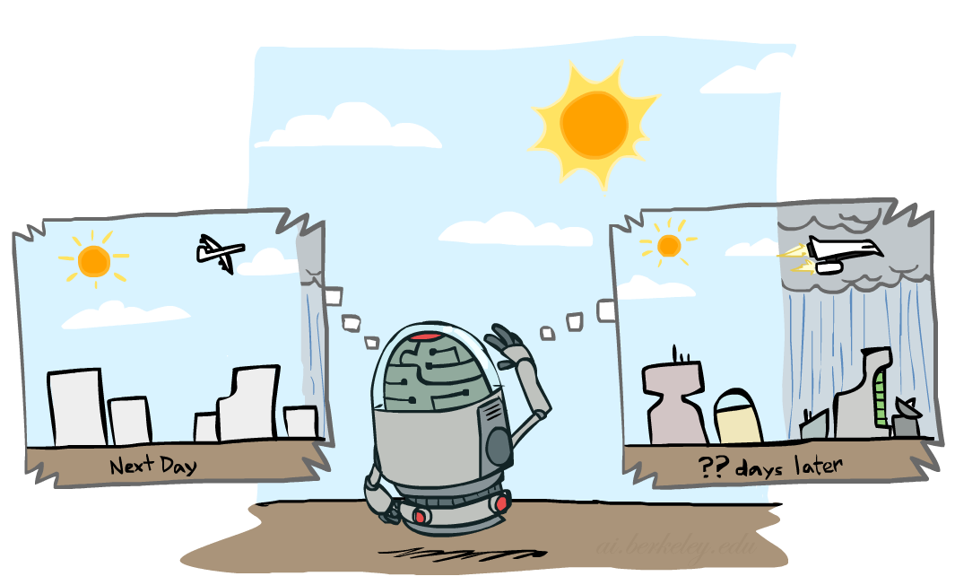
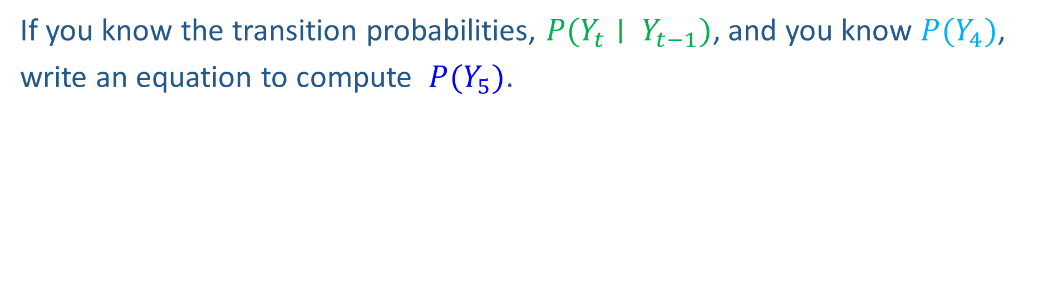
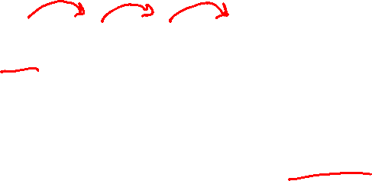
Markov Chain Inference
Y₁
Y₂
Y₃
Y₄
If you know the transition probabilities, $P(Y_{t}∣ Y_{t−1})$, and you know $P(Y_{4})$,
write an equation to compute $P(Y_{5})$.
Image: http://ai.berkeley.edu/

Slide 38
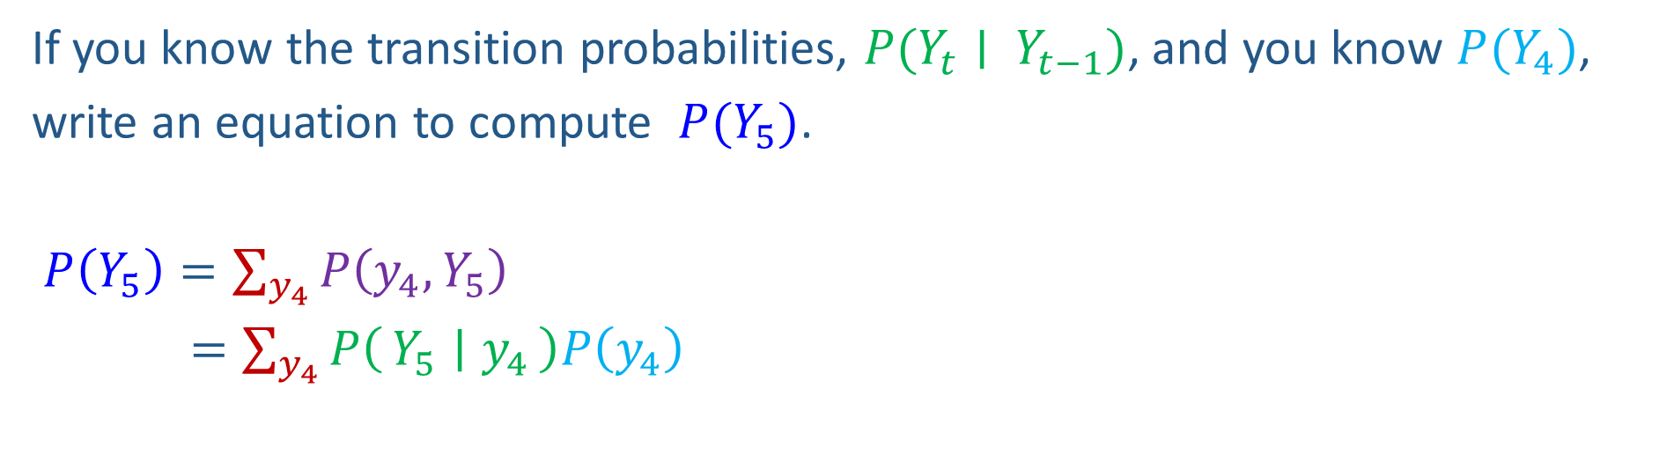

Markov Chain Inference
Y₁
Y₂
Y₃
Y₄
If you know the transition probabilities, $P(Y_{t}∣ Y_{t−1})$, and you know $P(Y_{4})$,
write an equation to compute $P(Y_{5})$.
$P\left(Y_{5}\right)=\sum_{y_{4}}{P\left(y_{4},Y_{5}\right)}$
$=\sum_{y_{4}}{P\left(Y_{5} ∣ y_{4}\right)P\left(y_{4}\right)}$

Slide 39
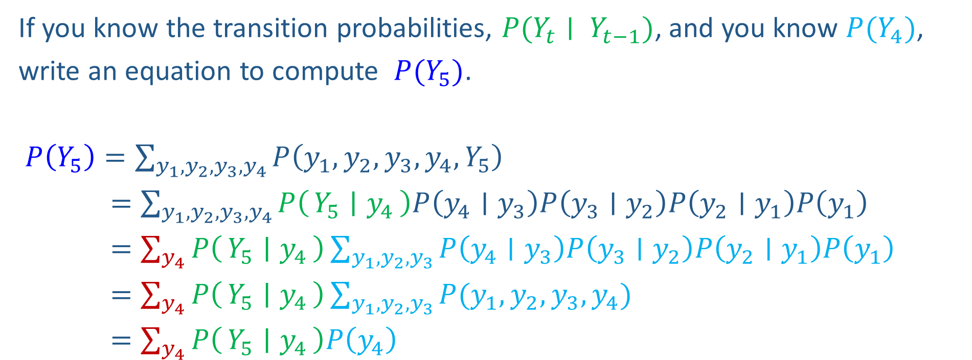
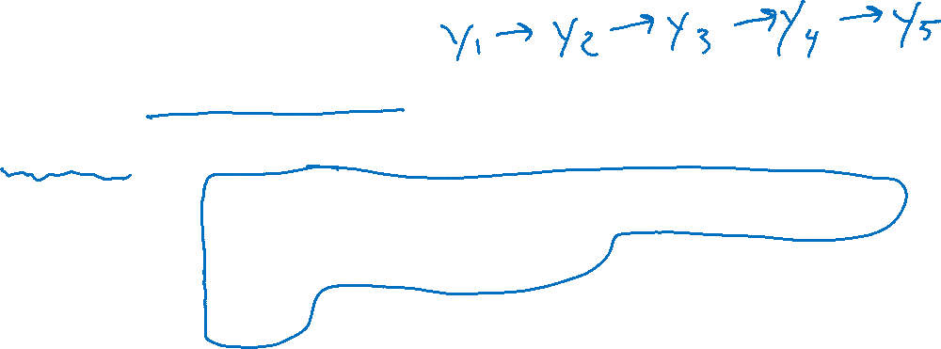
Markov Chain Inference
Y₁
Y₂
Y₃
Y₄
If you know the transition probabilities, $P(Y_{t}∣ Y_{t−1})$, and you know $P(Y_{4})$,
write an equation to compute $P(Y_{5})$.
$P\left(Y_{5}\right)=\sum_{{y_{1},y_{2}, y_{3},y}_{4}}{P\left({y_{1},y_{2},y_{3},y}_{4},Y_{5}\right)}$
$=\sum_{{y_{1},y_{2}, y_{3},y}_{4}}{P\left(Y_{5} ∣ y_{4}\right)P\left(y_{4}∣y_{3}\right)P\left(y_{3}∣y_{2}\right)P\left(y_{2}∣y_{1}\right)P\left(y_{1}\right)}$
$=\sum_{y_{4}}{P\left(Y_{5} ∣ y_{4}\right)}\sum_{y_{1},y_{2}, y_{3}}{P\left(y_{4}∣y_{3}\right)P\left(y_{3}∣y_{2}\right)P\left(y_{2}∣y_{1}\right)P\left(y_{1}\right)}$
$=\sum_{y_{4}}{P\left(Y_{5} ∣ y_{4}\right)}\sum_{y_{1},y_{2}, y_{3}}{P(y_{1},y_{2},y_{3},y_{4})}$
$=\sum_{y_{4}}{P\left(Y_{5} ∣ y_{4}\right)P\left(y_{4}\right)}$

Slide 40
Example: Markov Chain Weather
States {rain, sun}
Initial distribution P(Y₀)
Transition model P(X_{t} | X_{t-1})
P(Y₀)
sun | rain
0.5 | 0.5
Two other ways of representing the same CPT
0.9
0.3
Y_{t-1} | P(Y_{t}|Y_{t-1})
 | sun | rain
sun | 0.9 | 0.1
rain | 0.3 | 0.7
0.9
rain
sun
sun
sun
0.1
0.3
rain
rain
0.7
0.7
0.1
Image: http://ai.berkeley.edu/

Slide 41

Weather prediction
Y_{t-1} | P(Y_{t}|Y_{t-1})
 | sun | rain
sun | 0.9 | 0.1
rain | 0.3 | 0.7
Time 0: P(Y₀) =<0.5,0.5>
What is the weather like at time 1?
P(Y₁) =
∑_{y0} P(Y₀=y_{0,} Y₁)
= ∑_{y0} P(Y₁| Y₀=y₀) P(Y₀=y₀)
= 0.5<0.9,0.1> + 0.5<0.3,0.7>
= <0.6,0.4>
Y₀
Y₁
Image: http://ai.berkeley.edu/

Slide 42
Weather prediction, contd.
Y_{t-1} | P(Y_{t}|Y_{t-1})
 | sun | rain
sun | 0.9 | 0.1
rain | 0.3 | 0.7
Time 1: P(Y₁) =<0.6,0.4>
What is the weather like at time 2?
P(Y₂) =
∑_{y1} P(Y₁=y₁, Y₂)
= ∑_{y1} P(Y₂| Y₁=y₁) P(Y₁=y₁)
= 0.6<0.9,0.1> + 0.4<0.3,0.7>
= <0.66,0.34>
Y₀
Y₁
Y₂
Image: http://ai.berkeley.edu/

Slide 43
Weather prediction, contd.
Y_{t-1} | P(Y_{t}|Y_{t-1})
 | sun | rain
sun | 0.9 | 0.1
rain | 0.3 | 0.7
Time 2: P(Y₂) =<0.66,0.34>
What is the weather like at time 3?
P(Y₃) =
∑_{y2} P(Y₂=y₂, Y₃)
= ∑_{y2} P(Y₃| Y₂=y₂) P(Y₂=y₂)
= 0.66<0.9,0.1> + 0.34<0.3,0.7>
= <0.696,0.304>
Y₁
Y₂
Y₃
Image: http://ai.berkeley.edu/

Slide 44
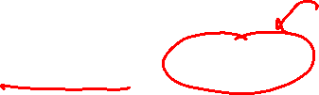
Forward algorithm (simple form)
Probability from previous iteration
What is the state at time t?
P(Y_{t}) = ∑_{yt-1} P(Y_{t-1}=y_{t-1}, Y_{t})
= ∑_{yt-1} P(Y_{t}| Y_{t-1}=y_{t-1}) P(Y_{t-1}=y_{t-1})
Iterate this update starting at t=1
Transition model

Slide 45
Inference: Hidden Markov Models
Image: http://ai.berkeley.edu/

Slide 46
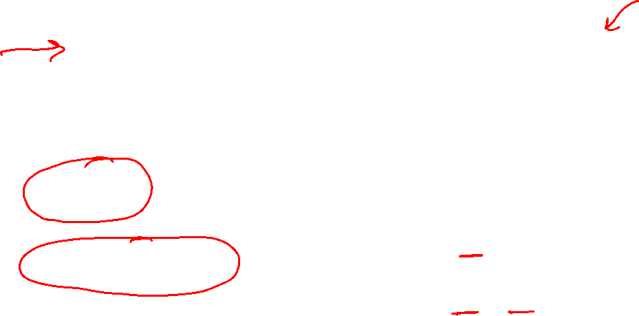
HMM as Probability Model
Joint distribution for Markov model:
P(Y₀,…, Y_{T}) = P(Y₀) ∏_{t=1:T} P(Y_{t} | Y_{t-1})
Joint distribution for hidden Markov model:
P(Y₀, Y₁,X₁, …, Y_{T},X_{T}) = P(Y₀) ∏_{t=1:T} P(Y_{t} | Y_{t-1}) P(X_{t} | Y_{t})
Future states are independent of the past given the present
Current evidence is independent of everything else given the current state
Are evidence variables independent of each other?
Y₀
Y₁
Y₂
Y₃
X₅
Notation alert!
Useful notation: Y_{a:b} = Y_{a} , Y_{a+1}, …, Y_{b}
For example: P(Y_{1:2} | x_{1:3}) = P(Y₁, Y₂, | x₁ , x₂, x₃)
x₁
x₂
x₃
E₅
Notes:
Add conditional independence consequences here

Slide 47
HMM Queries
Filtering: P(Y_{t}|x_{1:t})
Prediction: P(Y_{t+k}|x_{1:t})
Y₁
Y₂
Y₃
Y₄
Y₁
Y₂
Y₃
Y₄
Y₅
x₁
x₂
x₃
x₄
x₁
x₂
x₃
Smoothing: P(Y_{k}|x_{1:t}), k<t
Explanation: P(Y_{1:t}|x_{1:t})
Y₁
Y₂
Y₃
Y₄
Y₁
Y₂
Y₃
Y₄
x₁
x₂
x₃
x₄
x₁
x₂
x₃
x₄

