Slide 1

Announcements
Midterm 2
Mon, 11/9, during lecture
See Piazza for details
Schedule change
Lecture on Friday instead of recitation
Pre-recorded
Suggested that you watch during your recitation timeslot
TAs will be available during the Zoom session
Any polls will be open all day

Slide 2
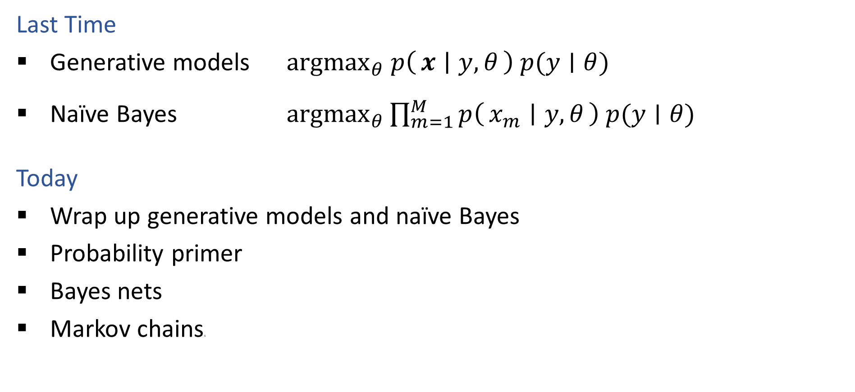
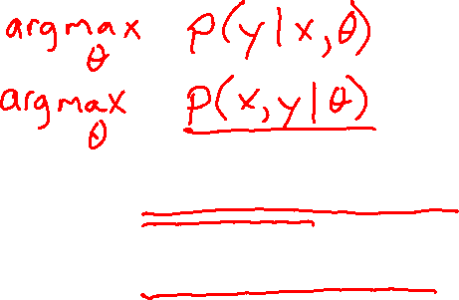
Plan
Last Time
Generative models ${argmax}_{θ} p\left(x ∣ y, θ\right) p(y∣θ)$
Naïve Bayes ${argmax}_{θ}\prod_{m=1}^{M}{p\left(x_{m} ∣ y, θ\right) p(y∣θ)}$
Today
Wrap up generative models and naïve Bayes
Probability primer
Bayes nets
Markov chainss

Slide 3
Wrap Up Generative Models and Naïve Bayes
Generative models and naïve Bayes slides…

Slide 4

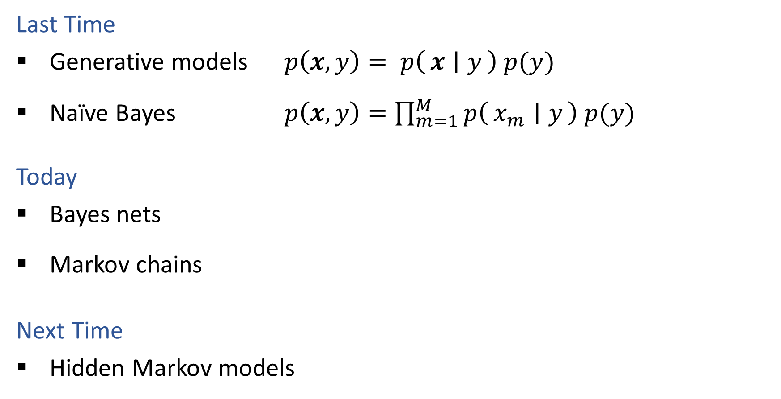
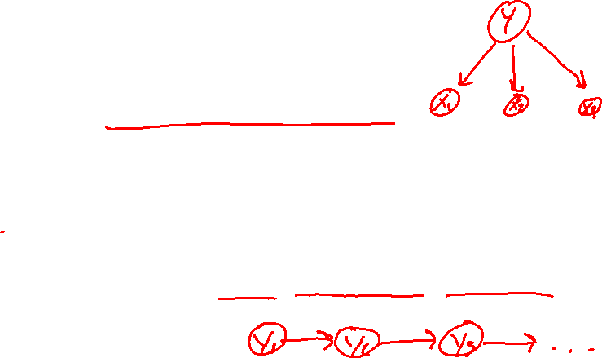
Plan
$p\left(z_{1}, z_{2}, z_{3}, z_{4},z_{5}\right)=\prod_{i}{p\left(z_{i} ∣ parents\left(z_{i}\right)\right)}$
$p\left(y_{1}, y_{2}, y_{3}, …\right)=p\left(y_{1}\right) p\left(y_{2} ∣ y_{1}\right) p\left(y_{3} ∣ y_{2}\right)…$
Last Time
Generative models $p\left(x, y\right)= p\left(x ∣ y\right) p(y)$
Naïve Bayes $p\left(x, y\right)=\prod_{m=1}^{M}{p\left(x_{m} ∣ y\right) p(y)}$
Today
Bayes nets
Markov chains
Next Time
Hidden Markov models

Slide 5

Introduction to Machine Learning Bayes Nets & Markov Chains
Instructor: Pat Virtue

Slide 6
Outline
Probability primer
Generative stories and Bayes nets
Bayes nets definition
Naïve Bayes
Markov chains

Slide 7

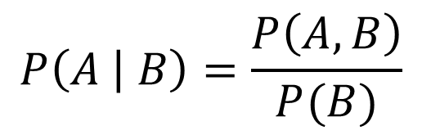

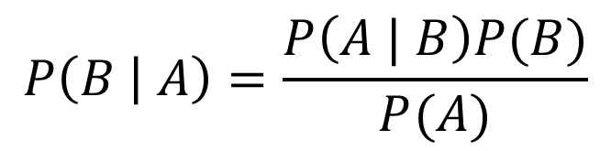
Probability Tools Summary
Our toolbox
Definition of conditional probability
Product Rule
Bayes’ theorem
$$P\left(A | B\right)=\frac{P\left(A, B\right)}{P(B)}$$
$$P(A,B)=P\left(A | B\right)P(B)$$
$$P\left(B | A\right)=\frac{P\left(A | B\right)P(B)}{P(A)}$$

Slide 8
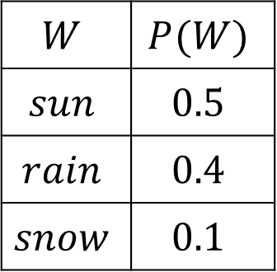
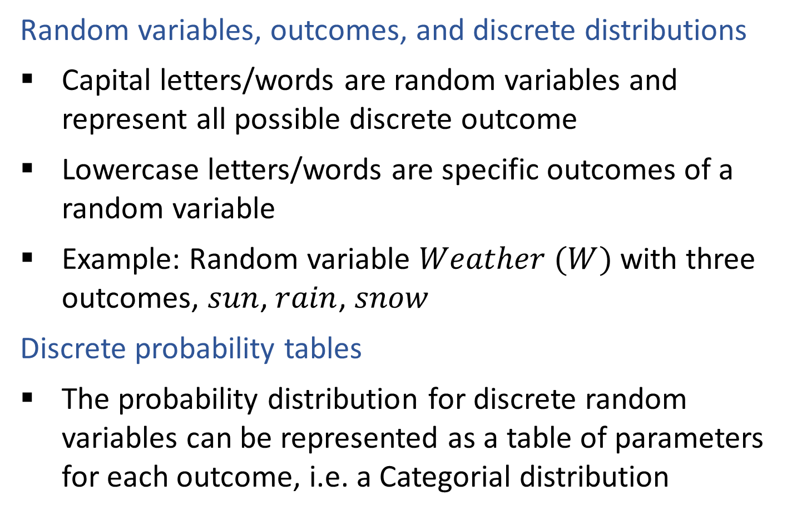
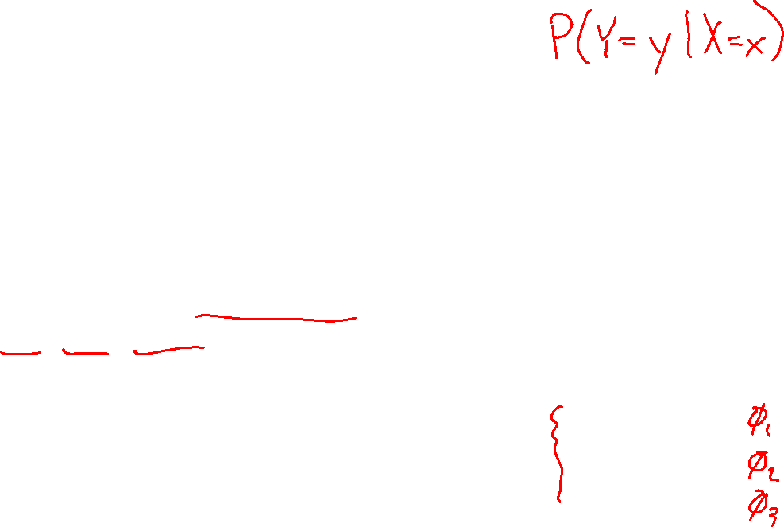
Discrete Probability Tables
Random variables, outcomes, and discrete distributions
Capital letters/words are random variables and represent all possible discrete outcome
Lowercase letters/words are specific outcomes of a random variable
Example: Random variable $Weather (W)$ with three outcomes, $sun$, $rain$, $snow$
Discrete probability tables
The probability distribution for discrete random variables can be represented as a table of parameters for each outcome, i.e. a Categorial distribution
$$W$$ | $$P(W)$$
$$sun$$ | $$0.5$$
$$rain$$ | $$0.4$$
$$snow$$ | $$0.1$$

Slide 9
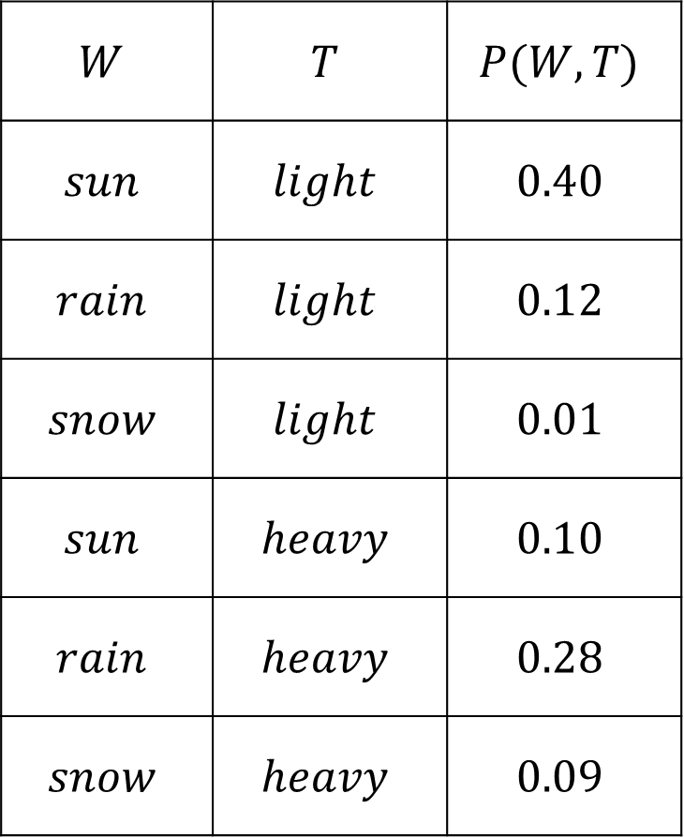
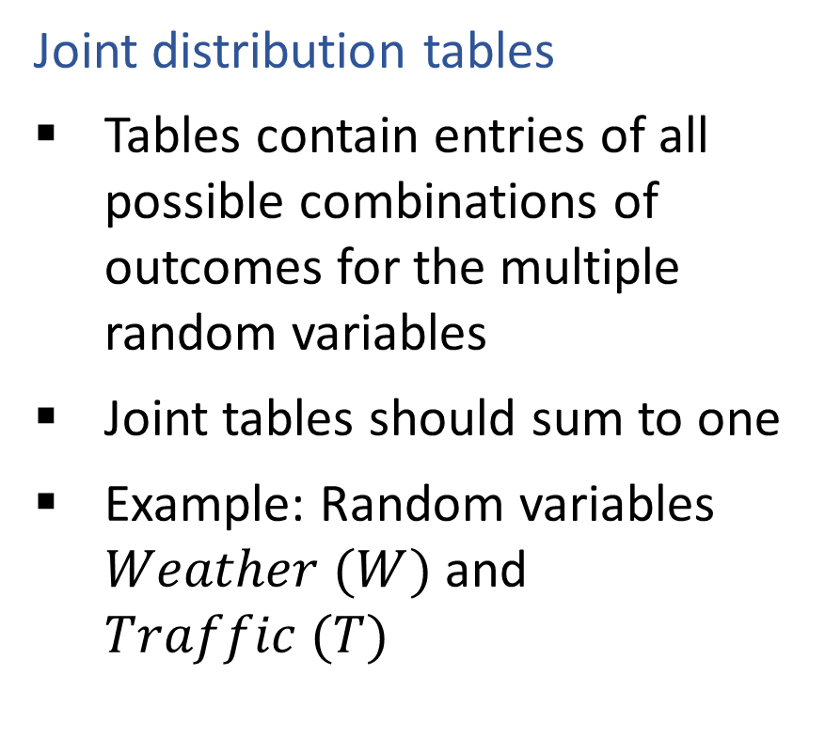
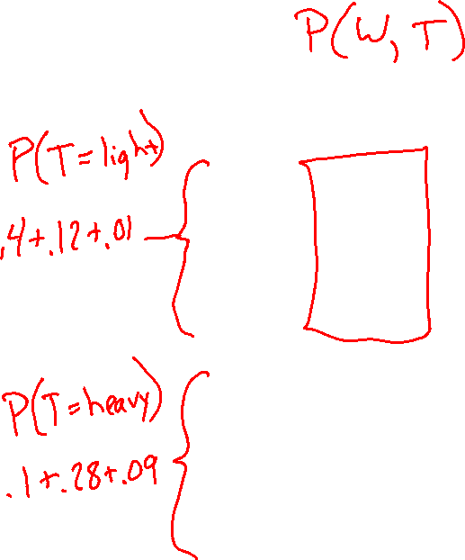
Discrete Probability Tables
$$W$$ | $$T$$ | $$P(W,T)$$
$$sun$$ | $$light$$ | $$0.40$$
$$rain$$ | $$light$$ | $$0.12$$
$$snow$$ | $$light$$ | $$0.01$$
$$sun$$ | $$heavy$$ | $$0.10$$
$$rain$$ | $$heavy$$ | $$0.28$$
$$snow$$ | $$heavy$$ | $$0.09$$
Joint distribution tables
Tables contain entries of all possible combinations of outcomes for the multiple random variables
Joint tables should sum to one
Example: Random variables $Weather (W)$ and $Traffic (T)$

Slide 10
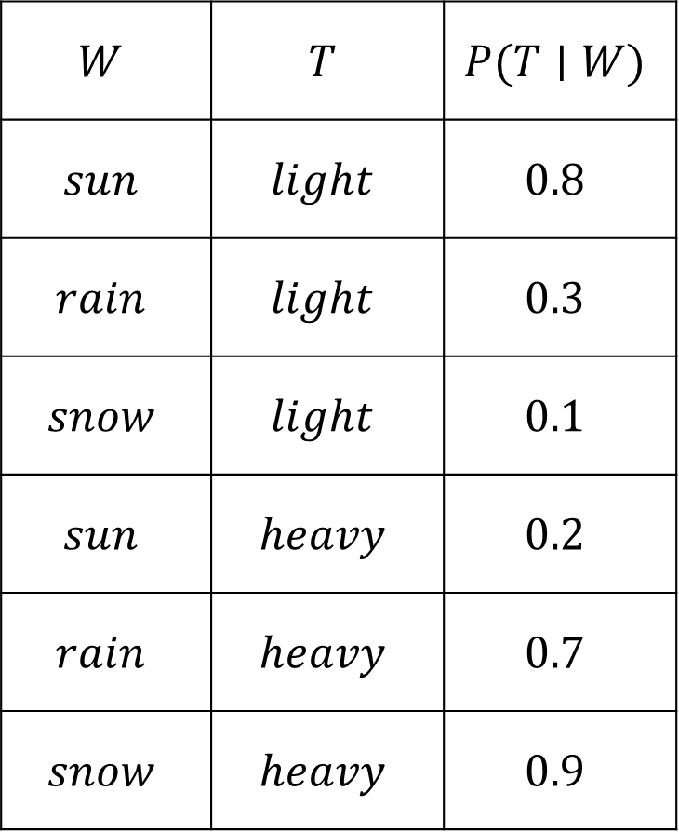
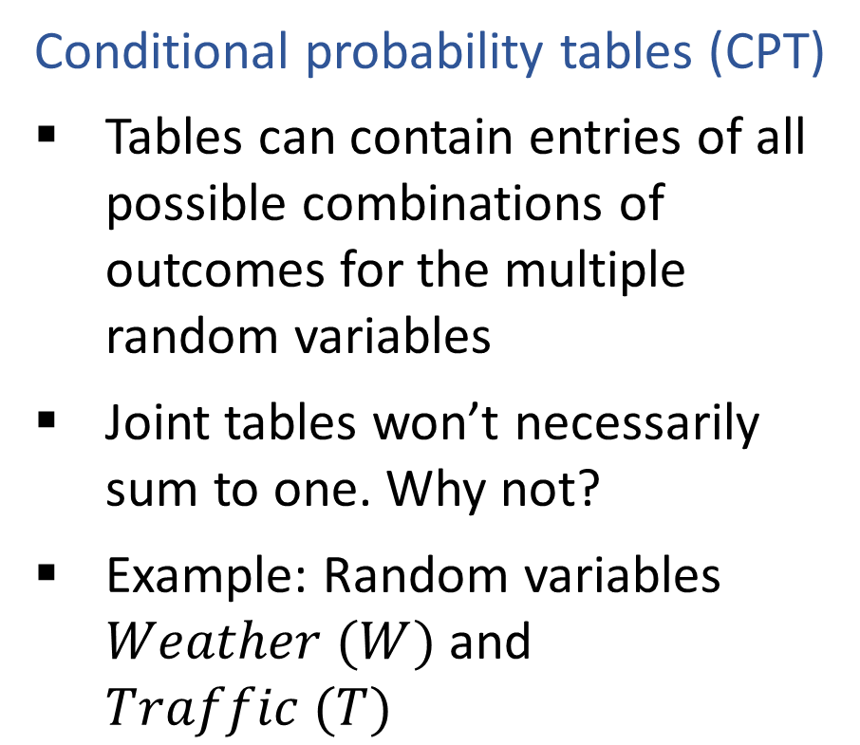
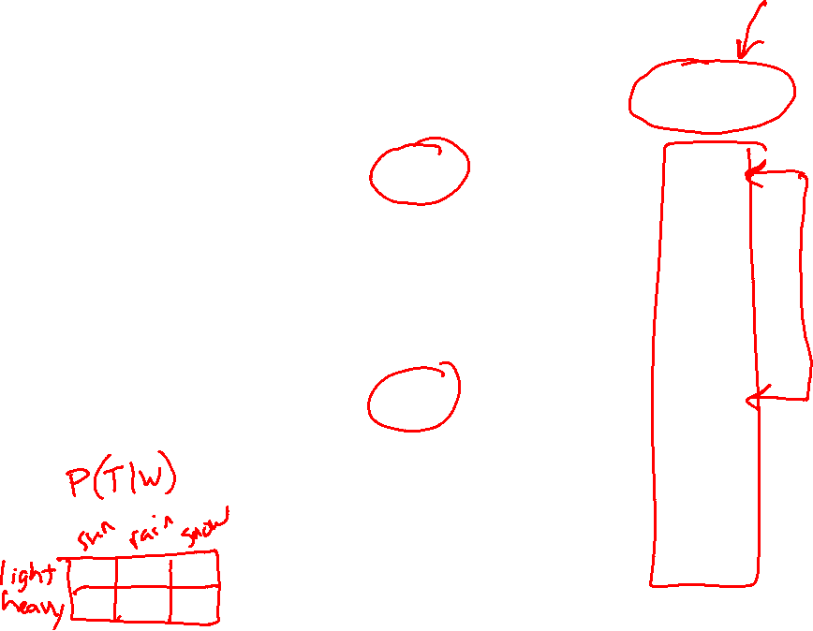
Discrete Probability Tables
$$W$$ | $$T$$ | $$P(T∣W)$$
$$sun$$ | $$light$$ | $$0.8$$
$$rain$$ | $$light$$ | $$0.3$$
$$snow$$ | $$light$$ | $$0.1$$
$$sun$$ | $$heavy$$ | $$0.2$$
$$rain$$ | $$heavy$$ | $$0.7$$
$$snow$$ | $$heavy$$ | $$0.9$$
Conditional probability tables (CPT)
Tables can contain entries of all possible combinations of outcomes for the multiple random variables
Joint tables won’t necessarily sum to one. Why not?
Example: Random variables $Weather (W)$ and $Traffic (T)$

Slide 11
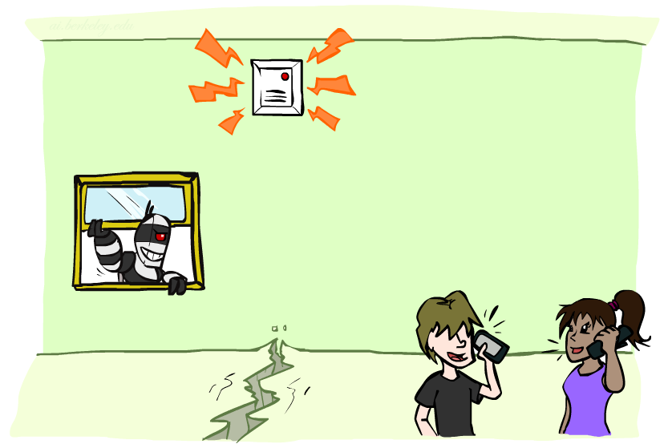
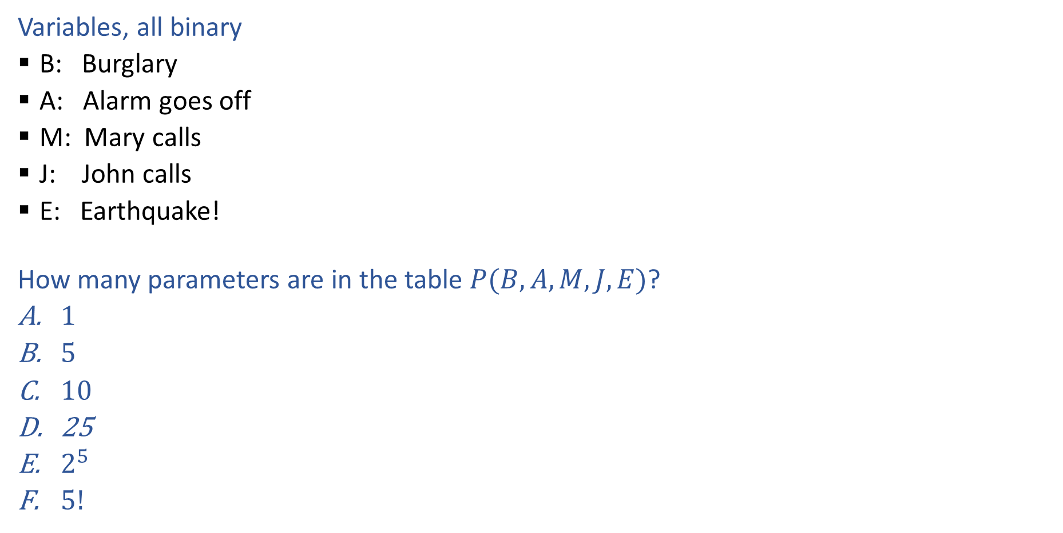

Piazza Poll 2
Variables, all binary
B: Burglary
A: Alarm goes off
M: Mary calls
J: John calls
E: Earthquake!
How many parameters are in the table $P(B, A, M,J, E)$?
$1$
$5$
$10$
25
$2^{5}$
$5!$
Image: http://ai.berkeley.edu/

Slide 12
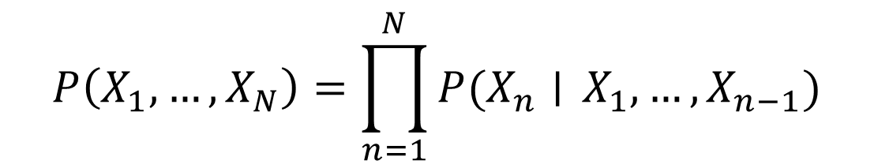

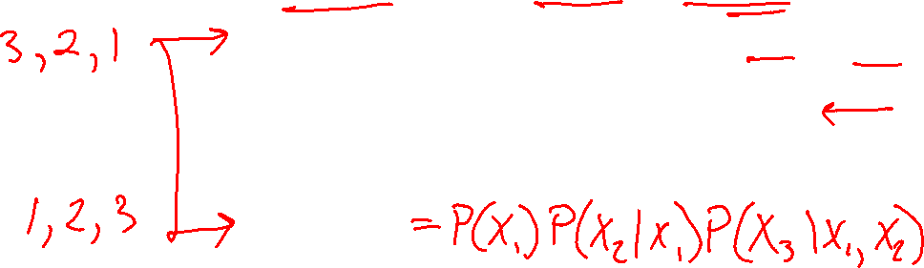
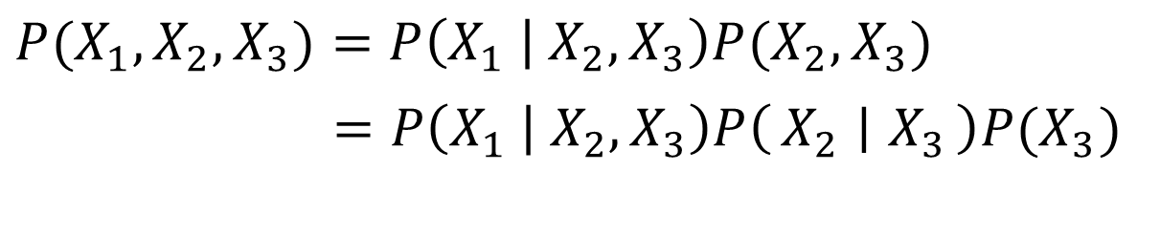
Probability Tools Summary
Our toolbox
Product Rule
Chain Rule
$$P(X_{1},X_{2})=P\left(X_{1} | X_{2}\right)P(X_{2})$$
$P(X_{1},X_{2},X_{3})=P\left(X_{1} | X_{2}, X_{3}\right)P(X_{2},X_{3})$
$=P\left(X_{1} | X_{2}, X_{3}\right)P\left(X_{2} ∣ X_{3}\right)P(X_{3})$
$$P\left(X_{1}, …, X_{N}\right)=\prod_{n=1}^{N}{P(X_{n}∣} X_{1},…, X_{n−1})$$

Slide 13
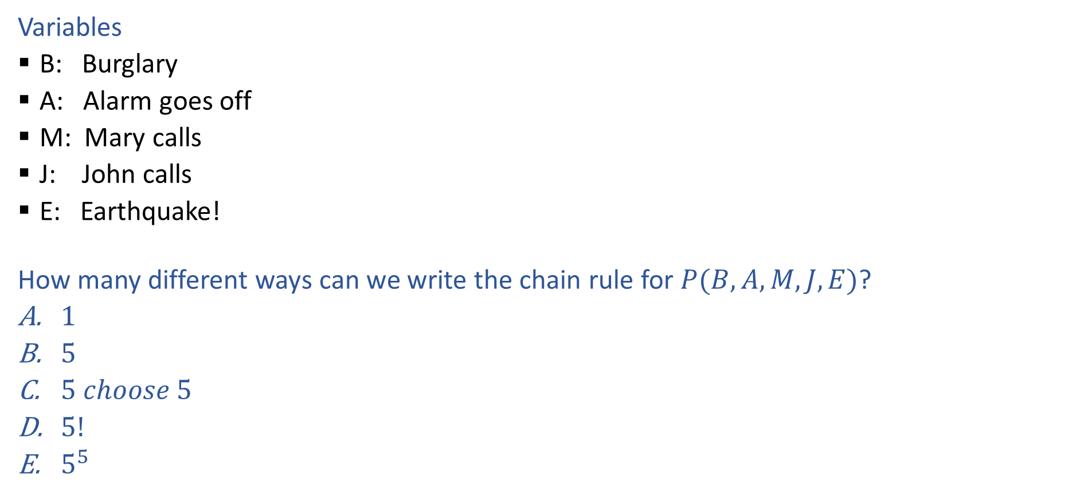

Piazza Poll 3
Variables
B: Burglary
A: Alarm goes off
M: Mary calls
J: John calls
E: Earthquake!
How many different ways can we write the chain rule for $P(B, A, M,J, E)$?
$1$
$5$
$5 choose 5$
$5!$
$5^{5}$
Image: http://ai.berkeley.edu/

Slide 14

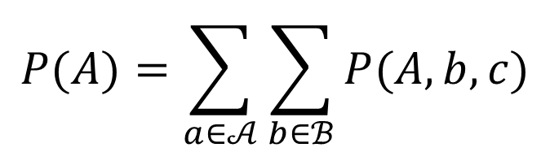

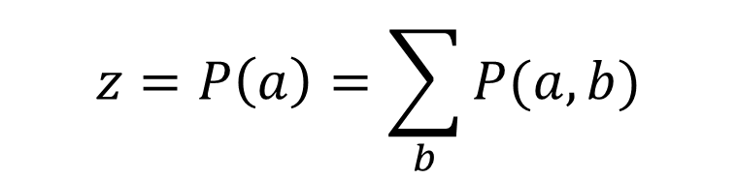
Probability Tools Summary
Marginalization
Normalization
$$P(A)=\sum_{a∈𝒜}{\sum_{b∈ℬ}{P(A, b, c)}}$$
$$P\left(B | a\right)=\frac{P(a,B)}{P(a)}$$
$P\left(B | a\right)∝P(a,B)$
$P\left(B | a\right)=\frac{1}{z}P(a,B)$
$$z=P\left(a\right)=\sum_{b}{P(a,b)}$$

Slide 15
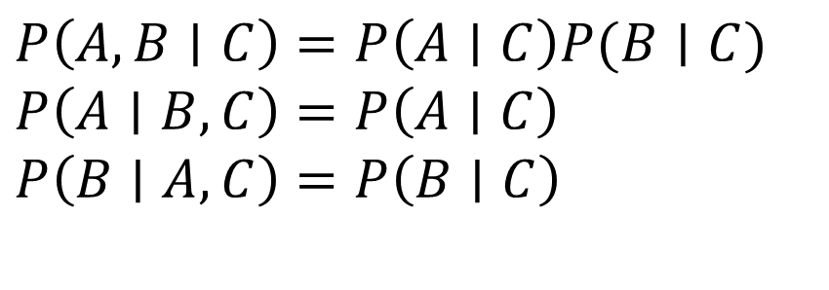
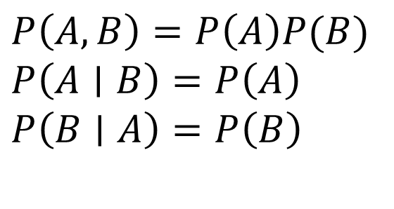
Probability Tools Summary
Independence
If A and B are independent, then:
Conditional independence
If A and B are conditionally
independent given C, then:
$P\left(A, B\right)=P\left(A\right)P(B)$
$P\left(A∣B\right)=P\left(A\right)$
$P\left(B∣A\right)=P\left(B\right)$
$P\left(A, B∣C\right)=P\left(A∣C\right)P(B∣C)$
$P\left(A∣B, C\right)=P\left(A∣C\right)$
$P\left(B∣A, C\right)=P\left(B∣C\right)$

Slide 16
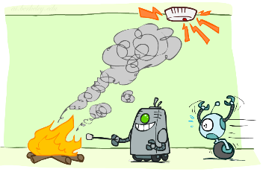
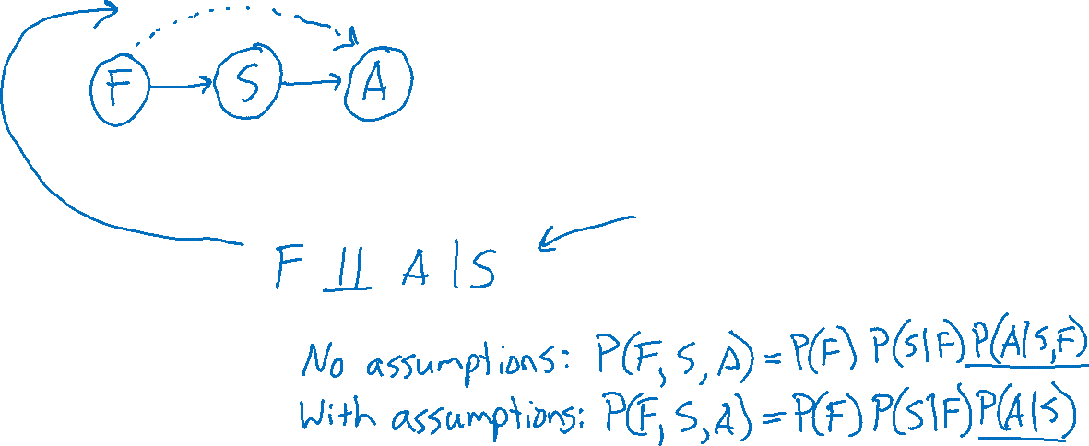
Generative Stories and Bayes Nets
Fire, Smoke, Alarm
Generative story and Bayes net
Assumptions
Joint distribution
Image: http://ai.berkeley.edu/

Slide 17

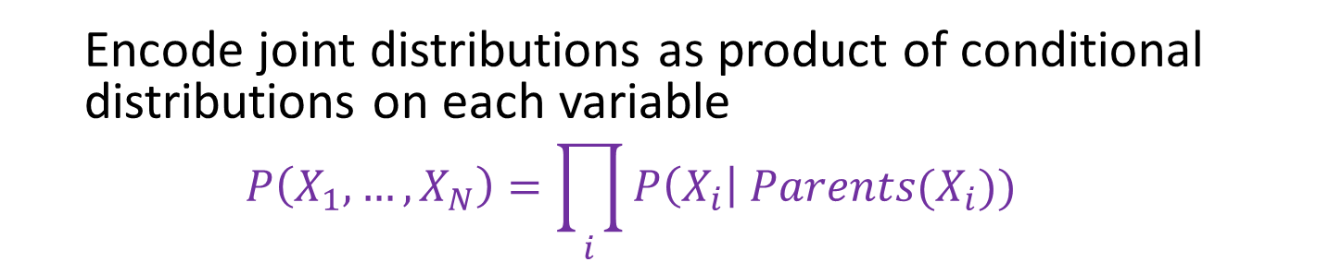



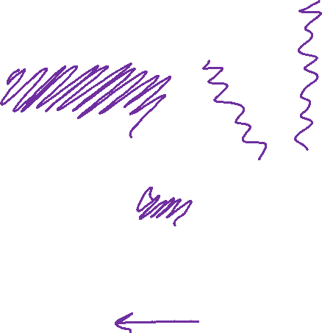
Bayesian Networks
Bayes net
One node per random variable
Directed-Acyclic-Graph
One CPT per node: P(node | Parents(node) )
$$A$$
$$B$$
$$C$$
$$D$$
$$P\left(A, B, C, D\right)=P\left(A\right) P\left(B | A\right) P\left(C | A,B\right) P\left(D | A,B,C\right)$$
Encode joint distributions as product of conditional distributions on each variable
$$P\left(X_{1},…,X_{N}\right)=\prod_{i}{P\left(X_{i}\right| Parents(X_{i})) }$$

Slide 18
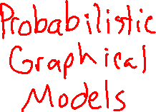
Bayesian Networks
Bayes net
One node per random variable
Directed-Acyclic-Graph
One CPT per node: P(node | Parents(node) )
$$A$$
$$B$$
$$C$$
$$D$$
$P\left(A, B, C, D\right)=P\left(A\right) P\left(B | A\right) P\left(C | A,B\right) P\left(D | C\right)$
Encode joint distributions as product of conditional distributions on each variable
$$P\left(X_{1},…,X_{N}\right)=\prod_{i}{P\left(X_{i}\right| Parents(X_{i})) }$$

