Slide 1
Announcements
Assignments
HW4
    Due Wed, 10/14, 11:59 pm
HW5
    Plan: Out tomorrow
    Due Mon, 10/26, 11:59 pm
Recitation
No recitation the next two Fridays ☹
We’ll post a worksheet for neural nets and record a walk-through
Survey

Slide 2

Introduction to Machine Learning
Neural Networks
Instructor: Pat Virtue

Slide 3
Plan
Last Time
Neural Networks
    Perceptron
    Multilayer perceptron
Today
Neural Networks
    Building blocks
    Optimization
        Composite functions and chain rule
        Forward-backward passes
        Matrix calculus

Slide 4
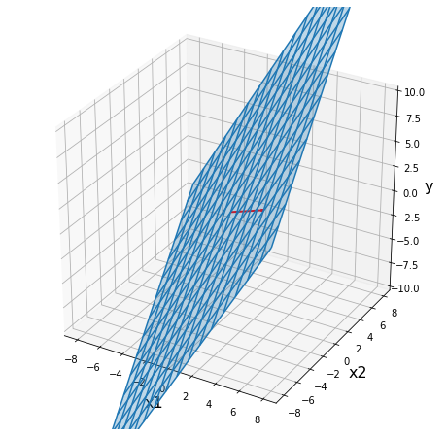
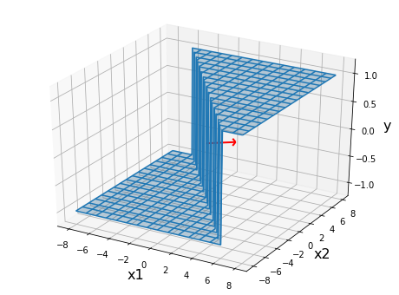
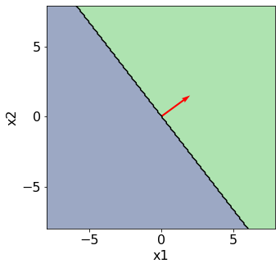
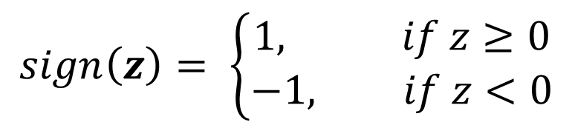

Perceptron
$$sign\left(z\right)= \left\{\begin{aligned}1, if z≥0 \\ −1, if z<0\end{aligned}\right.$$
Classification: Hard threshold on linear model
$$h\left(x\right)=sign\left(w^{T}x+b\right)$$

Slide 5


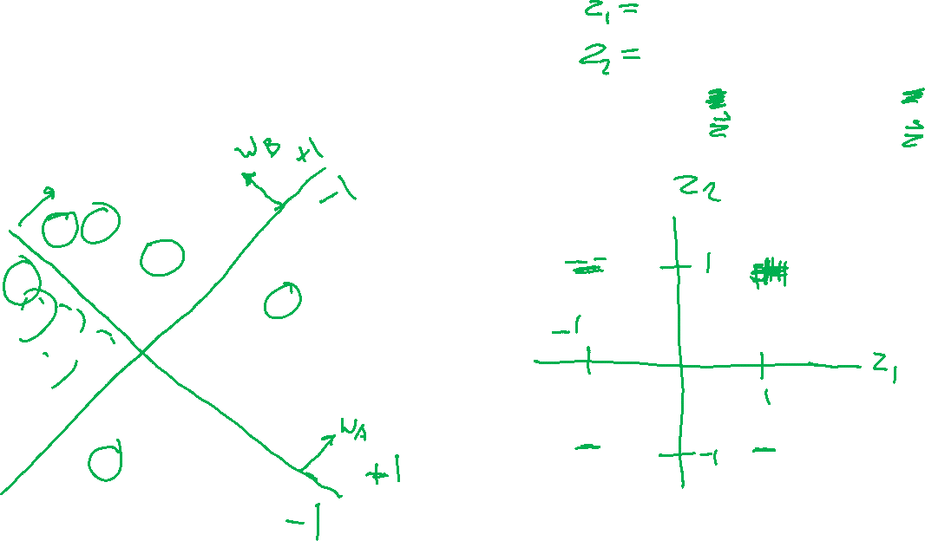
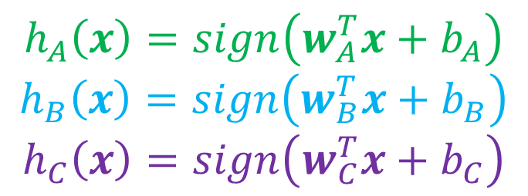
Classification Design Challenge
$$h_{A}\left(x\right)=sign\left(w_{A}^{T}x+b_{A}\right)$$
$$h_{B}\left(x\right)=sign\left(w_{B}^{T}x+b_{B}\right)$$
$$h_{C}\left(x\right)=sign\left(w_{C}^{T}x+b_{C}\right)$$
How could you configure three specific perceptrons to classify this data?
$$x2$$
$$x1$$

Slide 6
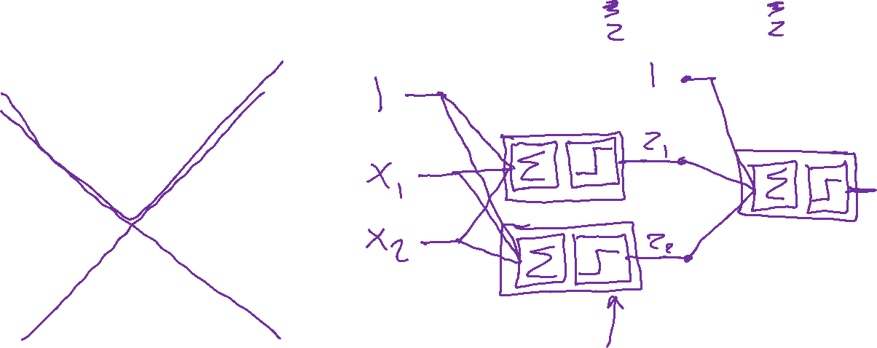
Classification Design Challenge
$$h_{A}\left(x\right)=sign\left(w_{A}^{T}x+b_{A}\right)$$
$$h_{B}\left(x\right)=sign\left(w_{B}^{T}x+b_{B}\right)$$
$$h_{C}\left(x\right)=sign\left(w_{C}^{T}x+b_{C}\right)$$
How could you configure three specific perceptrons to classify this data?
$$x2$$
$$x1$$

Slide 7
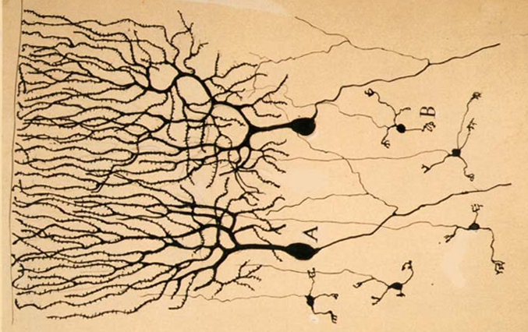
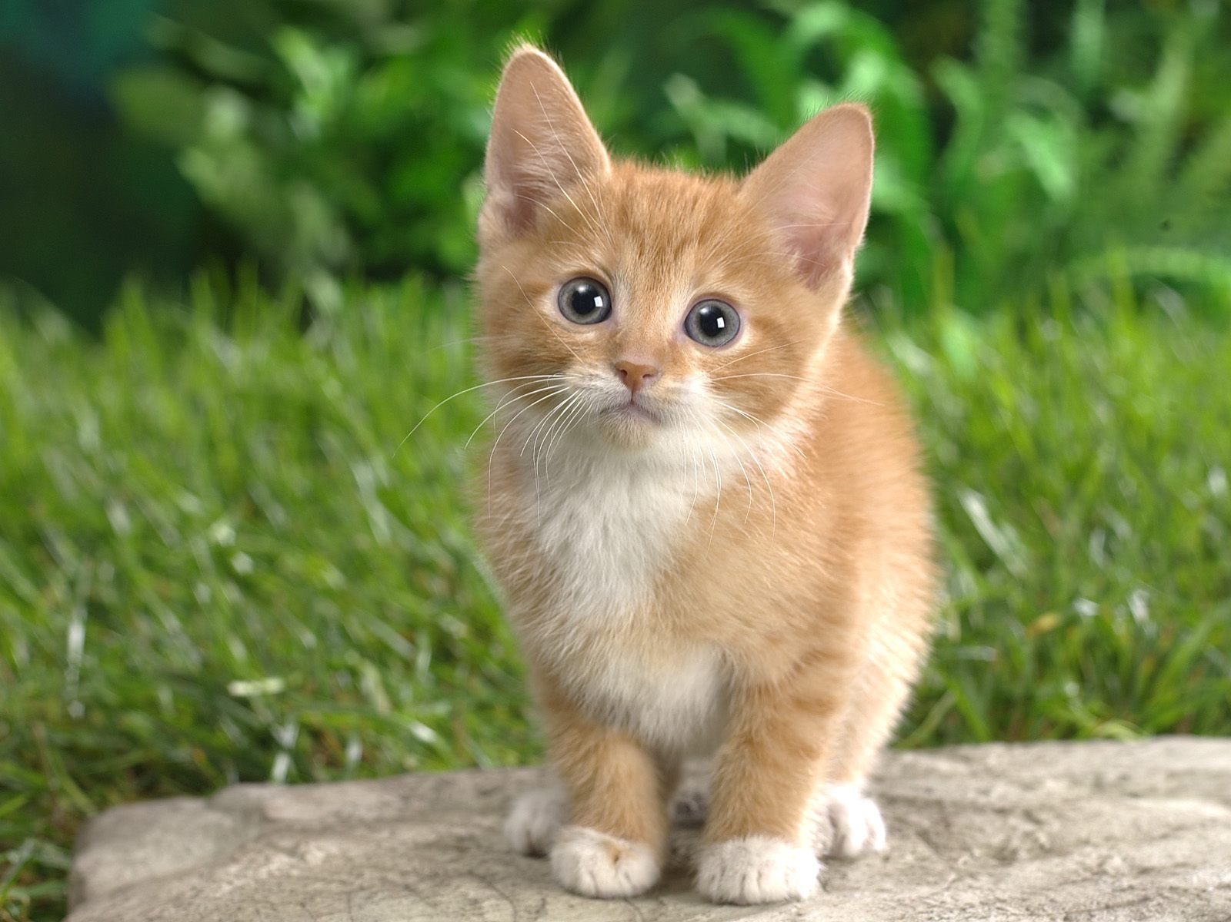
Neural Networks
Inspired by actual human brain
Output
Signal
Input Signal
DOG
CAT
TREE
CAR
SKY
Image: https://en.wikipedia.org/wiki/Neuron

Slide 8
Classification Design Challenge
$$h_{A}\left(x\right)=sign\left(w_{A}^{T}x+b_{A}\right)$$
$$h_{B}\left(x\right)=sign\left(w_{B}^{T}x+b_{B}\right)$$
$$h_{C}\left(x\right)=sign\left(w_{C}^{T}x+b_{C}\right)$$
How could you configure three specific perceptrons to classify this data?
$$x2$$
$$x1$$

Slide 9
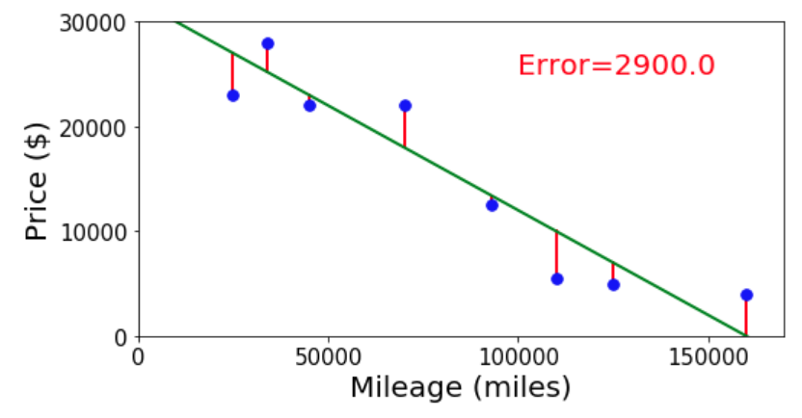
Neural Networks
Simple single neuron example:
Selling my car

Slide 10
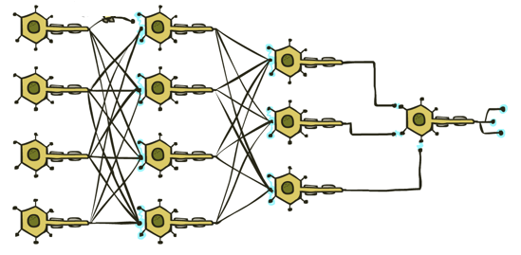

Neural Networks
Many layers of neurons, millions of parameters
Output
Signal
Input Signal
DOG
CAT
TREE
CAR
SKY

Slide 11
Neural Networks
Many layers of neurons, millions of parameters
Output
Signal
Input Signal
DOG
CAT
TREE
CAR
SKY

Slide 12

Neural Networks
Many layers of neurons, millions of parameters
Output
Signal
Input Signal
LEFT
RIGHT
UP
DOWN
BUTTON

Slide 13

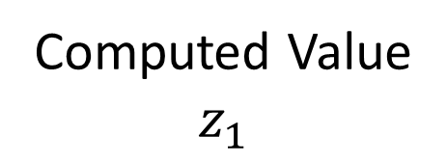

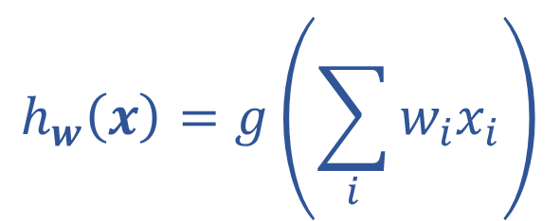
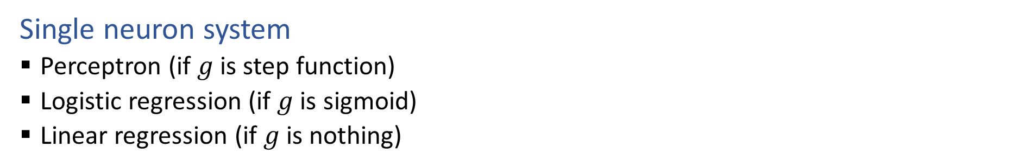






Single Neuron
Single neuron system
  Perceptron (if $g$ is step function)
  Logistic regression (if $g$ is sigmoid)
  Linear regression (if $g$ is nothing)
$$x1$$
$$w1$$
Computed Value
$$z_{1}$$
True Label
$$y$$
$$∑$$
$$g$$
$$x2$$
$$h_{w}\left(x\right)=z_{1}$$
$$w2$$
$$h_{w}\left(x\right)=g\left(\sum_{i}{w_{i}x_{i}}\right)$$

Slide 14
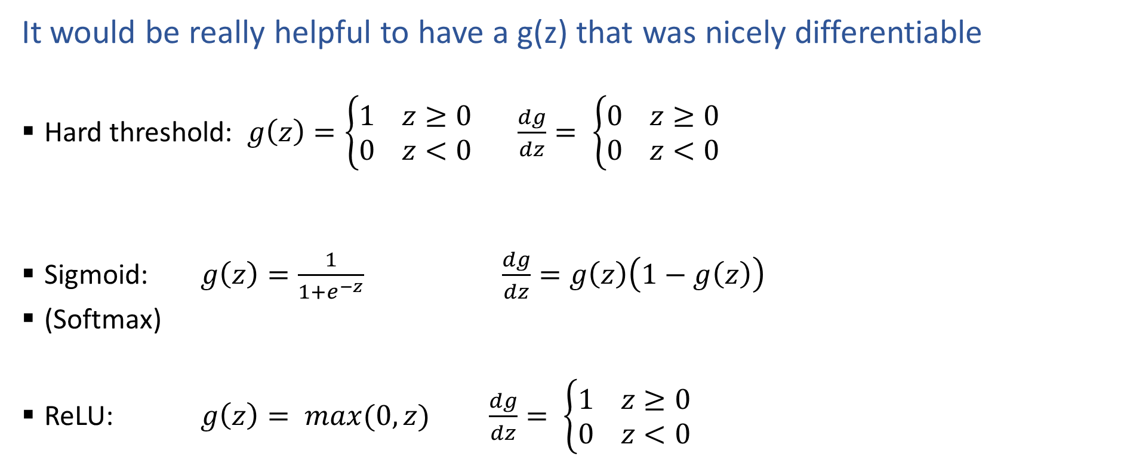
Activation Functions
It would be really helpful to have a g(z) that was nicely differentiable
  Hard threshold: $g\left(z\right)=\left\{\begin{aligned}1 z≥0 \\ 0 z<0\end{aligned}\right.$ $\frac{dg}{dz}= \left\{\begin{aligned}0 z≥0 \\ 0 z<0\end{aligned}\right.$
  Sigmoid: $g\left(z\right)=\frac{1}{1+e^{−z}}$ $\frac{dg}{dz}=g\left(z\right)\left(1−g\left(z\right)\right)$
  (Softmax)
  ReLU: $g\left(z\right)= max(0,z)$ $\frac{dg}{dz}= \left\{\begin{aligned}1 z≥0 \\ 0 z<0\end{aligned}\right.$

Slide 15
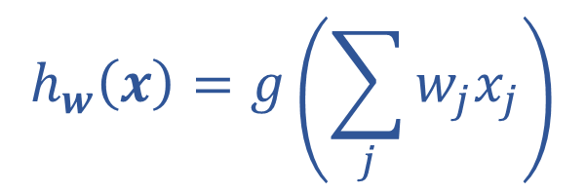
Optimizing
How do we find the “best” set of weights?
$$h_{w}\left(x\right)=g\left(\sum_{j}{w_{j}x_{j}}\right)$$

Slide 16

Loss Functions
Regression
  Squared error: $ℓ\left(y, \hat{y}\right)={\left(y−\hat{y}\right)}^{2}$
  Classification
  Cross entropy: $ℓ\left(y, \hat{y}\right)=−\sum_{k}{ y_{k}\log{{\hat{y}}_{k}}}$

Slide 17
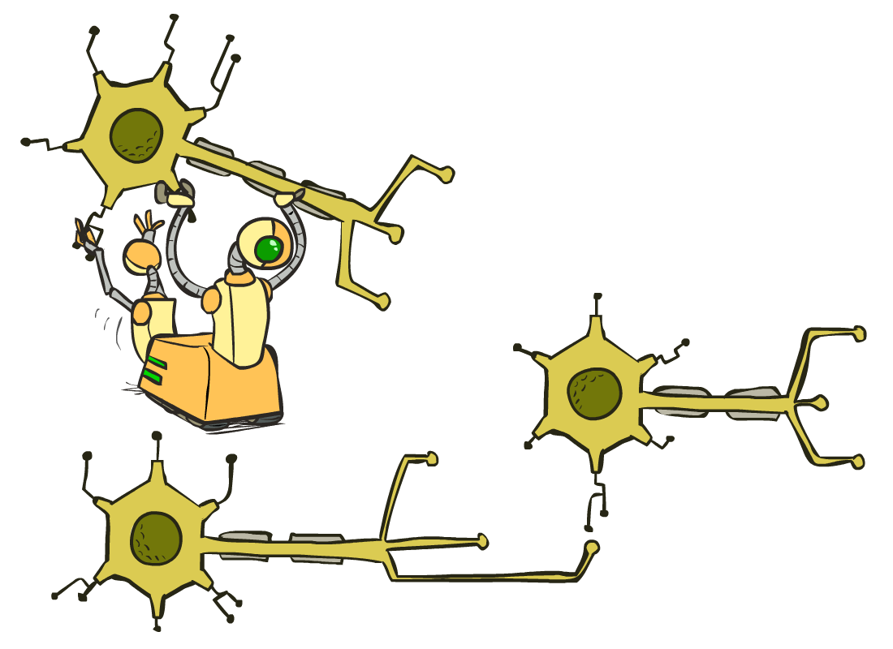
Multilayer Perceptrons
A multilayer perceptron is a feedforward neural network with at least one hidden layer (nodes that are neither inputs nor outputs)
MLPs with enough hidden nodes can represent any function
Slide from UC Berkeley AI

Slide 18










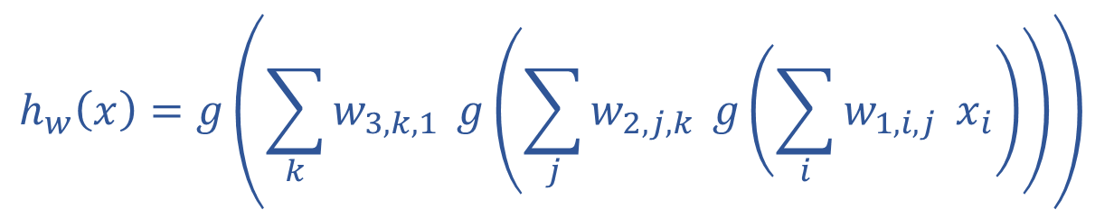


























Neural Network Equations
$$z11$$
$$w111$$
$$z21$$
$$x1$$
$$∑$$
$$g$$
$$w211$$
$$w112$$
$$w113$$
$$w212$$
$$z31$$
$$∑$$
$$g$$
$$w311$$
$$w121$$
$$w221$$
$$z12$$
$$z22$$
$$z41$$
$$x2$$
$$∑$$
$$g$$
$$∑$$
$$g$$
$$w123$$
$$w221$$
$$z32$$
$$w321$$
$$w131$$
$$∑$$
$$g$$
$$z13$$
$$z23$$
$$w232$$
$$x3$$
$$∑$$
$$g$$
w₁₃₃
$$h_{w}\left(x\right)=z_{4,1}$$
$z_{1,1}=x_{1}$
$z_{4,1}=g\left(\sum_{i}{w_{3,i,1} z_{3,i}}\right)$
$$h_{w}\left(x\right)=g\left(\sum_{k}{w_{3,k,1}} g\left(\sum_{j}{w_{2,j,k}} g\left(\sum_{i}{w_{1,i,j}} x_{i}\right)\right)\right)$$
$z_{3,1}=g\left(\sum_{i}{w_{2,i,1} z_{2,i}}\right)$
$z_{d,1}=g\left(\sum_{i}{w_{d−1,i,1} z_{d−1,i}}\right)$

Slide 19
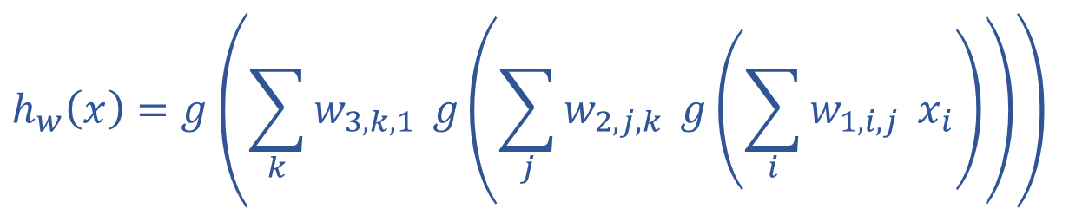
Optimizing
How do we find the “best” set of weights?
$$h_{w}\left(x\right)=g\left(\sum_{k}{w_{3,k,1}} g\left(\sum_{j}{w_{2,j,k}} g\left(\sum_{i}{w_{1,i,j}} x_{i}\right)\right)\right)$$

Slide 20
Neural Network Equations
$$z11$$
$$w111$$
$$z21$$
$$x1$$
$$∑$$
$$g$$
$$w211$$
$$w112$$
$$w113$$
$$w212$$
$$z31$$
$$∑$$
$$g$$
$$w311$$
$$w121$$
$$w221$$
$$z12$$
$$z22$$
$$z41$$
$$x2$$
$$∑$$
$$g$$
$$∑$$
$$g$$
$$w123$$
$$w221$$
$$z32$$
$$w321$$
$$w131$$
$$∑$$
$$g$$
$$z13$$
$$z23$$
$$w232$$
$$x3$$
$$∑$$
$$g$$
w₁₃₃
How do we describe this network?

Slide 21
Network Optimization Details

Slide 22
Reminder: Calculus Chain Rule (scalar version)
$$y=f\left(z\right)$$
$$z=g\left(x\right)$$
$$\frac{dy}{dx}=\frac{dy}{dz}\frac{dz}{dx}$$

Slide 23
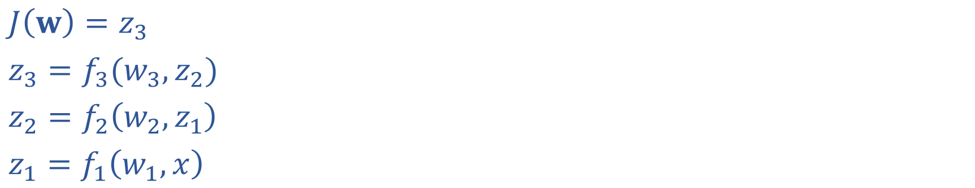
Network Optimization
$J\left(w\right)=z_{3}$
$z_{3}=f_{3}(w_{3}, z_{2})$
$z_{2}=f_{2}\left(w_{2}, z_{1}\right)$
$z_{1}=f_{1}\left(w_{1}, x\right)$

Slide 24
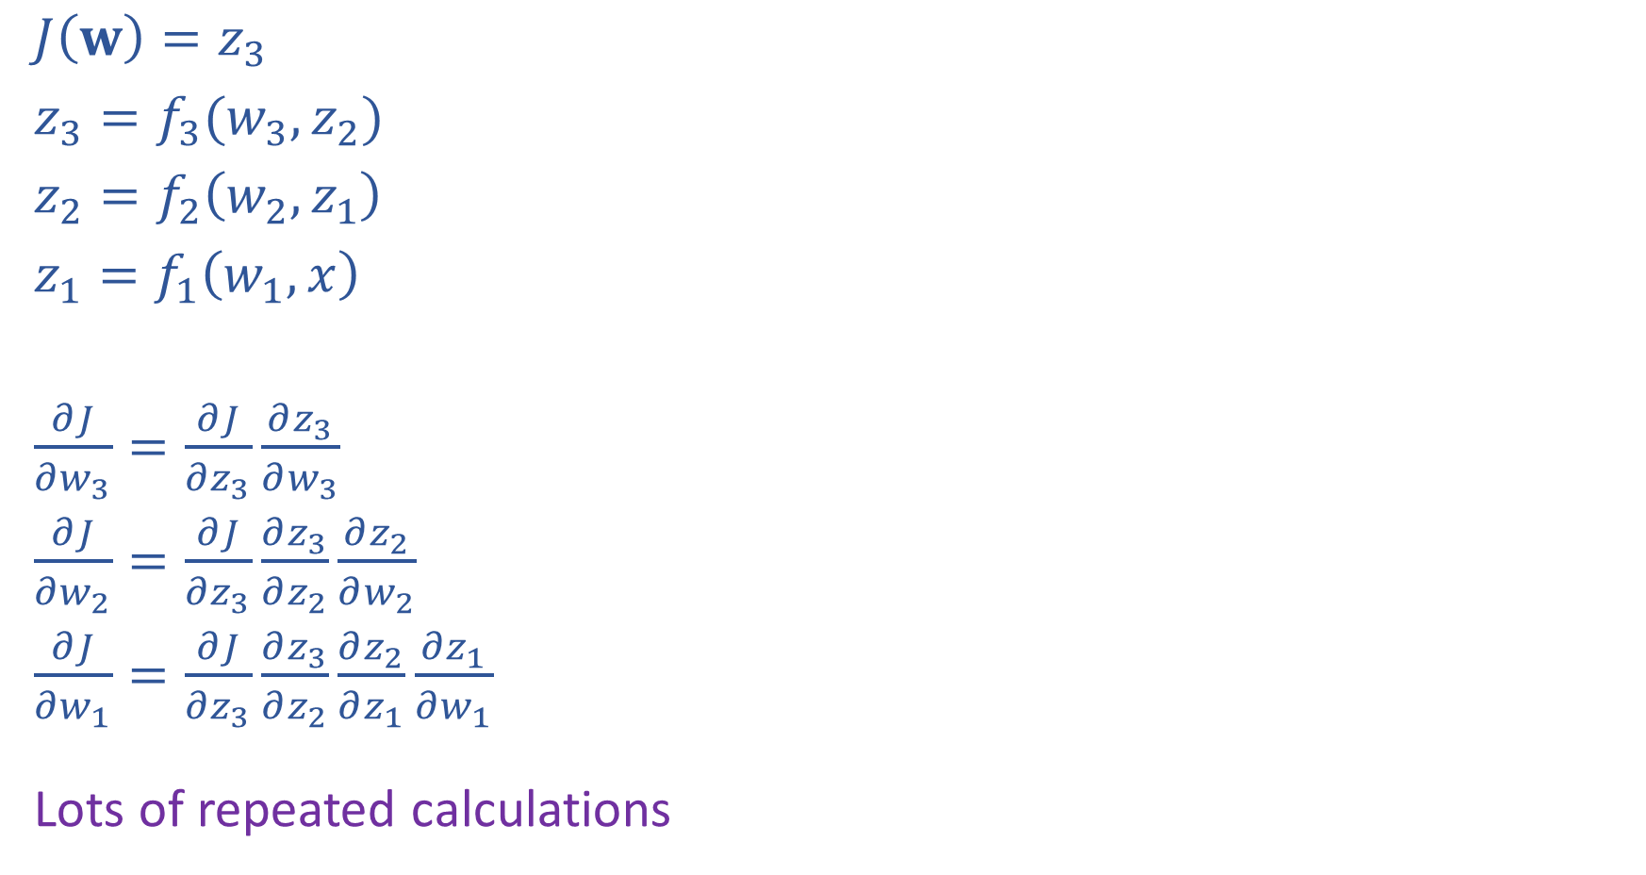
Network Optimization: Forward then Backwards
$J\left(w\right)=z_{3}$
$z_{3}=f_{3}(w_{3}, z_{2})$
$z_{2}=f_{2}\left(w_{2}, z_{1}\right)$
$z_{1}=f_{1}\left(w_{1}, x\right)$
$\frac{∂J}{∂w_{3}}=\frac{∂J}{∂z_{3}}\frac{∂z_{3}}{∂w_{3}}$
$\frac{∂J}{∂w_{2}}=\frac{∂J}{∂z_{3}}\frac{∂z_{3}}{∂z_{2}}\frac{∂z_{2}}{∂w_{2}}$
$\frac{∂J}{∂w_{1}}=\frac{∂J}{∂z_{3}}\frac{∂z_{3}}{∂z_{2}}\frac{∂z_{2}}{∂z_{1}}\frac{∂z_{1}}{∂w_{1}}$
Lots of repeated calculations

Slide 25
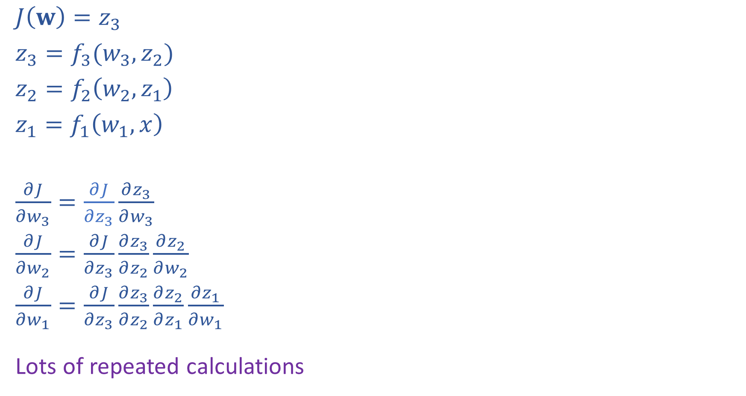
Network Optimization: Layer Implementation
$J\left(w\right)=z_{3}$
$z_{3}=f_{3}(w_{3}, z_{2})$
$z_{2}=f_{2}\left(w_{2}, z_{1}\right)$
$z_{1}=f_{1}\left(w_{1}, x\right)$
$\frac{∂J}{∂w_{3}}=\frac{∂J}{∂z_{3}}\frac{∂z_{3}}{∂w_{3}}$
$\frac{∂J}{∂w_{2}}=\frac{∂J}{∂z_{3}}\frac{∂z_{3}}{∂z_{2}}\frac{∂z_{2}}{∂w_{2}}$
$\frac{∂J}{∂w_{1}}=\frac{∂J}{∂z_{3}}\frac{∂z_{3}}{∂z_{2}}\frac{∂z_{2}}{∂z_{1}}\frac{∂z_{1}}{∂w_{1}}$
Lots of repeated calculations

Slide 26
Backpropagation (so-far)
Compute derivatives per layer, utilizing previous derivatives
Objective: $J\left(w\right)$
Arbitrary layer: $y=f\left(x, w\right)$
Need:
  $\frac{∂J}{∂x}=\frac{∂J}{∂y}\frac{∂y}{∂x}$
  $\frac{∂J}{∂w}=\frac{∂J}{∂y}\frac{∂y}{∂w}$
$$x$$
Layer $y=f\left(x, w\right)$
$\frac{∂y}{∂x}$
$\frac{∂y}{∂w}$
$$y$$
$$\frac{∂J}{∂x}$$
$$\frac{∂J}{∂y}$$
$$w$$
$$\frac{∂J}{∂w}$$

Slide 27
Matrix Calculus
One way to think of it: Bag of Derivatives

Slide 28
Matrix Calculus
One way to think of it: Bag of Derivatives

Slide 29
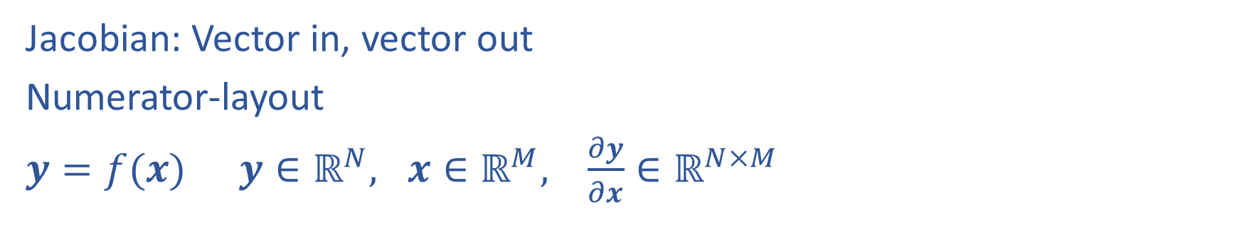
Matrix Calculus
Jacobian: Vector in, vector out
Numerator-layout
$y=f(x)$ $y∈ℝ^{N}, x∈ℝ^{M}, \frac{∂y}{∂x}∈ℝ^{N×M}$

Slide 30
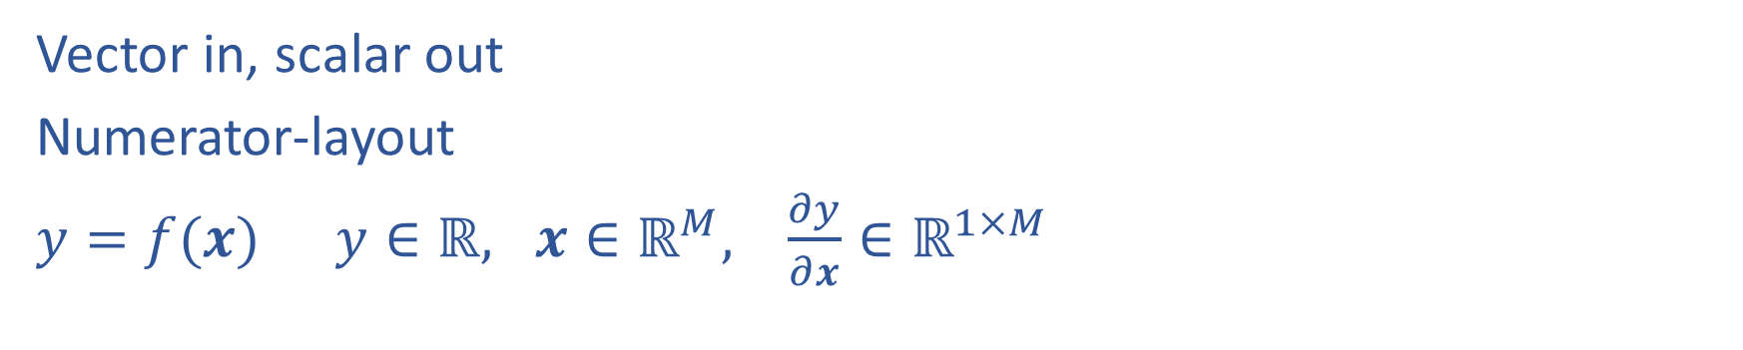
Matrix Calculus
Vector in, scalar out
Numerator-layout
$y=f(x)$ $y∈ℝ, x∈ℝ^{M}, \frac{∂y}{∂x}∈ℝ^{1×M}$

Slide 31
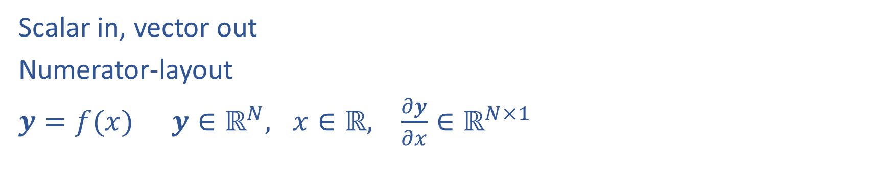
Matrix Calculus
Scalar in, vector out
Numerator-layout
$y=f(x)$ $y∈ℝ^{N}, x∈ℝ, \frac{∂y}{∂x}∈ℝ^{N×1}$

Slide 32
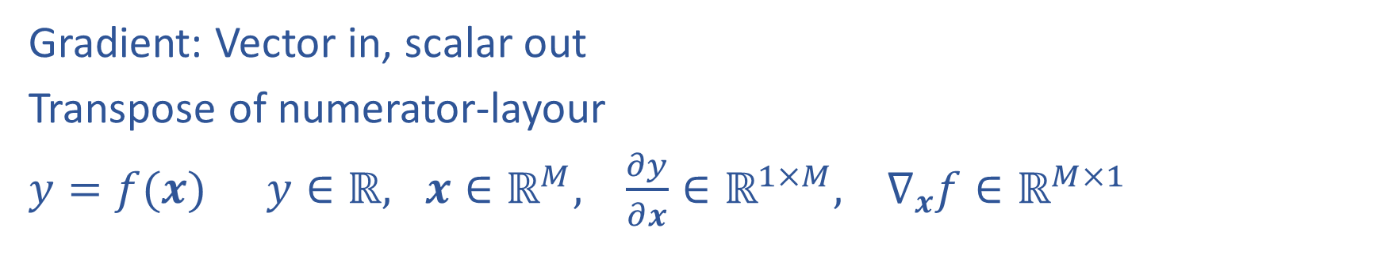
Matrix Calculus
Gradient: Vector in, scalar out
Transpose of numerator-layour
$y=f(x)$ $y∈ℝ, x∈ℝ^{M}, \frac{∂y}{∂x}∈ℝ^{1×M}, ∇_{x}f∈ℝ^{M×1}$

Slide 33
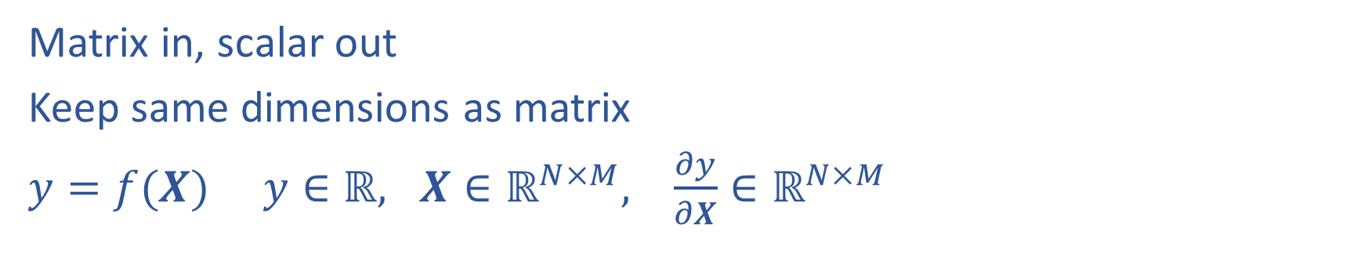
Matrix Calculus
Matrix in, scalar out
Keep same dimensions as matrix
$y=f(X)$ $y∈ℝ, X∈ℝ^{N×M}, \frac{∂y}{∂X}∈ℝ^{N×M}$

Slide 34
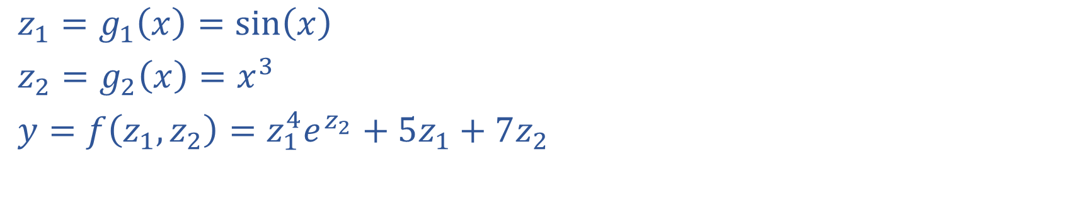
Multivariate Chain Rule
$z_{1}=g_{1}\left(x\right)=sin\left(x\right)$
$z_{2}=g_{2}\left(x\right)=x^{3}$
$y=f\left(z_{1}, z_{2}\right)=z_{1}^{4}e^{z_{2}}+5z_{1}+7z_{2}$

Slide 35
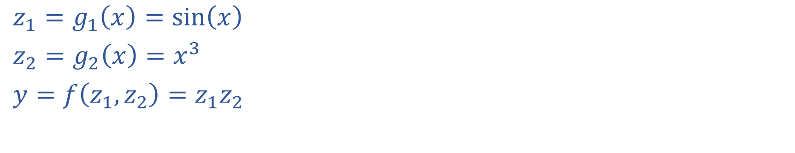
Multivariate Chain Rule
$z_{1}=g_{1}\left(x\right)=sin\left(x\right)$
$z_{2}=g_{2}\left(x\right)=x^{3}$
$y=f\left(z_{1}, z_{2}\right)=z_{1}z_{2}$

Slide 36
Calculus Chain Rule
Scalar:
$y=f\left(z\right)$
$z=g\left(x\right)$
$\frac{dy}{dx}=\frac{dy}{dz}\frac{dz}{dx}$
Multivariate:
$y=f\left(z\right)$
$z=g\left(x\right)$
$\frac{dy}{dx}=\sum_{j}{\frac{∂y}{∂z_{j}}\frac{∂z_{j}}{∂x}}$
Multivariate:
$y=f\left(z\right)$
$z=g\left(x\right)$
$\frac{dy_{i}}{dx_{k}}=\sum_{j}{\frac{∂y_{i}}{∂z_{j}}\frac{∂z_{j}}{∂x_{k}}}$

Slide 37
Network Optimization
$J\left(w\right)=z_{4}$
${z_{4}=f}_{4}\left(w_{D}, w_{E}, z_{2},z_{3}\right)$
$z_{3}=f_{3}\left(w_{C}, z_{1}\right)$
$z_{2}=f_{2}\left(w_{B}, z_{1}\right)$
$z_{1}=f_{1}\left(w_{A}, x\right)$
Need multivariate chain rule!

Slide 38
Network Optimization
$$\frac{∂J}{∂w_{E}}=\frac{∂J}{∂z_{4}}\frac{∂z_{4}}{∂w_{E}}$$
$$\frac{∂J}{∂w_{D}}=\frac{∂J}{∂z_{4}}\frac{∂z_{4}}{∂w_{D}}$$
$$\frac{∂J}{∂z_{3}}=\frac{∂J}{∂z_{4}}\frac{∂z_{4}}{∂z_{3}}$$
$$\frac{∂J}{∂z_{2}}=\frac{∂J}{∂z_{4}}\frac{∂z_{4}}{∂z_{2}}$$
$$\frac{∂J}{∂w_{C}}=\frac{∂J}{∂z_{3}}\frac{∂z_{3}}{∂w_{C}}$$
$$\frac{∂J}{∂w_{B}}=\frac{∂J}{∂z_{2}}\frac{∂z_{2}}{∂w_{B}}$$
$$\frac{∂J}{∂z_{1}}=\frac{∂J}{∂z_{2}}\frac{∂z_{2}}{∂z_{1}}+ \frac{∂J}{∂z_{3}}\frac{∂z_{3}}{∂z_{1}}$$
$$\frac{∂J}{∂w_{A}}=\frac{∂J}{∂z_{1}}\frac{∂z_{1}}{∂w_{A}}$$
$J\left(w\right)=z_{4}$
${z_{4}=f}_{4}\left(w_{D}, w_{E}, z_{2},z_{3}\right)$
$z_{3}=f_{3}\left(w_{C}, z_{1}\right)$
$z_{2}=f_{2}\left(w_{B}, z_{1}\right)$
$z_{1}=f_{1}\left(w_{A}, x\right)$
Need multivariate chain rule!
$$z_{2}$$
$$f_{2}$$
$$z_{1}$$
$$z_{4}$$
$$x$$
$$f_{1}$$
$$f_{4}$$
$$z_{3}$$
$$f_{3}$$

Slide 39
Backpropagation (updated)
Compute derivatives per layer, utilizing previous derivatives
Objective: $J\left(w\right)$
Arbitrary layer: $y=f\left(x, w\right)$
Init:
  $\frac{∂J}{∂x}=0$
  $\frac{∂J}{∂w}=0$
Compute:
  $\frac{∂J}{∂x}+=\frac{∂J}{∂y}\frac{∂y}{∂x}$
  $\frac{∂J}{∂w}+=\frac{∂J}{∂y}\frac{∂y}{∂w}$
$$x$$
Layer $y=f\left(x, w\right)$
$\frac{∂y}{∂x}$
$\frac{∂y}{∂w}$
$$y$$
$$\frac{∂J}{∂x}$$
$$\frac{∂J}{∂y}$$
$$w$$
$$\frac{∂J}{∂w}$$

Slide 40
Neural Networks Properties
Practical considerations
  Large number of neurons
      Danger for overfitting
  Modelling assumptions vs data assumptions trade-off
  Gradient descent can easily get stuck local optima
What if there are no non-linear activations?
A deep neural network with only linear layers can be reduced to an exactly equivalent single linear layer
Universal Approximation Theorem:
A two-layer neural network with a sufficient number of neurons can approximate any continuous function to any desired accuracy.

