Slide 1

Announcements
Assignments
HW4
Wed, 10/14, 11:59 pm
Survey
Thanks!
We’ll talk more Wednesday

Slide 2
Plan
Last Time
Feature engineering
Regularization with added penalty term
Today
Wrap-up regularization
Neural Networks
Perceptron
Multilayer perceptron
Building blocks
Objective
Optimization

Slide 3
Wrap-up Regularization

Slide 4

Example: Linear Regression
Goal: Learn y = w^{T} f(x) + b
where f(.) is a polynomial basis function
y | x | x² | … | x⁹
2.0 | 1.2 | (1.2)² | … | (1.2)⁹
1.3 | 1.7 | (1.7)² | … | (1.7)⁹
0.1 | 2.7 | (2.7)² | … | (2.7)⁹
1.1 | 1.9 | (1.9)² | … | (1.9)⁹
y
Slide credit: CMU MLD Matt Gormley
true “unknown” target function is linear with negative slope and gaussian noise
x

Slide 5
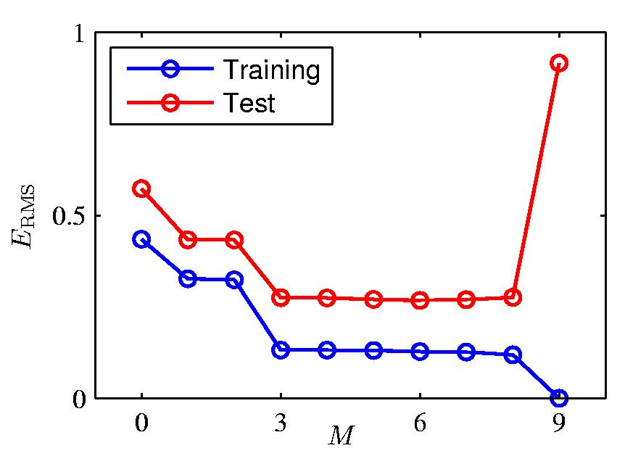
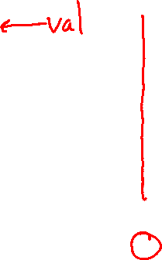
Over-fitting
Slide credit: CMU MLD William Cohen

Slide 6
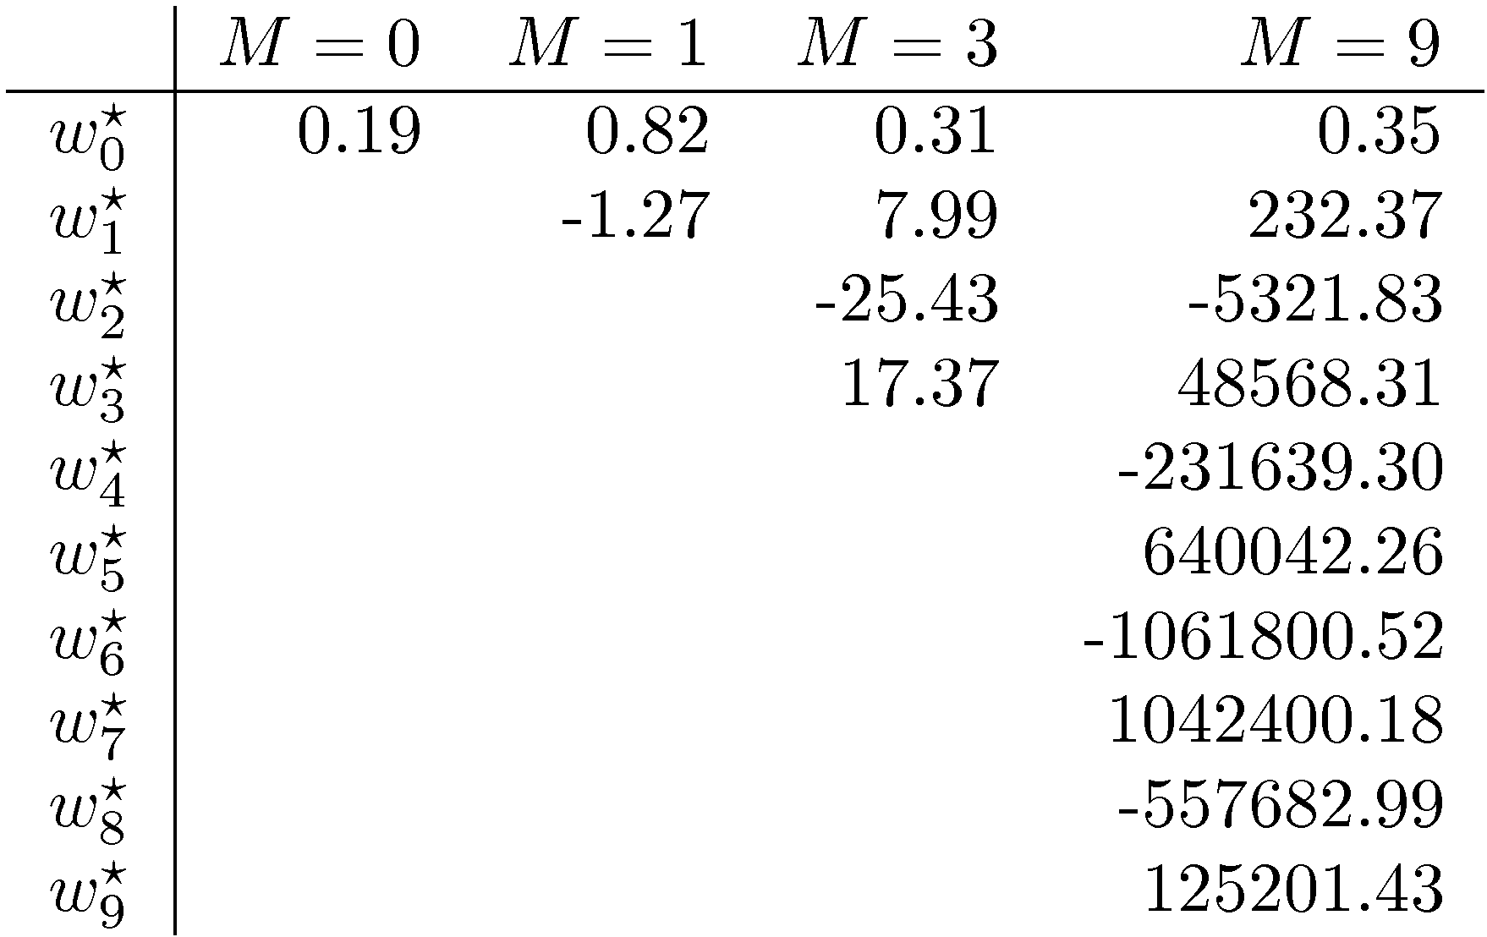
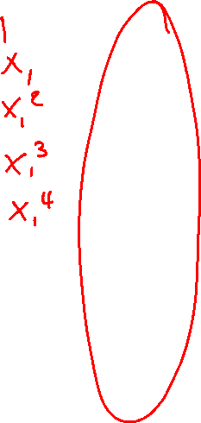
Polynomial Coefficients
Slide credit: CMU MLD William Cohen

Slide 7
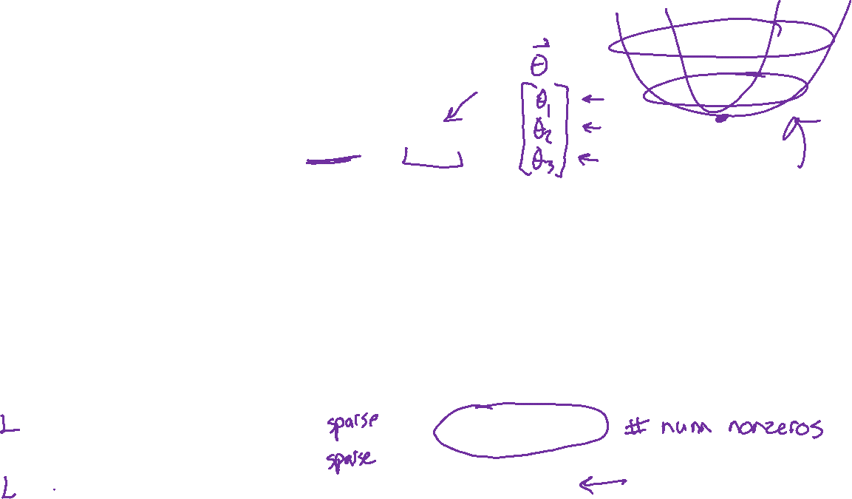
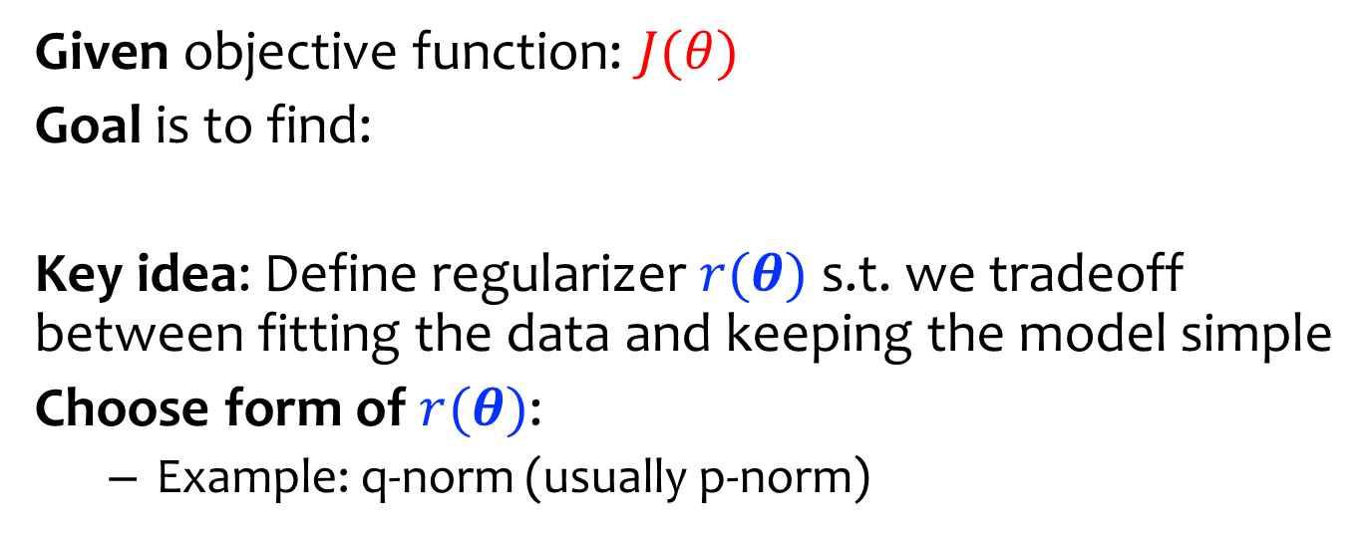
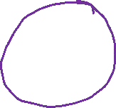
Regularization
Given objective function: $J(θ)$
Goal is to find:
Key idea: Define regularizer $r(θ)$ s.t. we tradeoff between fitting the data and keeping the model simple
Choose form of $r(θ)$:
Example: q-norm (usually p-norm)
Slide credit: CMU MLD Matt Gormley

Slide 8
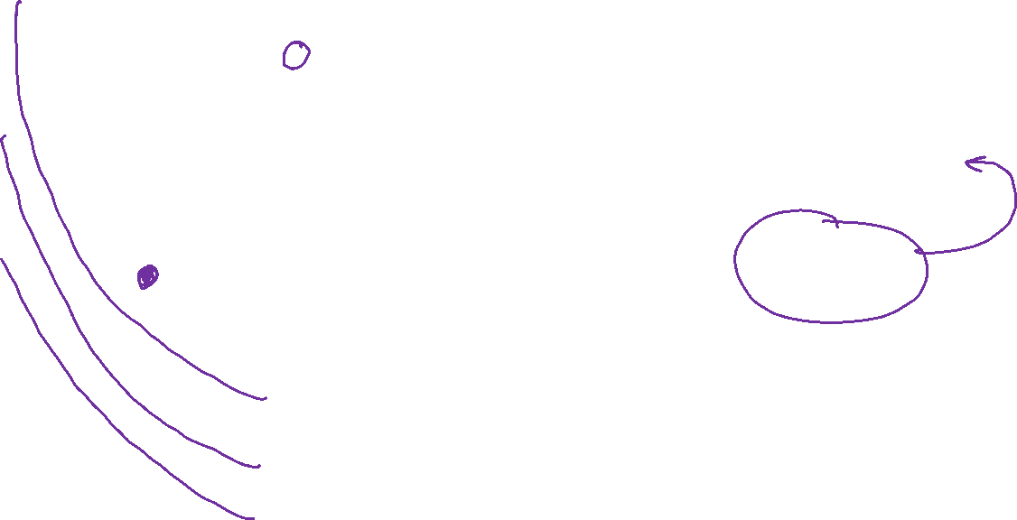
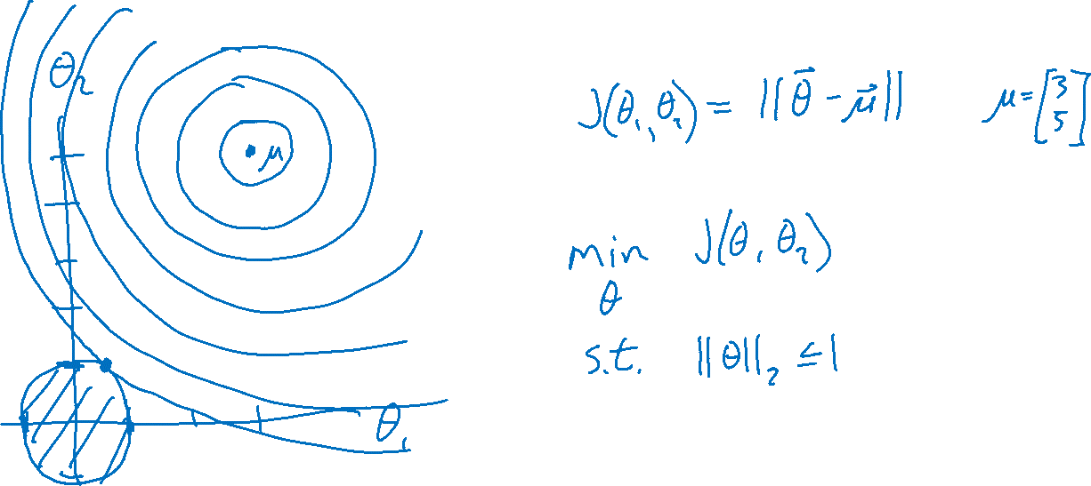
Regularization

Slide 9

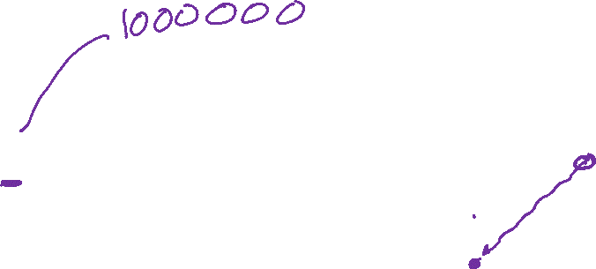
Previous Piazza Poll
Question:
Suppose we are minimizing J’(θ) where
As λ increases, the minimum of J’(θ) will…
…move towards the midpoint between J’(θ) and r(θ)
…move towards the minimum of J(θ)
…move towards the minimum of r(θ)
…move towards a theta vector of positive infinities
…move towards a theta vector of negative infinities
…stay the same
Slide credit: CMU MLD Matt Gormley

Slide 10
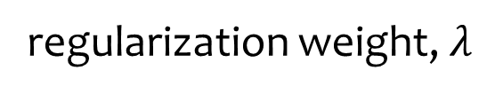
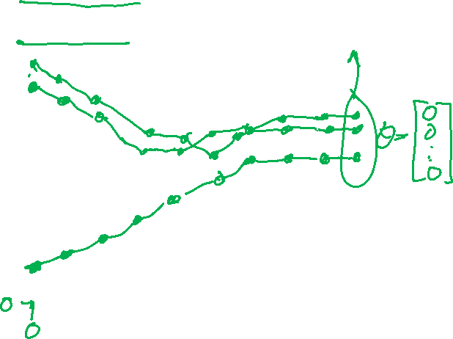
Regularization Exercise
In-class Exercise
Plot train error vs. regularization weight (cartoon)
Plot test error vs . regularization weight (cartoon)
error
Slide credit: CMU MLD Matt Gormley
regularization weight, $λ$

Slide 11

Piazza Poll 1
Question:
Suppose we are minimizing J’(θ) where
As we increase λ from zero, the validation error will…
…increase
…decrease
…first increase, then decrease
…first decrease, then increase
…stay the same
Slide credit: CMU MLD Matt Gormley

Slide 12
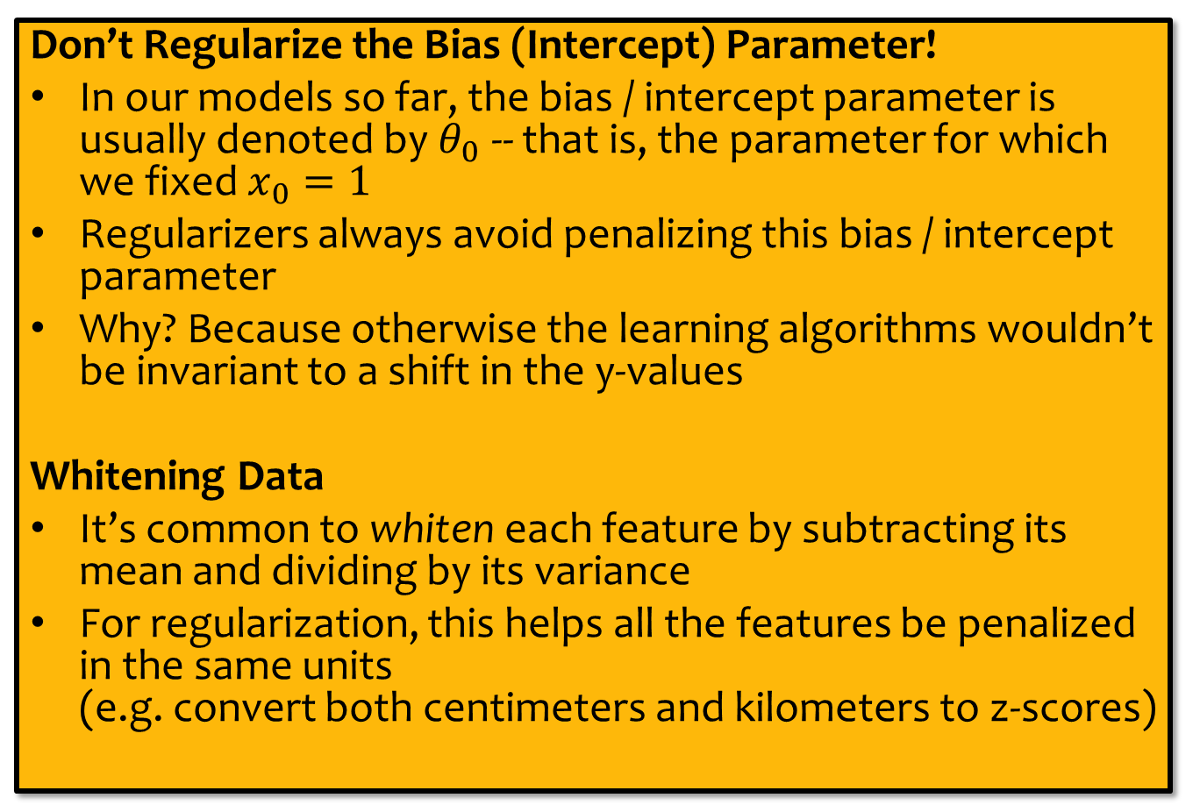

Regularization
Don’t Regularize the Bias (Intercept) Parameter!
In our models so far, the bias / intercept parameter is usually denoted by $θ_{0}$ -- that is, the parameter for which we fixed $x_{0}=1$
Regularizers always avoid penalizing this bias / intercept parameter
Why? Because otherwise the learning algorithms wouldn’t be invariant to a shift in the y-values
Whitening Data
It’s common to whiten each feature by subtracting its mean and dividing by its variance
For regularization, this helps all the features be penalized in the same units (e.g. convert both centimeters and kilometers to z-scores)
Slide credit: CMU MLD Matt Gormley

Slide 13
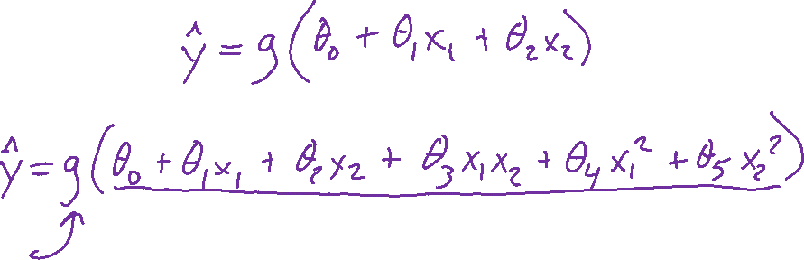
Logistic Regression with Nonlinear Features
Jupyter notebook demo

Slide 14

Example: Logistic Regression
For this example, we construct nonlinear features (i.e. feature engineering)
Specifically, we add polynomials up to order 9 of the two original features x₁ and x₂
Thus our classifier is linear in the high-dimensional feature space, but the decision boundary is nonlinear when visualized in low-dimensions (i.e. the original two dimensions)
Training Data
Test Data
Slide credit: CMU MLD Matt Gormley

Slide 15
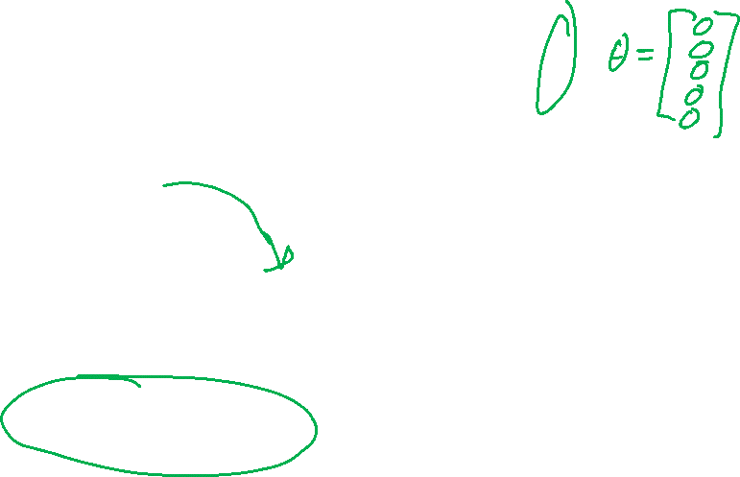
Example: Logistic Regression
error
lambda
Slide credit: CMU MLD Matt Gormley

Slide 16

Example: Logistic Regression
Slide credit: CMU MLD Matt Gormley

Slide 17
Example: Logistic Regression
Slide credit: CMU MLD Matt Gormley

Slide 18
Example: Logistic Regression
Slide credit: CMU MLD Matt Gormley

Slide 19
Example: Logistic Regression
Slide credit: CMU MLD Matt Gormley

Slide 20
Example: Logistic Regression
Slide credit: CMU MLD Matt Gormley

Slide 21
Example: Logistic Regression
Slide credit: CMU MLD Matt Gormley

Slide 22
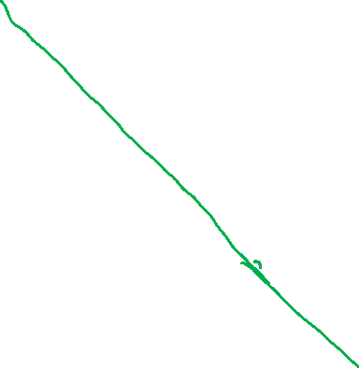
Example: Logistic Regression
Slide credit: CMU MLD Matt Gormley

Slide 23
Example: Logistic Regression
Slide credit: CMU MLD Matt Gormley

Slide 24
Example: Logistic Regression
Slide credit: CMU MLD Matt Gormley

Slide 25
Example: Logistic Regression
Slide credit: CMU MLD Matt Gormley

Slide 26
Example: Logistic Regression
Slide credit: CMU MLD Matt Gormley

Slide 27
Example: Logistic Regression
Slide credit: CMU MLD Matt Gormley

Slide 28
Example: Logistic Regression
Slide credit: CMU MLD Matt Gormley

Slide 29
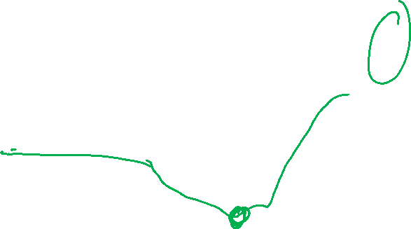
Example: Logistic Regression
error
lambda
Slide credit: CMU MLD Matt Gormley

Slide 30
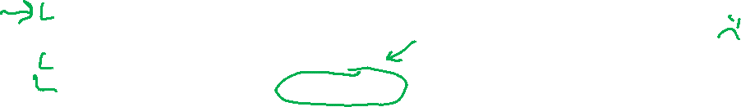
Regularization
Given objective function: $J(θ)$
Goal is to find:
Key idea: Define regularizer $r(θ)$ s.t. we tradeoff between fitting the data and keeping the model simple
Choose form of $r(θ)$:
Example: q-norm (usually p-norm)
Slide credit: CMU MLD Matt Gormley

Slide 31
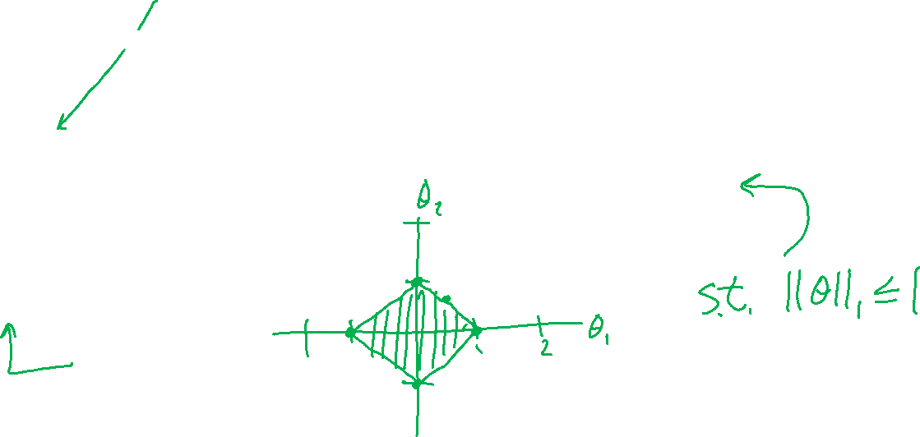
Regularization

Slide 32
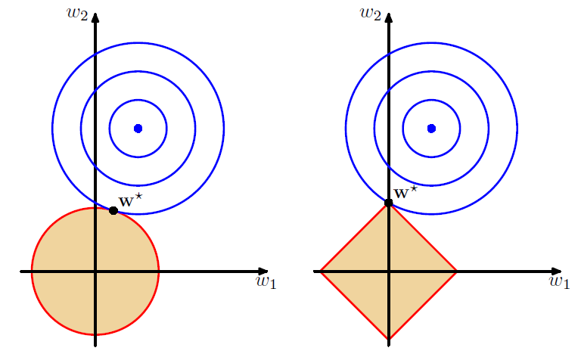

L2 vs L1 Regularization
Combine original objective with penalty on parameters
Figures: Bishop, Ch 3.1.4

Slide 33
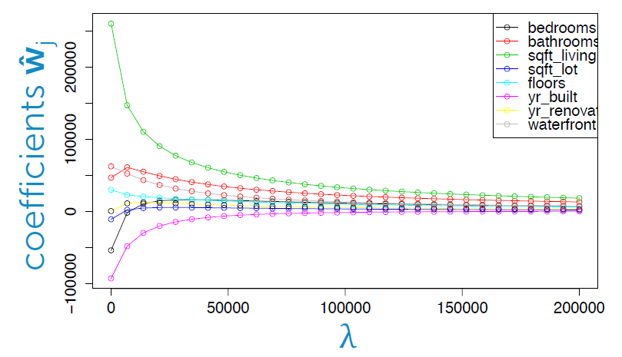
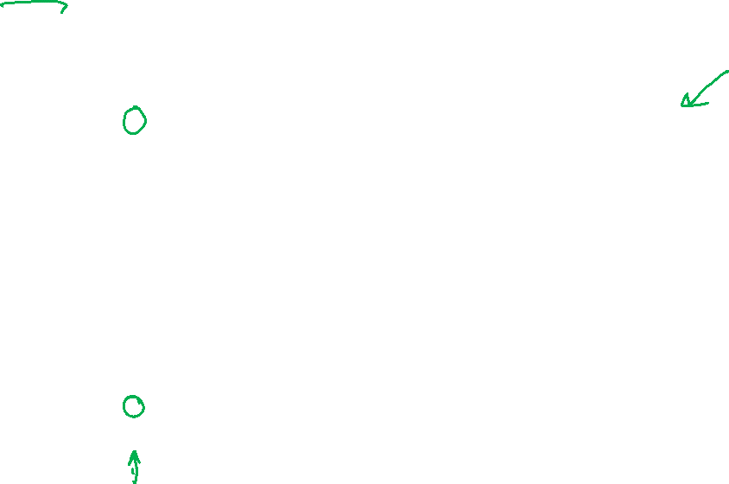
L2 vs L1: Housing Price Example
Predict housing price from several features
Figure: Emily Fox, University of Washington

Slide 34
L2 vs L1: Housing Price Example
Predict housing price from several features
Figure: Emily Fox, University of Washington

Slide 35
L2 vs L1: Housing Price Example
Predict housing price from several features
Figure: Emily Fox, University of Washington

Slide 36
L2 vs L1: Housing Price Example
Predict housing price from several features
Figure: Emily Fox, University of Washington

Slide 37
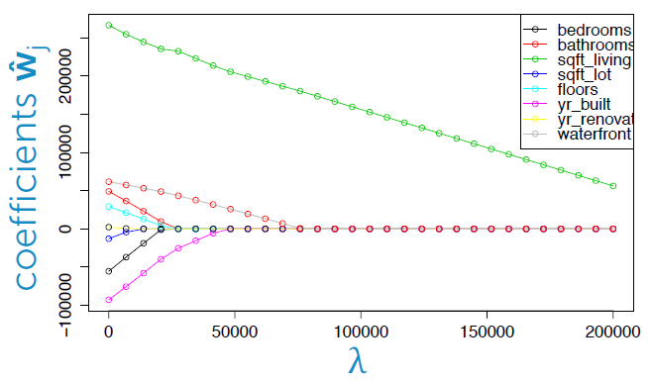

L2 vs L1: Housing Price Example
Predict housing price from several features
Figure: Emily Fox, University of Washington

Slide 38
L2 vs L1: Housing Price Example
Predict housing price from several features
Figure: Emily Fox, University of Washington

Slide 39
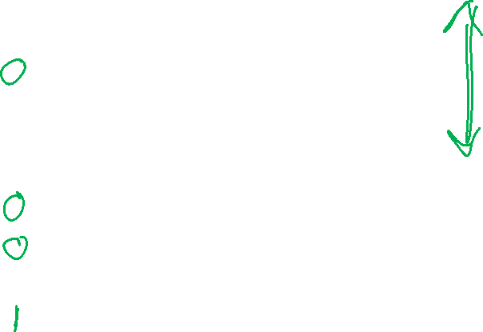
L2 vs L1: Housing Price Example
Predict housing price from several features
Figure: Emily Fox, University of Washington

Slide 40
L2 vs L1: Housing Price Example
Predict housing price from several features
Figure: Emily Fox, University of Washington

Slide 41
L2 vs L1: Housing Price Example
Predict housing price from several features
Figure: Emily Fox, University of Washington

Slide 42
Regularization as MAP
L1 and L2 regularization can be interpreted as maximum a-posteriori (MAP) estimation of the parameters
To be discussed later in the course…
Slide credit: CMU MLD Matt Gormley

Slide 43
Takeaways
Nonlinear basis functions allow linear models (e.g. Linear Regression, Logistic Regression) to capture nonlinear aspects of the original input
Nonlinear features require no changes to the model (i.e. just preprocessing)
Regularization helps to avoid overfitting
(Regularization and MAP estimation are equivalent for appropriately chosen priors)
Slide credit: CMU MLD Matt Gormley

Slide 44
Feature Engineering / Regularization Objectives
You should be able to…
Engineer appropriate features for a new task
Use feature selection techniques to identify and remove irrelevant features
Identify when a model is overfitting
Add a regularizer to an existing objective in order to combat overfitting
Convert linearly inseparable dataset to a linearly separable dataset in higher dimensions
Describe feature engineering in common application areas

Slide 45
“Dollar fifty in late charges at the public library”
https://www.youtube.com/watch?v=e1DnltskkWk
Breakout rooms: Why is a CMU course better than a library card?

Slide 46

Introduction to Machine Learning Neural Networks
Instructor: Pat Virtue

Slide 47
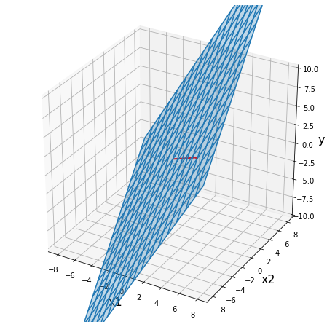
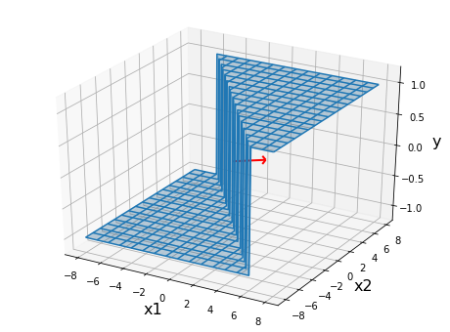
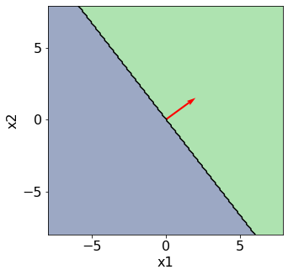
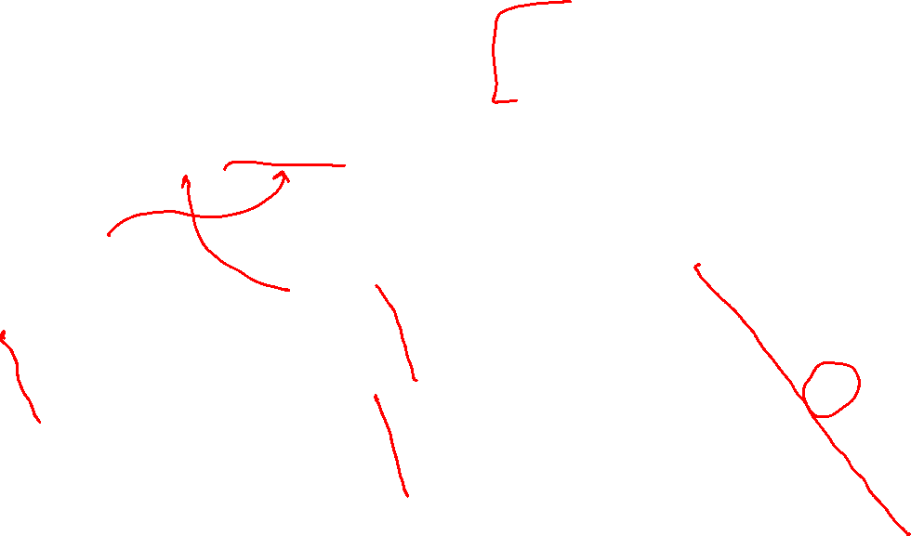
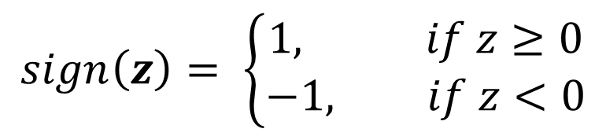

Perceptron
$$sign\left(z\right)= \left\{\begin{aligned}1, if z≥0 \\ −1, if z<0\end{aligned}\right.$$
Classification: Hard threshold on linear model
$$h\left(x\right)=sign\left(w^{T}x+b\right)$$

Slide 48

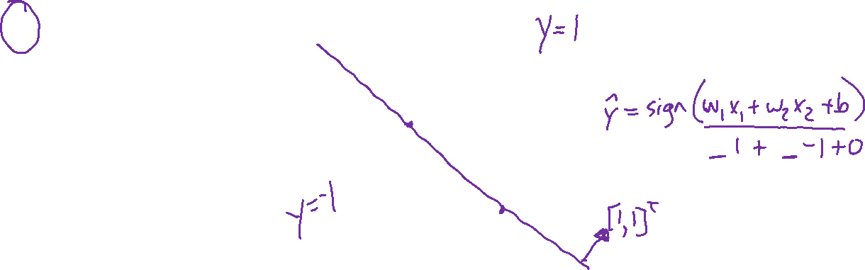
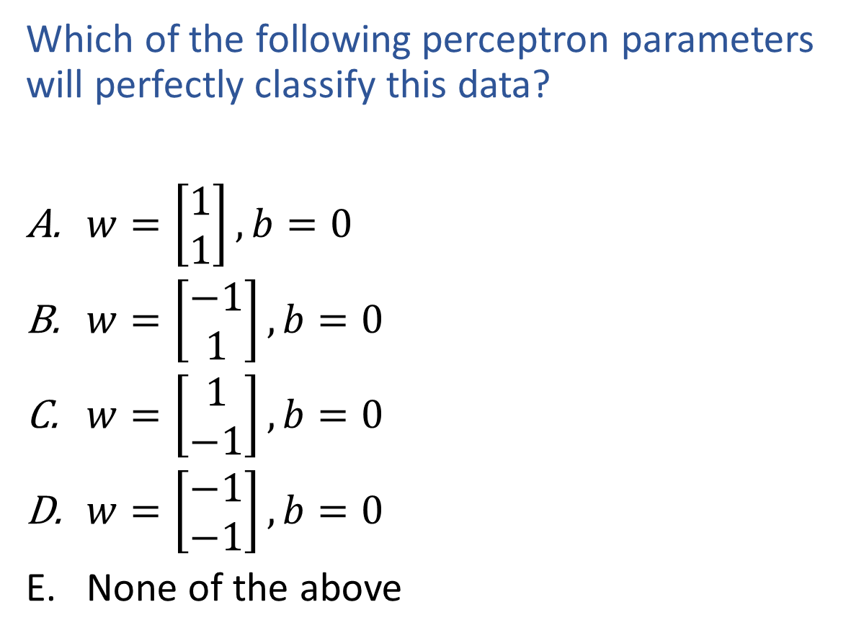
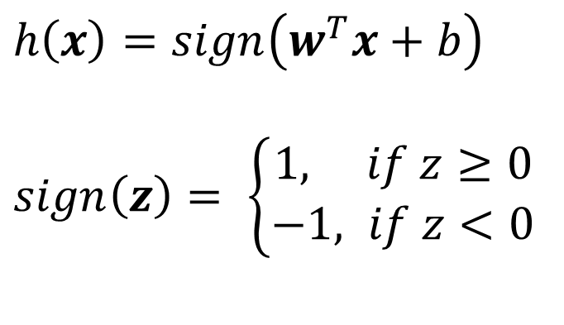

Piazza Poll 2
$h\left(x\right)=sign\left(w^{T}x+b\right)$
$sign\left(z\right)= \left\{\begin{aligned}1, if z≥0 \\ −1, if z<0\end{aligned}\right.$
Which of the following perceptron parameters will perfectly classify this data?
$w=\left[\begin{aligned}1 \\ 1\end{aligned}\right], b=0$
$w=\left[\begin{aligned}−1 \\ 1\end{aligned}\right], b=0$
$w=\left[\begin{aligned}1 \\ −1\end{aligned}\right], b=0$
$w=\left[\begin{aligned}−1 \\ −1\end{aligned}\right], b=0$
None of the above
$$x2$$
$$x1$$

Slide 49
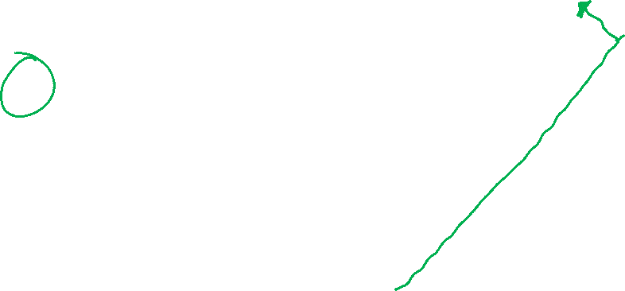
Piazza Poll 3
$h\left(x\right)=sign\left(w^{T}x+b\right)$
$sign\left(z\right)= \left\{\begin{aligned}1, if z≥0 \\ −1, if z<0\end{aligned}\right.$
Which of the following perceptron parameters will perfectly classify this data?
$w=\left[\begin{aligned}1 \\ 1\end{aligned}\right], b=0$
$w=\left[\begin{aligned}−1 \\ 1\end{aligned}\right], b=0$
$w=\left[\begin{aligned}1 \\ −1\end{aligned}\right], b=0$
$w=\left[\begin{aligned}−1 \\ −1\end{aligned}\right], b=0$
None of the above
$$x2$$
$$x1$$

Slide 50


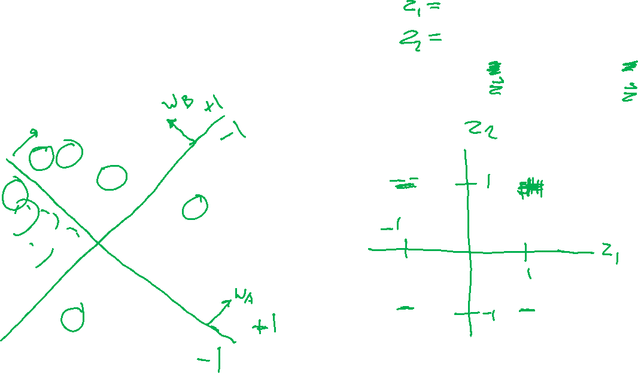
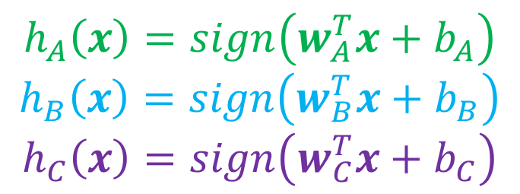
Classification Design Challenge
$$h_{A}\left(x\right)=sign\left(w_{A}^{T}x+b_{A}\right)$$
$$h_{B}\left(x\right)=sign\left(w_{B}^{T}x+b_{B}\right)$$
$$h_{C}\left(x\right)=sign\left(w_{C}^{T}x+b_{C}\right)$$
How could you configure three specific perceptrons to classify this data?
$$x2$$
$$x1$$

Slide 51

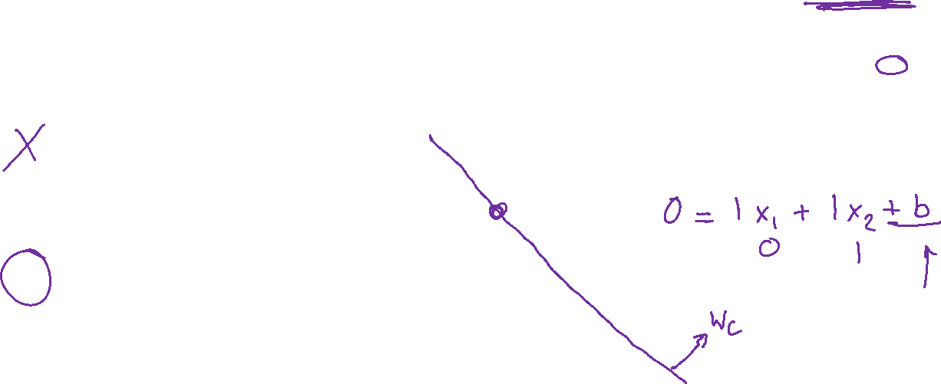
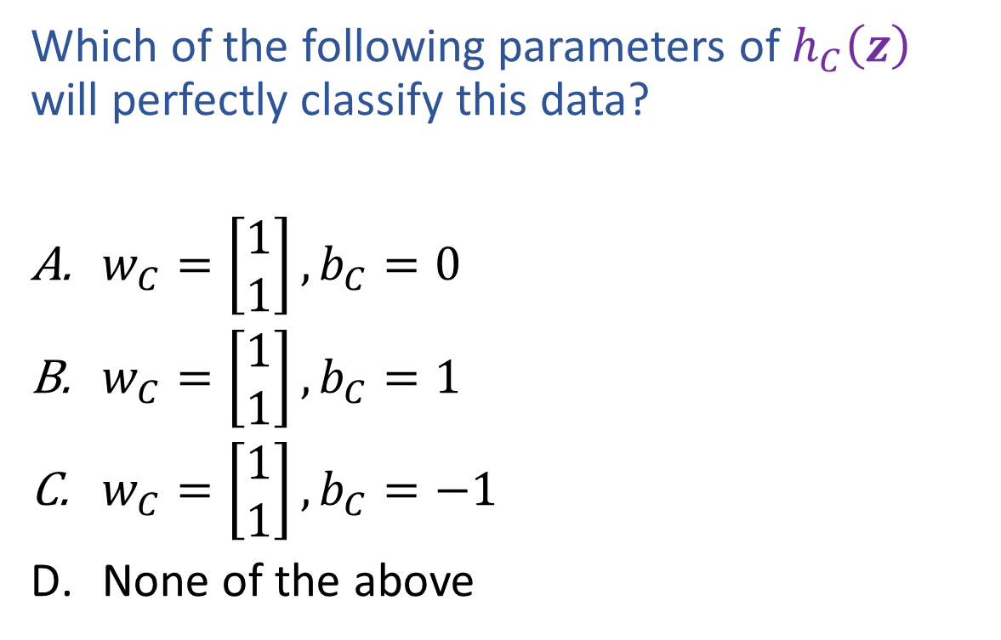
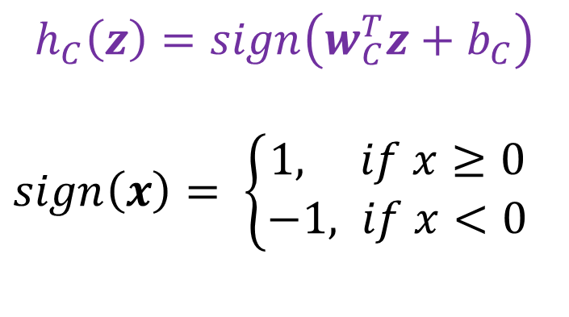

Piazza Poll 4
$$h_{C}\left(z\right)=sign\left(w_{C}^{T}z+b_{C}\right)$$
$sign\left(x\right)= \left\{\begin{aligned}1, if x≥0 \\ −1, if x<0\end{aligned}\right.$
Which of the following parameters of $h_{C}\left(z\right)$ will perfectly classify this data?
$w_{C}=\left[\begin{aligned}1 \\ 1\end{aligned}\right], b_{C}=0$
$w_{C}=\left[\begin{aligned}1 \\ 1\end{aligned}\right], b_{C}=1$
$w_{C}=\left[\begin{aligned}1 \\ 1\end{aligned}\right], b_{C}=−1$
None of the above
$$z2$$
$$z1$$

Slide 52
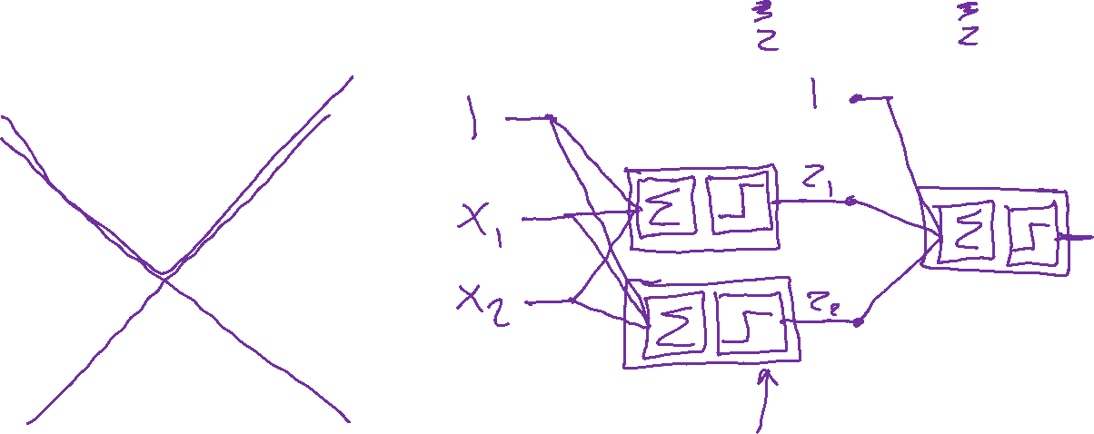
Classification Design Challenge
$$h_{A}\left(x\right)=sign\left(w_{A}^{T}x+b_{A}\right)$$
$$h_{B}\left(x\right)=sign\left(w_{B}^{T}x+b_{B}\right)$$
$$h_{C}\left(x\right)=sign\left(w_{C}^{T}x+b_{C}\right)$$
How could you configure three specific perceptrons to classify this data?
$$x2$$
$$x1$$

Slide 53

Multilayer Perceptrons
A multilayer perceptron is a feedforward neural network with at least one hidden layer (nodes that are neither inputs nor outputs)
MLPs with enough hidden nodes can represent any function
Slide from UC Berkeley AI

Slide 54
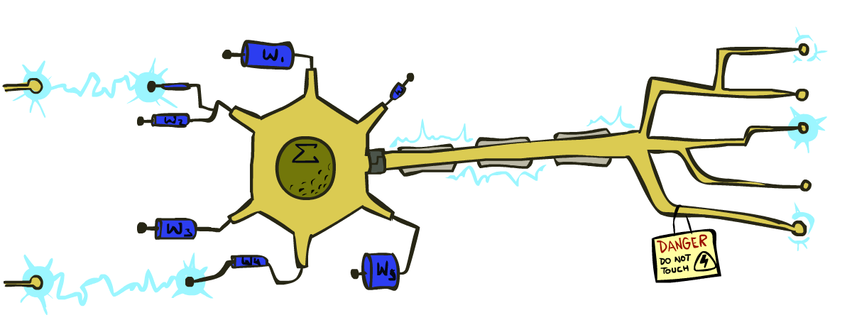

Very Loose Inspiration: Human Neurons
Slide from UC Berkeley AI

Slide 55

Simple Model of a Neuron (McCulloch & Pitts, 1943)
Inputs a_{i} come from the output of node i to this node j (or from “outside”)
Each input link has a weight w_{i,j}
There is an additional fixed input a₀ with bias weight w_{0,j}
The total input is in_{j} = Σ_{i} w_{i,j} a_{i}
The output is a_{j} = g(in_{j}) = g(Σ_{i} w_{i,j} a_{i}) = g(w.a)
Slide from UC Berkeley AI
Notes:
fix notation: x, a, h, etc, explain bias

Slide 56
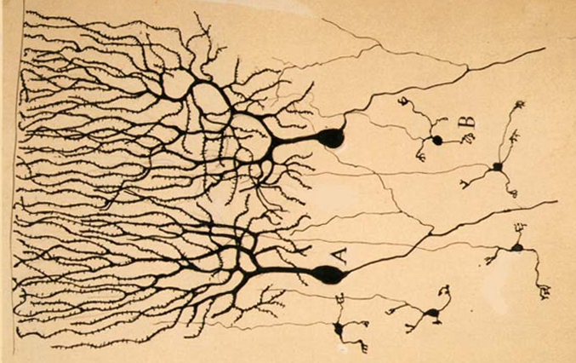

Neural Networks
Inspired by actual human brain
Output
Signal
Input Signal
DOG
CAT
TREE
CAR
SKY
Image: https://en.wikipedia.org/wiki/Neuron

