Slide 1
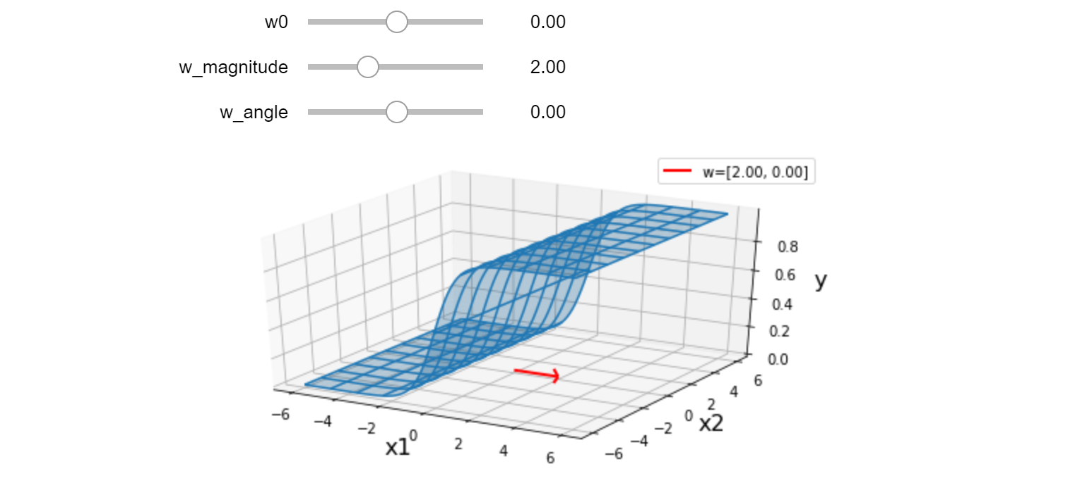

Warm-up as You Log In
Interact with the lec8.ipynb posted on the course website schedule

Slide 2
Announcements
Midterm 1
Monday
Lots of info on Piazza
Stay tuned for one more post regarding day-of details

Slide 3
Plan
Last time
Likelihood, MLE, conditional likelihood and M(C)LE
Today
Logistic regression
Solving logistic regression
Decision boundaries
Multiclass logistic regression
Feature engineering

Slide 4

Introduction to Machine Learning Logistic Regression and Feature Engineering
Instructor: Pat Virtue

Slide 5
Binary Logistic Regression

Slide 6
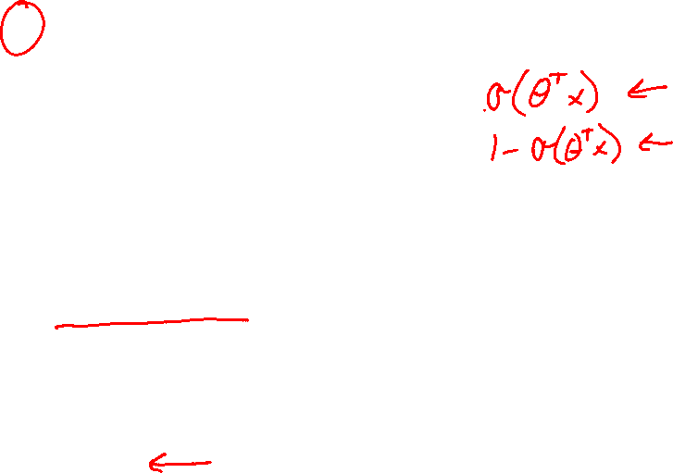
Binary Logistic Regression
Model: $Y∼Bern\left(μ\right)$ $μ=σ(θ^{T}x)$ $σ\left(z\right)=\frac{1}{1+e^{−z}}$

Slide 7
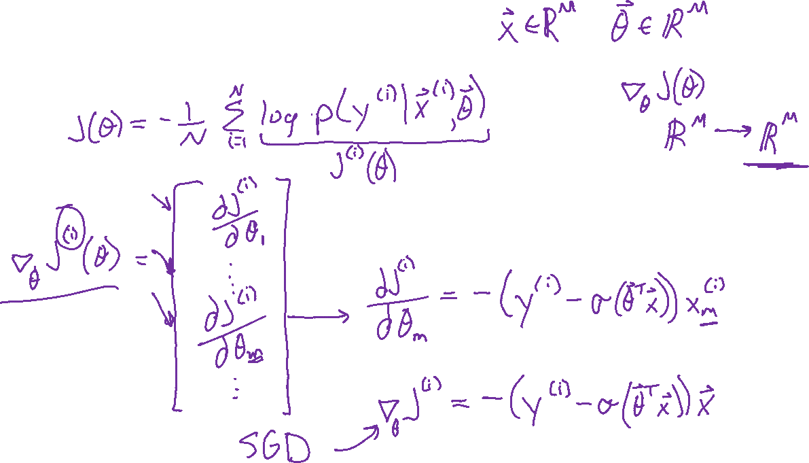
Binary Logistic Regression
Gradient

Slide 8
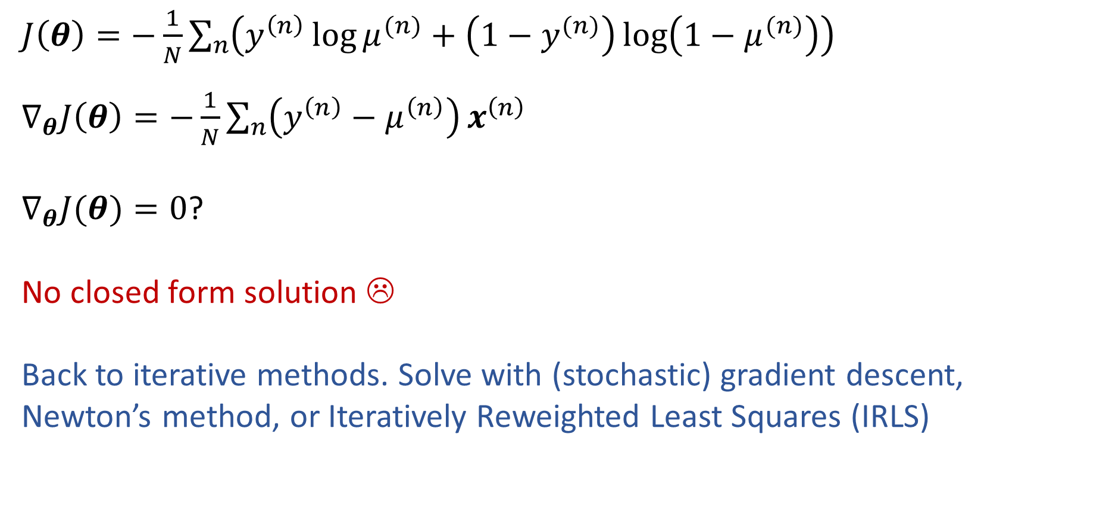
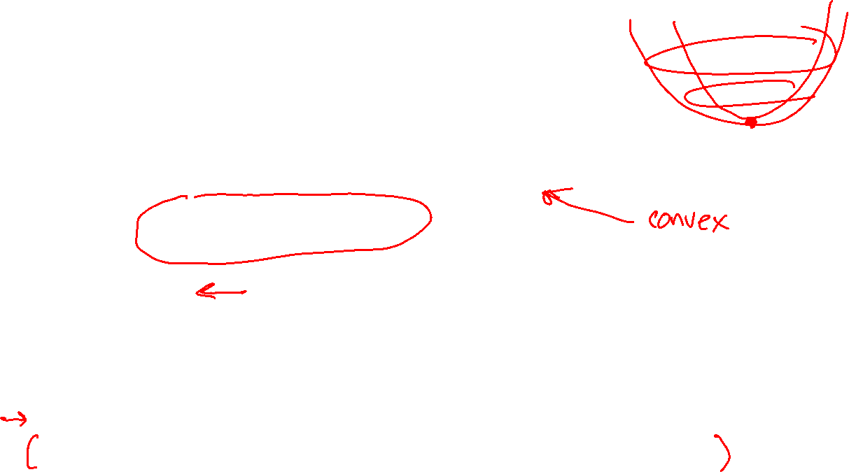
Solve Logistic Regression
$Y∼Bern\left(μ\right)$ $μ=σ\left(θ^{T}x\right)$ $σ\left(z\right)=\frac{1}{1+e^{−z}}$
$J\left(θ\right)=−\frac{1}{N}\sum_{n}{\left(y^{\left(n\right)}\log{μ^{(n)}}+\left(1−y^{(n)}\right)\log\left(1−μ^{(n)}\right)\right)}$
$∇_{θ}J\left(θ\right)=−\frac{1}{N}\sum_{n}{\left(y^{\left(n\right)}−μ^{\left(n\right)}\right)}x^{\left(n\right)}$
$∇_{θ}J(θ)=0$?
No closed form solution ☹
Back to iterative methods. Solve with (stochastic) gradient descent, Newton’s method, or Iteratively Reweighted Least Squares (IRLS)

Slide 9
Piazza Poll 1
Which of the following is a correct description of SGD for Logistic Regression?
(1) compute the gradient of the log-likelihood for all examples (2) update all the parameters using the gradient
(1) compute the gradient of the log-likelihood for all examples (2) randomly pick an example (3) update only the parameters for that example
(1) randomly pick a parameter, (2) compute the partial derivative of the log-likelihood with respect to that parameter, (3) update that parameter for all examples
(1) randomly pick an example, (2) compute the gradient of the log-likelihood for that example, (3) update all the parameters using that gradient
(1) randomly pick a parameter and an example, (2) compute the gradient of the log-likelihood for that example with respect to that parameter, (3) update that parameter using that gradient
Slide credit: CMU MLD Matt Gormley

Slide 10
Piazza Poll 1
Which of the following is a correct description of SGD for Logistic Regression?
(1) compute the gradient of the log-likelihood for all examples (2) update all the parameters using the gradient
(1) compute the gradient of the log-likelihood for all examples (2) randomly pick an example (3) update only the parameters for that example
(1) randomly pick a parameter, (2) compute the partial derivative of the log-likelihood with respect to that parameter, (3) update that parameter for all examples
(1) randomly pick an example, (2) compute the gradient of the log-likelihood for that example, (3) update all the parameters using that gradient
(1) randomly pick a parameter and an example, (2) compute the gradient of the log-likelihood for that example with respect to that parameter, (3) update that parameter using that gradient
Slide credit: CMU MLD Matt Gormley

Slide 11
Decision BoundarIES for Logistic Regression

Slide 12

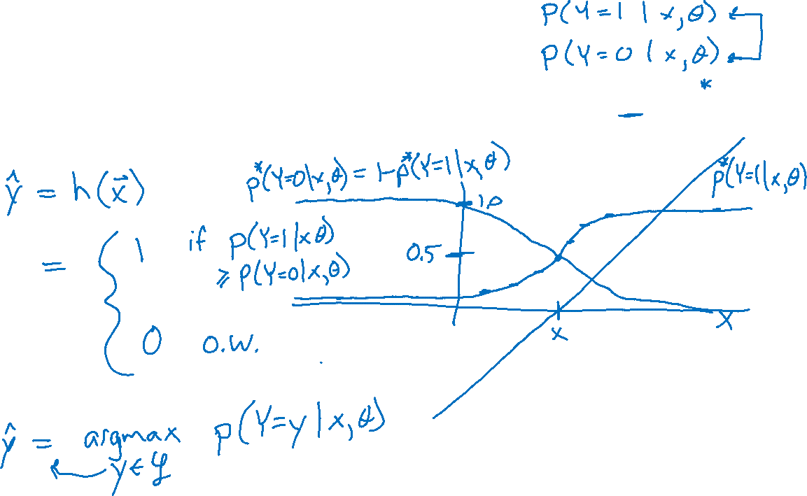
Bayes Optimal Classifier
Given an oracle that perfectly knows everything, e.g. $p^{∗}(Y=y∣x, θ)$,
What is the optimal classifier in this setting?

Slide 13
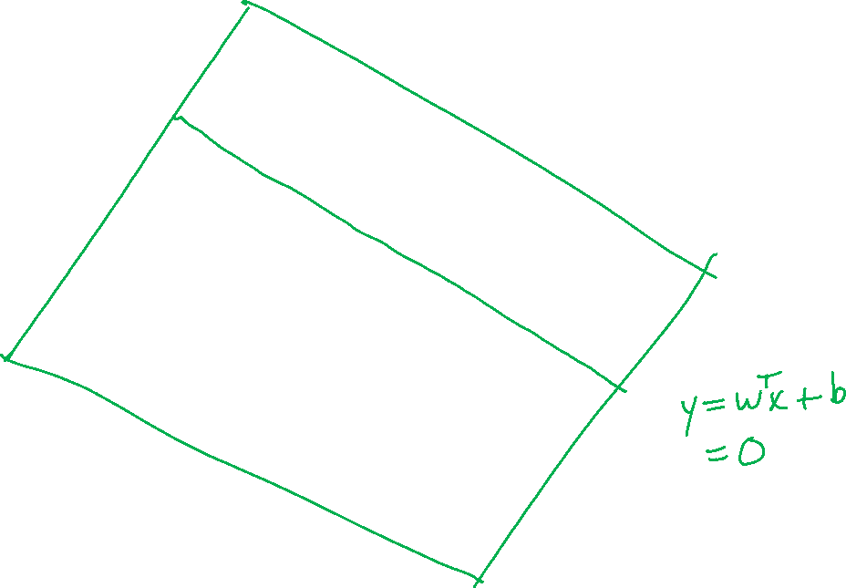
Logistic Regression
Slide credit: CMU MLD Matt Gormley
Notes:
Data are drawn from two Guassians.
There is irreducible error here b/c they overlap. SHOW: 3D representation with piece of paper.

Slide 14
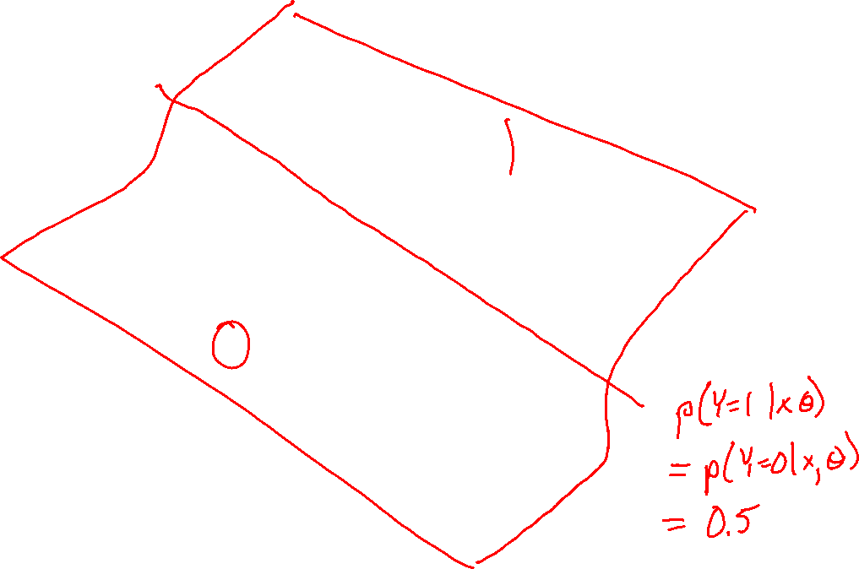
Logistic Regression
Slide credit: CMU MLD Matt Gormley

Slide 15
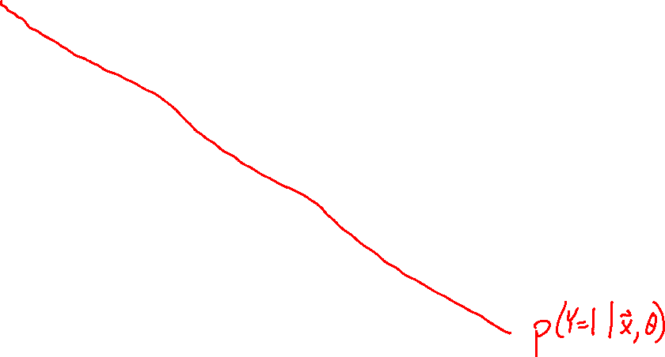
Logistic Regression
Slide credit: CMU MLD Matt Gormley

Slide 16
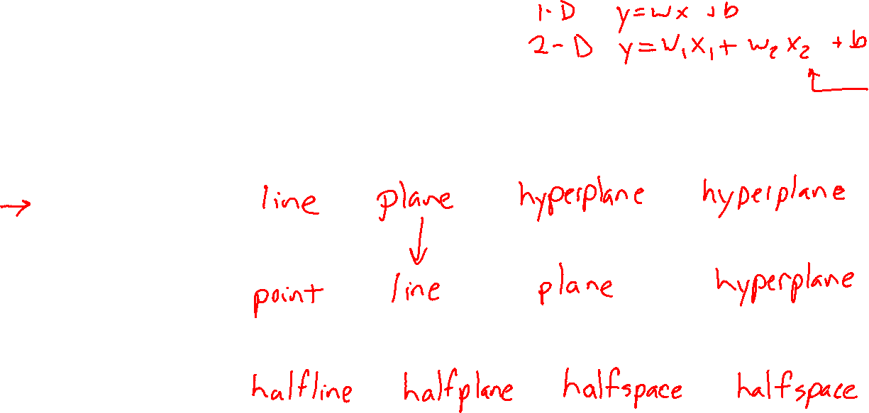




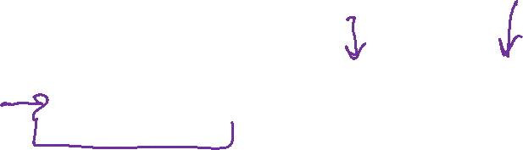

Linear in Higher Dimensions
What are these linear shapes called for 1-D, 2-D, 3-D, M-D input?
$$x∈ℝ$$
$$x∈ℝ^{2}$$
$$x∈ℝ^{3}$$
$$x∈ℝ^{M}$$
$y=w^{T}x+b$
$w^{T}x+b=0$
$w^{T}x+b≥0$

Slide 17
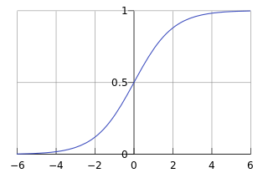

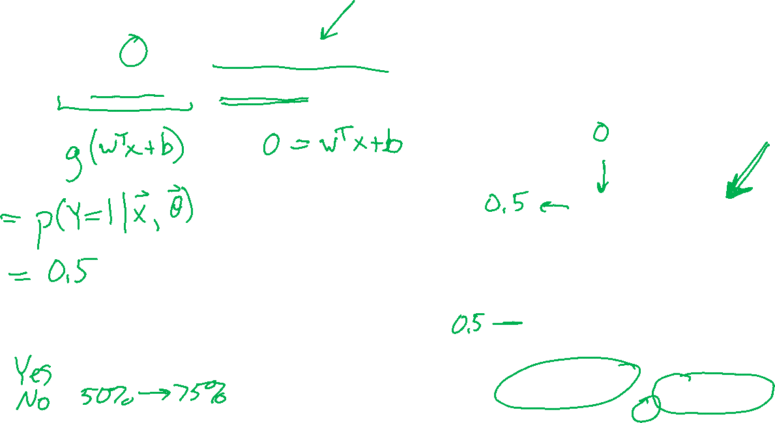

Piazza Poll 2
For a point $x$ on the decision boundary of logistic regression, does $g\left(w^{T}x+b\right)=w^{T}x+b$?
$$g\left(z\right)=\frac{1}{1+e^{−z}}$$

Slide 18
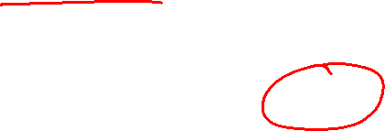
Logistic Regression
Data: Inputs are continuous vectors of length M. Outputs are discrete.
Model: Logistic function applied to dot product of parameters with input vector.
Learning: finds the parameters that minimize some objective function.
Prediction: Output is the most probable class.

Slide 19
Multi-class Logistic Regression

Slide 20


Prep: Multi-class Logistic Regression
Logistic function
$g\left(z\right)=\frac{e^{z}}{e^{z}+1}$
$p\left(Y=1 ∣ x,θ\right)=g\left(μ\right)=\frac{e^{μ}}{e^{μ}+1}$
$p\left(Y=0 ∣ x,θ\right)=1−g\left(μ\right)=1−\frac{e^{μ}}{e^{μ}+1}$
Probability distribution sums to 1
$\sum_{y}{p(Y=y∣x, θ)}$
$=p\left(Y=0 ∣ x,θ\right)+p\left(Y=1 ∣ x,θ\right)$
$= 1−\frac{e^{μ}}{e^{μ}+1}+ \frac{e^{μ}}{e^{μ}+1}=1$

Slide 21
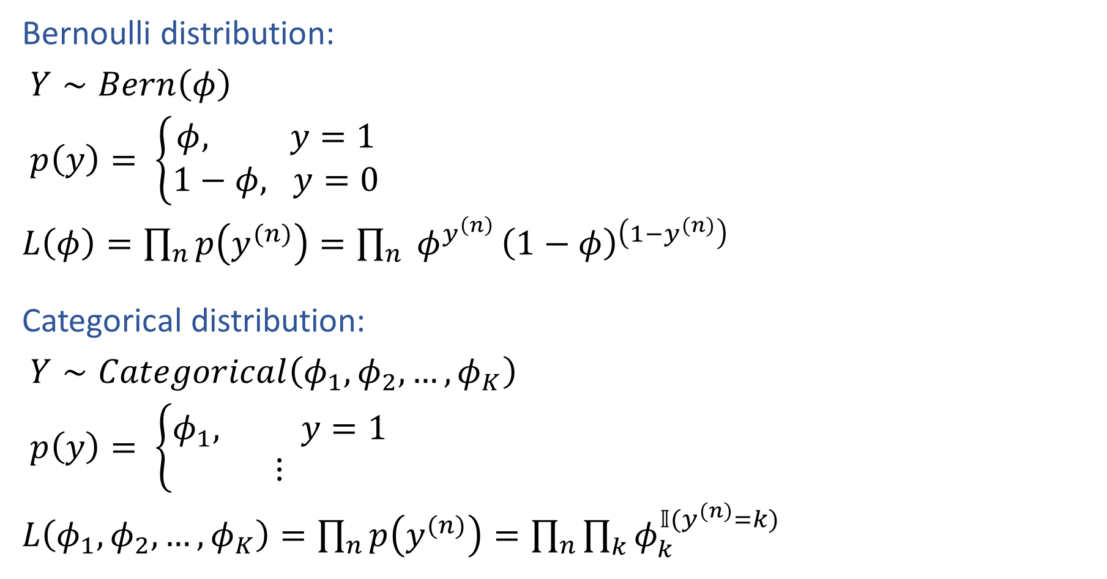
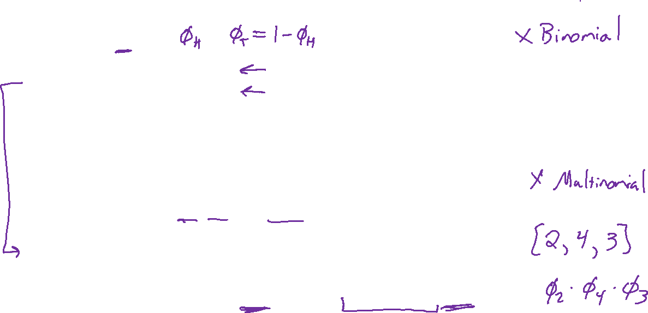
Prep: Multi-class Logistic Regression
Bernoulli distribution:
$Y∼Bern\left(φ\right)$
$p\left(y\right)= \left\{\begin{aligned}φ, y=1 \\ 1−φ, y=0\end{aligned}\right.$
$L\left(φ\right)=\prod_{n}{p\left(y^{(n)}\right)}=\prod_{n}{ φ^{y^{\left(n\right)}}}{\left(1−φ\right)}^{\left(1−y^{(n)}\right)}$
Categorical distribution:
$Y∼Categorical\left(φ_{1}, φ_{2},…, φ_{K}\right)$
$p\left(y\right)= \left\{\begin{aligned}φ_{1}, y=1 \\ ⋮\end{aligned}\right.$
$L\left(φ_{1},φ_{2},…,φ_{K}\right)=\prod_{n}{p\left(y^{(n)}\right)}=\prod_{n}{\prod_{k}{φ_{k}^{𝕀(y^{(n)}=k)}} }$

Slide 22
Slide credit: CMU MLD Matt Gormley
Notes:
https://www.jpl.nasa.gov/edu/teach/activity/whats-causing-sea-level-rise-land-ice-vs-sea-ice/

Slide 23
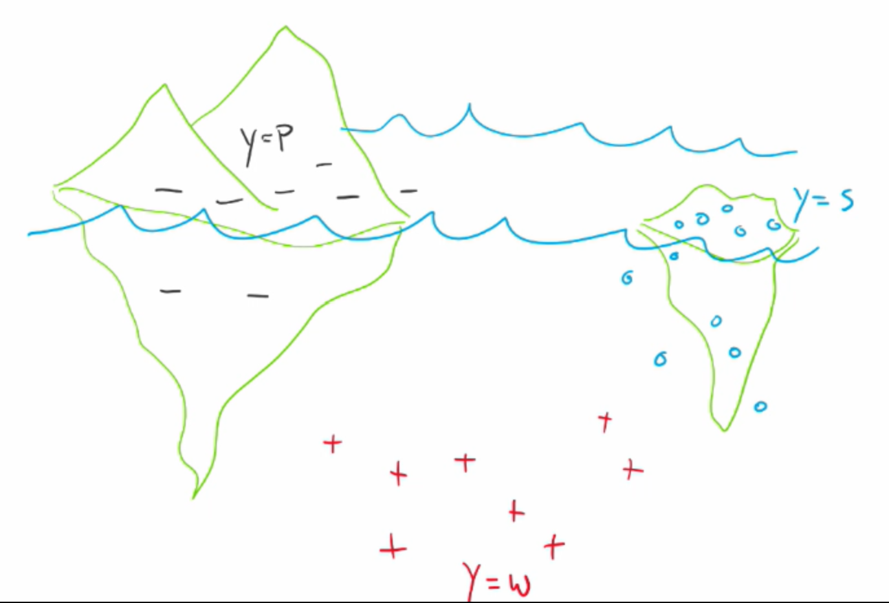
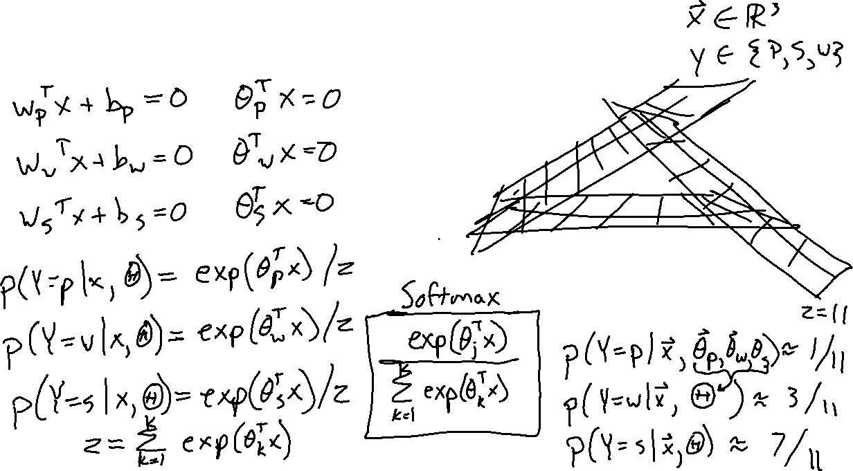
Multi-class Logistic Regression
Slide credit: CMU MLD Matt Gormley

Slide 24
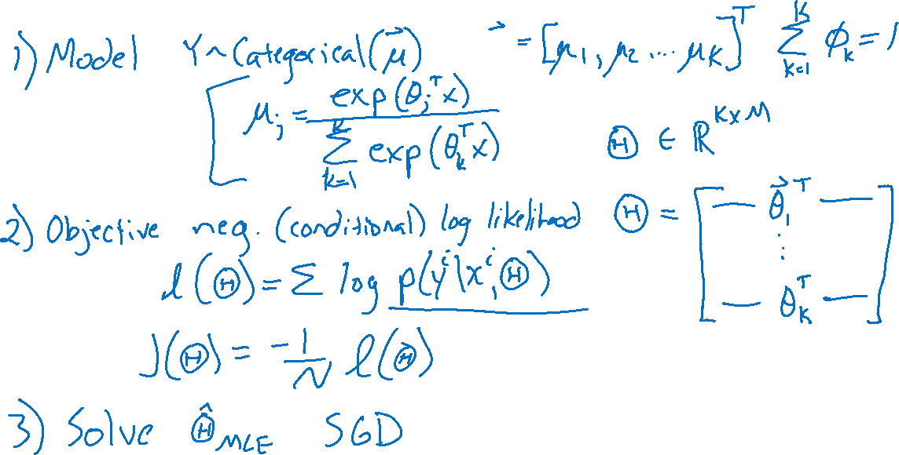
Multi-class Logistic Regression

Slide 25
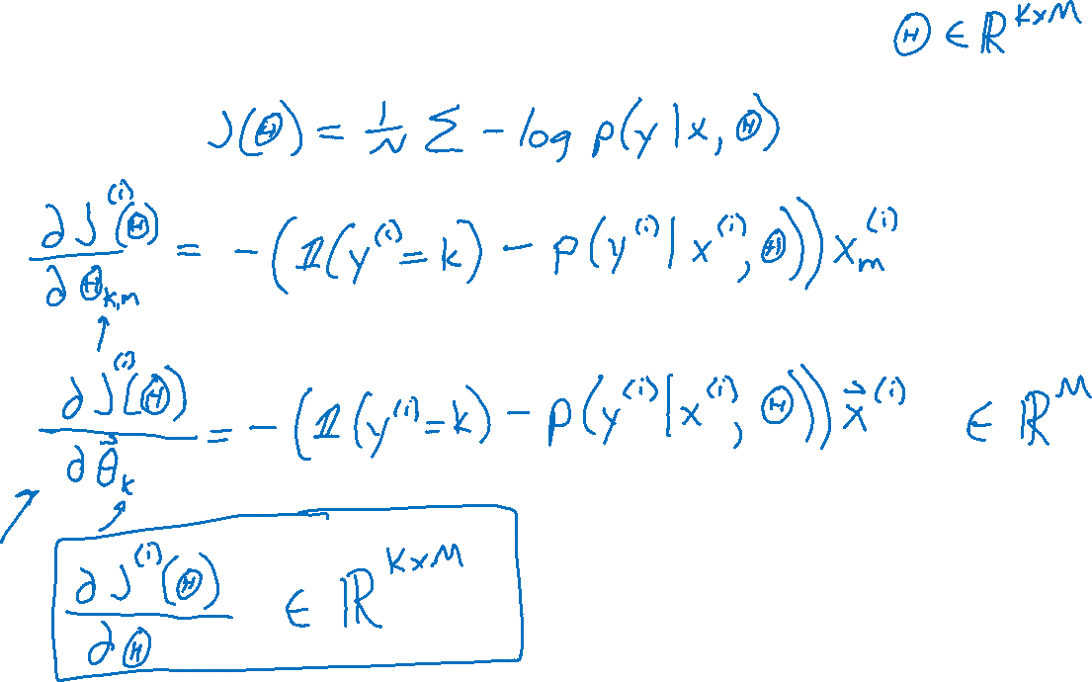
Multi-class Logistic Regression
Gradient

Slide 26
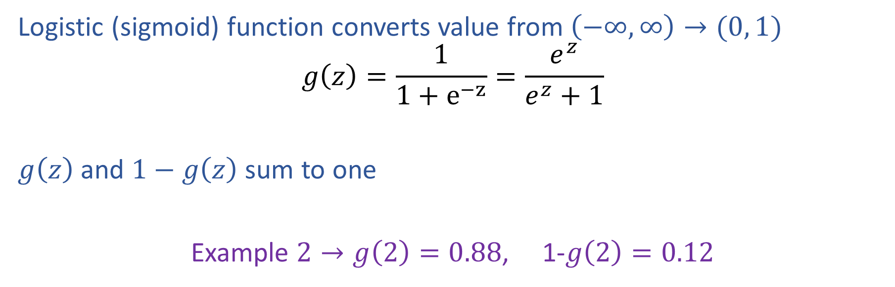
Summary: Logistic Function
Logistic (sigmoid) function converts value from $\left(−∞, ∞\right)→(0, 1)$
$$g\left(z\right)=\frac{1}{1+e^{−z}}=\frac{e^{z}}{e^{z}+1}$$
$g\left(z\right)$ and $1−g\left(z\right)$ sum to one
Example $2→g\left(2\right)=0.88$, 1-$g\left(2\right)=0.12$

Slide 27
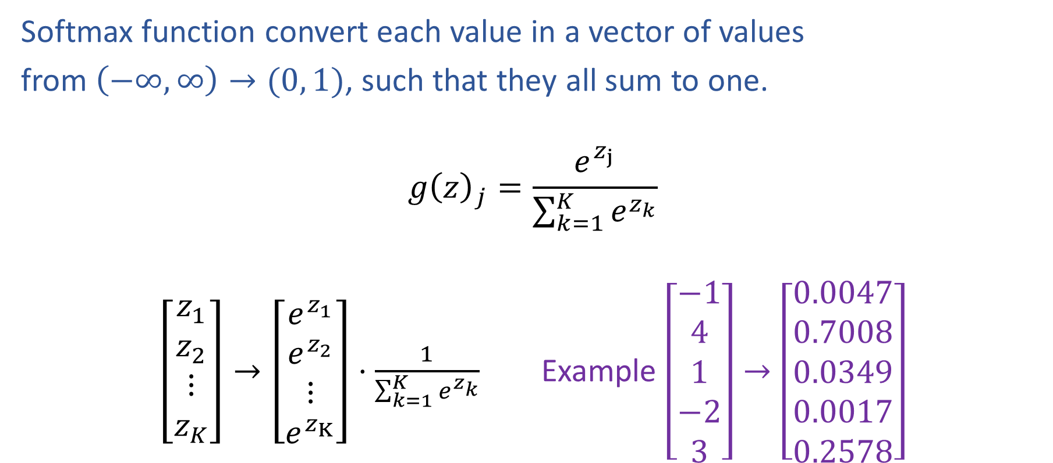
Summary: Softmax Function
Softmax function convert each value in a vector of values
from $\left(−∞, ∞\right)→(0, 1)$, such that they all sum to one.
$$g{\left(z\right)}_{j}=\frac{e^{z_{j}}}{\sum_{k=1}^{K}{e^{z_{k}}}}$$
$\left[\begin{aligned}z_{1} \\ z_{2} \\ ⋮ \\ z_{K}\end{aligned}\right]→\left[\begin{aligned}e^{z_{1}} \\ e^{z_{2}} \\ ⋮ \\ e^{z_{K}}\end{aligned}\right]⋅\frac{1}{\sum_{k=1}^{K}{e^{z_{k}}}}$ Example $\left[\begin{aligned}−1 \\ 4 \\ 1 \\ −2 \\ 3\end{aligned}\right]→\left[\begin{aligned}0.0047 \\ 0.7008 \\ 0.0349 \\ 0.0017 \\ 0.2578\end{aligned}\right]$

Slide 28
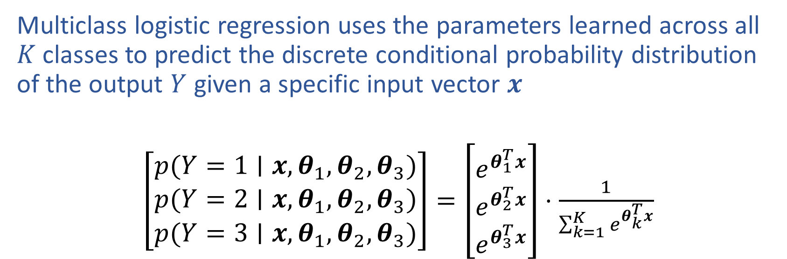
Summary: Multiclass Predicted Probability
Multiclass logistic regression uses the parameters learned across all $K$ classes to predict the discrete conditional probability distribution of the output $Y$ given a specific input vector $x$
$\left[\begin{aligned}p(Y=1∣x, θ_{1},θ_{2}, θ_{3}) \\ p(Y=2∣x,θ_{1},θ_{2}, θ_{3}) \\ p(Y=3∣x,θ_{1},θ_{2}, θ_{3})\end{aligned}\right]=\left[\begin{aligned}e^{θ_{1}^{T}x} \\ e^{θ_{2}^{T}x} \\ e^{θ_{3}^{T}x}\end{aligned}\right]⋅\frac{1}{\sum_{k=1}^{K}{e^{θ_{k}^{T}x}}}$

Slide 29
Debug that Program!
In-Class Exercise:
Debug the following program which is (incorrectly) attempting to run SGD for multinomial logistic regression
Buggy Program:
while not converged:
for i in shuffle([1,…,N]):
for k in [1,…,K]:
theta[k] = theta[k] - gamma * grad(x[i], y[i], theta, k)
Assume: grad(x[i], y[i], theta, k) returns the gradient of the negative log-likelihood of the training example (x[i],y[i]) with respect to vector theta[k]. gamma is the learning rate. N = # of examples. K = # of output classes. M = # of features. theta is a K by M matrix.
Slide credit: CMU MLD Matt Gormley
Notes:
& w_1 x_1 + w_2 x_2 + b > 0\\
& \text{where } w_1 = 2, w_2 = 3, b = 6

Slide 30
Feature Engineering

Slide 31
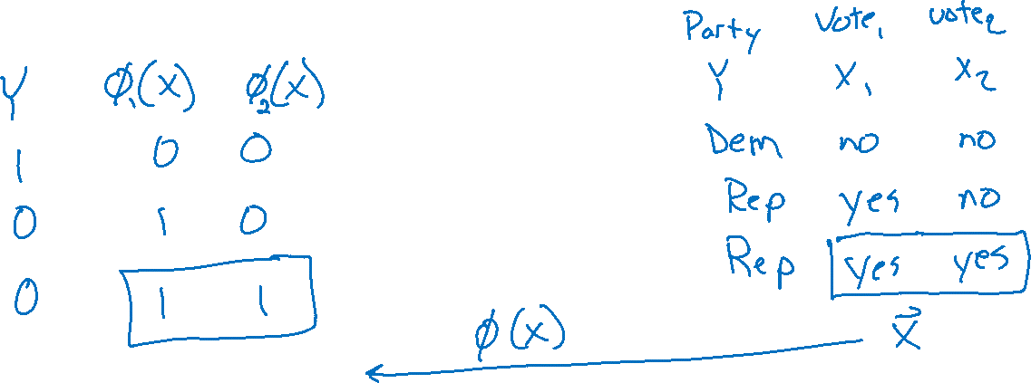
How Do We Deal with Real-world Problems
Politician Voting Classification

Slide 32
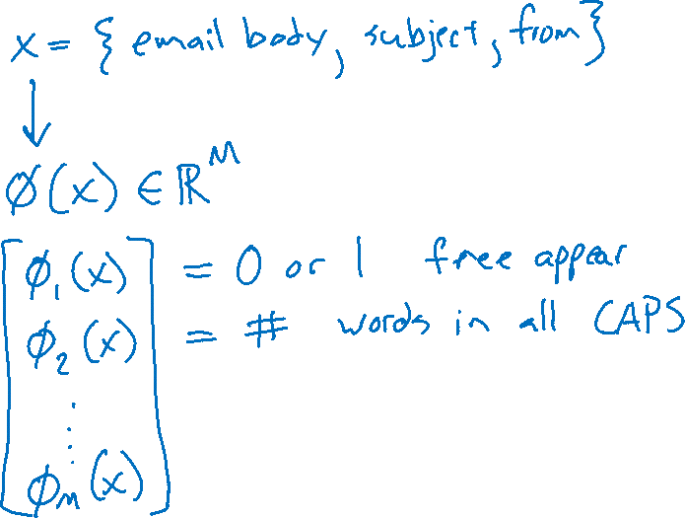
How Do We Deal with Real-world Problems
SPAM Classification

