Slide 1
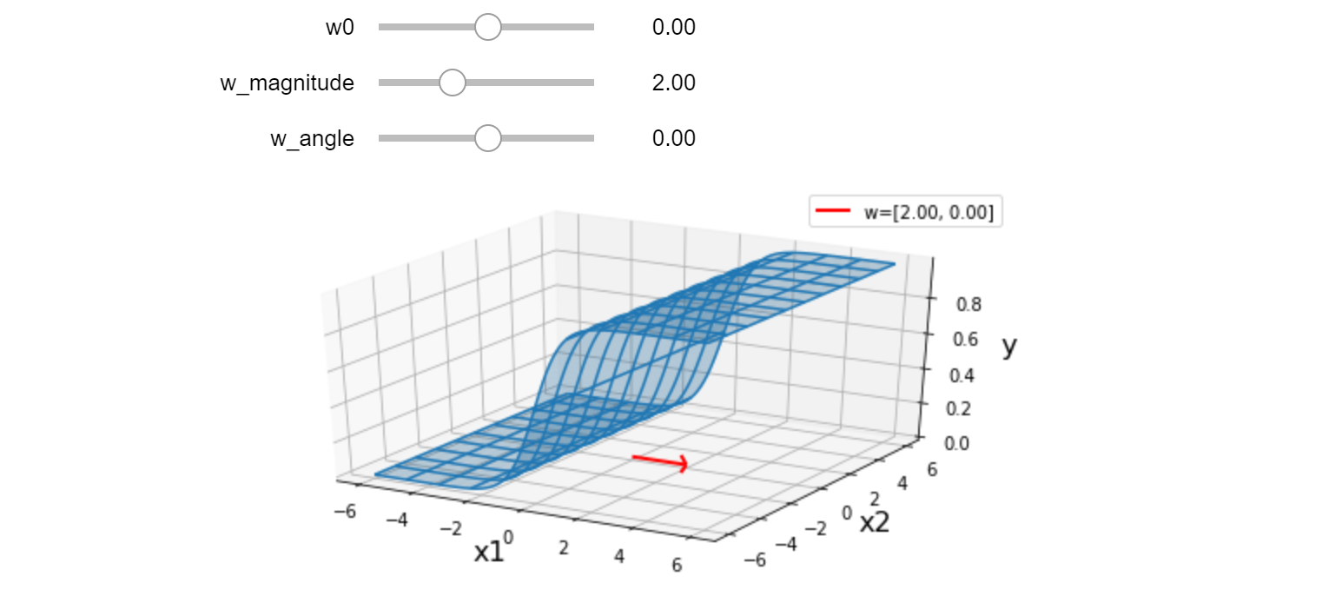
Warm-up as You Log In
Interact with the lec8.ipynb posted on the course website schedule

Slide 2
Announcements
Assignments
HW3
Solution Session: Fri, 10/2, 8 pm
Schedule change this week
Recitation slots this Friday will all be lecture (all three)
Midterm 1
Practice exam
Timed (90 min) exam in Gradescope
Open for a 24 hour window only, Tue 7 pm to Wed 7 pm
Need to take the practice exam to have access to the questions

Slide 3
Plan
Last time
Logistic Regression
Likelihood
Today
Likelihood
MLE
Conditional Likelihood and M(C)LE
Solving Linear Regression
Friday
Multiclass Logistic Regression

Slide 4

Introduction to Machine Learning Logistic Regression
Instructor: Pat Virtue

Slide 5

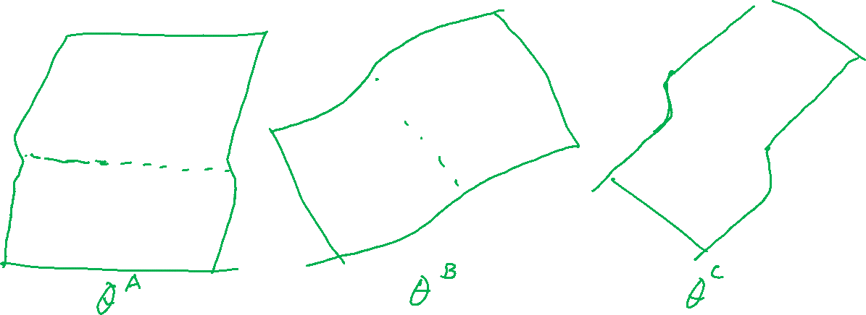
Prediction for Cancer Diagnosis
Learn to predict if a patient has cancer ($Y=1$) or not ($Y=0$) given the input of just one test result, $X_{A}$.
$$p\left(Y=1 ∣ x, θ\right)=\frac{1}{1+e^{−θ^{T}x}}$$

Slide 6
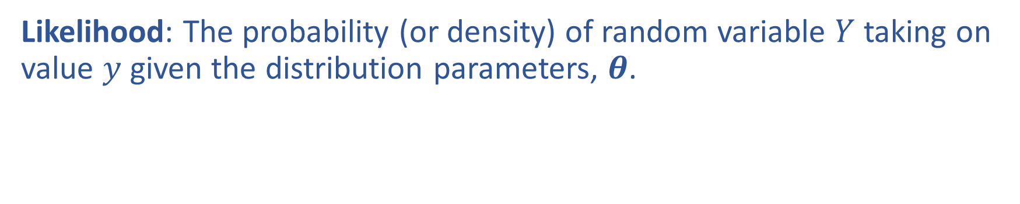

Likelihood
Likelihood: The probability (or density) of random variable $Y$ taking on value $y$ given the distribution parameters, $θ$.

Slide 7

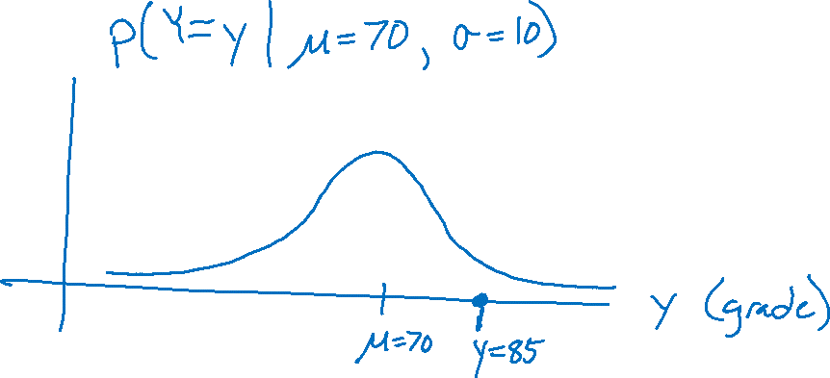
Likelihood
Likelihood: The probability (or density) of random variable $Y$ taking on value $y$ given the distribution parameters, $θ$.
Grades

Slide 8
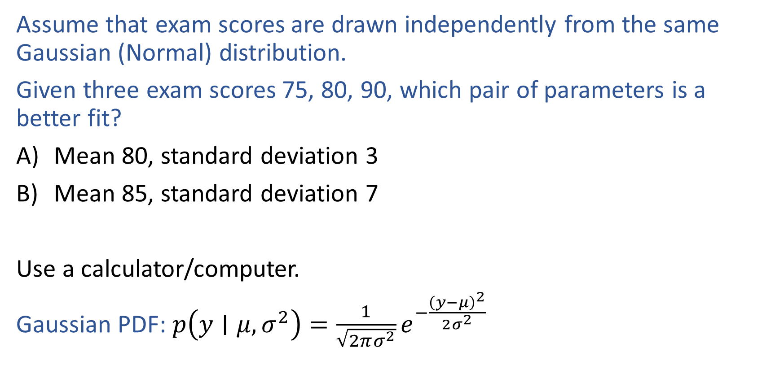
Warm-up as You Log In
Assume that exam scores are drawn independently from the same Gaussian (Normal) distribution.
Given three exam scores 75, 80, 90, which pair of parameters is a better fit?
Mean 80, standard deviation 3
Mean 85, standard deviation 7
Use a calculator/computer.
Gaussian PDF: $p\left(y∣μ, σ^{2}\right)=\frac{1}{\sqrt{2πσ^{2}}}e^{−\frac{{\left(y−μ\right)}^{2}}{2σ^{2}}}$

Slide 9
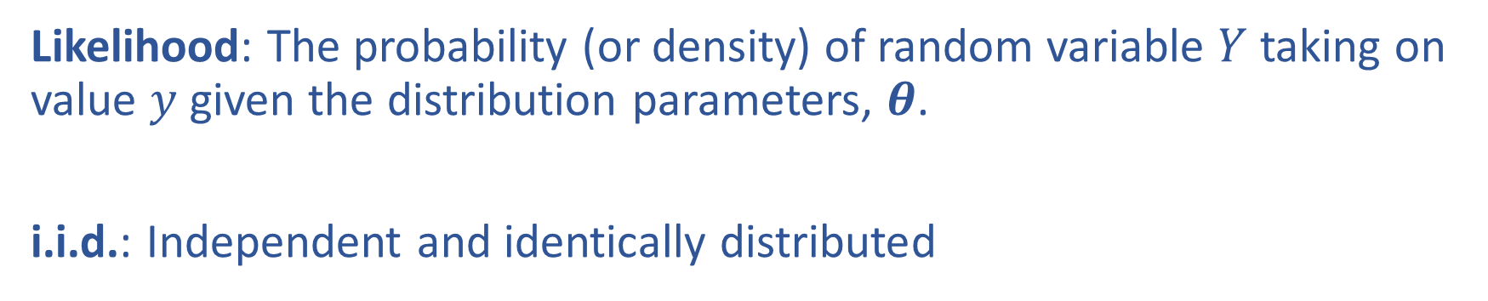
Likelihood
Likelihood: The probability (or density) of random variable $Y$ taking on value $y$ given the distribution parameters, $θ$.
i.i.d.: Independent and identically distributed

Slide 10
Piazza Poll 1
Assume that exam scores are drawn independently from the same Gaussian (Normal) distribution.
Given three exam scores 75, 80, 90, which pair of parameters is a better fit?
Mean 80, standard deviation 3
Mean 85, standard deviation 7
Use a calculator/computer.
Gaussian PDF: $p\left(y∣μ, σ^{2}\right)=\frac{1}{\sqrt{2πσ^{2}}}e^{−\frac{{\left(y−μ\right)}^{2}}{2σ^{2}}}$

Slide 11
Likelihood
Trick coin

Slide 12
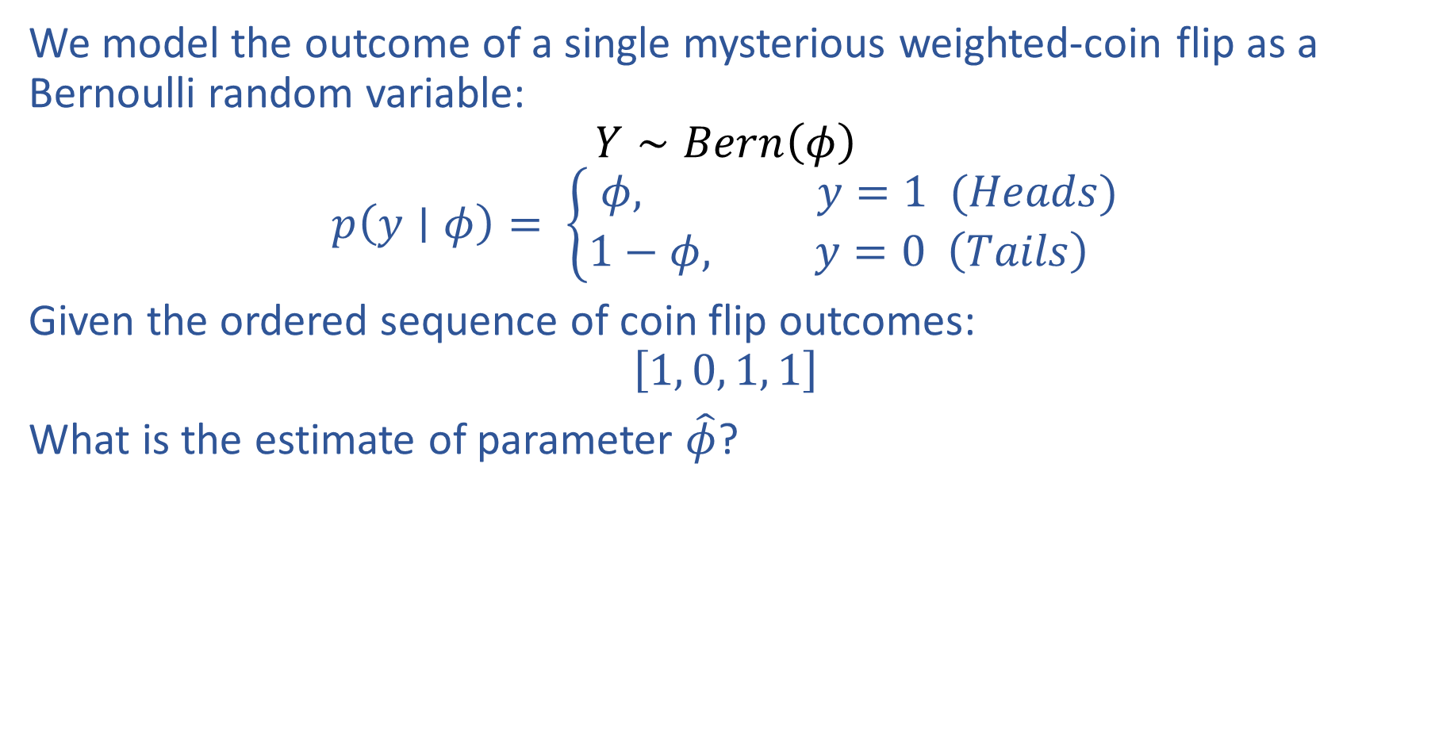
Piazza Poll 2
We model the outcome of a single mysterious weighted-coin flip as a Bernoulli random variable:
$$Y∼Bern\left(φ\right)$$
$$p\left(y∣φ\right)= \left\{\begin{aligned}φ, y=1 (Heads) \\ 1−φ, y=0 \left(Tails\right) \end{aligned}\right.$$
Given the ordered sequence of coin flip outcomes:
$$\left[1, 0, 1, 1\right]$$
What is the estimate of parameter $\hat{φ}$?

Slide 13
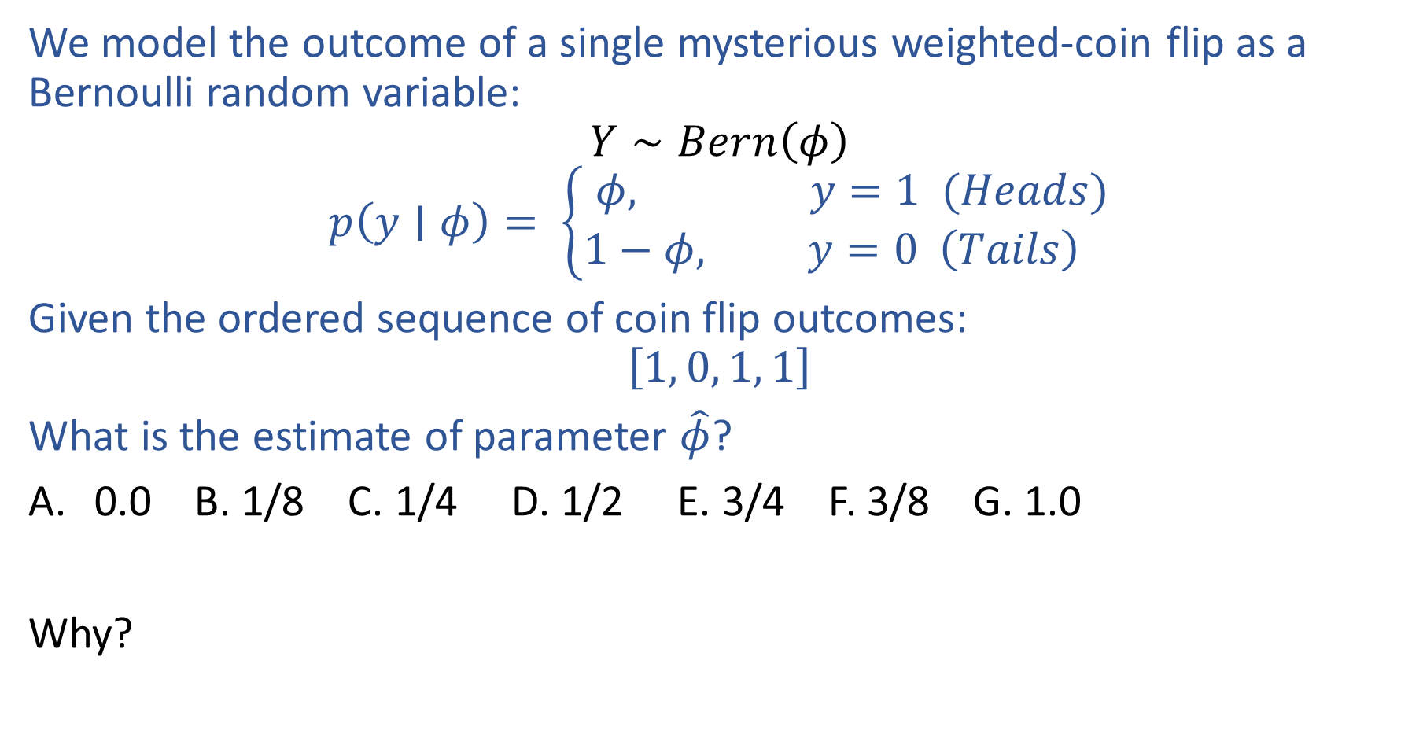
Piazza Poll 2
We model the outcome of a single mysterious weighted-coin flip as a Bernoulli random variable:
$$Y∼Bern\left(φ\right)$$
$$p\left(y∣φ\right)= \left\{\begin{aligned}φ, y=1 (Heads) \\ 1−φ, y=0 \left(Tails\right) \end{aligned}\right.$$
Given the ordered sequence of coin flip outcomes:
$$\left[1, 0, 1, 1\right]$$
What is the estimate of parameter $\hat{φ}$?
0.0 B. 1/8 C. 1/4 D. 1/2 E. 3/4 F. 3/8 G. 1.0
Why?

Slide 14
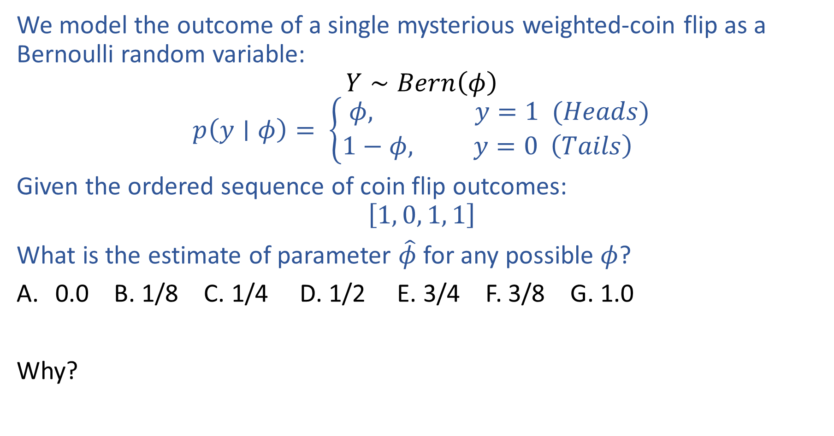
Piazza Poll 2
We model the outcome of a single mysterious weighted-coin flip as a Bernoulli random variable:
$$Y∼Bern\left(φ\right)$$
$$p\left(y∣φ\right)= \left\{\begin{aligned}φ, y=1 (Heads) \\ 1−φ, y=0 \left(Tails\right) \end{aligned}\right.$$
Given the ordered sequence of coin flip outcomes:
$$\left[1, 0, 1, 1\right]$$
What is the estimate of parameter $\hat{φ}$ for any possible $φ$?
0.0 B. 1/8 C. 1/4 D. 1/2 E. 3/4 F. 3/8 G. 1.0
Why?

Slide 15
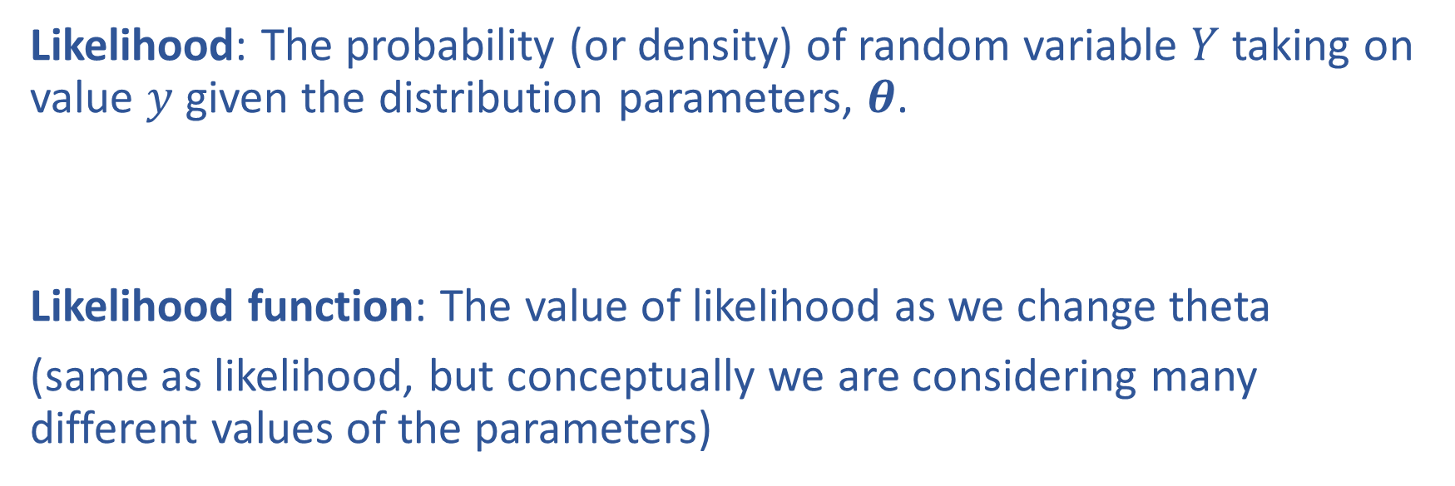
Likelihood and Maximum Likelihood Estimation
Likelihood: The probability (or density) of random variable $Y$ taking on value $y$ given the distribution parameters, $θ$.
Likelihood function: The value of likelihood as we change theta
(same as likelihood, but conceptually we are considering many different values of the parameters)

Slide 16
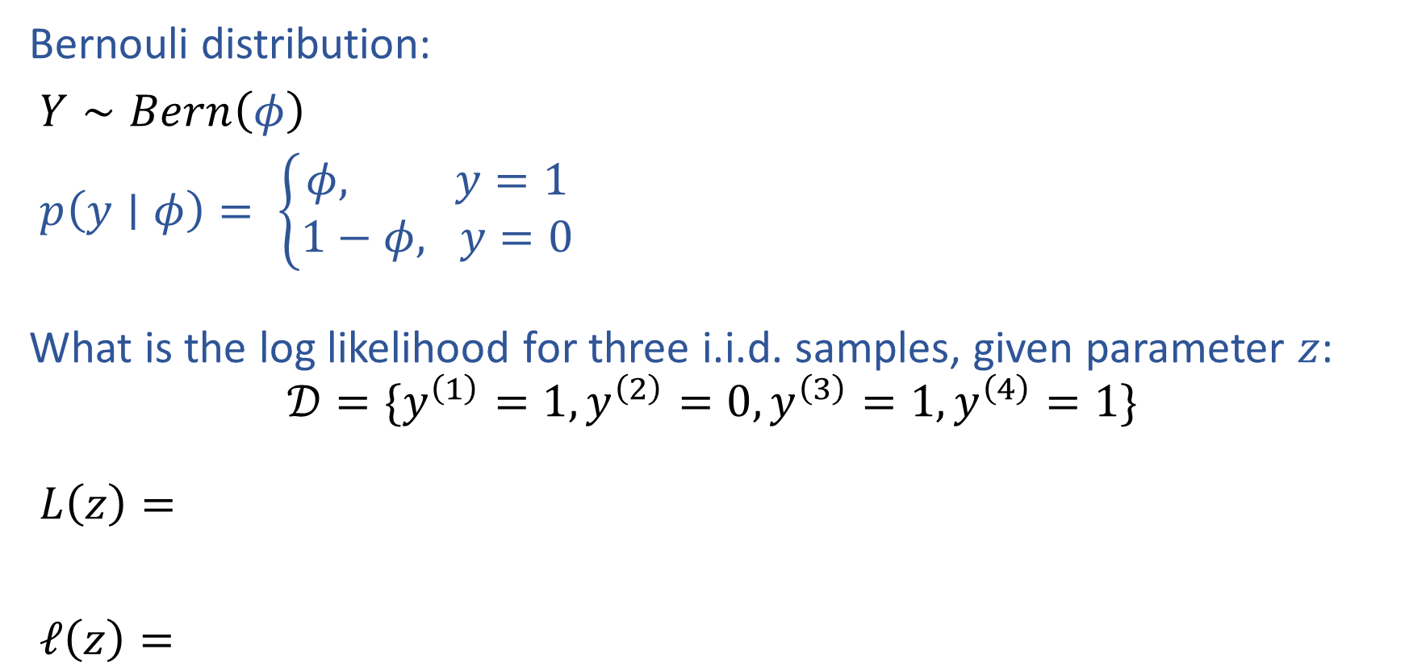
Likelihood and Log Likelihood
Bernouli distribution:
$Y∼Bern\left(φ\right)$
$p\left(y∣φ\right)= \left\{\begin{aligned}φ, y=1 \\ 1−φ, y=0\end{aligned}\right.$
What is the log likelihood for three i.i.d. samples, given parameter $z$:
$$𝒟=\{y^{\left(1\right)}=1, y^{\left(2\right)}=0,y^{\left(3\right)}=1,y^{\left(4\right)}=1\}$$
$L\left(z\right)=$
$ℓ\left(z\right)=$

Slide 17
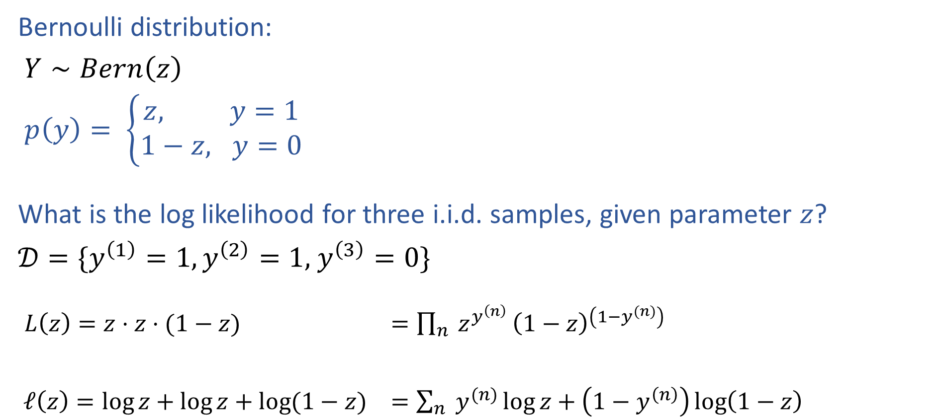
Likelihood and Log Likelihood
Bernoulli distribution:
$Y∼Bern\left(z\right)$
$p\left(y\right)= \left\{\begin{aligned}z, y=1 \\ 1−z, y=0\end{aligned}\right.$
What is the log likelihood for three i.i.d. samples, given parameter $z$?
$𝒟=\{y^{\left(1\right)}=1,y^{\left(2\right)}=1,$ $y^{\left(3\right)}=0\}$
$L\left(z\right)=z⋅z⋅(1−z)$ $=\prod_{n}{ z^{y^{\left(n\right)}}}{\left(1−z\right)}^{\left(1−y^{(n)}\right)}$
$ℓ\left(z\right)=\log{z}+\log{z}+\log{(1−z)}$ $=\sum_{n}{ y^{(n)}\log{z}}+\left(1−y^{\left(n\right)}\right)\log\left(1−z\right)$

Slide 18
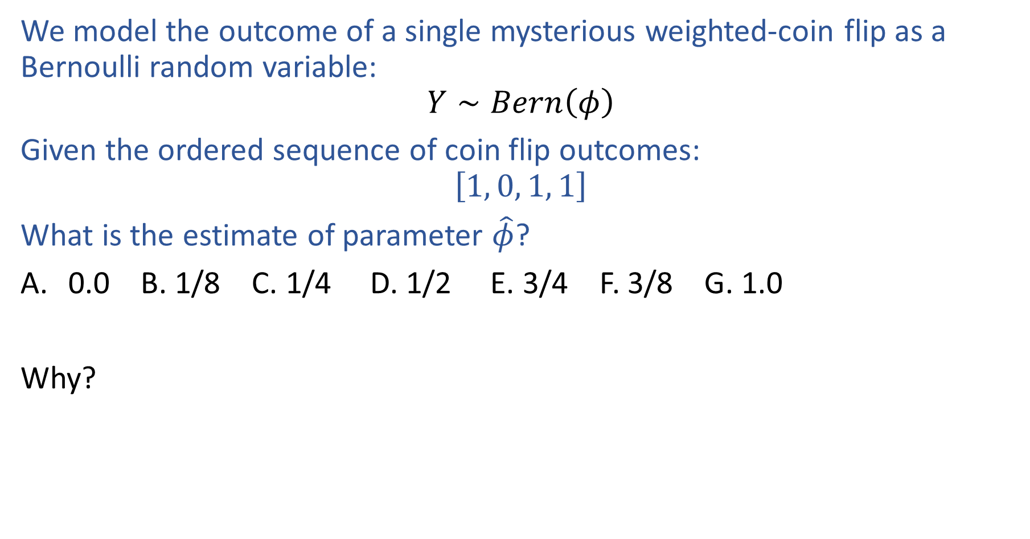
Previous Piazza Poll
We model the outcome of a single mysterious weighted-coin flip as a Bernoulli random variable:
$$Y∼Bern\left(φ\right)$$
Given the ordered sequence of coin flip outcomes:
$$\left[1, 0, 1, 1\right]$$
What is the estimate of parameter $\hat{φ}$?
0.0 B. 1/8 C. 1/4 D. 1/2 E. 3/4 F. 3/8 G. 1.0
Why?

Slide 19
Warm-up as You Log In
Assume that exam scores are drawn independently from the same Gaussian (Normal) distribution.
Given three exam scores 75, 80, 90, which pair of parameters is a better fit?
Mean 80, standard deviation 3
Mean 85, standard deviation 7
Use a calculator/computer.
Gaussian PDF: $p\left(y∣μ, σ^{2}\right)=\frac{1}{\sqrt{2πσ^{2}}}e^{−\frac{{\left(y−μ\right)}^{2}}{2σ^{2}}}$

Slide 20
Warm-up as You Log In
Assume that exam scores are drawn independently from the same Gaussian (Normal) distribution.
Given three exam scores 75, 80, 90, which pair of parameters is a better fit?

Slide 21
MLE
Principle of Maximum Likelihood Estimation:
Choose the parameters that maximize the likelihood of the data.
Maximum Likelihood Estimate (MLE)
θ₂
θ^{MLE}
L(θ)
L(θ₁, θ₂)
θ^{MLE}
θ₁
Slide credit: CMU MLD Matt Gormley

Slide 22

Maximum Likelihood Estimation
MLE of parameter $θ$ for i.i.d. dataset $𝒟={\left\{y^{(i)}\right\}}_{i=1}^{N}$
${\hat{θ}}_{MLE}=\underset{θ}{argmax}{p(𝒟∣θ)}$

Slide 23
Prediction for Cancer Diagnosis
Learn to predict if a patient has cancer ($Y=1$) or not ($Y=0$) given the input of just one test result, $X_{A}$.
$$p\left(Y=1 ∣ x, θ\right)=\frac{1}{1+e^{−θ^{T}x}}$$

Slide 24
Overly-simple Probabilistic Classifier

Slide 25

Overly-simple Probabilistic Classifier
1) Model: $Y∼Bern\left(φ\right)$
$p\left(y∣x, φ\right)= \left\{\begin{aligned}φ, y=1 \\ 1−φ, y=0\end{aligned}\right.$
2)

Slide 26
Binary Logistic Regression

Slide 27

Binary Logistic Regression
Model: $Y∼Bern\left(μ\right)$ $μ=σ(θ^{T}x)$ $σ\left(z\right)=\frac{1}{1+e^{−z}}$

Slide 28
Binary Logistic Regression
Gradient

Slide 29

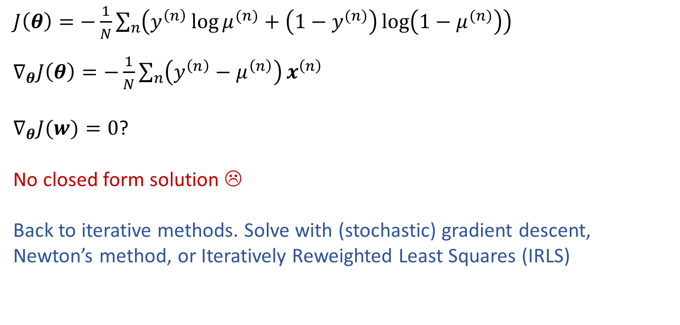
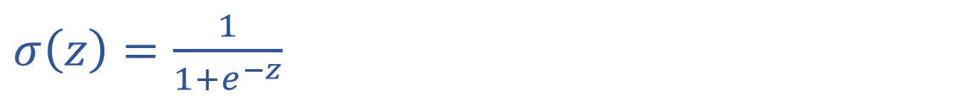
Solve Logistic Regression
$μ=σ\left(θ^{T}x\right)$
$σ\left(z\right)=\frac{1}{1+e^{−z}}$
$J\left(θ\right)=−\frac{1}{N}\sum_{n}{\left(y^{\left(n\right)}\log{μ^{(n)}}+\left(1−y^{(n)}\right)\log\left(1−μ^{(n)}\right)\right)}$
$∇_{θ}J\left(θ\right)=−\frac{1}{N}\sum_{n}{\left(y^{\left(n\right)}−μ^{\left(n\right)}\right)}x^{\left(n\right)}$
$∇_{θ}J(w)=0$?
No closed form solution ☹
Back to iterative methods. Solve with (stochastic) gradient descent, Newton’s method, or Iteratively Reweighted Least Squares (IRLS)

