Slide 1
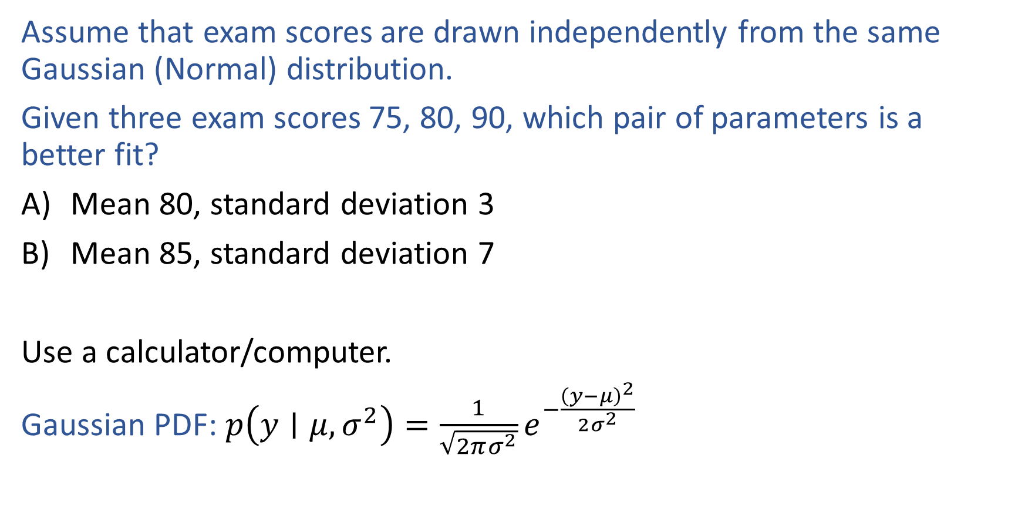
Warm-up as You Log In
Assume that exam scores are drawn independently from the same Gaussian (Normal) distribution.
Given three exam scores 75, 80, 90, which pair of parameters is a better fit?
Mean 80, standard deviation 3
Mean 85, standard deviation 7
Use a calculator/computer.
Gaussian PDF: $p\left(y∣μ, σ^{2}\right)=\frac{1}{\sqrt{2πσ^{2}}}e^{−\frac{{\left(y−μ\right)}^{2}}{2σ^{2}}}$

Slide 2
Announcements
Assignments
HW3
    Mon, 9/28, 11:59 pm
HW4
    Not out until after the midterm
Schedule change this week
Recitation slots this Friday will all be lecture (all three)

Slide 3
Announcements
Midterm 1
Mon, 10/5
See Piazza for details
SGD not in scope for Midterm 1
Practice exam
    Timed (90 min) exam in Gradescope
    Open for a 24 hour window only, Tue 7 pm to Wed 7 pm
    Need to take the practice exam to have access to the questions
    Also, practice exam zoom sessions
        Tue 7 pm
        Tue 11 pm

Slide 4
Plan
Last time
Optimization for linear regression
    Linear and convex functions
    (Batch) Gradient descent
    Closed-form solution
Today
Stochastic gradient descent
Logistic Regression
    Back to classification
Likelihood
MLE

Slide 5
Wrap-up (Stochastic) Gradient Descent
Previous lecture slides

Slide 6

Introduction to Machine Learning
Logistic Regression
Instructor: Pat Virtue

Slide 7

Prediction for Cancer Diagnosis
Learn to predict if a patient has cancer ($Y=1$) or not ($Y=0$) given the input of two test results, $X_{A}$ and $X_{B}$.

Slide 8

Prediction for Cancer Diagnosis
Learn to predict if a patient has cancer ($Y=1$) or not ($Y=0$) given the input of just one test result, $X_{A}$.

Slide 9
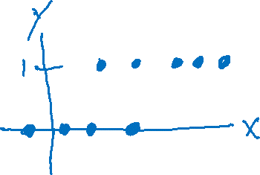
Building on a Linear Model
Linear vs Thresholded Linear vs Logistic Linear

Slide 10
Building on a Linear Model

Slide 11
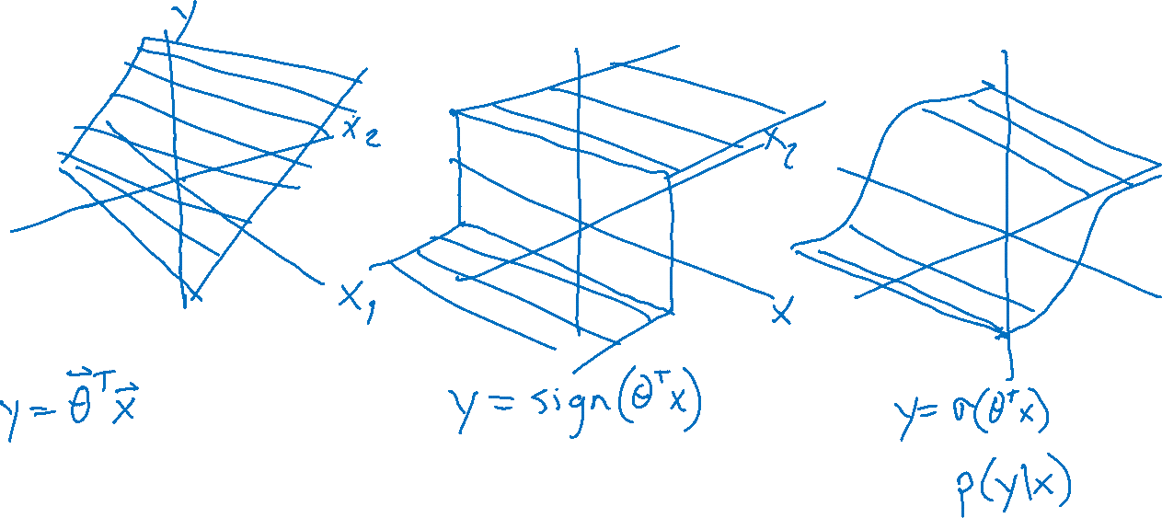
Building on a Linear Model

Slide 12
Logistic Regression
Slide credit: CMU MLD Matt Gormley
Notes:
Data are drawn from two Guassians.
There is irreducible error here b/c they overlap.
SHOW: 3D representation with piece of paper.

Slide 13
Logistic Regression
Slide credit: CMU MLD Matt Gormley

Slide 14
Logistic Regression
Slide credit: CMU MLD Matt Gormley

Slide 15

Prediction for Cancer Diagnosis
Learn to predict if a patient has cancer ($Y=1$) or not ($Y=0$) given the input of just one test result, $X_{A}$.
$$p\left(Y=1 ∣ x, θ\right)=\frac{1}{1+e^{−θ^{T}x}}$$

Slide 16
LIkeLiHOOD and MLE

Slide 17
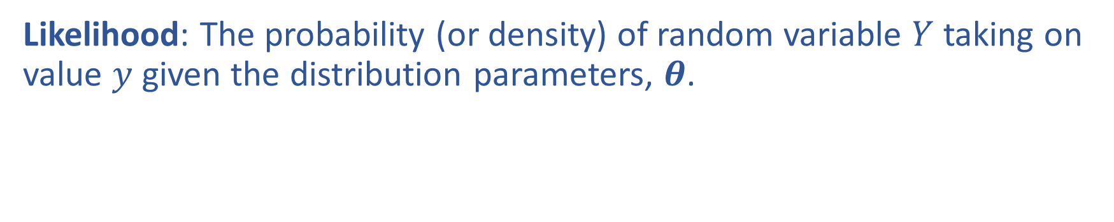
Likelihood
Likelihood: The probability (or density) of random variable $Y$ taking on value $y$ given the distribution parameters, $θ$.

Slide 18
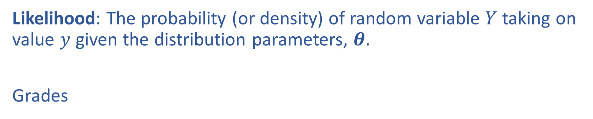
Likelihood
Likelihood: The probability (or density) of random variable $Y$ taking on value $y$ given the distribution parameters, $θ$.
Grades

Slide 19
Warm-up as You Log In
Assume that exam scores are drawn independently from the same Gaussian (Normal) distribution.
Given three exam scores 75, 80, 90, which pair of parameters is a better fit?
Mean 80, standard deviation 3
Mean 85, standard deviation 7
Use a calculator/computer.
Gaussian PDF: $p\left(y∣μ, σ^{2}\right)=\frac{1}{\sqrt{2πσ^{2}}}e^{−\frac{{\left(y−μ\right)}^{2}}{2σ^{2}}}$

Slide 20
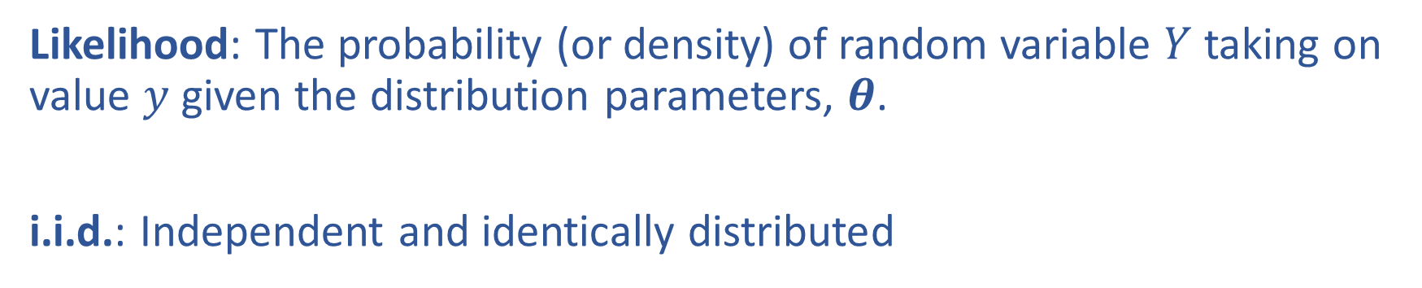
Likelihood
Likelihood: The probability (or density) of random variable $Y$ taking on value $y$ given the distribution parameters, $θ$.
i.i.d.: Independent and identically distributed

