Slide 1

Announcements
Assignments
HW3
Mon, 9/28, 11:59 pm
Midterm 1
Mon, 10/5
See Piazza for details
Fill out swap-section / conflict form by Friday

Slide 2
Plan
Last time
Regression
Linear regression
Optimization for linear regression
Today
Optimization for linear regression
Linear and convex function
(Batch) Gradient descent
Closed-form solution
Stochastic gradient descent

Slide 3

Introduction to Machine Learning Linear Regression and Optimization
Instructor: Pat Virtue

Slide 4
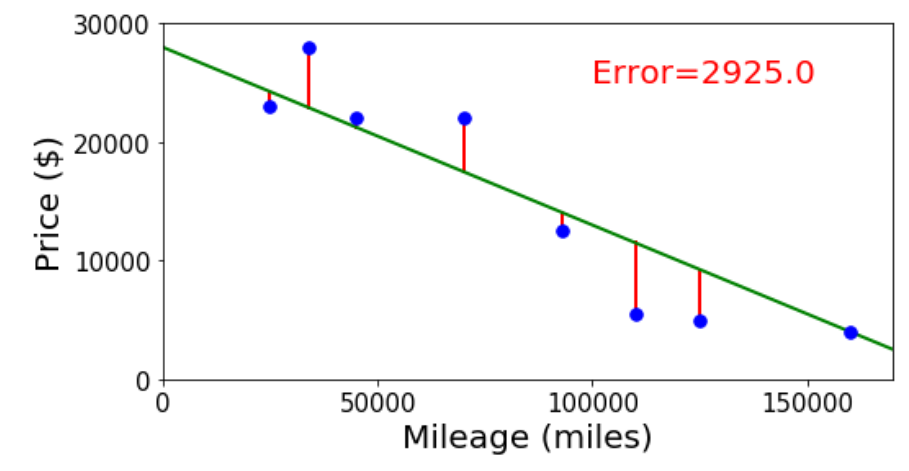
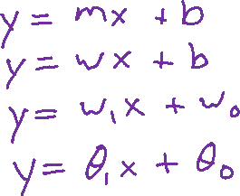
Linear Regression
Selling my car

Slide 5
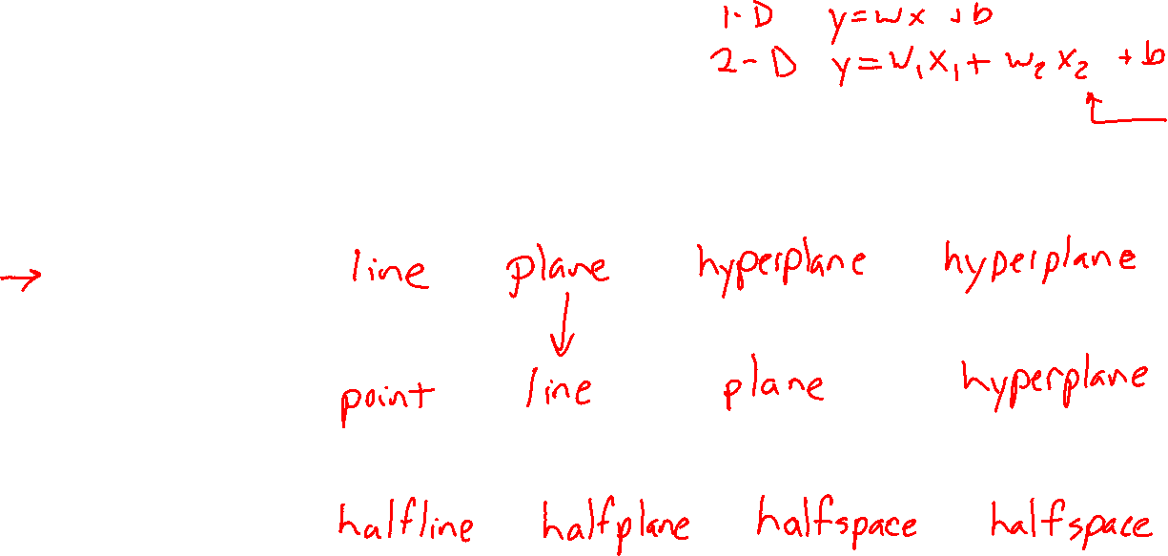




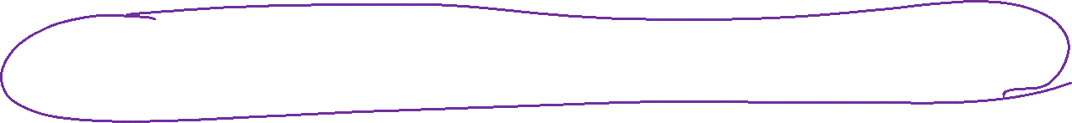

Linear in Higher Dimensions
What are these linear shapes called for 1-D, 2-D, 3-D, M-D input?
$$x∈ℝ$$
$$x∈ℝ^{2}$$
$$x∈ℝ^{3}$$
$$x∈ℝ^{M}$$
$y=w^{T}x+b$
$w^{T}x+b=0$
$w^{T}x+b≥0$

Slide 6


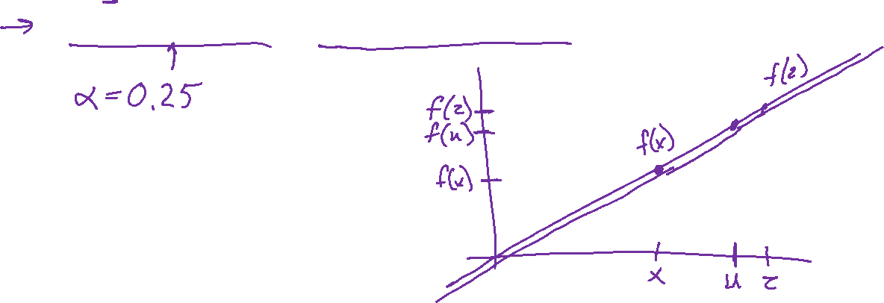
Linear Function
Linear function
If $f(x)$ is linear, then:
$f\left(x+z\right)=f\left(x\right)+f\left(z\right)$
$f\left(αx\right)=αf\left(x\right) ∀α$
$f\left(αx+\left(1−α\right)z\right)=αf\left(x\right)+\left(1−α\right)f\left(z\right) ∀α$

Slide 7
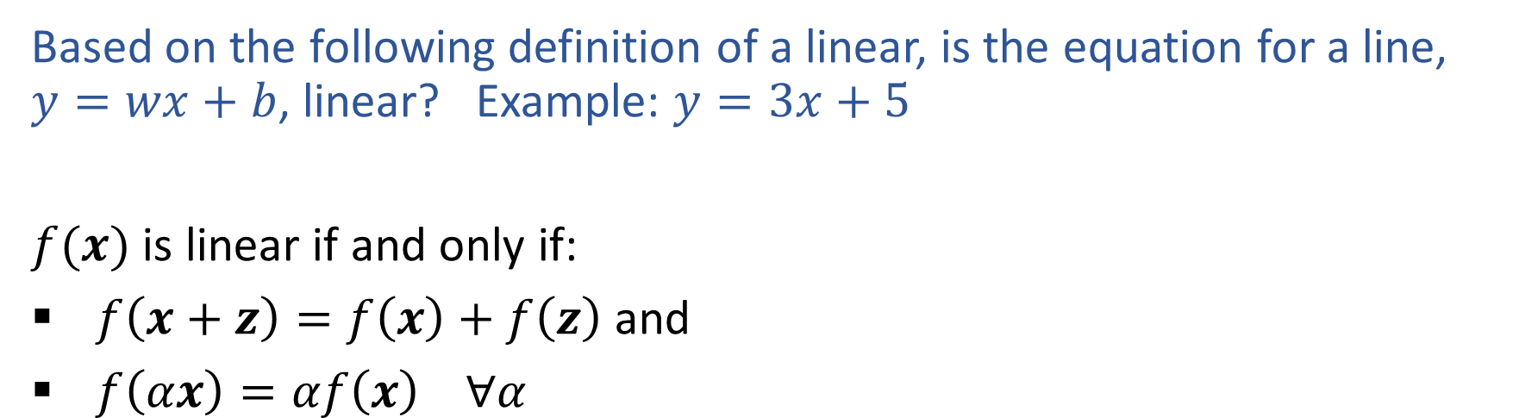
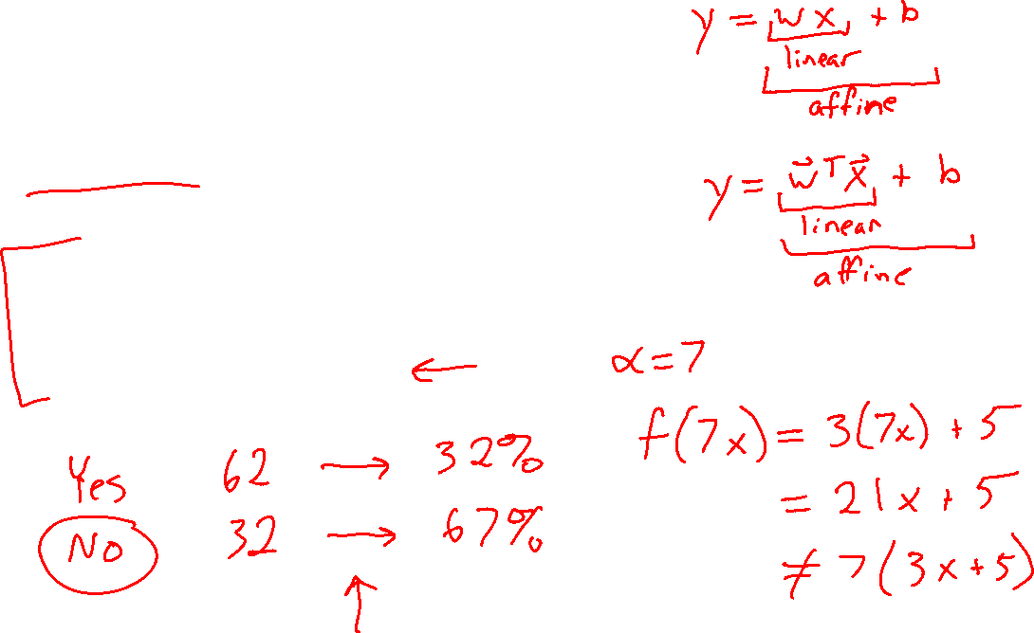
Piazza Poll 1
Based on the following definition of a linear, is the equation for a line, $y=wx+b$, linear? Example: $y=3x+5$
$f(x)$ is linear if and only if:
$f\left(x+z\right)=f\left(x\right)+f\left(z\right)$ and
$f\left(αx\right)=αf\left(x\right) ∀α$

Slide 8
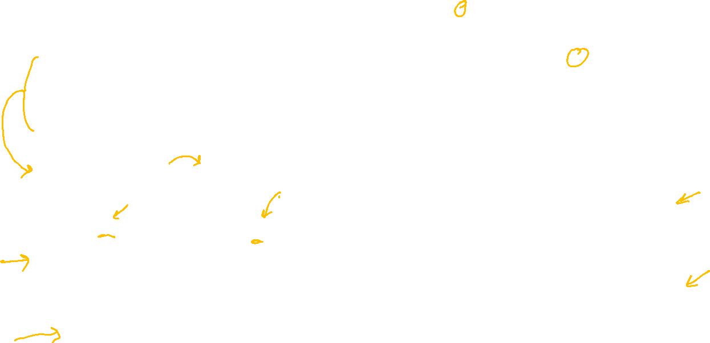
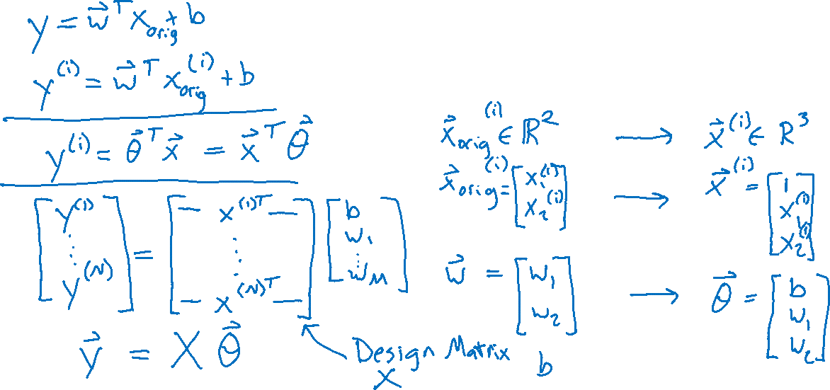
Linear Regression
Linear algebra formulation

Slide 9
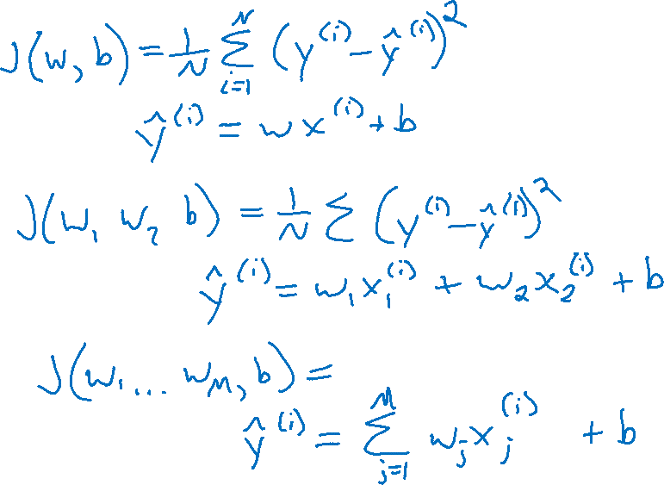
Linear Regression
Error and objectives

Slide 10
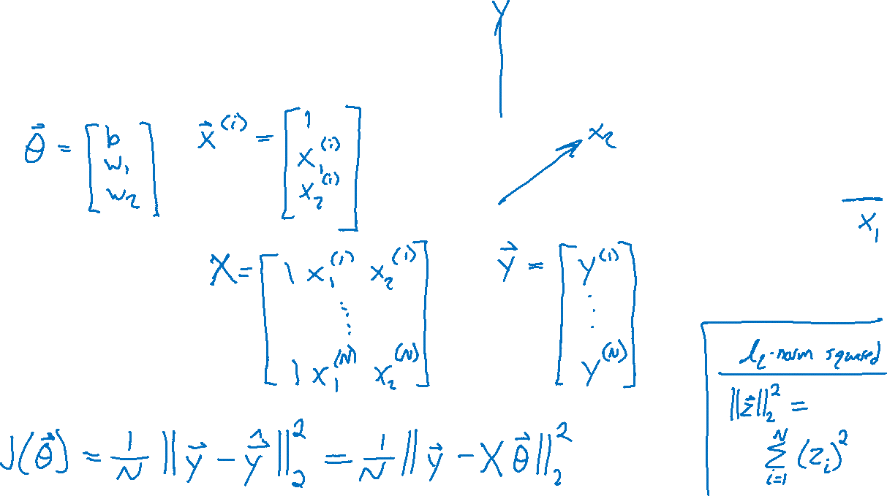
Linear Regression
Linear algebra formulation

Slide 11
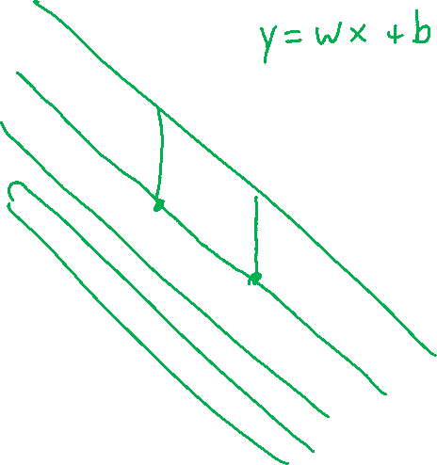
Previous Piazza Poll
y
For fixed data and fixed slope, w, what shape do we get by plotting MSE objective vs intercept, b?
Line
Plane
Half-plane
Convex Parabola (U-shape)
Concave parabola (up-side-down U)
None of the above
x

Slide 12
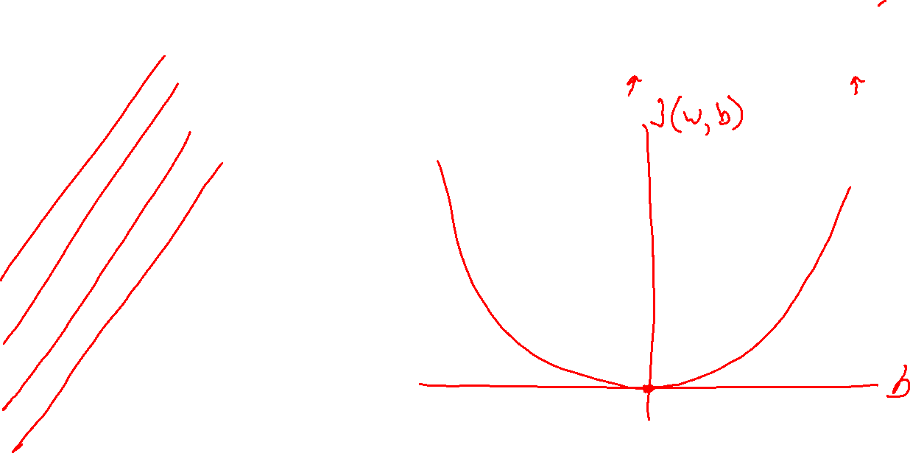
Linear Regression
$$J\left(w, b\right)=\frac{1}{2}\left[{\left(y^{(1)}−\left(wx^{(1)}+b\right)\right)}^{2}+{\left(y^{(2)}−\left(wx^{(2)}+b\right)\right)}^{2}\right]$$
Optimizing the objective
y
x

Slide 13
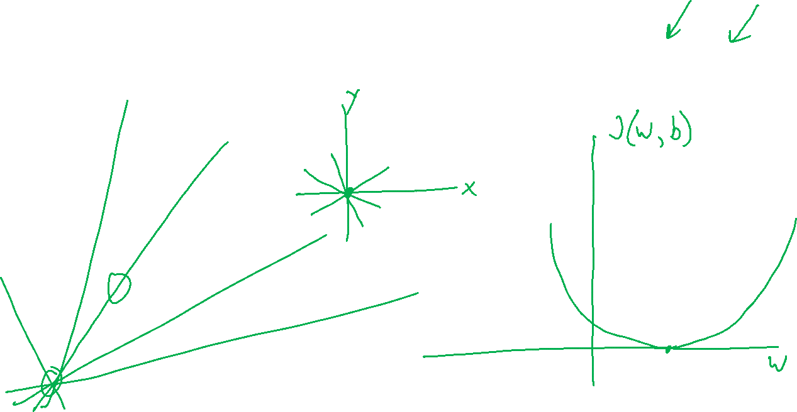
Linear Regression
$$J\left(w, b\right)=\frac{1}{2}\left[{\left(y^{(1)}−\left(wx^{(1)}+b\right)\right)}^{2}+{\left(y^{(2)}−\left(wx^{(2)}+b\right)\right)}^{2}\right]$$
Optimizing the objective
y
x

Slide 14
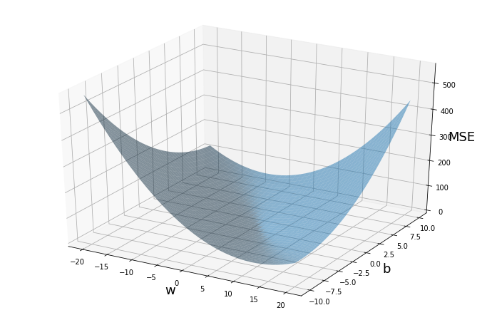
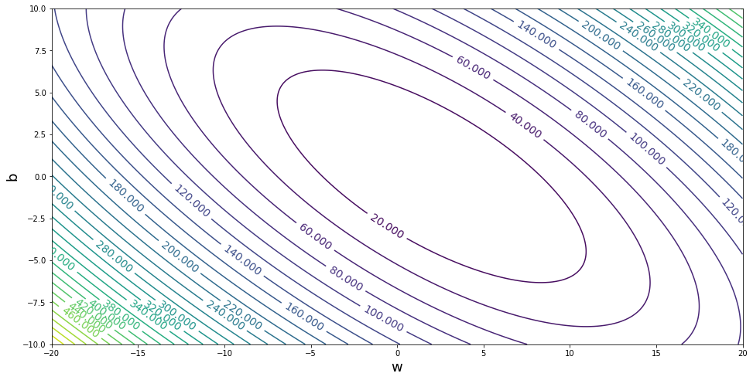
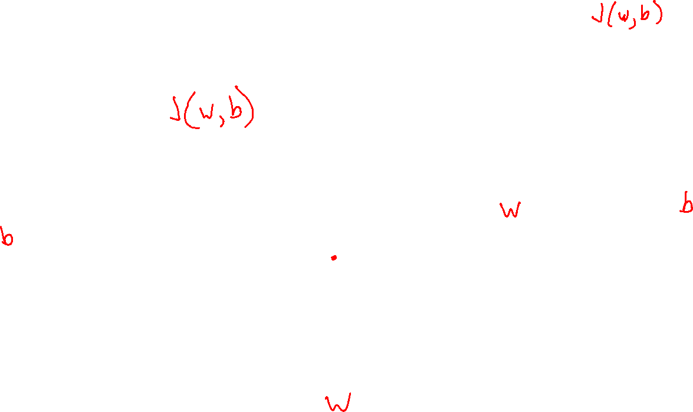
Linear Regression
Optimizing the objective

Slide 15

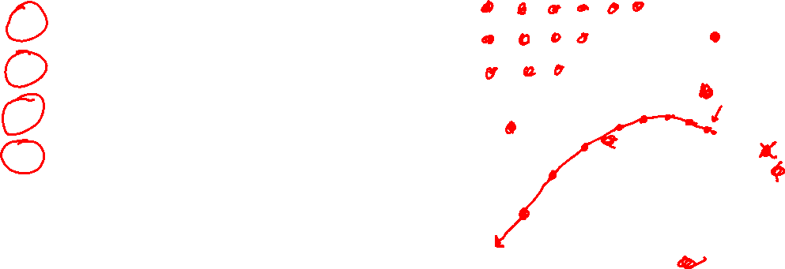


Linear Regression
Methods for optimizing the objective
Grid search
Random search
Closed-form solution
(Batch) Gradient descent
Stochastic gradient descent
$$J(w,b)$$
$$b$$
$$w$$

Slide 16
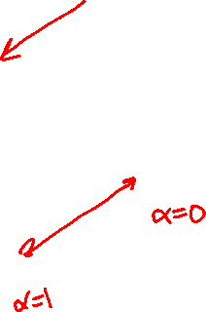
Optimization
Linear function
If $f(x)$ is linear, then:
$f\left(x+z\right)=f\left(x\right)+f\left(z\right)$
$f\left(αx\right)=αf\left(x\right) ∀α$
$f\left(αx+\left(1−α\right)z\right)=αf\left(x\right)+\left(1−α\right)f\left(z\right) ∀α$

Slide 17


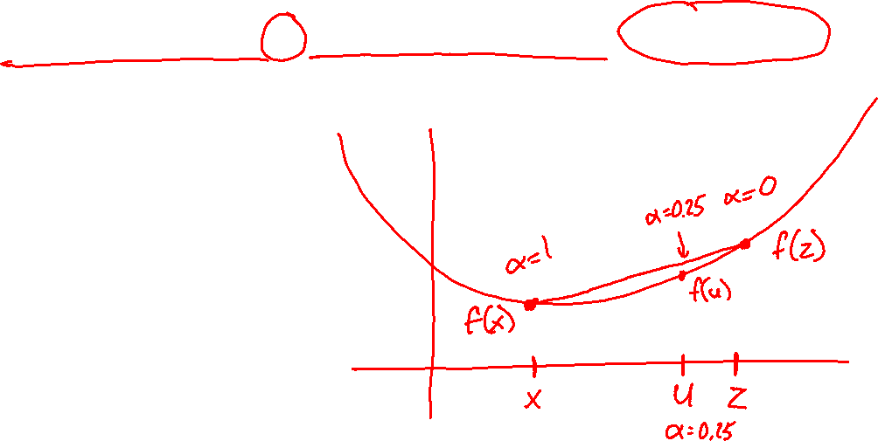
Optimization
Convex function
If $f(x)$ is convex, then:
$f\left(αx+\left(1−α\right)z\right)≤αf\left(x\right)+\left(1−α\right)f\left(z\right) ∀ 0≤α≤1$
Convex optimization
If $f(x)$ is convex, then:
Every local minimum is also a global minimum ☺

Slide 18
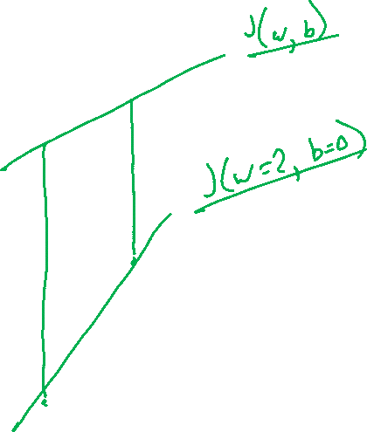
Linear Regression
Optimizing the objective
y
x

Slide 19
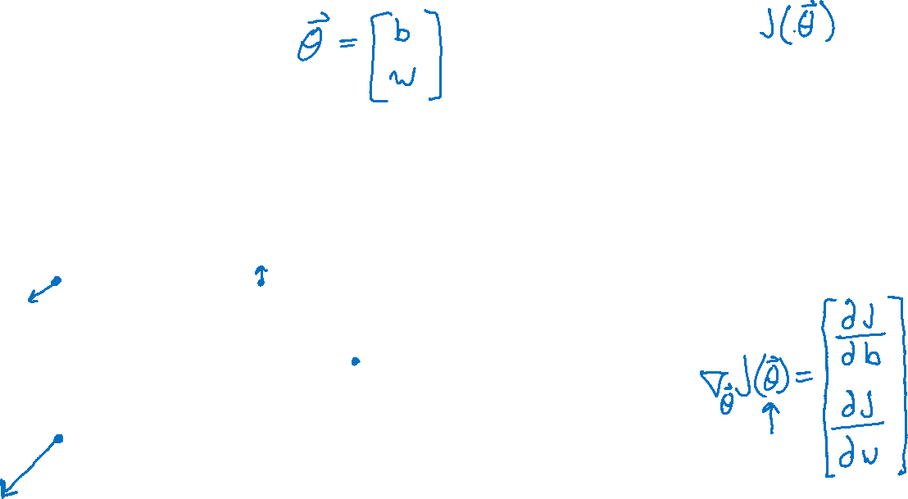
Optimization
Gradients

Slide 20
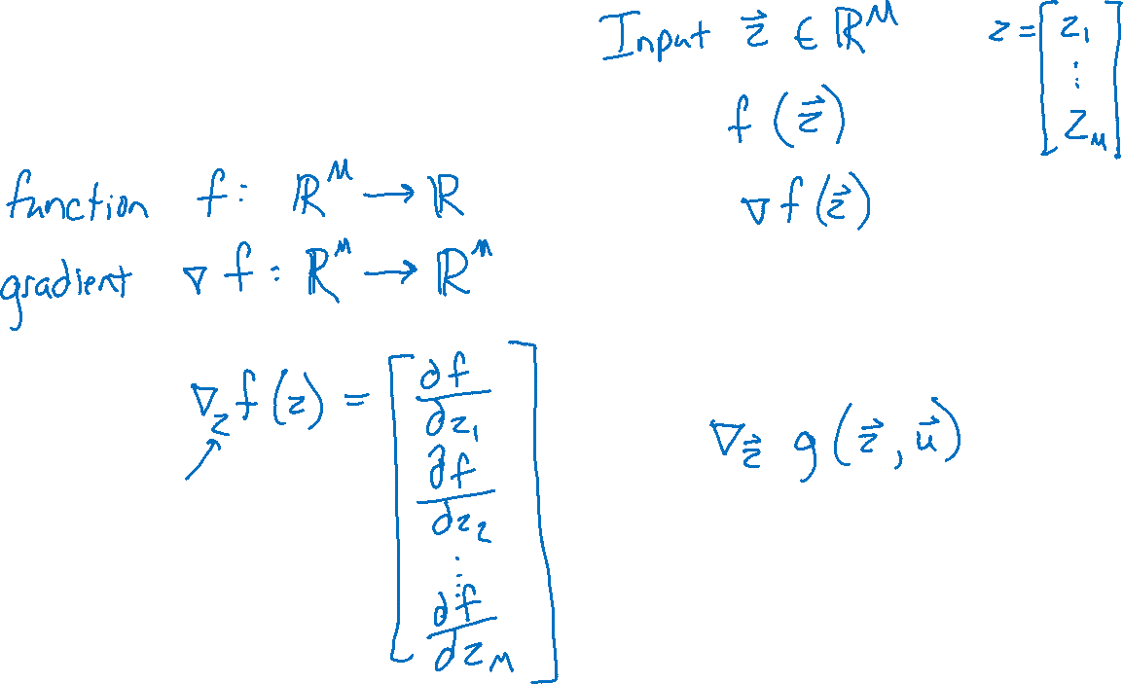
Optimization
Gradients

Slide 21
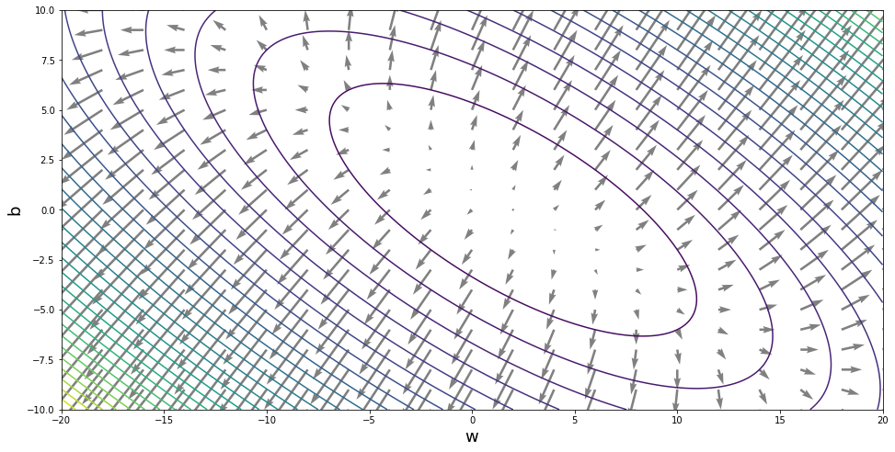
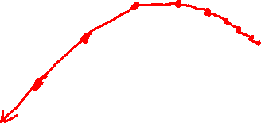
Optimization
Gradients

Slide 22
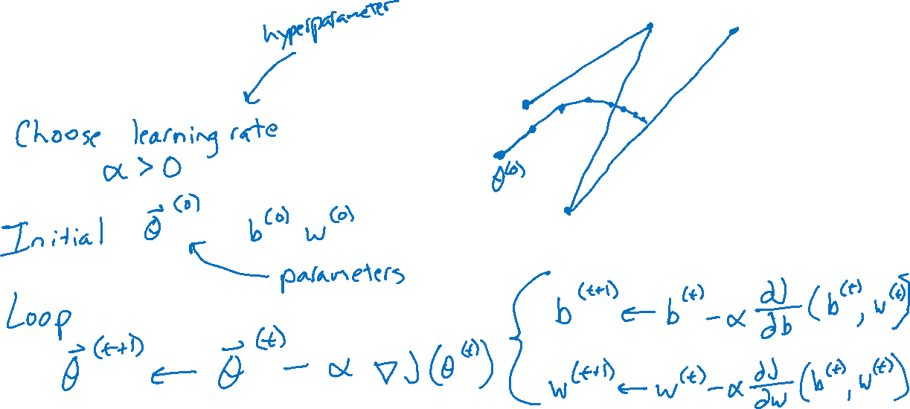
Optimization
Gradient descent

Slide 23
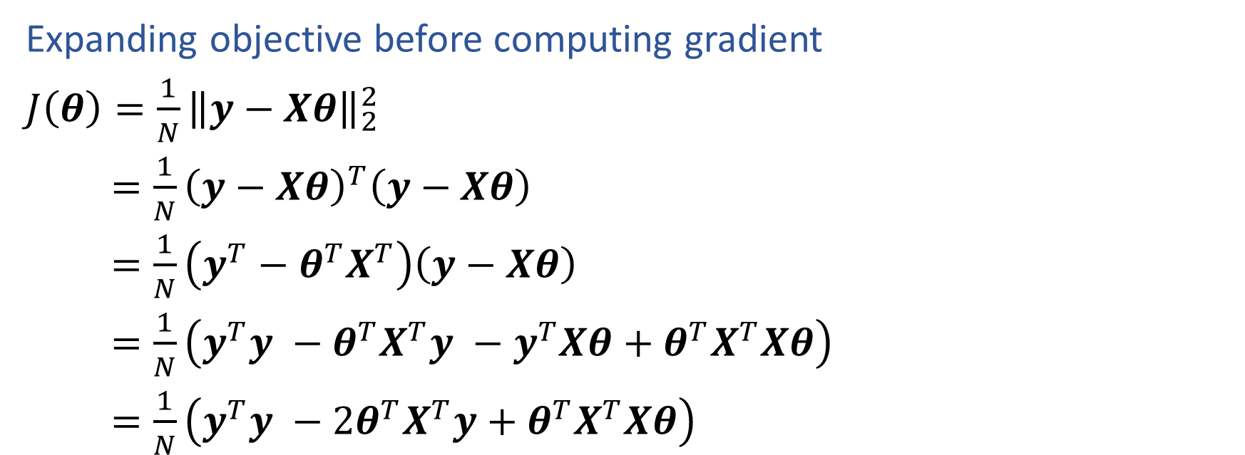
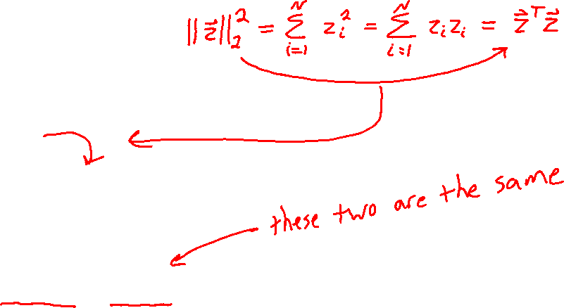
Linear Regression
Expanding objective before computing gradient
$J\left(θ\right)=\frac{1}{N}{\left\|y−Xθ\right\|}_{2}^{2}$
$=\frac{1}{N}{\left(y−Xθ\right)}^{T}\left(y−Xθ\right)$
$=\frac{1}{N}\left(y^{T}−θ^{T}X^{T}\right)\left(y−Xθ\right)$
$=\frac{1}{N}\left(y^{T}y −θ^{T}X^{T}y −y^{T}Xθ+θ^{T}X^{T}Xθ\right)$
$=\frac{1}{N}\left(y^{T}y −2θ^{T}X^{T}y+θ^{T}X^{T}Xθ\right)$

Slide 24

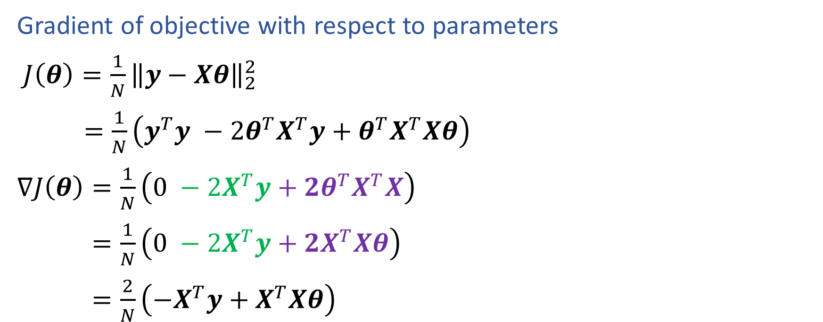
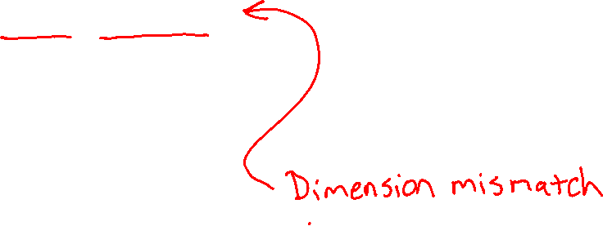
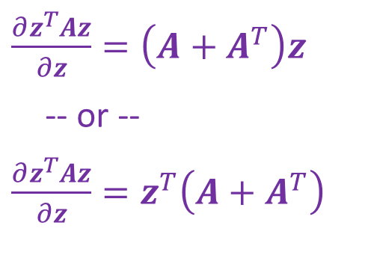
Linear Regression
$\frac{∂z^{T}u}{∂z}=u$
-- or --
$\frac{∂z^{T}u}{∂z} =u^{T}$
Gradient of objective with respect to parameters
$J\left(θ\right)=\frac{1}{N}{\left\|y−Xθ\right\|}_{2}^{2}$
$=\frac{1}{N}\left(y^{T}y −2θ^{T}X^{T}y+θ^{T}X^{T}Xθ\right)$
$∇J\left(θ\right)=\frac{1}{N}\left(0 −2X^{T}y+2θ^{T}X^{T}X\right)$
$=\frac{1}{N}\left(0 −2X^{T}y+2X^{T}Xθ\right)$
$=\frac{2}{N}\left(−X^{T}y+X^{T}Xθ\right)$
$\frac{∂z^{T}Az}{∂z}=\left(A+A^{T}\right)z$
-- or --
$\frac{∂z^{T}Az}{∂z}=z^{T}\left(A+A^{T}\right)$

Slide 25

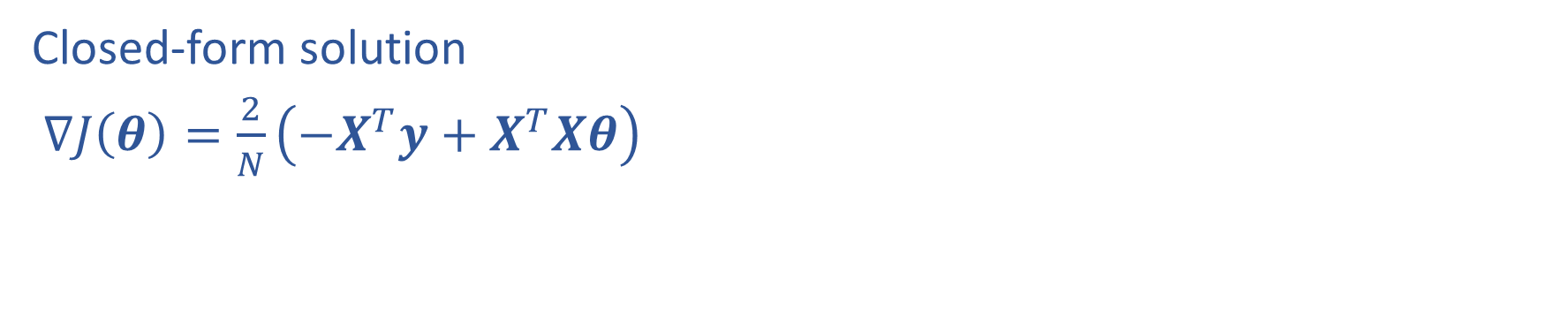
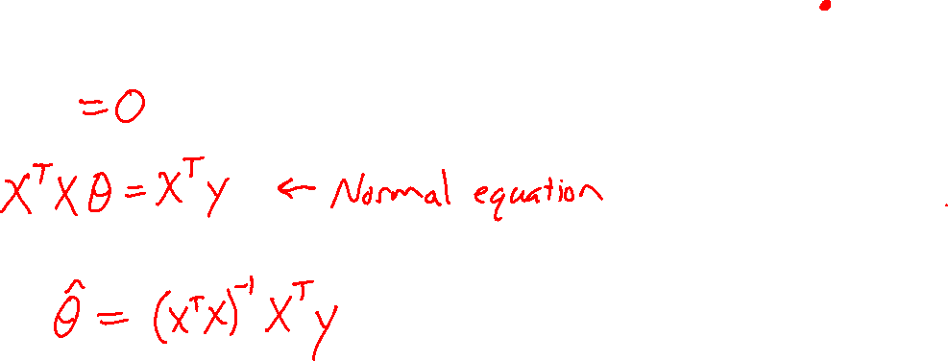
Linear Regression
Closed-form solution
$∇J\left(θ\right)=\frac{2}{N}\left(−X^{T}y+X^{T}Xθ\right)$

Slide 26
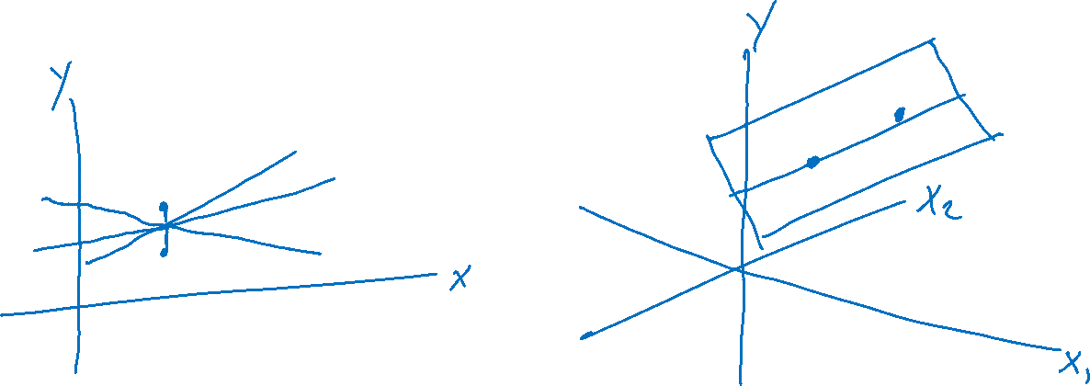
Linear Regression
Number of solutions

Slide 27
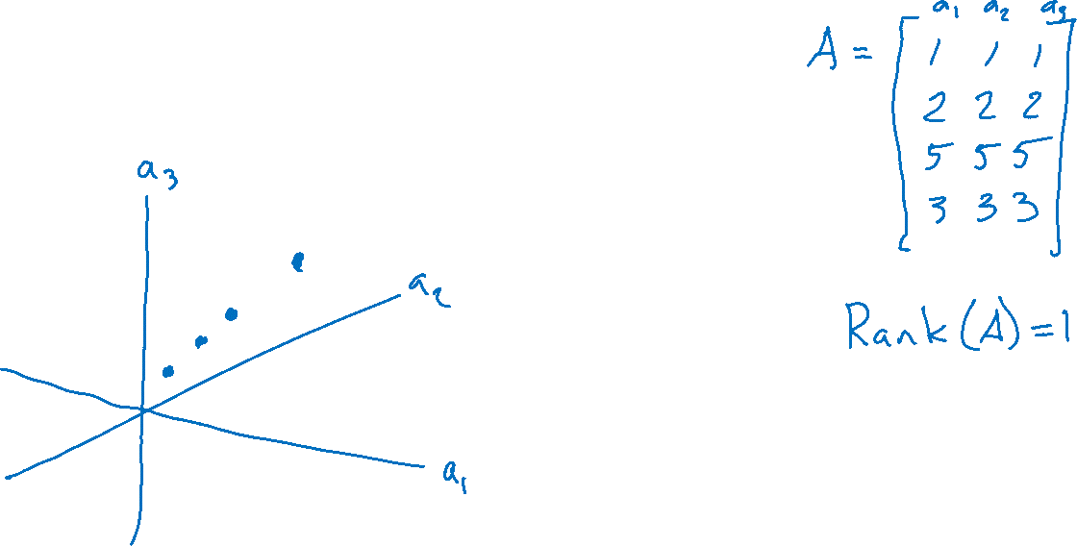
A Note on Matrix Rank
Underlying dimensionality of the data

Slide 28

Linear Regression
Methods for optimizing the objective
Grid search
Random search
Closed-form solution
(Batch) Gradient descent
Stochastic gradient descent
$$J(w,b)$$
$$b$$
$$w$$

Slide 29

Linear Regression
Methods for optimizing the objective
Grid search
Random search
Closed-form solution
(Batch) Gradient descent
Stochastic gradient descent
$$J(w,b)$$
$$b$$
$$w$$

Slide 30
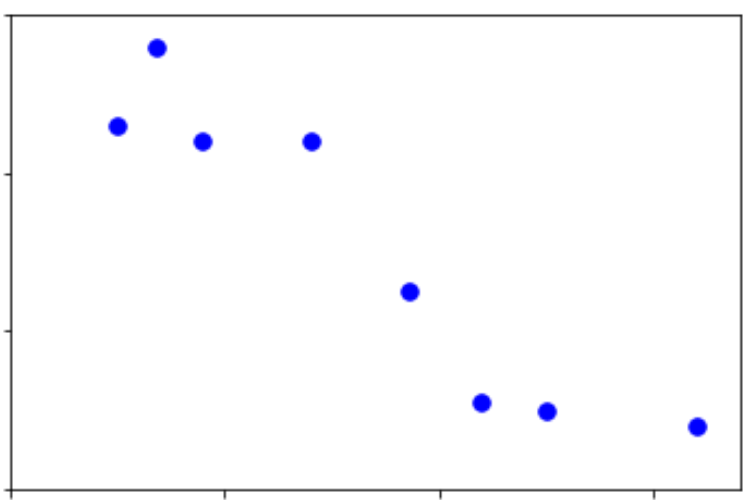
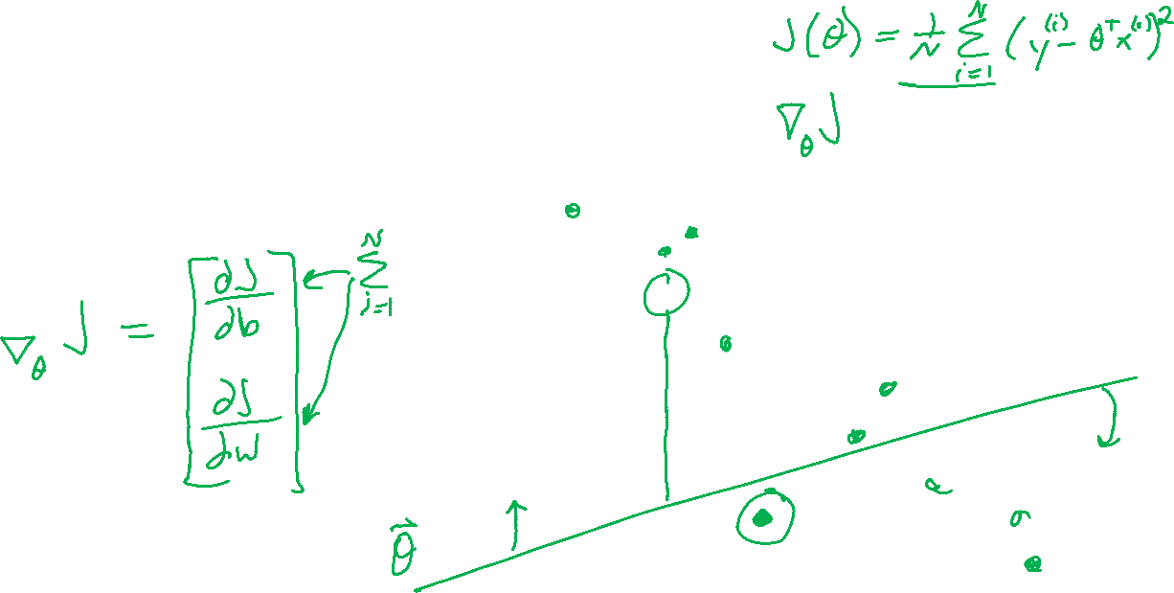
Linear Regression Gradient Descent
What happens in gradient descent when we have N=1,000,000 training points?
Output y
Input x

Slide 31
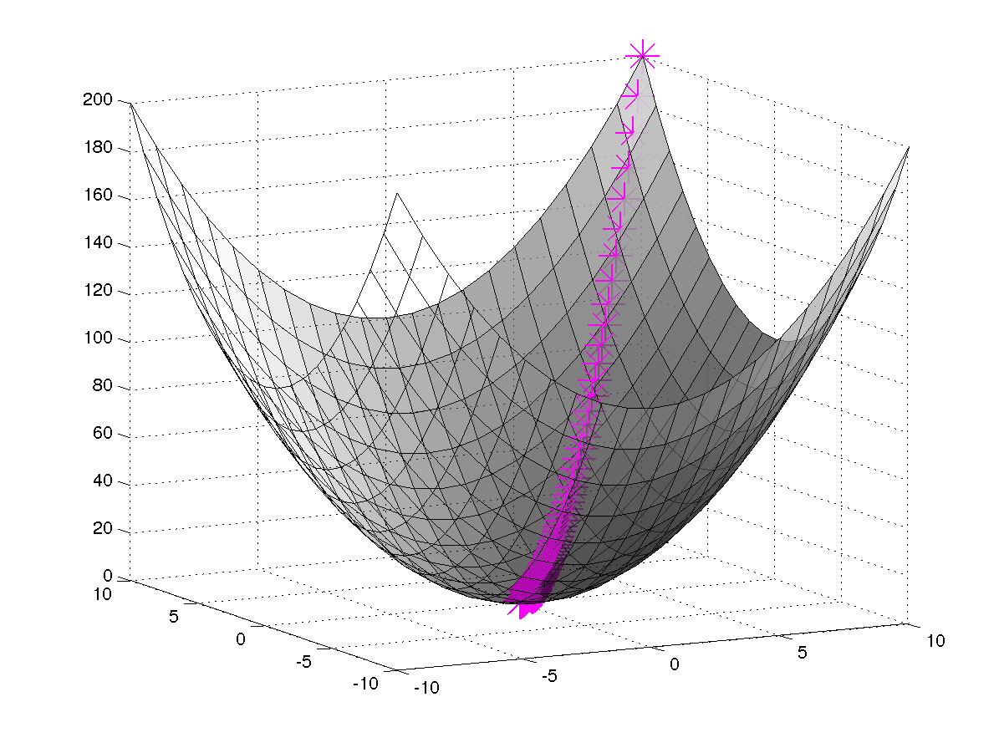
(Batch) Gradient Descent
—
M
Slide credit: CMU MLD Matt Gormley

Slide 32
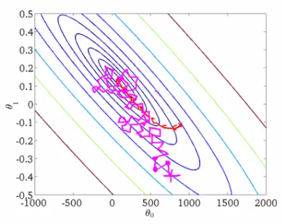
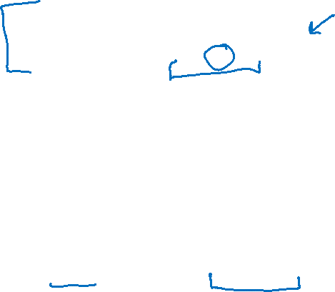
Stochastic Gradient Descent (SGD)
We need a per-example objective:
Slide credit: CMU MLD Matt Gormley

Slide 33

Linear Regression
Optimizing the objective
y
x

Slide 34
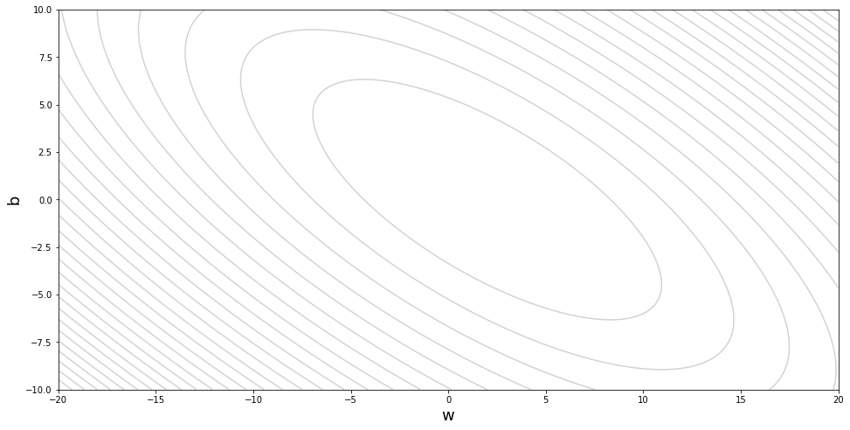
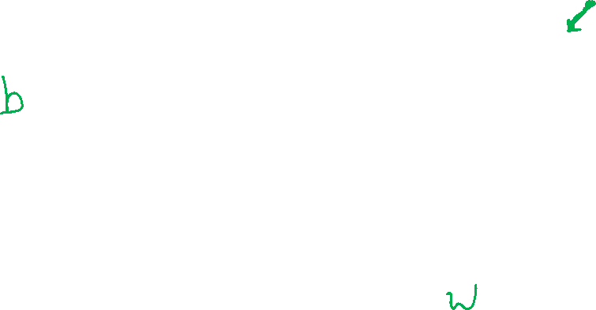
Stochastic Gradient Descent

Slide 35
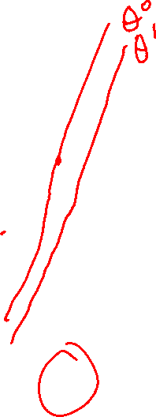
Linear Regression
Optimizing the objective
y
x

Slide 36
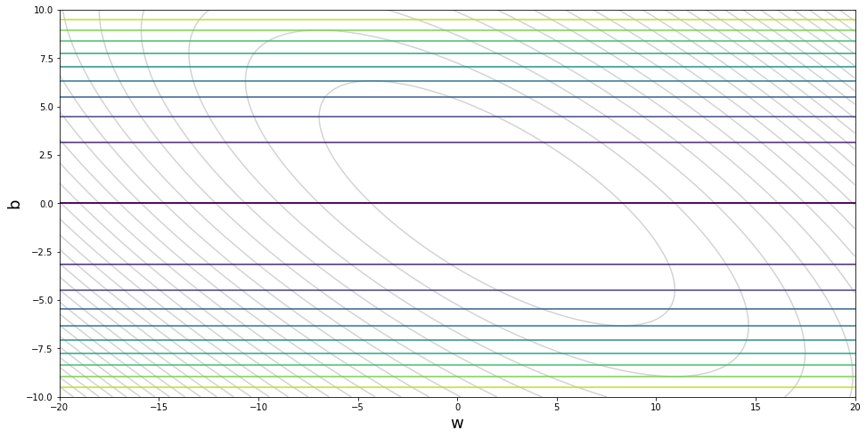
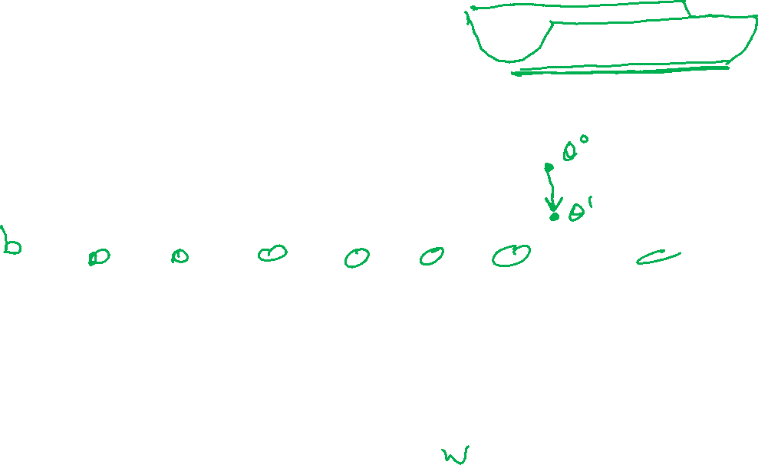
Stochastic Gradient Descent

Slide 37

Linear Regression
Optimizing the objective
y
x

Slide 38


Stochastic Gradient Descent

Slide 39
Stochastic Gradient Descent

Slide 40

Stochastic Gradient Descent (SGD)
We need a per-example objective:
Slide credit: CMU MLD Matt Gormley

Slide 41
Stochastic Gradient Descent (SGD)
In practice, it is common to implement SGD using sampling without replacement (i.e. shuffle({1,2,…N}), even though most of the theory is for sampling with replacement (i.e. Uniform({1,2,…N}).
We need a per-example objective:
Slide credit: CMU MLD Matt Gormley

Slide 42


Convergence Curves
Def: an epoch is a single pass through the training data
For GD, only one update per epoch
For SGD, N updates per epoch N = (# train examples)
Gradient Descent
SGD
Closed-form (normal eq.s)
SGD reduces MSE much more rapidly than GD
For GD / SGD, training MSE is initially large due to uninformed initialization
Slide credit: CMU MLD Matt Gormley and Eric P. Xing

