Slide 1

As you login
Rename yourself in Zoom to *pre*-pend your house number
e.g. “0 – Pat Virtue”
Open Piazza (getting ready for polls)
Download preview slides from course website
Grab something to write with/on ☺

Slide 2
Announcements
Assignments
HW1 Feedback
HW2
Due Mon, 9/21, 11:59 pm
Start now! OH will be *super* crowded as the deadline gets closer
Breakout rooms
Video on
Unmute
Introduce yourself if you haven’t already met

Slide 3

Introduction to Machine Learning Nearest Neighbor and Model Selection
Instructor: Pat Virtue

Slide 4
Plan
Last time
Decision trees
Continuous features, Overfitting
Nearest neighbor methods
Today
K-nearest neighbor
Nearest neighbor remarks
Model selection / hyperparameter optimization
Validation methods

Slide 5

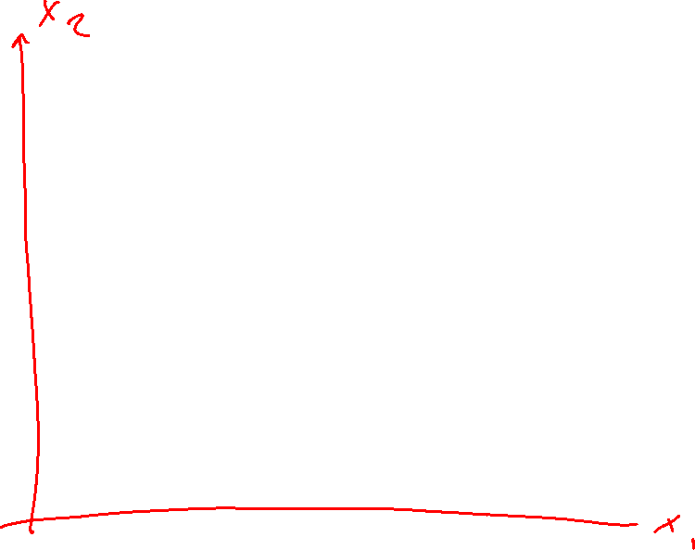
Nearest Neighbor Classifier
Test subject
Whales
Seals
Sharks

Slide 6
Nearest Neighbor on Fisher Iris Data
Slide credit: CMU MLD Matt Gormley

Slide 7

Piazza Poll 1
Which methods can achieve zero training error on this dataset?
Decision trees
1-Nearest Neighbor
Both
Neither
If zero error, draw the decision boundary.
Otherwise, why not?
x₂
x₁

Slide 8
Piazza Poll 1
Which methods can achieve zero training error on this dataset?
Decision trees
1-Nearest Neighbor
Both
Neither
If zero error, draw the decision boundary.
Otherwise, why not?
x₂
x₁

Slide 9
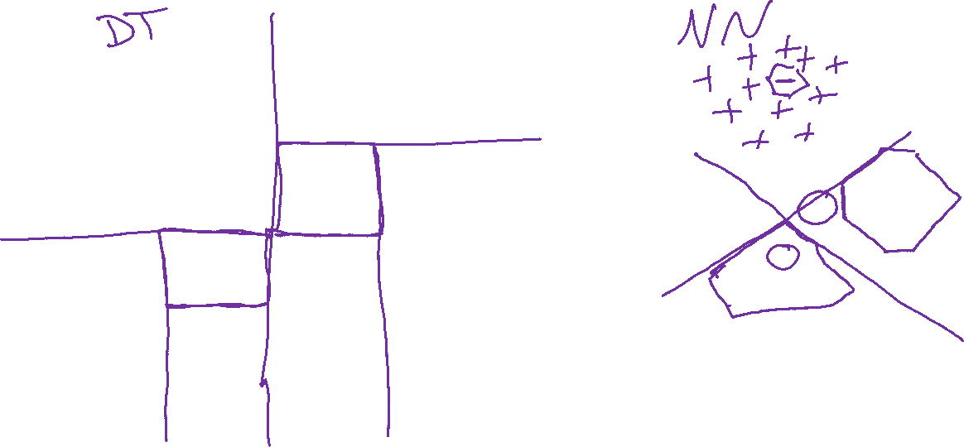
Piazza Poll 1
Which methods can achieve zero training error on this dataset?
x₂
x₂
x₁
x₁

Slide 10
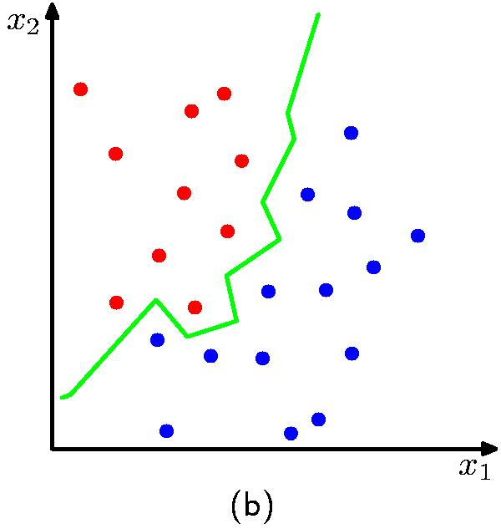
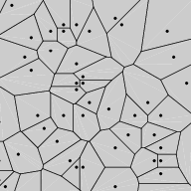
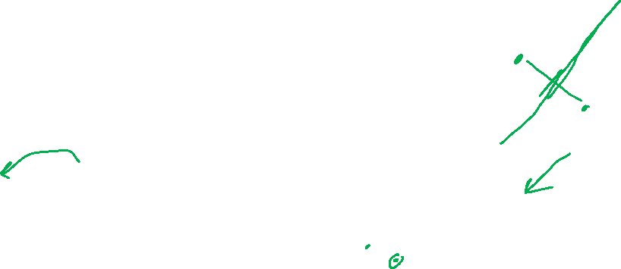
Nearest Neighbor Decision Boundary
1-nearest neighbor classifier decision boundary
Voronoi Diagram
K = 1

Slide 11

Piazza Poll 2
1-nearest neighbor will likely:
Overfit
Underfit
Neither (it’s a great learner!)

Slide 12
Piazza Poll 2
1-Nearest neighbor will likely:
Overfit
Underfit
Neither (it’s a great learner!)

Slide 13
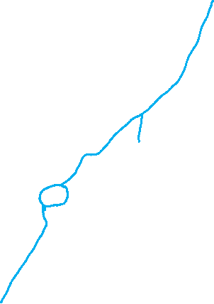
Nearest Neighbor on Fisher Iris Data
Slide credit: CMU MLD Matt Gormley

Slide 14
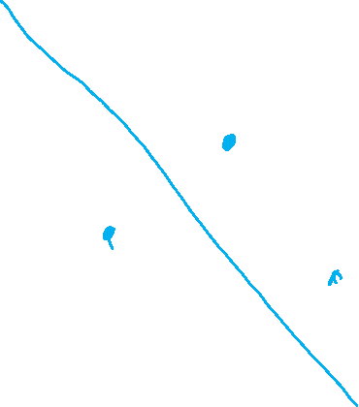
Nearest Neighbor on Gaussian Data
Slide credit: CMU MLD Matt Gormley

Slide 15
Nearest Neighbor on Gaussian Data
Slide credit: CMU MLD Matt Gormley

Slide 16
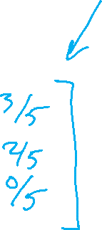
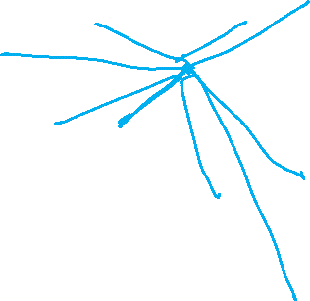
kNN classifier (k=5)
Test document
Whales
Seals
Sharks

Slide 17

Nearest Neighbor Classification
Given a training dataset $𝒟={\left\{y^{\left(n\right)}, x^{\left(n\right)}\right\}}_{n=1}^{N}, y∈\left\{1,…,C\right\}, x∈ℝ^{M}$
and a test input $x_{test}$, predict the class label, ${\hat{y}}_{test}$:
Find the closest point in the training data to $x_{test}$
$$n=\underset{n}{argmin}{d(x_{test}}, x^{(n)})$$
Return the class label of that closest point
$${\hat{y}}_{test}=y^{(n)}$$
Need distance function! What should $d(x, z)$ be?

Slide 18
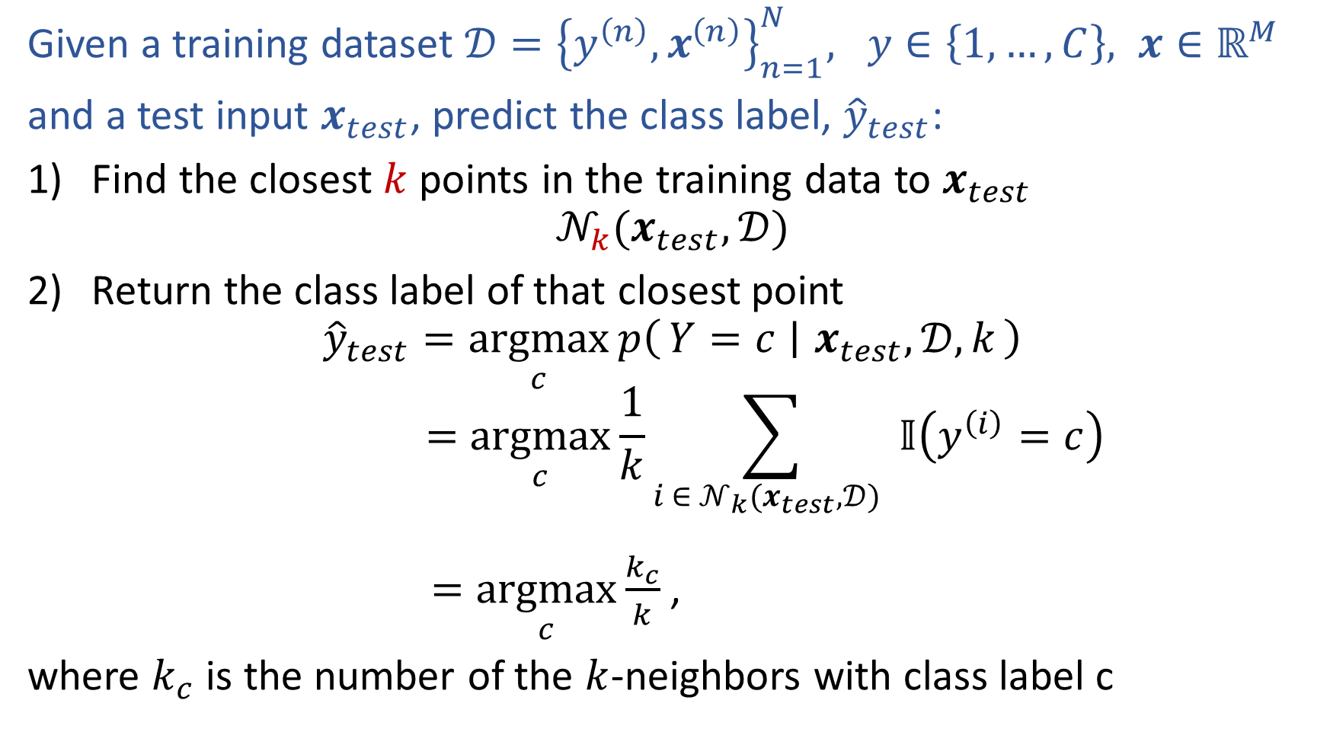
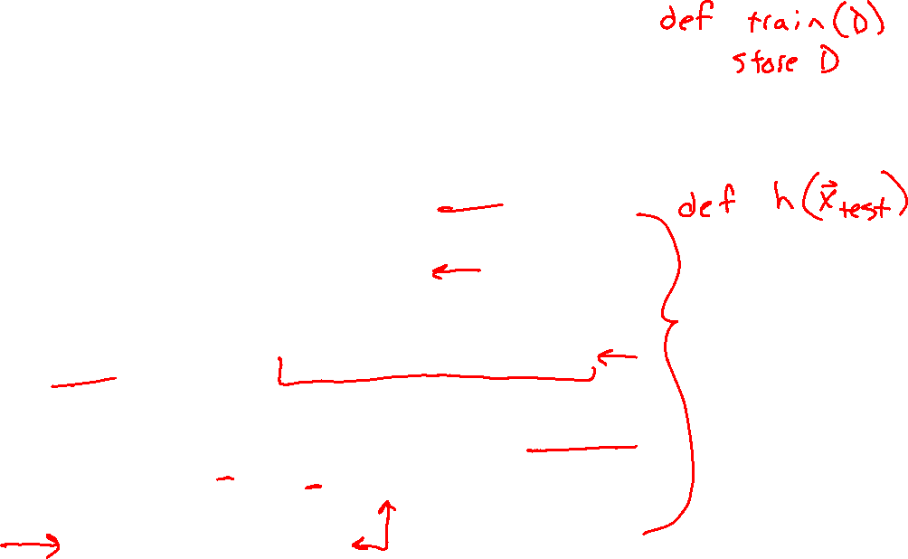
k-Nearest Neighbor Classification
Given a training dataset $𝒟={\left\{y^{\left(n\right)}, x^{\left(n\right)}\right\}}_{n=1}^{N}, y∈\left\{1,…,C\right\}, x∈ℝ^{M}$
and a test input $x_{test}$, predict the class label, ${\hat{y}}_{test}$:
Find the closest $k$ points in the training data to $x_{test}$
$$𝒩_{k}(x_{test},𝒟)$$
Return the class label of that closest point
$${\hat{y}}_{test}=\underset{c}{argmax}{p\left(Y=c ∣ x_{test},𝒟, k\right)}$$
$$=\underset{c}{argmax}{\frac{1}{k}\sum_{i ∈ 𝒩_{k}(x_{test},𝒟) }{𝕀\left(y^{\left(i\right)}=c\right)}}$$
$=\underset{c}{argmax}{\frac{k_{c}}{k}}$,
where $k_{c}$ is the number of the $k$-neighbors with class label c

Slide 19
1-Nearest Neighbor (kNN) classifier
Sports
Science
Arts

Slide 20

2-Nearest Neighbor (kNN) classifier
Sports
Science
Arts

Slide 21
3-Nearest Neighbor (kNN) classifier
Sports
Science
Arts

Slide 22
5-Nearest Neighbor (kNN) classifier
Sports
Science
Arts

Slide 23
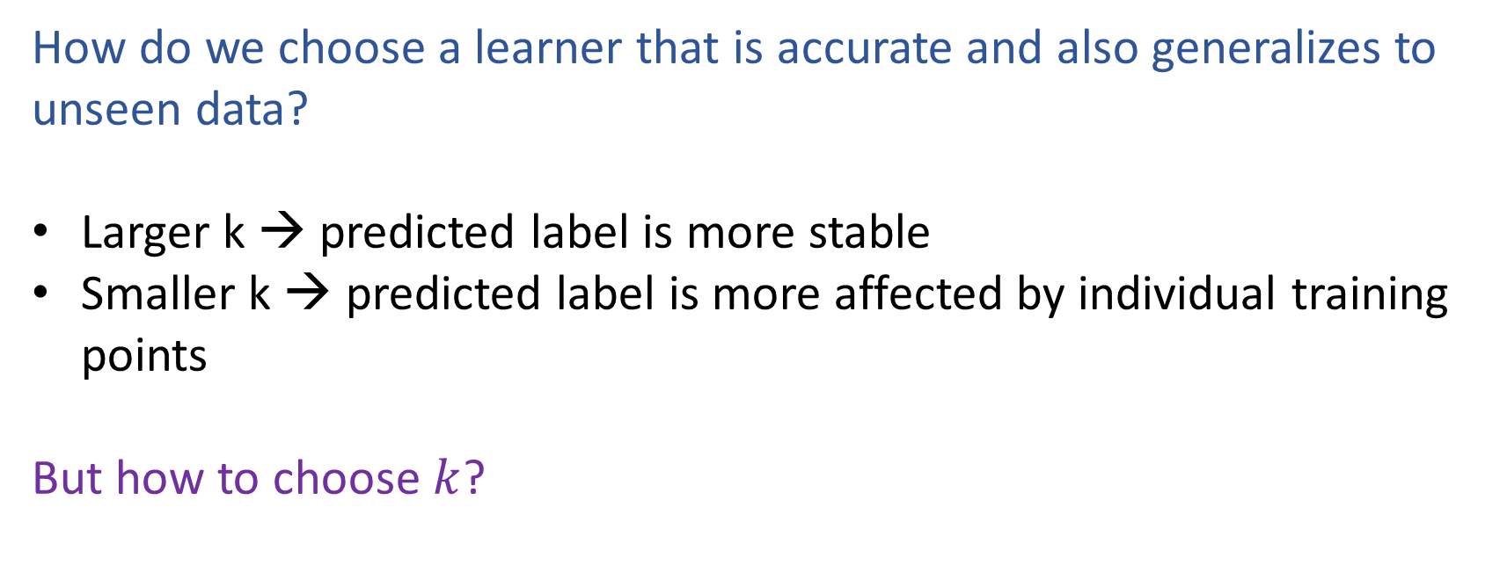
What is the best k?
How do we choose a learner that is accurate and also generalizes to unseen data?
Larger k → predicted label is more stable
Smaller k → predicted label is more affected by individual training points
But how to choose $k$?

Slide 24

k-NN on Fisher Iris Data
Special Case: Nearest Neighbor
Slide credit: CMU MLD Matt Gormley

Slide 25
k-NN on Fisher Iris Data
Slide credit: CMU MLD Matt Gormley

Slide 26
k-NN on Fisher Iris Data
Slide credit: CMU MLD Matt Gormley

Slide 27
k-NN on Fisher Iris Data
Slide credit: CMU MLD Matt Gormley

Slide 28
k-NN on Fisher Iris Data
Slide credit: CMU MLD Matt Gormley

Slide 29
k-NN on Fisher Iris Data
Slide credit: CMU MLD Matt Gormley

Slide 30
k-NN on Fisher Iris Data
Special Case: Majority Vote
Slide credit: CMU MLD Matt Gormley

Slide 31
k-NN: Remarks
Inductive Bias:
Close points should have similar labels
All dimensions are created equally!
Slide credit: CMU MLD Matt Gormley

Slide 32
k-NN: Remarks
Inductive Bias:
Close points should have similar labels
All dimensions are created equally!
Example: two features for k-NN
big problem: feature scale could dramatically influence classification results
length (cm)
length (cm)
Slide credit: CMU MLD Matt Gormley
width (cm)
width (m)

Slide 33
k-NN: Remarks
Computational Efficiency:
Suppose we have N training examples, and each one has M features
Computational complexity for the special case where k=1:
Slide credit: CMU MLD Matt Gormley
Notes:
https://www.ri.cmu.edu/pub_files/pub1/moore_andrew_1991_1/moore_andrew_1991_1.pdf

Slide 34
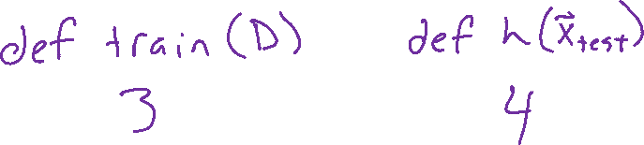
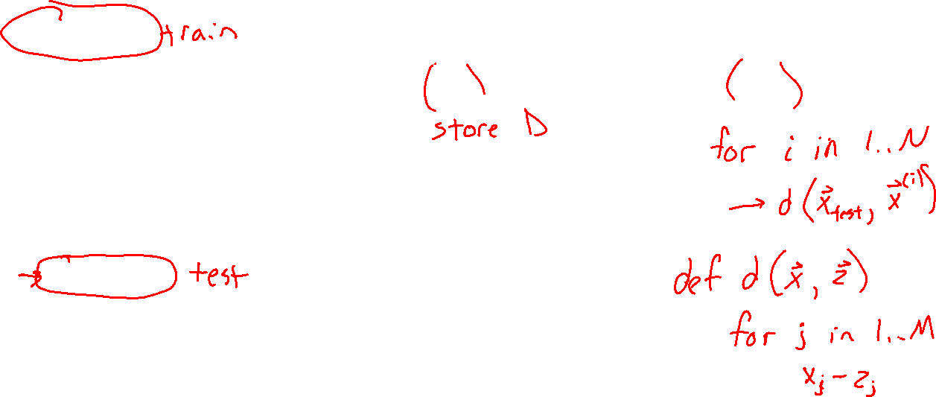
Piazza Poll 3 (train) and Poll 4 (test)
Suppose we have N training examples, and each one has M features
Computational complexity for the special case where k=1:
O(1)
O(log N)
O(log M)
O(log NM)
O(N)
O(M)
O(NM)
O(N^2)
O(N^2M)

Slide 35
Piazza Poll 3 (train) and Poll 4 (test)
Suppose we have N training examples, and each one has M features
Computational complexity for the special case where k=1:
O(1)
O(log N)
O(log M)
O(log NM)
O(N)
O(M)
O(NM)
O(N^2)
O(N^2M)

Slide 36
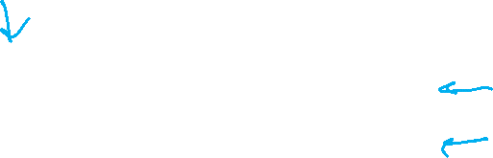

k-NN: Remarks
Computational Efficiency:
Suppose we have N training examples, and each one has M features
Computational complexity for the special case where k=1:
Task | Naive | k-d Tree
Train | O(1) | ~ O(M N log N)
Predict (one test example) | O(MN) | ~ O(2^{M} log N) on average
Problem: Very fast for small M, but very slow for large M
In practice: use stochastic approximations (very fast, and empirically often as good)
Slide credit: CMU MLD Matt Gormley
Notes:
https://www.ri.cmu.edu/pub_files/pub1/moore_andrew_1991_1/moore_andrew_1991_1.pdf

Slide 37
k-NN: Remarks
Theoretical Guarantees:
Cover & Hart (1967)
Let h(x) be a Nearest Neighbor (k=1) binary classifier. As the number of training examples N goes to infinity…
error_{true}(h) < 2 x Bayes Error Rate
“In this sense, it may be said that half the classification information in an infinite sample set is contained in the nearest neighbor.”
very informally, Bayes Error Rate can be thought of as:
‘the best you could possibly do’
Slide credit: CMU MLD Matt Gormley
Notes:
https://www.ri.cmu.edu/pub_files/pub1/moore_andrew_1991_1/moore_andrew_1991_1.pdf
Interesting because we are able to provide a bound on a quantity that we are not able to compute.

Slide 38
Nearest Neighbor on Gaussian Data
Slide credit: CMU MLD Matt Gormley

Slide 39
Nearest Neighbor on Gaussian Data
Slide credit: CMU MLD Matt Gormley

Slide 40
k-NN Learning Objectives
You should be able to…
Describe a dataset as points in a high dimensional space
Implement k-Nearest Neighbors with O(N) prediction
Describe the inductive bias of a k-NN classifier and relate it to feature scale
Sketch the decision boundary for a learning algorithm (compare k-NN and DT)

Slide 41
k-NN Learning Objectives
You should be able to…
Describe a dataset as points in a high dimensional space
Implement k-Nearest Neighbors with O(N) prediction
Describe the inductive bias of a k-NN classifier and relate it to feature scale
Sketch the decision boundary for a learning algorithm (compare k-NN and DT)
State Cover & Hart (1967)'s large sample analysis of a nearest neighbor classifier

Slide 42
Model Selection

Slide 43
Model Selection
WARNING:
In some sense, our discussion of model selection is premature.
The models we have considered thus far are fairly simple.
The models and the many decisions available to the data scientist wielding them will grow to be much more complex than what we’ve seen so far.
Slide credit: CMU MLD Matt Gormley

Slide 44
Model Selection
Statistics
Machine Learning
Def: a model defines the data generation process (i.e. a set or family of parametric probability distributions)
Def: model parameters are the values that give rise to a particular probability distribution in the model family
Def: learning (aka. estimation) is the process of finding the parameters that best fit the data
Def: hyperparameters are the parameters of a prior distribution over parameters
Def: (loosely) a model defines the hypothesis space over which learning performs its search
Def: model parameters are the numeric values or structure selected by the learning algorithm that give rise to a hypothesis
Def: the learning algorithm defines the data-driven search over the hypothesis space (i.e. search for good parameters)
Def: hyperparameters are the tunable aspects of the model, that the learning algorithm does not select
Slide credit: CMU MLD Matt Gormley

Slide 45
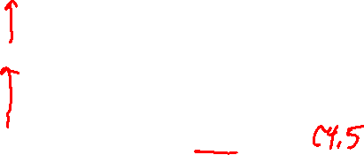
Model Selection
Example: Decision Tree
Machine Learning
model = set of all possible trees, possibly restricted by some hyperparameters (e.g. max depth)
parameters = structure of a specific decision tree
learning algorithm = ID3, CART, etc.
hyperparameters = max-depth, threshold for splitting criterion, etc.
Def: (loosely) a model defines the hypothesis space over which learning performs its search
Def: model parameters are the numeric values or structure selected by the learning algorithm that give rise to a hypothesis
Def: the learning algorithm defines the data-driven search over the hypothesis space (i.e. search for good parameters)
Def: hyperparameters are the tunable aspects of the model, that the learning algorithm does not select
Slide credit: CMU MLD Matt Gormley

Slide 46
Model Selection
Example: k-Nearest Neighbors
Machine Learning
model = set of all possible nearest neighbors classifiers
parameters = none (KNN is an instance-based or non-parametric method)
learning algorithm = for naïve setting, just storing the data
hyperparameters = k, the number of neighbors to consider
Def: (loosely) a model defines the hypothesis space over which learning performs its search
Def: model parameters are the numeric values or structure selected by the learning algorithm that give rise to a hypothesis
Def: the learning algorithm defines the data-driven search over the hypothesis space (i.e. search for good parameters)
Def: hyperparameters are the tunable aspects of the model, that the learning algorithm does not select
Slide credit: CMU MLD Matt Gormley

Slide 47
Model Selection
Statistics
Machine Learning
Def: a model defines the data generation process (i.e. a set or family of parametric probability distributions)
Def: model parameters are the values that give rise to a particular probability distribution in the model family
Def: learning (aka. estimation) is the process of finding the parameters that best fit the data
Def: hyperparameters are the parameters of a prior distribution over parameters
Def: (loosely) a model defines the hypothesis space over which learning performs its search
Def: model parameters are the numeric values or structure selected by the learning algorithm that give rise to a hypothesis
Def: the learning algorithm defines the data-driven search over the hypothesis space (i.e. search for good parameters)
Def: hyperparameters are the tunable aspects of the model, that the learning algorithm does not select
If “learning” is all about picking the best parameters how do we pick the best hyperparameters?
Slide credit: CMU MLD Matt Gormley

Slide 48
Model Selection
Two very similar definitions:
Def: model selection is the process by which we choose the “best” model from among a set of candidates
Def: hyperparameter optimization is the process by which we choose the “best” hyperparameters from among a set of candidates (could be called a special case of model selection)
Both assume access to a function capable of measuring the quality of a model
Both are typically done “outside” the main training algorithm --- typically training is treated as a black box
Slide credit: CMU MLD Matt Gormley

Slide 49
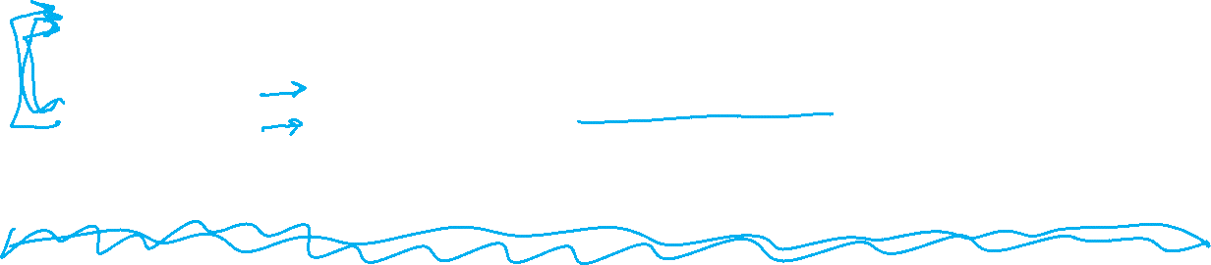
Experimental Design
 | Input | Output | Notes
Training | training dataset hyperparameters | best model parameters | We pick the best model parameters by learning on the training dataset for a fixed set of hyperparameters
Hyperparameter Optimization | training dataset validation dataset | best hyperparameters | We pick the best hyperparameters by learning on the training data and evaluating error on the validation error
Testing | test dataset hypothesis (i.e. fixed model parameters) | test error | We evaluate a hypothesis corresponding to a decision rule with fixed model parameters on a test dataset to obtain test error
Slide credit: CMU MLD Matt Gormley

Slide 50
Special Cases of k-NN
k=1: Nearest Neighbor
k=N: Majority Vote
Slide credit: CMU MLD Matt Gormley

Slide 51
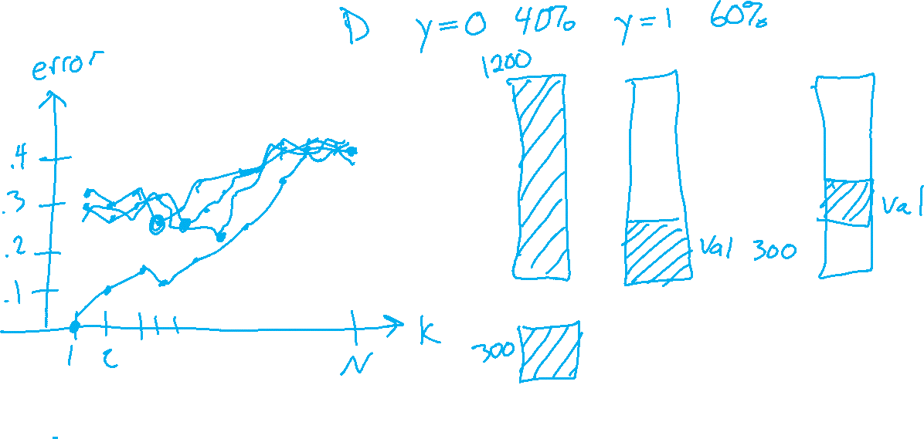
Example of Hyperparameter Optimization
Choosing k for k-NN
Slide credit: CMU MLD Matt Gormley

Slide 52
k-NN: Choosing k
Fisher Iris Data: varying the value of k
Slide credit: CMU MLD Matt Gormley

Slide 53
k-NN: Choosing k
Gaussian Data: varying the value of k
Slide credit: CMU MLD Matt Gormley

Slide 54
Validation
Why do we need validation?
Choose hyperparameters
Choose technique
Help make any choices beyond our parameters
But now, we have another choice to make!
How do we split training and validation?
Trade-offs
More held-out data, better meaning behind validation numbers
More held-out data, less data to train on!

Slide 55
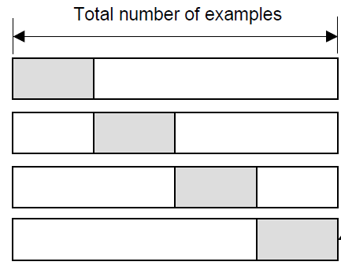
Cross-validation
K-fold cross-validation
Create K-fold partition of the dataset.
Do K runs: train using K-1 partitions and calculate validation error on remaining partition (rotating validation partition on each run).
Report average validation error
training
validation
Run 1
Run 2
Run K
Slide credit: CMU MLD Aarti Singh
TexPoint fonts used in EMF.
Read the TexPoint manual before you delete this box.: AAAAAAA

Slide 56
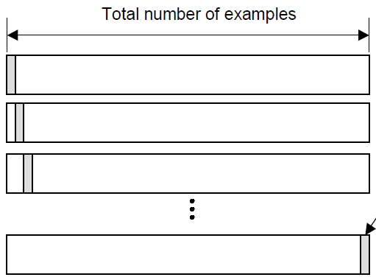
Cross-validation
Leave-one-out (LOO) cross-validation
Special case of K-fold with K=N partitions
Equivalently, train on N-1 samples and validate on only one sample per run for N runs
training
validation
Run 1
Run 2
Run K
Slide credit: CMU MLD Aarti Singh
TexPoint fonts used in EMF.
Read the TexPoint manual before you delete this box.: AAAAAAA

Slide 57
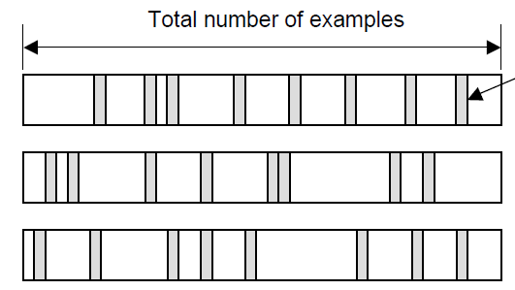
Cross-validation
Random subsampling
Randomly subsample a fixed fraction αN (0< α <1) of the dataset for validation.
Compute validation error with remaining data as training data.
Repeat K times
Report average validation error
training
validation
Run 1
Run 2
Run K
Slide credit: CMU MLD Aarti Singh
TexPoint fonts used in EMF.
Read the TexPoint manual before you delete this box.: AAAAAAA

Slide 58
Practical Issues in Cross-validation
How to decide the values for K and α ?
Large K
+ Validation error can approximate test error well
- Observed validation error will be unstable (few validation pts)
- The computational time will be very large as well (many experiments)
Small K
+ The # experiments and, therefore, computation time are reduced
+ Observed validation error will be stable (many validation pts)
- Validation error cannot approximate test error well
Common choice: K = 10, α = 0.1 ☺
Slide credit: CMU MLD Aarti Singh
TexPoint fonts used in EMF.
Read the TexPoint manual before you delete this box.: AAAAAAA

Slide 59
Model Selection
WARNING (again):
This section is only scratching the surface!
Lots of methods for hyperparameter optimization: (to talk about later)
Grid search
Random search
Bayesian optimization
Graduate-student descent
…
Main Takeaway:
Model selection / hyperparameter optimization is just another form of learning
Slide credit: CMU MLD Matt Gormley

Slide 60
Model Selection Learning Objectives
You should be able to…
Plan an experiment that uses training, validation, and test datasets to predict the performance of a classifier on unseen data (without cheating)
Explain the difference between (1) training error, (2) validation error, (3) cross-validation error, (4) test error, and (5) true error
For a given learning technique, identify the model, learning algorithm, parameters, and hyperparamters

