Slide 1

Announcements
Assignments
HW7: Thu, 11/19, 11:59 pm
Schedule change
Friday: Lecture in all three recitation slots
Monday: Recitation in both lecture slots
Final exam scheduled
Study groups

Slide 2

Introduction to Machine Learning
Markov Decision Processes
Instructor: Pat Virtue

Slide 3
Plan
Last time
Applications of sequential decision making (and Gridworld ☺)
Minimax and expectimax trees
MDP setup

Slide 4





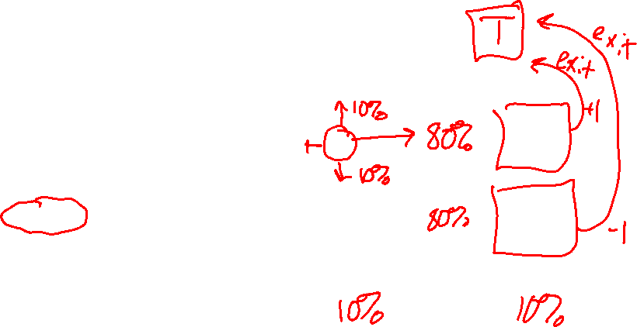
Markov Decision Processes
An MDP is defined by:
  A set of states s ∈ S
  A set of actions a ∈ A
  A transition function T(s, a, s’)
    Probability that a from s leads to s’, i.e., P(s’| s, a)
    Also called the model or the dynamics
  A reward function R(s, a, s’)
    Sometimes just R(s) or R(s’)
  A start state
  Maybe a terminal state
MDPs are non-deterministic search problems
  One way to solve them is with expectimax search
  We’ll have a new tool soon
Slide: ai.berkeley.edu
[Demo – gridworld manual intro (L8D1)]
Notes:
In search problems: did not talk about actions, but about successor functions --- now the information inside the successor function is unpacked into actions, transitions and reward
Write out S, A, example entry in T, entry in R
Reward function different from the book : R(s,a,s’)
In book simpler for equations, but not useful for the projects.
Need to modify expectimax a tiny little bit to account for rewards along the way, but that’s something you should be able to do, and so you can already solve MDP’s (not in most efficient way)

Slide 5


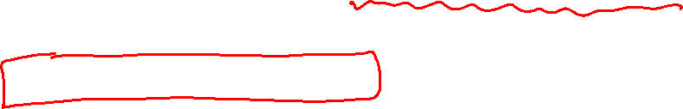
What is Markov about MDPs?
“Markov” generally means that given the present state, the future and the past are independent
For Markov decision processes, “Markov” means action outcomes depend only on the current state
Andrey Markov (1856-1922)
Slide: ai.berkeley.edu
Notes:
Like search: successor function only depended on current state
Can make this happen by stuffing more into the state;
Very similar to search problems: when solving a maze with food pellets, we stored which food pellets were eaten

Slide 6

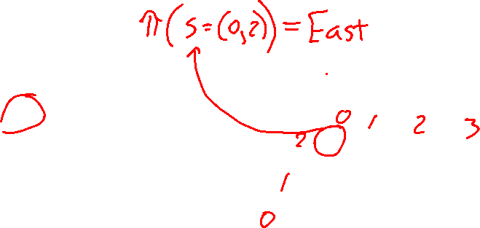
Policies
We don’t just want an optimal plan, or sequence of actions, from start to a goal
For MDPs, we want an optimal policy π*: S → A
  A policy π gives an action for each state
  An optimal policy is one that maximizes expected utility if followed
Expectimax didn’t compute entire policies
  It computed the action for a single state only
Optimal policy when R(s, a, s’) = -0.03 for all non-terminals s
Slide: ai.berkeley.edu
Notes:
Dan has a DEMO for this.

Slide 7
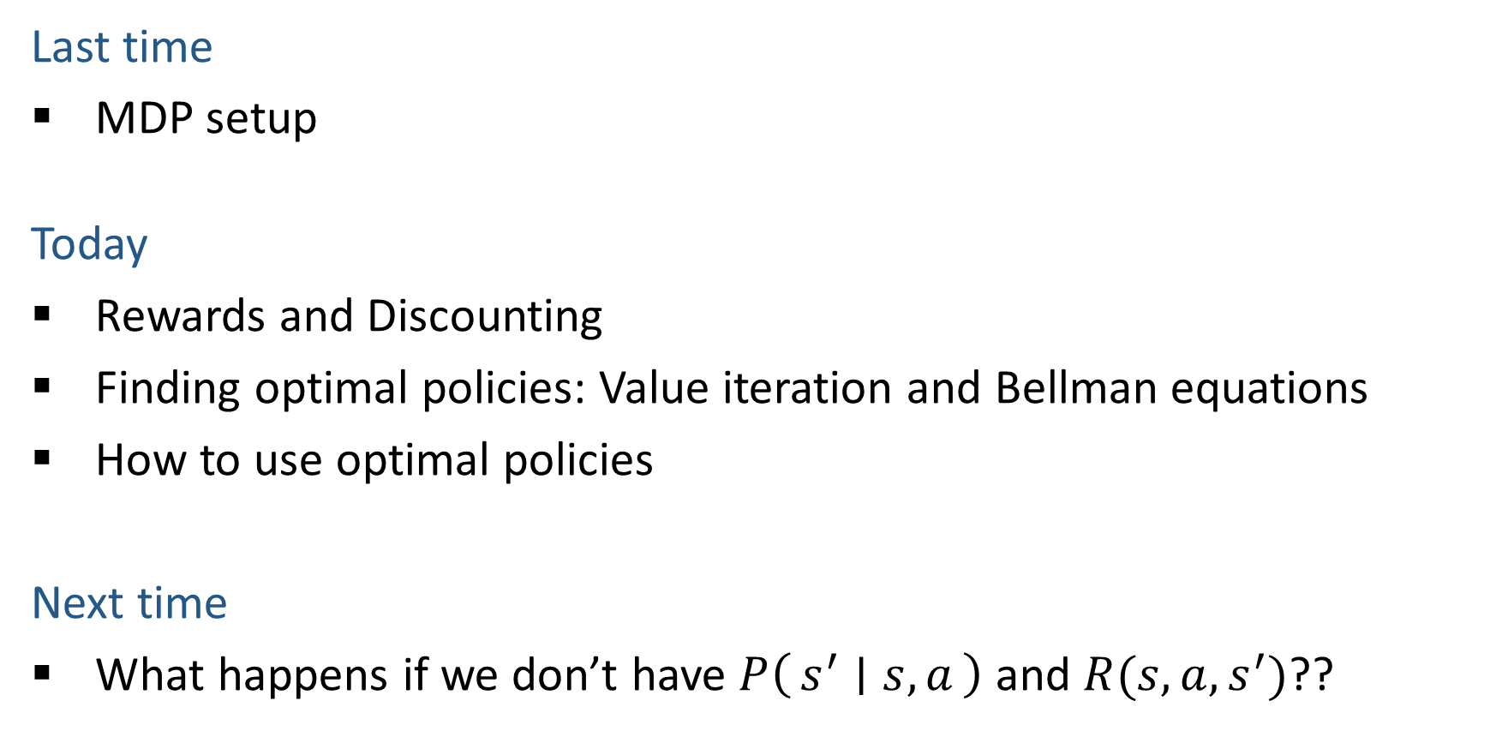
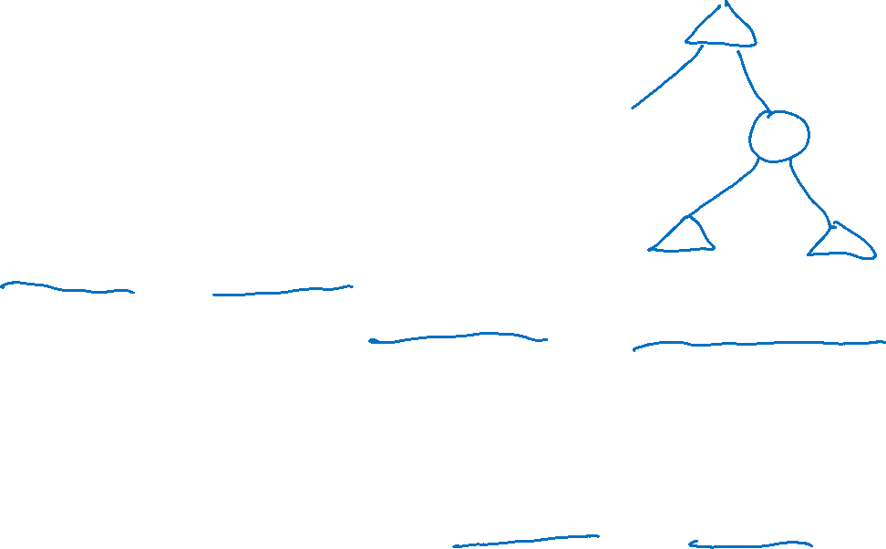
Plan
Last time
MDP setup
Today
Rewards and Discounting
Finding optimal policies: Value iteration and Bellman equations
How to use optimal policies
Next time
What happens if we don’t have $P\left(s^{′} ∣ s, a\right)$ and $R(s, a, s^{′})$??

Slide 8
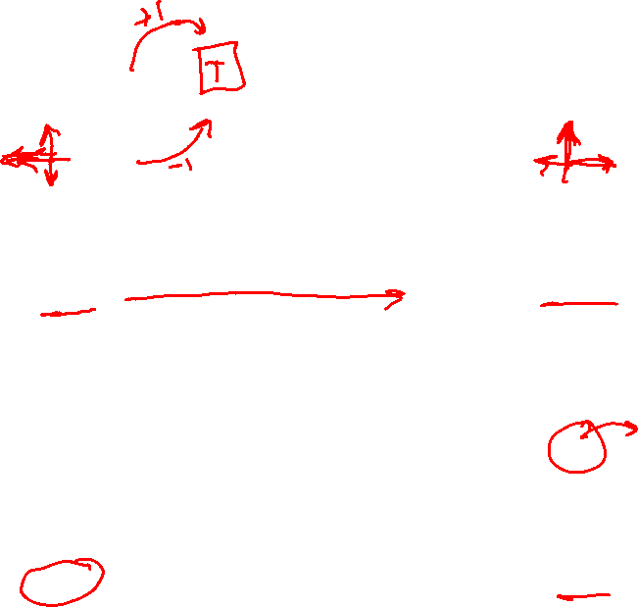
Optimal Policies
R(s) = -0.01
R(s) = -0.03
R(s) = -0.4
R(s) = -2.0
Slide: ai.berkeley.edu
Notes:
R(s) = the “living reward”

Slide 9
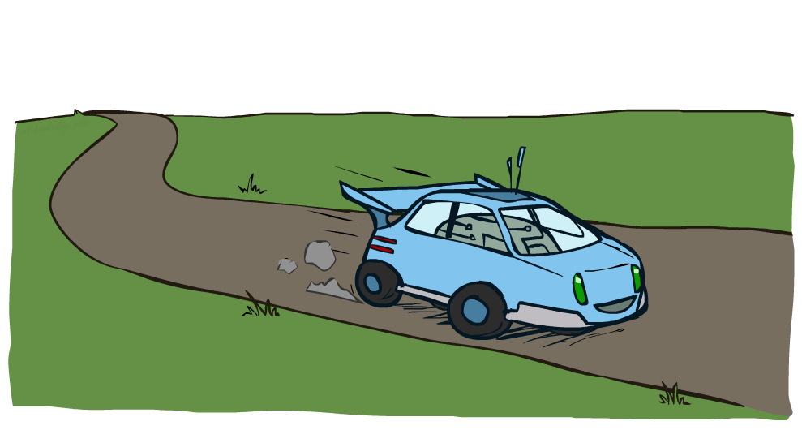
Example: Racing
Slide: ai.berkeley.edu

Slide 10


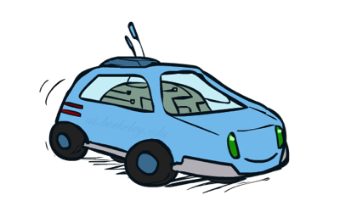

Example: Racing
A robot car wants to travel far, quickly
Three states: Cool, Warm, Overheated
Two actions: Slow, Fast
Going faster gets double reward
1.0
0.5
Fast
(R=-10)
0.5
+1
Slow (R=1)
1.0
Fast
Slow
-10
0.5
+1
0.5
Slow (R=1)
Warm
Slow
Fast
0.5
+2
Fast
(R=2)
0.5
Cool
0.5
Overheated
+1
1.0
1.0
+2
0.5
Slide: ai.berkeley.edu

Slide 11




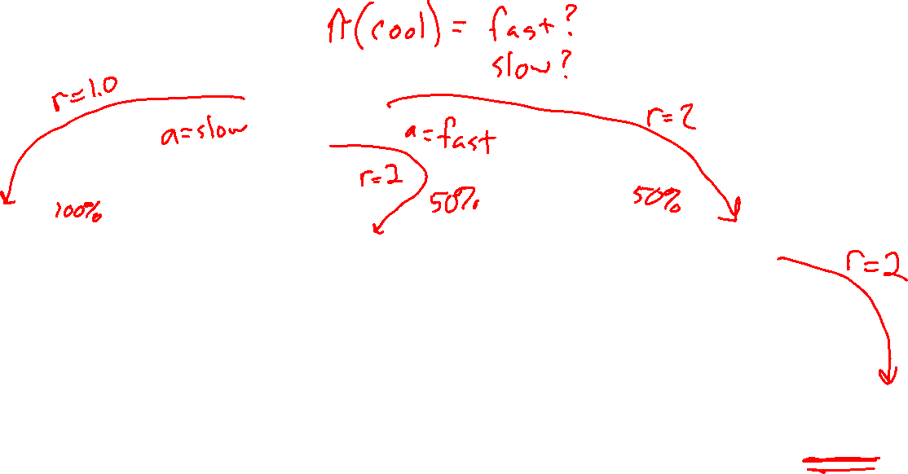
Racing Search Tree
Slide: ai.berkeley.edu

Slide 12



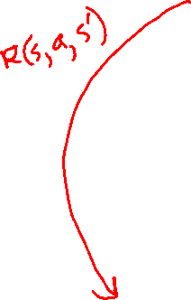
MDP Search Trees
Each MDP state projects an expectimax-like search tree
s
s is a state
a
(s, a) is a q-state
s, a
(s,a,s’) called a transition
T(s,a,s’) = P(s’|s,a)
R(s,a,s’)
s,a,s’
s’
Slide: ai.berkeley.edu
Notes:
In MDP chance node represents uncertainty about what might happen based on (s,a) [as opposed to being a random adversary]
Q-state (s,a) is when you were in a state and took an action

Slide 13
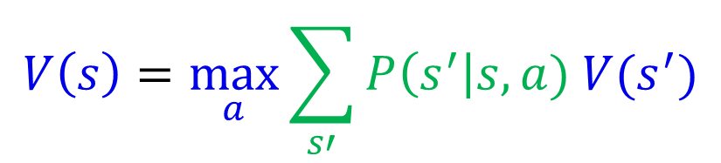

Recursive Expectimax
$$V\left(s\right)=\max_{a}{\sum_{s′}{P\left(s^{′}\right|s,a) V(s^{′})}}$$
s
a
s, a
s,a,s’
s’

Slide 14
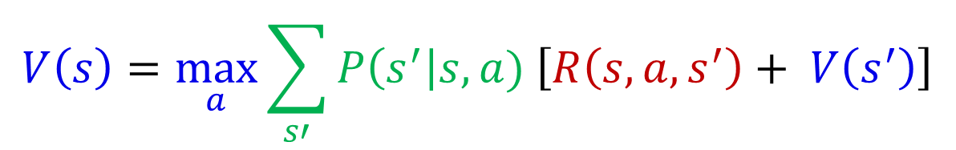
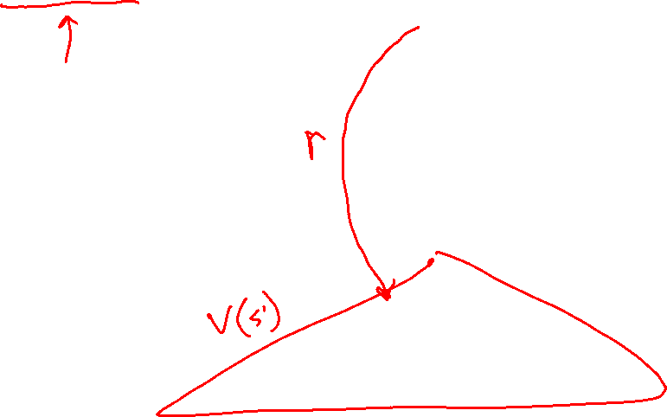
Recursive Expectimax
$$V\left(s\right)=\max_{a}{\sum_{s′}{P\left(s^{′}\right|s,a) \left[R\left(s, a, s^{′}\right)+ V\left(s^{′}\right)\right]}}$$
s
a
s, a
s,a,s’
s’

Slide 15
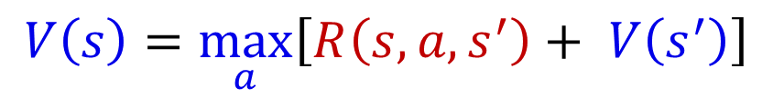
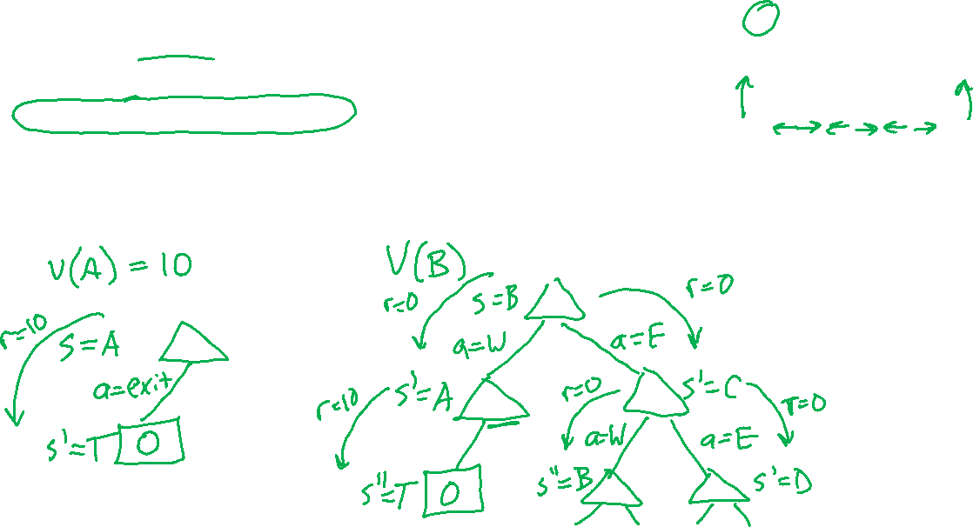
Simple Deterministic Example
T (Terminal)
R(A, Exit, T) = 10
R(A, Exit, T) = 1
  Actions: B, C, D: East, West
  Actions: A, E: Exit
  Transitions: deterministic
  Rewards only for transitioning to terminal state
A | B | C | D | E
$$V\left(s\right)=\max_{a}\left[R\left(s, a, s^{′}\right)+ V\left(s^{′}\right)\right]$$

Slide 16
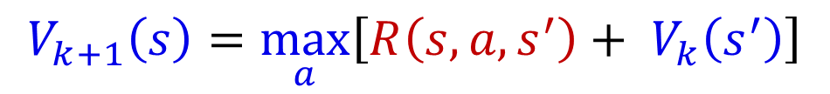
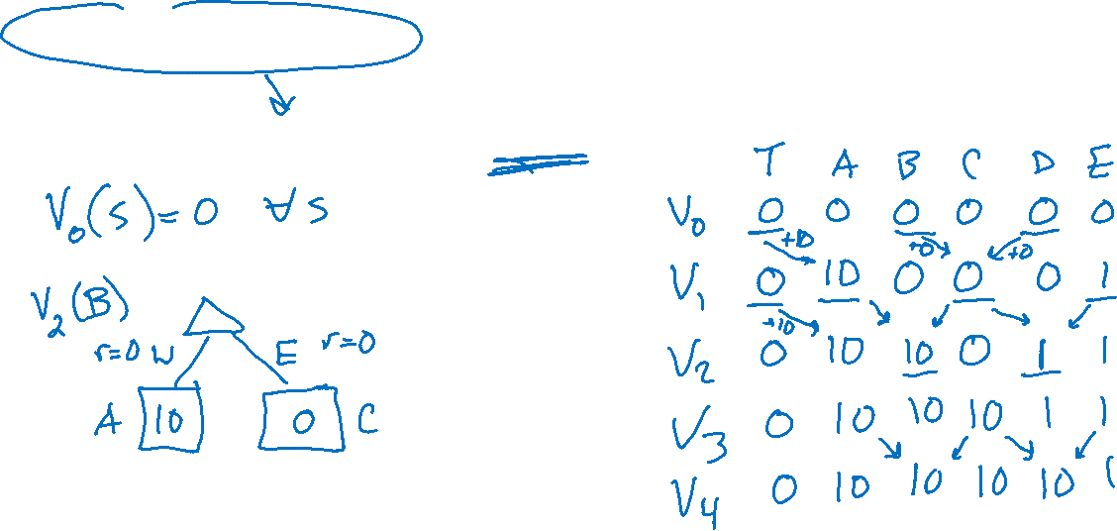
Simple Deterministic Example
T (Terminal)
R(A, Exit, T) = 10
R(A, Exit, T) = 1
  Actions: B, C, D: East, West
  Actions: A, E: Exit
  Transitions: deterministic
  Rewards only for transitioning to terminal state
A | B | C | D | E
$$V_{k+1}\left(s\right)=\max_{a}\left[R\left(s, a, s^{′}\right)+ V_{k}\left(s^{′}\right)\right]$$

Slide 17

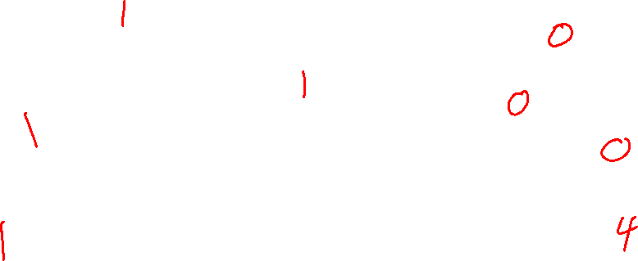
Utilities of Sequences
Slide: ai.berkeley.edu

Slide 18

Utilities of Sequences
What preferences should an agent have over reward sequences?
More or less?
Now or later?
[1, 2, 2]
or
[2, 3, 4]
[0, 0, 1]
or
[1, 0, 0]
Slide: ai.berkeley.edu

Slide 19




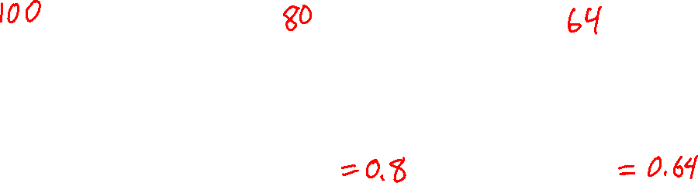
Discounting
It’s reasonable to maximize the sum of rewards
It’s also reasonable to prefer rewards now to rewards later
One solution: values of rewards decay exponentially
Worth Now
Worth Next Step
Worth In Two Steps
Slide: ai.berkeley.edu

Slide 20

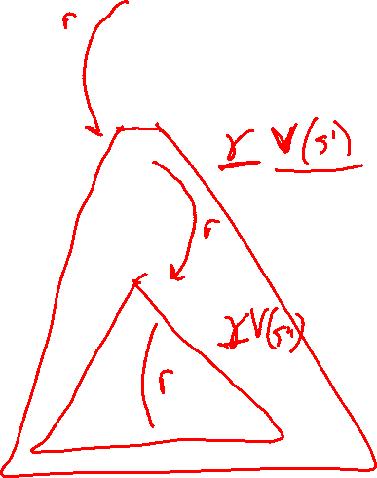
Discounting
How to discount?
  Each time we descend a level, we multiply in the discount once
Why discount?
  Sooner rewards probably do have higher utility than later rewards
  Also helps our algorithms converge
Slide: ai.berkeley.edu
Notes:
Rewards in the future (deeper in the tree) matter less
Interesting: running expectimax, if having to truncate the search, then not losing much; e.g., less then \gamma^d / (1-\gamma)

Slide 21
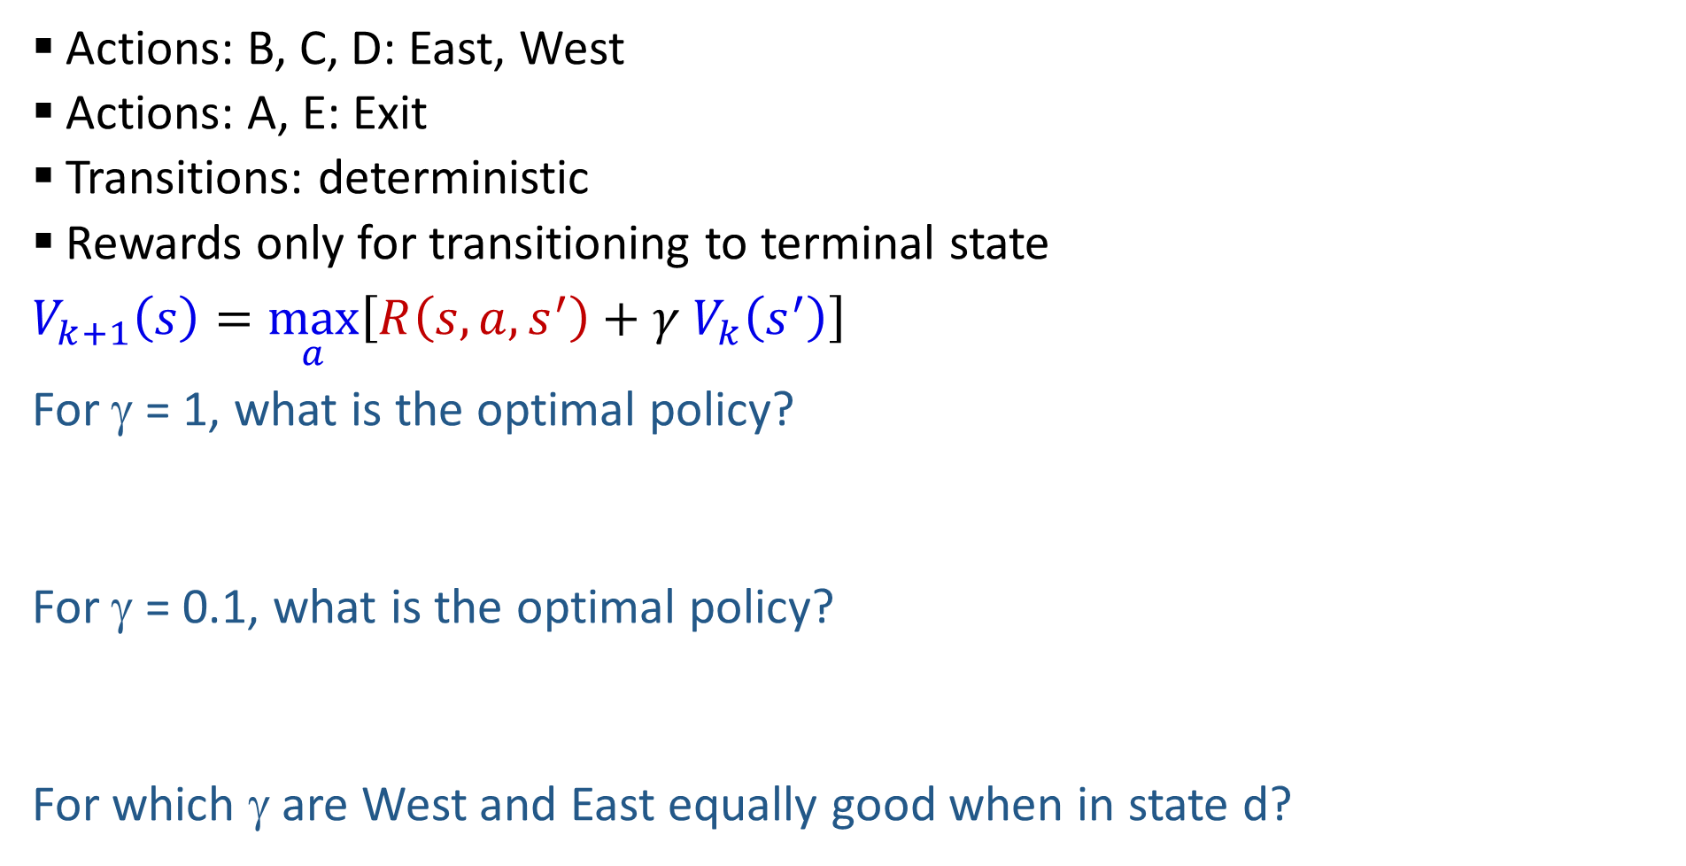
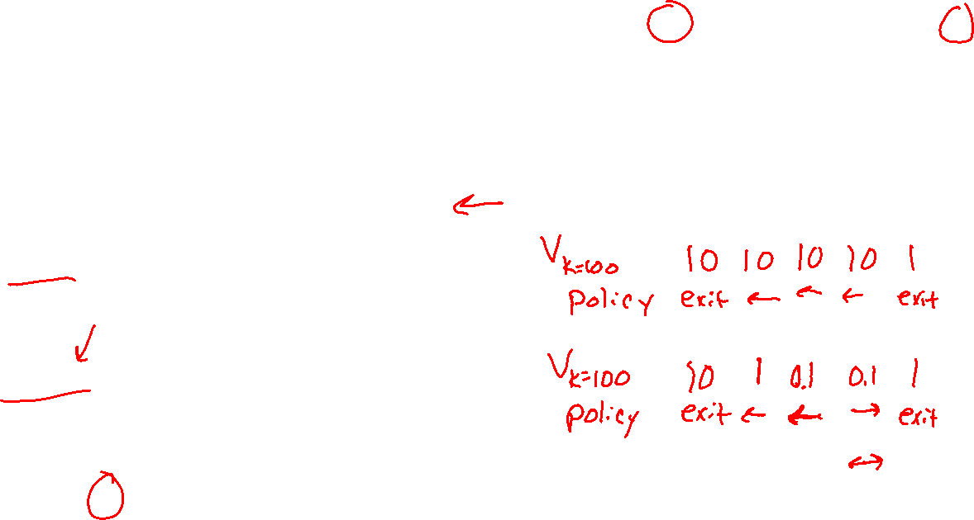
Discounting
T (Terminal)
R(A, Exit, T) = 10
R(A, Exit, T) = 1
  Actions: B, C, D: East, West
  Actions: A, E: Exit
  Transitions: deterministic
  Rewards only for transitioning to terminal state
$V_{k+1}\left(s\right)=\max_{a}\left[R\left(s, a, s^{′}\right)+γ V_{k}\left(s^{′}\right)\right]$
For γ = 1, what is the optimal policy?
For γ = 0.1, what is the optimal policy?
For which γ are West and East equally good when in state d?
A | B | C | D | E
Slide: ai.berkeley.edu

Slide 22

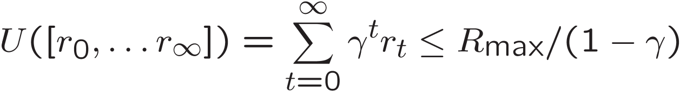
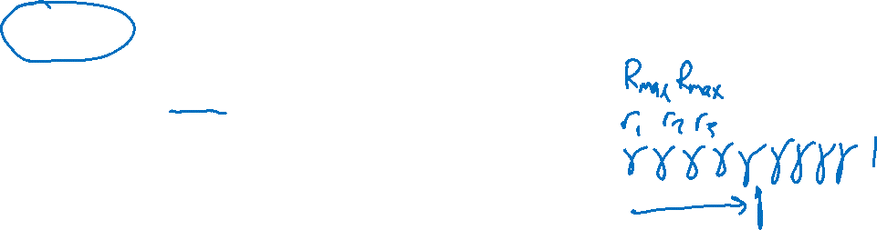
Infinite Utilities?!
Problem: What if the game lasts forever? Do we get infinite rewards?
Solutions:
  Finite horizon: (similar to depth-limited search)
    Terminate episodes after a fixed T steps (e.g. life)
    Gives nonstationary policies (π depends on time left)
  Discounting: use 0 < γ < 1
    Smaller γ means smaller “horizon” – shorter term focus
  Absorbing state: guarantee that for every policy, a terminal state will eventually be reached (like “overheated” for racing)
Slide: ai.berkeley.edu

Slide 23
Solving MDPs
Slide: ai.berkeley.edu

Slide 24

Value Iteration
Slide: ai.berkeley.edu

Slide 25
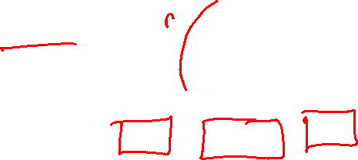
Value Iteration
Start with V₀(s) = 0: no time steps left means an expected reward sum of zero
Given vector of V_{k}(s) values, do one ply of expectimax from each state:
Repeat until convergence
V_{k+1}(s)
a
s, a
s,a,s’
V_{k}(s’)
Slide: ai.berkeley.edu
Notes:
Discuss computational complexity: S * A * S times number of iterations
Note: updates not in place [if in place, it means something else and not even clear what it means]

Slide 26

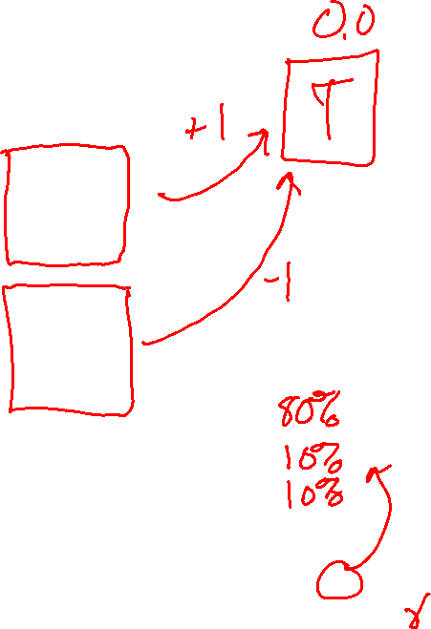
k=0
Noise = 0.2
Discount = 0.9
Living reward = 0
Slide: ai.berkeley.edu
Notes:
Assuming zero living reward

Slide 27

k=1
Noise = 0.2
Discount = 0.9
Living reward = 0
Slide: ai.berkeley.edu
Notes:
Assuming zero living reward

Slide 28

k=2
Noise = 0.2
Discount = 0.9
Living reward = 0
Slide: ai.berkeley.edu
Notes:
Assuming zero living reward

Slide 29

k=3
Noise = 0.2
Discount = 0.9
Living reward = 0
Slide: ai.berkeley.edu
Notes:
Assuming zero living reward

Slide 30

k=4
Noise = 0.2
Discount = 0.9
Living reward = 0
Slide: ai.berkeley.edu
Notes:
Assuming zero living reward

Slide 31

k=5
Noise = 0.2
Discount = 0.9
Living reward = 0
Slide: ai.berkeley.edu
Notes:
Assuming zero living reward

Slide 32

k=6
Noise = 0.2
Discount = 0.9
Living reward = 0
Slide: ai.berkeley.edu
Notes:
Assuming zero living reward

Slide 33

k=7
Noise = 0.2
Discount = 0.9
Living reward = 0
Slide: ai.berkeley.edu
Notes:
Assuming zero living reward

Slide 34

k=8
Noise = 0.2
Discount = 0.9
Living reward = 0
Slide: ai.berkeley.edu
Notes:
Assuming zero living reward

Slide 35

k=9
Noise = 0.2
Discount = 0.9
Living reward = 0
Slide: ai.berkeley.edu
Notes:
Assuming zero living reward

Slide 36

k=10
Noise = 0.2
Discount = 0.9
Living reward = 0
Slide: ai.berkeley.edu
Notes:
Assuming zero living reward

Slide 37

k=11
Noise = 0.2
Discount = 0.9
Living reward = 0
Slide: ai.berkeley.edu
Notes:
Assuming zero living reward

Slide 38

k=12
Noise = 0.2
Discount = 0.9
Living reward = 0
Slide: ai.berkeley.edu
Notes:
Assuming zero living reward

Slide 39

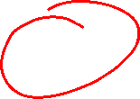
k=100
Noise = 0.2
Discount = 0.9
Living reward = 0
Slide: ai.berkeley.edu
Notes:
Assuming zero living reward

Slide 40
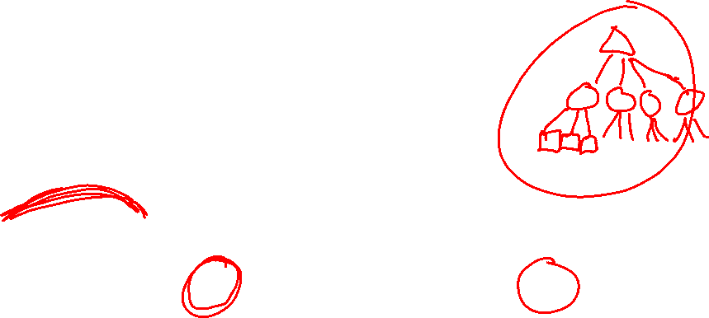
Exercise
As we moved from k=1 to k=2 to k=3, how did we get these specific values for s=(2,2)?
0
1
2
3
2
1
0

Slide 41













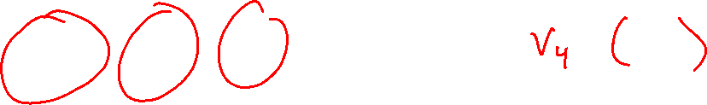
Racing Tree Example
Slide: ai.berkeley.edu

Slide 42

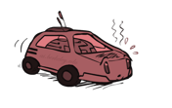

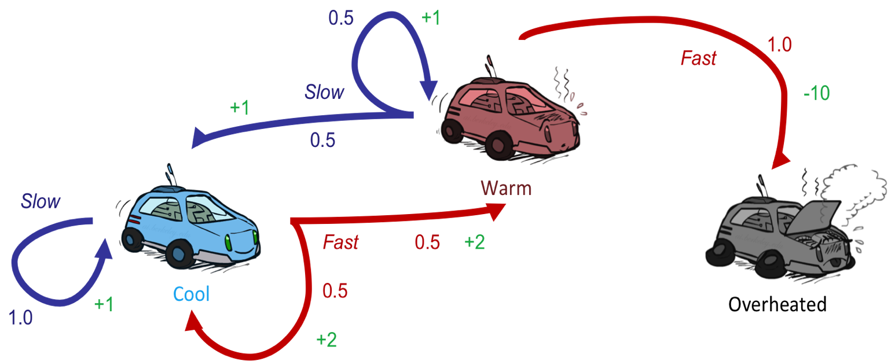




Example: Value Iteration
0.5
1.0
Fast
(R=-10)
Slow (R=1)
0.5
3.5 2.5 0
Slow (R=1)
Fast
(R=2)
0.5
2 1 0
1.0
0.5
Assume no discount! $γ=1$
0 0 0
Slide: ai.berkeley.edu

Slide 43


Convergence
How do we know the V_{k} vectors are going to converge?
Case 1: If the tree has maximum depth M, then V_{M} holds the actual untruncated values
Case 2: If the discount is less than 1
  Sketch: For any state V_{k} and V_{k+1} can be viewed as depth k+1 expectimax results in nearly identical search trees
  The difference is that on the bottom layer, V_{k+1} has actual rewards while V_{k} has zeros
  That last layer is at best all R_{MAX}
  It is at worst R_{MIN}
  But everything is discounted by γ^{k} that far out
  So V_{k} and V_{k+1} are at most γ^{k} max|R| different
  So as k increases, the values converge
Slide: ai.berkeley.edu

Slide 44
Value Iteration
Start with V₀(s) = 0: no time steps left means an expected reward sum of zero
Given vector of V_{k}(s) values, do one ply of expectimax from each state:
Repeat until convergence
V_{k+1}(s)
a
s, a
s,a,s’
V_{k}(s’)
Slide: ai.berkeley.edu
Notes:
Discuss computational complexity: S * A * S times number of iterations
Note: updates not in place [if in place, it means something else and not even clear what it means]

Slide 45
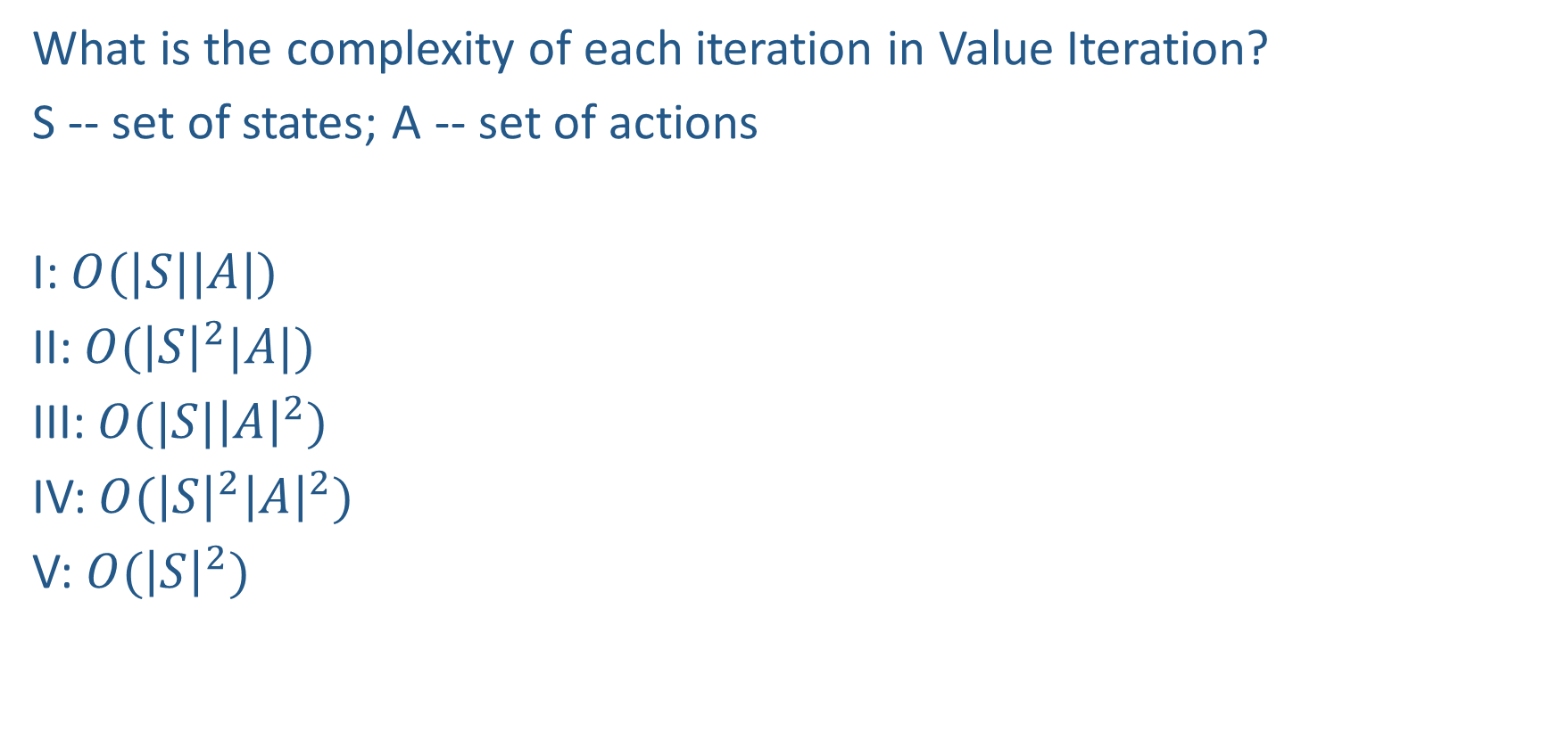
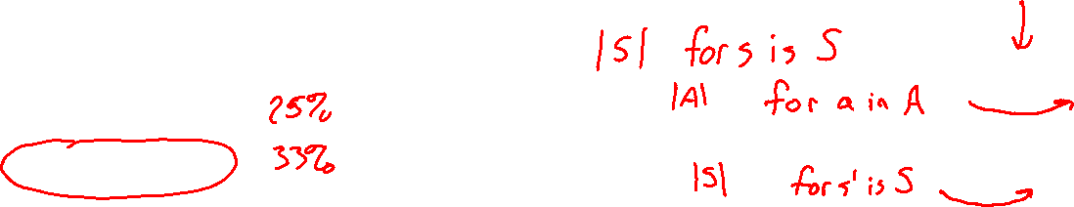
Piazza Poll 1
What is the complexity of each iteration in Value Iteration?
S -- set of states; A -- set of actions
I: $O(|S||A|)$
II: $O({\left|S\right|}^{2}|A|)$
III: $O(|S|{\left|A\right|}^{2})$
IV: $O({\left|S\right|}^{2}{\left|A\right|}^{2})$
V: $O({\left|S\right|}^{2})$
V_{k+1}(s)
a
s, a
s,a,s’
V_{k}(s’)

Slide 46
Piazza Poll 1
What is the complexity of each iteration in Value Iteration?
S -- set of states; A -- set of actions
I: $O(|S||A|)$
II: $O({\left|S\right|}^{2}|A|)$
III: $O(|S|{\left|A\right|}^{2})$
IV: $O({\left|S\right|}^{2}{\left|A\right|}^{2})$
V: $O({\left|S\right|}^{2})$
V_{k+1}(s)
a
s, a
s,a,s’
V_{k}(s’)

Slide 47

Value Iteration
Start with V₀(s) = 0: no time steps left means an expected reward sum of zero
Given vector of V_{k}(s) values, do one ply of expectimax from each state:
Repeat until convergence
Complexity of each iteration: O(S²A)
Theorem: will converge to unique optimal values
  Basic idea: approximations get refined towards optimal values
  Policy may converge long before values do
V_{k+1}(s)
a
s, a
s,a,s’
V_{k}(s’)
Slide: ai.berkeley.edu
Notes:
Discuss computational complexity: S * A * S times number of iterations
Note: updates not in place [if in place, it means something else and not even clear what it means]

Slide 48
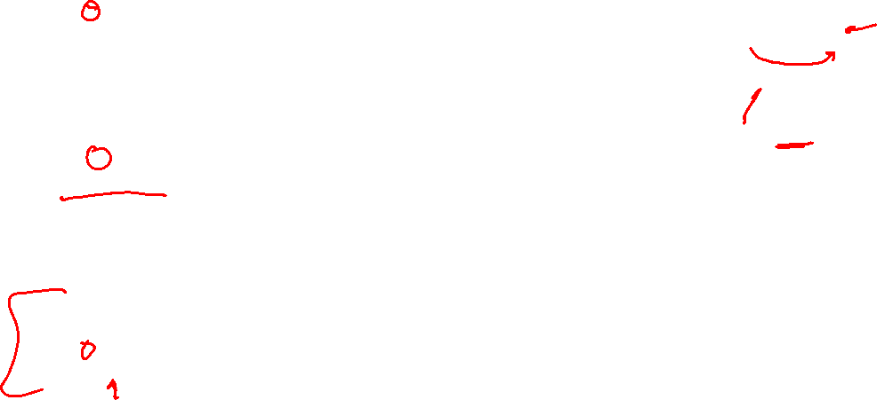
Optimal Quantities
The value (utility) of a state s:
  V*(s) = expected utility starting in s and acting optimally
The value (utility) of a q-state (s,a):
  Q*(s,a) = expected utility starting out having taken action a from state s and (thereafter) acting optimally
The optimal policy:
  π*(s) = optimal action from state s
s
s is a state
a
(s, a) is a q-state
s, a
s,a,s’
(s,a,s’) is a
transition
s’
[Demo – gridworld values (L8D4)]
Notes:
[Note: this demo doesn’t show anything in action, just pops up V and Q values.]

Slide 49

Snapshot of Demo – Gridworld V Values
Noise = 0.2
Discount = 0.9
Living reward = 0
Slide: ai.berkeley.edu
Notes:
This demo doesn’t show anything in action, it just shows the V and Q values.

Slide 50

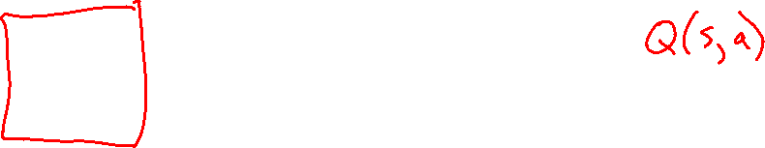
Snapshot of Demo – Gridworld Q Values
Noise = 0.2
Discount = 0.9
Living reward = 0
Slide: ai.berkeley.edu
Notes:
This demo doesn’t show anything in action, it just shows the V and Q values.

Slide 51


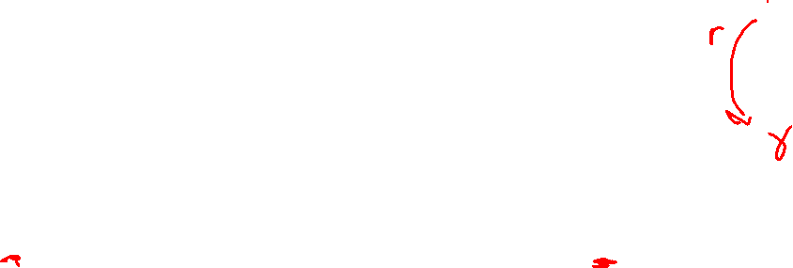
Values of States
Fundamental operation: compute the (expectimax) value of a state
  Expected utility under optimal action
  Average sum of (discounted) rewards
  This is just what expectimax computed!
Recursive definition of value:
s
a
s, a
s,a,s’
s’
Slide: ai.berkeley.edu

Slide 52

The Bellman Equations
How to be optimal:
Step 1: Take correct first action
Step 2: Keep being optimal
Slide: ai.berkeley.edu

Slide 53
The Bellman Equations
s
Definition of “optimal utility” via expectimax recurrence gives a simple one-step lookahead relationship amongst optimal utility values
a
s, a
s,a,s’
s’
Slide: ai.berkeley.edu
Notes:
Let’s start by equations that characterize these quantities through mutual recursions. [step through this by writing on slide, one step at a time]
Recursive characterization of V* in terms of V*; not necessarily helpful; but it is a characterization.
Note: this is a set of equations that needs to be satisfied; but it could have multiple solutions (it does not, but at this stage of our knowledge it could).

Slide 54

The Bellman Equations
s
Definition of “optimal utility” via expectimax recurrence gives a simple one-step lookahead relationship amongst optimal utility values
a
s, a
s,a,s’
s’
Slide: ai.berkeley.edu
Notes:
Let’s start by equations that characterize these quantities through mutual recursions. [step through this by writing on slide, one step at a time]
Recursive characterization of V* in terms of V*; not necessarily helpful; but it is a characterization.
Note: this is a set of equations that needs to be satisfied; but it could have multiple solutions (it does not, but at this stage of our knowledge it could).

Slide 55
The Bellman Equations
s
Definition of “optimal utility” via expectimax recurrence gives a simple one-step lookahead relationship amongst optimal utility values
a
s, a
s,a,s’
s’
Slide: ai.berkeley.edu
Notes:
Let’s start by equations that characterize these quantities through mutual recursions. [step through this by writing on slide, one step at a time]
Recursive characterization of V* in terms of V*; not necessarily helpful; but it is a characterization.
Note: this is a set of equations that needs to be satisfied; but it could have multiple solutions (it does not, but at this stage of our knowledge it could).

Slide 56
The Bellman Equations
s
Definition of “optimal utility” via expectimax recurrence gives a simple one-step lookahead relationship amongst optimal utility values
These are the Bellman equations, and they characterize optimal values in a way we’ll use over and over
a
s, a
s,a,s’
s’
Slide: ai.berkeley.edu
Notes:
Let’s start by equations that characterize these quantities through mutual recursions. [step through this by writing on slide, one step at a time]
Recursive characterization of V* in terms of V*; not necessarily helpful; but it is a characterization.
Note: this is a set of equations that needs to be satisfied; but it could have multiple solutions (it does not, but at this stage of our knowledge it could).

Slide 57
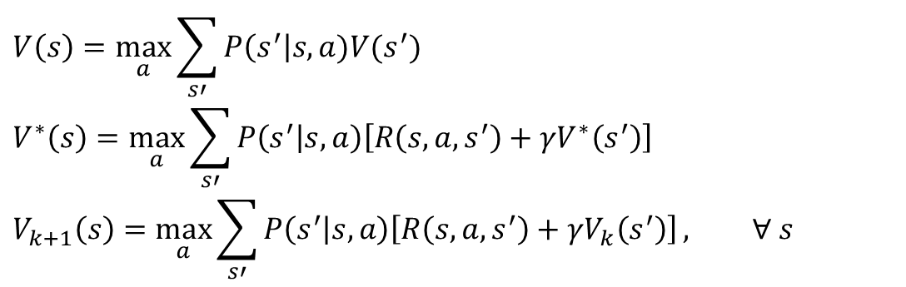
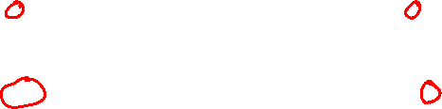
MDP Notation
$$V\left(s\right)=\max_{a}{\sum_{s′}{P\left(s^{′}\right|s,a)V(s^{′})}}$$
$$V^{∗}\left(s\right)=\max_{a}{\sum_{s′}{P\left(s^{′} | s,a\right)\left[R\left(s,a,s^{′}\right)+γV^{∗}\left(s^{′}\right)\right]}}$$
$$V_{k+1}\left(s\right)=\max_{a}{\sum_{s′}{P\left(s^{′} | s,a\right)\left[R\left(s,a,s^{′}\right)+γV_{k}\left(s^{′}\right)\right]}}, ∀ s$$
Standard expectimax:
Bellman equations:
Value iteration:

Slide 58
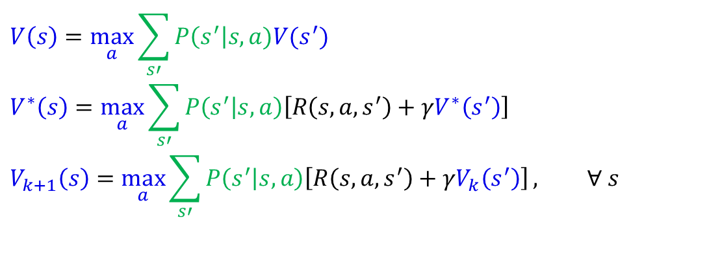
MDP Notation
$$V\left(s\right)=\max_{a}{\sum_{s′}{P\left(s^{′}\right|s,a)V(s^{′})}}$$
$$V^{∗}\left(s\right)=\max_{a}{\sum_{s′}{P\left(s^{′} | s,a\right)\left[R\left(s,a,s^{′}\right)+γV^{∗}\left(s^{′}\right)\right]}}$$
$$V_{k+1}\left(s\right)=\max_{a}{\sum_{s′}{P\left(s^{′} | s,a\right)\left[R\left(s,a,s^{′}\right)+γV_{k}\left(s^{′}\right)\right]}}, ∀ s$$
Standard expectimax:
Bellman equations:
Value iteration:

Slide 59
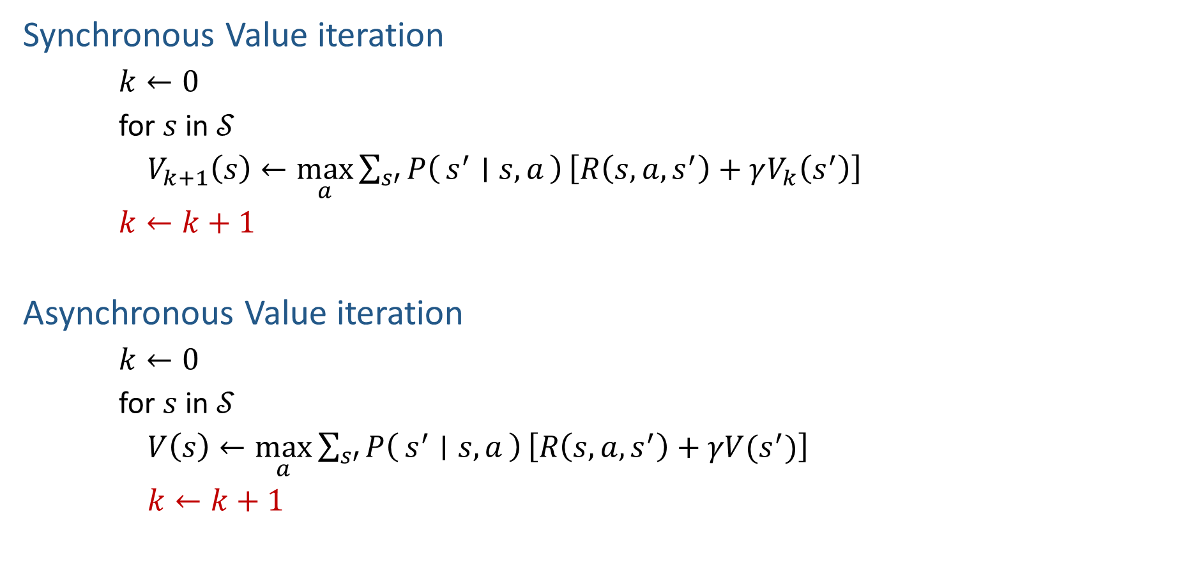
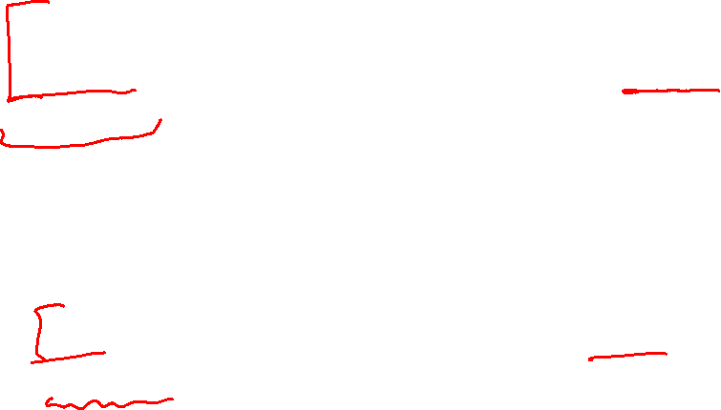
Synchronous vs Asynchronous Value Iteration
synchronous updates: compute all the fresh values of V(s) from all the stale values of V(s), then update V(s) with fresh values
Synchronous Value iteration
$k←0$
for $s$ in $𝒮$
$V_{k+1}\left(s\right)←\max_{a}\sum_{s′}{P\left(s^{′} ∣ s, a\right)}\left[R\left(s, a, s^{′}\right)+γV_{k}\left(s^{′}\right)\right]$
$k←k+1$
Asynchronous Value iteration
$k←0$
for $s$ in $𝒮$
$V\left(s\right)←\max_{a}\sum_{s′}{P\left(s^{′} ∣ s, a\right)}\left[R\left(s, a, s^{′}\right)+γV(s^{′})\right]$
$k←k+1$
asynchronous updates: compute and update V(s) for each state one at a time
Notes:
Discuss computational complexity: S * A * S times number of iterations
Note: updates not in place [if in place, it means something else and not even clear what it means]

Slide 60
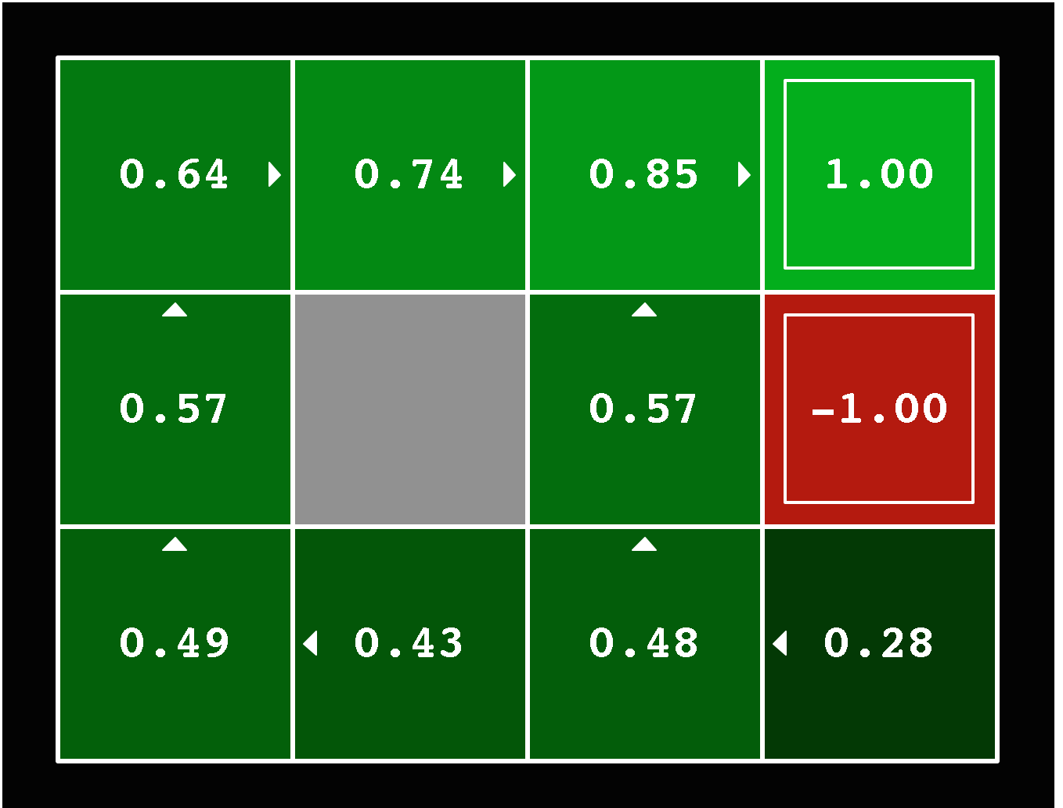
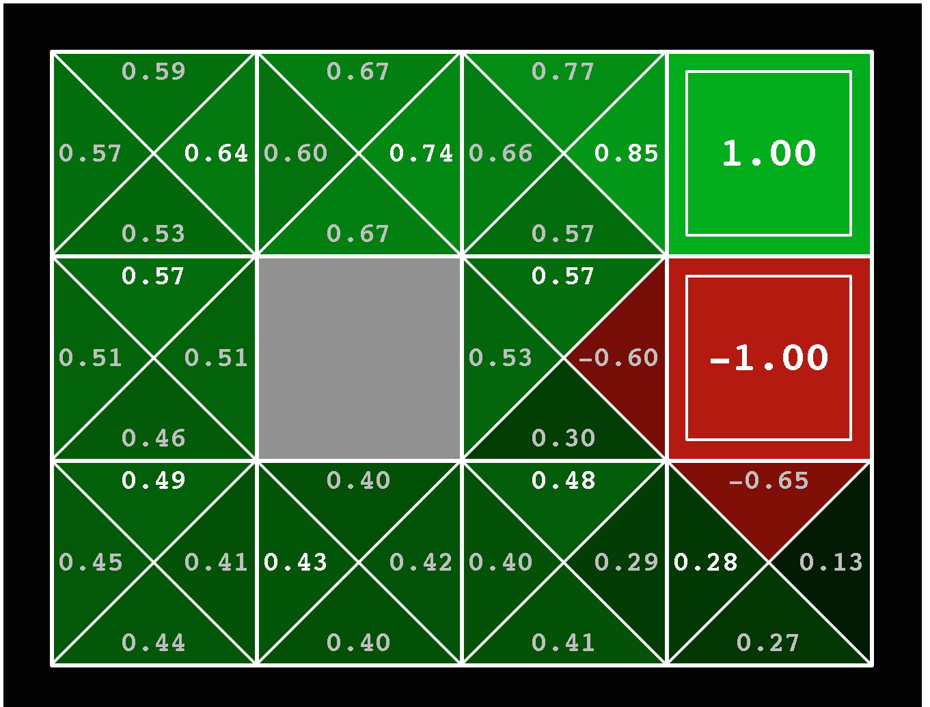


Solved MDP! Now what?
What are we going to do with these values??
$$V^{∗}\left(s\right)$$
$$Q^{∗}\left(s,a\right)$$

