Slide 1
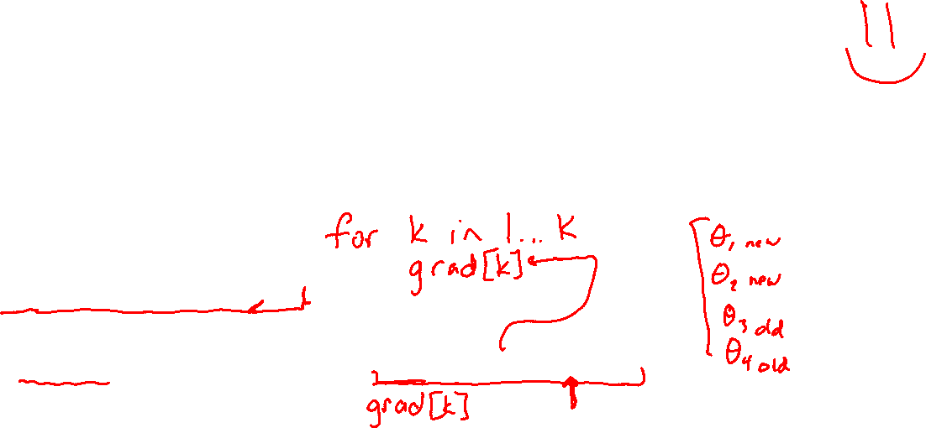
Warm-up as You Log In
In-Class Exercise:
Debug the following program which is (incorrectly) attempting to run SGD for multinomial logistic regression
Buggy Program:
while not converged:
for i in shuffle([1,…,N]):
for k in [1,…,K]:
theta[k] = theta[k] - gamma * grad(x[i], y[i], theta, k)
Assume: grad(x[i], y[i], theta, k) returns the gradient of the negative log-likelihood of the training example (x[i],y[i]) with respect to vector theta[k]. gamma is the learning rate. N = # of examples. K = # of output classes. M = # of features. theta is a K by M matrix.

Slide 2
Announcements
Assignments
HW4
Wed, 10/14, 11:59 pm
Midterm
Almost finished, grades will hopefully be out later today
Come talk to us if you’re not happy with how you are doing in the course

Slide 3
Plan
Today
Wrap-up multi-class logistic regression
Feature engineering
Make our linear methods more powerful!!
Regularization
Make sure they aren’t too powerful ☺

Slide 4
Wrap-up Logistic Regression
Logistic regression slides

Slide 5
Feedback Survey
See Piazza for link

Slide 6

Introduction to Machine Learning Feature Engineering and Regularization
Instructor: Pat Virtue

Slide 7
How Do We Deal with Real-world Problems
SPAM Classification

Slide 8
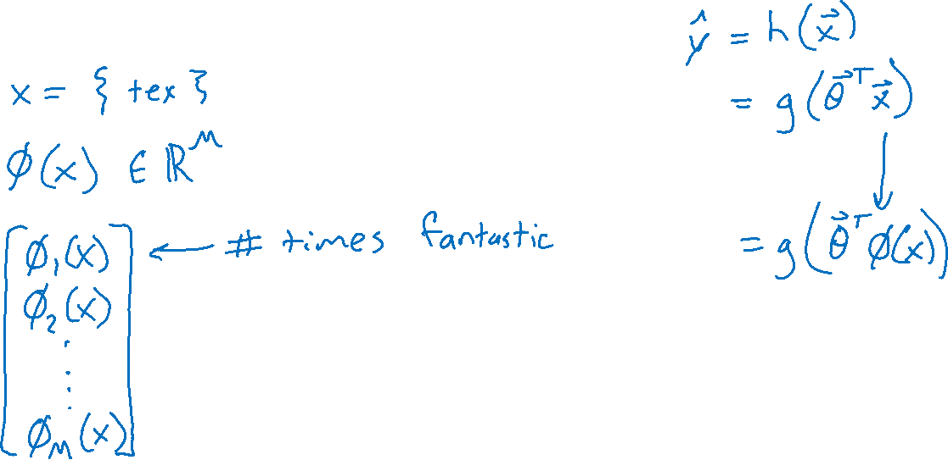
How Do We Deal with Real-world Problems
Predicting Rating from Written Movie Review

Slide 9
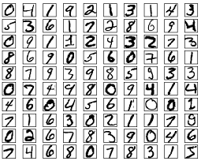
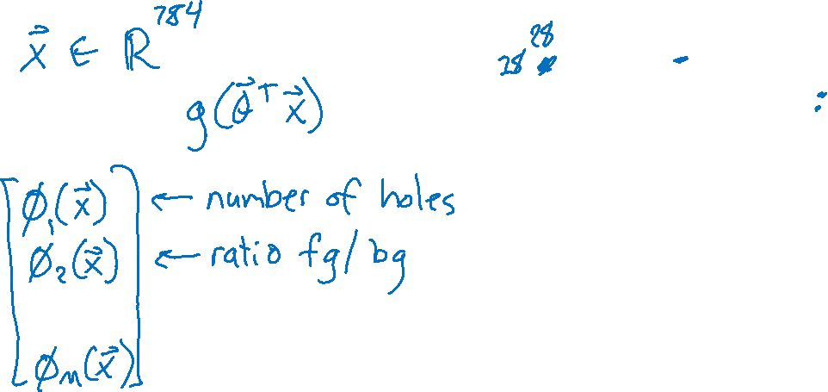
How Do We Deal with Real-world Problems
Images: Handwritten Digits

Slide 10
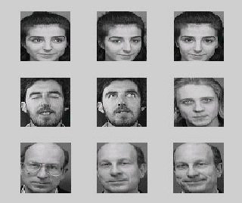

How Do We Deal with Real-world Problems
Images: Face Recognition

Slide 11
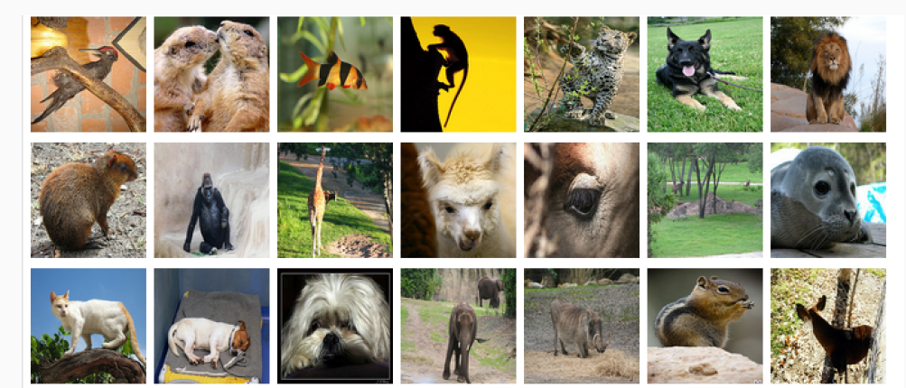
How Do We Deal with Real-world Problems
Images: Animal Classification
Image: ImageNet

Slide 12
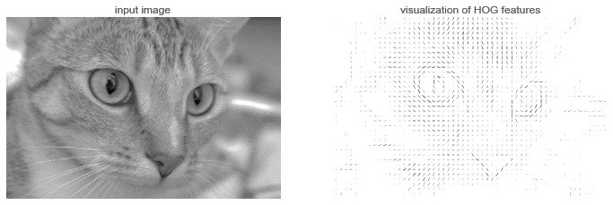
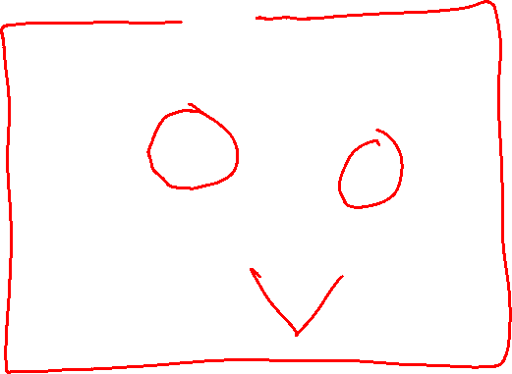
How Do We Deal with Real-world Problems
Images: Animal Classification
Image: https://jakevdp.github.io/PythonDataScienceHandbook/05.14-image-features.html

Slide 13
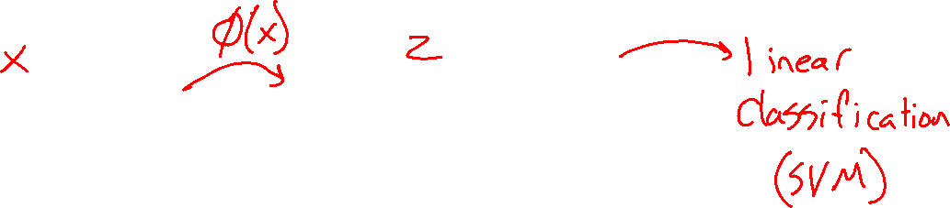
How Do We Deal with Real-world Problems
Preview: Neural Networks
Image: https://jakevdp.github.io/PythonDataScienceHandbook/05.14-image-features.html

Slide 14
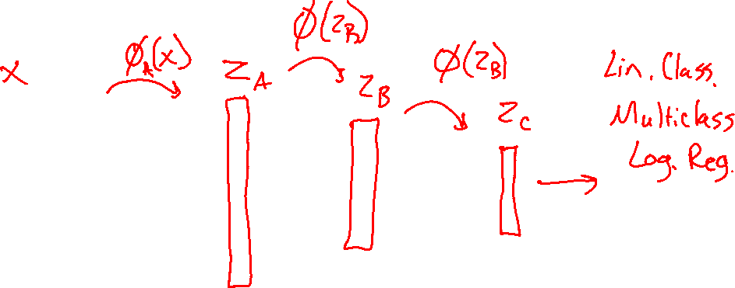
How Do We Deal with Real-world Problems
Preview: Neural Networks
Image: https://jakevdp.github.io/PythonDataScienceHandbook/05.14-image-features.html

Slide 15
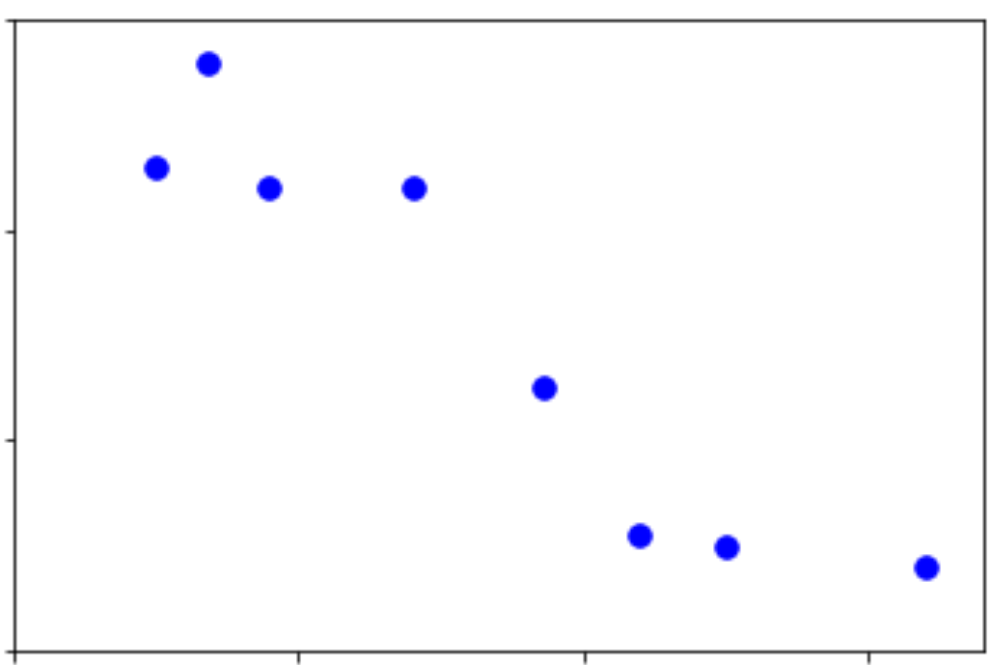
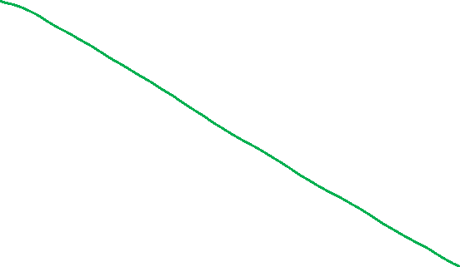
Linear Data
Regression on simple linear dataset
Output y
Input x

Slide 16
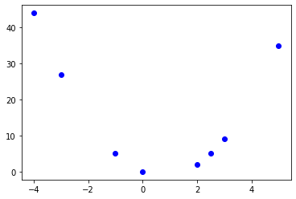
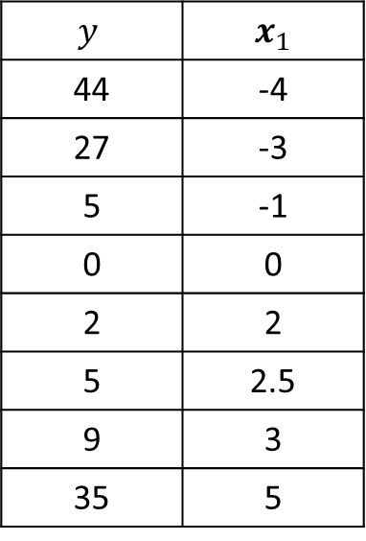
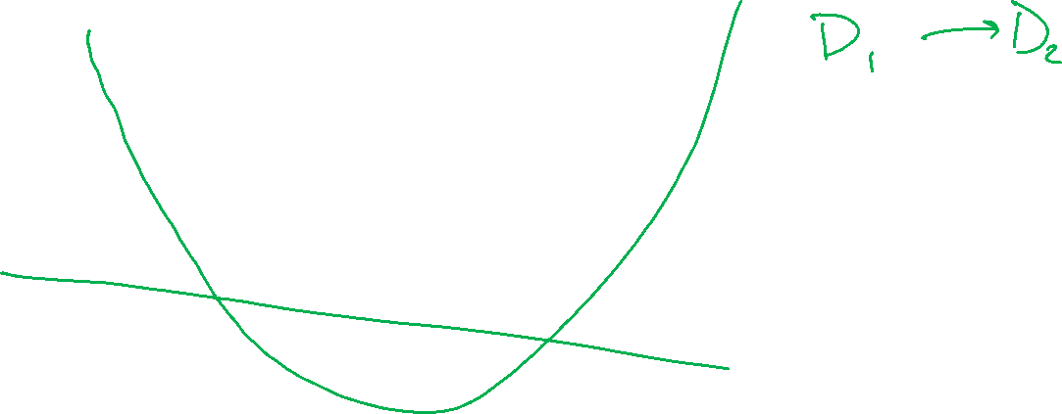
Non-linear Data
Linear regression on polynomial data?
$$y$$ | $x_{1}$
44 | -4
27 | -3
5 | -1
0 | 0
2 | 2
5 | 2.5
9 | 3
35 | 5
Output y
Input x

Slide 17
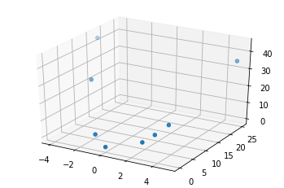
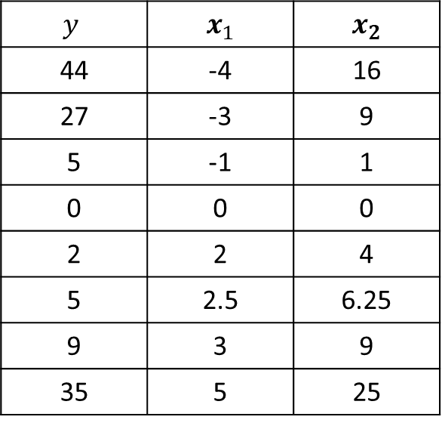
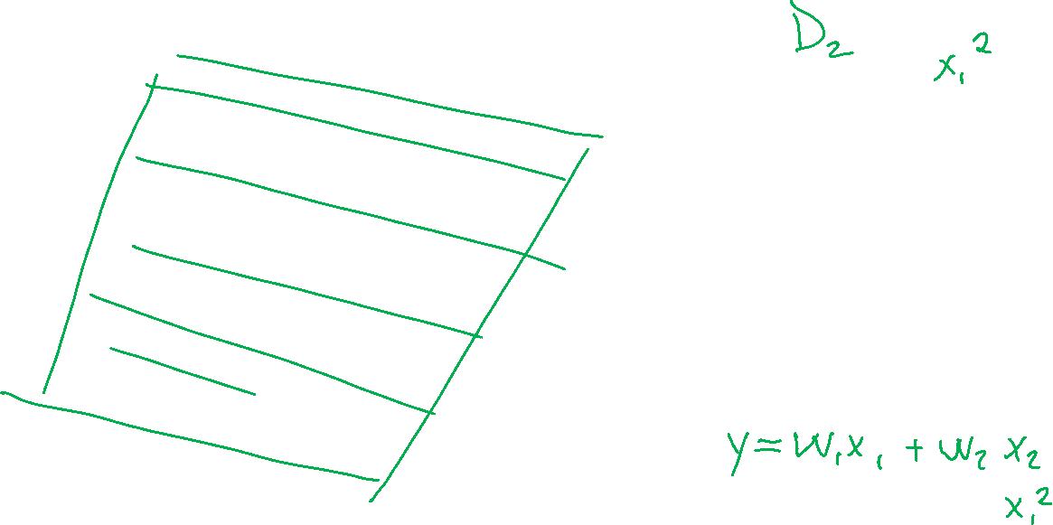
Non-linear Data
Regression on simple linear dataset
$$y$$ | $x_{1}$ | $x_{2}$
44 | -4 | 16
27 | -3 | 9
5 | -1 | 1
0 | 0 | 0
2 | 2 | 4
5 | 2.5 | 6.25
9 | 3 | 9
35 | 5 | 25

Slide 18
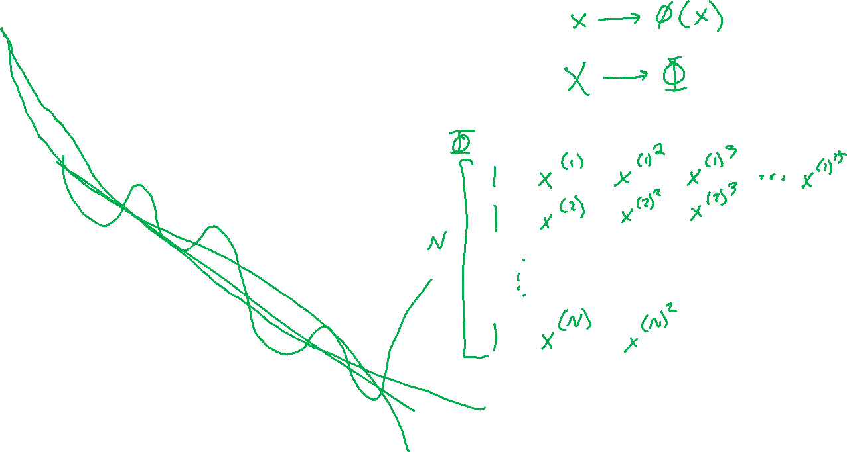
Non-linear Data
Polynomial feature map for linear regression
Output y
Input x

Slide 19
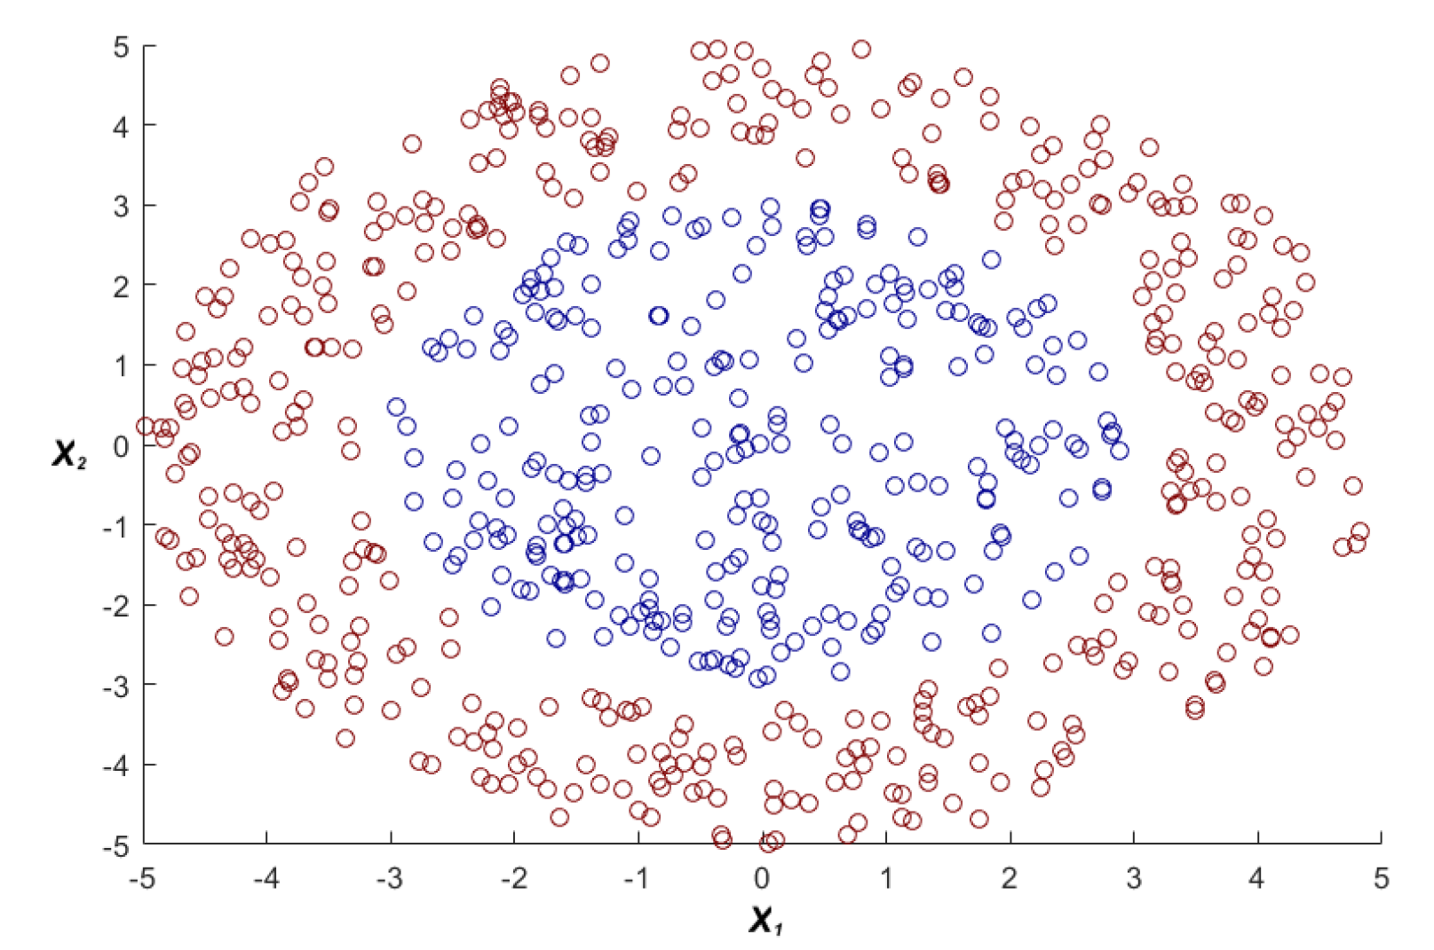
Non-linear Data
Polynomial feature map for linear classification
https://www.youtube.com/watch?v=3liCbRZPrZA

Slide 20
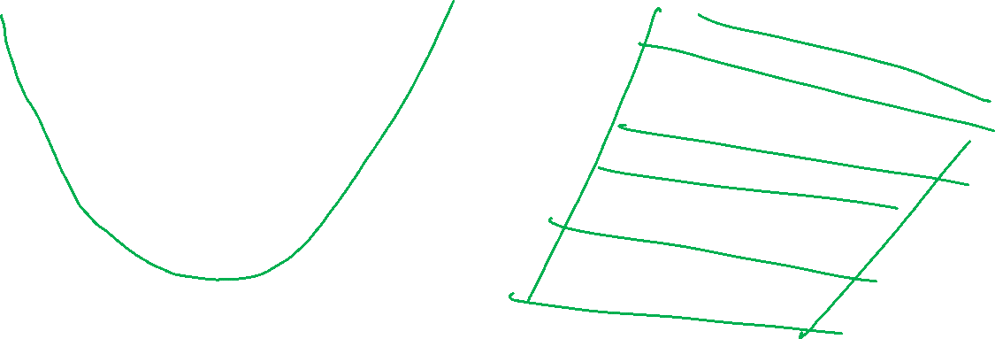
Feature Maps
Two ways to think about it

Slide 21
Example: Linear Regression
Goal: Learn y = w^{T} f(x) + b
where f(.) is a polynomial basis function
y | x
2.0 | 1.2
1.3 | 1.7
0.1 | 2.7
1.1 | 1.9
y
Slide credit: CMU MLD Matt Gormley
true “unknown” target function is linear with negative slope and gaussian noise
x

Slide 22
Example: Linear Regression
Goal: Learn y = w^{T} f(x) + b
where f(.) is a polynomial basis function
y | x
2.0 | 1.2
1.3 | 1.7
0.1 | 2.7
1.1 | 1.9
y
Slide credit: CMU MLD Matt Gormley
true “unknown” target function is linear with negative slope and gaussian noise
x

Slide 23
Example: Linear Regression
Goal: Learn y = w^{T} f(x) + b
where f(.) is a polynomial basis function
y | x | x²
2.0 | 1.2 | (1.2)²
1.3 | 1.7 | (1.7)²
0.1 | 2.7 | (2.7)²
1.1 | 1.9 | (1.9)²
y
Slide credit: CMU MLD Matt Gormley
true “unknown” target function is linear with negative slope and gaussian noise
x

Slide 24
Example: Linear Regression
Goal: Learn y = w^{T} f(x) + b
where f(.) is a polynomial basis function
y | x | x² | x³
2.0 | 1.2 | (1.2)² | (1.2)³
1.3 | 1.7 | (1.7)² | (1.7)³
0.1 | 2.7 | (2.7)² | (2.7)³
1.1 | 1.9 | (1.9)² | (1.9)³
y
Slide credit: CMU MLD Matt Gormley
true “unknown” target function is linear with negative slope and gaussian noise
x

Slide 25
Example: Linear Regression
Goal: Learn y = w^{T} f(x) + b
where f(.) is a polynomial basis function
y | x | x² | … | x⁵
2.0 | 1.2 | (1.2)² | … | (1.2)⁵
1.3 | 1.7 | (1.7)² | … | (1.7)⁵
0.1 | 2.7 | (2.7)² | … | (2.7)⁵
1.1 | 1.9 | (1.9)² | … | (1.9)⁵
y
Slide credit: CMU MLD Matt Gormley
true “unknown” target function is linear with negative slope and gaussian noise
x

Slide 26
Example: Linear Regression
Goal: Learn y = w^{T} f(x) + b
where f(.) is a polynomial basis function
y | x | x² | … | x⁸
2.0 | 1.2 | (1.2)² | … | (1.2)⁸
1.3 | 1.7 | (1.7)² | … | (1.7)⁸
0.1 | 2.7 | (2.7)² | … | (2.7)⁸
1.1 | 1.9 | (1.9)² | … | (1.9)⁸
y
Slide credit: CMU MLD Matt Gormley
true “unknown” target function is linear with negative slope and gaussian noise
x

Slide 27

Example: Linear Regression
Goal: Learn y = w^{T} f(x) + b
where f(.) is a polynomial basis function
y | x | x² | … | x⁹
2.0 | 1.2 | (1.2)² | … | (1.2)⁹
1.3 | 1.7 | (1.7)² | … | (1.7)⁹
0.1 | 2.7 | (2.7)² | … | (2.7)⁹
1.1 | 1.9 | (1.9)² | … | (1.9)⁹
y
Slide credit: CMU MLD Matt Gormley
true “unknown” target function is linear with negative slope and gaussian noise
x

Slide 28
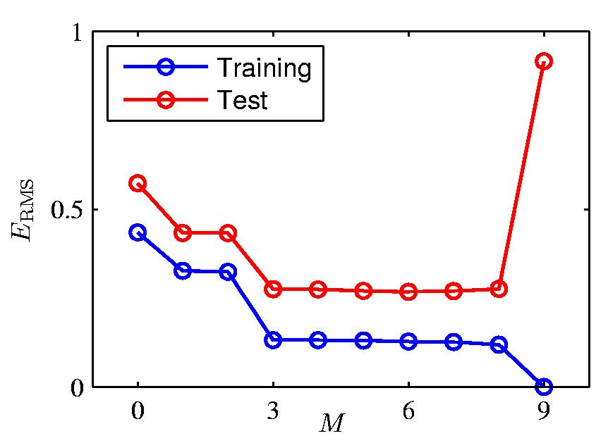

Over-fitting
Slide credit: CMU MLD William Cohen

Slide 29
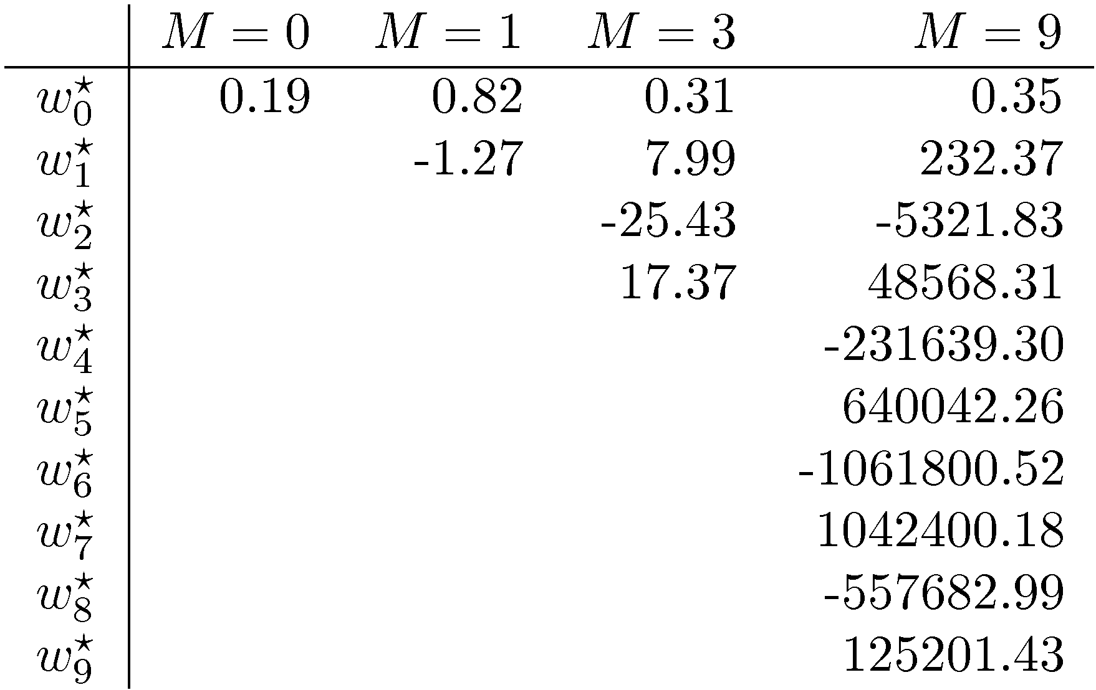

Polynomial Coefficients
Slide credit: CMU MLD William Cohen

Slide 30
Example: Linear Regression
With just N = 10 points we overfit!
But with N = 100 points, the overfitting (mostly) disappears
Takeaway: more data helps prevent overfitting
Goal: Learn y = w^{T} f(x) + b
where f(.) is a polynomial basis function
i | y | x | … | x⁹
1 | 2.0 | 1.2 | … | (1.2)⁹
2 | 1.3 | 1.7 | … | (1.7)⁹
… | … | … | … | …
10 | 1.1 | 1.9 | … | (1.9)⁹
y
Slide credit: CMU MLD Matt Gormley
x

Slide 31
Example: Linear Regression
With just N = 10 points we overfit!
But with N = 100 points, the overfitting (mostly) disappears
Takeaway: more data helps prevent overfitting
Goal: Learn y = w^{T} f(x) + b
where f(.) is a polynomial basis function
i | y | x | … | x⁹
1 | 2.0 | 1.2 | … | (1.2)⁹
2 | 1.3 | 1.7 | … | (1.7)⁹
3 | 0.1 | 2.7 | … | (2.7)⁹
4 | 1.1 | 1.9 | … | (1.9)⁹
… | … | … | … | …
… | … | … | … | …
… | … | … | … | …
98 | … | … | … | …
99 | … | … | … | …
100 | 0.9 | 1.5 | … | (1.5)⁹
y
Slide credit: CMU MLD Matt Gormley
true “unknown” target function is linear with negative slope and gaussian noise
x

Slide 32
Regularization

Slide 33
Overfitting
Definition: The problem of overfitting is when the model captures the noise in the training data instead of the underlying structure
Overfitting can occur in all the models we’ve seen so far:
Decision Trees (e.g. when tree is too deep)
KNN (e.g. when k is small)
Perceptron (e.g. when sample isn’t representative)
Linear Regression (e.g. with nonlinear features)
Logistic Regression (e.g. with many rare features)
Slide credit: CMU MLD Matt Gormley

Slide 34
Motivation: Regularization
Example: Stock Prices
Suppose we wish to predict Google’s stock price at time t+1
What features should we use? (putting all computational concerns aside)
Stock prices of all other stocks at times t, t-1, t-2, …, t - k
Mentions of Google with positive / negative sentiment words in all newspapers and social media outlets
Do we believe that all of these features are going to be useful?
Slide credit: CMU MLD Matt Gormley

Slide 35
Motivation: Regularization
Occam’s Razor: prefer the simplest hypothesis
What does it mean for a hypothesis (or model) to be simple?
small number of features (model selection)
small number of “important” features (shrinkage)
Slide credit: CMU MLD Matt Gormley

Slide 36
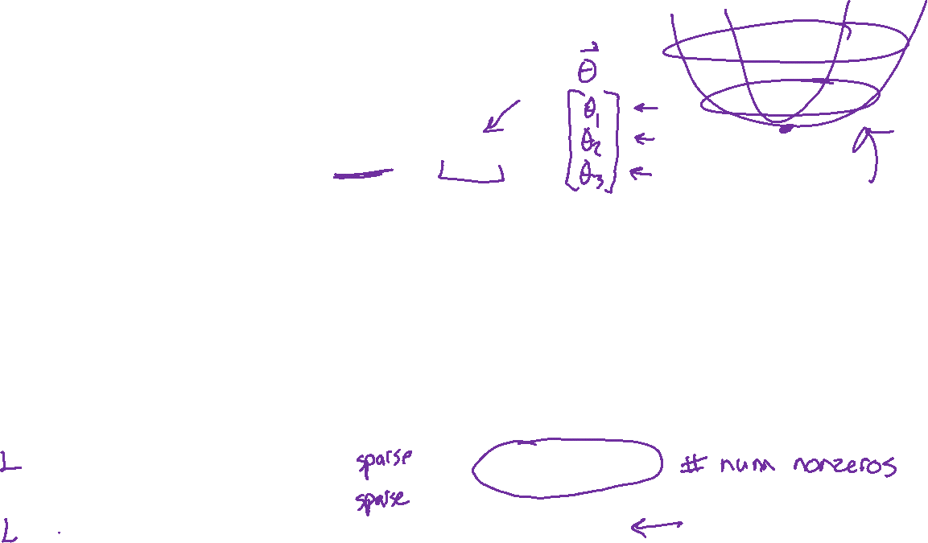
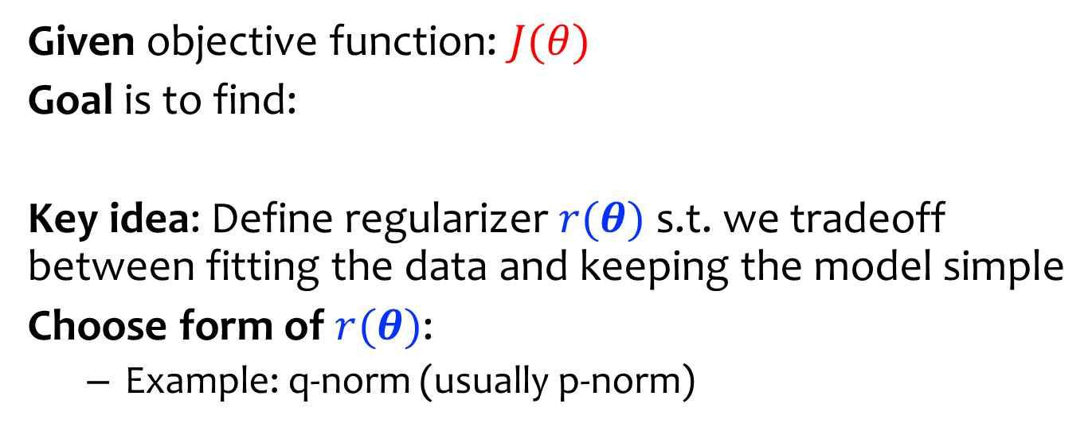
Regularization
Given objective function: $J(θ)$
Goal is to find:
Key idea: Define regularizer $r(θ)$ s.t. we tradeoff between fitting the data and keeping the model simple
Choose form of $r(θ)$:
Example: q-norm (usually p-norm)
Slide credit: CMU MLD Matt Gormley

Slide 37
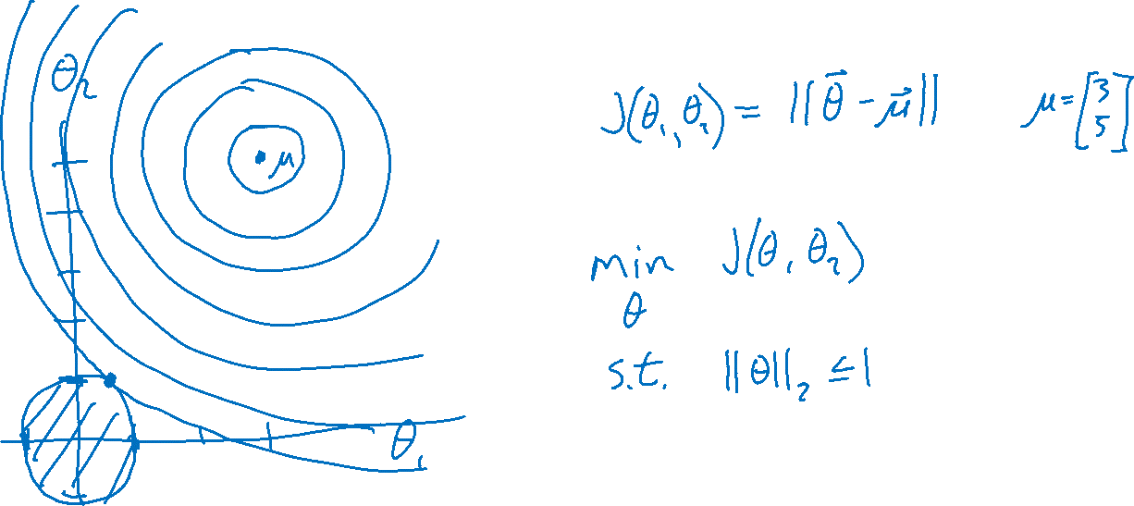
Regularization

Slide 38

Piazza Poll 1
Question:
Suppose we are minimizing J’(θ) where
As λ increases, the minimum of J’(θ) will…
…move towards the midpoint between J’(θ) and r(θ)
…move towards the minimum of J(θ)
…move towards the minimum of r(θ)
…move towards a theta vector of positive infinities
…move towards a theta vector of negative infinities
…stay the same
Slide credit: CMU MLD Matt Gormley

Slide 39
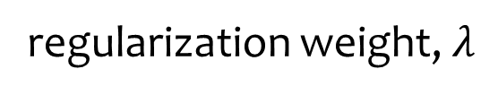
Regularization Exercise
In-class Exercise
Plot train error vs. regularization weight (cartoon)
Plot test error vs . regularization weight (cartoon)
error
Slide credit: CMU MLD Matt Gormley
regularization weight, $λ$

Slide 40
Piazza Poll 2
Question:
Suppose we are minimizing J’(θ) where
As we increase λ from 0, the the validation error will…
…increase
…decrease
…first increase, then decrease
…first decrease, then increase
…stay the same
Slide credit: CMU MLD Matt Gormley

Slide 41
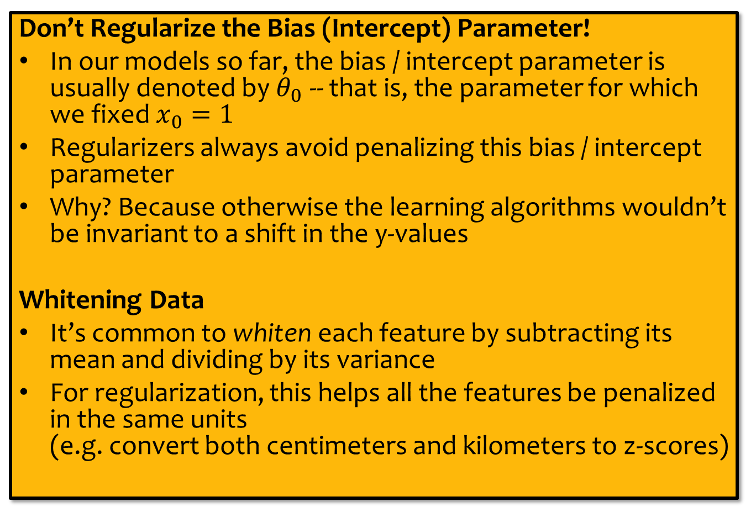
Regularization
Don’t Regularize the Bias (Intercept) Parameter!
In our models so far, the bias / intercept parameter is usually denoted by $θ_{0}$ -- that is, the parameter for which we fixed $x_{0}=1$
Regularizers always avoid penalizing this bias / intercept parameter
Why? Because otherwise the learning algorithms wouldn’t be invariant to a shift in the y-values
Whitening Data
It’s common to whiten each feature by subtracting its mean and dividing by its variance
For regularization, this helps all the features be penalized in the same units (e.g. convert both centimeters and kilometers to z-scores)
Slide credit: CMU MLD Matt Gormley

Slide 42
Example: Logistic Regression
For this example, we construct nonlinear features (i.e. feature engineering)
Specifically, we add polynomials up to order 9 of the two original features x₁ and x₂
Thus our classifier is linear in the high-dimensional feature space, but the decision boundary is nonlinear when visualized in low-dimensions (i.e. the original two dimensions)
Training Data
Test Data
Slide credit: CMU MLD Matt Gormley

Slide 43
Example: Logistic Regression
error
lambda
Slide credit: CMU MLD Matt Gormley

Slide 44
Example: Logistic Regression
Slide credit: CMU MLD Matt Gormley

Slide 45
Example: Logistic Regression
Slide credit: CMU MLD Matt Gormley

Slide 46
Example: Logistic Regression
Slide credit: CMU MLD Matt Gormley

Slide 47
Example: Logistic Regression
Slide credit: CMU MLD Matt Gormley

Slide 48
Example: Logistic Regression
Slide credit: CMU MLD Matt Gormley

Slide 49
Example: Logistic Regression
Slide credit: CMU MLD Matt Gormley

Slide 50
Example: Logistic Regression
Slide credit: CMU MLD Matt Gormley

Slide 51
Example: Logistic Regression
Slide credit: CMU MLD Matt Gormley

Slide 52
Example: Logistic Regression
Slide credit: CMU MLD Matt Gormley

Slide 53
Example: Logistic Regression
Slide credit: CMU MLD Matt Gormley

Slide 54
Example: Logistic Regression
Slide credit: CMU MLD Matt Gormley

Slide 55
Example: Logistic Regression
Slide credit: CMU MLD Matt Gormley

Slide 56
Example: Logistic Regression
Slide credit: CMU MLD Matt Gormley

Slide 57
Example: Logistic Regression
error
lambda
Slide credit: CMU MLD Matt Gormley

Slide 58
Regularization
Given objective function: $J(θ)$
Goal is to find:
Key idea: Define regularizer $r(θ)$ s.t. we tradeoff between fitting the data and keeping the model simple
Choose form of $r(θ)$:
Example: q-norm (usually p-norm)
Slide credit: CMU MLD Matt Gormley

Slide 59
Regularization

Slide 60
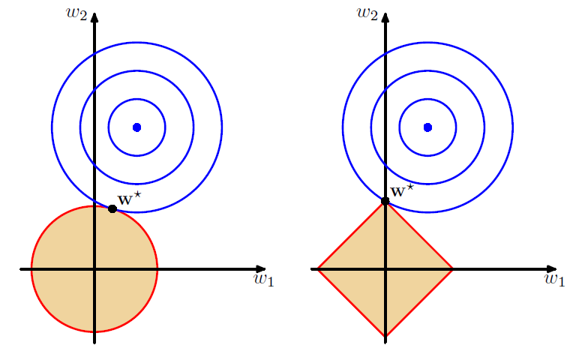
L2 vs L1 Regularization
Combine original objective with penalty on parameters
Figures: Bishop, Ch 3.1.4

Slide 61
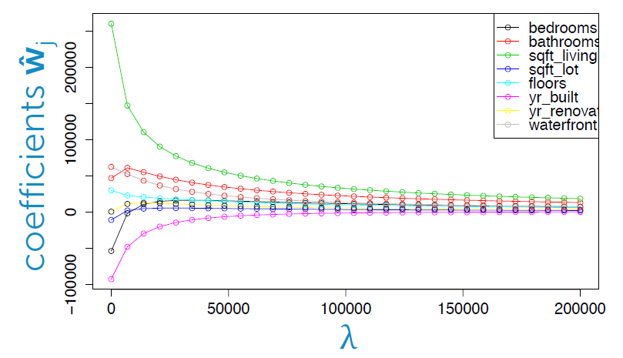
L2 vs L1: Housing Price Example
Predict housing price from several features
Figure: Emily Fox, University of Washington

Slide 62
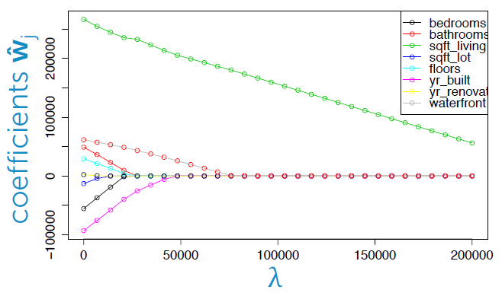
L2 vs L1: Housing Price Example
Predict housing price from several features
Figure: Emily Fox, University of Washington

Slide 63
Regularization as MAP
L1 and L2 regularization can be interpreted as maximum a-posteriori (MAP) estimation of the parameters
To be discussed later in the course…
Slide credit: CMU MLD Matt Gormley

Slide 64
Takeaways
Nonlinear basis functions allow linear models (e.g. Linear Regression, Logistic Regression) to capture nonlinear aspects of the original input
Nonlinear features are require no changes to the model (i.e. just preprocessing)
Regularization helps to avoid overfitting
Regularization and MAP estimation are equivalent for appropriately chosen priors
Slide credit: CMU MLD Matt Gormley

Slide 65
Feature Engineering / Regularization Objectives
You should be able to…
Engineer appropriate features for a new task
Use feature selection techniques to identify and remove irrelevant features
Identify when a model is overfitting
Add a regularizer to an existing objective in order to combat overfitting
Convert linearly inseparable dataset to a linearly separable dataset in higher dimensions
Describe feature engineering in common application areas

