Slide 1

10-315 Introduction to ML Logistic Regression
Instructor: Pat Virtue

Slide 2
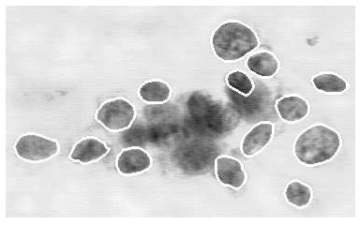

Example: Breast cancer classification
Well-known classification example: using machine learning to diagnose whether a breast tumor is benign or malignant [Street et al., 1992]
Setting: doctor extracts a sample of fluid from tumor, stains cells, then outlines several of the cells (image processing refines outline)
System computes features for each cell such as area, perimeter, concavity, texture (10 total); computes mean/std/max for all features
Slide credit: CMU AI Zico Kolter

Slide 3
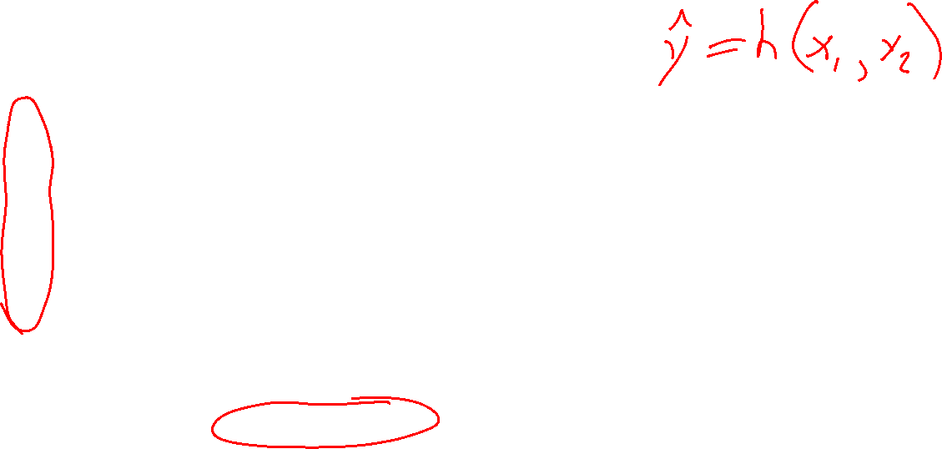
Example: Breast cancer classification
Plot of two features: mean area vs. mean concave points, for two classes
Slide credit: CMU AI Zico Kolter

Slide 4
Linear classification example
Linear classification: linear decision boundary
Slide credit: CMU AI Zico Kolter

Slide 5
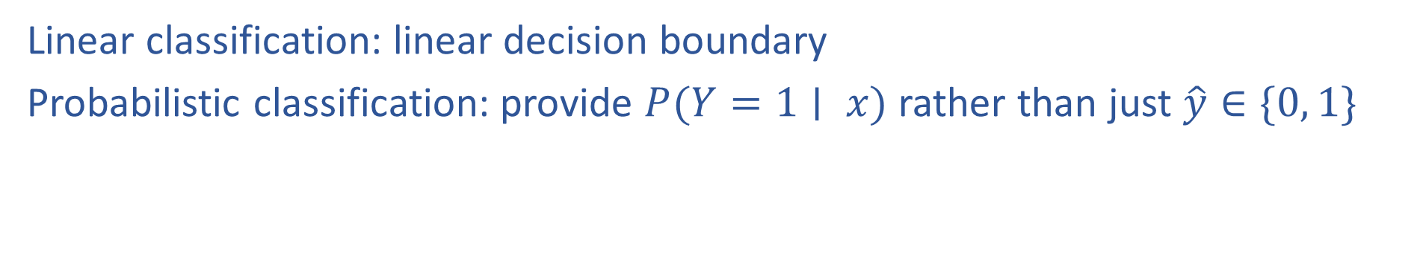
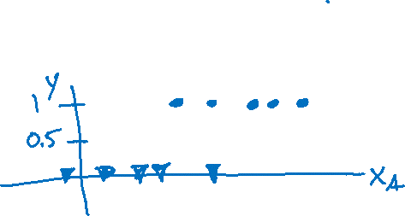
Logistic regression for classification
Linear classification: linear decision boundary
Probabilistic classification: provide $P(Y=1∣ x)$ rather than just $\hat{y}∈\{0, 1\}$
Slide credit: CMU AI Zico Kolter

Slide 6
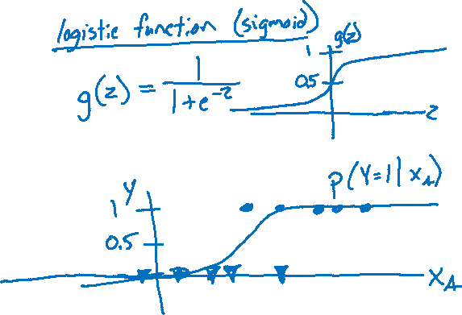
Logistic regression for classification
Linear classification: linear decision boundary
Probabilistic classification: provide $P(Y=1∣ x)$ rather than just $\hat{y}∈\{0, 1\}$
Slide credit: CMU AI Zico Kolter

Slide 7

Logistic regression for classification
Linear classification: linear decision boundary
Probabilistic classification: provide $P(Y=1∣ x)$ rather than just $\hat{y}∈\{0, 1\}$
Slide credit: CMU AI Zico Kolter

Slide 8
Pre-reading
Cross-entropy loss

Slide 9
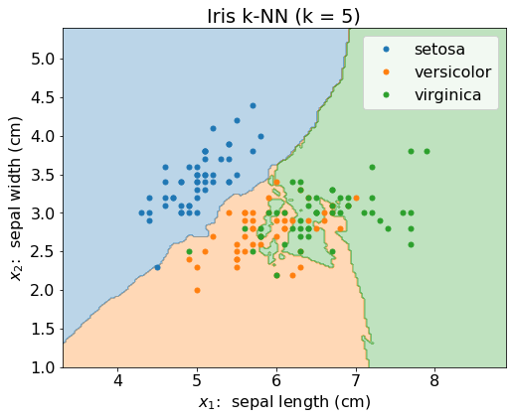
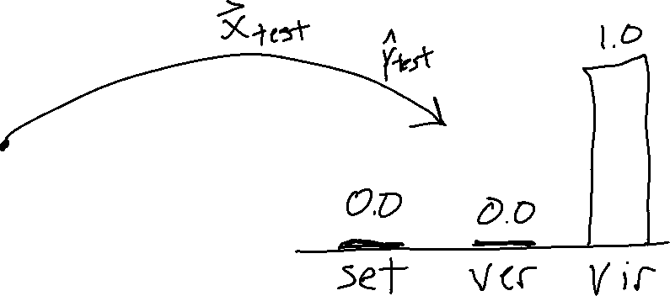
Classification Decisions
Predicting one specific class is troubling, especially when we know that there is some uncertainty in our prediction

Slide 10
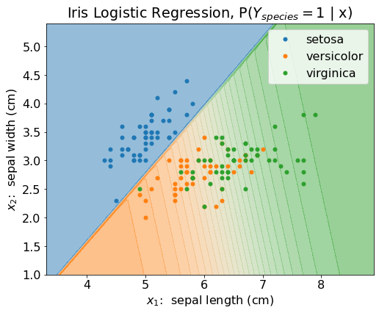
Classification Probability
Constructing a model than can return the probability of the output being a specific class could be incredibly useful

Slide 11





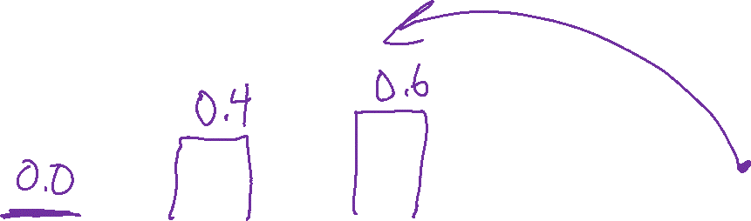
Classification Probability
Constructing a model than can return the probability of the output being a specific class could be incredibly useful
$$1.0$$
$$P(Y_{setosa}=1∣x)$$
$$P(Y_{vers}=1∣x)$$
$$P(Y_{virg}=1∣x)$$
We can still make decisions, .e.g,
$$\underset{k}{argmax} P(Y_{k}=1∣x)$$

Slide 12

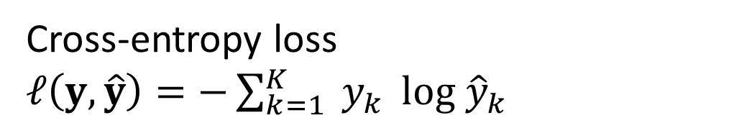
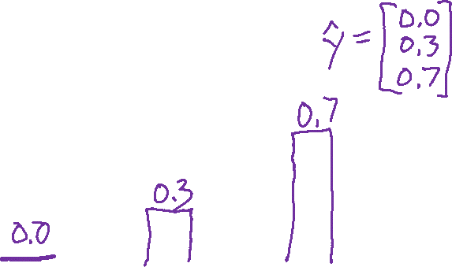

Loss for Probabilty Disributions
We need a way to compare how good/bad each prediction is
$$1.0$$
$$P(Y_{setosa}=1∣x)$$
$$P(Y_{vers}=1∣x)$$
$$P(Y_{virg}=1∣x)$$
Cross-entropy loss
$ℓ\left(y, \hat{y}\right)=−\sum_{k=1}^{K}{{ y}_{k}} log {\hat{y}}_{k}$

Slide 13



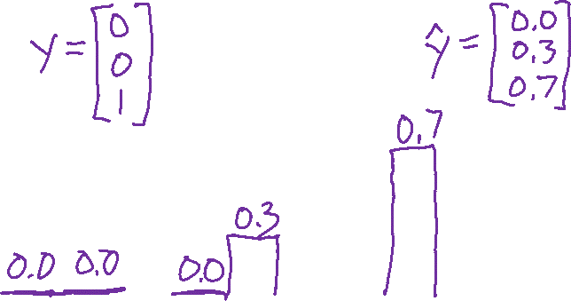


Loss for Probabilty Disributions
We need a way to compare how good/bad each prediction is
$$1.0$$
$$y_{1} {\hat{y}}_{1}$$
$$y_{2} {\hat{y}}_{2}$$
$$y_{3} {\hat{y}}_{3}$$
Cross-entropy loss
$ℓ\left(y, \hat{y}\right)=−\sum_{k=1}^{K}{{ y}_{k}} log {\hat{y}}_{k}$

Slide 14


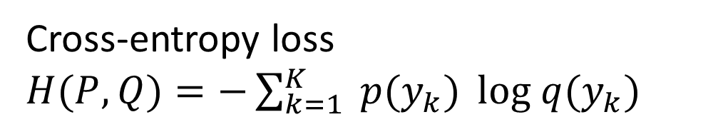



Loss for Probabilty Disributions
Cross-entropy more generally is a way to compare any to probability distributions*
*when used in logistic regression
$y$ is always a one-hot vector
$$1.0$$
$$p\left(y_{1}\right) q(y_{1})$$
$$p\left(y_{2}\right) q(y_{2})$$
$$p\left(y_{3}\right) q(y_{3})$$
Cross-entropy loss
$H(P,Q)=−\sum_{k=1}^{K}{{ p(y}_{k})} log q(y_{k})$

Slide 15
Pre-reading
Linear model for classification

Slide 16

Prediction for Cancer Diagnosis
Learn to predict if a patient has cancer ($Y=1$) or not ($Y=0$) given the input of two test results, $X_{A}$ and $X_{B}$.

Slide 17

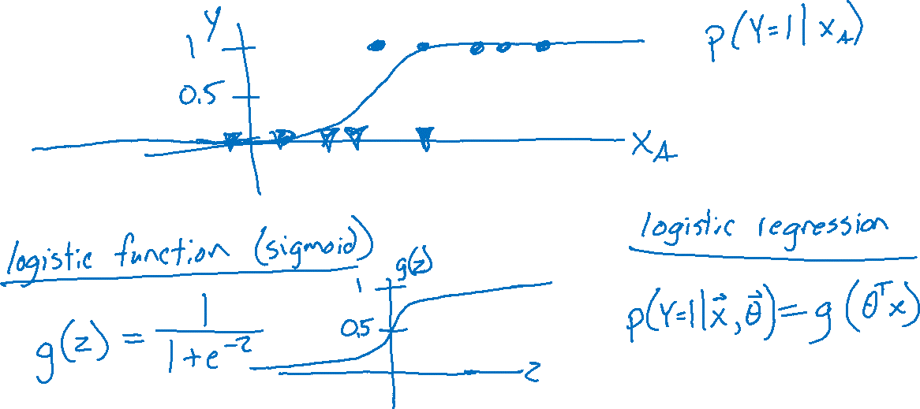
Prediction for Cancer Diagnosis
Learn to predict if a patient has cancer ($Y=1$) or not ($Y=0$) given the input of just one test result, $X_{A}$.

Slide 18
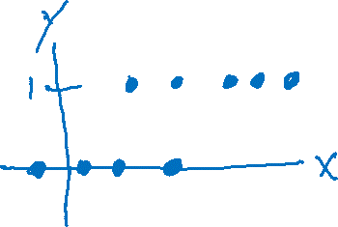
Building on a Linear Model
Linear vs Thresholded Linear vs Logistic Linear

Slide 19
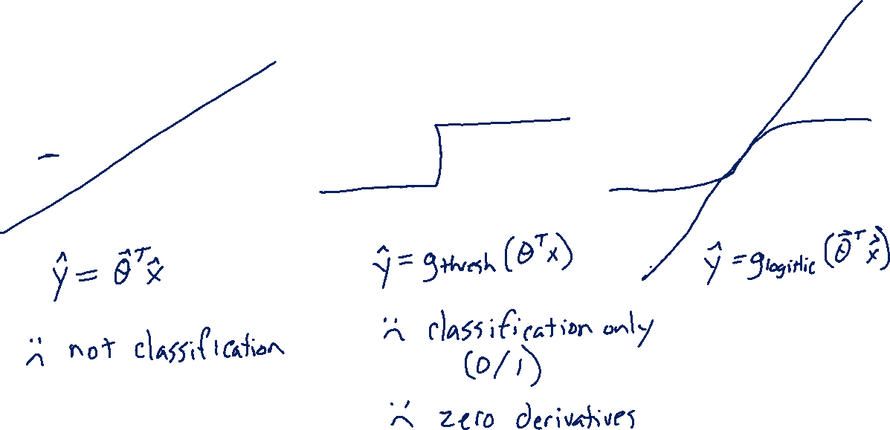
Building on a Linear Model
Linear vs Thresholded Linear vs Logistic Linear

Slide 20
Logistic Regression
Linear model for classification
(now with 2+ input features)

Slide 21
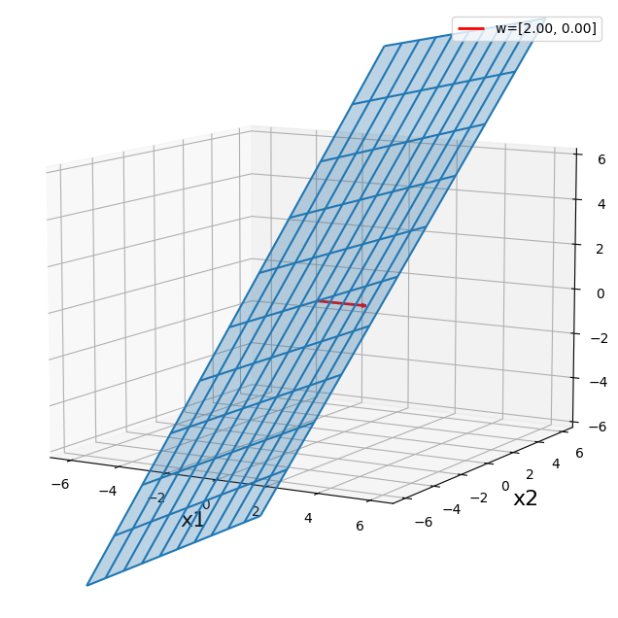
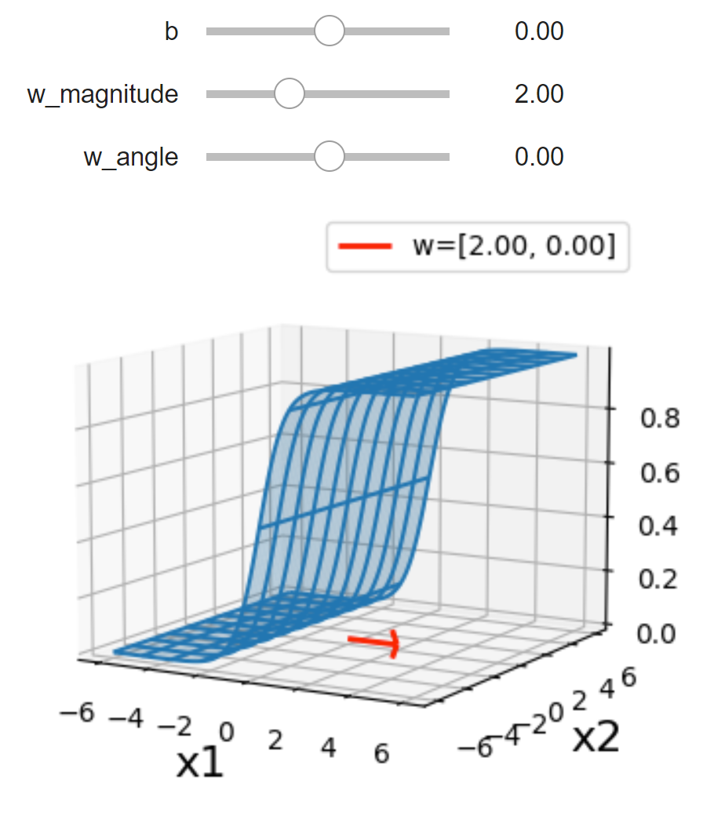


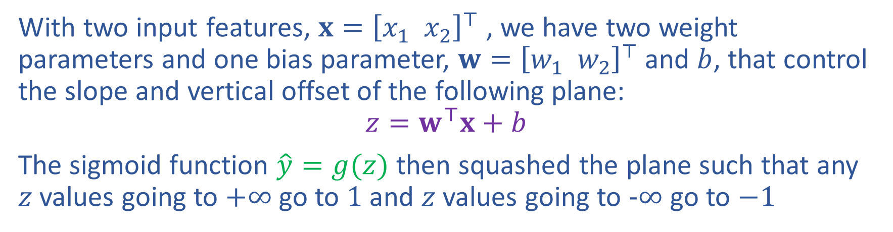


Building on a Linear Model
With two input features, $x={\left[x_{1} x_{2}\right]}^{⊤}$ , we have two weight parameters and one bias parameter, $w={\left[w_{1} w_{2}\right]}^{⊤}$ and $b$, that control the slope and vertical offset of the following plane:
$$z=w^{⊤}x+b$$
The sigmoid function $\hat{y}=g(z)$ then squashed the plane such that any $z$ values going to $+∞$ go to $1$ and $z$ values going to $−∞$ go to $−1$
$$z$$
$$g(z)$$
$$x_{1}$$
$$x_{2}$$

Slide 22
Building on a Linear Model
Slide credit: CMU MLD Matt Gormley

Slide 23
Building on a Linear Model
Slide credit: CMU MLD Matt Gormley

Slide 24
Logistic Regression Decision Boundary
Slide credit: CMU MLD Matt Gormley

Slide 25
Logistic Regression
Linear decision boundary

Slide 26
Logistic Regression Decision Boundary
Slide credit: CMU MLD Matt Gormley

Slide 27
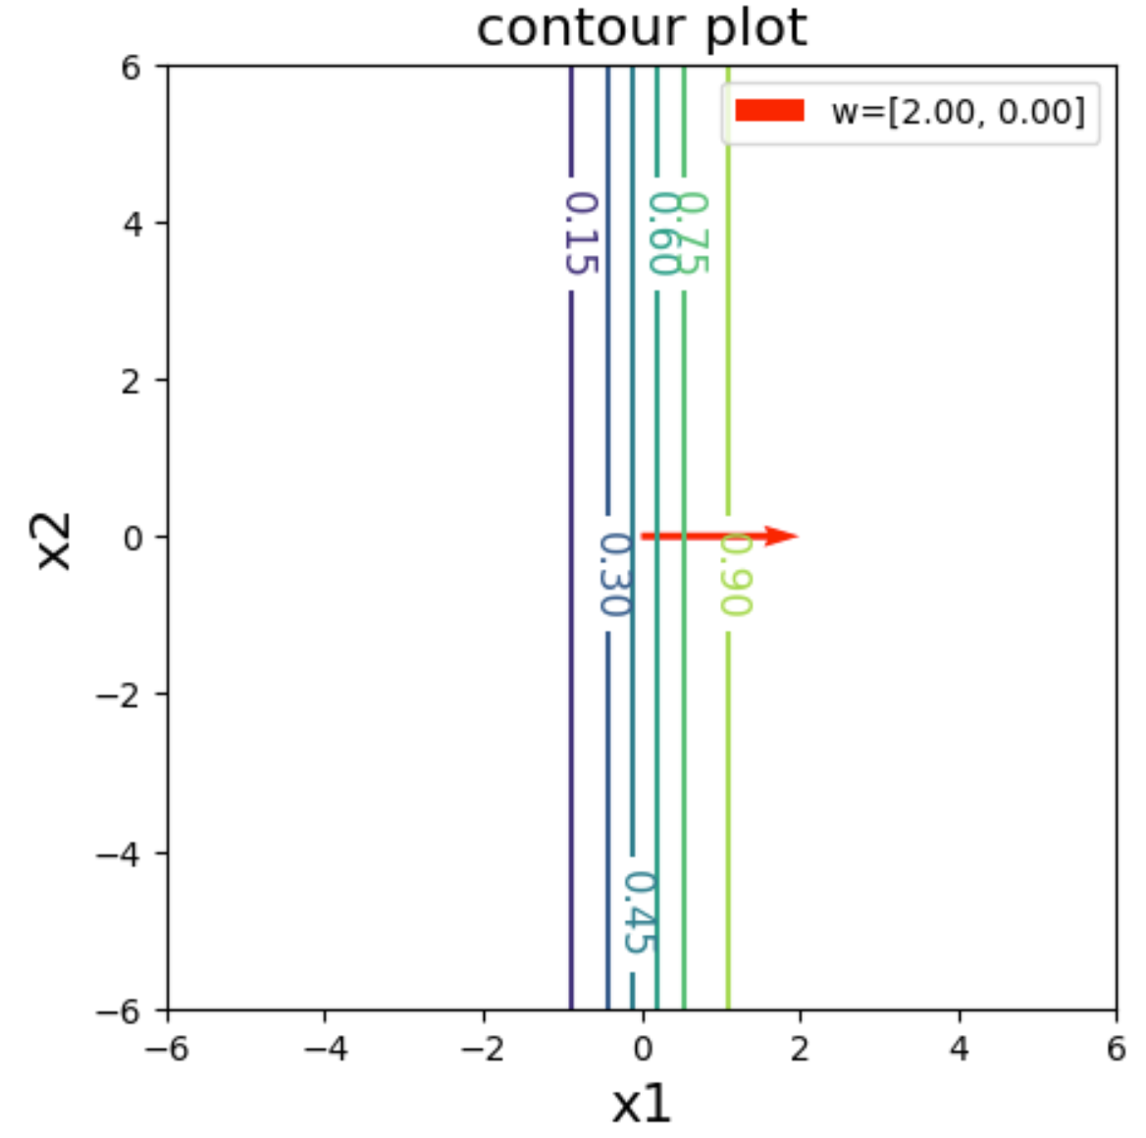
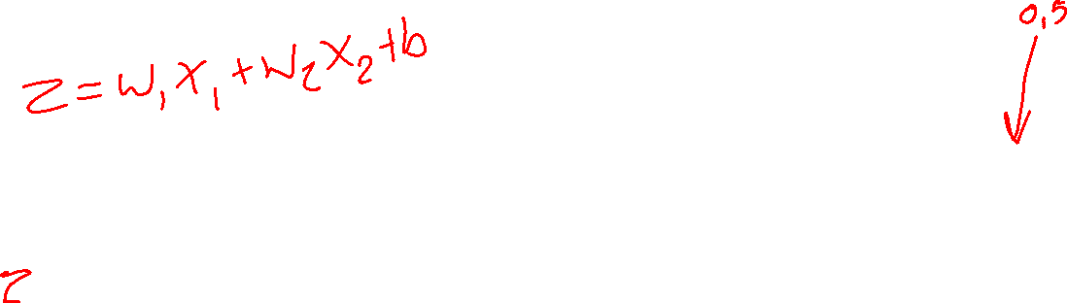
Exercise
Interact with the linear_logistic.ipynb posted on the course website schedule

Slide 28
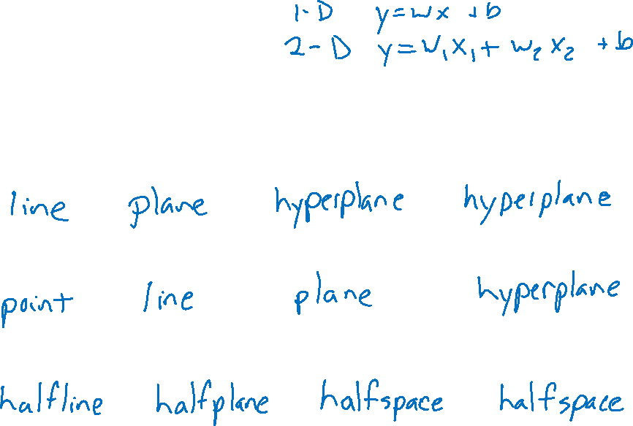






Linear in Higher Dimensions
What are these linear shapes called for 1-D, 2-D, 3-D, M-D input?
$$x∈ℝ$$
$$x∈ℝ^{2}$$
$$x∈ℝ^{3}$$
$$x∈ℝ^{M}$$
$y=w^{⊤}x+b$
$w^{⊤}x+b=0$
$w^{⊤}x+b≥0$

Slide 29
Logistic Regression
Slide credit: CMU MLD Matt Gormley
Notes:
Data are drawn from two Guassians.
There is irreducible error here b/c they overlap. SHOW: 3D representation with piece of paper.

Slide 30
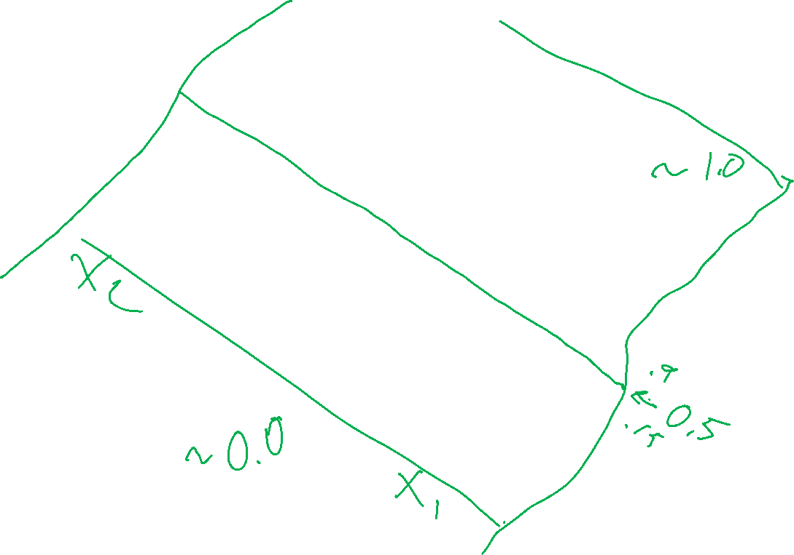
Logistic Regression
Slide credit: CMU MLD Matt Gormley

Slide 31
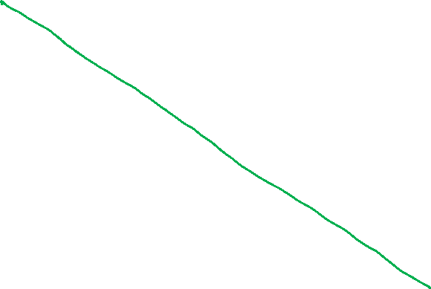
Logistic Regression
Slide credit: CMU MLD Matt Gormley

Slide 32

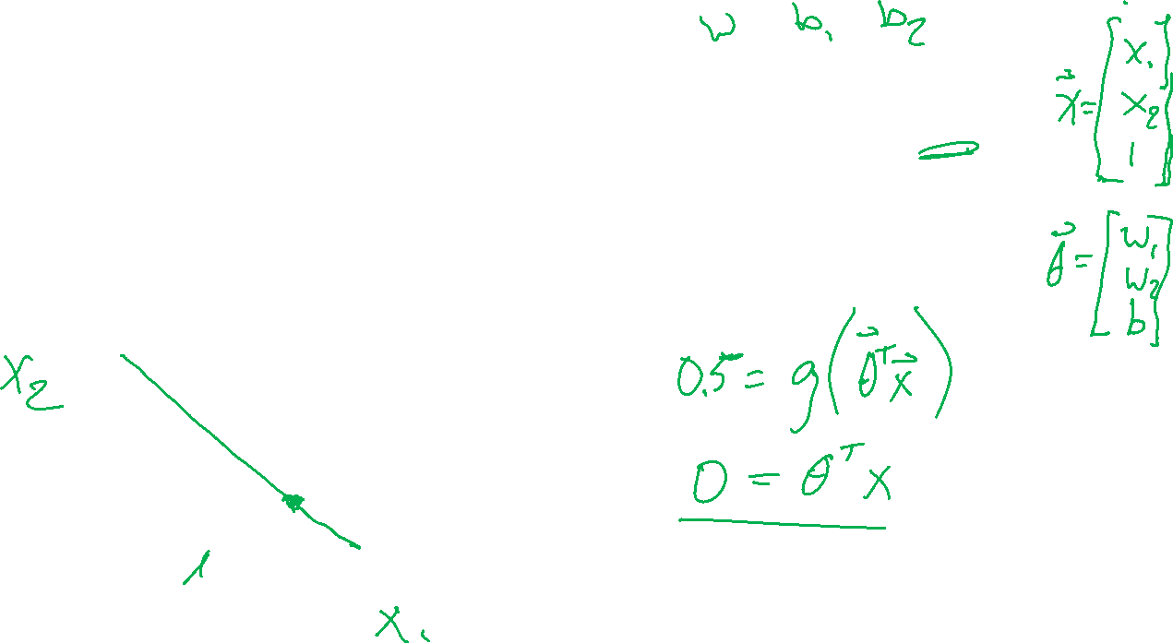
Exercise
Write the equation for this is decision boundary line (in terms of $θ)$.

Slide 33
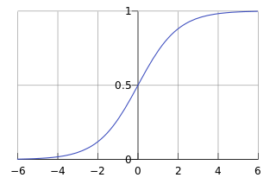

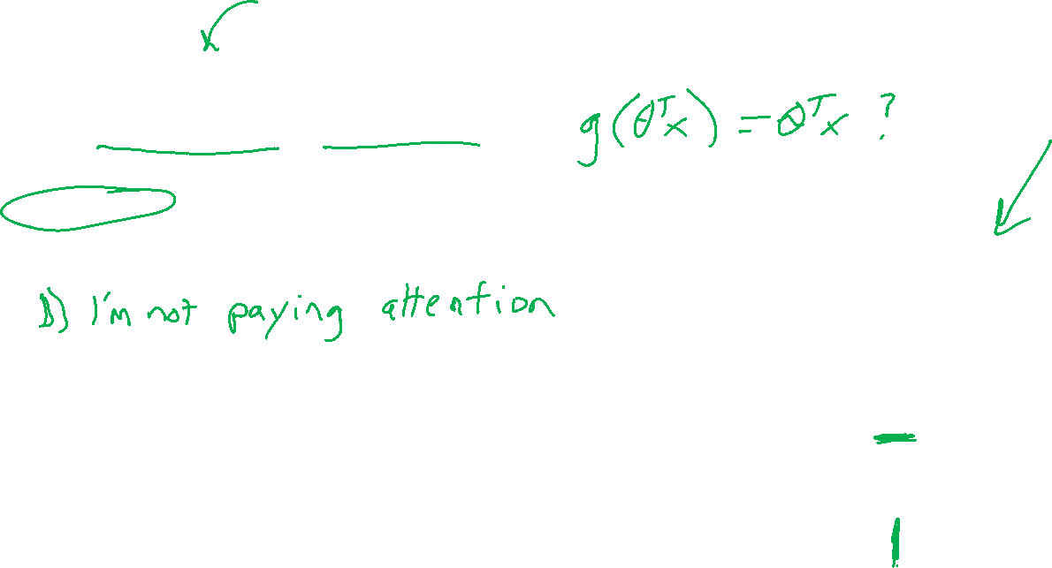

Poll 1
For a point $x$ on the decision boundary of logistic regression, does $g\left(w^{T}x+b\right)=w^{T}x+b$?
Yes
No
I have no idea
$$g\left(z\right)=\frac{1}{1+e^{−z}}$$

Slide 34
Multi-class Logistic Regression

Slide 35
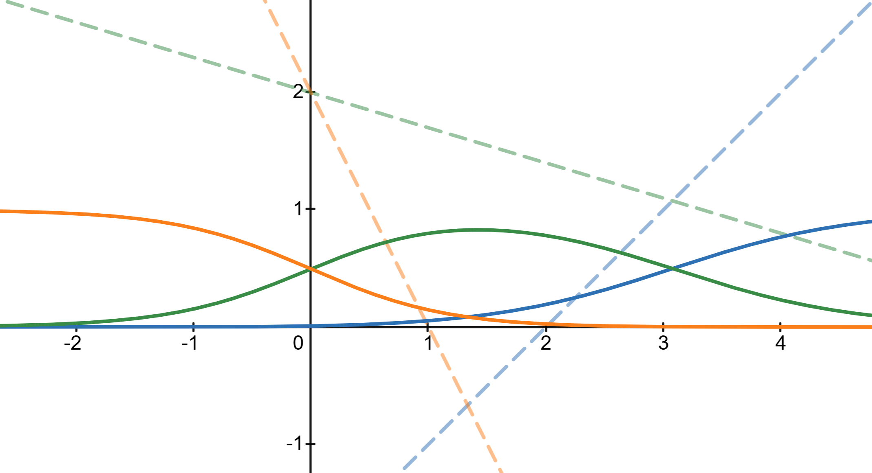
Multi-class Logistic Regression
Desmos Demo:
https://www.desmos.com/calculator/tu2wg7bhnn

Slide 36
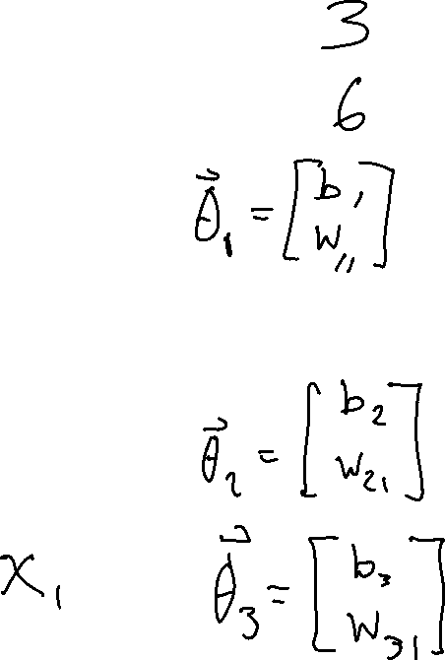
Poll 2
How many parameters are in this model?

Slide 37
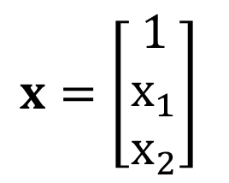

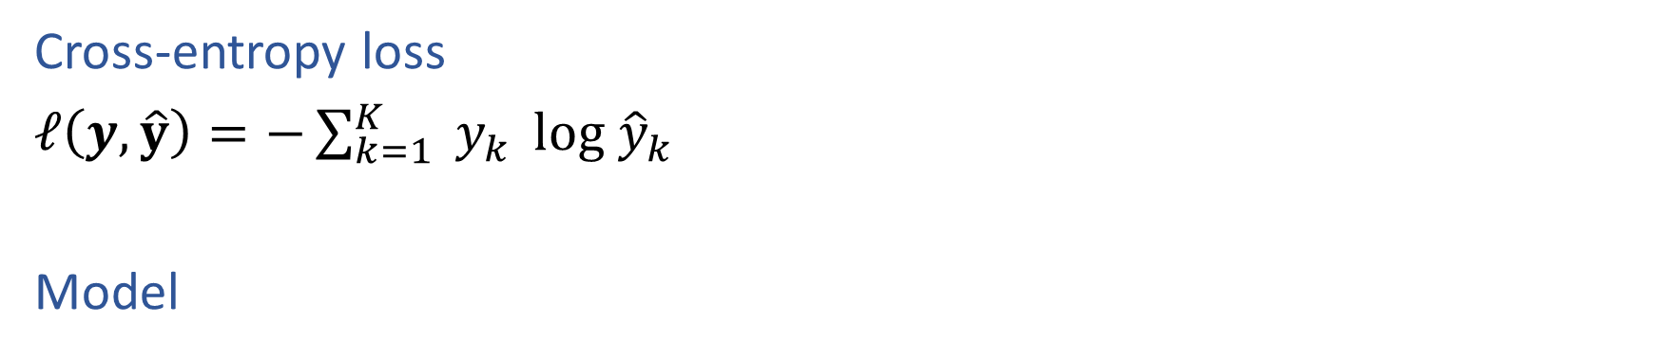




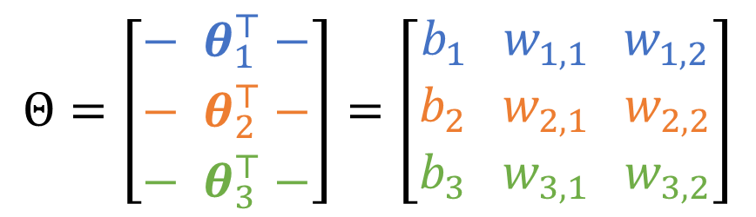
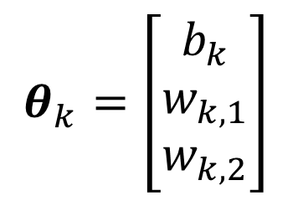
Multi-class Logistic Regression
Cross-entropy loss
$ℓ\left(y, \hat{y}\right)=−\sum_{k=1}^{K}{{ y}_{k}} log {\hat{y}}_{k}$
Model
$$\hat{y}=h\left(x\right)=g_{softmax}\left(z\right)$$
$$z=Θx$$
One vector of parameters for each class
$$z_{k}=θ_{k}x$$
Stacked into a matrix of $K×M$ parameters
$$x=\left[\begin{matrix}1 \\ x_{1} \\ x_{2}\end{matrix}\right]$$
$$θ_{k}=\left[\begin{matrix}b_{k} \\ w_{k,1} \\ w_{k,2}\end{matrix}\right]$$
$$Θ=\left[\begin{matrix}{− θ}_{1}^{⊤}− \\ {− θ}_{2}^{⊤}− \\ {− θ}_{3}^{⊤}−\end{matrix}\right]=\left[\begin{matrix}b_{1} w_{1,1} w_{1,2} \\ b_{2} w_{2,1} w_{2,2} \\ b_{3} w_{3,1} w_{3,2}\end{matrix}\right]$$

Slide 38

Prep: Multi-class Logistic Regression
Logistic function
$g\left(z\right)=\frac{e^{z}}{e^{z}+1}$
$p\left(Y=1 ∣ x,θ\right)=g\left(μ\right)=\frac{e^{μ}}{e^{μ}+1}$
$p\left(Y=0 ∣ x,θ\right)=1−g\left(μ\right)=1−\frac{e^{μ}}{e^{μ}+1}$
Probability distribution sums to 1
$\sum_{y}{p(Y=y∣x, θ)}$
$=p\left(Y=0 ∣ x,θ\right)+p\left(Y=1 ∣ x,θ\right)$
$= 1−\frac{e^{μ}}{e^{μ}+1}+ \frac{e^{μ}}{e^{μ}+1}=1$

Slide 39
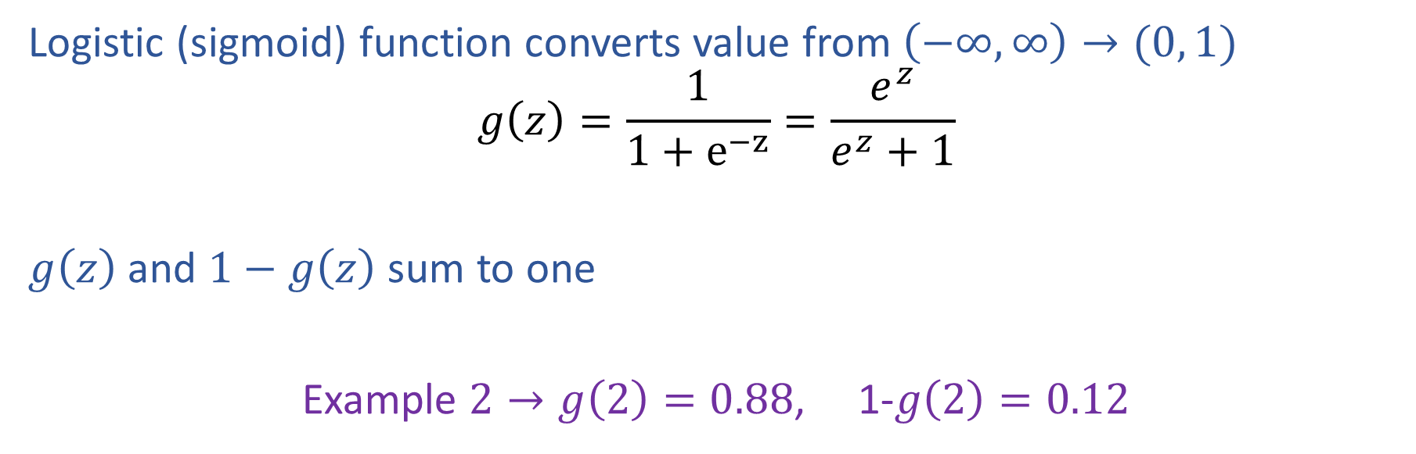
Logistic Function
Logistic (sigmoid) function converts value from $\left(−∞, ∞\right)→(0, 1)$
$$g\left(z\right)=\frac{1}{1+e^{−z}}=\frac{e^{z}}{e^{z}+1}$$
$g\left(z\right)$ and $1−g\left(z\right)$ sum to one
Example $2→g\left(2\right)=0.88$, 1-$g\left(2\right)=0.12$

Slide 40
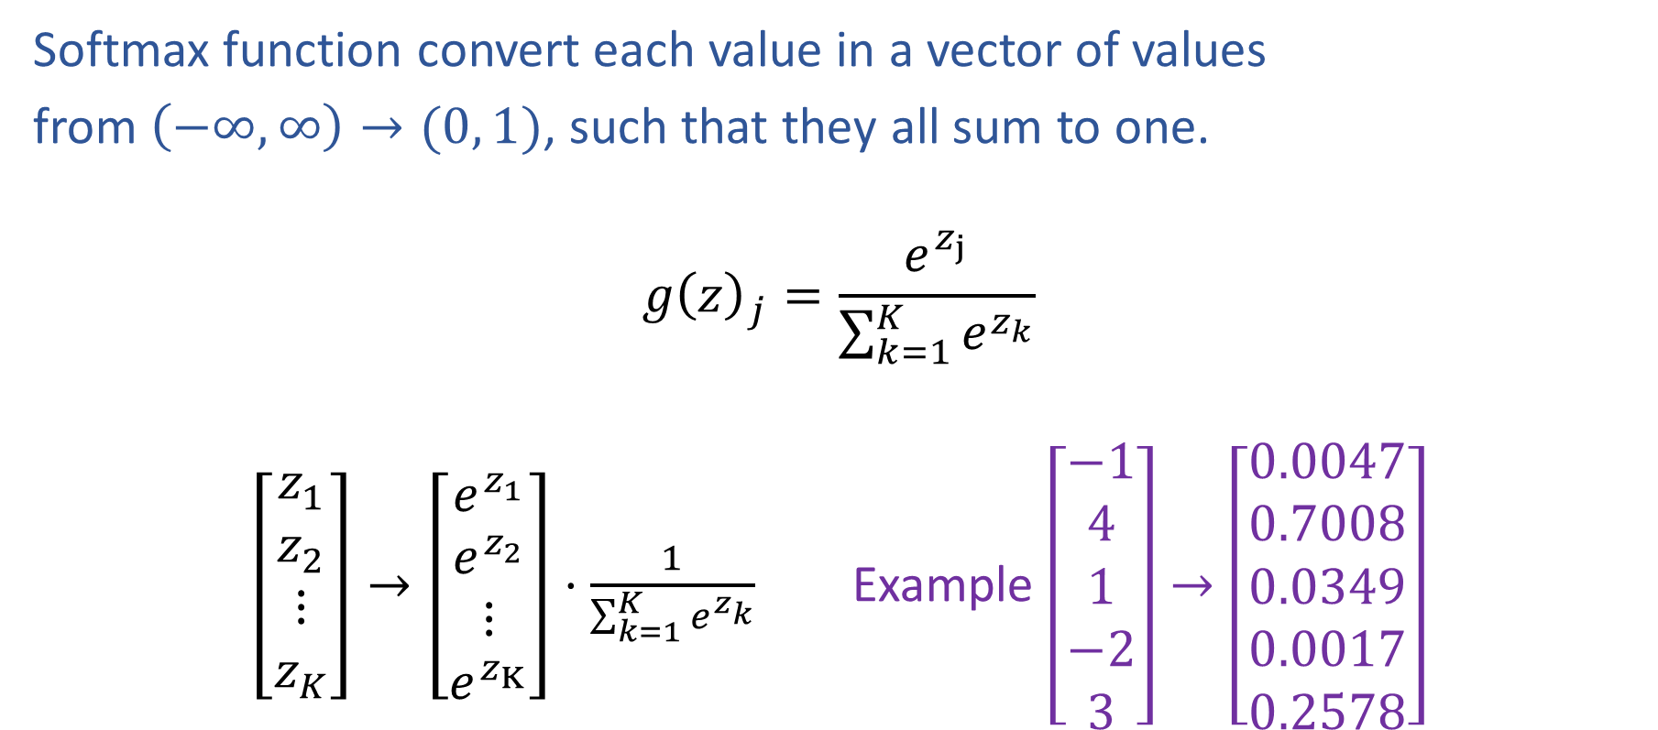
Softmax Function
Softmax function convert each value in a vector of values
from $\left(−∞, ∞\right)→(0, 1)$, such that they all sum to one.
$$g{\left(z\right)}_{j}=\frac{e^{z_{j}}}{\sum_{k=1}^{K}{e^{z_{k}}}}$$
$\left[\begin{aligned}z_{1} \\ z_{2} \\ ⋮ \\ z_{K}\end{aligned}\right]→\left[\begin{aligned}e^{z_{1}} \\ e^{z_{2}} \\ ⋮ \\ e^{z_{K}}\end{aligned}\right]⋅\frac{1}{\sum_{k=1}^{K}{e^{z_{k}}}}$ Example $\left[\begin{aligned}−1 \\ 4 \\ 1 \\ −2 \\ 3\end{aligned}\right]→\left[\begin{aligned}0.0047 \\ 0.7008 \\ 0.0349 \\ 0.0017 \\ 0.2578\end{aligned}\right]$

Slide 41
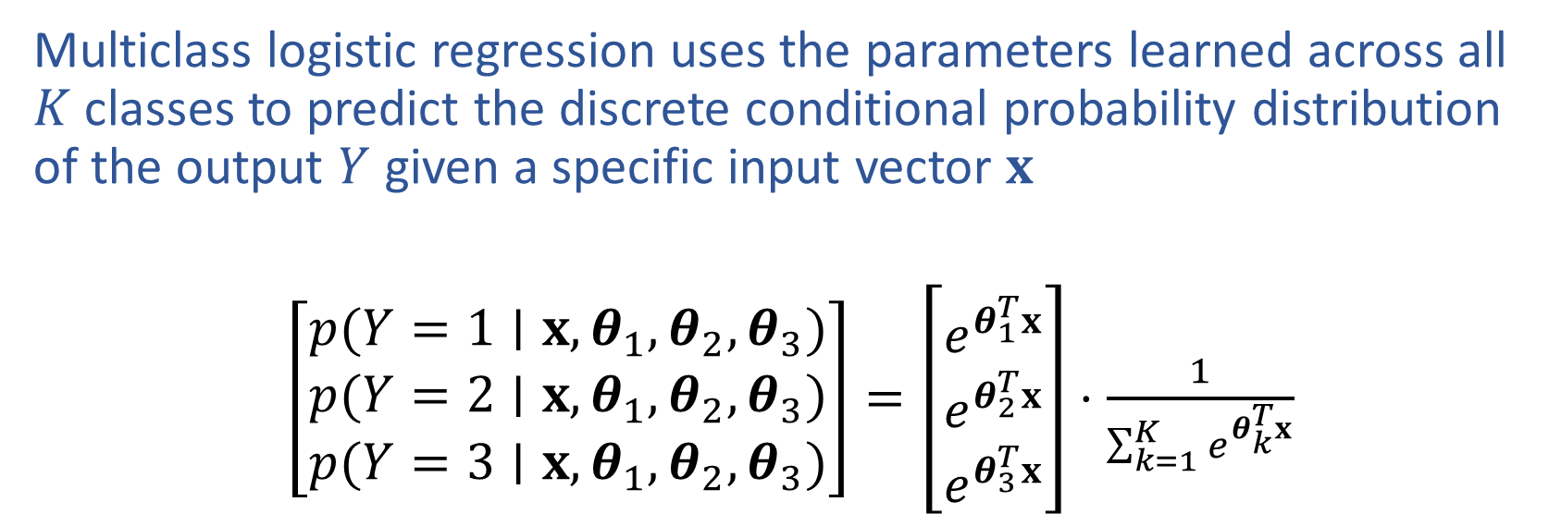
Multiclass Predicted Probability
Multiclass logistic regression uses the parameters learned across all $K$ classes to predict the discrete conditional probability distribution of the output $Y$ given a specific input vector $x$
$\left[\begin{aligned}p(Y=1∣x, θ_{1},θ_{2}, θ_{3}) \\ p(Y=2∣x,θ_{1},θ_{2}, θ_{3}) \\ p(Y=3∣x,θ_{1},θ_{2}, θ_{3})\end{aligned}\right]=\left[\begin{aligned}e^{θ_{1}^{T}x} \\ e^{θ_{2}^{T}x} \\ e^{θ_{3}^{T}x}\end{aligned}\right]⋅\frac{1}{\sum_{k=1}^{K}{e^{θ_{k}^{T}x}}}$

Slide 42
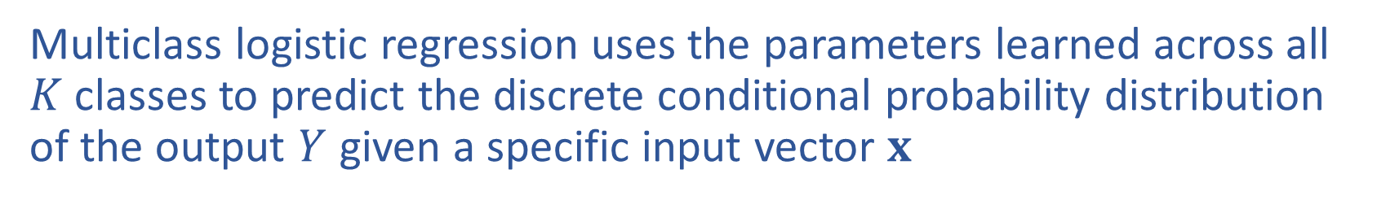
Multiclass Predicted Probability
Multiclass logistic regression uses the parameters learned across all $K$ classes to predict the discrete conditional probability distribution of the output $Y$ given a specific input vector $x$

Slide 43
Logistic Regression
Optimization

Slide 44

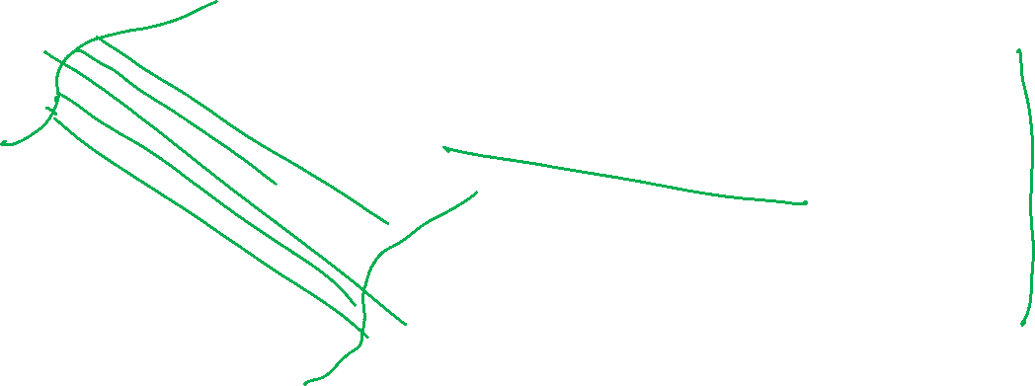
Optimizing a Model for Cancer Diagnosis
Learn to predict if a patient has cancer ($Y=1$) or not ($Y=0$) given the input of two test results, $X_{A}$, $X_{B}$. Note: bias term included in $x$.
$$p\left(Y=1 ∣ x, θ\right)=\frac{1}{1+e^{−θ^{T}x}}$$

Slide 45

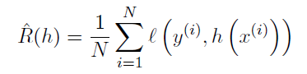
Empirical Risk Minimization
Still doing empirical risk minimization, just with a cross-entropy loss

Slide 46
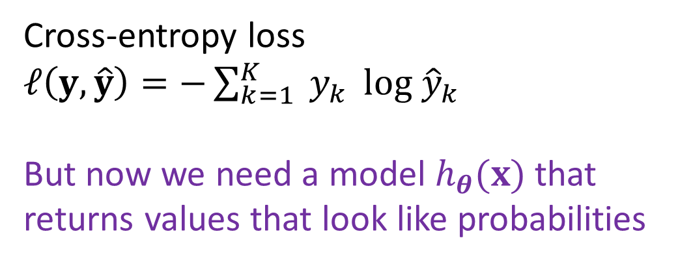
Empirical Risk Minimization
Still doing empirical risk minimization, just with a cross-entropy loss
Cross-entropy loss
$ℓ\left(y, \hat{y}\right)=−\sum_{k=1}^{K}{{ y}_{k}} log {\hat{y}}_{k}$
But now we need a model $h_{θ}(x)$ that returns values that look like probabilities

Slide 47


Binary Logistic Regression
Model
Objective function
Solve for $\hat{θ}$

Slide 48





Binary Logistic Regression
$$g\left(z\right)=\frac{1}{1+e^{−z}}$$
Objective: Special case for binary logistic regression
$\hat{y}=g\left(θ^{T}x\right)$
$$J\left(θ\right)=−\frac{1}{N}\sum_{i}{\sum_{k}{y_{k}^{\left(i\right)} log {\hat{y}}_{k}^{\left(i\right)}}}$$
$$=−\frac{1}{N}\sum_{i}{\left(y^{\left(i\right)}\log{{\hat{y}}^{(i)}}+\left(1−y^{(i)}\right)\log\left(1−{\hat{y}}^{(i)}\right)\right)}$$

Slide 49





Solve Logistic Regression
$$g\left(z\right)=\frac{1}{1+e^{−z}}$$
$$\frac{dg}{dz}=g\left(z\right)\left(1−g\left(z\right)\right)$$
$\hat{y}=g\left(θ^{T}x\right)$
$J^{(i)}\left(θ\right)=−\left[y^{\left(i\right)}\log{{\hat{y}}^{\left(i\right)}}+\left(1−y^{\left(i\right)}\right)\log\left(1−{\hat{y}}^{\left(i\right)}\right)\right]$
$\frac{∂J^{\left(i\right)}}{∂θ}=−\left(y^{\left(i\right)}−{\hat{y}}^{\left(i\right)}\right) x^{\left(i\right)}$

Slide 50





Solve Logistic Regression
$$g\left(z\right)=\frac{1}{1+e^{−z}}$$
$$\frac{dg}{dz}=g\left(z\right)\left(1−g\left(z\right)\right)$$
$\hat{y}=g\left(θ^{T}x\right)$
$J^{(i)}\left(θ\right)=−\left[y^{\left(i\right)}\log{{\hat{y}}^{\left(i\right)}}+\left(1−y^{(i)}\right)\log\left(1−{\hat{y}}^{(i)}\right)\right]$
$\frac{∂J^{\left(i\right)}}{∂θ}=−\left(y^{\left(i\right)}−{\hat{y}}^{\left(i\right)}\right) x^{\left(i\right)}$

Slide 51





Solve Logistic Regression
$$g\left(z\right)=\frac{1}{1+e^{−z}}$$
$$\frac{dg}{dz}=g\left(z\right)\left(1−g\left(z\right)\right)$$
$\hat{y}=g\left(θ^{T}x\right)$
$J^{(i)}\left(θ\right)=−\left[y^{\left(i\right)}\log{{\hat{y}}^{\left(i\right)}}+\left(1−y^{(i)}\right)\log\left(1−{\hat{y}}^{(i)}\right)\right]$
$\frac{∂J^{\left(i\right)}}{∂θ}=−\left(y^{\left(i\right)}−{\hat{y}}^{\left(i\right)}\right) x^{\left(i\right)}$

Slide 52



Solve Logistic Regression
$\hat{y}=g\left(θ^{T}x\right)$
$g\left(z\right)=\frac{1}{1+e^{−z}}$
$J\left(θ\right)=−\frac{1}{N}\sum_{i}{\left(y^{\left(i\right)}\log{{\hat{y}}^{(i)}}+\left(1−y^{(i)}\right)\log\left(1−{\hat{y}}^{(i)}\right)\right)}$
$∇_{θ}J\left(θ\right)=−\frac{1}{N}\sum_{i}{\left(y^{\left(i\right)}−{\hat{y}}^{\left(i\right)}\right)}x^{\left(i\right)}$
$∇_{θ}J(θ)=0$?
No closed form solution ☹
Back to iterative methods. Solve with (stochastic) gradient descent, Newton’s method, or Iteratively Reweighted Least Squares (IRLS)

Slide 53



Solve Logistic Regression
$\hat{y}=g\left(θ^{T}x\right)$
$g\left(z\right)=\frac{1}{1+e^{−z}}$
$J\left(θ\right)=−\frac{1}{N}\sum_{i}{\left(y^{\left(i\right)}\log{{\hat{y}}^{(i)}}+\left(1−y^{(i)}\right)\log\left(1−{\hat{y}}^{(i)}\right)\right)}$
$∇_{θ}J\left(θ\right)=−\frac{1}{N}\sum_{i}{\left(y^{\left(i\right)}−{\hat{y}}^{\left(i\right)}\right)}x^{\left(i\right)}$
No closed form solution ☹
Back to iterative methods. Solve with (stochastic) gradient descent, Newton’s method, or Iteratively Reweighted Least Squares (IRLS)
Good news: The logistic regression optimization function is convex!

Slide 54
Logistic Regression
Convexity

Slide 55

Optimization
Linear function
If $f(x)$ is linear, then:
$f\left(x+z\right)=f\left(x\right)+f\left(z\right)$
$f\left(αx\right)=αf\left(x\right) ∀α$
$f\left(αx+\left(1−α\right)z\right)=αf\left(x\right)+\left(1−α\right)f\left(z\right) ∀α$

Slide 56

Optimization
Convex function
If $f(x)$ is convex, then:
$f\left(αx+\left(1−α\right)z\right)≤αf\left(x\right)+\left(1−α\right)f\left(z\right) ∀ 0≤α≤1$

Slide 57



Optimization
Convex function
If $f(x)$ is convex, then:
$f\left(αx+\left(1−α\right)z\right)≤αf\left(x\right)+\left(1−α\right)f\left(z\right)$ $∀ 0≤α≤1$
Demo on Desmos

Slide 58

Optimization
Convex function
If $f(x)$ is convex, then:
$f\left(αx+\left(1−α\right)z\right)≤αf\left(x\right)+\left(1−α\right)f\left(z\right) ∀ 0≤α≤1$
Convex optimization
If second derivative is $≥0$ everywhere then function is convex
If $f(x)$ is convex, then:
Every local minimum is also a global minimum ☺

Slide 59

Optimization
$h\left(x\right)=g(w^{⊤}x+b)$ is definitely not convex
But...what are we optimizing over in logistic regression?
$$J\left(θ\right)=−\frac{1}{N}\sum_{i}{\sum_{k}{y_{k}^{\left(i\right)} log y_{k}^{\left(i\right)}}}$$
$$= −\frac{1}{N}\sum_{i}{\left(y^{\left(i\right)}\log{{\hat{y}}^{(i)}}+\left(1−y^{(i)}\right)\log\left(1−{\hat{y}}^{(i)}\right)\right)}$$

Slide 60
Logistic Regression with Polynomial Features

Slide 61

Exercise
Interact with the logistic_quadratic.ipynb posted on the course website schedule

Slide 62



Exercise
Interact with the logistic_quadratic.ipynb posted on the course website schedule

