Slide 1

10-315 Introduction to ML Model Selection
Instructor: Pat Virtue

Slide 2

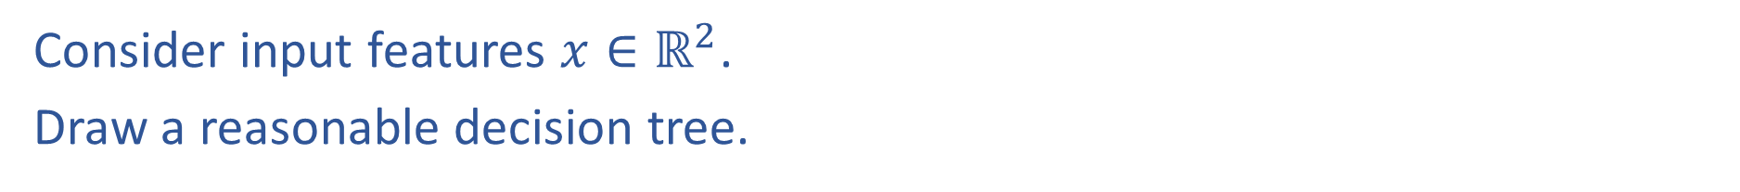
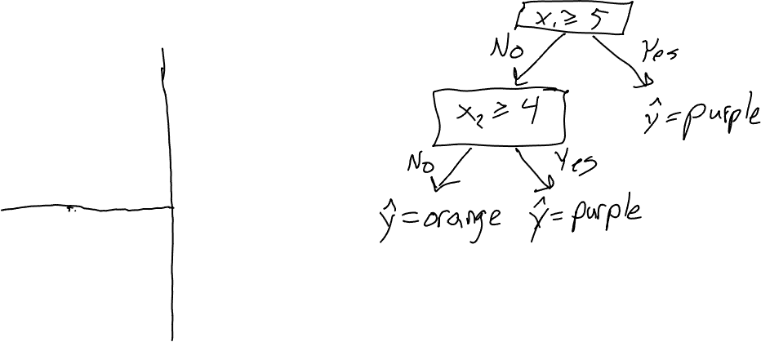

Reminder: Decision Tree Worksheet
Consider input features $x∈ℝ^{2}$.
Draw a reasonable decision tree.
$$x_{2}$$
10
5
$$x_{1}$$
5
10

Slide 3
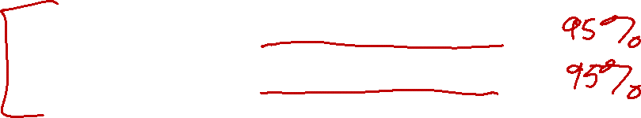


Poll 2
Decision tree generalization
Which of the following generalize best to unseen examples?
Small tree with low training accuracy
Large tree with low training accuracy
Small tree with high training accuracy
Large tree with high training accuracy

Slide 4
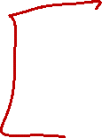
Underfitting and Overfitting
Underfitting occurs when model:
is too simple
can’t capture the actual pattern of interest in the training dataset
has too much inductive bias
Overfitting occurs when model:
is too complex
fits noise or “outliers” in the training dataset as opposed to the actual pattern of interest
doesn’t have enough inductive bias pushing it to generalize
Slide credit: CMU MLD Henry Chai

Slide 5


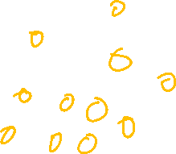


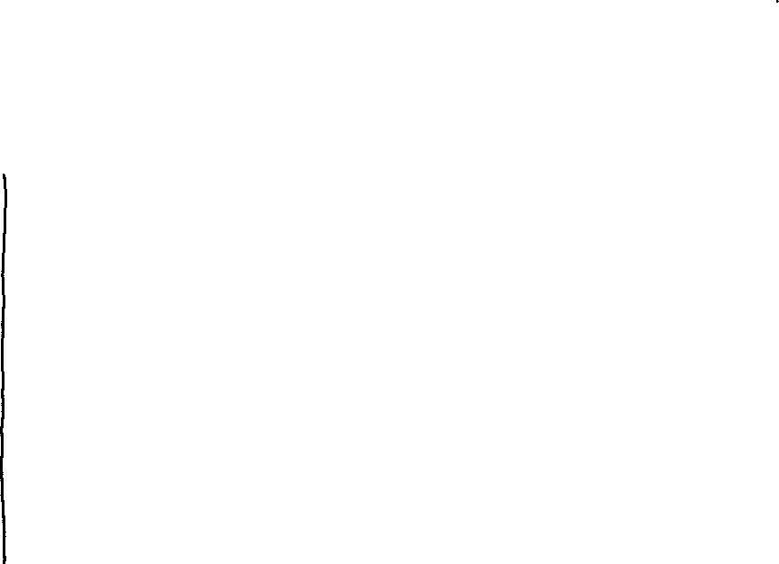


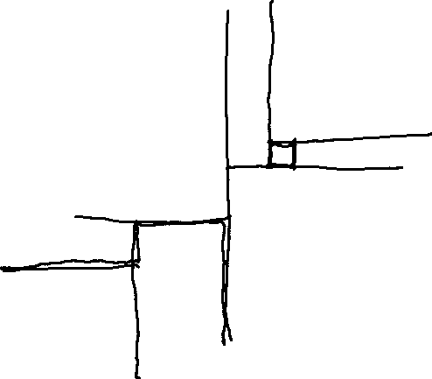

Underfitting and Overfitting: Classification
Underfitting
Overfitting
$$x_{2}$$
$$x_{2}$$
10
10
5
5
$$x_{1}$$
$$x_{1}$$
5
10
5
10

Slide 6
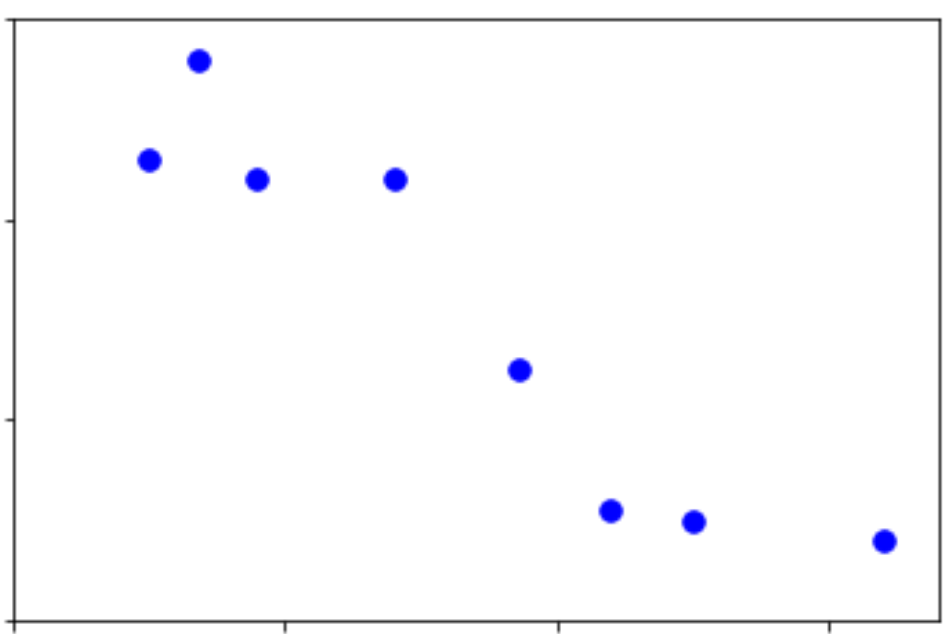
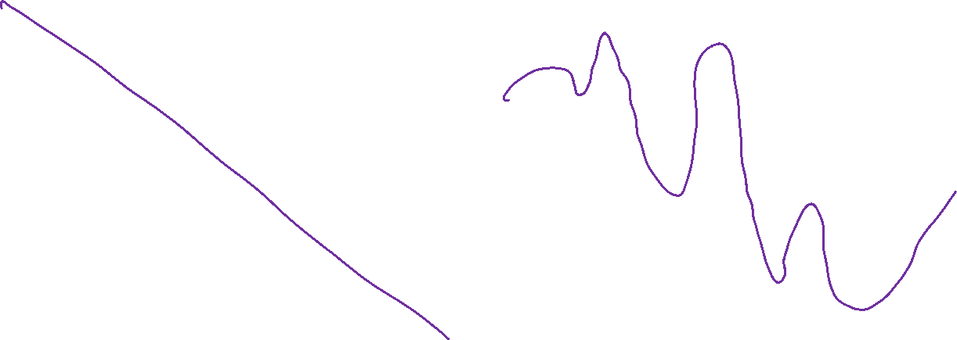
Underfitting and Overfitting: Regression
Underfitting
Overfitting
y
y
x1
x1

Slide 7
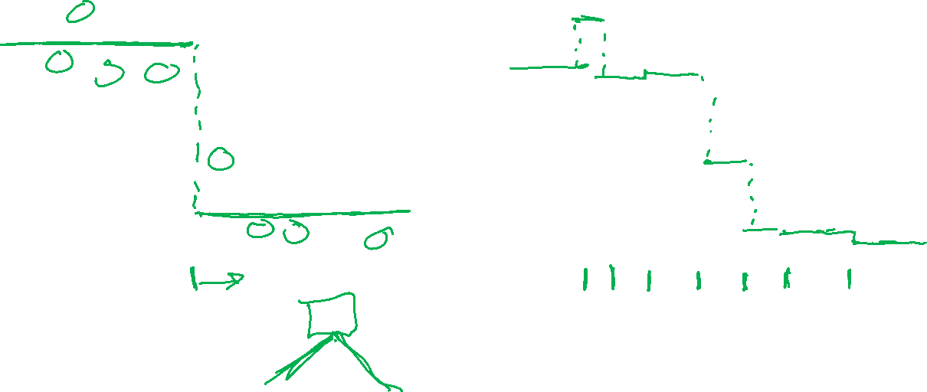
Underfitting and Overfitting: Regression
Underfitting
Overfitting
y
y
x1
x1

Slide 8
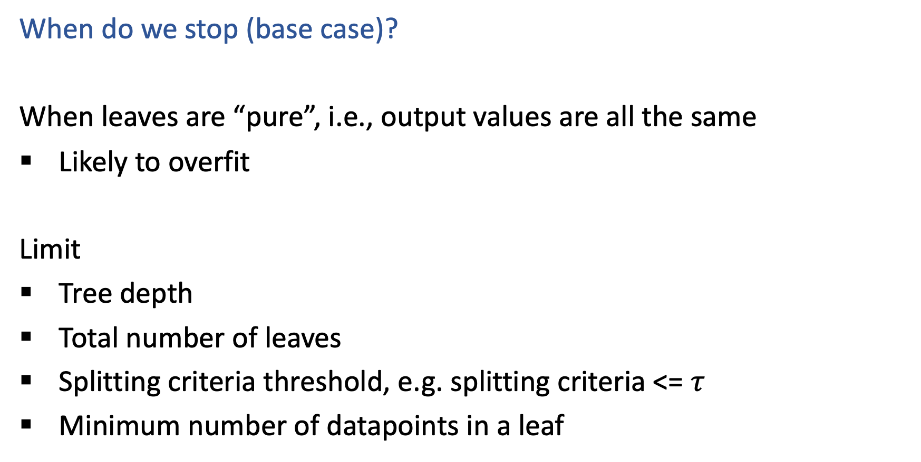
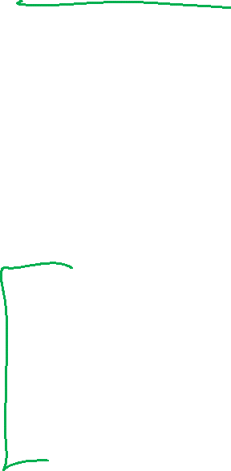
Reminder: Decision Trees
When do we stop (base case)?
When leaves are “pure”, i.e., output values are all the same
Likely to overfit
Limit
Tree depth
Total number of leaves
Splitting criteria threshold, e.g. splitting criteria <= $τ$
Minimum number of datapoints in a leaf

Slide 9
But how do we choose all of those limits?!?
Answer: Model selection
Model selection is the process to choose the “best” among a set of (trained) models

Slide 10
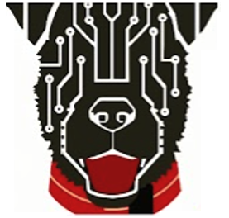
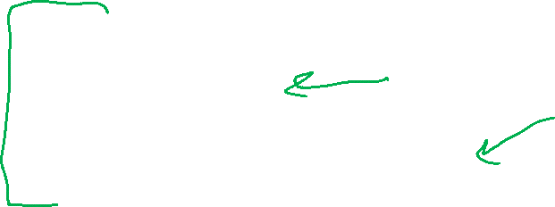
Today
k-Nearest Neighbor
1-NN, k-NN (mostly notation)
Practical details
Underfitting and Overfitting
Decision Tree stopping criteria
Classification and regression examples
Model Selection
Define terms
Stress importance
Cross-validation techniques

Slide 11
Model Selection

Slide 12
Model Selection
WARNING:
In some sense, our discussion of model selection is premature.
The models we have considered thus far are fairly simple.
The models and the many decisions available to the data scientist wielding them will grow to be much more complex than what we’ve seen so far.
Slide credit: CMU MLD Matt Gormley

Slide 13
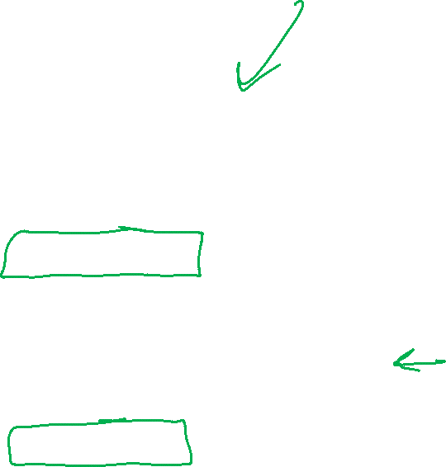
Model Selection
Statistics
Machine Learning
Def: a model defines the data generation process (i.e. a set or family of parametric probability distributions)
Def: model parameters are the values that give rise to a particular probability distribution in the model family
Def: learning (aka. estimation) is the process of finding the parameters that best fit the data
Def: hyperparameters are the parameters of a prior distribution over parameters
Def: (loosely) a model defines the hypothesis space over which learning performs its search
Def: model parameters are the numeric values or structure selected by the learning algorithm that give rise to a hypothesis
Def: the learning algorithm defines the data-driven search over the hypothesis space (i.e. search for good parameters)
Def: hyperparameters are the tunable aspects of the model, that the learning algorithm does not select
Slide credit: CMU MLD Matt Gormley

Slide 14

Model Selection
Example: Decision Tree
Machine Learning
model = set of all possible trees, possibly restricted by some hyperparameters (e.g. max depth)
parameters = structure of a specific decision tree
learning algorithm = ID3, CART, etc.
hyperparameters = max-depth, threshold for splitting criterion, etc.
Def: (loosely) a model defines the hypothesis space over which learning performs its search
Def: model parameters are the numeric values or structure selected by the learning algorithm that give rise to a hypothesis
Def: the learning algorithm defines the data-driven search over the hypothesis space (i.e. search for good parameters)
Def: hyperparameters are the tunable aspects of the model, that the learning algorithm does not select
Slide credit: CMU MLD Matt Gormley

Slide 15

Model Selection
Example: k-Nearest Neighbors
Machine Learning
model = set of all possible nearest neighbors classifiers
parameters = none (KNN is an instance-based or non-parametric method)
learning algorithm = for naïve setting, just storing the data
hyperparameters = k, the number of neighbors to consider
Def: (loosely) a model defines the hypothesis space over which learning performs its search
Def: model parameters are the numeric values or structure selected by the learning algorithm that give rise to a hypothesis
Def: the learning algorithm defines the data-driven search over the hypothesis space (i.e. search for good parameters)
Def: hyperparameters are the tunable aspects of the model, that the learning algorithm does not select
Slide credit: CMU MLD Matt Gormley

Slide 16
Model Selection
Statistics
Machine Learning
Def: a model defines the data generation process (i.e. a set or family of parametric probability distributions)
Def: model parameters are the values that give rise to a particular probability distribution in the model family
Def: learning (aka. estimation) is the process of finding the parameters that best fit the data
Def: hyperparameters are the parameters of a prior distribution over parameters
Def: (loosely) a model defines the hypothesis space over which learning performs its search
Def: model parameters are the numeric values or structure selected by the learning algorithm that give rise to a hypothesis
Def: the learning algorithm defines the data-driven search over the hypothesis space (i.e. search for good parameters)
Def: hyperparameters are the tunable aspects of the model, that the learning algorithm does not select
If “learning” is all about picking the best parameters how do we pick the best hyperparameters?
Slide credit: CMU MLD Matt Gormley

Slide 17
Model Selection
Two very similar definitions:
Def: model selection is the process by which we choose the “best” model from among a set of candidates
Def: hyperparameter optimization is the process by which we choose the “best” hyperparameters from among a set of candidates (could be called a special case of model selection)
Both assume access to a function capable of measuring the quality of a model
Both are typically done “outside” the main training algorithm --- typically training is treated as a black box
Slide credit: CMU MLD Matt Gormley

Slide 18
Special Cases of k-NN
k=1: Nearest Neighbor
k=N: Majority Vote
Slide credit: CMU MLD Matt Gormley

Slide 19
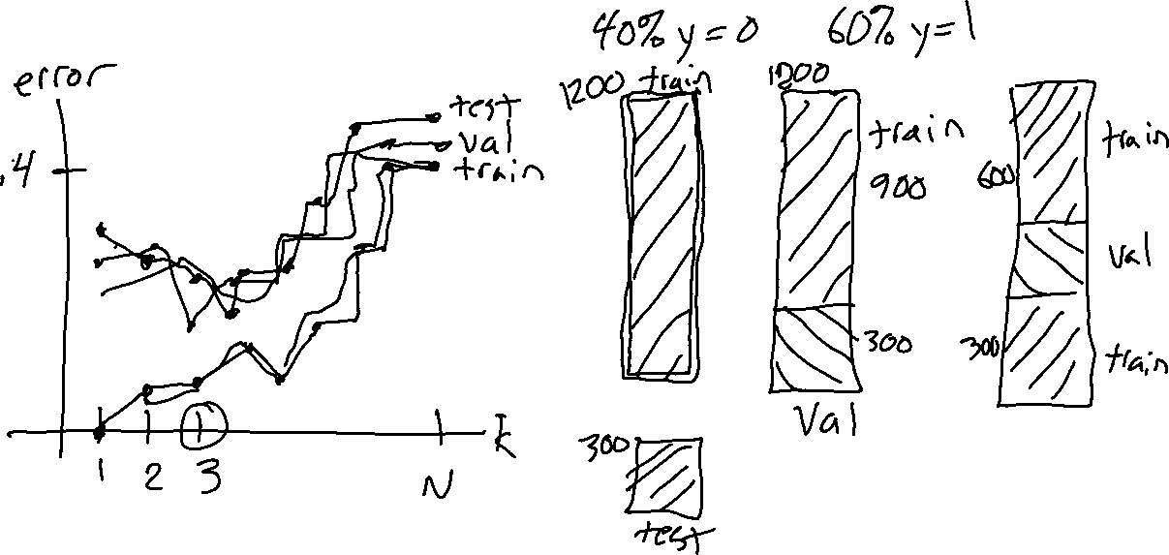
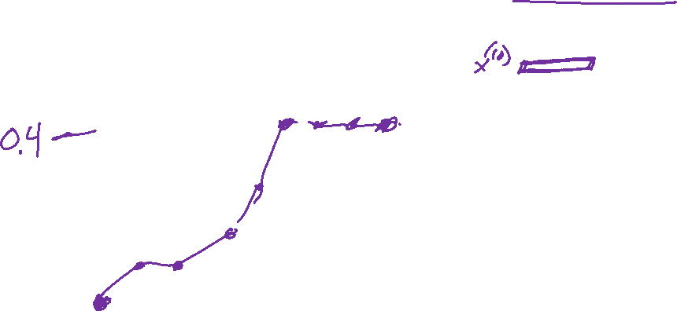
Example of Hyperparameter Optimization
Choosing k for k-NN
Slide credit: CMU MLD Matt Gormley

Slide 20



Example of Hyperparameter Optimization
Choosing k for k-NN
Slide credit: CMU MLD Matt Gormley

Slide 21
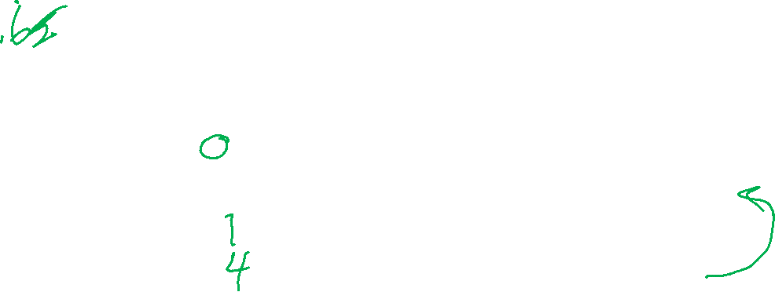
Example of Hyperparameter Optimization
Choosing k for k-NN
Slide credit: CMU MLD Matt Gormley

Slide 22
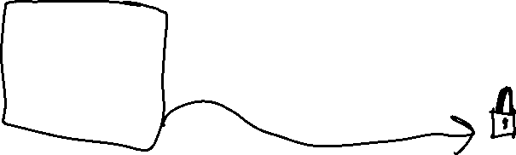
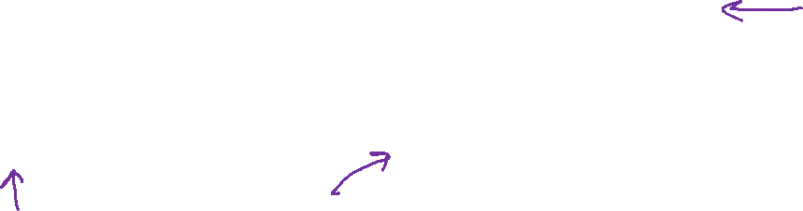
Example of Hyperparameter Optimization
Choosing k for k-NN
Slide credit: CMU MLD Matt Gormley

Slide 23
Example of Hyperparameter Optimization
Choosing k for k-NN
Slide credit: CMU MLD Matt Gormley

Slide 24
k-NN: Choosing k
Fisher Iris Data: varying the value of k
Slide credit: CMU MLD Matt Gormley

Slide 25
k-NN: Choosing k
Gaussian Data: varying the value of k
Slide credit: CMU MLD Matt Gormley

Slide 26
Cross-validation
Why do we need cross-validation?
Choose hyperparameters
Choose technique
Help make any choices beyond our parameters
But now, we have another choice to make!
How do we split training and validation?
Trade-offs
More held-out data, better meaning behind validation numbers
More held-out data, less data to train on!

Slide 27
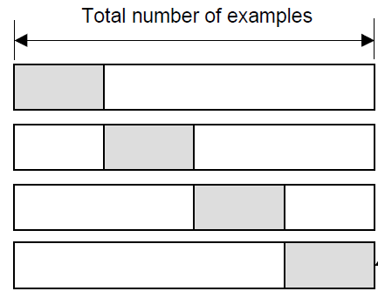
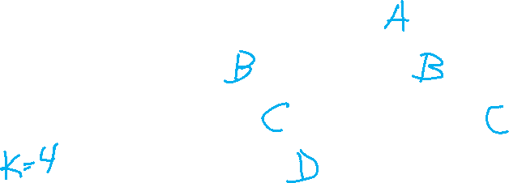
Cross-validation
K-fold cross-validation
Create K-fold partition of the dataset.
Do K runs: train using K-1 partitions and calculate validation error on remaining partition (rotating validation partition on each run).
Report average validation error
training
validation
Run 1
Run 2
Run K
Slide credit: CMU MLD Aarti Singh
TexPoint fonts used in EMF.
Read the TexPoint manual before you delete this box.: AAAAAAA

Slide 28
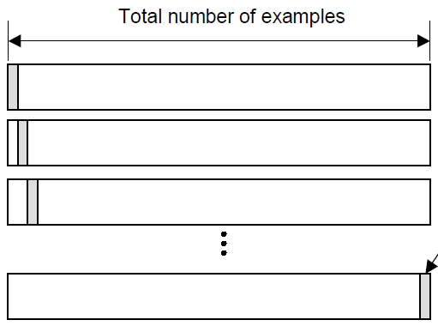
Cross-validation
Leave-one-out (LOO) cross-validation
Special case of K-fold with K=N partitions
Equivalently, train on N-1 samples and validate on only one sample per run for N runs
training
validation
Run 1
Run 2
Run K
Slide credit: CMU MLD Aarti Singh
TexPoint fonts used in EMF.
Read the TexPoint manual before you delete this box.: AAAAAAA

Slide 29
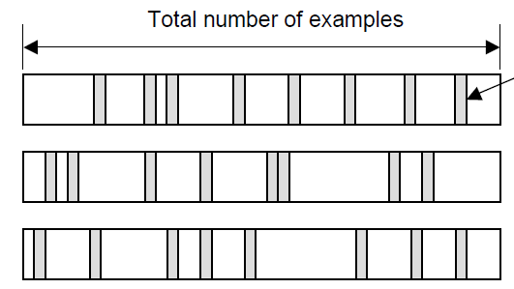
Cross-validation
Random subsampling
Randomly subsample a fixed fraction αN (0< α <1) of the dataset for validation.
Compute validation error with remaining data as training data.
Repeat K times
Report average validation error
training
validation
Run 1
Run 2
Run K
Slide credit: CMU MLD Aarti Singh
TexPoint fonts used in EMF.
Read the TexPoint manual before you delete this box.: AAAAAAA

Slide 30
Poll 3
Say you are choosing amongst 7 discrete values of a decision tree mutual information threshold, and you want to do K=5-fold cross-validation.
How many times do I have to train my model?
1
5
7
12
35
5⁷
Notes:
0

Slide 31


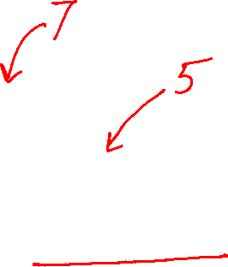
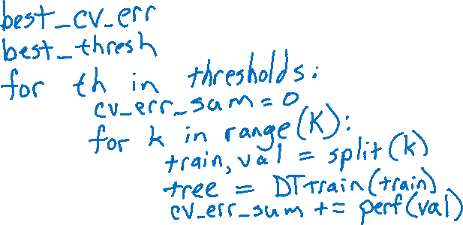
Poll 3
Say you are choosing amongst 7 discrete values of a decision tree mutual information threshold, and you want to do K=5-fold cross-validation.
How many times do I have to train my model?
1
5
7
12
35
5⁷
Notes:
0

Slide 32
Experimental Design
 | Input | Output | Notes
Training | training dataset hyperparameters | best model parameters | We pick the best model parameters by learning on the training dataset for a fixed set of hyperparameters
Hyperparameter Optimization | training dataset validation dataset | best hyperparameters | We pick the best hyperparameters by learning on the training data and evaluating error on the validation error
Testing | test dataset hypothesis (i.e. fixed model parameters) | test error | We evaluate a hypothesis corresponding to a decision rule with fixed model parameters on a test dataset to obtain test error
Slide credit: CMU MLD Matt Gormley

