Slide 1

10-315 Introduction to ML K-Nearest Neighbor
Instructor: Pat Virtue

Slide 2
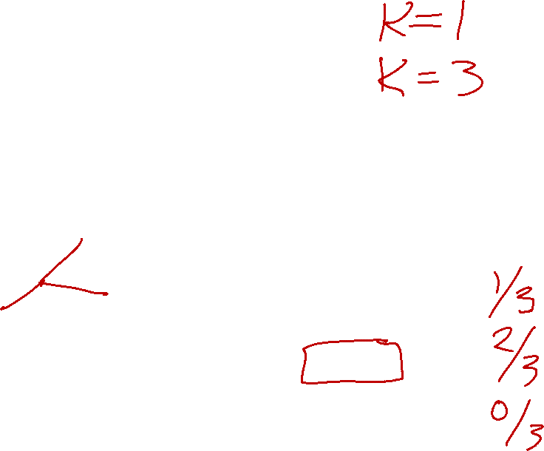

Nearest Neighbor Classifier
Test subject
Whales
Seals
Sharks

Slide 3
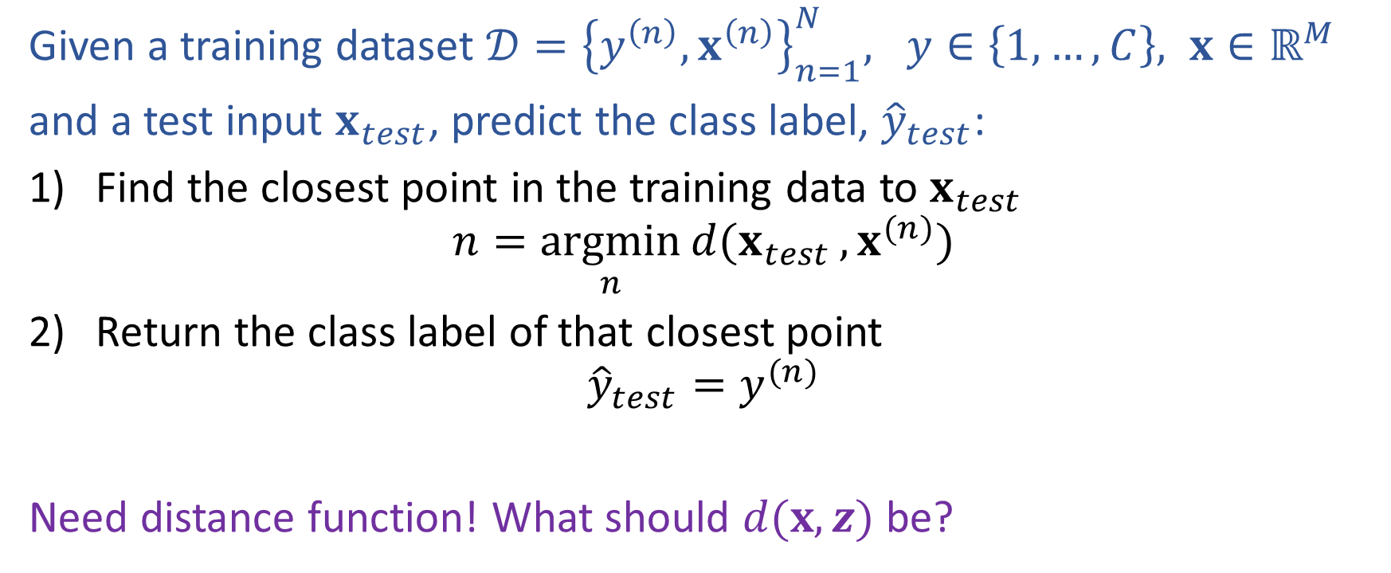
Nearest Neighbor Classification
Given a training dataset $𝒟={\left\{y^{\left(n\right)}, x^{\left(n\right)}\right\}}_{n=1}^{N}, y∈\left\{1,…,C\right\}, x∈ℝ^{M}$
and a test input $x_{test}$, predict the class label, ${\hat{y}}_{test}$:
Find the closest point in the training data to $x_{test}$
$$n=\underset{n}{argmin}{d(x_{test}}, x^{(n)})$$
Return the class label of that closest point
$${\hat{y}}_{test}=y^{(n)}$$
Need distance function! What should $d(x, z)$ be?

Slide 4
Fisher Iris Dataset
Fisher (1936) used 150 measurements of flowers from 3 different species: Iris setosa (0), Iris virginica (1), Iris versicolor (2) collected by Anderson (1936)
Species | Sepal Length | Sepal Width | Petal Length | Petal Width
0 | 4.3 | 3.0 | 1.1 | 0.1
0 | 4.9 | 3.6 | 1.4 | 0.1
0 | 5.3 | 3.7 | 1.5 | 0.2
1 | 4.9 | 2.4 | 3.3 | 1.0
1 | 5.7 | 2.8 | 4.1 | 1.3
1 | 6.3 | 3.3 | 4.7 | 1.6
1 | 6.7 | 3.0 | 5.0 | 1.7
Full dataset: https://en.wikipedia.org/wiki/Iris_flower_data_set

Slide 5
Fisher Iris Dataset
Fisher (1936) used 150 measurements of flowers from 3 different species: Iris setosa (0), Iris virginica (1), Iris versicolor (2) collected by Anderson (1936)
Species | Sepal Length | Sepal Width
0 | 4.3 | 3.0
0 | 4.9 | 3.6
0 | 5.3 | 3.7
1 | 4.9 | 2.4
1 | 5.7 | 2.8
1 | 6.3 | 3.3
1 | 6.7 | 3.0
Deleted two of the four features, so that input space is 2D
Full dataset: https://en.wikipedia.org/wiki/Iris_flower_data_set

Slide 6
Nearest Neighbor on Fisher Iris Data
Slide credit: CMU MLD Matt Gormley

Slide 7
Nearest Neighbor on Fisher Iris Data
Slide credit: CMU MLD Matt Gormley

Slide 8
Poll (unused)
Which methods can achieve zero training error on this dataset?
Decision trees
1-Nearest Neighbor
Both
Neither
If zero error, draw the decision boundary.
Otherwise, why not?
x₂
x₁

Slide 9

Recitation: Decision Boundaries
Decision tree
Nearest neighbor
x₂
x₂
x₁
x₁

Slide 10
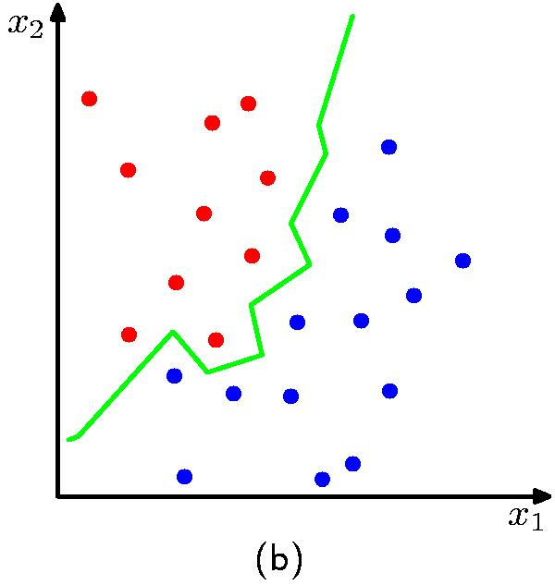
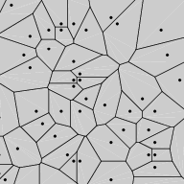
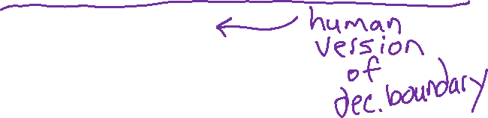

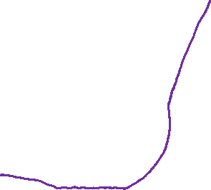
Nearest Neighbor Decision Boundary
1-nearest neighbor classifier decision boundary
Voronoi Diagram

Slide 11




Nearest Neighbor Classification
Consider input features $x∈ℝ^{2}$.
$$x_{2}$$
10
5
$$x_{1}$$
5
10

Slide 12
Nearest Neighbor on Fisher Iris Data
Slide credit: CMU MLD Matt Gormley

Slide 13
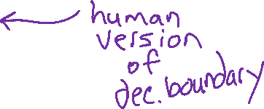
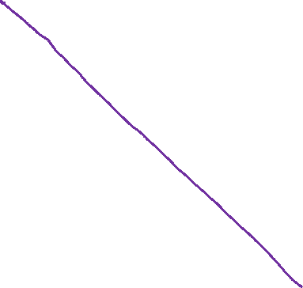
Nearest Neighbor on Gaussian Data
Slide credit: CMU MLD Matt Gormley

Slide 14
Nearest Neighbor on Gaussian Data
Slide credit: CMU MLD Matt Gormley

Slide 15
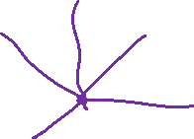
kNN classifier (k=5)
Test subject
Whales
Seals
Sharks

Slide 16
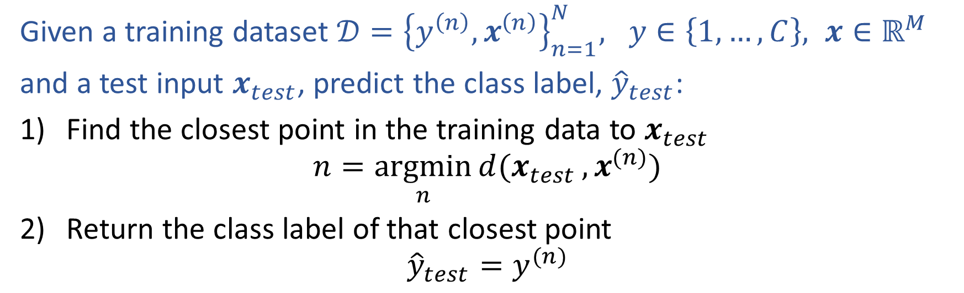
Nearest Neighbor Classification
Given a training dataset $𝒟={\left\{y^{\left(n\right)}, x^{\left(n\right)}\right\}}_{n=1}^{N}, y∈\left\{1,…,C\right\}, x∈ℝ^{M}$
and a test input $x_{test}$, predict the class label, ${\hat{y}}_{test}$:
Find the closest point in the training data to $x_{test}$
$$n=\underset{n}{argmin}{d(x_{test}}, x^{(n)})$$
Return the class label of that closest point
$${\hat{y}}_{test}=y^{(n)}$$

Slide 17
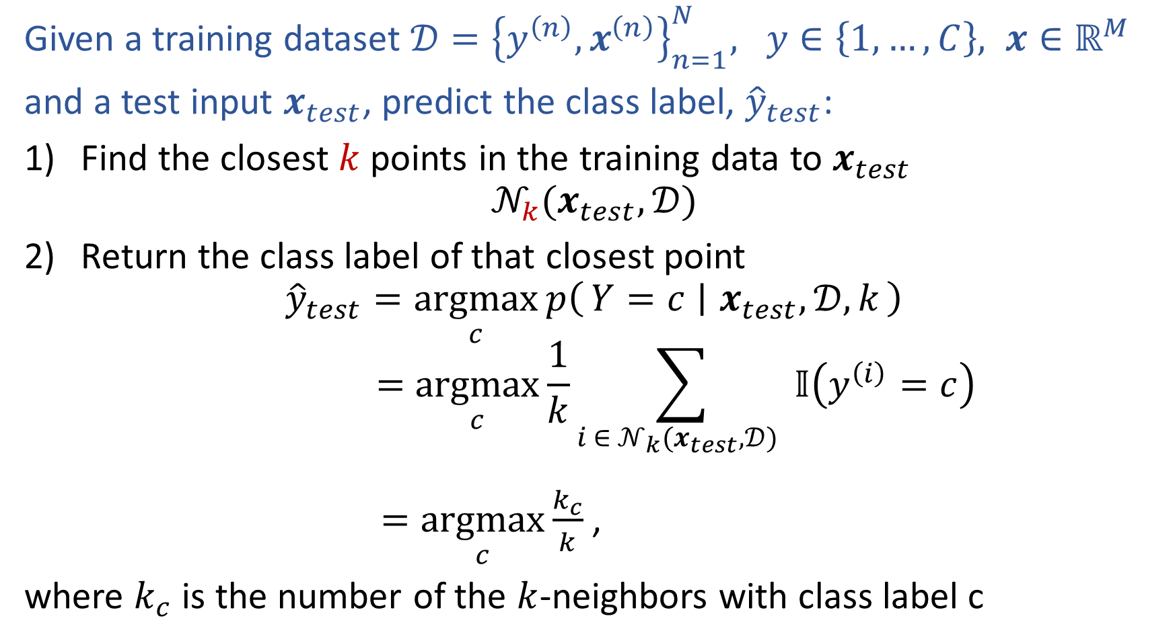
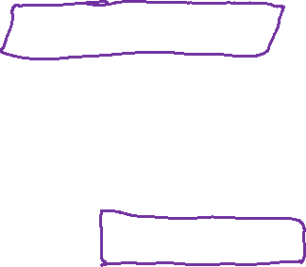
k-Nearest Neighbor Classification
Given a training dataset $𝒟={\left\{y^{\left(n\right)}, x^{\left(n\right)}\right\}}_{n=1}^{N}, y∈\left\{1,…,C\right\}, x∈ℝ^{M}$
and a test input $x_{test}$, predict the class label, ${\hat{y}}_{test}$:
Find the closest $k$ points in the training data to $x_{test}$
$$𝒩_{k}(x_{test},𝒟)$$
Return the class label of that closest point
$${\hat{y}}_{test}=\underset{c}{argmax}{p\left(Y=c ∣ x_{test},𝒟, k\right)}$$
$$=\underset{c}{argmax}{\frac{1}{k}\sum_{i ∈ 𝒩_{k}(x_{test},𝒟) }{𝕀\left(y^{\left(i\right)}=c\right)}}$$
$=\underset{c}{argmax}{\frac{k_{c}}{k}}$,
where $k_{c}$ is the number of the $k$-neighbors with class label c

Slide 18
1-Nearest Neighbor (kNN) classifier
Sports
Whales
Seals
Science
Sharks
Arts

Slide 19
2-Nearest Neighbor (kNN) classifier
Sports
Whales
Seals
Science
Sharks
Arts

Slide 20
3-Nearest Neighbor (kNN) classifier
Sports
Whales
Seals
Science
Sharks
Arts

Slide 21
5-Nearest Neighbor (kNN) classifier
Sports
Whales
Seals
Science
Sharks
Arts

Slide 22
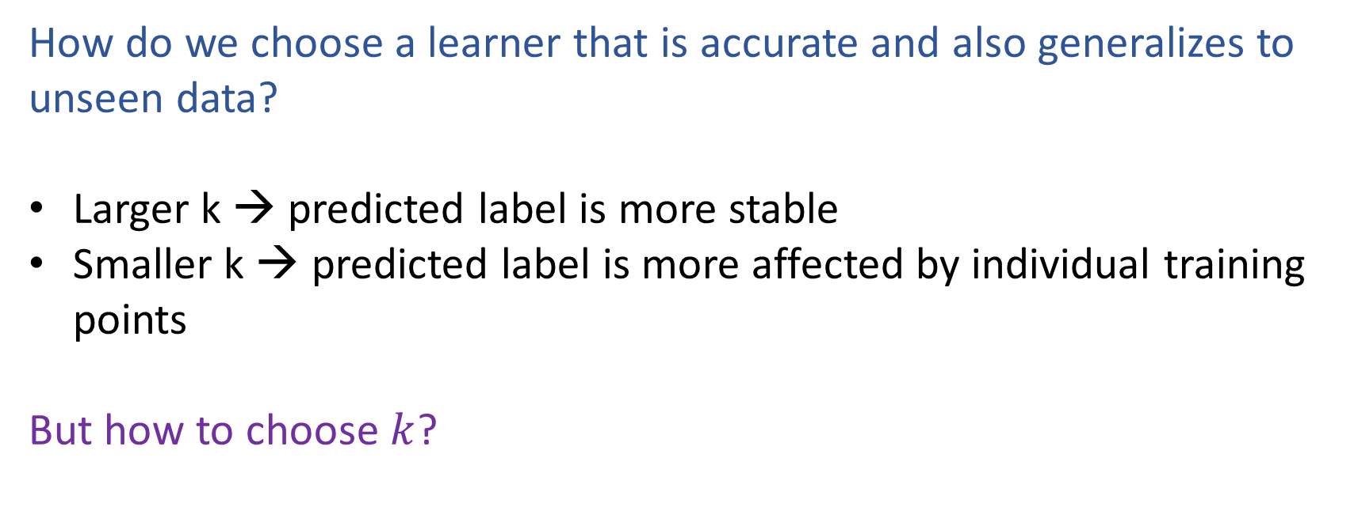
What is the best k?
How do we choose a learner that is accurate and also generalizes to unseen data?
Larger k → predicted label is more stable
Smaller k → predicted label is more affected by individual training points
But how to choose $k$?

Slide 23
k-NN on Fisher Iris Data
Special Case: Nearest Neighbor
Slide credit: CMU MLD Matt Gormley

Slide 24
k-NN on Fisher Iris Data
Slide credit: CMU MLD Matt Gormley

Slide 25
k-NN on Fisher Iris Data
Slide credit: CMU MLD Matt Gormley

Slide 26
k-NN on Fisher Iris Data
Slide credit: CMU MLD Matt Gormley

Slide 27
k-NN on Fisher Iris Data
Slide credit: CMU MLD Matt Gormley

Slide 28
k-NN on Fisher Iris Data
Slide credit: CMU MLD Matt Gormley

Slide 29
k-NN on Fisher Iris Data
Special Case: Majority Vote
Slide credit: CMU MLD Matt Gormley

Slide 30
K-NN Details

Slide 31
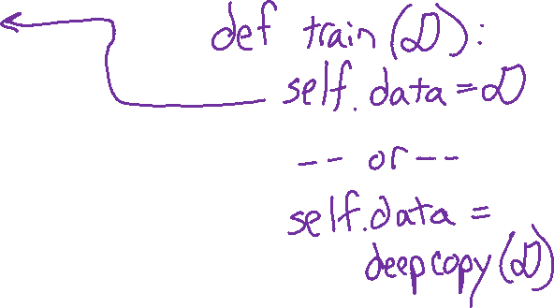
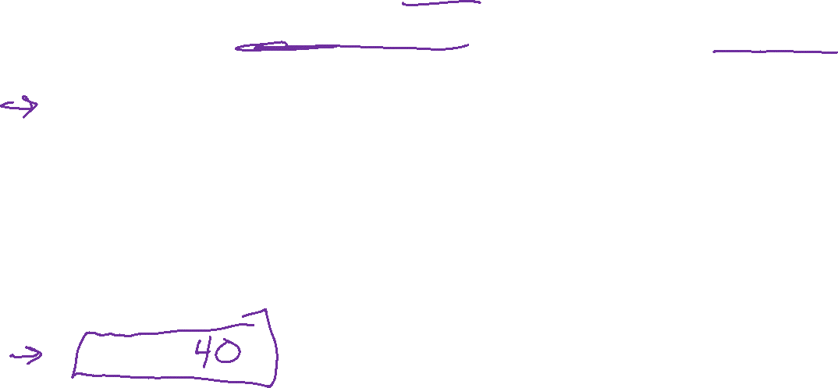
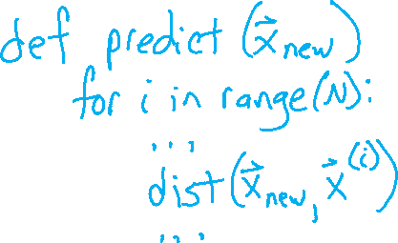
Poll 1: Two questions (train) and (predict)
Suppose we have N training examples, and each one has M features
Computational complexity for the special case where k=1:
O(1)
O(log N)
O(log M)
O(log NM)
O(N)
O(M)
O(NM)
O(N^2)
O(N^2M)

Slide 32

k-NN: Details
Computational Efficiency:
Suppose we have N training examples, and each one has M features
Computational complexity for the special case where k=1:
Task | Naive
Train | O(1)
Predict (one test example) | O(MN)
In practice:
k-d trees
stochastic approximations (very fast, and empirically often as good)
Slide credit: CMU MLD Matt Gormley
Notes:
https://www.ri.cmu.edu/pub_files/pub1/moore_andrew_1991_1/moore_andrew_1991_1.pdf

Slide 33

k-NN: Details
The inductive bias of a machine learning algorithm is the principal by which it generalizes to unseen examples
Inductive Bias:
Close points should have similar labels
All dimensions are created equally!
Slide credit: CMU MLD Matt Gormley

Slide 34
k-NN: Details
Inductive Bias:
Close points should have similar labels
All dimensions are created equally!
Example: two features for k-NN
big problem: feature scale could dramatically influence classification results
length (cm)
length (cm)
Slide credit: CMU MLD Matt Gormley
width (cm)
width (m)

