Slide 1

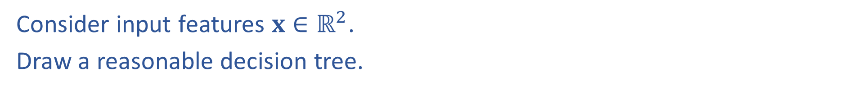
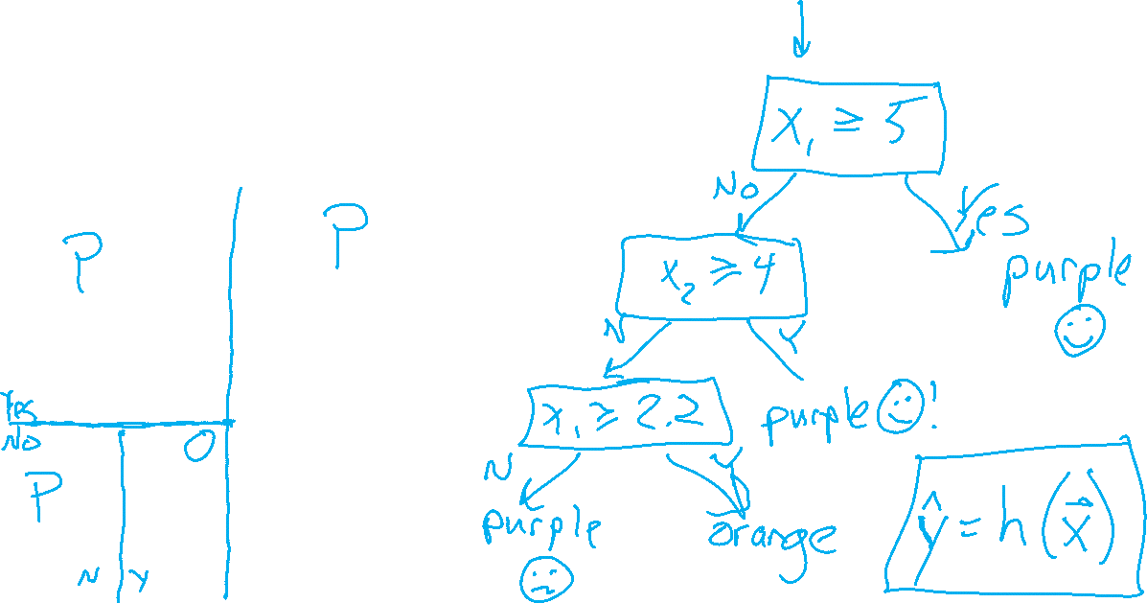


Warm-up as you walk in: Worksheet
Consider input features $x∈ℝ^{2}$.
Draw a reasonable decision tree.
$$x_{2}$$
10
5
$$x_{1}$$
5
10

Slide 2

10-315 Introduction to ML Decision Trees
Instructor: Pat Virtue

Slide 3

Outline: Decision Trees
Motivation
Pre-reading Content
Example decision trees for classification tasks
Majority vote and classification error rate
Decision stumps
Decision Boundaries
Building Decision Trees
Splitting criteria: Entropy and Mutual Information
Stopping criteria

Slide 4
Decision Trees
Why are we talking about decision trees?
Explainability
Decision trees can be incredibly useful as they can more easily be interpreted and altered by humans than other ML algorithms
Basis of very powerful set of techniques: Random Forests
Random forests train many simple decision trees (ML topic: ensemble learning)
While powerful, random forests unfortunately have poor explainablility

Slide 5
Pre-reading Content

Slide 6

Problem Formulation
$x={\left[\begin{aligned}x_{1} \\ x_{2} \\ x_{3}\end{aligned}\right]=\left[x_{1},x_{2}, x_{3}\right]}^{T}$
$x_{1}∈\{Vertex, Breech, Abn\}$
$x_{2}∈\{Y,N\}$
$x_{3}∈\{Y,N\}$
$y∈\{Csection, Natural\}$
$\hat{y}=h(x)$
Medical Prediction
$y$ $x_{1} x_{2}$ $x_{3}$
Outcome | Fetal Position | Fetal Distress | Previous C-sec
Natural | Vertex | N | N
C-section | Breech | N | N
Natural | Vertex | Y | Y
C-section | Vertex | N | Y
Natural | Abnormal | N | N

Slide 7
Decision Tree
Fetal
Position
Medical Prediction
(Oversimplified example)
Vertex
Abnormal
Breech
Fetal
Distress
C-section
C-section
No
Yes
Previous
C-section
C-section
No
Yes
Natural
C-section

Slide 8
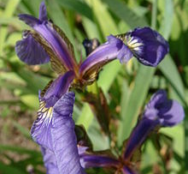
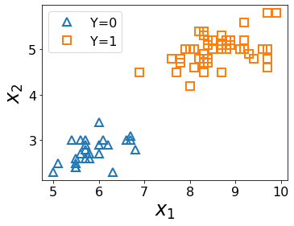
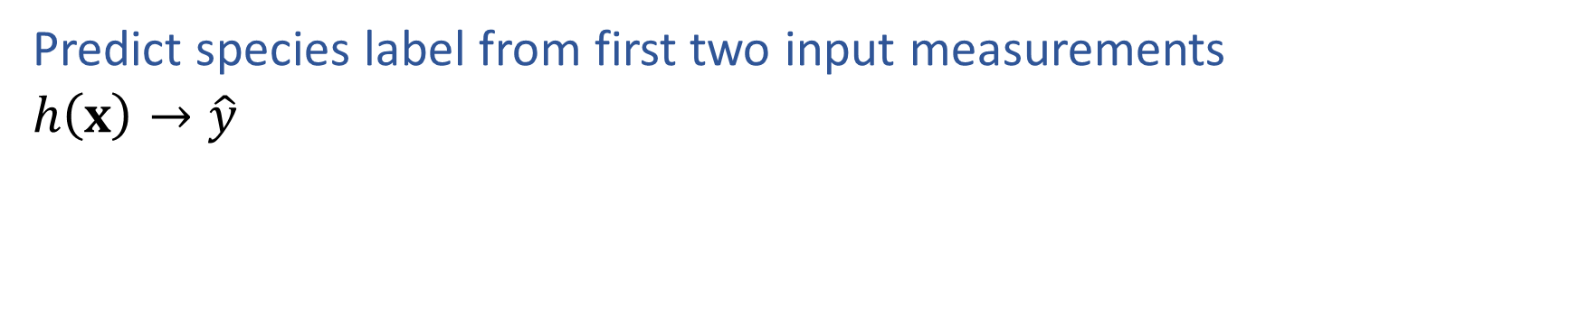
ML Task: Classification
Predict species label from first two input measurements
$h\left(x\right)→\hat{y}$
Species | Sepal Length | Sepal Width
0 | 4.3 | 3.0
0 | 4.9 | 3.6
0 | 5.3 | 3.7
1 | 4.9 | 2.4
1 | 5.7 | 2.8
1 | 6.3 | 3.3
Images and full dataset: https://en.wikipedia.org/wiki/Iris_flower_data_set

Slide 9
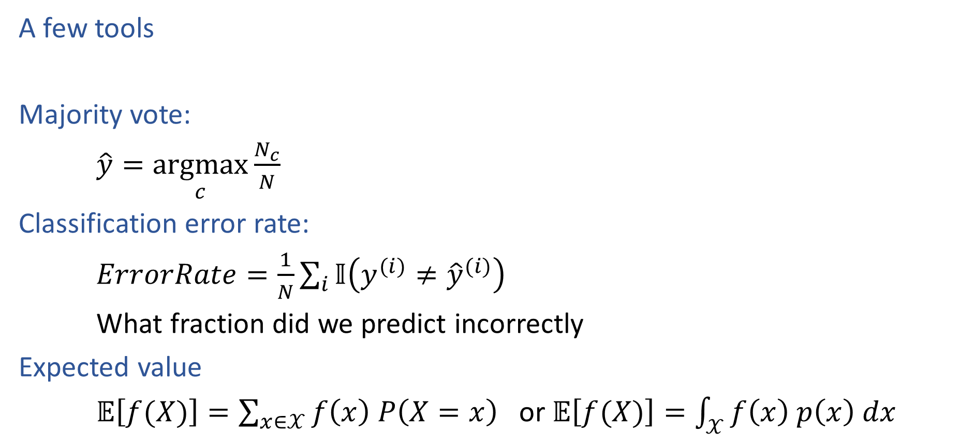
Decision Trees
Species | Sepal Length | Sepal Width | Petal Length | Petal Width
0 | 4.3 | 3.0 | 1.1 | 0.1
0 | 4.9 | 3.6 | 1.4 | 0.1
0 | 5.3 | 3.7 | 1.5 | 0.2
1 | 4.9 | 2.4 | 3.3 | 1.0
1 | 5.7 | 2.8 | 4.1 | 1.3
1 | 6.3 | 3.3 | 4.7 | 1.6
2 | 5.9 | 3.0 | 5.1 | 1.8
A few tools
Majority vote:
$\hat{y}=\underset{c}{argmax}{\frac{N_{c}}{N}}$
Classification error rate:
$ErrorRate=\frac{1}{N}\sum_{i}{𝕀\left(y^{(i)}≠{\hat{y}}^{(i)}\right)}$
What fraction did we predict incorrectly
Expected value
$𝔼\left[f(X)\right]=\sum_{x∈𝒳}{f\left(x\right) P\left(X=x\right)}$ or $𝔼\left[f(X)\right]=\int_{𝒳}{f\left(x\right) p\left(x\right) dx}$

Slide 10
Decision Stumps
Split data based on a single attribute
Majority vote at leaves
Dataset: Output Y, Attributes A, B, C
Y | A | B | C
- | 1 | 0 | 0
- | 1 | 0 | 1
- | 1 | 0 | o
+ | 0 | 0 | 1
+ | 1 | 1 | 0
+ | 1 | 1 | 1
+ | 1 | 1 | 0
+ | 1 | 1 | 1
Slide credit: CMU MLD Matt Gormley

Slide 11
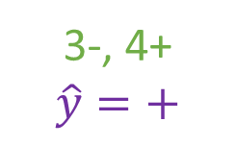
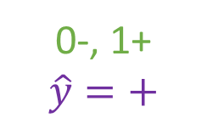
Decision Stumps
Split data based on a single attribute
Majority vote at leaves
Dataset: Output Y, Attributes A, B, C
Y | A | B | C
- | 1 | 0 | 0
- | 1 | 0 | 1
- | 1 | 0 | o
+ | 0 | 0 | 1
+ | 1 | 1 | 0
+ | 1 | 1 | 1
+ | 1 | 1 | 0
+ | 1 | 1 | 1
3-, 5+
A
A=0
A=1
0-, 1+
$$\hat{y}=+$$
3-, 4+
$$\hat{y}=+$$
Error: ( 0 + 3 ) / 8
= 3/8
Slide credit: CMU MLD Matt Gormley

Slide 12
Poll (not used)
Splitting on which attribute {A, B, C} creates a decision stump with the lowest training error?
Dataset: Output Y, Attributes A, B, C
Y | A | B | C
- | 1 | 0 | 0
- | 1 | 0 | 1
- | 1 | 0 | o
+ | 0 | 0 | 1
+ | 1 | 1 | 0
+ | 1 | 1 | 1
+ | 1 | 1 | 0
+ | 1 | 1 | 1
3-, 5+
A
A=0
A=1
0-, 1+
$$\hat{y}=+$$
3-, 4+
$$\hat{y}=+$$
Error: ( 0 + 3 ) / 8
= 3/8
Slide credit: CMU MLD Matt Gormley

Slide 13
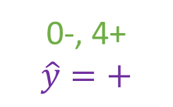
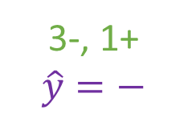
Poll (not used)
Splitting on which attribute {A, B, C} creates a decision stump with the lowest training error?
Answer: B
Dataset: Output Y, Attributes A, B, C
Y | A | B | C
- | 1 | 0 | 0
- | 1 | 0 | 1
- | 1 | 0 | o
+ | 0 | 0 | 1
+ | 1 | 1 | 0
+ | 1 | 1 | 1
+ | 1 | 1 | 0
+ | 1 | 1 | 1
3-, 5+
B
B=0
B=1
3-, 1+
$$\hat{y}=−$$
0-, 4+
$$\hat{y}=+$$
Error: ( 1 + 0 ) / 8
= 1/8
Slide credit: CMU MLD Matt Gormley

Slide 14
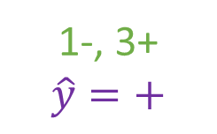
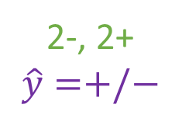
Poll (not used)
Splitting on which attribute {A, B, C} creates a decision stump with the lowest training error?
Answer: B
Dataset: Output Y, Attributes A, B, C
Y | A | B | C
- | 1 | 0 | 0
- | 1 | 0 | 1
- | 1 | 0 | o
+ | 0 | 0 | 1
+ | 1 | 1 | 0
+ | 1 | 1 | 1
+ | 1 | 1 | 0
+ | 1 | 1 | 1
3-, 5+
C
C=0
C=1
2-, 2+
$$\hat{y}=+/−$$
1-, 3+
$$\hat{y}=+$$
Error: ( 2 + 1 ) / 8
= 3/8
Slide credit: CMU MLD Matt Gormley

Slide 15

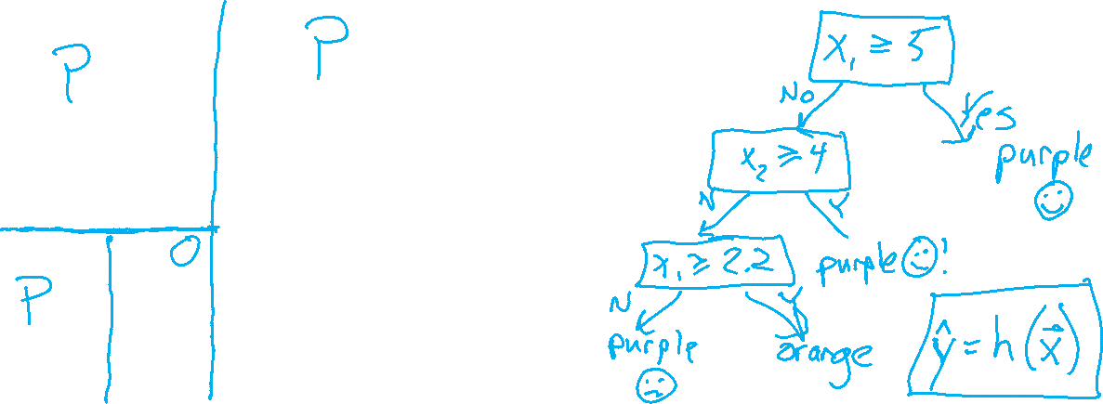
Decision Boundaries
Decision boundaries are the locations in the input space that separate regions where input points $x$ are classified as different classes.
$$x_{2}$$
10
5
$$x_{1}$$
5
10

Slide 16
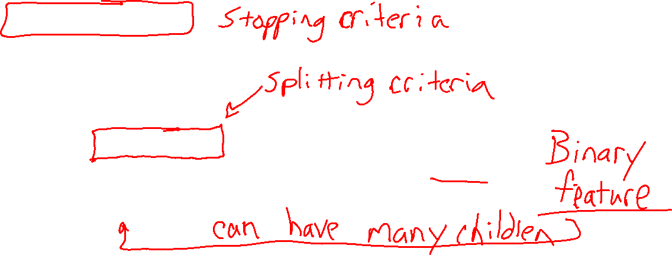
Building a Decision Tree
Function BuildTree(D, Attributes)
# D: dataset at current node
# Attributes : current set of attributes
# TODO Base Case
else
# Internal node
X ⇐ bestAttribute(D, Attributes)
LeftNode = BuildTree(D(X=1), Attributes \ {X})
RightNode = BuildTree(D(X=0), Attributes \ {X})
end
end

Slide 17
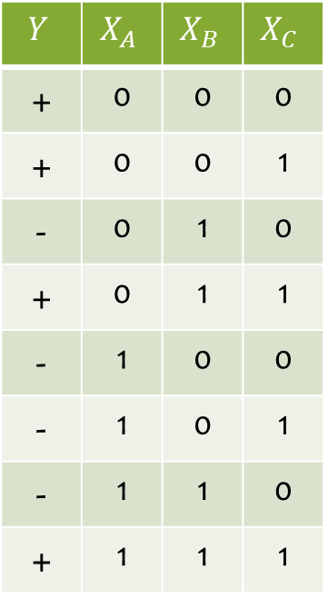
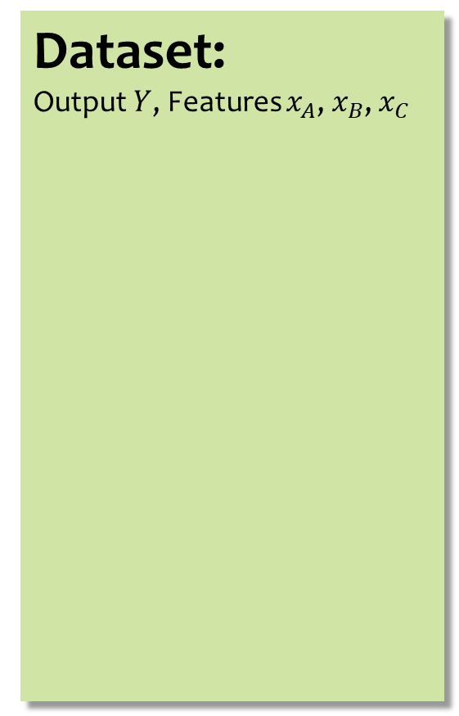
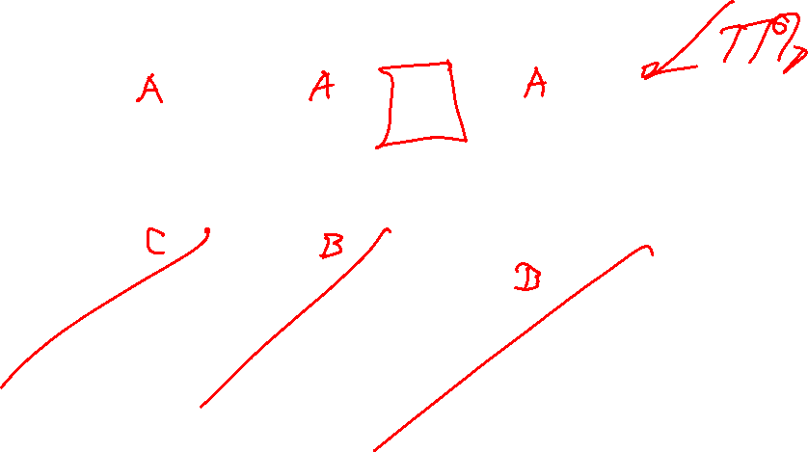
Poll 1
Dataset: Output $Y$, Features $x_{A}$, $x_{B}$, $x_{C}$
Which of the following trees would be learned by the decision tree learning algorithm using “error rate” as the splitting criterion?
(Assume ties are broken alphabetically.)
$$Y$$ | $$X_{A}$$ | $$X_{B}$$ | $$X_{C}$$
+ | 0 | 0 | 0
+ | 0 | 0 | 1
- | 0 | 1 | 0
+ | 0 | 1 | 1
- | 1 | 0 | 0
- | 1 | 0 | 1
- | 1 | 1 | 0
+ | 1 | 1 | 1
1
A
2
A
3
A
0
1
0
1
0
1
C
C
B
C
B
B
0
1
0
1
0
1
0
1
0
1
0
1
+
-
-
+
+
-
-
+
+
C
-
C
0
1
0
1
4
C
5
B
-
+
-
+
0
1
0
1
6
B
B
A
A
C
0
1
0
1
0
1
0
1
0
1
A
A
+
-
-
+
+
-
-
+
0
1
0
1
+
-
C
C
0
1
0
1
+
-
-
+
Slide credit: CMU MLD Matt Gormley

Slide 18
Poll 1
Dataset: Output $Y$, Features $x_{A}$, $x_{B}$, $x_{C}$
Which of the following trees would be learned by the the decision tree learning algorithm using “error rate” as the splitting criterion?
(Assume ties are broken alphabetically.)
$$Y$$ | $$X_{A}$$ | $$X_{B}$$ | $$X_{C}$$
+ | 0 | 0 | 0
+ | 0 | 0 | 1
- | 0 | 1 | 0
+ | 0 | 1 | 1
- | 1 | 0 | 0
- | 1 | 0 | 1
- | 1 | 1 | 0
+ | 1 | 1 | 1
1
A
2
A
3
A
0
1
0
1
0
1
C
C
B
C
B
B
0
1
0
1
0
1
0
1
0
1
0
1
+
-
-
+
+
-
-
+
+
C
-
C
0
1
0
1
4
C
5
B
-
+
-
+
0
1
0
1
6
B
B
A
A
C
0
1
0
1
0
1
0
1
0
1
A
A
+
-
-
+
+
-
-
+
0
1
0
1
+
-
C
C
0
1
0
1
+
-
-
+
Slide credit: CMU MLD Matt Gormley

Slide 19
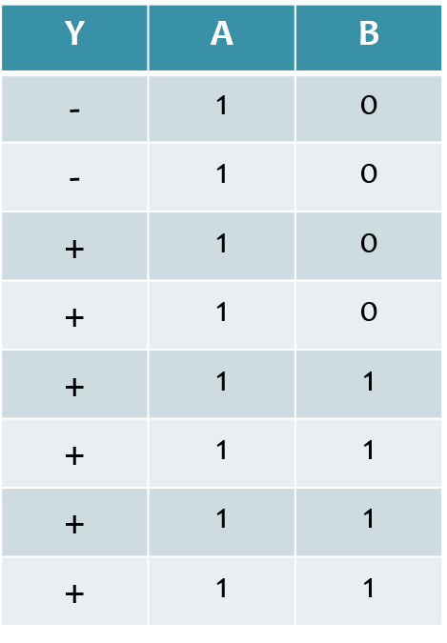
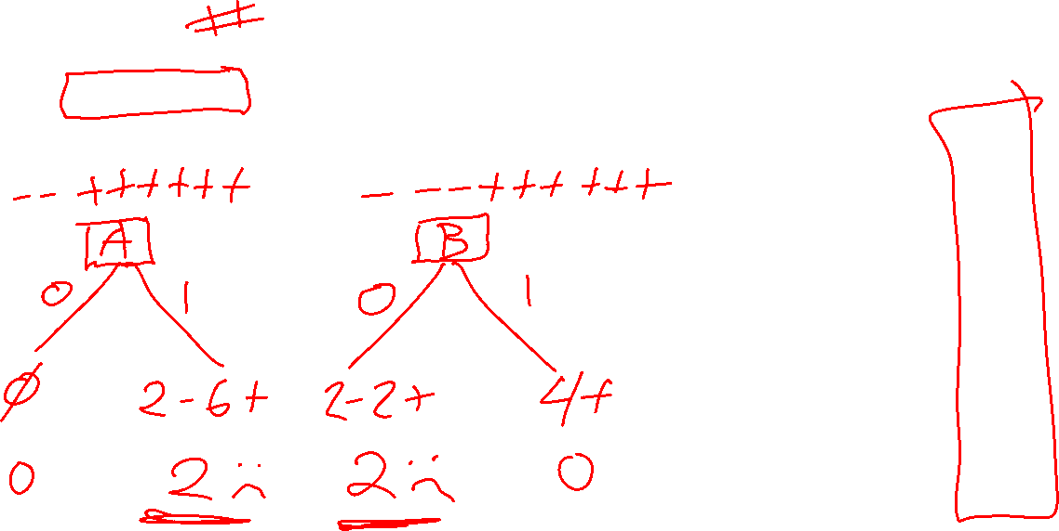
Poll 2
Dataset: Output Y, Features A and B
How many errors do each of the two decision stumps make on the training set?
Slide credit: CMU MLD Matt Gormley

Slide 20
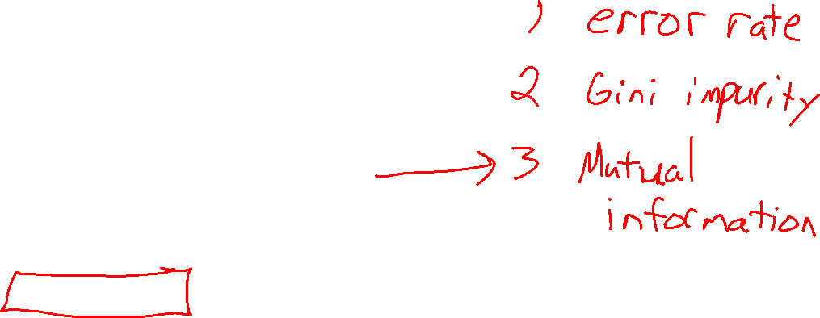
Building a Decision Tree
Function BuildTree(D, Attributes)
# D: dataset at current node
# Attributes : current set of attributes
# TODO Base Case
else
# Internal node
X ⇐ bestAttribute(D, Attributes)
LeftNode = BuildTree(D(X=1), Attributes \ {X})
RightNode = BuildTree(D(X=0), Attributes \ {X})
end
end

Slide 21
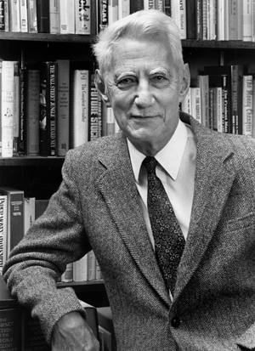
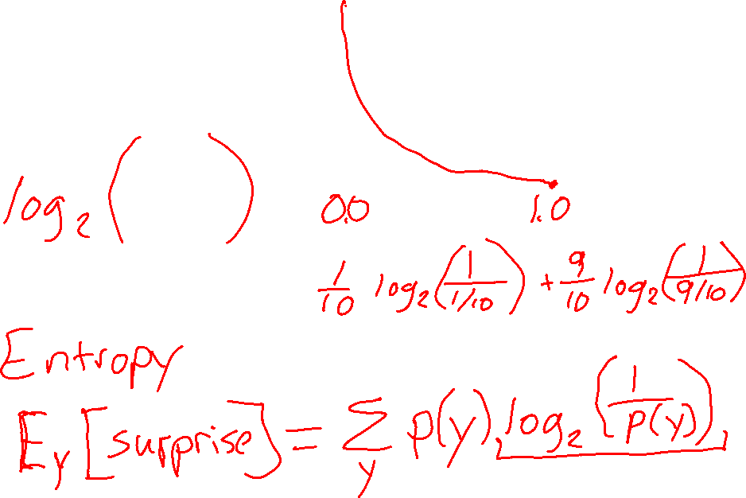
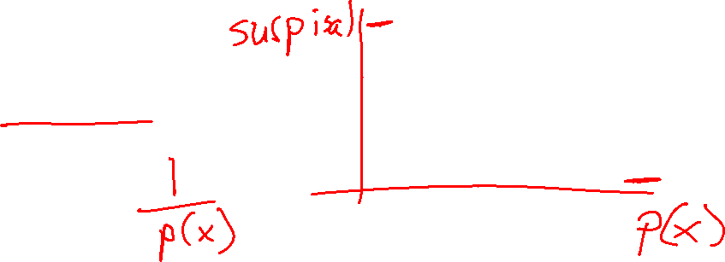
Entropy
Surprisal
Claude Shannon (1916 – 2001), most of the work was done in Bell labs

Slide 22
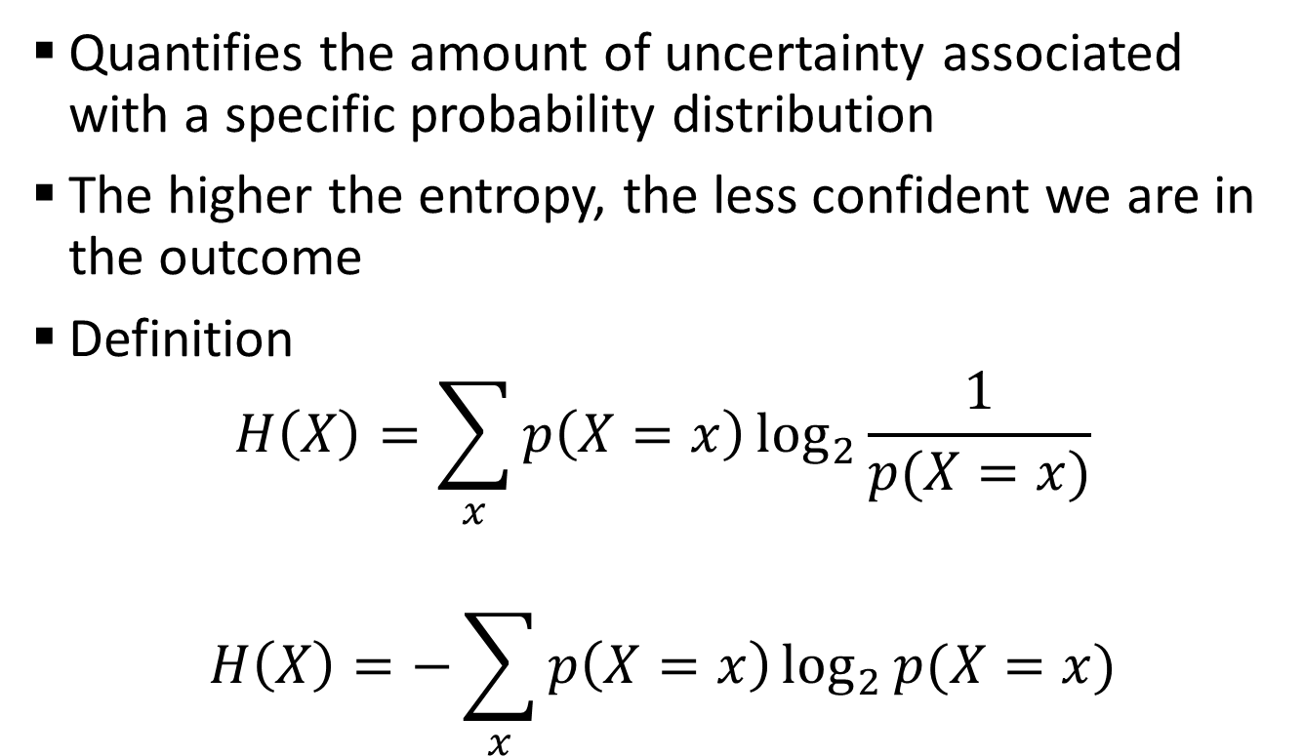
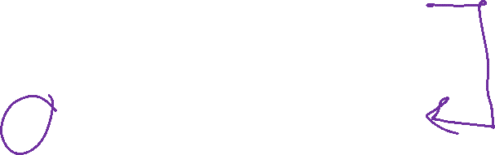
Entropy
Quantifies the amount of uncertainty associated with a specific probability distribution
The higher the entropy, the less confident we are in the outcome
Definition
$$H\left(X\right)=\sum_{x}{p\left(X=x\right)\log_{2}{\frac{1}{p(X=x)}}}$$
$$H\left(X\right)=−\sum_{x}{p\left(X=x\right)\log_{2}{p(X=x)}}$$
Claude Shannon (1916 – 2001), most of the work was done in Bell labs

Slide 23
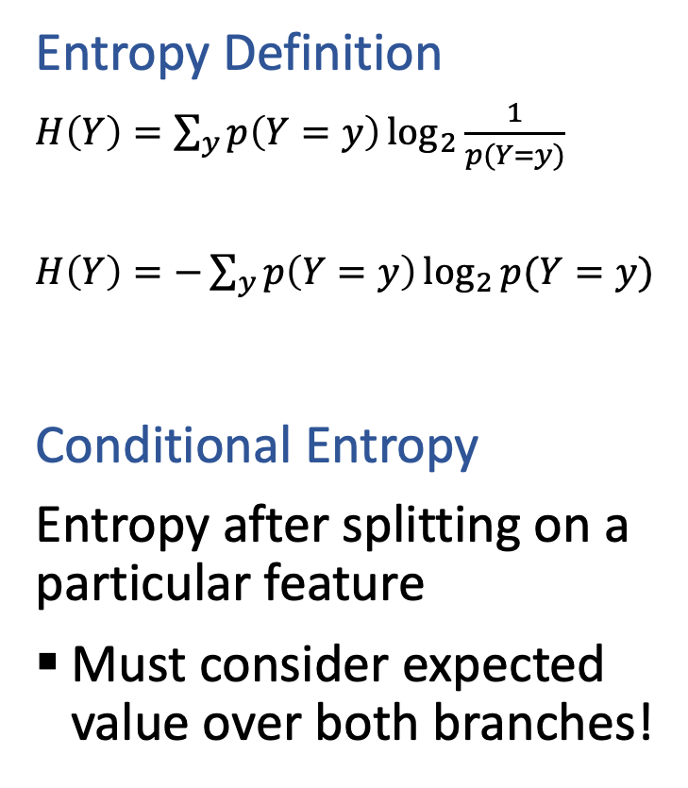
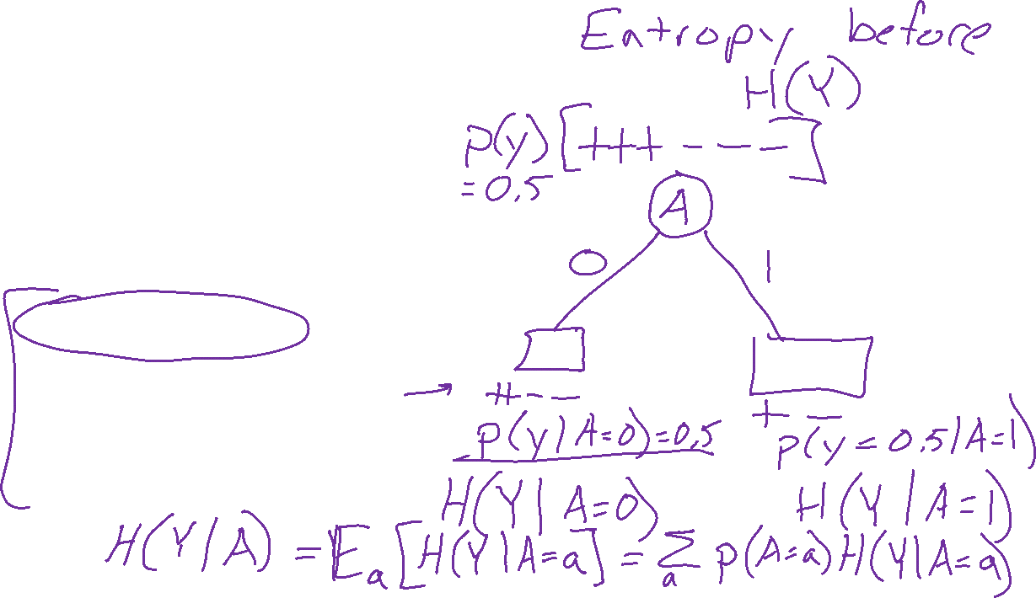
Conditional Entropy
Entropy Definition
$H\left(Y\right)=\sum_{y}{p\left(Y=y\right)\log_{2}{\frac{1}{p(Y=y)}}}$
$H\left(Y\right)=−\sum_{y}{p\left(Y=y\right)\log_{2}{p(Y=y)}}$
Conditional Entropy
Entropy after splitting on a particular feature
Must consider expected value over both branches!

Slide 24
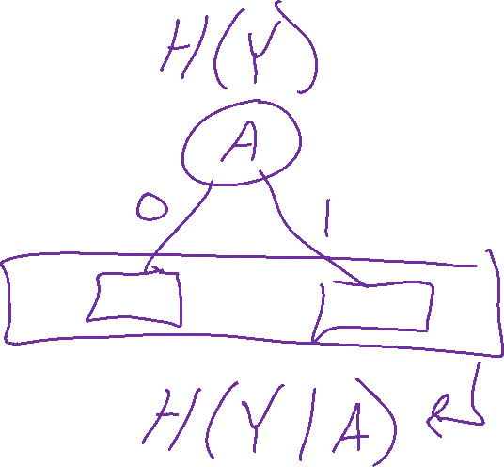
Conditional Entropy
Entropy Definition
$H\left(Y\right)=\sum_{y}{p\left(Y=y\right)\log_{2}{\frac{1}{p(Y=y)}}}$
$H\left(Y\right)=−\sum_{y}{p\left(Y=y\right)\log_{2}{p(Y=y)}}$
Conditional Entropy
Entropy after splitting on a particular feature
Must consider expected value over both branches!

Slide 25
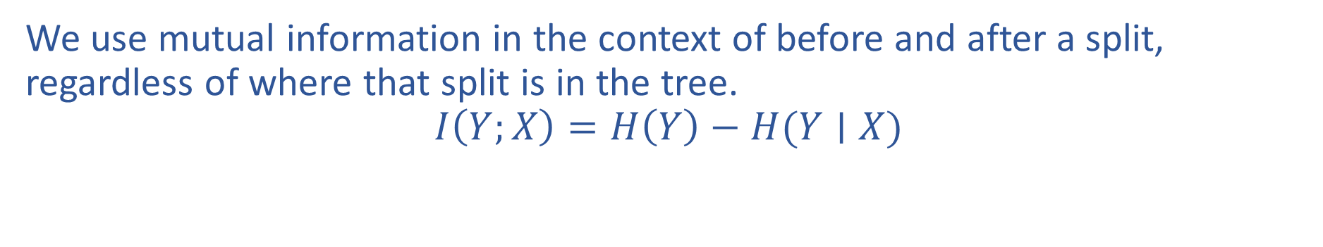
Mutual Information Notation
We use mutual information in the context of before and after a split, regardless of where that split is in the tree.
$$I\left(Y;X\right)=H\left(Y\right)−H(Y∣X)$$

Slide 26
Mutual Information
Slide credit: CMU MLD Matt Gormley
Notes:
In the preamble: \usepackage[fleqn]{amsmath}
Entropy:
\begin{align*} H(Y) = - \sum_{y \in \Yc} P(Y=y) \log_2 P(Y=y) \end{align*}
Specific Conditional Entropy:
\begin{align*} H(Y \mid X=x) = - \sum_{y \in \Yc} P(Y=y \mid X=x) \log_2 P(Y=y \mid X=x) \end{align*}
Conditional Entropy:
\begin{align*} H(Y \mid X) = \sum_{x \in \Xc} P(X=x) H(Y \mid X=x) \end{align*}
Mutual Information:
\begin{align*} I(Y; X) = H(Y) - H(Y|X) = H(X) - H(X|Y) \end{align*}

Slide 27
Mutual Information
Slide credit: CMU MLD Matt Gormley
For a decision tree, we can use mutual information of the output class Y and some attribute X on which to split as a splitting criterion
Given a dataset D of training examples, we can estimate the required probabilities as…
Notes:
In the preamble: \usepackage[fleqn]{amsmath}
Entropy:
\begin{align*} H(Y) = - \sum_{y \in \Yc} P(Y=y) \log_2 P(Y=y) \end{align*}
Specific Conditional Entropy:
\begin{align*} H(Y \mid X=x) = - \sum_{y \in \Yc} P(Y=y \mid X=x) \log_2 P(Y=y \mid X=x) \end{align*}
Conditional Entropy:
\begin{align*} H(Y \mid X) = \sum_{x \in \Xc} P(X=x) H(Y \mid X=x) \end{align*}
Mutual Information:
\begin{align*} I(Y; X) = H(Y) - H(Y|X) = H(X) - H(X|Y) \end{align*}

Slide 28
Mutual Information
Entropy measures the expected # of bits to code one random draw from X.
For a decision tree, we want to reduce the entropy of the random variable we are trying to predict!
Slide credit: CMU MLD Matt Gormley
For a decision tree, we can use mutual information of the output class Y and some attribute X on which to split as a splitting criterion
Given a dataset D of training examples, we can estimate the required probabilities as…
Conditional entropy is the expected value of specific conditional entropy E_{P(X=x)}[H(Y | X = x)]
Informally, we say that mutual information is a measure of the following: If we know X, how much does this reduce our uncertainty about Y?
Notes:
In the preamble: \usepackage[fleqn]{amsmath}
Entropy:
\begin{align*} H(Y) = - \sum_{y \in \Yc} P(Y=y) \log_2 P(Y=y) \end{align*}
Specific Conditional Entropy:
\begin{align*} H(Y \mid X=x) = - \sum_{y \in \Yc} P(Y=y \mid X=x) \log_2 P(Y=y \mid X=x) \end{align*}
Conditional Entropy:
\begin{align*} H(Y \mid X) = \sum_{x \in \Xc} P(X=x) H(Y \mid X=x) \end{align*}
Mutual Information:
\begin{align*} I(Y; X) = H(Y) - H(Y|X) = H(X) - H(X|Y) \end{align*}

Slide 29
Splitting with Mutual Information
Which attribute {A, B} would mutual information select for the next split?
A
B
A or B (tie)
I don’t know
Dataset: Output Y, Attributes A and B

Slide 30
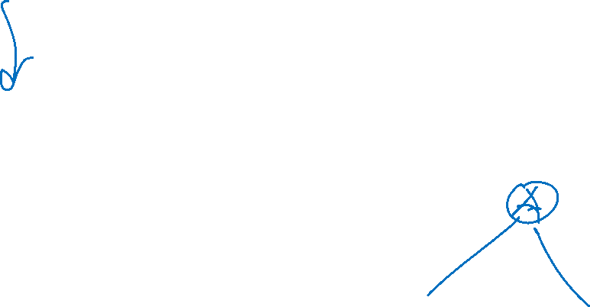
Decision Tree Learning Example
Y | A | B
- | 1 | 0
- | 1 | 0
+ | 1 | 0
+ | 1 | 0
+ | 1 | 1
+ | 1 | 1
+ | 1 | 1
+ | 1 | 1
Slide credit: CMU MLD Matt Gormley

Slide 31
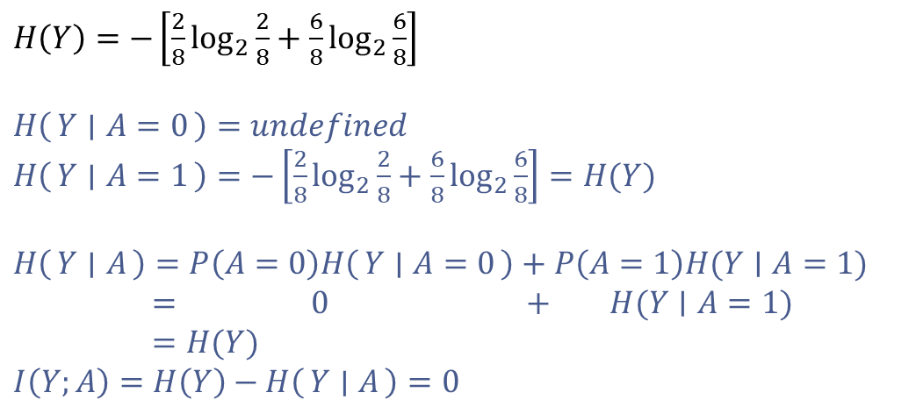
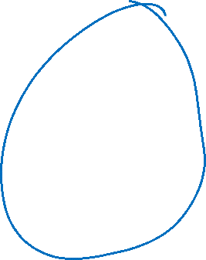
Decision Tree Learning Example
Y | A | B
- | 1 | 0
- | 1 | 0
+ | 1 | 0
+ | 1 | 0
+ | 1 | 1
+ | 1 | 1
+ | 1 | 1
+ | 1 | 1
$H\left(Y\right)=−\left[\frac{2}{8}\log_{2}{\frac{2}{8}}+\frac{6}{8}\log_{2}{\frac{6}{8}}\right]$
$H\left(Y ∣ A=0\right)=undefined$
$H\left(Y ∣ A=1\right)=−\left[\frac{2}{8}\log_{2}{\frac{2}{8}}+\frac{6}{8}\log_{2}{\frac{6}{8}}\right]=H(Y)$
$H\left(Y ∣ A\right)=P\left(A=0\right)H\left(Y ∣ A=0\right)+P\left(A=1\right)H(Y∣A=1)$
$= 0 + H(Y∣A=1)$
$=H(Y)$
$I\left(Y;A\right)=H\left(Y\right)−H\left(Y ∣ A\right)=0$
[2-, 6+]
A
A=0
A=1
[0-, 0+]
P(A=0) = 0
[2-, 6+]
P(A=1)=1
Slide credit: CMU MLD Matt Gormley

Slide 32
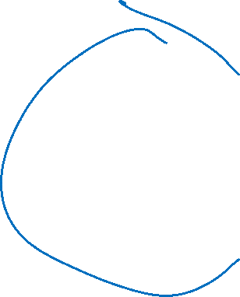
Decision Tree Learning Example
Y | A | B
- | 1 | 0
- | 1 | 0
+ | 1 | 0
+ | 1 | 0
+ | 1 | 1
+ | 1 | 1
+ | 1 | 1
+ | 1 | 1
[2-, 6+]
B
B=0
B=1
[2-, 2+]
P(B=0)=4/8
[0-, 4+]
P(B=1)=4/8
Slide credit: CMU MLD Matt Gormley

Slide 33
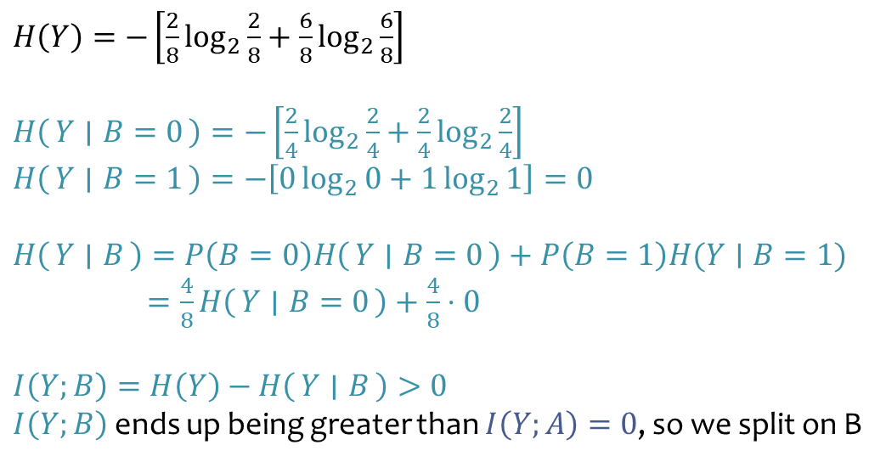
Decision Tree Learning Example
Y | A | B
- | 1 | 0
- | 1 | 0
+ | 1 | 0
+ | 1 | 0
+ | 1 | 1
+ | 1 | 1
+ | 1 | 1
+ | 1 | 1
$H\left(Y\right)=−\left[\frac{2}{8}\log_{2}{\frac{2}{8}}+\frac{6}{8}\log_{2}{\frac{6}{8}}\right]$
$H\left(Y ∣ B=0\right)=−\left[\frac{2}{4}\log_{2}{\frac{2}{4}}+\frac{2}{4}\log_{2}{\frac{2}{4}}\right]$
$H\left(Y ∣ B=1\right)=−\left[0\log_{2}{0}+1\log_{2}{1}\right]=0$
$H\left(Y ∣ B\right)=P\left(B=0\right)H\left(Y ∣ B=0\right)+P\left(B=1\right)H(Y∣B=1)$
$=\frac{4}{8}H\left(Y ∣ B=0\right)+\frac{4}{8}⋅0$
$I\left(Y;B\right)=H\left(Y\right)−H\left(Y ∣ B\right)>0$ $I\left(Y;B\right)$ ends up being greater than $I\left(Y;A\right)=0$, so we split on B
[2-, 6+]
B
B=0
B=1
[2-, 2+]
P(B=0)=4/8
[0-, 4+]
P(B=1)=4/8
Slide credit: CMU MLD Matt Gormley

Slide 34
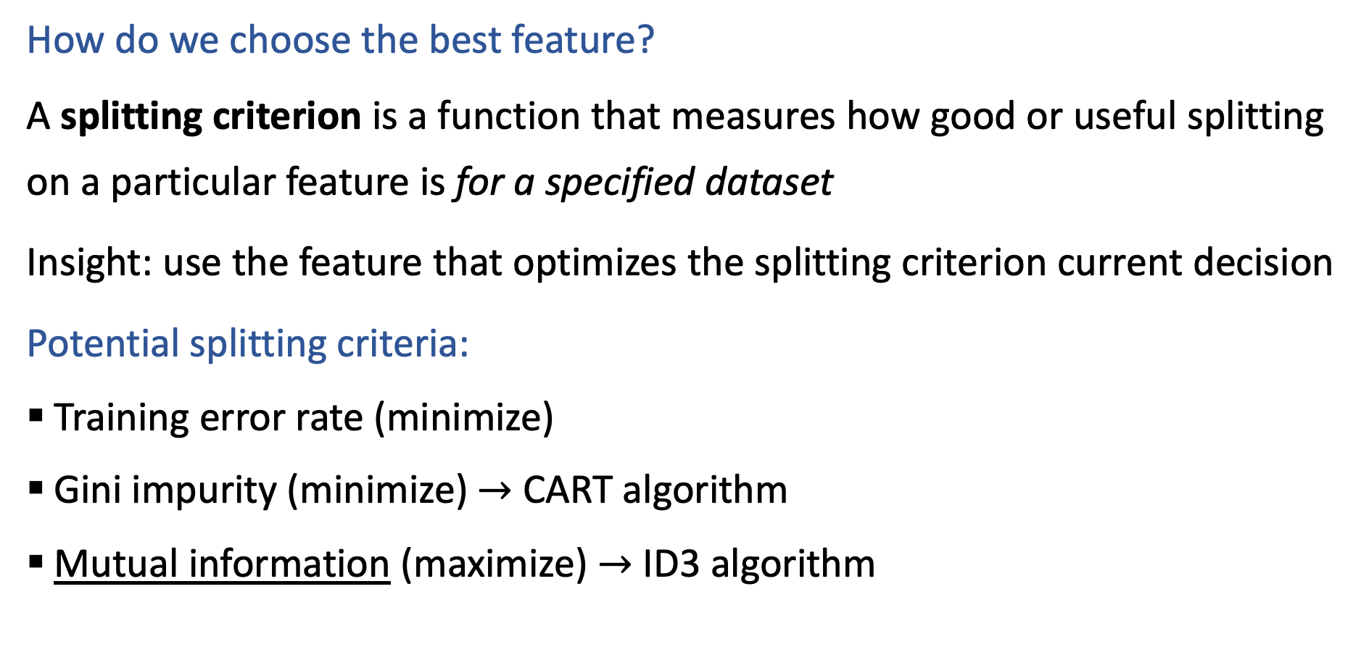
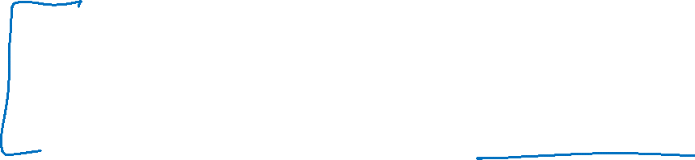
Building a Decision Tree
How do we choose the best feature?
A splitting criterion is a function that measures how good or useful splitting on a particular feature is for a specified dataset
Insight: use the feature that optimizes the splitting criterion current decision
Potential splitting criteria:
Training error rate (minimize)
Gini impurity (minimize) $→$ CART algorithm
Mutual information (maximize) $→$ ID3 algorithm
Slide credit: CMU MLD Henry Chai

Slide 35
Why bother with splitting criteria at all?
Occam’s razor: try to find the “simplest” (e.g., smallest decision tree) classifier that explains the training dataset
The inductive bias of a machine learning algorithm is the principal by which it generalizes to unseen examples
What is the inductive bias of the ID3 algorithm i.e., decision tree learning with mutual information maximization as the splitting criterion?
Try to find the tree that achieves with features at the top
Slide credit: CMU MLD Henry Chai

Slide 36
Are decision trees algorithms optimal?
Well, what do we mean by optimal?
Considering all possible decision trees (i.e., trees splitting on one feature per node),
will the ID3 algorithm (each split maximizes mutual information; stopping when mutual information is zero)…
produce the smallest decision tree that has lowest classification training error?
No, they aren’t optimal
Decision trees are greedy algorithms, i.e., they make the best local decision without considering longer term possibilities.
Better trees are possible, but it takes too long to search all combinations

Slide 37

Recall: Building a Decision Tree
Function BuildTree(D, Attributes)
# D: dataset at current node
# Attributes : current set of attributes
# TODO Base Case
else
# Internal node
X ⇐ bestAttribute(D, Attributes)
LeftNode = BuildTree(D(X=1), Attributes \ {X})
RightNode = BuildTree(D(X=0), Attributes \ {X})
end
end

Slide 38
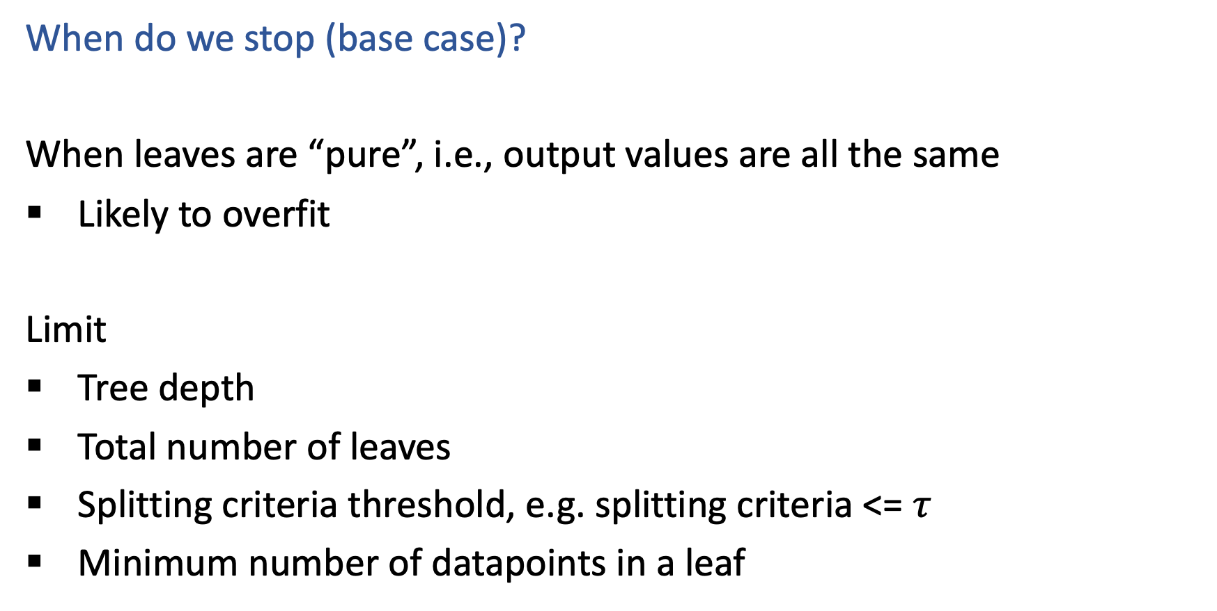
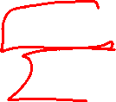
Stopping Criteria
When do we stop (base case)?
When leaves are “pure”, i.e., output values are all the same
Likely to overfit
Limit
Tree depth
Total number of leaves
Splitting criteria threshold, e.g. splitting criteria <= $τ$
Minimum number of datapoints in a leaf

Slide 39
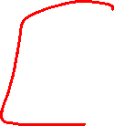
Sopping Criteria
But how do we choose all of those limits?!?
Answer: Model selection
Model selection is the process to choose the “best” among a set of (trained) models

Slide 40
Decision Trees: Pros & Cons
Pros
Interpretable
Efficient (computational cost and storage)
Can be used for classification and regression tasks
Compatible with categorical and real-valued features
Cons
Greedy: each split only considers the immediate impact
Not guaranteed to find the smallest (fewest number of splits) tree that achieves a training error rate of 0.
Liable to overfit!
Slide credit: CMU MLD Henry Chai

