Slide 1

10-315 Introduction to ML Recommender Systems
Instructor: Pat Virtue

Slide 2
Recommender Systems
A Common Challenge:
Assume you’re a company selling items of some sort: movies, songs, products, etc.
Company collects millions of ratings from users of their items
To maximize profit / user happiness, you want to recommend items that users are likely to want
Slide credit: CMU MLD Matt Gormley

Slide 3

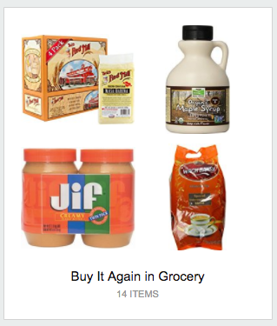
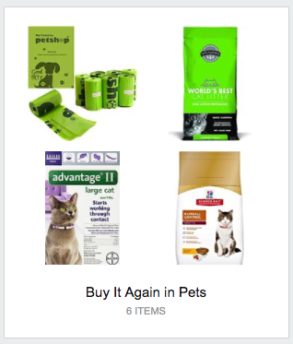

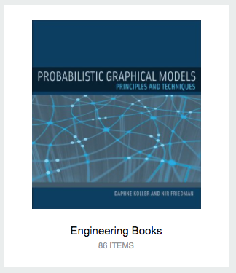
Recommender Systems
Slide credit: CMU MLD Matt Gormley

Slide 4
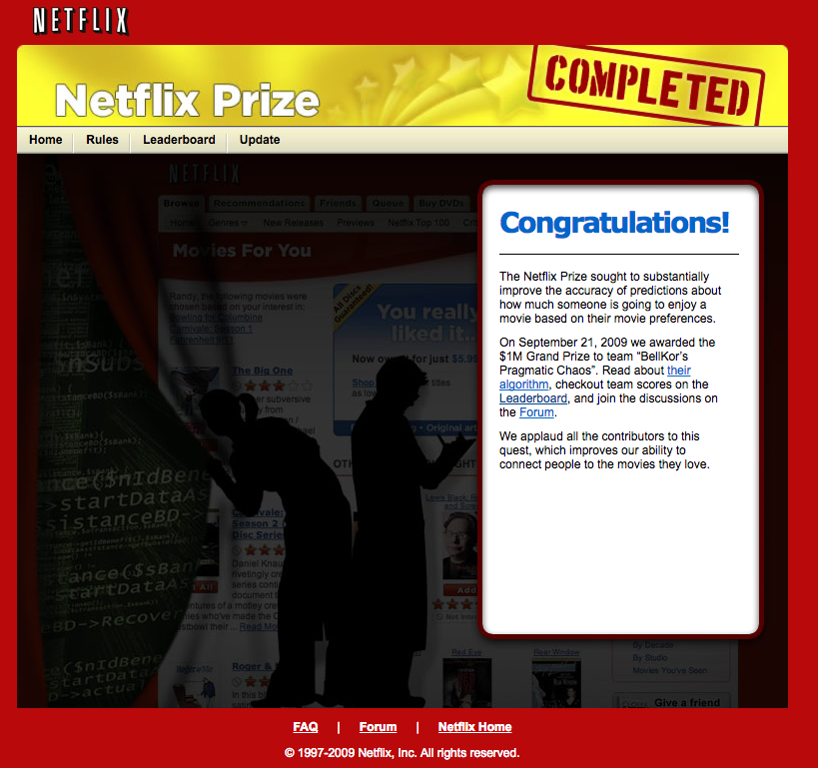
Recommender Systems
Slide credit: CMU MLD Matt Gormley

Slide 5
ML System Design: Movie Recommendation
Task
Experience
Performance measure

Slide 6
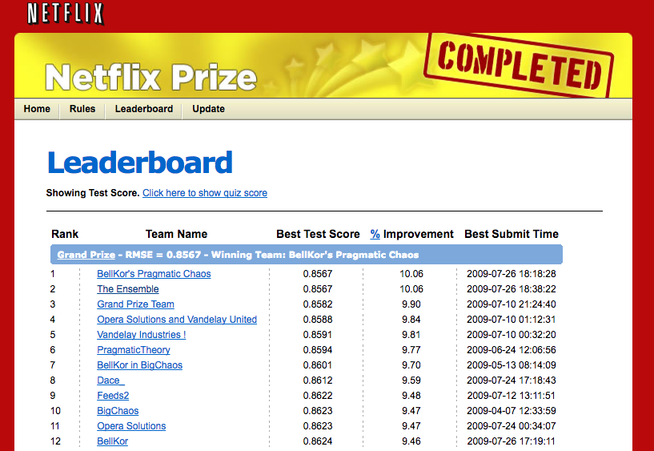
Recommender Systems
Problem Setup
500,000 users
20,000 movies
100 million ratings
Goal: To obtain lower root mean squared error (RMSE) than Netflix’s existing system on 3 million held out ratings
Slide credit: CMU MLD Matt Gormley

Slide 7
ML System Design: Movie Recommendation
Model

Slide 8
ML System Design: Movie Recommendation
Model

Slide 9
Recommender Systems
 | Doctor Strange | Star Trek: Beyond | Zootopia
Alita | 1 |  | 5
BB-8 | 3 | 4
C-3P0 | 3 | 5 | 2
Setup:
Items: movies, songs, products, etc. (often many thousands)
Users: watchers, listeners, purchasers, etc. (often many millions)
Feedback: 5-star ratings, not-clicking ‘next’, purchases, etc.
Challenge:
Users only rate a small number of items (the user/item rating data is sparse)
Slide credit: CMU MLD Matt Gormley

Slide 10
Different Approaches
Item-based (Content filtering)
Features about each item
Given an item, other “close” items have similar values
e.g. Pandora.com, music genome project

Slide 11
Different Approaches
Item-based (Content filtering)
Features about each item
Given an item, other “close” items have similar values
e.g. Pandora.com, music genome project
User-based
Features about each user
Given a user, other “close” users have similar preferences
Market segmentation
Learning user-item relationship
Can be done without features on either user or item
Collaborative filtering techniques

Slide 12
Collaborative Filtering

Slide 13
Collaborative Filtering
Everyday Examples of Collaborative Filtering...
Bestseller lists
Top 40 music lists
The “recent returns” shelf at the library
Unmarked but well-used paths thru the woods
The printer room at work
“Read any good books lately?”
…
Common insight: personal tastes are correlated
If Alita and BB-8 both like X and Alita likes Y then BB-8 is more likely to like Y
especially (perhaps) if BB-8 knows Alita
Slide from William Cohen

Slide 14
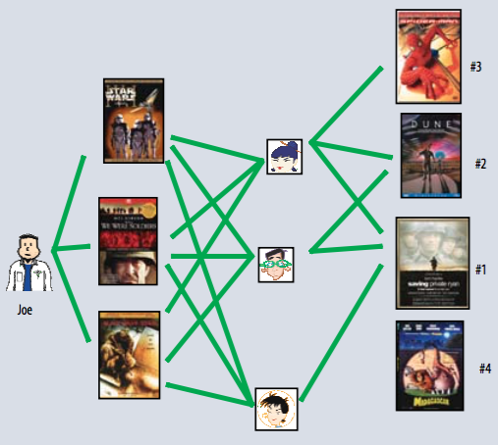
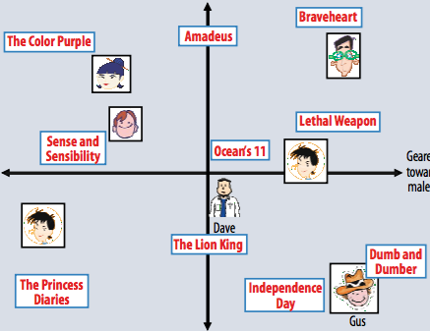
Two Types of Collaborative Filtering
1. Neighborhood Methods
2. Latent Factor Methods
Figures from Koren et al. (2009)

Slide 15
Two Types of Collaborative Filtering
1. Neighborhood Methods
In the figure, assume that a green line indicates the movie was watched
Algorithm:
Find neighbors based on similarity of movie preferences
Recommend movies that those neighbors watched
Figures from Koren et al. (2009)

Slide 16
Two Types of Collaborative Filtering
2. Latent Factor Methods
Assume that both movies and users can be mapped to the same feature space
Recommend a movie based on its proximity to the user in the feature (latent) space
Example algorithm: Latent factor method
Figures from Koren et al. (2009)

Slide 17
Collaborative Filtering: Latent Factor (Matrix Factorization) Method

Slide 18
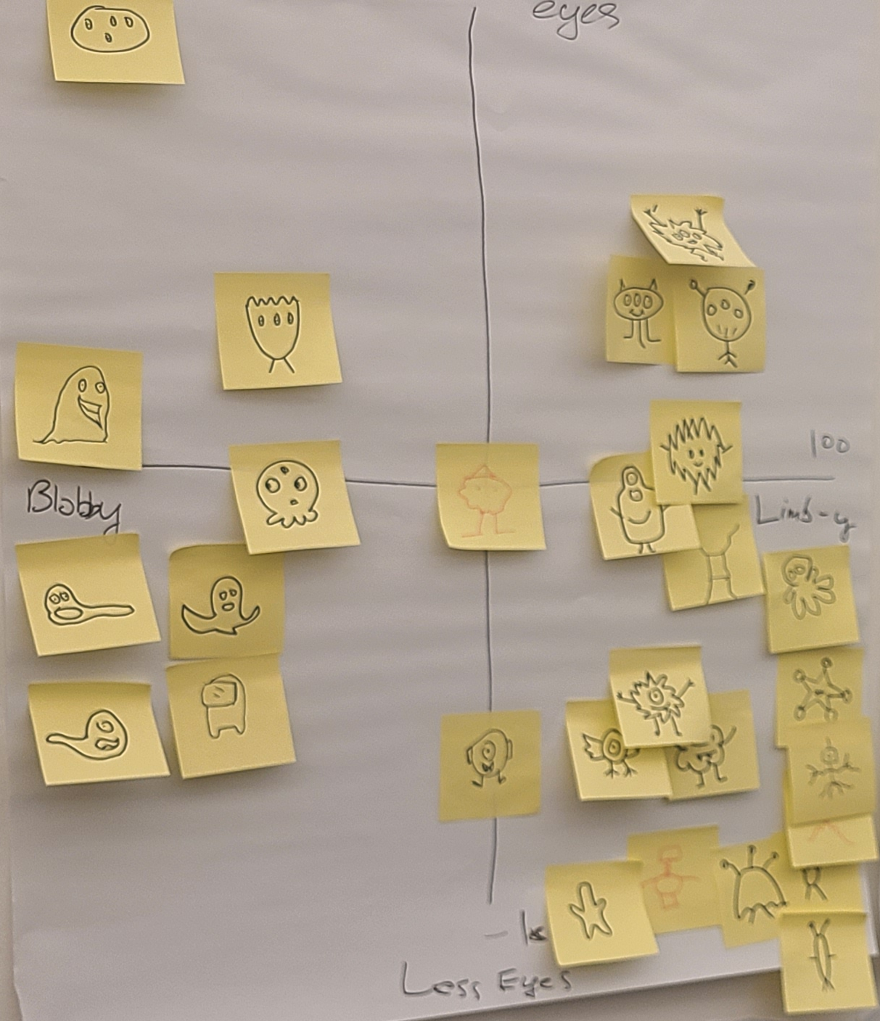
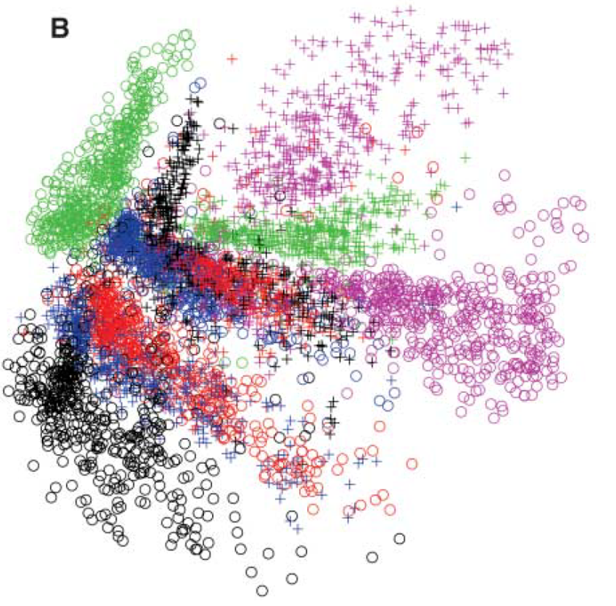

Background: Learn a Feature Space
Autoencoders
Image: Hinton & Salakhutdinov. Science 313.5786 (2006): 504-507.

Slide 19
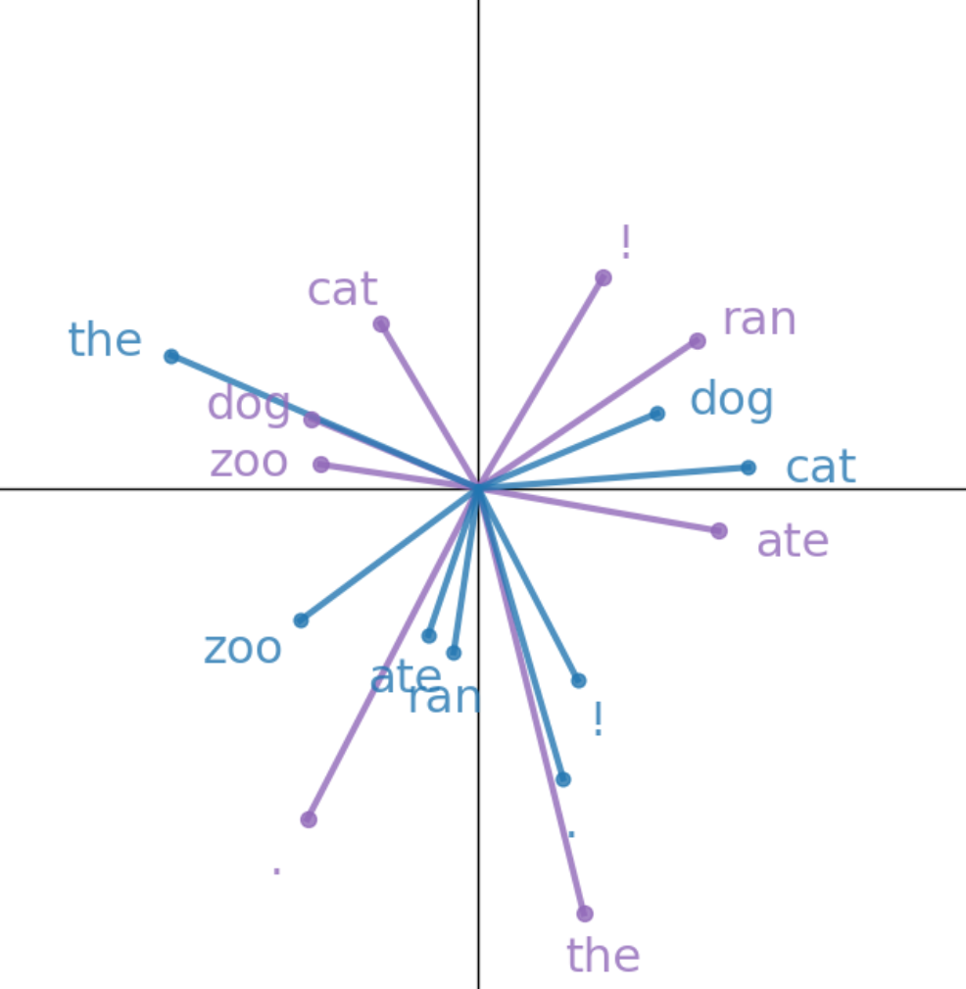
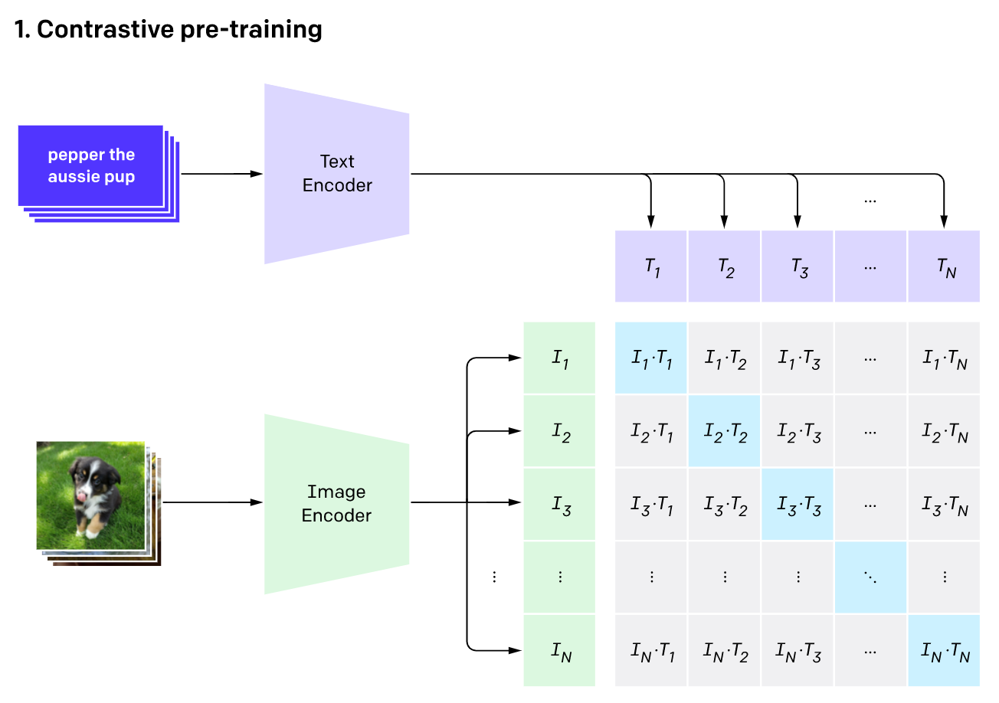
Background: Learn a Feature Space
Word2vec:
Feature space for words
CLIP:
Common feature space for text and images

Slide 20
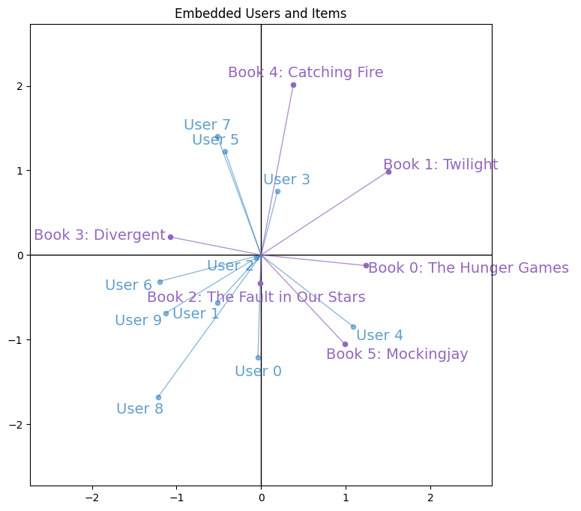
Recommender System: Latent Factor Model
Learning to map items and users to the same lower dimensional space

Slide 21
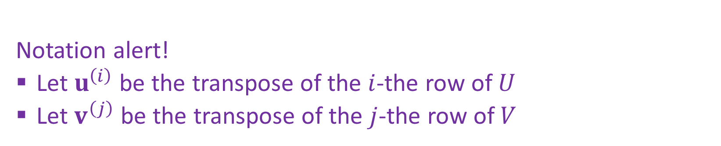

Recommender System: Latent Factor Model
Optimization: Objective function using only the labels we have
$J\left(U,V\right)= \sum_{i,j,r ∈ 𝒟}{{\left(r−{u^{\left(i\right)}}^{T}v^{(j)}\right)}^{2}}$
Notation alert!
Let $u^{\left(i\right)}$ be the transpose of the $i$-the row of $U$
Let $v^{\left(j\right)}$ be the transpose of the $j$-the row of $V$

Slide 22
Latent Factor (Matrix Factorization) Method
SGD Optimization

Slide 23
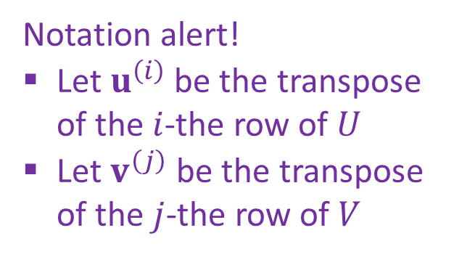
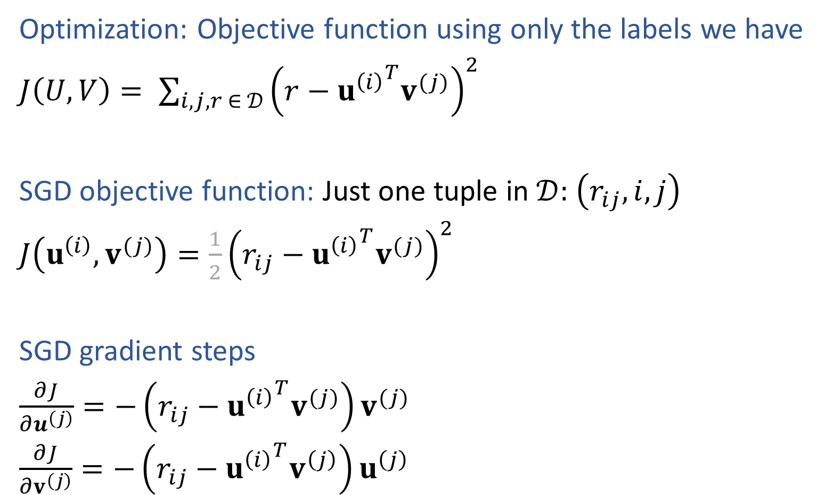
Recommender System: Matrix Factorization
Optimization: Objective function using only the labels we have
$J\left(U,V\right)= \sum_{i,j,r ∈ 𝒟}{{\left(r−{u^{\left(i\right)}}^{T}v^{(j)}\right)}^{2}}$
SGD objective function: Just one tuple in $𝒟:$ $\left(r_{ij}, i, j\right)$
$J\left(u^{\left(i\right)},v^{(j)}\right)=\frac{1}{2}{\left(r_{ij}−{u^{\left(i\right)}}^{T}v^{(j)}\right)}^{2}$
SGD gradient steps
$\frac{∂J}{∂u^{\left(j\right)}}=−\left(r_{ij}−{u^{\left(i\right)}}^{T}v^{(j)}\right)v^{(j)}$
$\frac{∂J}{∂v^{\left(j\right)}}=−\left(r_{ij}−{u^{\left(i\right)}}^{T}v^{\left(j\right)}\right)u^{\left(j\right)}$
Notation alert!
Let $u^{\left(i\right)}$ be the transpose of the $i$-the row of $U$
Let $v^{\left(j\right)}$ be the transpose of the $j$-the row of $V$

Slide 24
Latent Factor Method
Inference

Slide 25

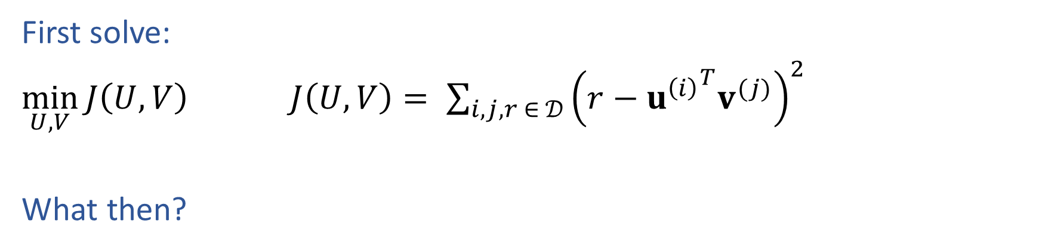

Inference for Recommender Systems
First solve:
$\min_{U,V}{J\left(U,V\right)}$ $J\left(U,V\right)= \sum_{i,j,r ∈ 𝒟}{{\left(r−{u^{\left(i\right)}}^{T}v^{(j)}\right)}^{2}}$
What then?
$$U$$
$$V$$
 | Doctor Strange | Star Trek: Beyond | Zootopia
Alita | 1 |  | 5
BB-8 | 3 | 4
C-3P0 | 3 | 5 | 2

Slide 26
Inference for Recommender Systems
Recommendations

Slide 27
Latent Factor Method
Practical Considerations

Slide 28
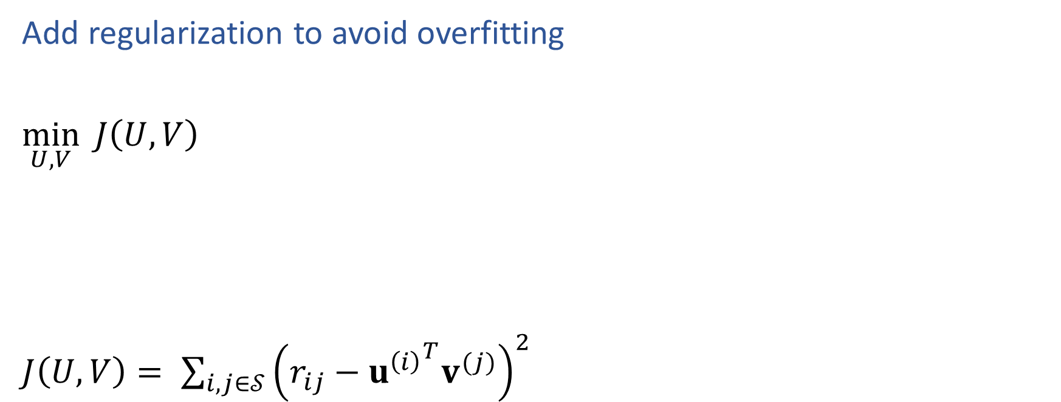
Latent Factor Regularization
Add regularization to avoid overfitting
$\min_{U,V}{ J\left(U,V\right)}$
$J\left(U,V\right)= \sum_{i,j∈𝒮}{{\left(r_{ij}−{u^{\left(i\right)}}^{T}v^{(j)}\right)}^{2}}$

Slide 29
Bias in Recommender Systems
What high-level problems can occur from recommender systems?

Slide 30
Summary
Recommender systems solve many real-world (*large-scale) problems
Collaborative filtering using a latent factor model can be done without any features about the users or items other than their past ratings
Solving for latent factors is just another example of a common recipe:
define a model
define an objective function
optimize
Optimization
Use SGD
Add regularization to avoid overfitting

