Slide 1

10-315 Introduction to ML Probabilistic Models: Generative and Naïve Bayes
Instructor: Pat Virtue

Slide 2
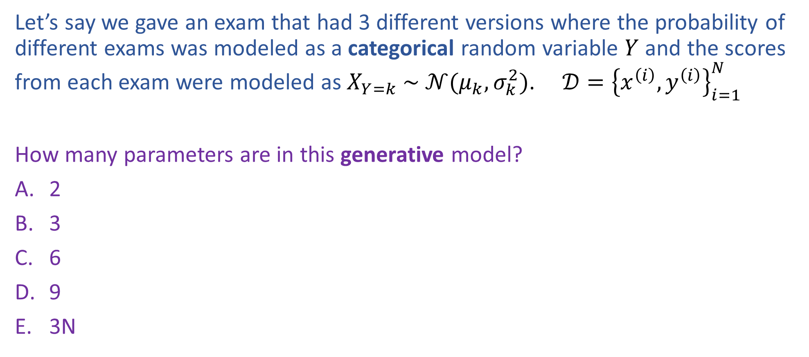
Poll 1
Let’s say we gave an exam that had 3 different versions where the probability of different exams was modeled as a categorical random variable $Y$ and the scores from each exam were modeled as $X_{Y=k} \sim 𝒩(μ_{k},σ_{k}^{2})$. $𝒟={\left\{x^{\left(i\right)}, y^{\left(i\right)}\right\}}_{i=1}^{N}$
How many parameters are in this generative model?
2
3
6
9
3N

Slide 3
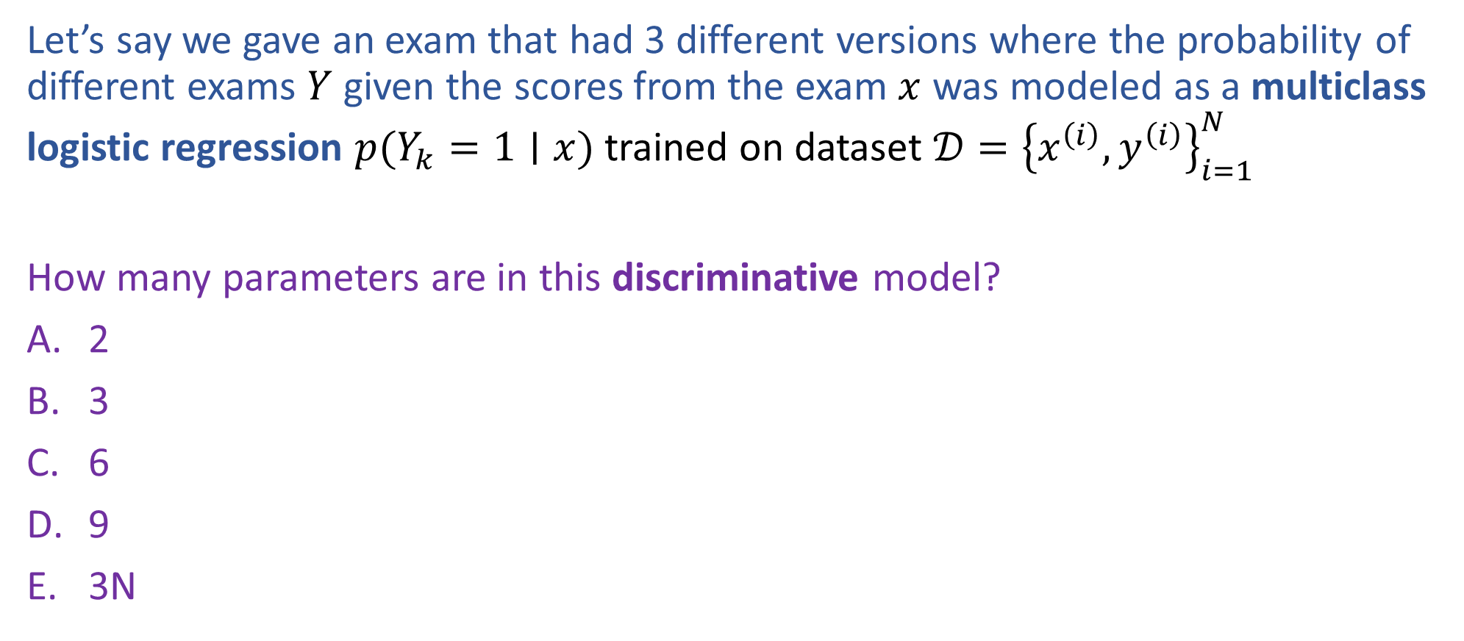
Poll 2
Let’s say we gave an exam that had 3 different versions where the probability of different exams $Y$ given the scores from the exam $x$ was modeled as a multiclass logistic regression $p(Y_{k}=1∣x)$ trained on dataset $𝒟={\left\{x^{\left(i\right)}, y^{\left(i\right)}\right\}}_{i=1}^{N}$
How many parameters are in this discriminative model?
2
3
6
9
3N

Slide 4
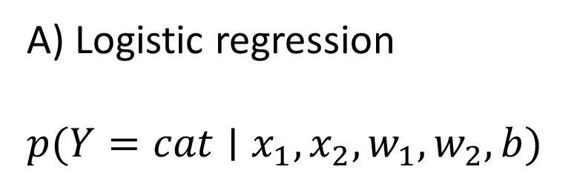
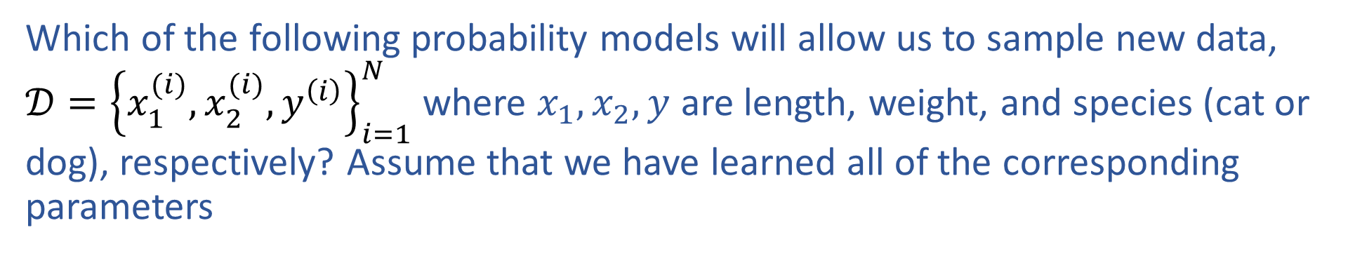
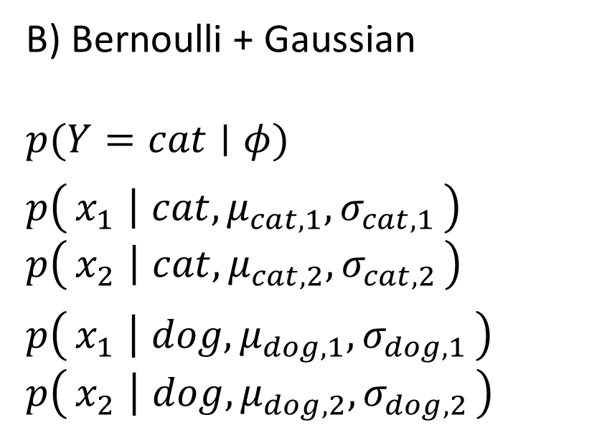
Poll 3
Which of the following probability models will allow us to sample new data, $𝒟={\left\{x_{1}^{(i)},x_{2}^{(i)}, y^{\left(i\right)}\right\}}_{i=1}^{N}$ where $x_{1}, x_{2},y$ are length, weight, and species (cat or dog), respectively? Assume that we have learned all of the corresponding parameters
A) Logistic regression
$p(Y=cat∣x_{1}, x_{2},w_{1}, w_{2},b)$
B) Bernoulli + Gaussian
$p(Y=cat∣φ)$
$p\left(x_{1} ∣ cat, μ_{cat,1},σ_{cat,1}\right)$
$p\left(x_{2} ∣ cat, μ_{cat,2},σ_{cat,2}\right)$
$p\left(x_{1} ∣ dog, μ_{dog,1},σ_{dog,1}\right)$
$p\left(x_{2} ∣ dog, μ_{dog,2},σ_{dog,2}\right)$
C) None of the above

Slide 5
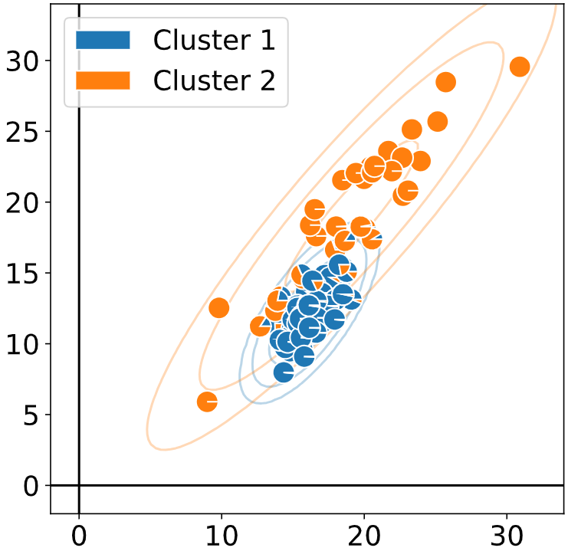
Sampling Cats and Dogs
B) Bernoulli + Gaussian
$p(Y=cat∣φ)$
$p\left(x_{1} ∣ cat, μ_{cat,1},σ_{cat,1}\right)$
$p\left(x_{2} ∣ cat, μ_{cat,2},σ_{cat,2}\right)$
$p\left(x_{1} ∣ dog, μ_{dog,1},σ_{dog,1}\right)$
$p\left(x_{2} ∣ dog, μ_{dog,2},σ_{dog,2}\right)$

Slide 6
Generative Stories

Slide 7

Generative vs Discriminative Modeling
Discriminative: $p(y∣x)$
Generative: $p(y | x)=α p(x, y)=α p\left(x ∣ y\right) p\left(y\right)$
Model assumptions vs Data
Discriminative:
Generative:

Slide 8
Generative Story Examples
Spam Generation
Discriminative
Generative Generative + Naive Bayes

Slide 9
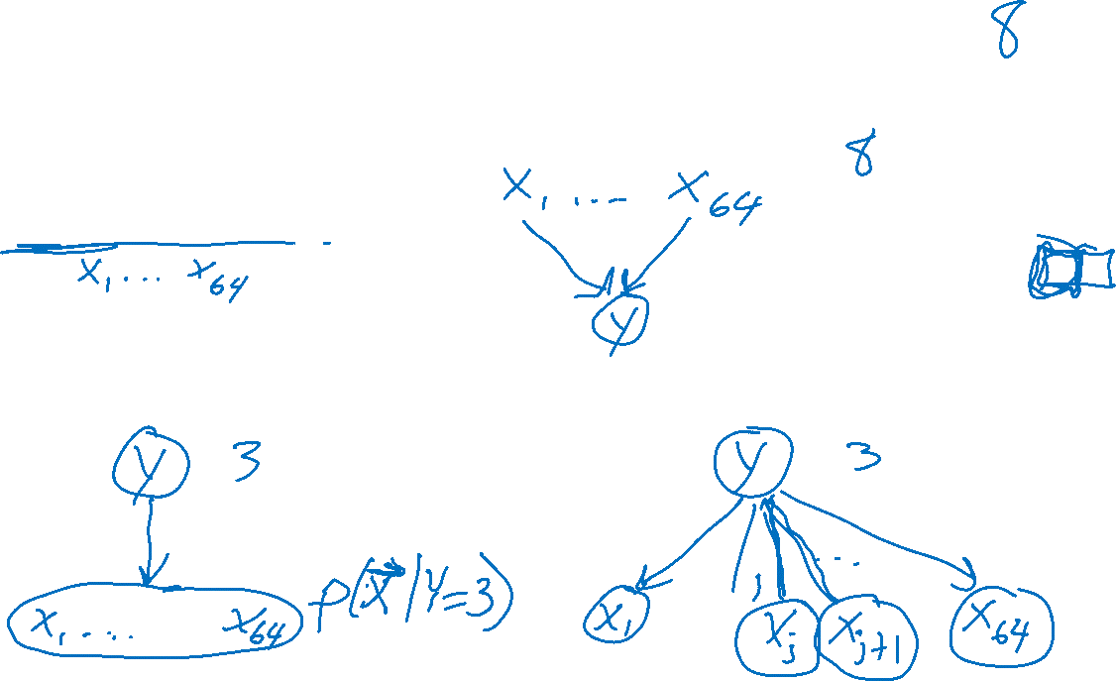
Generative Story Examples
Discriminative
Hand-written digits
y: Digit class: 0-9
x: Pixels in images
Generative Generative + Naive Bayes

Slide 10
Discriminative and Generative

Slide 11
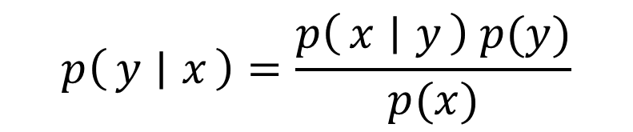
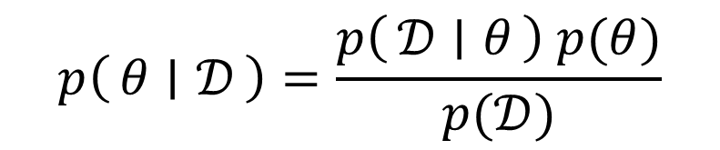
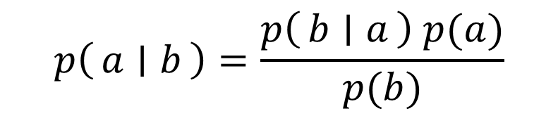
Two Applications of Bayes Rule
$$p\left(a ∣ b\right)=\frac{p\left(b ∣ a\right) p(a)}{p(b)}$$
$$p\left(θ ∣ 𝒟\right)=\frac{p\left(𝒟 ∣ θ\right) p(θ)}{p(𝒟)}$$
$$p\left(y ∣ x\right)=\frac{p\left(x ∣ y\right) p(y)}{p(x)}$$

Slide 12
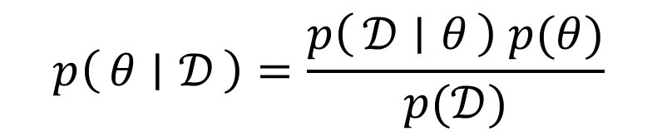
Bayes Rule
Terminology
Posterior Likelihood Prior
$$p\left(θ ∣ 𝒟\right)=\frac{p\left(𝒟 ∣ θ\right) p(θ)}{p(𝒟)}$$

Slide 13
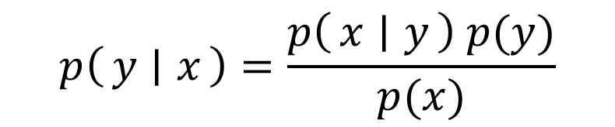
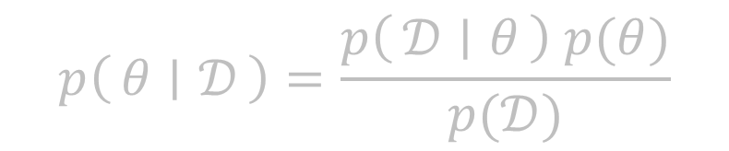
Bayes Rule
Terminology
Posterior Likelihood Prior
Posterior Class conditional Class prior
Conditional likelihood
$$p\left(θ ∣ 𝒟\right)=\frac{p\left(𝒟 ∣ θ\right) p(θ)}{p(𝒟)}$$
$$p\left(y ∣ x\right)=\frac{p\left(x ∣ y\right) p(y)}{p(x)}$$

Slide 14

Bayes Rule
Where did the parameters go?!?
$$p\left(y ∣ x\right)=\frac{p\left(x ∣ y\right) p(y)}{p(x)}$$

Slide 15
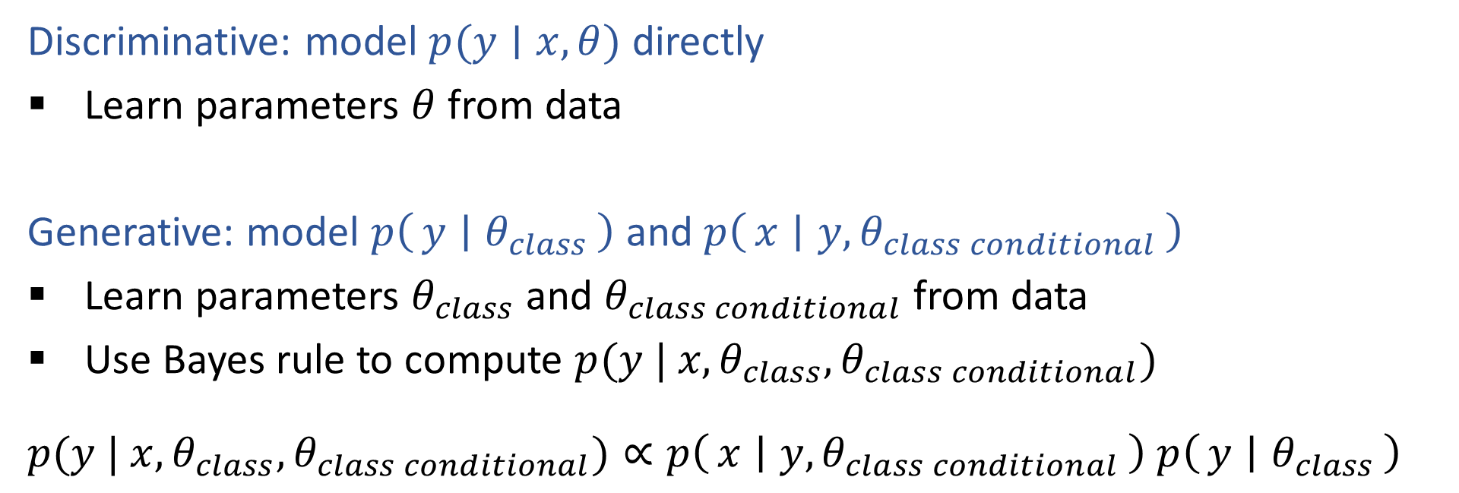
Optimization: Generative vs Discriminative
Discriminative: model $p(y∣x, θ)$ directly
Learn parameters $θ$ from data
Generative: model $p\left(y ∣ θ_{class}\right)$ and $p\left(x ∣ {y, θ}_{class conditional}\right)$
Learn parameters $θ_{class}$ and $θ_{class conditional}$ from data
Use Bayes rule to compute $p(y | x, θ_{class}, θ_{class conditional})$
$p(y | x, θ_{class}, θ_{class conditional})∝p\left(x ∣ {y, θ}_{class conditional}\right)$ $p\left(y ∣ θ_{class}\right)$

Slide 16
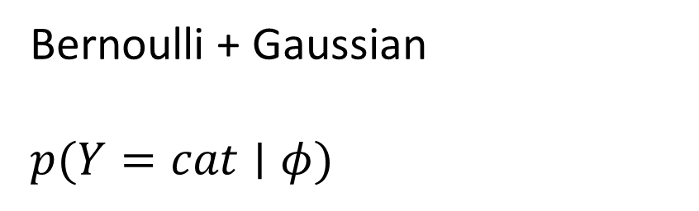
Estimating Cats and Dogs
Bernoulli + Gaussian
$p(Y=cat∣φ)$

Slide 17
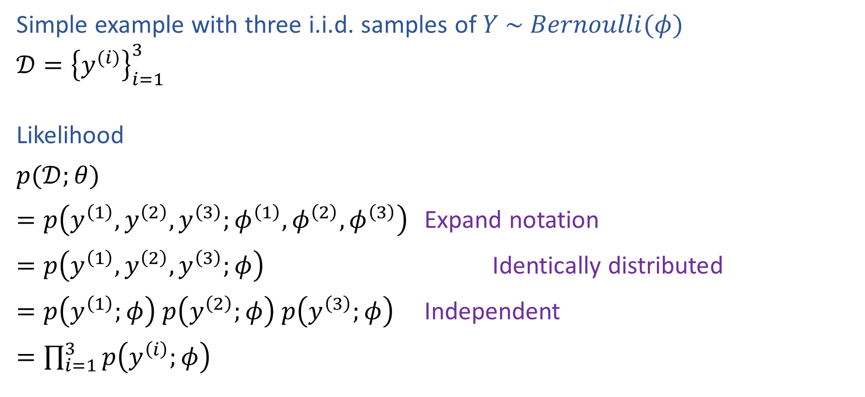
Reminder: Likelihood
Simple example with three i.i.d. samples of $Y \sim Bernoulli(φ)$
$𝒟={\left\{y^{(i)}\right\}}_{i=1}^{3}$
Likelihood
$p(𝒟;θ)$
$=p\left(y^{\left(1\right)},y^{\left(2\right)},y^{\left(3\right)};φ^{\left(1\right)}, φ^{\left(2\right)},φ^{\left(3\right)}\right)$ Expand notation
$=p\left(y^{\left(1\right)},y^{\left(2\right)},y^{\left(3\right)};φ\right)$ Identically distributed
$=p\left(y^{\left(1\right)};φ\right) p\left(y^{\left(2\right)};φ\right) p\left(y^{\left(3\right)};φ\right)$ Independent
$=\prod_{i=1}^{3}{p\left(y^{\left(i\right)};φ\right)}$

Slide 18


Generative MLE
$𝒟={\left\{y^{\left(i\right)}, x^{(i)}\right\}}_{i=1}^{N}$
$y^{(i)}∈\{0,1\}$
$x^{(i)}∈{\left\{0,1\right\}}^{M}$
$φ∈[0,1]$
$Θ∈{\left[0,1\right]}^{Mx2}$
$L\left(ϕ, Θ\right)=p\left(𝒟 \right| ϕ, Θ)$
$=Π_{n=1}^{N} p\left(𝒟^{\left(n\right)} ∣ ϕ, Θ\right)$ i.i.d assumption
$=Π_{n=1}^{N} p\left(y^{\left(n\right)}, x^{\left(n\right)} ∣ ϕ, Θ\right)$
$=Π_{n=1}^{N} p\left(y^{\left(n\right)} ∣ ϕ\right) p\left(x^{\left(n\right)} ∣ y^{\left(n\right)}, Θ\right)$ Generative model story
$=Π_{n=1}^{N} p\left(y^{\left(n\right)} ∣ ϕ\right) p\left(x_{1}^{(n)},x_{2}^{(n)},…,x_{M}^{(n)} ∣ y^{\left(n\right)}, Θ\right)$
Generative model

Slide 19
Naïve Bayes

Slide 20
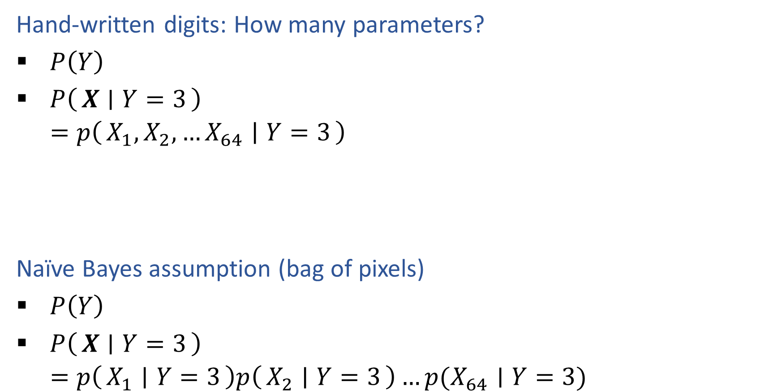

Multivariate Generative Models
Hand-written digits: How many parameters?
$P\left(Y\right)$
$P\left(X ∣ Y=3\right)$
$=p\left(X_{1}, X_{2},…X_{64} ∣ Y=3\right)$
Naïve Bayes assumption (bag of pixels)
$P\left(Y\right)$
$P\left(X ∣ Y=3\right)$
$=p\left(X_{1} ∣ Y=3\right)p\left(X_{2} ∣ Y=3\right)…p(X_{64}∣Y=3)$

Slide 21
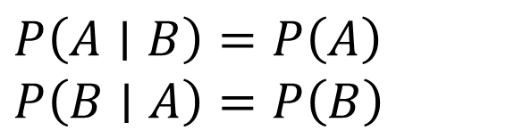
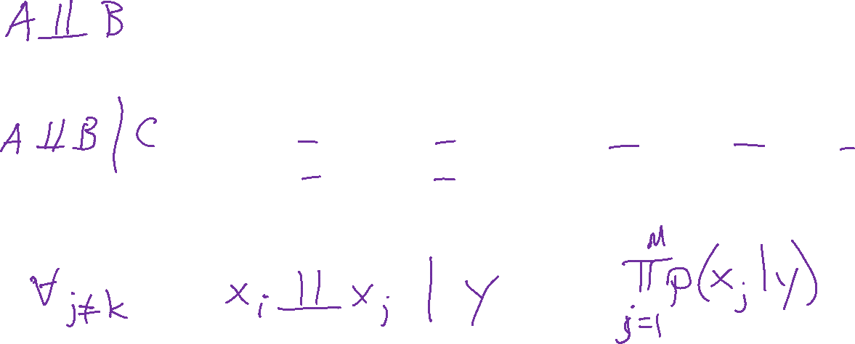


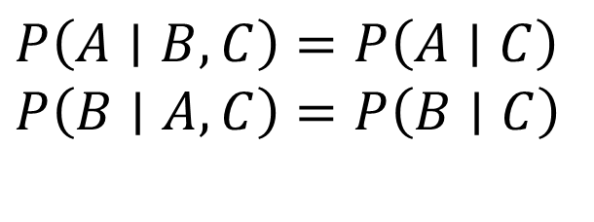
Conditional Independence and Naïve Bayes
Independence
Conditional independence
Naïve Bayes assumption
$P\left(A∣B\right)=P\left(A\right)$
$P\left(B∣A\right)=P\left(B\right)$
$P\left(A, B\right)=P\left(A\right)P(B)$
$P\left(A∣B, C\right)=P\left(A∣C\right)$
$P\left(B∣A, C\right)=P\left(B∣C\right)$
$P\left(A, B∣C\right)=P\left(A∣C\right)P(B∣C)$

Slide 22
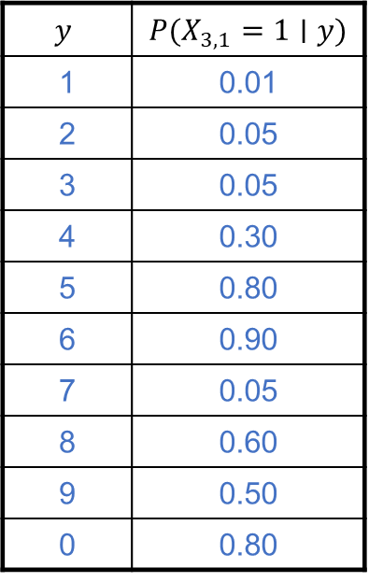
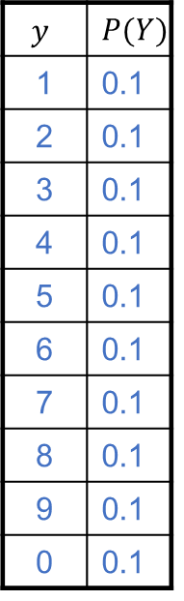
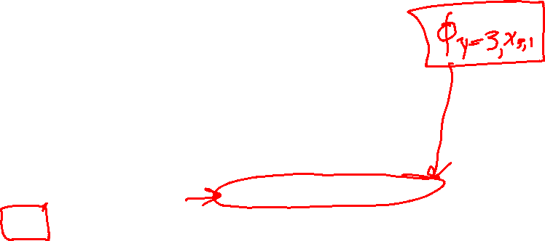
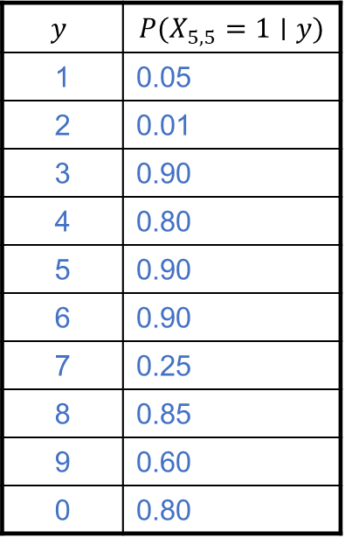
Naïve Bayes for Digits
$$y$$ | $$P(Y)$$
1 | 0.1
2 | 0.1
3 | 0.1
4 | 0.1
5 | 0.1
6 | 0.1
7 | 0.1
8 | 0.1
9 | 0.1
0 | 0.1
$$y$$ | $$P(X_{3,1}=1∣y)$$
1 | 0.01
2 | 0.05
3 | 0.05
4 | 0.30
5 | 0.80
6 | 0.90
7 | 0.05
8 | 0.60
9 | 0.50
0 | 0.80
$$y$$ | $$P(X_{5,5}=1∣y)$$
1 | 0.05
2 | 0.01
3 | 0.90
4 | 0.80
5 | 0.90
6 | 0.90
7 | 0.25
8 | 0.85
9 | 0.60
0 | 0.80

Slide 23
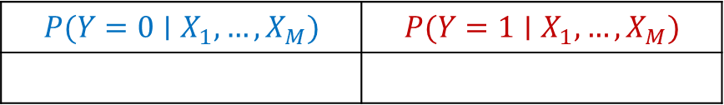
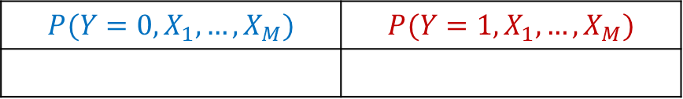
SPAM Classification
Recitation Exercise
$$P(Y=0,X_{1},…,X_{M})$$ | $$P(Y=1,X_{1},…,X_{M})$$
$$P(Y=0∣X_{1},…,X_{M})$$ | $$P(Y=1∣X_{1},…,X_{M})$$

Slide 24


Naïve Bayes MLE
$𝒟={\left\{y^{\left(n\right)}, x^{(n)}\right\}}_{n=1}^{N}$
$y^{(n)}∈\{0,1\}$
$x^{(n)}∈{\left\{0,1\right\}}^{M}$
$φ∈[0,1]$
$Θ∈{\left[0,1\right]}^{Mx2}$
$L\left(ϕ, Θ\right)=p\left(𝒟 \right| ϕ, Θ)$
$=Π_{n=1}^{N} p\left(𝒟^{\left(n\right)} ∣ ϕ, Θ\right)$ i.i.d assumption
$=Π_{n=1}^{N} p\left(y^{\left(n\right)}, x^{\left(n\right)} ∣ ϕ, Θ\right)$
$=Π_{n=1}^{N} p\left(y^{\left(n\right)} ∣ ϕ\right) p\left(x^{\left(n\right)} ∣ y^{\left(n\right)}, Θ\right)$ Generative model
$=Π_{n=1}^{N} p\left(y^{\left(n\right)} ∣ ϕ\right) p\left(x_{1}^{(n)},x_{2}^{(n)},…,x_{M}^{(n)} ∣ y^{\left(n\right)}, Θ\right)$
$=Π_{n=1}^{N} p\left(y^{\left(n\right)} ∣ ϕ\right) Π_{m=1}^{M} p\left(x_{m}^{(n)} ∣ y^{\left(n\right)}, θ_{m,y}\right)$ Naïve Bayes

Slide 25
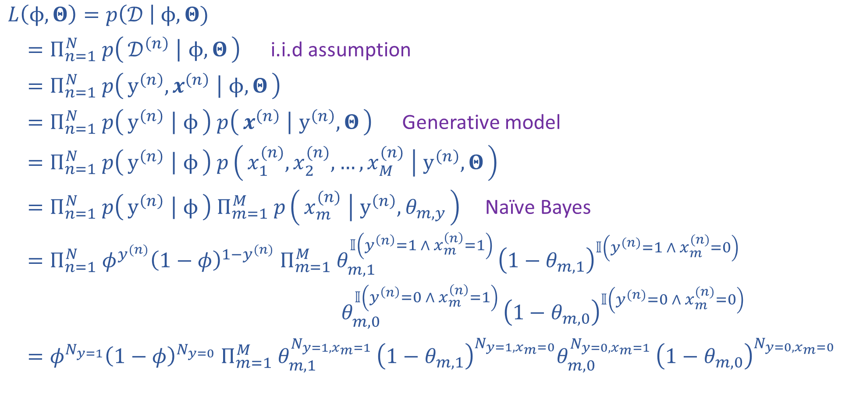

Naïve Bayes MLE
$𝒟={\left\{y^{\left(n\right)}, x^{(n)}\right\}}_{n=1}^{N}$
$y^{(n)}∈\{0,1\}$
$x^{(n)}∈{\left\{0,1\right\}}^{M}$
$φ∈[0,1]$
$Θ∈{\left[0,1\right]}^{Mx2}$
$L\left(ϕ, Θ\right)=p\left(𝒟 \right| ϕ, Θ)$
$=Π_{n=1}^{N} p\left(𝒟^{\left(n\right)} ∣ ϕ, Θ\right)$ i.i.d assumption
$=Π_{n=1}^{N} p\left(y^{\left(n\right)}, x^{\left(n\right)} ∣ ϕ, Θ\right)$
$=Π_{n=1}^{N} p\left(y^{\left(n\right)} ∣ ϕ\right) p\left(x^{\left(n\right)} ∣ y^{\left(n\right)}, Θ\right)$ Generative model
$=Π_{n=1}^{N} p\left(y^{\left(n\right)} ∣ ϕ\right) p\left(x_{1}^{(n)},x_{2}^{(n)},…,x_{M}^{(n)} ∣ y^{\left(n\right)}, Θ\right)$
$=Π_{n=1}^{N} p\left(y^{\left(n\right)} ∣ ϕ\right) Π_{m=1}^{M} p\left(x_{m}^{(n)} ∣ y^{\left(n\right)}, θ_{m,y}\right)$ Naïve Bayes
$=Π_{n=1}^{N} φ^{y^{(n)}}{\left(1−φ\right)}^{1−y^{(n)}} Π_{m=1}^{M} θ_{m,1}^{𝕀\left(y^{\left(n\right)}=1 ∧ x_{m}^{\left(n\right)}=1\right) }{\left(1−θ_{m,1}\right)}^{𝕀\left(y^{(n)}=1 ∧ x_{m}^{(n)}=0\right)}$
$θ_{m,0}^{𝕀\left(y^{\left(n\right)}=0 ∧ x_{m}^{\left(n\right)}=1\right) }{\left(1−θ_{m,0}\right)}^{𝕀\left(y^{(n)}=0 ∧ x_{m}^{(n)}=0\right)}$
$=φ^{N_{y=1}}{\left(1−φ\right)}^{N_{y=0}} Π_{m=1}^{M} θ_{m,1}^{N_{y=1,x_{m}=1} }{\left(1−θ_{m,1}\right)}^{N_{y=1,x_{m}=0}}θ_{m,0}^{N_{y=0,x_{m}=1} }{\left(1−θ_{m,0}\right)}^{N_{y=0,x_{m}=0}}$

Slide 26

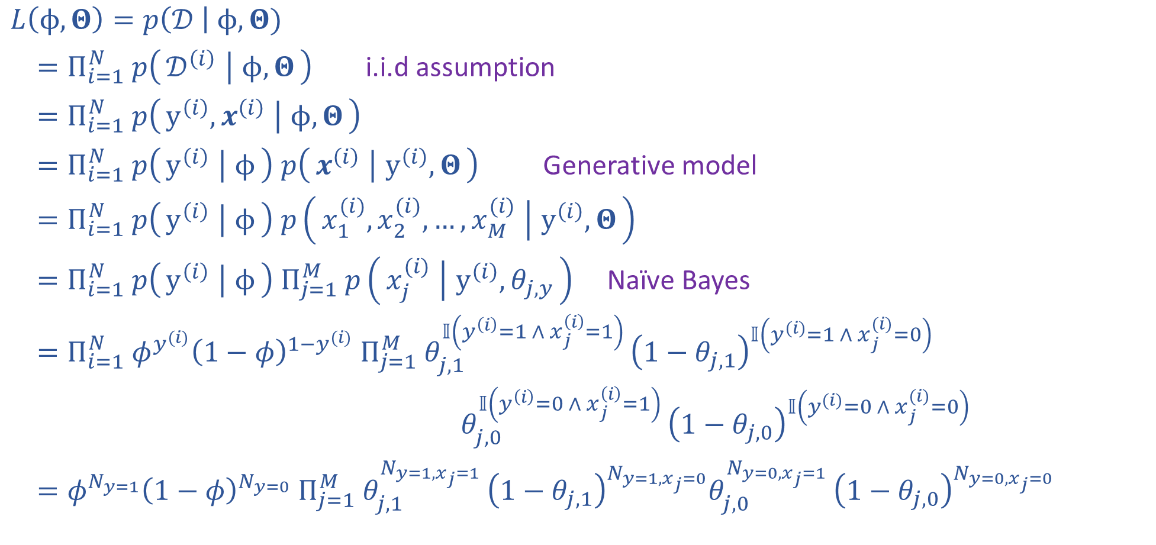
Naïve Bayes MLE
$𝒟={\left\{y^{\left(i\right)}, x^{(i)}\right\}}_{i=1}^{N}$
$y^{(i)}∈\{0,1\}$
$x^{(i)}∈{\left\{0,1\right\}}^{M}$
$φ∈[0,1]$
$Θ∈{\left[0,1\right]}^{Mx2}$
$L\left(ϕ, Θ\right)=p\left(𝒟 \right| ϕ, Θ)$
$=Π_{i=1}^{N} p\left(𝒟^{\left(i\right)} ∣ ϕ, Θ\right)$ i.i.d assumption
$=Π_{i=1}^{N} p\left(y^{\left(i\right)}, x^{\left(i\right)} ∣ ϕ, Θ\right)$
$=Π_{i=1}^{N} p\left(y^{\left(i\right)} ∣ ϕ\right) p\left(x^{\left(i\right)} ∣ y^{\left(i\right)}, Θ\right)$ Generative model
$=Π_{i=1}^{N} p\left(y^{\left(i\right)} ∣ ϕ\right) p\left(x_{1}^{(i)},x_{2}^{(i)},…,x_{M}^{(i)} ∣ y^{\left(i\right)}, Θ\right)$
$=Π_{i=1}^{N} p\left(y^{\left(i\right)} ∣ ϕ\right) Π_{j=1}^{M} p\left(x_{j}^{(i)} ∣ y^{\left(i\right)}, θ_{j,y}\right)$ Naïve Bayes
$=Π_{i=1}^{N} φ^{y^{(i)}}{\left(1−φ\right)}^{1−y^{(i)}} Π_{j=1}^{M} θ_{j,1}^{𝕀\left(y^{\left(i\right)}=1 ∧ x_{j}^{\left(i\right)}=1\right) }{\left(1−θ_{j,1}\right)}^{𝕀\left(y^{(i)}=1 ∧ x_{j}^{(i)}=0\right)}$
$θ_{j,0}^{𝕀\left(y^{\left(i\right)}=0 ∧ x_{j}^{\left(i\right)}=1\right) }{\left(1−θ_{j,0}\right)}^{𝕀\left(y^{(i)}=0 ∧ x_{j}^{(i)}=0\right)}$
$=φ^{N_{y=1}}{\left(1−φ\right)}^{N_{y=0}} Π_{j=1}^{M} θ_{j,1}^{N_{y=1,x_{j}=1} }{\left(1−θ_{j,1}\right)}^{N_{y=1,x_{j}=0}}θ_{j,0}^{N_{y=0,x_{j}=1} }{\left(1−θ_{j,0}\right)}^{N_{y=0,x_{j}=0}}$

Slide 27
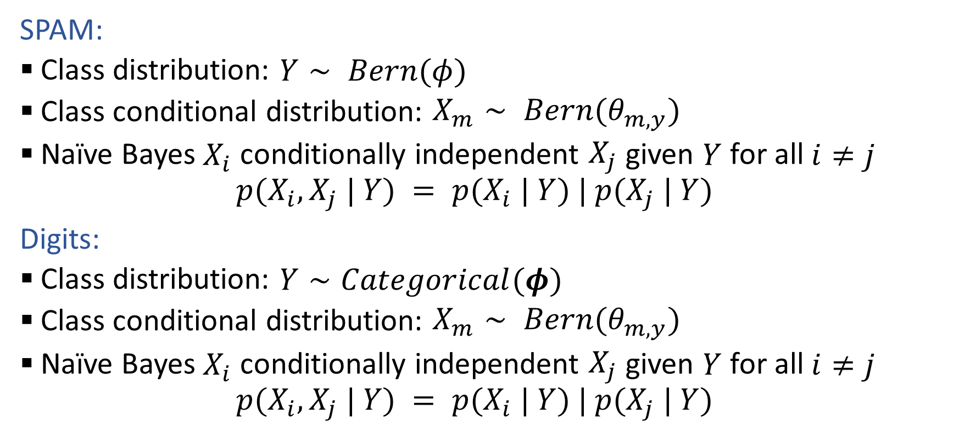
Generative Models
SPAM:
Class distribution: $Y∼ Bern(φ)$
Class conditional distribution: $X_{m}∼ Bern(θ_{m,y})$
Naïve Bayes $X_{i}$ conditionally independent $X_{j}$ given $Y$ for all $i≠j$
$$p(X_{i}, X_{j} | Y) = p(X_{i} | Y) | p(X_{j} | Y)$$
Digits:
Class distribution: $Y∼Categorical(φ)$
Class conditional distribution: $X_{m}∼ Bern(θ_{m,y})$
Naïve Bayes $X_{i}$ conditionally independent $X_{j}$ given $Y$ for all $i≠j$
$$p(X_{i}, X_{j} | Y) = p(X_{i} | Y) | p(X_{j} | Y)$$

Slide 28
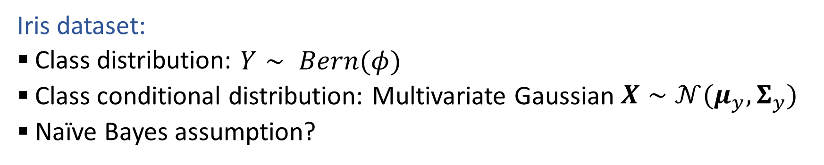
Generative Models with Continuous Features
Iris dataset:
Class distribution: $Y∼ Bern(φ)$
Class conditional distribution: Multivariate Gaussian $X∼𝒩(μ_{y}, Σ_{y})$
Naïve Bayes assumption?

Slide 29
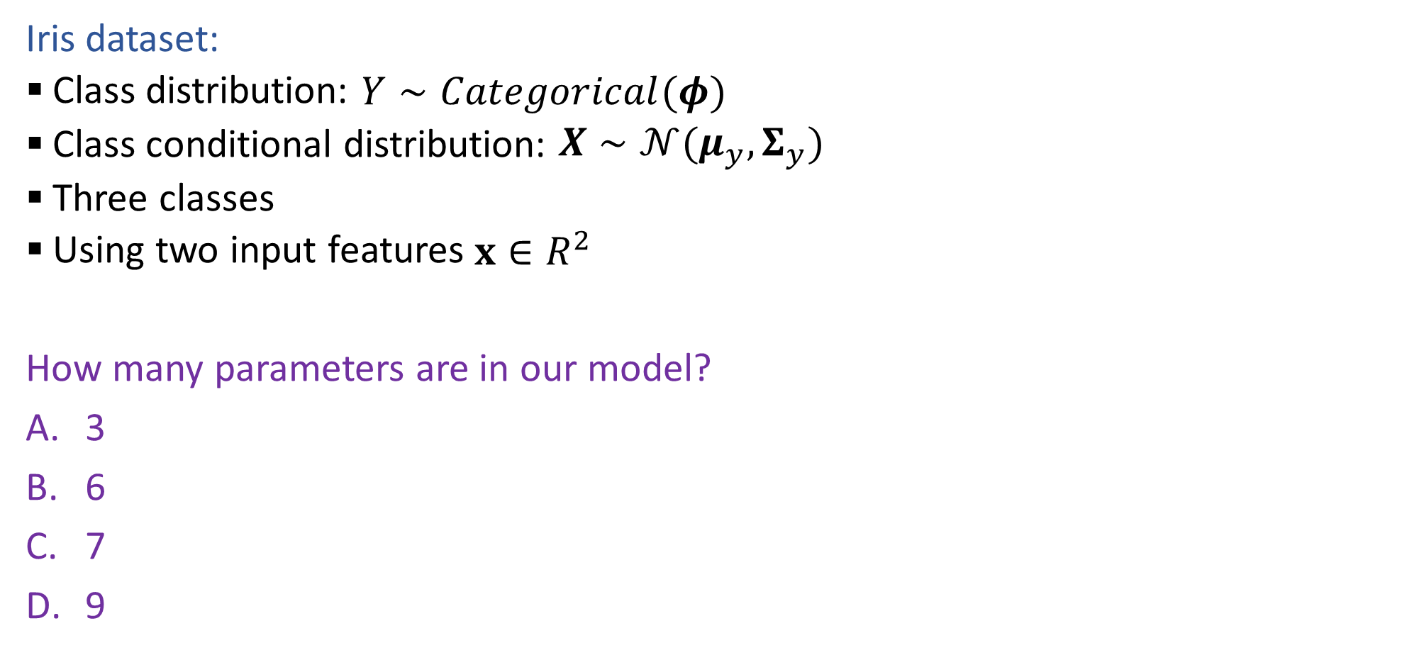
Poll 4
Iris dataset:
Class distribution: $Y∼Categorical(φ)$
Class conditional distribution: $X∼𝒩(μ_{y}, Σ_{y})$
Three classes
Using two input features $x∈R^{2}$
How many parameters are in our model?
3
6
7
9
15
18
920

Slide 30
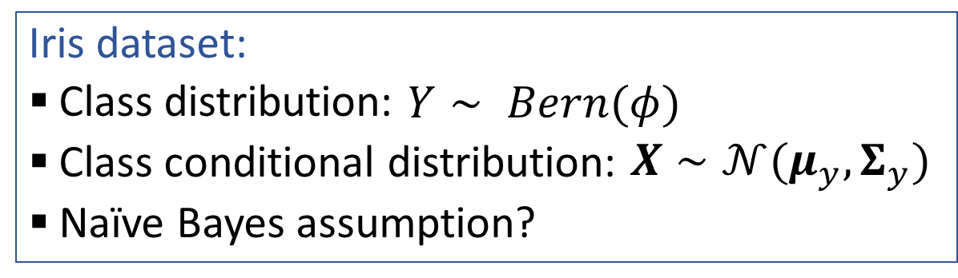
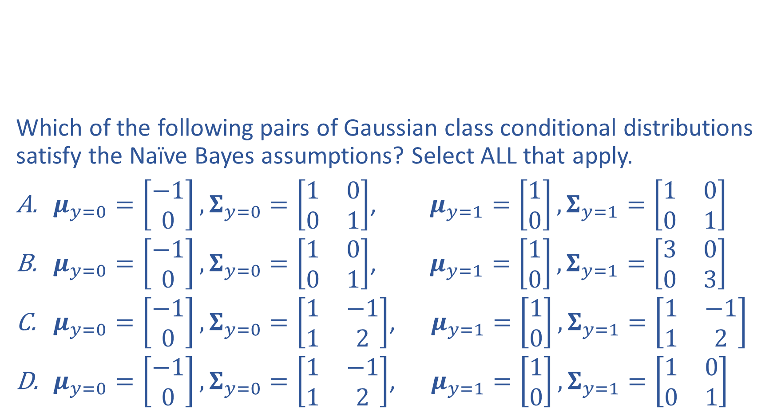
Poll 5
Iris dataset:
Class distribution: $Y∼ Bern(φ)$
Class conditional distribution: $X∼𝒩(μ_{y}, Σ_{y})$
Naïve Bayes assumption?
Which of the following pairs of Gaussian class conditional distributions satisfy the Naïve Bayes assumptions? Select ALL that apply.
$μ_{y=0}=\left[\begin{aligned}−1 \\ 0\end{aligned}\right],Σ_{y=0}=\left[\begin{matrix}1 & 0 \\ 0 & 1\end{matrix}\right]$, $μ_{y=1}=\left[\begin{aligned}1 \\ 0\end{aligned}\right],Σ_{y=1}=\left[\begin{matrix}1 & 0 \\ 0 & 1\end{matrix}\right]$
$μ_{y=0}=\left[\begin{aligned}−1 \\ 0\end{aligned}\right],Σ_{y=0}=\left[\begin{matrix}1 & 0 \\ 0 & 1\end{matrix}\right]$, $μ_{y=1}=\left[\begin{aligned}1 \\ 0\end{aligned}\right],Σ_{y=1}=\left[\begin{matrix}3 & 0 \\ 0 & 3\end{matrix}\right]$
$μ_{y=0}=\left[\begin{aligned}−1 \\ 0\end{aligned}\right],Σ_{y=0}=\left[\begin{matrix}1 & −1 \\ 1 & 2\end{matrix}\right]$, $μ_{y=1}=\left[\begin{aligned}1 \\ 0\end{aligned}\right],Σ_{y=1}=\left[\begin{matrix}1 & −1 \\ 1 & 2\end{matrix}\right]$
$μ_{y=0}=\left[\begin{aligned}−1 \\ 0\end{aligned}\right],Σ_{y=0}=\left[\begin{matrix}1 & −1 \\ 1 & 2\end{matrix}\right]$, $μ_{y=1}=\left[\begin{aligned}1 \\ 0\end{aligned}\right],Σ_{y=1}=\left[\begin{matrix}1 & 0 \\ 0 & 1\end{matrix}\right]$

Slide 31
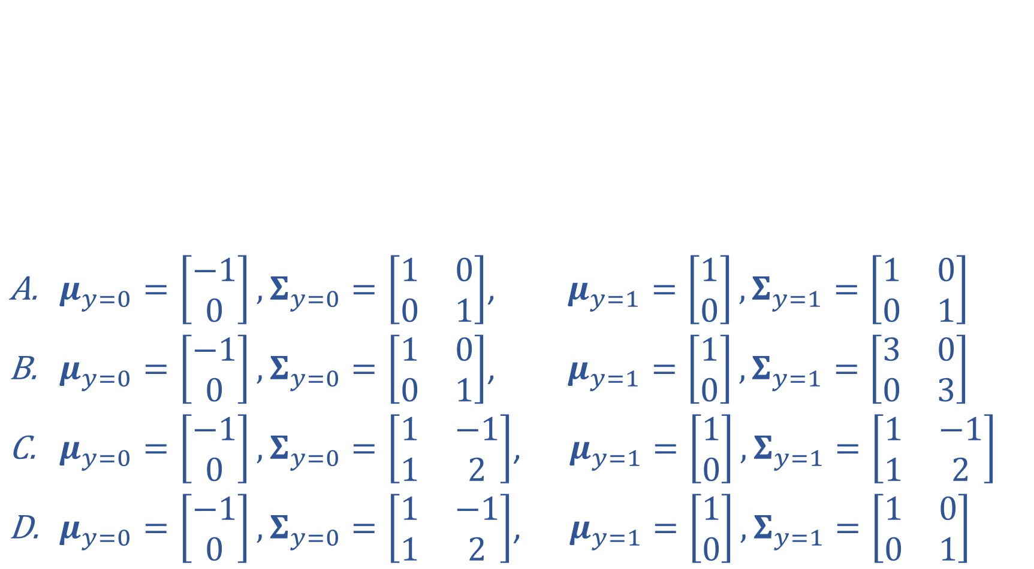
Poll 5
$μ_{y=0}=\left[\begin{aligned}−1 \\ 0\end{aligned}\right],Σ_{y=0}=\left[\begin{matrix}1 & 0 \\ 0 & 1\end{matrix}\right]$, $μ_{y=1}=\left[\begin{aligned}1 \\ 0\end{aligned}\right],Σ_{y=1}=\left[\begin{matrix}1 & 0 \\ 0 & 1\end{matrix}\right]$
$μ_{y=0}=\left[\begin{aligned}−1 \\ 0\end{aligned}\right],Σ_{y=0}=\left[\begin{matrix}1 & 0 \\ 0 & 1\end{matrix}\right]$, $μ_{y=1}=\left[\begin{aligned}1 \\ 0\end{aligned}\right],Σ_{y=1}=\left[\begin{matrix}3 & 0 \\ 0 & 3\end{matrix}\right]$
$μ_{y=0}=\left[\begin{aligned}−1 \\ 0\end{aligned}\right],Σ_{y=0}=\left[\begin{matrix}1 & −1 \\ 1 & 2\end{matrix}\right]$, $μ_{y=1}=\left[\begin{aligned}1 \\ 0\end{aligned}\right],Σ_{y=1}=\left[\begin{matrix}1 & −1 \\ 1 & 2\end{matrix}\right]$
$μ_{y=0}=\left[\begin{aligned}−1 \\ 0\end{aligned}\right],Σ_{y=0}=\left[\begin{matrix}1 & −1 \\ 1 & 2\end{matrix}\right]$, $μ_{y=1}=\left[\begin{aligned}1 \\ 0\end{aligned}\right],Σ_{y=1}=\left[\begin{matrix}1 & 0 \\ 0 & 1\end{matrix}\right]$

Slide 32
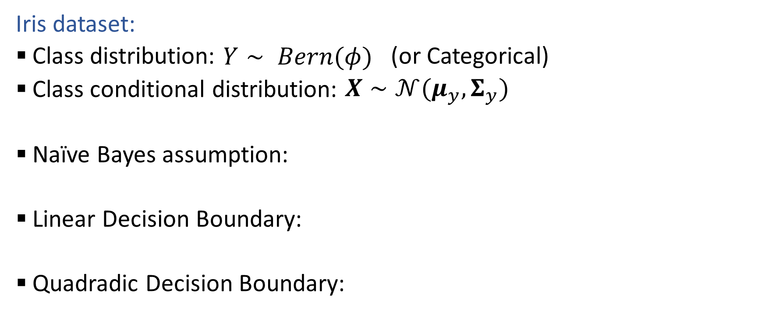
Class-conditional Gaussian Distributions
Iris dataset:
Class distribution: $Y∼ Bern(φ)$ (or Categorical)
Class conditional distribution: $X∼𝒩(μ_{y}, Σ_{y})$
Naïve Bayes assumption:
Linear Decision Boundary:
Quadradic Decision Boundary:

Slide 33
Generative + MAP

Slide 34

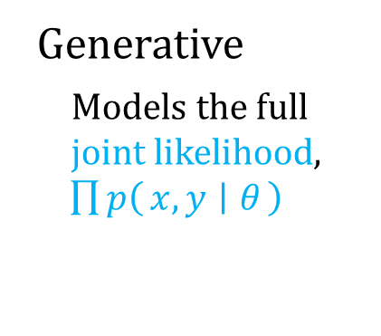
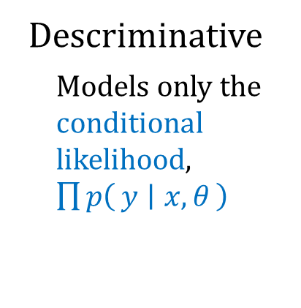
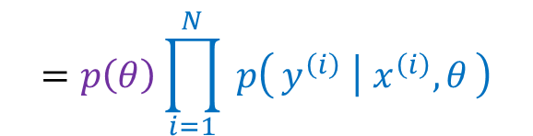


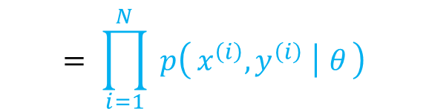


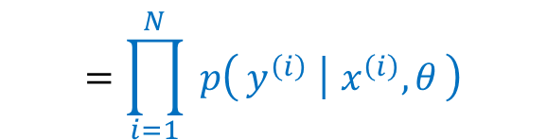
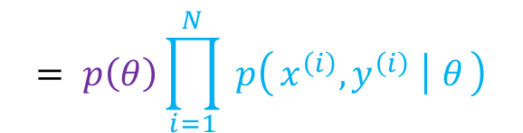
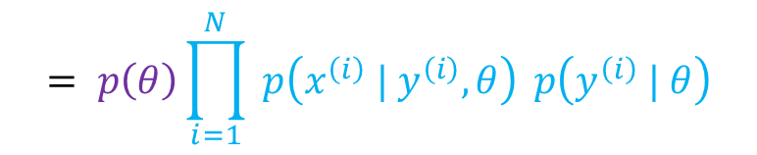
MLE vs MAP vs Generative vs Discriminative
Maximum likelihood estimation
Maximum a posteriori estimation
Descriminative
Models only the conditional likelihood, $\prod{p\left(y ∣ x, θ\right)}$
$$p(𝒟^{∗}∣θ)$$
* conditional likelihood
$$p\left(θ\right) p(𝒟^{∗} ∣ θ)$$
* conditional likelihood
$$=\prod_{i=1}^{N}{ p\left(y^{\left(i\right)} ∣ x^{\left(i\right)}, θ\right)}$$
$$=p\left(θ\right)\prod_{i=1}^{N}{ p\left(y^{\left(i\right)} ∣ x^{\left(i\right)}, θ\right)}$$
$$p(𝒟 ∣ θ)$$
* actual likelihood
$$p\left(θ\right) p(𝒟 ∣ θ)$$
* actual likelihood
Generative
Models the full joint likelihood,
$\prod{p\left(x, y ∣ θ\right)}$
$$= \prod_{i=1}^{N}{ p\left(x^{\left(i\right)},y^{\left(i\right)} ∣ θ\right)}$$
$$= p\left(θ\right)\prod_{i=1}^{N}{ p\left(x^{\left(i\right)},y^{\left(i\right)} ∣ θ\right)}$$
$$= \prod_{i=1}^{N}{ p\left(x^{\left(i\right)} | y^{\left(i\right)}, θ\right)} p\left(y^{\left(i\right)} | θ\right)$$
$$= p\left(θ\right)\prod_{i=1}^{N}{ p\left(x^{\left(i\right)} | y^{\left(i\right)}, θ\right)} p\left(y^{\left(i\right)} | θ\right)$$
class-conditional
class prior
class-conditional
class prior

Slide 35
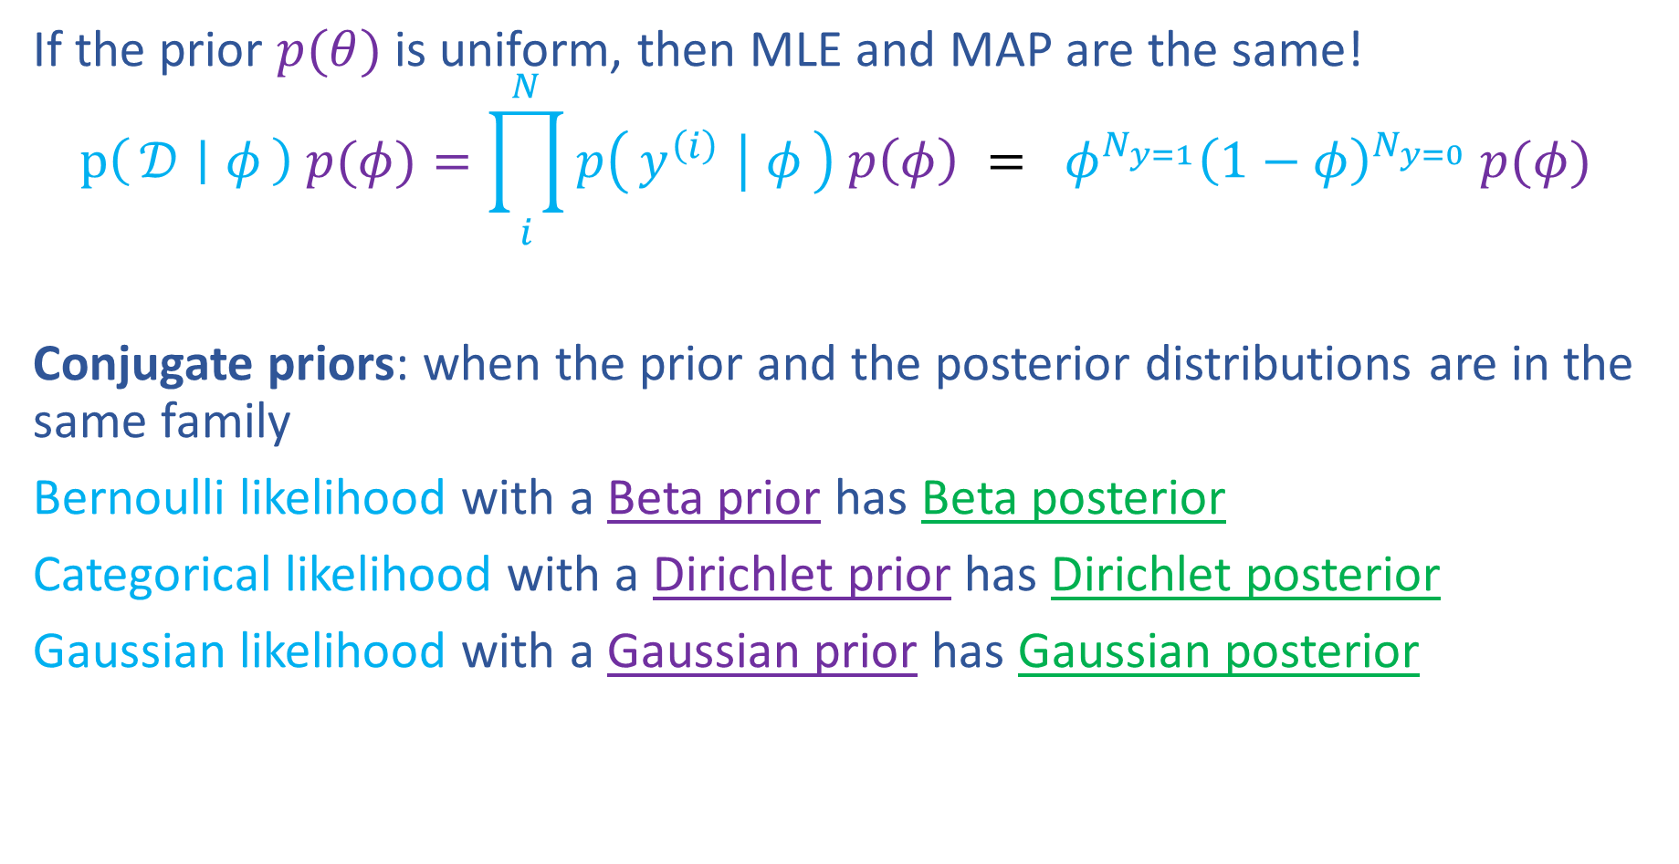
Reminder: Prior Distributions for MAP
If the prior $p(θ)$ is uniform, then MLE and MAP are the same!
$$p\left(𝒟 ∣ φ\right) p(φ)=\prod_{i}^{N}{p\left(y^{\left(i\right)} ∣ φ\right) p\left(φ\right)} = φ^{N_{y=1}}{\left(1−φ\right)}^{N_{y=0}} p(φ)$$
Conjugate priors: when the prior and the posterior distributions are in the same family
Bernoulli likelihood with a Beta prior has Beta posterior
Categorical likelihood with a Dirichlet prior has Dirichlet posterior
Gaussian likelihood with a Gaussian prior has Gaussian posterior
https://www.desmos.com/calculator/kr7m2m6cf7

