Slide 1

10-315 Introduction to ML Dimensionality Reduction: PCA, Autoencoders, and Feature Learning
Instructor: Pat Virtue

Slide 2
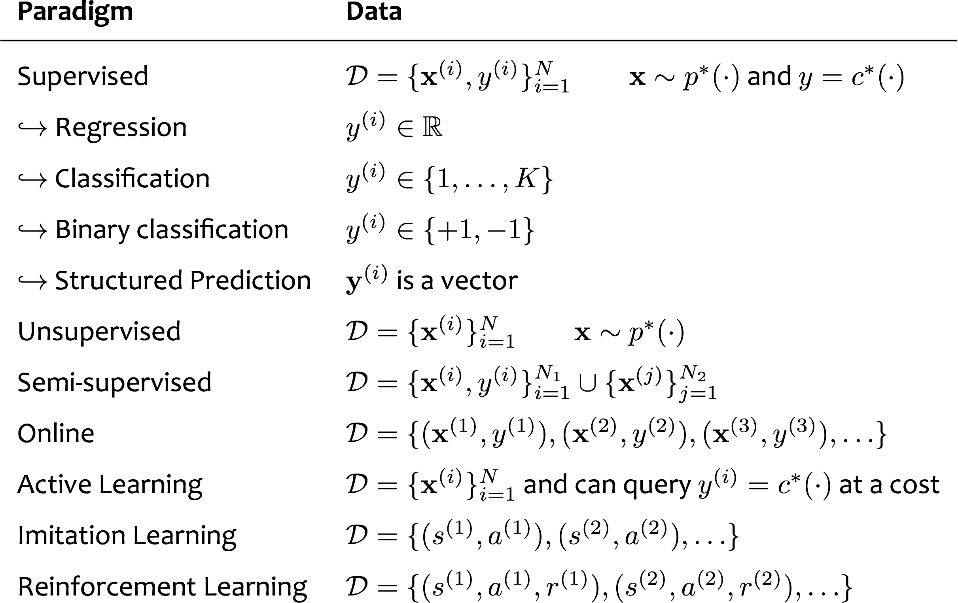
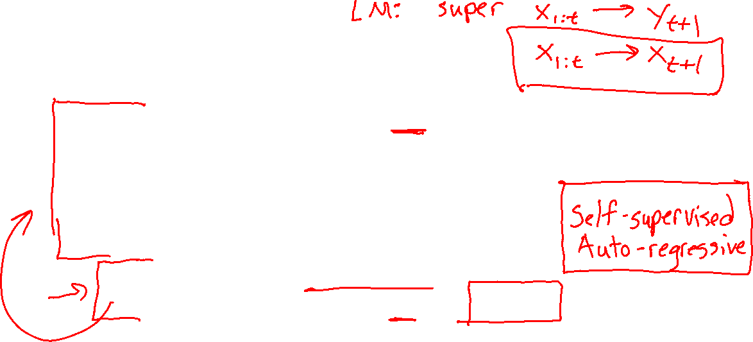
Learning Paradigms
Slide credit: CMU MLD, Matt Gormley

Slide 3
Outline
Unsupervised Learning
Dimensionality Reduction
Embedded Spaces and Feature Learning
Autoencoders
Principal Component Analysis (PCA)
Examples: 2D and 3D
PCA algorithm
PCA, eigenvectors, and eigenvalues
PCA objective and optimization

Slide 4
Dimensionality Reduction

Slide 5
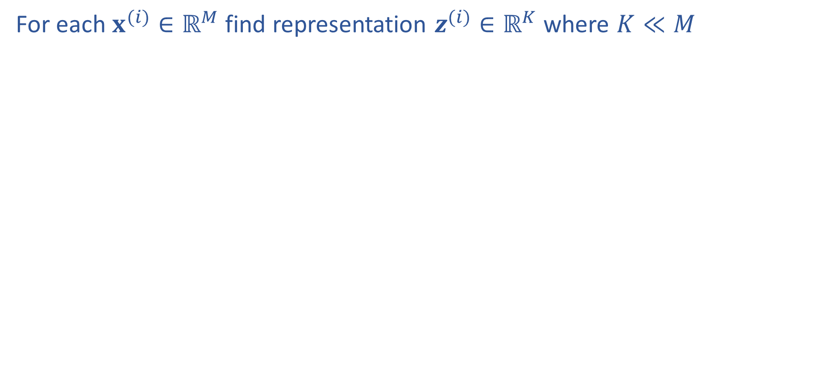
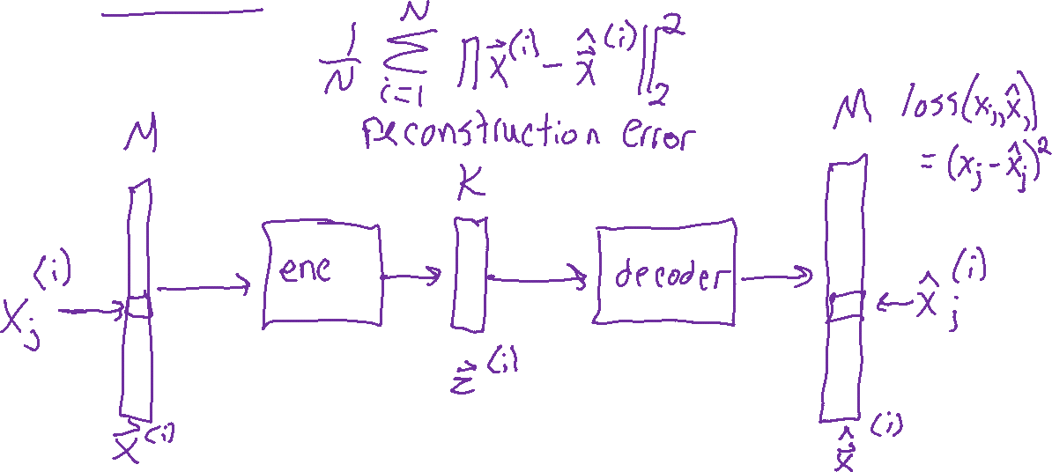
Dimensionality Reduction

Slide 6
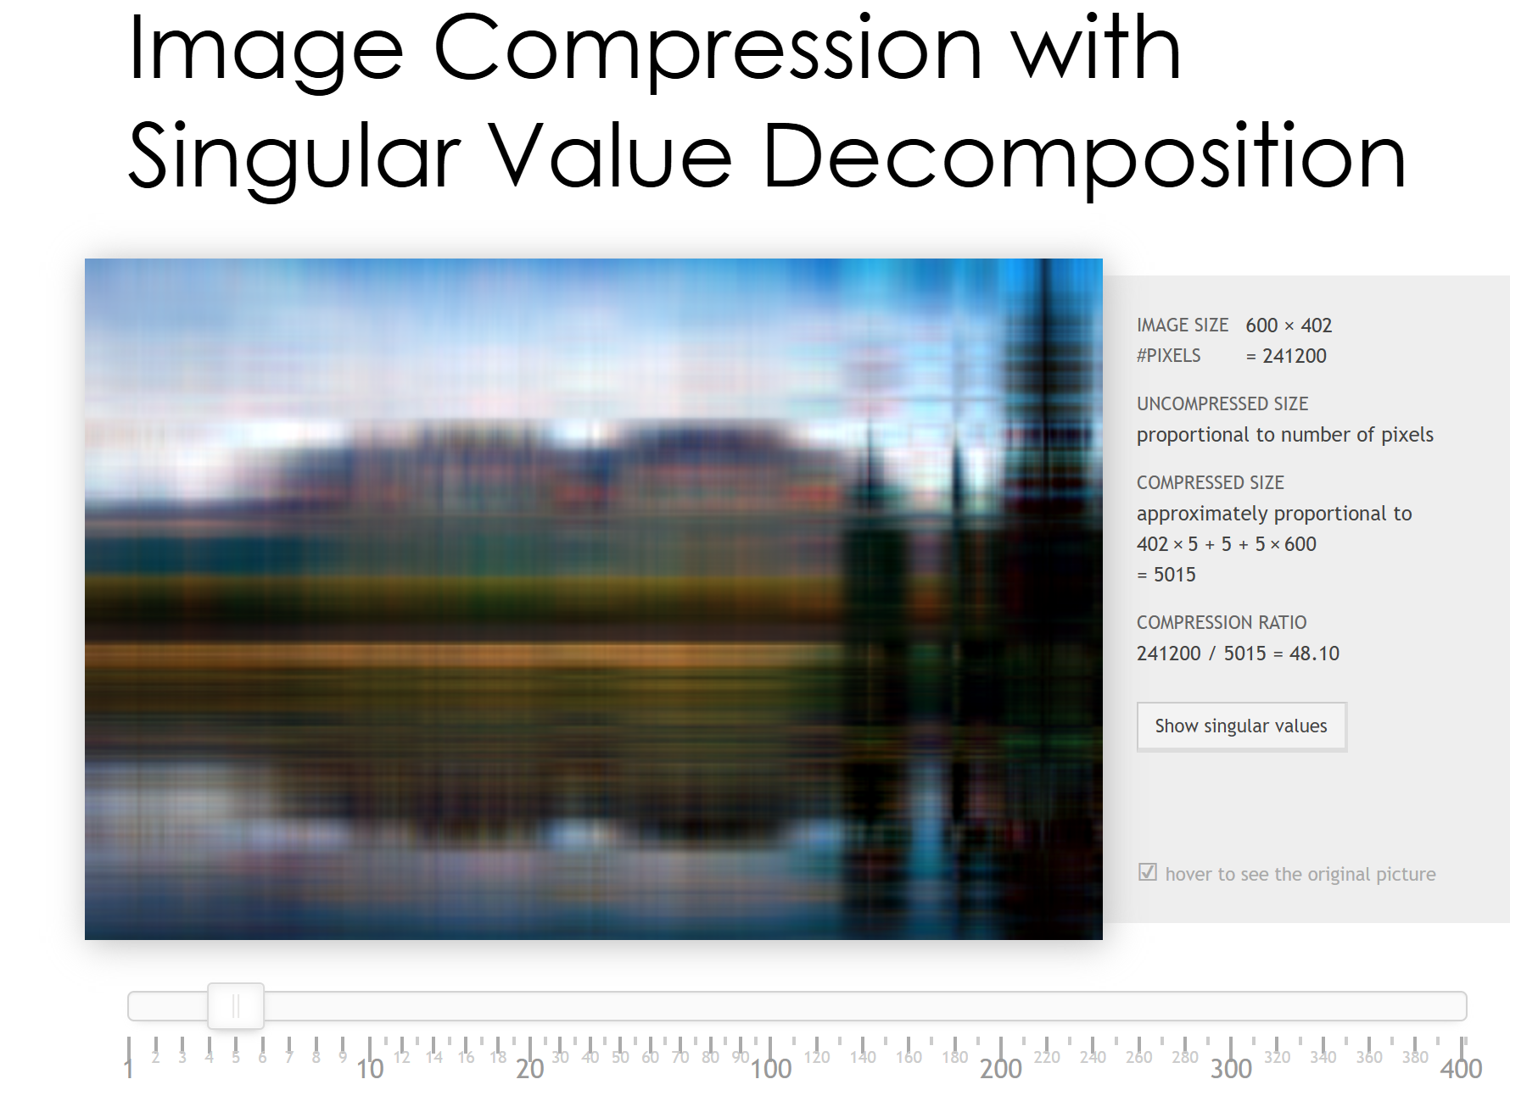
Dimensionality Reduction
http://timbaumann.info/svd-image-compression-demo/

Slide 7
Dimensionality Reduction
http://timbaumann.info/svd-image-compression-demo/
https://cs.stanford.edu/people/karpathy/convnetjs/demo/autoencoder.html

Slide 8
Feature Learning
Learning a lower dimensional representation of our data rather than doing feature engineering to represent the data
Also called feature embedding
(embedding data in a lower/different dimensional space)

Slide 9
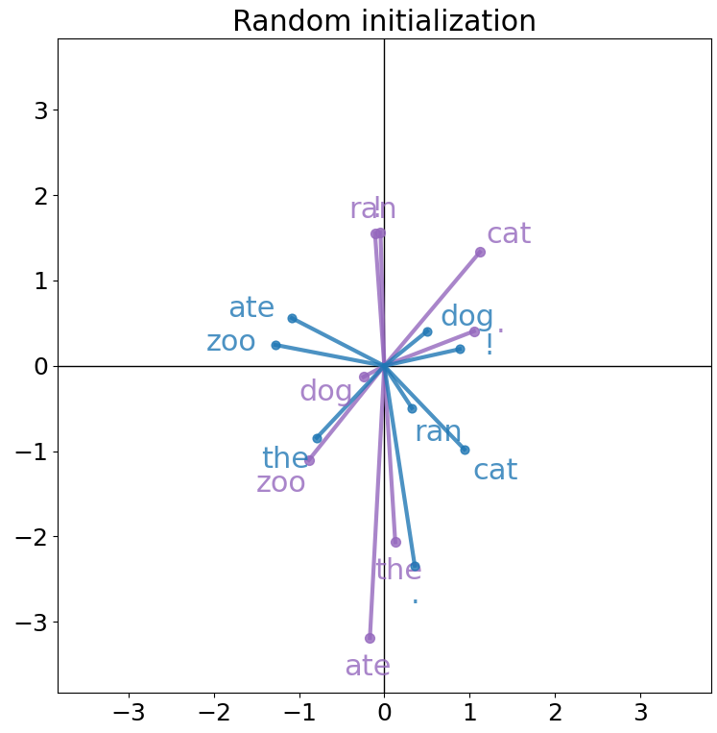
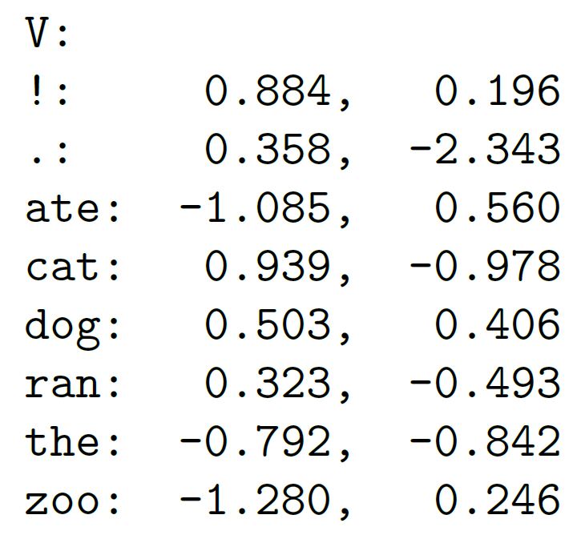
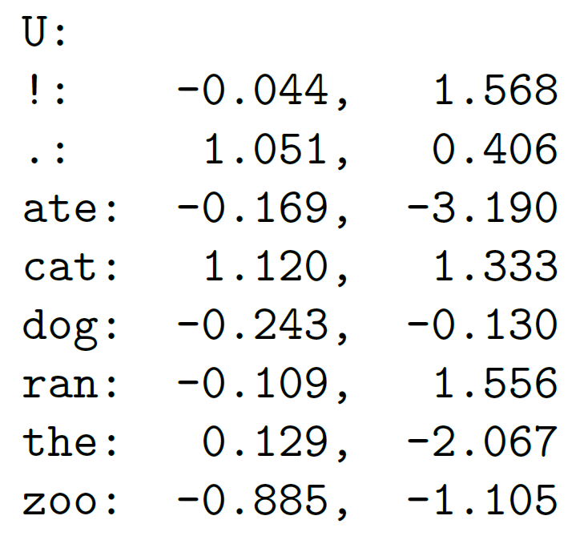



Word Embeddings
Vector representation for each token in vocabulary (initially random)
$V$: Previous
$U$: Next

Slide 10
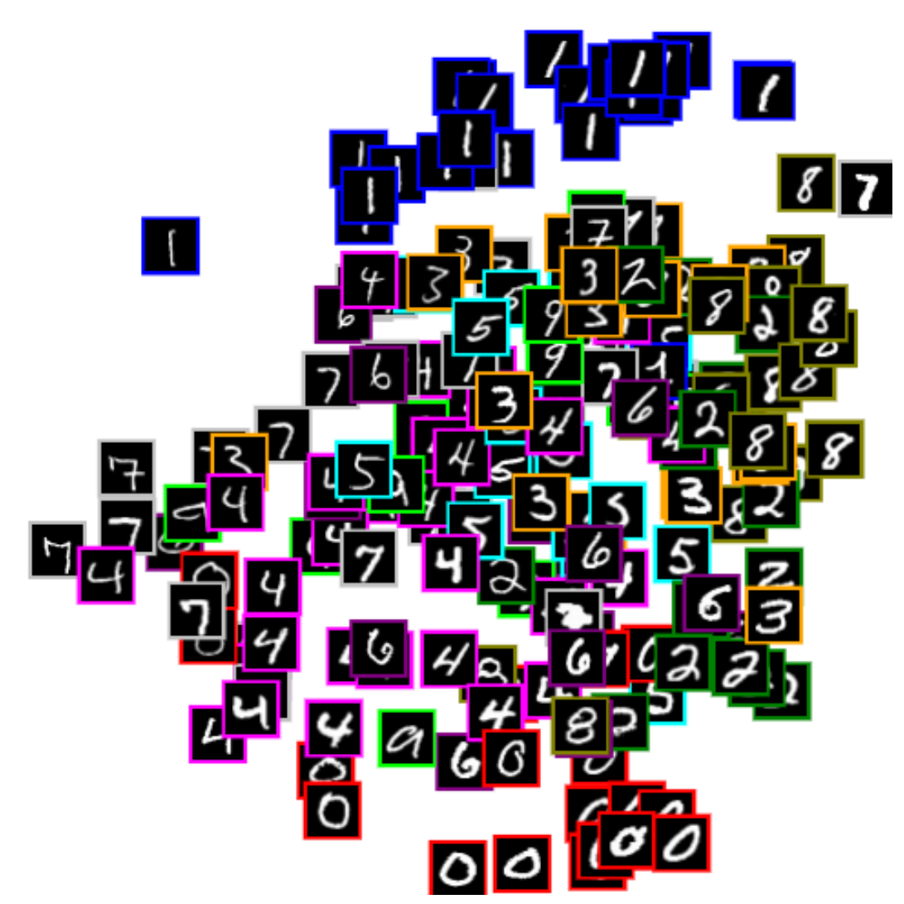
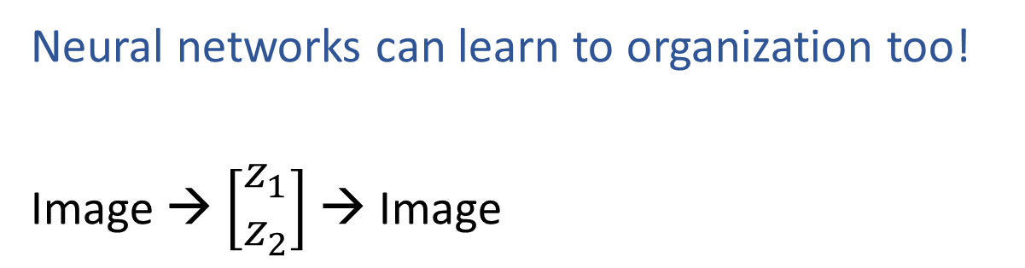


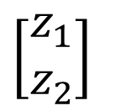

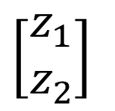
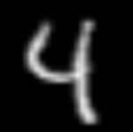


Learning to Organize Data
Net
Net
Net
Net
https://cs.stanford.edu/people/karpathy/convnetjs/demo/autoencoder.html

Slide 11

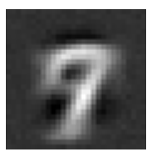
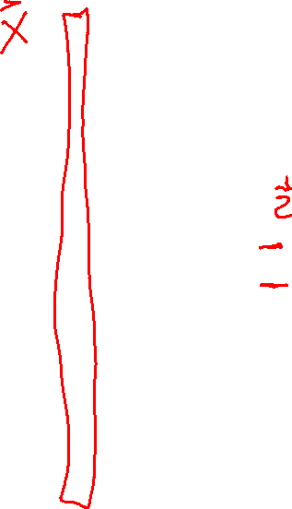
Digit Autoencoder
https://cs.stanford.edu/people/karpathy/convnetjs/demo/autoencoder.html
Layer 1
Layer 2
Layer 4
Layer 5
Layer 6
Input
28x28 = 784 pixels
Layer 3
50 neurons
50 neurons
784 neurons
50 neurons
50 neurons
2 neurons
Autoencoder network

Slide 12

Digit Autoencoder
Demo: Using a learned feature space

Slide 13
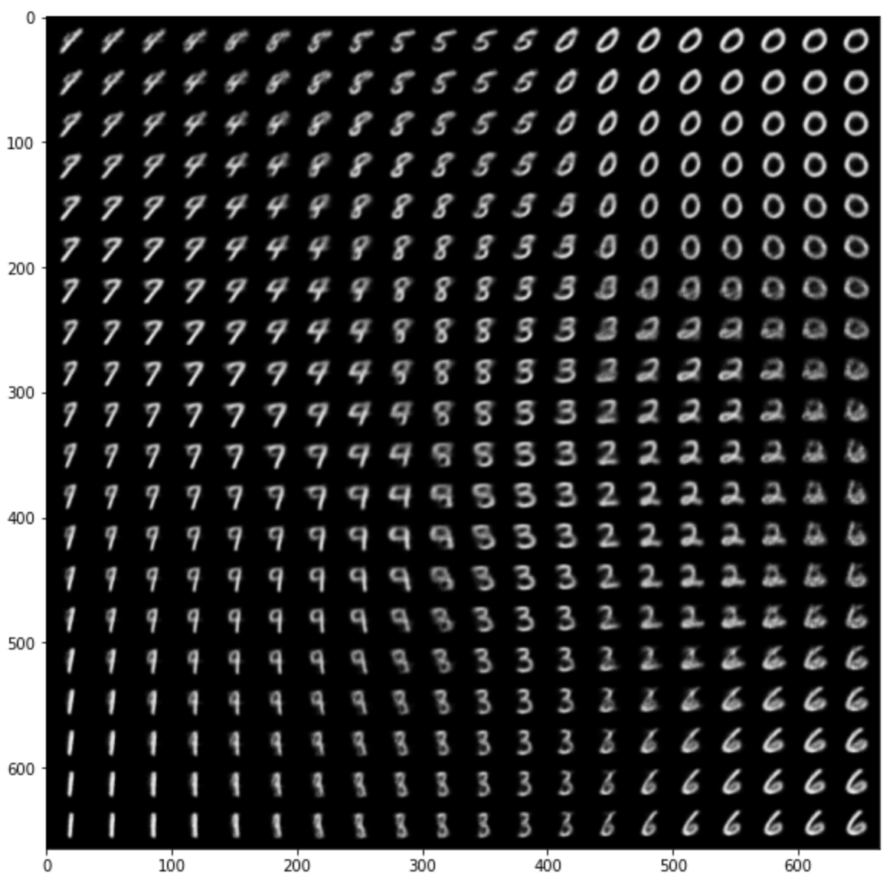
Variational Autoencoder Demo
Zhuoyue Lyu, Safinah Ali, and Cynthia Breazeal. EAAI 2022.
https://colab.research.google.com/gist/ZhuoyueLyu/5046225a9ae3675cf633c1df5f63be06/digits-interpolation-notebook-eaai.ipynb

Slide 14
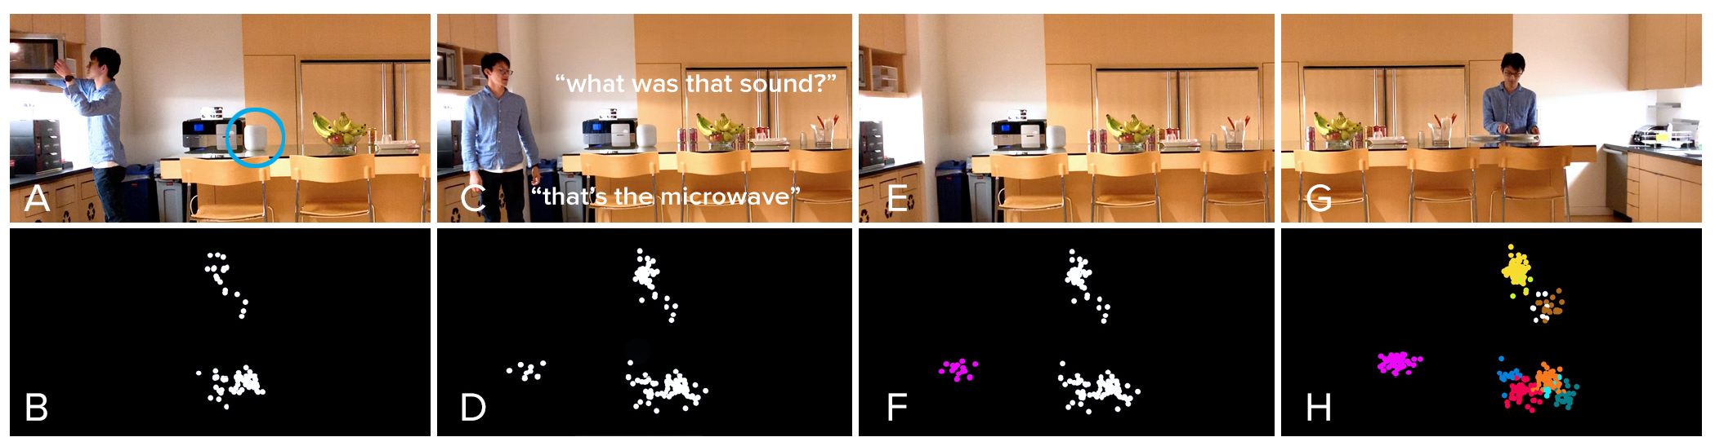
Feature Learning
Listen Learner
https://chrisharrison.net/index.php/Research/ListenLearner

Slide 15

Exploring Feature Space
https://experiments.withgoogle.com/ai/melody-mixer/view/

Slide 16

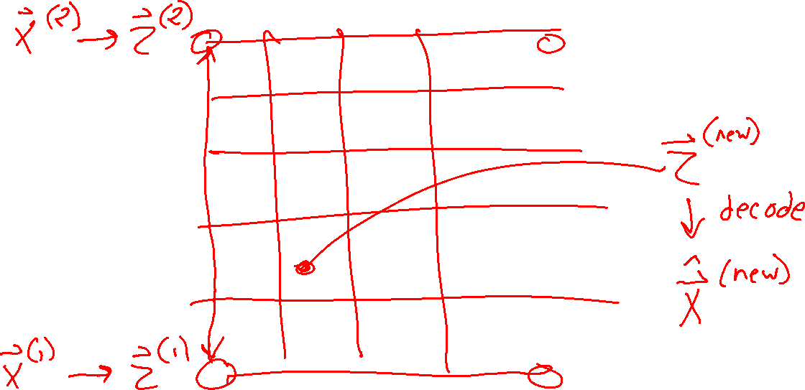
Exploring Feature Space
https://experiments.withgoogle.com/ai/beat-blender/view/

Slide 17
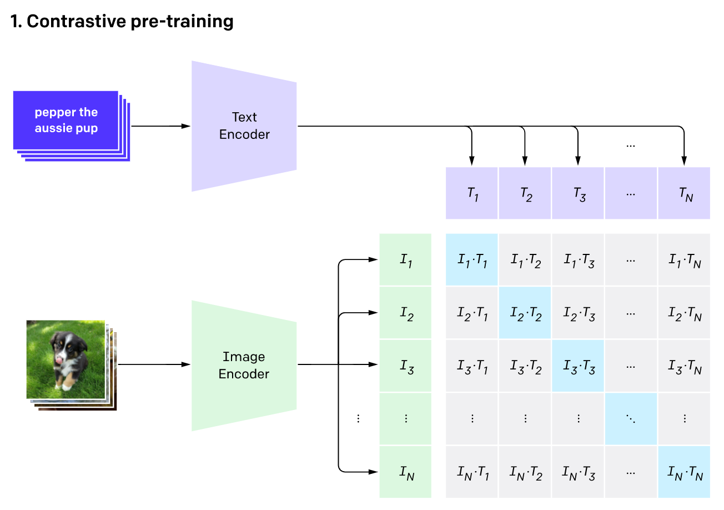
Feature Learning
CLIP: Connecting text and images
https://openai.com/research/clip

Slide 18
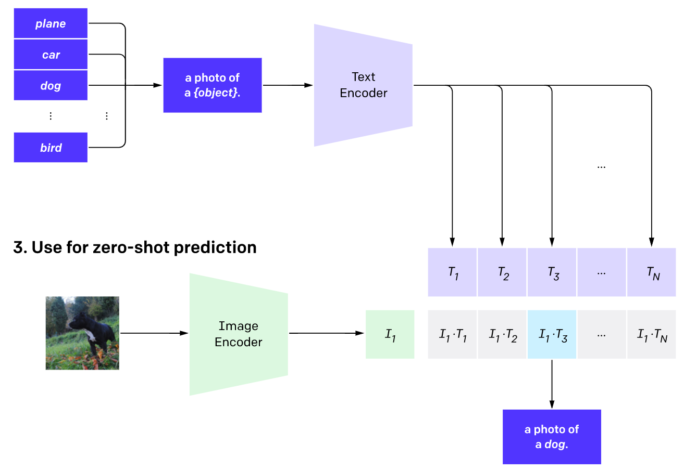

Feature Learning
CLIP: Connecting text and images
https://openai.com/research/clip

Slide 19

Outline
Unsupervised Learning
Dimensionality Reduction
Embedded Spaces and Feature Learning
Autoencoders
Principal Component Analysis (PCA)
Examples: 2D and 3D
PCA algorithm
PCA, eigenvectors, and eigenvalues
PCA objective and optimization

Slide 20
Autoencoders

Slide 21
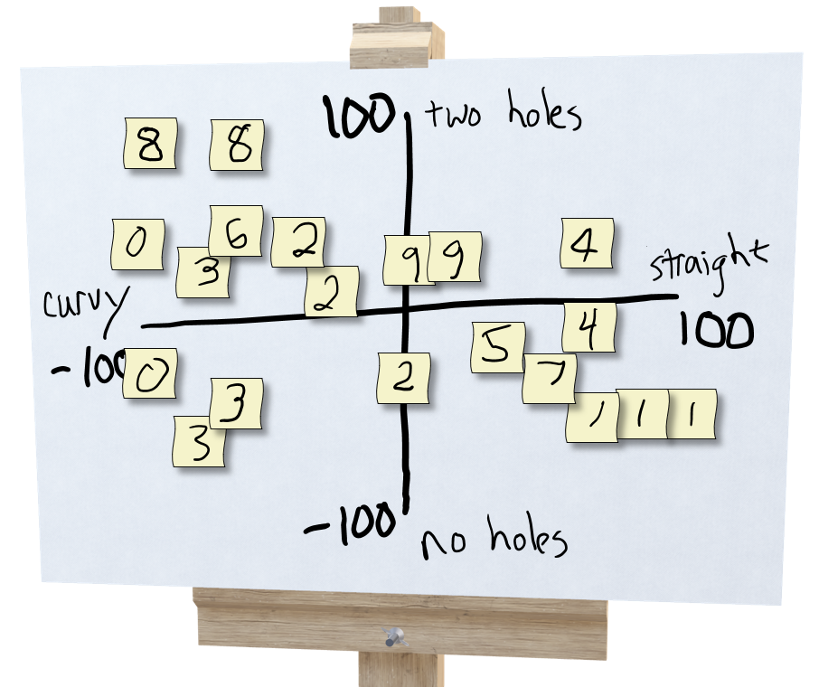
Exercise: Human-defined Feature Space
Step 4: Creation!
Select three students: A,B,C
Student A draws a new digit and hands it to student B
Student B thinks about where to plot it and comes up with a 2-D coordinate, (x, y)
Student C looks at the coordinate and the plot (but not the drawing from A) and draws a new digit

Slide 22
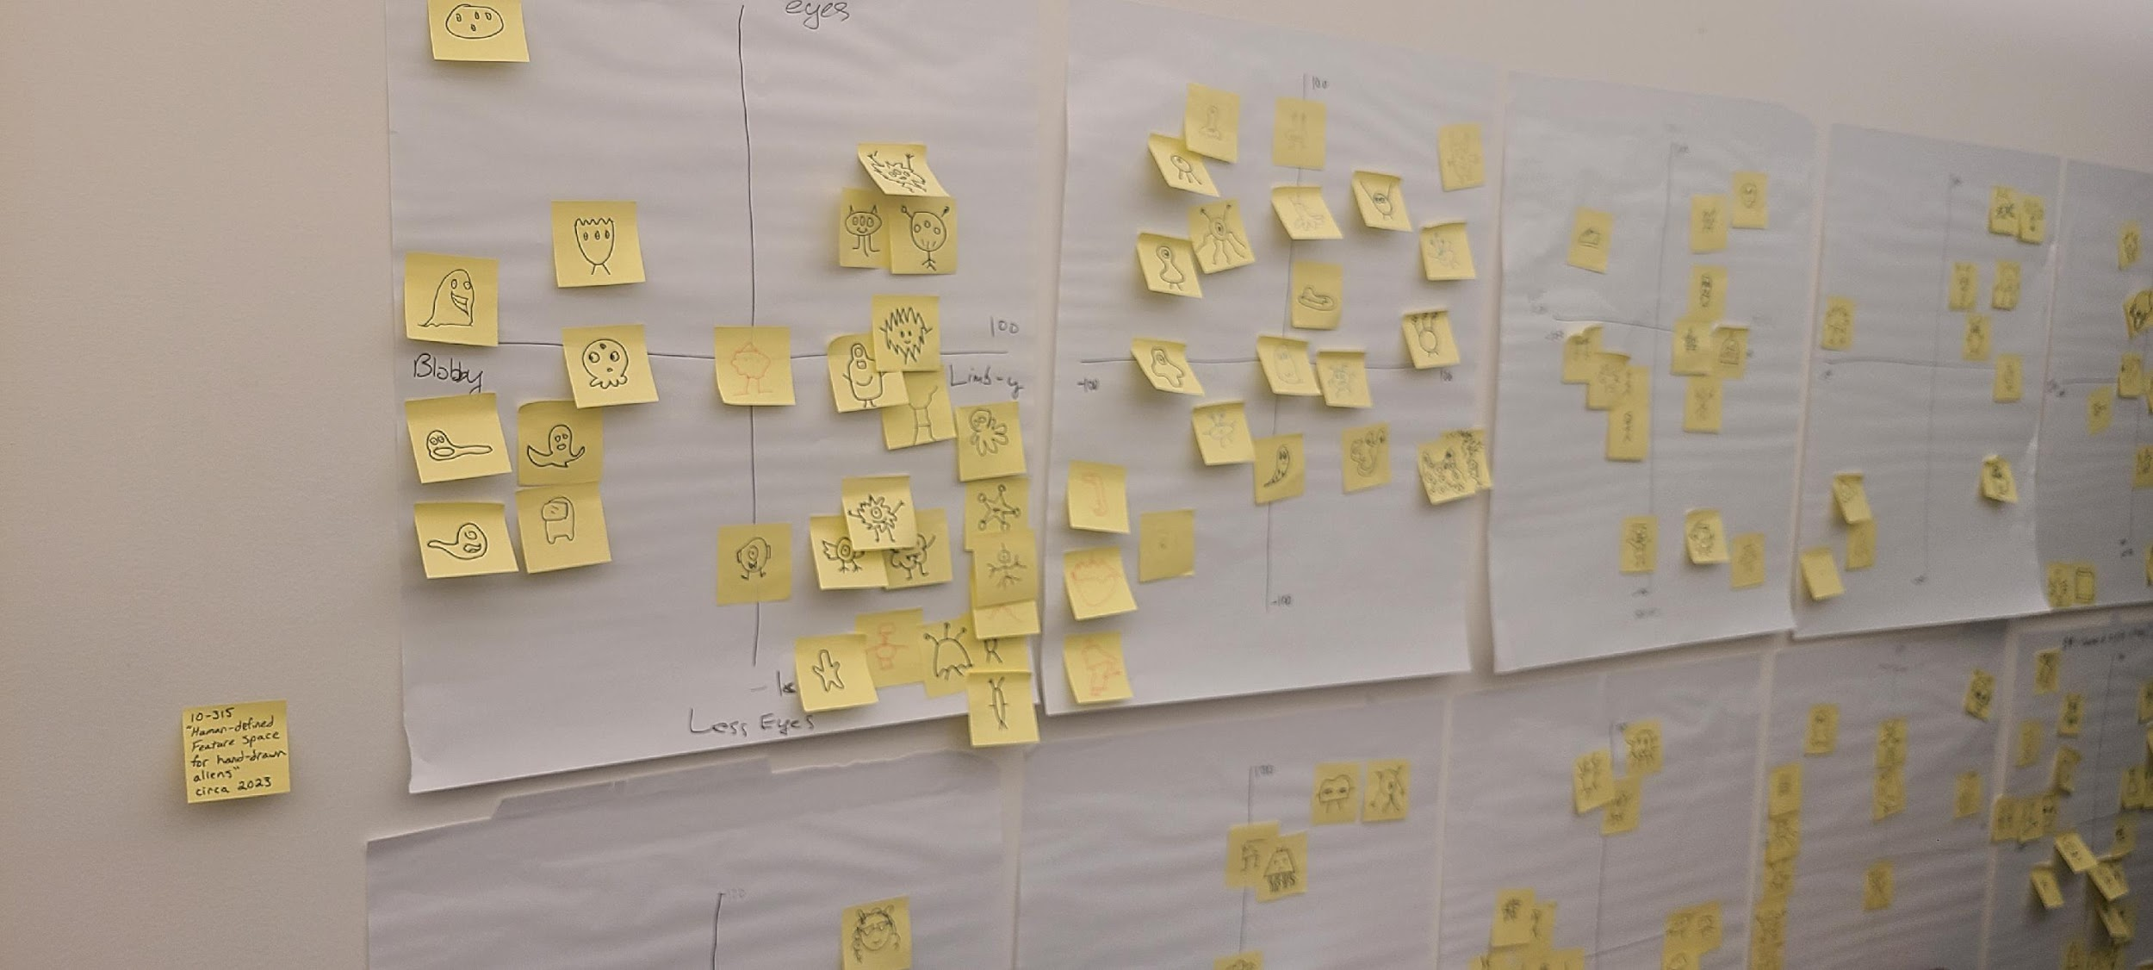
Exercise: Human-defined Feature Space

Slide 23
Learning to Organize Data
Net
Net
Net
Net
https://cs.stanford.edu/people/karpathy/convnetjs/demo/autoencoder.html

Slide 24
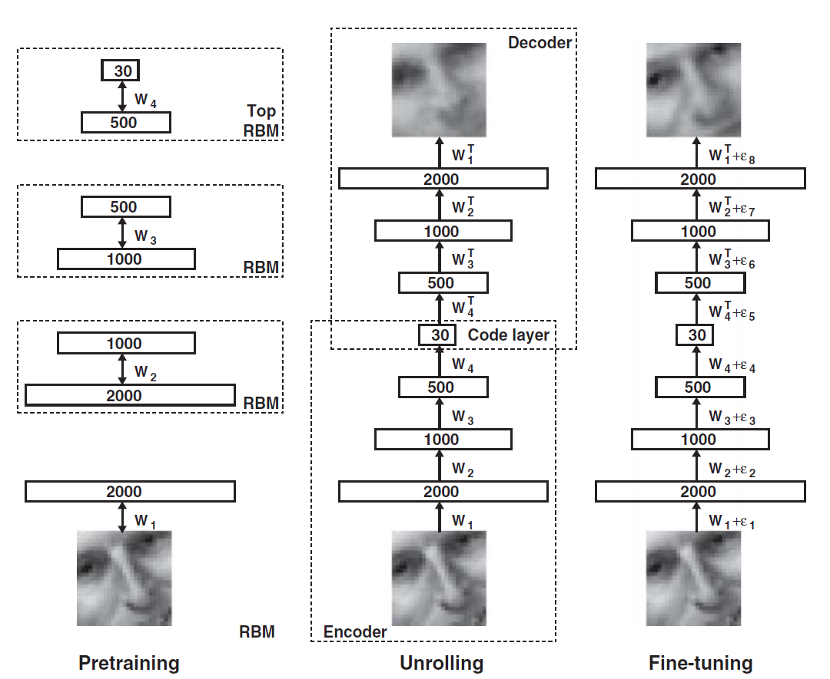

Dimensionality Reduction with Deep Learning
Hinton, Geoffrey E., and Ruslan R. Salakhutdinov.
"Reducing the dimensionality of data with neural networks.”
Science 313.5786 (2006): 504-507.

Slide 25
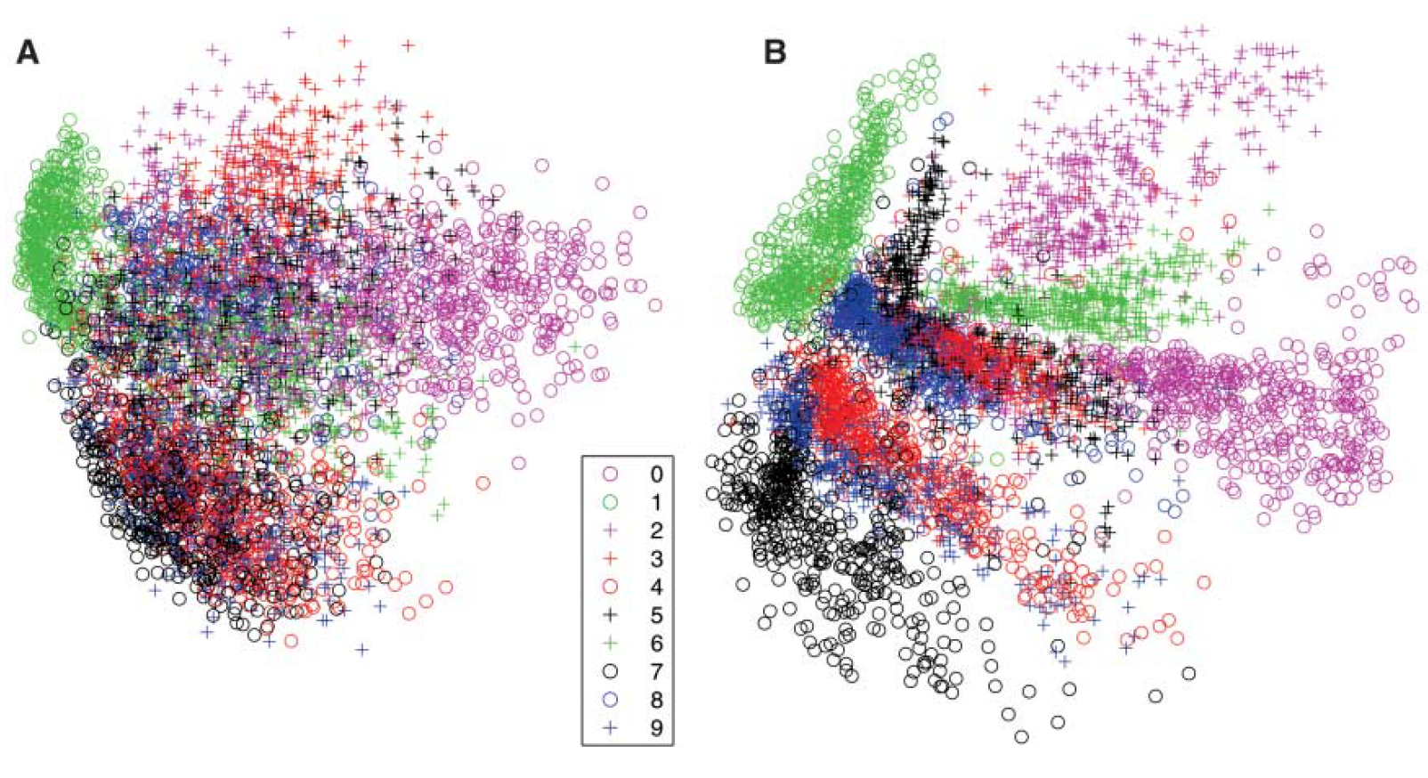
Dimensionality Reduction with Deep Learning
Hinton, Geoffrey E., and Ruslan R. Salakhutdinov.
"Reducing the dimensionality of data with neural networks.”
Science 313.5786 (2006): 504-507.
Neural Network
PCA

Slide 26
Digit Autoencoder
https://cs.stanford.edu/people/karpathy/convnetjs/demo/autoencoder.html
Layer 1
Layer 2
Layer 4
Layer 5
Layer 6
Input
28x28 = 784 pixels
Layer 3
50 neurons
50 neurons
784 neurons
50 neurons
50 neurons
2 neurons
Autoencoder network

Slide 27
Digit Autoencoder
Demo: Using a learned feature space

Slide 28
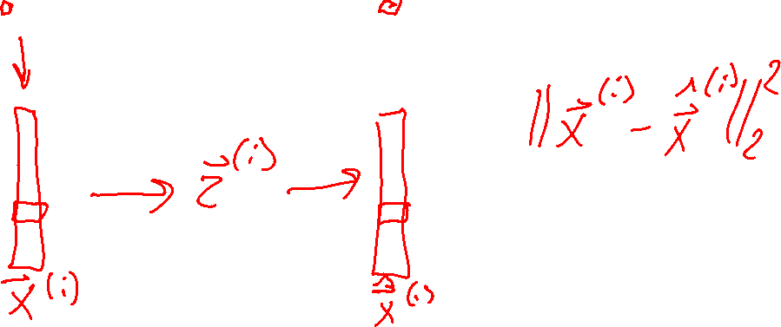
Autoencoder objective
Minimize reconstruction error
Net
Net

Slide 29
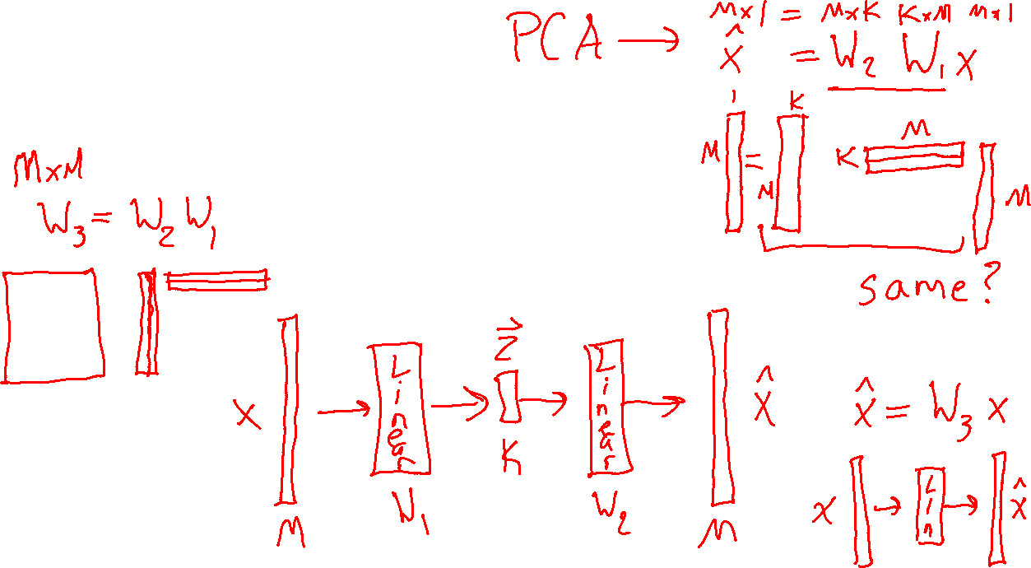
Autoencoder objective
What if networks are just one linear layer?
Net
Net

Slide 30
Outline
Unsupervised Learning
Dimensionality Reduction
Embedded Spaces and Feature Learning
Autoencoders
Principal Component Analysis (PCA)
Examples: 2D and 3D
PCA algorithm
PCA, eigenvectors, and eigenvalues
PCA objective and optimization

Slide 31
Principal Component Analysis (PCA)

Slide 32
Dimensionality Reduction with Deep Learning
Hinton, Geoffrey E., and Ruslan R. Salakhutdinov.
"Reducing the dimensionality of data with neural networks.”
Science 313.5786 (2006): 504-507.
Autoencoder
PCA

Slide 33
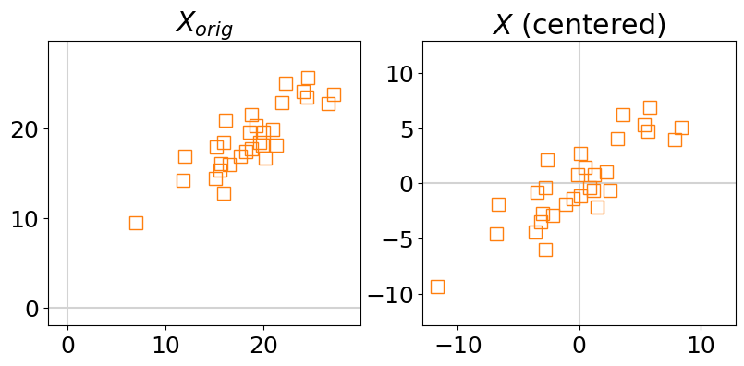
Principle Component Axes
2-D Gaussian Data: 1st and 2nd principle component axes
Spoiler: The PCA axes can be found using eigenvectors!

Slide 34
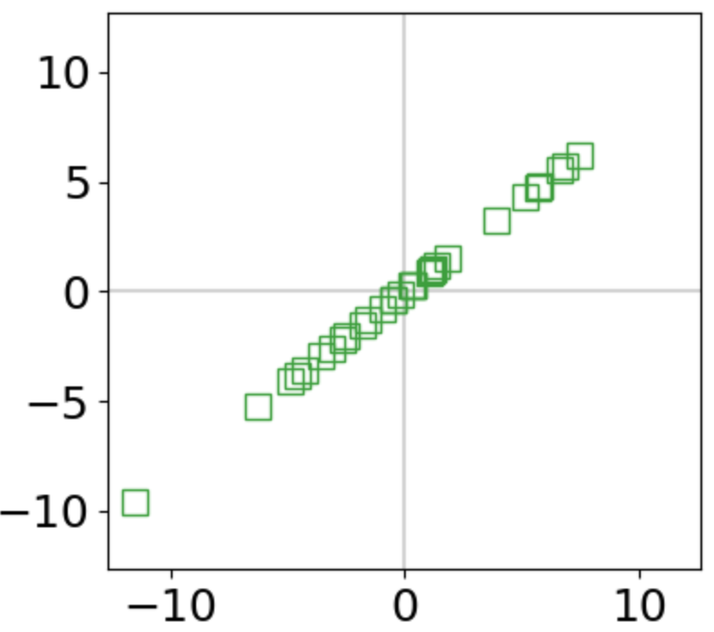
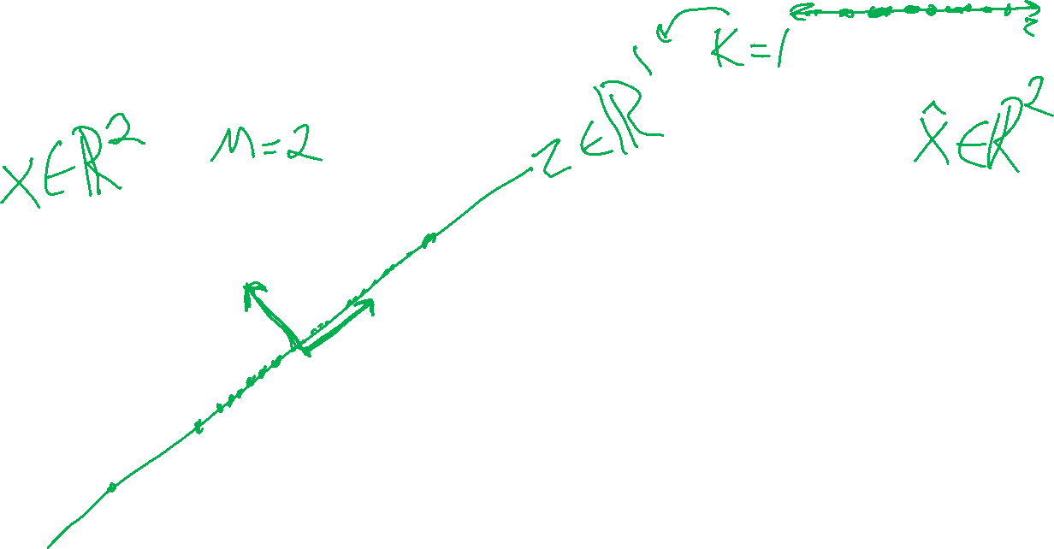
PCA Dimensionality Reduction
2-D Gaussian Data: Reduced along 1st principle component

Slide 35
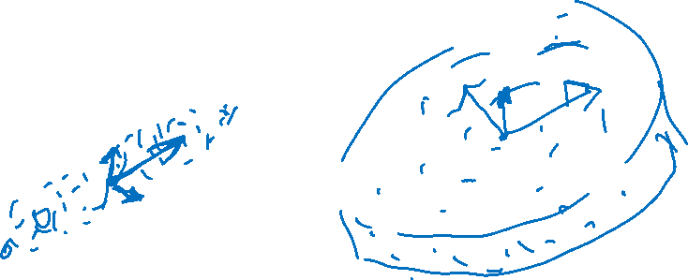
PCA Axes
3-D Data

Slide 36
PCA: Pre-processing
What if the data isn't centered

Slide 37
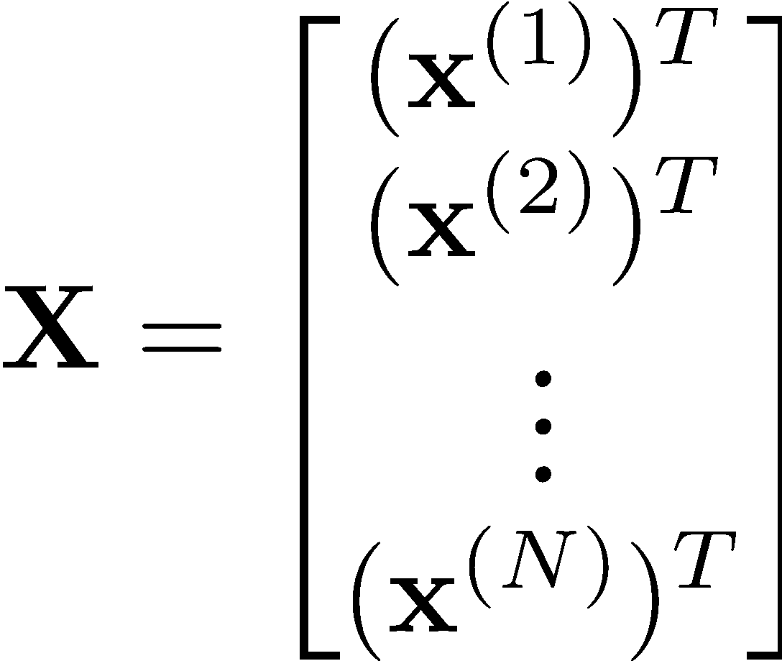
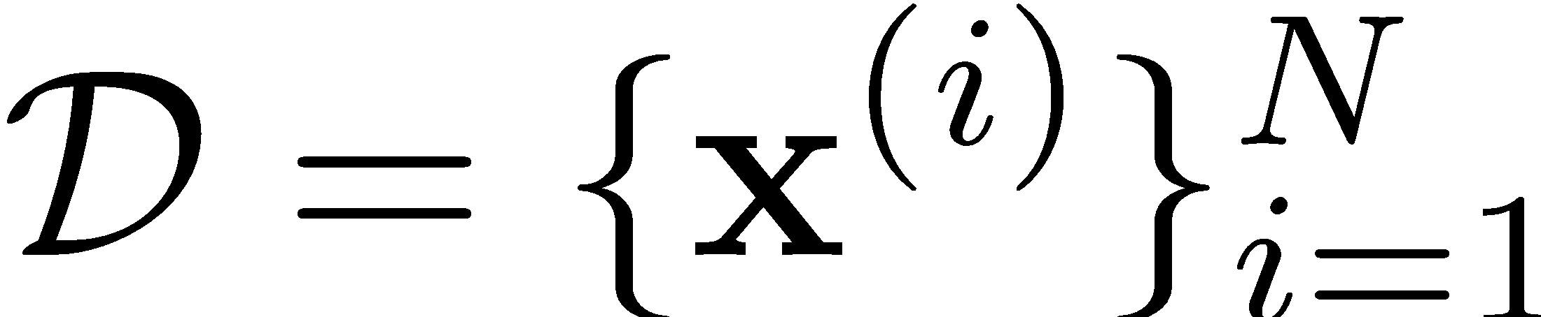
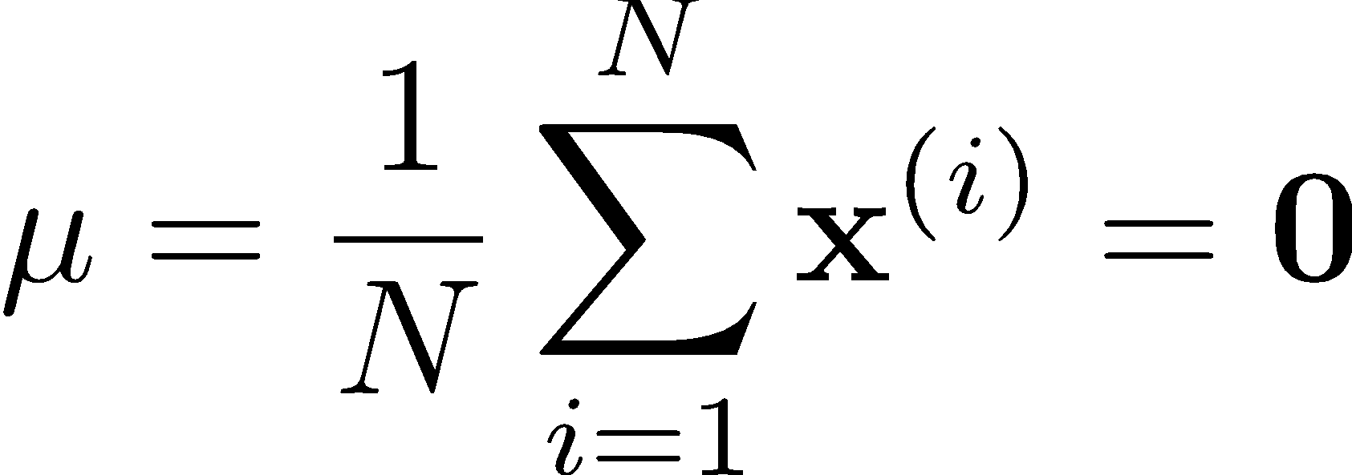
PCA: Centering Data
We assume the data is centered
Q: What if your data is not centered?
A: Subtract off the sample mean
Slide from Matt Gormley

Slide 38
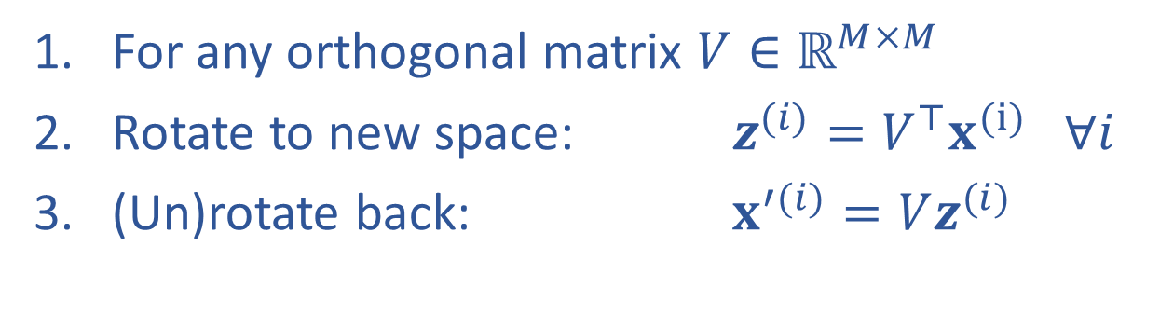
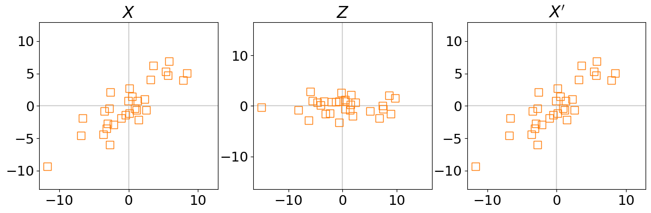
Rotation of Data (and back)

Slide 39
PCA Algorithm

Slide 40
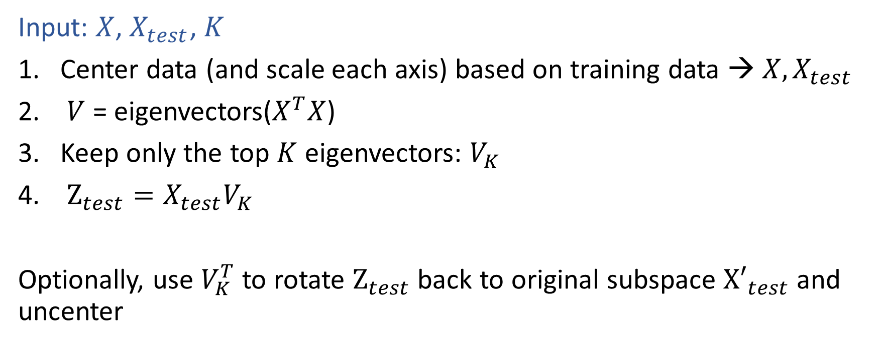
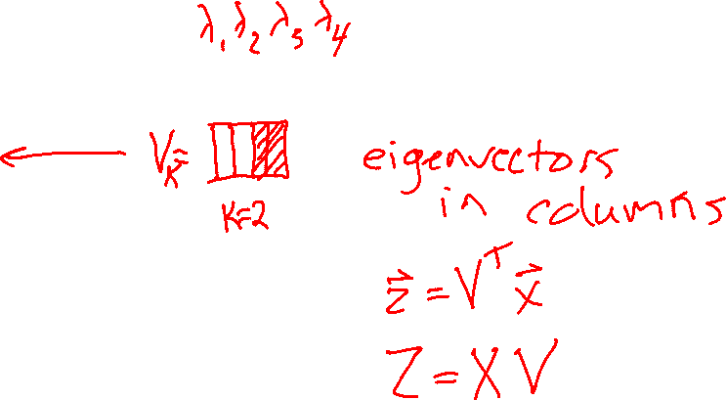
PCA Algorithm

Slide 41
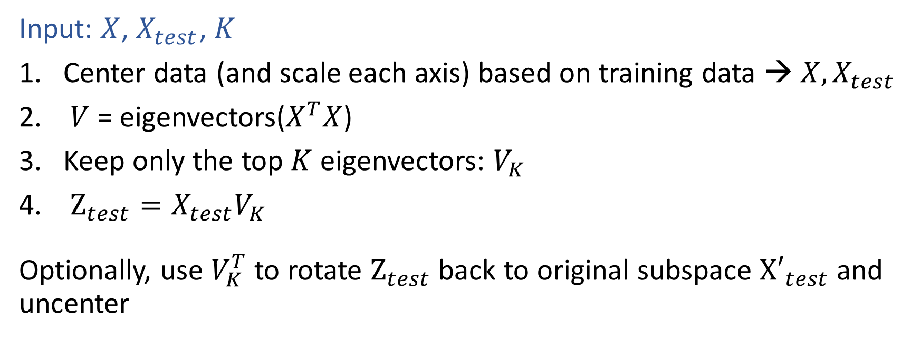
PCA Algorithm

Slide 42

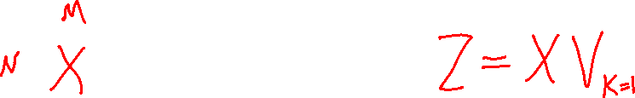
PCA Algorithm

Slide 43
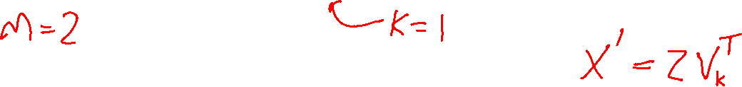
PCA Algorithm

Slide 44
PCA Examples

Slide 45
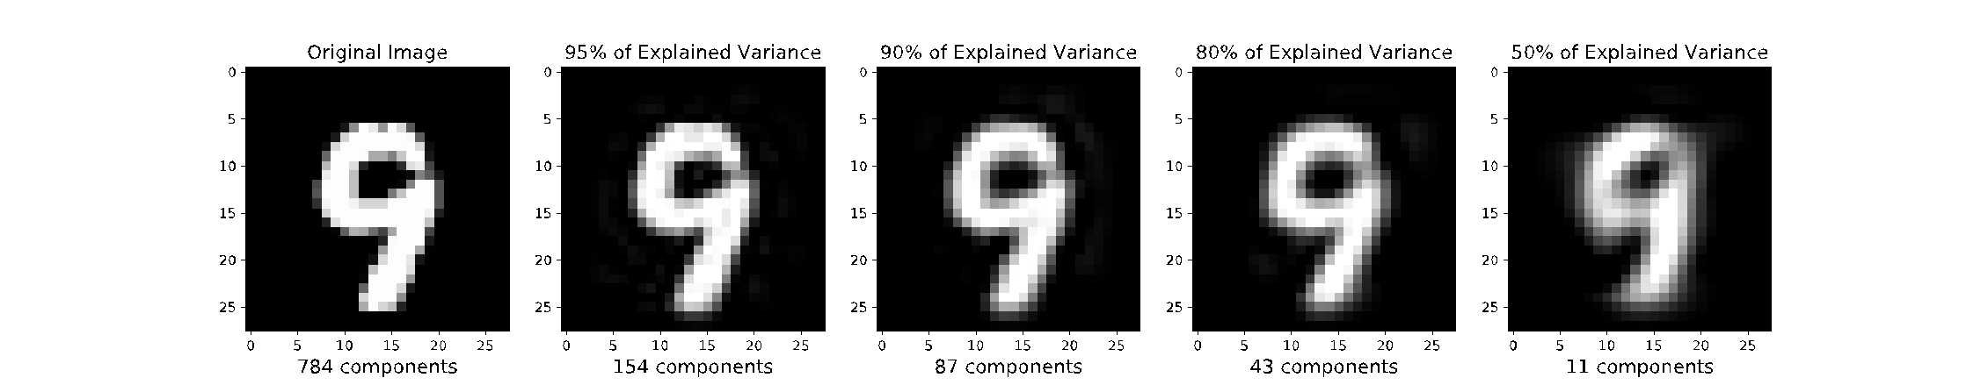
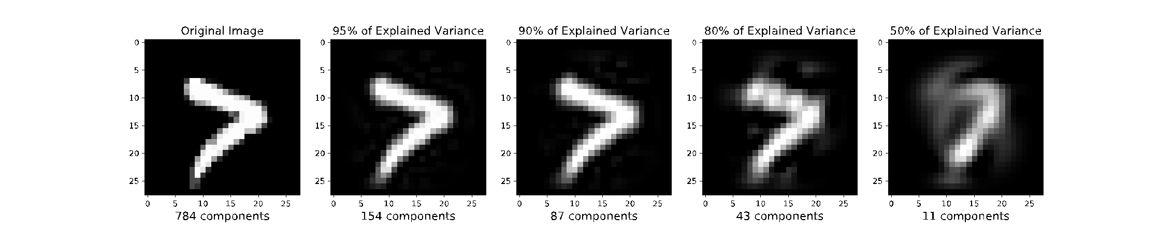
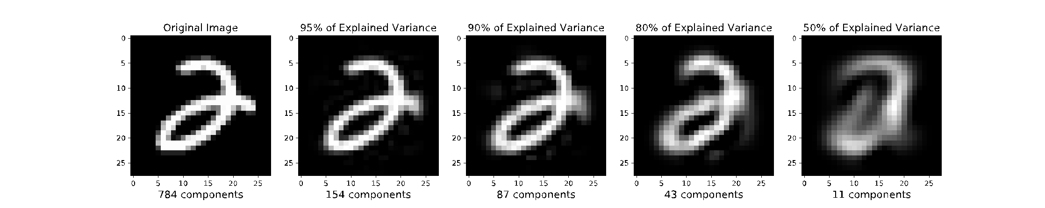
Projecting MNIST digits
Task Setting
Take 28x28 images of digits and project them down to K components
Report percent of variance explained for K components
Then project back up to 28x28 image to visualize how much information was preserved

Slide 46
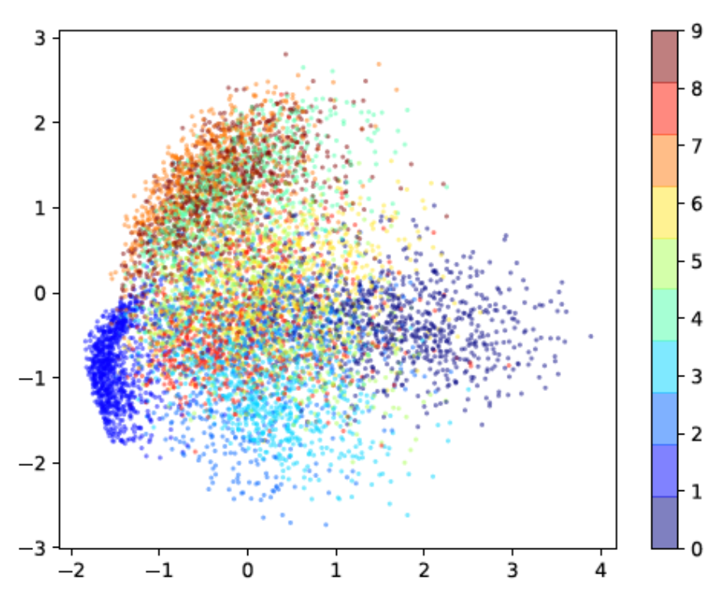
Projecting MNIST digits
Task Setting:
Take 28x28 images of digits and project them down to 2 components
Plot the 2 dimensional points

Slide 47
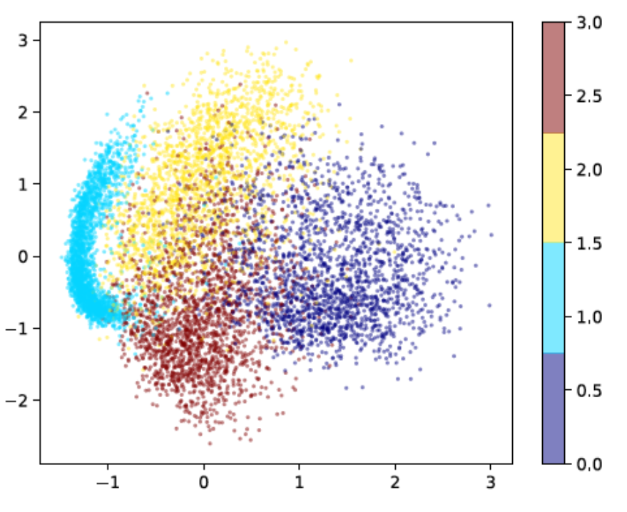
Projecting MNIST digits
Task Setting:
Take 28x28 images of digits and project them down to 2 components
Plot the 2 dimensional points

Slide 48
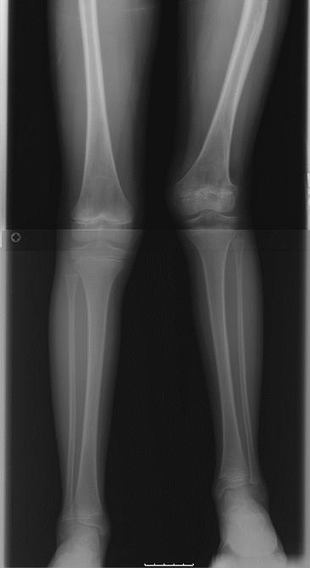
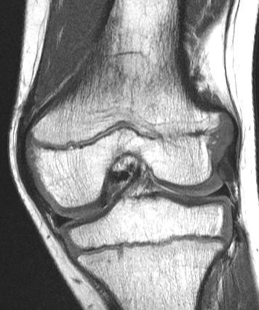
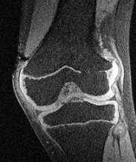
Growth Plate Imaging
Growth Plate Disruption and Limb Length Discrepancy
8 year-old boy with previous fracture and 4cm leg length discrepancy
Images Courtesy H. Potter, H.S.S.

Slide 49
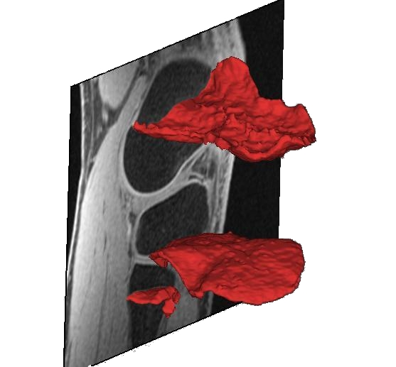

Growth Plate Imaging
Growth Plate Disruption and Limb Length Discrepancy
8 year-old boy with previous fracture and 4cm leg length discrepancy
Images Courtesy H. Potter, H.S.S.

Slide 50
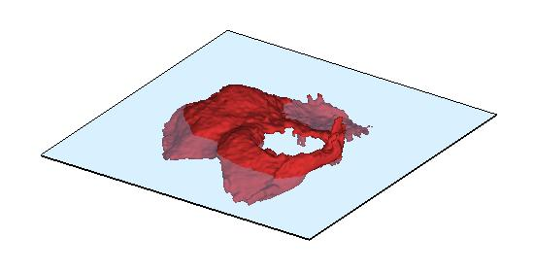

Growth Plate Imaging
Area Measurement

Slide 51



Growth Plate Imaging
Area Measurement
Flatten Growth Plate to Enable 2D Area Measurement

Slide 52

Outline
Unsupervised Learning
Dimensionality Reduction
Embedded Spaces and Feature Learning
Autoencoders
Principal Component Analysis (PCA)
Examples: 2D and 3D
PCA algorithm
PCA, eigenvectors, and eigenvalues
PCA objective and optimization

Slide 53
PCA Objective

Slide 54

Poll 1

Slide 55
PCA Algorithm

Slide 56

Sketch of PCA
Select "best" $V∈ℝ^{M×K}$
Project down: ${ z}^{(i)} =V^{⊤}x^{(i)} ∀ i$
Reconstruct up: $x^{′(i)}= V z^{(i)} ∀ i$

Slide 57
Select “Best” Vector
Reconstruction Error vs Variance of Projection

Slide 58
Poll 2 & Poll 3
Consider the two projections below
Poll 2: Which maximizes the variance?
Poll 3: Which minimizes the reconstruction error?
Option A
Option B

Slide 59


Select “Best” Vector
Reconstruction Error vs Variance of Projection

Slide 60

PCA Objective Equivalence
Equivalence of Maximizing Variance and Minimizing Reconstruction Error

Slide 61

Sketch of PCA
Select "best" $V∈ℝ^{M×K}$
Project down: ${ z}^{(i)} =V^{⊤}x^{(i)} ∀ i$
Reconstruct up: $x^{′(i)}= V z^{(i)} ∀ i$

Slide 62
PCA Eigenvalues and Eigenvectors

Slide 63
PCA: The First Principal Component
Use method of Lagrange multipliers to show that the first principle component is an eigenvalue of the covariance matrix

Slide 64

Poll 4

Slide 65


PCA: the First Principal Component

Slide 66
PCA: The Next Principal Component
Compute the next principal component from the residuals

Slide 67




Principal Component Analysis (PCA)
And so on …
Slide from Nina Balcan

Slide 68

How Many PCs?
For M original dimensions, sample covariance matrix is MxM, and has up to M eigenvectors. So M PCs.
Where does dimensionality reduction come from?
Can ignore the components of lesser significance.
Variance (%) = ratio of variance along given principal component to total variance of all principal components
You do lose some information, but if the eigenvalues are small, you don’t lose much
M dimensions in original data
calculate M eigenvectors and eigenvalues
choose only the first D eigenvectors, based on their eigenvalues
final data set has only D dimensions

Slide 69

SVD for PCA

Slide 70



SVD for PCA

