Slide 1

10-315 Introduction to ML LLMs: Attention & Transformers
Instructor: Pat Virtue

Slide 2
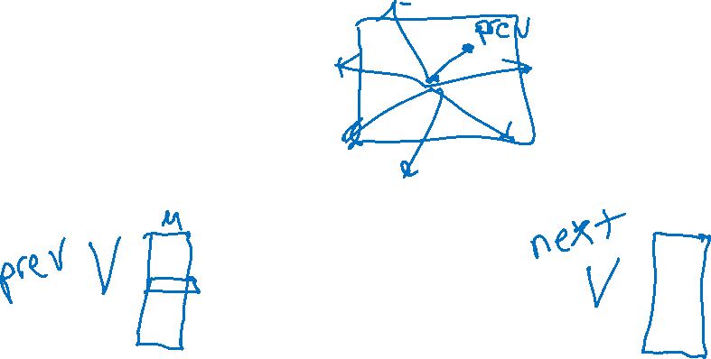
Simple Word Embedding LM
Building a language model with just word embedding layers ☺
Current text
Really Small Language Model
Next text
Tokenizer
Tokenizer
Sampling
Input tokens
Next token
Probabilty
of each token
in vocab
Word Embedding
Output Embedding
Softmax
Embedded vector representation
Similarity scores
for each token
in vocab

Slide 3

Word (Token) Embeddings
The beginning and the end of LLM networks
Current text
Large Language Model
e.g GPT, Llama, etc
Next text
Tokenizer
Tokenizer
Sampling
Input tokens
Next token
Probabilty
of each token
in vocab
Word Embedding
Many layers of
transformer/attention blocks
Output Embedding
Softmax
Embedded vector representation
Embedded vector representation
Similarity scores
for each token
in vocab

Slide 4

Building up to Large Language Models
N-gram LMs
Word Embedding LMs
Vector representation of vocab tokens
Sampling next token
Learning better vectors
Transformer LMs
Increasing context size
Attention
Tranformer blocks
More Transformers

Slide 5
Transformer LMs

Slide 6
Transformer Language Models
Increasing context size
Uniform average of context vectors
Position encoding
Attention
Weighted average of context vectors
Query Keys Values
Expressive power of linear transforms
Transformer blocks

Slide 7
Attention

Slide 8

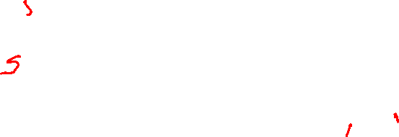

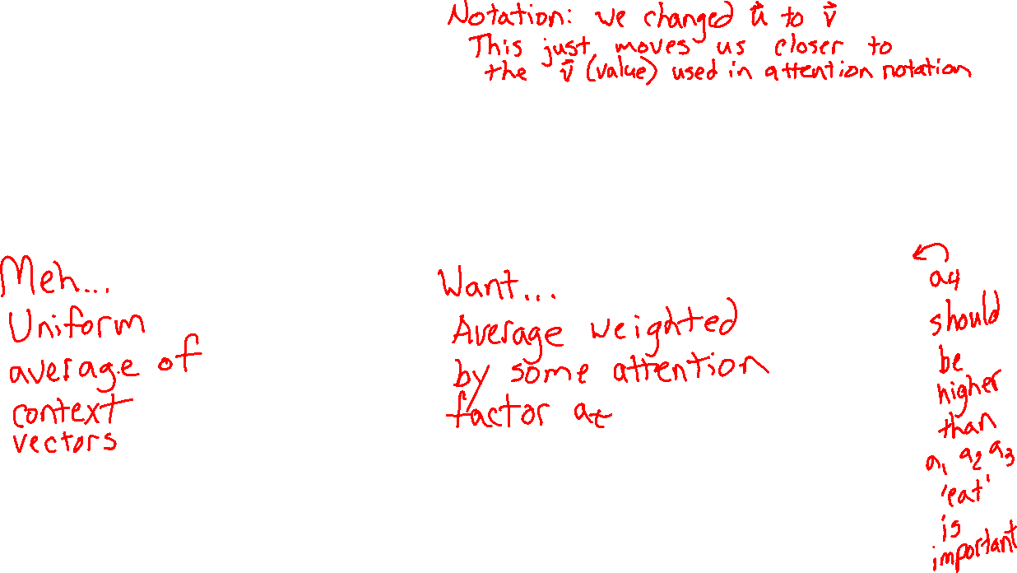
Learn to pay attention!
Context: v'
We can do better than uniform combination of input
$$v′=\sum_{t=1}^{T}{{\frac{1}{T}v}_{t}}$$
$$v′=\sum_{t=1}^{T}{{a_{t}v}_{t}}$$
a₁
a₂
a₃
a₄
Context: v'
v₁
v₂
v₃
v₄
v₁
v₂
v₃
v₄
I
will
not
eat
I
will
not
eat

Slide 9
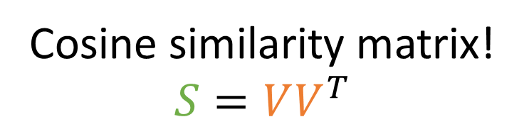
Learn to pay attention!
context
If only we had a way to measure vector similarity
$$v′=\sum_{t=1}^{T}{{a_{t}v}_{t}}$$
Cosine similarity matrix!
$$S=VV^{T}$$
a₁
a₂
a₃
a₄
I
will
not
eat
1
2
3
4
Je
1
s_{4,1}
s_{4,2}
s_{4,3}
s_{4,4}
na
2
mange
3
v₁
v₂
v₃
v₄
pas
4
I
will
not
eat

Slide 10
Learn to pay attention!
context
If only we had a way to measure vector similarity
$$v′=\sum_{t=1}^{T}{{a_{t}v}_{t}}$$
Cosine similarity matrix!
$$S=VV^{T}$$
a₁
a₂
a₃
a₄
I
will
not
eat
1
2
3
4
softmax
1
s_{4,1}
s_{4,2}
s_{4,3}
s_{4,4}
2
3
v₁
v₂
v₃
v₄
4
I
will
not
eat

Slide 11


Learn to pay attention!
context
We can do better than uniform combination of input
$$v=\sum_{t=1}^{T}{{\frac{1}{T}v}_{t}}$$
$$v=\sum_{t=1}^{T}{{a_{t}v}_{t}}$$
a₁
a₂
a₃
a₄
context
softmax
s_{4,1}
s_{4,2}
s_{4,3}
s_{4,4}
v₁
v₂
v₃
v₄
v₁
v₂
v₃
v₄
I
will
not
eat
I
will
not
eat

Slide 12
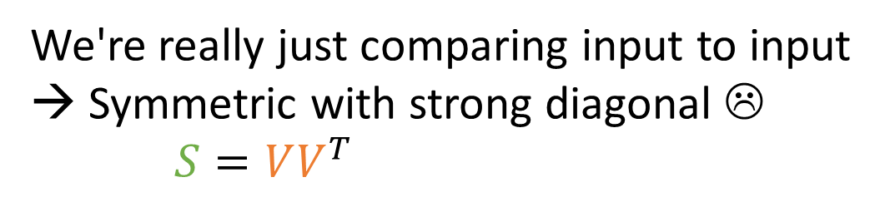
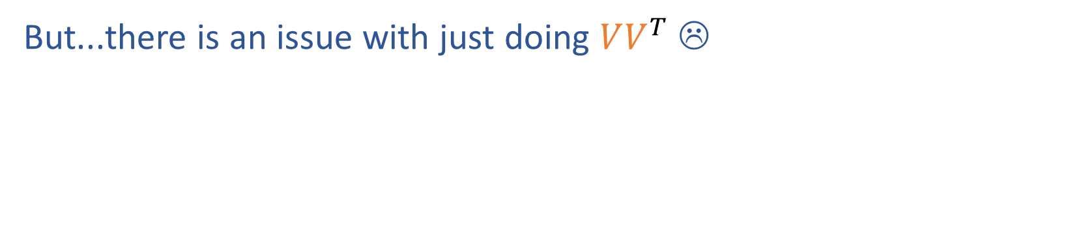
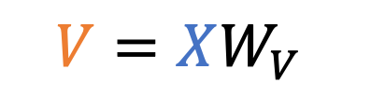
Learn to pay attention!
context
But...there is an issue with just doing $VV^{T}$ ☹
a₁
a₂
a₃
a₄
We're really just comparing input to input
→ Symmetric with strong diagonal ☹
$S=VV^{T}$
softmax
s_{4,1}
s_{4,2}
s_{4,3}
s_{4,4}
I
will
not
eat
1
2
3
4
1
eat
v₁
v₂
v₃
v₄
4
2
3
$$V=XW_{V}$$
4
x₁
x₂
x₃
x₄
I
will
not
eat

Slide 13
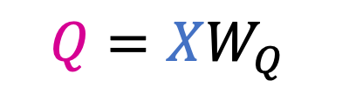
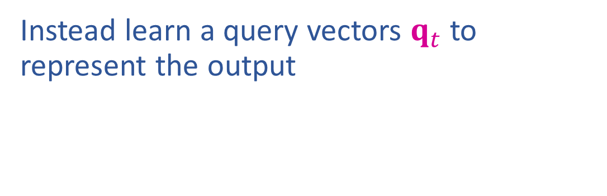
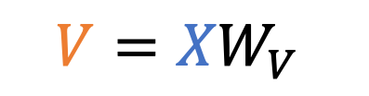

Learn to pay attention!
context
Instead learn a query vectors $q_{t}$ to represent the output
a₁
a₂
a₃
a₄
I
will
not
eat
1
2
3
4
softmax
1
eat
4
s_{4,1}
s_{4,2}
s_{4,3}
s_{4,4}
$S=QV^{T}$
2
3
v₁
v₂
v₃
v₄
4
$$Q=XW_{Q}$$
$$V={XW}_{V}$$
x₁
x₂
x₃
x₄
I
will
not
eat

Slide 14
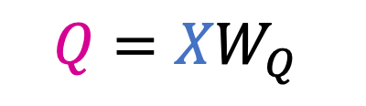
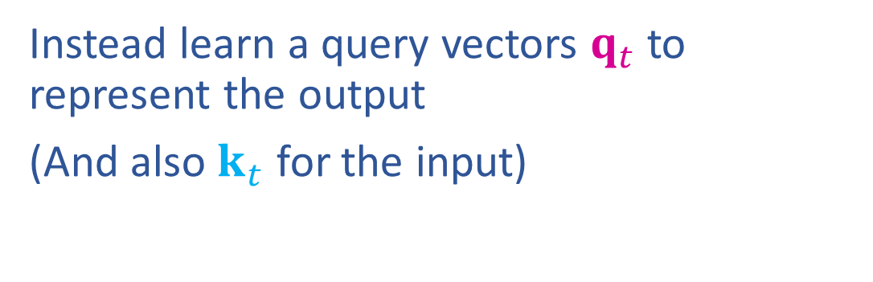
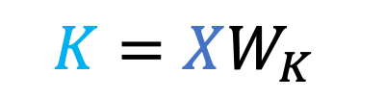
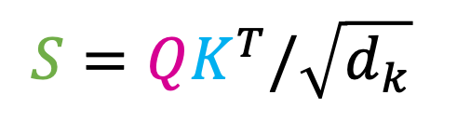
Learn to pay attention!
context
Instead learn a query vectors $q_{t}$ to represent the output
(And also $k_{t}$ for the input)
a₁
a₂
a₃
a₄
I
will
not
eat
1
2
3
4
softmax
1
eat
4
s_{4,1}
s_{4,2}
s_{4,3}
s_{4,4}
$$S=QK^{T}/\sqrt{d_{k}}$$
2
3
v₁
v₂
v₃
v₄
4
$$Q={XW}_{Q}$$
$$K=XW_{K}$$
$$V=XW_{V}$$
x₁
x₂
x₃
x₄
I
will
not
eat

Slide 15
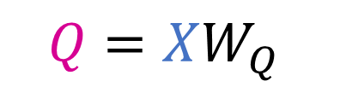
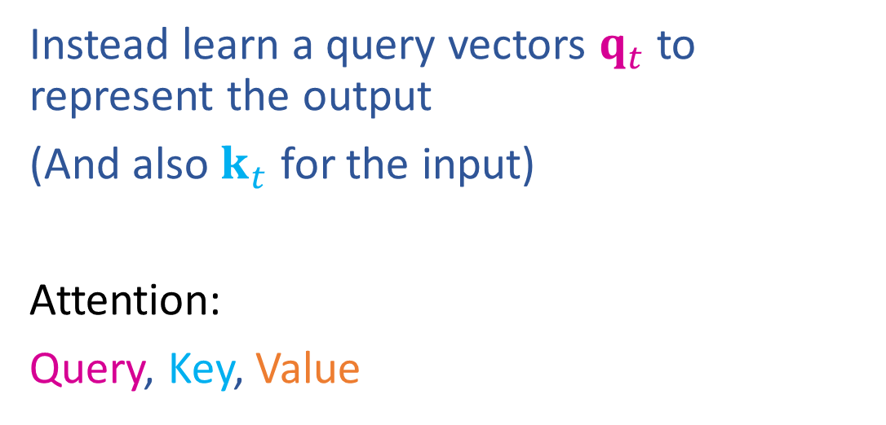


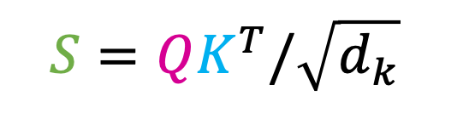
Learn to pay attention!
Instead learn a query vectors $q_{t}$ to represent the output
(And also $k_{t}$ for the input)
Attention:
Query, Key, Value
$$Q=XW_{Q}$$
$$S=QK^{T}/\sqrt{d_{k}}$$
$$K=XW_{K}$$
$$V=XW_{V}$$

Slide 16
Scaled Dot-Product Attention
attention
a_{4,1}
a_{4,2}
a_{4,3}
a_{4,4}
attention weights
softmax
W_{q}
s_{4,1}
s_{4,2}
s_{4,3}
s_{4,4}
scores
q₁
q₂
q₃
q₄
queries
W_{k}
k₁
k₂
k₃
k₄
keys
W_{v}
v₁
v₂
v₃
v₄
values
x₁
x₂
x₃
x₄

Slide 17






















Attention
$$o_{4}$$
Vector representation
$$W_{O}$$
$$z_{4}$$
$o_{t}=W_{O}^{⊤}$ $z_{t}$
$$z_{t}=V^{⊤}a_{t}$$
$$a_{4}=softmax\left(s_{t}\right)$$
$$s_{4,j}=k_{j}^{⊤}q_{4}/\sqrt{d_{k}}$$
$$a_{t}=\operatorname{softmax}\left(s_{t}\right)$$
$$a_{4,1}$$
$$q_{4}^{⊤}$$
$$s_{t}=Kq_{t}/\sqrt{d_{k}}$$
$$v_{1}$$
$$v_{4}$$
$$K^{⊤}$$
$$q_{t}=W_{Q}^{⊤}x_{t}$$
$$W_{V}$$
$$k_{t}=W_{K}^{⊤}x_{t}$$
$$W_{K}$$
$$v_{t}=W_{V}^{⊤}x_{t}$$
$$x_{1}$$
$$x_{4}$$
$$W_{Q}$$

Slide 18












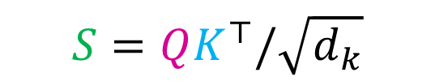








Attention
$${X′}^{⊤}$$
Matrix representation
$$+$$
$$O^{⊤}$$
$$X^{′}=X⊕O$$
$$O={ZW}_{O}$$
$$W_{O}$$
$$Z^{⊤}$$
$$Z=AV$$
$$A=softmax\left(S\right)$$
$$S=QK^{⊤}/\sqrt{d_{k}}$$
$$A={\operatorname{softmax}\left(S\right)}_{row−wise}$$
$S=QK^{⊤}/\sqrt{d_{k}}$
$$A$$
$$Q$$
$$Q=XW_{Q}$$
$$V^{⊤}$$
$$K^{⊤}$$
$$K=XW_{K}$$
$$V=XW_{V}$$
$$X^{⊤}$$
$W_{V}, W_{K},$ $W_{Q }$

Slide 19

Attention
$${X′}^{⊤}$$
Matrix representation
$$+$$
$$O^{⊤}$$
$$X^{′}=X⊕O$$
$$O={ZW}_{O}$$
$$W_{O}$$
$$Z^{⊤}$$
$$Z=AV$$
$$A=softmax\left(S\right)$$
$$S=QK^{⊤}/\sqrt{d_{k}}$$
$$A={\operatorname{softmax}\left(S\right)}_{row−wise}$$
$S=QK^{⊤}/\sqrt{d_{k}}$
$$A$$
$$Q$$
$$Q=XW_{Q}$$
$$V^{⊤}$$
$$K^{⊤}$$
$$K=XW_{K}$$
$$V=XW_{V}$$
$$X^{⊤}$$
$W_{V}, W_{K},$ $W_{Q }$

Slide 20
Attention
$${X′}^{⊤}$$
Matrix representation
$$+$$
$$O^{⊤}$$
$$X^{′}=X⊕O$$
$$O={ZW}_{O}$$
$$W_{O}$$
$$Z^{⊤}$$
$$Z=AV$$
$$A=softmax\left(S\right)$$
$$S=QK^{⊤}/\sqrt{d_{k}}$$
$$A={\operatorname{softmax}\left(S\right)}_{row−wise}$$
$S=QK^{⊤}/\sqrt{d_{k}}$
$$A$$
$$Q$$
$$Q=XW_{Q}$$
$$V^{⊤}$$
$$K^{⊤}$$
$$K=XW_{K}$$
$$V=XW_{V}$$
$$X^{⊤}$$
$W_{V}, W_{K},$ $W_{Q }$

Slide 21
Attention
$${X′}^{⊤}$$
Matrix representation
$$+$$
$$O^{⊤}$$
$$X^{′}=X⊕O$$
$$O={ZW}_{O}$$
$$W_{O}$$
$$Z^{⊤}$$
$$Z=AV$$
$$A=softmax\left(S\right)$$
$$S=QK^{⊤}/\sqrt{d_{k}}$$
$$A={\operatorname{softmax}\left(S\right)}_{row−wise}$$
$S=QK^{⊤}/\sqrt{d_{k}}$
$$A$$
$$Q$$
$$Q=XW_{Q}$$
$$V^{⊤}$$
$$K^{⊤}$$
$$K=XW_{K}$$
$$V=XW_{V}$$
$$X^{⊤}$$
$W_{V}, W_{K},$ $W_{Q }$

Slide 22
Attention
$${X′}^{⊤}$$
Matrix representation
$$+$$
$$O^{⊤}$$
$$X^{′}=X⊕O$$
$$O={ZW}_{O}$$
$$W_{O}$$
$$Z^{⊤}$$
$$Z=AV$$
$$A=softmax\left(S\right)$$
$$S=QK^{⊤}/\sqrt{d_{k}}$$
$$A={\operatorname{softmax}\left(S\right)}_{row−wise}$$
$S=QK^{⊤}/\sqrt{d_{k}}$
$$A$$
$$Q$$
$$Q=XW_{Q}$$
$$V^{⊤}$$
$$K^{⊤}$$
$$K=XW_{K}$$
$$V=XW_{V}$$
$$X^{⊤}$$
$W_{V}, W_{K},$ $W_{Q }$

Slide 23
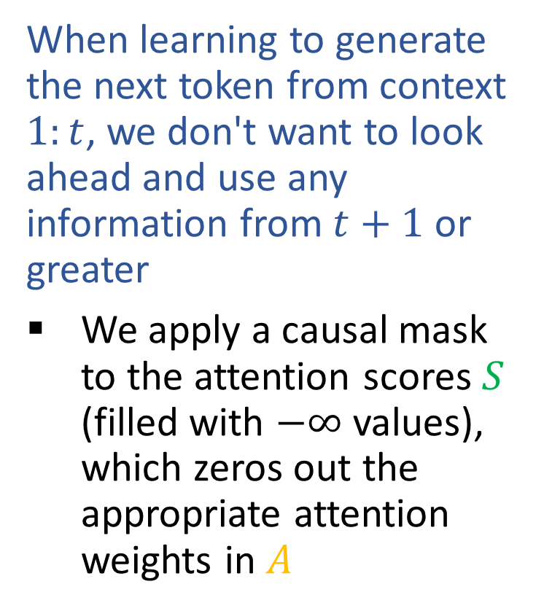
Causal Attention
$${X′}^{⊤}$$
When learning to generate the next token from context $1:t$, we don't want to look ahead and use any information from $t+1$ or greater
We apply a causal mask to the attention scores $S$ (filled with $−∞$ values), which zeros out the appropriate attention weights in $A$
$$+$$
$$O^{⊤}$$
$$W_{O}$$
$$Z^{⊤}$$
$$A=softmax\left(S\right)$$
$$S=QK^{⊤}/\sqrt{d_{k}}$$
$$A$$
$$Q$$
$$V^{⊤}$$
$$K^{⊤}$$
$$X^{⊤}$$
$W_{V}, W_{K},$ $W_{Q }$

Slide 24

Causal Attention
$${X′}^{⊤}$$
When learning to generate the next token from context $1:t$, we don't want to look ahead and use any information from $t+1$ or greater
We apply a causal mask to the attention scores $S$ (filled with $−∞$ values), which zeros out the appropriate attention weights in $A$
$$+$$
$$O^{⊤}$$
$$W_{O}$$
$$Z^{⊤}$$
$$A=softmax\left(S\right)$$
$$S=QK^{⊤}/\sqrt{d_{k}}$$
$$A$$
$$Q$$
$$V^{⊤}$$
$$K^{⊤}$$
$$X^{⊤}$$
$W_{V}, W_{K},$ $W_{Q }$

Slide 25
Causal Attention
$${X′}^{⊤}$$
When learning to generate the next token from context $1:t$, we don't want to look ahead and use any information from $t+1$ or greater
We apply a causal mask to the attention scores $S$ (filled with $−∞$ values), which zeros out the appropriate attention weights in $A$
$$+$$
$$O^{⊤}$$
$$W_{O}$$
$$Z^{⊤}$$
$$A=softmax\left(S\right)$$
$$S=QK^{⊤}/\sqrt{d_{k}}$$
$$A$$
$$Q$$
$$V^{⊤}$$
$$K^{⊤}$$
$$X^{⊤}$$
$W_{V}, W_{K},$ $W_{Q }$

Slide 26
Causal Attention
$${X′}^{⊤}$$
When learning to generate the next token from context $1:t$, we don't want to look ahead and use any information from $t+1$ or greater
We apply a causal mask to the attention scores $S$ (filled with $−∞$ values), which zeros out the appropriate attention weights in $A$
$$+$$
$$O^{⊤}$$
$$W_{O}$$
$$Z^{⊤}$$
$$A=softmax\left(S\right)$$
$$S=QK^{⊤}/\sqrt{d_{k}}$$
$$A$$
$$Q$$
$$V^{⊤}$$
$$K^{⊤}$$
$$X^{⊤}$$
$W_{V}, W_{K},$ $W_{Q }$

Slide 27
Causal Attention
$${X′}^{⊤}$$
When learning to generate the next token from context $1:t$, we don't want to look ahead and use any information from $t+1$ or greater
We apply a causal mask to the attention scores $S$ (filled with $−∞$ values), which zeros out the appropriate attention weights in $A$
$$+$$
$$O^{⊤}$$
$$W_{O}$$
$$Z^{⊤}$$
$$A=softmax\left(S\right)$$
$$S=QK^{⊤}/\sqrt{d_{k}}$$
$$A$$
$$Q$$
$$V^{⊤}$$
$$K^{⊤}$$
$$X^{⊤}$$
$W_{V}, W_{K},$ $W_{Q }$

Slide 28


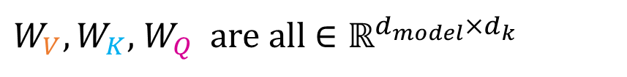

Causal Attention
$${X′}^{⊤}$$
Inference time
Done training. Watch this attention block as the context size increases as we generate more and more tokens
Note how different components build up as the context grows
But the size of the parameters don't change!
$$+$$
$$O^{⊤}$$
$$W_{O}∈ℝ^{{d_{k}×d}_{model}}$$
$$Z^{⊤}$$
$$A=softmax\left(S\right)$$
$$S=QK^{⊤}/\sqrt{d_{k}}$$
$$A$$
$$Q$$
$$V^{⊤}$$
$$K^{⊤}$$
$$X^{⊤}$$
$W_{V}, W_{K},$ $W_{Q }$ are all $∈ℝ^{d_{model}×d_{k}}$

Slide 29



Causal Attention
$${X′}^{⊤}$$
Inference time
Done training. Watch this attention block as the context size increases as we generate more and more tokens
Note how different components build up as the context grows
But the size of the parameters don't change!
$$+$$
$$O^{⊤}$$
$$W_{O}$$
$$Z^{⊤}$$
$$A=softmax\left(S\right)$$
$$S=QK^{⊤}/\sqrt{d_{k}}$$
$$A$$
$$Q$$
$$V^{⊤}$$
$$K^{⊤}$$
$$X^{⊤}$$
$W_{V}, W_{K},$ $W_{Q }$

Slide 30

Causal Attention
$${X′}^{⊤}$$
Inference time
Done training. Watch this attention block as the context size increases as we generate more and more tokens
Note how different components build up as the context grows
But the size of the parameters don't change!
$$+$$
$$O^{⊤}$$
$$W_{O}$$
$$Z^{⊤}$$
$$A=softmax\left(S\right)$$
$$S=QK^{⊤}/\sqrt{d_{k}}$$
$$A$$
$$Q$$
$$V^{⊤}$$
$$K^{⊤}$$
$$X^{⊤}$$
$W_{V}, W_{K},$ $W_{Q }$

Slide 31
Causal Attention
$${X′}^{⊤}$$
Inference time
Done training. Watch this attention block as the context size increases as we generate more and more tokens
Note how different components build up as the context grows
But the size of the parameters don't change!
$$+$$
$$O^{⊤}$$
$$W_{O}$$
$$Z^{⊤}$$
$$A=softmax\left(S\right)$$
$$S=QK^{⊤}/\sqrt{d_{k}}$$
$$A$$
$$Q$$
$$V^{⊤}$$
$$K^{⊤}$$
$$X^{⊤}$$
$W_{V}, W_{K},$ $W_{Q }$

Slide 32

Causal Attention
$${X′}^{⊤}$$
Inference time
(Repeated without red arrows showing attention combination)
$$+$$
$$O^{⊤}$$
$$W_{O}$$
$$Z^{⊤}$$
$$A=softmax\left(S\right)$$
$$S=QK^{⊤}/\sqrt{d_{k}}$$
$$A$$
$$Q$$
$$V^{⊤}$$
$$K^{⊤}$$
$$X^{⊤}$$
$W_{V}, W_{K},$ $W_{Q }$

Slide 33
Causal Attention
$${X′}^{⊤}$$
Inference time
(Repeated without red arrows showing attention combination)
$$+$$
$$O^{⊤}$$
$$W_{O}$$
$$Z^{⊤}$$
$$A=softmax\left(S\right)$$
$$S=QK^{⊤}/\sqrt{d_{k}}$$
$$A$$
$$Q$$
$$V^{⊤}$$
$$K^{⊤}$$
$$X^{⊤}$$
$W_{V}, W_{K},$ $W_{Q }$

Slide 34
Causal Attention
$${X′}^{⊤}$$
Inference time
(Repeated without red arrows showing attention combination)
$$+$$
$$O^{⊤}$$
$$W_{O}$$
$$Z^{⊤}$$
$$A=softmax\left(S\right)$$
$$S=QK^{⊤}/\sqrt{d_{k}}$$
$$A$$
$$Q$$
$$V^{⊤}$$
$$K^{⊤}$$
$$X^{⊤}$$
$W_{V}, W_{K},$ $W_{Q }$

Slide 35
Causal Attention
$${X′}^{⊤}$$
Inference time
(Repeated without red arrows showing attention combination)
$$+$$
$$O^{⊤}$$
$$W_{O}$$
$$Z^{⊤}$$
$$A=softmax\left(S\right)$$
$$S=QK^{⊤}/\sqrt{d_{k}}$$
$$A$$
$$Q$$
$$V^{⊤}$$
$$K^{⊤}$$
$$X^{⊤}$$
$W_{V}, W_{K},$ $W_{Q }$

Slide 36
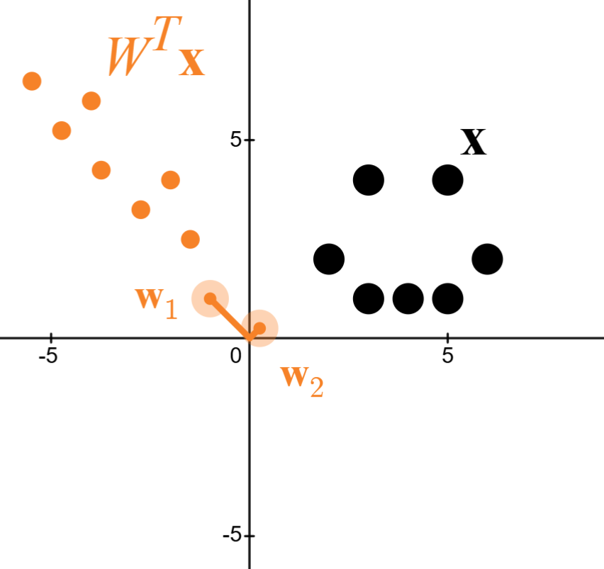
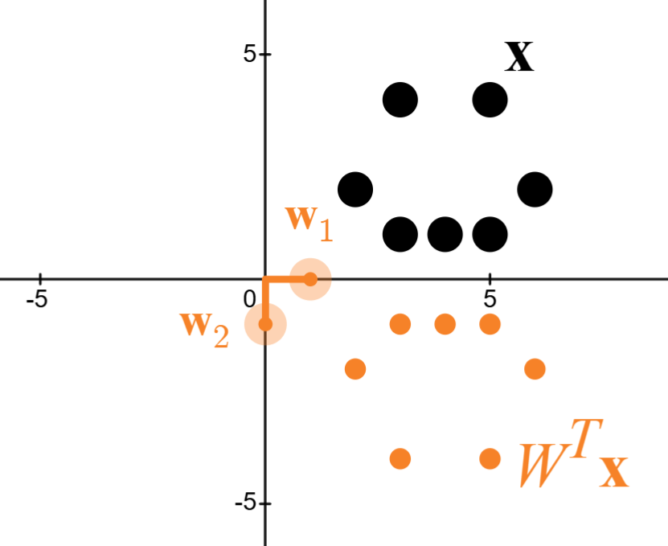
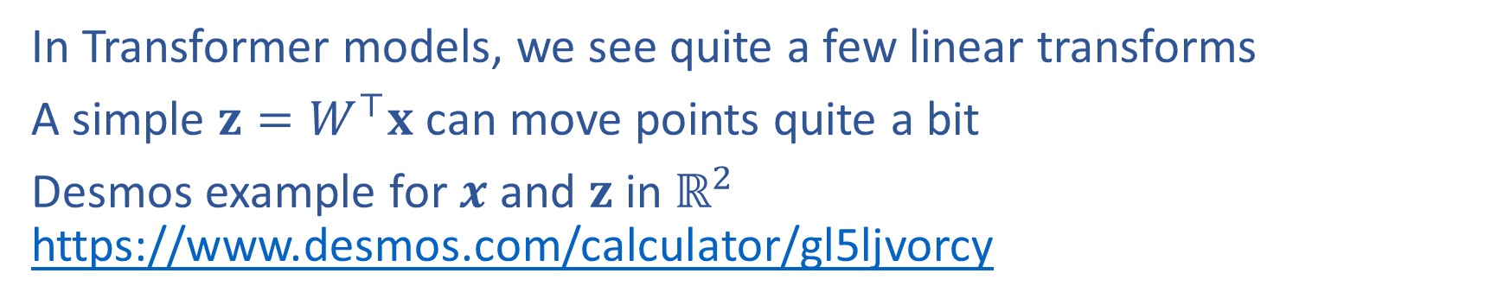
Linear Transforms: Graphical Intuition
In Transformer models, we see quite a few linear transforms
A simple $z=W^{⊤}x$ can move points quite a bit
Desmos example for $x$ and $z$ in $ℝ^{2}$ https://www.desmos.com/calculator/gl5ljvorcy

Slide 37
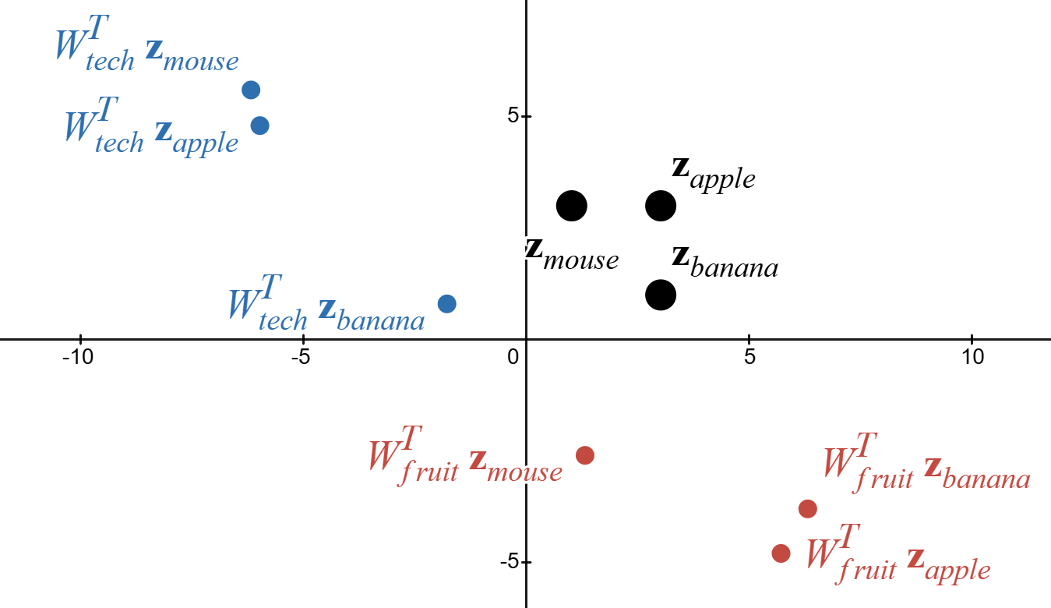
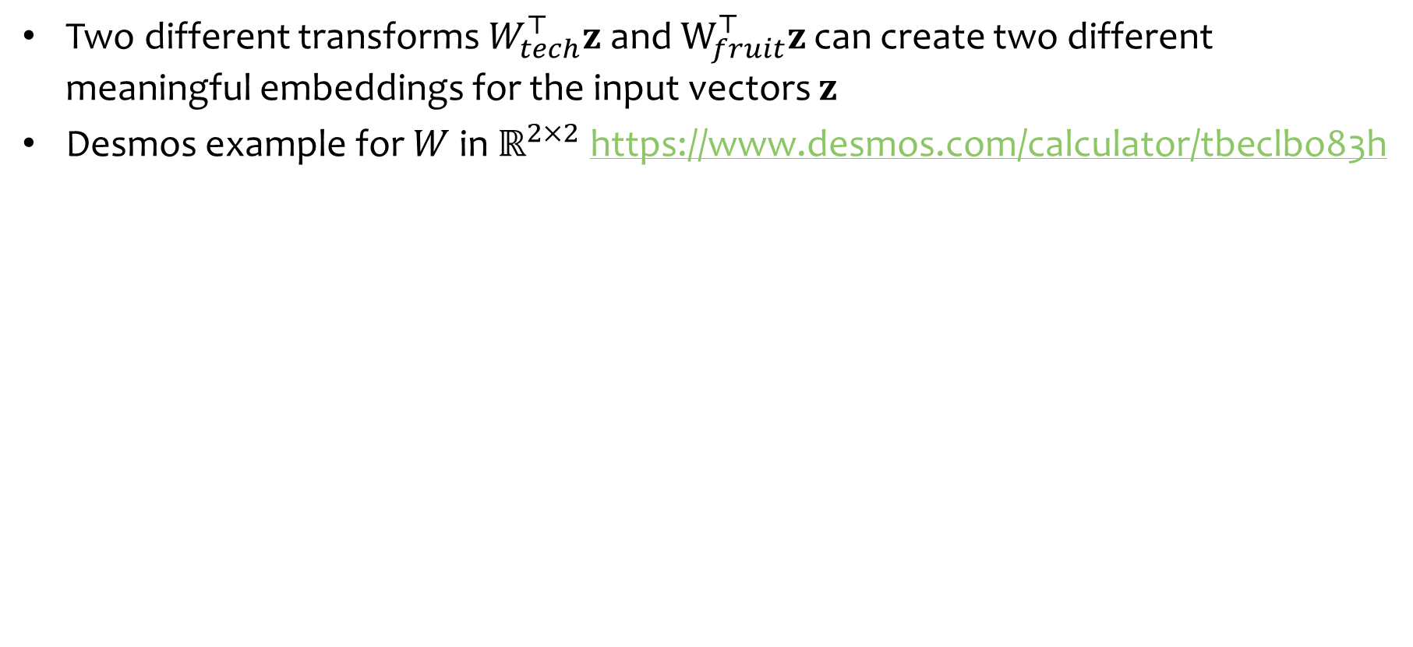
Linear Transforms: Graphical Intuition
Two different transforms $W_{tech}^{⊤}z$ and $W_{fruit}^{⊤}z$ can create two different meaningful embeddings for the input vectors $z$
Desmos example for $W$ in $ℝ^{2×2}$ https://www.desmos.com/calculator/tbeclbo83h

Slide 38
Transformer Layer

Slide 39
Transformer Layer
x₁’
x₂’
x₃’
x₄’
Each layer of a Transformer LM consists of several sublayers:
attention
feed-forward neural network
layer normalization
residual connections
layer normalization
residual connections
feed forward neural network
layer normalization
residual connections
W_{q}
multi-headed attention
W_{k}
W_{v}
x₁
x₂
x₃
x₄

Slide 40
Transformer Layer
x₁’
x₂’
x₃’
x₄’
Transformer Layer
Each layer of a Transformer LM consists of several sublayers:
attention
feed-forward neural network
layer normalization
residual connections
layer normalization
residual connections
feed forward neural network
layer normalization
residual connections
W_{q}
multi-headed attention
W_{k}
W_{v}
x₁
x₂
x₃
x₄

Slide 41
Transformer Layer
x₁’
x₂’
x₃’
x₄’
Transformer Layer
Each layer of a Transformer LM consists of several sublayers:
attention
feed-forward neural network
layer normalization
residual connections
layer normalization
residual connections
feed forward neural network
layer normalization
residual connections
W_{q}
multi-headed attention
W_{k}
W_{v}
x₁
x₂
x₃
x₄

Slide 42
Transformer Layer
Each layer of a Transformer LM consists of several sublayers:
attention
feed-forward neural network
layer normalization
residual connections
x₁’
x₂’
x₃’
x₄’
Transformer layer
x₁
x₂
x₃
x₄

Slide 43
Transformer Language Model
The
bat
made
noise
Each layer of a Transformer LM consists of several sublayers:
attention
feed-forward neural network
layer normalization
residual connections
Each hidden vector looks back at the hidden vectors of the current and previous timesteps in the previous layer.
The language model part is just like an RNN-LM!
p(w₁|h₁)
p(w₂|h₂)
p(w₃|h₃)
p(w₄|h₄)
h₁
h₂
h₃
h₄
Transformer layer
Transformer layer
Transformer layer
x₁
x₂
x₃
x₄
…
START
The
bat
made

Slide 44
More Transformers

Slide 45
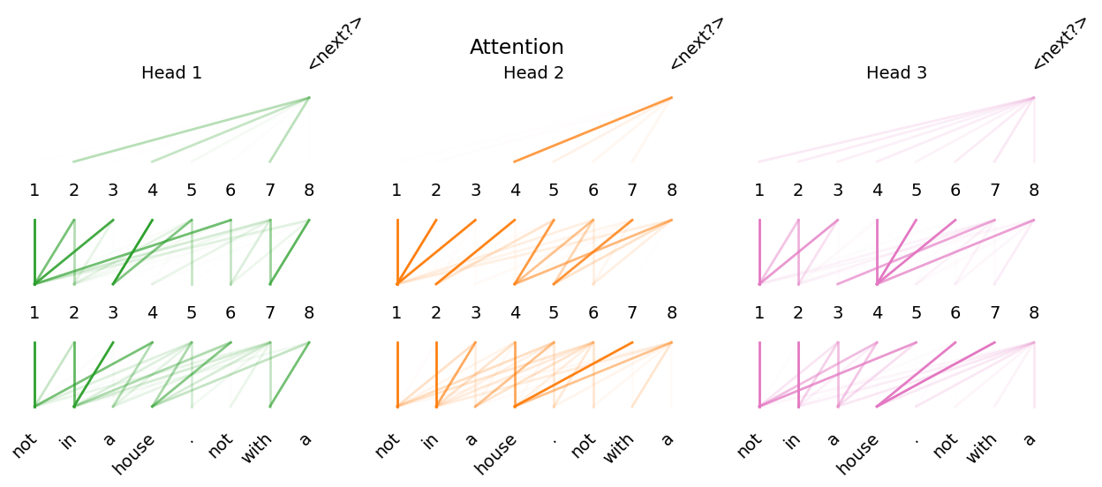
More Transformers
Multihead Attention
Different types of attention
Causal self attention
Self attention
Cross attention
Vision Transformers

Slide 46
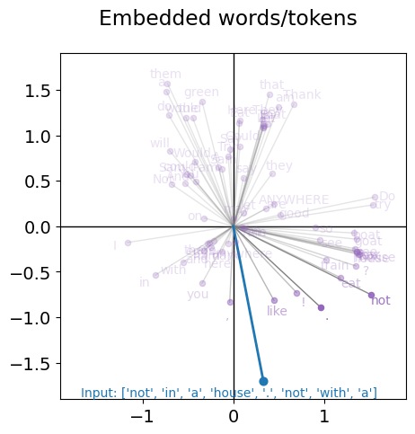
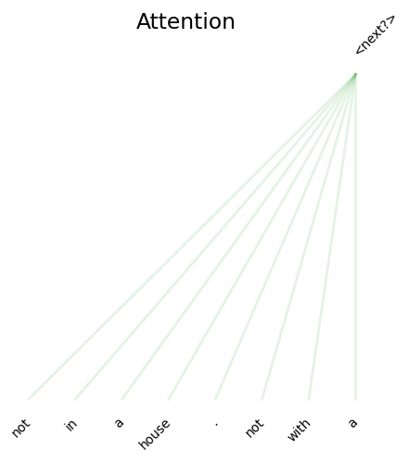
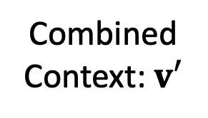
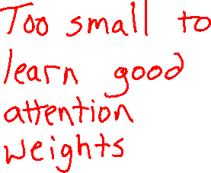
MinGPT Femto
2-D embedded space
1 attention layer
1 attention head (think channel)
Combined Context: $v′$
GPT
v₁
v₂
v₃
v₄

Slide 47
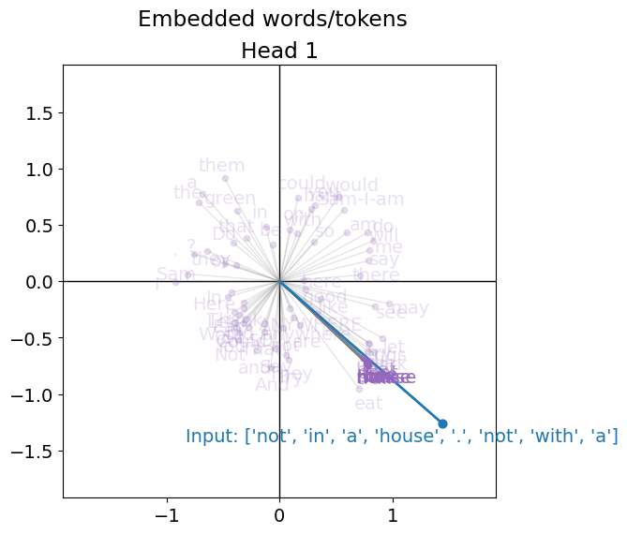
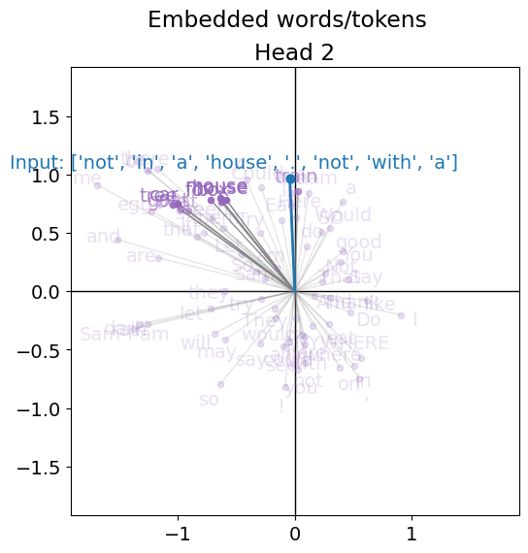
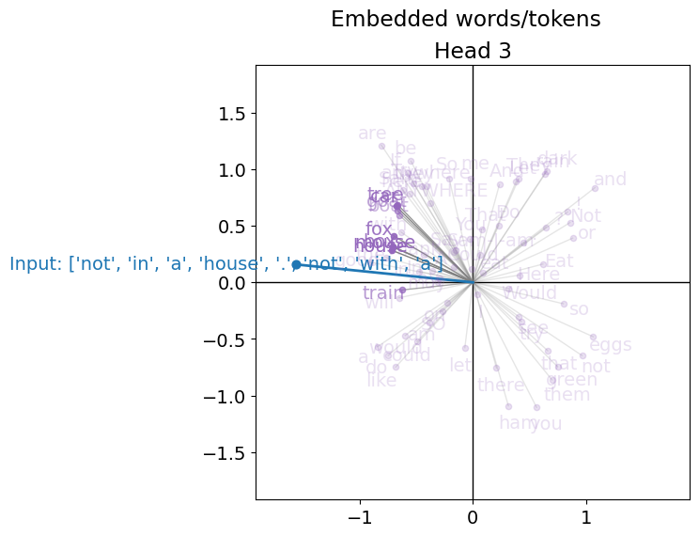
MinGPT Pico
2-D embedded space
3 attention layer
3 attention heads (think channels)
Combined Context: $v′$
GPT
v₁
v₂
v₃
v₄

Slide 48

MinGPT Pico: Output embedded space - 3 heads

Slide 49
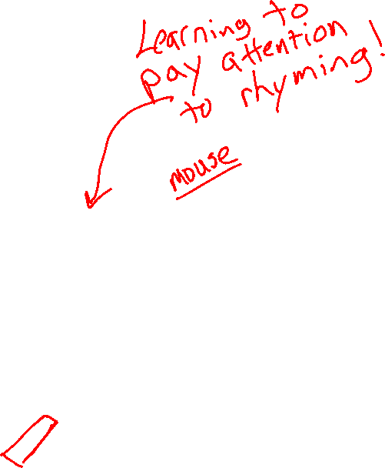
MinGPT Pico: Attention Weights – 3 layers, 3 heads

Slide 50
Vision Transformers

Slide 51
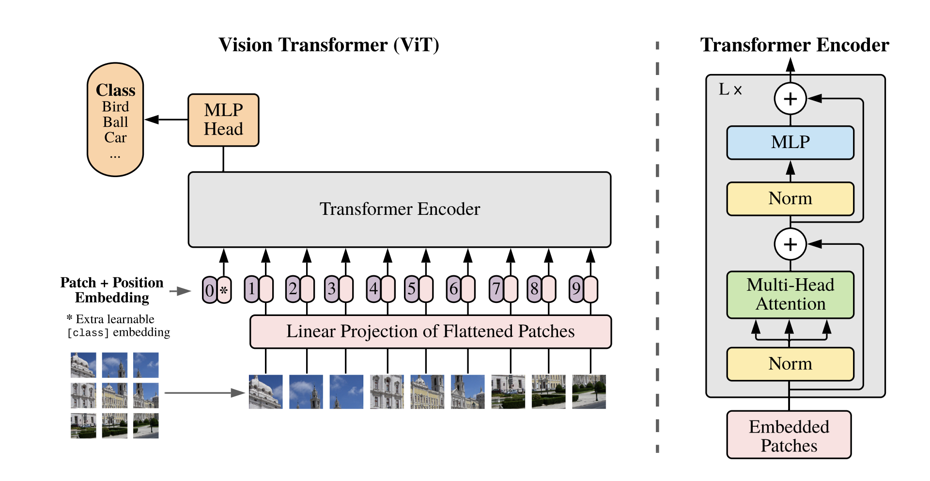
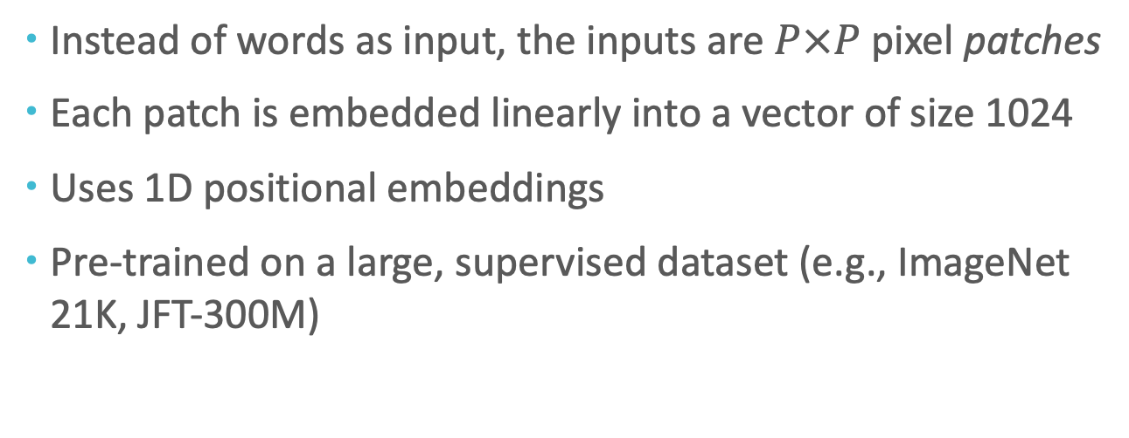
Vision Transformer (ViT)
Instead of words as input, the inputs are $P×P$ pixel patches
Each patch is embedded linearly into a vector of size 1024
Uses 1D positional embeddings
Pre-trained on a large, supervised dataset (e.g., ImageNet 21K, JFT-300M)
Source: https://arxiv.org/pdf/2010.11929

Slide 52
In-Context Learning

Slide 53
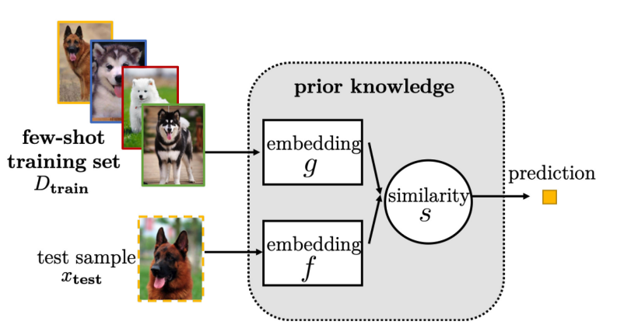
Few-shot Learning
Definition: in few-shot learning we assume that training data contains a handful (maybe two, three, or four) examples of each label
Figure from https://dl.acm.org/doi/10.1145/3386252

Slide 54
Few-shot Learning with LLMs
Suppose you have…
a dataset D = {(x_{i}, y_{i})}_{i=1}^{N} and N is rather small (i.e. few-shot setting)
a very large (billions of parameters) pre-trained language model
There are two ways to “learn”
This section!
Option A: Supervised fine-tuning
Option B: In-context learning
Definition: fine-tune the LLM on the training data using…
a standard supervised objective
backpropagation to compute gradients
your favorite optimizer (e.g. Adam)
Pro: fits into the standard ML recipe
Pro: still works if N is large
Con: backpropagation requires ~3x the memory and computation time as the forward computation
Con: you might not have access to the model weights at all (e.g. because the model is proprietary)
Definition:
feed training examples to the LLM as a prompt
allow the LLM to infer patterns in the training examples during inference (i.e. decoding)
take the output of the LLM following the prompt as its prediction
Con: the prompt may be very long and Transformer LMs require O(N²) time/space where N = length of context
Pro: no backpropagation required and only one pass through the training data
Pro: does not require model weights, only API access

Slide 55
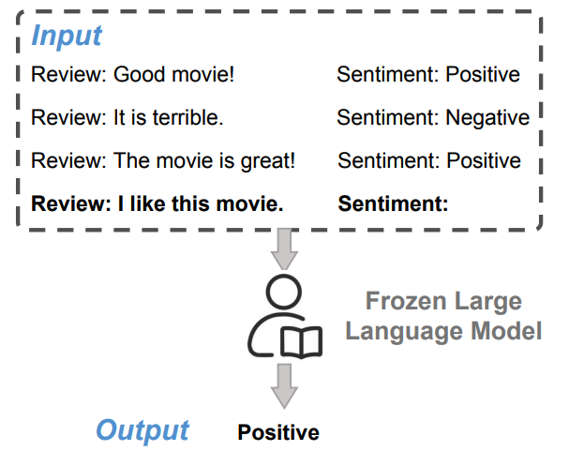
Few-shot In-context Learning
Few-shot learning can be done via in-context learning
Typically, a task description is presented first
Then a sequence of input/output pairs from a training dataset are presented in sequence
Figure from https://arxiv.org/pdf/2310.09881.pdf

Slide 56
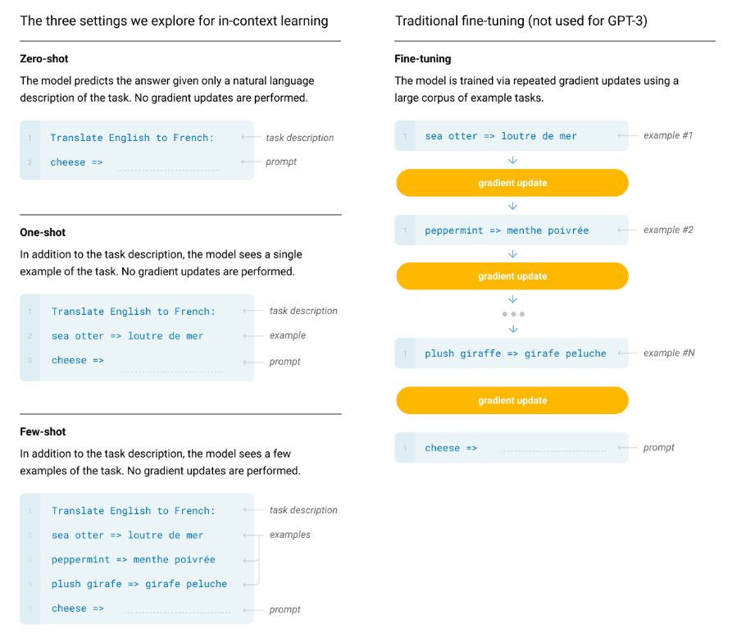
Few-shot In-context Learning
Few-shot learning can be done via in-context learning
Typically, a task description is presented first
Then a sequence of input/output pairs from a training dataset are presented in sequence
Figure from http://arxiv.org/abs/2005.14165

