Slide 1

10-315
Introduction to ML
LLMs:
Word Embeddings & Attention
Instructor: Pat Virtue

Slide 2


Building up to Large Language Models
N-gram LMs
Word Embedding LMs
Vector representation of vocab tokens
Sampling next token
Learning better vectors
Transformer LMs
Increasing context size
Attention
Tranformer blocks
More Transformers

Slide 3
Word Embedding LMs

Slide 4
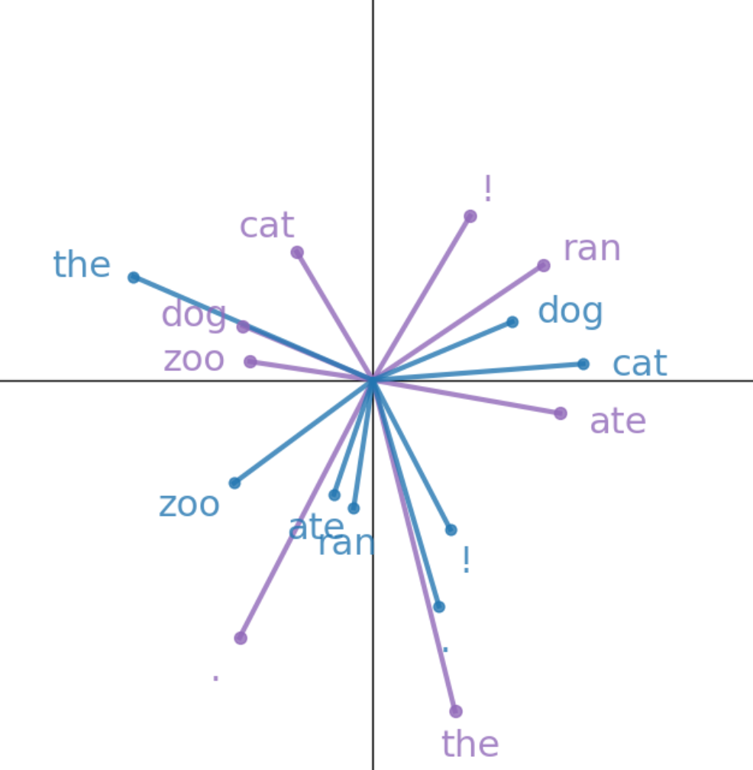

Word Embedding Language Models
Vector representation of vocab tokens
Set of vectors for both previous and next token
Sampling next token
Cosine similarity
Softmax
Sample from categorical distribution
Learning better vectors
Cross-entropy loss
SGD: looping through pairs of tokens in our corpus

Slide 5
Word (Token) Embeddings
The beginning and the end of LLM networks
Current text
Large Language Model
e.g GPT, Llama, etc
Next text
Tokenizer
Tokenizer
Sampling
Input tokens
Next token
Probabilty
of each token
in vocab
Word Embedding
Many layers of
transformer/attention blocks
Output Embedding
Softmax
Embedded vector representation
Embedded vector representation
Similarity scores
for each token
in vocab

Slide 6
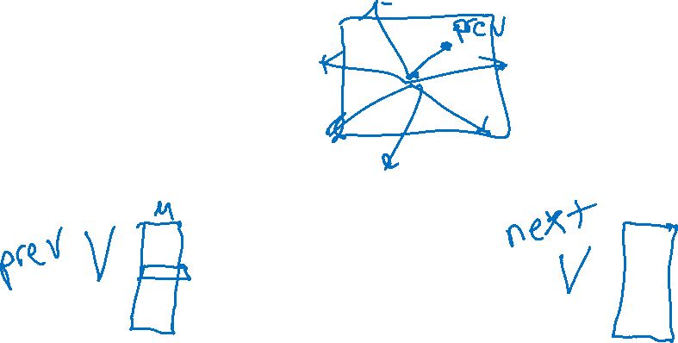
Simple Word Embedding LM
Building a language model with just word embedding layers ☺
Current text
Really Small Language Model
Next text
Tokenizer
Tokenizer
Sampling
Input tokens
Next token
Probabilty
of each token
in vocab
Word Embedding
Output Embedding
Softmax
Embedded vector representation
Similarity scores
for each token
in vocab

Slide 7
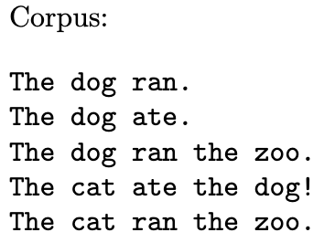
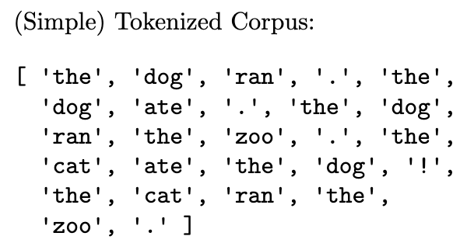
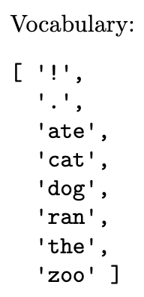
Simple Word Embedding LM
Setup
Tokenizer

Slide 8
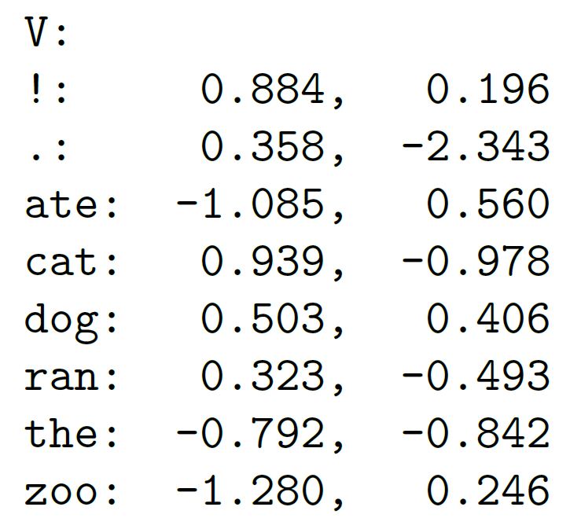
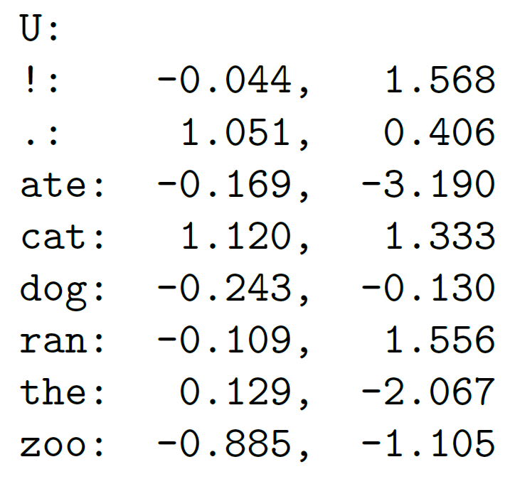
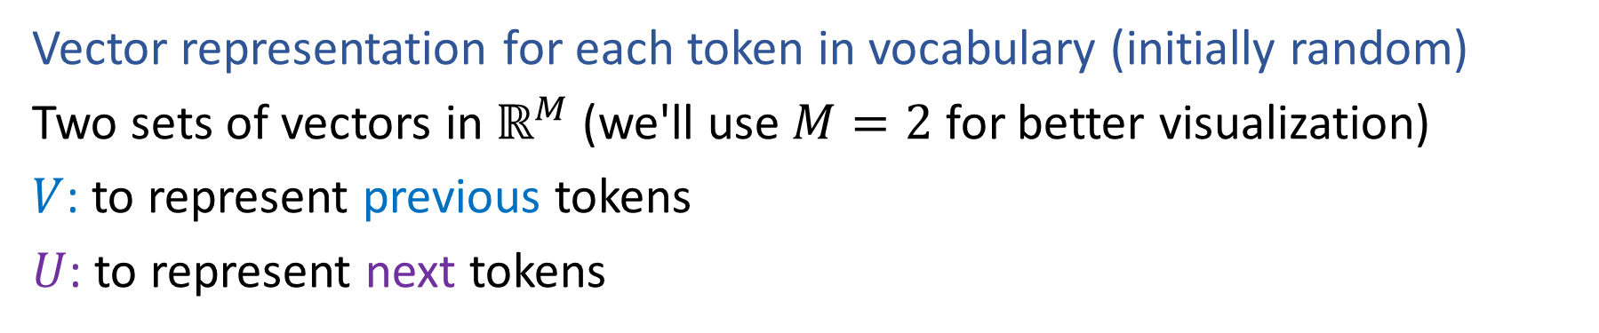
Simple Word Embedding LM
Vector representation for each token in vocabulary (initially random)
Two sets of vectors in $ℝ^{M}$ (we'll use $M=2$ for better visualization)
$V$: to represent previous tokens
$U$: to represent next tokens

Slide 9
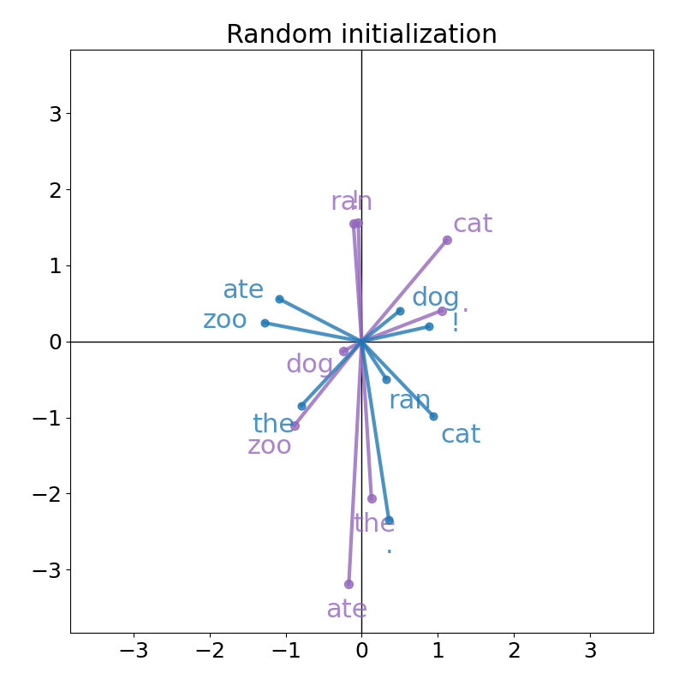

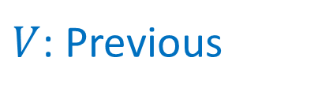
Simple Word Embedding LM
Vector representation for each token in vocabulary (initially random)
$V$: Previous
$U$: Next

Slide 10
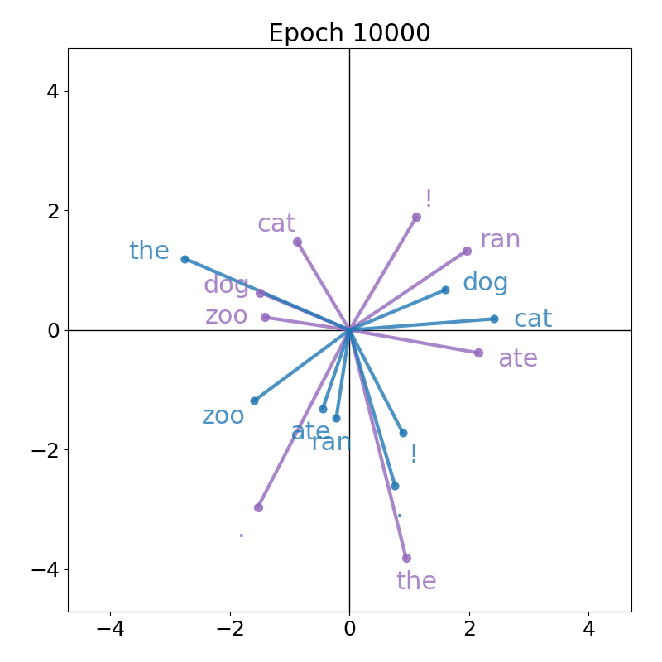
Simple Word Embedding LM
After training our LM, we'll learn more organized vectors (details later)

Slide 11
Simple Word Embedding LM
We can use either of these models to generate text, staring with "the dog"
Random vectors
Trained vectors
Generated tokens from random and trained models
the dog cat ate ran zoo zoo zoo dog dog cat cat ate ran . ate . ate ate ! the ate
the dog ate . the dog ! the zoo . the dog ran the zoo . the dog ate the dog !

Slide 12

Outline: Word Embedding LM
Vector representation of vocab tokens
Set of vectors for both previous and next token
Sampling next token
Cosine similarity
Softmax
Sample from categorical distribution
Learning better vectors
Cross-entropy loss
SGD: looping through pairs of tokens in our corpus

Slide 13
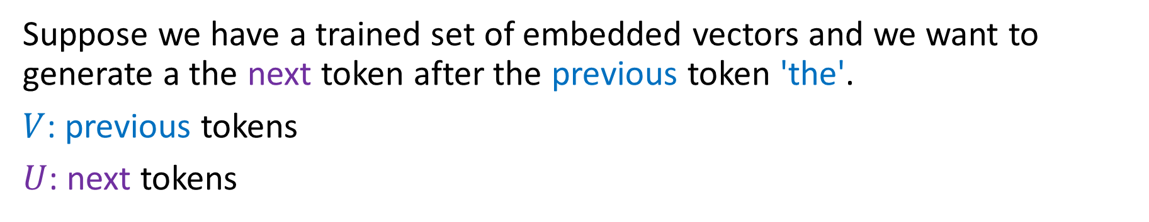
Sampling from Word Embeddings
Suppose we have a trained set of embedded vectors and we want to generate a the next token after the previous token 'the'.
$V$: previous tokens
$U$: next tokens
Which token should be our next token?

Slide 14
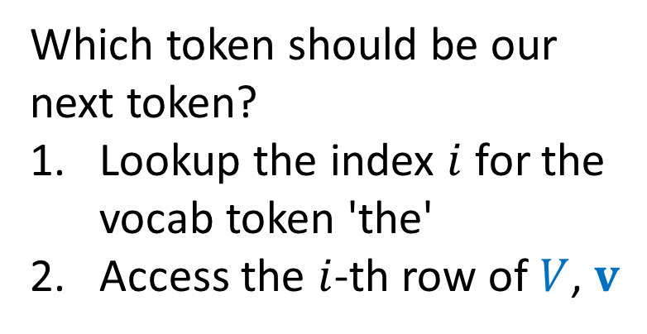
Sampling from Word Embeddings
Suppose we have a trained set of embedded vectors and we want to generate a the next token after the previous token 'the'.
$V$: previous tokens
$U$: next tokens
Which token should be our next token?
Lookup the index $i$ for the vocab token 'the'
Access the $i$-th row of $V$, $v$

Slide 15
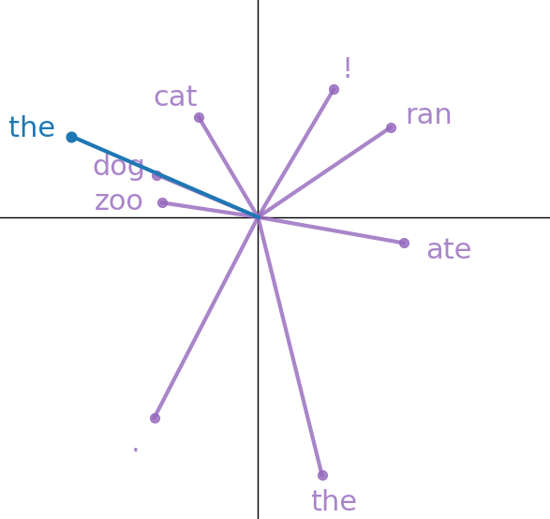
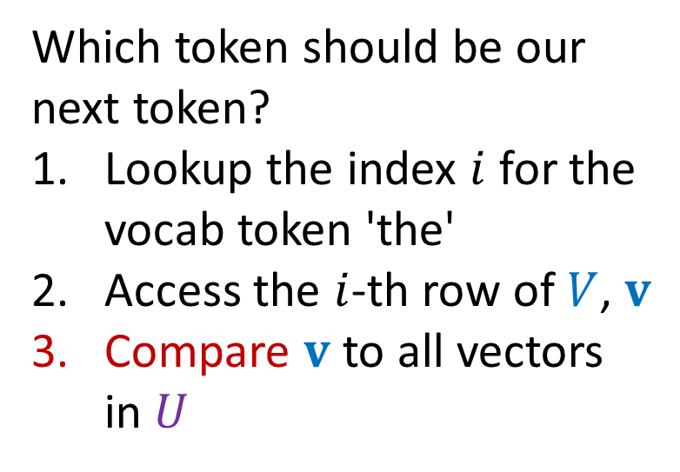
Sampling from Word Embeddings
Suppose we have a trained set of embedded vectors and we want to generate a the next token after the previous token 'the'.
$V$: previous tokens
$U$: next tokens
Which token should be our next token?
Lookup the index $i$ for the vocab token 'the'
Access the $i$-th row of $V$, $v$
Compare $v$ to all vectors in $U$

Slide 16
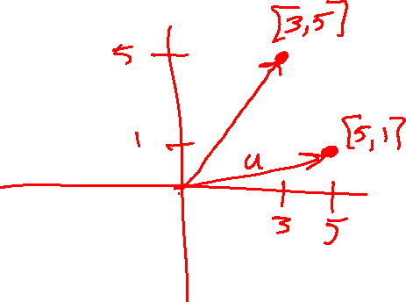
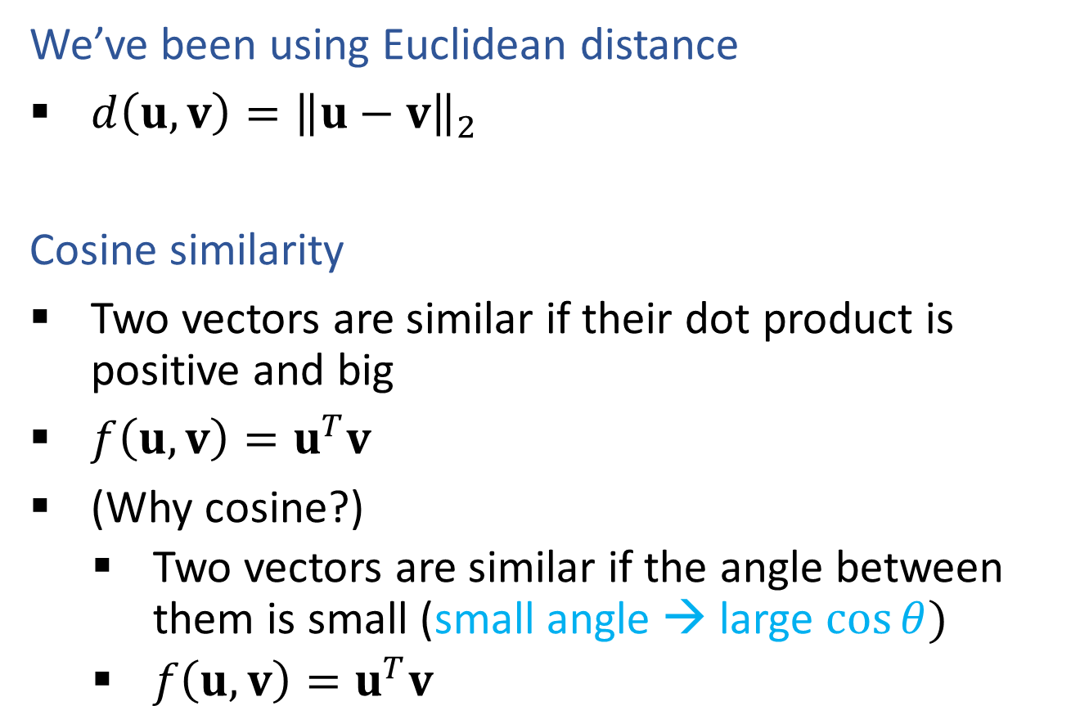

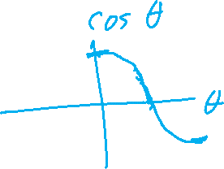
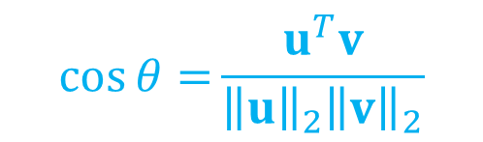
(Unnormalized) Cosine Similarity Metric
We’ve been using Euclidean distance
$d\left(u, v\right)={\left\|u−v\right\|}_{2}$
Cosine similarity
Two vectors are similar if their dot product is positive and big
$f\left(u, v\right)=u^{T}v$
(Why cosine?)
    Two vectors are similar if the angle between them is small (small angle → large $cos⁡θ)$
    $f\left(u, v\right)=u^{T}v$
$$\cos{θ=}\frac{u^{T}v}{{\left\|u\right\|}_{2}{\left\|v\right\|}_{2}}$$

Slide 17
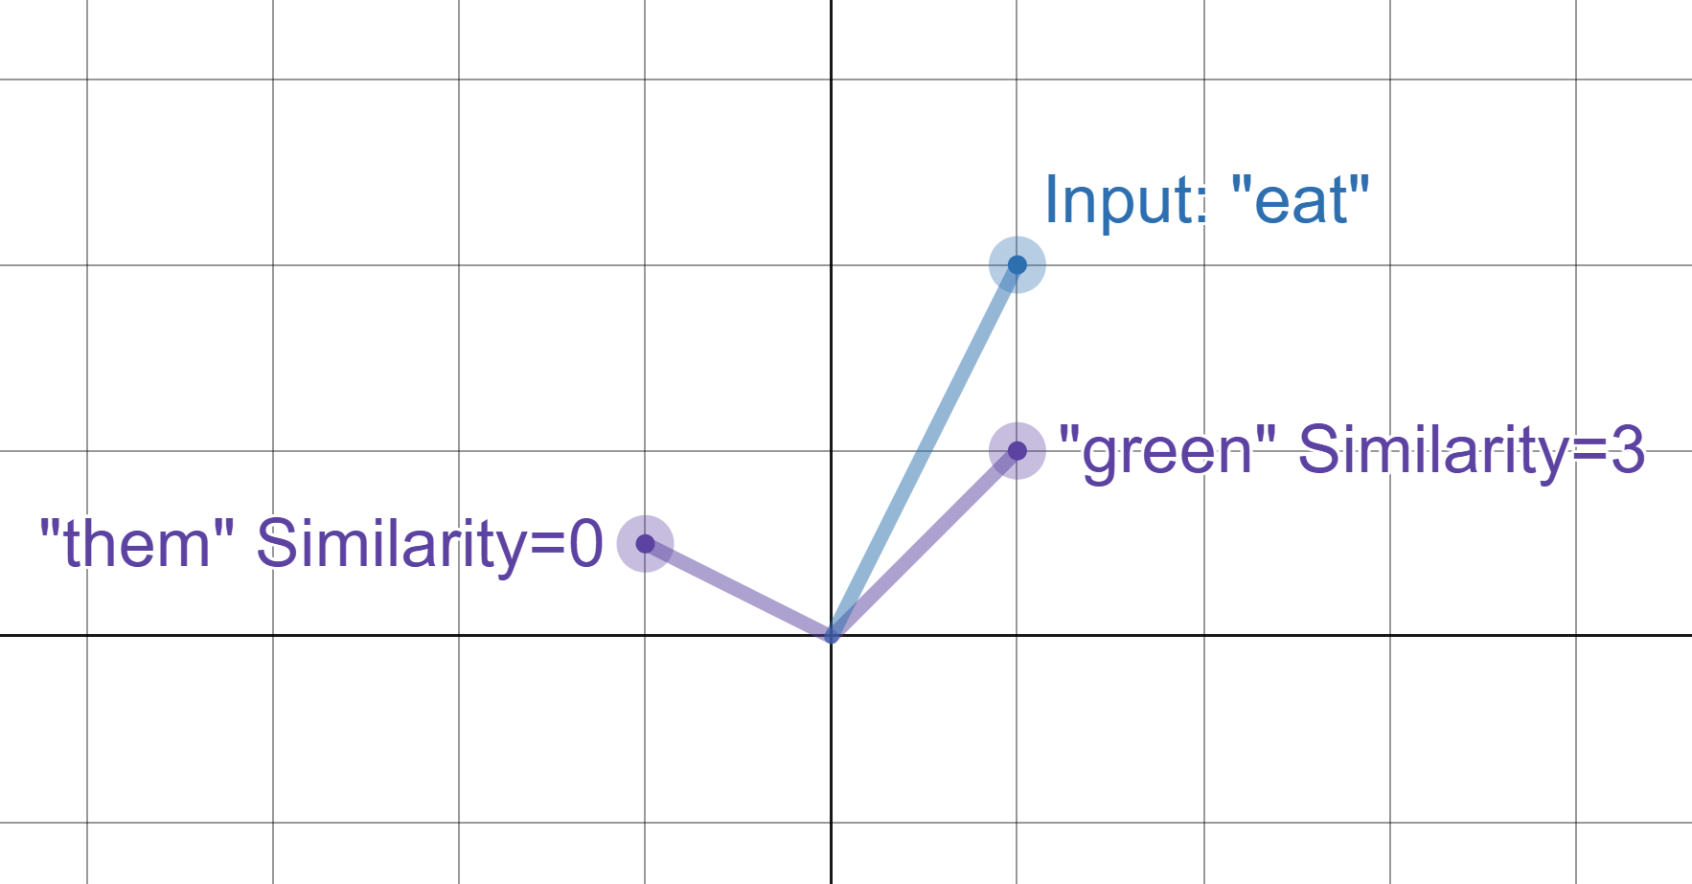
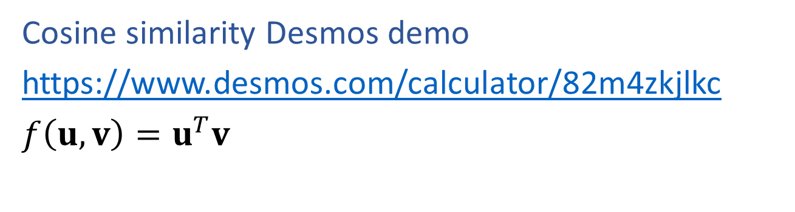
(Unnormalized) Cosine Similarity Metric
Cosine similarity Desmos demo
https://www.desmos.com/calculator/82m4zkjlkc
$f\left(u, v\right)=u^{T}v$

Slide 18
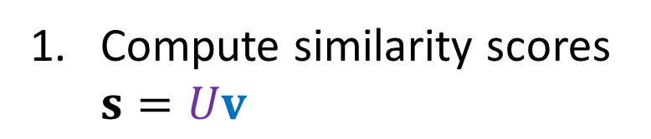
Sampling from Word Embeddings
Suppose we have a trained set of embedded vectors and we want to generate a the next token after the previous token 'the'.
$V$: previous tokens
$U$: next tokens
Compute similarity scores $s=Uv$

Slide 19
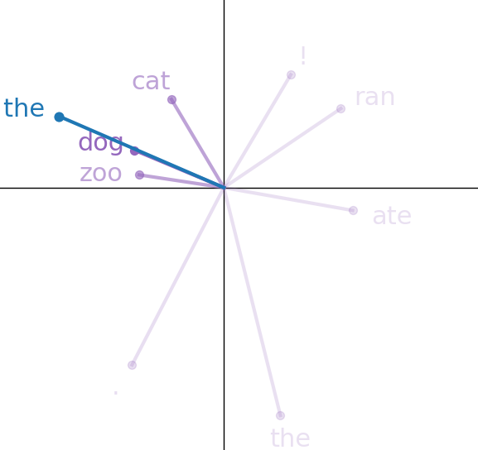
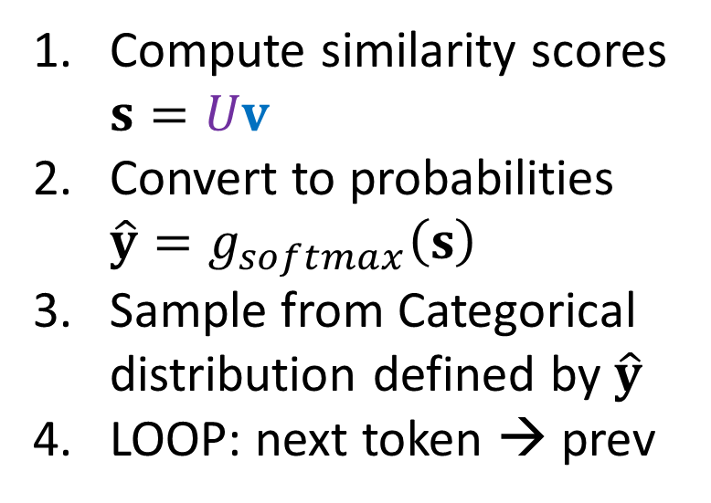

Sampling from Word Embeddings
Suppose we have a trained set of embedded vectors and we want to generate a the next token after the previous token 'the'.
$V$: previous tokens
$U$: next tokens
Compute similarity scores $s=Uv$
Convert to probabilities $\hat{y}=g_{softmax}\left(s\right)$
Sample from Categorical distribution defined by $\hat{y}$
LOOP: next token → prev

Slide 20
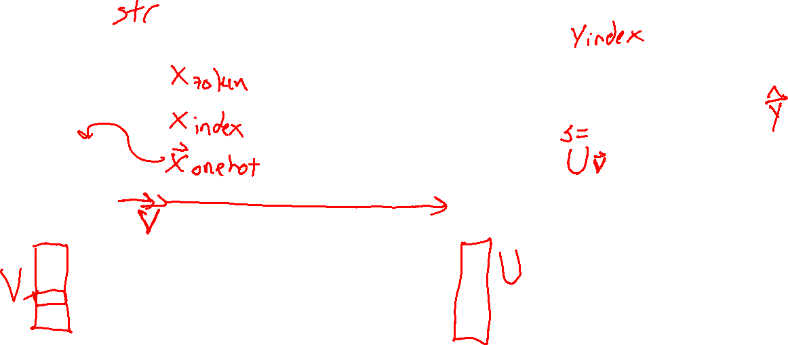
Simple Word Embedding LM
Building a language model with just word embedding layers ☺
Current text
Really Small Language Model
Next text
Tokenizer
Tokenizer
Sampling
Input tokens
Next token
Probabilty
of each token
in vocab
Word Embedding
Output Embedding
Softmax
Embedded vector representation
Similarity scores
for each token
in vocab

Slide 21
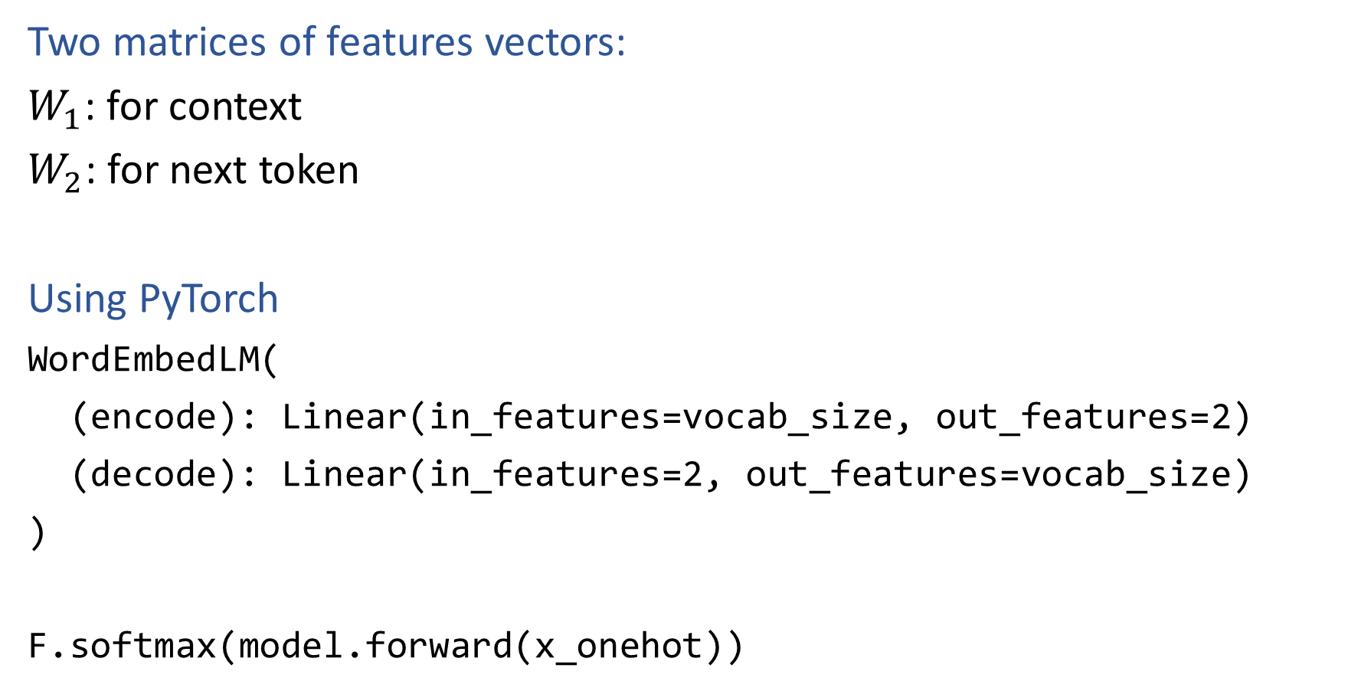
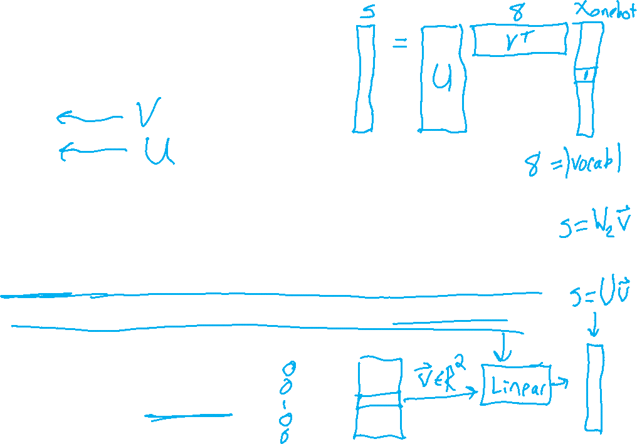
PyTorch for Word Embedding LM
Two matrices of features vectors:
$W_{1}$: for context
$W_{2}$: for next token
Using PyTorch
WordEmbedLM(
(encode): Linear(in_features=vocab_size, out_features=2)
(decode): Linear(in_features=2, out_features=vocab_size)
)
F.softmax(model.forward(x_onehot))

Slide 22
PyTorch for Word Embedding LM
Two matrices of features vectors:
$W_{1}$: for context
$W_{2}$: for next token
Using PyTorch
WordEmbedLM(
(encode): Linear(in_features=vocab_size, out_features=2)
(decode): Linear(in_features=2, out_features=vocab_size)
)
F.softmax(model.forward(x_onehot))
torch.nn.Embedding(num_embeddings, embedding_dim)
x_index

Slide 23
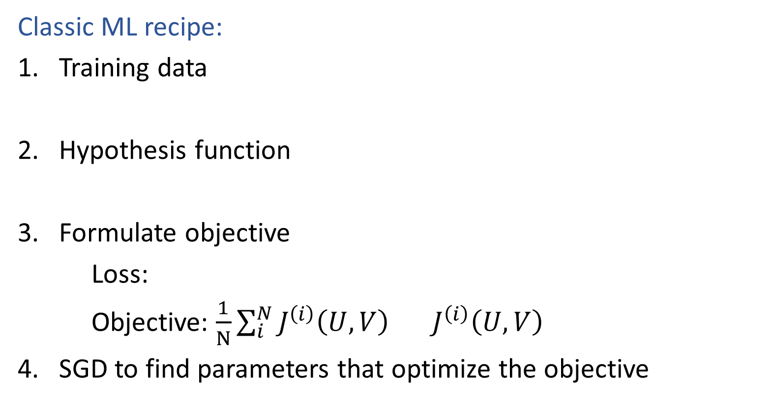
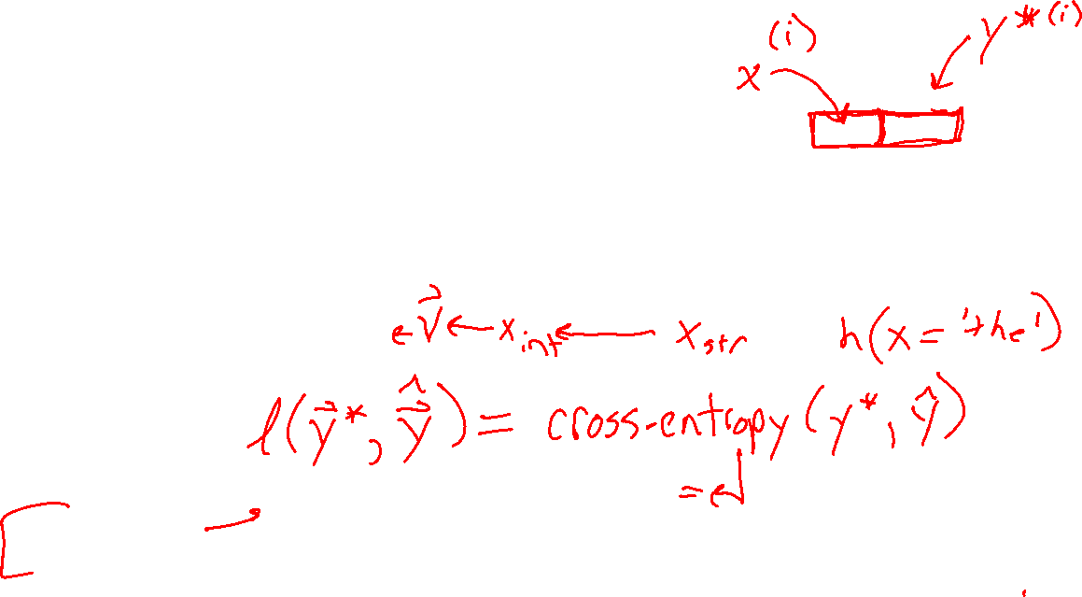

Learning Better Vectors
Classic ML recipe:
Training data
Hypothesis function
Formulate objective
Loss:
Objective: $\frac{1}{N}\sum_{i}^{N}{J^{\left(i\right)}\left(U, V\right)} J^{\left(i\right)}\left(U, V\right)$
SGD to find parameters that optimize the objective
$$\hat{y}= g_{softmax}(Uv)$$

Slide 24
Tranformer LMs

Slide 25

Transformer Language Models
Increasing context size
Uniform average of context vectors
Position encoding
Attention
Weighted average of context vectors
Query Keys Values
Expressive power of linear transforms
Transformer blocks

Slide 26
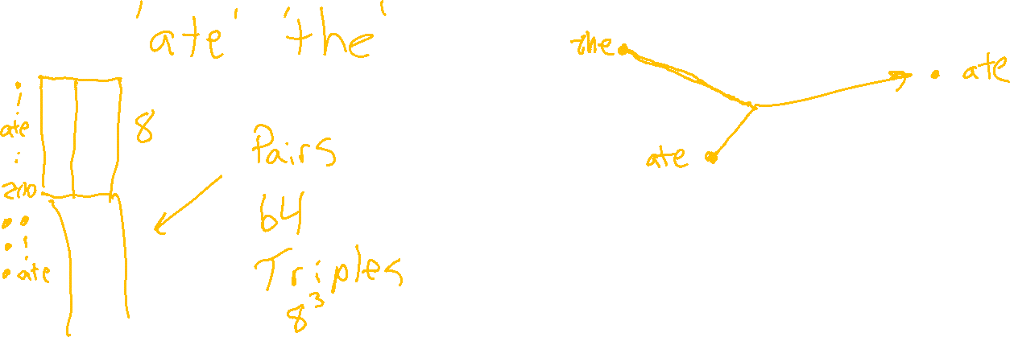
Increasing Context Size
What if we want to have more input tokens?
V: for context
U: for next token

Slide 27

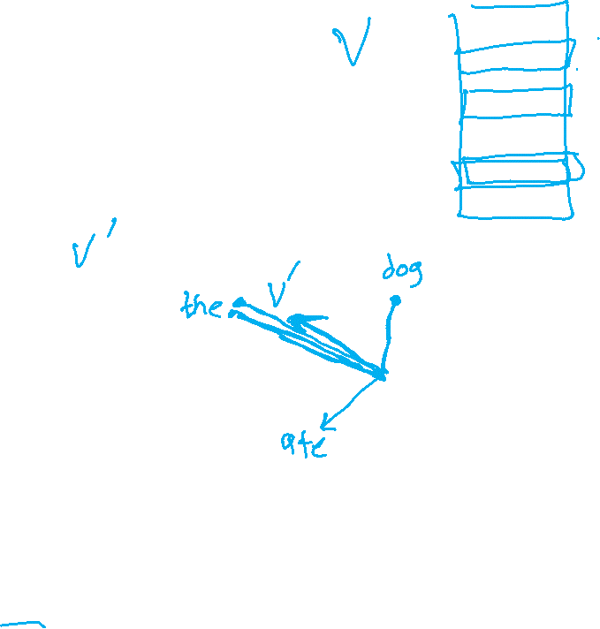
Increasing Context Size
What if we want to have more input tokens?
Uniform average over T input context tokens
context
$$v′=\sum_{t=1}^{T}{{\frac{1}{T}v}_{t}}$$
v₁
v₂
v₃
v₄
the
dog
ate
the

Slide 28
Position Encoding
What about position within the input context??
v₁
v₂
v₃
v₄
the
dog
ate
the

Slide 29
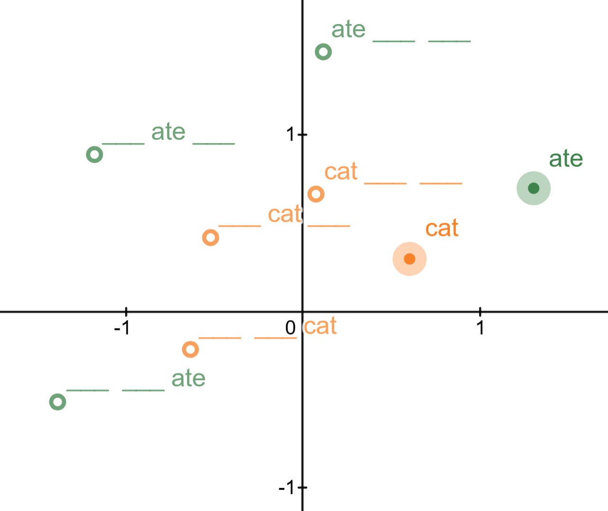
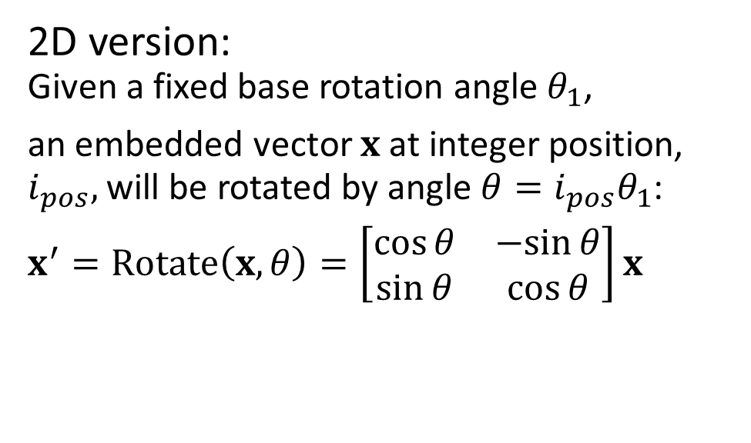
Position Encoding
What about position within the input context??
Rotary Position Encoding (RoPE) Desmos Demo
https://www.desmos.com/calculator/88combmfxv
2D version:
Given a fixed base rotation angle $θ_{1}$,
an embedded vector $x$ at integer position, $i_{pos},$ will be rotated by angle $θ=i_{pos}θ_{1}$:
$x^{′}=Rotate\left(x, θ\right)=\left[\begin{matrix}\cos{θ} & −sin{θ} \\ \sin{θ} & \cos{θ}\end{matrix}\right]x$

Slide 30
Attention

Slide 31

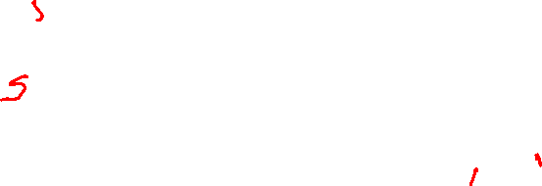

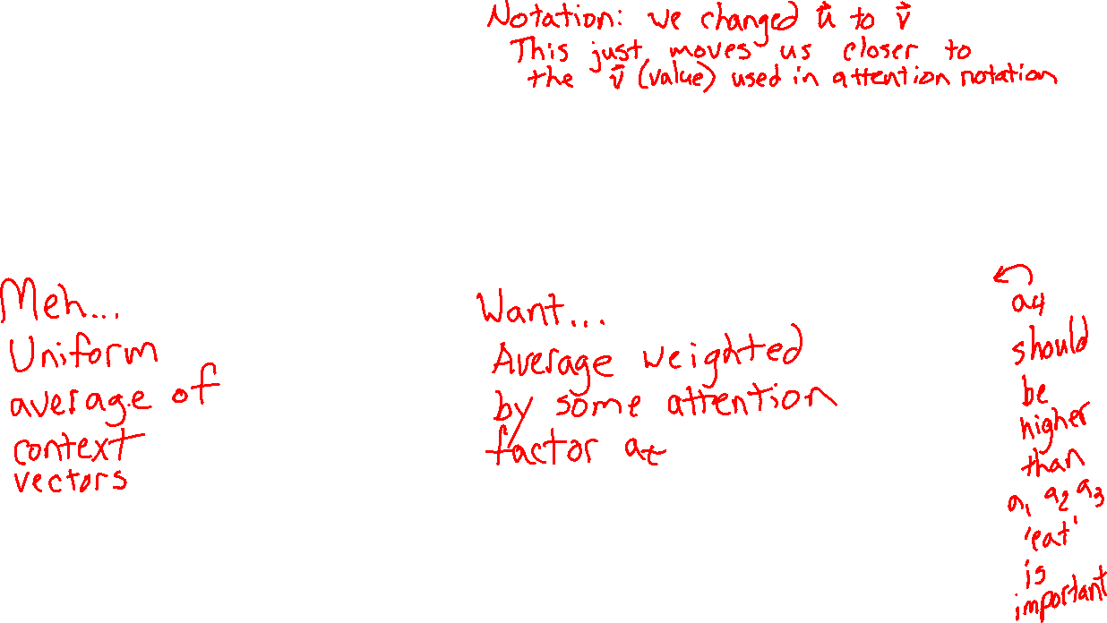
Learn to pay attention!
Context: v'
We can do better than uniform combination of input
$$v′=\sum_{t=1}^{T}{{\frac{1}{T}v}_{t}}$$
$$v′=\sum_{t=1}^{T}{{a_{t}v}_{t}}$$
a₁
a₂
a₃
a₄
Context: v'
v₁
v₂
v₃
v₄
v₁
v₂
v₃
v₄
I
will
not
eat
I
will
not
eat

Slide 32

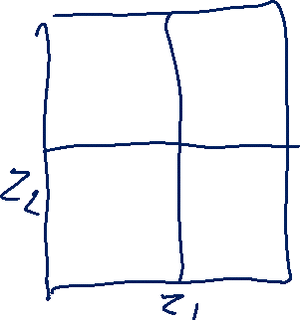

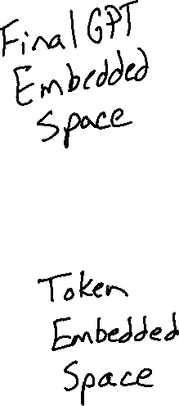
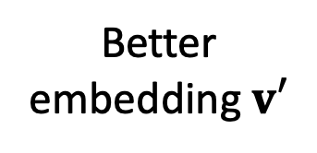
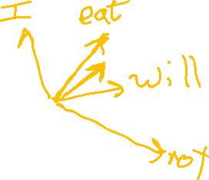

GPT Skeleton
Better embedding $v′$
GPT
(Layers of Attention Blocks)
v₁
v₂
v₃
v₄
Embedded context tokens

Slide 33
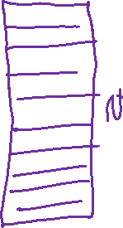

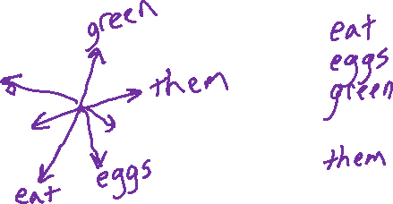

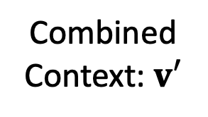
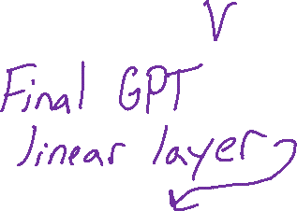
GPT Skeleton
Combined Context: $v′$
GPT
(Layers of Attention Blocks)
$$\hat{y}= g_{softmax}(Uv′)$$
v₁
v₂
v₃
v₄
$$next_idx= \underset{j}{argmax} \hat{y}$$
Embedded context tokens

Slide 34
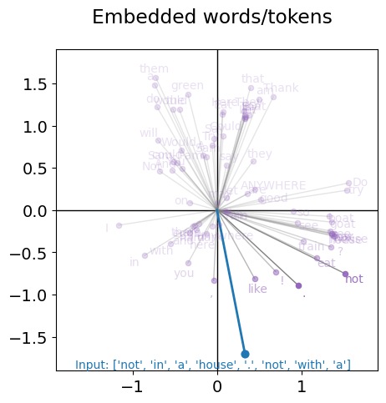

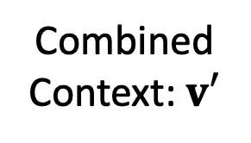

MinGPT Femto
2-D embedded space
1 attention layer
1 attention head (think channel)
Combined Context: $v′$
$$\hat{y}= g_{softmax}(Uv′)$$
GPT
$$next_idx= \underset{j}{argmax} \hat{y}$$
v₁
v₂
v₃
v₄

Slide 35
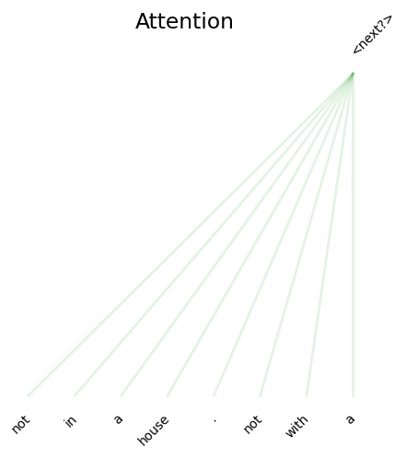
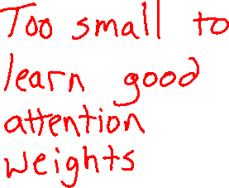
MinGPT Femto
2-D embedded space
1 attention layer
1 attention head (think channel)
Combined Context: $v′$
GPT
v₁
v₂
v₃
v₄

Slide 36





MinGPT Pico
2-D embedded space
3 attention layer
3 attention heads (think channels)
Combined Context: $v′$
GPT
v₁
v₂
v₃
v₄

Slide 37

MinGPT Pico: Output embedded space - 3 heads

Slide 38


MinGPT Pico: Attention Weights – 3 layers, 3 heads

Slide 39
Learn to pay attention!
context
We can do better than uniform combination of input
$$v′=\sum_{t=1}^{T}{{\frac{1}{T}v}_{t}}$$
$$v′=\sum_{t=1}^{T}{{a_{t}v}_{t}}$$
a₁
a₂
a₃
a₄
context
s_{4,1}
s_{4,2}
s_{4,3}
s_{4,4}
v₁
v₂
v₃
v₄
v₁
v₂
v₃
v₄
I
will
not
eat
I
will
not
eat

Slide 40

Learn to pay attention!
context
If only we had a way to measure vector similarity
$$v′=\sum_{t=1}^{T}{{a_{t}v}_{t}}$$
Cosine similarity matrix!
$$S=VV^{T}$$
a₁
a₂
a₃
a₄
I
will
not
eat
1
2
3
4
Je
1
s_{4,1}
s_{4,2}
s_{4,3}
s_{4,4}
na
2
pa
3
v₁
v₂
v₃
v₄
mange
4
I
will
not
eat

Slide 41

Learn to pay attention!
context
If only we had a way to measure vector similarity
$$v′=\sum_{t=1}^{T}{{a_{t}v}_{t}}$$
Cosine similarity matrix!
$$S=VV^{T}$$
a₁
a₂
a₃
a₄
I
will
not
eat
1
2
3
4
softmax
1
s_{4,1}
s_{4,2}
s_{4,3}
s_{4,4}
2
3
v₁
v₂
v₃
v₄
4
I
will
not
eat

Slide 42


Learn to pay attention!
context
We can do better than uniform combination of input
$$v=\sum_{t=1}^{T}{{\frac{1}{T}v}_{t}}$$
$$v=\sum_{t=1}^{T}{{a_{t}v}_{t}}$$
a₁
a₂
a₃
a₄
context
softmax
s_{4,1}
s_{4,2}
s_{4,3}
s_{4,4}
v₁
v₂
v₃
v₄
v₁
v₂
v₃
v₄
I
will
not
eat
I
will
not
eat

Slide 43




Learn to pay attention!
context
But...there is an issue with just doing $VV^{T}$ ☹
a₁
a₂
a₃
a₄
We're really just comparing input to input
→ Symmetric with strong diagonal ☹
$S=VV^{T}$
softmax
s_{4,1}
s_{4,2}
s_{4,3}
s_{4,4}
I
will
not
eat
1
2
3
4
1
eat
v₁
v₂
v₃
v₄
4
2
3
$$V=XW_{V}$$
4
x₁
x₂
x₃
x₄
I
will
not
eat

Slide 44





Learn to pay attention!
context
Instead learn a query vectors $q_{t}$ to represent the output
a₁
a₂
a₃
a₄
I
will
not
eat
1
2
3
4
softmax
1
eat
4
s_{4,1}
s_{4,2}
s_{4,3}
s_{4,4}
$S=QV^{T}$
2
3
v₁
v₂
v₃
v₄
4
$$Q=XW_{Q}$$
$$V={XW}_{V}$$
x₁
x₂
x₃
x₄
I
will
not
eat

Slide 45




Learn to pay attention!
context
Instead learn a query vectors $q_{t}$ to represent the output
(And also $k_{t}$ for the input)
a₁
a₂
a₃
a₄
I
will
not
eat
1
2
3
4
softmax
1
eat
4
s_{4,1}
s_{4,2}
s_{4,3}
s_{4,4}
$$S=QK^{T}/\sqrt{d_{k}}$$
2
3
v₁
v₂
v₃
v₄
4
$$Q={XW}_{Q}$$
$$K=XW_{K}$$
$$V=XW_{V}$$
x₁
x₂
x₃
x₄
I
will
not
eat

Slide 46





Learn to pay attention!
Instead learn a query vectors $q_{t}$ to represent the output
(And also $k_{t}$ for the input)
Attention:
Query, Key, Value
$$Q=XW_{Q}$$
$$S=QK^{T}/\sqrt{d_{k}}$$
$$K=XW_{K}$$
$$V=XW_{V}$$

