Slide 1

10-315 Introduction to ML Natural Language Processing
Instructor: Pat Virtue

Slide 2
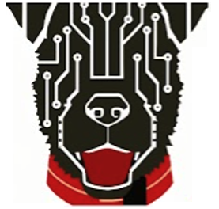
Natural Language Processing (NLP)
Practical Deep Learning
NLP Intro
Feature Engineering/Learning for Text
N-gram Language Models
Word Embedding Language Models

Slide 3
Practical Deep Learning

Slide 4
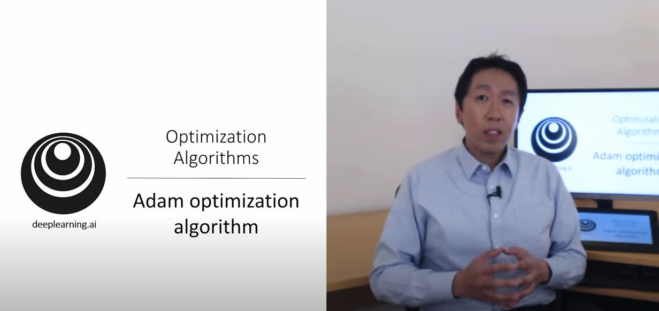
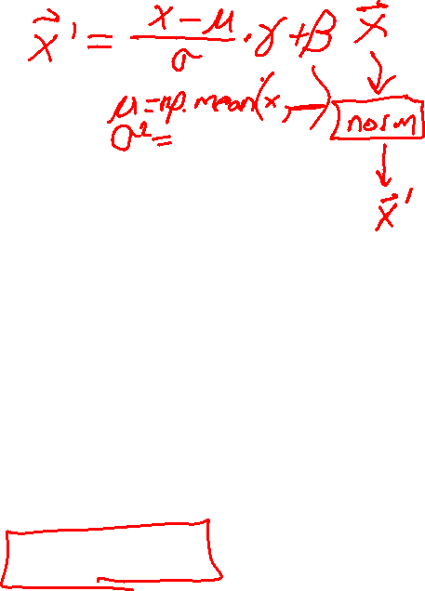
Deep learning issues and Fixes
Issues
Numerical Stability
Vanishing/Exploding gradients
Overfitting
Andrew Ng videos on Hyperparameter Tuning!
Fixes
Input normalization
Weight initialization
Batch normalization
Adam
Exponential moving average
Momentum
RMSprop
Learning rate decay
Skip connections
Dropout

Slide 5

















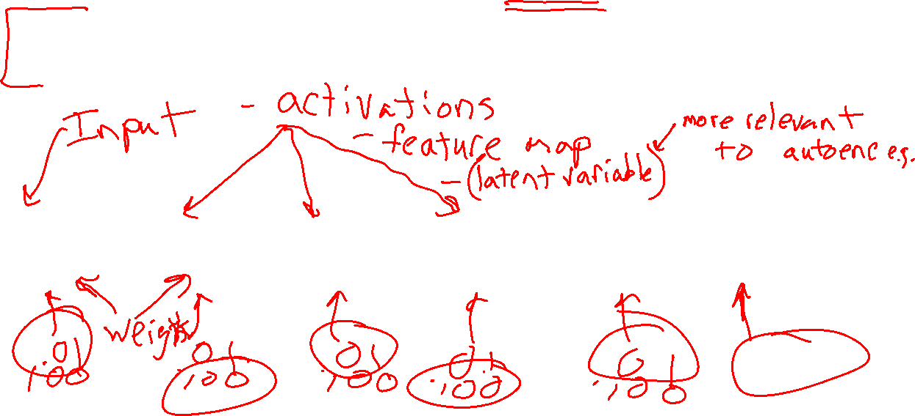












Deep learning issues and Fixes
Issues
Numerical Stability
Vanishing/Exploding gradients
Fixes
Input normalization
Weight initialization
Batch normalization
$$y$$
$$x$$
$$z1$$
$$a1$$
$$z2$$
$$a2$$
$$z3$$
$$a3$$
$$z4$$
$$a4$$
$$z5$$
$$a5=\hat{y}$$
$$J$$
$$f$$
$$g$$
$$f$$
$$g$$
$$f$$
$$g$$
$$f$$
$$g$$
$$f$$
$$g$$
$$ℓ$$
$$w1$$
$$w2$$
$$w3$$
$$w4$$
$$w5$$

Slide 6
















Deep learning issues and Fixes
Issues
Numerical Stability
Vanishing/Exploding gradients
Fixes
Input normalization
Weight initialization
Batch normalization
$$\frac{∂J}{∂z_{1}}$$
$$\frac{∂J}{∂a_{1}}$$
$$\frac{∂J}{∂z_{2}}$$
$$\frac{∂J}{∂a_{2}}$$
$$\frac{∂J}{∂z_{3}}$$
$$\frac{∂J}{∂a_{3}}$$
$$\frac{∂J}{∂z_{4}}$$
$$\frac{∂J}{∂a_{4}}$$
$$\frac{∂J}{∂z_{5}}$$
$$\frac{∂J}{∂\hat{y}}$$
$$y$$
$$x$$
$$z1$$
$$a1$$
$$z2$$
$$a2$$
$$z3$$
$$a3$$
$$z4$$
$$a4$$
$$z5$$
$$a5=\hat{y}$$
$$J$$
$$f$$
$$g$$
$$f$$
$$g$$
$$f$$
$$g$$
$$f$$
$$g$$
$$f$$
$$g$$
$$ℓ$$
$$w1$$
$$w2$$
$$w3$$
$$w4$$
$$w5$$
$$\frac{∂J}{∂w_{1}}$$
$$\frac{∂J}{∂w_{2}}$$
$$\frac{∂J}{∂w_{3}}$$
$$\frac{∂J}{∂w_{4}}$$
$$\frac{∂J}{∂w_{5}}$$

Slide 7
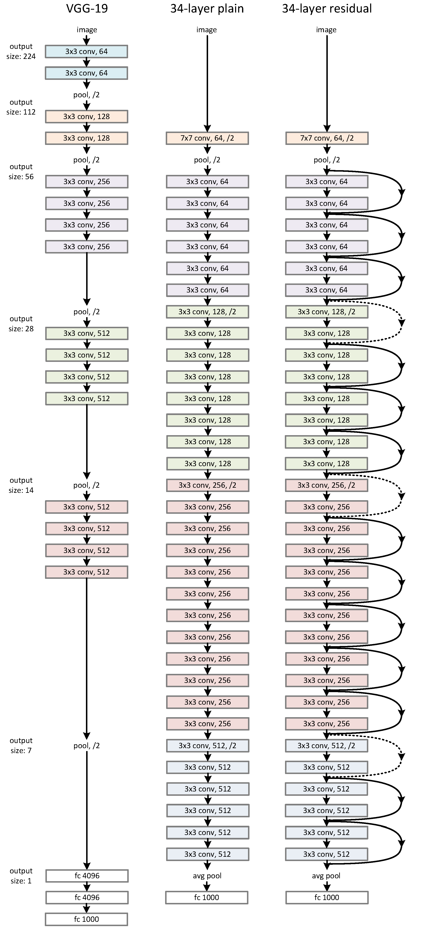
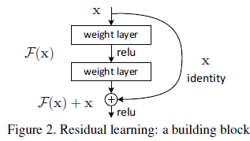
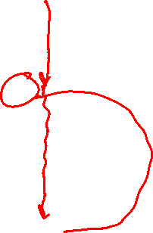
Deep learning issues and Fixes
Issues
Numerical Stability
Vanishing/Exploding gradients
Overfitting
Fixes
Input normalization
Weight initialization
Batch normalization
Adam
Exponential moving average
Momentum
RMSprop
Learning rate decay
Skip connections
Dropout

Slide 8
Natural Language Processing (NLP)

Slide 9
Language is Hard
Emphasis can drastically change meaning
I didn’t eat your dog

Slide 10
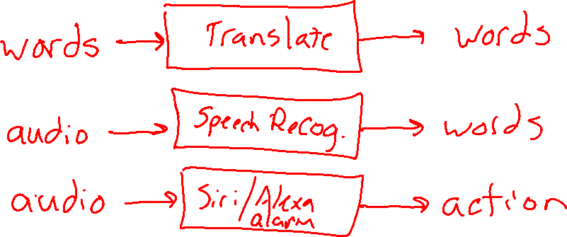
NLP Tasks Examples
How many different NLP Input/Output agents can you think of?
Task
Input
Output

Slide 11
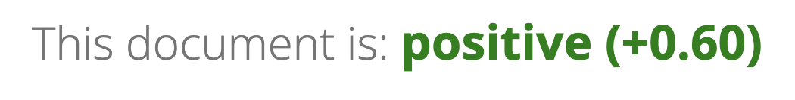
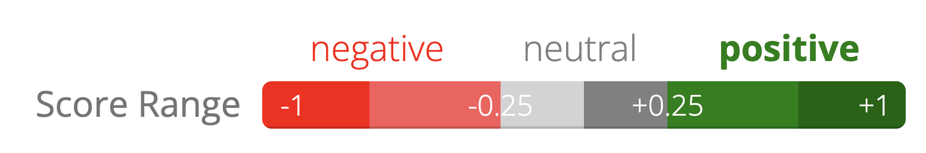
NLP Task: Sentiment Analysis
Sentiment analysis demo
https://text2data.com/Demo
“I recommend that you find something better to do with your time”

Slide 12
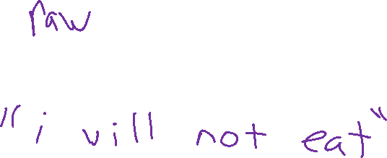
Text Features

Slide 13
Text Features
SPAM Classification

Slide 14
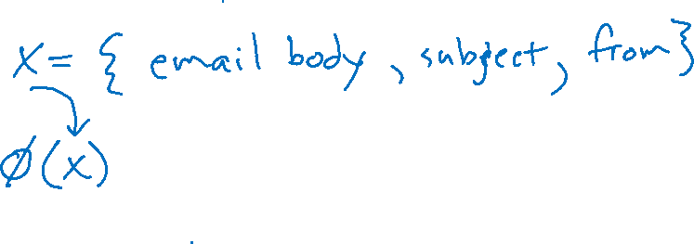
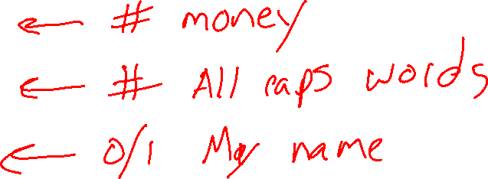
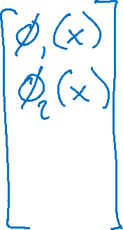
Text Features
SPAM Classification

Slide 15
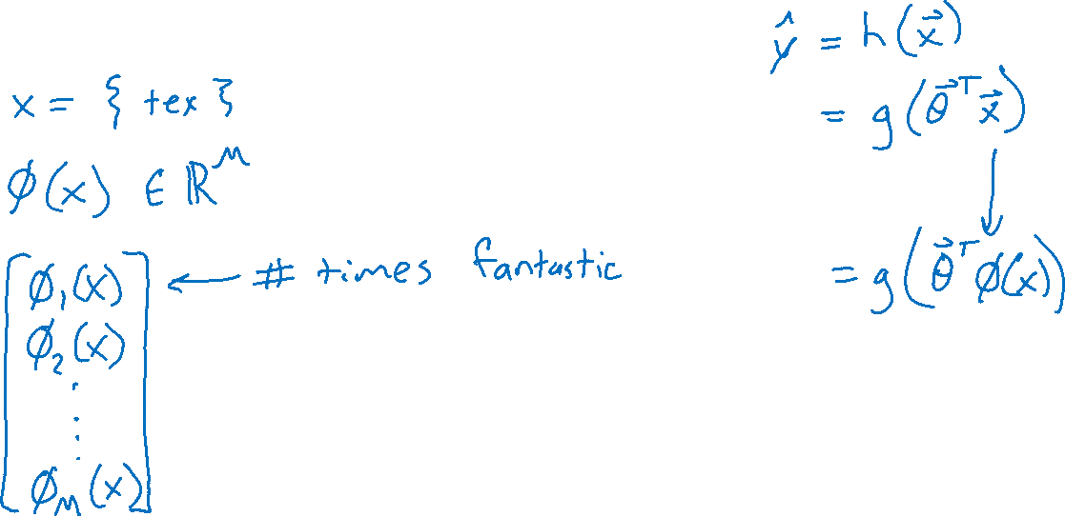

Text Features
Bag of words: Vector of length the size of the vocabulary
Two options
Word occurrence: Binary: does the word exist (at least once) or not
Word histogram: Integer: count of how many times the word appears

Slide 16
Text Features
Predicting Rating from Written Movie Review

Slide 17

Text Features: Tokenization
Text encoding: token → index within vocabulary
What is our "vocabulary", i.e., what are our tokens?
Characters
Byte pair encoding
Words and punctuation
Corpus
I am Sam. I am Sam. Sam I am. That Sam-I-am. That Sam-I-am!

Slide 18
Text Features : Tokenization
I am Sam. I am Sam. Sam I am. That Sam-I-am. That Sam-I-am!
Text encoding: token → index within vocabulary
What is our "vocabulary", i.e., what are our tokens?
Character token vocabulary
BPE token vocabulary
Word token vocabulary
0:
1:
2:
3:
4:
5:
6:
7:
8:
9:
10:
0:
1:
2:
3:
4:
5:
6:
7:
8:
9:
10:
11:
12:
13:
14:
15:
Sam
Th
am
_Sam
_am
0:
1:
2:
3:
4:
5:
6:
!
.
am
I
Sam
That
Sam-I-am
!
-
.
I
S
T
a
h
m
t
_ (space)
!
-
.
I
S
T
a
h
m
t
_(space)

Slide 19
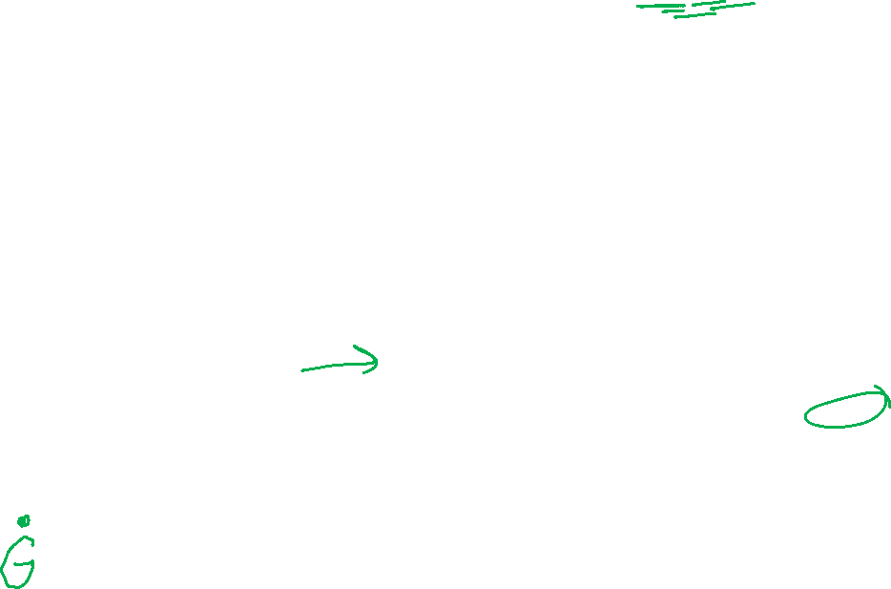
Text Features : Tokenization
I am Sam. I am Sam. Sam I am. That Sam-I-am. That Sam-I-am!
Text encoding: token → index within vocabulary
Byte pair encoding (BPE)
Current token vocabulary
(Initialize to characters in corpus)
Pair frequencies
Count frequencies of all pairs of current tokens appearting together in corpus
New tokens
Add most frequent pair to tokens
!
-
.
I
S
T
a
h
m
t
_ (space)
!
-
.
I
S
T
a
h
m
t
_ (space)
am
_a: 3 am: 10 _S: 4 Sa: 5 _I: 1 Th: 2 ha: 2 at: 2

Slide 20
Text Features : Tokenization
I am Sam. I am Sam. Sam I am. That Sam-I-am. That Sam-I-am!
Text encoding: token → index within vocabulary
Byte pair encoding (BPE)
Current token vocabulary
(Initialize to characters in corpus)
Pair frequencies
Count frequencies of all pairs of current tokens appearting together in corpus
New tokens
Add most frequent pair to tokens
!
-
.
I
S
T
a
h
m
t
_ (space)
am
!
-
.
I
S
T
a
h
m
t
_ (space)
am
Sam
_S: 4 _I: 1 Th: 2 ha: 2 at: 2
_am: 3
Sam: 5

Slide 21
Text Features : Tokenization
I am Sam. I am Sam. Sam I am. That Sam-I-am. That Sam-I-am!
Text encoding: token → index within vocabulary
What is our "vocabulary", i.e., what are our tokens?
Character token vocabulary
BPE token vocabulary
Word token vocabulary
0:
1:
2:
3:
4:
5:
6:
7:
8:
9:
10:
0:
1:
2:
3:
4:
5:
6:
7:
8:
9:
10:
11:
12:
13:
14:
15:
Sam
Th
am
_Sam
_am
0:
1:
2:
3:
4:
5:
6:
!
.
am
I
Sam
That
Sam-I-am
!
-
.
I
S
T
a
h
m
t
_ (space)
!
-
.
I
S
T
a
h
m
t
_(space)

Slide 22
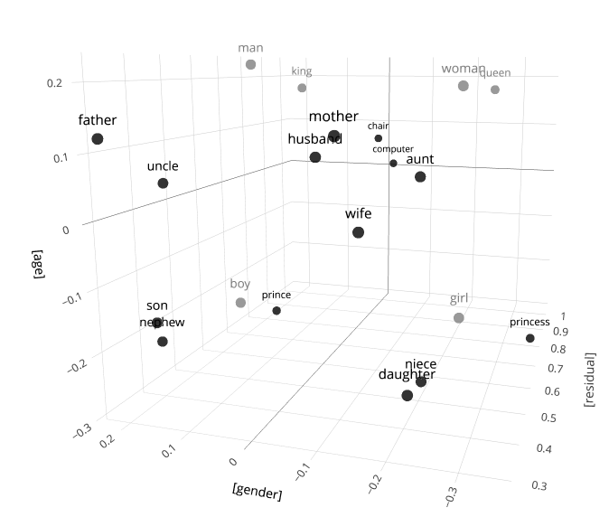
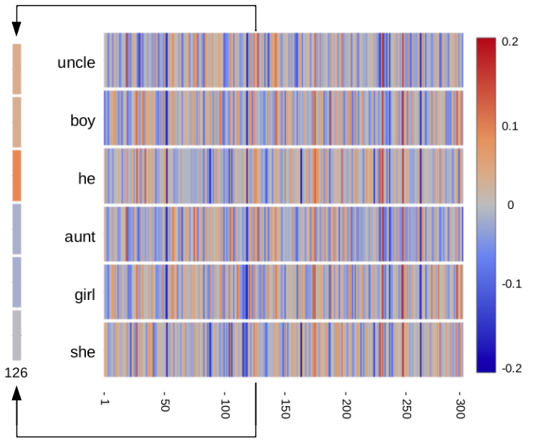
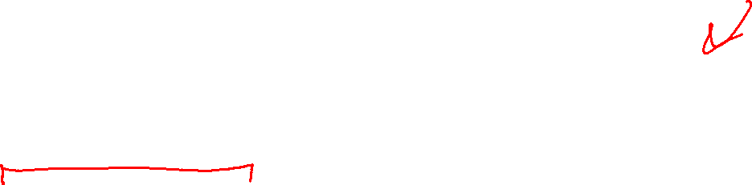
Text Feature Learning
Feature learning
Word to Vec
https://www.cs.cmu.edu/~dst/WordEmbeddingDemo/tutorial.html

Slide 23
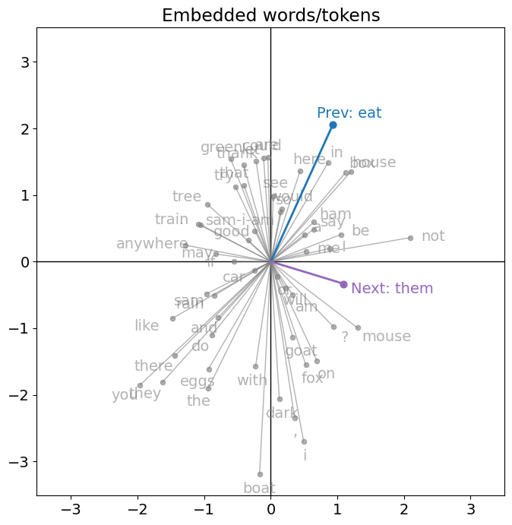
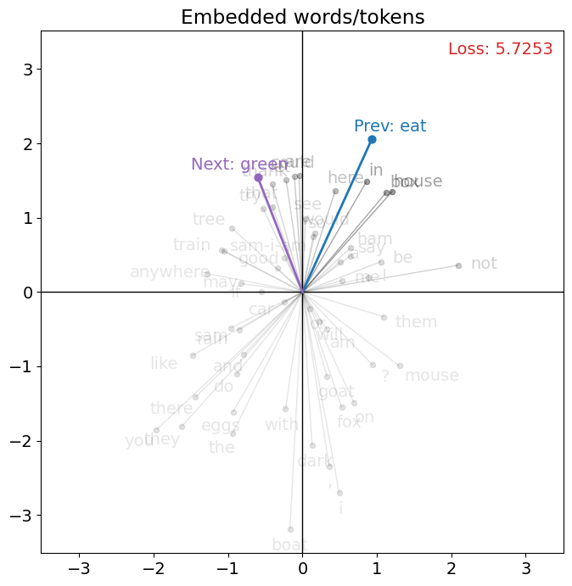
Text Feature Learning
Word embeddings

Slide 24

Feature Engineering vs Feature Learning
Feature engineering
Humans decide what the features may be useful
Humans implement feature extraction algorithms
Feature learning
Humans choose data and performance measure
Humans decide on structure/algorithm to learn features
Features are just intermediate values between input and output
Structure defines number of feature values
Allow machine to map data to feature values as needed

Slide 25
Feature Engineering vs Feature Learning
Feature engineering
Humans decide what the features may be useful
Leverage human experience for that input
Consider data available
Humans implement feature extraction algorithms
Leverage data and compute power
Pro: Human interpretable features → trained models easier to explain
Con: Features may not be sufficient for effective training
Con: Humans likely needed to adapt to new tasks
Pro: Less likely to overfit as humans have selected impactful features

Slide 26
Feature Engineering vs Feature Learning
Feature learning
Humans choose data and performance measure
Humans decide on structure/algorithm to learn features
Features are just intermediate values between input and output
Structure defines number of feature values
Allow machine to map data to feature values as needed
Con: Humans cannot interpret features → trained models unexplainable
Pro: Allow machine to search larger space for efficient features
Pro: Humans may not be needed to adapt to new tasks (just new/more data)
Con: Can overfit to data as there is no human logic in feature definition

Slide 27
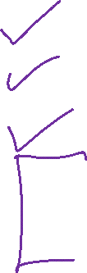
Natural Language Processing (NLP)
Practical Deep Learning
NLP Intro
Feature Engineering/Learning for Text
N-gram Language Models
Word Embedding Language Models

Slide 28
Language Models

Slide 29
Language Models
N-grams

Slide 30
N-gram Exercise

Slide 31
The Chain Rule of Probability
Question: How can we define a probability distribution over a sequence of length T?
The
bat
made
noise
at
night
w₁
w₂
w₃
w₄
w₅
w₆
p(w₁, w₂, w₃, … , w₆) =
p(w₁)
p(w₂ | w₁)
p(w₃ | w₂, w₁)
p(w₄ | w₃, w₂, w₁)
p(w₅ | w₄, w₃, w₂, w₁)
p(w₆ | w₅, w₄, w₃, w₂, w₁)
The
The
bat
The
bat
made
The
bat
made
noise
The
bat
made
noise
at
The
bat
made
noise
at
night
Notes:
p(w_1, w_2, \ldots, w_T) = \prod_{t=1}^T p(w_t \mid w_{t-1}, \ldots, w_{1})

Slide 32
n-Gram Language Model
Question: How can we define a probability distribution over a sequence of length T?
The
bat
made
noise
at
night
w₁
w₂
w₃
w₄
w₅
w₆
n-Gram Model (n=2)
p(w₁, w₂, w₃, … , w₆) =
p(w₁)
p(w₂ | w₁)
p(w₃ | w₂)
p(w₄ | w₃)
p(w₅ | w₄)
p(w₆ | w₅)
The
The
bat
bat
made
made
noise
noise
at
at
night
Notes:
p(w_1, w_2, \ldots, w_T) = \prod_{t=1}^T p(w_t \mid w_{t-1})

Slide 33
n-Gram Language Model
Question: How can we define a probability distribution over a sequence of length T?
The
bat
made
noise
at
night
w₁
w₂
w₃
w₄
w₅
w₆
n-Gram Model (n=3)
p(w₁, w₂, w₃, … , w₆) =
p(w₁)
p(w₂ | w₁)
p(w₃ | w₂, w₁)
p(w₄ | w₃, w₂)
p(w₅ | w₄, w₃)
p(w₆ | w₅, w₄)
The
The
bat
The
bat
made
bat
made
noise
made
noise
at
noise
at
night
Notes:
p(w_1, w_2, \ldots, w_T) = \prod_{t=1}^T p(w_t \mid w_{t-1}, w_{t-2})

Slide 34
Human NLP
Wheel of Fortune

Slide 35
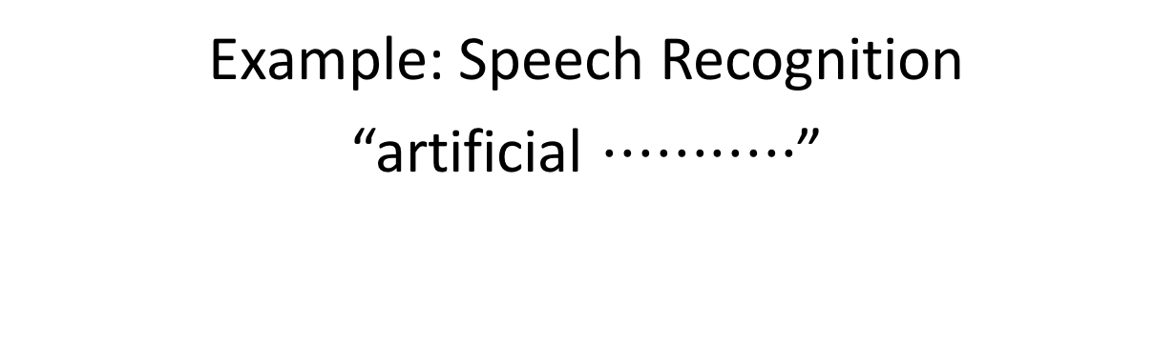
Probability Models
Example: Speech Recognition
“artificial $⋅⋅⋅⋅⋅⋅⋅⋅⋅⋅⋅$”
Find most probable next word given “artificial” and the audio for second word.

Slide 36
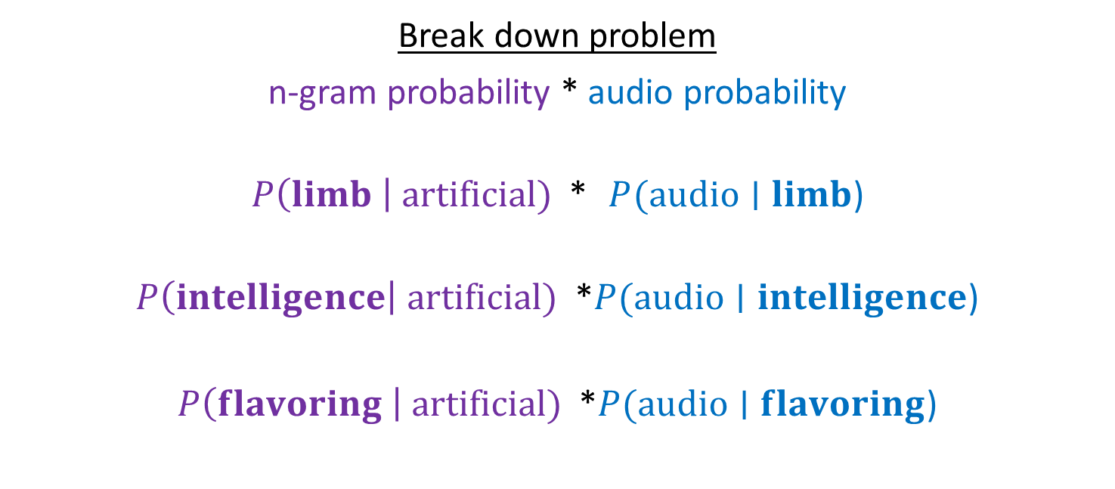
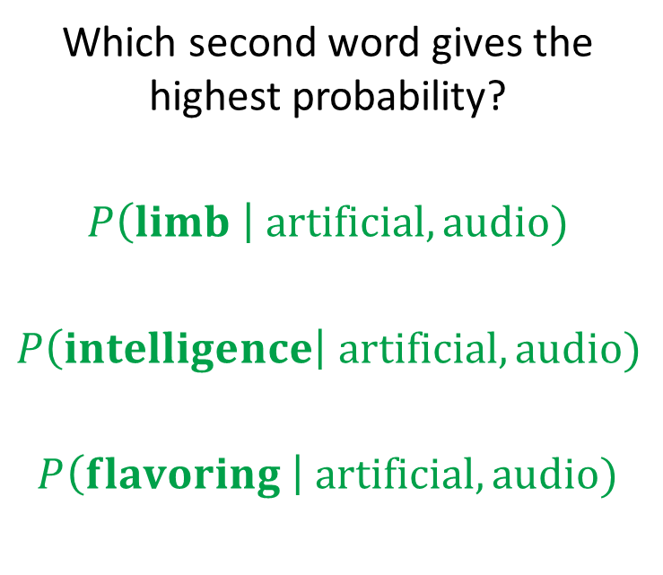
Probability Models
Example: Speech Recognition
“artificial $⋅⋅⋅⋅⋅⋅⋅⋅⋅⋅⋅$”
Find most probable next word given “artificial” and the audio for second word.
Which second word gives the highest probability?
$$P\left(limb \right| artificial, audio)$$
$$P\left(intelligence\right| artificial, audio)$$
$$P\left(flavoring \right| artificial, audio)$$
Break down problem
n-gram probability * audio probability
$P\left(limb \right| artificial)$ * $P(audio∣limb$)
$P\left(intelligence\right| artificial)$ *$P(audio∣intelligence$)
$P\left(flavoring \right| artificial)$ *$P(audio∣flavoring$)

Slide 37
N-gram Training
Where do the n-gram probabilities come from?
Google n-grams demo

Slide 38
N-gram Training
N-gram probabilities
Vocabulary size: 30,000

Slide 39
N-gram Training
Self-supervised
Example: Jane Austen, Pride and Prejudice
Vanity and pride are different things, though the words are often used synonymously. A person may be proud without being vain. Pride relates more to our opinion of ourselves, vanity to what we would have others think of us.

Slide 40
N-gram Training
Self-supervised learning (auto-regressive)
Example: Jane Austen, Pride and Prejudice
Vanity and pride are different things, though the words are often used synonymously. A person may be proud without being vain. Pride relates more to our opinion of ourselves, vanity to what we would have others think of us.

Slide 41
Sampling from a Language Model
Question: How do we sample from a Language Model?
Answer:
Treat each probability distribution like a (50k-sided) weighted die
Pick the die corresponding to p(w_{t} | w_{t-2}, w_{t-1})
Roll that die and generate whichever word w_{t} lands face up
Repeat
p(· | noise, at)
p(· | made, noise)
p(· | bat, made)
p(· | START)
p(· | The, bat)
p(· | START, The)
START
The
bat
made
noise
at
night
Notes:
https://pixabay.com/vectors/dice-red-two-game-rolling-chance-25637/

Slide 42
N-gram Examples
Random samples from language model trained on Shakespeare:
n=1: “in as , stands gods revenge ! france pitch good in fair hoist an what fair shallow-rooted , . that with wherefore it what a as your . , powers course which thee dalliance all”
n=2: “look you may i have given them to the dank here to the jaws of tune of great difference of ladies . o that did contemn what of ear is shorter time ; yet seems to”
n=3: “believe , they all confess that you withhold his levied host , having brought the fatal bowels of the pope ! ' and that this distemper'd messenger of heaven , since thou deniest the gentle desdemona ,”
n=7: “so express'd : but what of that ? 'twere good you do so much for charity . i cannot find it ; 'tis not in the bond . you , merchant , have you any thing to say ? but little”
This is starting to look a lot like Shakespeare… because it is Shakespeare
Slide: CMU, Zico Kolter

