Slide 1


10-315 Introduction to ML Practical and Responsible ML
Instructor: Pat Virtue

Slide 2
Great Power

Slide 3
Neural Network Toolkits
Pytorch

Slide 4
Network Network Toolkits
Pytorch in this course
Already used behind the scenes in HW1
HW7 transfer learning and exploration
Mini-project if you want

Slide 5
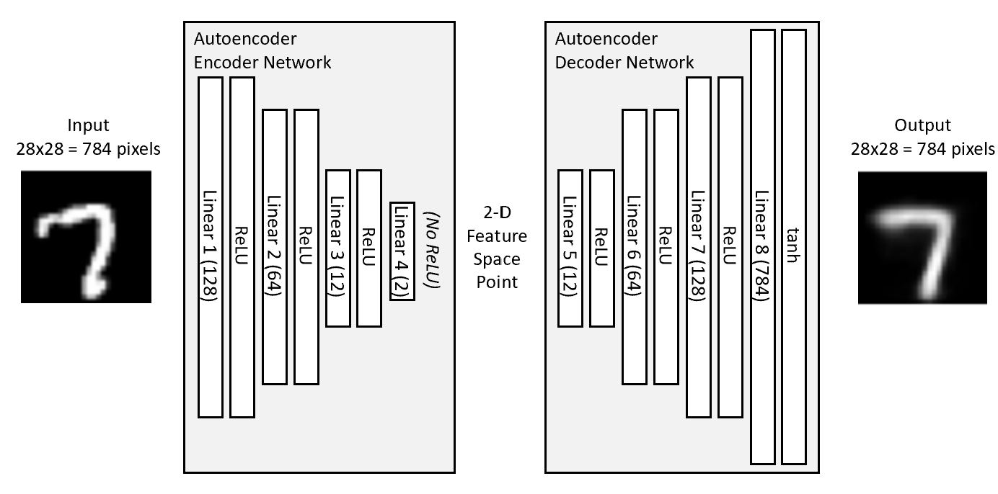

Pytorch for HW1 Networks
class autoencoder(nn.Module):
def __init__(self, bottleneck=2):
super().__init__()
self.encoder = nn.Sequential(
nn.Linear(28 * 28, 128),
nn.ReLU(True),
nn.Linear(128, 64),
nn.ReLU(True),
nn.Linear(64, 12),
nn.ReLU(True),
# nn.Linear(12, 2))
nn.Linear(12, bottleneck))
self.decoder = nn.Sequential(
# nn.Linear(2, 12),
nn.Linear(bottleneck, 12),
nn.ReLU(True),
nn.Linear(12, 64),
nn.ReLU(True),
nn.Linear(64, 128),
nn.ReLU(True),
nn.Linear(128, 28 * 28),
nn.Tanh())
def forward(self, x):
x = self.encoder(x)
x = self.decoder(x)
return x
Autoencoder
Source: https://github.com/L1aoXingyu/pytorch-beginner/blob/master/08-AutoEncoder/simple_autoencoder.py

Slide 6
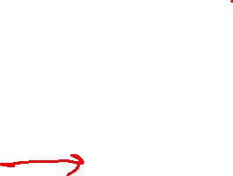
Pytorch for HW1 Networks
class autoencoder(nn.Module):
def __init__(self, bottleneck=2):
super().__init__()
self.encoder = nn.Sequential(
nn.Linear(28 * 28, 128),
nn.ReLU(True),
nn.Linear(128, 64),
nn.ReLU(True),
nn.Linear(64, 12),
nn.ReLU(True),
# nn.Linear(12, 2))
nn.Linear(12, bottleneck))
self.decoder = nn.Sequential(
# nn.Linear(2, 12),
nn.Linear(bottleneck, 12),
nn.ReLU(True),
nn.Linear(12, 64),
nn.ReLU(True),
nn.Linear(64, 128),
nn.ReLU(True),
nn.Linear(128, 28 * 28),
nn.Tanh())
def forward(self, x):
x = self.encoder(x)
x = self.decoder(x)
return x
Autoencoder
for epoch in range(num_epochs):
for data in dataloader:
img, _ = data
img = img.view(img.size(0), -1)
if torch.cuda.is_available():
img = img.cuda()
# ===================forward=====================
output = model(img)
loss = criterion(output, img)
# ===================backward====================
optimizer.zero_grad()
loss.backward()
optimizer.step()
Source: https://github.com/L1aoXingyu/pytorch-beginner/blob/master/08-AutoEncoder/simple_autoencoder.py

Slide 7

Pytorch for HW1 Networks
Autoencoder
class MiniImageCSVDataset:
def __init__(self, csv_filename, has_labels=True, header=0):
df = pd.read_csv(csv_filename, header=header)
data = df.values
if has_labels:
self.data = data[:, 1:]
self.labels = data[:, 0]
else:
self.data = data
self.labels = None
self.data = self.data.astype('float32')
self.data = self.data / 255
def __len__(self):
return len(self.data)
def __getitem__(self, idx):
if self.labels is not None:
return self.data[idx], self.labels[idx]
else:
return self.data[idx]
for epoch in range(num_epochs):
for data in dataloader:
img, _ = data
img = img.view(img.size(0), -1)
if torch.cuda.is_available():
img = img.cuda()
# ===================forward=====================
output = model(img)
loss = criterion(output, img)
# ===================backward====================
optimizer.zero_grad()
loss.backward()
optimizer.step()

Slide 8
Network Network Toolkits
More PyTorch to come in recitation (and HW7)!

Slide 9
Great Responsibility

Slide 10

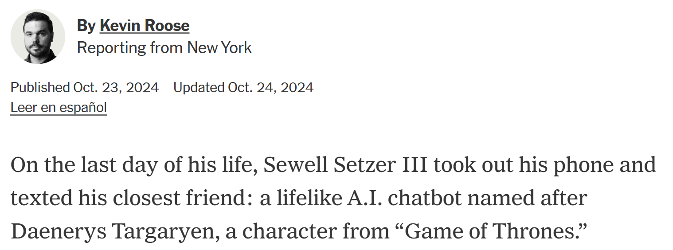
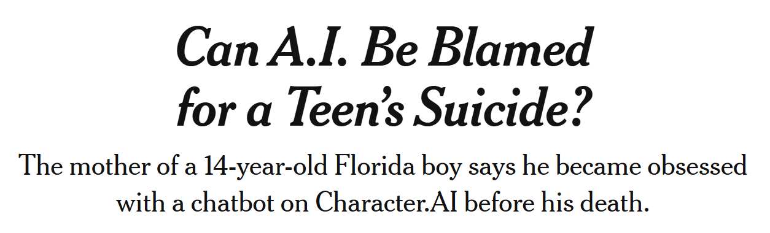
Example: Character.AI
https://www.nytimes.com/2024/10/23/technology/characterai-lawsuit-teen-suicide.html

Slide 11
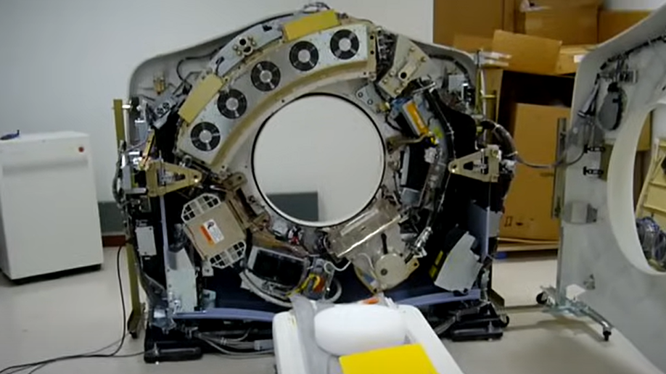
Example: Medical Imaging Systems
CT scanner without it's covers on
https://www.youtube.com/watch?v=2CWpZKuy-NE

Slide 12
Managing Risk
Design Controls
ML Model Cards
Full-cycle Accountability

Slide 13
Responsible Engineering: Design Controls

Slide 14
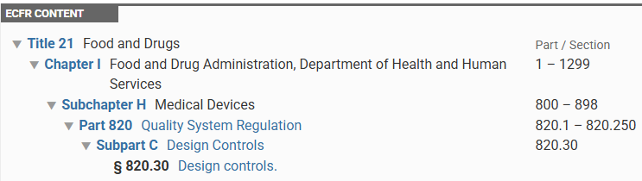
Responsible Engineering
Design controls
Documentation
Verification/Validation
FMEA
CAPA
https://www.ecfr.gov/current/title-21/chapter-I/subchapter-H/part-820/subpart-C?toc=1

Slide 15
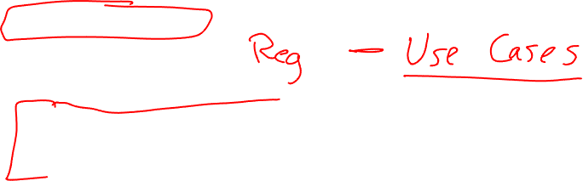
Responsible Engineering
Design controls
Documentation
Verification/Validation
FMEA
CAPA
https://www.ecfr.gov/current/title-21/chapter-I/subchapter-H/part-820/subpart-C?toc=1

Slide 16
Responsible Engineering
FMEA (Failure Modes & Effects Analysis)
Process Step/Input | Potential Failure Mode | Potential Failure Effects | SEVERITY (1 - 10) | Potential Causes | OCCURRENCE (1 - 10) | Current Controls | DETECTION (1 - 10)
What is the process step, change or feature under investigation? | In what ways could the step, change or feature go wrong? | What is the impact on the customer if this failure is not prevented or corrected? |  | What causes the step, change or feature to go wrong? (how could it occur?) |  | What controls exist that either prevent or detect the failure?
https://goleansixsigma.com/failure-modes-effects-analysis-fmea

Slide 17
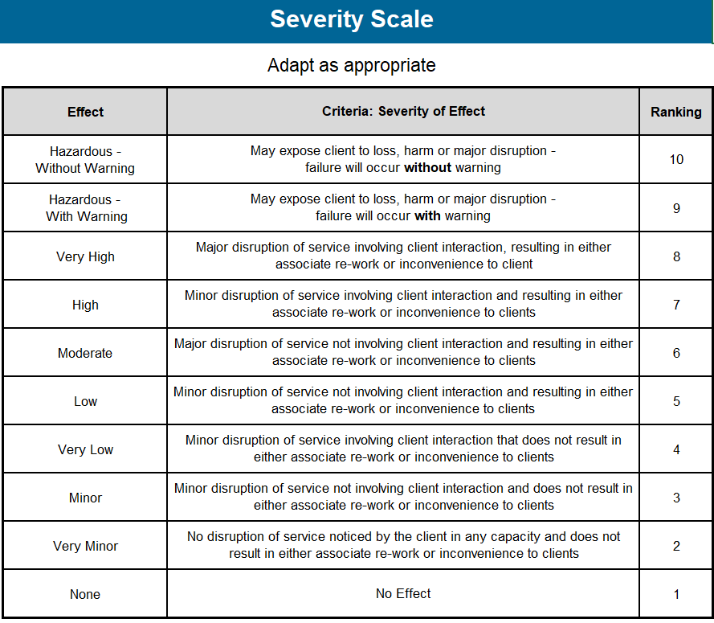
Responsible Engineering
FMEA (Failure Modes & Effects Analysis)
Process Step/Input | Potential Failure Mode | Potential Failure Effects | SEVERITY (1 - 10) | Potential Causes | OCCURRENCE (1 - 10) | Current Controls | DETECTION (1 - 10) | RPN
What is the process step, change or feature under investigation? | In what ways could the step, change or feature go wrong? | What is the impact on the customer if this failure is not prevented or corrected? |  | What causes the step, change or feature to go wrong? (how could it occur?) |  | What controls exist that either prevent or detect the failure?
https://goleansixsigma.com/failure-modes-effects-analysis-fmea

Slide 18
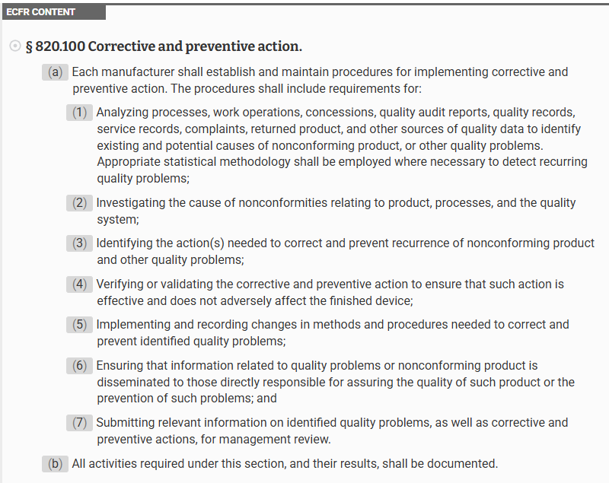
Responsible Engineering
Design controls
Documentation
Verification/Validation
FMEA
CAPA
https://www.ecfr.gov/current/title-21/chapter-I/subchapter-H/part-820/subpart-J/section-820.100

Slide 19
Managing Risk
Design Controls
ML Model Cards
Full-cycle Accountability

Slide 20
ML Model Cards

Slide 21
ML Model Cards
Mitchell, Margaret, et al.
"Model cards for model reporting.“
Proceedings of the conference on fairness, accountability, and transparency. 2019.

Slide 22
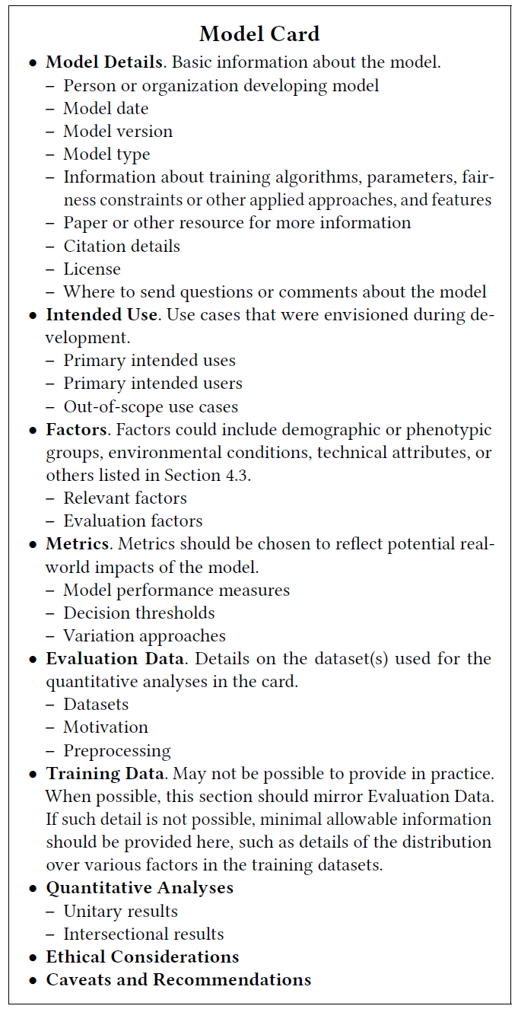
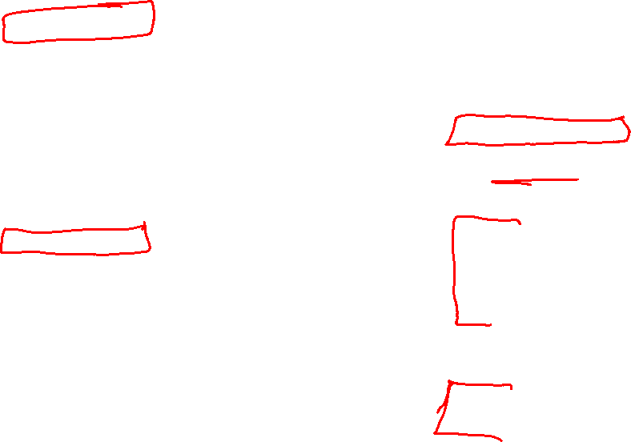
ML Model Cards

Slide 23
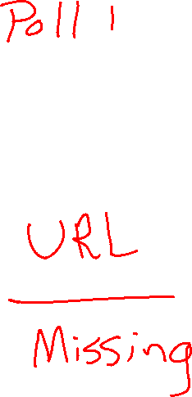
Poll 1: ML Model Hunt
Search the web to find the model card for a real-world model

Slide 24
Full-cycle Accountability

Slide 25
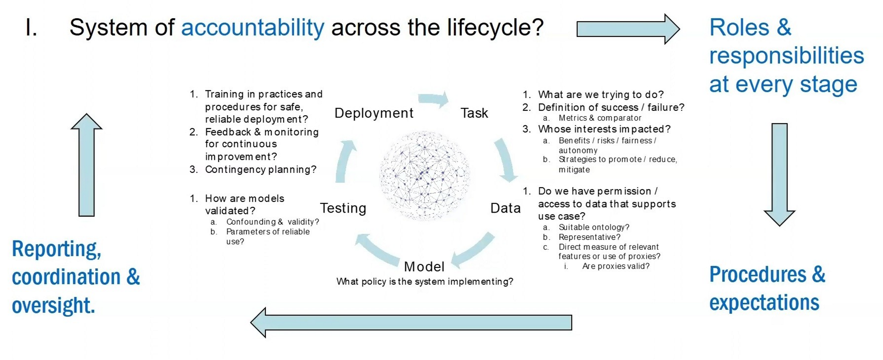
AI Accountability
Slide from Alex London, CMU

