Slide 1

10-315 Introduction to ML Probabilistic Models: MAP
Instructor: Pat Virtue

Slide 2
Course Feedback
Going well
Recitation
Pre-reading
Homework
Lecture Polls
Room for improvement
Lecture slide ink handwritting
Connecting lecture to other components
Lecture detail
Not enough
Too much

Slide 3
Plan
Today
MLE
Linear Regression
Probability Motivation
MAP
ML Applications of Bayes Rule
Linear Regression

Slide 4
Probability Motivation

Slide 5
Empirical Risk Minimization vs MLE/MAP
We seem to be redoing a lot of work? ...well, we are. But there is a reason

Slide 6
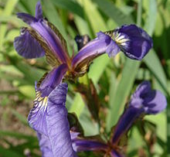
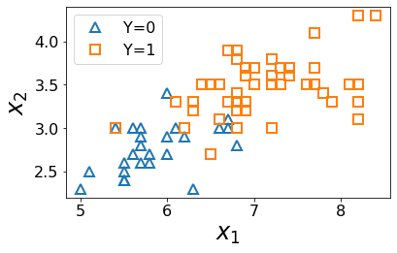
Why Probabilistic Models?
Iris Data

Slide 7
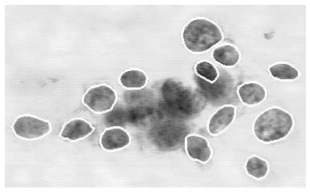
Why Probabilistic Models?
Breast Cancer Diagnosis

Slide 8
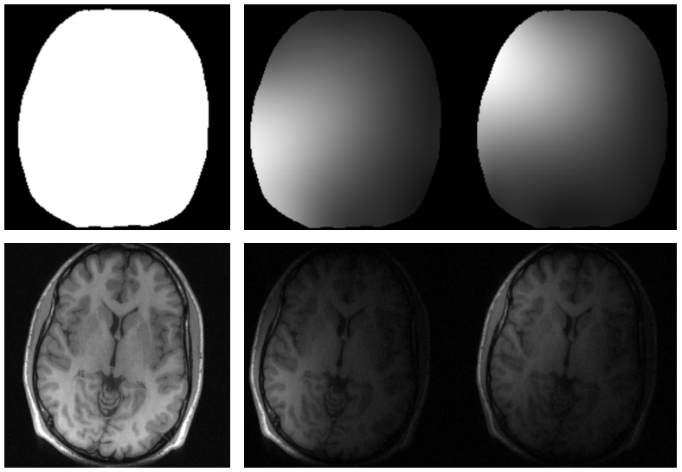
Why Probabilistic Models?
MRI Image Reconstruction

Slide 9
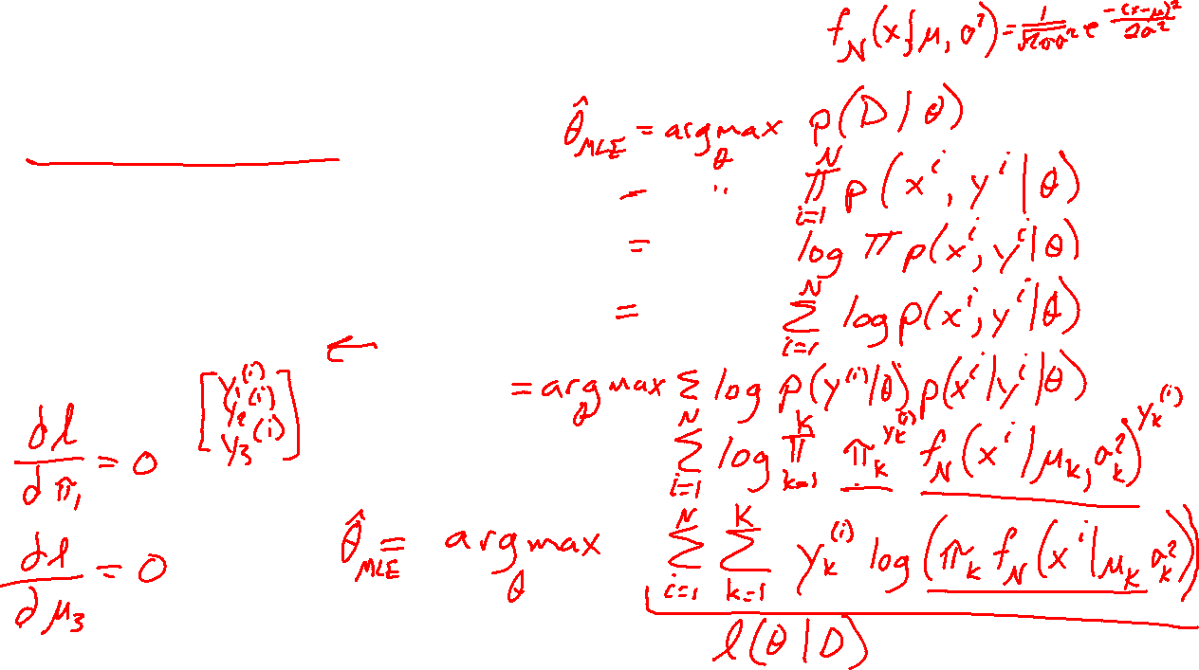
Categorical Gaussian Generative Model
PREVIEW
Estimating parameters
$Y \sim Categorical\left(π_{1},π_{2},π_{3}\right)$
$X_{Y=k} \sim 𝒩(μ_{k},σ_{k}^{2})$.
$𝒟={\left\{x^{\left(i\right)}, y^{\left(i\right)}\right\}}_{i=1}^{N}$

Slide 10
Autoencoders

Slide 11
Language Models

Slide 12
ML Applications of Bayes Rule

Slide 13
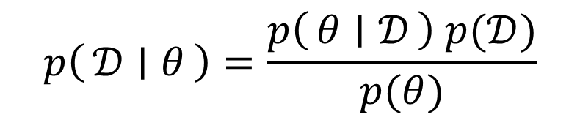
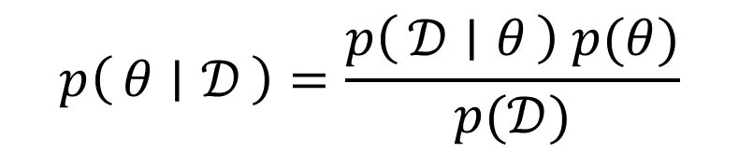
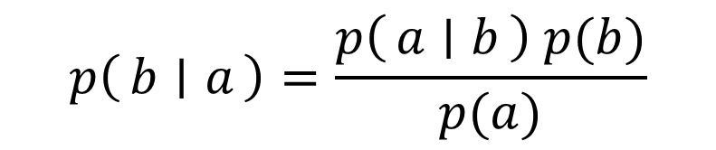
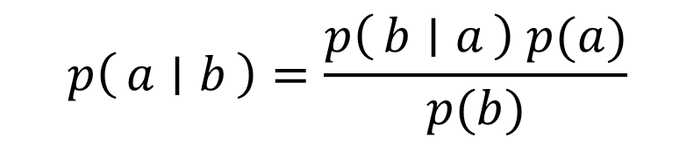
Bayes Rule
$$p\left(a ∣ b\right)=\frac{p\left(b ∣ a\right) p(a)}{p(b)}$$
$$p\left(b ∣ a\right)=\frac{p\left(a ∣ b\right) p(b)}{p(a)}$$
$$p\left(θ ∣ 𝒟\right)=\frac{p\left(𝒟 ∣ θ\right) p(θ)}{p(𝒟)}$$
$$p\left(𝒟 ∣ θ\right)=\frac{p\left(θ ∣ 𝒟\right) p(𝒟)}{p(θ)}$$

Slide 14
Poll 1
Which of these terms is the likelihood?
Select all that apply
A
B
C
E
F
G
$$p\left(θ ∣ 𝒟\right)=\frac{p\left(𝒟 ∣ θ\right) p(θ)}{p(𝒟)}$$
$$p\left(𝒟 ∣ θ\right)=\frac{p\left(θ ∣ 𝒟\right) p(𝒟)}{p(θ)}$$
D
H

Slide 15
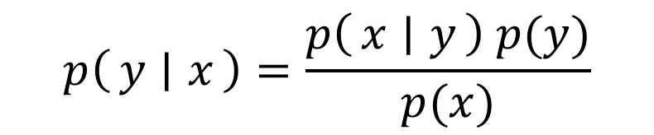
Poll
Which of these terms is the likelihood?
Select all that apply
A
B
C
E
F
G
$$p\left(θ ∣ 𝒟\right)=\frac{p\left(𝒟 ∣ θ\right) p(θ)}{p(𝒟)}$$
$$p\left(y ∣ x\right)=\frac{p\left(x ∣ y\right) p(y)}{p(x)}$$
D
H

Slide 16
Bayes Rule
Terminology
Posterior Likelihood Prior
$$p\left(θ ∣ 𝒟\right)=\frac{p\left(𝒟 ∣ θ\right) p(θ)}{p(𝒟)}$$

Slide 17
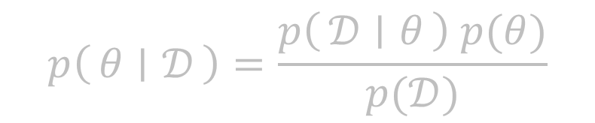
Bayes Rule
Terminology
Posterior Likelihood Prior
Posterior Class conditional Class prior
Conditional likelihood
$$p\left(θ ∣ 𝒟\right)=\frac{p\left(𝒟 ∣ θ\right) p(θ)}{p(𝒟)}$$
$$p\left(y ∣ x\right)=\frac{p\left(x ∣ y\right) p(y)}{p(x)}$$

Slide 18
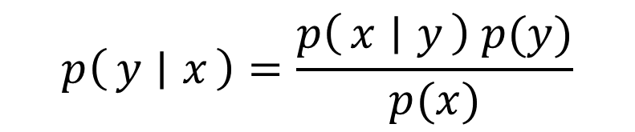
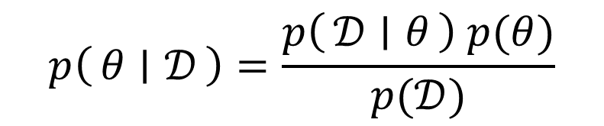
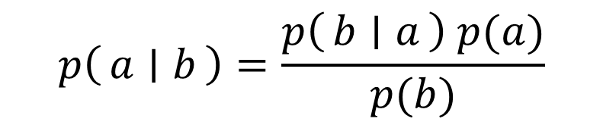
Two Applications of Bayes Rule
$$p\left(a ∣ b\right)=\frac{p\left(b ∣ a\right) p(a)}{p(b)}$$
$$p\left(θ ∣ 𝒟\right)=\frac{p\left(𝒟 ∣ θ\right) p(θ)}{p(𝒟)}$$
$$p\left(y ∣ x\right)=\frac{p\left(x ∣ y\right) p(y)}{p(x)}$$

Slide 19
MLE and MAP

Slide 20

Poll 2
Where do we plug in the pdf that we used for MLE, e.g., $f\left(x\right)=λe^{−λx}$?
A
B
C
$$p\left(θ ∣ 𝒟\right)=\frac{p\left(𝒟 ∣ θ\right) p(θ)}{p(𝒟)}$$
D

Slide 21
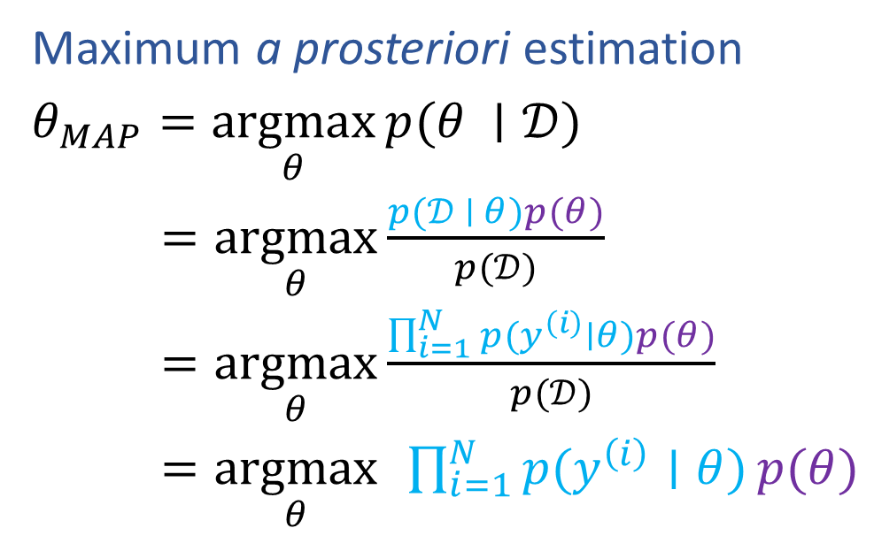
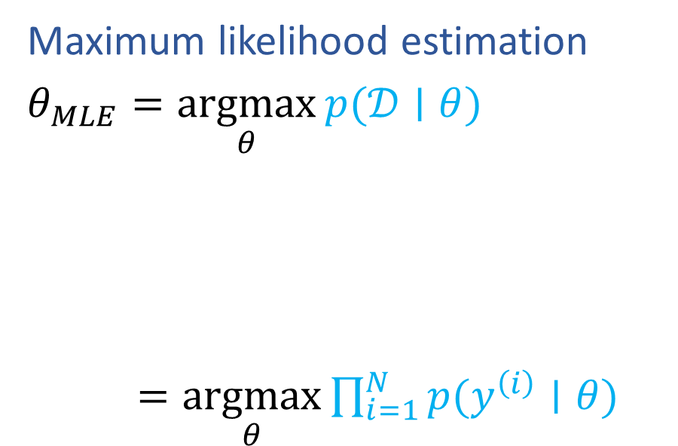
MLE and MAP
Maximum likelihood estimation
$θ_{MLE}=\underset{θ}{argmax}{p(𝒟∣θ)}$
$=\underset{θ}{argmax}{\prod_{i=1}^{N}{p(y^{\left(i\right)}∣θ)}}$
Maximum a prosteriori estimation
$θ_{MAP}=\underset{θ}{argmax}{p(θ ∣𝒟)}$
$=\underset{θ}{argmax}{\frac{p(𝒟 ∣ θ)p(θ)}{p(𝒟)}}$
$=\underset{θ}{argmax}{\frac{\prod_{i=1}^{N}{p(y^{\left(i\right)}∣θ)}p(θ)}{p(𝒟)}}$
$=\underset{θ}{argmax}{ }\prod_{i=1}^{N}{p(y^{\left(i\right)}∣θ)}p(θ)$

Slide 22
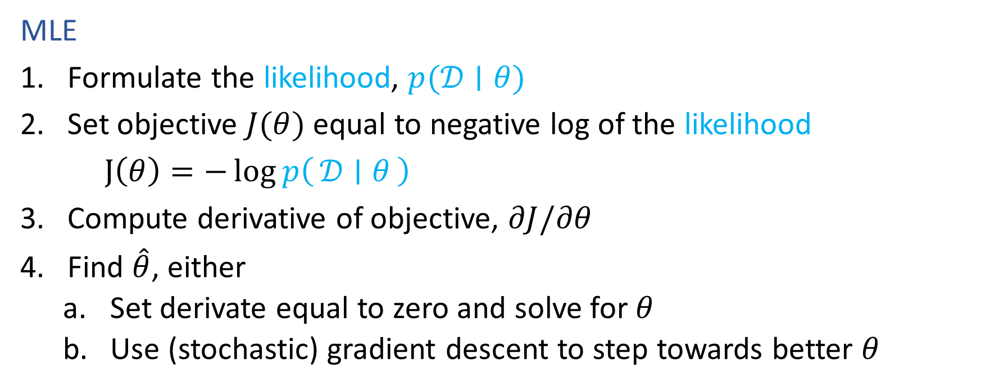
Recipe for Estimation
MLE
Formulate the likelihood, $p(𝒟∣θ)$
Set objective $J(θ)$ equal to negative log of the likelihood
$J\left(θ\right)=−\log{p\left(𝒟 ∣ θ\right)}$
Compute derivative of objective, $∂J/∂θ$
Find $\hat{θ}$, either
Set derivate equal to zero and solve for $θ$
Use (stochastic) gradient descent to step towards better $θ$

Slide 23
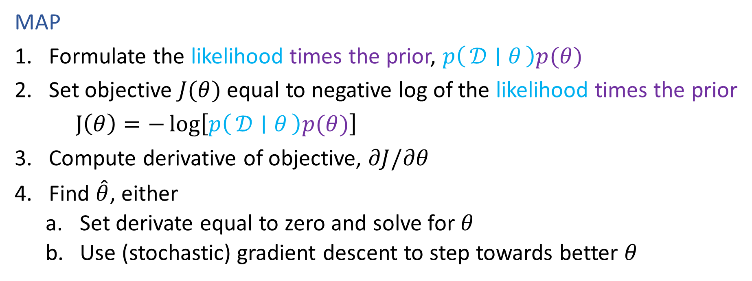
Recipe for Estimation
MAP
Formulate the likelihood times the prior, $p\left(𝒟 ∣ θ\right)p(θ)$
Set objective $J(θ)$ equal to negative log of the likelihood times the prior
$J\left(θ\right)=−\log\left[p\left(𝒟 ∣ θ\right)p(θ)\right]$
Compute derivative of objective, $∂J/∂θ$
Find $\hat{θ}$, either
Set derivate equal to zero and solve for $θ$
Use (stochastic) gradient descent to step towards better $θ$

Slide 24
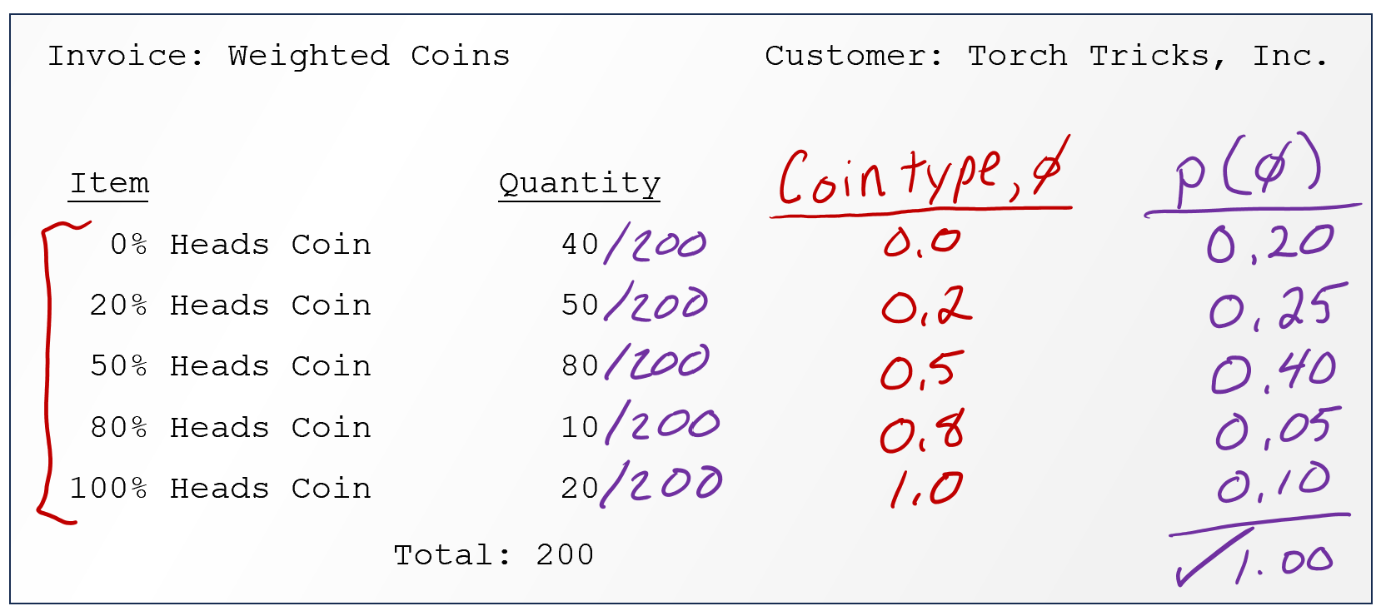

Coin Flipping Example
Trick coin from pre-reading
Initially: no information about the coin, so we just default to a uniform belief about the Bernoulli parameter $φ$

Slide 25
Poll 3
As we collect more and more data (more coin flips), will the peak of the likelihood curve increase or decrease?
Increase
Decrease
I have no idea

Slide 26
Coin Flipping Example
Trick coin from pre-reading
Suppose we discover information about the distribution of trick coin types? How can we use this information both before and after flipping coins?

Slide 27
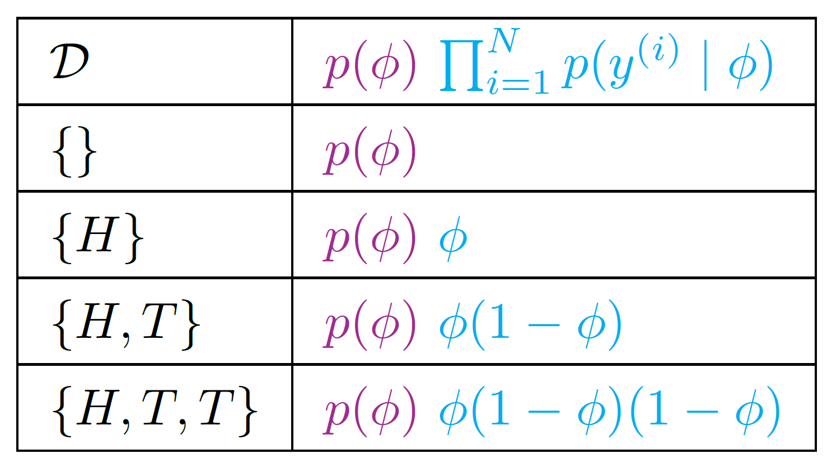
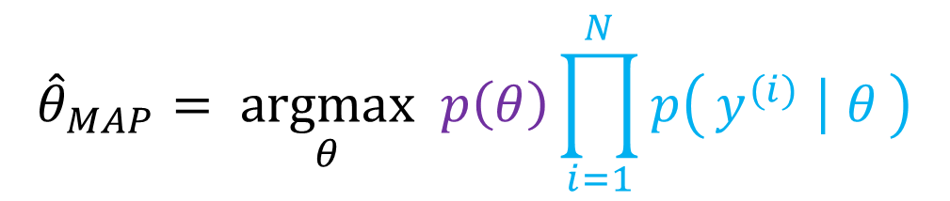
Coin Flipping Example
$${\hat{θ}}_{MAP}= \underset{θ}{argmax} p\left(θ\right)\prod_{i=1}^{N}{p\left(y^{(i)} ∣ θ\right)}$$
Trick coin from pre-reading
Suppose we discover information about the distribution of trick coin types? How can we use this information both before and after flipping coins?

Slide 28

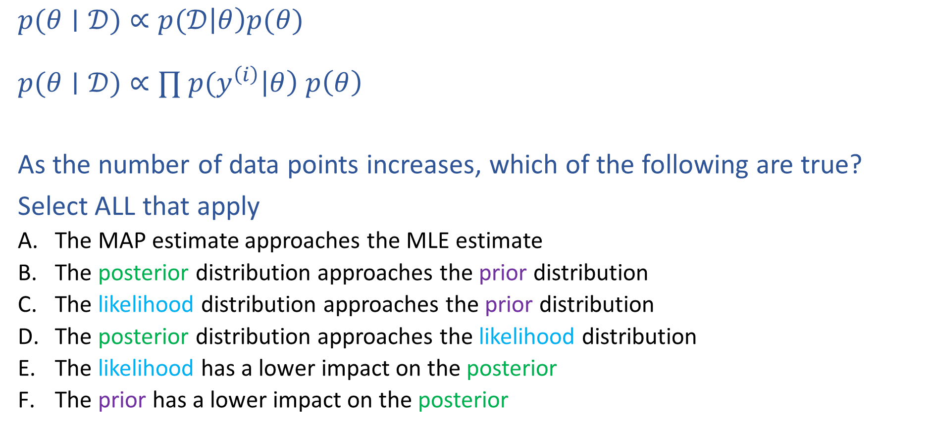
Poll 4
$$posterior∝likelihood⋅prior$$
$p(θ∣𝒟)∝p(𝒟\left|θ\right)p(θ)$
$p(θ∣𝒟)∝∏ p(y^{\left(i\right)}\left|θ\right) p\left(θ\right)$
As the number of data points increases, which of the following are true?
Select ALL that apply
The MAP estimate approaches the MLE estimate
The posterior distribution approaches the prior distribution
The likelihood distribution approaches the prior distribution
The posterior distribution approaches the likelihood distribution
The likelihood has a lower impact on the posterior
The prior has a lower impact on the posterior

Slide 29
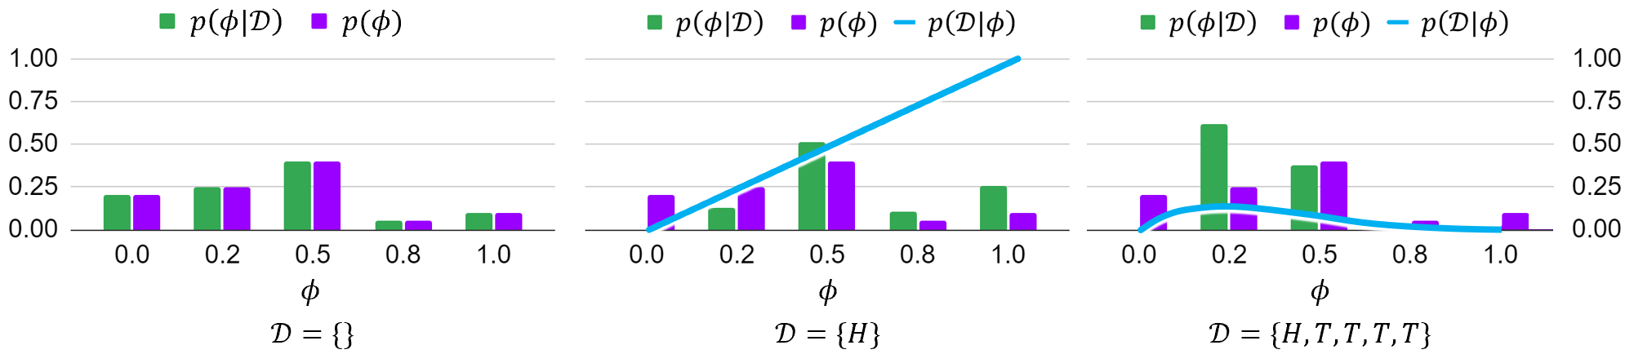

MAP as Data Increases
Given the ordered sequence of coin flip outcomes:
$$p\left(𝒟 ∣ φ\right) p(φ)=\prod_{i}^{N}{p\left(y^{\left(i\right)} ∣ φ\right) p\left(φ\right)} = φ^{N_{y=1}}{\left(1−φ\right)}^{N_{y=0}} p(φ)$$
What happens as we flip more coins?
$N=0: 𝒟=\{\}$

Slide 30

MAP as Data Increases
Given the ordered sequence of coin flip outcomes:
$$p\left(𝒟 ∣ φ\right) p(φ)=\prod_{i}^{N}{p\left(y^{\left(i\right)} ∣ φ\right) p\left(φ\right)} = φ^{N_{y=1}}{\left(1−φ\right)}^{N_{y=0}} p(φ)$$
What happens as we flip more coins?
$N=0: 𝒟=\{H\}$

Slide 31

MAP as Data Increases
Given the ordered sequence of coin flip outcomes:
$$p\left(𝒟 ∣ φ\right) p(φ)=\prod_{i}^{N}{p\left(y^{\left(i\right)} ∣ φ\right) p\left(φ\right)} = φ^{N_{y=1}}{\left(1−φ\right)}^{N_{y=0}} p(φ)$$
What happens as we flip more coins?
$N=0: 𝒟=\{H,T,T,T,T\}$

Slide 32

Prior Distributions for MAP
If the prior $p(θ)$ is uniform, then MLE and MAP are the same!
$$p\left(𝒟 ∣ φ\right) p(φ)=\prod_{i}^{N}{p\left(y^{\left(i\right)} ∣ φ\right) p\left(φ\right)} = φ^{N_{y=1}}{\left(1−φ\right)}^{N_{y=0}} p(φ)$$
https://www.desmos.com/calculator/kr7m2m6cf7

Slide 33
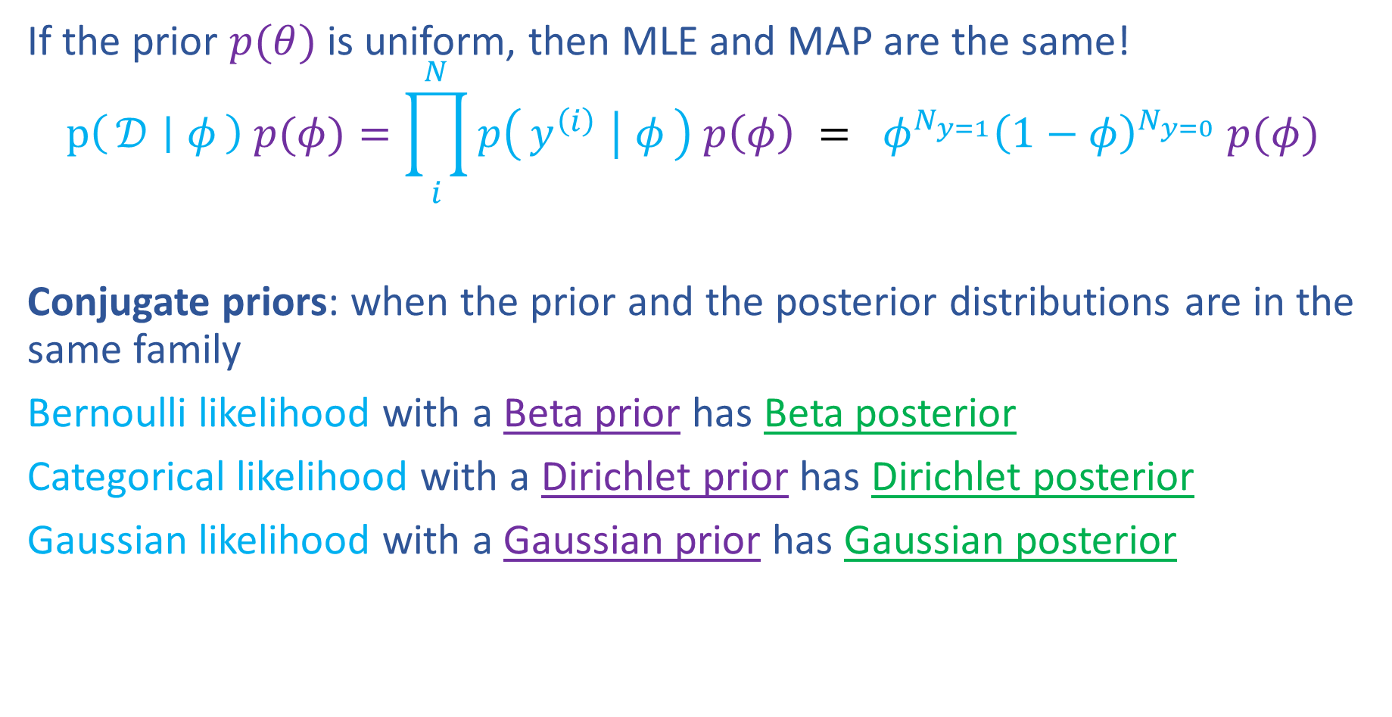
Prior Distributions for MAP
If the prior $p(θ)$ is uniform, then MLE and MAP are the same!
$$p\left(𝒟 ∣ φ\right) p(φ)=\prod_{i}^{N}{p\left(y^{\left(i\right)} ∣ φ\right) p\left(φ\right)} = φ^{N_{y=1}}{\left(1−φ\right)}^{N_{y=0}} p(φ)$$
Conjugate priors: when the prior and the posterior distributions are in the same family
Bernoulli likelihood with a Beta prior has Beta posterior
Categorical likelihood with a Dirichlet prior has Dirichlet posterior
Gaussian likelihood with a Gaussian prior has Gaussian posterior
https://www.desmos.com/calculator/kr7m2m6cf7

Slide 34
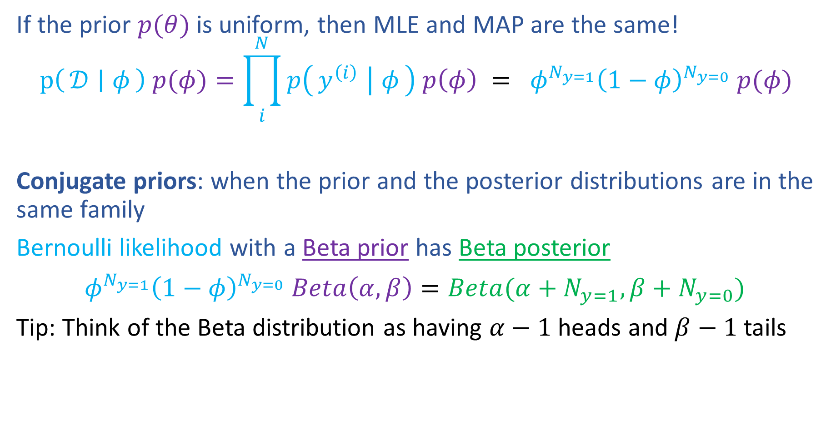
Prior Distributions for MAP
If the prior $p(θ)$ is uniform, then MLE and MAP are the same!
$$p\left(𝒟 ∣ φ\right) p(φ)=\prod_{i}^{N}{p\left(y^{\left(i\right)} ∣ φ\right) p\left(φ\right)} = φ^{N_{y=1}}{\left(1−φ\right)}^{N_{y=0}} p(φ)$$
Conjugate priors: when the prior and the posterior distributions are in the same family
Bernoulli likelihood with a Beta prior has Beta posterior
$φ^{N_{y=1}}{\left(1−φ\right)}^{N_{y=0}} Beta\left(α,β\right)=Beta(α+N_{y=1},β+N_{y=0})$
Tip: Think of the Beta distribution as having $α−1$ heads and $β−1$ tails
https://www.desmos.com/calculator/kr7m2m6cf7

Slide 35

M(C)LE for Linear Regression
Probabilistic interpretation of linear regression
$${\hat{θ}}_{MLE}=\underset{θ}{argmax}\prod_{i}^{N}{p\left(y^{\left(i\right)} ∣ x^{\left(i\right)}, θ\right)}$$

Slide 36
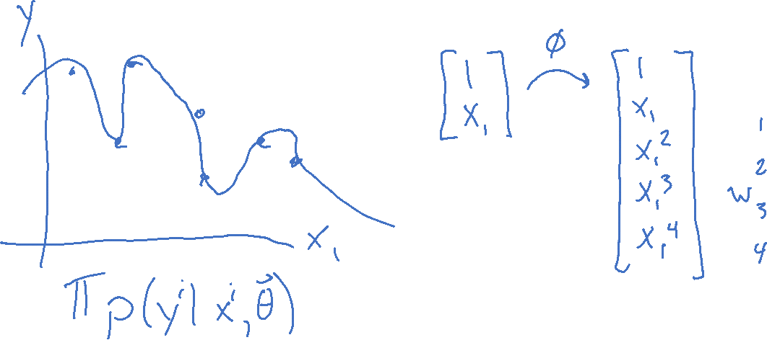
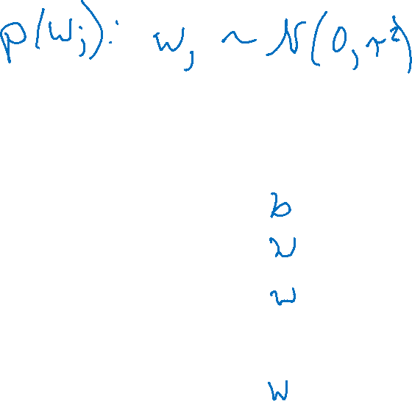
MAP for Linear Regression
What assumptions are we making about our parameters?

Slide 37
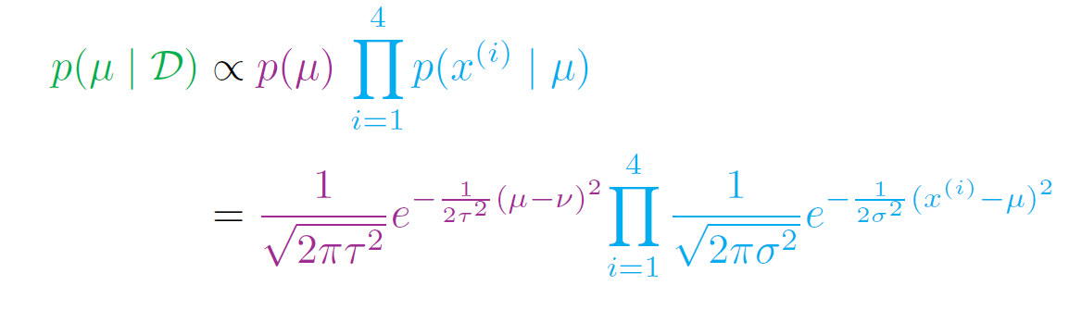
MAP for Linear Regression
Recall prereading example of Gausssian prior for Gaussian likelihood
Linear Regression with Gaussian prior on weights

Slide 38
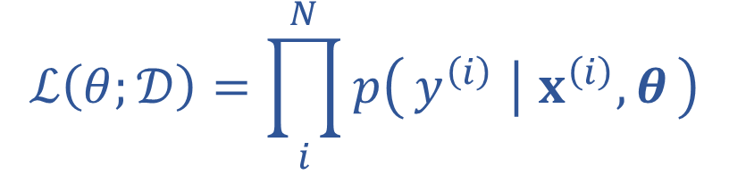
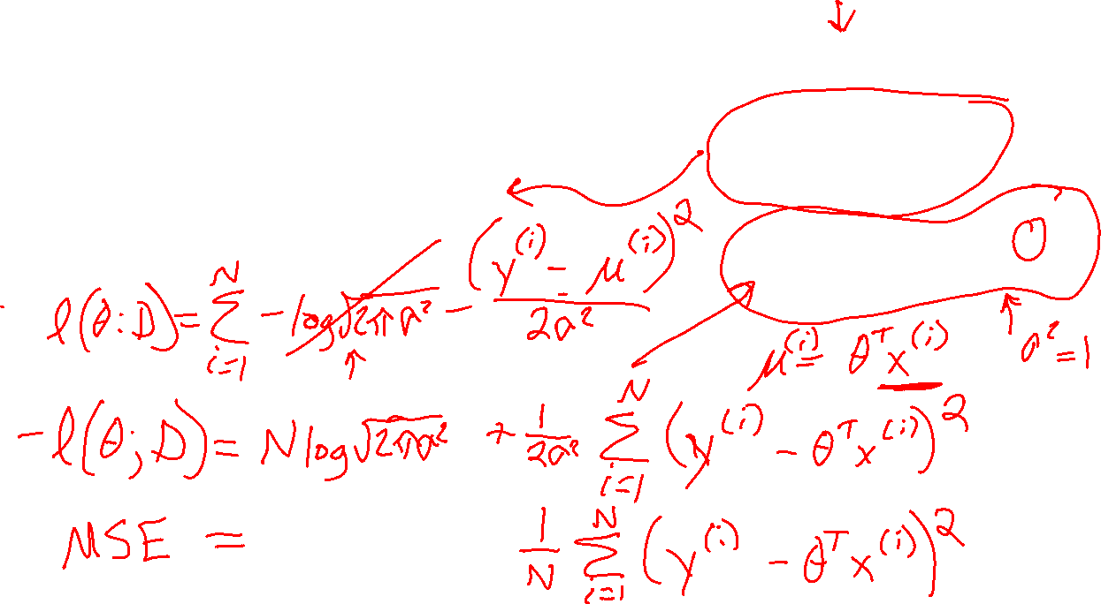
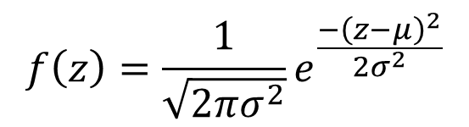
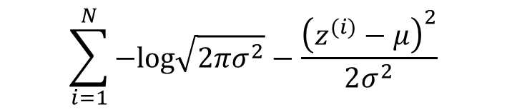
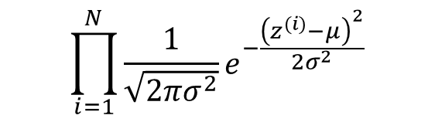
M(C)LE for Linear Regression
$$f\left(z\right)=\frac{1}{\sqrt{2πσ^{2}}}e^{\frac{−{\left(z−μ\right)}^{2}}{2σ^{2}}}$$
Probabilistic interpretation of linear regression
$$\prod_{i=1}^{N}{\frac{1}{\sqrt{2πσ^{2}}}e^{−\frac{{\left(z^{(i)}−μ\right)}^{2}}{2σ^{2}}}}$$
$$ℒ\left(θ;𝒟\right)=\prod_{i}^{N}{p\left(y^{\left(i\right)} ∣ x^{\left(i\right)}, θ\right)}$$
$$\sum_{i=1}^{N}{−log\sqrt{2πσ^{2}}−\frac{{\left(z^{(i)}−μ\right)}^{2}}{2σ^{2}}}$$
RECALL

Slide 39
Regularization and MAP
$$f\left(z\right)=\frac{1}{\sqrt{2πσ^{2}}}e^{\frac{−{\left(z−μ\right)}^{2}}{2σ^{2}}}$$
Linear Regression

Slide 40
Regularization and MAP
Linear Regression

Slide 41
Discriminative and Generative
Sneak peek

Slide 42
Two Applications of Bayes Rule
$$p\left(a ∣ b\right)=\frac{p\left(b ∣ a\right) p(a)}{p(b)}$$
$$p\left(θ ∣ 𝒟\right)=\frac{p\left(𝒟 ∣ θ\right) p(θ)}{p(𝒟)}$$
$$p\left(y ∣ x\right)=\frac{p\left(x ∣ y\right) p(y)}{p(x)}$$

