Slide 1

10-315 Introduction to ML MLE and Probabilistic Formulation of Machine Learning
Instructor: Pat Virtue

Slide 2
Poll 1
Course feedback link on Ed
Are you finished with the course feedback form?
Yes
No
Still working on it

Slide 3
Likelihood
Pre-reading

Slide 4

Likelihood
Likelihood: The probability (or density) of random variable $Y$ taking on value $y$ given the distribution parameters, $θ$.

Slide 5
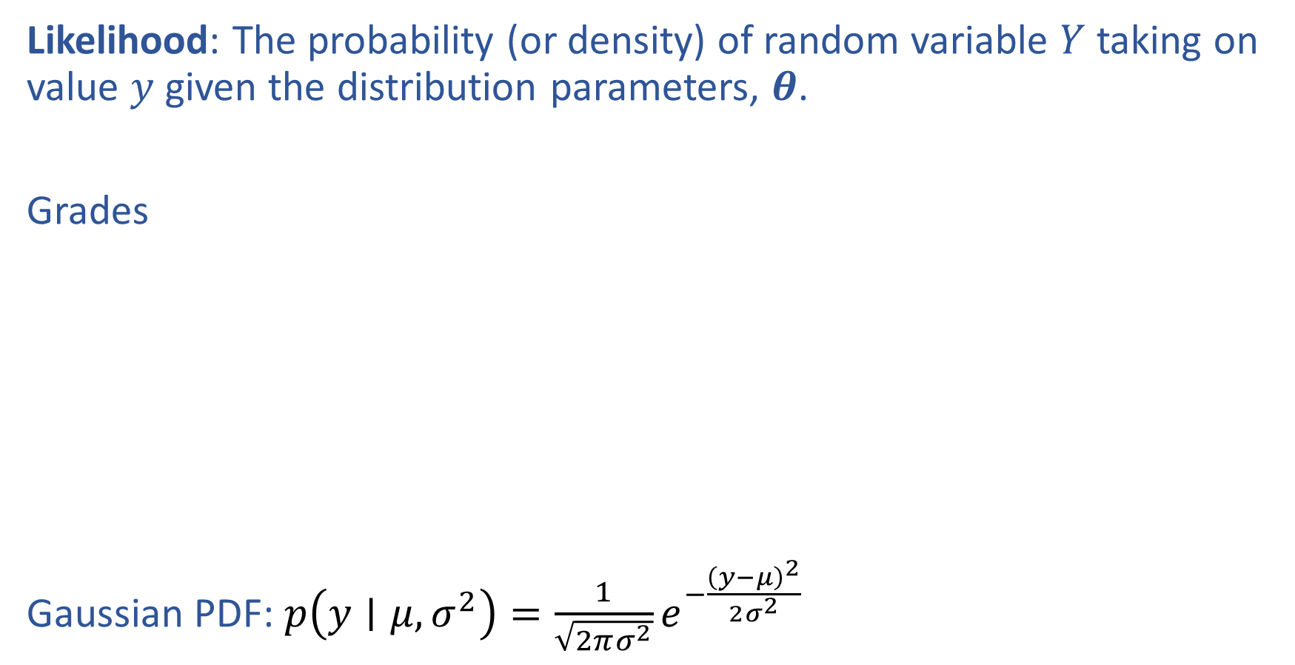
Likelihood
Likelihood: The probability (or density) of random variable $Y$ taking on value $y$ given the distribution parameters, $θ$.
Grades
Gaussian PDF: $p\left(y∣μ, σ^{2}\right)=\frac{1}{\sqrt{2πσ^{2}}}e^{−\frac{{\left(y−μ\right)}^{2}}{2σ^{2}}}$

Slide 6
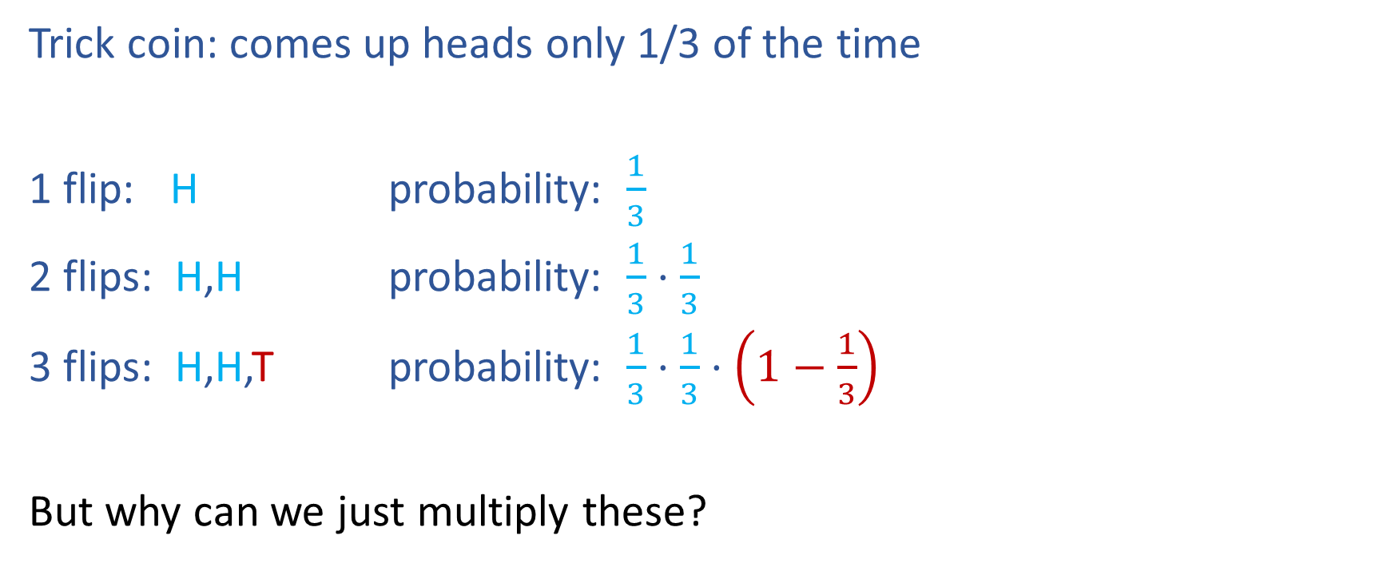
Likelihood
Trick coin: comes up heads only 1/3 of the time
1 flip: H probability: $\frac{1}{3}$
2 flips: H,H probability: $\frac{1}{3}⋅\frac{1}{3}$
3 flips: H,H,T probability: $\frac{1}{3}⋅\frac{1}{3}⋅\left(1−\frac{1}{3}\right)$
But why can we just multiply these?

Slide 7
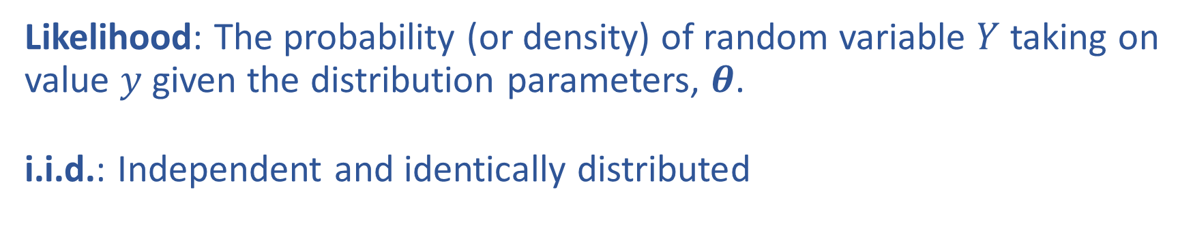
Likelihood and i.i.d
Likelihood: The probability (or density) of random variable $Y$ taking on value $y$ given the distribution parameters, $θ$.
i.i.d.: Independent and identically distributed

Slide 8
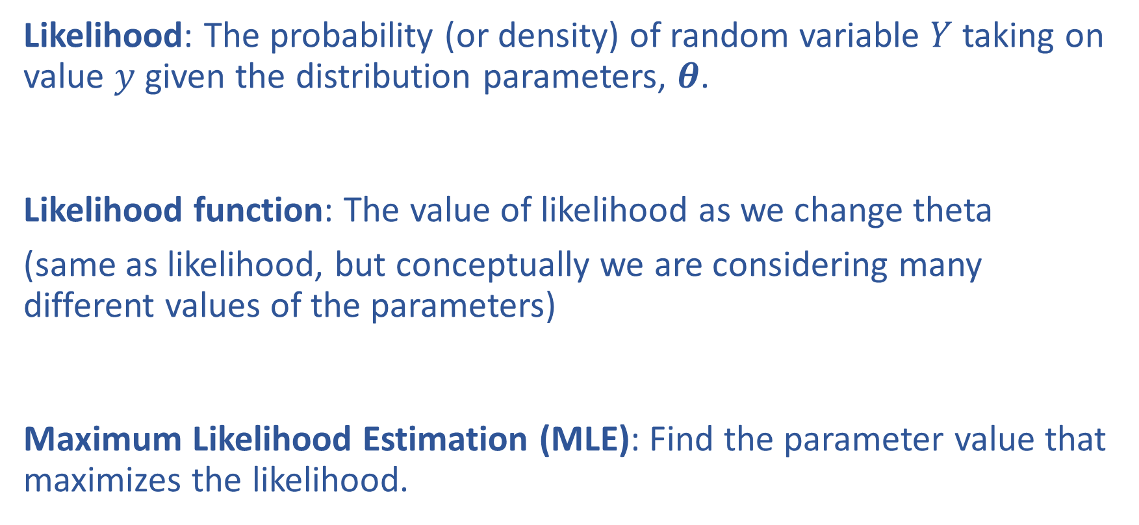
Likelihood and Maximum Likelihood Estimation
Likelihood: The probability (or density) of random variable $Y$ taking on value $y$ given the distribution parameters, $θ$.
Likelihood function: The value of likelihood as we change theta
(same as likelihood, but conceptually we are considering many different values of the parameters)
Maximum Likelihood Estimation (MLE): Find the parameter value that maximizes the likelihood.

Slide 9
From Probability to Statistics

Slide 10
MLE – Logistic Regression

Slide 11
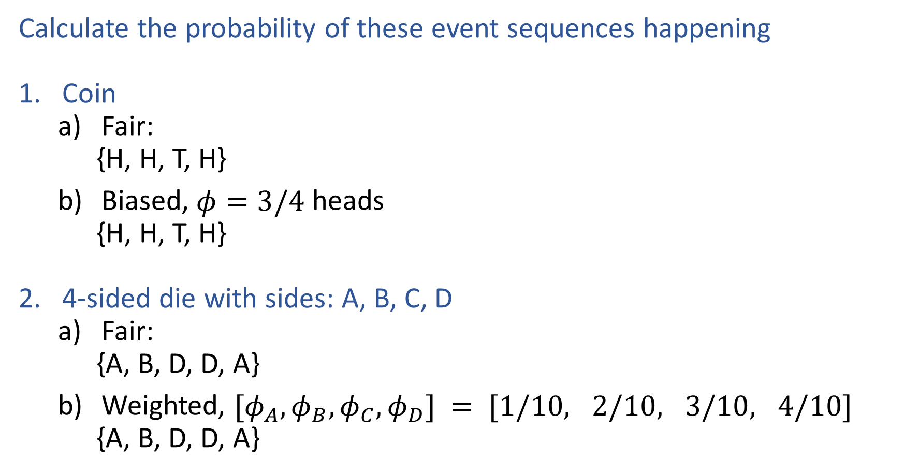
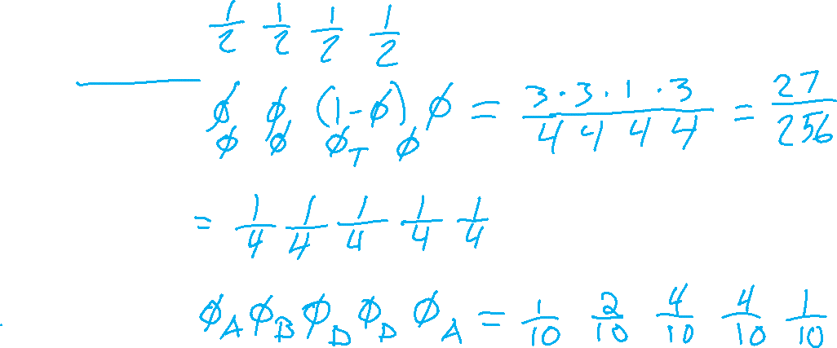
Exercises
Calculate the probability of these event sequences happening
Coin
Fair:
{H, H, T, H}
Biased, $φ=3/4$ heads
{H, H, T, H}
4-sided die with sides: A, B, C, D
Fair:
{A, B, D, D, A}
Weighted, $[φ_{A}, φ_{B},φ_{C}, φ_{D}] = [1/10, 2/10, 3/10, 4/10]$
{A, B, D, D, A}

Slide 12
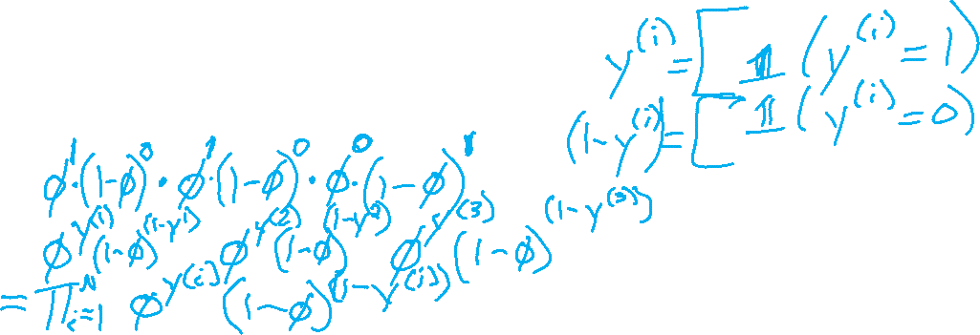
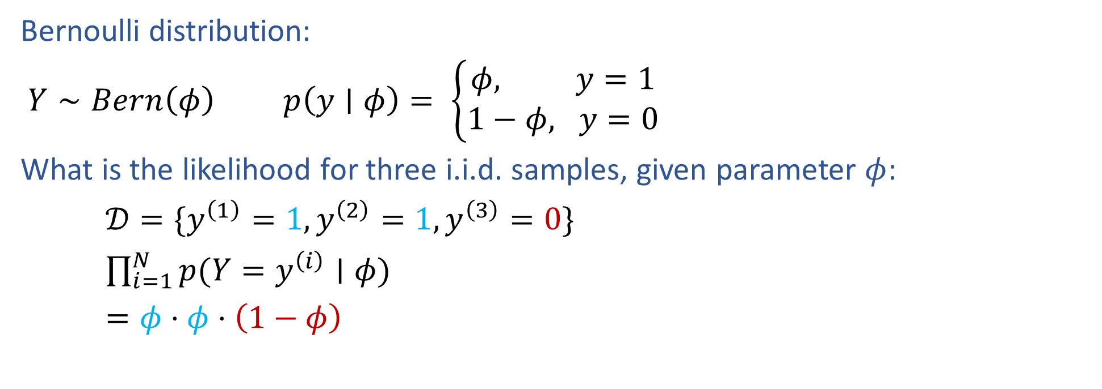
Bernoulli Likelihood
Bernoulli distribution:
$Y∼Bern\left(φ\right)$ $p\left(y∣φ\right)= \left\{\begin{aligned}φ, y=1 \\ 1−φ, y=0\end{aligned}\right.$
What is the likelihood for three i.i.d. samples, given parameter $φ$:
$𝒟=\{y^{\left(1\right)}=1, y^{\left(2\right)}=1,y^{\left(3\right)}=0\}$
$\prod_{i=1}^{N}{p(Y=y^{\left(i\right)}∣φ)}$
$=φ⋅φ⋅\left(1−φ\right)$

Slide 13
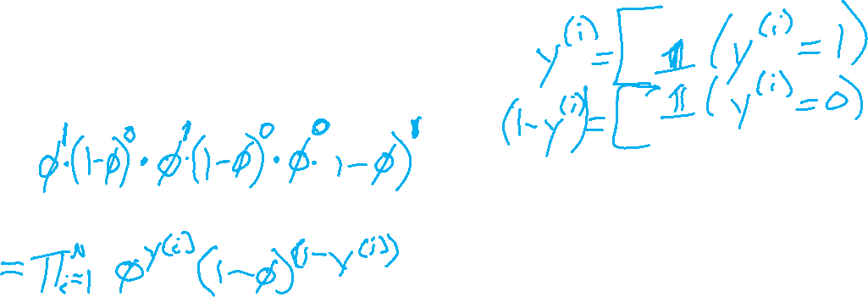
Bernoulli Likelihood
Bernoulli distribution:
$Y∼Bern\left(φ\right)$ $p\left(y∣φ\right)= \left\{\begin{aligned}φ, y=1 \\ 1−φ, y=0\end{aligned}\right.$
What is the likelihood for three i.i.d. samples, given parameter $φ$:
$𝒟=\{y^{\left(1\right)}=1, y^{\left(2\right)}=1,y^{\left(3\right)}=0\}$
$\prod_{i=1}^{N}{p(Y=y^{\left(i\right)}∣φ)}$
$=φ⋅φ⋅\left(1−φ\right)$

Slide 14
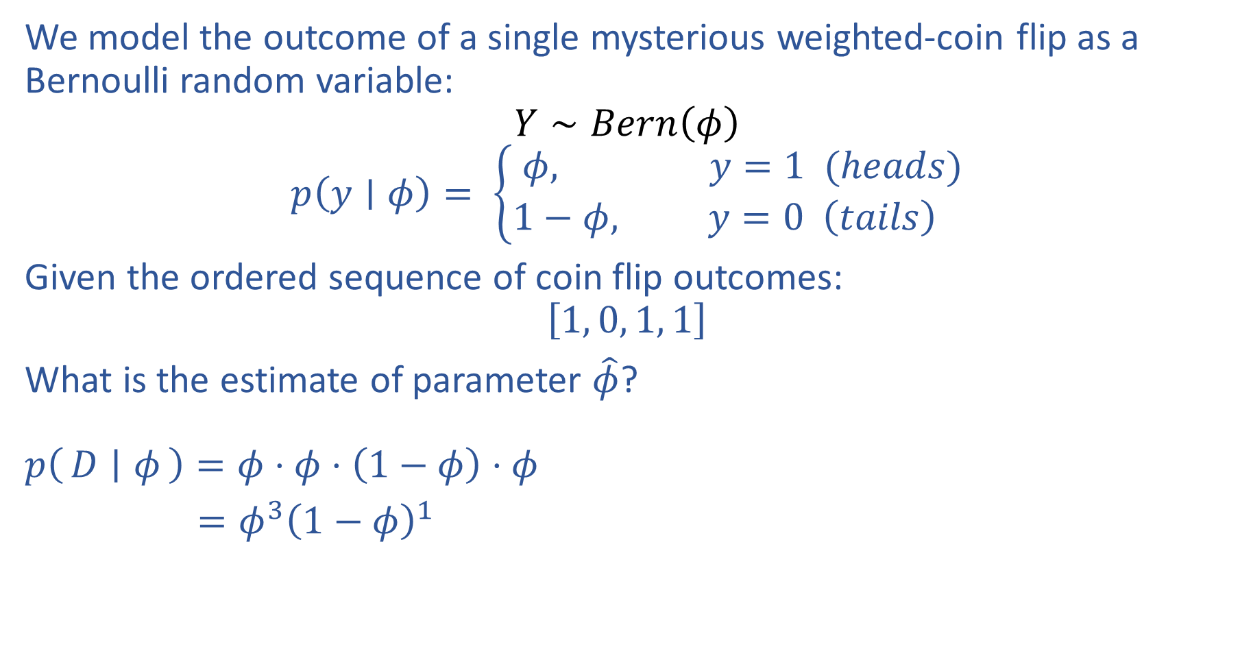
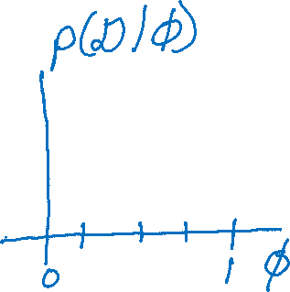
Estimating Parameters with Likelihood
We model the outcome of a single mysterious weighted-coin flip as a Bernoulli random variable:
$$Y∼Bern\left(φ\right)$$
$$p\left(y∣φ\right)= \left\{\begin{aligned}φ, y=1 (heads) \\ 1−φ, y=0 \left(tails\right) \end{aligned}\right.$$
Given the ordered sequence of coin flip outcomes:
$$\left[1, 0, 1, 1\right]$$
What is the estimate of parameter $\hat{φ}$?
$p\left(D ∣ φ\right)=φ⋅φ⋅\left(1−φ\right)⋅φ$
$=φ^{3}{\left(1−φ\right)}^{1}$
https://www.desmos.com/calculator/kr7m2m6cf7

Slide 15
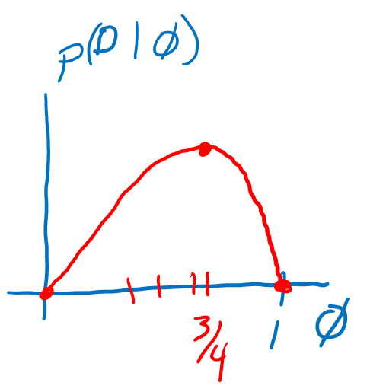

MLE as Data Increases
Given the ordered sequence of coin flip outcomes:
$$\left[1, 0, 1, 1\right]$$
$$p(𝒟∣φ)=\prod_{i}^{N}{p\left(y^{\left(i\right)} ∣ φ\right)} = φ^{N_{y=1}}{\left(1−φ\right)}^{N_{y=0}}$$
What happens as we flip more coins?
https://www.desmos.com/calculator/kr7m2m6cf7

Slide 16
MLE for Categorical

Slide 17

M(C)LE for Logistic Regression
Learn to predict if a patient has cancer ($Y=1$) or not ($Y=0$) given the input of just one test results, $X_{A}$ and $X_{B}$
$${\hat{θ}}_{MLE}=\underset{θ}{argmax}\prod_{i}^{N}{p\left(y^{\left(i\right)} ∣ x^{\left(i\right)}, θ\right)}$$

Slide 18
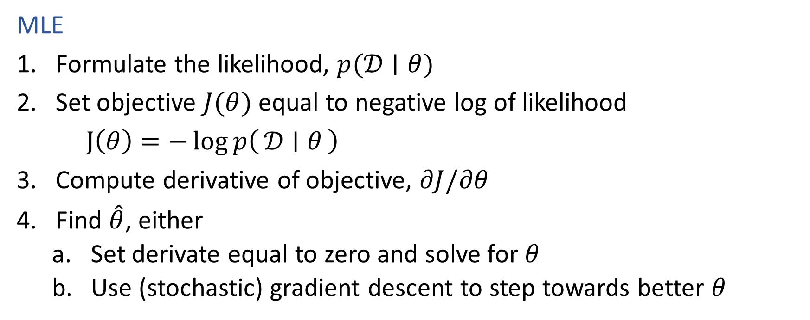
Recipe for Estimation
MLE
Formulate the likelihood, $p(𝒟∣θ)$
Set objective $J(θ)$ equal to negative log of likelihood
$J\left(θ\right)=−\log{p\left(𝒟 ∣ θ\right)}$
Compute derivative of objective, $∂J/∂θ$
Find $\hat{θ}$, either
Set derivate equal to zero and solve for $θ$
Use (stochastic) gradient descent to step towards better $θ$

Slide 19

M(C)LE for Multi-class Logistic Regression
Learn to predict if probability of output belonging to class $k$, $Y_{k}$ , given input $X$, $P(Y_{k}=1∣X, θ_{1}, …, θ_{K})$

Slide 20

M(C)LE for Multi-class Logistic Regression
Learn to predict if probability of output belonging to class $k$, $Y_{k}$ , given input $X$, $P(Y_{k}=1∣X, θ_{1}, …, θ_{K})$
$$ℒ\left(Θ;𝒟\right)=\prod_{i}^{N}{\prod_{k}^{K}{{\frac{{e^{θ_{k}^{T}x}}^{\left(i\right)}}{\sum_{l=1}^{K}{{e^{θ_{l}^{T}x}}^{\left(i\right)}}}}^{𝕀\left(y_{k}^{\left(i\right)}=1\right)}}}$$

Slide 21
MLE – Linear Regression

Slide 22
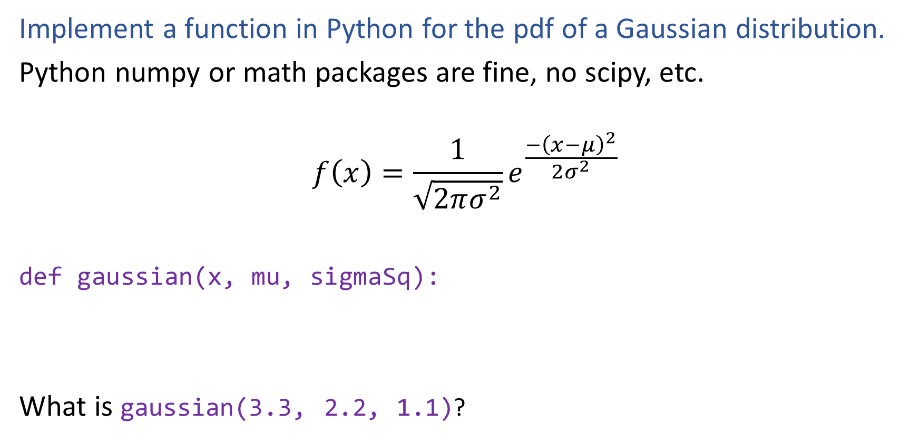
Poll
Implement a function in Python for the pdf of a Gaussian distribution.
Python numpy or math packages are fine, no scipy, etc.
$$f\left(x\right)=\frac{1}{\sqrt{2πσ^{2}}}e^{\frac{−{\left(x−μ\right)}^{2}}{2σ^{2}}}$$
def gaussian(x, mu, sigmaSq):
What is gaussian(3.3, 2.2, 1.1)?

Slide 23
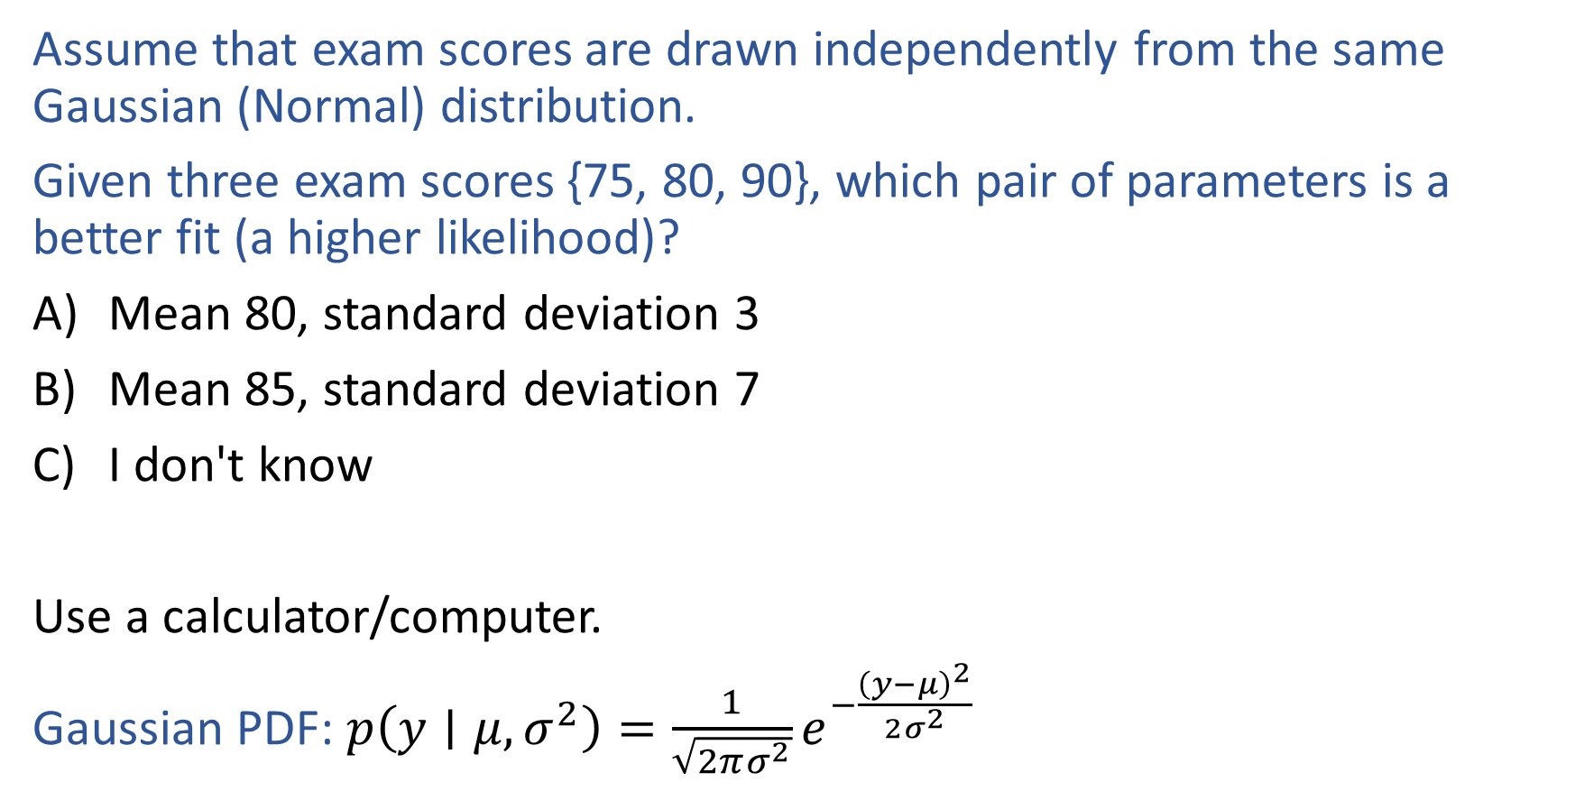
Poll
Assume that exam scores are drawn independently from the same Gaussian (Normal) distribution.
Given three exam scores {75, 80, 90}, which pair of parameters is a better fit (a higher likelihood)?
Mean 80, standard deviation 3
Mean 85, standard deviation 7
I don't know
Use a calculator/computer.
Gaussian PDF: $p\left(y∣μ, σ^{2}\right)=\frac{1}{\sqrt{2πσ^{2}}}e^{−\frac{{\left(y−μ\right)}^{2}}{2σ^{2}}}$

Slide 24
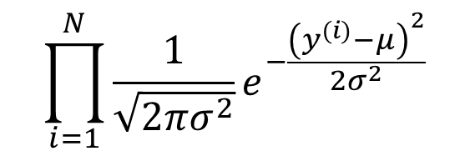
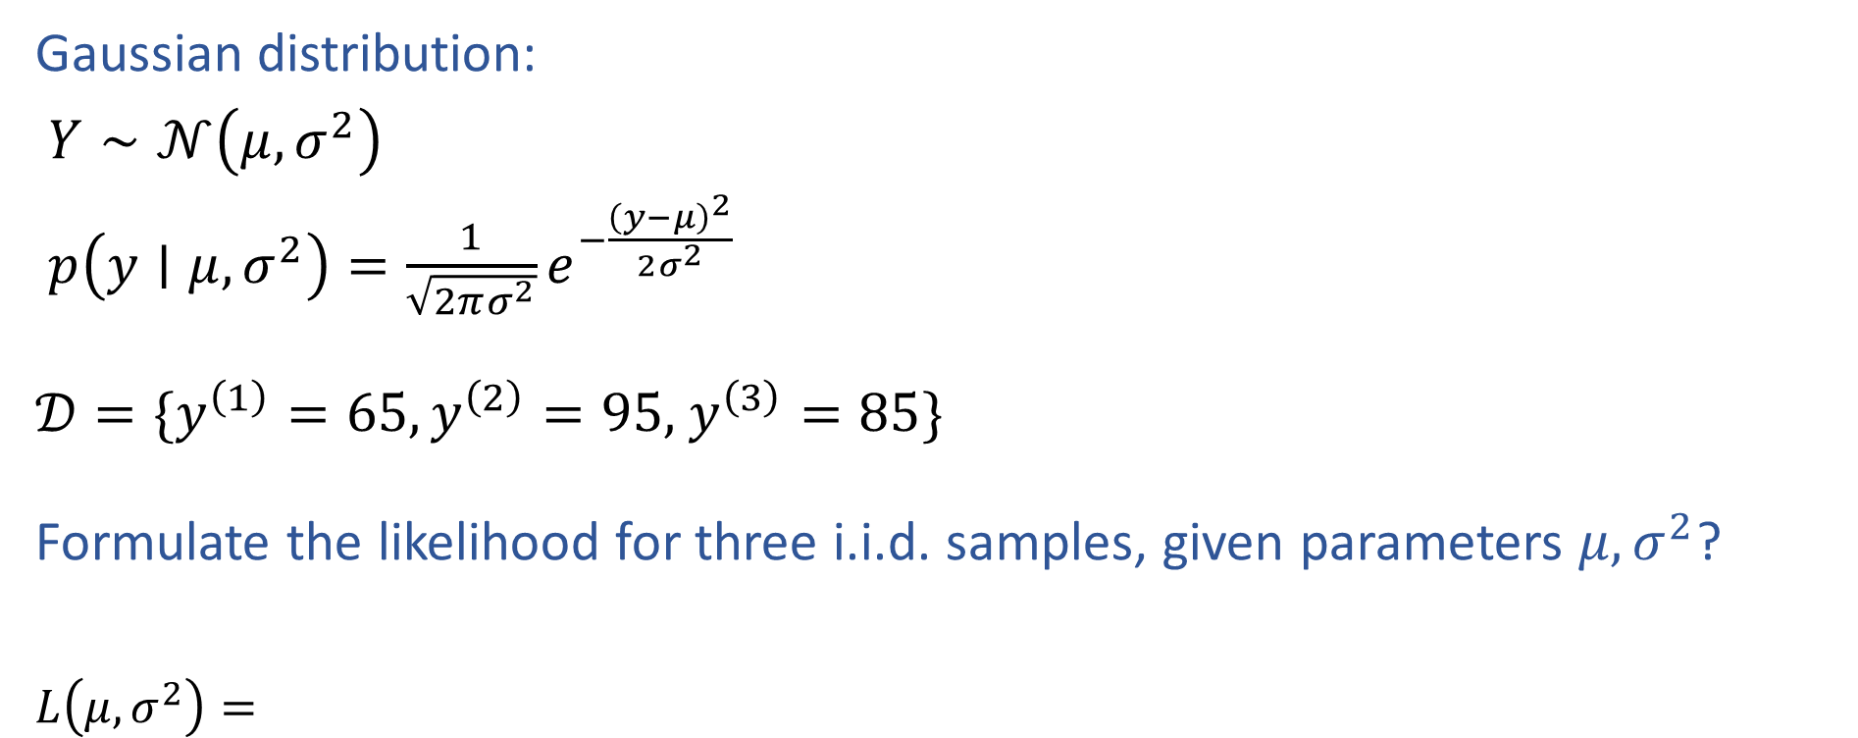
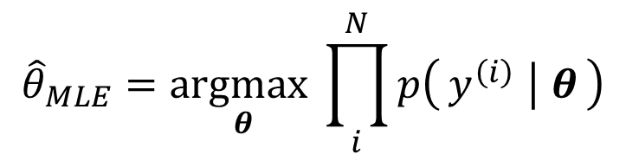
MLE for Gaussian
Gaussian distribution:
$Y∼𝒩\left(μ, σ^{2}\right)$
$p\left(y∣μ, σ^{2}\right)=\frac{1}{\sqrt{2πσ^{2}}}e^{−\frac{{\left(y−μ\right)}^{2}}{2σ^{2}}}$
$𝒟=\{y^{\left(1\right)}=65,y^{\left(2\right)}=95,$ $y^{\left(3\right)}=85\}$
Formulate the likelihood for three i.i.d. samples, given parameters $μ, σ^{2}$?
$L\left(μ, σ^{2}\right)=$
$$\prod_{i=1}^{N}{\frac{1}{\sqrt{2πσ^{2}}}e^{−\frac{{\left(y^{(i)}−μ\right)}^{2}}{2σ^{2}}}}$$
$${\hat{θ}}_{MLE}=\underset{θ}{argmax}\prod_{i}^{N}{p\left(y^{\left(i\right)} ∣ θ\right)}$$

Slide 25
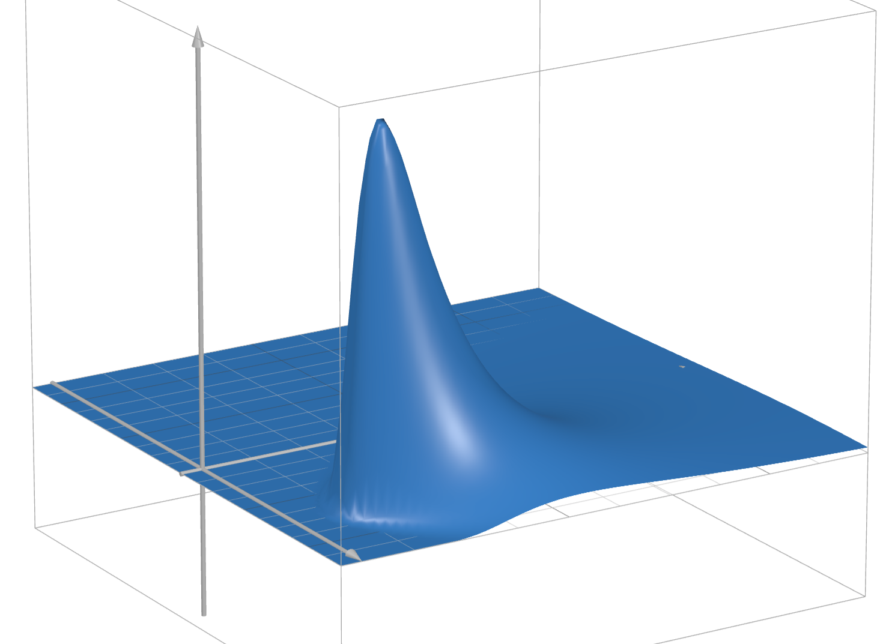
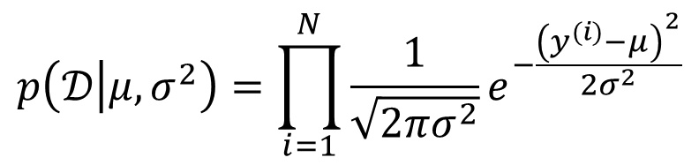
MLE for Gaussian
Assume that exam scores are drawn independently from the same Gaussian (Normal) distribution.
Given three exam scores 2, 3, 4, which pair of parameters is the best fit (the highest likelihood)?
$$p\left(𝒟 | μ, σ^{2}\right)=\prod_{i=1}^{N}{\frac{1}{\sqrt{2πσ^{2}}}e^{−\frac{{\left(y^{(i)}−μ\right)}^{2}}{2σ^{2}}}}$$
https://www.desmos.com/3d/988327bd26

Slide 26
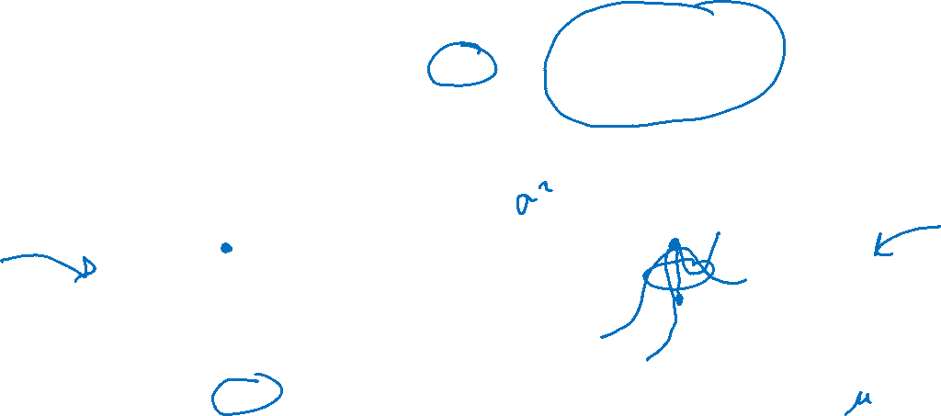
MLE
Principle of Maximum Likelihood Estimation:
Choose the parameters that maximize the likelihood of the data.
Maximum Likelihood Estimate (MLE)
θ₂
θ^{MLE}
L(θ)
L(θ₁, θ₂)
θ^{MLE}
θ₁
Slide credit: CMU MLD Matt Gormley

Slide 27
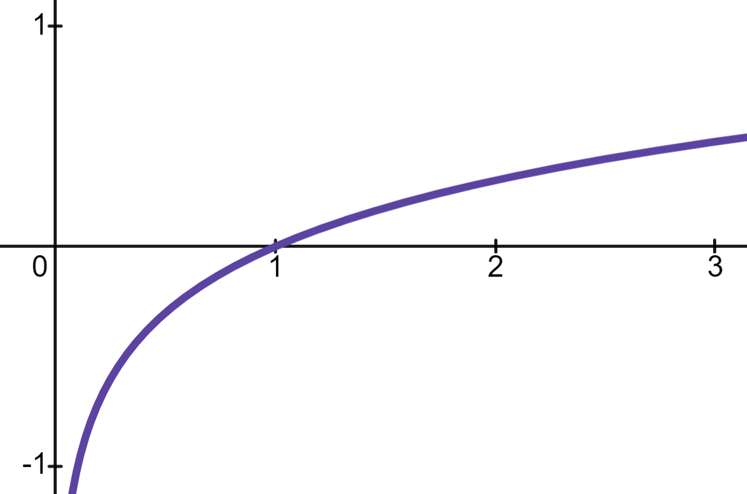
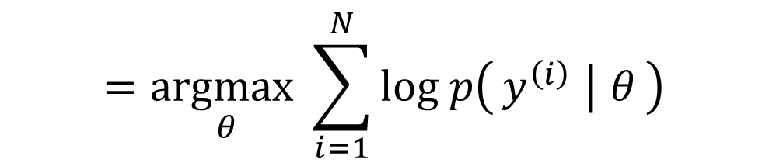
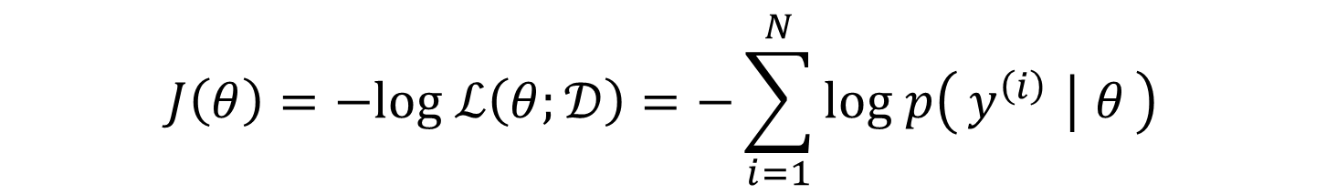
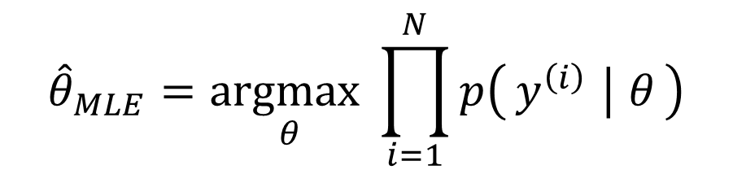
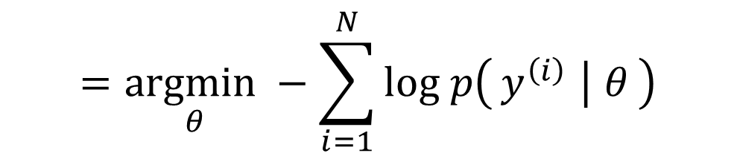

Why Log Likelihood?
Log is monotonic:
If $a < b$
then $\log{a}<\log{b}$
Updating our objective: Minimize neg. log likelihood
$${\hat{θ}}_{MLE}=\underset{θ}{argmax}\prod_{i=1}^{N}{p\left(y^{\left(i\right)} ∣ θ\right)}$$
$$=\underset{θ}{argmax}\sum_{i=1}^{N}{log p\left(y^{\left(i\right)} ∣ θ\right)}$$
$$=\underset{θ}{argmin}−\sum_{i=1}^{N}{log p\left(y^{\left(i\right)} ∣ θ\right)}$$
$$J\left(θ\right)=−log ℒ\left(θ;𝒟\right)=−\sum_{i=1}^{N}{log p\left(y^{\left(i\right)} ∣ θ\right)}$$
Minimize

Slide 28

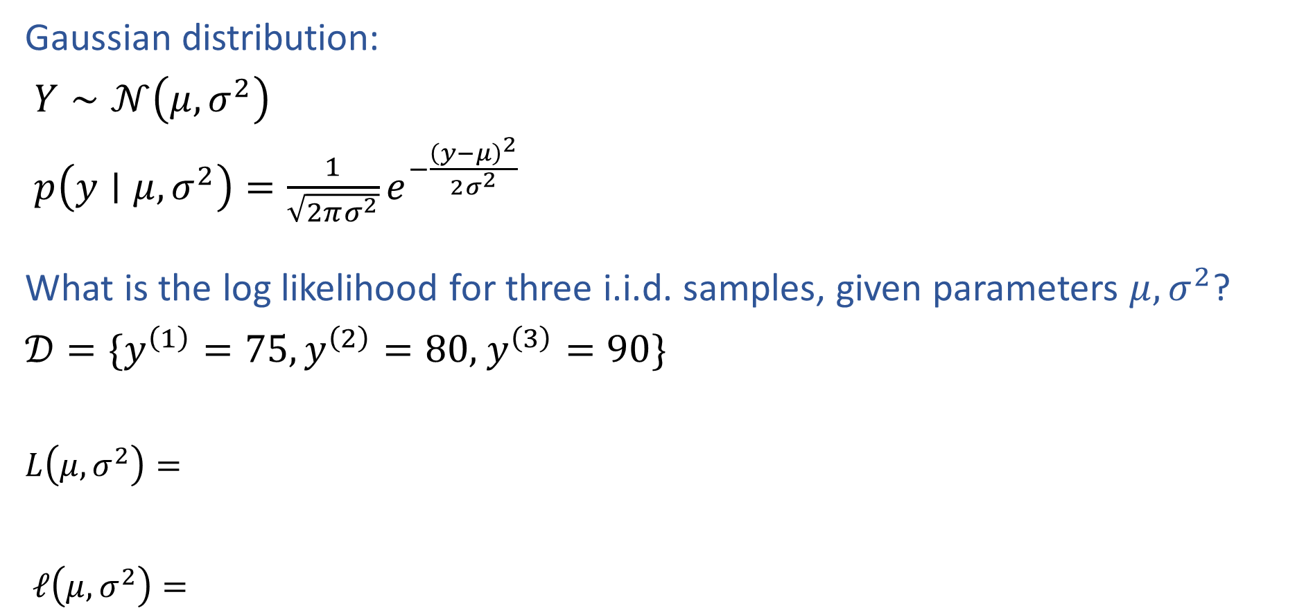
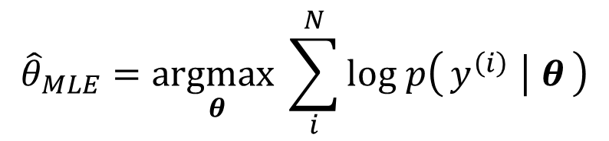
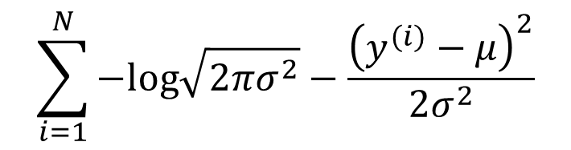
MLE for Gaussian
Gaussian distribution:
$Y∼𝒩\left(μ, σ^{2}\right)$
$p\left(y∣μ, σ^{2}\right)=\frac{1}{\sqrt{2πσ^{2}}}e^{−\frac{{\left(y−μ\right)}^{2}}{2σ^{2}}}$
What is the log likelihood for three i.i.d. samples, given parameters $μ, σ^{2}$?
$𝒟=\{y^{\left(1\right)}=75,y^{\left(2\right)}=80,$ $y^{\left(3\right)}=90\}$
$L\left(μ, σ^{2}\right)=$
$ℓ\left(μ, σ^{2}\right)=$
$$\prod_{i=1}^{N}{\frac{1}{\sqrt{2πσ^{2}}}e^{−\frac{{\left(y^{(i)}−μ\right)}^{2}}{2σ^{2}}}}$$
$${\hat{θ}}_{MLE}=\underset{θ}{argmax}\prod_{i}^{N}{p\left(y^{\left(i\right)} ∣ θ\right)}$$
$$\sum_{i=1}^{N}{−log\sqrt{2πσ^{2}}−\frac{{\left(y^{(i)}−μ\right)}^{2}}{2σ^{2}}}$$
$${\hat{θ}}_{MLE}=\underset{θ}{argmax}\sum_{i}^{N}{log p\left(y^{\left(i\right)} ∣ θ\right)}$$

Slide 29
Recipe for Estimation
MLE
Formulate the likelihood, $p(𝒟∣θ)$
Set objective $J(θ)$ equal to negative log of likelihood
$J\left(θ\right)=−\log{p\left(𝒟 ∣ θ\right)}$
Compute derivative of objective, $∂J/∂θ$
Find $\hat{θ}$, either
Set derivate equal to zero and solve for $θ$
Use (stochastic) gradient descent to step towards better $θ$

Slide 30
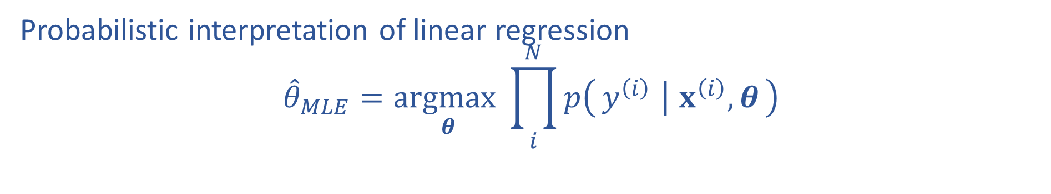
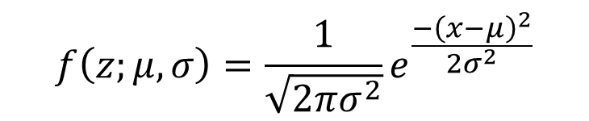
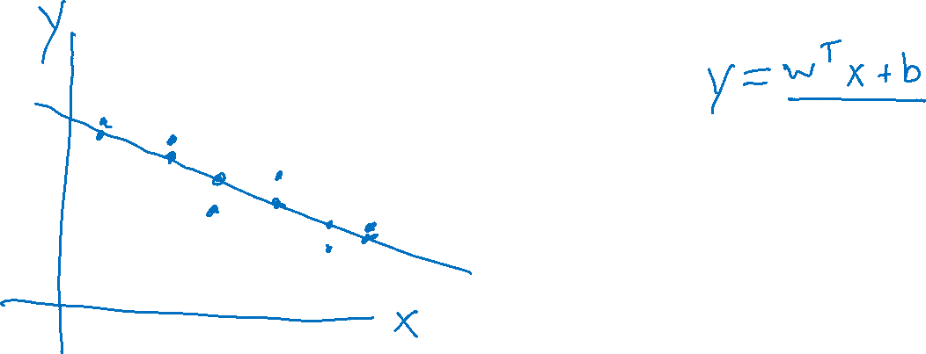
M(C)LE for Linear Regression
$$f\left(z;μ,σ\right)=\frac{1}{\sqrt{2πσ^{2}}}e^{\frac{−{\left(x−μ\right)}^{2}}{2σ^{2}}}$$
Probabilistic interpretation of linear regression
$${\hat{θ}}_{MLE}=\underset{θ}{argmax}\prod_{i}^{N}{p\left(y^{\left(i\right)} ∣ x^{\left(i\right)}, θ\right)}$$

Slide 31
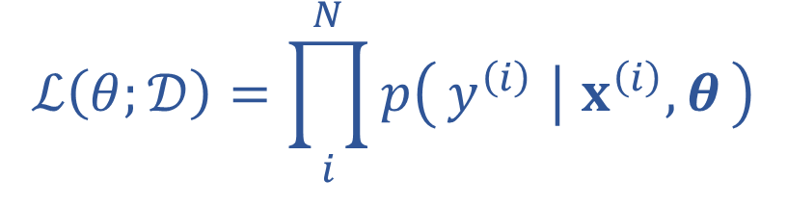
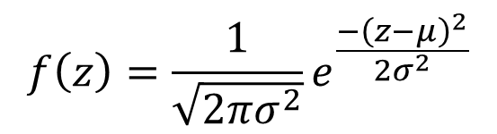
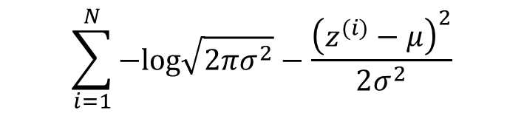
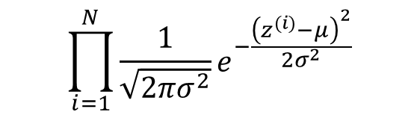
M(C)LE for Linear Regression
$$f\left(z\right)=\frac{1}{\sqrt{2πσ^{2}}}e^{\frac{−{\left(z−μ\right)}^{2}}{2σ^{2}}}$$
Probabilistic interpretation of linear regression
$$\prod_{i=1}^{N}{\frac{1}{\sqrt{2πσ^{2}}}e^{−\frac{{\left(z^{(i)}−μ\right)}^{2}}{2σ^{2}}}}$$
$$ℒ\left(θ;𝒟\right)=\prod_{i}^{N}{p\left(y^{\left(i\right)} ∣ x^{\left(i\right)}, θ\right)}$$
$$\sum_{i=1}^{N}{−log\sqrt{2πσ^{2}}−\frac{{\left(z^{(i)}−μ\right)}^{2}}{2σ^{2}}}$$

