Slide 1


10-315 Introduction to ML Regularization
Instructor: Pat Virtue

Slide 2
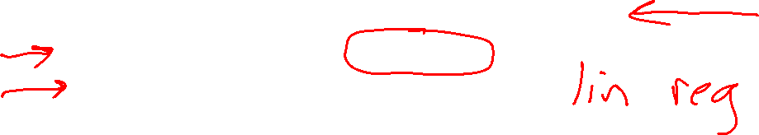
Plan
Today
Regularization
(Make sure they aren’t too powerful ☺)
Regularization with L2 norm
Regularization optimization
Regularization with L1 norm

Slide 3
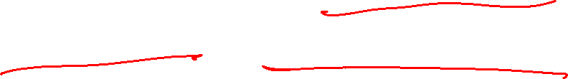
Regularization with L2 norm
Example: Linear regression with polynomial features

Slide 4
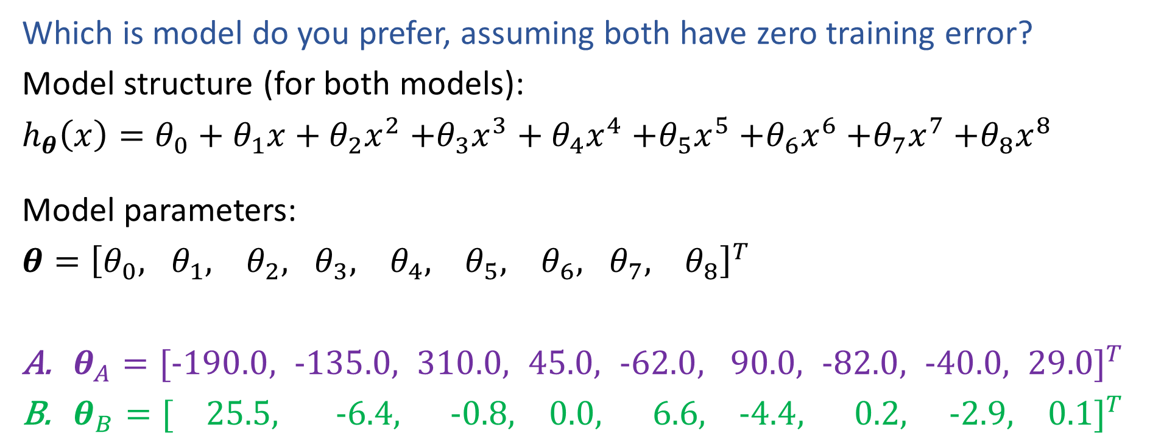
Poll 1
Which is model do you prefer, assuming both have zero training error?
Model structure (for both models):
$h_{θ}\left(x\right)=θ_{0}+θ_{1}x+θ_{2}x^{2}$ $+θ_{3}x^{3}+θ_{4}x^{4}$ $+θ_{5}x^{5}$ $+θ_{6}x^{6}$ $+θ_{7}x^{7}$ $+θ_{8}x^{8}$
Model parameters:
$θ={\left[θ_{0}, θ_{1}, θ_{2}, θ_{3}, θ_{4}, θ_{5}, θ_{6}, θ_{7}, θ_{8}\right]}^{T}$
$θ_{A}={[−190.0, −135.0, 310.0, 45.0, −62.0, 90.0, −82.0, −40.0, 29.0]}^{T}$
$θ_{B}={[ 25.5, −6.4, −0.8, 0.0, 6.6, −4.4, 0.2, −2.9, 0.1]}^{T}$

Slide 5
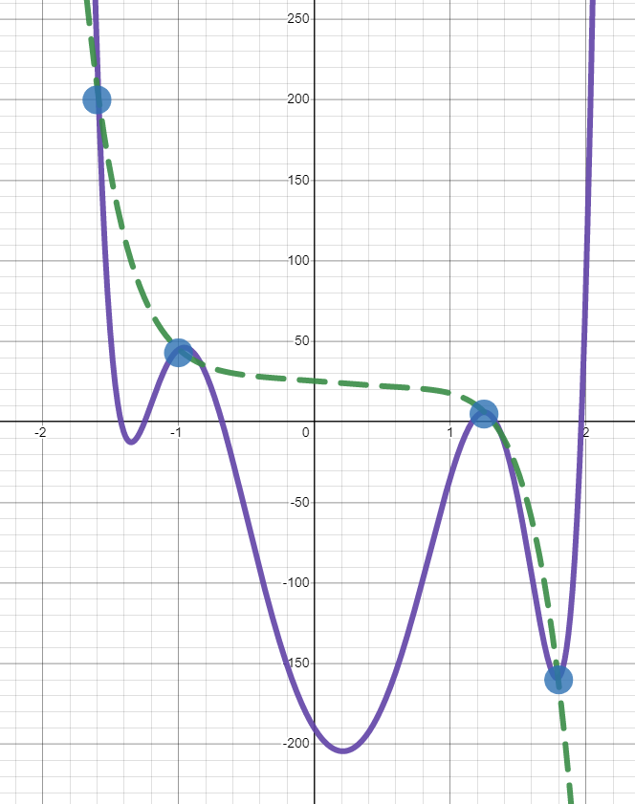
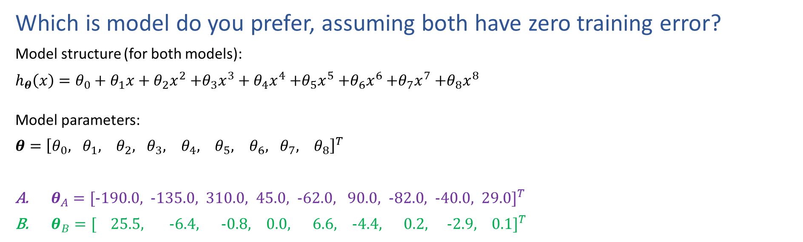
Poll 1
Which is model do you prefer, assuming both have zero training error?
Model structure (for both models):
$h_{θ}\left(x\right)=θ_{0}+θ_{1}x+θ_{2}x^{2}$ $+θ_{3}x^{3}+θ_{4}x^{4}$ $+θ_{5}x^{5}$ $+θ_{6}x^{6}$ $+θ_{7}x^{7}$ $+θ_{8}x^{8}$
Model parameters:
$θ={\left[θ_{0}, θ_{1}, θ_{2}, θ_{3}, θ_{4}, θ_{5}, θ_{6}, θ_{7}, θ_{8}\right]}^{T}$
$θ_{A}={[−190.0, −135.0, 310.0, 45.0, −62.0, 90.0, −82.0, −40.0, 29.0]}^{T}$
$θ_{B}={[ 25.5, −6.4, −0.8, 0.0, 6.6, −4.4, 0.2, −2.9, 0.1]}^{T}$

Slide 6
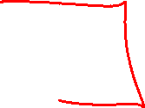
Overfitting
Definition: The problem of overfitting is when the model captures the noise in the training data instead of the underlying structure
Overfitting can occur in all the models we’ve seen so far:
Decision Trees (e.g. when tree is too deep)
K-NN (e.g. when k is small)
Linear Regression (e.g. with nonlinear features or extraneous features)
Logistic Regression (e.g. with nonlinear features or extraneous features)
Neural networks
Slide credit: CMU MLD Matt Gormley

Slide 7
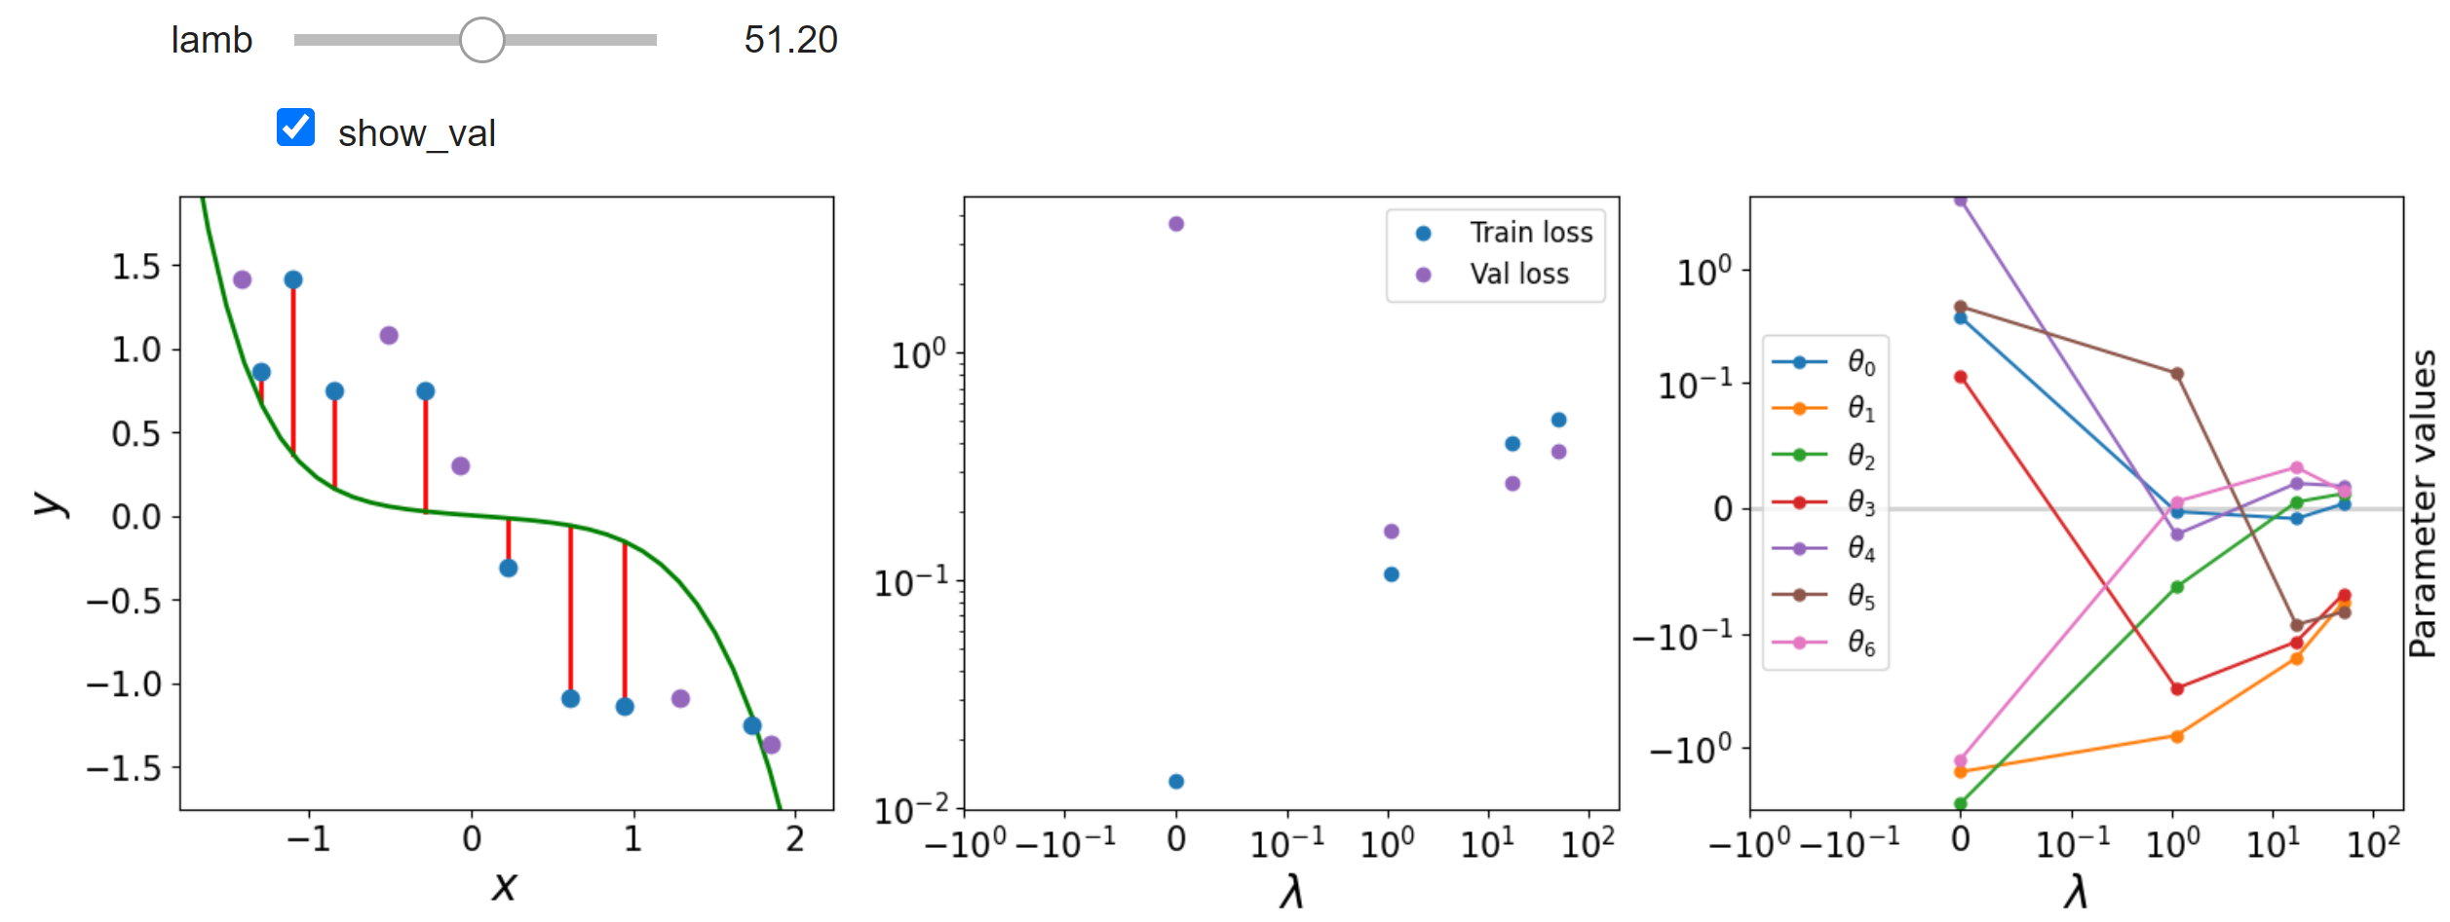
Best of both worlds
How can we keep the expressive power of a complex model while still avoiding overfitting?
Notebook demo: regression_regularization.ipynb

Slide 8
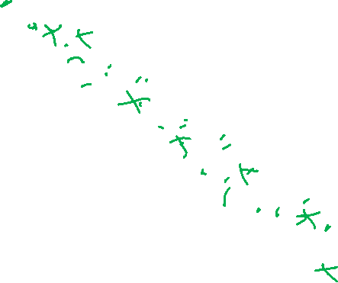
Example: Linear Regression
Goal: Learn y = w^{T} f(x) + b
where f(.) is a polynomial basis function
y | x | x² | … | x⁹
2.0 | 1.2 | (1.2)² | … | (1.2)⁹
1.3 | 1.7 | (1.7)² | … | (1.7)⁹
0.1 | 2.7 | (2.7)² | … | (2.7)⁹
1.1 | 1.9 | (1.9)² | … | (1.9)⁹
y
Slide credit: CMU MLD Matt Gormley
true “unknown” target function is linear with negative slope and gaussian noise
x

Slide 9
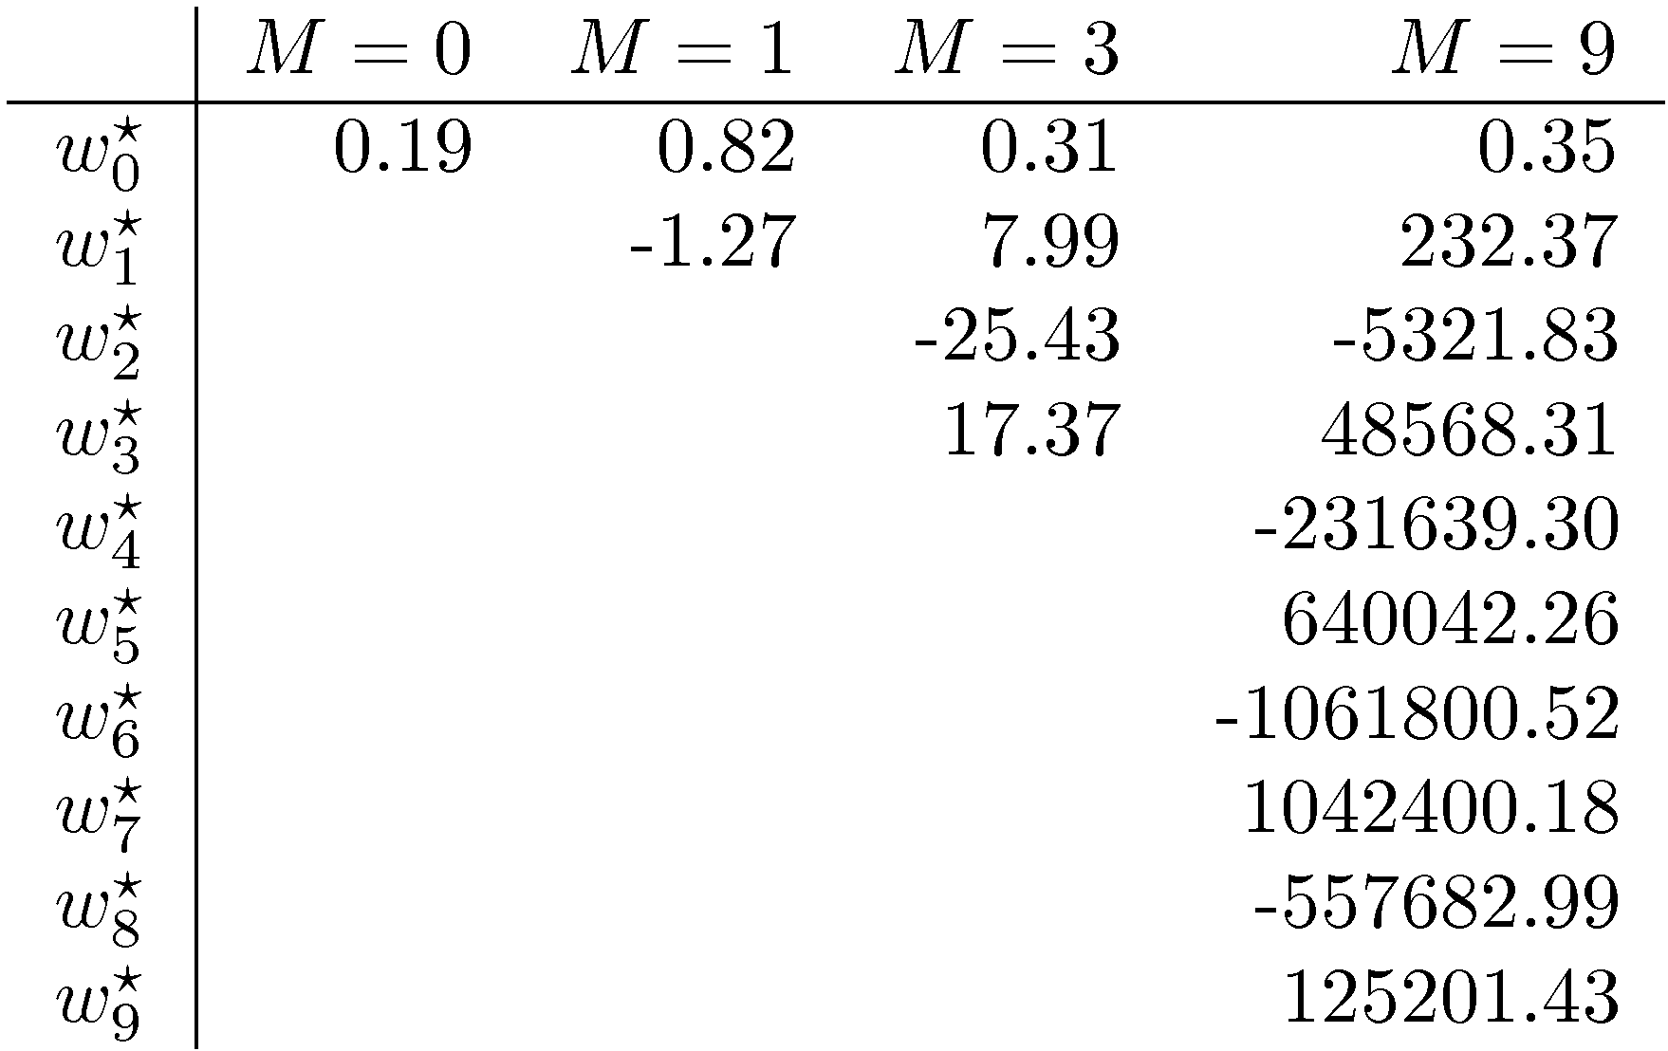
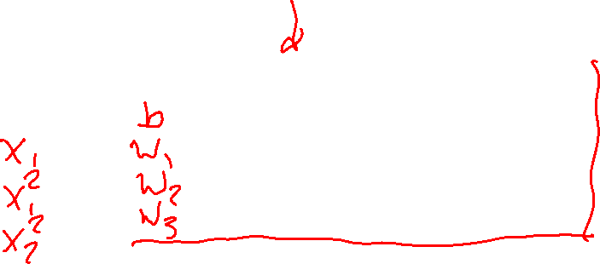
Symptoms of Overfitting
Slide credit: CMU MLD William Cohen

Slide 10
Motivation: Regularization
Occam’s Razor: prefer the simplest hypothesis
What does it mean for a hypothesis (or model) to be simple?
small number of features (model selection)
small number of “important” features (feature reduction)
small values for associated parameters
Slide credit: CMU MLD Matt Gormley

Slide 11
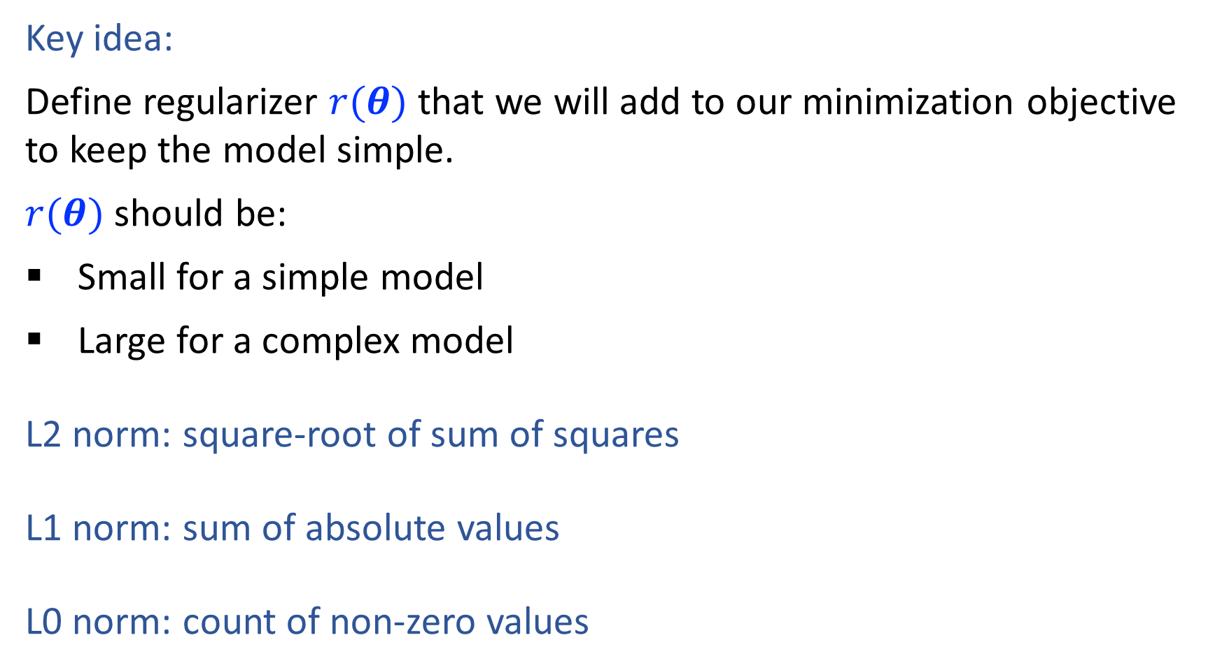
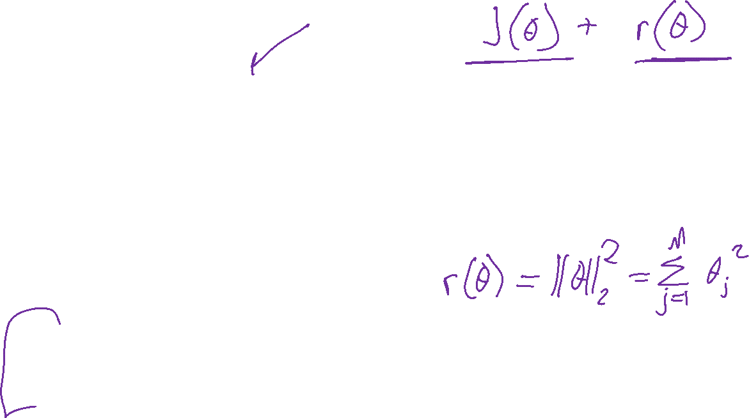
Regularization
Key idea:
Define regularizer $r(θ)$ that we will add to our minimization objective to keep the model simple.
$r(θ)$ should be:
Small for a simple model
Large for a complex model
L2 norm: square-root of sum of squares
L1 norm: sum of absolute values
L0 norm: count of non-zero values

Slide 12

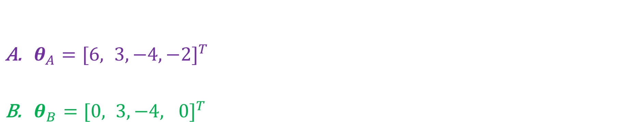
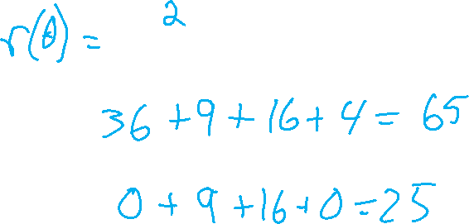
Regularization
$${\left\|θ\right\|}_{2}$$
$θ_{A}={[6, 3, −4, −2]}^{T}$
$θ_{B}={[0, 3, −4, 0]}^{T}$

Slide 13
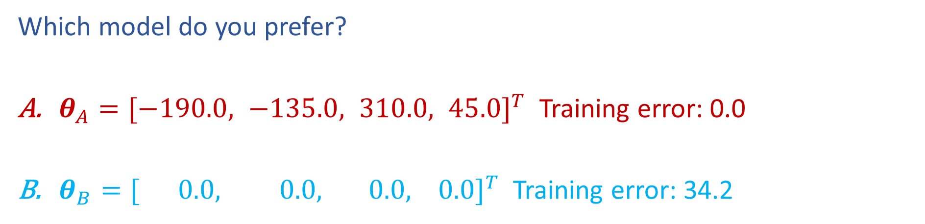
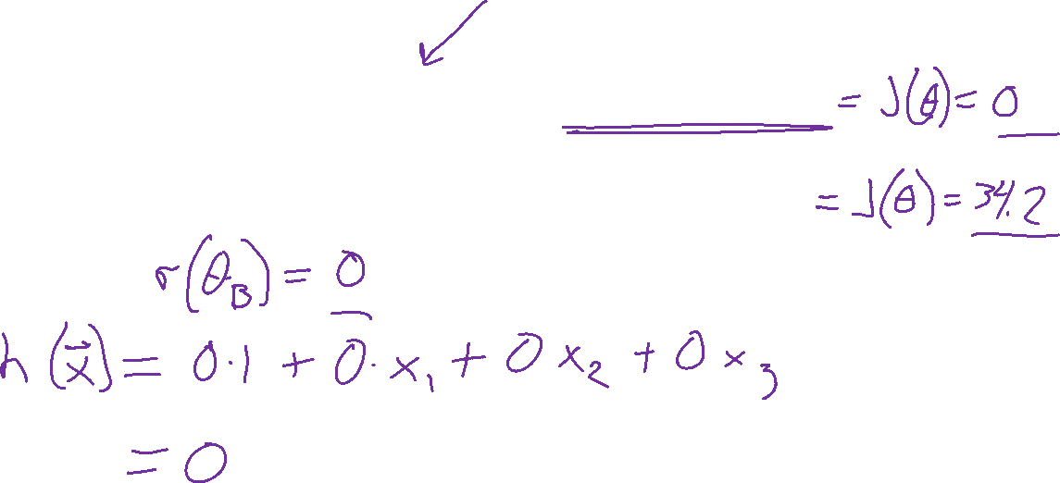
Poll 2
Which model do you prefer?
$θ_{A}={[−190.0, −135.0, 310.0, 45.0]}^{T}$ Training error: 0.0
$θ_{B}={[ 0.0, 0.0, 0.0, 0.0]}^{T}$ Training error: 34.2

Slide 14
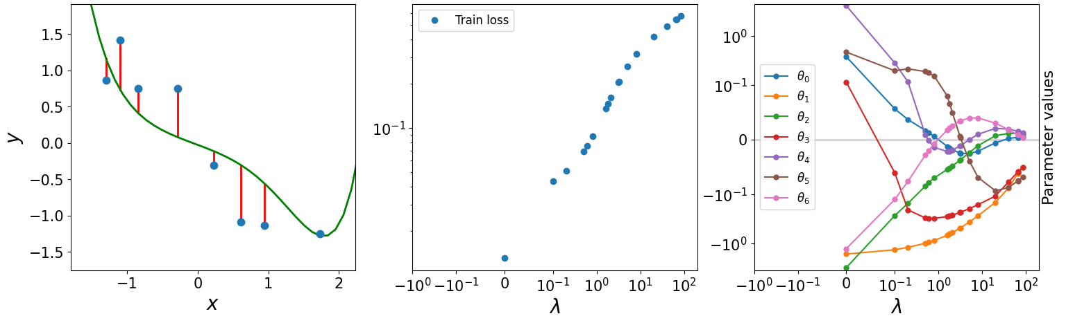
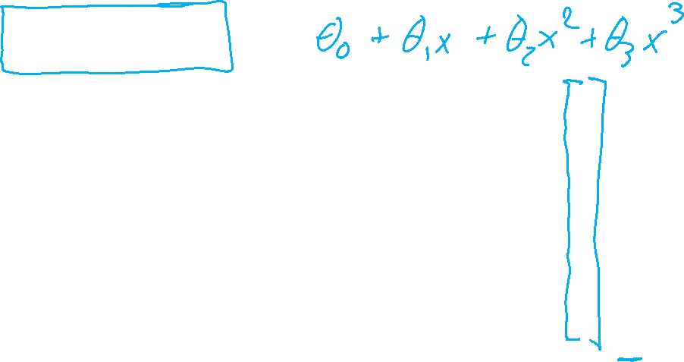
Poll 3
Notebook demo: regression_regularization.ipynb on course website
What is the best value for lambda?

Slide 15
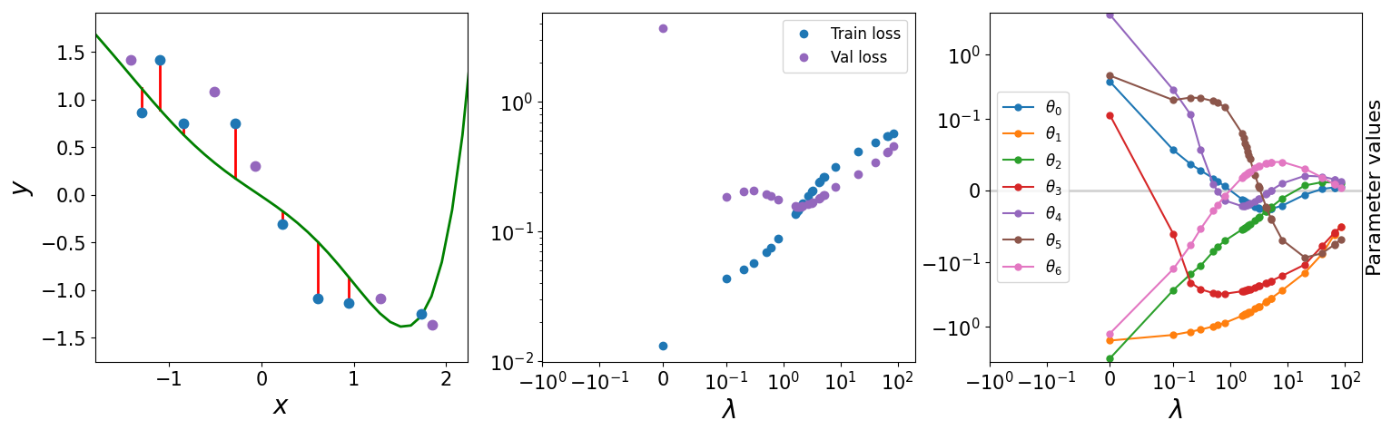

Poll 3
Notebook demo: regression_regularization.ipynb on course website
What is the best value for lambda?

Slide 16
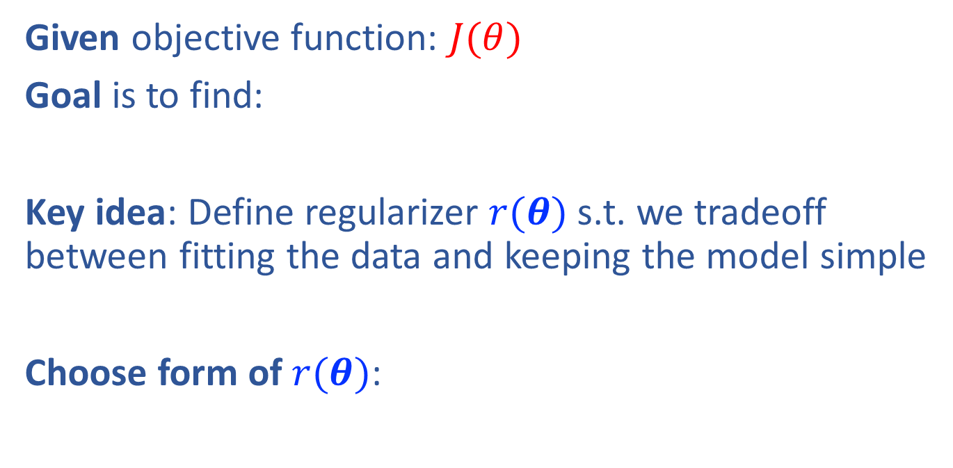
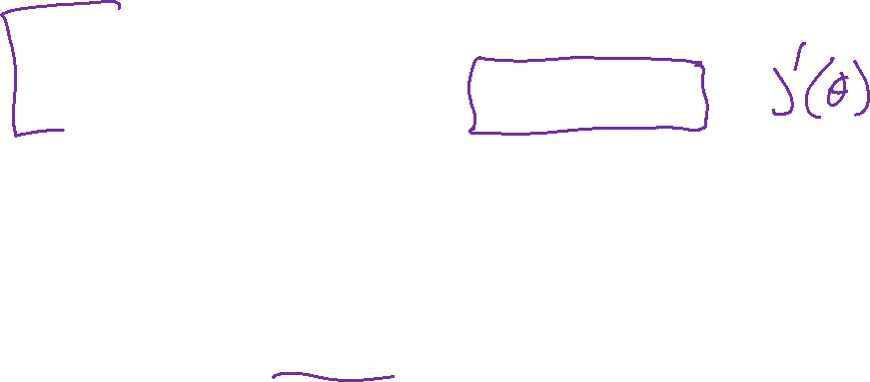
Regularization
Given objective function: $J(θ)$
Goal is to find:
Key idea: Define regularizer $r(θ)$ s.t. we tradeoff between fitting the data and keeping the model simple
Choose form of $r(θ)$:
Slide credit: CMU MLD Matt Gormley

Slide 17
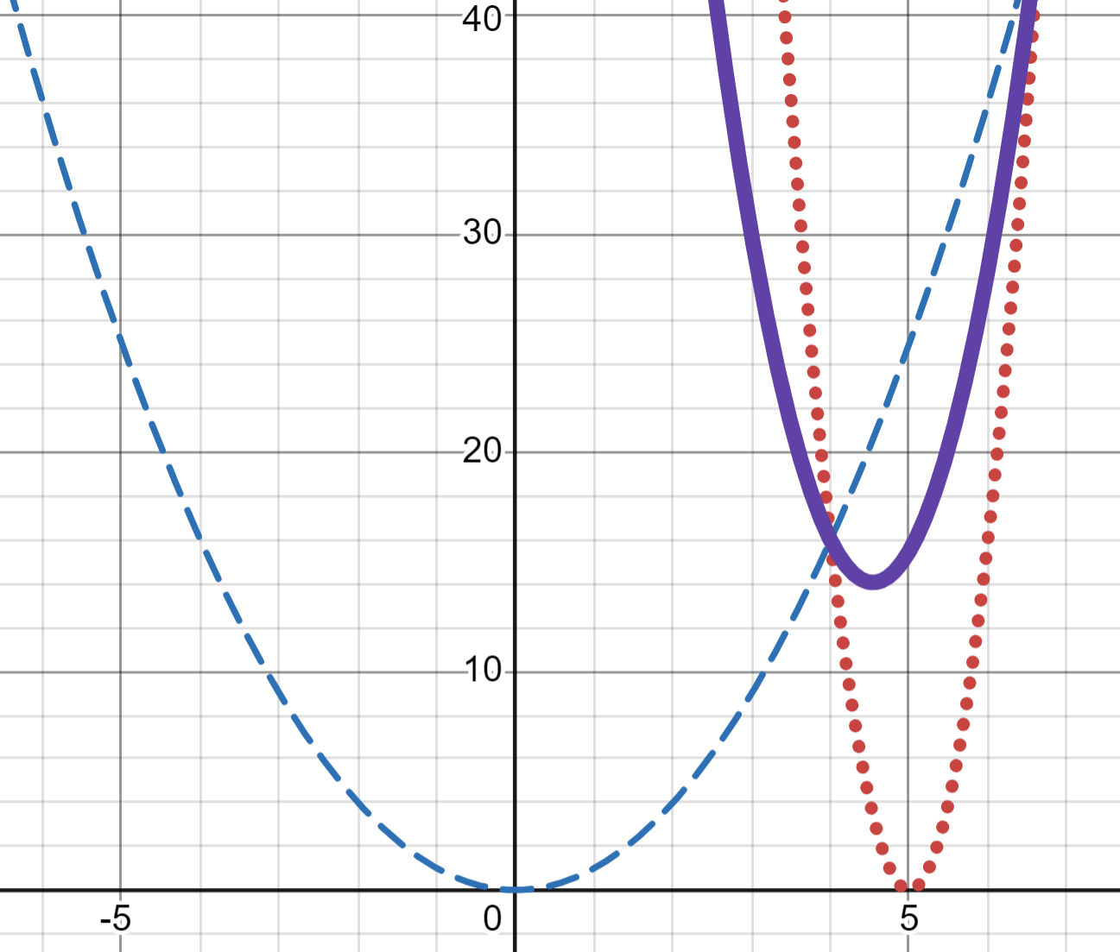
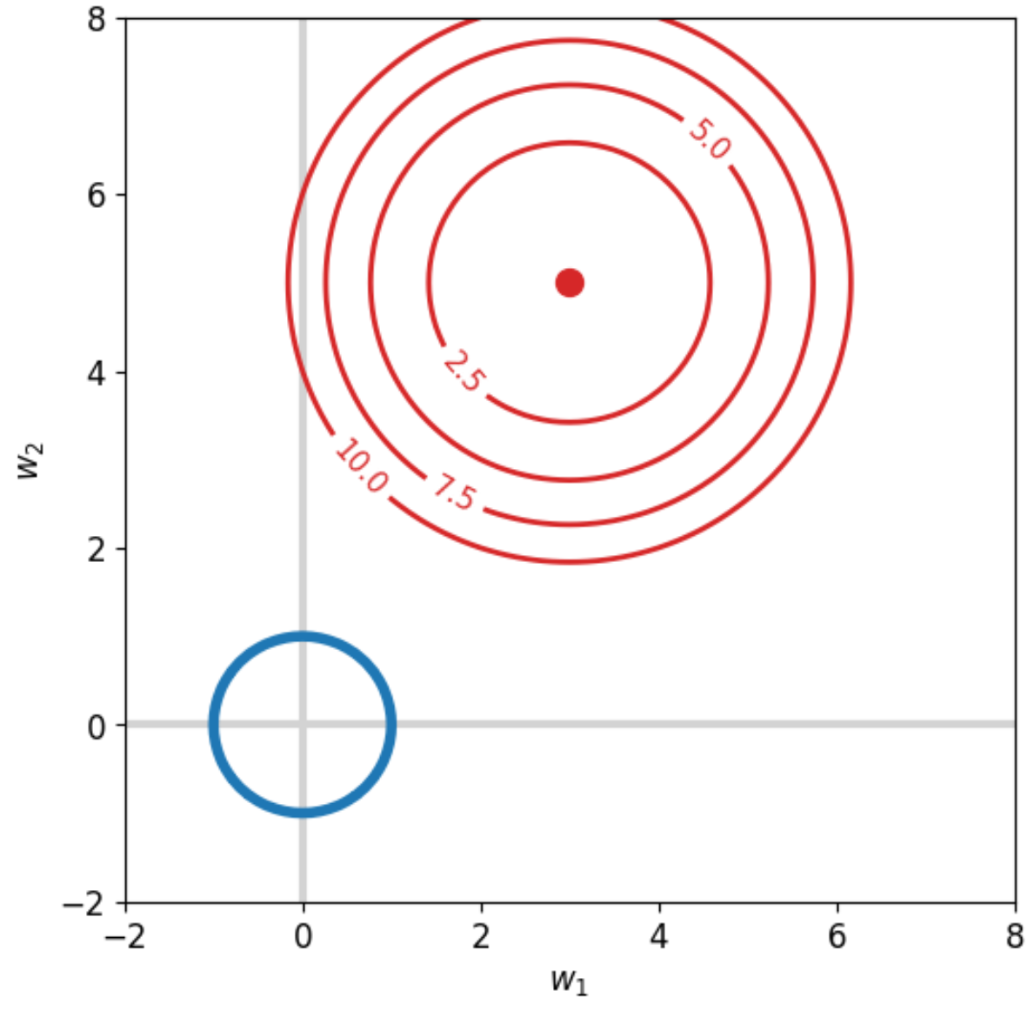
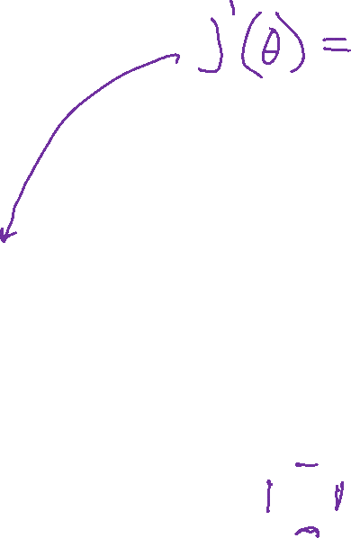
Regularization
L2 Demos
Desmos: 1-D
Regularization Interpolation
Notebook: 2-D
L1_sparsity.ipynb (L2 part for now)

Slide 18
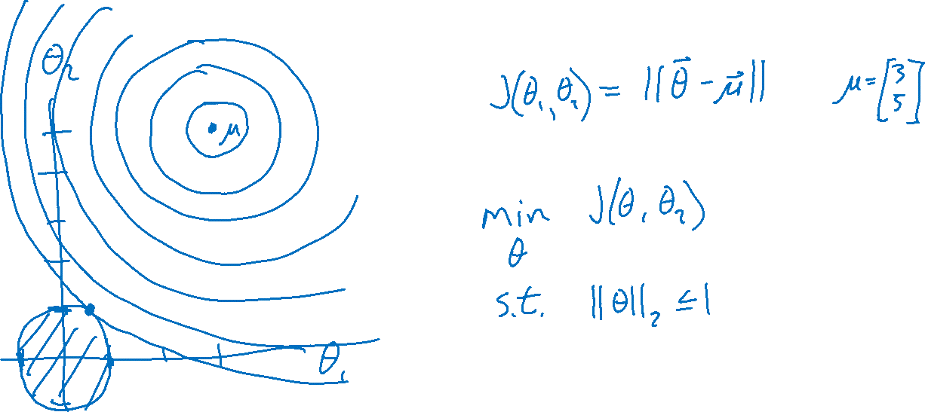
Regularization

Slide 19

Poll 4
Suppose we are minimizing J’(θ) where
As λ increases, the minimum of J’(θ) will…
…move towards the midpoint between J’(θ) and r(θ)
…move towards the minimum of J(θ)
…move towards the minimum of r(θ)
…move towards a theta vector of positive infinities
…move towards a theta vector of negative infinities
…stay the same
Slide credit: CMU MLD Matt Gormley

Slide 20
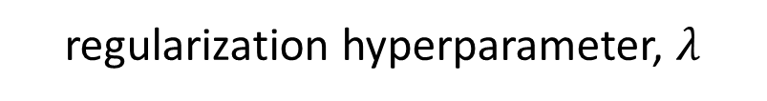
Regularization Exercise
In-class Exercise
Plot train error vs. regularization hyperparameter (cartoon)
Plot validation error vs . regularization hyperparameter (cartoon)
error
Slide credit: CMU MLD Matt Gormley
regularization hyperparameter, $λ$

Slide 21
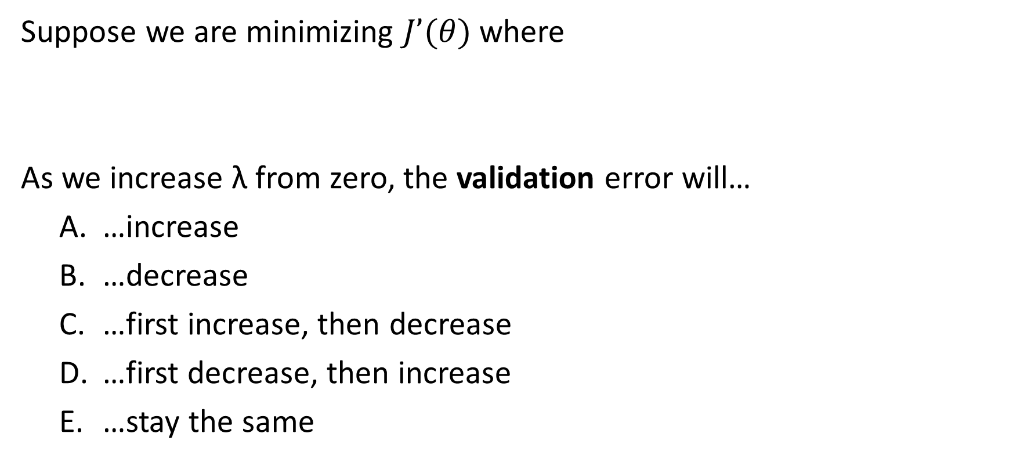
Poll 5
Suppose we are minimizing $J’(θ)$ where
As we increase λ from zero, the validation error will…
…increase
…decrease
…first increase, then decrease
…first decrease, then increase
…stay the same
Slide credit: CMU MLD Matt Gormley

Slide 22
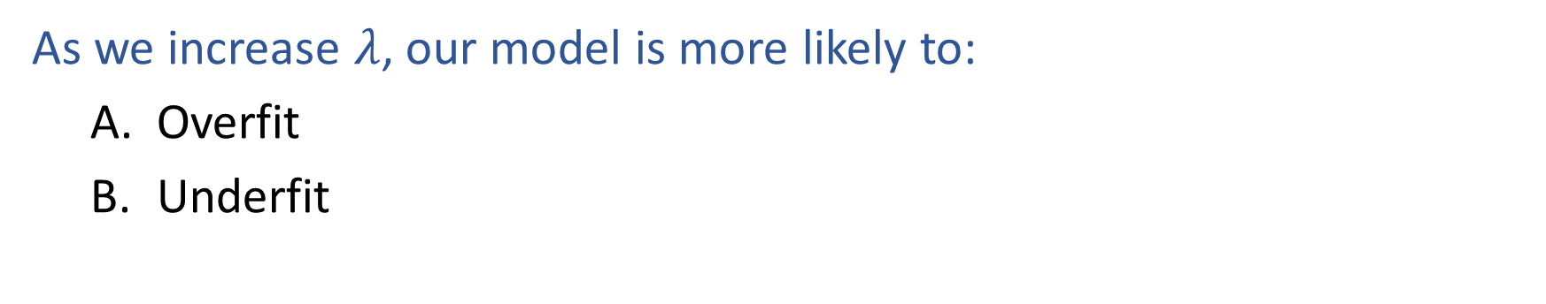
Poll 6
As we increase $λ$, our model is more likely to:
Overfit
Underfit

Slide 23
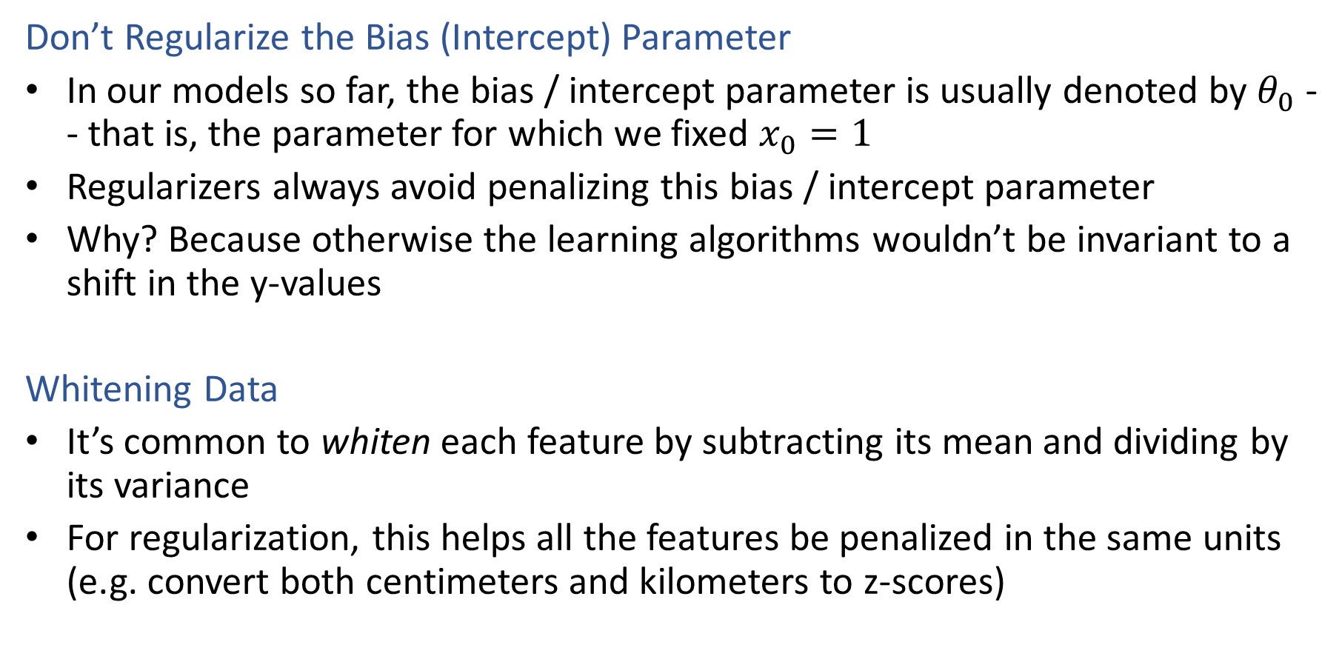
Regularization
Don’t Regularize the Bias (Intercept) Parameter
In our models so far, the bias / intercept parameter is usually denoted by $θ_{0}$ -- that is, the parameter for which we fixed $x_{0}=1$
Regularizers always avoid penalizing this bias / intercept parameter
Why? Because otherwise the learning algorithms wouldn’t be invariant to a shift in the y-values
Whitening Data
It’s common to whiten each feature by subtracting its mean and dividing by its variance
For regularization, this helps all the features be penalized in the same units (e.g. convert both centimeters and kilometers to z-scores)
Slide credit: CMU MLD Matt Gormley

Slide 24
Regularization Optimization

Slide 25
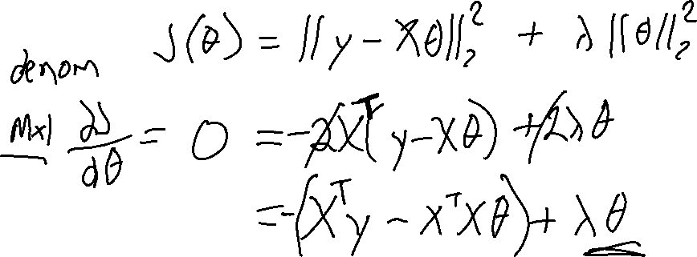
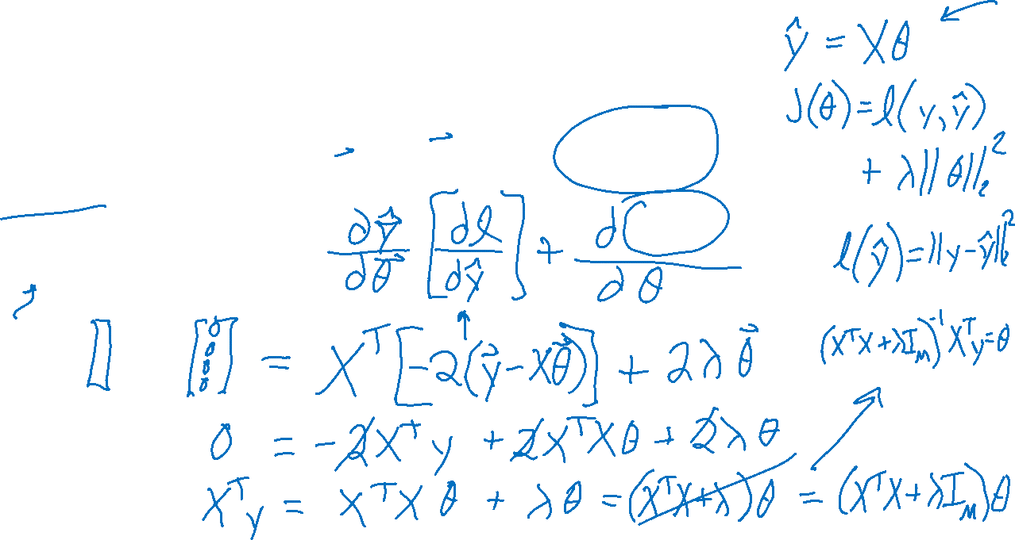
Linear Regression with L2 Regularization
a.k.a Ridge regression or Tychonov regression

Slide 26
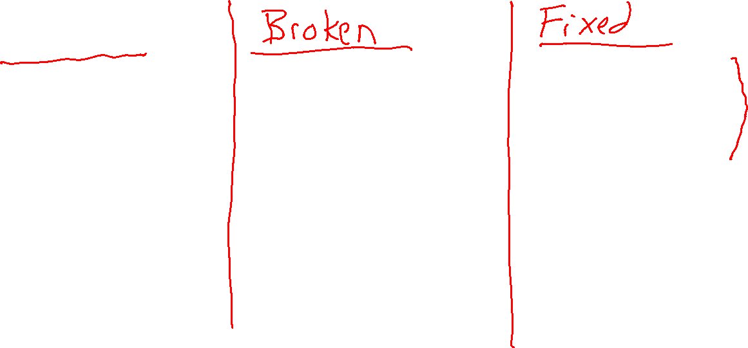
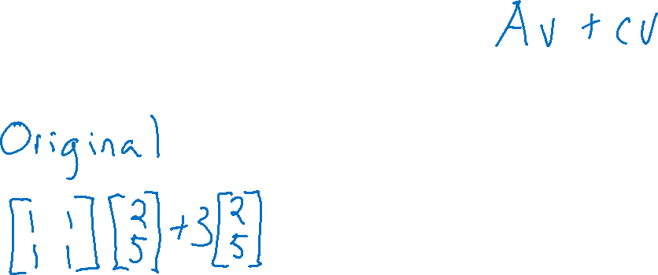

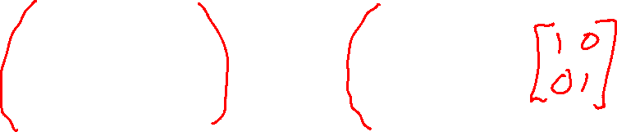
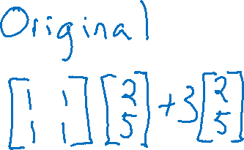

Linear Algebra Timeout
Distribution of multiplication and addition with scalar involved

Slide 27
Regularization with L1 norm

Slide 28
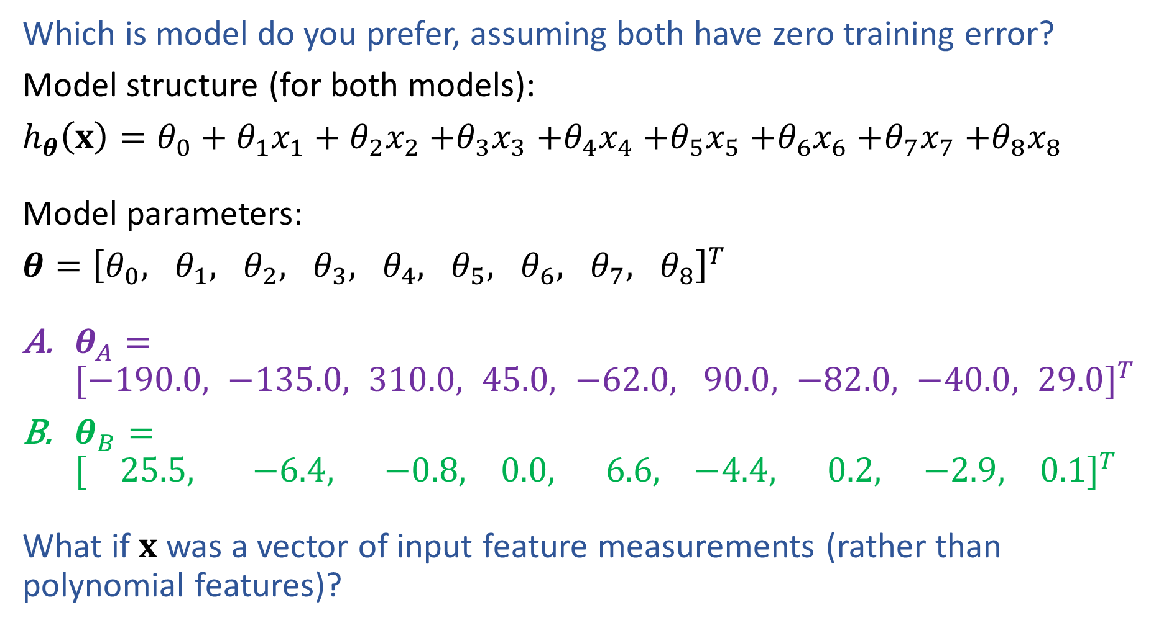

Model Preference
Which is model do you prefer, assuming both have zero training error?
Model structure (for both models):
$h_{θ}\left(x\right)=θ_{0}+θ_{1}x_{1}+θ_{2}x_{2}$ $+θ_{3}x_{3}$ $+θ_{4}x_{4}$ $+θ_{5}x_{5}$ $+θ_{6}x_{6}$ $+θ_{7}x_{7}$ $+θ_{8}x_{8}$
Model parameters:
$θ={\left[θ_{0}, θ_{1}, θ_{2}, θ_{3}, θ_{4}, θ_{5}, θ_{6}, θ_{7}, θ_{8}\right]}^{T}$
$θ_{A}={[−190.0, −135.0, 310.0, 45.0, −62.0, 90.0, −82.0, −40.0, 29.0]}^{T}$
$θ_{B}={[ 25.5, −6.4, −0.8, 0.0, 6.6, −4.4, 0.2, −2.9, 0.1]}^{T}$
What if $x$ was a vector of input feature measurements (rather than polynomial features)?

Slide 29
Motivation: Regularization
Example: Stock Prices
Suppose we wish to predict Google’s stock price at time t+1
What features should we use? (putting all computational concerns aside)
Stock prices of all other stocks at times t, t-1, t-2, …, t - k
Mentions of Google with positive / negative sentiment words in all newspapers and social media outlets
Do we believe that all of these features are going to be useful?
Slide credit: CMU MLD Matt Gormley

Slide 30
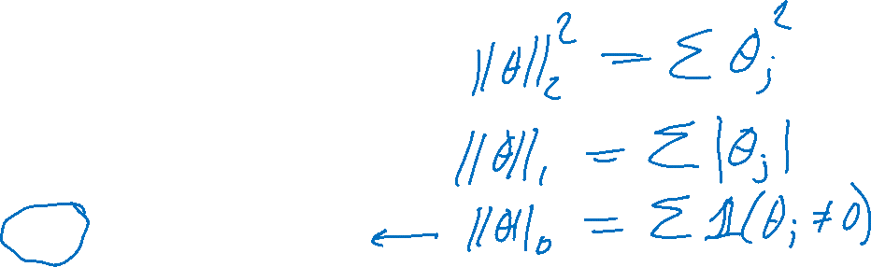
Regularization
Key idea:
Define regularizer $r(θ)$ that we will add to our minimization objective to keep the model simple.
$r(θ)$ should be:
Small for a simple model
Large for a complex model
L2 norm: square-root of sum of squares
L1 norm: sum of absolute values
L0 norm: count of non-zero values

Slide 31

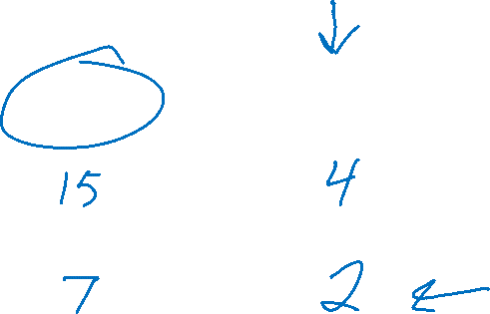


Regularization
$${\left\|θ\right\|}_{2}$$
$${\left\|θ\right\|}_{1}$$
$${\left\|θ\right\|}_{0}$$
$θ_{A}={[6, 3, −4, −2]}^{T}$
$θ_{B}={[0, 3, −4, 0]}^{T}$

Slide 32
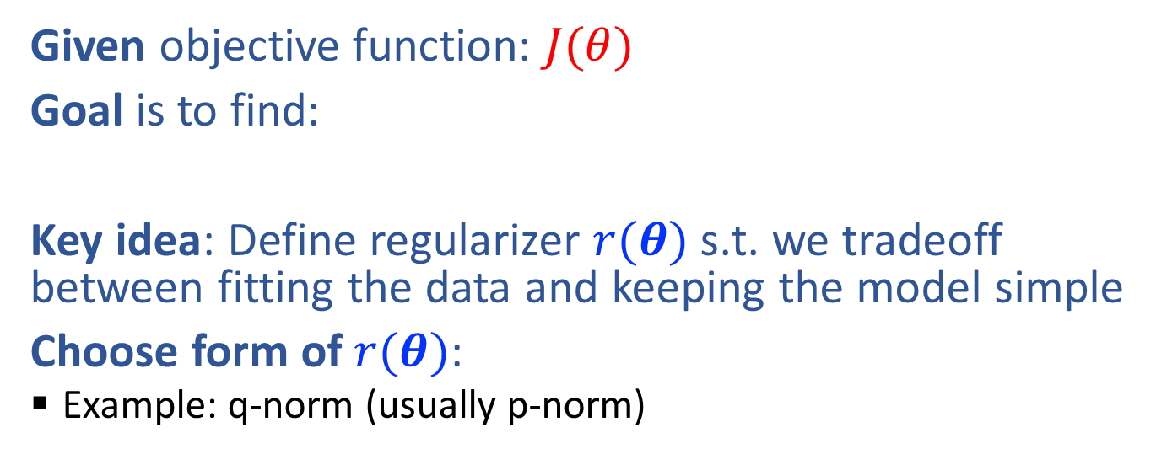
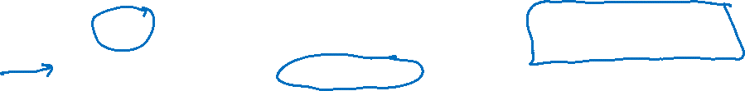
Regularization
Given objective function: $J(θ)$
Goal is to find:
Key idea: Define regularizer $r(θ)$ s.t. we tradeoff between fitting the data and keeping the model simple
Choose form of $r(θ)$:
Example: q-norm (usually p-norm)
Slide credit: CMU MLD Matt Gormley

Slide 33
Regularization

Slide 34
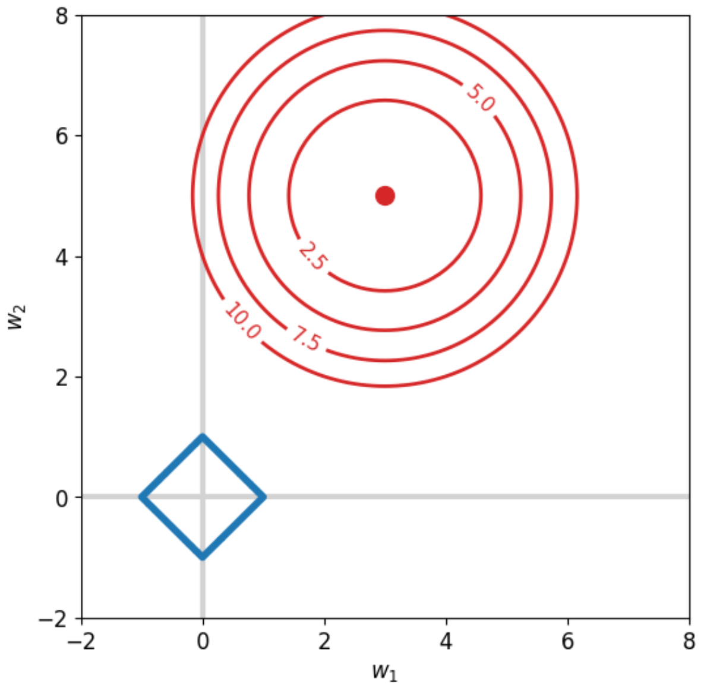
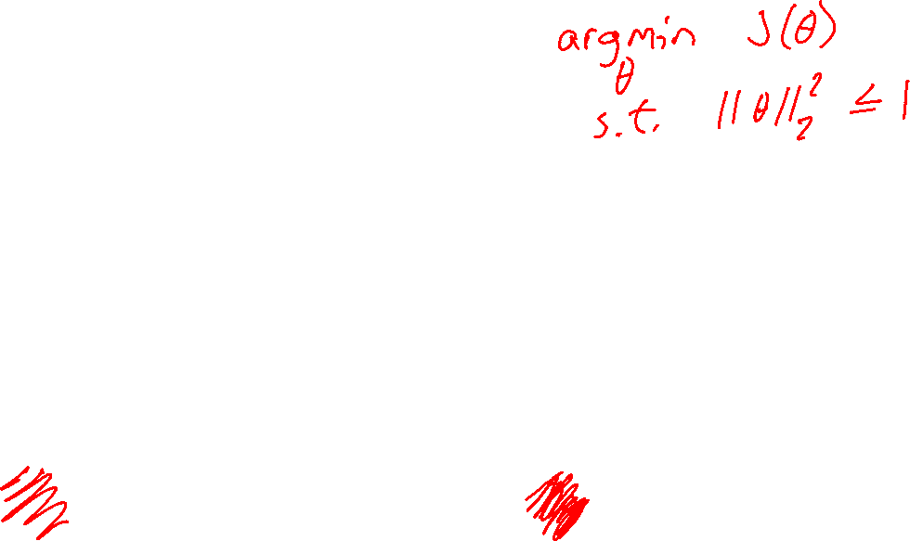
Regularization
L1 demo: L1_sparsity.ipynb

Slide 35
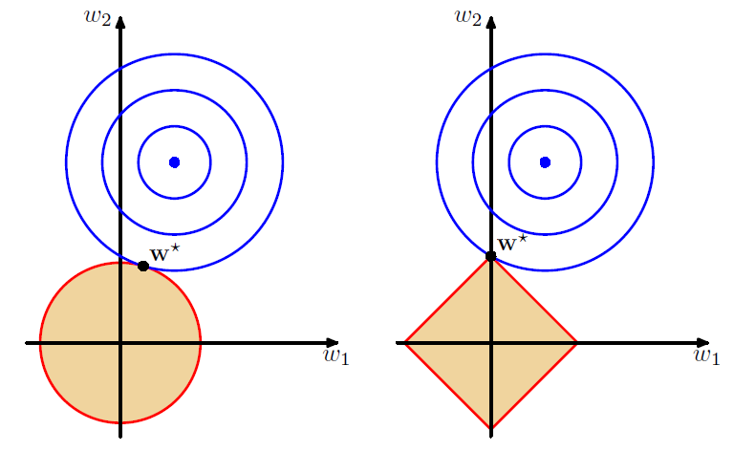
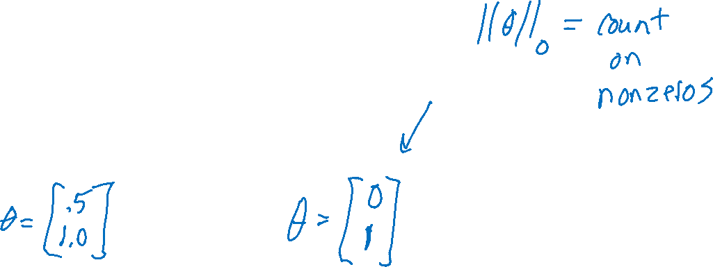
L2 vs L1 Regularization
Combine original objective with penalty on parameters
Figures: Bishop, Ch 3.1.4

Slide 36
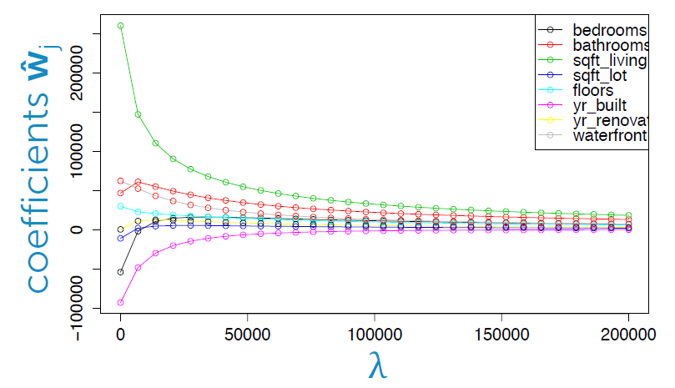
L2 vs L1: Housing Price Example
Predict housing price from several features
Figure: Emily Fox, University of Washington

Slide 37
L2 vs L1: Housing Price Example
Predict housing price from several features
Figure: Emily Fox, University of Washington

Slide 38
L2 vs L1: Housing Price Example
Predict housing price from several features
Figure: Emily Fox, University of Washington

Slide 39

L2 vs L1: Housing Price Example
Predict housing price from several features
Figure: Emily Fox, University of Washington

Slide 40
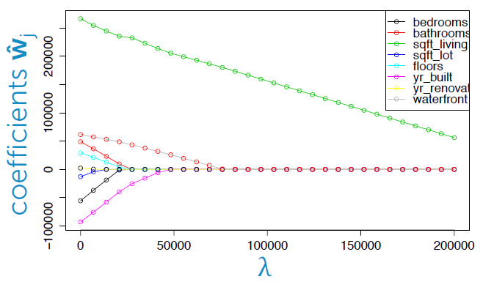
L2 vs L1: Housing Price Example
Predict housing price from several features
Figure: Emily Fox, University of Washington

Slide 41
L2 vs L1: Housing Price Example
Predict housing price from several features
Figure: Emily Fox, University of Washington

Slide 42
L2 vs L1: Housing Price Example
Predict housing price from several features
Figure: Emily Fox, University of Washington

Slide 43
L2 vs L1: Housing Price Example
Predict housing price from several features
Figure: Emily Fox, University of Washington

Slide 44
L2 vs L1: Housing Price Example
Predict housing price from several features
Figure: Emily Fox, University of Washington

Slide 45
Regularization as MAP
L1 and L2 regularization can be interpreted as maximum a-posteriori (MAP) estimation of the parameters
To be discussed later in the course…
Slide credit: CMU MLD Matt Gormley

Slide 46
Additional Slides

Slide 47
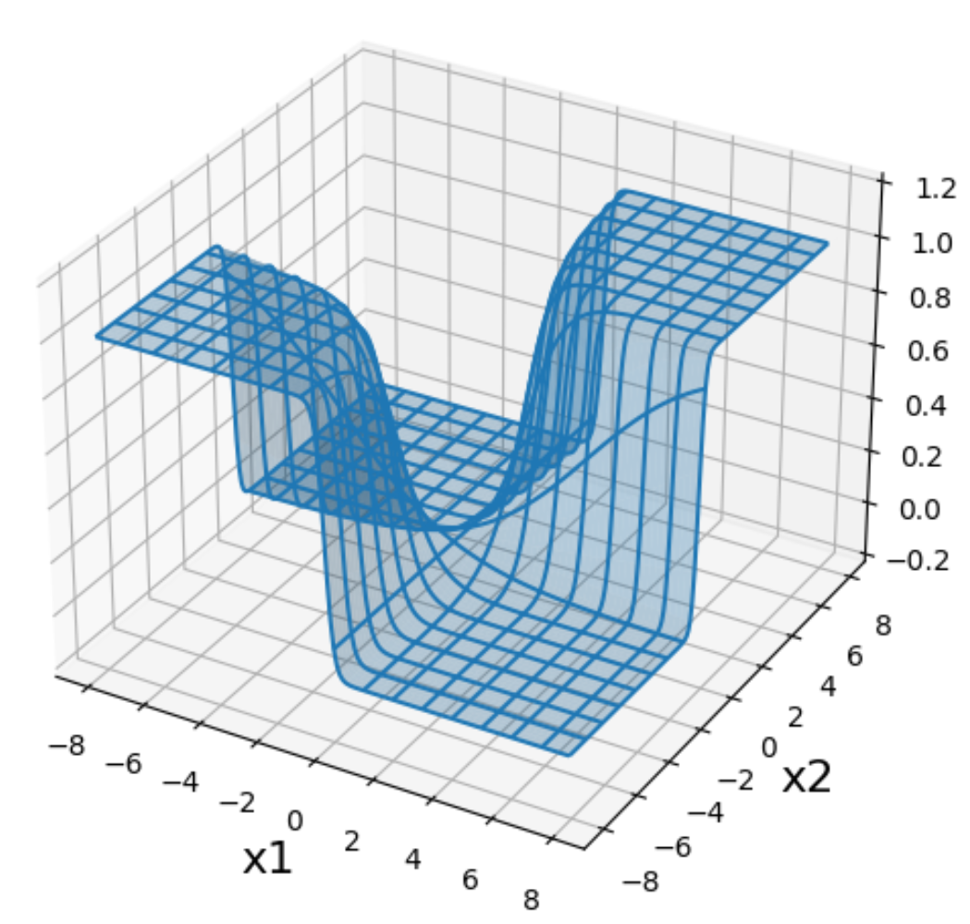
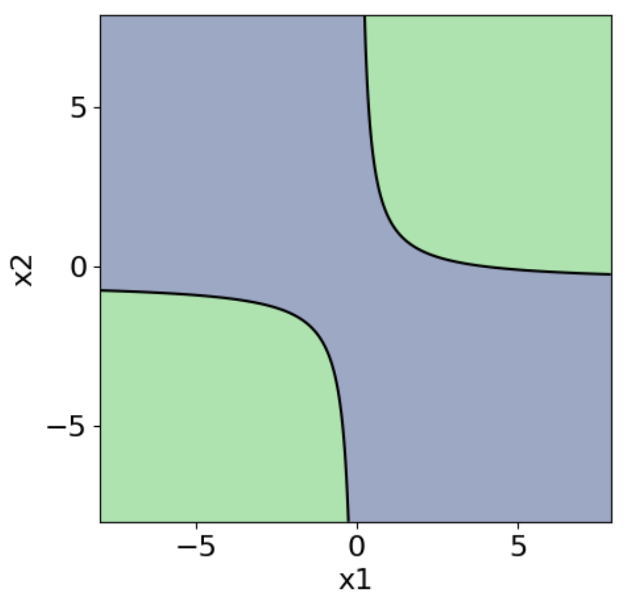
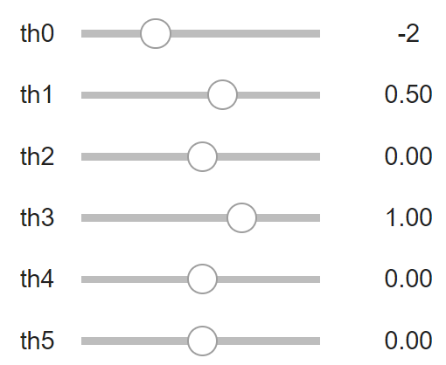
Logistic Regression with Nonlinear Features
Jupyter notebook demo: quadratic_logistic.ipynb

Slide 48
Example: Logistic Regression
For this example, we construct nonlinear features (i.e. feature engineering)
Specifically, we add polynomials up to order 9 of the two original features x₁ and x₂
Thus our classifier is linear in the high-dimensional feature space, but the decision boundary is nonlinear when visualized in low-dimensions (i.e. the original two dimensions)
Training Data
Test Data
Slide credit: CMU MLD Matt Gormley

Slide 49
Example: Logistic Regression
error
lambda
Slide credit: CMU MLD Matt Gormley

Slide 50
Example: Logistic Regression
Slide credit: CMU MLD Matt Gormley

Slide 51
Example: Logistic Regression
Slide credit: CMU MLD Matt Gormley

Slide 52
Example: Logistic Regression
Slide credit: CMU MLD Matt Gormley

Slide 53
Example: Logistic Regression
Slide credit: CMU MLD Matt Gormley

Slide 54
Example: Logistic Regression
Slide credit: CMU MLD Matt Gormley

Slide 55
Example: Logistic Regression
Slide credit: CMU MLD Matt Gormley

Slide 56
Example: Logistic Regression
Slide credit: CMU MLD Matt Gormley

Slide 57
Example: Logistic Regression
Slide credit: CMU MLD Matt Gormley

Slide 58
Example: Logistic Regression
Slide credit: CMU MLD Matt Gormley

Slide 59
Example: Logistic Regression
Slide credit: CMU MLD Matt Gormley

Slide 60
Example: Logistic Regression
Slide credit: CMU MLD Matt Gormley

Slide 61
Example: Logistic Regression
Slide credit: CMU MLD Matt Gormley

Slide 62
Example: Logistic Regression
Slide credit: CMU MLD Matt Gormley

Slide 63
Example: Logistic Regression
error
lambda
Slide credit: CMU MLD Matt Gormley

