Slide 1

10-315 Introduction to ML Neural Networks
Instructor: Pat Virtue

Slide 2
Outline
Last time: Neural Networks
Three-neuron network + optimization
Neural network structure (adding more neurons)
Forward pass and Backpropagation (scalar version)
Today: Neural Networks
Calculus: multi-variate chain rule
Backpropagation (vector version)
Neural Network Properties and Intuition

Slide 3


























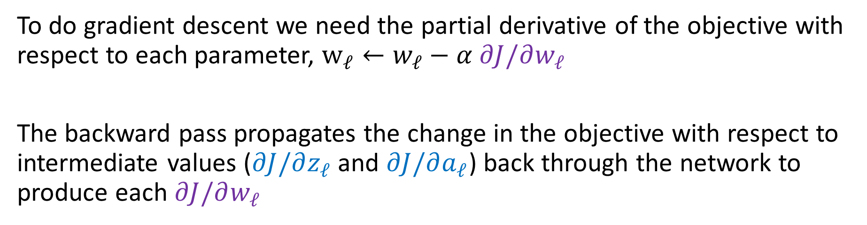






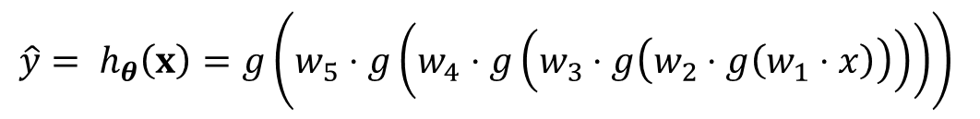












Backpropagation
$$\hat{y}= h_{θ}\left(x\right)=g\left(w_{5}⋅g\left(w_{4}⋅g\left(w_{3}⋅g\left(w_{2}⋅g\left(w_{1}⋅x\right)\right)\right)\right)\right)$$
Width 1 deep network (no bias) (dumb but will help with calculus)
$$\frac{∂J}{∂z_{1}}$$
$$\frac{∂J}{∂a_{1}}$$
$$\frac{∂J}{∂z_{2}}$$
$$\frac{∂J}{∂a_{2}}$$
$$\frac{∂J}{∂z_{3}}$$
$$\frac{∂J}{∂a_{3}}$$
$$\frac{∂J}{∂z_{4}}$$
$$\frac{∂J}{∂a_{4}}$$
$$\frac{∂J}{∂z_{5}}$$
$$\frac{∂J}{∂\hat{y}}$$
$$y$$
$$x$$
$$z1$$
$$a1$$
$$z2$$
$$a2$$
$$z3$$
$$a3$$
$$z4$$
$$a4$$
$$z5$$
$$a5=\hat{y}$$
$$J$$
$$f$$
$$g$$
$$f$$
$$g$$
$$f$$
$$g$$
$$f$$
$$g$$
$$f$$
$$g$$
$$ℓ$$
$$w1$$
$$w2$$
$$w3$$
$$w4$$
$$w5$$
$$\frac{∂J}{∂w_{1}}$$
$$\frac{∂J}{∂w_{2}}$$
$$\frac{∂J}{∂w_{3}}$$
$$\frac{∂J}{∂w_{4}}$$
$$\frac{∂J}{∂w_{5}}$$
To do gradient descent we need the partial derivative of the objective with respect to each parameter, $w_{ℓ}←w_{ℓ}−α ∂J/∂w_{ℓ}$
The backward pass propagates the change in the objective with respect to intermediate values ($∂J/∂z_{ℓ}$ and $∂J/∂a_{ℓ}$) back through the network to produce each $∂J/∂w_{ℓ}$

Slide 4
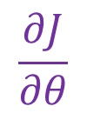

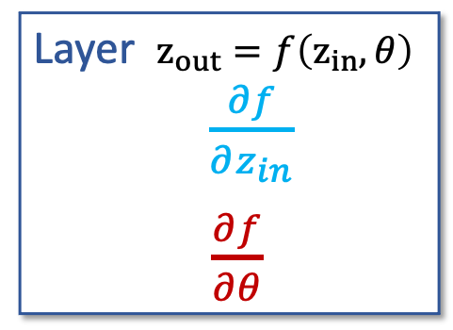



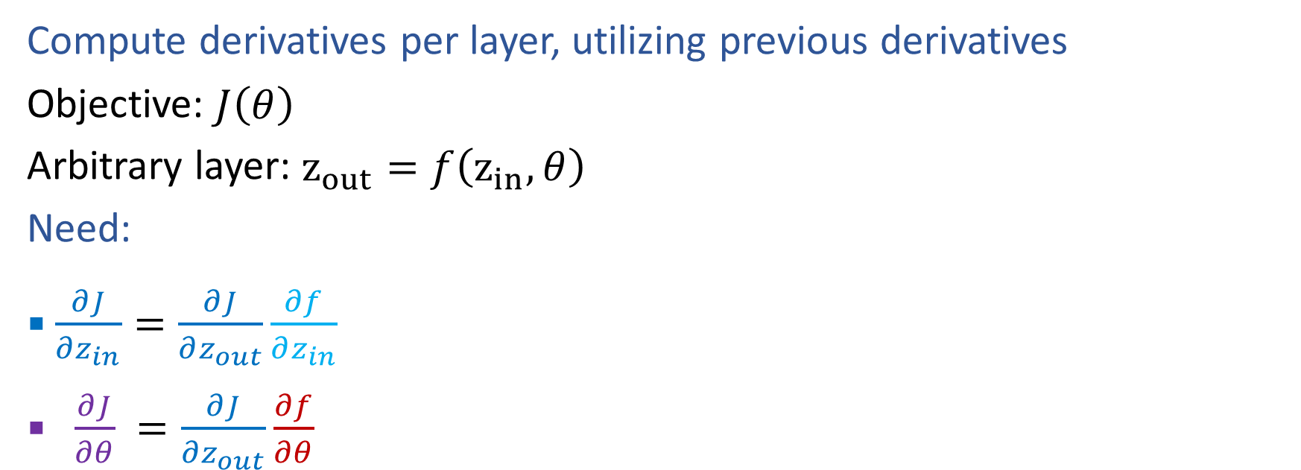

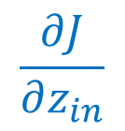




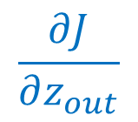


Generic Layer Implementation (so-far)
Compute derivatives per layer, utilizing previous derivatives
Objective: $J\left(θ\right)$
Arbitrary layer: $z_{out}=f\left(z_{in}, θ\right)$
Need:
$\frac{∂J}{∂z_{in}}=\frac{∂J}{∂z_{out}}\frac{∂f}{∂z_{in}}$
$\frac{∂J}{∂θ} =\frac{∂J}{∂z_{out}}\frac{∂f}{∂θ}$
$$zin$$
$$zout$$
$$J$$
$$f$$
$$θ$$
$$z_{in}$$
Layer $z_{out}=f\left(z_{in}, θ\right)$
$\frac{∂f}{∂z_{in}}$
$\frac{∂f}{∂θ}$
$$z_{out}$$
$$\frac{∂J}{∂z_{in}}$$
$$\frac{∂J}{∂z_{out}}$$
$$θ$$
$$\frac{∂J}{∂θ}$$

Slide 5












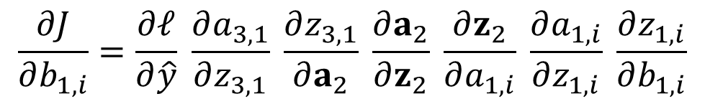





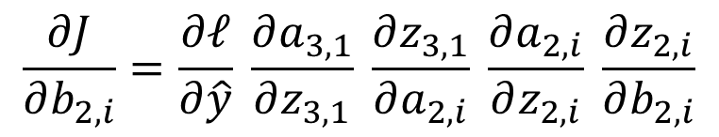







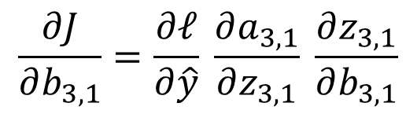







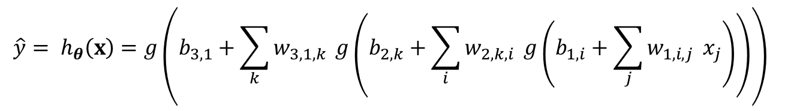





Optimization
$$\hat{y}= h_{θ}\left(x\right)=g\left(b_{3,1}+\sum_{k}{w_{3,1,k}} g\left(b_{2,k}+\sum_{i}{w_{2,k,i}} g\left(b_{1,i}+\sum_{j}{w_{1,i,j}} x_{j}\right)\right)\right)$$
Tons of repeated partial derivatives
$$z11$$
$$a11$$
$$x1$$
$$f$$
$$g$$
$$b11$$
$$z21$$
$$a21$$
$$f$$
$$g$$
$$z12$$
$$a12$$
$$b21$$
$$z31$$
$$\hat{y}$$
$$J$$
$$x2$$
$$f$$
$$g$$
$$f$$
$$g$$
$$ℓ$$
$$b12$$
$$z22$$
$$a22$$
$$b31$$
$$f$$
$$g$$
$$y$$
$$z13$$
$$a13$$
$$b22$$
$$\frac{∂J}{∂b_{3,1}}=\frac{∂ℓ}{∂\hat{y}} \frac{∂a_{3,1}}{∂z_{3,1}} \frac{∂z_{3,1}}{∂b_{3,1}}$$
$$x3$$
$$f$$
$$g$$
$$b13$$
$$\frac{∂J}{∂b_{2,i}}=\frac{∂ℓ}{∂\hat{y}} \frac{∂a_{3,1}}{∂z_{3,1}} \frac{∂z_{3,1}}{∂a_{2,i}} \frac{∂a_{2,i}}{∂z_{2,i}} \frac{∂z_{2,i}}{∂b_{2,i}}$$
$$\frac{∂J}{∂b_{1,i}}=\frac{∂ℓ}{∂\hat{y}} \frac{∂a_{3,1}}{∂z_{3,1}} \frac{∂z_{3,1}}{∂a_{2}} \frac{∂a_{2}}{∂z_{2}} \frac{∂z_{2}}{∂a_{1,i}} \frac{∂a_{1,i}}{∂z_{1,i}} \frac{∂z_{1,i}}{∂b_{1,i}}$$

Slide 6











Optimization
$$\hat{y}= h_{θ}\left(x\right)=g\left(b_{3,1}+\sum_{k}{w_{3,1,k}} g\left(b_{2,k}+\sum_{i}{w_{2,k,i}} g\left(b_{1,i}+\sum_{j}{w_{1,i,j}} x_{j}\right)\right)\right)$$
Tons of repeated partial derivatives
$$z11$$
$$a11$$
$$x1$$
$$f$$
$$g$$
$$b11$$
$$z21$$
$$a21$$
$$f$$
$$g$$
$$z12$$
$$a12$$
$$b21$$
$$z31$$
$$\hat{y}$$
$$J$$
$$x2$$
$$f$$
$$g$$
$$f$$
$$g$$
$$ℓ$$
$$b12$$
$$z22$$
$$a22$$
$$b31$$
$$f$$
$$g$$
$$y$$
$$z13$$
$$a13$$
$$b22$$
$$\frac{∂J}{∂b_{3,1}}=\frac{∂ℓ}{∂\hat{y}} \frac{∂a_{3,1}}{∂z_{3,1}} \frac{∂z_{3,1}}{∂b_{3,1}}$$
$$x3$$
$$f$$
$$g$$
$$b13$$
$$\frac{∂J}{∂b_{2,i}}=\frac{∂ℓ}{∂\hat{y}} \frac{∂a_{3,1}}{∂z_{3,1}} \frac{∂z_{3,1}}{∂a_{2,i}} \frac{∂a_{2,i}}{∂z_{2,i}} \frac{∂z_{2,i}}{∂b_{2,i}}$$
$$\frac{∂J}{∂b_{1,i}}=\frac{∂ℓ}{∂\hat{y}} \frac{∂a_{3,1}}{∂z_{3,1}} \frac{∂z_{3,1}}{∂a_{2}} \frac{∂a_{2}}{∂z_{2}} \frac{∂z_{2}}{∂a_{1,i}} \frac{∂a_{1,i}}{∂z_{1,i}} \frac{∂z_{1,i}}{∂b_{1,i}}$$

Slide 7
Calculus Time-out

Slide 8
Multivariate-chain rule

Slide 9
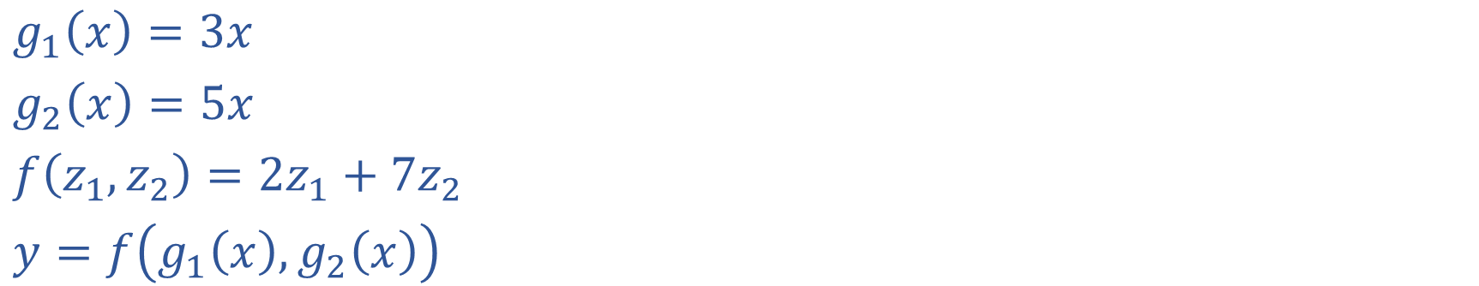
Multivariable Chain Rule
$g_{1}\left(x\right)=3x$
$g_{2}\left(x\right)=5x$
$f\left(z_{1}, z_{2}\right)={2z}_{1}+{7z}_{2}$
$y=f\left(g_{1}\left(x\right),g_{2}\left(x\right)\right)$

Slide 10
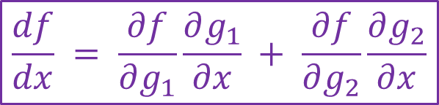
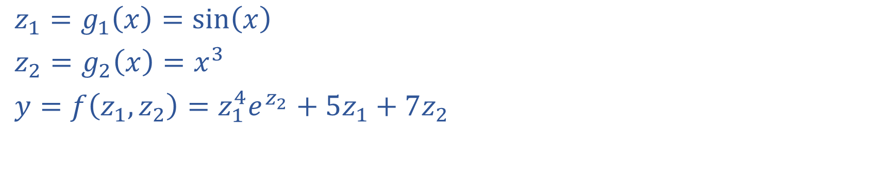
Exercise: Multivariable Chain Rule
$$\frac{df}{dx} = \frac{∂f}{∂g_{1}}\frac{∂g_{1}}{∂x} + \frac{∂f}{∂g_{2}}\frac{∂g_{2}}{∂x}$$
$z_{1}=g_{1}\left(x\right)=sin\left(x\right)$
$z_{2}=g_{2}\left(x\right)=x^{3}$
$y=f\left(z_{1}, z_{2}\right)=z_{1}^{4}e^{z_{2}}+5z_{1}+7z_{2}$

Slide 11



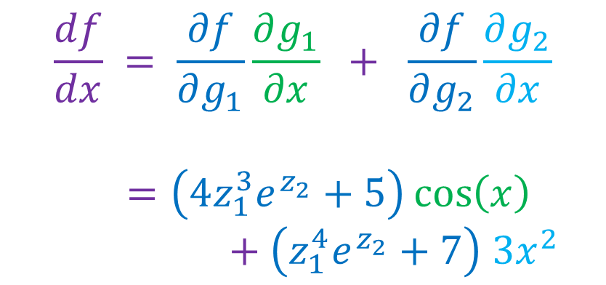
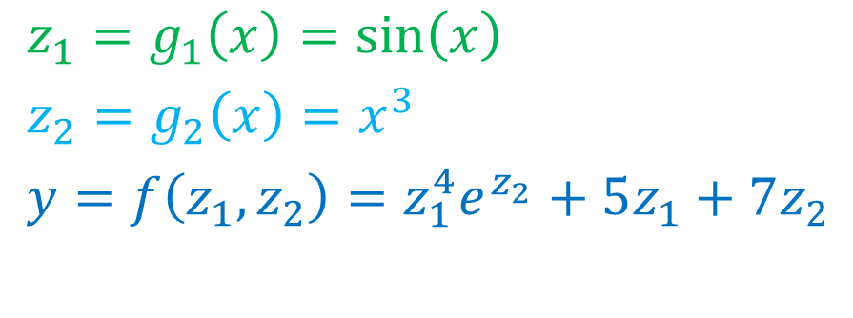




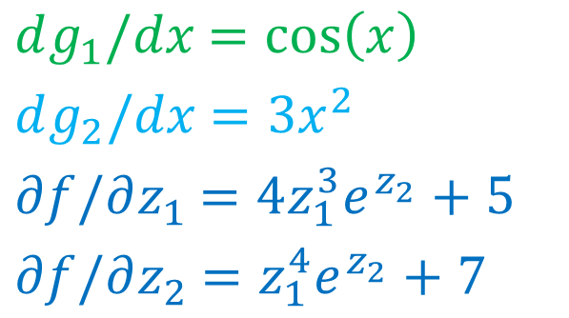

Exercise: Multivariable Chain Rule
$$\frac{df}{dx} = \frac{∂f}{∂g_{1}}\frac{∂g_{1}}{∂x} + \frac{∂f}{∂g_{2}}\frac{∂g_{2}}{∂x}$$
$z_{1}=g_{1}\left(x\right)=sin\left(x\right)$
$z_{2}=g_{2}\left(x\right)=x^{3}$
$y=f\left(z_{1}, z_{2}\right)=z_{1}^{4}e^{z_{2}}+5z_{1}+7z_{2}$
$dg_{1}/dx$ $=\cos\left(x\right)$
$dg_{2}/dx$ $=3x^{2}$
$∂f/∂z_{1}$ $=4z_{1}^{3}e^{z_{2}}+5$
$∂f/∂z_{2}$ $=z_{1}^{4}e^{z_{2}}+7$
$$\frac{df}{dx} = \frac{∂f}{∂g_{1}}\frac{∂g_{1}}{∂x} + \frac{∂f}{∂g_{2}}\frac{∂g_{2}}{∂x}$$
$=\left(4z_{1}^{3}e^{z_{2}}+5\right)\cos\left(x\right)$
$+ \left(z_{1}^{4}e^{z_{2}}+7\right) 3x^{2}$
$$z1$$
$$g_{1}$$
$$x$$
$$y$$
$$f$$
$$z_{2}$$
$$g_{2}$$

Slide 12
Calculus Chain Rule
Scalar:
$y=f\left(z\right)$
$z=g\left(x\right)$
$\frac{dy}{dx}=\frac{dy}{dz}\frac{dz}{dx}$
Multivariate:
$y=f\left(z\right)$
$z=g\left(x\right)$
$\frac{dy}{dx}=\sum_{j}{\frac{∂y}{∂z_{j}}\frac{∂z_{j}}{∂x}}$
Multivariate:
$y=f\left(z\right)$
$z=g\left(x\right)$
$\frac{dy_{i}}{dx_{k}}=\sum_{j}{\frac{∂y_{i}}{∂z_{j}}\frac{∂z_{j}}{∂x_{k}}}$

Slide 13
Calculus Chain Rule
Scalar:
$y=f\left(z\right)$
$z=g\left(x\right)$
$\frac{dy}{dx}=\frac{dy}{dz}\frac{dz}{dx}$
Multivariate:
$y=f\left(z\right)$
$z=g\left(x\right)$
$\frac{dy}{dx}=\sum_{j}{\frac{∂y}{∂z_{j}}\frac{∂z_{j}}{∂x}}$
Multivariate:
$y=f\left(z\right)$
$z=g\left(x\right)$
$\frac{dy_{i}}{dx_{k}}=\sum_{j}{\frac{∂y_{i}}{∂z_{j}}\frac{∂z_{j}}{∂x_{k}}}$

Slide 14
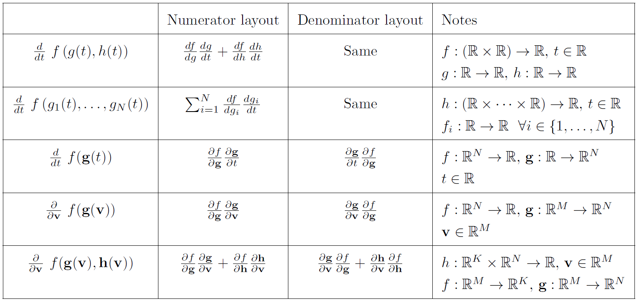
Multivariable Chain Rule

Slide 15
Backpropagation (vector version)

Slide 16

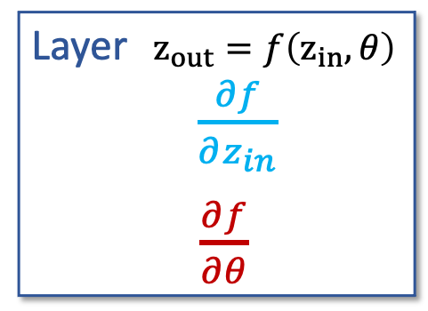

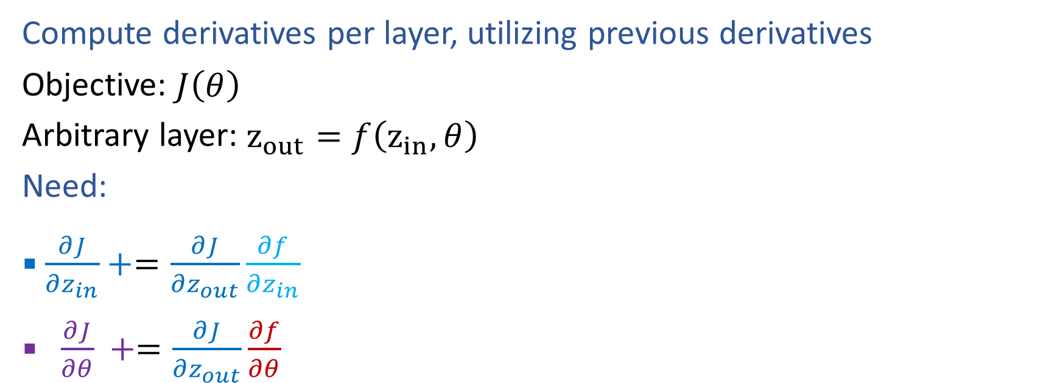




Generic Layer Implementation (updated)
Compute derivatives per layer, utilizing previous derivatives
Objective: $J\left(θ\right)$
Arbitrary layer: $z_{out}=f\left(z_{in}, θ\right)$
Need:
$\frac{∂J}{∂z_{in}}+=\frac{∂J}{∂z_{out}}\frac{∂f}{∂z_{in}}$
$\frac{∂J}{∂θ} +=\frac{∂J}{∂z_{out}}\frac{∂f}{∂θ}$
$$zout$$
$$zin$$
$$J$$
$$f$$
$$θ$$
$$z_{in}$$
Layer $z_{out}=f\left(z_{in}, θ\right)$
$\frac{∂f}{∂z_{in}}$
$\frac{∂f}{∂θ}$
$$z_{out}$$
$$\frac{∂J}{∂z_{in}}$$
$$\frac{∂J}{∂z_{out}}$$
$$θ$$
$$\frac{∂J}{∂θ}$$

Slide 17
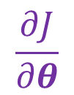

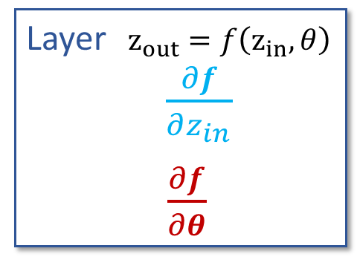





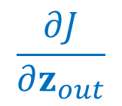


Generic Layer Implementation (vector output version)
Compute derivatives per layer, utilizing previous derivatives
Objective: $J\left(θ\right)$
Arbitrary layer: $z_{out}=f\left(z_{in}, θ\right)$
Need:
$\frac{∂J}{∂z_{in}}=$
$\frac{∂J}{∂θ_{j}} =$
$$zin$$
$$zout∈ℝ^{K}$$
$$J$$
$$f$$
$$θ∈ℝ^{M}$$
$$z_{in}$$
Layer $z_{out}=f\left(z_{in}, θ\right)$
$\frac{∂f}{∂z_{in}}$
$\frac{∂f}{∂θ}$
$$z_{out}$$
$$\frac{∂J}{∂z_{in}}$$
$$\frac{∂J}{∂z_{out}}$$
$$θ$$
$$\frac{∂J}{∂θ}$$

Slide 18




Generic Layer Implementation (vector output version)
Compute derivatives per layer, utilizing previous derivatives
Objective: $J\left(θ\right)$
Arbitrary layer: $z_{out}=f\left(z_{in}, θ\right)$
Need:
$\frac{∂J}{∂z_{in}}=\sum_{k}{\frac{∂J}{∂z_{out,k}}\frac{∂z_{out,k}}{∂z_{in}}}$
$\frac{∂J}{∂θ_{j}} =\sum_{k}{\frac{∂J}{∂z_{out,k}}\frac{∂f}{∂θ_{j}}}$
$$z_{out,1}$$
$$zin$$
$$zout∈ℝ^{K}$$
$$z_{out,2}$$
$$J$$
$$f$$
$$z_{out,3}$$
$$θ∈ℝ^{M}$$
$$z_{in}$$
Layer $z_{out}=f\left(z_{in}, θ\right)$
$\frac{∂f}{∂z_{in}}$
$\frac{∂f}{∂θ}$
$$z_{out}$$
$$\frac{∂J}{∂z_{in}}$$
$$\frac{∂J}{∂z_{out}}$$
$$θ$$
$$\frac{∂J}{∂θ}$$

Slide 19



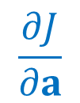


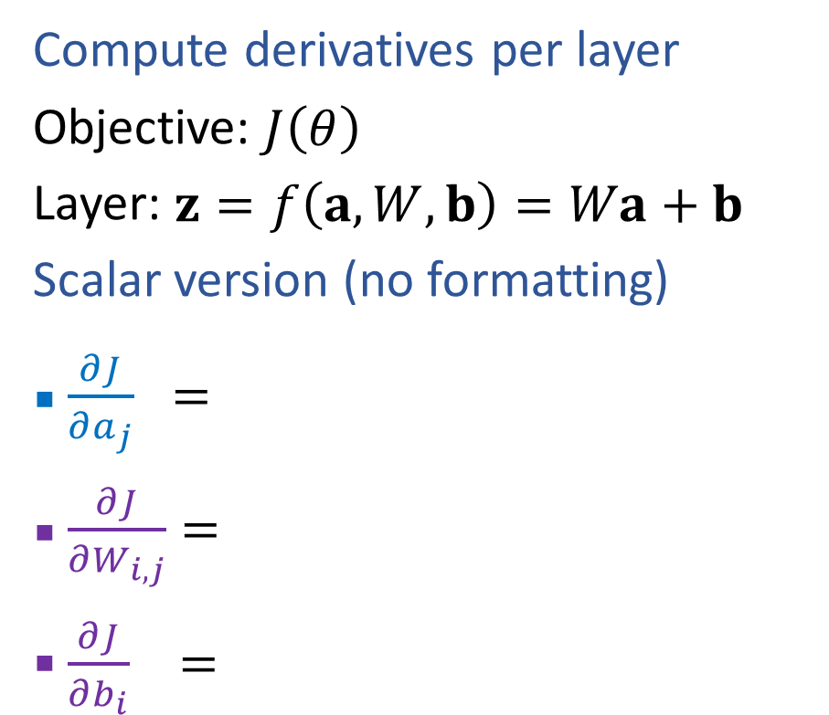






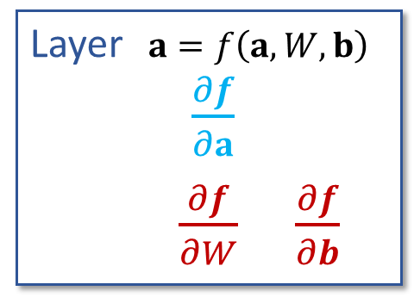
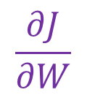

Linear Layer Implementation
$$a∈ℝ^{M}$$
$$z∈ℝ^{K}$$
$$J$$
$$f$$
$$W∈ℝ^{K×M}, b∈ℝ^{K}$$
Compute derivatives per layer
Objective: $J\left(θ\right)$
Layer: $z=f\left(a, W,b\right)=Wa+b$
Scalar version (no formatting)
$\frac{∂J}{∂a_{j}} =$
$\frac{∂J}{∂W_{i,j}}=$
$\frac{∂J}{∂b_{i}} =$
$$a$$
Layer $a=f\left(a, W,b\right)$
$\frac{∂f}{∂a}$
$\frac{∂f}{∂W}$ $\frac{∂f}{∂b}$
$$z$$
$$\frac{∂J}{∂a}$$
$$\frac{∂J}{∂z}$$
$$W b$$
$$\frac{∂J}{∂W}$$
$$\frac{∂J}{∂b}$$
$$z=Wa+b$$
$z_{k}=b_{k}+\sum_{j}{W_{k,j}a_{j}}$

Slide 20
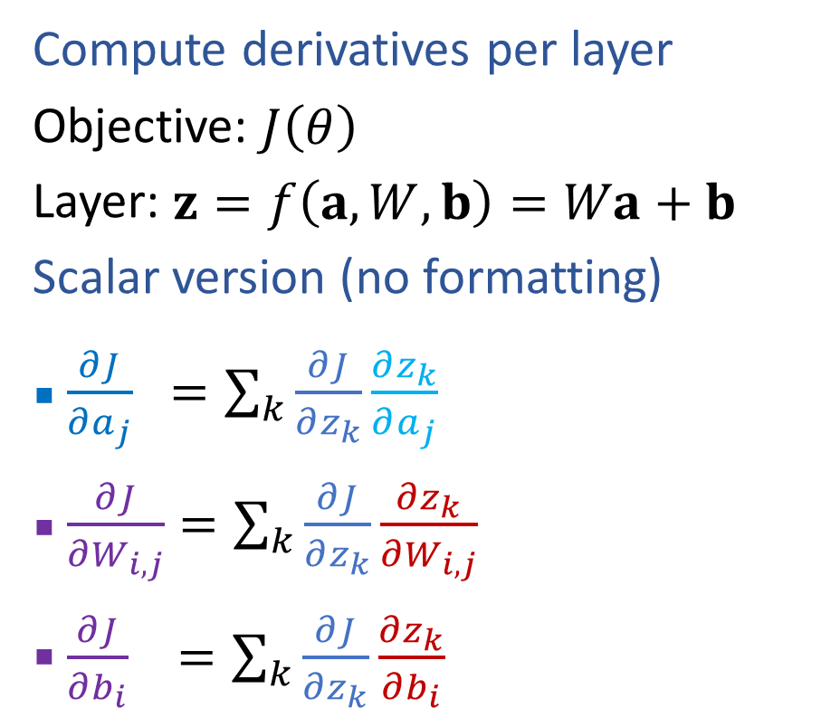
Linear Layer Implementation
$$a∈ℝ^{M}$$
$$z∈ℝ^{K}$$
$$J$$
$$f$$
$$W∈ℝ^{K×M}, b∈ℝ^{K}$$
Compute derivatives per layer
Objective: $J\left(θ\right)$
Layer: $z=f\left(a, W,b\right)=Wa+b$
Scalar version (no formatting)
$\frac{∂J}{∂a_{j}} =\sum_{k}{\frac{∂J}{∂z_{k}}}\frac{∂z_{k}}{∂a_{j}}$
$\frac{∂J}{∂W_{i,j}}=\sum_{k}{\frac{∂J}{∂z_{k}}}\frac{∂z_{k}}{∂W_{i,j}}$
$\frac{∂J}{∂b_{i}} =\sum_{k}{\frac{∂J}{∂z_{k}}}\frac{∂z_{k}}{∂b_{i}}$
$$a$$
Layer $a=f\left(a, W,b\right)$
$\frac{∂f}{∂a}$
$\frac{∂f}{∂W}$ $\frac{∂f}{∂b}$
$$z$$
$$\frac{∂J}{∂a}$$
$$\frac{∂J}{∂z}$$
$$W b$$
$$\frac{∂J}{∂W}$$
$$\frac{∂J}{∂b}$$
$$z=Wa+b$$
$z_{k}=b_{k}+\sum_{j}{W_{k,j}a_{j}}$

Slide 21
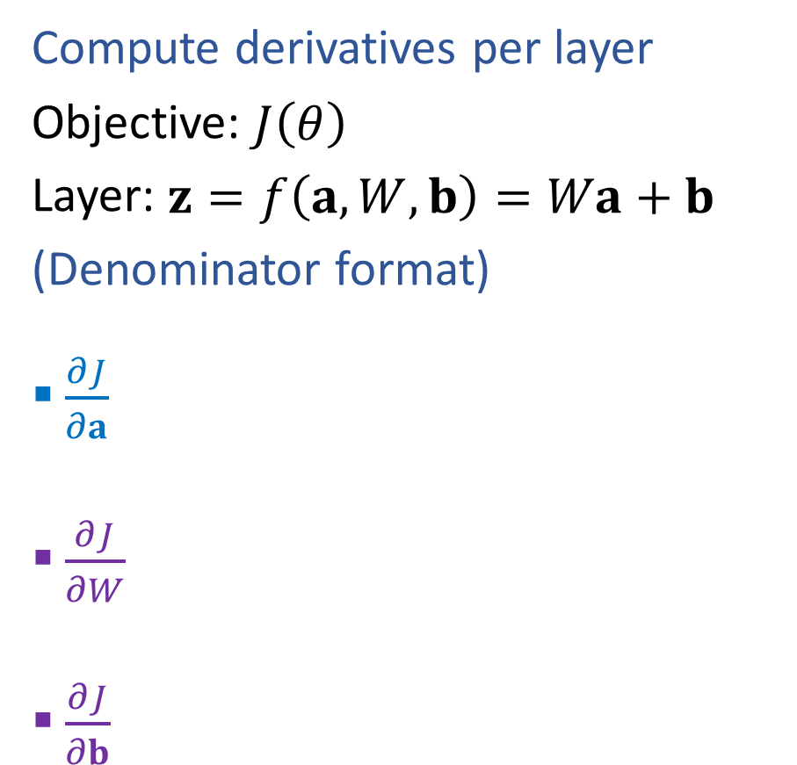


Linear Layer Implementation
$$a∈ℝ^{M}$$
$$z∈ℝ^{K}$$
$$J$$
$$f$$
$$W∈ℝ^{K×M}, b∈ℝ^{K}$$
Compute derivatives per layer
Objective: $J\left(θ\right)$
Layer: $z=f\left(a, W,b\right)=Wa+b$
(Denominator format)
$\frac{∂J}{∂a}$
$\frac{∂J}{∂W}$
$\frac{∂J}{∂b}$
$$a$$
Layer $z=f\left(a, W,b\right)$
$\frac{∂f}{∂a}$
$\frac{∂f}{∂W}$ $\frac{∂f}{∂b}$
$$z$$
$$\frac{∂J}{∂a}$$
$$\frac{∂J}{∂z}$$
$$W b$$
$$\frac{∂J}{∂W}$$
$$\frac{∂J}{∂b}$$

Slide 22
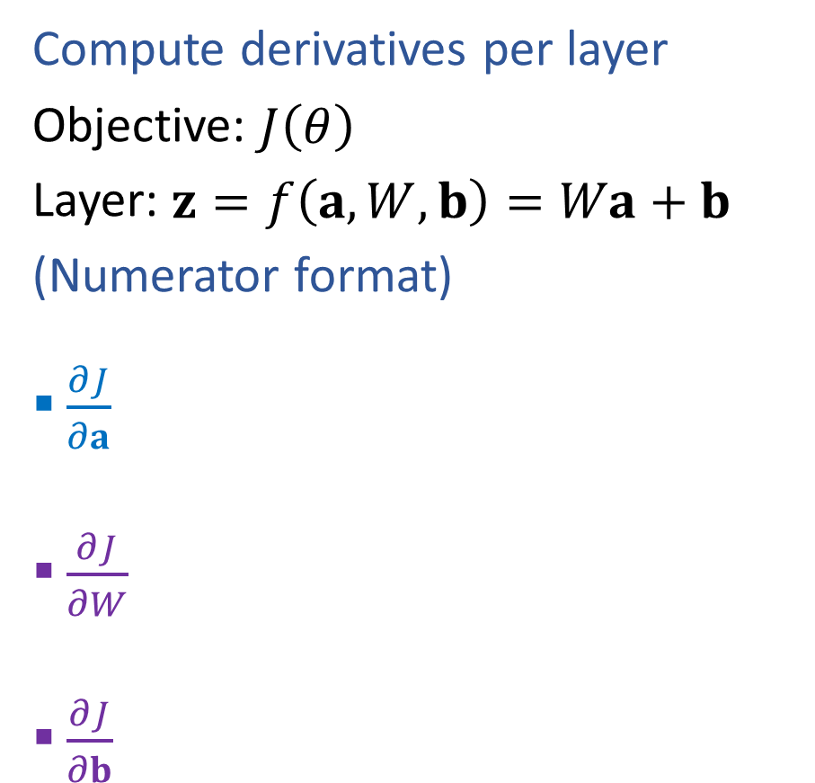
Linear Layer Implementation
$$a∈ℝ^{M}$$
$$z∈ℝ^{K}$$
$$J$$
$$f$$
$$W∈ℝ^{K×M}, b∈ℝ^{K}$$
Compute derivatives per layer
Objective: $J\left(θ\right)$
Layer: $z=f\left(a, W,b\right)=Wa+b$
(Numerator format)
$\frac{∂J}{∂a}$
$\frac{∂J}{∂W}$
$\frac{∂J}{∂b}$
$$a$$
Layer $z=f\left(a, W,b\right)$
$\frac{∂f}{∂a}$
$\frac{∂f}{∂W}$ $\frac{∂f}{∂b}$
$$z$$
$$\frac{∂J}{∂a}$$
$$\frac{∂J}{∂z}$$
$$W b$$
$$\frac{∂J}{∂W}$$
$$\frac{∂J}{∂b}$$

Slide 23
Outline
Last time: Neural Networks
Three-neuron network + optimization
Neural network structure (adding more neurons)
Forward pass and Backpropagation (scalar version)
Today: Neural Networks
Calculus: multi-variate chain rule
Backpropagation (vector version)
Neural Network Properties and Intuition

Slide 24
Neural Network Properties

Slide 25
Neural Networks Properties
Practical considerations
Large number of neurons
Danger for overfitting
Modeling assumptions vs data assumptions trade-off
Gradient descent can easily get stuck local optima
What if there are no non-linear activations?
A deep neural network with only linear layers can be reduced to an exactly equivalent single linear layer
Universal Approximation Theorem:
A two-layer neural network with a sufficient number of neurons can approximate any continuous function to any desired accuracy.

Slide 26
Neural Networks Properties
Non-linearity
Fitting complex functions
Fitting any! function (universal approximation theorem)
Overfitting

Slide 27
Neural Network Properties
Non-linearity

Slide 28
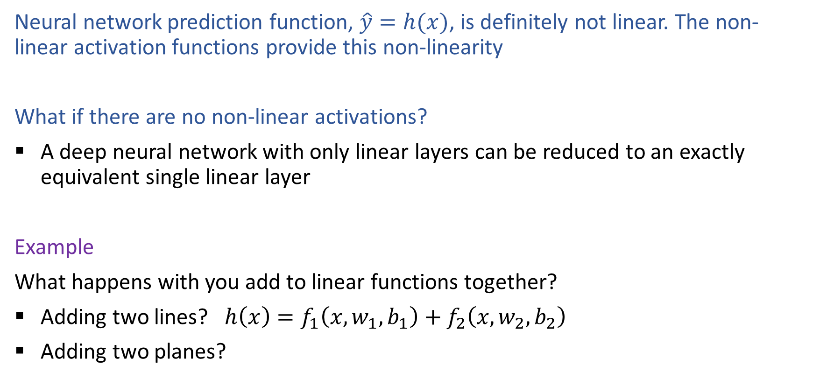
Non-linearity
Neural network prediction function, $\hat{y}=h(x)$, is definitely not linear. The non-linear activation functions provide this non-linearity
What if there are no non-linear activations?
A deep neural network with only linear layers can be reduced to an exactly equivalent single linear layer
Example
What happens with you add to linear functions together?
Adding two lines? $h\left(x\right)=f_{1}\left(x, w_{1},b_{1}\right)+f_{2}\left(x, w_{2}, b_{2}\right)$
Adding two planes?

Slide 29
Objective Function is Not Convex
Objective function for… | Convex? | Closed-form solution?
Linear regression
Logistic regression
Neural networks

Slide 30
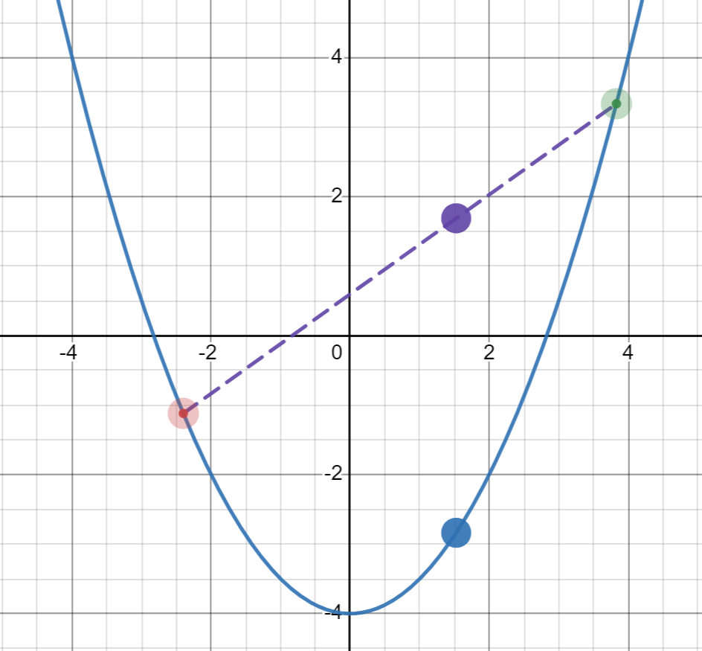

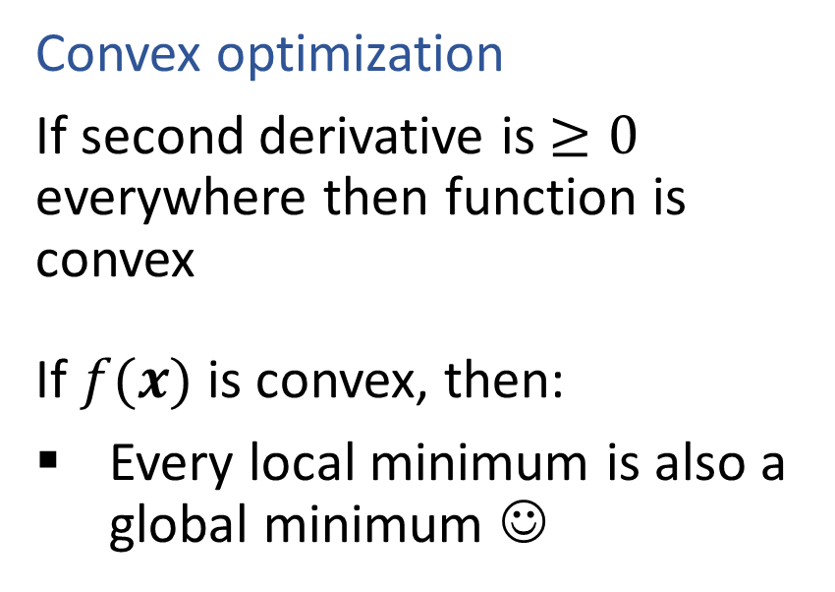
Optimization
Convex function
If $f(x)$ is convex, then:
$f\left(αx+\left(1−α\right)z\right)≤αf\left(x\right)+\left(1−α\right)f\left(z\right)$ $∀ 0≤α≤1$
Convex optimization
If second derivative is $≥0$ everywhere then function is convex
If $f(x)$ is convex, then:
Every local minimum is also a global minimum ☺

Slide 31
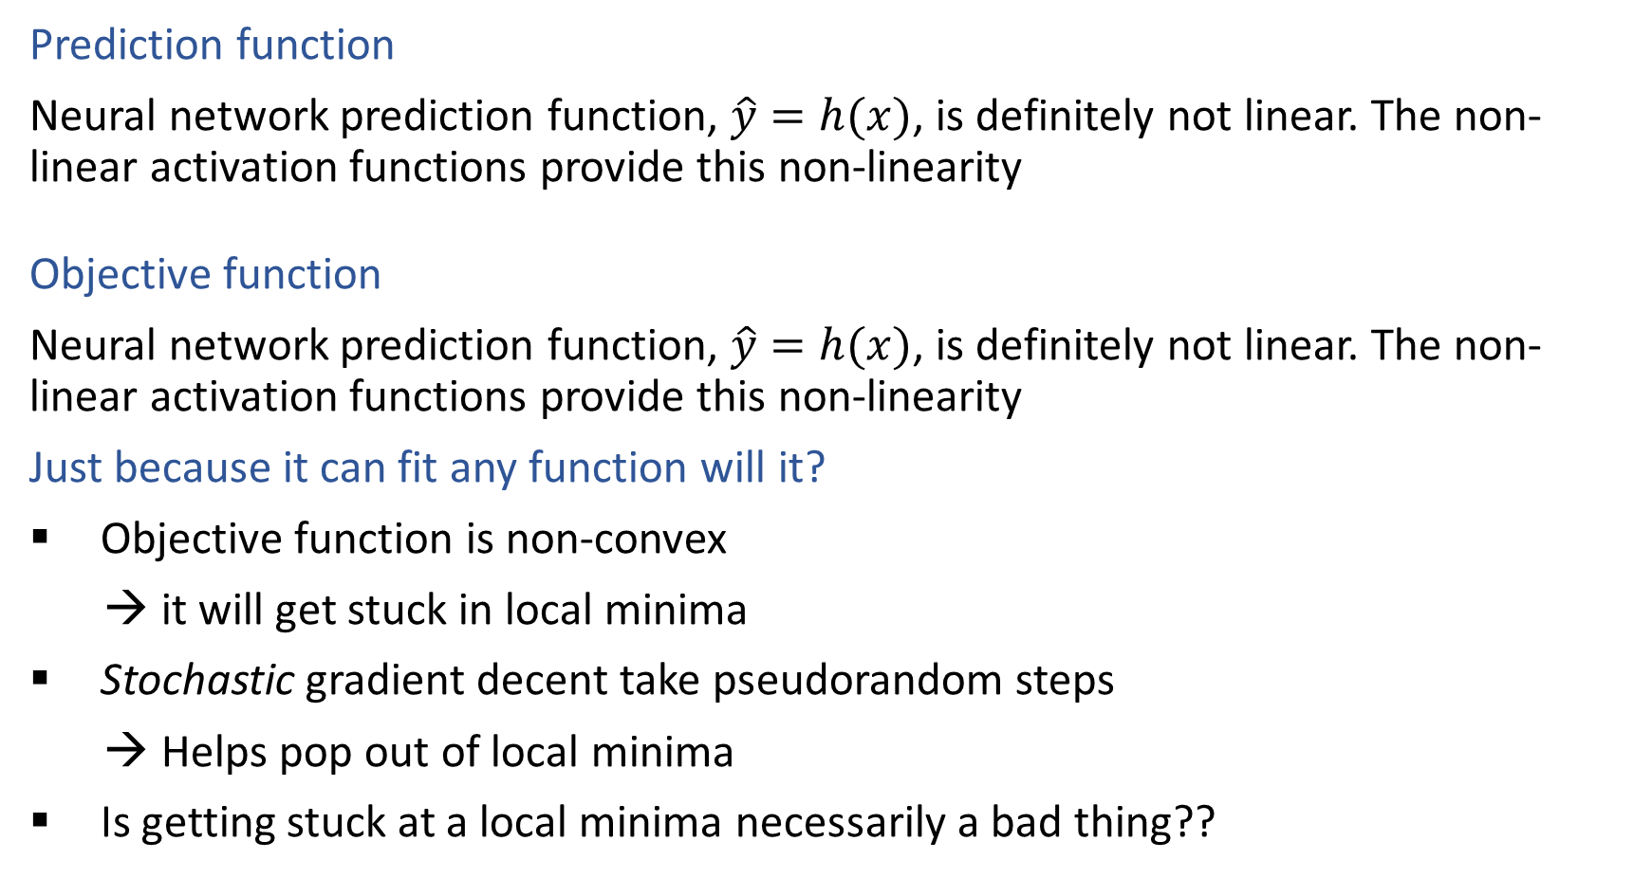
Non-linearity
Prediction function
Neural network prediction function, $\hat{y}=h(x)$, is definitely not linear. The non-linear activation functions provide this non-linearity
Objective function
Neural network prediction function, $\hat{y}=h(x)$, is definitely not linear. The non-linear activation functions provide this non-linearity
Just because it can fit any function will it?
Objective function is non-convex
→ it will get stuck in local minima
Stochastic gradient decent take pseudorandom steps
→ Helps pop out of local minima
Is getting stuck at a local minima necessarily a bad thing??

Slide 32
Neural Network Properties
Fitting complex functions (with 1-D input)

Slide 33
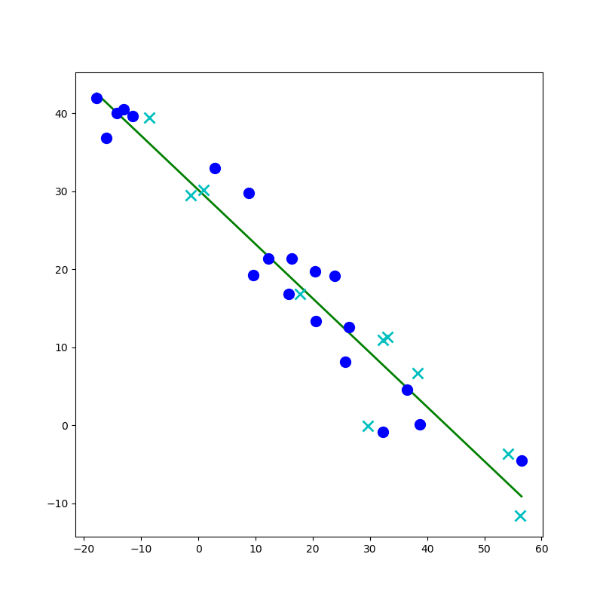
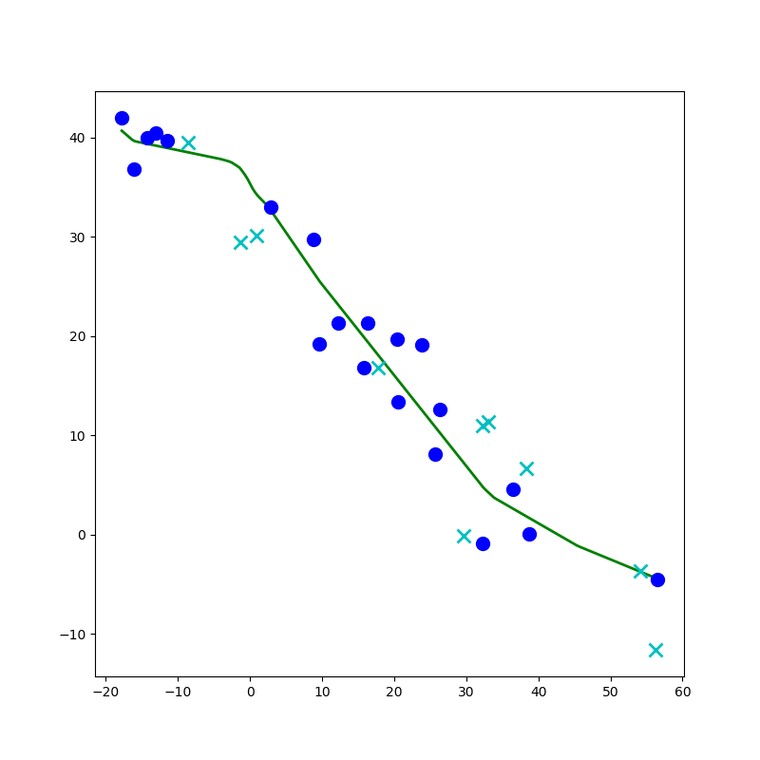
Network to Approximate a 1-D Function

Slide 34
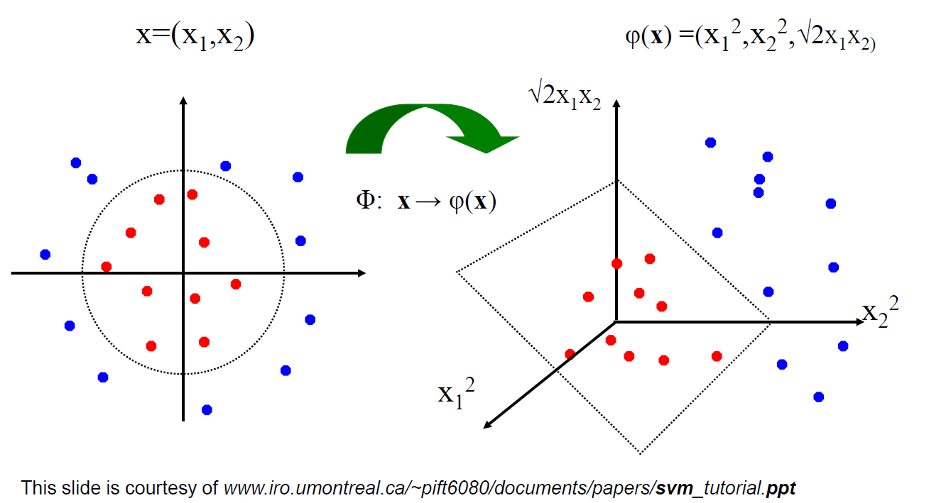
Linear Classifiers for Nonlinear Data
Linear classifiers have linear decision boundaries
Feature mapping can convert nonlinear data to higher dimensions
Today, instead of choosing a feature mapping function, we’ll use neural networks to learn nonlinear decision boundaries and regression functions

Slide 35
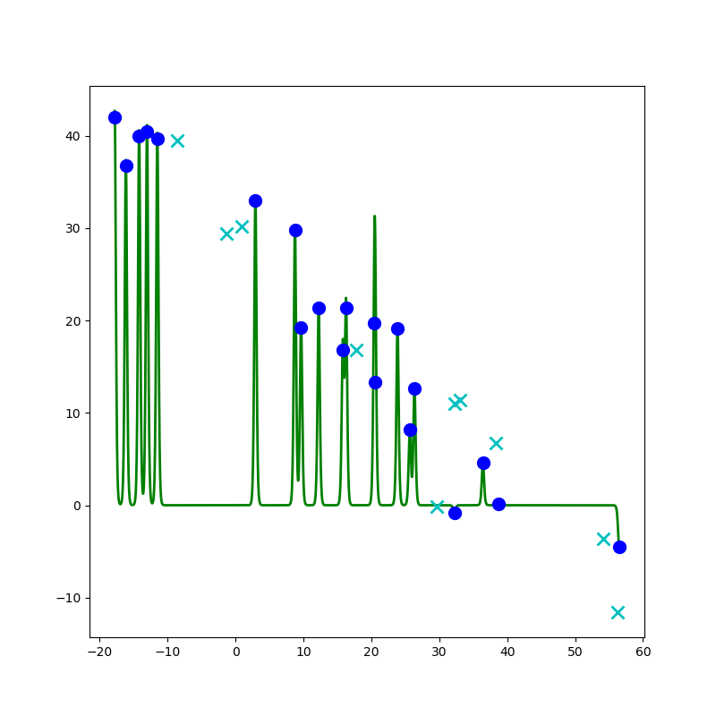
Network to Approximate a 1-D Function

Slide 36
Network to Approximate a 1-D Function
Design a network to approximate this function using:
Linear, Sigmoid, Step, or ReLU

Slide 37
Network to Approximate a 1-D Function

Slide 38
Neural Network Properties
Fitting complicated functions (with 2-D input)

Slide 39


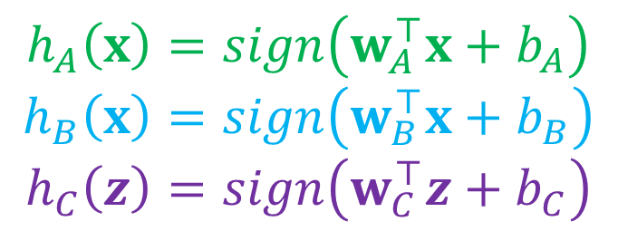
Classification Design Challenge
$$h_{A}\left(x\right)=sign\left(w_{A}^{⊤}x+b_{A}\right)$$
$$h_{B}\left(x\right)=sign\left(w_{B}^{⊤}x+b_{B}\right)$$
$$h_{C}\left(z\right)=sign\left(w_{C}^{⊤}z+b_{C}\right)$$
How could you configure three specific perceptrons to classify this data?
$$x2$$
$$x1$$

Slide 40
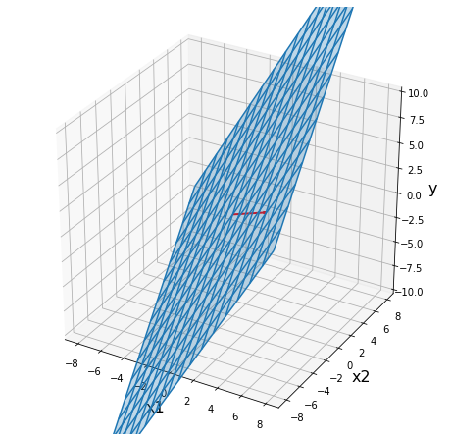
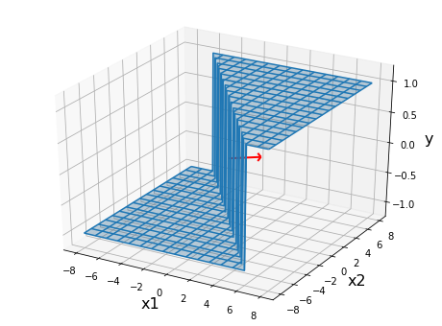
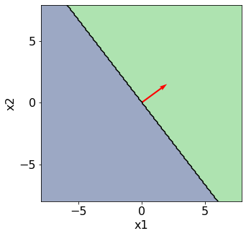
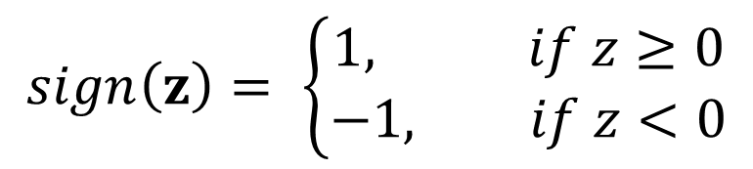

Perceptron
$$sign\left(z\right)= \left\{\begin{aligned}1, if z≥0 \\ −1, if z<0\end{aligned}\right.$$
Classification: Hard threshold on linear model
$$h\left(x\right)=sign\left(w^{⊤}x+b\right)$$

Slide 41
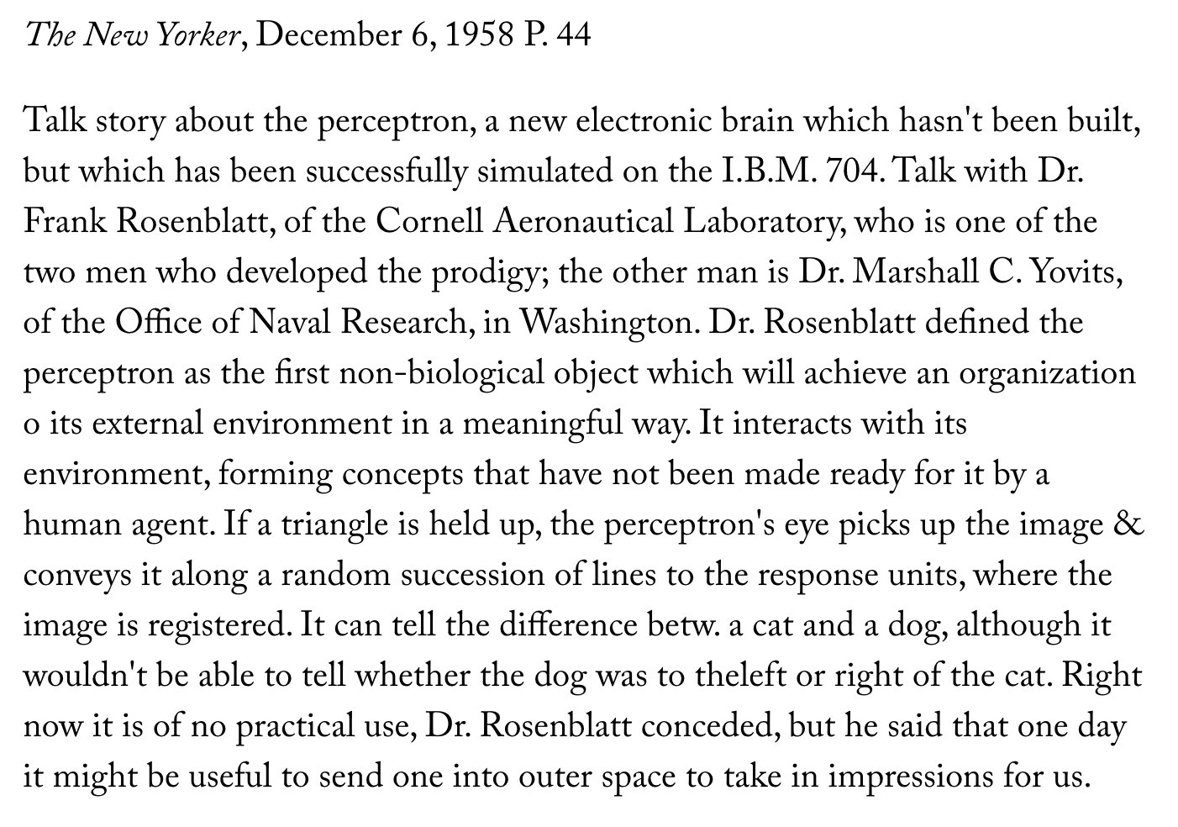
Perceptron History
Frank Rosenblatt, 1957

Slide 42

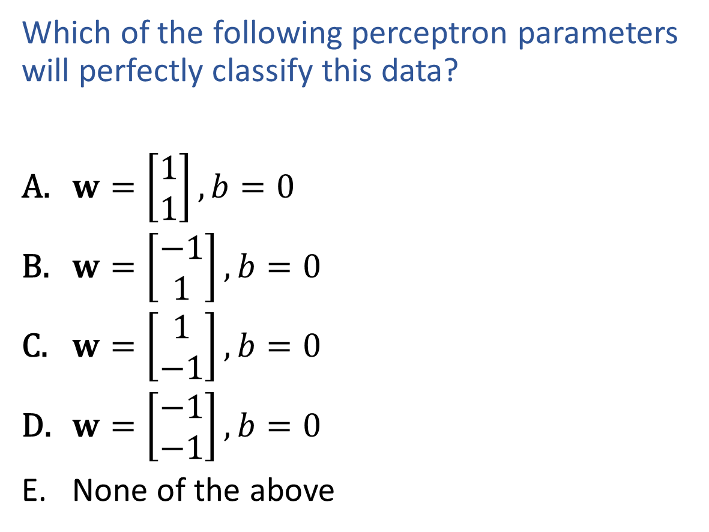
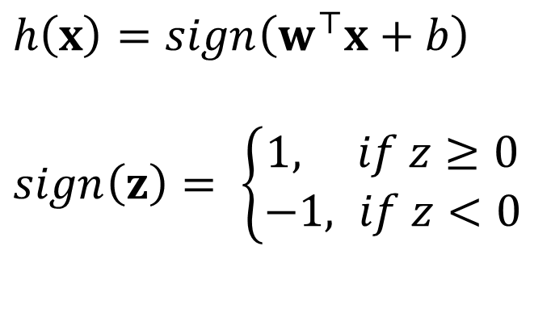

Exercise
$h\left(x\right)=sign\left(w^{⊤}x+b\right)$
$sign\left(z\right)= \left\{\begin{aligned}1, if z≥0 \\ −1, if z<0\end{aligned}\right.$
Which of the following perceptron parameters will perfectly classify this data?
$w=\left[\begin{aligned}1 \\ 1\end{aligned}\right], b=0$
$w=\left[\begin{aligned}−1 \\ 1\end{aligned}\right], b=0$
$w=\left[\begin{aligned}1 \\ −1\end{aligned}\right], b=0$
$w=\left[\begin{aligned}−1 \\ −1\end{aligned}\right], b=0$
None of the above
$$x2$$
$$x1$$

Slide 43
Poll
$h\left(x\right)=sign\left(w^{⊤}x+b\right)$
$sign\left(z\right)= \left\{\begin{aligned}1, if z≥0 \\ −1, if z<0\end{aligned}\right.$
Which of the following perceptron parameters will perfectly classify this data?
$w=\left[\begin{aligned}1 \\ 1\end{aligned}\right], b=0$
$w=\left[\begin{aligned}−1 \\ 1\end{aligned}\right], b=0$
$w=\left[\begin{aligned}1 \\ −1\end{aligned}\right], b=0$
$w=\left[\begin{aligned}−1 \\ −1\end{aligned}\right], b=0$
None of the above
$$x2$$
$$x1$$

Slide 44

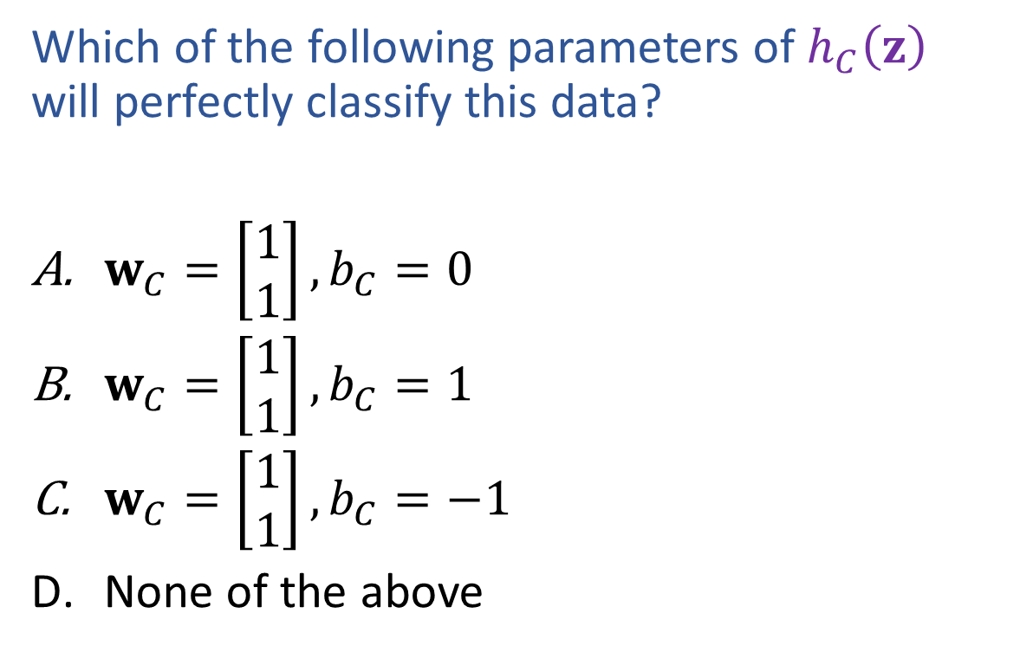


Poll
$$h_{C}\left(z\right)=sign\left(w_{C}^{⊤}z+b_{C}\right)$$
$sign\left(x\right)= \left\{\begin{aligned}1, if x≥0 \\ −1, if x<0\end{aligned}\right.$
Which of the following parameters of $h_{C}\left(z\right)$ will perfectly classify this data?
$w_{C}=\left[\begin{aligned}1 \\ 1\end{aligned}\right], b_{C}=0$
$w_{C}=\left[\begin{aligned}1 \\ 1\end{aligned}\right], b_{C}=1$
$w_{C}=\left[\begin{aligned}1 \\ 1\end{aligned}\right], b_{C}=−1$
None of the above
$$z2$$
$$z1$$

Slide 45
Classification Design Challenge
$$h_{A}\left(x\right)=sign\left(w_{A}^{⊤}x+b_{A}\right)$$
$$h_{B}\left(x\right)=sign\left(w_{B}^{⊤}x+b_{B}\right)$$
$$h_{C}\left(z\right)=sign\left(w_{C}^{⊤}z+b_{C}\right)$$
How could you configure three specific perceptrons to classify this data?
$$x2$$
$$x1$$

Slide 46

Network to Approximate Binary Classification
https://playground.tensorflow.org/#activation=sigmoid

Slide 47

Network to Approximate Binary Classification
Approximate arbitrary decision boundary
https://cs.stanford.edu/people/karpathy/convnetjs/demo/classify2d.html

Slide 48


Network to Approximate Binary Classification
Approximate arbitrary decision boundary
https://cs.stanford.edu/people/karpathy/convnetjs/demo/classify2d.html

Slide 49
Network to Approximate Binary Classification
Approximate arbitrary decision boundary
https://cs.stanford.edu/people/karpathy/convnetjs/demo/classify2d.html

Slide 50
Neural Network Properties
(Over?) Fitting any function

Slide 51
Neural Networks Properties
Universal Approximation Theorem
A two-layer neural network with a sufficient number of neurons can approximate any continuous function to any desired accuracy
Reminder
Just because it can fit any function will it?
Objective function is non-convex
→ it will get stuck in local minima
Stochastic gradient decent take pseudorandom steps
→ Helps pop out of local minima
Is getting stuck at a local minima necessarily a bad thing??

Slide 52
Network to Approximate a 1-D Function

Slide 53
Debugging Overfitting and Underfitting
Underfitting (check this first!)
Evidence: poor training loss (and poor validation loss)
Note: Compare with human performance as a baseline, i.e., make sure the task isn't impossible for a human (with unlimited resources)
Try: Adding more capacity to network (wider or deeper)
But how do we choose a new network structure?
Overfitting
Evidence: good training loss, but poor validation loss
Evidence: really large parameter values
Try: Regularization (we'll learn about this soon!)
Try: Adding more data

Slide 54
Summary: Neural Networks Properties
Practical considerations
Large number of neurons
Danger for overfitting
Modeling assumptions vs data assumptions trade-off
Gradient descent can easily get stuck local optima
What if there are no non-linear activations?
A deep neural network with only linear layers can be reduced to an exactly equivalent single linear layer
Universal Approximation Theorem:
A two-layer neural network with a sufficient number of neurons can approximate any continuous function to any desired accuracy.

