Slide 1

10-315
Introduction to ML
Optimization and Linear Regression
Instructor: Pat Virtue

Slide 2
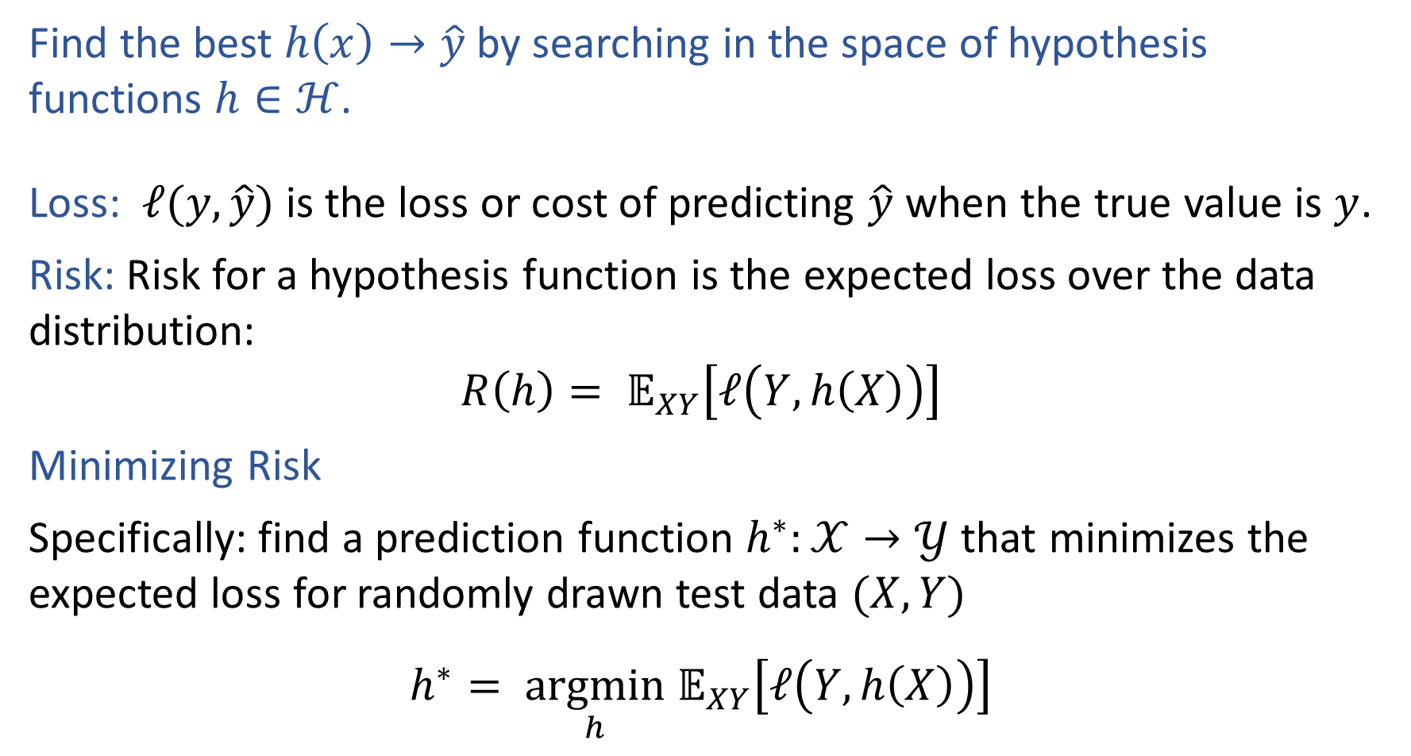
Pre-reading: Optimization Formulation
Find the best $h\left(x\right)→\hat{y}$ by searching in the space of hypothesis functions $h∈ℋ$.
Loss: $ℓ(y, \hat{y})$ is the loss or cost of predicting $\hat{y}$ when the true value is $y$.
Risk: Risk for a hypothesis function is the expected loss over the data distribution:
$$R\left(h\right)= 𝔼_{XY}\left[ℓ\left(Y, h\left(X\right)\right)\right]$$
Minimizing Risk
Specifically: find a prediction function $h^{∗}:𝒳→𝒴$ that minimizes the expected loss for randomly drawn test data $(X, Y)$
$$h^{∗}= \underset{h}{argmin} 𝔼_{XY}\left[ℓ\left(Y, h\left(X\right)\right)\right]$$

Slide 3

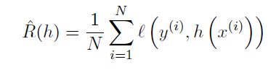


Pre-reading: Empirical Risk Minimization
Risk
Empirical Risk
Empirical Risk Minimization

Slide 4

Pre-reading: Loss Functions
$$h^{∗}= \underset{h}{argmin} 𝔼_{XY}\left[L\left(Y, h\left(X\right)\right)\right]$$
Loss function:
$L:𝒴×𝒴→ℝ$
Classification:
Two-class, 0,1 loss
Two-class, arbitrary loss
False positives and false negatives:

Slide 5
Poll (unused)
For a healthcare classification problem where:
Y=0 represents a negative test for cancer (healthy)
Y=1 represents a positive test for cancer (sick)
Which two-class loss value should be highest?
True negative
False negative
False positive
True positive

Slide 6
Poll (unused)
Does our decision tree algorithm (recursively finding the best attribute to split on a each node) find a hypothesis that minimizes empirical risk for zero-one loss?
Yes, always
Yes, but only when splitting with error rate
Yes, but only when splitting with mutual information
No

Slide 7
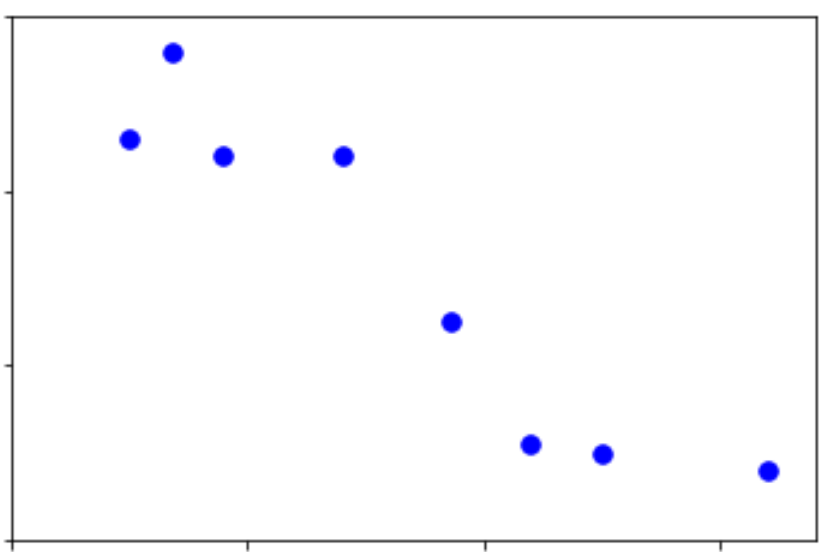
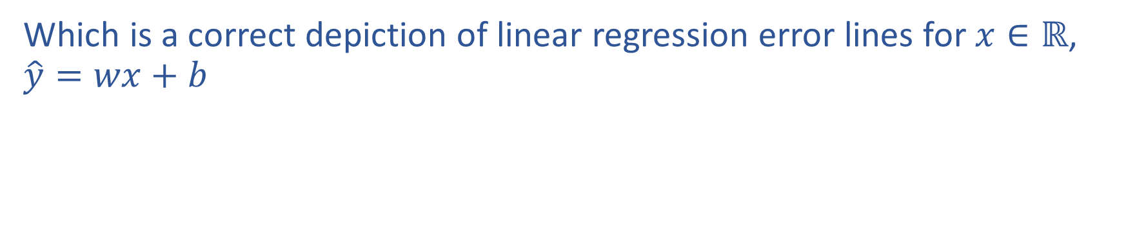
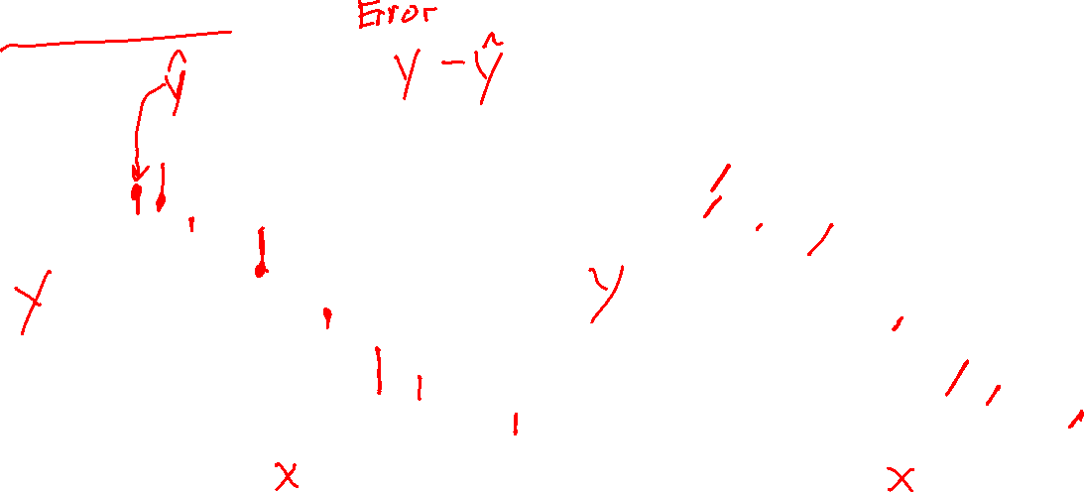
Poll 1
Which is a correct depiction of linear regression error lines for $x∈ℝ$, $\hat{y}=wx+b$
A
B

Slide 8
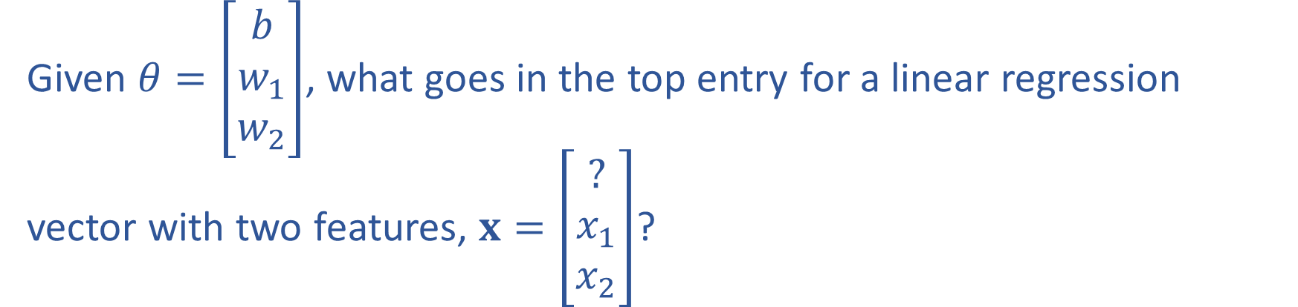
Poll 2
Given $θ=\left[\begin{matrix}b \\ w_{1} \\ w_{2}\end{matrix}\right]$, what goes in the top entry for a linear regression vector with two features, $x=\left[\begin{matrix}? \\ x_{1} \\ x_{2}\end{matrix}\right]$?

Slide 9
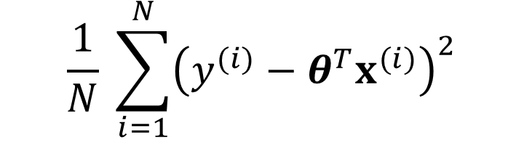
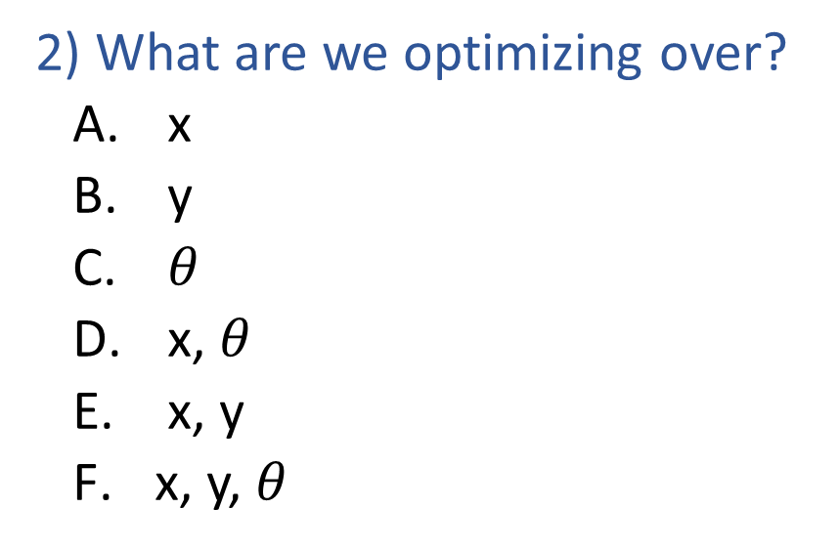
Poll 3: Two questions
Fill in the blanks: Linear regession optimization
$$\frac{1}{N} \sum_{i=1}^{N}{{\left(y^{(i)}−θ^{T}x^{(i)}\right)}^{2}}$$
_1) ____?_____
_2) ?__
1) What type of optimization?
  min
  max
  argmin
  argmax
2) What are we optimizing over?
  x
  y
  $θ$
  x, $θ$
  x, y
  x, y, $θ$

Slide 10
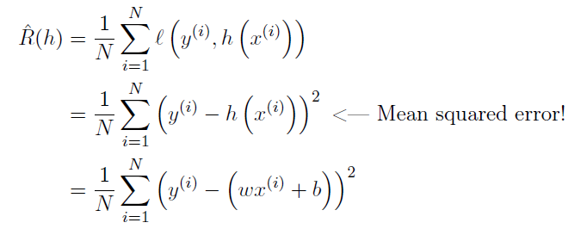
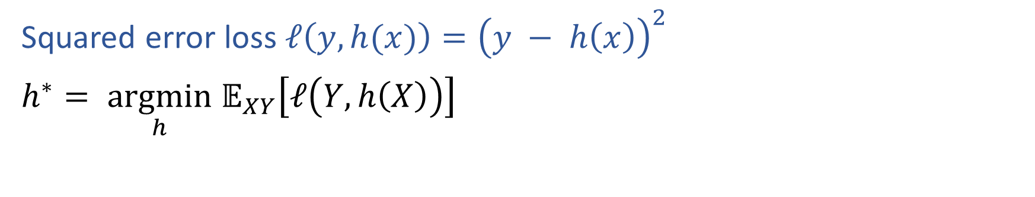
Pre-reading: Risk in Regression
Squared error loss $ℓ\left(y, h(x)\right)={\left(y − h\left(x\right)\right)}^{2}$
$h^{∗}= \underset{h}{argmin} 𝔼_{XY}\left[ℓ\left(Y, h\left(X\right)\right)\right]$

Slide 11
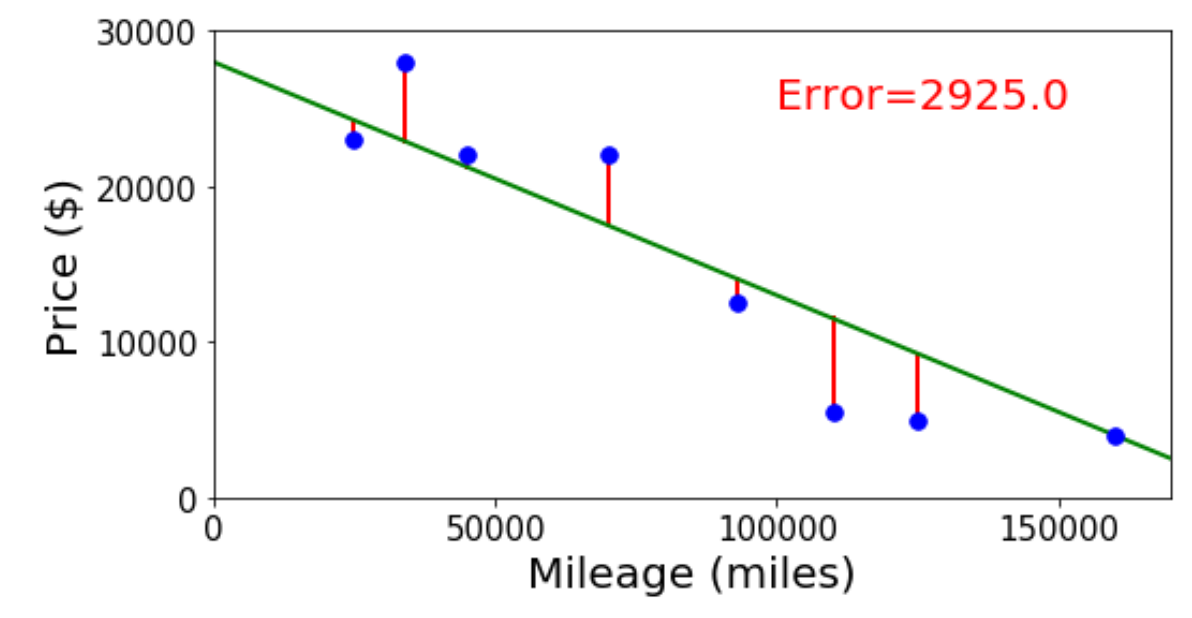
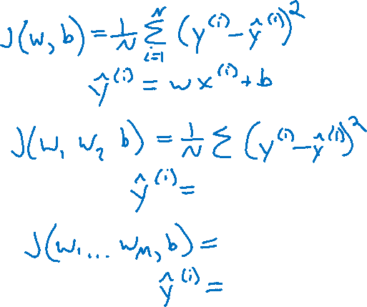
Linear Regression Optimzation
Finding the parameter values that minimize the mean squared error objective function

Slide 12
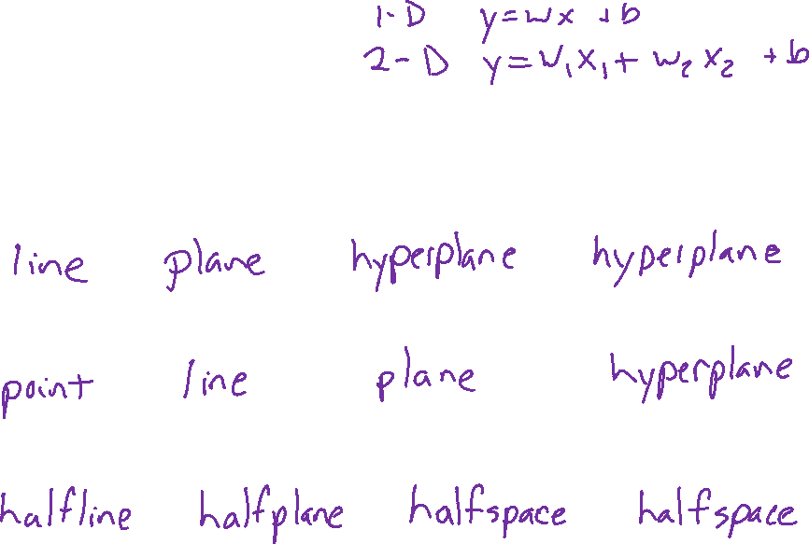





Linear in Higher Dimensions
What are these linear shapes called for 1-D, 2-D, 3-D, M-D input?
$$x∈ℝ$$
$$x∈ℝ^{2}$$
$$x∈ℝ^{3}$$
$$x∈ℝ^{M}$$
$y=w^{T}x+b$
$w^{T}x+b=0$
$w^{T}x+b≥0$

Slide 13

Linear Regression Optimzation
Finding the parameter values that minimize the mean squared error objective function

Slide 14
Contructing the Design Matrix

Slide 15
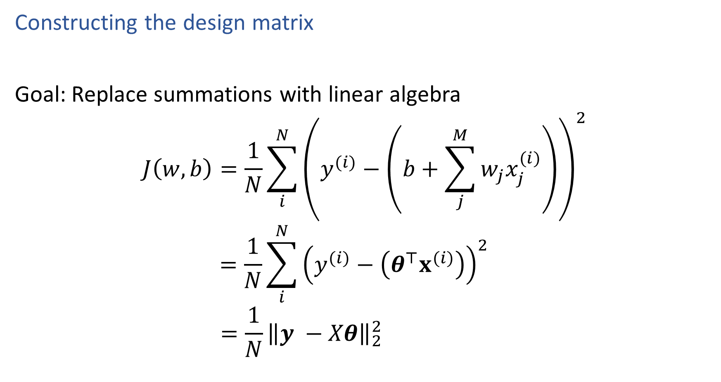
Linear Algebra Formulation
Constructing the design matrix
Goal: Replace summations with linear algebra
$$J\left(w, b\right)=\frac{1}{N}\sum_{i}^{N}{{\left(y^{(i)}−\left(b+\sum_{j}^{M}{w_{j}x_{j}^{(i)}}\right)\right)}^{2}}$$
$$=\frac{1}{N}\sum_{i}^{N}{{\left(y^{(i)}−\left(θ^{⊤}x^{(i)}\right)\right)}^{2}}$$
$$=\frac{1}{N}{\left\|y −Xθ\right\|}_{2}^{2}$$
← From pre-reading

Slide 16
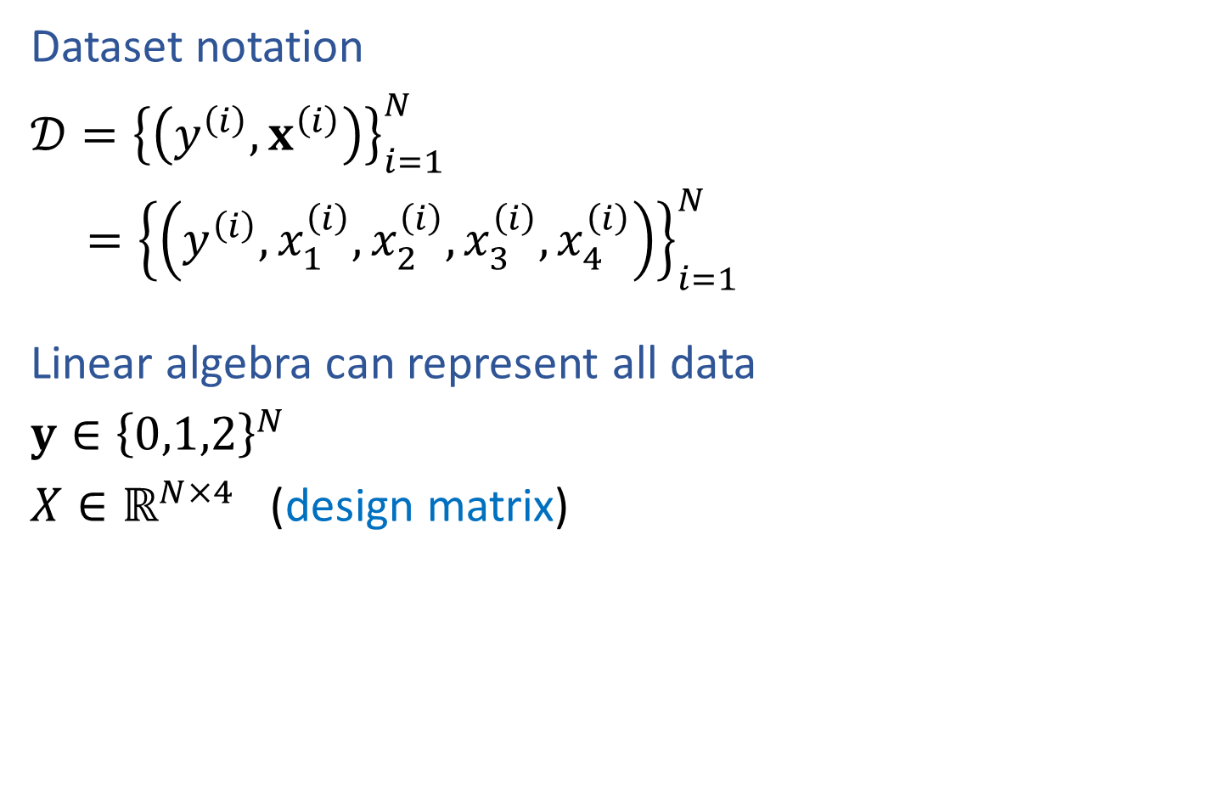
Reminder (Lec 2): Dataset notation
Dataset notation
$𝒟={\left\{\left(y^{\left(i\right)}, x^{\left(i\right)}\right)\right\}}_{i=1}^{N}$
$={\left\{\left(y^{\left(i\right)}, x_{1}^{\left(i\right)},x_{2}^{\left(i\right)},x_{3}^{\left(i\right)},x_{4}^{\left(i\right)}\right)\right\}}_{i=1}^{N}$
Linear algebra can represent all data
$y∈{\left\{0,1,2\right\}}^{N}$
$X∈ℝ^{N×4}$ (design matrix)
Species | Sepal Length | Sepal Width | Petal Length | Petal Width
0 | 4.3 | 3.0 | 1.1 | 0.1
0 | 4.9 | 3.6 | 1.4 | 0.1
0 | 5.3 | 3.7 | 1.5 | 0.2
1 | 4.9 | 2.4 | 3.3 | 1.0
1 | 5.7 | 2.8 | 4.1 | 1.3
1 | 6.3 | 3.3 | 4.7 | 1.6
2 | 5.9 | 3.0 | 5.1 | 1.8

Slide 17
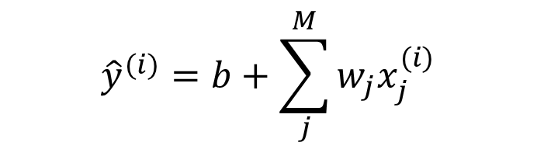
Linear Algebra Formulation
$${\hat{y}}^{(i)}=b+\sum_{j}^{M}{w_{j}x_{j}^{(i)}}$$
Constructing the design matrix
Species | Sepal Length | Sepal Width | Petal Length | Petal Width
0 | 4.3 | 3.0 | 1.1 | 0.1
0 | 4.9 | 3.6 | 1.4 | 0.1
0 | 5.3 | 3.7 | 1.5 | 0.2
1 | 4.9 | 2.4 | 3.3 | 1.0
1 | 5.7 | 2.8 | 4.1 | 1.3
1 | 6.3 | 3.3 | 4.7 | 1.6
2 | 5.9 | 3.0 | 5.1 | 1.8

Slide 18
Linear Algebra Formulation
$${\hat{y}}^{(i)}=b+\sum_{j}^{M}{w_{j}x_{j}^{(i)}}$$
Constructing the design matrix
Species
0
0
0
1
1
1
2
Sepal Length | Sepal Width | Petal Length | Petal Width
4.3 | 3.0 | 1.1 | 0.1
4.9 | 3.6 | 1.4 | 0.1
5.3 | 3.7 | 1.5 | 0.2
4.9 | 2.4 | 3.3 | 1.0
5.7 | 2.8 | 4.1 | 1.3
6.3 | 3.3 | 4.7 | 1.6
5.9 | 3.0 | 5.1 | 1.8

Slide 19


Linear Algebra Formulation
$${\hat{y}}^{(i)}=b+\sum_{j}^{M}{w_{j}x_{j}^{(i)}}$$
Constructing the design matrix
$${\hat{y}}^{(i)}=θ^{⊤}x^{(i)}$$
Species
0
0
0
1
1
1
2
(account for bias) | Sepal Length | Sepal Width | Petal Length | Petal Width
1 | 4.3 | 3.0 | 1.1 | 0.1
1 | 4.9 | 3.6 | 1.4 | 0.1
1 | 5.3 | 3.7 | 1.5 | 0.2
1 | 4.9 | 2.4 | 3.3 | 1.0
1 | 5.7 | 2.8 | 4.1 | 1.3
1 | 6.3 | 3.3 | 4.7 | 1.6
1 | 5.9 | 3.0 | 5.1 | 1.8

Slide 20
Linear Regression
System of Equations

Slide 21
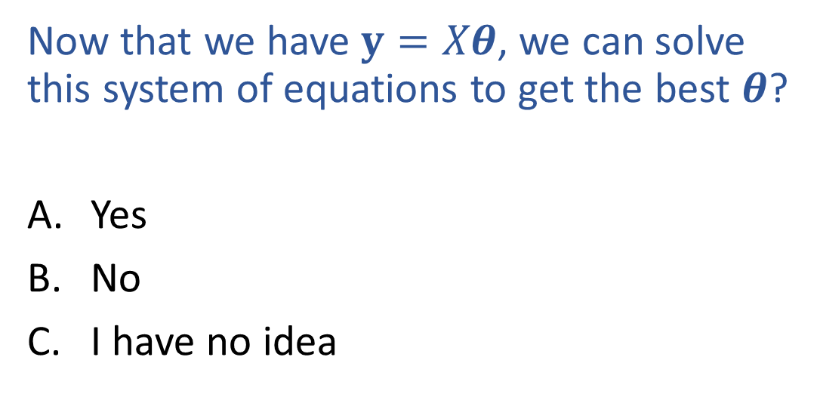
Poll 4
Now that we have $y=Xθ$, we can solve this system of equations to get the best $θ$?
Yes
No
I have no idea

Slide 22

Linear Regression
Number of solutions? Objective function value, $J\left(θ\right)$?
Output y
Input x

Slide 23
Linear Regression
Linear algebra formulation

Slide 24
Closed-form Solution

Slide 25
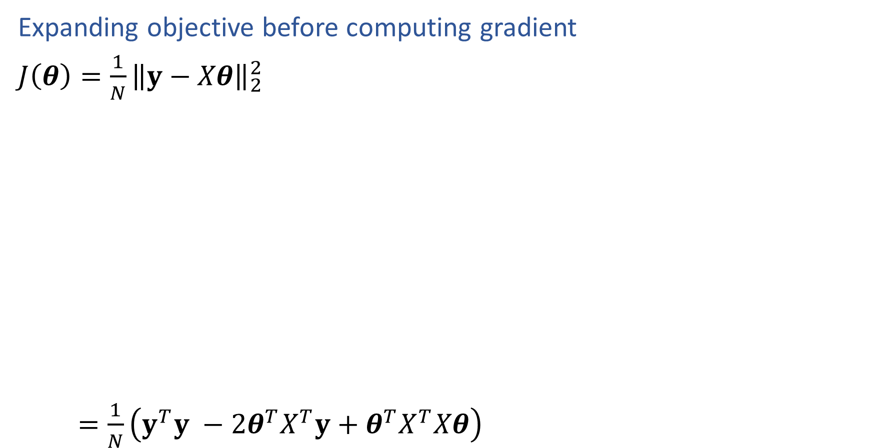

Linear Regression
Expanding objective before computing gradient
$J\left(θ\right)=\frac{1}{N}{\left\|y−Xθ\right\|}_{2}^{2}$
$=\frac{1}{N}\left(y^{T}y −2θ^{T}X^{T}y+θ^{T}X^{T}Xθ\right)$

Slide 26
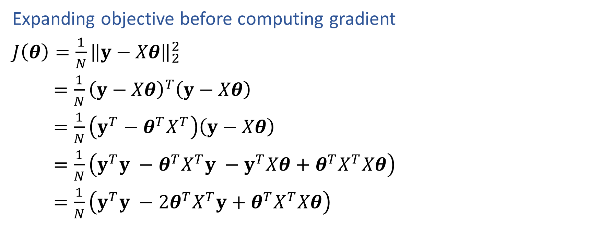
Linear Regression
Expanding objective before computing gradient
$J\left(θ\right)=\frac{1}{N}{\left\|y−Xθ\right\|}_{2}^{2}$
$=\frac{1}{N}{\left(y−Xθ\right)}^{T}\left(y−Xθ\right)$
$=\frac{1}{N}\left(y^{T}−θ^{T}X^{T}\right)\left(y−Xθ\right)$
$=\frac{1}{N}\left(y^{T}y −θ^{T}X^{T}y −y^{T}Xθ+θ^{T}X^{T}Xθ\right)$
$=\frac{1}{N}\left(y^{T}y −2θ^{T}X^{T}y+θ^{T}X^{T}Xθ\right)$

Slide 27
Calculus Time-out
Partial derivatives

Slide 28
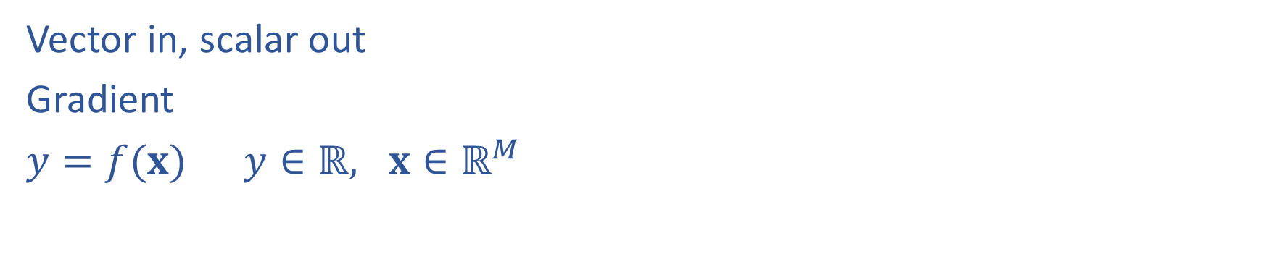
Calculus with Linear Algebra
Vector in, scalar out
Gradient
$y=f(x)$ $y∈ℝ, x∈ℝ^{M}$

Slide 29
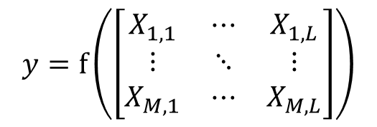

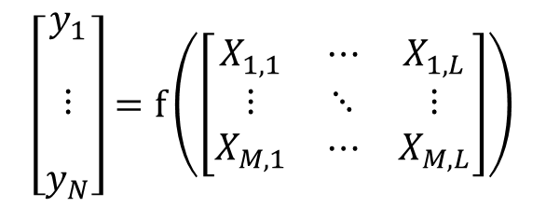
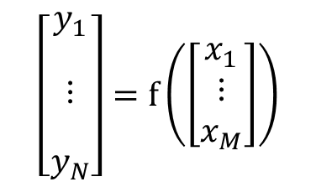
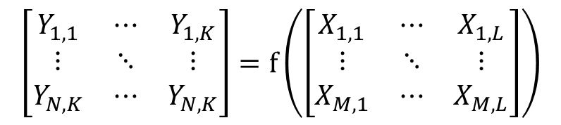
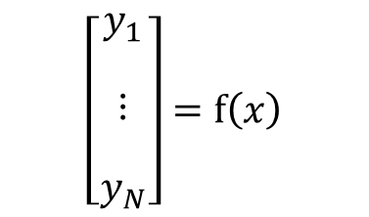
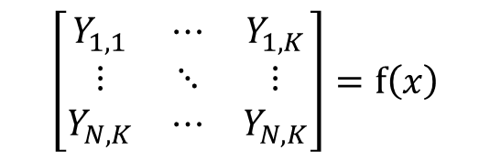

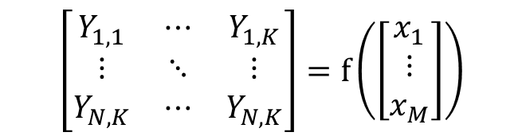
Calculus with Linear Algebra
Functions with linear algebra
$$y=f\left(\left[\begin{matrix}x_{1} \\ ⋮ \\ x_{M}\end{matrix}\right]\right)$$
$$y=f\left(\left[\begin{matrix}X_{1,1} & ⋯ & X_{1,L} \\ ⋮ & ⋱ & ⋮ \\ X_{M,1} & ⋯ & X_{M,L}\end{matrix}\right]\right)$$
$$y=f\left(x\right)$$
$$\left[\begin{matrix}\begin{aligned}y_{1} \\ \end{aligned} \\ \begin{aligned}⋮ \\ \end{aligned} \\ y_{N}\end{matrix}\right]=f\left(x\right)$$
$$\left[\begin{matrix}\begin{aligned}y_{1} \\ \end{aligned} \\ \begin{aligned}⋮ \\ \end{aligned} \\ y_{N}\end{matrix}\right]=f\left(\left[\begin{matrix}x_{1} \\ ⋮ \\ x_{M}\end{matrix}\right]\right)$$
$$\left[\begin{matrix}\begin{aligned}y_{1} \\ \end{aligned} \\ \begin{aligned}⋮ \\ \end{aligned} \\ y_{N}\end{matrix}\right]=f\left(\left[\begin{matrix}X_{1,1} & ⋯ & X_{1,L} \\ ⋮ & ⋱ & ⋮ \\ X_{M,1} & ⋯ & X_{M,L}\end{matrix}\right]\right)$$
$$\left[\begin{matrix}Y_{1,1} & ⋯ & Y_{1,K} \\ ⋮ & ⋱ & ⋮ \\ Y_{N,K} & ⋯ & Y_{N,K}\end{matrix}\right]=f\left(x\right)$$
$$\left[\begin{matrix}Y_{1,1} & ⋯ & Y_{1,K} \\ ⋮ & ⋱ & ⋮ \\ Y_{N,K} & ⋯ & Y_{N,K}\end{matrix}\right]=f\left(\left[\begin{matrix}x_{1} \\ ⋮ \\ x_{M}\end{matrix}\right]\right)$$
$$\left[\begin{matrix}Y_{1,1} & ⋯ & Y_{1,K} \\ ⋮ & ⋱ & ⋮ \\ Y_{N,K} & ⋯ & Y_{N,K}\end{matrix}\right]=f\left(\left[\begin{matrix}X_{1,1} & ⋯ & X_{1,L} \\ ⋮ & ⋱ & ⋮ \\ X_{M,1} & ⋯ & X_{M,L}\end{matrix}\right]\right)$$

Slide 30
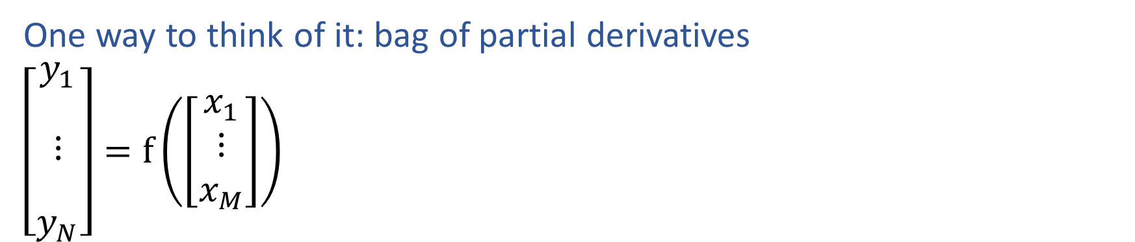
Calculus with Linear Algebra
One way to think of it: bag of partial derivatives
$\left[\begin{matrix}\begin{aligned}y_{1} \\ \end{aligned} \\ \begin{aligned}⋮ \\ \end{aligned} \\ y_{N}\end{matrix}\right]=f\left(\left[\begin{matrix}x_{1} \\ ⋮ \\ x_{M}\end{matrix}\right]\right)$

Slide 31
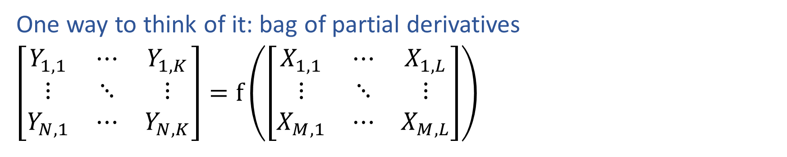
Calculus with Linear Algebra
One way to think of it: bag of partial derivatives
$\left[\begin{matrix}Y_{1,1} & ⋯ & Y_{1,K} \\ ⋮ & ⋱ & ⋮ \\ Y_{N,1} & ⋯ & Y_{N,K}\end{matrix}\right]=f\left(\left[\begin{matrix}X_{1,1} & ⋯ & X_{1,L} \\ ⋮ & ⋱ & ⋮ \\ X_{M,1} & ⋯ & X_{M,L}\end{matrix}\right]\right)$

Slide 32
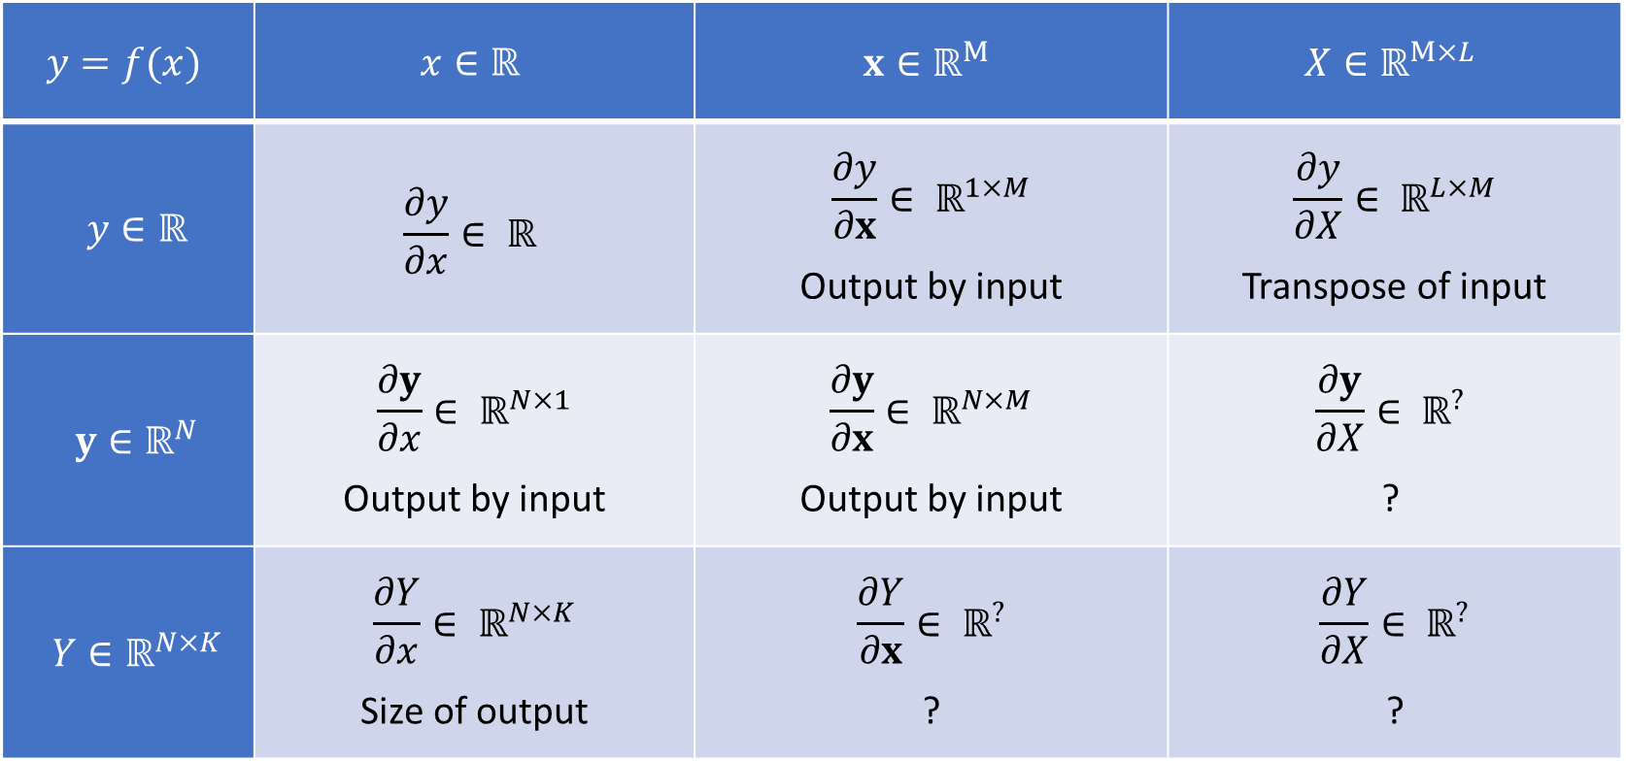
Numerator Layout
$$y=f(x)$$ | $$x∈ℝ$$ | $$x∈ℝ^{M}$$ | $$X∈ℝ^{M×L}$$
$y∈ℝ$ | $$\frac{∂y}{∂x}∈ ℝ$$ | $$\frac{∂y}{∂x}∈ ℝ^{1×M}$$ Output by input | $$\frac{∂y}{∂X}∈ ℝ^{L×M}$$ Transpose of input
$y∈ℝ^{N}$ | $$\frac{∂y}{∂x}∈ ℝ^{N×1}$$ Output by input | $$\frac{∂y}{∂x}∈ ℝ^{N×M}$$ Output by input | $$\frac{∂y}{∂X}∈ ℝ^{?}$$ ?
$Y∈ℝ^{N×K}$ | $$\frac{∂Y}{∂x}∈ ℝ^{N×K}$$ Size of output | $$\frac{∂Y}{∂x}∈ ℝ^{?}$$ ? | $$\frac{∂Y}{∂X}∈ ℝ^{?}$$ ?

Slide 33

Denominator Layout
$$y=f(x)$$ | $$x∈ℝ$$ | $$x∈ℝ^{M}$$ | $$X∈ℝ^{M×L}$$
$y∈ℝ$ | $$\frac{∂y}{∂x}∈ ℝ$$ | $$\frac{∂y}{∂x}∈ ℝ^{M×1}$$ Input by output | $$\frac{∂y}{∂X}∈ ℝ^{M×L}$$ Size of input
$y∈ℝ^{N}$ | $$\frac{∂y}{∂x}∈ ℝ^{1×N}$$ Input by output | $$\frac{∂y}{∂x}∈ ℝ^{M×N}$$ Input by output | $$\frac{∂y}{∂X}∈ ℝ^{?}$$ ?
$Y∈ℝ^{N×K}$ | $$\frac{∂Y}{∂x}∈ ℝ^{K×N}$$ Transpose of output | $$\frac{∂Y}{∂x}∈ ℝ^{?}$$ ? | $$\frac{∂Y}{∂X}∈ ℝ^{?}$$ ?

Slide 34
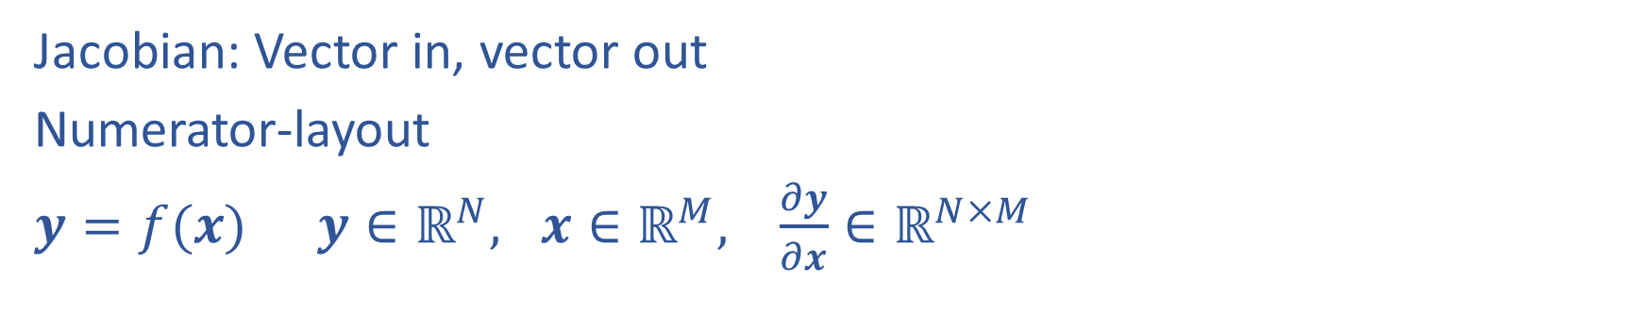
Calculus with Linear Algebra
Jacobian: Vector in, vector out
Numerator-layout
$y=f(x)$ $y∈ℝ^{N}, x∈ℝ^{M}, \frac{∂y}{∂x}∈ℝ^{N×M}$

Slide 35
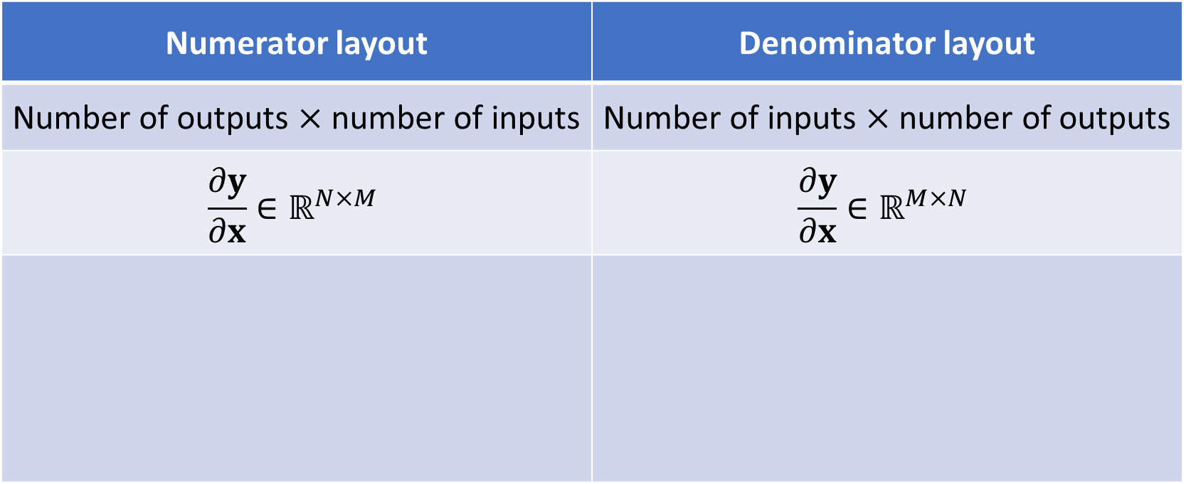
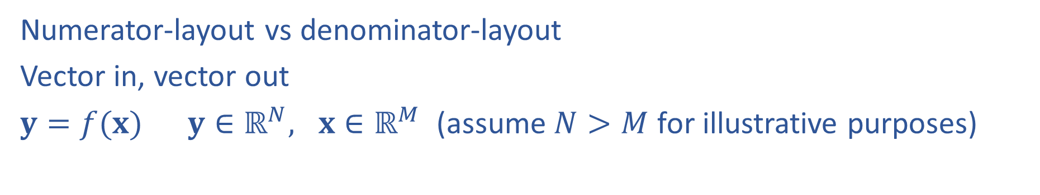

Calculus with Linear Algebra
$$\left[\begin{matrix}\begin{aligned}y_{1} \\ \end{aligned} \\ \begin{aligned}⋮ \\ \end{aligned} \\ y_{N}\end{matrix}\right]=f\left(\left[\begin{matrix}x_{1} \\ ⋮ \\ x_{M}\end{matrix}\right]\right)$$
Numerator-layout vs denominator-layout
Vector in, vector out
$y=f(x)$ $y∈ℝ^{N}, x∈ℝ^{M}$ (assume $N>M$ for illustrative purposes)
Numerator layout | Denominator layout
Number of outputs $×$ number of inputs | Number of inputs $×$ number of outputs
$$\frac{∂y}{∂x}∈ℝ^{N×M}$$ | $$\frac{∂y}{∂x}∈ℝ^{M×N}$$

Slide 36

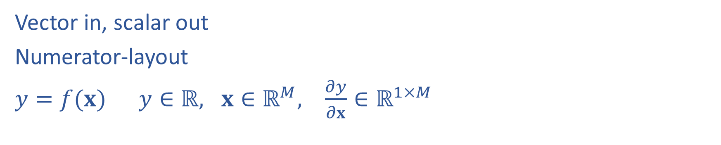
Calculus with Linear Algebra
$$y=f\left(\left[\begin{matrix}x_{1} \\ ⋮ \\ x_{M}\end{matrix}\right]\right)$$
Vector in, scalar out
Numerator-layout
$y=f(x)$ $y∈ℝ, x∈ℝ^{M}, \frac{∂y}{∂x}∈ℝ^{1×M}$

Slide 37
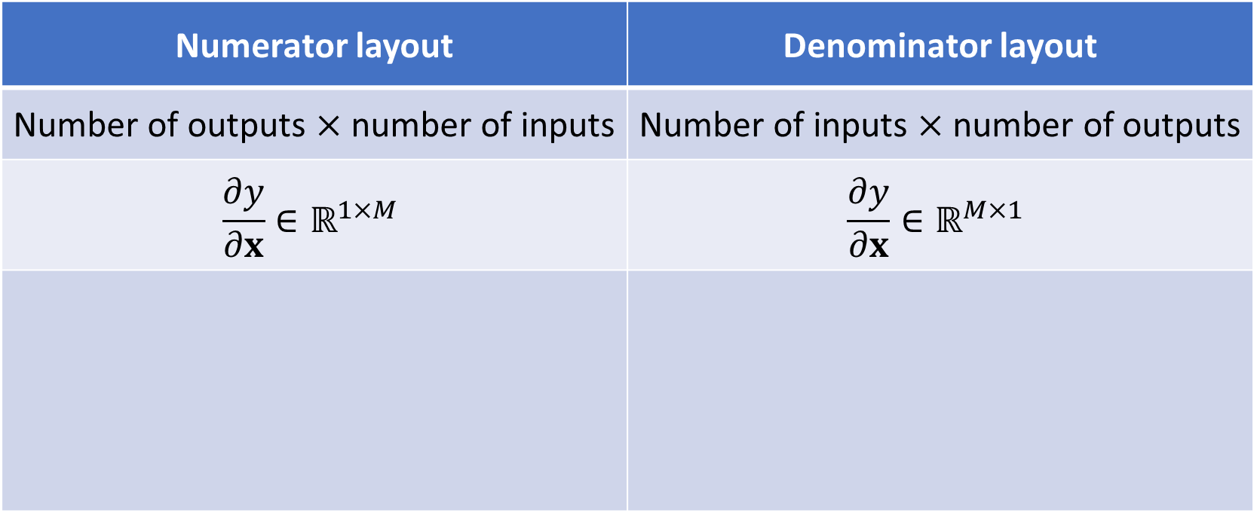
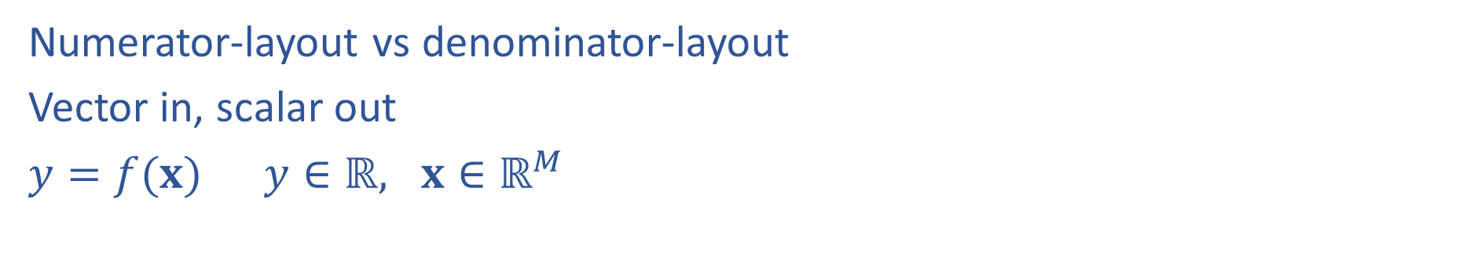
Calculus with Linear Algebra
$$y=f\left(\left[\begin{matrix}x_{1} \\ ⋮ \\ x_{M}\end{matrix}\right]\right)$$
Numerator-layout vs denominator-layout
Vector in, scalar out
$y=f(x)$ $y∈ℝ, x∈ℝ^{M}$
Numerator layout | Denominator layout
Number of outputs $×$ number of inputs | Number of inputs $×$ number of outputs
$$\frac{∂y}{∂x}∈ℝ^{1×M}$$ | $$\frac{∂y}{∂x}∈ℝ^{M×1}$$

Slide 38

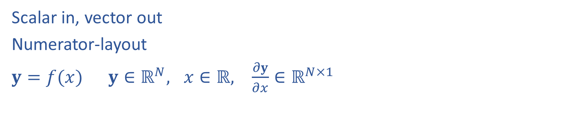
Calculus with Linear Algebra
$$\left[\begin{matrix}\begin{aligned}y_{1} \\ \end{aligned} \\ \begin{aligned}⋮ \\ \end{aligned} \\ y_{N}\end{matrix}\right]=f\left(x\right)$$
Scalar in, vector out
Numerator-layout
$y=f(x)$ $y∈ℝ^{N}, x∈ℝ, \frac{∂y}{∂x}∈ℝ^{N×1}$

Slide 39
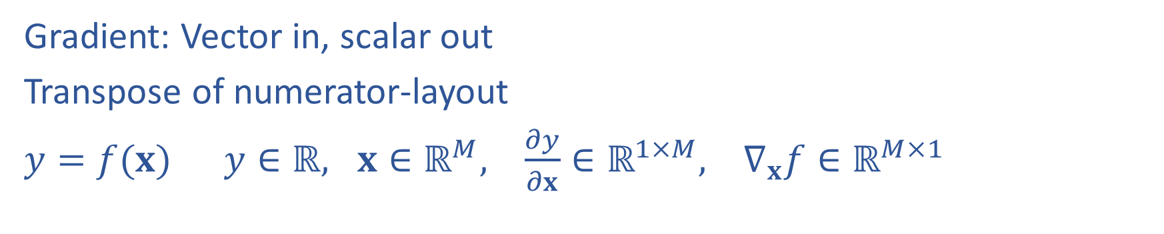
Calculus with Linear Algebra
$$y=f\left(\left[\begin{matrix}x_{1} \\ ⋮ \\ x_{M}\end{matrix}\right]\right)$$
Gradient: Vector in, scalar out
Transpose of numerator-layout
$y=f(x)$ $y∈ℝ, x∈ℝ^{M}, \frac{∂y}{∂x}∈ℝ^{1×M}, ∇_{x}f∈ℝ^{M×1}$

Slide 40

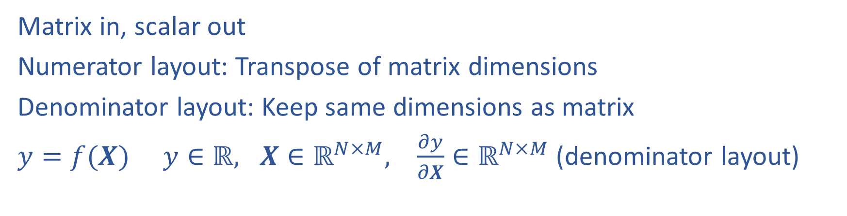
Calculus with Linear Algebra
$$y=f\left(\left[\begin{matrix}X_{1,1} & ⋯ & X_{1,L} \\ ⋮ & ⋱ & ⋮ \\ X_{M,1} & ⋯ & X_{M,L}\end{matrix}\right]\right)$$
Matrix in, scalar out
Numerator layout: Transpose of matrix dimensions
Denominator layout: Keep same dimensions as matrix
$y=f(X)$ $y∈ℝ, X∈ℝ^{N×M}, \frac{∂y}{∂X}∈ℝ^{N×M}$ (denominator layout)

Slide 41
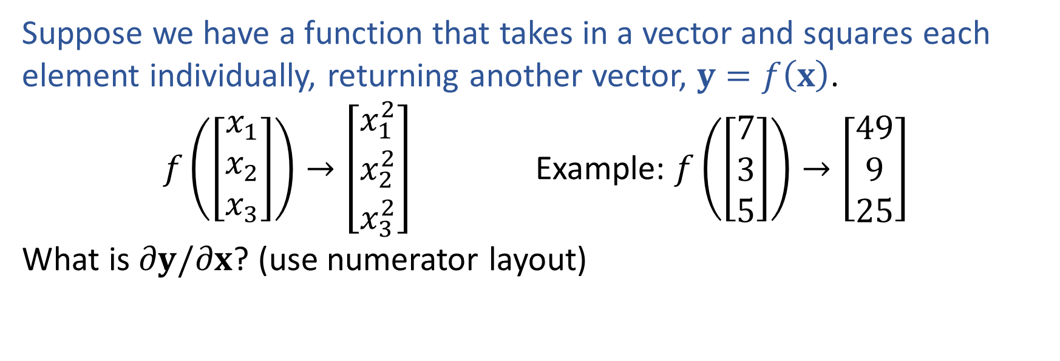
Exercise
Suppose we have a function that takes in a vector and squares each element individually, returning another vector, $y=f\left(x\right)$.
$f\left(\left[\begin{aligned}x_{1} \\ x_{2} \\ x_{3}\end{aligned}\right]\right)→\left[\begin{aligned}x_{1}^{2} \\ x_{2}^{2} \\ x_{3}^{2}\end{aligned}\right]$ Example: $f\left(\left[\begin{aligned}7 \\ 3 \\ 5\end{aligned}\right]\right)→\left[\begin{aligned}49 \\ 9 \\ 25\end{aligned}\right]$
What is $∂y/∂x$? (use numerator layout)

Slide 42
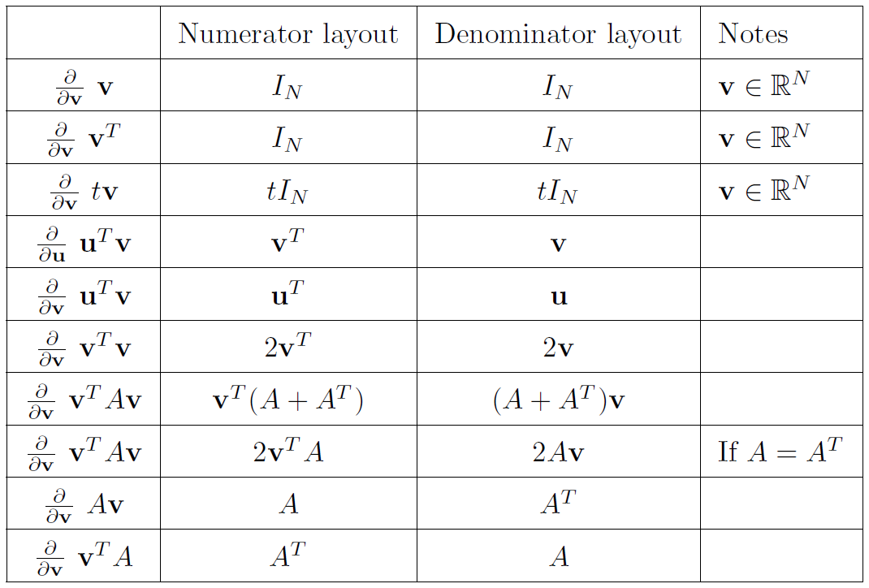
Derivatives of Functions with Respect to Vectors

Slide 43
Numerator Layout
$$y=f(x)$$ | $$x∈ℝ$$ | $$x∈ℝ^{M}$$ | $$X∈ℝ^{M×L}$$
$y∈ℝ$ | $$\frac{∂y}{∂x}∈ ℝ$$ | $$\frac{∂y}{∂x}∈ ℝ^{1×M}$$ Output by input | $$\frac{∂y}{∂X}∈ ℝ^{L×M}$$ Transpose of input
$y∈ℝ^{N}$ | $$\frac{∂y}{∂x}∈ ℝ^{N×1}$$ Output by input | $$\frac{∂y}{∂x}∈ ℝ^{N×M}$$ Output by input | $$\frac{∂y}{∂X}∈ ℝ^{?}$$ ?
$Y∈ℝ^{N×K}$ | $$\frac{∂Y}{∂x}∈ ℝ^{N×K}$$ Size of output | $$\frac{∂Y}{∂x}∈ ℝ^{?}$$ ? | $$\frac{∂Y}{∂X}∈ ℝ^{?}$$ ?

Slide 44
Denominator Layout
$$y=f(x)$$ | $$x∈ℝ$$ | $$x∈ℝ^{M}$$ | $$X∈ℝ^{M×L}$$
$y∈ℝ$ | $$\frac{∂y}{∂x}∈ ℝ$$ | $$\frac{∂y}{∂x}∈ ℝ^{M×1}$$ Input by output | $$\frac{∂y}{∂X}∈ ℝ^{M×L}$$ Size of input
$y∈ℝ^{N}$ | $$\frac{∂y}{∂x}∈ ℝ^{1×N}$$ Input by output | $$\frac{∂y}{∂x}∈ ℝ^{M×N}$$ Input by output | $$\frac{∂y}{∂X}∈ ℝ^{?}$$ ?
$Y∈ℝ^{N×K}$ | $$\frac{∂Y}{∂x}∈ ℝ^{K×N}$$ Transpose of output | $$\frac{∂Y}{∂x}∈ ℝ^{?}$$ ? | $$\frac{∂Y}{∂X}∈ ℝ^{?}$$ ?

Slide 45
Linear Regression
Closed-form Solution

Slide 46
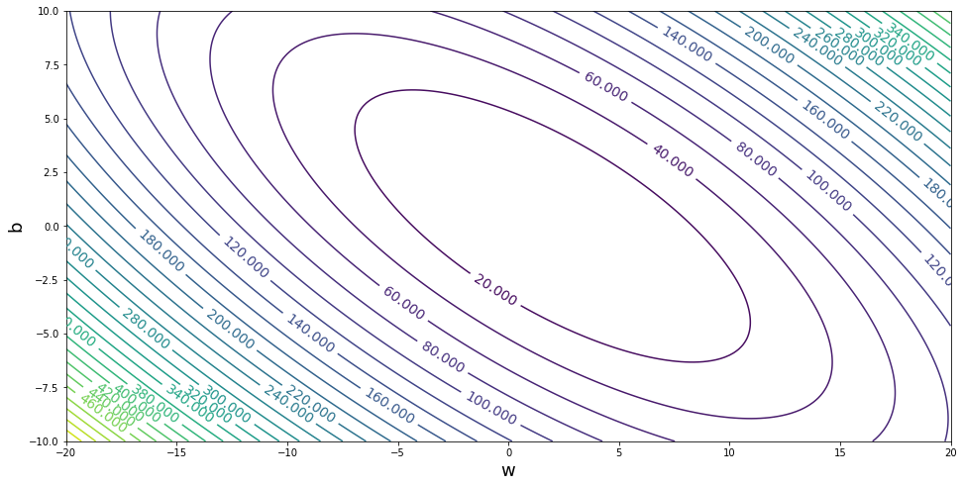



Linear Regression
Methods for optimizing the objective
Closed-form solution
$$J(w,b)$$
$$b$$
$$w$$

Slide 47
Linear Regression
Expanding objective before computing gradient
$J\left(θ\right)=\frac{1}{N}{\left\|y−Xθ\right\|}_{2}^{2}$
$=\frac{1}{N}{\left(y−Xθ\right)}^{T}\left(y−Xθ\right)$
$=\frac{1}{N}\left(y^{T}−θ^{T}X^{T}\right)\left(y−Xθ\right)$
$=\frac{1}{N}\left(y^{T}y −θ^{T}X^{T}y −y^{T}Xθ+θ^{T}X^{T}Xθ\right)$
$=\frac{1}{N}\left(y^{T}y −2θ^{T}X^{T}y+θ^{T}X^{T}Xθ\right)$

Slide 48



Linear Regression
$\frac{∂z^{T}u}{∂z}=u$
-- or --
$\frac{∂z^{T}u}{∂z} =u^{T}$
Gradient of objective with respect to parameters
$J\left(θ\right)=\frac{1}{N}{\left\|y−Xθ\right\|}_{2}^{2}$
$=\frac{1}{N}\left(y^{T}y −2θ^{T}X^{T}y+θ^{T}X^{T}Xθ\right)$
$∇J\left(θ\right)=\frac{1}{N}$
$\frac{∂z^{T}Az}{∂z}=\left(A+A^{T}\right)z$
-- or --
$\frac{∂z^{T}Az}{∂z}=z^{T}\left(A+A^{T}\right)$

Slide 49

Linear Regression
$\frac{∂z^{T}u}{∂z}=u$
-- or --
$\frac{∂z^{T}u}{∂z} =u^{T}$
Gradient of objective with respect to parameters
$J\left(θ\right)=\frac{1}{N}{\left\|y−Xθ\right\|}_{2}^{2}$
$=\frac{1}{N}\left(y^{T}y −2θ^{T}X^{T}y+θ^{T}X^{T}Xθ\right)$
$∇J\left(θ\right)=\frac{1}{N}\left(0 −2X^{T}y+2θ^{T}X^{T}X\right)$
$\frac{∂z^{T}Az}{∂z}=\left(A+A^{T}\right)z$
-- or --
$\frac{∂z^{T}Az}{∂z}=z^{T}\left(A+A^{T}\right)$

Slide 50

Linear Regression
$\frac{∂z^{T}u}{∂z}=u$
-- or --
$\frac{∂z^{T}u}{∂z} =u^{T}$
Gradient of objective with respect to parameters
$J\left(θ\right)=\frac{1}{N}{\left\|y−Xθ\right\|}_{2}^{2}$
$=\frac{1}{N}\left(y^{T}y −2θ^{T}X^{T}y+θ^{T}X^{T}Xθ\right)$
$∇J\left(θ\right)=\frac{1}{N}\left(0 −2X^{T}y+2θ^{T}X^{T}X\right)$
$=\frac{1}{N}\left(0 −2X^{T}y+2X^{T}Xθ\right)$
$\frac{∂z^{T}Az}{∂z}=\left(A+A^{T}\right)z$
-- or --
$\frac{∂z^{T}Az}{∂z}=z^{T}\left(A+A^{T}\right)$

Slide 51

Linear Regression
$\frac{∂z^{T}u}{∂z}=u$
-- or --
$\frac{∂z^{T}u}{∂z} =u^{T}$
Gradient of objective with respect to parameters
$J\left(θ\right)=\frac{1}{N}{\left\|y−Xθ\right\|}_{2}^{2}$
$=\frac{1}{N}\left(y^{T}y −2θ^{T}X^{T}y+θ^{T}X^{T}Xθ\right)$
$∇J\left(θ\right)=\frac{1}{N}\left(0 −2X^{T}y+2θ^{T}X^{T}X\right)$
$=\frac{1}{N}\left(0 −2X^{T}y+2X^{T}Xθ\right)$
$=\frac{2}{N}\left(−X^{T}y+X^{T}Xθ\right)$
$\frac{∂z^{T}Az}{∂z}=\left(A+A^{T}\right)z$
-- or --
$\frac{∂z^{T}Az}{∂z}=z^{T}\left(A+A^{T}\right)$

Slide 52

Linear Regression
Closed-form solution
$∇J\left(θ\right)=\frac{2}{N}\left(−X^{T}y+X^{T}Xθ\right)$

Slide 53

Linear Regression
Number of solutions
A note on matrix rank:

Slide 54
Optimization
Grid Search, Gradient Descent, Stochastic Gradient Descent

Slide 55
Linear Regression
$$J\left(w, b\right)=\frac{1}{2}\left[{\left(y^{(1)}−\left(wx^{(1)}+b\right)\right)}^{2}+{\left(y^{(2)}−\left(wx^{(2)}+b\right)\right)}^{2}\right]$$
Optimizing the objective
b
y
w
x

Slide 56


Poll 5
$$J\left(w, b\right)=\frac{1}{2}\left[{\left(y^{(1)}−\left(wx^{(1)}+b\right)\right)}^{2}+{\left(y^{(2)}−\left(wx^{(2)}+b\right)\right)}^{2}\right]$$
For fixed data and fixed slope, w, what shape do we get by plotting MSE objective vs intercept, b?
Line
Plane
Half-plane
Convex parabola (U-shape)
Concave parabola (up-side-down U)
None of the above
$$y$$
$$x$$

Slide 57

Linear Regression
$$J\left(w, b\right)=\frac{1}{2}\left[{\left(y^{(1)}−\left(wx^{(1)}+b\right)\right)}^{2}+{\left(y^{(2)}−\left(wx^{(2)}+b\right)\right)}^{2}\right]$$
Optimizing the objective
y
x

Slide 58

Linear Regression
$$J\left(w, b\right)=\frac{1}{2}\left[{\left(y^{(1)}−\left(wx^{(1)}+b\right)\right)}^{2}+{\left(y^{(2)}−\left(wx^{(2)}+b\right)\right)}^{2}\right]$$
Optimizing the objective
y
x

Slide 59


Linear Regression
$$J\left(w, b\right)=\frac{1}{2}\left[{\left(y^{(1)}−\left(wx^{(1)}+b\right)\right)}^{2}+{\left(y^{(2)}−\left(wx^{(2)}+b\right)\right)}^{2}\right]$$
What shape is the obejective function when we consider both parameters w and b?
$$J\left(w, b\right)$$
y
b
w
x

Slide 60

Linear Regression
$$J\left(w, b\right)=\frac{1}{2}\left[{\left(y^{(1)}−\left(wx^{(1)}+b\right)\right)}^{2}+{\left(y^{(2)}−\left(wx^{(2)}+b\right)\right)}^{2}\right]$$
What shape is the obejective function when we consider both parameters w and b?
$$J\left(w, b\right)$$
y
b
w
x

Slide 61


Linear Regression
Optimizing the objective

Slide 62


Optimization
Gradients

Slide 63


Optimization
Linear regression has a closed-form solution!!
Solve for $∇J\left(w,b\right)=0$ for $w,^{∗} b^{∗}$

Slide 64
Optimization
$$J\left(w, b\right)=\frac{1}{2}\left[{\left(y^{(1)}−\left(wx^{(1)}+b\right)\right)}^{2}+{\left(y^{(2)}−\left(wx^{(2)}+b\right)\right)}^{2}\right]$$
Gradients

Slide 65
Linear Regression
Gradient Descent

Slide 66




Linear Regression
Demos to optimize the objective
Linear model optimization
regression_interactive.ipynb
Blind version
regression_blind_interactive.ipynb

Slide 67
Poll 6
Open blind optimization on course website
Mess with sliders to find best model
What's the best RMSE that you got?
What's are the corresponding best parameters?

Slide 68
Linear Regression
Methods for optimizing the objective
Closed-form solution
Grid search
Random search
Gradient descent
Stochastic gradient descent (SGD)
Minibatch SGD
$$J(w,b)$$
$$b$$
$$w$$

Slide 69
Optimization
Gradients

Slide 70

Optimization
Gradient descent
Hyperparameter:
learning rate $α$ (or sometimes $γ$, $η$)
While not converged
Compute gradient: $∇J={\left[\frac{∂J}{∂w},\frac{∂J}{∂b}\right]}^{⊤}$
Update parameters
$w←w −α\frac{∂J}{∂w}$
$b ←b −α\frac{∂J}{∂b}$

Slide 71
Linear Regression
Methods for optimizing the objective
Closed-form solution
Grid search
Random search
Gradient descent
Stochastic gradient descent (SGD)
Minibatch SGD
$$J(w,b)$$
$$b$$
$$w$$

Slide 72
Linear Regression Gradient Descent
What happens in gradient descent when we have N=1,000,000 training points?
Output y
Input x

Slide 73
Linear Regression Gradient Descent
What happens in gradient descent when we have N=1,000,000 training points?
Output y
Input x

Slide 74



Gradient Descent
Batch -> Mini-batch -> Stochastic
Basically, just a difference in how many training points are each time we compute a gradient (and then take a step with that gradient
(Batch) GD
Effective batch size = $N$
Mini-batch SGD
Batch size = $B$, e.g., $B=10$
SGD
Effective batch size = $1$

Slide 75

Convergence Curves
Def: an epoch is a single pass through the training data
For GD, only one update per epoch
For SGD, N updates per epoch
N = (# train examples)
Gradient Descent
SGD
Closed-form (normal eq.s)
SGD reduces MSE much more rapidly than GD
For GD / SGD, training MSE is initially large due to uninformed initialization
Slide credit: CMU MLD Matt Gormley and Eric P. Xing

Slide 76
Additional Slides
(Batch) Gradient Descent and SGD

Slide 77


(Batch) Gradient Descent
$$− α$$
—
Slide credit: CMU MLD Matt Gormley

Slide 78


Stochastic Gradient Descent (SGD)
$$− α$$
We need a per-example objective:
Slide credit: CMU MLD Matt Gormley

Slide 79
Stochastic Gradient Descent (SGD)
$$− α$$
In practice, it is common to implement SGD using sampling without replacement (i.e. shuffle({1,2,…N}), even though most of the theory is for sampling with replacement (i.e. Uniform({1,2,…N}).
We need a per-example objective:
Slide credit: CMU MLD Matt Gormley

Slide 80




(Batch) Gradient Descent
Optimizing the objective using all points (just two in this example)
y
$$J\left(w, b\right)=\frac{1}{2}\left[{\left(y^{(1)}−\left(wx^{(1)}+b\right)\right)}^{2}+{\left(y^{(2)}−\left(wx^{(2)}+b\right)\right)}^{2}\right]$$
$$J\left(w, b\right)=\frac{1}{2}\left[{ J}^{(1)}\left(w, b\right) + J^{(2)}\left(w, b\right) \right]$$
$$J^{(1)}\left(w, b\right)={\left(y^{(1)}−\left(wx^{(1)}+b\right)\right)}^{2}$$
$$J^{(2)}\left(w, b\right)={\left(y^{(2)}−\left(wx^{(2)}+b\right)\right)}^{2}$$
x

Slide 81




(Batch) Gradient Descent
$$J\left(w, b\right)=\frac{1}{2}\left[{ J}^{(1)}\left(w, b\right) + J^{(2)}\left(w, b\right) \right]$$

Slide 82





Stochastic Gradient Descent
Optimizing the objective for one point at a time
y
$$J\left(w, b\right)=\frac{1}{2}\left[{ J}^{(1)}\left(w, b\right) + J^{(2)}\left(w, b\right) \right]$$
$$J^{(1)}\left(w, b\right)={\left(y^{(1)}−\left(wx^{(1)}+b\right)\right)}^{2}$$
$$J^{(2)}\left(w, b\right)={\left(y^{(2)}−\left(wx^{(2)}+b\right)\right)}^{2}$$
x

Slide 83





Stochastic Gradient Descent
$$J^{(1)}\left(w, b\right)={\left(y^{(1)}−\left(wx^{(1)}+b\right)\right)}^{2}$$

Slide 84




Stochastic Gradient Descent
Optimizing the objective for one point at a time
y
$$J\left(w, b\right)=\frac{1}{2}\left[{ J}^{(1)}\left(w, b\right) + J^{(2)}\left(w, b\right) \right]$$
$$J^{(1)}\left(w, b\right)={\left(y^{(1)}−\left(wx^{(1)}+b\right)\right)}^{2}$$
$$J^{(2)}\left(w, b\right)={\left(y^{(2)}−\left(wx^{(2)}+b\right)\right)}^{2}$$
x

Slide 85





Stochastic Gradient Descent
$$J^{(2)}\left(w, b\right)={\left(y^{(2)}−\left(wx^{(2)}+b\right)\right)}^{2}$$

Slide 86

Stochastic Gradient Descent
Optimizing the objective for one point at a time
y
$$J\left(w, b\right)=\frac{1}{2}\left[{ J}^{(1)}\left(w, b\right) + J^{(2)}\left(w, b\right) \right]$$
$$J^{(1)}\left(w, b\right)={\left(y^{(1)}−\left(wx^{(1)}+b\right)\right)}^{2}$$
$$J^{(2)}\left(w, b\right)={\left(y^{(2)}−\left(wx^{(2)}+b\right)\right)}^{2}$$
x

Slide 87

Stochastic Gradient Descent
$$J^{(1)}\left(w, b\right)={\left(y^{(1)}−\left(wx^{(1)}+b\right)\right)}^{2}$$

