Slide 1


10-315
Machine Learning Problem Formulation
Instructor: Pat Virtue

Slide 2
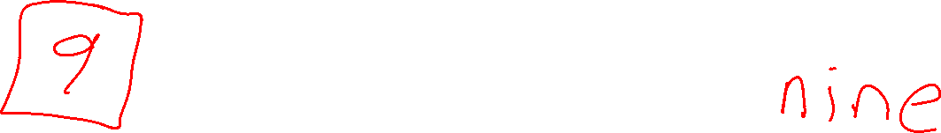
Agent: Simple Input/Output Task
Agent
Input
?
Predicted
Output

Slide 3
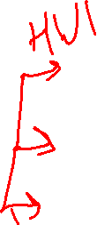

Task Input and Output
Input
Task
Output
Petal measurements
Time of day
Image
Image
Text
???
Iris classification
Traffic prediction
Image classification
Image denoising
Text to image generation
Face generation
Category
Traffic Volume
Category
Image
Image
Image

Slide 4
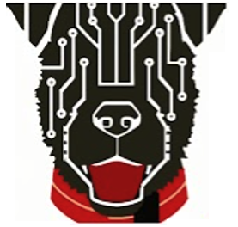
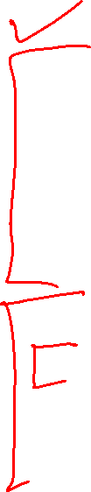
Today
ML Problem Formulation
Task input and output
Task, Performance, Experience
Data and notation
Supervised Learning
    Classification and Regression
Unsupervised Learning
ML Training and Models
Nearest Neighbor
Linear
Neuron

Slide 5
ML Problem Formulation

Slide 6

Machine Learning Problem Formulation
Three components <T,P,E>:
  Task, T
  Performance measure, P
  Experience, E
Definition of learning:
A computer program learns if its performance at tasks in T, as measured by P, improves with experience E
Definition from (Mitchell, 1997)

Slide 7
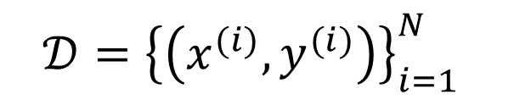


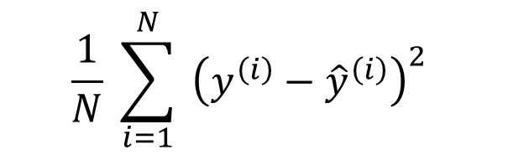
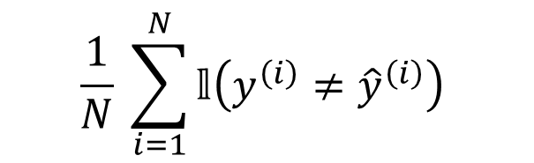
Machine Learning Problem Formulation
Notation
Task
Formalize the task as a mapping from input to output
Experience
Data! Task experience examples will usually be pairs: (input, measured output)
Performance measure
Objective function that gives a single numerical value representing how well the system performs for a given dataset
Classification: error rate
Regression: mean squared error
$$h\left(x\right)→\hat{y}$$
$$𝒟={\left\{\left(x^{(i)},y^{(i)}\right)\right\}}_{i=1}^{N}$$
$$\frac{1}{N} \sum_{i=1}^{N}{𝕝\left(y^{\left(i\right)}≠{\hat{y}}^{\left(i\right)}\right)}$$
$$\frac{1}{N} \sum_{i=1}^{N}{ {\left(y^{\left(i\right)}−{\hat{y}}^{\left(i\right)}\right)}^{2}}$$
Slide: CMU ML, Tom Mitchel and Roni Rosenfeld

Slide 8
Experience: Data and Notation

Slide 9
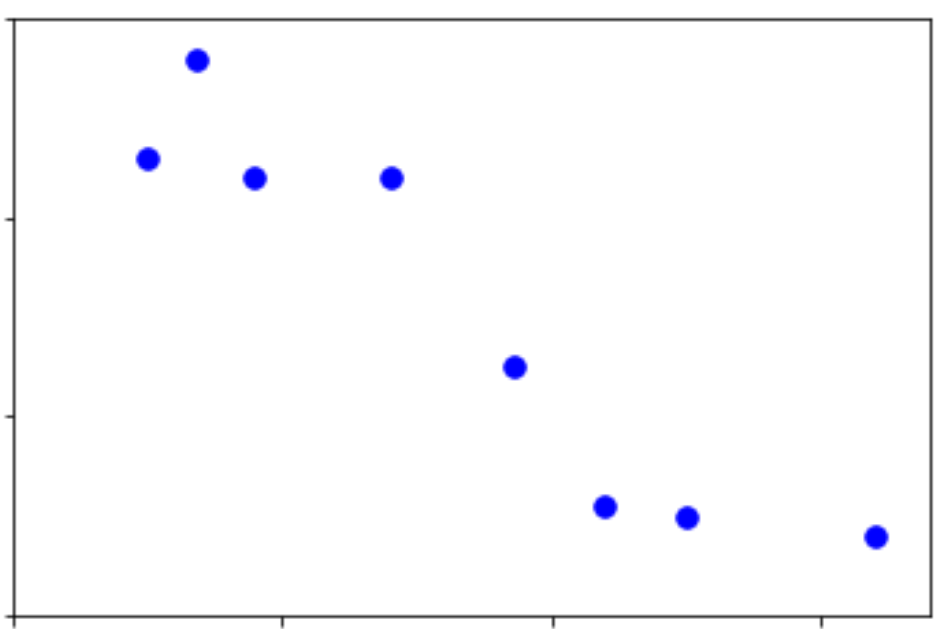
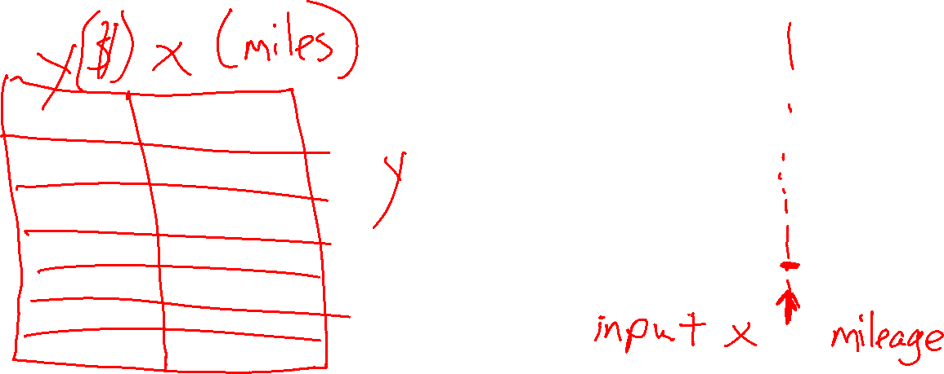
Example Dataset: Selling My Car
Example
Trying to see how much I should sell my car for. Looking up data from car websites, I find the mileage for a set of cars and the selling price for each car.

Slide 10
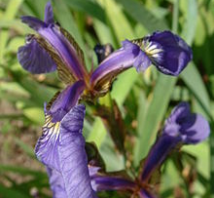
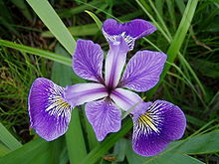
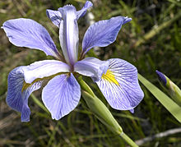
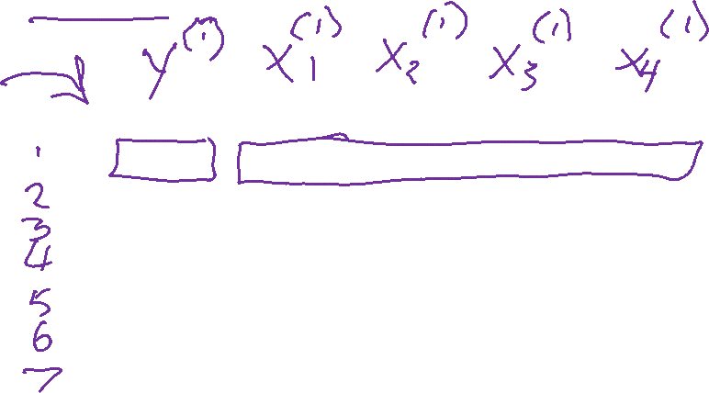
Example Dataset: Fisher Iris Dataset
Fisher (1936) used 150 measurements of flowers from 3 different species: Iris setosa (0), Iris virginica (1), Iris versicolor (2) collected by Anderson (1936)
Species | Sepal Length | Sepal Width | Petal Length | Petal Width
0 | 4.3 | 3.0 | 1.1 | 0.1
0 | 4.9 | 3.6 | 1.4 | 0.1
0 | 5.3 | 3.7 | 1.5 | 0.2
1 | 4.9 | 2.4 | 3.3 | 1.0
1 | 5.7 | 2.8 | 4.1 | 1.3
1 | 6.3 | 3.3 | 4.7 | 1.6
2 | 5.9 | 3.0 | 5.1 | 1.8
Images and full dataset: https://en.wikipedia.org/wiki/Iris_flower_data_set

Slide 11
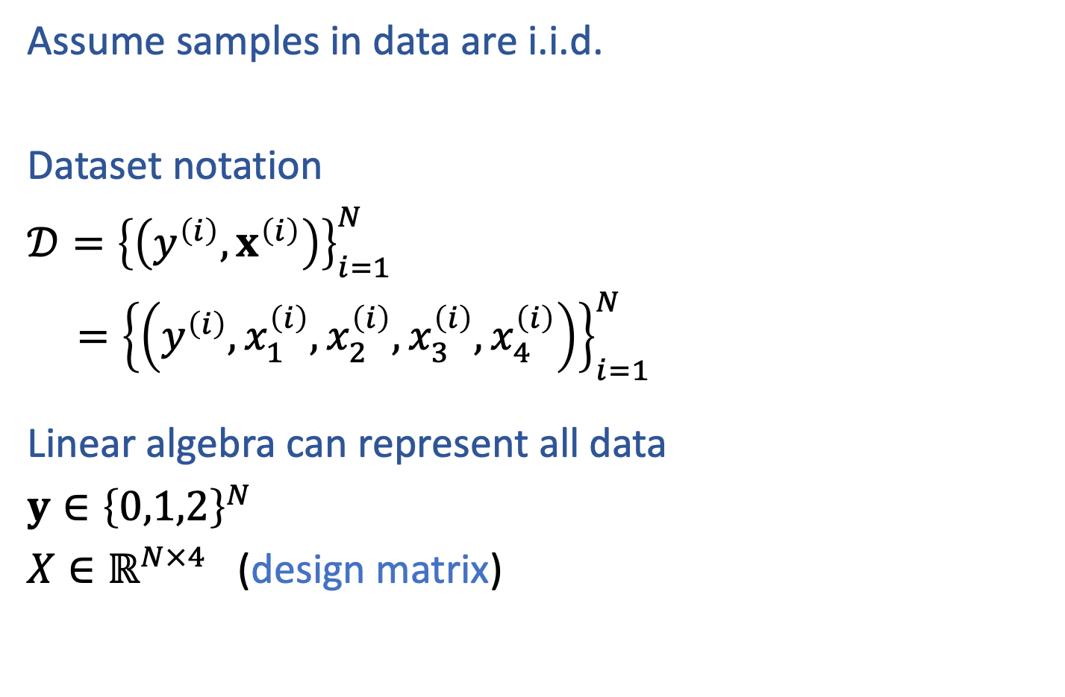
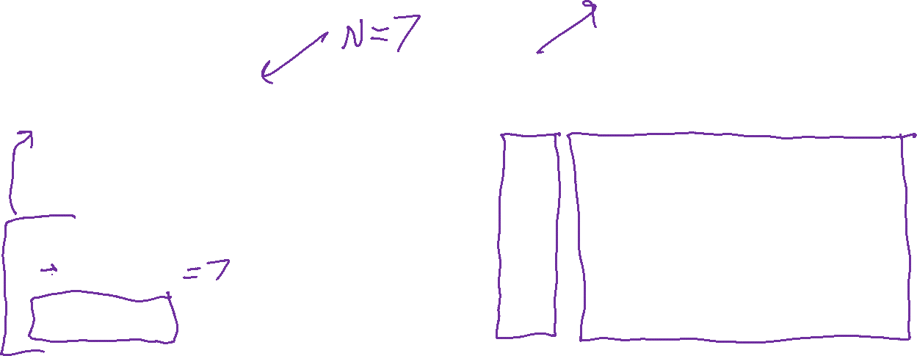
Example Dataset: Fisher Iris Dataset
from sklearn import datasets
iris = datasets.load_iris()
X = iris.data
y = iris.target
Assume samples in data are i.i.d.
Dataset notation
$𝒟={\left\{\left(y^{\left(i\right)}, x^{\left(i\right)}\right)\right\}}_{i=1}^{N}$
$={\left\{\left(y^{\left(i\right)}, x_{1}^{\left(i\right)},x_{2}^{\left(i\right)},x_{3}^{\left(i\right)},x_{4}^{\left(i\right)}\right)\right\}}_{i=1}^{N}$
Linear algebra can represent all data
$y∈{\left\{0,1,2\right\}}^{N}$
$X∈ℝ^{N×4}$ (design matrix)
Species | Sepal Length | Sepal Width | Petal Length | Petal Width
0 | 4.3 | 3.0 | 1.1 | 0.1
0 | 4.9 | 3.6 | 1.4 | 0.1
0 | 5.3 | 3.7 | 1.5 | 0.2
1 | 4.9 | 2.4 | 3.3 | 1.0
1 | 5.7 | 2.8 | 4.1 | 1.3
1 | 6.3 | 3.3 | 4.7 | 1.6
2 | 5.9 | 3.0 | 5.1 | 1.8
Images and full dataset: https://en.wikipedia.org/wiki/Iris_flower_data_set

Slide 12
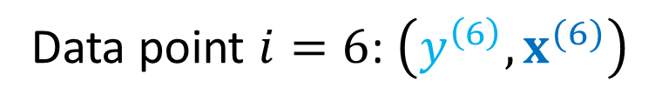

Example Dataset: Fisher Iris Dataset
from sklearn import datasets
iris = datasets.load_iris()
X = iris.data
y = iris.target
Assume samples in data are i.i.d.
Dataset notation
$𝒟={\left\{\left(y^{\left(i\right)}, x^{\left(i\right)}\right)\right\}}_{i=1}^{N}$
$={\left\{\left(y^{\left(i\right)}, x_{1}^{\left(i\right)},x_{2}^{\left(i\right)},x_{3}^{\left(i\right)},x_{4}^{\left(i\right)}\right)\right\}}_{i=1}^{N}$
Species | Sepal Length | Sepal Width | Petal Length | Petal Width
0 | 4.3 | 3.0 | 1.1 | 0.1
0 | 4.9 | 3.6 | 1.4 | 0.1
0 | 5.3 | 3.7 | 1.5 | 0.2
1 | 4.9 | 2.4 | 3.3 | 1.0
1 | 5.7 | 2.8 | 4.1 | 1.3
1 | 6.3 | 3.3 | 4.7 | 1.6
2 | 5.9 | 3.0 | 5.1 | 1.8
Data point $i=6$: $\left(y^{\left(6\right)},x^{(6)}\right)$
Images and full dataset: https://en.wikipedia.org/wiki/Iris_flower_data_set

Slide 13

Example Dataset: Fisher Iris Dataset
from sklearn import datasets
iris = datasets.load_iris()
X = iris.data
y = iris.target
Assume samples in data are i.i.d.
Dataset notation
$𝒟={\left\{\left(y^{\left(i\right)}, x^{\left(i\right)}\right)\right\}}_{i=1}^{N}$
$={\left\{\left(y^{\left(i\right)}, x_{1}^{\left(i\right)},x_{2}^{\left(i\right)},x_{3}^{\left(i\right)},x_{4}^{\left(i\right)}\right)\right\}}_{i=1}^{N}$
Linear algebra can represent all data
$y∈{\left\{0,1,2\right\}}^{N}$
$X∈ℝ^{N×4}$ (design matrix)
Species | Sepal Length | Sepal Width | Petal Length | Petal Width
0 | 4.3 | 3.0 | 1.1 | 0.1
0 | 4.9 | 3.6 | 1.4 | 0.1
0 | 5.3 | 3.7 | 1.5 | 0.2
1 | 4.9 | 2.4 | 3.3 | 1.0
1 | 5.7 | 2.8 | 4.1 | 1.3
1 | 6.3 | 3.3 | 4.7 | 1.6
2 | 5.9 | 3.0 | 5.1 | 1.8
Images and full dataset: https://en.wikipedia.org/wiki/Iris_flower_data_set

Slide 14
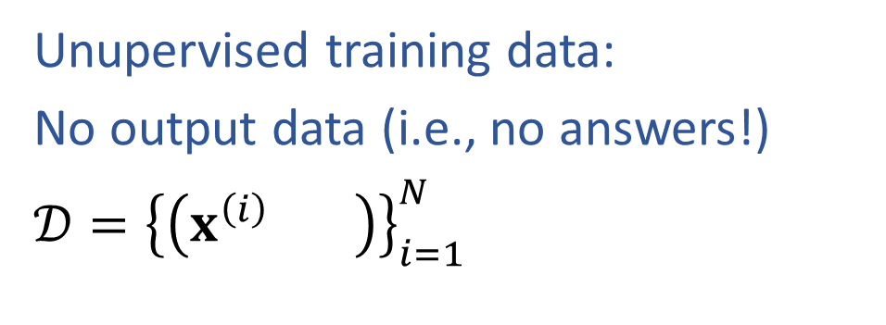
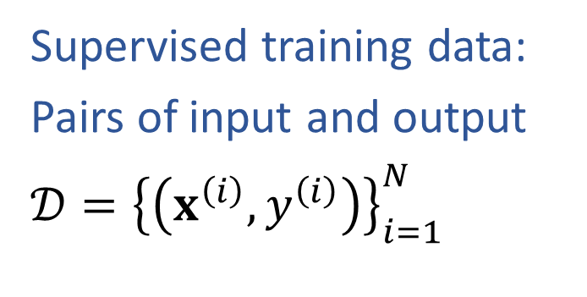
ML Data : Supervised vs Unsupervised
Supervised training data:
Pairs of input and output
$𝒟={\left\{\left(x^{\left(i\right)},y^{\left(i\right)}\right)\right\}}_{i=1}^{N}$
Unupervised training data:
No output data (i.e., no answers!)
$𝒟={\left\{\left(x^{\left(i\right)} \right)\right\}}_{i=1}^{N}$
Species | Sepal Length | Sepal Width | Petal Length | Petal Width
0 | 4.3 | 3.0 | 1.1 | 0.1
0 | 4.9 | 3.6 | 1.4 | 0.1
0 | 5.3 | 3.7 | 1.5 | 0.2
1 | 4.9 | 2.4 | 3.3 | 1.0
1 | 5.7 | 2.8 | 4.1 | 1.3
1 | 6.3 | 3.3 | 4.7 | 1.6
2 | 5.9 | 3.0 | 5.1 | 1.8
Sepal Length | Sepal Width | Petal Length | Petal Width
4.3 | 3.0 | 1.1 | 0.1
4.9 | 3.6 | 1.4 | 0.1
5.3 | 3.7 | 1.5 | 0.2
4.9 | 2.4 | 3.3 | 1.0
5.7 | 2.8 | 4.1 | 1.3
6.3 | 3.3 | 4.7 | 1.6
5.9 | 3.0 | 5.1 | 1.8

Slide 15
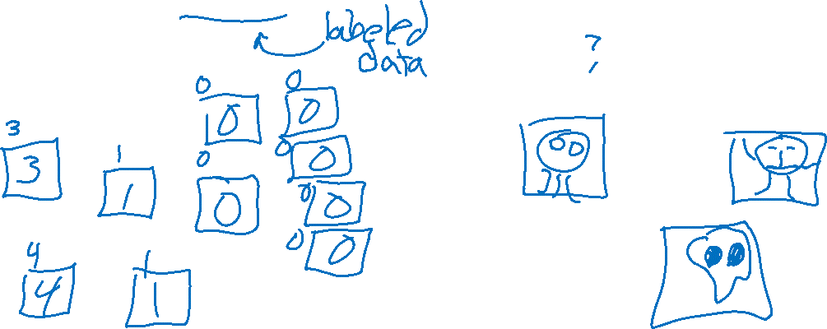
ML Data : Supervised vs Unsupervised
Supervised training data:
Pairs of input and output
$𝒟={\left\{\left(x^{\left(i\right)},y^{\left(i\right)}\right)\right\}}_{i=1}^{N}$
Unupervised training data:
No output data (i.e., no answers!)
$𝒟={\left\{\left(x^{\left(i\right)} \right)\right\}}_{i=1}^{N}$

Slide 16
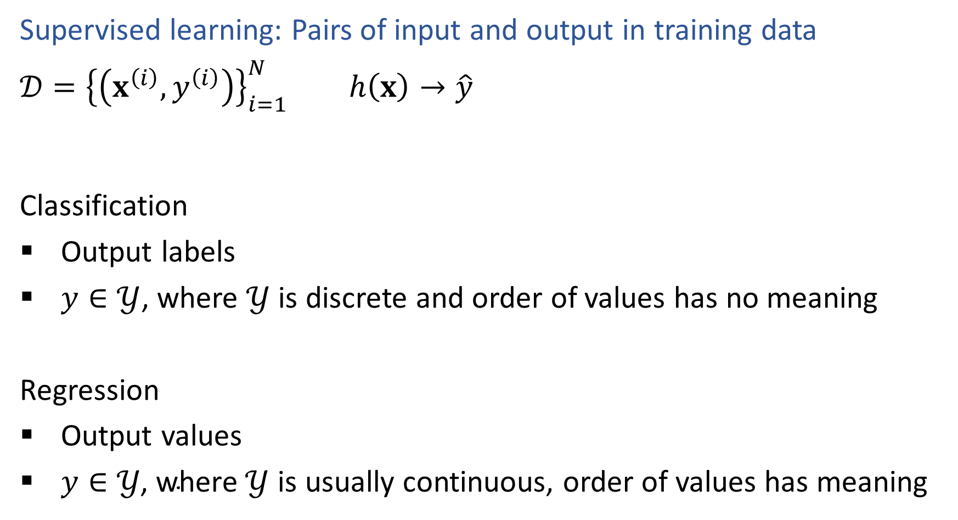

ML Tasks: Supervised Learning
Supervised learning: Pairs of input and output in training data
$𝒟={\left\{\left(x^{\left(i\right)},y^{\left(i\right)}\right)\right\}}_{i=1}^{N}$ $h\left(x\right)→\hat{y}$
Classification
Output labels
$y∈𝒴$, where $𝒴$ is discrete and order of values has no meaning
Regression
Output values
$y∈𝒴\text{, }\text{where} 𝒴$ is usually continuous, order of values has meaning

Slide 17
Task: Classification

Slide 18
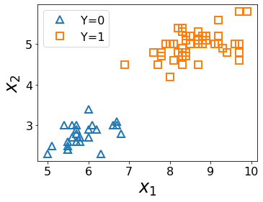
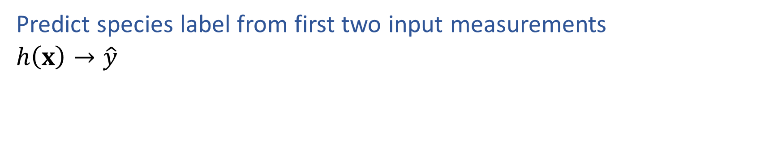
ML Task: Classification
Predict species label from first two input measurements
$h\left(x\right)→\hat{y}$
Species | Sepal Length | Sepal Width
0 | 4.3 | 3.0
0 | 4.9 | 3.6
0 | 5.3 | 3.7
1 | 4.9 | 2.4
1 | 5.7 | 2.8
1 | 6.3 | 3.3
Images and full dataset: https://en.wikipedia.org/wiki/Iris_flower_data_set

Slide 19
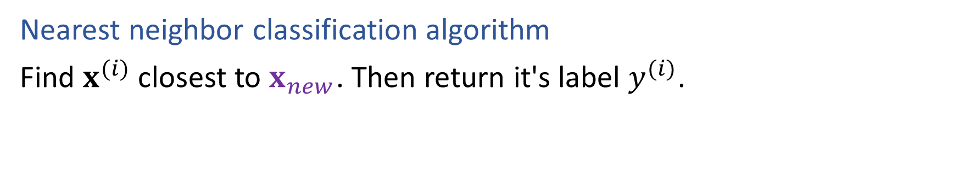
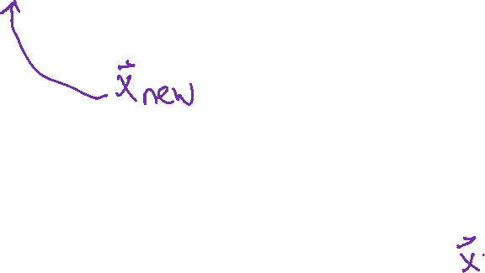
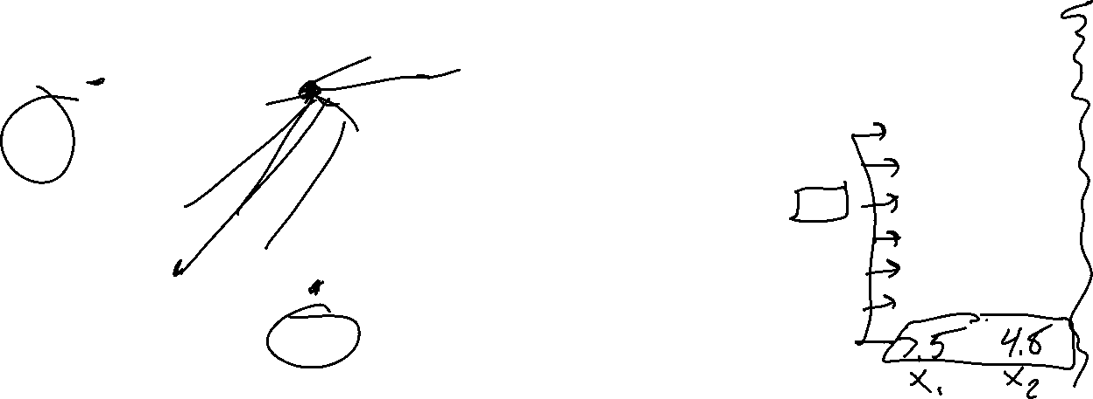
ML Task: Classification
Nearest neighbor classification algorithm
Find $x^{(i)}$ closest to $x_{new}$. Then return it's label $y^{(i)}$.
Species | Sepal Length | Sepal Width
0 | 4.3 | 3.0
0 | 4.9 | 3.6
0 | 5.3 | 3.7
1 | 4.9 | 2.4
1 | 5.7 | 2.8
1 | 6.3 | 3.3
Images and full dataset: https://en.wikipedia.org/wiki/Iris_flower_data_set

Slide 20
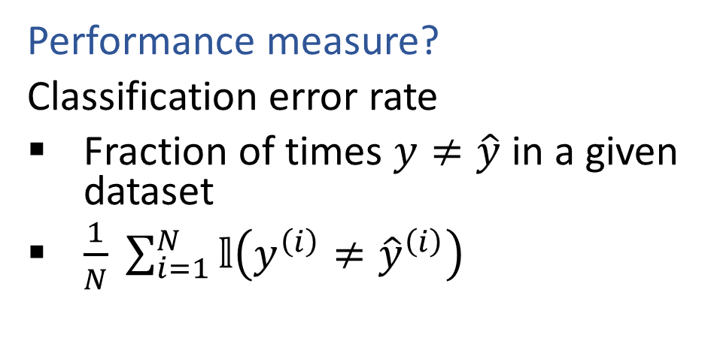


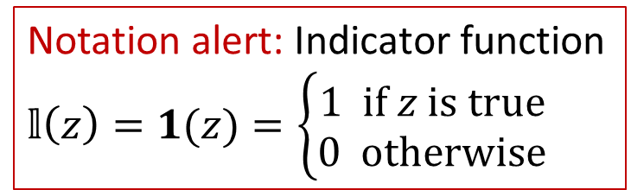
Classification
Notation alert: Indicator function
$𝕝\left(z\right)=1(z)=\left\{\begin{aligned}1 if z is true \\ 0 otherwise\end{aligned}\right.$
Iris data example
$𝒟={\left\{\left( x^{\left(i\right)},y^{\left(i\right)}\right)\right\}}_{i=1}^{N}$, where $x^{(i)}∈ℝ^{4}$, $y^{(i)}∈\{0, 1, 2\}$
Predict species label from input measurements
$h\left(x\right)→\hat{y}$
Species | Sepal Length | Sepal Width | Petal Length | Petal Width
0 | 4.3 | 3.0 | 1.1 | 0.1
0 | 4.9 | 3.6 | 1.4 | 0.1
0 | 5.3 | 3.7 | 1.5 | 0.2
1 | 4.9 | 2.4 | 3.3 | 1.0
1 | 5.7 | 2.8 | 4.1 | 1.3
1 | 6.3 | 3.3 | 4.7 | 1.6
2 | 5.9 | 3.0 | 5.1 | 1.8
Performance measure?
Classification error rate
Fraction of times $y≠\hat{y}$ in a given dataset
$\frac{1}{N} \sum_{i=1}^{N}{𝕝\left(y^{\left(i\right)}≠{\hat{y}}^{\left(i\right)}\right)}$
Images and full dataset: https://en.wikipedia.org/wiki/Iris_flower_data_set

Slide 21
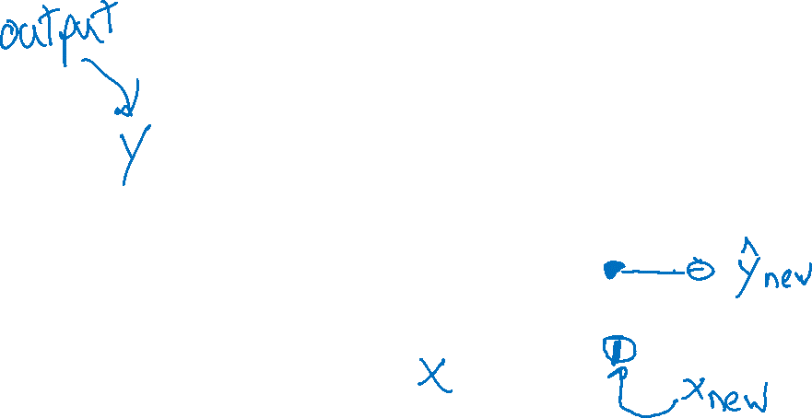
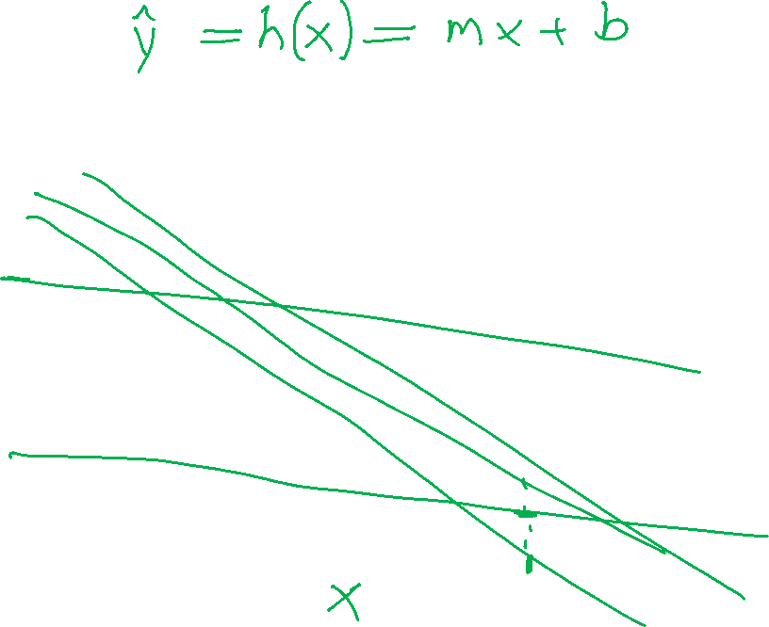
ML Task: Regression
Regression: learning a model to predict a numerical output (but not numbers that just represent categories, that would be classification)
Example
Trying to see how much I should sell my car for. Looking up data from car websites, I find the mileage for a set of cars and the selling price for each car.

Slide 22
Unsupervised Tasks

Slide 23
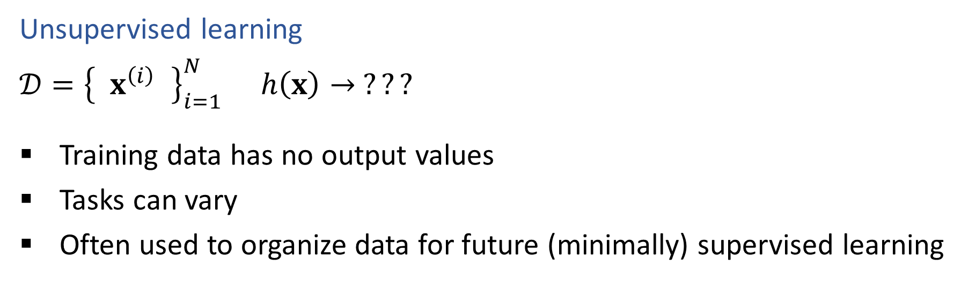

ML Tasks
Unsupervised learning
$𝒟={\left\{ x^{\left(i\right) }\right\}}_{i=1}^{N}$ $h\left(x\right)→ ???$
Training data has no output values
Tasks can vary
Often used to organize data for future (minimally) supervised learning

Slide 24
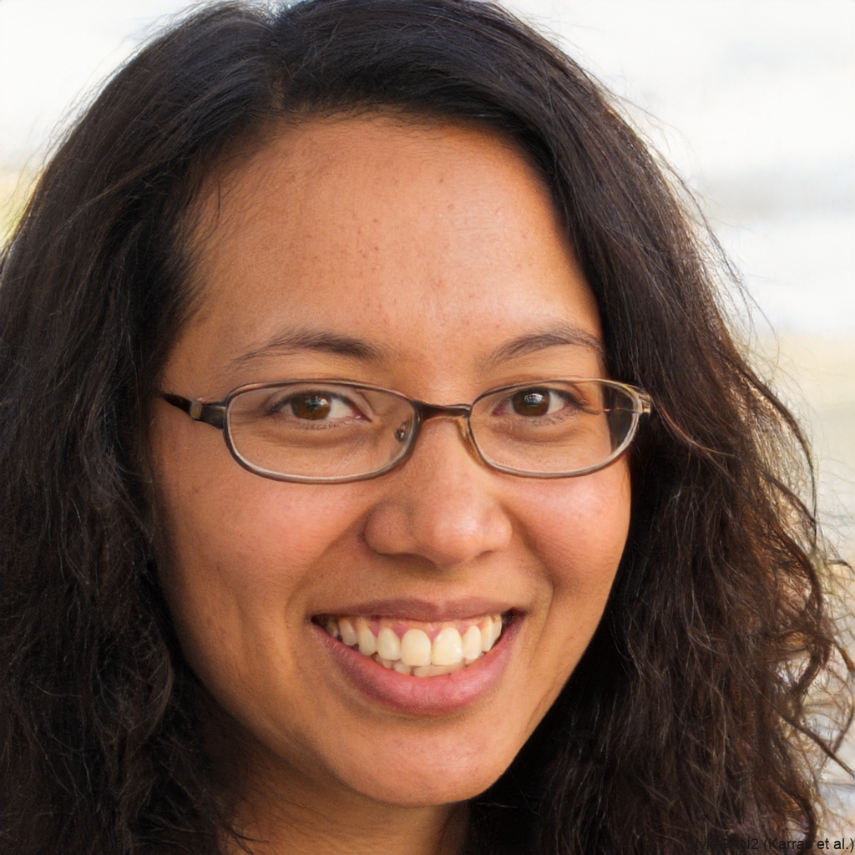
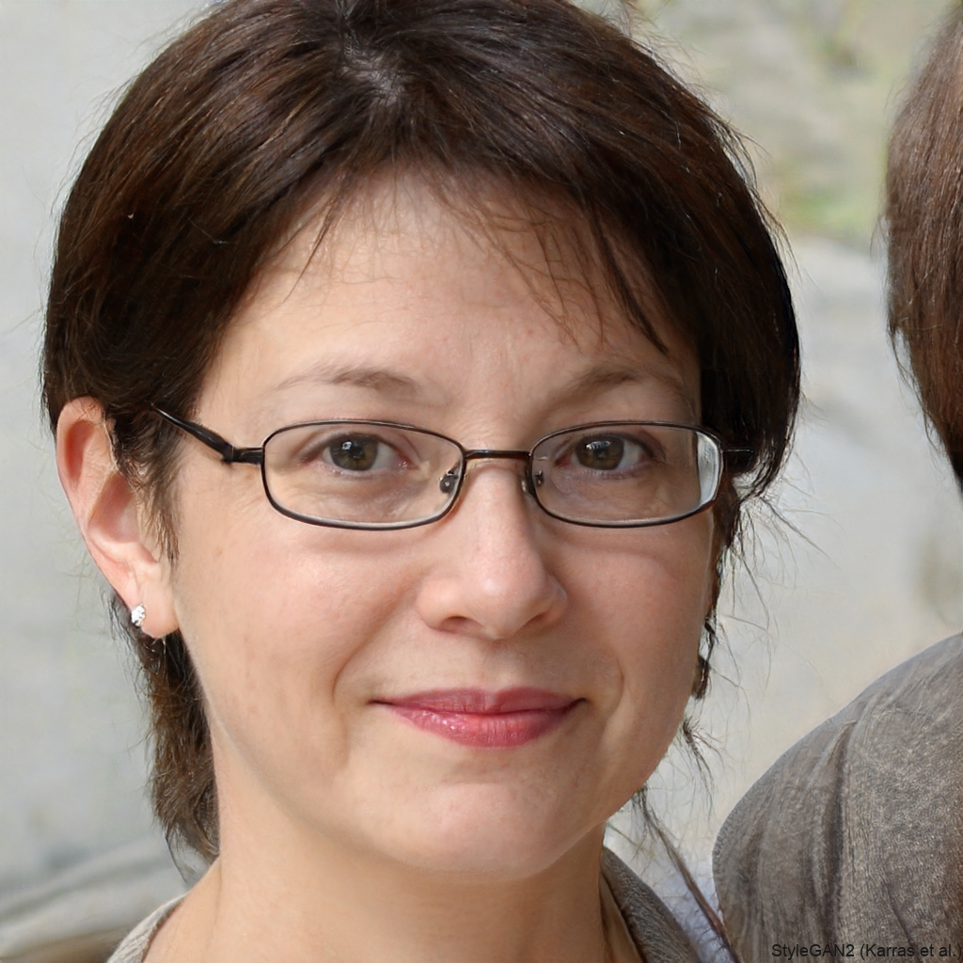
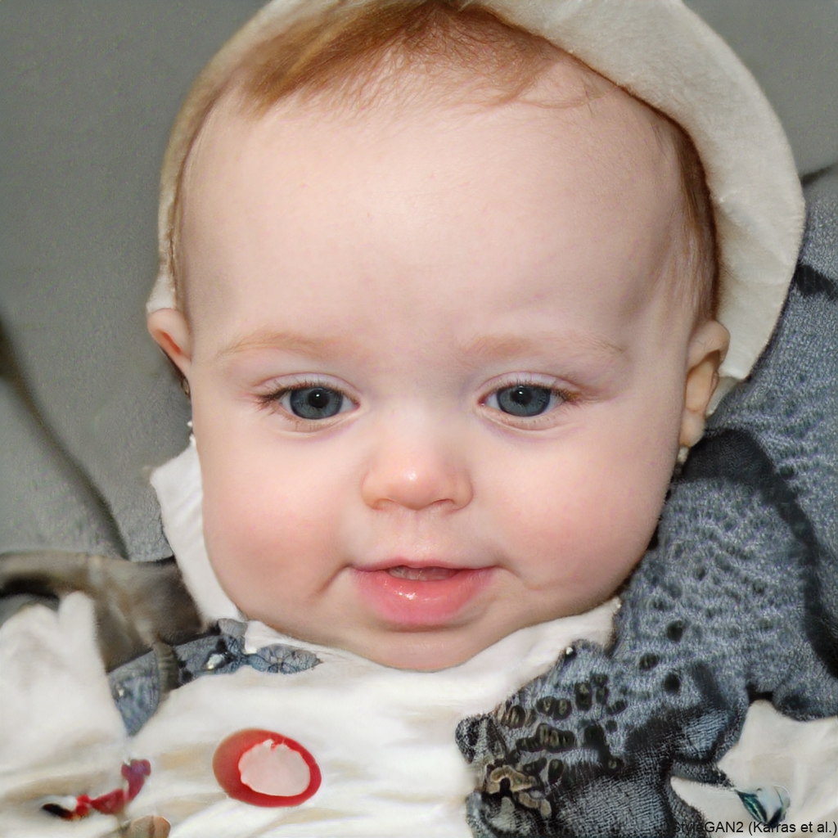
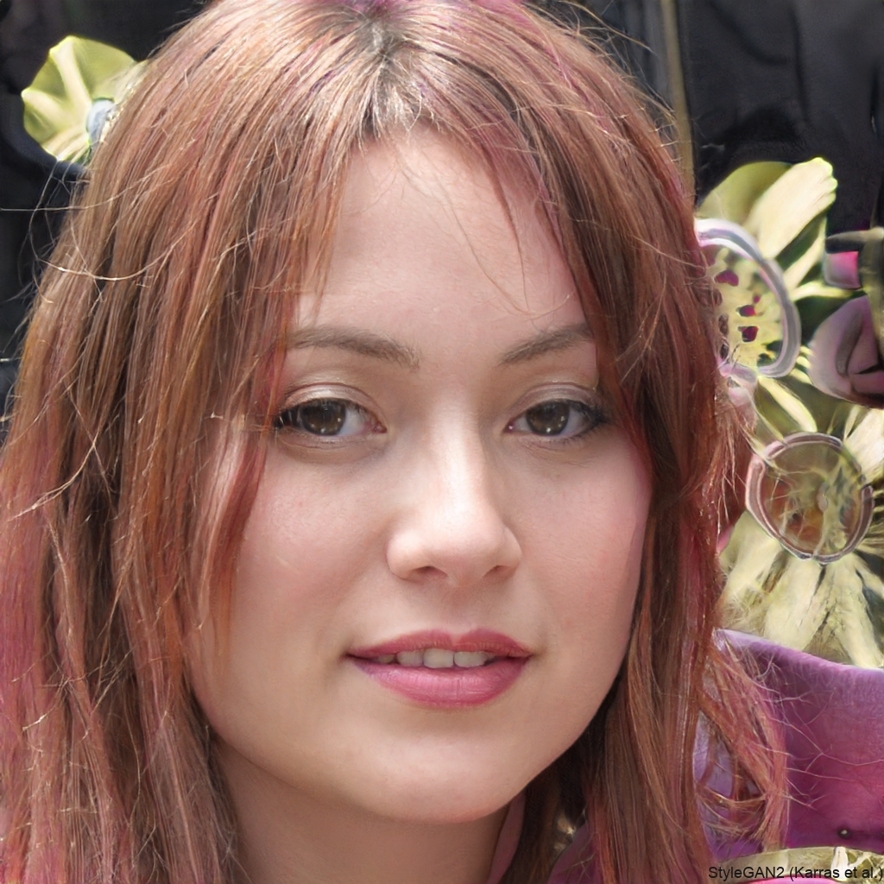
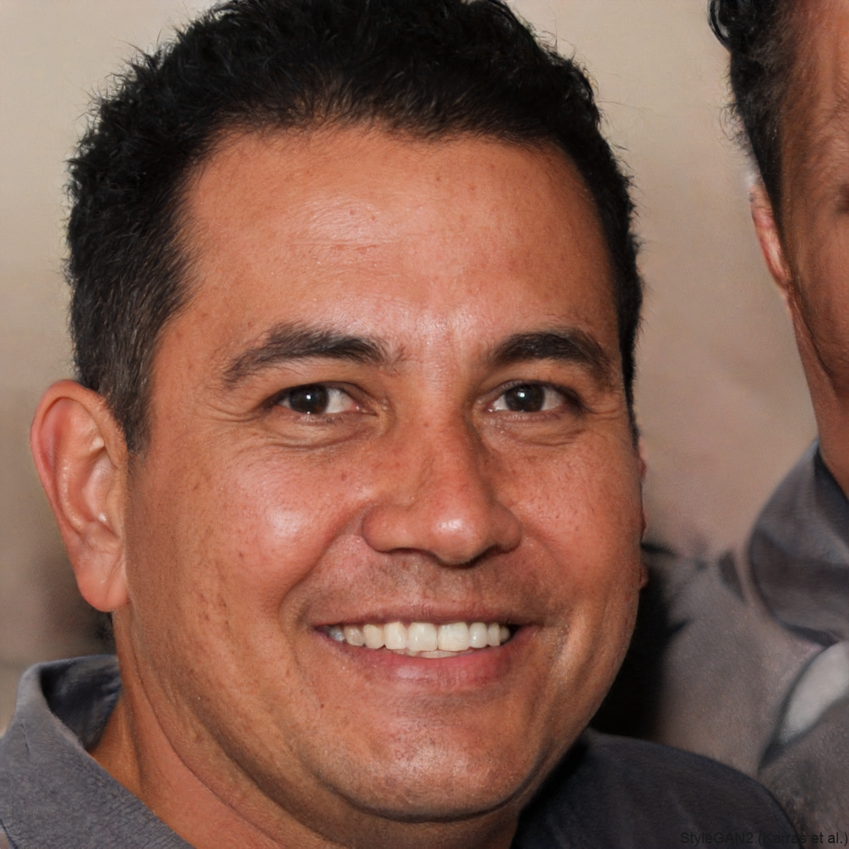
Task: Unsupervised Face Generation
https://thispersondoesnotexist.com/

Slide 25
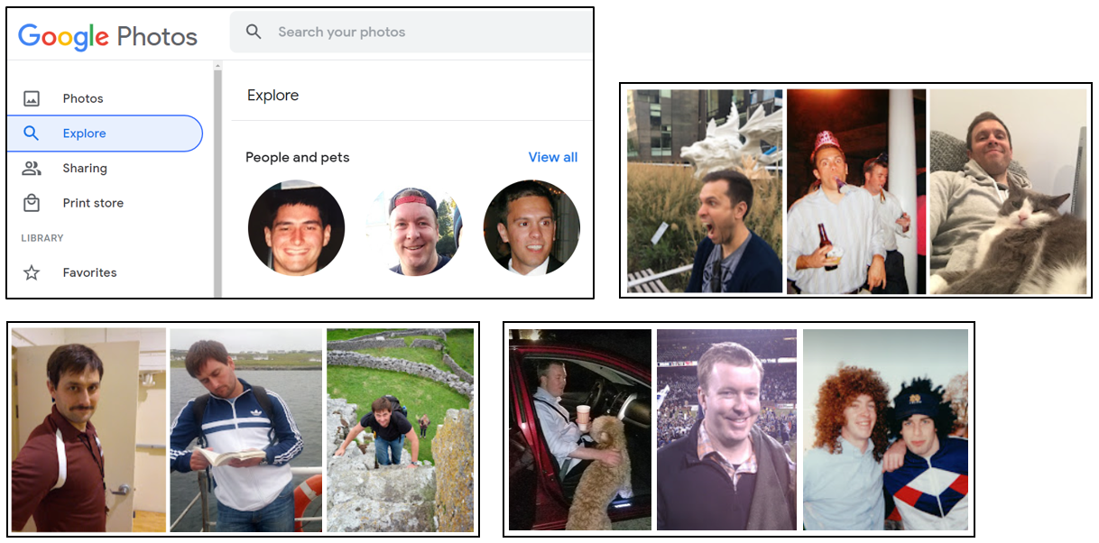
Tasks: Unsupervised Clustering (Photos)

Slide 26
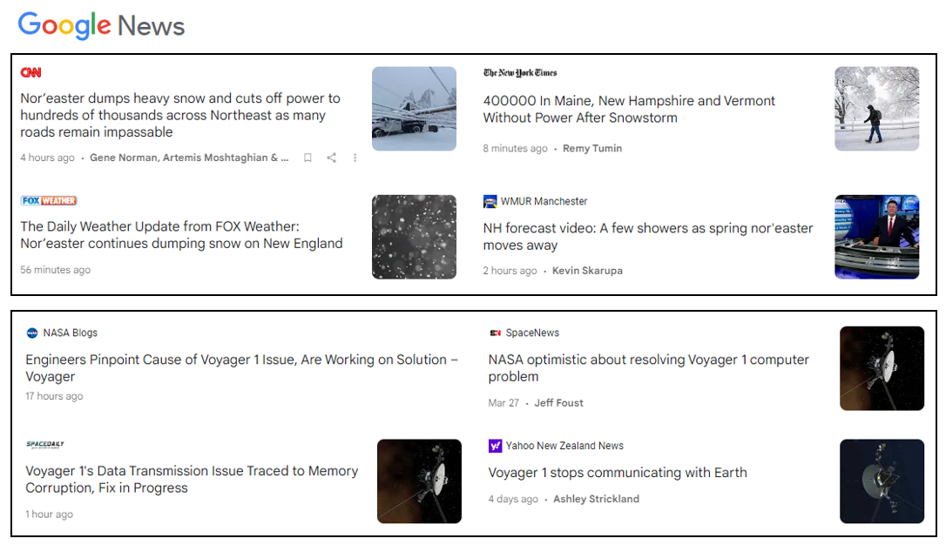
Tasks: Unsupervised Clustering (News)

Slide 27
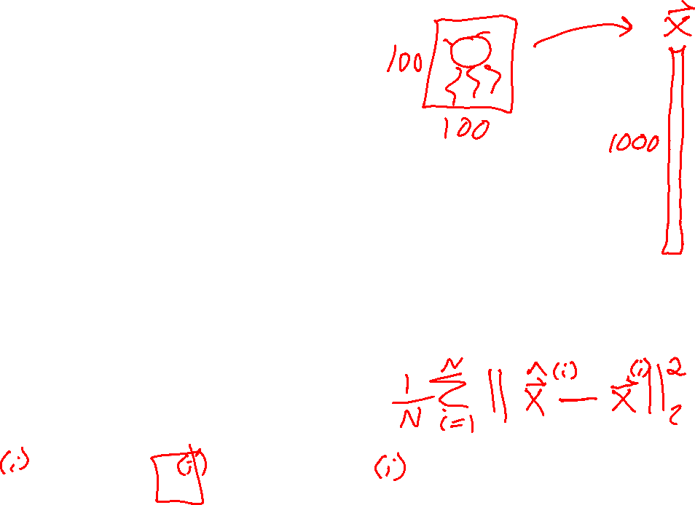

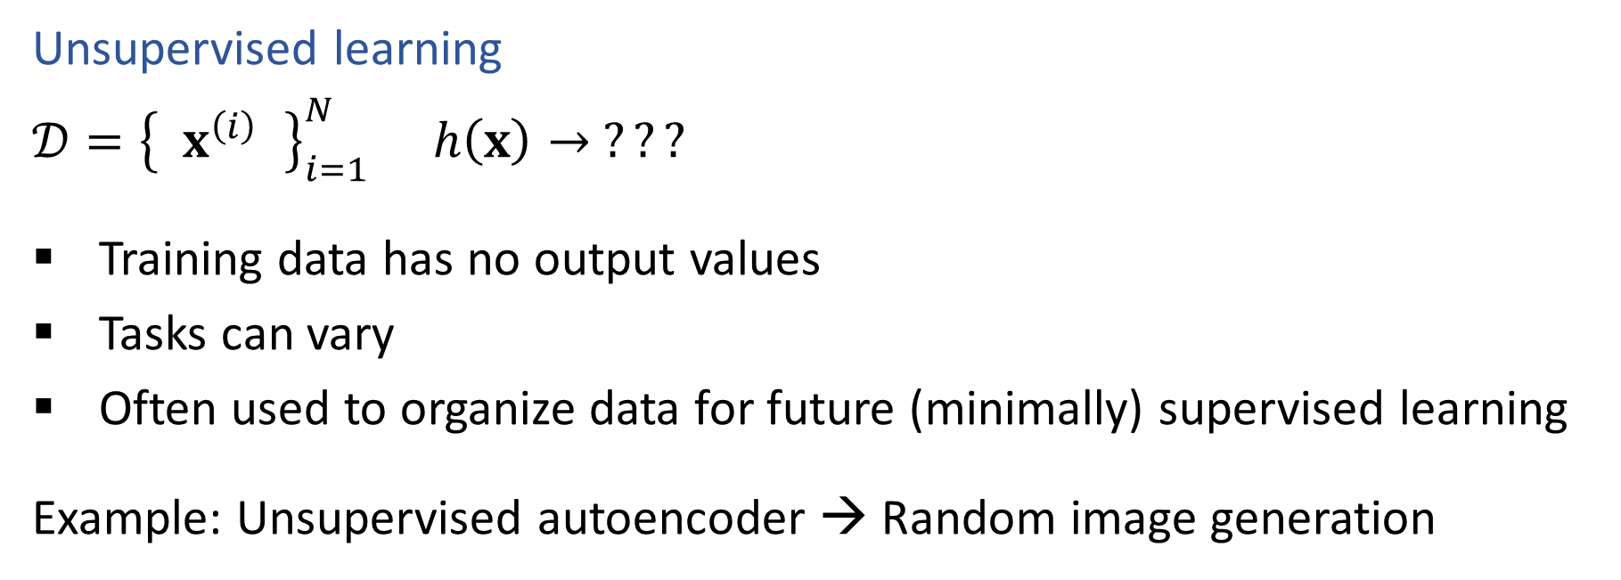
ML Tasks
Unsupervised learning
$𝒟={\left\{ x^{\left(i\right) }\right\}}_{i=1}^{N}$ $h\left(x\right)→ ???$
Training data has no output values
Tasks can vary
Often used to organize data for future (minimally) supervised learning
Example: Unsupervised autoencoder → Random image generation
$$x → h\left(x\right) → \hat{x}$$
$$x → f\left(x\right) →z→ g\left(z\right) → \hat{x}$$
$$z→ g\left(z\right) → \hat{x}$$

Slide 28
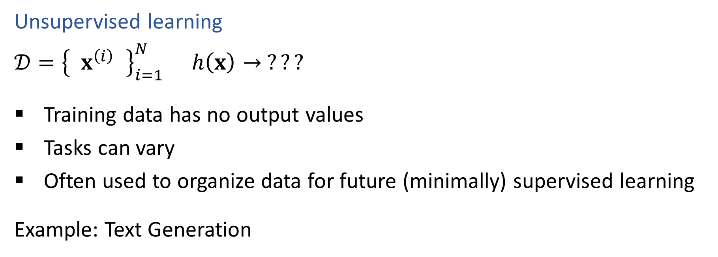
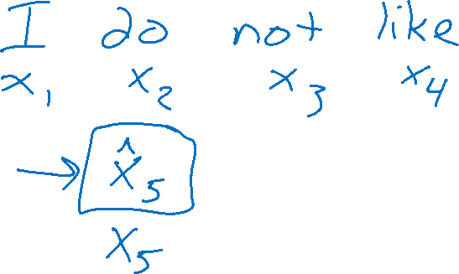
ML Tasks
Unsupervised learning
$𝒟={\left\{ x^{\left(i\right) }\right\}}_{i=1}^{N}$ $h\left(x\right)→ ???$
Training data has no output values
Tasks can vary
Often used to organize data for future (minimally) supervised learning
Example: Text Generation

Slide 29
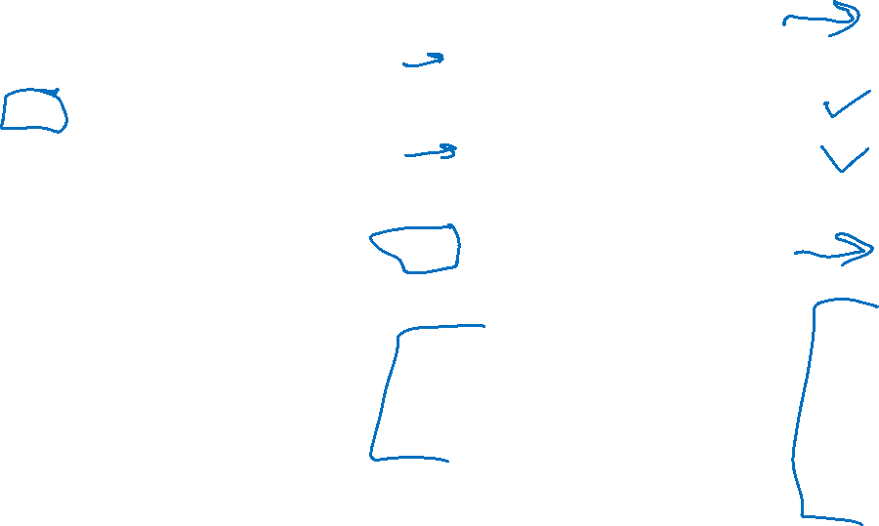
Vocab pause
Experience/Data
Input
Input feature
Measurement
Attribute
Output
Target
Class/category/label
True output
Measured output
Predicted output
Supervised
Unsupervised
Performance Measure
Objective function
Classification
Error rate
Accuracy rate
Regression
Mean squared error
Task
Prediction
Inference
Hypothesis function
Classification
Regression
Training
Model
Model structure
Model parameters

Slide 30
Training and ML Models

Slide 31
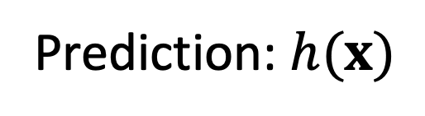


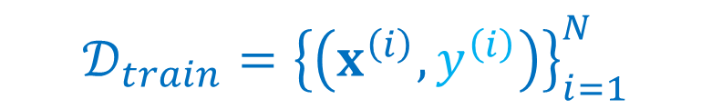


Machine Learning
Using (training) data to learn a model that we’ll later use for prediction
Training Data
Input and Measured Output
Model
Structure and Parameters, $θ$
Training
$$𝒟_{train}={\left\{\left(x^{\left(i\right)},y^{\left(i\right)}\right)\right\}}_{i=1}^{N}$$
Prediction: $h(x)$
Input
Predicted
Output
Model
$$x^{(new)}$$
$${\hat{y}}^{(new)}$$

Slide 32
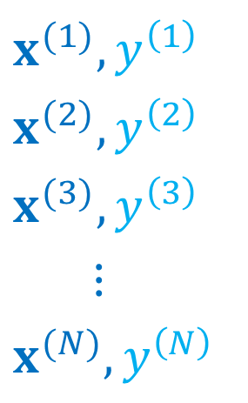

Machine Learning
Using (training) data to learn a model that we’ll later use for prediction
Training Data
$$x^{(1)},y^{\left(1\right)}$$
$$x^{(2)},y^{\left(2\right)}$$
$$x^{(3)},y^{\left(3\right)}$$
$$⋮$$
$$x^{(N)},y^{\left(N\right)}$$
Model
Structure and Parameters, $θ$
Training
Prediction: $h(x)$
Input
Predicted
Output
Model
$$x^{(new)}$$
$${\hat{y}}^{(new)}$$

Slide 33

Machine Learning
Using (training) data to learn a model that we’ll later use for prediction
Training Data
Input and Measured Output
Model
Structure and Parameters
Training
Prediction
Input
Model
Predicted
Output

Slide 34


Classification
Iris data example
$𝒟={\left\{\left(y^{\left(i\right)}, x^{\left(i\right)}\right)\right\}}_{i=1}^{N}$, where $x^{(i)}∈ℝ^{4}$, $y^{(i)}∈\{0, 1, 2\}$
Predict species label from input measurements
$h\left(x\right)→\hat{y}$
Species | Sepal Length | Sepal Width | Petal Length | Petal Width
0 | 4.3 | 3.0 | 1.1 | 0.1
0 | 4.9 | 3.6 | 1.4 | 0.1
0 | 5.3 | 3.7 | 1.5 | 0.2
1 | 4.9 | 2.4 | 3.3 | 1.0
1 | 5.7 | 2.8 | 4.1 | 1.3
1 | 6.3 | 3.3 | 4.7 | 1.6
2 | 5.9 | 3.0 | 5.1 | 1.8
Performance measure?
Classification error rate
Fraction of times $y≠\hat{y}$ in a given dataset
Images and full dataset: https://en.wikipedia.org/wiki/Iris_flower_data_set

Slide 35
Classification
Notation alert: Indicator function
$𝕝\left(z\right)=1(z)=\left\{\begin{aligned}1 if z is true \\ 0 otherwise\end{aligned}\right.$
Iris data example
$𝒟={\left\{\left(y^{\left(i\right)}, x^{\left(i\right)}\right)\right\}}_{i=1}^{N}$, where $x^{(i)}∈ℝ^{4}$, $y^{(i)}∈\{0, 1, 2\}$
Predict species label from input measurements
$h\left(x\right)→\hat{y}$
Species | Sepal Length | Sepal Width | Petal Length | Petal Width
0 | 4.3 | 3.0 | 1.1 | 0.1
0 | 4.9 | 3.6 | 1.4 | 0.1
0 | 5.3 | 3.7 | 1.5 | 0.2
1 | 4.9 | 2.4 | 3.3 | 1.0
1 | 5.7 | 2.8 | 4.1 | 1.3
1 | 6.3 | 3.3 | 4.7 | 1.6
2 | 5.9 | 3.0 | 5.1 | 1.8
Performance measure?
Classification error rate
Fraction of times $y≠\hat{y}$ in a given dataset
$\frac{1}{N} \sum_{i=1}^{N}{𝕝\left(y^{\left(i\right)}≠{\hat{y}}^{\left(i\right)}\right)}$
Images and full dataset: https://en.wikipedia.org/wiki/Iris_flower_data_set

Slide 36


Regression Model
Regression: learning a model to predict a numerical output (but not numbers that just represent categories, that would be classification)
Model: Linear
Structure:
Parameters:

Slide 37
Regression Model
Regression: learning a model to predict a numerical output (but not numbers that just represent categories, that would be classification)
How do we know which model and model parameters are best?

Slide 38


Regression Model
Regression: learning a model to predict a numerical output (but not numbers that just represent categories, that would be classification)
How do we know which model and model parameters are best?

Slide 39
Regression Model
Regression: learning a model to predict a numerical output (but not numbers that just represent categories, that would be classification)
Model Single Neuron

Slide 40
Regression Model
Regression: learning a model to predict a numerical output (but not numbers that just represent categories, that would be classification)
Model: Memorization

