Slide 1

10-315 Introduction to ML Variational Autoencoders
Instructor: Pat Virtue

Slide 2

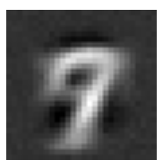
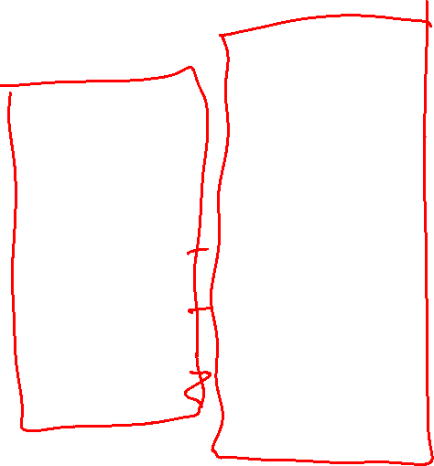
Digit Autoencoder
https://cs.stanford.edu/people/karpathy/convnetjs/demo/autoencoder.html
Layer 1
Layer 2
Layer 4
Layer 5
Layer 6
Input
28x28 = 784 pixels
Layer 3
50 neurons
50 neurons
784 neurons
50 neurons
50 neurons
2 neurons
Autoencoder network

Slide 3


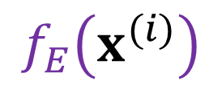
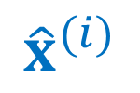

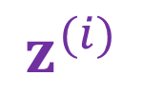
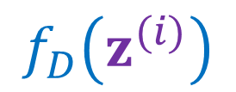

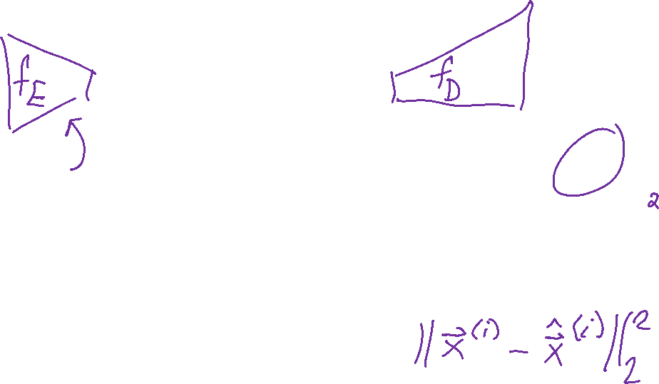


Autoencoder
$$J\left(θ,φ\right)$$
$$p_{θ}\left(x∣z\right)$$
$$x^{(i)}$$
$$z^{(i)}$$
$${\hat{x}}^{(i)}$$
$$f_{E}\left(x^{(i)}\right)$$
$$f_{D}\left(z^{(i)}\right)$$
$$φ$$
$$θ$$
$$L_{2}$$

Slide 4
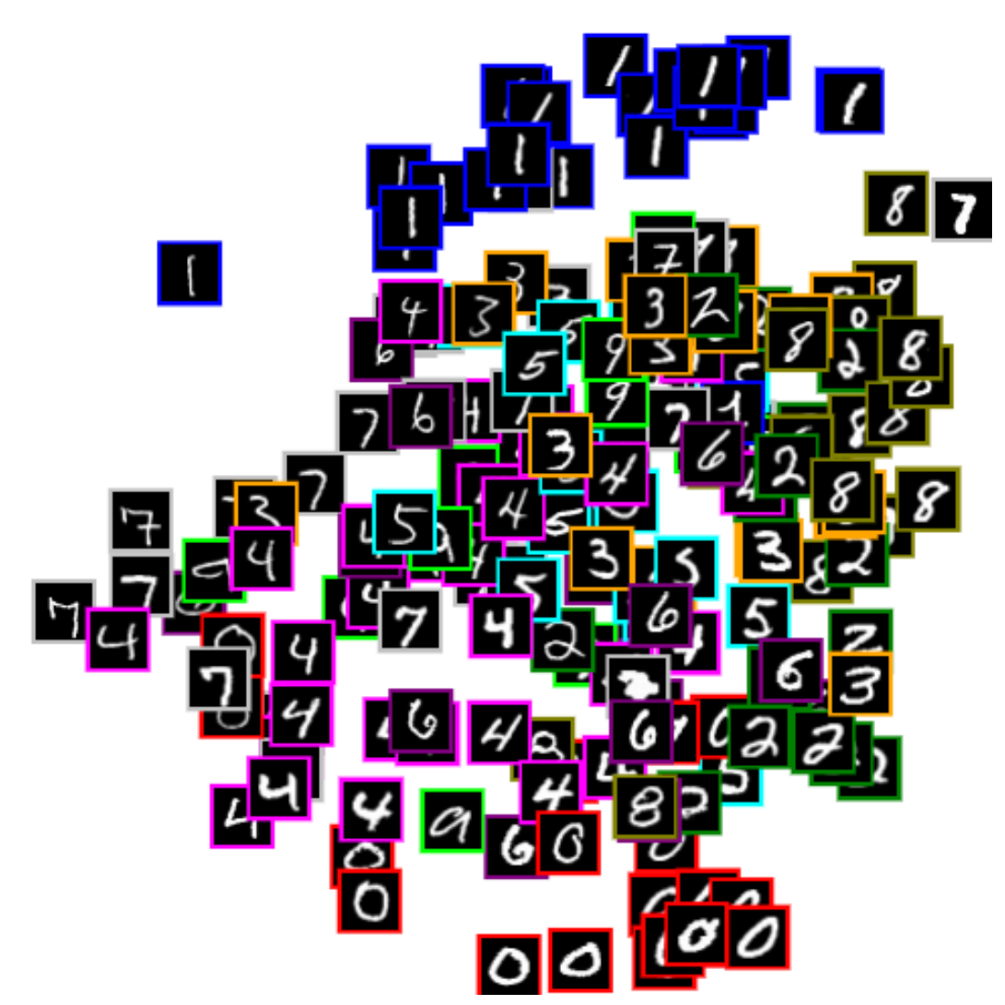
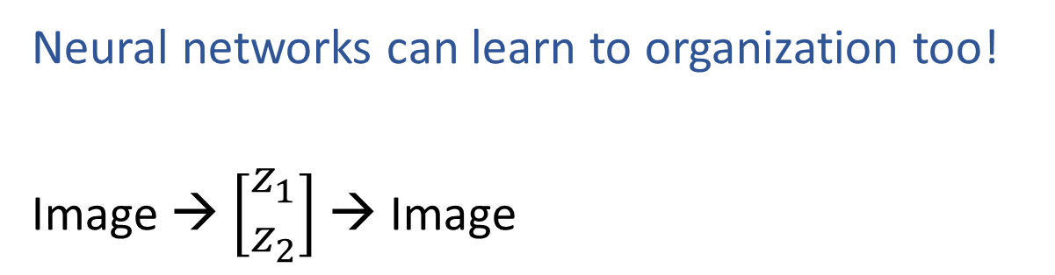


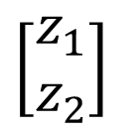

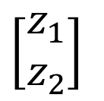
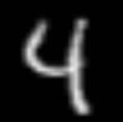

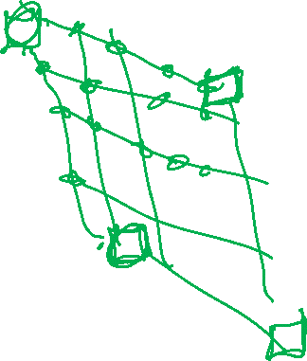
Autoencoder
Net
Net
Net
Net
https://cs.stanford.edu/people/karpathy/convnetjs/demo/autoencoder.html

Slide 5
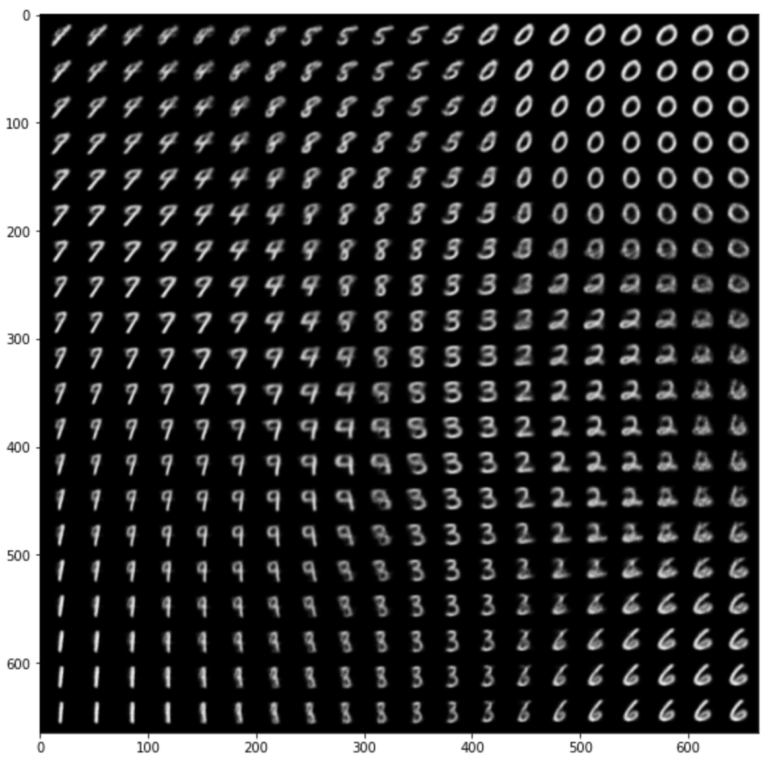

Variational Autoencoder Demo
Zhuoyue Lyu, Safinah Ali, and Cynthia Breazeal. EAAI 2022.
https://colab.research.google.com/gist/ZhuoyueLyu/5046225a9ae3675cf633c1df5f63be06/digits-interpolation-notebook-eaai.ipynb

Slide 6
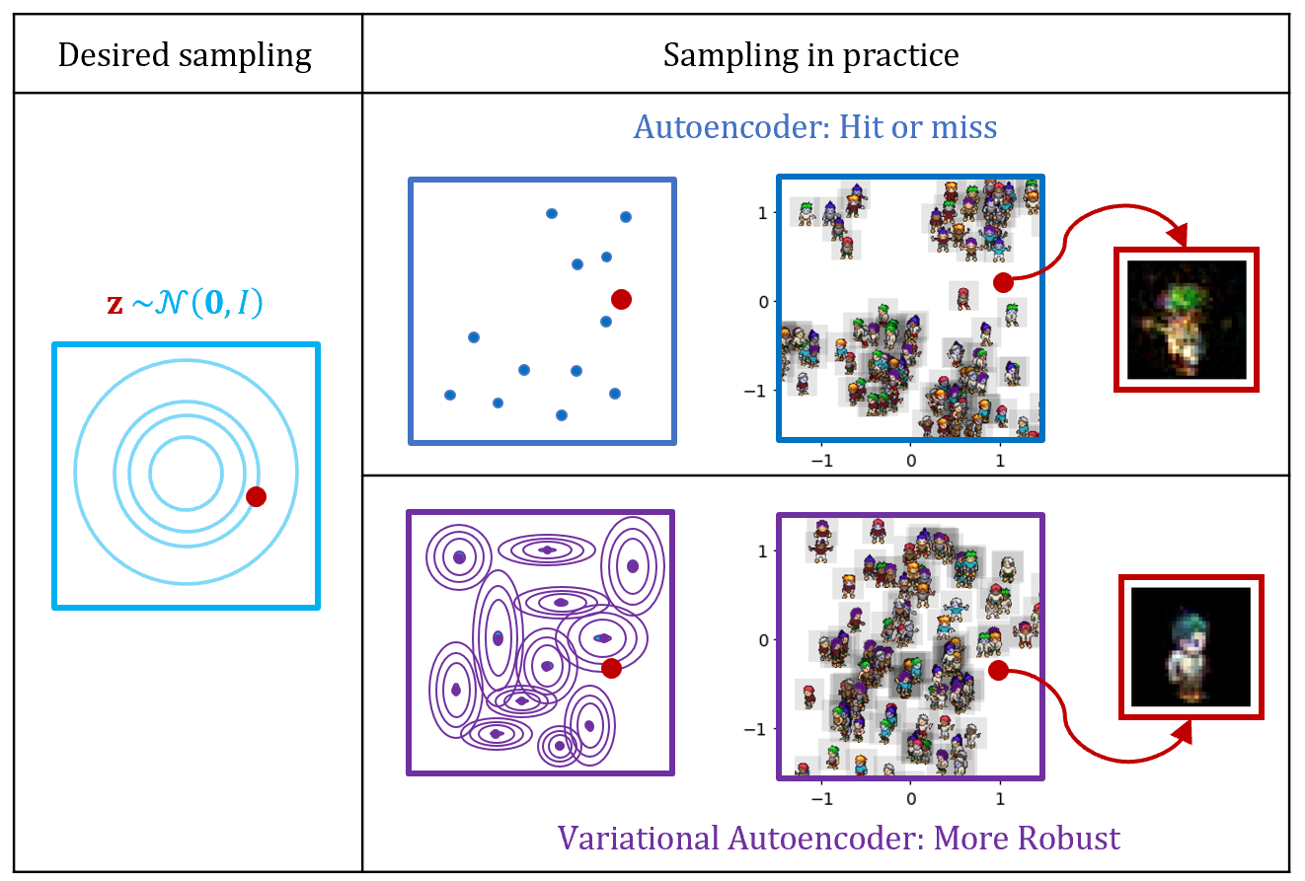
How do we sample a new image?
Dataset source: https://github.com/YingzhenLi/Sprites

Slide 7
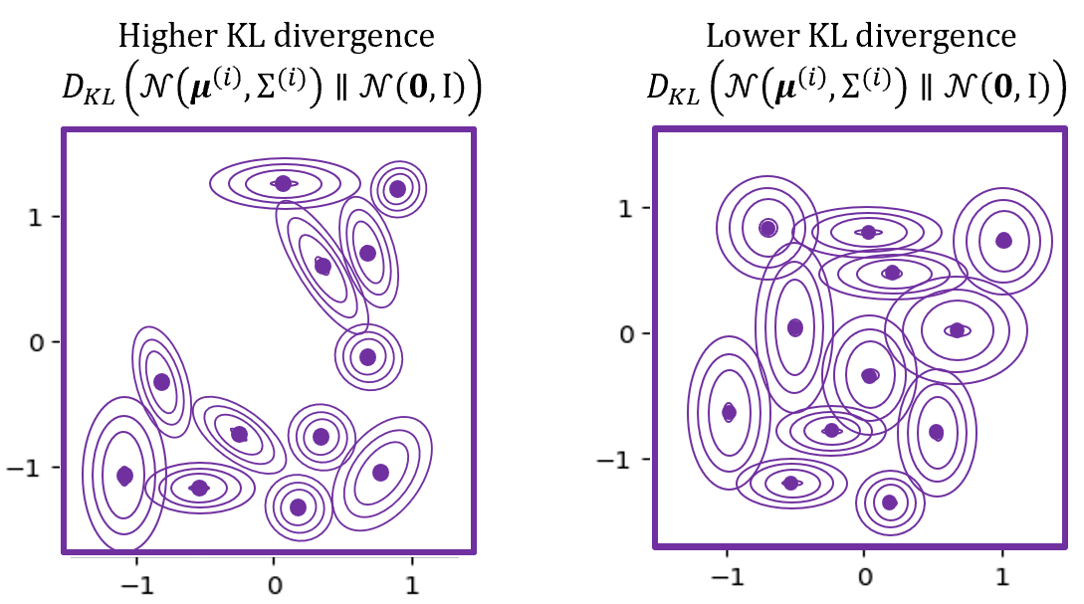
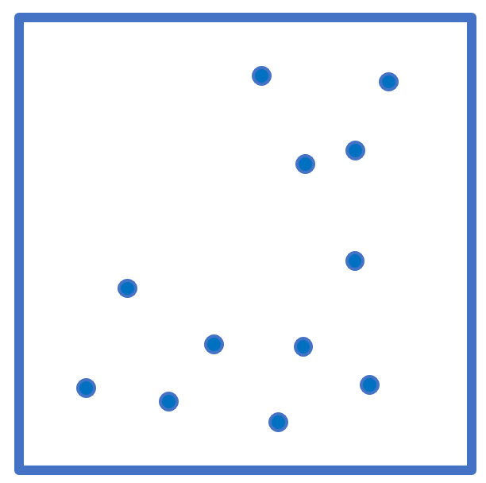
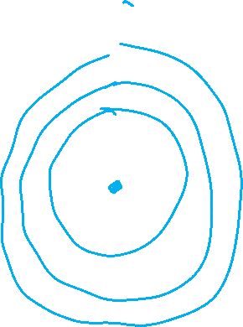
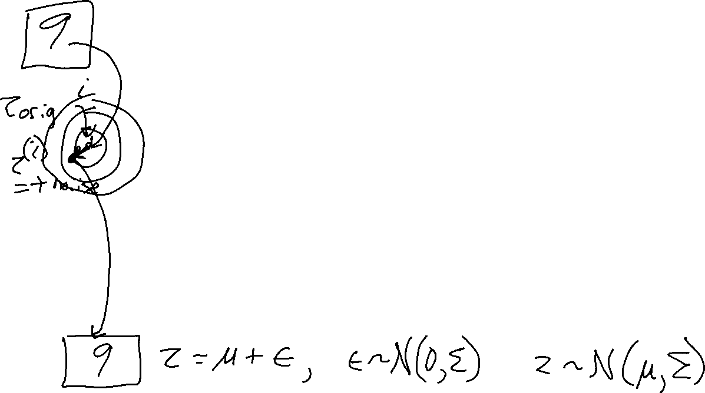
From Autoencoders to VAE

Slide 8



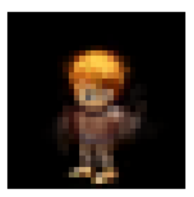
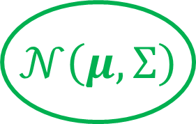
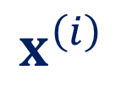

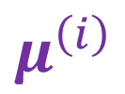
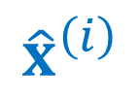





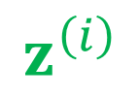


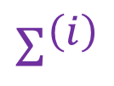
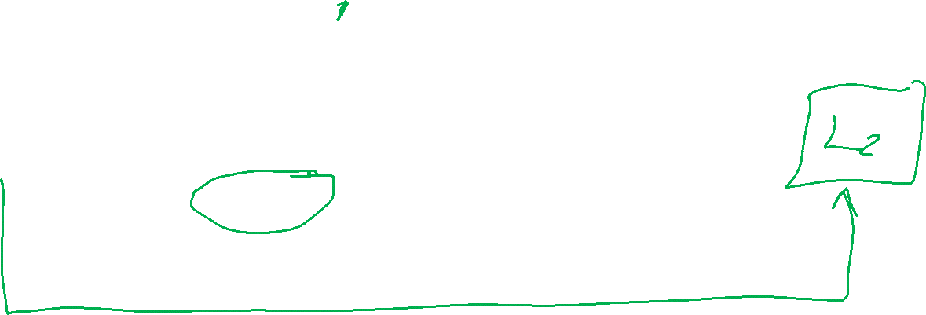
From Autoencoders to VAE
$$x^{\left(1\right)}$$
$${\hat{x}}^{\left(1\right)}$$
$$x^{\left(2\right)}$$
$${\hat{x}}^{\left(2\right)}$$
$$μ^{\left(i\right)}$$
$$z^{\left(i\right)}$$
$${\hat{x}}^{\left(i\right)}$$
$$x^{\left(i\right)}$$
$$f_{E}\left(x^{\left(i\right)}\right)$$
$$f_{D}\left(z^{\left(i\right)}\right)$$
$$φ$$
$$θ$$
$$Σ^{\left(i\right)}$$
randn(mu,sig)
Dataset source: https://github.com/YingzhenLi/Sprites

Slide 9



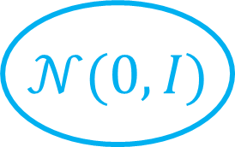
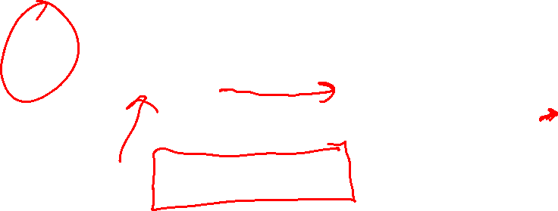


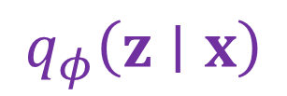



From Autoencoders to VAE
Want:
$$p_{θ}\left(x∣z\right)$$
$$f_{D}\left(z\right)$$
$$θ$$
Autoencoder:
$$q_{φ}\left(z∣x\right)$$
$$p_{θ}\left(x∣z\right)$$
$$μ^{\left(i\right)}$$
$$z^{\left(i\right)}$$
$${\hat{x}}^{\left(i\right)}$$
$$x^{\left(i\right)}$$
$$f_{E}\left(x^{\left(i\right)}\right)$$
$$f_{D}\left(z^{\left(i\right)}\right)$$
$$φ$$
$$θ$$
$$Σ^{\left(i\right)}$$
randn(mu,sig)

Slide 10



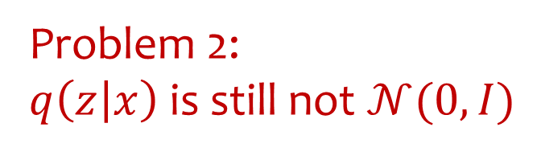

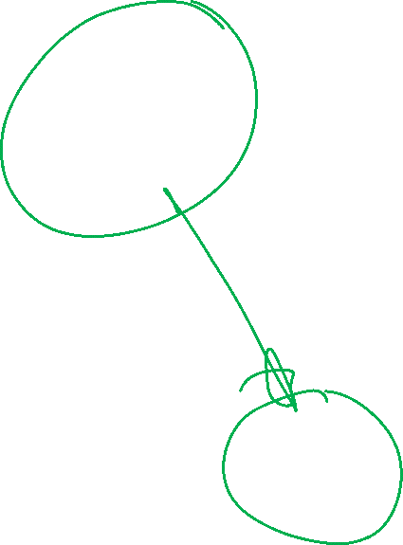


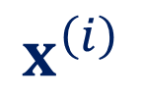
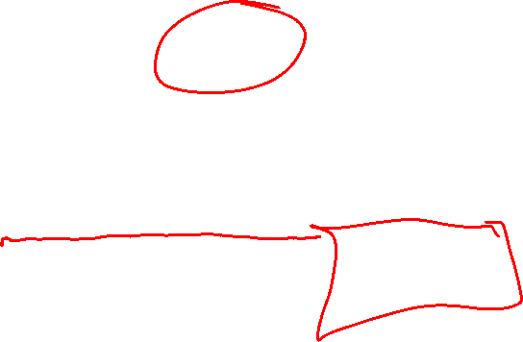



From Autoencoders to VAE
Want:
$$p_{θ}\left(x∣z\right)$$
$$f_{D}\left(z\right)$$
$$θ$$
Autoencoder:
Reparameterization trick
$$p_{θ}\left(x∣z\right)$$
$$x^{\left(i\right)}$$
$$μ^{\left(i\right)}$$
$$z^{\left(i\right)}$$
$${\hat{x}}^{\left(i\right)}$$
$$f_{E}\left(x^{\left(i\right)}\right)$$
$$f_{D}\left(z^{\left(i\right)}\right)$$
$$φ$$
$$θ$$
$$Σ^{\left(i\right)}$$
mu + sig*randn(0,1)

Slide 11



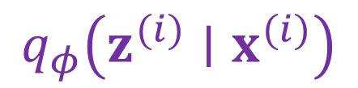





From Autoencoders to VAE
Want:
$$p_{θ}\left(x∣z\right)$$
$$f_{D}\left(z\right)$$
$$θ$$
Autoencoder:
$$q_{φ}\left(z^{(i)}∣x^{(i)}\right)$$
$$J\left(θ,φ\right)$$
$$p_{θ}\left(x∣z\right)$$
$$x^{\left(i\right)}$$
$$μ^{\left(i\right)}$$
$$z^{\left(i\right)}$$
$${\hat{x}}^{\left(i\right)}$$
$$f_{E}\left(x^{\left(i\right)}\right)$$
$$f_{D}\left(z^{\left(i\right)}\right)$$
$$φ$$
$$θ$$
$$L_{2}$$
$$Σ^{\left(i\right)}$$
$$q_{φ}\left(z^{(i)}∣x^{(i)}\right)$$

Slide 12
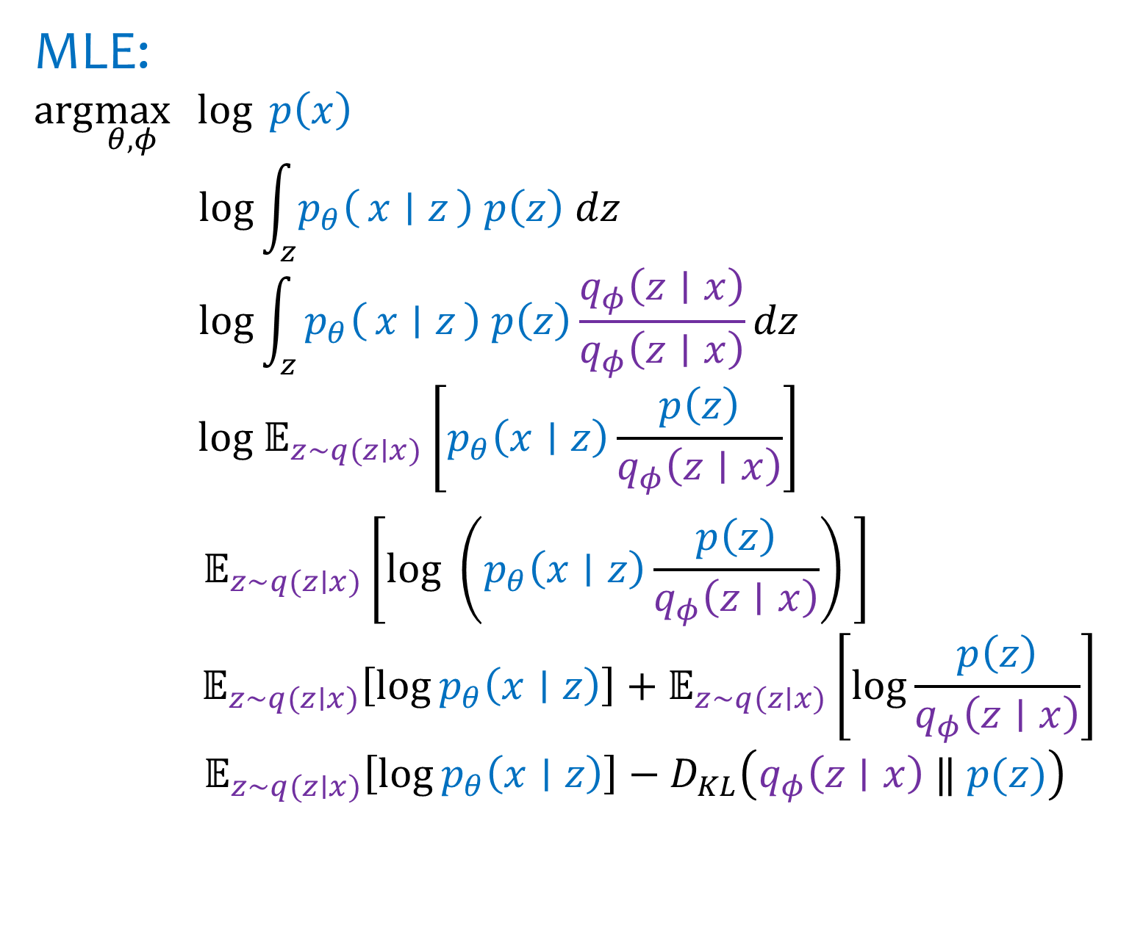
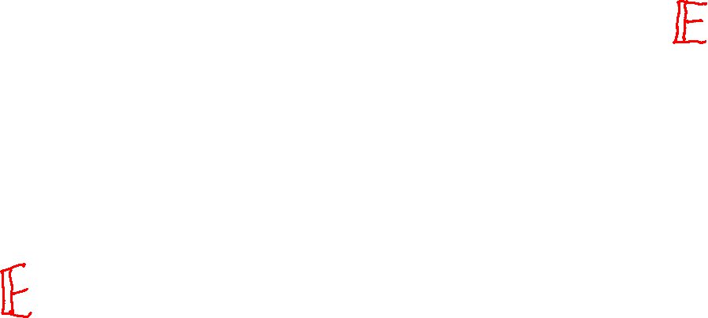
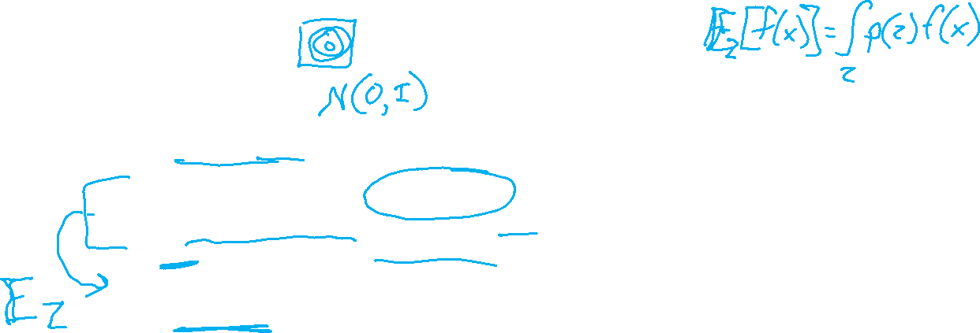
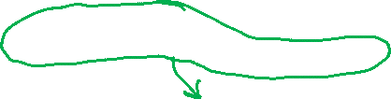
VAE Objective
Multiply by 1
Evidence Lower bound (ELBO)

Slide 13
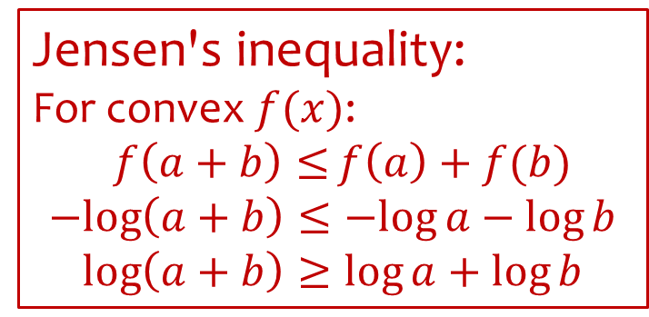
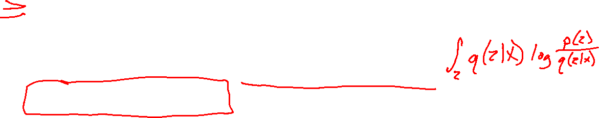
VAE Objective
Multiply by 1
Evidence Lower bound (ELBO)

Slide 14
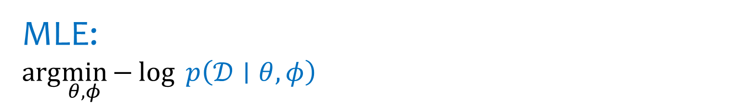


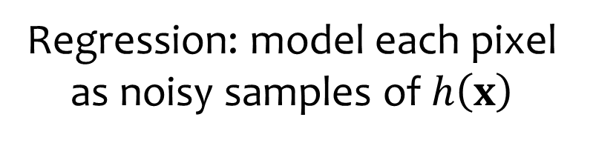
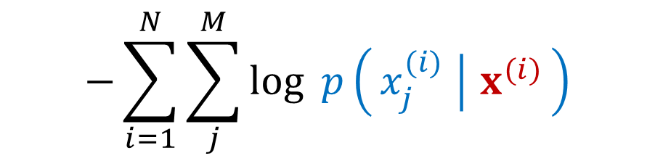






Regular Autoencoder Objective
$$\hat{x}=h_{θ,φ}\left(x\right)=f_{D}\left(z;θ\right)$$
$$loss\left(x, \hat{x}\right)={\left\|x−\hat{x}\right\|}_{2}^{2}={\left\|x−f_{D}\left(f_{E}(x)\right)\right\|}_{2}^{2}$$

Slide 15




VAE Objective

