Slide 1
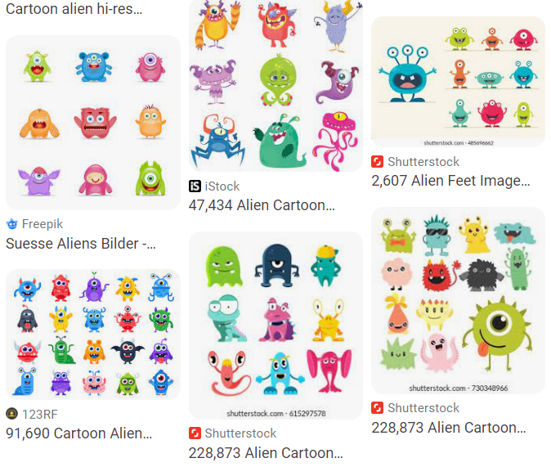
As you walk in
Welcome!
Help draw some aliens for our dataset today!
    Grab a sharpie and some sticky notes
    Just stick figures, nothing quite this fancy →

Slide 2

10-315
Introduction to ML
Instructor: Pat Virtue

Slide 3
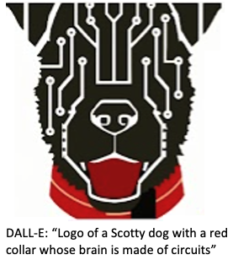
Today
Course team
Quick course info
What is AI and ML?
ML: Input/Ouput Tasks
Example Input/Output Tasks
Autoencoder (Aliens)

Slide 4


Course Team
Instructor
Education Associate
Best way to contact Pat:
Post on Ed (private post as needed)
Just grab an OH appointment slot
(Not email ☹)
Email Nichelle, nichellp@andrew.cmu.edu:
Exceptions, extensions, etc
    (may replace with exceptions form)
Any course logistics

Slide 5
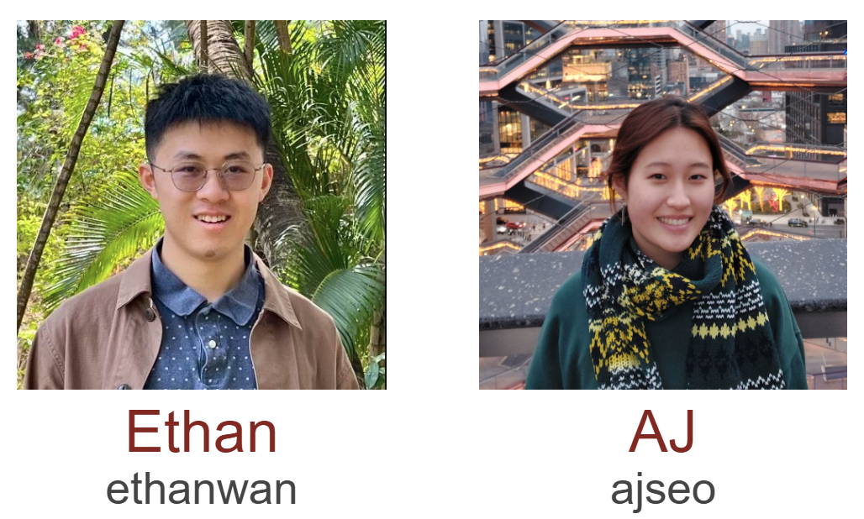

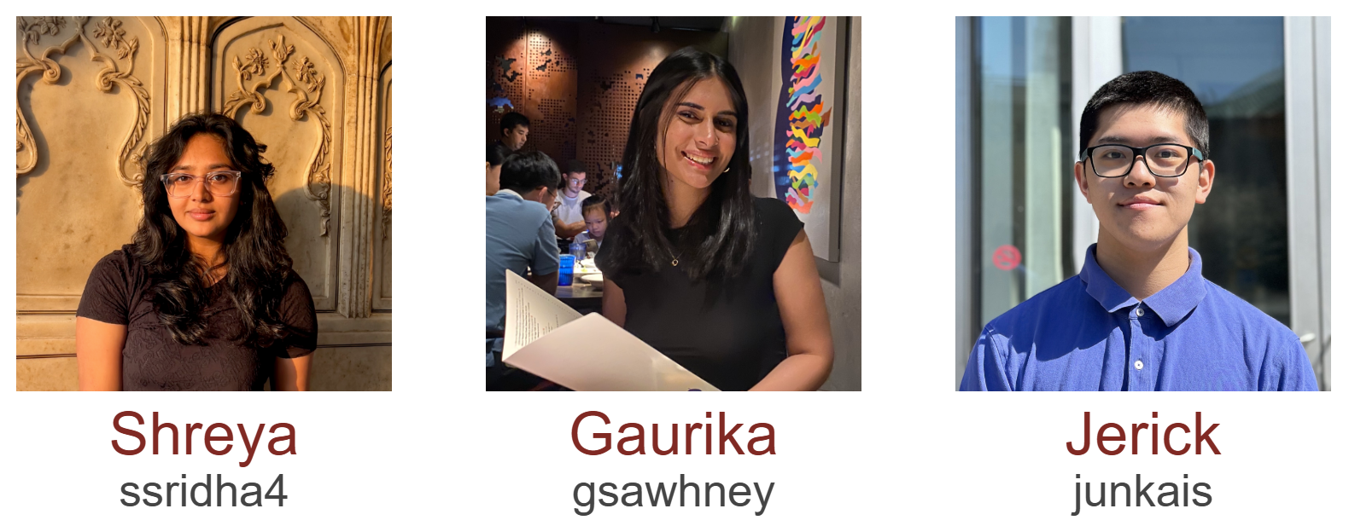
Course Team
Teaching Assistants

Slide 6
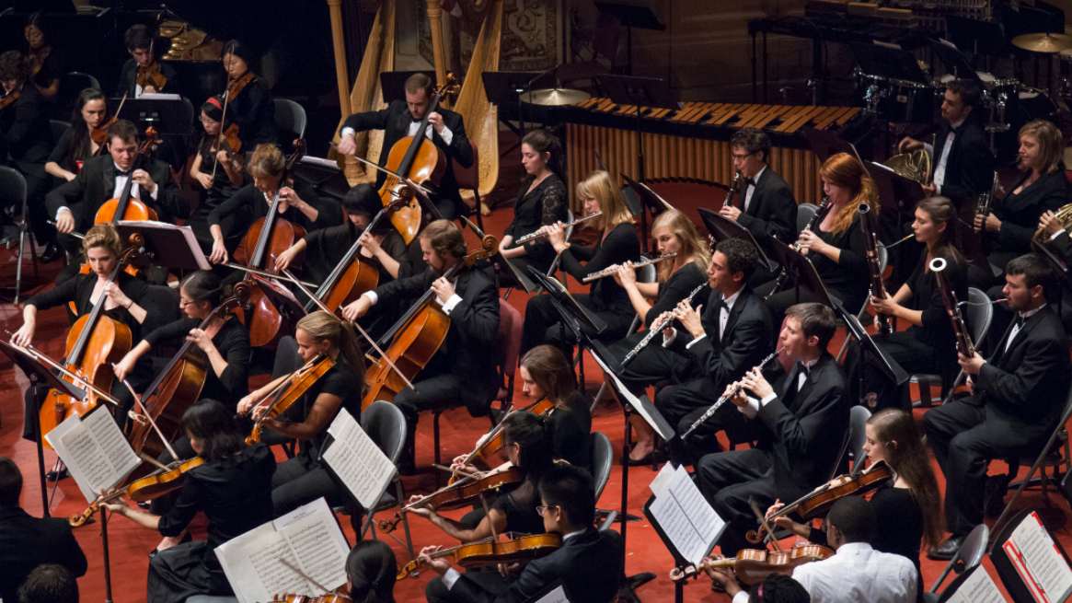
Course Team
Students!!

Slide 7

Course Information
Website: https://www.cs.cmu.edu/~10315
Communication:
https://edstem.org/
E-mail Nichelle if piazza doesn’t work:
nichellp@andrew.cmu.edu
Important posts coming soon!
Office Hours
Jupyter notebooks
Recitation (Fri)
Pre-reading (due Tue)
HW0
HW1

Slide 8
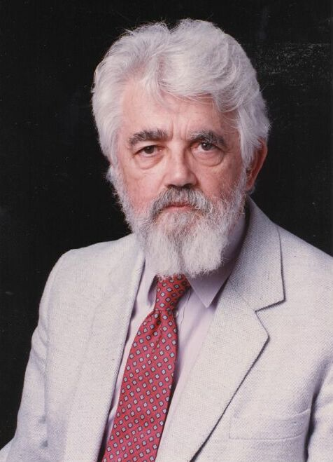

AI Definition by John McCarthy
What is artificial intelligence
  It is the science and engineering of making intelligent machines, especially intelligent computer programs
What is intelligence
  Intelligence is the computational part of the ability to achieve goals in the world
http://www-formal.stanford.edu/jmc/whatisai/whatisai.html

Slide 9
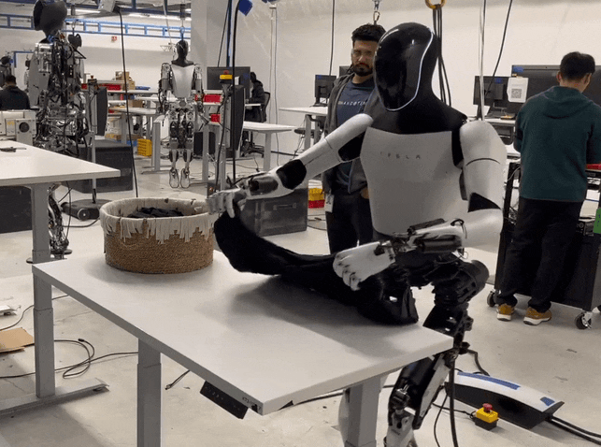
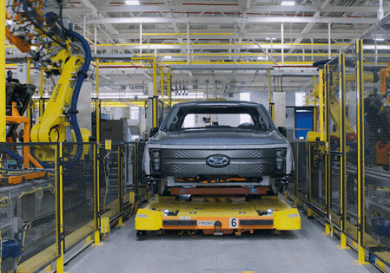
What is artificial Intelligence?
Why is folding clothes a research problem while robots are actively being used to assemble cars in factories?

Slide 10


AI Definition (Pat's Version)
What is intelligence
  Intelligence is the ability to perform well on a task that involves uncertainty
Intelligence is not binary
  How well an agent performs and how much uncertainty is involved will determine how intelligent we consider the agent to be

Slide 11

Artificial Intelligence vs Machine Learning?
Artificial Intelligence
Machine Learning
Deep Learning

Slide 12
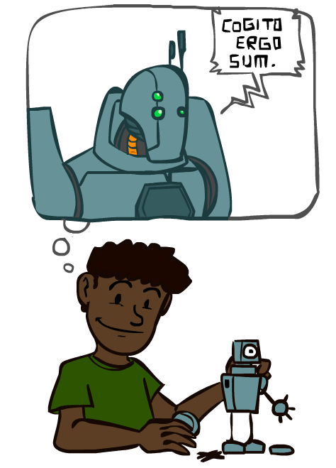
A Brief History of AI
Images: ai.berkeley.edu

Slide 13
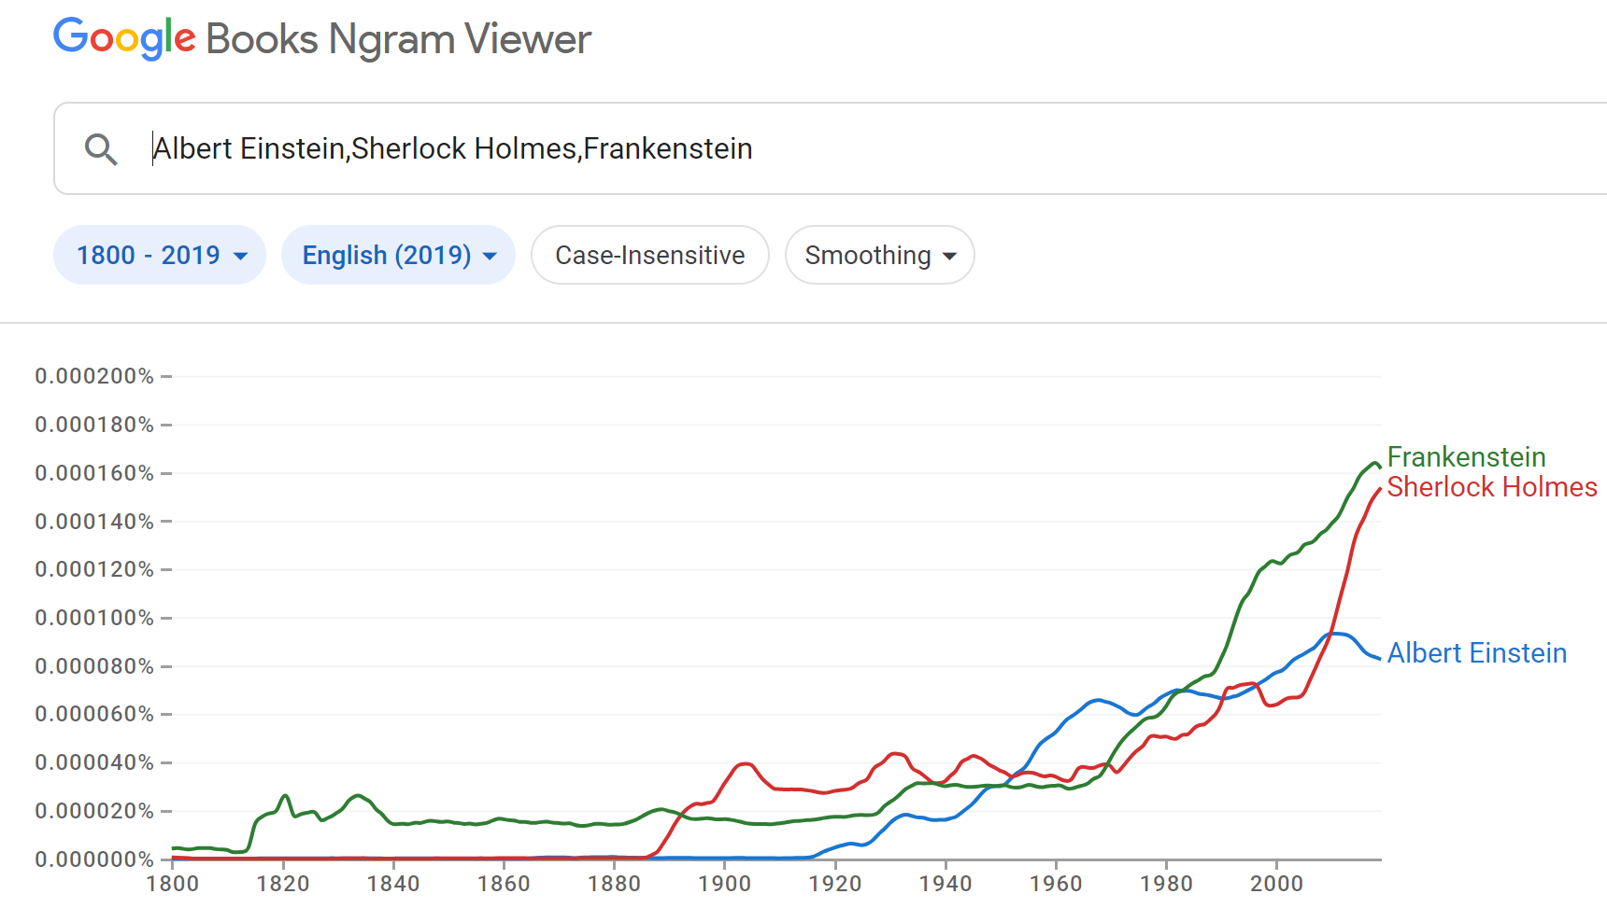
A Brief History of AI: Via Google N-grams Viewer
https://books.google.com/ngrams
https://books.google.com/ngrams

Slide 14
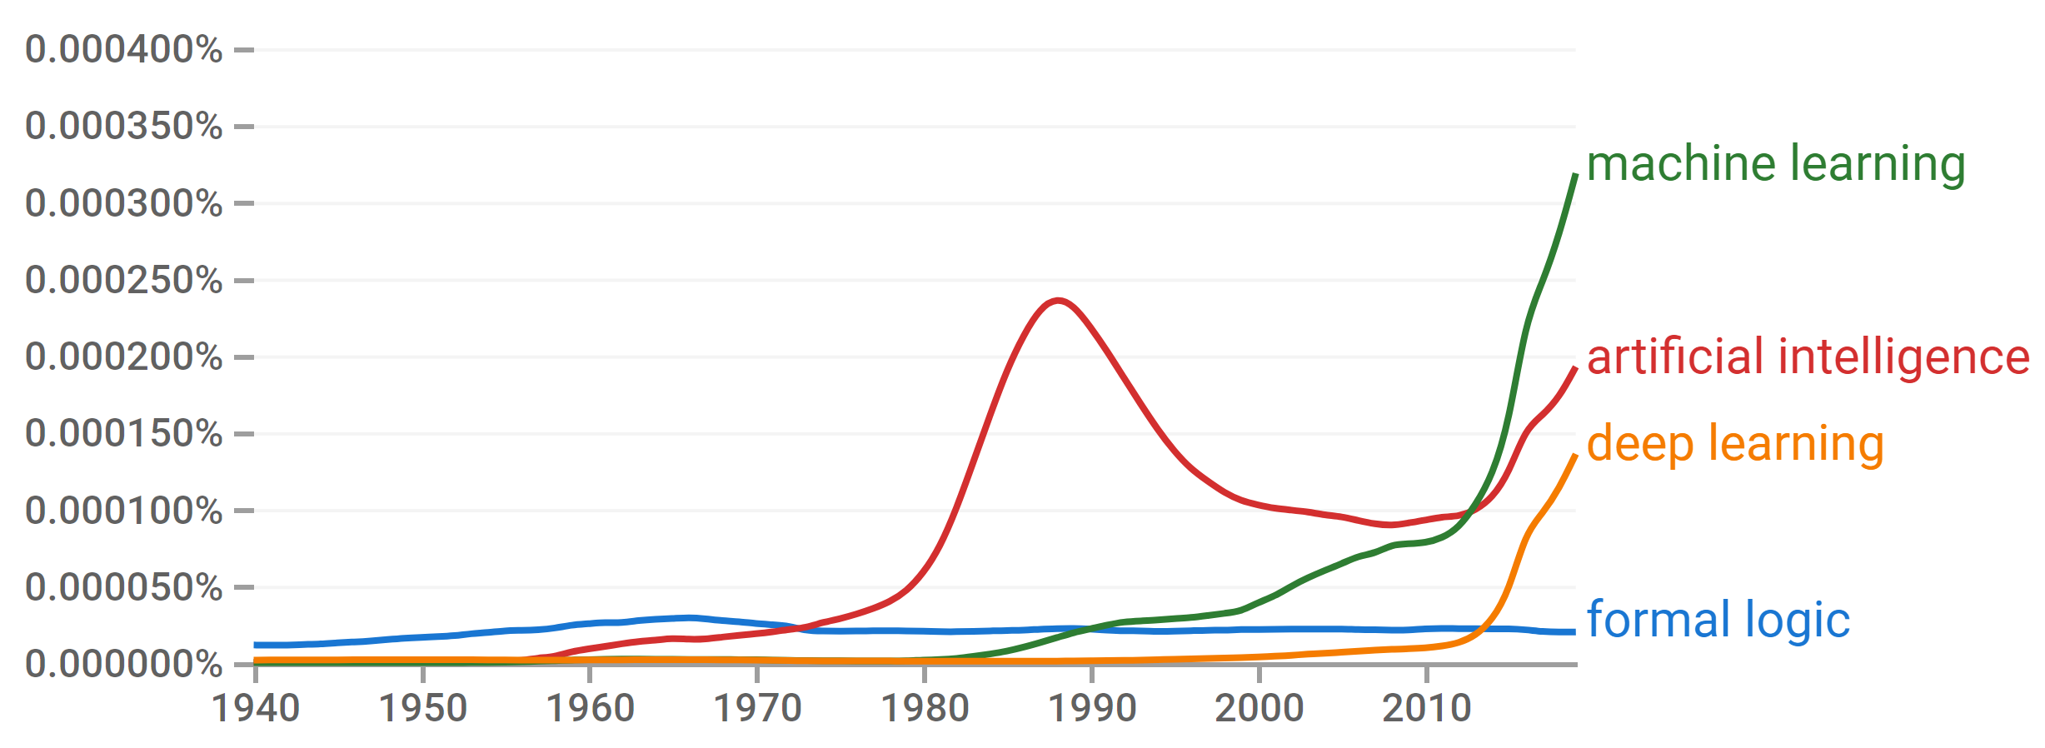
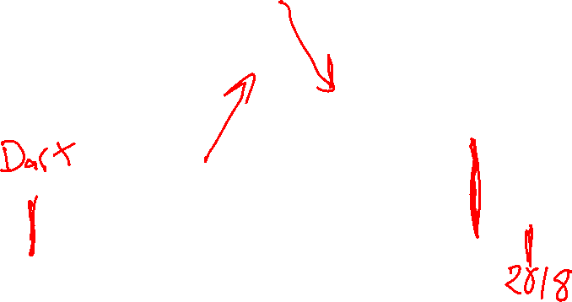
A Brief History of AI
Knowledge Based
Systems
1970-1990
Statistical Approaches
1990-
Deep Learning Era
2012-
Generative AI Era
2023-
AI
Excitement!
1950-1970
https://books.google.com/ngrams

Slide 15
A Brief History of AI
1940-1950: Early days
  1943: McCulloch & Pitts: Boolean circuit model of brain
  1950: Turing's “Computing Machinery and Intelligence”
1950—70: Excitement: Look, Ma, no hands!
  1950s: Early AI programs, including Samuel's checkers program, Newell & Simon's Logic Theorist, Gelernter's Geometry Engine
  1956: Dartmouth meeting: “Artificial Intelligence” adopted
1970—90: Knowledge-based approaches
  1969—79: Early development of knowledge-based systems
  1980—88: Expert systems industry booms
  1988—93: Expert systems industry busts: “AI Winter”
1990—: Statistical approaches
  Resurgence of probability, focus on uncertainty
  General increase in technical depth
  Agents and learning systems… “AI Spring”?
2012—: Deep learning
  2012: ImageNet & AlexNet
2023—: Generative AI
  2023: ChatGPT
Images: ai.berkeley.edu
Notes:
Million dollar computer with less computation than your phone
MT was

Slide 16
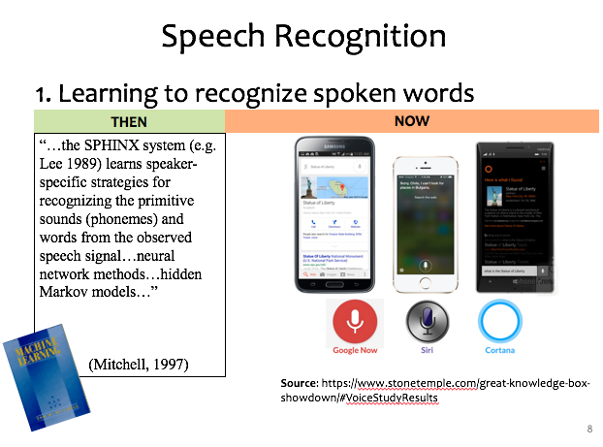
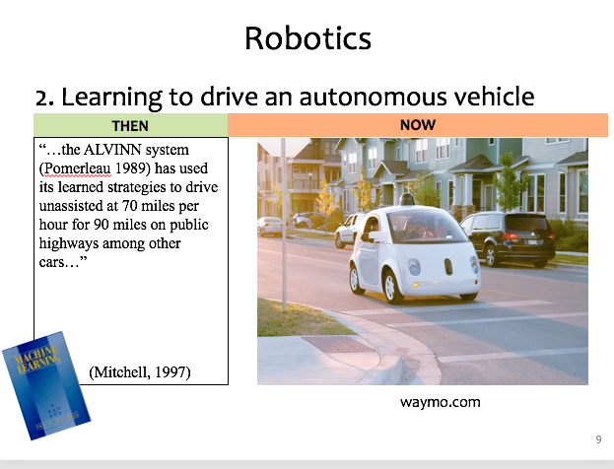
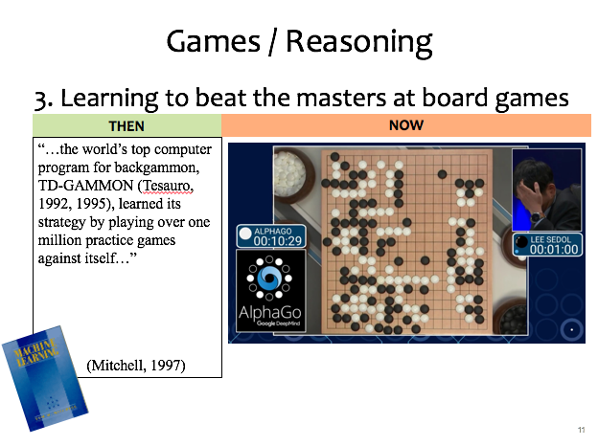
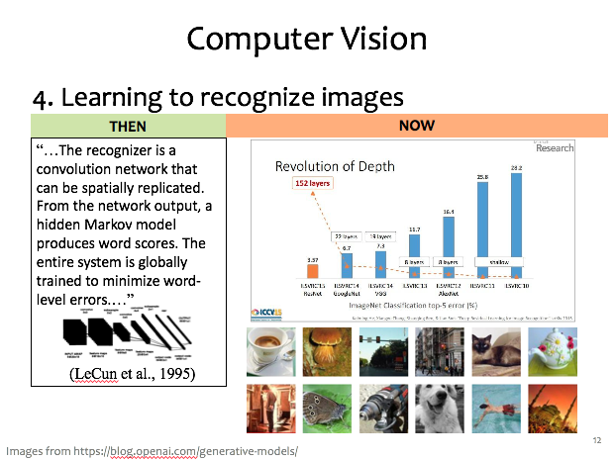
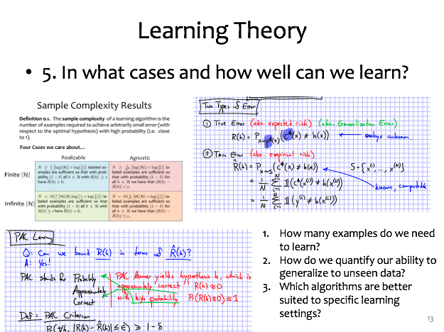

ML Applications?

Slide 17
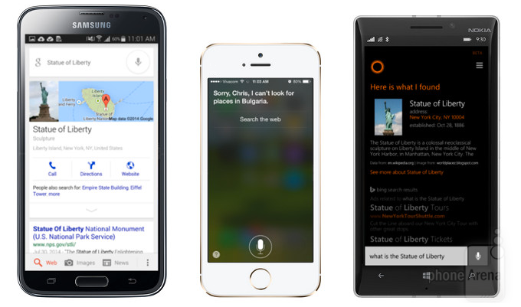

Speech Recognition
1. Learning to recognize spoken words
THEN
NOW
“…the SPHINX system (e.g. Lee 1989) learns speaker-specific strategies for recognizing the primitive sounds (phonemes) and words from the observed speech signal…neural network methods…hidden Markov models…”
(Mitchell, 1997)
Source: https://www.stonetemple.com/great-knowledge-box-
showdown/#VoiceStudyResults
Slide credit: CMU MLD Matt Gormley

Slide 18
Robotics
2. Learning to drive an autonomous vehicle
NOW
THEN
NOW
“…the ALVINN system (Pomerleau 1989) has used its learned strategies to drive unassisted at 70 miles per hour for 90 miles on public highways among other cars…”
(Mitchell, 1997)
https://www.geek.com/wp-content/uploads/2016/03/uber.jpg
waymo.com
Slide credit: CMU MLD Matt Gormley
Notes:
This a Google self-driving car; it looks really cute and friendly.
But these things weigh a *ton* and there is a person sitting inside this thing!
So this machine needs to know a lot about its environment, what actions to take, or policy to follow.
If a person were to enter the crosswalk, it would need to know how to slow down, or that person would learn a very uncomfortable lesson about physics

Slide 19
Games / Reasoning
3. Learning to beat the masters at board games
THEN
NOW
“…the world’s top computer program for backgammon, TD-GAMMON (Tesauro, 1992, 1995), learned its strategy by playing over one million practice games against itself…”
(Mitchell, 1997)
Slide credit: CMU MLD Matt Gormley

Slide 20
Computer Vision
4. Learning to recognize images
THEN
NOW
“…The recognizer is a convolution network that can be spatially replicated. From the network output, a hidden Markov model produces word scores. The entire system is globally trained to minimize word-level errors.…”
(LeCun et al., 1995)
Slide credit: CMU MLD Matt Gormley
Images from https://blog.openai.com/generative-models/

Slide 21
Learning Theory
5. In what cases and how well can we learn?
Slide credit: CMU MLD Matt Gormley
How many examples do we need to learn?
How do we quantify our ability to generalize to unseen data?
Which algorithms are better suited to specific learning settings?

Slide 22
Machine Learning and Statistics
Statistics is also about learning from data
Statistics has been around from much longer!
What’s the difference?
Until the mid 1990s:
Statistics:
  A branch of mathematics
  Emphasized rigor, correctness, provable properties (“is it correct?”)
  Was not very concerned with scaling
Machine Learning:
  A branch of Computer Science / AI
  Focus on heuristics, making things work in practice (“does it work?”)
  Not much awareness of statistical theory
Slide: CMU ML, Roni Rosenfeld

Slide 23
ML: Input/Output Tasks

Slide 24
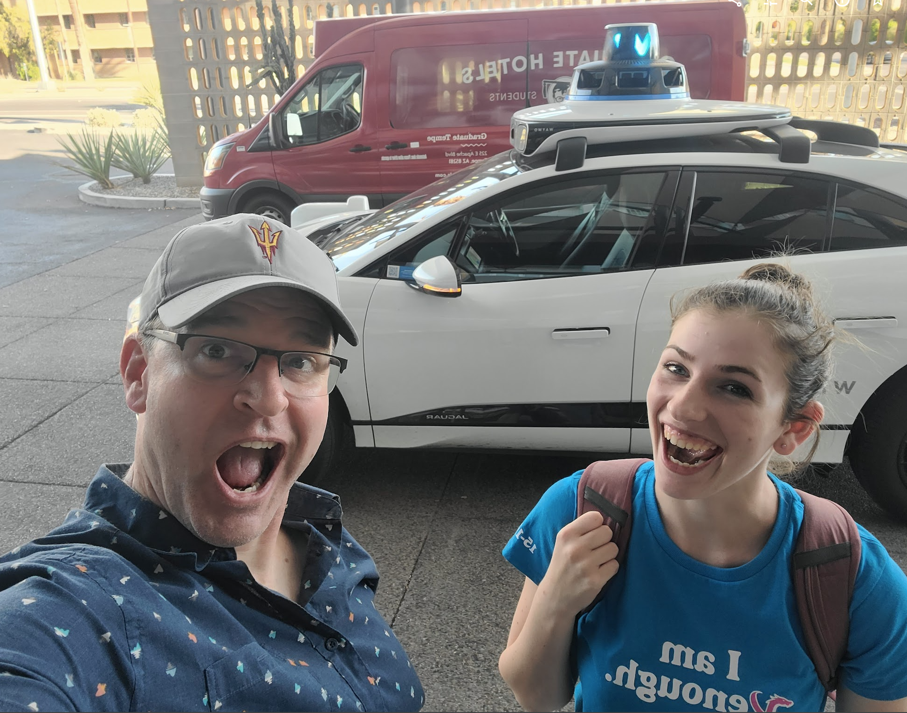
Agents
An agent is an entity that perceives and acts.
Actions can have an effect on the environment.
The specific sensors and actuators affect what the agent is capable of perceiving and what actions it is capable of taking
Sensors
Percepts
Agent
Environment
?
Actuators
Actions
Slide credit: ai.berkeley.edu

Slide 25
Agent: Simple Input/Output Task
Agent
Input
?
Predicted
Output

Slide 26
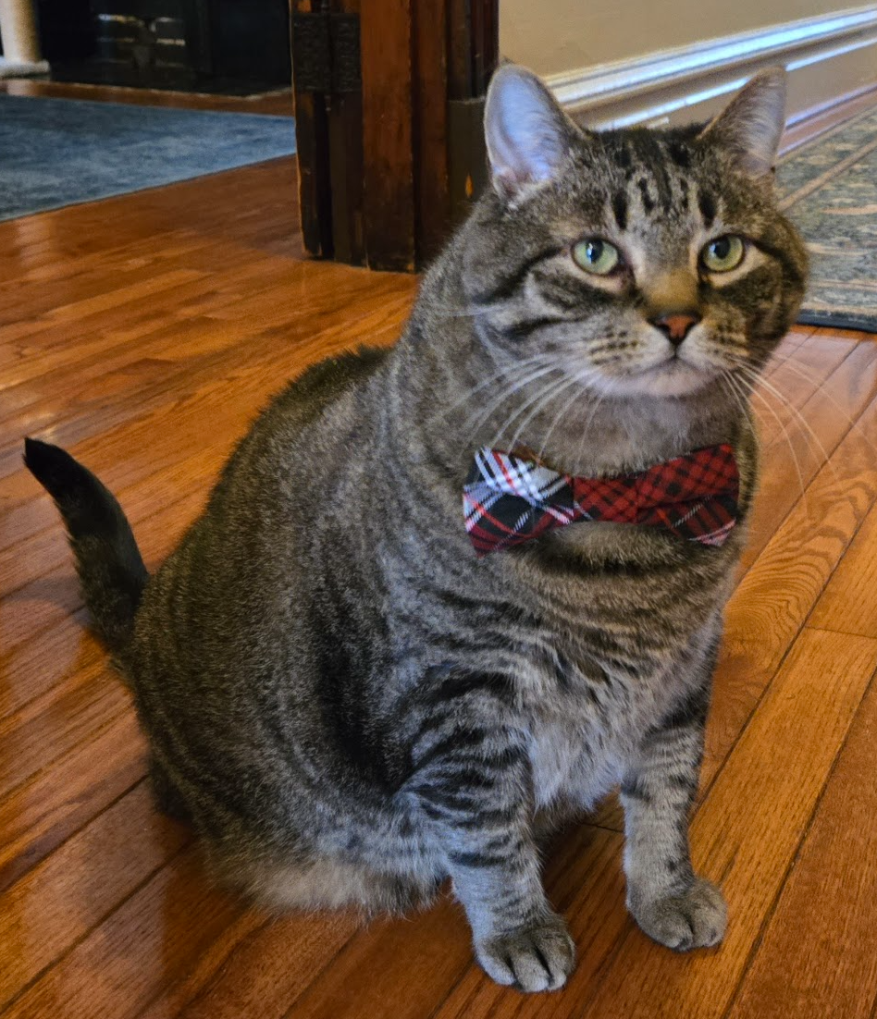
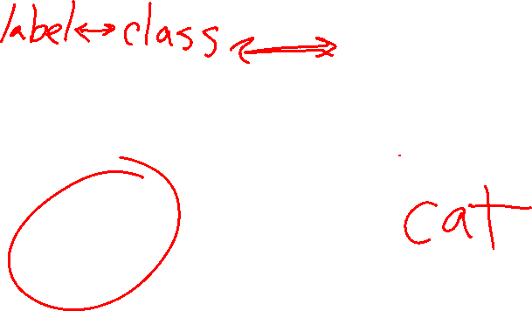
Task: Image Classification
What is this?
Input:
Image (pixels)
Predicted Output:
Category
Agent

Slide 27
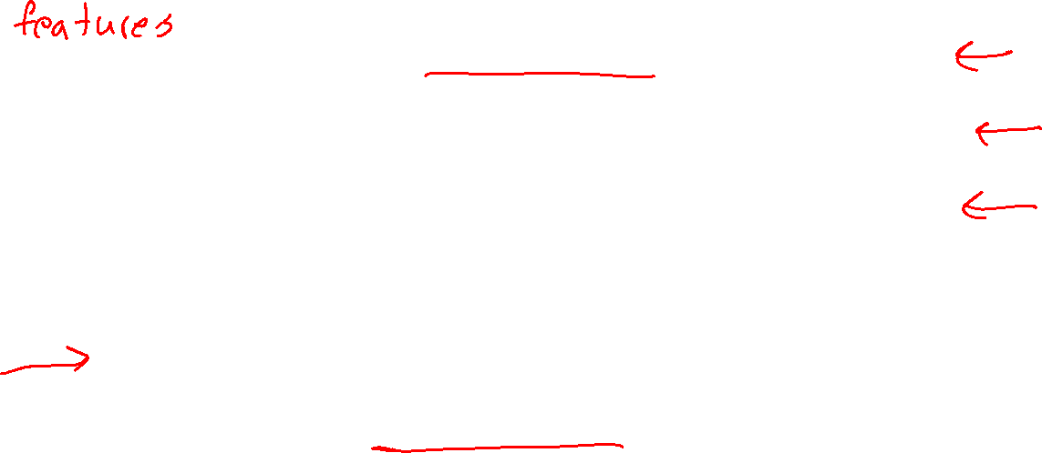
Task Input and Output
Input
Task
Output
Petal measurements
Time of day
Image
Image
Text
???
Iris classification
Traffic prediction
Image classification
Image denoising
Text to image generation
Face generation
Category
Traffic Volume
Category
Image
Image
Image

Slide 28
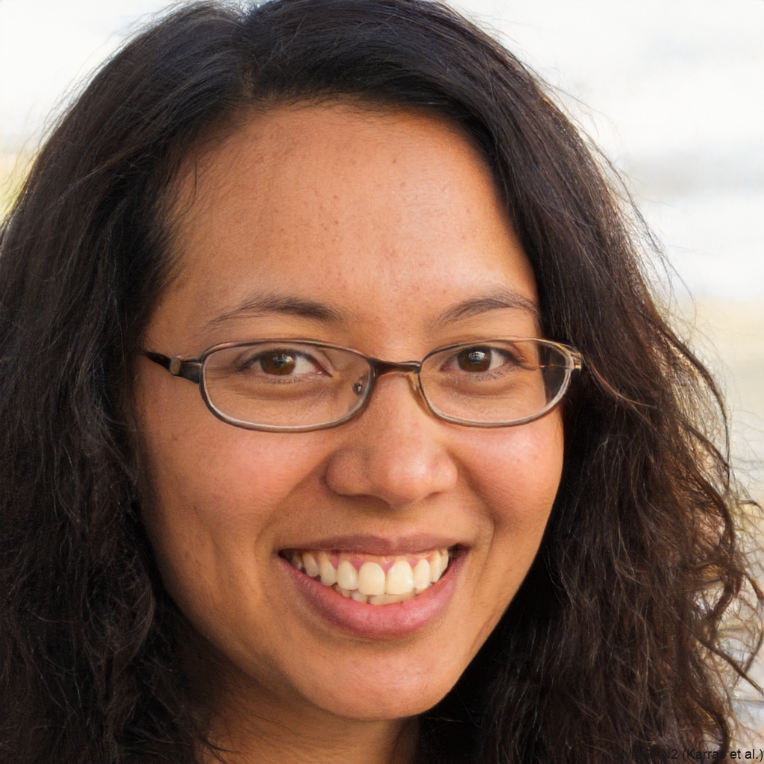
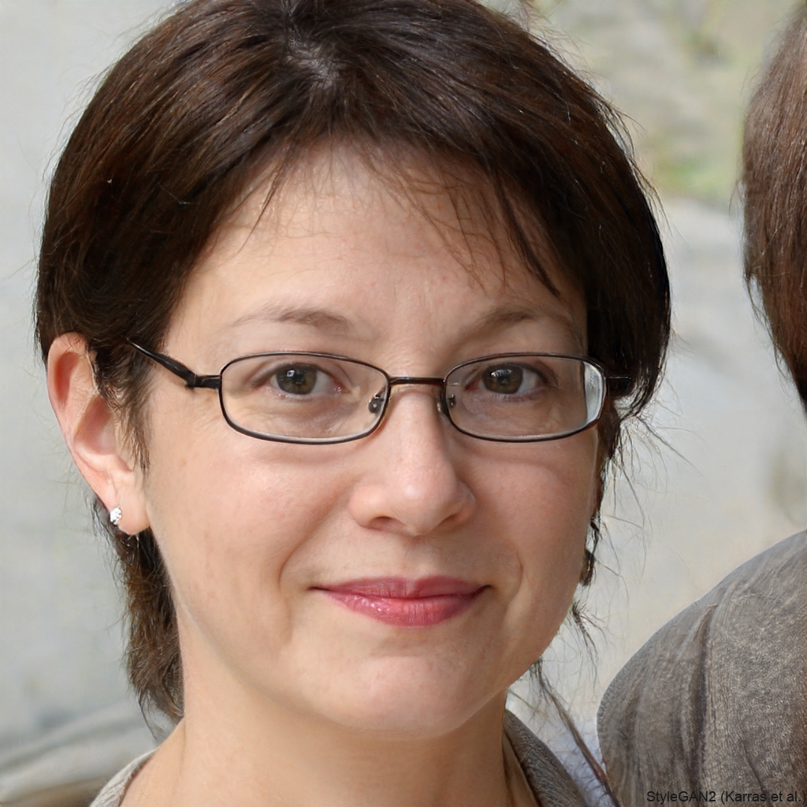
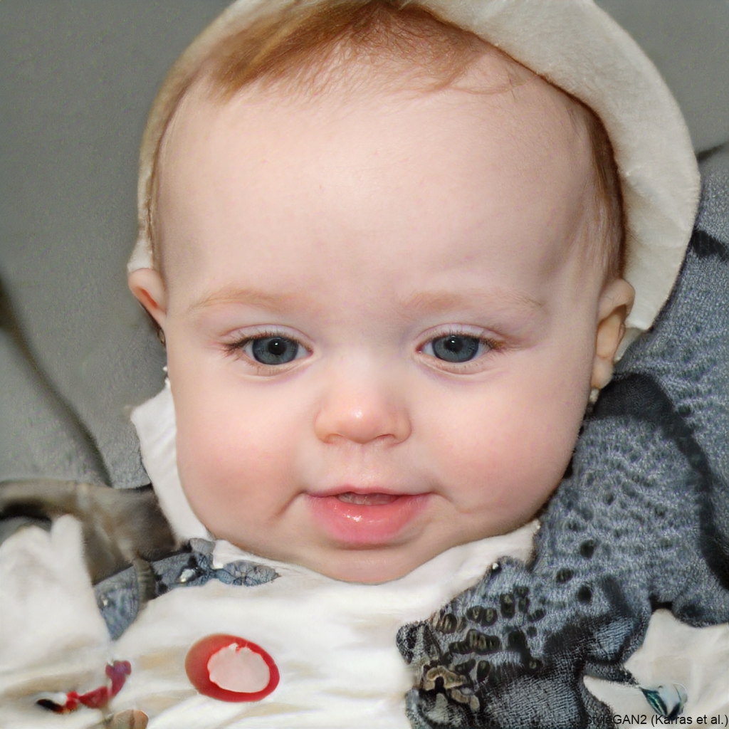
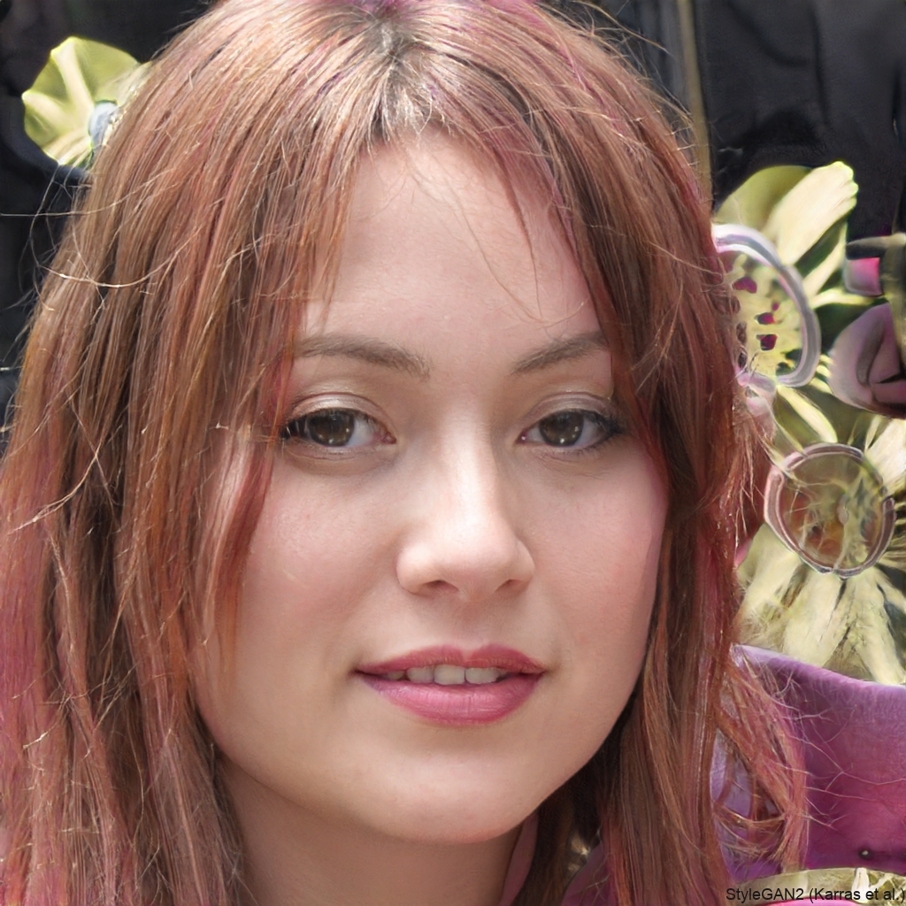

Task: Face Generation
https://thispersondoesnotexist.com/

Slide 29


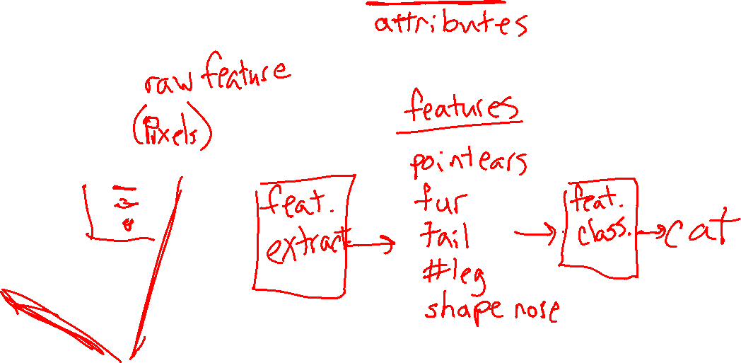
Task: Classification from Features
What is this?
Input:
Image
Predicted Output:
Category

Slide 30
As you walk in
Welcome!
Help draw some aliens for our dataset today!
    See table up front
    Just stick figures, nothing quite this fancy →

Slide 31
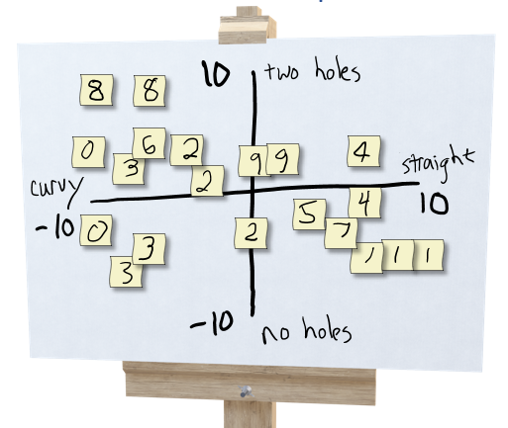
Exercise: Human-defined Feature Space
Try to organize data on a 2-D coordinate plot
to win the following game:
Select three students: A, B, C
Student A draws a new alien and hands it to student B
Student B thinks about where to plot it and comes up with a 2-D coordinate, (x, y)
Student C looks at the coordinate and the plot (but not the drawing from A) and draws a new alien

Slide 32
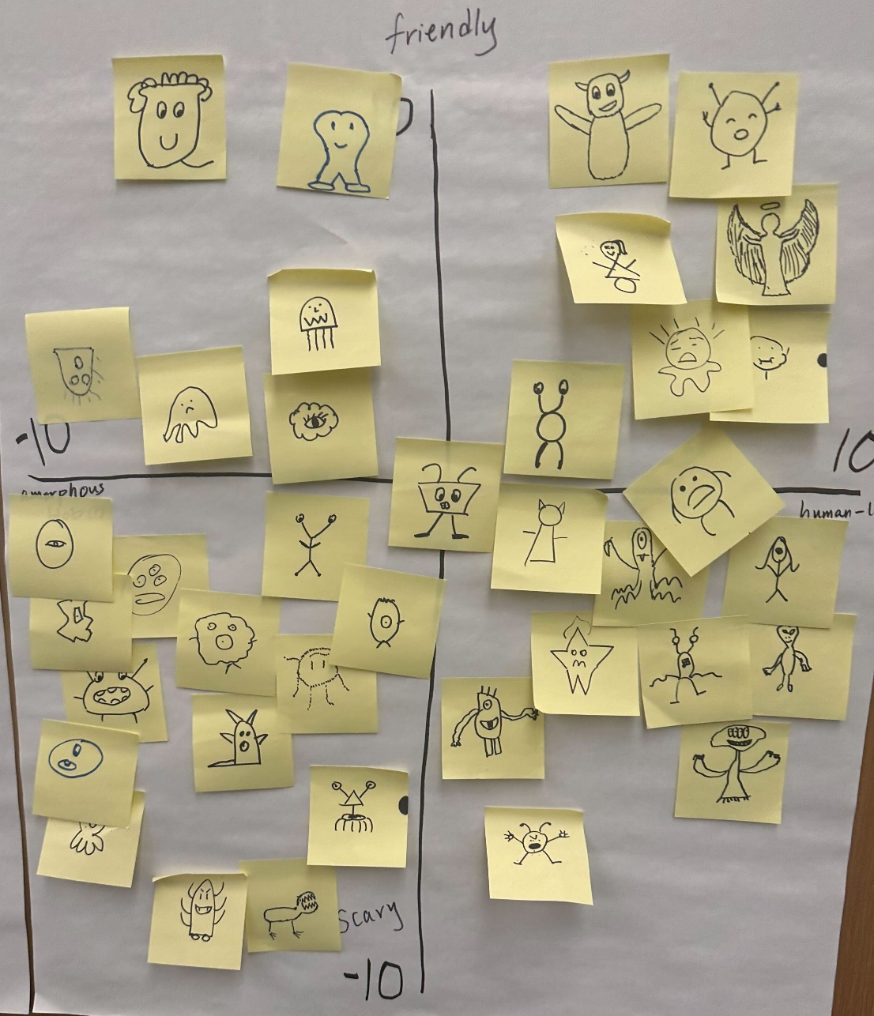

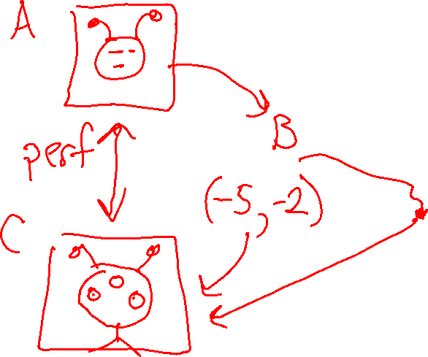
Exercise: Human-defined Feature Space

Slide 33
Poll 1
What features did you use?

Slide 34
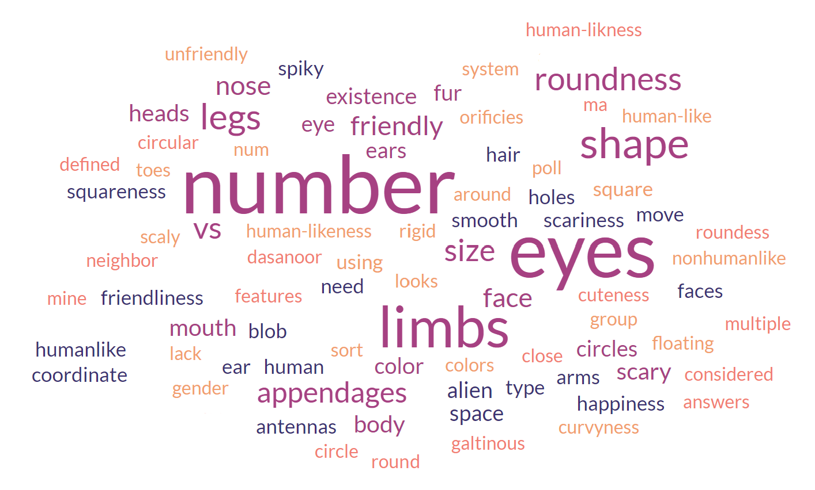
Poll 1
What features did you use?

Slide 35
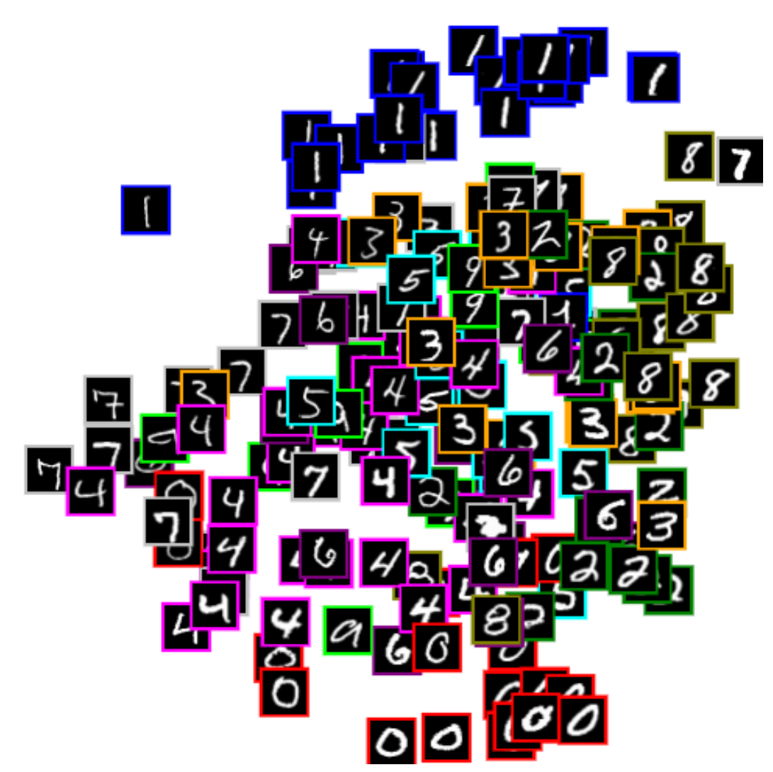


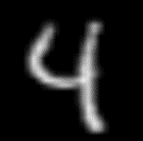


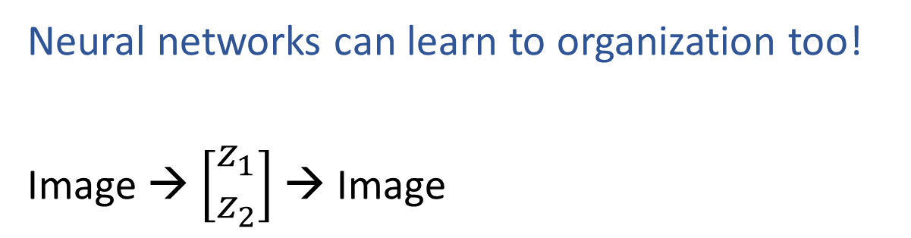
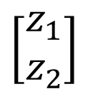
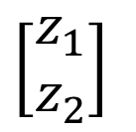
Learning to Organize Data
Neural networks can learn to organization too!
Image → $\left[\begin{aligned}z_{1} \\ z_{2}\end{aligned}\right]$ → Image
$$z_{2}$$
Net
Net
$$\left[\begin{aligned}z_{1} \\ z_{2}\end{aligned}\right]$$
Net
Net
$$\left[\begin{aligned}z_{1} \\ z_{2}\end{aligned}\right]$$
$$z_{1}$$
https://cs.stanford.edu/people/karpathy/convnetjs/demo/autoencoder.html

Slide 36

Digit Autoencoder
Demo: Using a learned feature space

Slide 37





Task: Face Generation
https://thispersondoesnotexist.com/

Slide 38
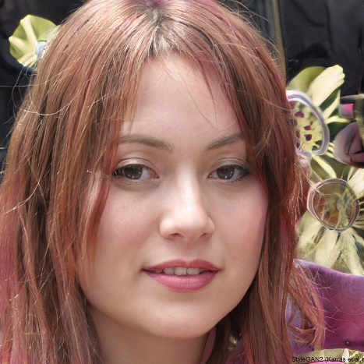

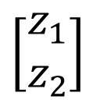
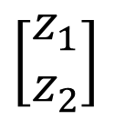
Task: Face Generation
https://thispersondoesnotexist.com/
Random
Net
$$\left[\begin{aligned}z_{1} \\ z_{2}\end{aligned}\right]$$
Random
$$\left[\begin{aligned}z_{1} \\ z_{2}\end{aligned}\right]$$
Net

Slide 39
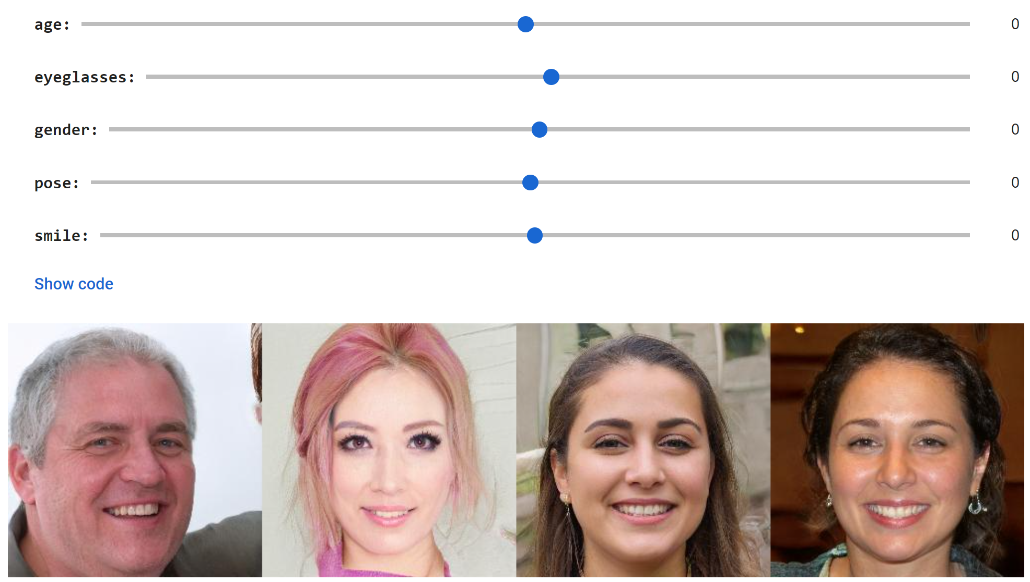
Face GAN Slider Demo
https://github.com/genforce/interfacegan
https://colab.research.google.com/github/genforce/interfacegan/blob/master/docs/InterFaceGAN.ipynb

Slide 40
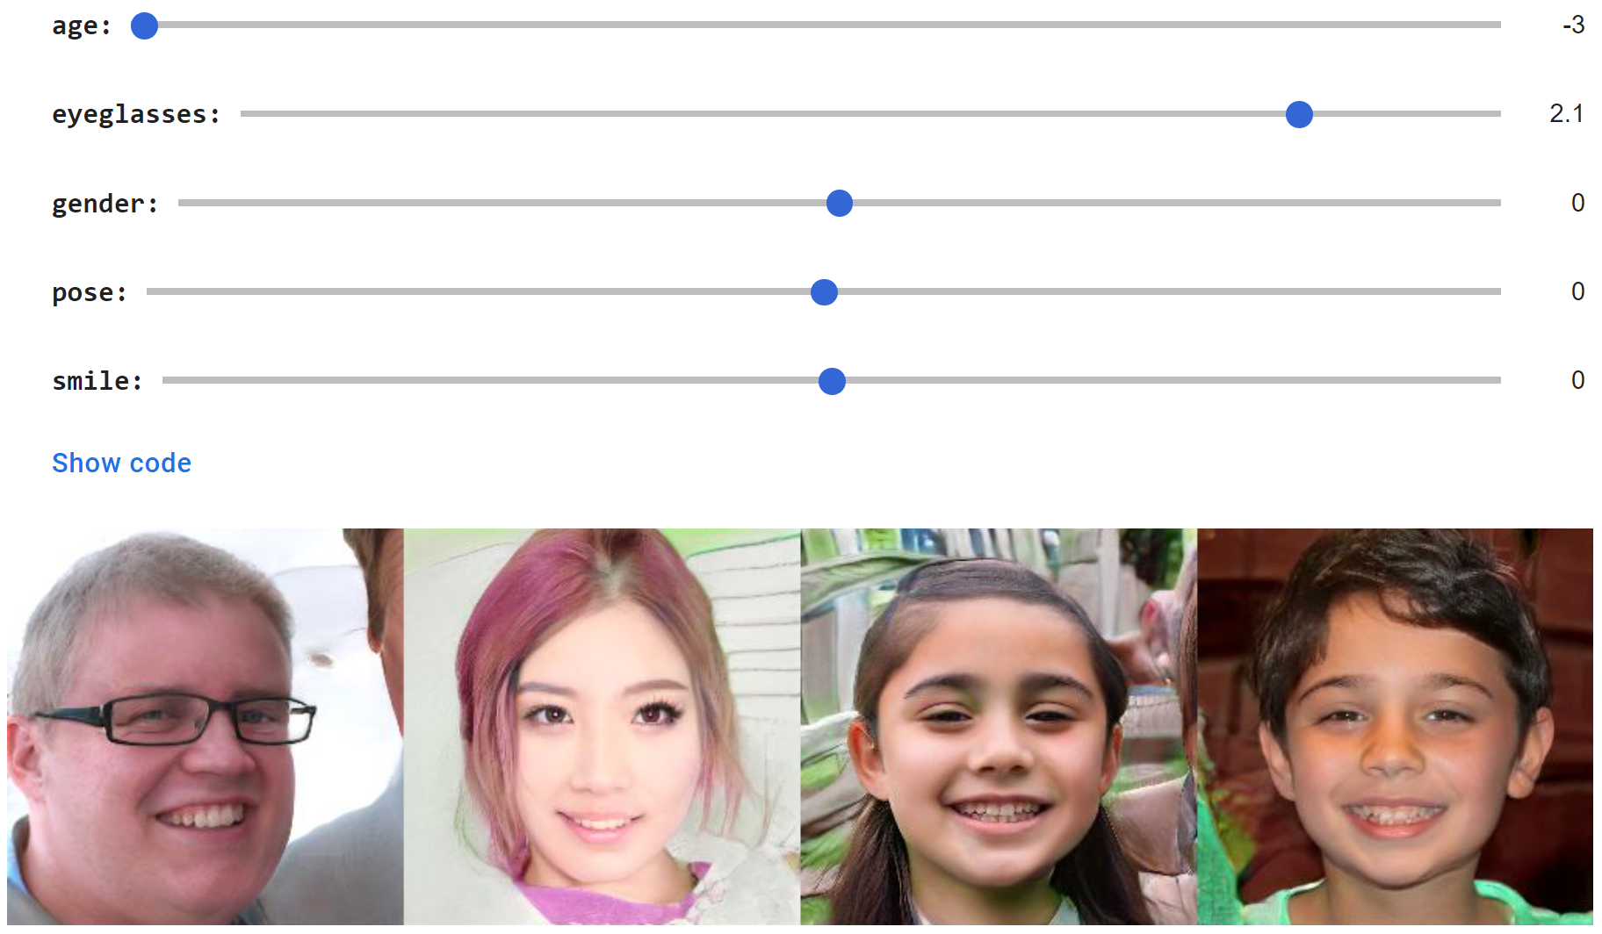
Face GAN Slider Demo
https://github.com/genforce/interfacegan
https://colab.research.google.com/github/genforce/interfacegan/blob/master/docs/InterFaceGAN.ipynb

Slide 41
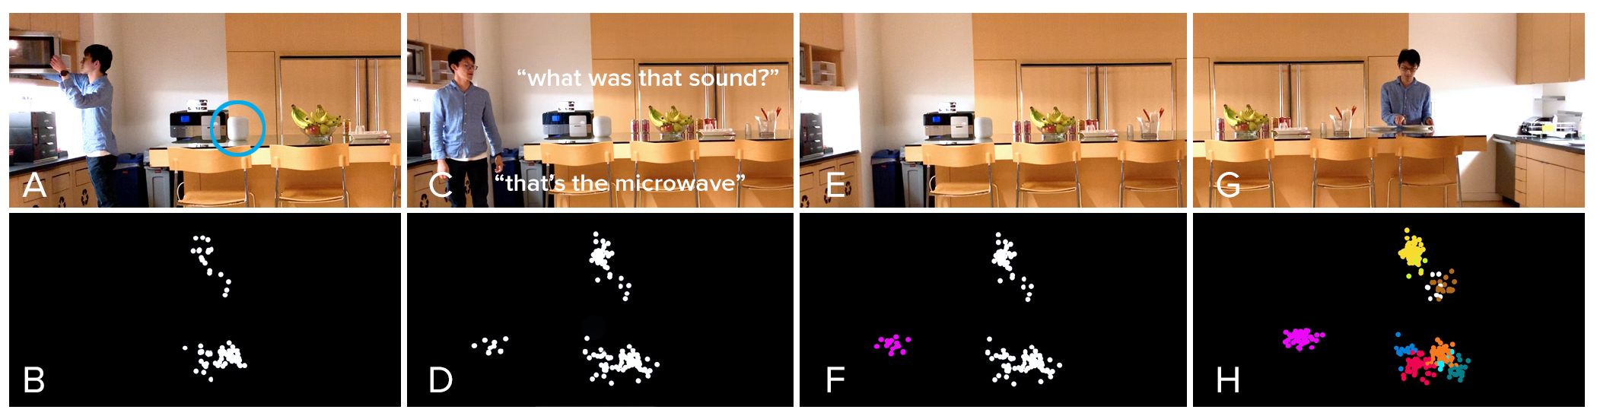
Listen Learner
Chris Harrison, CMU
https://chrisharrison.net/index.php/Research/ListenLearner

Slide 42
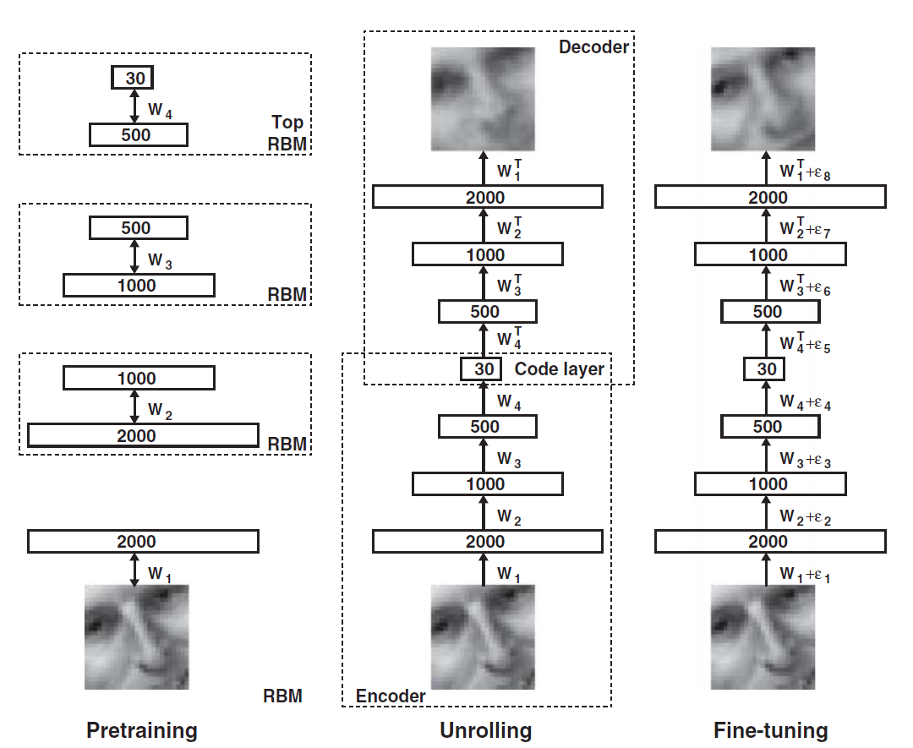
Dimensionality Reduction with Deep Learning
Hinton, Geoffrey E., and Ruslan R. Salakhutdinov.
"Reducing the dimensionality of data with neural networks.”
Science 313.5786 (2006): 504-507.

Slide 43

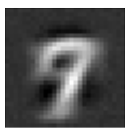
Digit Autoencoder
https://cs.stanford.edu/people/karpathy/convnetjs/demo/autoencoder.html
Layer 1
Layer 2
Layer 4
Layer 5
Layer 6
Input
28x28 = 784 pixels
Layer 3
50 neurons
50 neurons
784 neurons
50 neurons
50 neurons
2 neurons
Autoencoder network

Slide 44
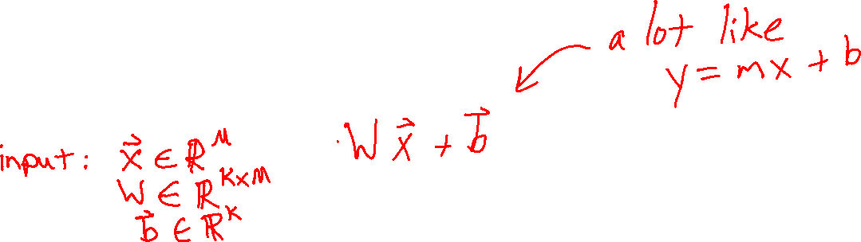
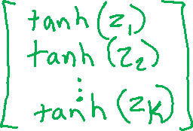
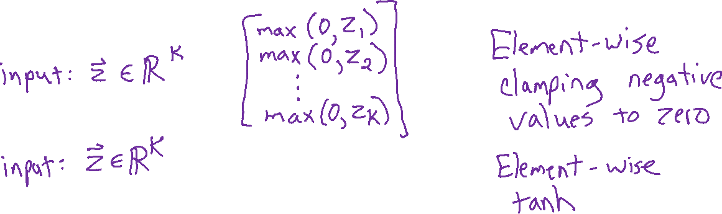

Digit Autoencoder
Math for autoencoder model
Linear layer
ReLU layer
Tanh layer

