Slide 1

10-315
Introduction to ML
Deep Learning for Computer Vision
Instructor: Pat Virtue

Slide 2
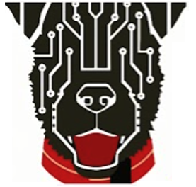
Deep Learning for Computer Vision
Computer vision tasks
Image features
Convolution Channels & CNNs
Computer vision history: Deep learning boom
CNN architectures & Practical deep learning

Slide 3
Computer Vision
Image in → information out

Slide 4
Computer Vision Tasks

Slide 5
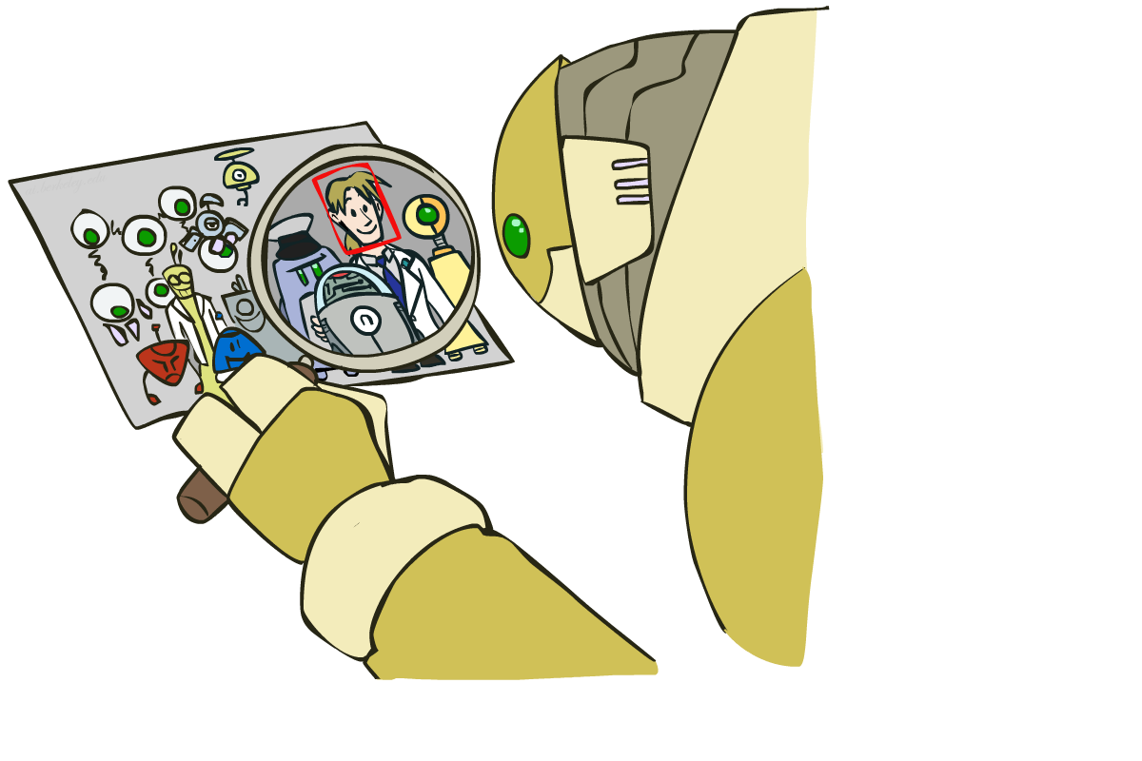
Computer Vision Tasks: How far along are we?

Slide 6
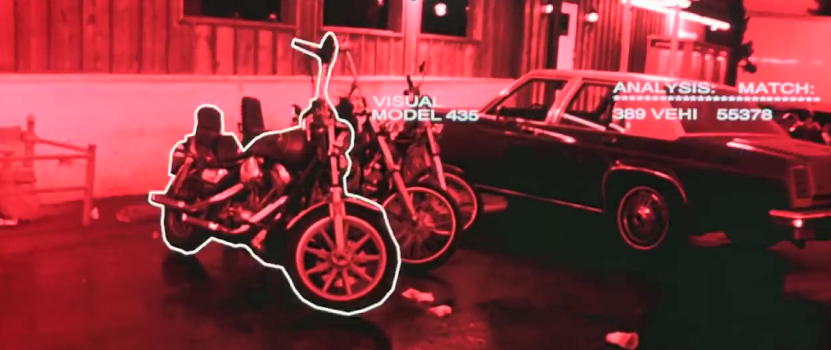
Computer Vision Tasks: How far along are we?
Terminator 2, 1991 https://www.youtube.com/watch?v=9MeaaCwBW28

Slide 7
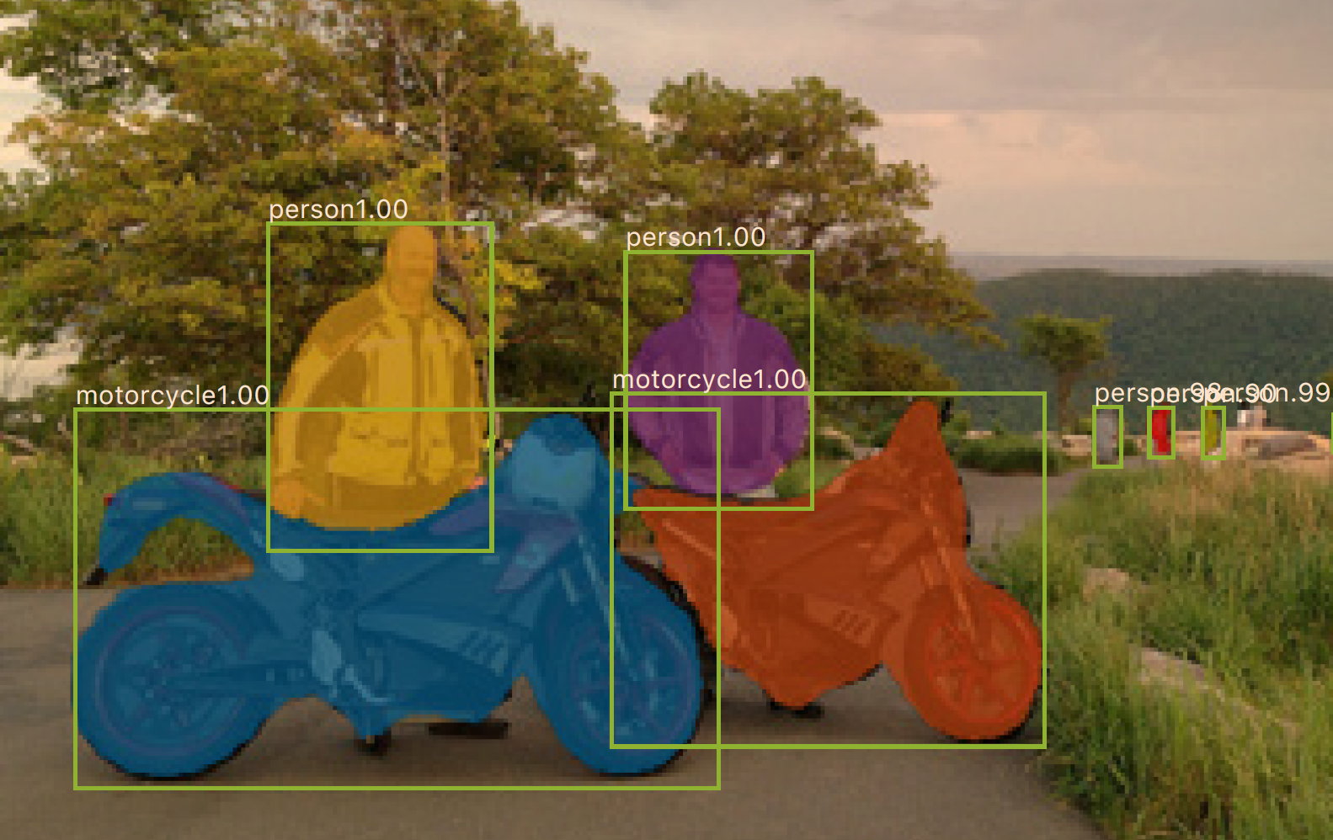
Computer Vision Tasks: How far along are we?
2017:
0.2 seconds per image
Mask R-CNN
He, Kaiming, et al. "Mask R-CNN." Computer Vision (ICCV), 2017 IEEE International Conference on. IEEE, 2017.

Slide 8
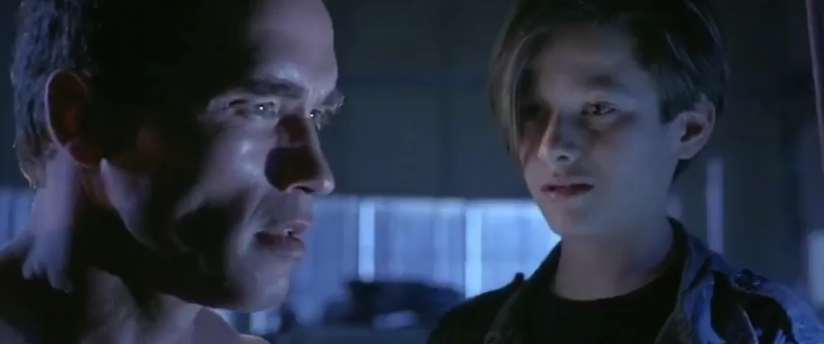
Computer Vision Tasks: How far along are we?
“My CPU is a neural net processor, a learning computer”
Terminator 2, 1991

Slide 9
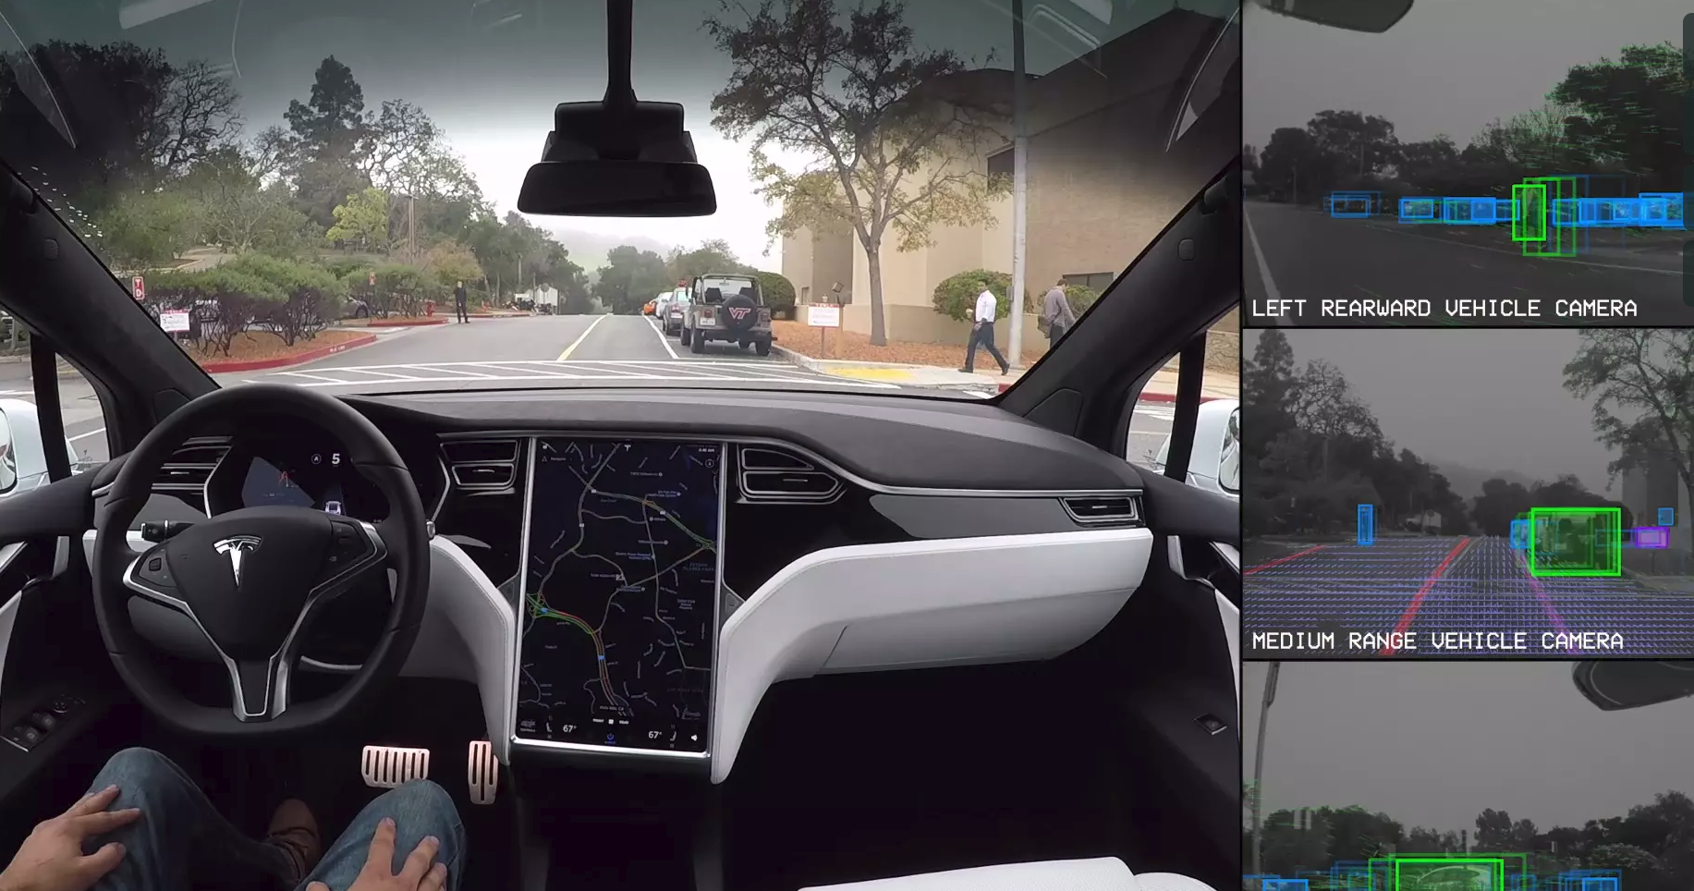
Computer Vision Tasks: Autonomous Driving
Tesla, Inc: https://vimeo.com/192179726

Slide 10

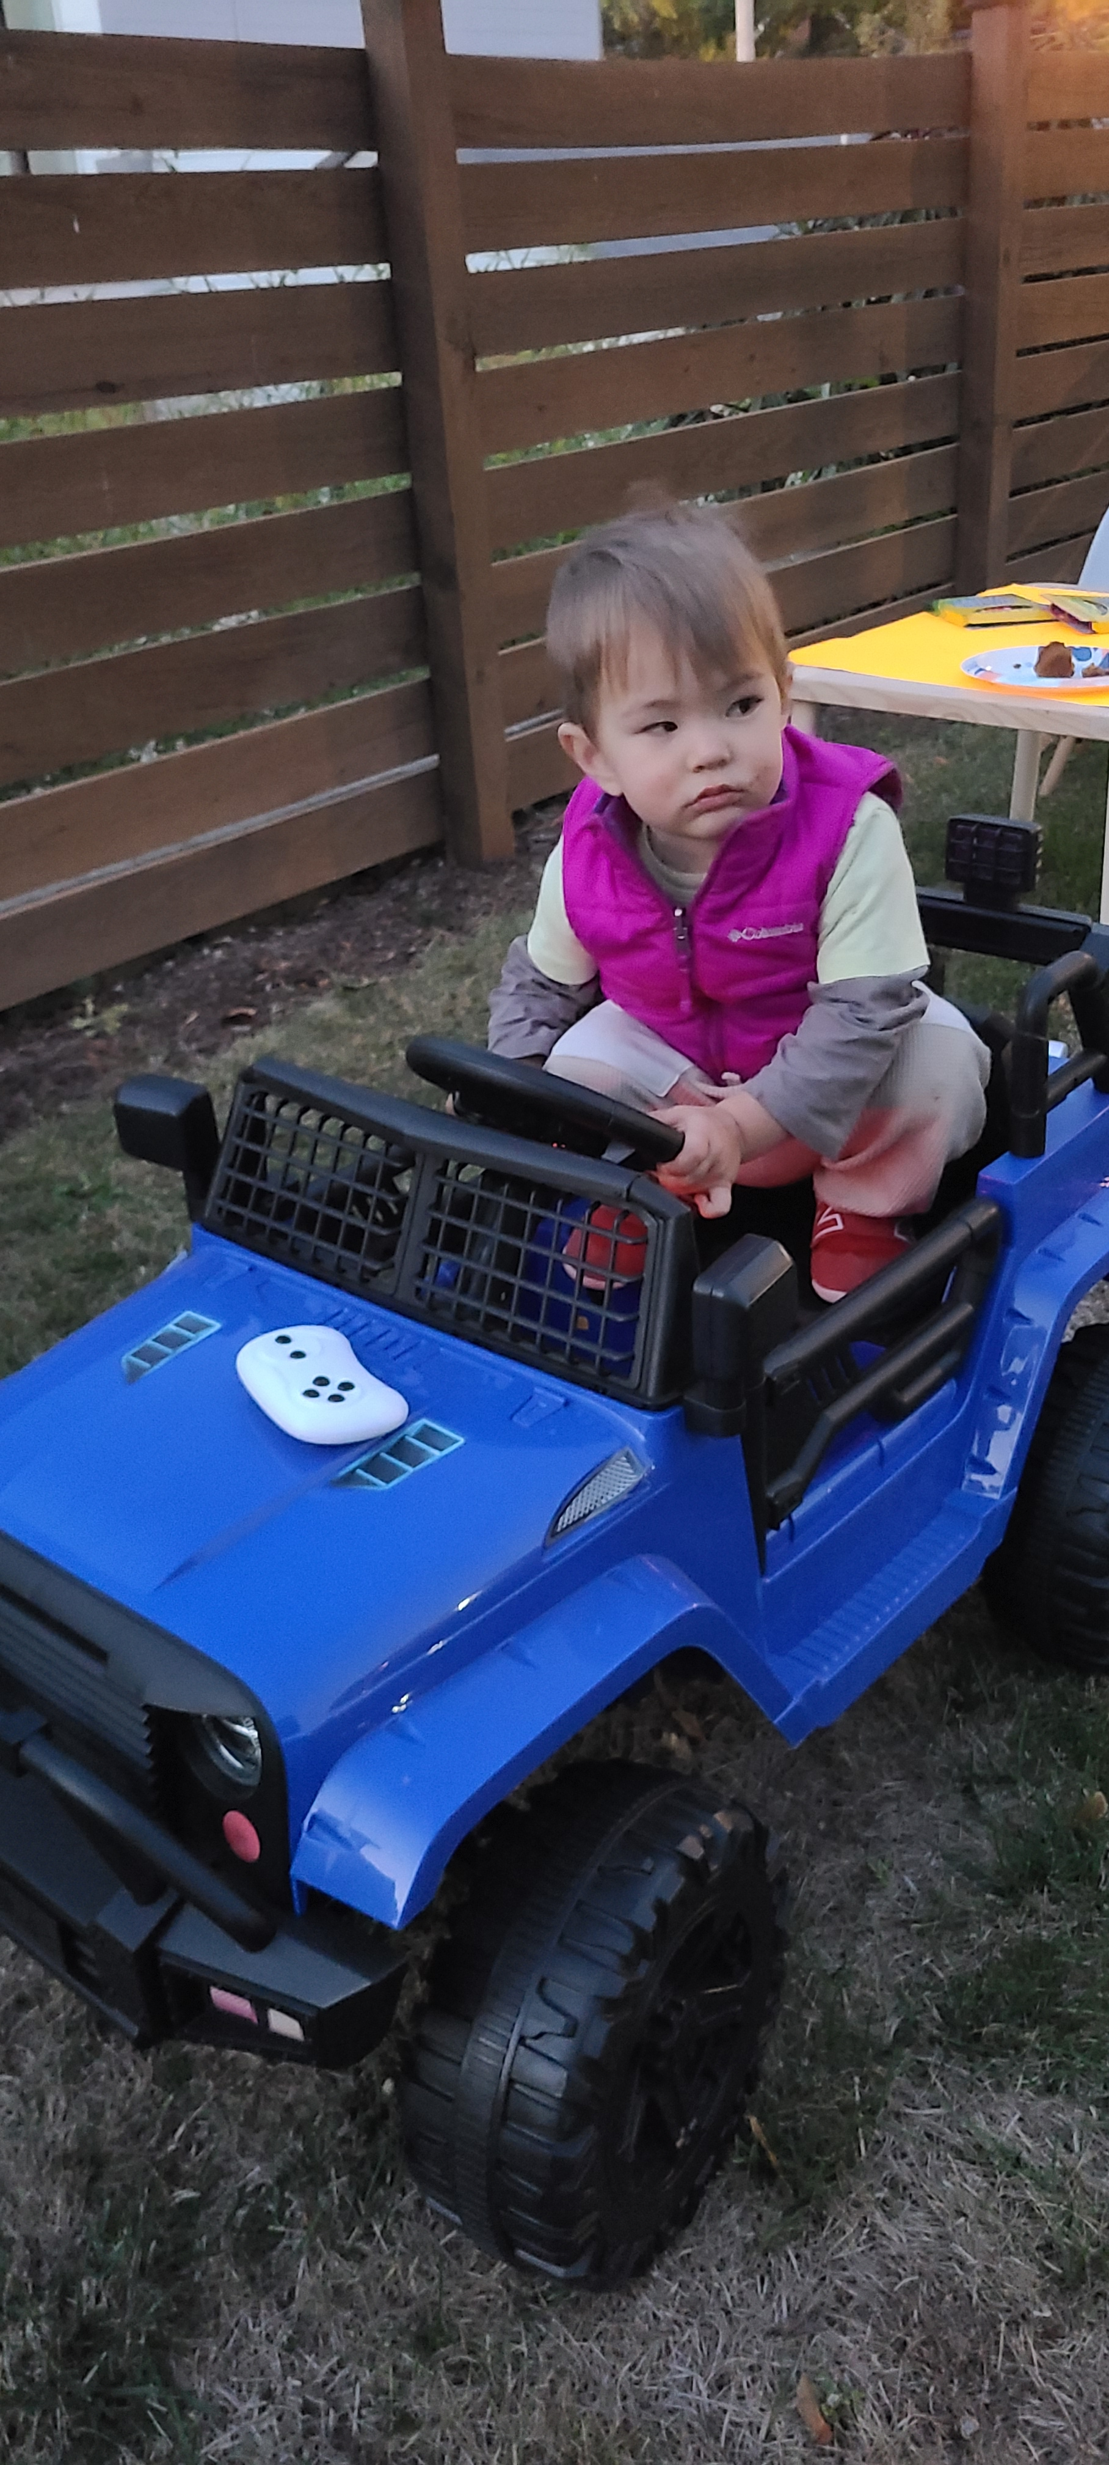
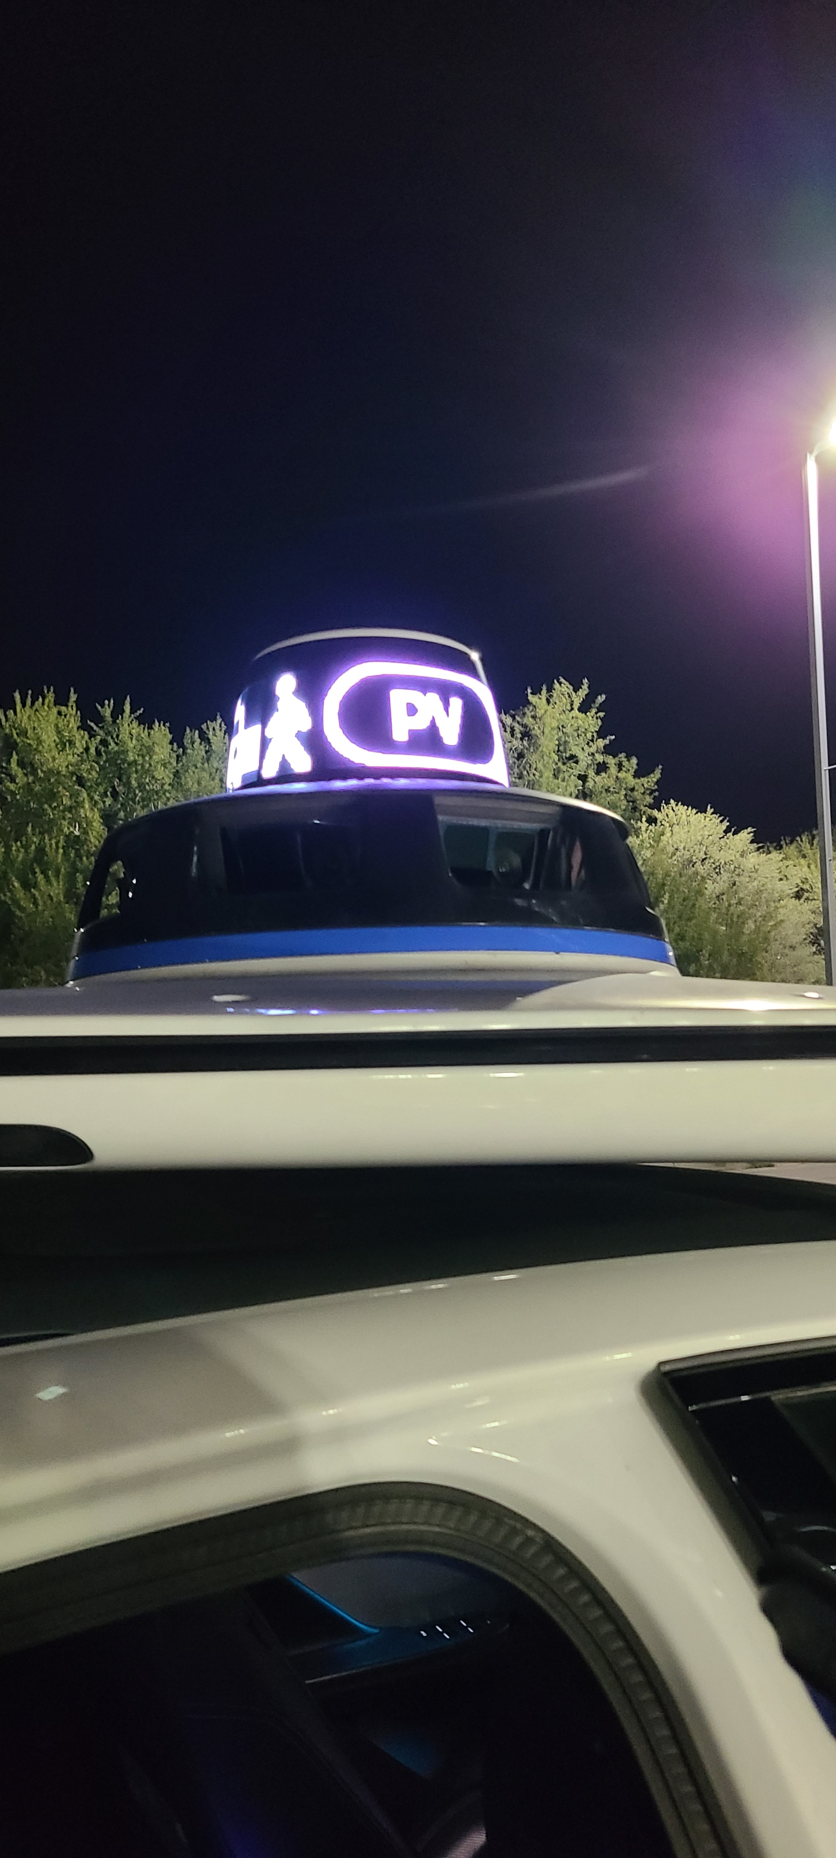
Computer Vision Tasks: Autonomous Driving

Slide 11
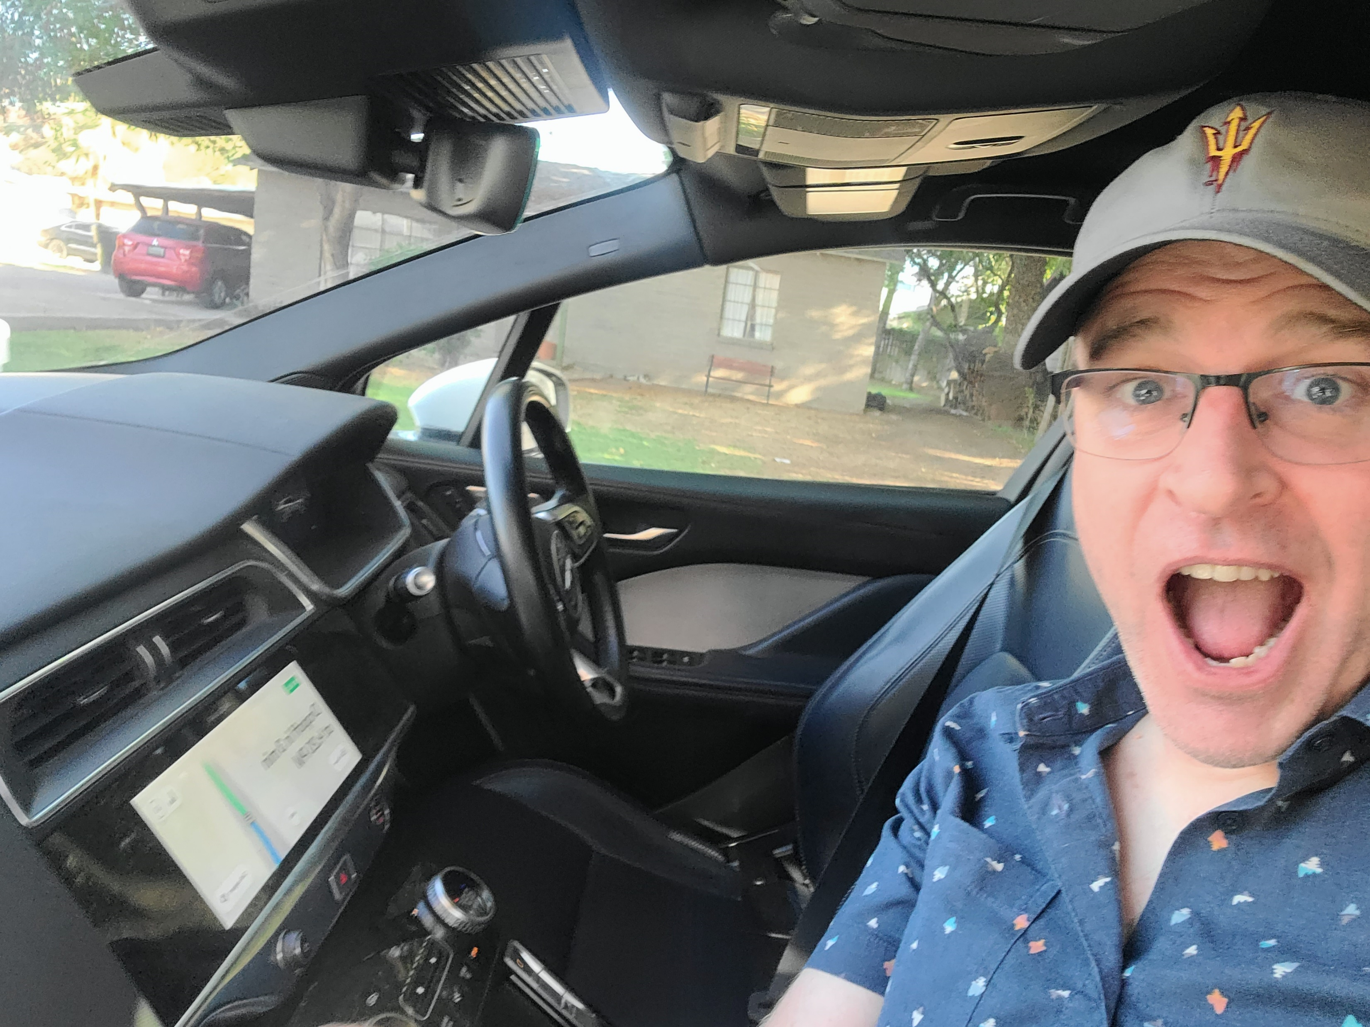
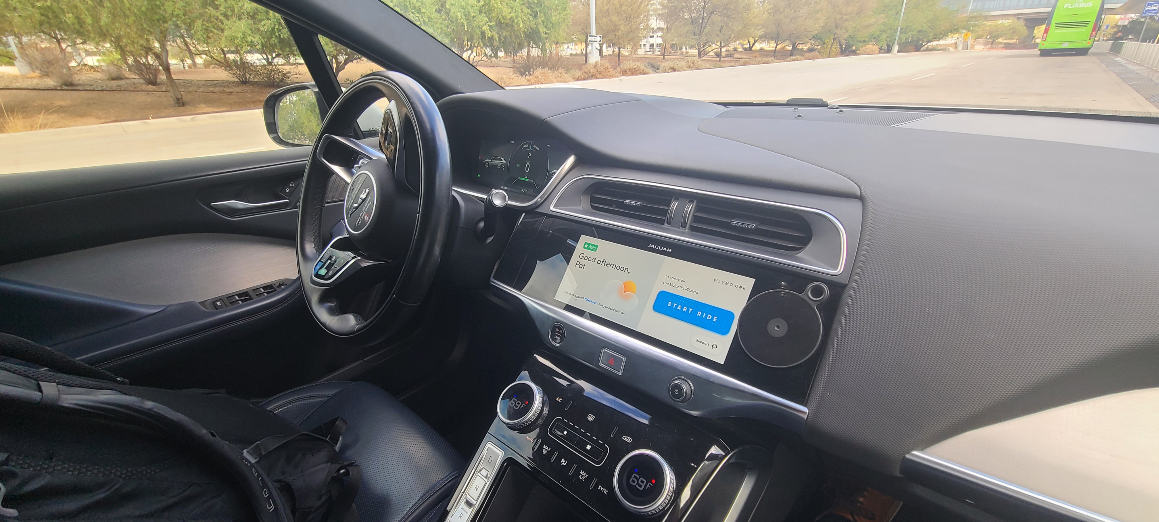
Computer Vision: Autonomous Driving

Slide 12
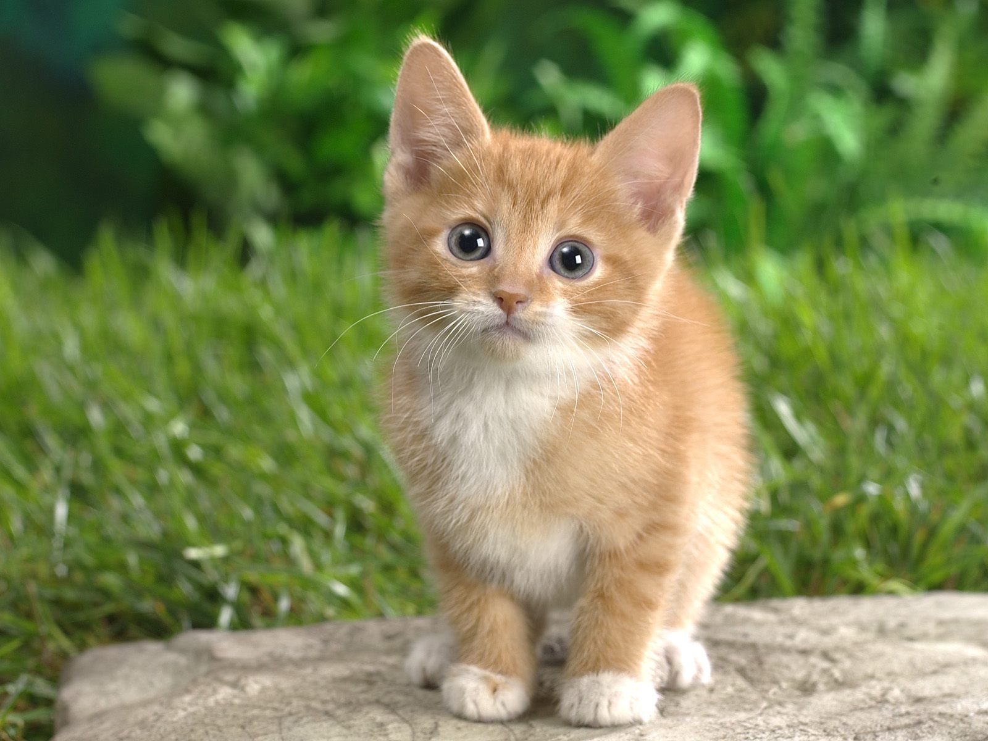
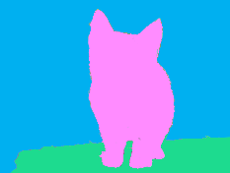
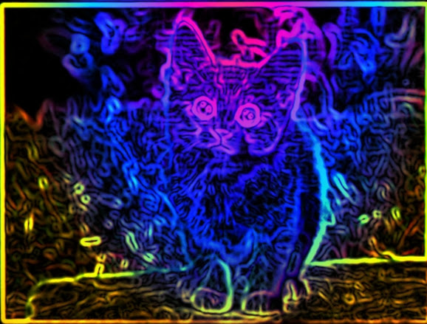
Image-related Tasks: Input/Output
Input | Task | Output
Image | Image classification | Category
Image | Image detection | Bounding box
Image | Image segmentation | Image: category per pixel
Image | Image processing* | Image
CAT

Slide 13
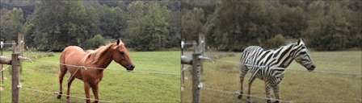
Image-related Tasks: Domain Transfer
CycleGAN
Jun-Yan Zhu*, Taesung Park*, Phillip Isola, and Alexei A. Efros
Jun-Yan Zhu*, Taesung Park*, Phillip Isola, and Alexei A. Efros. "Unpaired Image-to-Image Translation using Cycle-Consistent Adversarial Networks", ICCV 2017.

Slide 14
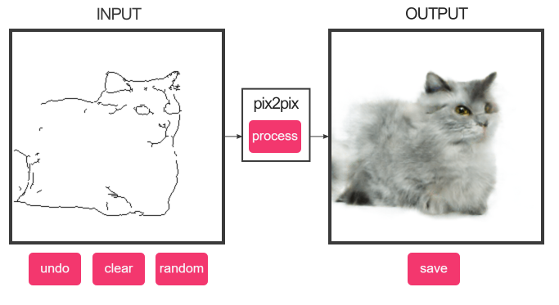
Image-related Tasks : Domain Transfer
Pix2pix
Phillip Isola, Jun-Yan Zhu, Tinghui Zhou, and Alexei A. Efros
https://affinelayer.com/pixsrv/ and https://phillipi.github.io/pix2pix/

Slide 15
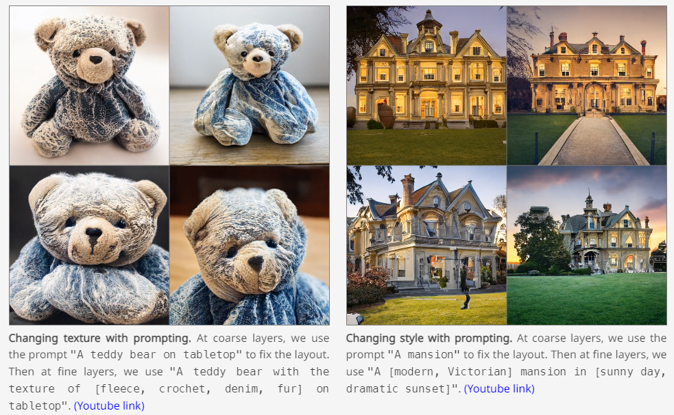
Text to Image
GigaGAN
https://mingukkang.github.io/GigaGAN/
Minguk Kang, Jun-Yan Zhu, Richard Zhang, Jaesik Park, Eli Shechtman, Sylvain Paris, Taesung Park. "Scaling up GANs for Text-to-Image Synthesis", CVPR 2023.

Slide 16
Image-related Tasks: Input/Output
Input | Task | Output
Image | Image classification | Category
Image | Image detection | Bounding box
Image | Image segmentation | Image: category per pixel
Image | Image processing* | Image
Image (portion missing) | In-painting | Image
Random values | Image generation | Image
Text | Image generation | Image
Image | Image captioning | Text

Slide 17
Image Features

Slide 18
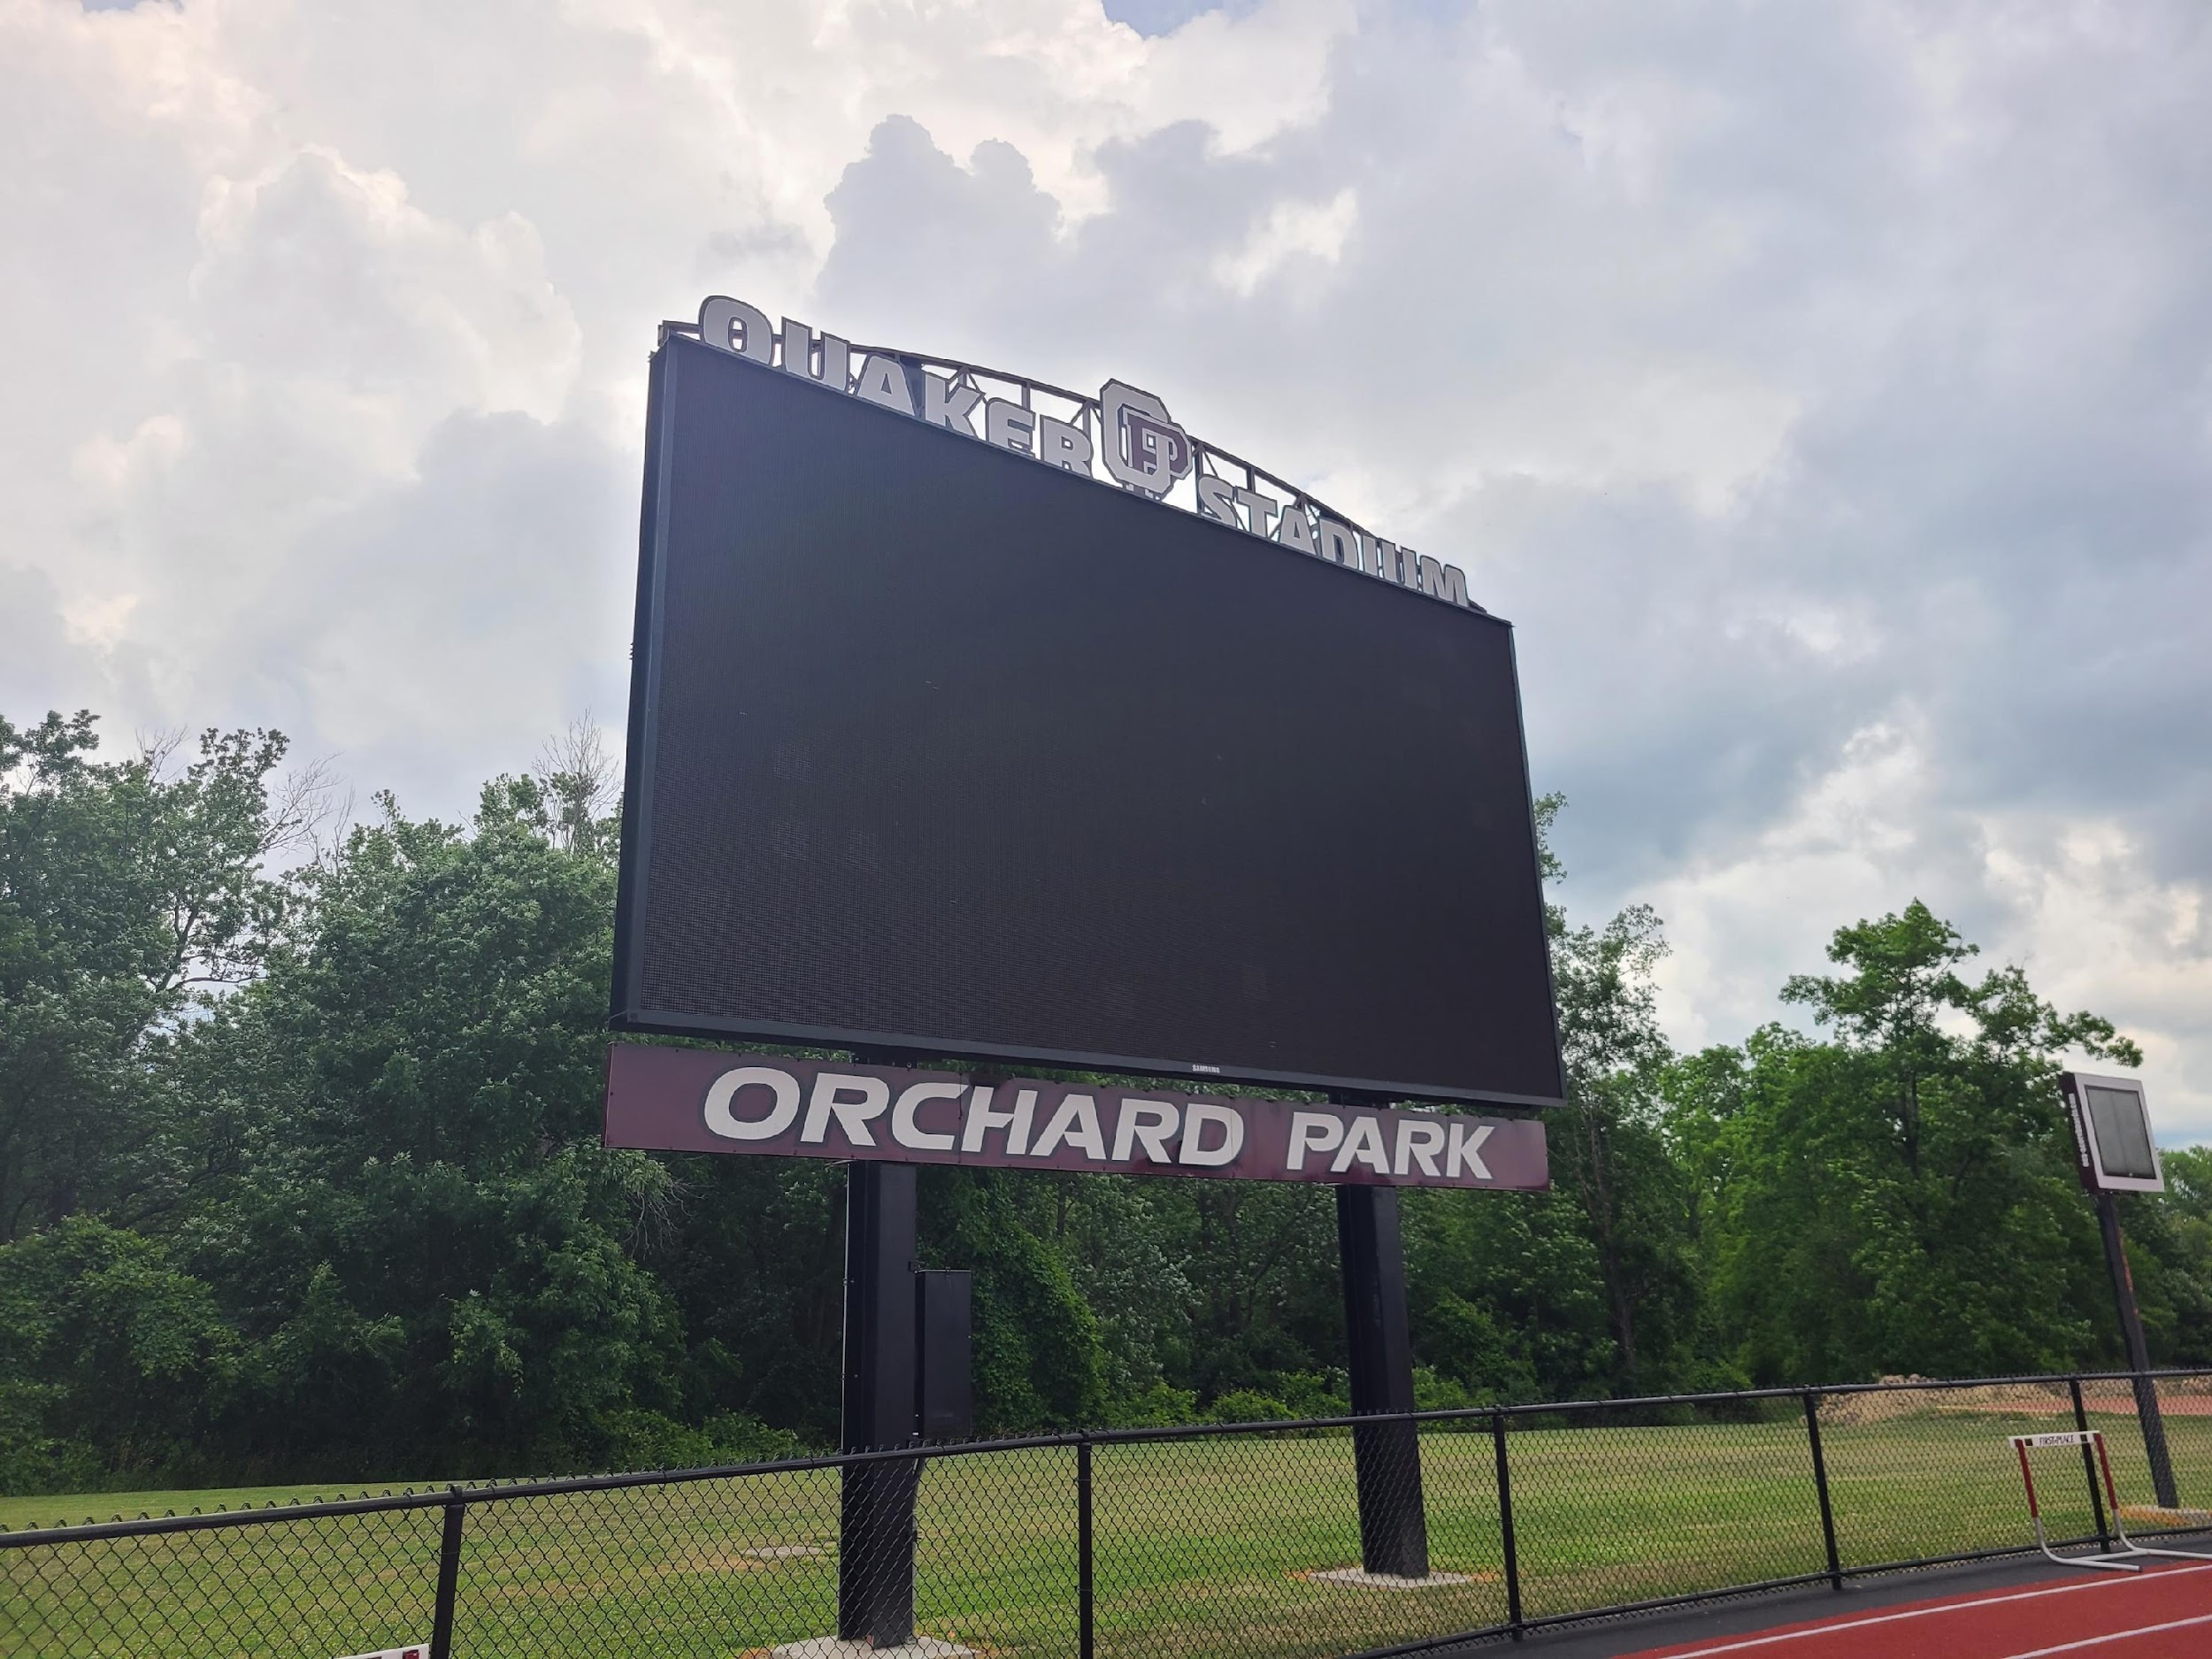
Image Features
Raw Data

Slide 19
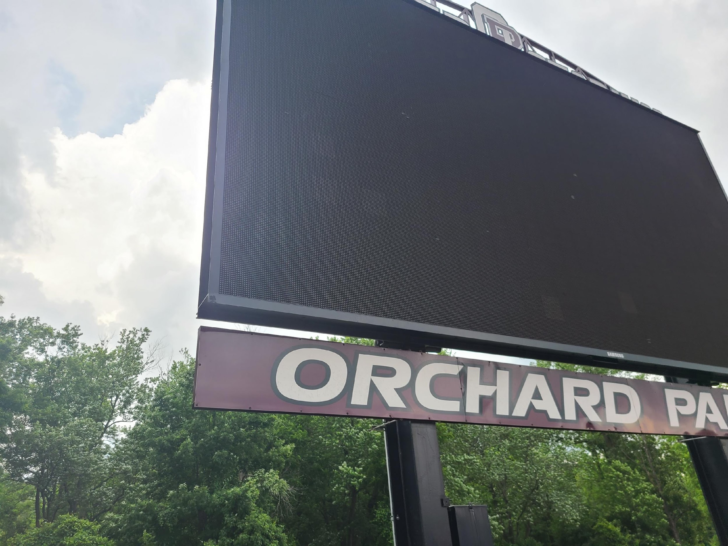
Image Features
Raw Data

Slide 20
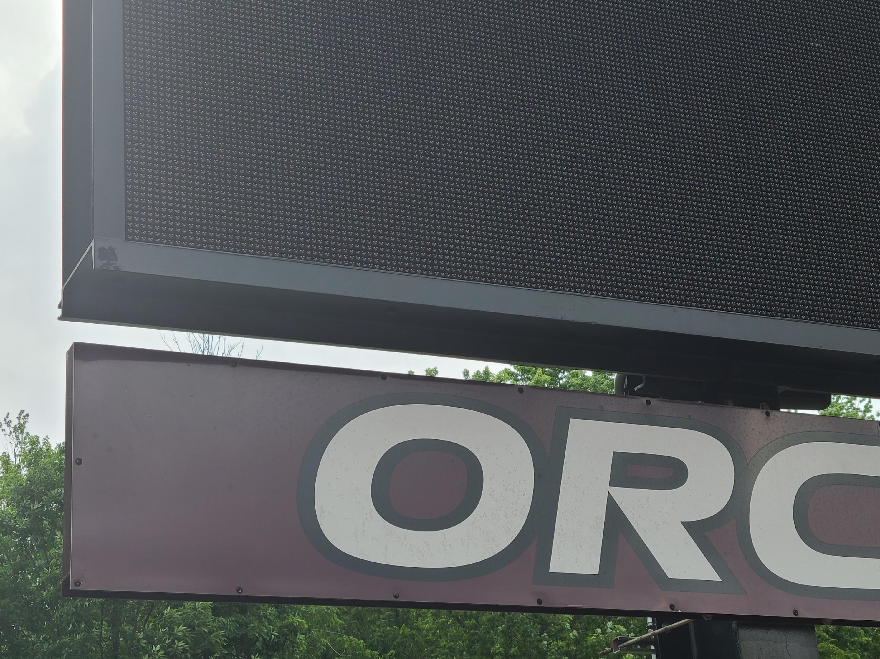
Image Features
Raw Data

Slide 21
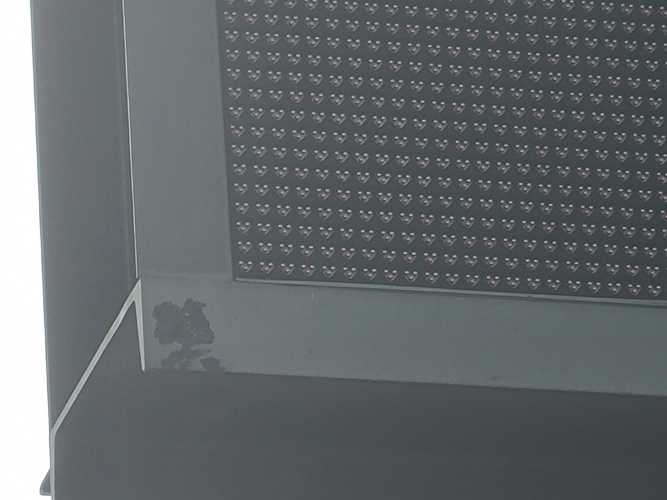
Image Features
Raw Data

Slide 22
Image Features
Raw Data

Slide 23
Image Features
Raw Data

Slide 24
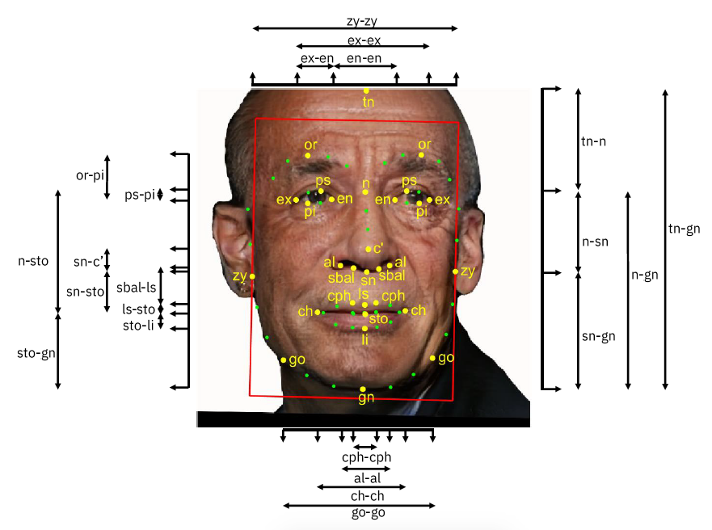
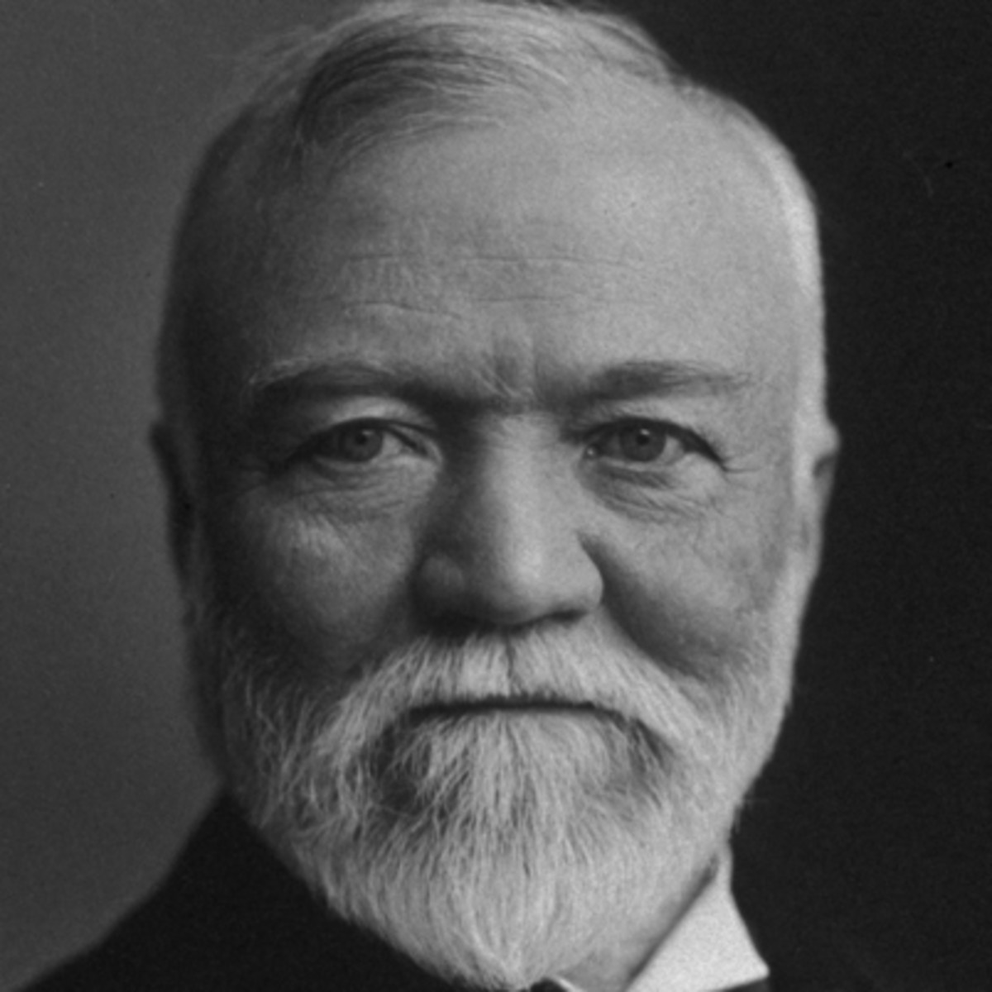
Image Features
Converting more complex data into a table of numerical values
Task: Face recognition from image
Image credit: https://arxiv.org/abs/1901.10436

Slide 25
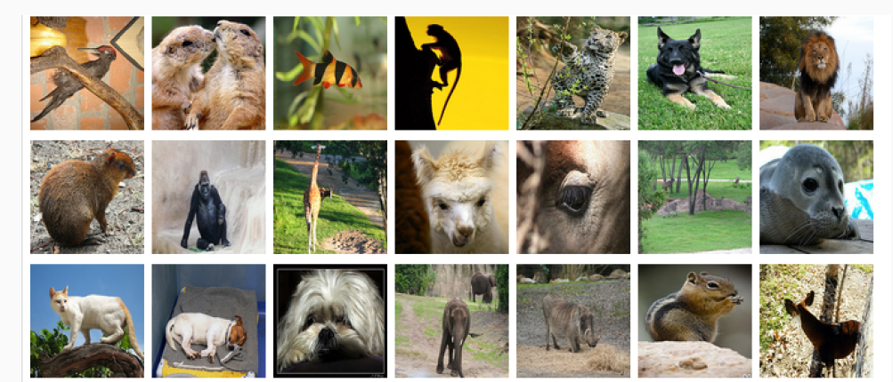
Image Features
But what are the numerical features for e.g. animal classification??
Image: ImageNet

Slide 26
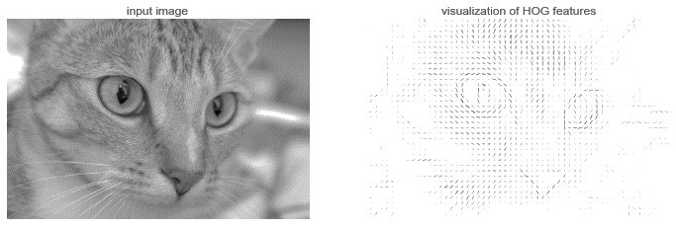
Image Features
Feature engineering
Edge detection convolutions (direction and strength of edges in image patch)
HOG filer: Histogram of gradients (edges)
Image: https://jakevdp.github.io/PythonDataScienceHandbook/05.14-image-features.html

Slide 27
Image Features
Feature engineering
Edge detection convolutions (direction and strength of edges in image patch)
HOG filer: Histogram of gradients (edges)
Image: https://jakevdp.github.io/PythonDataScienceHandbook/05.14-image-features.html

Slide 28
Image Features
Feature learning
Convolutional neural nets
Image: https://jakevdp.github.io/PythonDataScienceHandbook/05.14-image-features.html

Slide 29
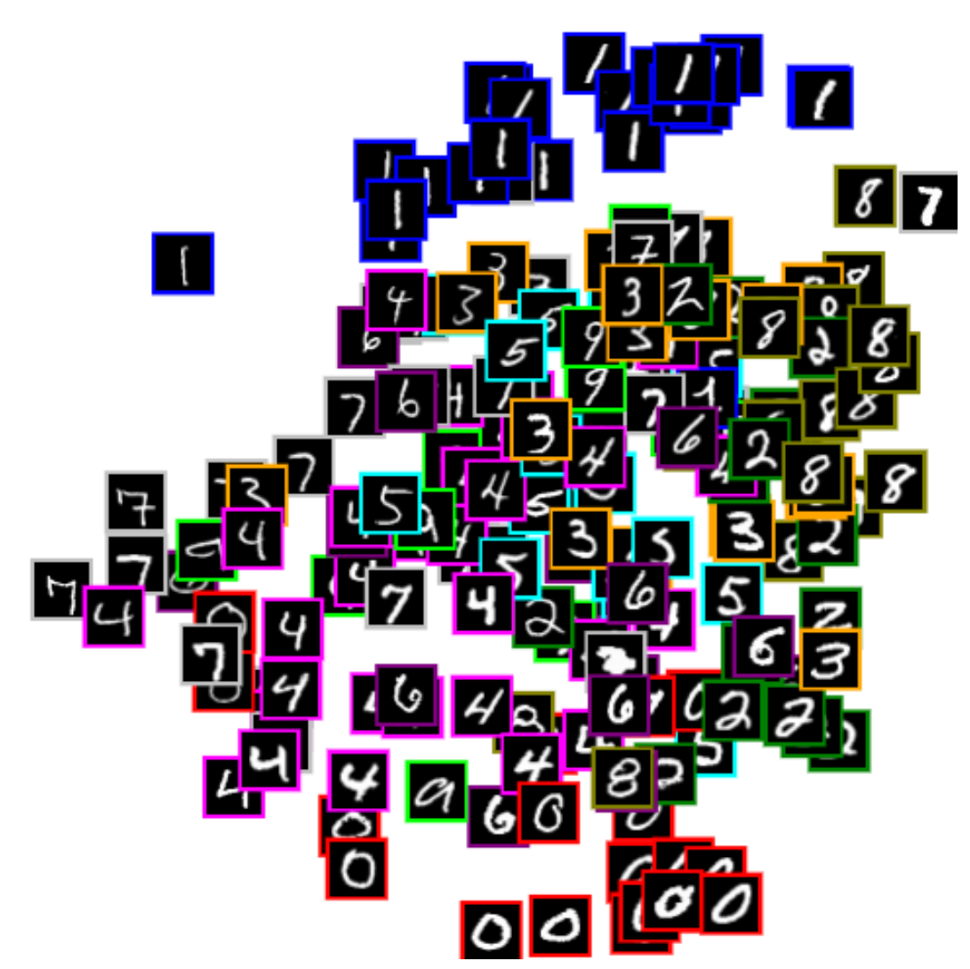


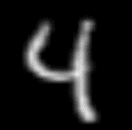





Image Features
Feature learning
Self-supervised, e.g. autoencoders
Image → $\left[\begin{aligned}z_{1} \\ z_{2}\end{aligned}\right]$ → Image
$$z_{2}$$
Net
Net
$$\left[\begin{aligned}z_{1} \\ z_{2}\end{aligned}\right]$$
Net
Net
$$\left[\begin{aligned}z_{1} \\ z_{2}\end{aligned}\right]$$
$$z_{1}$$
https://cs.stanford.edu/people/karpathy/convnetjs/demo/autoencoder.html

Slide 30
Deep Learning for Computer Vision
Computer vision tasks
Image features
Convolution Channels & CNNs
Computer vision history: Deep learning boom
CNN architectures & Practical deep learning

Slide 31
CNNs

Slide 32
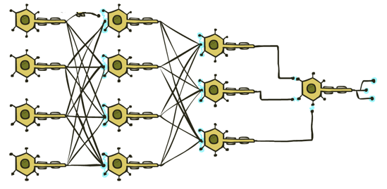

Deep Learning for Images
What if we just used logistic regression?
i.e., just directly classify the raw pixels
CAT

Slide 33
Poll 1
Logistic regression for 28x28=784 pixel hand-written digit images into 10 classes:
How many parameters (including bias terms)?
10
10+784
10*784
10*784 + 10
10*784 + 784
I don't know

Slide 34

Poll 2
Given a training set of 1000 MNIST digits 0-9, what training accuracy do you think we can get using just logistic regression?
Value between 0.0 and 1.0.
Input
(28x28)

Slide 35
Classification: Deep Learning
What if we just used fully connected networks?
CAT

Slide 36
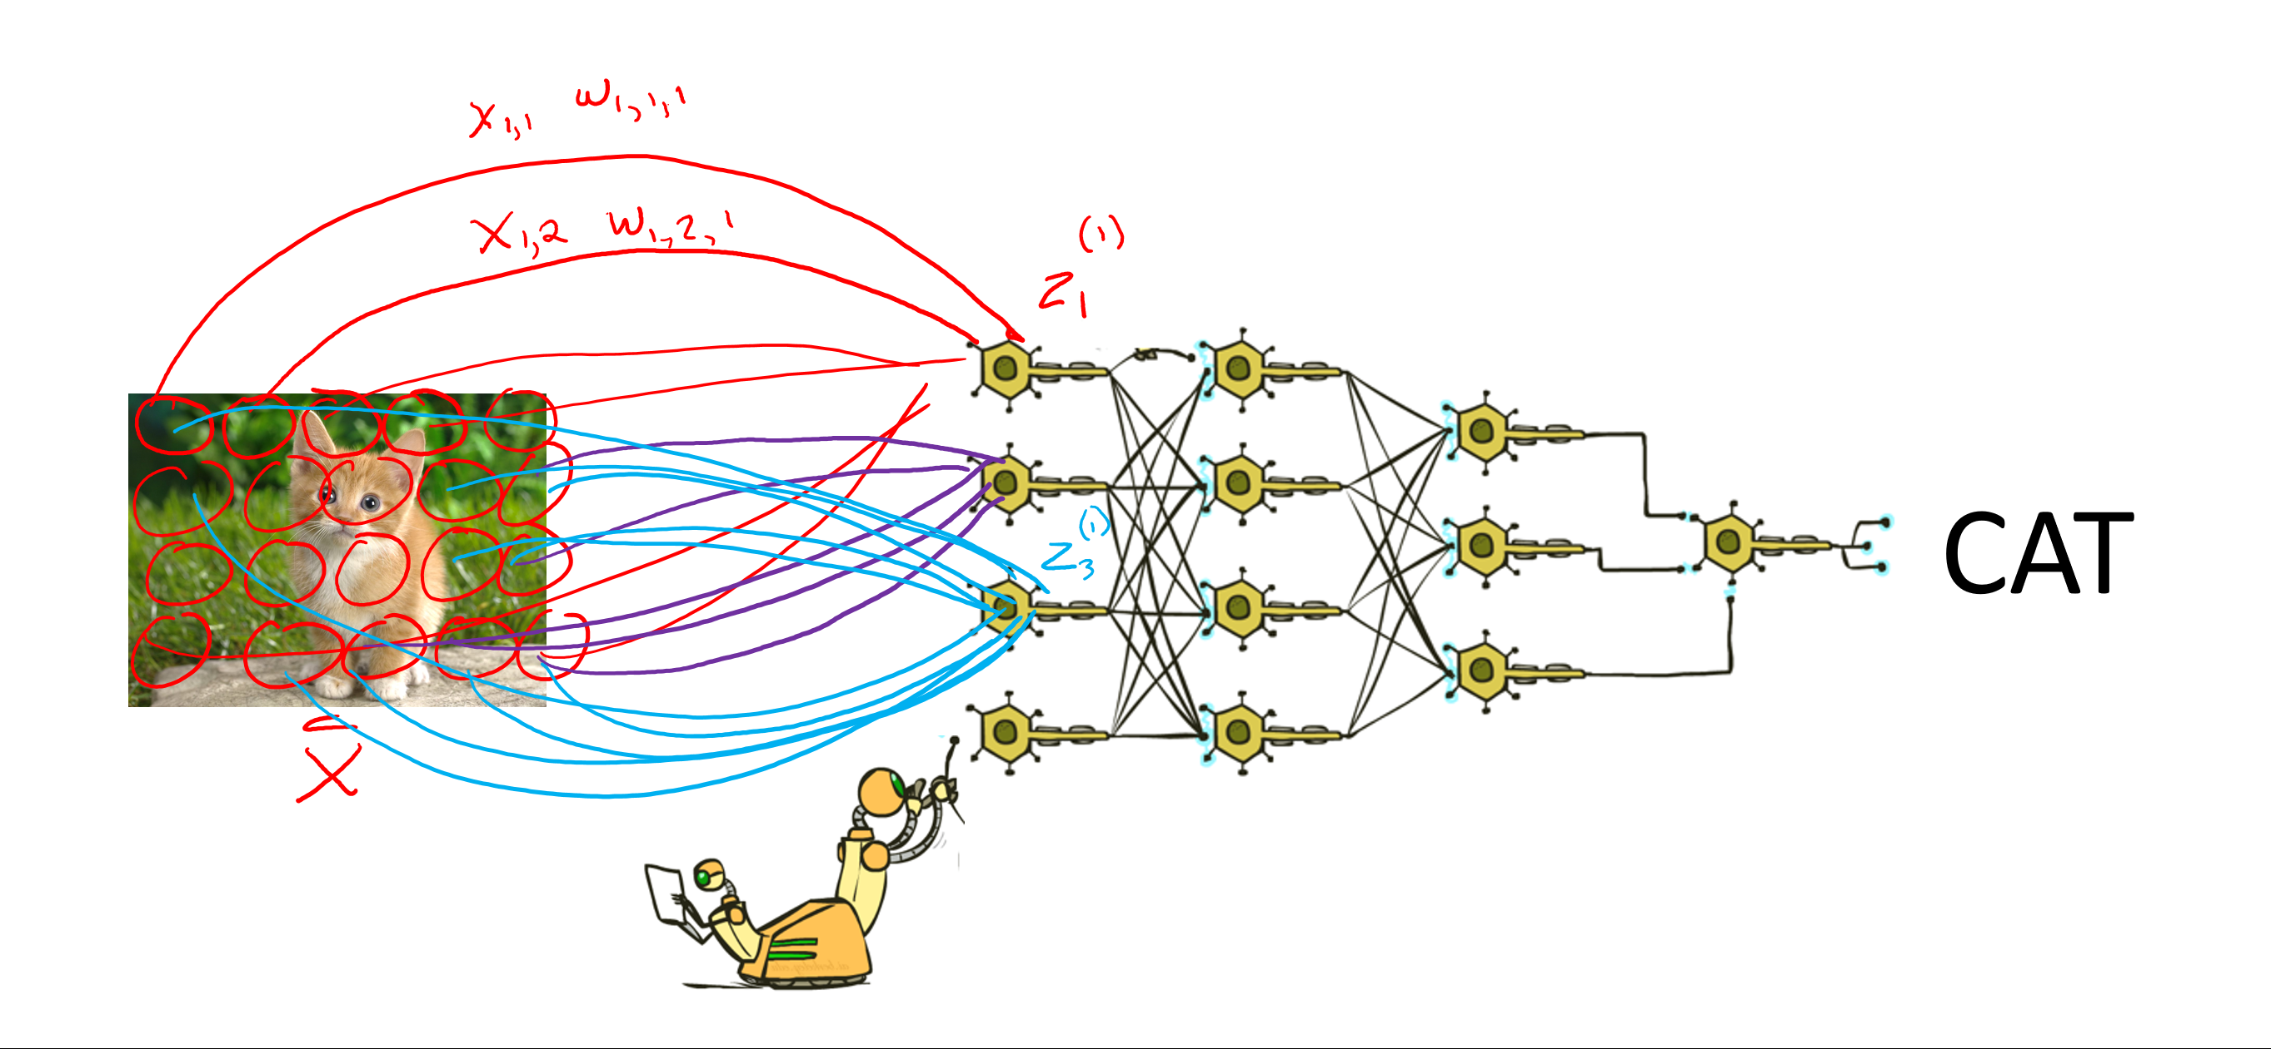
Classification: Deep Learning
What if we just used fully connected networks?
CAT
Lost spatial content after first layer
Not spatially invariant
Too many weights to learn

Slide 37
Convolutional Layers
Convolutional layers (vs Fully-connected layers)
  Nodes in the input layer are only connected to some nodes in the next layer but not all nodes.
  Shared weight parameters across sliding window locations
  → Many fewer weights than a fully connected layer!
Just like fully-connected layers
Linear operations
Parameters are weights (the values in conv. kernel) and biases
Convolution weights are learned using gradient descent/ backpropagation (not hand-crafted)
Notes:
Convolution is a matrix version of a dot product between two vectors, you multiply elementwise and then add them all up.

Slide 38
Convolutional Neural Networks
Neural networks are frequently applied to inputs with some inherent spatial structure, e.g., images
Insight: for spatially-structured inputs, many useful features are shift or location-invariant
Source: Felzenszwalb, et al. PAMI 2009

Slide 39
Convolutional Neural Networks
Neural networks are frequently applied to inputs with some inherent spatial structure, e.g., images
Insight: for spatially-structured inputs, many useful features are shift or location-invariant
Strategy:
  Learn a filter for micro-feature detection in a small window and apply it over the entire image
  Downsample (shink) resulting feature image(s)
  Repeat at future layers to learn increasingly macro features
Slide: Henry Chair, CMU MLD

Slide 40
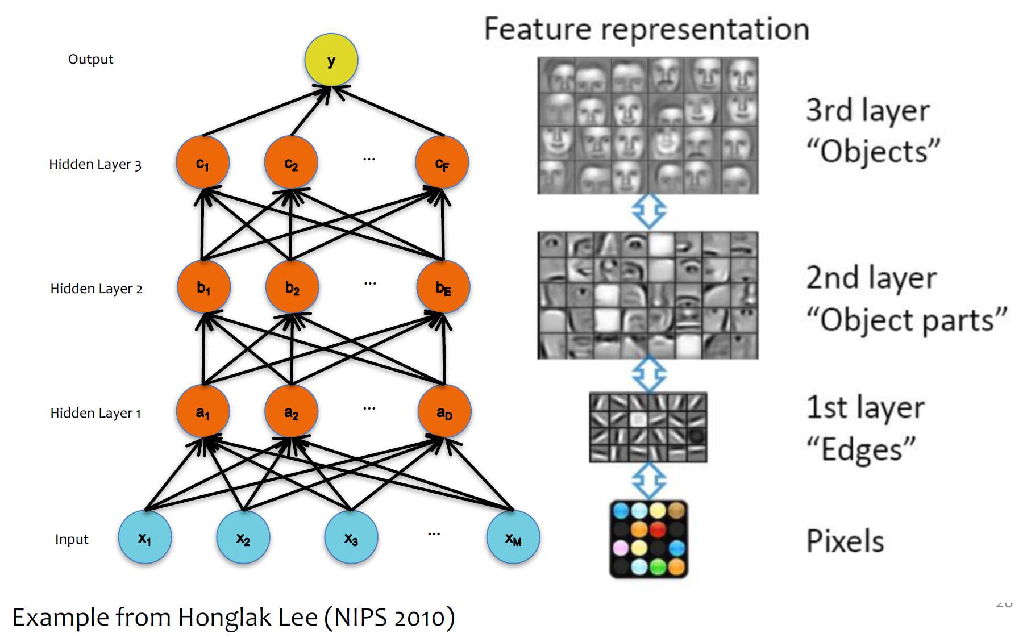
Classification: Learning Features

Slide 41
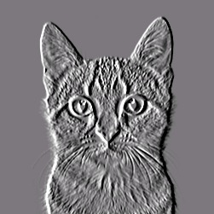
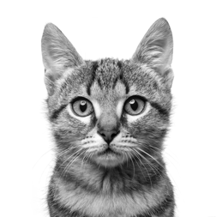
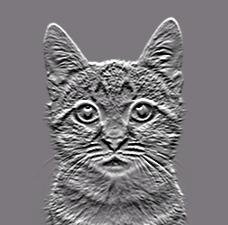
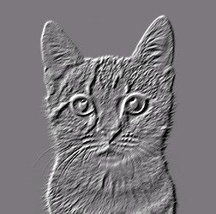
Convolutional Neural Networks
Convolution
CAT

Slide 42
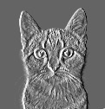
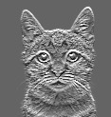
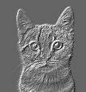
Convolutional Neural Networks
Pooling
Convolution

Slide 43
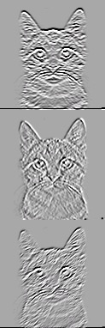

Convolutional Neural Networks
Warning: Not quite right
Pooling
Convolution

Slide 44
Convolutional Neural Networks
Pooling
Convolution

Slide 45
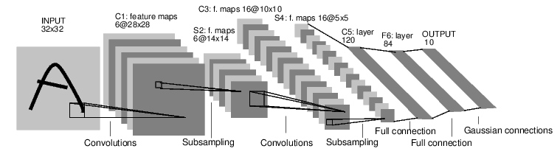
Convolutional Neural Networks
Lenet5 – Lecun, et al, 1998
  Convnets for digit recognition
LeCun, Yann, et al. "Gradient-based learning applied to document recognition." Proceedings of the IEEE 86.11 (1998): 2278-2324.

Slide 46
Question:
How big many convolutional weights between S2 and C3?
  S2: 6 channels @14x14
  Conv: 5x5, pad=0, stride=1
  C3: 16 channels @ 10x10

Slide 47
Question:
How big many convolutional weights between S2 and C3?
  S2: 6 channels @14x14
  Conv: 5x5, pad=0, stride=1
  C3: 16 channels @ 10x10
One image in C3 is actually the result of a 3D convolution
Kernel_1: 6x5x5
C3_1: 1x10x10
S2: 6x14x14

Slide 48
Question:
How big many convolutional weights between S2 and C3?
  S2: 6 channels @14x14
  Conv: 5x5, pad=0, stride=1
  C3: 16 channels @ 10x10
Each image in C3 convolved S2 convolved with a different 3D kernel
Kernel_2: 6x5x5
C3_2: 1x10x10
Kernel_1: 6x5x5
C3_1: 1x10x10
S2: 6x14x14

Slide 49
Question:
How big many convolutional weights between S2 and C3?
  S2: 6 channels @14x14
  Conv: 5x5, pad=0, stride=1
  C3: 16 channels @ 10x10
The 16 images in C3 are the result of doing 16 3D convolutions of S2 with 16 different 6x5x5 kernels.
Assuming no bias term, this is 16x6x5x5 weights!
Kernels: 16@6x5x5
S2: 6x14x14
C3: 16@10x10

Slide 50
Deep Learning for Computer Vision
Computer vision tasks
Image features
Convolution Channels & CNNs
Computer vision history: Deep learning boom
CNN architectures & Practical deep learning

Slide 51
Computer Vision History
Deep Learning Boom

Slide 52
CNNs for Image Recognition
Slide from Kaiming He

Slide 53
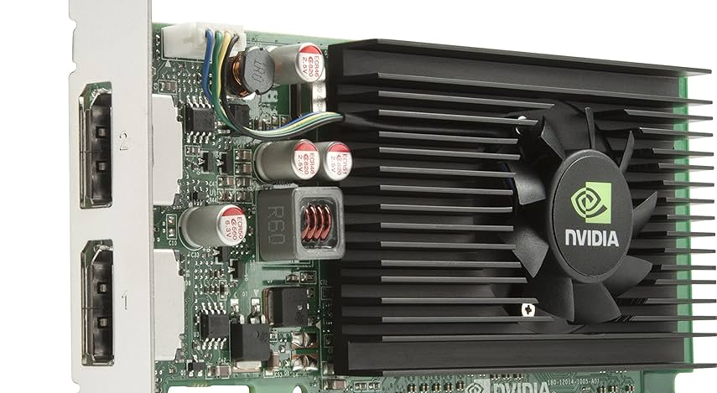
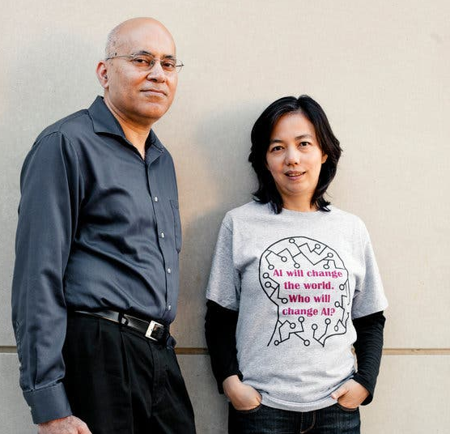
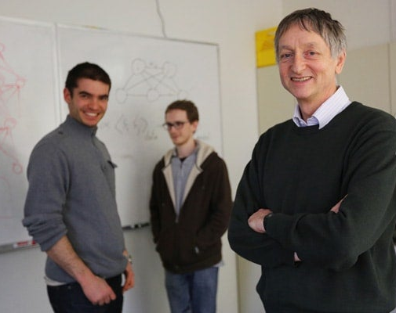
What happened in 2012?
The challenge.
Computer Vision
Neural Networks
Jitendra Malik
Fei-Fei Li
Ilya and Alex
Geoff Hinton
Images: https://www.nytimes.com/2016/09/20/science/computer-vision-tesla-driverless-cars.html
https://www.utoronto.ca/news/google-acquires-u-t-neural-networks-company

Slide 54
Vision / Computer Vision History
LeNet 5, 1998
AlexNet, 2012
Input: 1, 32, 32
nn.Conv2d(out_channels=6, kernel_size=5),
nn.Tanh(),
nn.AvgPool2d(kernel_size=2, stride=2),
nn.Conv2d(out_channels=16, kernel_size=5),
nn.Tanh(),
nn.AvgPool2d(kernel_size=2, stride=2)
nn.Linear(out_features=120),
nn.Tanh(),
nn.Linear(out_features=84),
nn.Tanh(),
nn.Linear(out_features=10)
Input: 3, 224, 224
nn.Conv2d(channels=96, kernel_size=11, stride=4),
nn.BatchNorm(), nn.ReLU(),
nn.MaxPool2d(kernel_size=3, stride=2),
nn.Conv2d(channels=256, kernel_size=5),
nn.BatchNorm(256), nn.ReLU(),
nn.MaxPool2d(kernel_size=3, stride=2),
nn.Conv2d(channels=384, kernel_size=3),
nn.BatchNorm(384), nn.ReLU(),
nn.Conv2d(channels=384, kernel_size=3),
nn.BatchNorm(384), nn.ReLU(),
nn.Conv2d(channels=256, kernel_size=3),
nn.BatchNorm(256), nn.ReLU(),
nn.MaxPool2d(kernel_size=3, stride=2),
nn.Dropout(0.5),
nn.Linear(channels=4096), nn.ReLU(),
nn.Dropout(0.5),
nn.Linear(channels=4096), nn.ReLU(),
nn.Linear(channels=1000)
Network changes (other than bigger, deeper)
tanh → ReLU
Avg Pool → Max Pool
+ Batch Normalization (keep values in reasonable range)
+ Dropout (form of regularization)

Slide 55
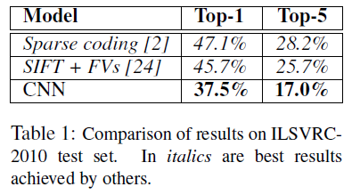
Vision / Computer Vision History
State-of-the-art Classification
AlexNet, 2012
Input: 3, 224, 224
nn.Conv2d(channels=96, kernel_size=11, stride=4),
nn.BatchNorm(), nn.ReLU(),
nn.MaxPool2d(kernel_size=3, stride=2),
nn.Conv2d(channels=256, kernel_size=5),
nn.BatchNorm(256), nn.ReLU(),
nn.MaxPool2d(kernel_size=3, stride=2),
nn.Conv2d(channels=384, kernel_size=3),
nn.BatchNorm(384), nn.ReLU(),
nn.Conv2d(channels=384, kernel_size=3),
nn.BatchNorm(384), nn.ReLU(),
nn.Conv2d(channels=256, kernel_size=3),
nn.BatchNorm(256), nn.ReLU(),
nn.MaxPool2d(kernel_size=3, stride=2),
nn.Dropout(0.5),
nn.Linear(channels=4096), nn.ReLU(),
nn.Dropout(0.5),
nn.Linear(channels=4096), nn.ReLU(),
nn.Linear(channels=1000)
Network changes (other than bigger, deeper)
tanh → ReLU
Avg Pool → Max Pool
+ Batch Normalization (keep values in reasonable range)
+ Dropout (form of regularization)

Slide 56
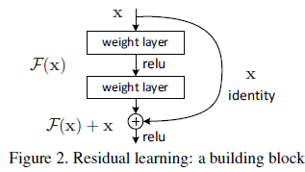
2012: AlexNet (+ ImageNet + GPUs) opened doors
Key
Network + Data + Compute
Additional innovations
Deep learning toolkits
    (Caffe, Torch) → (PyTorch, Tensorflow)
    "Model zoos"
Residual connections (ResNet)
    (aka skip connections)
    Shortcuts for information flow (forward and backward)
Kaiming He, et al, Deep Residual Learning for Image Recognition

Slide 57
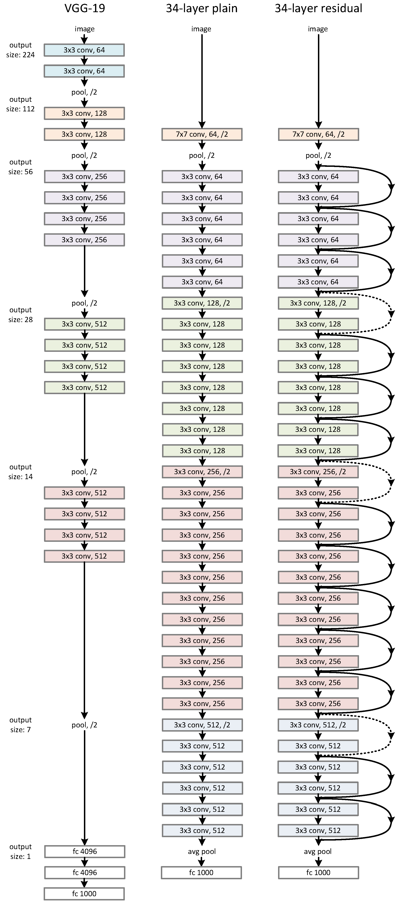
2012: AlexNet (+ ImageNet + GPUs) opened doors
VGG-19 34-layer plain 34-layer residual
Kaiming He, et al, Deep Residual Learning for Image Recognition

Slide 58
CNN Architectures

Slide 59
Convolutional Neural Networks
Lenet5 – Lecun, et al, 1998
  Convnets for digit recognition
LeCun, Yann, et al. "Gradient-based learning applied to document recognition." Proceedings of the IEEE 86.11 (1998): 2278-2324.

Slide 60
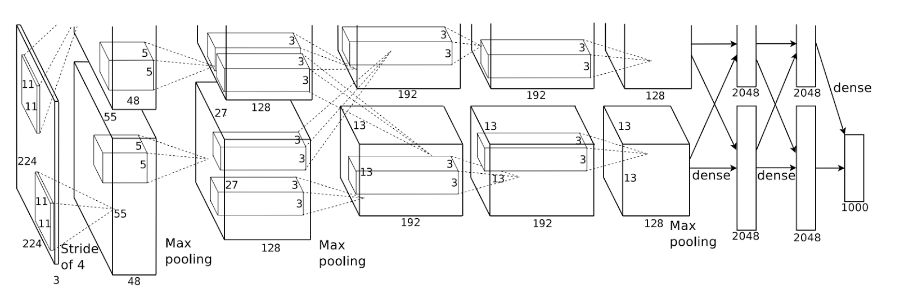
Convolutional Neural Networks
Alexnet – Krizhevsky, et al, 2012
  Convnets for image classification
  More data & more compute power
Krizhevsky, Alex, Ilya Sutskever, and Geoffrey E. Hinton. "ImageNet classification with deep convolutional neural networks." NIPS, 2012.

Slide 61
2012: AlexNet (+ ImageNet + GPUs) opened doors
Key
Network + Data + Compute
Additional innovations
Deep learning toolkits
    (Caffe, Torch) → (PyTorch, Tensorflow)
    "Model zoos"
Residual connections (ResNet)
    (aka skip connections)
    Shortcuts for information flow (forward and backward)
Kaiming He, et al, Deep Residual Learning for Image Recognition

Slide 62
2012: AlexNet (+ ImageNet + GPUs) opened doors
VGG-19 34-layer plain 34-layer residual
Kaiming He, et al, Deep Residual Learning for Image Recognition

Slide 63
Practical Deep Learning

Slide 64
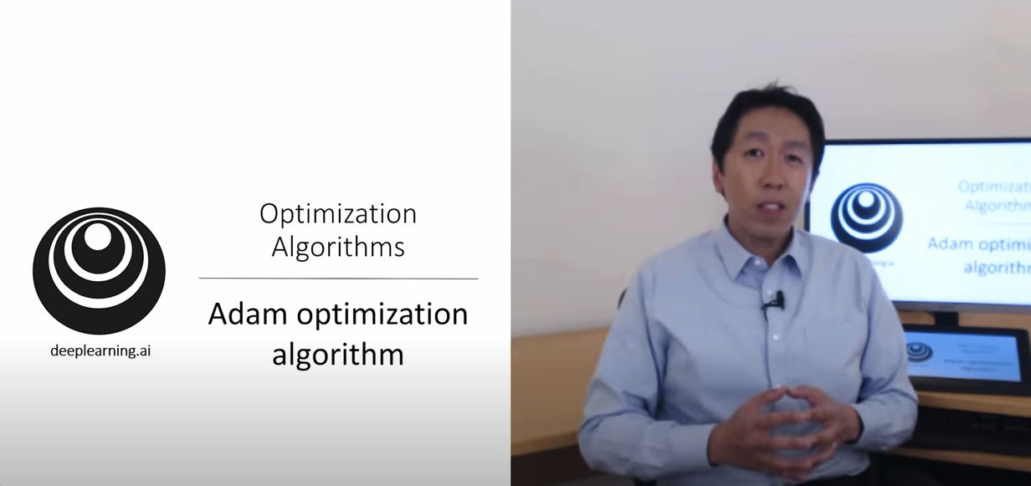
Deep learning issues and Fixes
Issues
Numerical Stability
Vanishing/Exploding gradients
Overfitting
Andrew Ng videos on Hyperparameter Tuning!
Fixes
Input normalization
Weight initialization
Batch normalization
Adam
    Exponential moving average
    Momentum
    RMSprop
Learning rate decay
Skip connections
Dropout

Slide 65
CNN Summary

Slide 66
Convolution and Pooling Layers
Maintain spatial context across first layer
The output of a convolution layer is still an image
Can represent the location of the detected features
Leverage spatially invariance
The same kernel moves across the image to detect features regardless of where they are in the image
Fewer weights
Avoids having to learn specific weights to detect features in many, many different locations in the image
Downsampling
Convolution/pooling layers with stride > 1 will reduce the total number of values going forward, easing the next layer learning

Slide 67
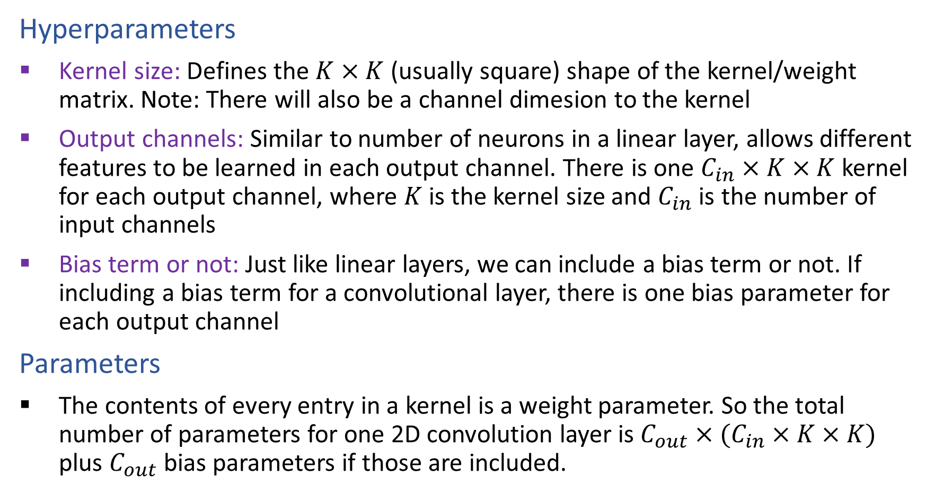
Convolution and Pooling Layers
Hyperparameters
Kernel size: Defines the $K×K$ (usually square) shape of the kernel/weight matrix. Note: There will also be a channel dimesion to the kernel
Output channels: Similar to number of neurons in a linear layer, allows different features to be learned in each output channel. There is one $C_{in}×K×K$ kernel for each output channel, where $K$ is the kernel size and $C_{in}$ is the number of input channels
Bias term or not: Just like linear layers, we can include a bias term or not. If including a bias term for a convolutional layer, there is one bias parameter for each output channel
Parameters
The contents of every entry in a kernel is a weight parameter. So the total number of parameters for one 2D convolution layer is $C_{out}×(C_{in}×K×K)$ plus $C_{out}$ bias parameters if those are included.

Slide 68
Convolution and Pooling Layers
Hyperparameters (cont.)
Stride: How much to shift the kernel over while performing the convolution (usually the same in each direction). A stride of 1 will output and image that is roughly the same size as the input (see padding), while a stride of 2 will produce an image that is 2x smaller in both width and height
Padding: Effectively add rows/columns around the input image to deal with (literal) edge cases better. Often used to keep the exact same size output image as the input (with stride=1)
Pooling: Average or Max convolutions are just operations to combine pixels and don't have any parameters. Max pooling is more common over average pooling

Slide 69
Convolution and Pooling Layers
Forward and backward passes
Math: Convolutions are just multiplications and additions with a bunch of for-loops, just like the matrix multiplication in linear layers. In fact, convolutions are linear layers; they just apply the linear operations to different combinations of input values and weights. Thus, the calculus for backpropagation is essentially the same as a linear layer, just with some reshaping of the data.
Computation: Just like linear layers convolutions and pooling layers have a ton of embarrassingly parallel multiplication and addition operations across lots of data. GPUs and more recently TPUs are designed for these operations, making these hardware components essentially for neural net training

Slide 70
Vision / Computer Vision History
LeNet 5, 1998
AlexNet, 2012
Input: 1, 32, 32
nn.Conv2d(out_channels=6, kernel_size=5),
nn.Tanh(),
nn.AvgPool2d(kernel_size=2, stride=2),
nn.Conv2d(out_channels=16, kernel_size=5),
nn.Tanh(),
nn.AvgPool2d(kernel_size=2, stride=2)
nn.Linear(out_features=120),
nn.Tanh(),
nn.Linear(out_features=84),
nn.Tanh(),
nn.Linear(out_features=10)
Input: 3, 224, 224
nn.Conv2d(channels=96, kernel_size=11, stride=4),
nn.BatchNorm(), nn.ReLU(),
nn.MaxPool2d(kernel_size=3, stride=2),
nn.Conv2d(channels=256, kernel_size=5),
nn.BatchNorm(256), nn.ReLU(),
nn.MaxPool2d(kernel_size=3, stride=2),
nn.Conv2d(channels=384, kernel_size=3),
nn.BatchNorm(384), nn.ReLU(),
nn.Conv2d(channels=384, kernel_size=3),
nn.BatchNorm(384), nn.ReLU(),
nn.Conv2d(channels=256, kernel_size=3),
nn.BatchNorm(256), nn.ReLU(),
nn.MaxPool2d(kernel_size=3, stride=2),
nn.Dropout(0.5),
nn.Linear(channels=4096), nn.ReLU(),
nn.Dropout(0.5),
nn.Linear(channels=4096), nn.ReLU(),
nn.Linear(channels=1000)
Network changes (other than bigger, deeper)
tanh → ReLU
Avg Pool → Max Pool
+ Batch Normalization (keep values in reasonable range)
+ Dropout (form of regularization)

Slide 71
2012: AlexNet (+ ImageNet + GPUs) opened doors
Key
Network + Data + Compute
Additional innovations
Deep learning toolkits
    (Caffe, Torch) → (PyTorch, Tensorflow)
    "Model zoos"
Residual connections (ResNet)
    (aka skip connections)
    Shortcuts for information flow (forward and backward)
Kaiming He, et al, Deep Residual Learning for Image Recognition

Slide 72
Additional Slides

Slide 73
Pre-reading
Convolutions and CNNs

Slide 74
Convolutional Neural Networks
Convolution
CAT

Slide 75
Convolution
-1 | 0 | 1
-1 | 0 | 1
-1 | 0 | 1

Slide 76
Convolution
-1 | 0 | 1
-1 | 0 | 1
-1 | 0 | 1
0 | 0 | 0 | 1 | 1 | 1 | 1 | 0 | 0 | 0
0 | 0 | 0 | 1 | 1 | 1 | 1 | 0 | 0 | 0
0 | 0 | 0 | 1 | 1 | 1 | 1 | 0 | 0 | 0
0 | 0 | 0 | 1 | 1 | 1 | 1 | 0 | 0 | 0
0 | 0 | 0 | 1 | 1 | 1 | 1 | 0 | 0 | 0
0 | 0 | 0 | 1 | 1 | 1 | 1 | 0 | 0 | 0
0 | 0 | 0 | 1 | 1 | 1 | 1 | 0 | 0 | 0
0 | 0 | 0 | 1 | 1 | 1 | 1 | 0 | 0 | 0
0 | 0 | 0 | 1 | 1 | 1 | 1 | 0 | 0 | 0
0 | 0 | 0 | 1 | 1 | 1 | 1 | 0 | 0 | 0

Slide 77
Convolution
-1 | 0 | 1
-1 | 0 | 1
-1 | 0 | 1
0 | 0 | 0 | 1 | 1 | 1 | 1 | 0 | 0 | 0
0 | 0 | 0 | 1 | 1 | 1 | 1 | 0 | 0 | 0
0 | 0 | 0 | 1 | 1 | 1 | 1 | 0 | 0 | 0
0 | 0 | 0 | 1 | 1 | 1 | 1 | 0 | 0 | 0
0 | 0 | 0 | 1 | 1 | 1 | 1 | 0 | 0 | 0
0 | 0 | 0 | 1 | 1 | 1 | 1 | 0 | 0 | 0
0 | 0 | 0 | 1 | 1 | 1 | 1 | 0 | 0 | 0
0 | 0 | 0 | 1 | 1 | 1 | 1 | 0 | 0 | 0
0 | 0 | 0 | 1 | 1 | 1 | 1 | 0 | 0 | 0
0 | 0 | 0 | 1 | 1 | 1 | 1 | 0 | 0 | 0
-1 | 0 | 1
-1 | 0 | 1
-1 | 0 | 1
0

Slide 78
Convolution
-1 | 0 | 1
-1 | 0 | 1
-1 | 0 | 1
0 | 0 | 0 | 1 | 1 | 1 | 1 | 0 | 0 | 0
0 | 0 | 0 | 1 | 1 | 1 | 1 | 0 | 0 | 0
0 | 0 | 0 | 1 | 1 | 1 | 1 | 0 | 0 | 0
0 | 0 | 0 | 1 | 1 | 1 | 1 | 0 | 0 | 0
0 | 0 | 0 | 1 | 1 | 1 | 1 | 0 | 0 | 0
0 | 0 | 0 | 1 | 1 | 1 | 1 | 0 | 0 | 0
0 | 0 | 0 | 1 | 1 | 1 | 1 | 0 | 0 | 0
0 | 0 | 0 | 1 | 1 | 1 | 1 | 0 | 0 | 0
0 | 0 | 0 | 1 | 1 | 1 | 1 | 0 | 0 | 0
0 | 0 | 0 | 1 | 1 | 1 | 1 | 0 | 0 | 0
-1 | 0 | 1
-1 | 0 | 1
-1 | 0 | 1
0
 | 3

Slide 79
Convolution
-1 | 0 | 1
-1 | 0 | 1
-1 | 0 | 1
0 | 0 | 0 | 1 | 1 | 1 | 1 | 0 | 0 | 0
0 | 0 | 0 | 1 | 1 | 1 | 1 | 0 | 0 | 0
0 | 0 | 0 | 1 | 1 | 1 | 1 | 0 | 0 | 0
0 | 0 | 0 | 1 | 1 | 1 | 1 | 0 | 0 | 0
0 | 0 | 0 | 1 | 1 | 1 | 1 | 0 | 0 | 0
0 | 0 | 0 | 1 | 1 | 1 | 1 | 0 | 0 | 0
0 | 0 | 0 | 1 | 1 | 1 | 1 | 0 | 0 | 0
0 | 0 | 0 | 1 | 1 | 1 | 1 | 0 | 0 | 0
0 | 0 | 0 | 1 | 1 | 1 | 1 | 0 | 0 | 0
0 | 0 | 0 | 1 | 1 | 1 | 1 | 0 | 0 | 0
-1 | 0 | 1
-1 | 0 | 1
-1 | 0 | 1
0 | 3 | 3

Slide 80
Convolution
-1 | 0 | 1
-1 | 0 | 1
-1 | 0 | 1
0 | 0 | 0 | 1 | 1 | 1 | 1 | 0 | 0 | 0
0 | 0 | 0 | 1 | 1 | 1 | 1 | 0 | 0 | 0
0 | 0 | 0 | 1 | 1 | 1 | 1 | 0 | 0 | 0
0 | 0 | 0 | 1 | 1 | 1 | 1 | 0 | 0 | 0
0 | 0 | 0 | 1 | 1 | 1 | 1 | 0 | 0 | 0
0 | 0 | 0 | 1 | 1 | 1 | 1 | 0 | 0 | 0
0 | 0 | 0 | 1 | 1 | 1 | 1 | 0 | 0 | 0
0 | 0 | 0 | 1 | 1 | 1 | 1 | 0 | 0 | 0
0 | 0 | 0 | 1 | 1 | 1 | 1 | 0 | 0 | 0
0 | 0 | 0 | 1 | 1 | 1 | 1 | 0 | 0 | 0
-1 | 0 | 1
-1 | 0 | 1
-1 | 0 | 1
0 | 3 | 3 | 0

Slide 81
Convolution
-1 | 0 | 1
-1 | 0 | 1
-1 | 0 | 1
0 | 0 | 0 | 1 | 1 | 1 | 1 | 0 | 0 | 0
0 | 0 | 0 | 1 | 1 | 1 | 1 | 0 | 0 | 0
0 | 0 | 0 | 1 | 1 | 1 | 1 | 0 | 0 | 0
0 | 0 | 0 | 1 | 1 | 1 | 1 | 0 | 0 | 0
0 | 0 | 0 | 1 | 1 | 1 | 1 | 0 | 0 | 0
0 | 0 | 0 | 1 | 1 | 1 | 1 | 0 | 0 | 0
0 | 0 | 0 | 1 | 1 | 1 | 1 | 0 | 0 | 0
0 | 0 | 0 | 1 | 1 | 1 | 1 | 0 | 0 | 0
0 | 0 | 0 | 1 | 1 | 1 | 1 | 0 | 0 | 0
0 | 0 | 0 | 1 | 1 | 1 | 1 | 0 | 0 | 0
-1 | 0 | 1
-1 | 0 | 1
-1 | 0 | 1
0 | 3 | 3 | 0 | 0

Slide 82
Convolution
-1 | 0 | 1
-1 | 0 | 1
-1 | 0 | 1
0 | 0 | 0 | 1 | 1 | 1 | 1 | 0 | 0 | 0
0 | 0 | 0 | 1 | 1 | 1 | 1 | 0 | 0 | 0
0 | 0 | 0 | 1 | 1 | 1 | 1 | 0 | 0 | 0
0 | 0 | 0 | 1 | 1 | 1 | 1 | 0 | 0 | 0
0 | 0 | 0 | 1 | 1 | 1 | 1 | 0 | 0 | 0
0 | 0 | 0 | 1 | 1 | 1 | 1 | 0 | 0 | 0
0 | 0 | 0 | 1 | 1 | 1 | 1 | 0 | 0 | 0
0 | 0 | 0 | 1 | 1 | 1 | 1 | 0 | 0 | 0
0 | 0 | 0 | 1 | 1 | 1 | 1 | 0 | 0 | 0
0 | 0 | 0 | 1 | 1 | 1 | 1 | 0 | 0 | 0
-1 | 0 | 1
-1 | 0 | 1
-1 | 0 | 1
0 | 3 | 3 | 0 | 0 | -3

Slide 83
Convolution
-1 | 0 | 1
-1 | 0 | 1
-1 | 0 | 1
0 | 0 | 0 | 1 | 1 | 1 | 1 | 0 | 0 | 0
0 | 0 | 0 | 1 | 1 | 1 | 1 | 0 | 0 | 0
0 | 0 | 0 | 1 | 1 | 1 | 1 | 0 | 0 | 0
0 | 0 | 0 | 1 | 1 | 1 | 1 | 0 | 0 | 0
0 | 0 | 0 | 1 | 1 | 1 | 1 | 0 | 0 | 0
0 | 0 | 0 | 1 | 1 | 1 | 1 | 0 | 0 | 0
0 | 0 | 0 | 1 | 1 | 1 | 1 | 0 | 0 | 0
0 | 0 | 0 | 1 | 1 | 1 | 1 | 0 | 0 | 0
0 | 0 | 0 | 1 | 1 | 1 | 1 | 0 | 0 | 0
0 | 0 | 0 | 1 | 1 | 1 | 1 | 0 | 0 | 0
-1 | 0 | 1
-1 | 0 | 1
-1 | 0 | 1
0 | 3 | 3 | 0 | 0 | -3 | -3

Slide 84
Convolution
-1 | 0 | 1
-1 | 0 | 1
-1 | 0 | 1
0 | 0 | 0 | 1 | 1 | 1 | 1 | 0 | 0 | 0
0 | 0 | 0 | 1 | 1 | 1 | 1 | 0 | 0 | 0
0 | 0 | 0 | 1 | 1 | 1 | 1 | 0 | 0 | 0
0 | 0 | 0 | 1 | 1 | 1 | 1 | 0 | 0 | 0
0 | 0 | 0 | 1 | 1 | 1 | 1 | 0 | 0 | 0
0 | 0 | 0 | 1 | 1 | 1 | 1 | 0 | 0 | 0
0 | 0 | 0 | 1 | 1 | 1 | 1 | 0 | 0 | 0
0 | 0 | 0 | 1 | 1 | 1 | 1 | 0 | 0 | 0
0 | 0 | 0 | 1 | 1 | 1 | 1 | 0 | 0 | 0
0 | 0 | 0 | 1 | 1 | 1 | 1 | 0 | 0 | 0
-1 | 0 | 1
-1 | 0 | 1
-1 | 0 | 1
0 | 3 | 3 | 0 | 0 | -3 | -3 | 0

Slide 85
Convolution
-1 | 0 | 1
-1 | 0 | 1
-1 | 0 | 1
0 | 0 | 0 | 1 | 1 | 1 | 1 | 0 | 0 | 0
0 | 0 | 0 | 1 | 1 | 1 | 1 | 0 | 0 | 0
0 | 0 | 0 | 1 | 1 | 1 | 1 | 0 | 0 | 0
0 | 0 | 0 | 1 | 1 | 1 | 1 | 0 | 0 | 0
0 | 0 | 0 | 1 | 1 | 1 | 1 | 0 | 0 | 0
0 | 0 | 0 | 1 | 1 | 1 | 1 | 0 | 0 | 0
0 | 0 | 0 | 1 | 1 | 1 | 1 | 0 | 0 | 0
0 | 0 | 0 | 1 | 1 | 1 | 1 | 0 | 0 | 0
0 | 0 | 0 | 1 | 1 | 1 | 1 | 0 | 0 | 0
0 | 0 | 0 | 1 | 1 | 1 | 1 | 0 | 0 | 0
-1 | 0 | 1
-1 | 0 | 1
-1 | 0 | 1
0 | 3 | 3 | 0 | 0 | -3 | -3 | 0
0
3 3 0 0 -3 -3

Slide 86
Convolution
-1 | 0 | 1
-1 | 0 | 1
-1 | 0 | 1
0 | 0 | 0 | 1 | 1 | 1 | 1 | 0 | 0 | 0
0 | 0 | 0 | 1 | 1 | 1 | 1 | 0 | 0 | 0
0 | 0 | 0 | 1 | 1 | 1 | 1 | 0 | 0 | 0
0 | 0 | 0 | 1 | 1 | 1 | 1 | 0 | 0 | 0
0 | 0 | 0 | 1 | 1 | 1 | 1 | 0 | 0 | 0
0 | 0 | 0 | 1 | 1 | 1 | 1 | 0 | 0 | 0
0 | 0 | 0 | 1 | 1 | 1 | 1 | 0 | 0 | 0
0 | 0 | 0 | 1 | 1 | 1 | 1 | 0 | 0 | 0
0 | 0 | 0 | 1 | 1 | 1 | 1 | 0 | 0 | 0
0 | 0 | 0 | 1 | 1 | 1 | 1 | 0 | 0 | 0
-1 | 0 | 1
-1 | 0 | 1
-1 | 0 | 1
0 | 3 | 3 | 0 | 0 | -3 | -3 | 0
0 | 3 | 3 | 0 | 0 | -3 | -3 | 0

Slide 87
Convolution
-1 | 0 | 1
-1 | 0 | 1
-1 | 0 | 1
0 | 0 | 0 | 1 | 1 | 1 | 1 | 0 | 0 | 0
0 | 0 | 0 | 1 | 1 | 1 | 1 | 0 | 0 | 0
0 | 0 | 0 | 1 | 1 | 1 | 1 | 0 | 0 | 0
0 | 0 | 0 | 1 | 1 | 1 | 1 | 0 | 0 | 0
0 | 0 | 0 | 1 | 1 | 1 | 1 | 0 | 0 | 0
0 | 0 | 0 | 1 | 1 | 1 | 1 | 0 | 0 | 0
0 | 0 | 0 | 1 | 1 | 1 | 1 | 0 | 0 | 0
0 | 0 | 0 | 1 | 1 | 1 | 1 | 0 | 0 | 0
0 | 0 | 0 | 1 | 1 | 1 | 1 | 0 | 0 | 0
0 | 0 | 0 | 1 | 1 | 1 | 1 | 0 | 0 | 0
0 | 3 | 3 | 0 | 0 | -3 | -3 | 0
0 | 3 | 3 | 0 | 0 | -3 | -3 | 0
0
-1 | 0 | 1
-1 | 0 | 1
-1 | 0 | 1
3 3 0 0 -3 -3

Slide 88
Convolution
-1 | 0 | 1
-1 | 0 | 1
-1 | 0 | 1
0 | 0 | 0 | 1 | 1 | 1 | 1 | 0 | 0 | 0
0 | 0 | 0 | 1 | 1 | 1 | 1 | 0 | 0 | 0
0 | 0 | 0 | 1 | 1 | 1 | 1 | 0 | 0 | 0
0 | 0 | 0 | 1 | 1 | 1 | 1 | 0 | 0 | 0
0 | 0 | 0 | 1 | 1 | 1 | 1 | 0 | 0 | 0
0 | 0 | 0 | 1 | 1 | 1 | 1 | 0 | 0 | 0
0 | 0 | 0 | 1 | 1 | 1 | 1 | 0 | 0 | 0
0 | 0 | 0 | 1 | 1 | 1 | 1 | 0 | 0 | 0
0 | 0 | 0 | 1 | 1 | 1 | 1 | 0 | 0 | 0
0 | 0 | 0 | 1 | 1 | 1 | 1 | 0 | 0 | 0
0 | 3 | 3 | 0 | 0 | -3 | -3 | 0
0 | 3 | 3 | 0 | 0 | -3 | -3 | 0
0 | 3 | 3 | 0 | 0 | -3 | -3 | 0
0 | 3 | 3 | 0 | 0 | -3 | -3 | 0
0 | 3 | 3 | 0 | 0 | -3 | -3 | 0
0 | 3 | 3 | 0 | 0 | -3 | -3 | 0
0 | 3 | 3 | 0 | 0 | -3 | -3 | 0
0 | 3 | 3 | 0 | 0 | -3 | -3 | 0
-1 | 0 | 1
-1 | 0 | 1
-1 | 0 | 1

Slide 89

Convolution
0 | 0 | 0 | 1 | 1 | 1 | 1 | 0 | 0 | 0
0 | 0 | 0 | 1 | 1 | 1 | 1 | 0 | 0 | 0
0 | 0 | 0 | 1 | 1 | 1 | 1 | 0 | 0 | 0
0 | 0 | 0 | 1 | 1 | 1 | 1 | 0 | 0 | 0
0 | 0 | 0 | 1 | 1 | 1 | 1 | 0 | 0 | 0
0 | 0 | 0 | 1 | 1 | 1 | 1 | 0 | 0 | 0
0 | 0 | 0 | 1 | 1 | 1 | 1 | 0 | 0 | 0
0 | 0 | 0 | 1 | 1 | 1 | 1 | 0 | 0 | 0
0 | 0 | 0 | 1 | 1 | 1 | 1 | 0 | 0 | 0
0 | 0 | 0 | 1 | 1 | 1 | 1 | 0 | 0 | 0
-1 | 0 | 1
-1 | 0 | 1
-1 | 0 | 1

Slide 90
Convolution
-1 | 0 | 1
-1 | 0 | 1
-1 | 0 | 1

Slide 91

Convolution
Signal processing definition
$$z\left[i,j\right]= \sum_{u=−∞}^{∞}{\sum_{v=−∞}^{∞}{x\left[i−u, j−v\right]⋅w[u},v]}$$
Relaxed definition
  Drop infinity; don’t flip kernel
$$z\left[i,j\right]= \sum_{u=0}^{K−1}{\sum_{v=0}^{K−1}{x\left[i+u, j+v\right]⋅w[u},v]}$$
-1 | 0 | 1
-2 | 0 | 2
-1 | 0 | 1

Slide 92

Convolution
Relaxed definition
$$z\left[i,j\right]= \sum_{u=0}^{K−1}{\sum_{v=0}^{K−1}{x\left[i+u, j+v\right]⋅w[u},v]}$$
for i in range(0, im_width - K + 1):
for j in range(0, im_height - K):
im_out[i,j] = 0
for u in range(0, K):
for v in range(0, K):
im_out[i,j] += im[i+u, j+v] * kernel[u,v]
GPU!!
-1 | 0 | 1
-2 | 0 | 2
-1 | 0 | 1

Slide 93
Convolution: Padding
0 | 0 | 0 | 0 | 0 | 0 | 0 | 0 | 0 | 0
0 |  |  |  |  |  |  |  |  | 0
0 |  |  |  |  |  |  |  |  | 0
0 |  |  |  |  |  |  |  |  | 0
0 |  |  |  |  |  |  |  |  | 0
0 |  |  |  |  |  |  |  |  | 0
0 |  |  |  |  |  |  |  |  | 0
0 |  |  |  |  |  |  |  |  | 0
0 |  |  |  |  |  |  |  |  | 0
0 | 0 | 0 | 0 | 0 | 0 | 0 | 0 | 0 | 0
0 | 0 | 1 | 1 | 1 | 1 | 0 | 0
0 | 0 | 1 | 1 | 1 | 1 | 0 | 0
0 | 0 | 1 | 1 | 1 | 1 | 0 | 0
0 | 0 | 1 | 1 | 1 | 1 | 0 | 0
0 | 0 | 1 | 1 | 1 | 1 | 0 | 0
0 | 0 | 1 | 1 | 1 | 1 | 0 | 0
0 | 0 | 1 | 1 | 1 | 1 | 0 | 0
0 | 0 | 1 | 1 | 1 | 1 | 0 | 0
0 | 2 | 2 | 0 | 0 | -2 | -2 | 0
0 |  |  |  |  |  |  | 0
0 |  |  |  |  |  |  | 0
0 |  |  |  |  |  |  | 0
0 |  |  |  |  |  |  | 0
0 |  |  |  |  |  |  | 0
0 |  |  |  |  |  |  | 0
0 | 2 | 2 | 0 | 0 | -2 | -2 | 0
3 | 3 | 0 | 0 | -3 | -3
3 | 3 | 0 | 0 | -3 | -3
3 | 3 | 0 | 0 | -3 | -3
3 | 3 | 0 | 0 | -3 | -3
3 | 3 | 0 | 0 | -3 | -3
3 | 3 | 0 | 0 | -3 | -3

Slide 94




Exercise: Which kernel goes with which output image?
Input
K1
K2
K3
-1 | 0 | 1
-2 | 0 | 2
-1 | 0 | 1
-1 | -2 | -1
0 | 0 | 0
1 | 2 | 1
0 | 0 | -1 | 0
0 | -2 | 0 | 1
-1 | 0 | 2 | 0
0 | 1 | 0 | 0
Im1
Im2
Im3

Slide 95
Exercise: Which kernel goes with which output image?
Input
K1
K2
K3
-1 | 0 | 1
-2 | 0 | 2
-1 | 0 | 1
-1 | -2 | -1
0 | 0 | 0
1 | 2 | 1
0 | 0 | -1 | 0
0 | -2 | 0 | 1
-1 | 0 | 2 | 0
0 | 1 | 0 | 0
Im1
Im2
Im3

Slide 96
Convolutional Neural Networks
Convolution
-1 | 0 | 1
-2 | 0 | 2
-1 | 0 | 1
-1 | -2 | -1
0 | 0 | 0
1 | 2 | 1
CAT
0 | 0 | -1 | 0
0 | -2 | 0 | 1
-1 | 0 | 2 | 0
0 | 1 | 0 | 0

Slide 97
Convolutional Neural Networks
Pooling
Convolution
-1 | 0 | 1
-2 | 0 | 2
-1 | 0 | 1
-1 | -2 | -1
0 | 0 | 0
1 | 2 | 1
0 | 0 | -1 | 0
0 | -2 | 0 | 1
-1 | 0 | 2 | 0
0 | 1 | 0 | 0

Slide 98
Convolution: Stride=2
0 | 0 | 0 | 1 | 1 | 1 | 1 | 0 | 0 | 0
0 | 0 | 0 | 1 | 1 | 1 | 1 | 0 | 0 | 0
0 | 0 | 0 | 1 | 1 | 1 | 1 | 0 | 0 | 0
0 | 0 | 0 | 1 | 1 | 1 | 1 | 0 | 0 | 0
0 | 0 | 0 | 1 | 1 | 1 | 1 | 0 | 0 | 0
0 | 0 | 0 | 1 | 1 | 1 | 1 | 0 | 0 | 0
0 | 0 | 0 | 1 | 1 | 1 | 1 | 0 | 0 | 0
0 | 0 | 0 | 1 | 1 | 1 | 1 | 0 | 0 | 0
0 | 0 | 0 | 1 | 1 | 1 | 1 | 0 | 0 | 0
0 | 0 | 0 | 1 | 1 | 1 | 1 | 0 | 0 | 0
.25 | .25
.25 | .25

Slide 99

Stride: Max Pooling
Stanford CS 231n, Spring 2017

Slide 100
Convolutional Neural Networks
Pooling
Convolution
-1 | 0 | 1
-2 | 0 | 2
-1 | 0 | 1
-1 | -2 | -1
0 | 0 | 0
1 | 2 | 1
0 | 0 | -1 | 0
0 | -2 | 0 | 1
-1 | 0 | 2 | 0
0 | 1 | 0 | 0

Slide 101
Computer Vision History

Slide 102
CNNs for Image Classification
Slide from Kaiming He

Slide 103
Which neural network are they talking about?
From Wikipedia:
V2 receives strong feedforward connections from V1 and sends robust connections to V3, V4, and V5. Additionally, it plays a crucial role in the integration and processing of visual information.
The feedforward connections from V1 to V2 contribute to the hierarchical processing of visual stimuli. V2 neurons build upon the basic features detected in V1, extracting more complex visual attributes such as texture, depth, and color. This hierarchical processing is essential for the construction of a more nuanced and detailed representation of the visual scene.
Furthermore, the reciprocal feedback connections from V2 to V1 play a significant role in modulating the activity of V1 neurons. This feedback loop is thought to be involved in processes such as attention, perceptual grouping, and figure-ground segregation.

Slide 104



Vision / Computer Vision History
A few highlights ☺
1782: Documenting the (human) visual cortex
Mitchell Glickstein, The Discovery of the Visual Cortex. 1998

Slide 105

Vision / Computer Vision History
A few highlights ☺
1782: Documenting the (human) visual cortex
1959: V1 (cat) sensitive to edge orientation
Hubel and Wiesel, RECEPTIVE FIELDS OF SINGLE NEURONES IN THE CAT'S STRIATE CORTEX. 1959

Slide 106




Vision / Computer Vision History
A few highlights ☺
1782: Documenting the (human) visual cortex
1959: V1 (cat) sensitive to edge orientation
M. Li, F. Liu, H. Jiang, Tai Sing Lee, S. Tang, Long-Term Two-Photon Imaging in Awake Macaque Monkey. 2017

Slide 107



Vision / Computer Vision History
A few highlights ☺
1782: Documenting the (human) visual cortex
1959: V1 (cat) sensitive to edge orientation
1986: Canny edge detection
John Canny, A Computational Approach To Edge Detection. 1986

Slide 108

Vision / Computer Vision History
A few highlights ☺
1782: Documenting the (human) visual cortex
1959: V1 (cat) sensitive to edge orientation
1986: Canny edge detection
1989: LeNet (1) CNN
LeCun, et al, Backpropagation Applied to Handwritten Zip Code Recognition. 1989

Slide 109

Vision / Computer Vision History
A few highlights ☺
1782: Documenting the (human) visual cortex
1959: V1 (cat) sensitive to edge orientation
1986: Canny edge detection
1994: MNIST Database
https://en.wikipedia.org/wiki/MNIST_database

Slide 110

Vision / Computer Vision History
A few highlights ☺
1782: Documenting the (human) visual cortex
1959: V1 (cat) sensitive to edge orientation
1986: Canny edge detection
1996: Learning convolutional filters from natural images
Olshausen & Field, Emergence of simple-cell receptive field properties by learning a sparse code for natural images. 1996

Slide 111

Vision / Computer Vision History
A few highlights ☺
1782: Documenting the (human) visual cortex
1959: V1 (cat) sensitive to edge orientation
1986: Canny edge detection
1998: LeNet-5 CNN → state-of-the-art digit classification
LeCun, Bengio, Haffner, Gradient-Based Learning Applied to Document Recognition. 1995

Slide 112
Vision / Computer Vision History
A few highlights ☺
1782: Documenting the (human) visual cortex
1959: V1 (cat) sensitive to edge orientation
1986: Canny edge detection
1998: LeNet-5 CNN → state-of-the-art digit classification
1998-2012: Lots of edge detection
2012: AlexNet CNN → state-of-the-art ImageNet classification
Alex Krizhevsky, Ilya Sutskever, Geoff Hinton, ImageNet Classification with Deep Convolutional Neural Networks. 2012

Slide 113
What happened in 2012?
Slide from Kaiming He

Slide 114

Computer Vision 1998-2012
HoG: Histogram of oriented gradients
[Dalal and Triggs, 2005]

Slide 115



Computer Vision 1998-2012
HoG: Histogram of oriented gradients
[Dalal and Triggs, 2005]

Slide 116

Image Classification
HOG features passed to a linear classifier (logistic regression / SVM)
Not CAT
CAT
CAT

