Slide 1


10-315 Introduction to ML Feature Engineering
Instructor: Pat Virtue

Slide 2

Today
Student support
Feature engineering
Just touch on polynomial feature engineering
— stop —
We'll get back to more feature engineering and feature learning later in the semester
Logistic Regression

Slide 3
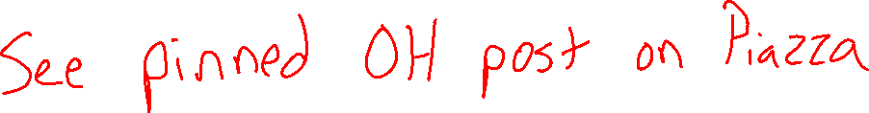
Poll 1
How many appointment slots does Pat have available this Friday?

Slide 4
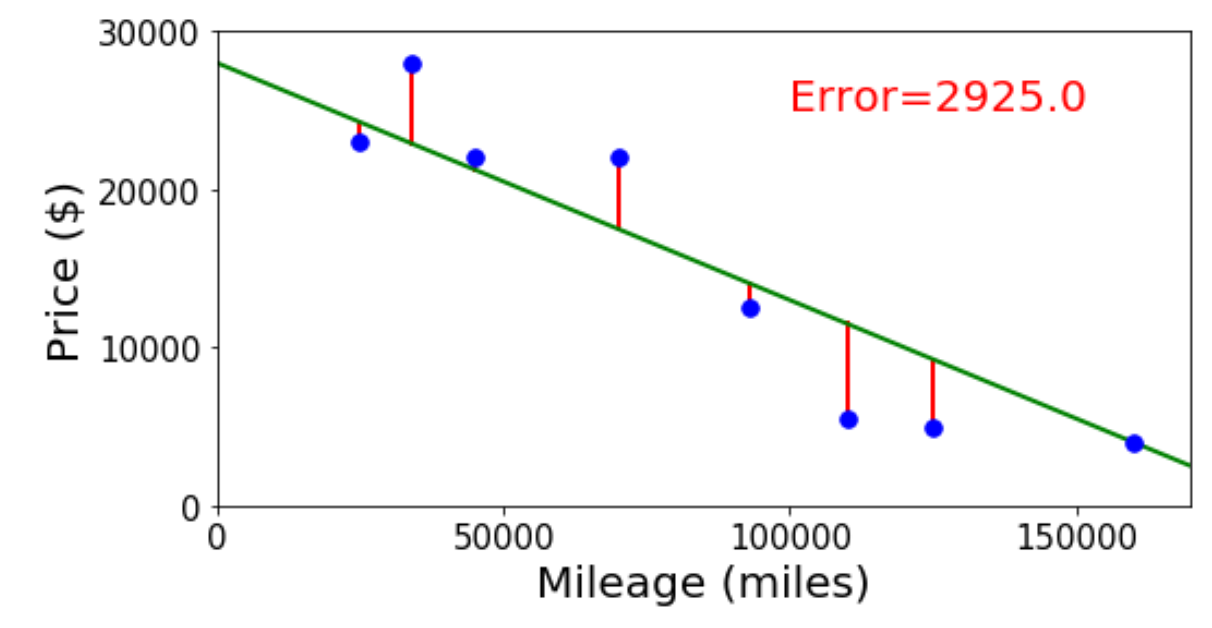

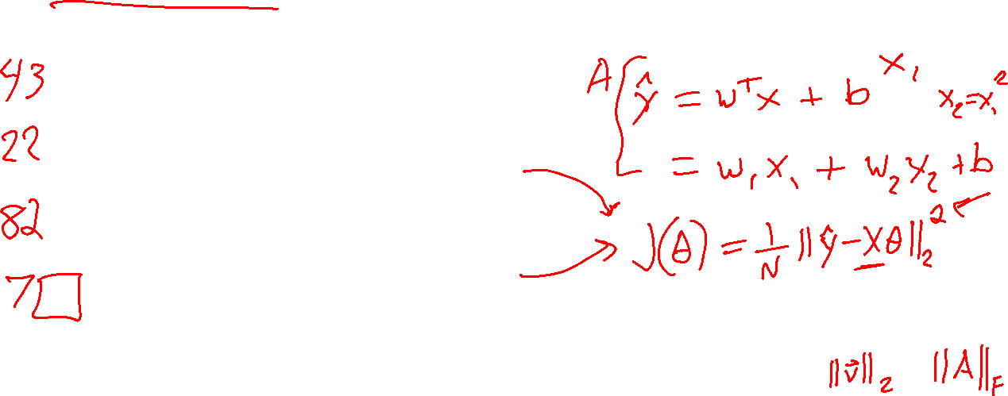
Poll 2
Linear regression. What is linear about it?
Select all that apply.
Always fits a linear (or affine) shape to the data
Linear objective function with respect to the input
Linear objective function with respect to the parameters
None of the above

Slide 5
Pre-reading
Polynomial Features

Slide 6
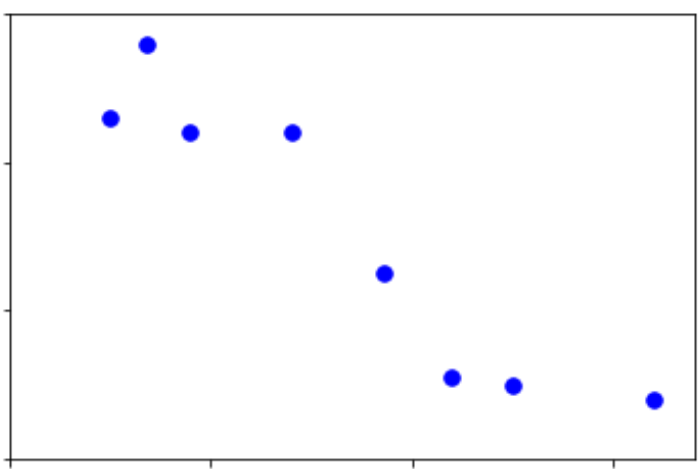
Linear Data
Regression on simple linear dataset
Output y
Input x

Slide 7
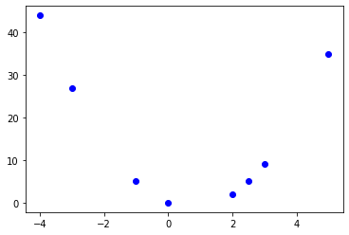
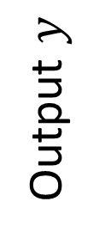
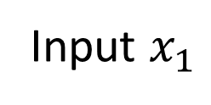
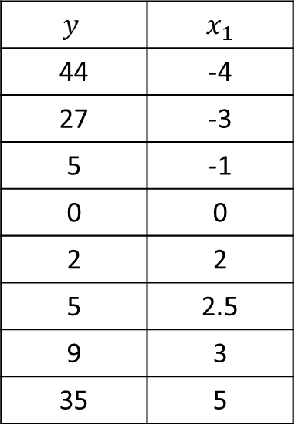
Non-linear Data
Linear regression on polynomial data?
$$y$$ | $x_{1}$
44 | -4
27 | -3
5 | -1
0 | 0
2 | 2
5 | 2.5
9 | 3
35 | 5
Output $y$
Input $x_{1}$

Slide 8
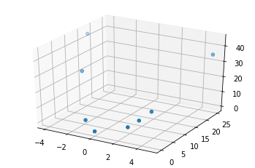

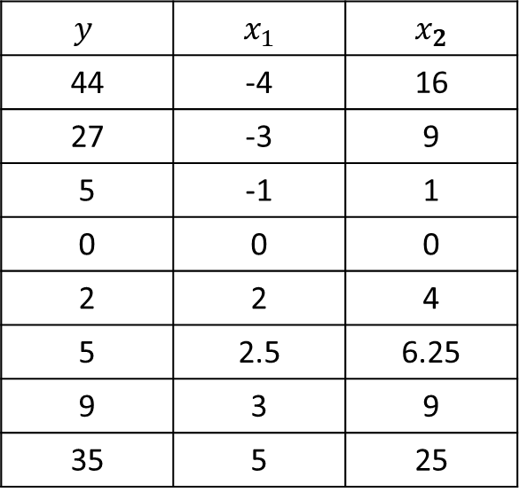
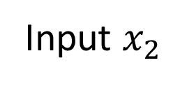
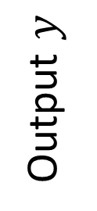
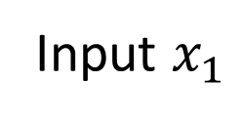
Non-linear Data
Regression on simple linear dataset
$$y$$ | $x_{1}$ | $x_{2}$
44 | -4 | 16
27 | -3 | 9
5 | -1 | 1
0 | 0 | 0
2 | 2 | 4
5 | 2.5 | 6.25
9 | 3 | 9
35 | 5 | 25
Output $y$
Input $x_{2}$
Input $x_{1}$

Slide 9
Non-linear Data
Polynomial feature map for linear regression
Output y
Input x

Slide 10
Example: Linear Regression
Goal: Learn y = w^{T} f(x) + b
where f(.) is a polynomial basis function
y | x
2.0 | 1.2
1.3 | 1.7
0.1 | 2.7
1.1 | 1.9
y
Slide credit: CMU MLD Matt Gormley
true “unknown” target function is linear with negative slope and gaussian noise
x

Slide 11
Example: Linear Regression
Goal: Learn y = w^{T} f(x) + b
where f(.) is a polynomial basis function
y | x
2.0 | 1.2
1.3 | 1.7
0.1 | 2.7
1.1 | 1.9
y
Slide credit: CMU MLD Matt Gormley
true “unknown” target function is linear with negative slope and gaussian noise
x

Slide 12
Example: Linear Regression
Goal: Learn y = w^{T} f(x) + b
where f(.) is a polynomial basis function
y | x | x²
2.0 | 1.2 | (1.2)²
1.3 | 1.7 | (1.7)²
0.1 | 2.7 | (2.7)²
1.1 | 1.9 | (1.9)²
y
Slide credit: CMU MLD Matt Gormley
true “unknown” target function is linear with negative slope and gaussian noise
x

Slide 13
Example: Linear Regression
Goal: Learn y = w^{T} f(x) + b
where f(.) is a polynomial basis function
y | x | x² | x³
2.0 | 1.2 | (1.2)² | (1.2)³
1.3 | 1.7 | (1.7)² | (1.7)³
0.1 | 2.7 | (2.7)² | (2.7)³
1.1 | 1.9 | (1.9)² | (1.9)³
y
Slide credit: CMU MLD Matt Gormley
true “unknown” target function is linear with negative slope and gaussian noise
x

Slide 14
Example: Linear Regression
Goal: Learn y = w^{T} f(x) + b
where f(.) is a polynomial basis function
y | x | x² | … | x⁵
2.0 | 1.2 | (1.2)² | … | (1.2)⁵
1.3 | 1.7 | (1.7)² | … | (1.7)⁵
0.1 | 2.7 | (2.7)² | … | (2.7)⁵
1.1 | 1.9 | (1.9)² | … | (1.9)⁵
y
Slide credit: CMU MLD Matt Gormley
true “unknown” target function is linear with negative slope and gaussian noise
x

Slide 15
Example: Linear Regression
Goal: Learn y = w^{T} f(x) + b
where f(.) is a polynomial basis function
y | x | x² | … | x⁸
2.0 | 1.2 | (1.2)² | … | (1.2)⁸
1.3 | 1.7 | (1.7)² | … | (1.7)⁸
0.1 | 2.7 | (2.7)² | … | (2.7)⁸
1.1 | 1.9 | (1.9)² | … | (1.9)⁸
y
Slide credit: CMU MLD Matt Gormley
true “unknown” target function is linear with negative slope and gaussian noise
x

Slide 16
Example: Linear Regression
Goal: Learn y = w^{T} f(x) + b
where f(.) is a polynomial basis function
y | x | x² | … | x⁹
2.0 | 1.2 | (1.2)² | … | (1.2)⁹
1.3 | 1.7 | (1.7)² | … | (1.7)⁹
0.1 | 2.7 | (2.7)² | … | (2.7)⁹
1.1 | 1.9 | (1.9)² | … | (1.9)⁹
y
Slide credit: CMU MLD Matt Gormley
true “unknown” target function is linear with negative slope and gaussian noise
x

Slide 17
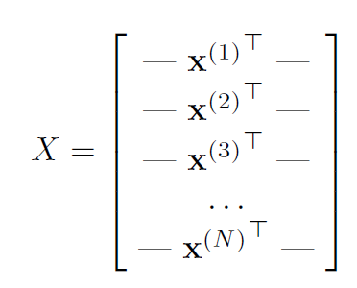
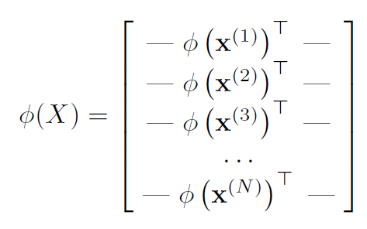
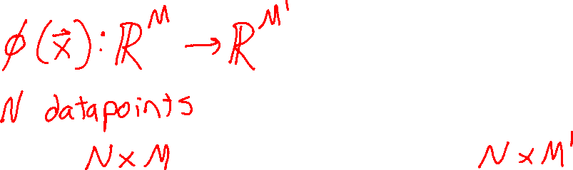
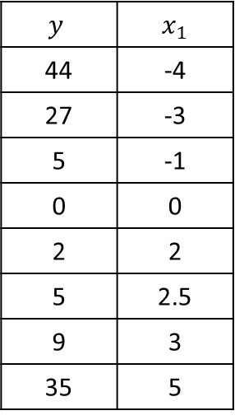
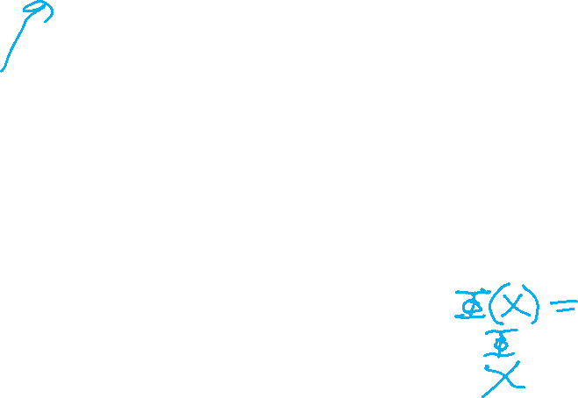
Polynomial Features
$$y$$ | $x_{1}$
44 | -4
27 | -3
5 | -1
0 | 0
2 | 2
5 | 2.5
9 | 3
35 | 5
Design Matrix

Slide 18
Polynomial Features

Slide 19
Non-linear Data
Linear regression on polynomial data?
$$y$$ | $x_{1}$
44 | -4
27 | -3
5 | -1
0 | 0
2 | 2
5 | 2.5
9 | 3
35 | 5
Output $y$
Input $x_{1}$

Slide 20
Non-linear Data
Regression on simple linear dataset
$$y$$ | $x_{1}$ | $x_{2}$
44 | -4 | 16
27 | -3 | 9
5 | -1 | 1
0 | 0 | 0
2 | 2 | 4
5 | 2.5 | 6.25
9 | 3 | 9
35 | 5 | 25
Output $y$
Input $x_{2}$
Input $x_{1}$

Slide 21
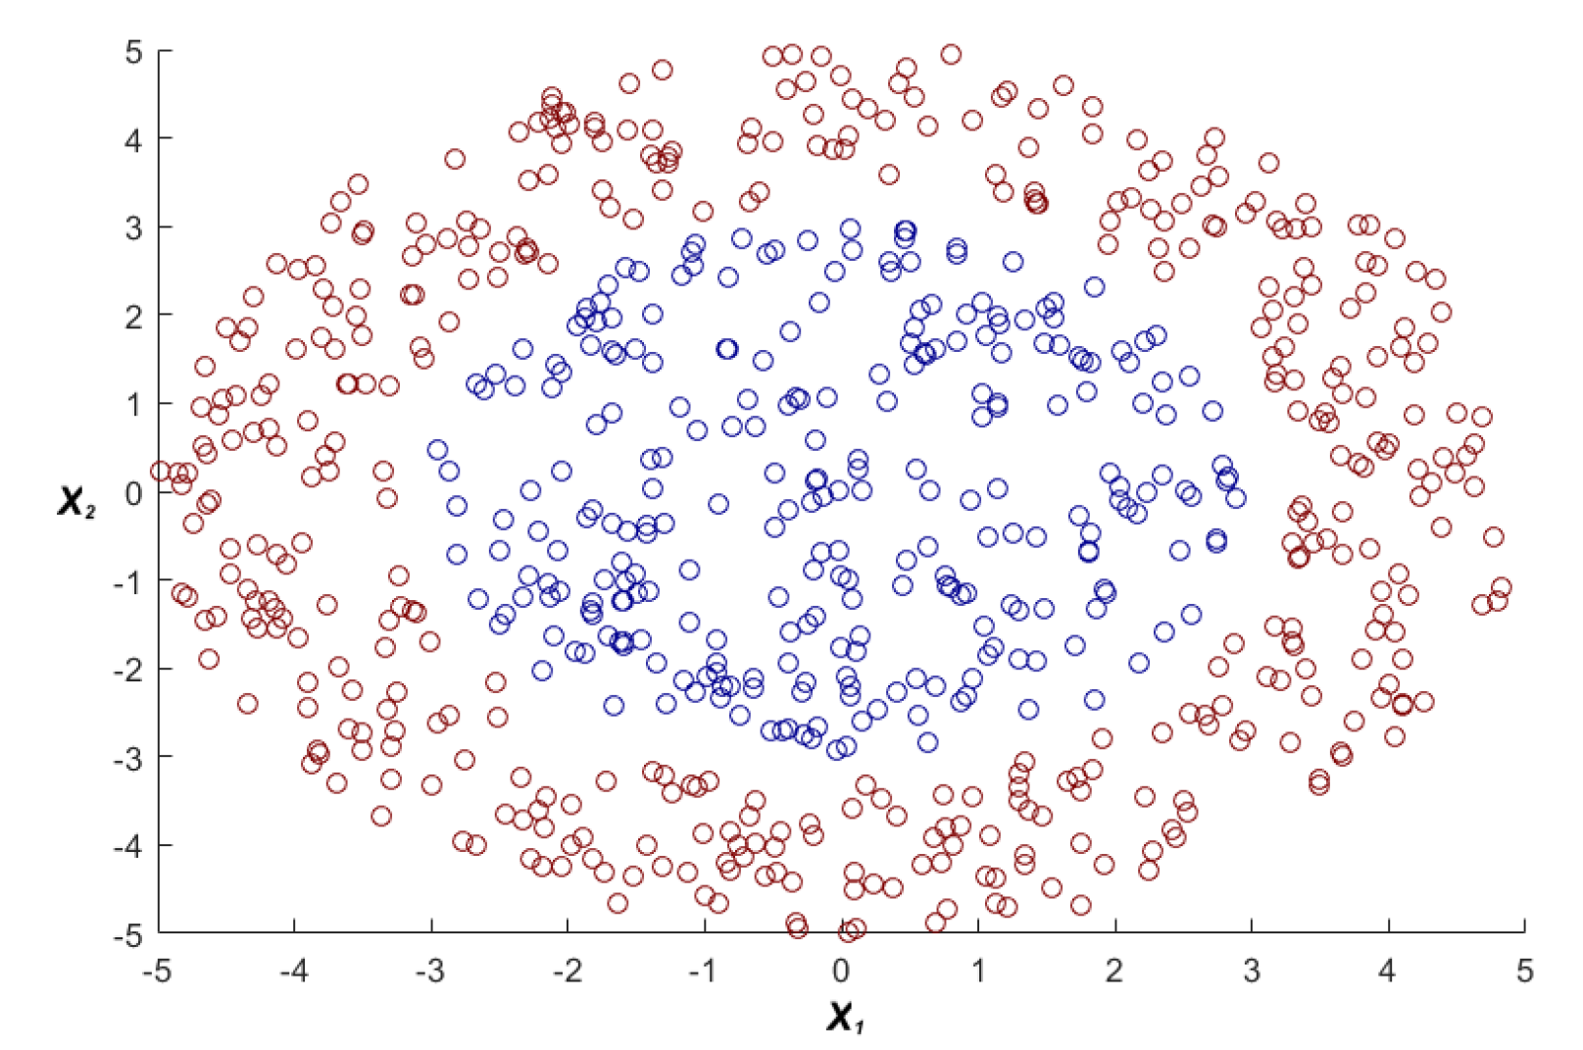
Non-linear Data
Polynomial feature map for linear classification
https://www.youtube.com/watch?v=3liCbRZPrZA

Slide 22
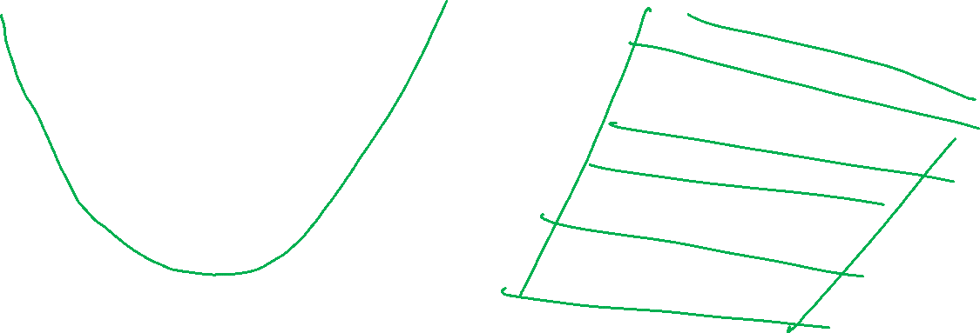
Feature Maps
Two ways to think about it

Slide 23
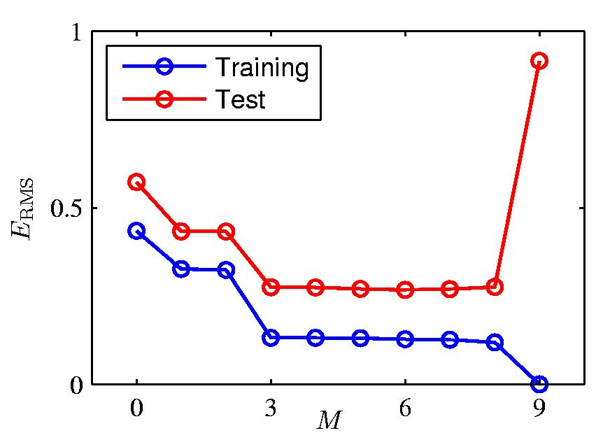

Overfitting: Symptoms
Slide credit: CMU MLD William Cohen

Slide 24
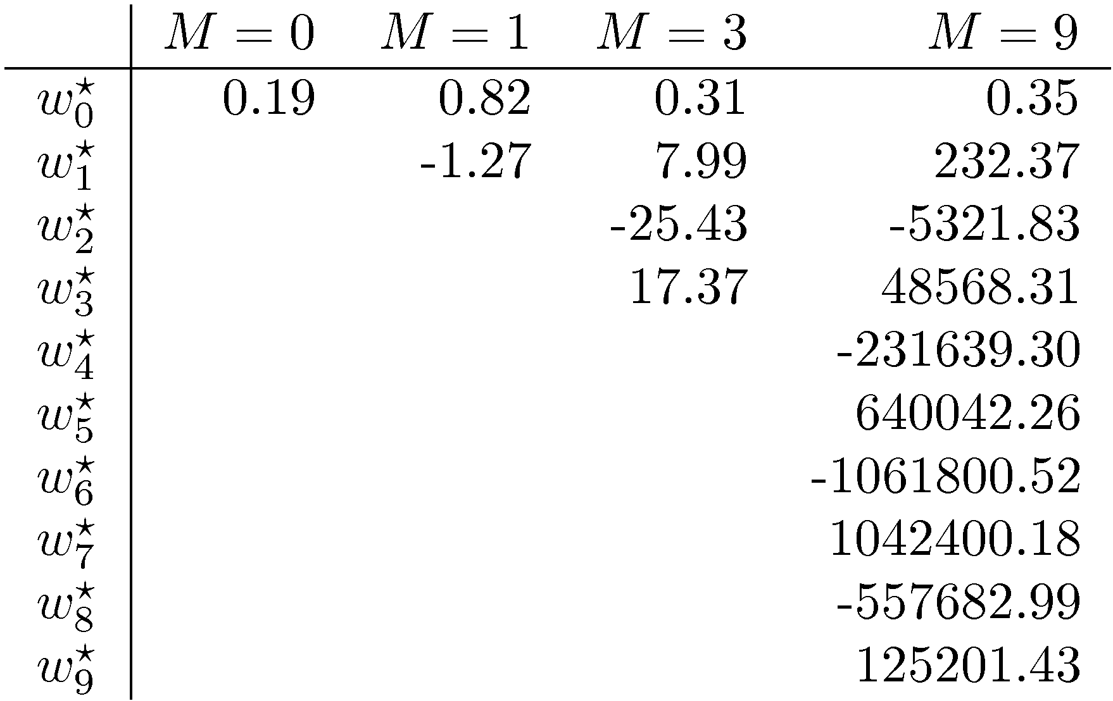
Overfitting: Symptoms
Slide credit: CMU MLD William Cohen

Slide 25
Overfitting: Fix?
N = 10 points we overfit!
Goal: Learn y = w^{T} f(x) + b
where f(.) is a polynomial basis function
i | y | x | … | x⁹
1 | 2.0 | 1.2 | … | (1.2)⁹
2 | 1.3 | 1.7 | … | (1.7)⁹
… | … | … | … | …
10 | 1.1 | 1.9 | … | (1.9)⁹
y
Slide credit: CMU MLD Matt Gormley
x

Slide 26
Overfitting: More training data!
N = 10 points we overfit!
N = 100 points, the overfitting (mostly) disappears
Takeaway:
More data helps prevent overfitting
Goal: Learn y = w^{T} f(x) + b
where f(.) is a polynomial basis function
i | y | x | … | x⁹
1 | 2.0 | 1.2 | … | (1.2)⁹
2 | 1.3 | 1.7 | … | (1.7)⁹
3 | 0.1 | 2.7 | … | (2.7)⁹
4 | 1.1 | 1.9 | … | (1.9)⁹
… | … | … | … | …
… | … | … | … | …
… | … | … | … | …
98 | … | … | … | …
99 | … | … | … | …
100 | 0.9 | 1.5 | … | (1.5)⁹
y
Slide credit: CMU MLD Matt Gormley
true “unknown” target function is linear with negative slope and gaussian noise
x

Slide 27
Polynomial Features
$$y$$ | $x_{1}$
44 | -4
27 | -3
5 | -1
0 | 0
2 | 2
5 | 2.5
9 | 3
35 | 5
Design Matrix

Slide 28
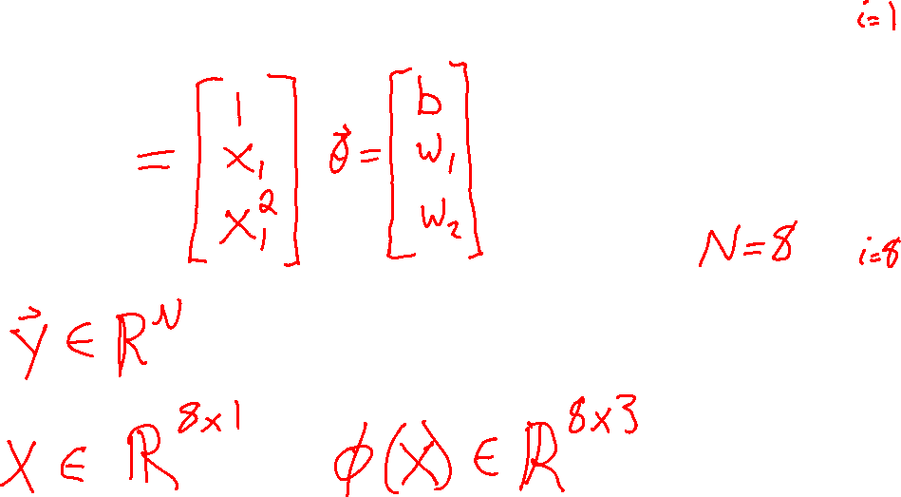

Polynomial Features
$$y$$ | $x_{1}$
44 | -4
27 | -3
5 | -1
0 | 0
2 | 2
5 | 2.5
9 | 3
35 | 5
Solving linear regression

Slide 29
Feature Engineering vs Feature Learning
Feature engineering
Humans decide what the features may be useful
Humans implement feature extraction algorithms
Feature learning
Humans choose data and performance measure
Humans decide on structure/algorithm to learn features
Features are just intermediate values between input and output
Structure defines number of feature values
Allow machine to map data to feature values as needed

Slide 30
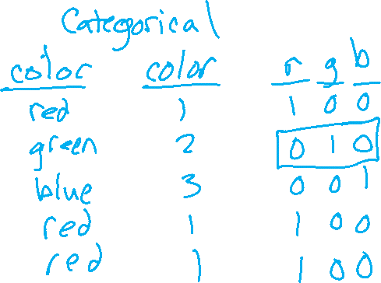
One-hot encoding
Need to convert text for categories into numerical values for input and output
Categorical variables
Enumeration
One-hot vector (or one-hot columns)
One-hot vector
Vector of length M with exactly one 1 and M-1 zeros
Series of M binary values, exactly one of which is 1

Slide 31
More to come later in the semester
✅Polynomial feature engineering
✅Categorical features and one-hot encoding
Images
Raw data, feature engineering
Feature learning
Audio
Raw data, feature engineering
Feature learning
Text
Raw data, feature engineering
Feature learning

