Slide 1

10-315
Introduction to ML
Optimization and Linear Regression
Instructor: Pat Virtue

Slide 2
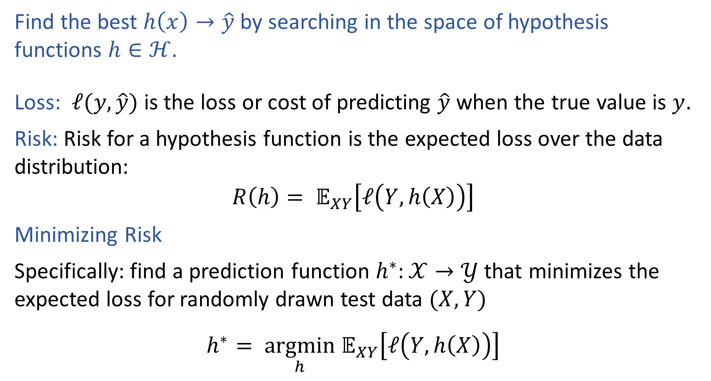
Pre-reading: Optimization Formulation
Find the best $h\left(x\right)→\hat{y}$ by searching in the space of hypothesis functions $h∈ℋ$.
Loss: $ℓ(y, \hat{y})$ is the loss or cost of predicting $\hat{y}$ when the true value is $y$.
Risk: Risk for a hypothesis function is the expected loss over the data distribution:
$$R\left(h\right)= 𝔼_{XY}\left[ℓ\left(Y, h\left(X\right)\right)\right]$$
Minimizing Risk
Specifically: find a prediction function $h^{∗}:𝒳→𝒴$ that minimizes the expected loss for randomly drawn test data $(X, Y)$
$$h^{∗}= \underset{h}{argmin} 𝔼_{XY}\left[ℓ\left(Y, h\left(X\right)\right)\right]$$

Slide 3

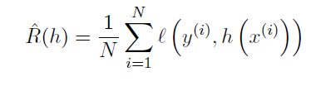


Pre-reading: Empirical Risk Minimization
Risk
Empirical Risk
Empirical Risk Minimization

Slide 4

Pre-reading: Loss Functions
$$h^{∗}= \underset{h}{argmin} 𝔼_{XY}\left[L\left(Y, h\left(X\right)\right)\right]$$
Loss function:
$L:𝒴×𝒴→ℝ$
Classification:
Two-class, 0,1 loss
Two-class, arbitrary loss
False positives and false negatives:

Slide 5
Poll (unused)
For a healthcare classification problem where:
Y=0 represents a negative test for cancer (healthy)
Y=1 represents a positive test for cancer (sick)
Which two-class loss value should be highest?
True negative
False negative
False positive
True positive

Slide 6
Poll (unused)
Does our decision tree algorithm (recursively finding the best attribute to split on a each node) find a hypothesis that minimizes empirical risk for zero-one loss?
Yes, always
Yes, but only when splitting with error rate
Yes, but only when splitting with mutual information
No

Slide 7
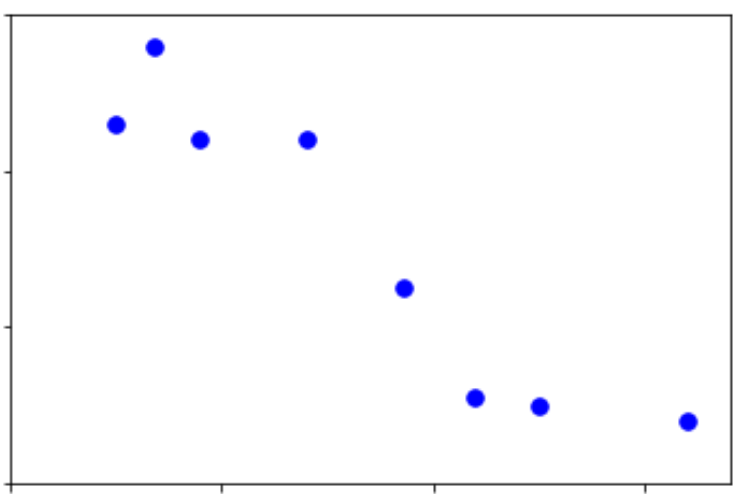
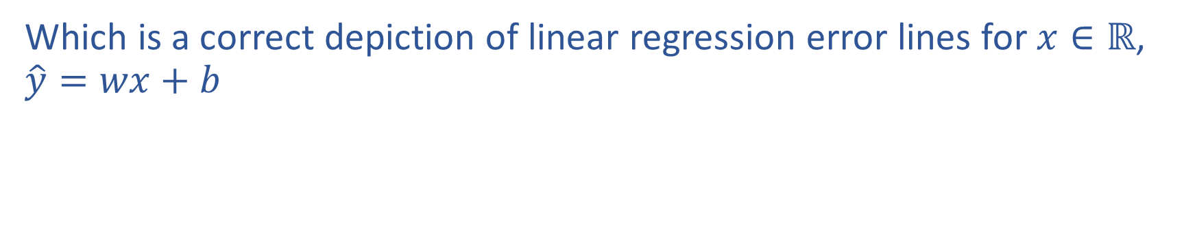
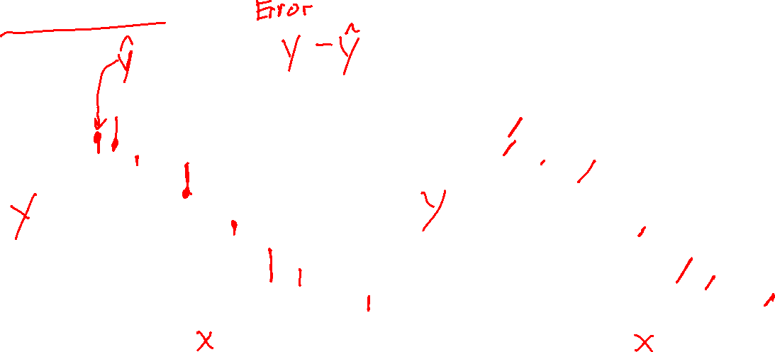
Poll 1
Which is a correct depiction of linear regression error lines for $x∈ℝ$, $\hat{y}=wx+b$
A
B

Slide 8

Poll 1
Which is a correct depiction of linear regression error lines for $x∈ℝ$, $\hat{y}=wx+b$
A
B

Slide 9
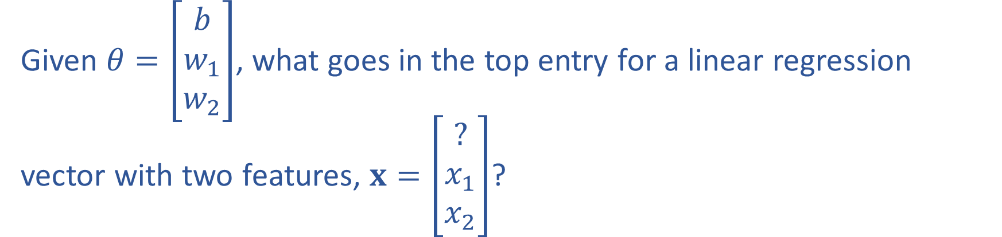
Poll 2
Given $θ=\left[\begin{matrix}b \\ w_{1} \\ w_{2}\end{matrix}\right]$, what goes in the top entry for a linear regression vector with two features, $x=\left[\begin{matrix}? \\ x_{1} \\ x_{2}\end{matrix}\right]$?

Slide 10
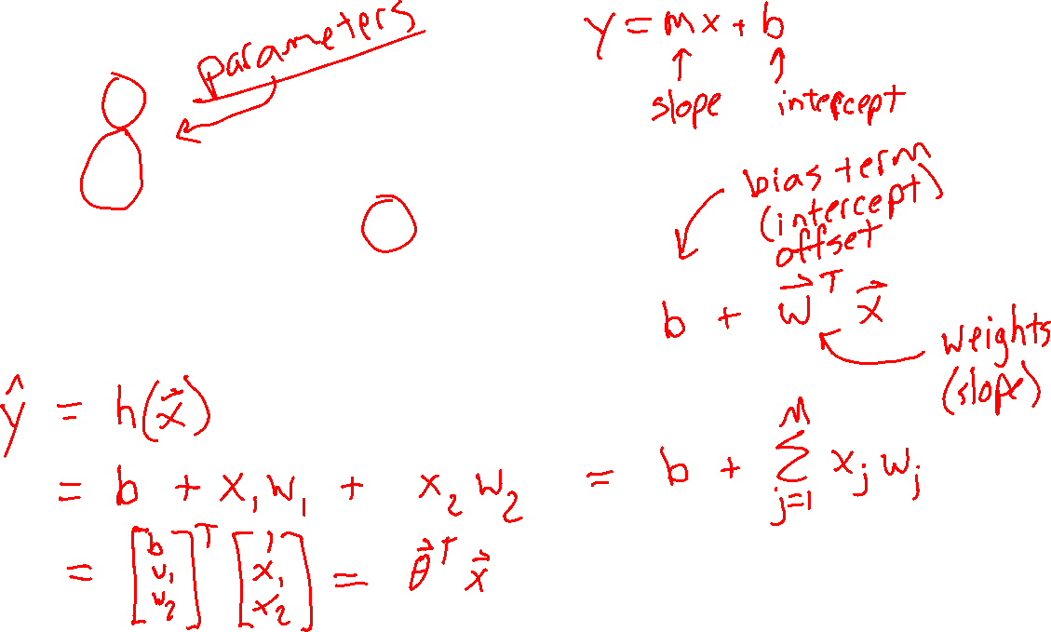
Poll 2
Given $θ=\left[\begin{matrix}b \\ w_{1} \\ w_{2}\end{matrix}\right]$, what goes in the top entry for a linear regression vector with two features, $x=\left[\begin{matrix}? \\ x_{1} \\ x_{2}\end{matrix}\right]$?

Slide 11
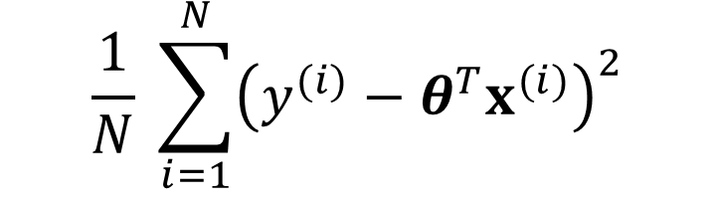
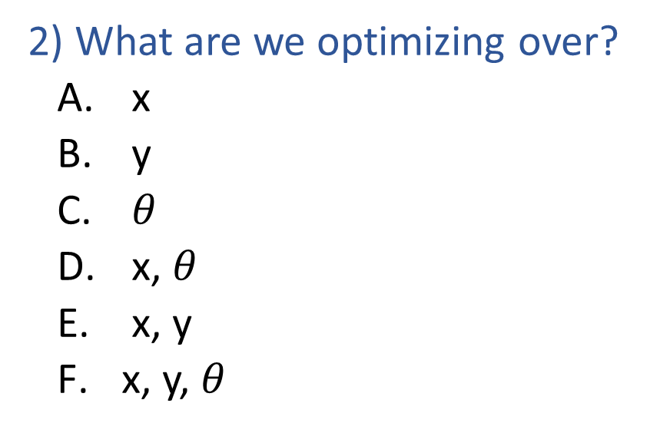
Poll 3: Two questions (unused)
Fill in the blanks: Linear regession optimization
$$\frac{1}{N} \sum_{i=1}^{N}{{\left(y^{(i)}−θ^{T}x^{(i)}\right)}^{2}}$$
_1) min/max/argmin/argmax?_
__2) ?__
1) What type of optimization?
  min
  max
  argmin
  argmax
2) What are we optimizing over?
  x
  y
  $θ$
  x, $θ$
  x, y
  x, y, $θ$

Slide 12
Poll 3: Two questions (unused)
Fill in the blanks: Linear regession optimization
$$\frac{1}{N} \sum_{i=1}^{N}{{\left(y^{(i)}−θ^{T}x^{(i)}\right)}^{2}}$$
_1) min/max/argmin/argmax?_
__2) ?__
1) What type of optimization?
  min
  max
  argmin
  argmax
2) What are we optimizing over?
  x
  y
  $θ$
  x, $θ$
  x, y
  x, y, $θ$

Slide 13
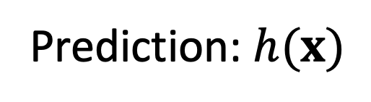




Machine Learning
Using (training) data to learn a model that we’ll later use for prediction
Training Data
Input and Measured Output
Model
Structure and Parameters, $θ$
Training
$$𝒟_{train}={\left\{\left(x^{\left(i\right)},y^{\left(i\right)}\right)\right\}}_{i=1}^{N}$$
Prediction: $h(x)$
Input
Predicted
Output
Model
$$x^{(new)}$$
$${\hat{y}}^{(new)}$$

Slide 14
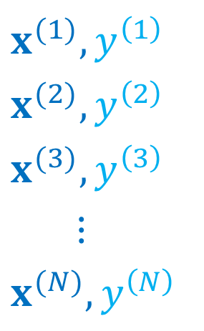

Machine Learning
Using (training) data to learn a model that we’ll later use for prediction
Training Data
$$x^{(1)},y^{\left(1\right)}$$
$$x^{(2)},y^{\left(2\right)}$$
$$x^{(3)},y^{\left(3\right)}$$
$$⋮$$
$$x^{(N)},y^{\left(N\right)}$$
Model
Structure and Parameters, $θ$
Training
Prediction: $h(x)$
Input
Predicted
Output
Model
$$x^{(new)}$$
$${\hat{y}}^{(new)}$$

Slide 15
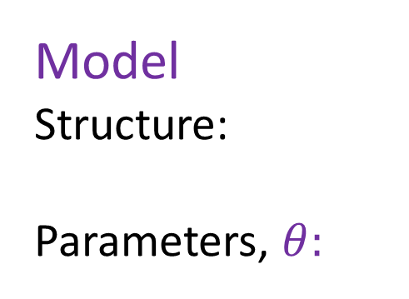
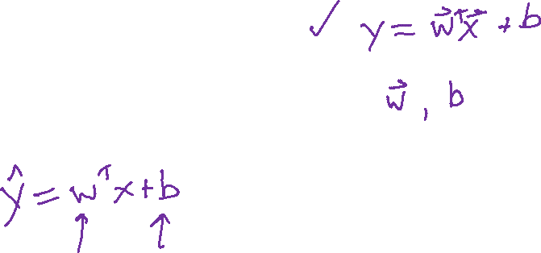
Machine Learning
Using (training) data to learn a model that we’ll later use for prediction
Training Data
$$x^{(1)},y^{\left(1\right)}$$
$$x^{(2)},y^{\left(2\right)}$$
$$x^{(3)},y^{\left(3\right)}$$
$$⋮$$
$$x^{(N)},y^{\left(N\right)}$$
Model
Structure:
Parameters, $θ:$
Training
Prediction: $h(x)$
Input
Predicted
Output
$$x^{(new)}$$
$${\hat{y}}^{(new)}$$

Slide 16
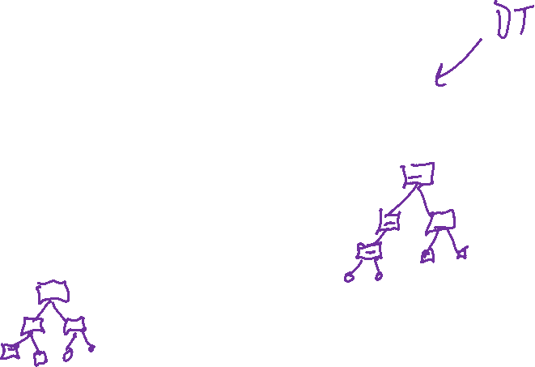
Machine Learning
Using (training) data to learn a model that we’ll later use for prediction
Training Data
$$x^{(1)},y^{\left(1\right)}$$
$$x^{(2)},y^{\left(2\right)}$$
$$x^{(3)},y^{\left(3\right)}$$
$$⋮$$
$$x^{(N)},y^{\left(N\right)}$$
Model
Structure and Parameters, $θ$
Training
Prediction: $h(x)$
Input
Predicted
Output
$$x^{(new)}$$
$${\hat{y}}^{(new)}$$

Slide 17


Machine Learning
Using (training) data to learn a model that we’ll later use for prediction
Training Data
$$x^{(1)},y^{\left(1\right)}$$
$$x^{(2)},y^{\left(2\right)}$$
$$x^{(3)},y^{\left(3\right)}$$
$$⋮$$
$$x^{(N)},y^{\left(N\right)}$$
Model
Structure and Parameters, $θ$
Training
Prediction: $h(x)$
Input
Predicted
Output
$$x^{(new)}$$
$${\hat{y}}^{(new)}$$

Slide 18
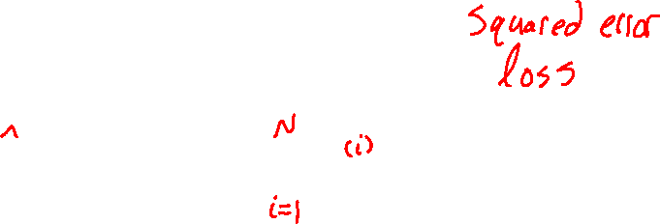

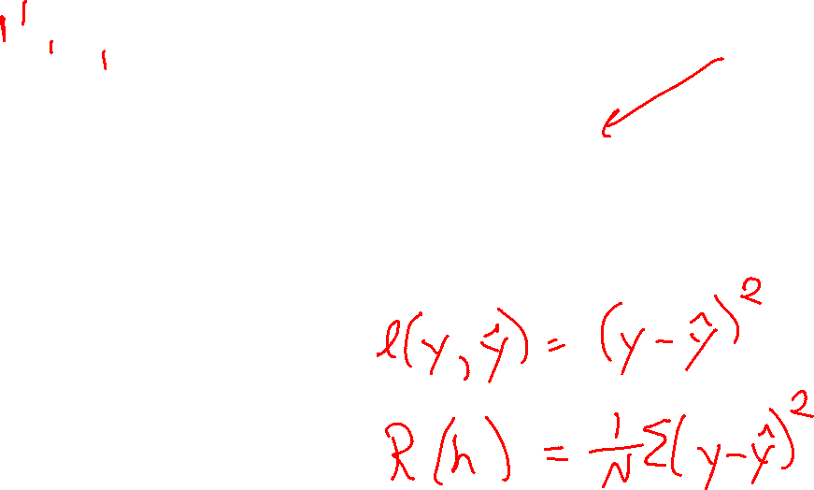

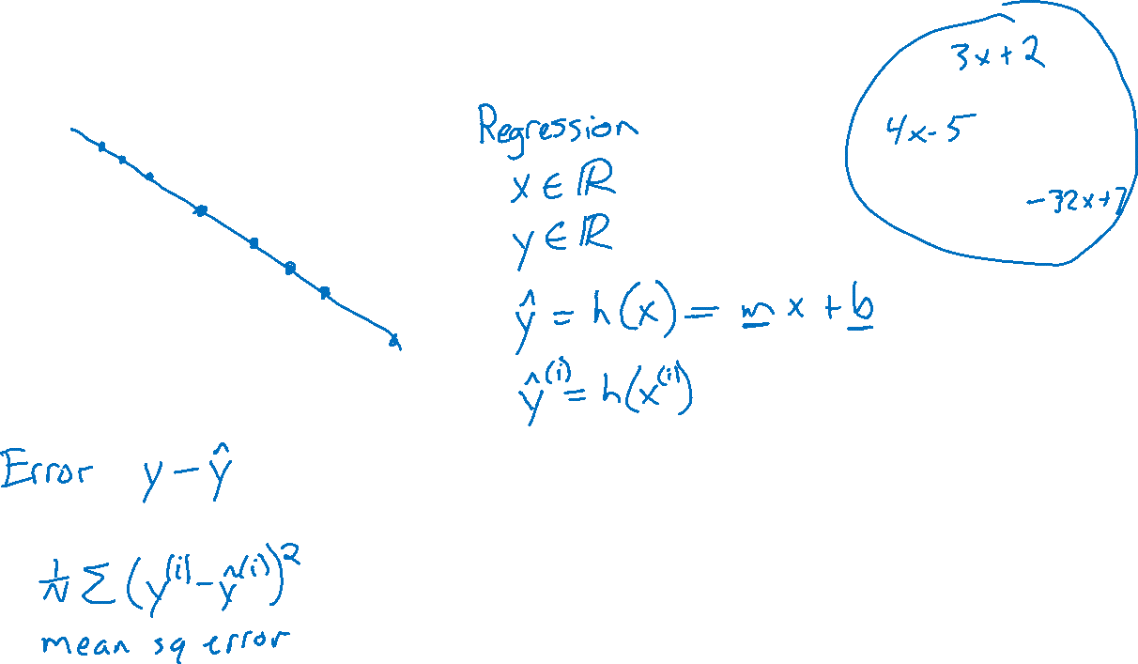
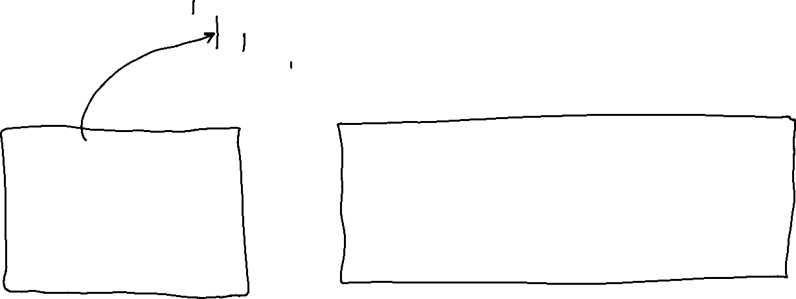
Linear Regression
Output y
Input x

Slide 19
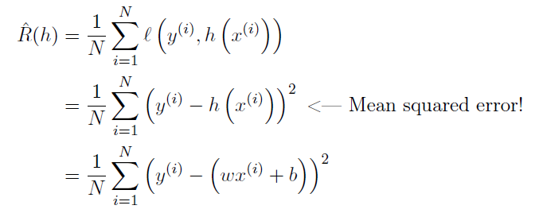
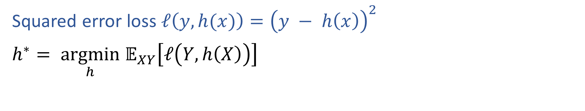
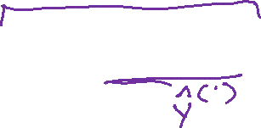

Risk in Regression
Squared error loss $ℓ\left(y, h(x)\right)={\left(y − h\left(x\right)\right)}^{2}$
$h^{∗}= \underset{h}{argmin} 𝔼_{XY}\left[ℓ\left(Y, h\left(X\right)\right)\right]$

Slide 20
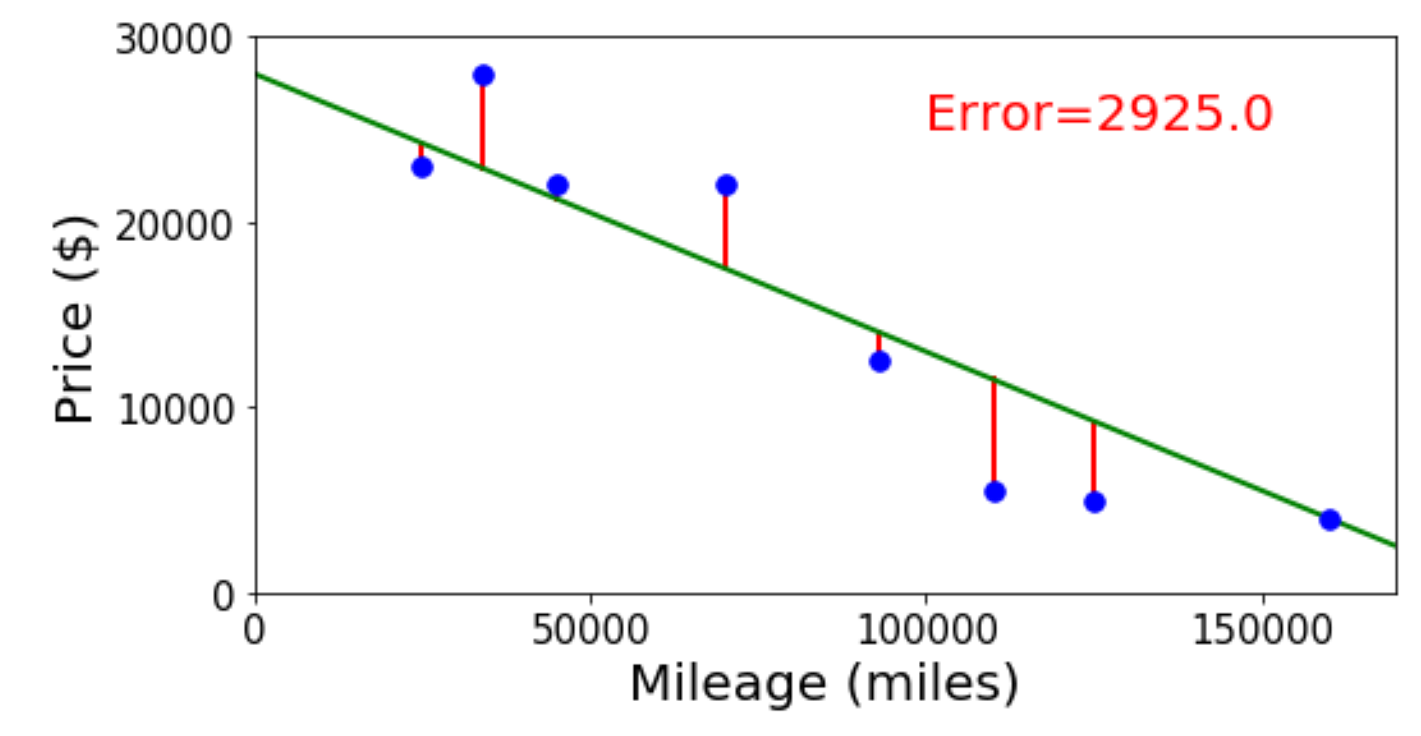
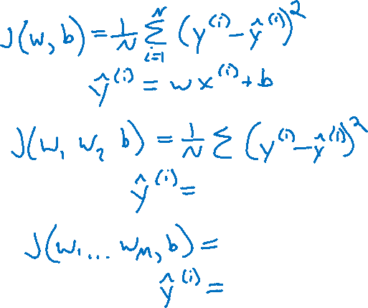
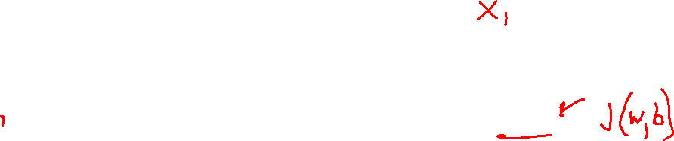

Linear Regression Optimzation
Finding the parameter values that minimize the mean squared error objective function

Slide 21
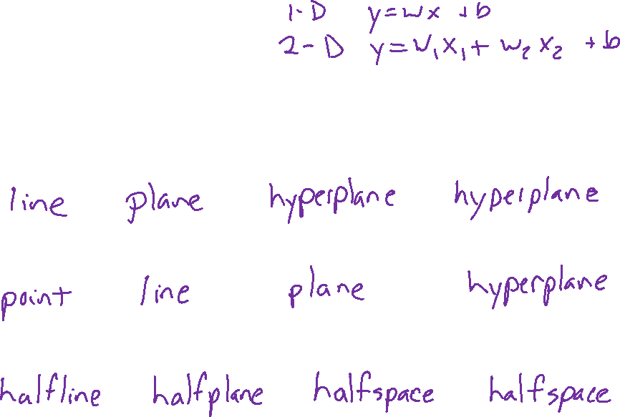




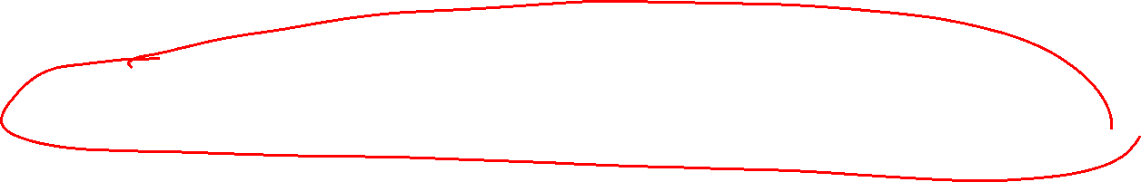

Linear in Higher Dimensions
What are these linear shapes called for 1-D, 2-D, 3-D, M-D input?
$$x∈ℝ$$
$$x∈ℝ^{2}$$
$$x∈ℝ^{3}$$
$$x∈ℝ^{M}$$
$y=w^{T}x+b$
$w^{T}x+b=0$
$w^{T}x+b≥0$

Slide 22
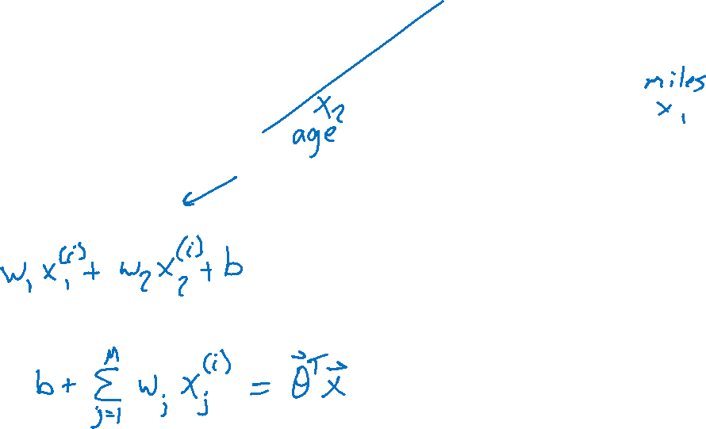

Linear Regression Optimzation
Finding the parameter values that minimize the mean squared error objective function

Slide 23
Contructing the Design Matrix

Slide 24
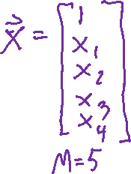


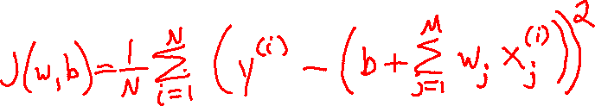
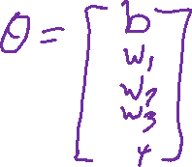
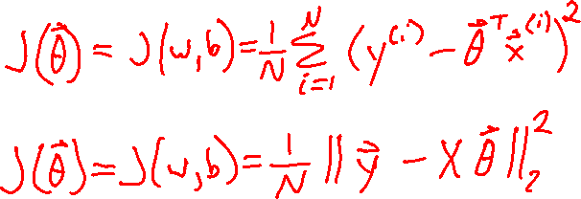

Linear Algebra Formulation
Constructing the design matrix

Slide 25
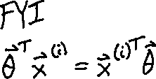
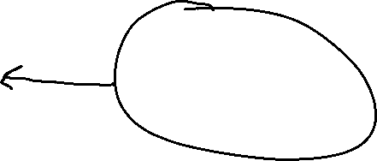
Linear Algebra Formulation
Constructing the design matrix

Slide 26


Linear Algebra Formulation
Constructing the design matrix
Species | Sepal Length | Sepal Width | Petal Length | Petal Width
0 | 4.3 | 3.0 | 1.1 | 0.1
0 | 4.9 | 3.6 | 1.4 | 0.1
0 | 5.3 | 3.7 | 1.5 | 0.2
1 | 4.9 | 2.4 | 3.3 | 1.0
1 | 5.7 | 2.8 | 4.1 | 1.3
1 | 6.3 | 3.3 | 4.7 | 1.6
2 | 5.9 | 3.0 | 5.1 | 1.8

Slide 27

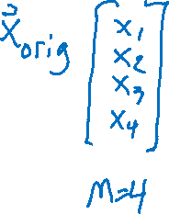
Linear Algebra Formulation
Constructing the design matrix
Species
0
0
0
1
1
1
2
Sepal Length | Sepal Width | Petal Length | Petal Width
4.3 | 3.0 | 1.1 | 0.1
4.9 | 3.6 | 1.4 | 0.1
5.3 | 3.7 | 1.5 | 0.2
4.9 | 2.4 | 3.3 | 1.0
5.7 | 2.8 | 4.1 | 1.3
6.3 | 3.3 | 4.7 | 1.6
5.9 | 3.0 | 5.1 | 1.8

Slide 28



Linear Algebra Formulation
Constructing the design matrix
Species
0
0
0
1
1
1
2
(account for bias) | Sepal Length | Sepal Width | Petal Length | Petal Width
1 | 4.3 | 3.0 | 1.1 | 0.1
1 | 4.9 | 3.6 | 1.4 | 0.1
1 | 5.3 | 3.7 | 1.5 | 0.2
1 | 4.9 | 2.4 | 3.3 | 1.0
1 | 5.7 | 2.8 | 4.1 | 1.3
1 | 6.3 | 3.3 | 4.7 | 1.6
1 | 5.9 | 3.0 | 5.1 | 1.8

Slide 29

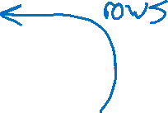
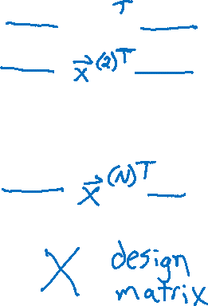

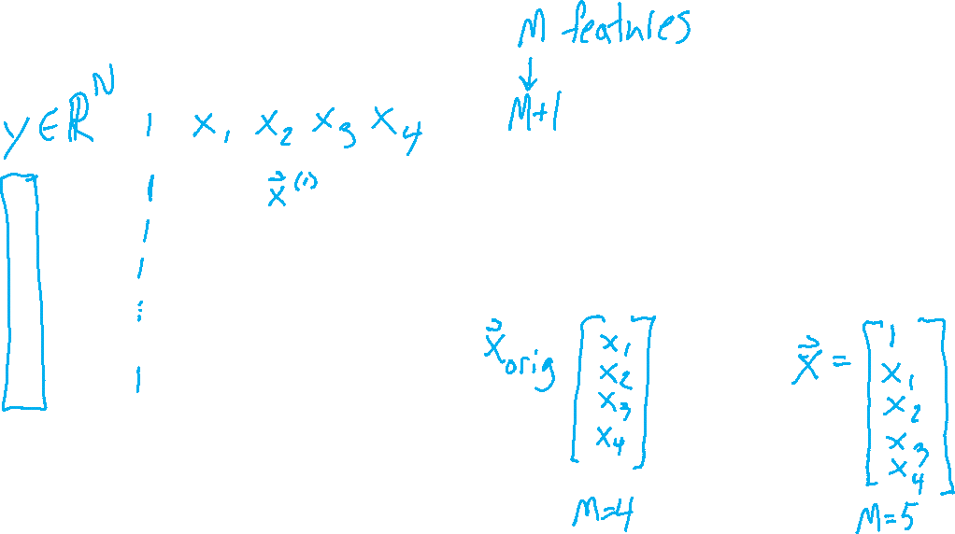
Linear Algebra Formulation
Constructing the design matrix

Slide 30
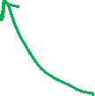
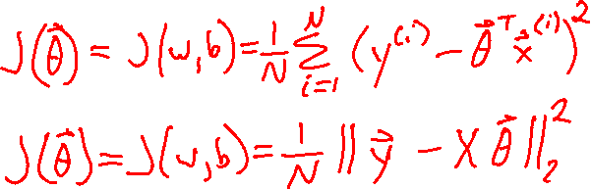
Linear Algebra Formulation
Constructing the design matrix

Slide 31
Linear Regression
System of Equations

Slide 32
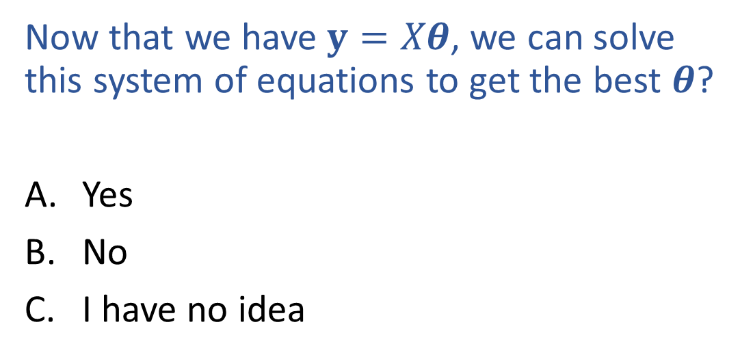
Poll 4 (unused)
Now that we have $y=Xθ$, we can solve this system of equations to get the best $θ$?
Yes
No
I have no idea

Slide 33

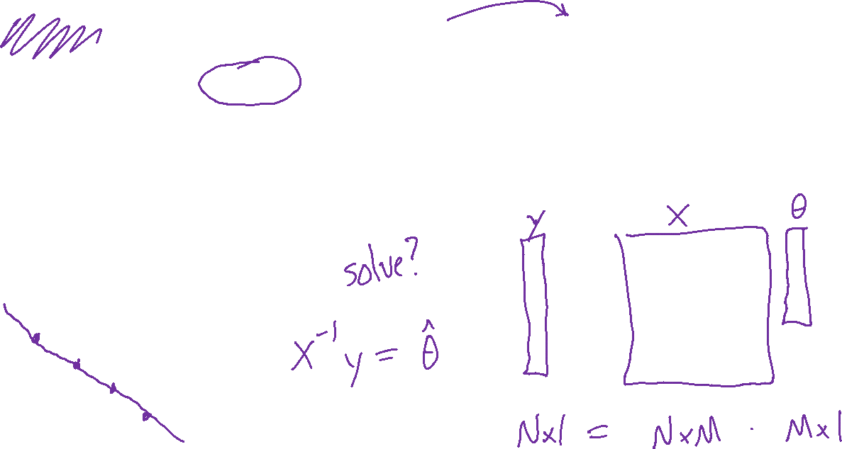
Poll 4 (unused)
Now that we have $y=Xθ$, we can solve this system of equations to get the best $θ$?
Yes
No
I have no idea

Slide 34
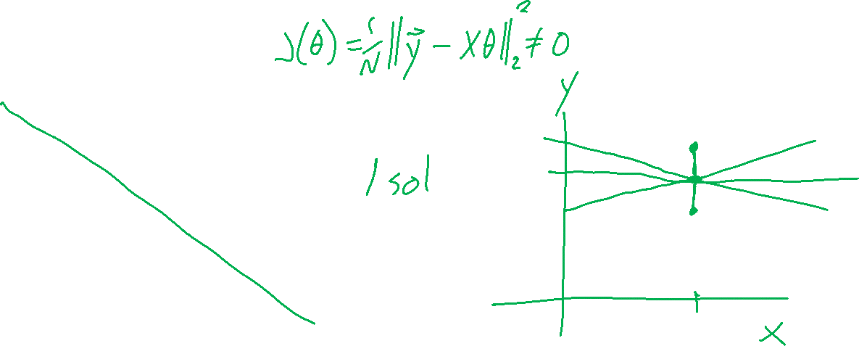
Linear Regression
Number of solutions?
Output y
Input x

Slide 35
Linear Regression
Linear algebra formulation

Slide 36
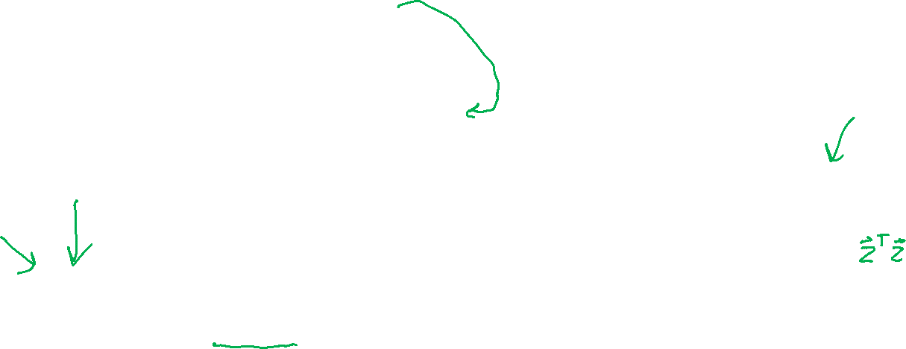
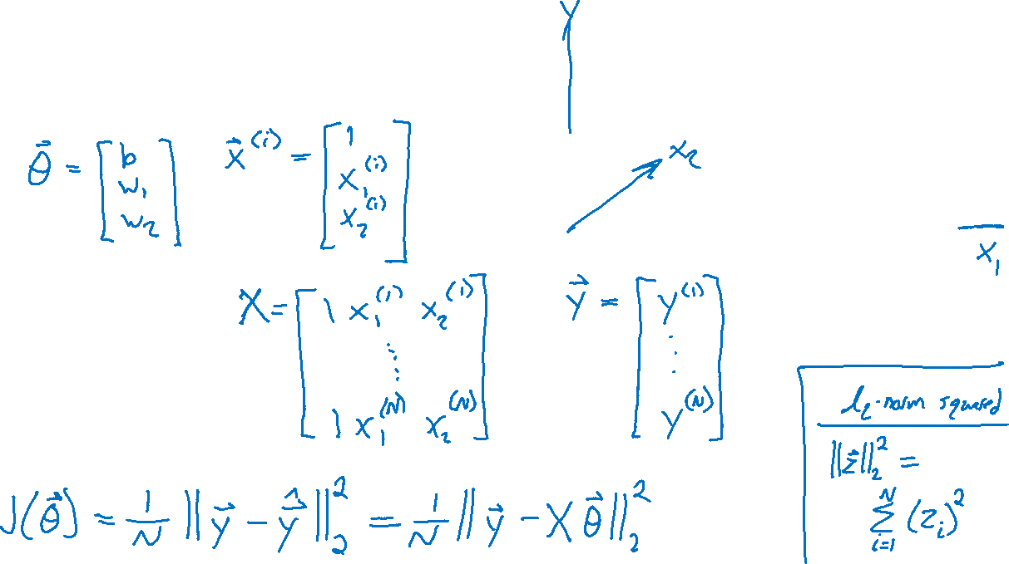
Linear Regression
Linear algebra formulation

Slide 37
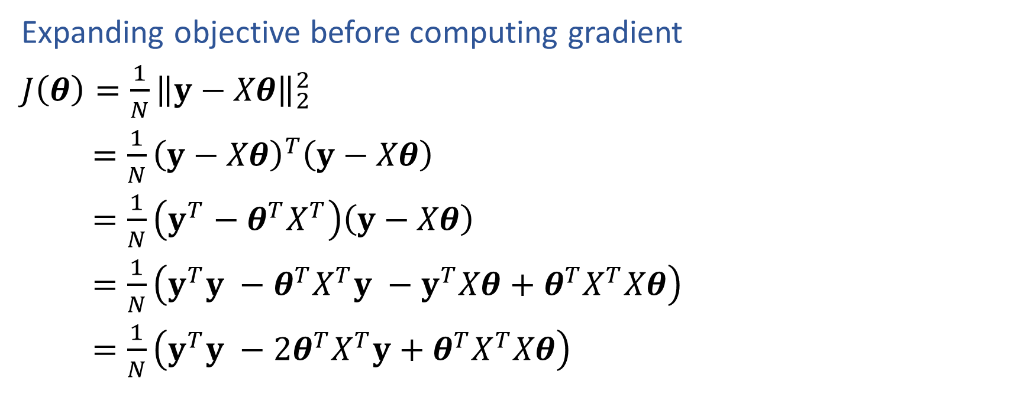
Linear Regression
Expanding objective before computing gradient
$J\left(θ\right)=\frac{1}{N}{\left\|y−Xθ\right\|}_{2}^{2}$
$=\frac{1}{N}{\left(y−Xθ\right)}^{T}\left(y−Xθ\right)$
$=\frac{1}{N}\left(y^{T}−θ^{T}X^{T}\right)\left(y−Xθ\right)$
$=\frac{1}{N}\left(y^{T}y −θ^{T}X^{T}y −y^{T}Xθ+θ^{T}X^{T}Xθ\right)$
$=\frac{1}{N}\left(y^{T}y −2θ^{T}X^{T}y+θ^{T}X^{T}Xθ\right)$

Slide 38
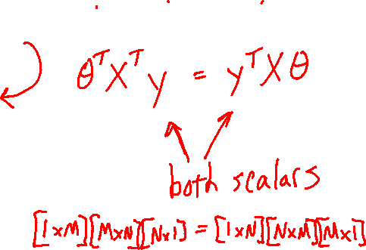
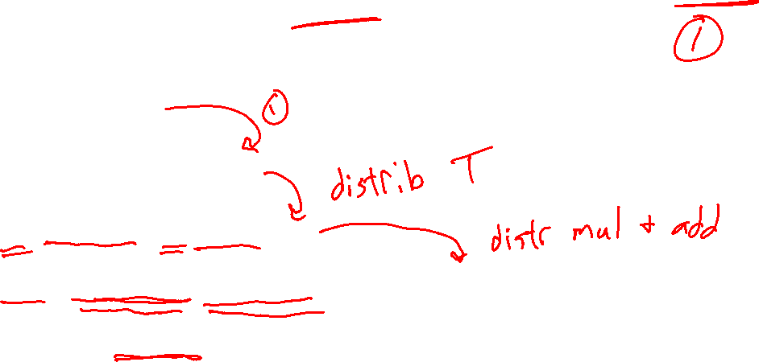

Linear Regression
Expanding objective before computing gradient
$J\left(θ\right)=\frac{1}{N}{\left\|y−Xθ\right\|}_{2}^{2}$
$=\frac{1}{N}{\left(y−Xθ\right)}^{T}\left(y−Xθ\right)$
$=\frac{1}{N}\left(y^{T}−θ^{T}X^{T}\right)\left(y−Xθ\right)$
$=\frac{1}{N}\left(y^{T}y −θ^{T}X^{T}y −y^{T}Xθ+θ^{T}X^{T}Xθ\right)$
$=\frac{1}{N}\left(y^{T}y −2θ^{T}X^{T}y+θ^{T}X^{T}Xθ\right)$

Slide 39
Linear Regression
Optimizing the objective
From course website under lectures:
Demo: interactive_regression.ipynb
Exercise: interactive_blind_regression.ipynb

Slide 40

Linear Regression
$$J\left(w, b\right)=\frac{1}{2}\left[{\left(y^{(1)}−\left(wx^{(1)}+b\right)\right)}^{2}+{\left(y^{(2)}−\left(wx^{(2)}+b\right)\right)}^{2}\right]$$
Optimizing the objective
b
y
w
x

Slide 41


Linear Regression
$$J\left(w, b\right)=\frac{1}{2}\left[{\left(y^{(1)}−\left(wx^{(1)}+b\right)\right)}^{2}+{\left(y^{(2)}−\left(wx^{(2)}+b\right)\right)}^{2}\right]$$
Optimizing the objective
b
y
w
x

Slide 42

Poll 5
$$J\left(w, b\right)=\frac{1}{2}\left[{\left(y^{(1)}−\left(wx^{(1)}+b\right)\right)}^{2}+{\left(y^{(2)}−\left(wx^{(2)}+b\right)\right)}^{2}\right]$$
For fixed data and fixed slope, w, what shape do we get by plotting MSE objective vs intercept, b?
Line
Plane
Half-plane
Convex parabola (U-shape)
Concave parabola (up-side-down U)
None of the above
y
x

Slide 43


Poll 5
$$J\left(w, b\right)=\frac{1}{2}\left[{\left(y^{(1)}−\left(wx^{(1)}+b\right)\right)}^{2}+{\left(y^{(2)}−\left(wx^{(2)}+b\right)\right)}^{2}\right]$$
For fixed data and fixed slope, w, what shape do we get by plotting MSE objective vs intercept, b?
Line
Plane
Half-plane
Convex parabola (U-shape)
Concave parabola (up-side-down U)
None of the above
y
x

Slide 44



Linear Regression
$$J\left(w, b\right)=\frac{1}{2}\left[{\left(y^{(1)}−\left(wx^{(1)}+b\right)\right)}^{2}+{\left(y^{(2)}−\left(wx^{(2)}+b\right)\right)}^{2}\right]$$
Optimizing the objective
y
x

Slide 45



Linear Regression
$$J\left(w, b\right)=\frac{1}{2}\left[{\left(y^{(1)}−\left(wx^{(1)}+b\right)\right)}^{2}+{\left(y^{(2)}−\left(wx^{(2)}+b\right)\right)}^{2}\right]$$
Optimizing the objective
y
x

Slide 46


Linear Regression
$$J\left(w, b\right)=\frac{1}{2}\left[{\left(y^{(1)}−\left(wx^{(1)}+b\right)\right)}^{2}+{\left(y^{(2)}−\left(wx^{(2)}+b\right)\right)}^{2}\right]$$
What shape is the obejective function when we consider both parameters w and b?
$$J\left(w, b\right)$$
y
b
w
x

Slide 47

Linear Regression
$$J\left(w, b\right)=\frac{1}{2}\left[{\left(y^{(1)}−\left(wx^{(1)}+b\right)\right)}^{2}+{\left(y^{(2)}−\left(wx^{(2)}+b\right)\right)}^{2}\right]$$
What shape is the obejective function when we consider both parameters w and b?
$$J\left(w, b\right)$$
y
b
w
x

Slide 48



Linear Regression
Optimizing the objective

Slide 49




Optimization
Gradients

Slide 50




Optimization
Linear regression has a closed-form solution!!
Solve for $∇J\left(w,b\right)=0$ for $w,^{∗} b^{∗}$

Slide 51

Optimization
$$J\left(w, b\right)=\frac{1}{2}\left[{\left(y^{(1)}−\left(wx^{(1)}+b\right)\right)}^{2}+{\left(y^{(2)}−\left(wx^{(2)}+b\right)\right)}^{2}\right]$$
Gradients

Slide 52
Calculus Time-out
Partial derivatives

Slide 53



Calculus with Linear Algebra
Vector in, scalar out
Gradient
$y=f(x)$ $y∈ℝ, x∈ℝ^{M}$

Slide 54










Calculus with Linear Algebra
Functions with linear algebra
$$y=f\left(\left[\begin{matrix}x_{1} \\ ⋮ \\ x_{M}\end{matrix}\right]\right)$$
$$y=f\left(\left[\begin{matrix}X_{1,1} & ⋯ & X_{1,L} \\ ⋮ & ⋱ & ⋮ \\ X_{M,1} & ⋯ & X_{M,L}\end{matrix}\right]\right)$$
$$y=f\left(x\right)$$
$$\left[\begin{matrix}\begin{aligned}y_{1} \\ \end{aligned} \\ \begin{aligned}⋮ \\ \end{aligned} \\ y_{N}\end{matrix}\right]=f\left(x\right)$$
$$\left[\begin{matrix}\begin{aligned}y_{1} \\ \end{aligned} \\ \begin{aligned}⋮ \\ \end{aligned} \\ y_{N}\end{matrix}\right]=f\left(\left[\begin{matrix}x_{1} \\ ⋮ \\ x_{M}\end{matrix}\right]\right)$$
$$\left[\begin{matrix}\begin{aligned}y_{1} \\ \end{aligned} \\ \begin{aligned}⋮ \\ \end{aligned} \\ y_{N}\end{matrix}\right]=f\left(\left[\begin{matrix}X_{1,1} & ⋯ & X_{1,L} \\ ⋮ & ⋱ & ⋮ \\ X_{M,1} & ⋯ & X_{M,L}\end{matrix}\right]\right)$$
$$\left[\begin{matrix}Y_{1,1} & ⋯ & Y_{1,K} \\ ⋮ & ⋱ & ⋮ \\ Y_{N,K} & ⋯ & Y_{N,K}\end{matrix}\right]=f\left(x\right)$$
$$\left[\begin{matrix}Y_{1,1} & ⋯ & Y_{1,K} \\ ⋮ & ⋱ & ⋮ \\ Y_{N,K} & ⋯ & Y_{N,K}\end{matrix}\right]=f\left(\left[\begin{matrix}x_{1} \\ ⋮ \\ x_{M}\end{matrix}\right]\right)$$
$$\left[\begin{matrix}Y_{1,1} & ⋯ & Y_{1,K} \\ ⋮ & ⋱ & ⋮ \\ Y_{N,K} & ⋯ & Y_{N,K}\end{matrix}\right]=f\left(\left[\begin{matrix}X_{1,1} & ⋯ & X_{1,L} \\ ⋮ & ⋱ & ⋮ \\ X_{M,1} & ⋯ & X_{M,L}\end{matrix}\right]\right)$$

Slide 55


Calculus with Linear Algebra
One way to think of it: bag of partial derivatives
$\left[\begin{matrix}\begin{aligned}y_{1} \\ \end{aligned} \\ \begin{aligned}⋮ \\ \end{aligned} \\ y_{N}\end{matrix}\right]=f\left(\left[\begin{matrix}x_{1} \\ ⋮ \\ x_{M}\end{matrix}\right]\right)$

Slide 56


Calculus with Linear Algebra
One way to think of it: bag of partial derivatives
$\left[\begin{matrix}Y_{1,1} & ⋯ & Y_{1,K} \\ ⋮ & ⋱ & ⋮ \\ Y_{N,K} & ⋯ & Y_{N,K}\end{matrix}\right]=f\left(\left[\begin{matrix}X_{1,1} & ⋯ & X_{1,L} \\ ⋮ & ⋱ & ⋮ \\ X_{M,1} & ⋯ & X_{M,L}\end{matrix}\right]\right)$

Slide 57


Numerator Layout
$$y=f(x)$$ | $$x∈ℝ$$ | $$x∈ℝ^{M}$$ | $$X∈ℝ^{M×L}$$
$y∈ℝ$ | $$\frac{∂y}{∂x}∈ ℝ$$ | $$\frac{∂y}{∂x}∈ ℝ^{1×M}$$ Output by input | $$\frac{∂y}{∂X}∈ ℝ^{L×M}$$ Transpose of input
$y∈ℝ^{N}$ | $$\frac{∂y}{∂x}∈ ℝ^{N×1}$$ Output by input | $$\frac{∂y}{∂x}∈ ℝ^{N×M}$$ Output by input | $$\frac{∂y}{∂X}∈ ℝ^{?}$$ ?
$Y∈ℝ^{N×K}$ | $$\frac{∂Y}{∂x}∈ ℝ^{N×K}$$ Size of output | $$\frac{∂Y}{∂x}∈ ℝ^{?}$$ ? | $$\frac{∂Y}{∂X}∈ ℝ^{?}$$ ?

Slide 58

Denominator Layout
$$y=f(x)$$ | $$x∈ℝ$$ | $$x∈ℝ^{M}$$ | $$X∈ℝ^{M×L}$$
$y∈ℝ$ | $$\frac{∂y}{∂x}∈ ℝ$$ | $$\frac{∂y}{∂x}∈ ℝ^{M×1}$$ Input by output | $$\frac{∂y}{∂X}∈ ℝ^{M×L}$$ Size of input
$y∈ℝ^{N}$ | $$\frac{∂y}{∂x}∈ ℝ^{1×N}$$ Input by output | $$\frac{∂y}{∂x}∈ ℝ^{M×N}$$ Input by output | $$\frac{∂y}{∂X}∈ ℝ^{?}$$ ?
$Y∈ℝ^{N×K}$ | $$\frac{∂Y}{∂x}∈ ℝ^{K×N}$$ Transpose of output | $$\frac{∂Y}{∂x}∈ ℝ^{?}$$ ? | $$\frac{∂Y}{∂X}∈ ℝ^{?}$$ ?

Slide 59


Calculus with Linear Algebra
Jacobian: Vector in, vector out
Numerator-layout
$y=f(x)$ $y∈ℝ^{N}, x∈ℝ^{M}, \frac{∂y}{∂x}∈ℝ^{N×M}$

Slide 60




Calculus with Linear Algebra
$$\left[\begin{matrix}\begin{aligned}y_{1} \\ \end{aligned} \\ \begin{aligned}⋮ \\ \end{aligned} \\ y_{N}\end{matrix}\right]=f\left(\left[\begin{matrix}x_{1} \\ ⋮ \\ x_{M}\end{matrix}\right]\right)$$
Numerator-layout vs denominator-layout
Vector in, vector out
$y=f(x)$ $y∈ℝ^{N}, x∈ℝ^{M}$ (assume $N>M$ for illustrative purposes)
Numerator layout | Denominator layout
Number of outputs $×$ number of inputs | Number of inputs $×$ number of outputs
$$\frac{∂y}{∂x}∈ℝ^{N×M}$$ | $$\frac{∂y}{∂x}∈ℝ^{M×N}$$

Slide 61


Calculus with Linear Algebra
$$y=f\left(\left[\begin{matrix}x_{1} \\ ⋮ \\ x_{M}\end{matrix}\right]\right)$$
Vector in, scalar out
Numerator-layout
$y=f(x)$ $y∈ℝ, x∈ℝ^{M}, \frac{∂y}{∂x}∈ℝ^{1×M}$

Slide 62


Calculus with Linear Algebra
$$y=f\left(\left[\begin{matrix}x_{1} \\ ⋮ \\ x_{M}\end{matrix}\right]\right)$$
Numerator-layout vs denominator-layout
Vector in, scalar out
$y=f(x)$ $y∈ℝ, x∈ℝ^{M}$
Numerator layout | Denominator layout
Number of outputs $×$ number of inputs | Number of inputs $×$ number of outputs
$$\frac{∂y}{∂x}∈ℝ^{1×M}$$ | $$\frac{∂y}{∂x}∈ℝ^{M×1}$$

Slide 63


Calculus with Linear Algebra
$$\left[\begin{matrix}\begin{aligned}y_{1} \\ \end{aligned} \\ \begin{aligned}⋮ \\ \end{aligned} \\ y_{N}\end{matrix}\right]=f\left(x\right)$$
Scalar in, vector out
Numerator-layout
$y=f(x)$ $y∈ℝ^{N}, x∈ℝ, \frac{∂y}{∂x}∈ℝ^{N×1}$

Slide 64

Calculus with Linear Algebra
$$y=f\left(\left[\begin{matrix}x_{1} \\ ⋮ \\ x_{M}\end{matrix}\right]\right)$$
Gradient: Vector in, scalar out
Transpose of numerator-layout
$y=f(x)$ $y∈ℝ, x∈ℝ^{M}, \frac{∂y}{∂x}∈ℝ^{1×M}, ∇_{x}f∈ℝ^{M×1}$

Slide 65


Calculus with Linear Algebra
$$y=f\left(\left[\begin{matrix}X_{1,1} & ⋯ & X_{1,L} \\ ⋮ & ⋱ & ⋮ \\ X_{M,1} & ⋯ & X_{M,L}\end{matrix}\right]\right)$$
Matrix in, scalar out
Numerator layout: Transpose of matrix dimensions
Denominator layout: Keep same dimensions as matrix
$y=f(X)$ $y∈ℝ, X∈ℝ^{N×M}, \frac{∂y}{∂X}∈ℝ^{N×M}$ (denominator layout)

Slide 66


Exercise
Suppose we have a function that takes in a vector and squares each element individually, returning another vector, $y=f\left(x\right)$.
$f\left(\left[\begin{aligned}x_{1} \\ x_{2} \\ x_{3}\end{aligned}\right]\right)→\left[\begin{aligned}x_{1}^{2} \\ x_{2}^{2} \\ x_{3}^{2}\end{aligned}\right]$ Example: $f\left(\left[\begin{aligned}7 \\ 3 \\ 5\end{aligned}\right]\right)→\left[\begin{aligned}49 \\ 9 \\ 25\end{aligned}\right]$
What is $∂y/∂x$? (use numerator layout)

Slide 67


Derivatives of Functions with Respect to Vectors

Slide 68
Numerator Layout
$$y=f(x)$$ | $$x∈ℝ$$ | $$x∈ℝ^{M}$$ | $$X∈ℝ^{M×L}$$
$y∈ℝ$ | $$\frac{∂y}{∂x}∈ ℝ$$ | $$\frac{∂y}{∂x}∈ ℝ^{1×M}$$ Output by input | $$\frac{∂y}{∂X}∈ ℝ^{L×M}$$ Transpose of input
$y∈ℝ^{N}$ | $$\frac{∂y}{∂x}∈ ℝ^{N×1}$$ Output by input | $$\frac{∂y}{∂x}∈ ℝ^{N×M}$$ Output by input | $$\frac{∂y}{∂X}∈ ℝ^{?}$$ ?
$Y∈ℝ^{N×K}$ | $$\frac{∂Y}{∂x}∈ ℝ^{N×K}$$ Size of output | $$\frac{∂Y}{∂x}∈ ℝ^{?}$$ ? | $$\frac{∂Y}{∂X}∈ ℝ^{?}$$ ?

Slide 69
Denominator Layout
$$y=f(x)$$ | $$x∈ℝ$$ | $$x∈ℝ^{M}$$ | $$X∈ℝ^{M×L}$$
$y∈ℝ$ | $$\frac{∂y}{∂x}∈ ℝ$$ | $$\frac{∂y}{∂x}∈ ℝ^{M×1}$$ Input by output | $$\frac{∂y}{∂X}∈ ℝ^{M×L}$$ Size of input
$y∈ℝ^{N}$ | $$\frac{∂y}{∂x}∈ ℝ^{1×N}$$ Input by output | $$\frac{∂y}{∂x}∈ ℝ^{M×N}$$ Input by output | $$\frac{∂y}{∂X}∈ ℝ^{?}$$ ?
$Y∈ℝ^{N×K}$ | $$\frac{∂Y}{∂x}∈ ℝ^{K×N}$$ Transpose of output | $$\frac{∂Y}{∂x}∈ ℝ^{?}$$ ? | $$\frac{∂Y}{∂X}∈ ℝ^{?}$$ ?

Slide 70
Linear Regression
Closed-form Solution

Slide 71



Linear Regression
Methods for optimizing the objective
Closed-form solution
$$J(w,b)$$
$$b$$
$$w$$

Slide 72
Linear Regression
Expanding objective before computing gradient
$J\left(θ\right)=\frac{1}{N}{\left\|y−Xθ\right\|}_{2}^{2}$
$=\frac{1}{N}{\left(y−Xθ\right)}^{T}\left(y−Xθ\right)$
$=\frac{1}{N}\left(y^{T}−θ^{T}X^{T}\right)\left(y−Xθ\right)$
$=\frac{1}{N}\left(y^{T}y −θ^{T}X^{T}y −y^{T}Xθ+θ^{T}X^{T}Xθ\right)$
$=\frac{1}{N}\left(y^{T}y −2θ^{T}X^{T}y+θ^{T}X^{T}Xθ\right)$

Slide 73



Linear Regression
$\frac{∂z^{T}u}{∂z}=u$
-- or --
$\frac{∂z^{T}u}{∂z} =u^{T}$
Gradient of objective with respect to parameters
$J\left(θ\right)=\frac{1}{N}{\left\|y−Xθ\right\|}_{2}^{2}$
$=\frac{1}{N}\left(y^{T}y −2θ^{T}X^{T}y+θ^{T}X^{T}Xθ\right)$
$∇J\left(θ\right)=\frac{1}{N}$
$\frac{∂z^{T}Az}{∂z}=\left(A+A^{T}\right)z$
-- or --
$\frac{∂z^{T}Az}{∂z}=z^{T}\left(A+A^{T}\right)$

Slide 74


Linear Regression
$\frac{∂z^{T}u}{∂z}=u$
-- or --
$\frac{∂z^{T}u}{∂z} =u^{T}$
Gradient of objective with respect to parameters
$J\left(θ\right)=\frac{1}{N}{\left\|y−Xθ\right\|}_{2}^{2}$
$=\frac{1}{N}\left(y^{T}y −2θ^{T}X^{T}y+θ^{T}X^{T}Xθ\right)$
$∇J\left(θ\right)=\frac{1}{N}\left(0 −2X^{T}y+2θ^{T}X^{T}X\right)$
$\frac{∂z^{T}Az}{∂z}=\left(A+A^{T}\right)z$
-- or --
$\frac{∂z^{T}Az}{∂z}=z^{T}\left(A+A^{T}\right)$

Slide 75

Linear Regression
$\frac{∂z^{T}u}{∂z}=u$
-- or --
$\frac{∂z^{T}u}{∂z} =u^{T}$
Gradient of objective with respect to parameters
$J\left(θ\right)=\frac{1}{N}{\left\|y−Xθ\right\|}_{2}^{2}$
$=\frac{1}{N}\left(y^{T}y −2θ^{T}X^{T}y+θ^{T}X^{T}Xθ\right)$
$∇J\left(θ\right)=\frac{1}{N}\left(0 −2X^{T}y+2θ^{T}X^{T}X\right)$
$=\frac{1}{N}\left(0 −2X^{T}y+2X^{T}Xθ\right)$
$\frac{∂z^{T}Az}{∂z}=\left(A+A^{T}\right)z$
-- or --
$\frac{∂z^{T}Az}{∂z}=z^{T}\left(A+A^{T}\right)$

Slide 76

Linear Regression
$\frac{∂z^{T}u}{∂z}=u$
-- or --
$\frac{∂z^{T}u}{∂z} =u^{T}$
Gradient of objective with respect to parameters
$J\left(θ\right)=\frac{1}{N}{\left\|y−Xθ\right\|}_{2}^{2}$
$=\frac{1}{N}\left(y^{T}y −2θ^{T}X^{T}y+θ^{T}X^{T}Xθ\right)$
$∇J\left(θ\right)=\frac{1}{N}\left(0 −2X^{T}y+2θ^{T}X^{T}X\right)$
$=\frac{1}{N}\left(0 −2X^{T}y+2X^{T}Xθ\right)$
$=\frac{2}{N}\left(−X^{T}y+X^{T}Xθ\right)$
$\frac{∂z^{T}Az}{∂z}=\left(A+A^{T}\right)z$
-- or --
$\frac{∂z^{T}Az}{∂z}=z^{T}\left(A+A^{T}\right)$

Slide 77


Linear Regression
Closed-form solution
$∇J\left(θ\right)=\frac{2}{N}\left(−X^{T}y+X^{T}Xθ\right)$

Slide 78


Linear Regression
Number of solutions

Slide 79


A Note on Matrix Rank
Underlying dimensionality of the data

Slide 80
Linear Regression
Gradient Descent

Slide 81




Linear Regression
Demos to optimize the objective
Linear model optimization
regression_interactive.ipynb
Blind version
regression_blind_interactive.ipynb

Slide 82
Poll 6 (unused)
Open blind optimization on course website
Mess with sliders to find best model
What's the best RMSE that you got?
What's are the corresponding best parameters?

Slide 83


Linear Regression
Methods for optimizing the objective
Closed-form solution
Grid search
Random search
Gradient descent
Stochastic gradient descent (SGD)
Minibatch SGD
$$J(w,b)$$
$$b$$
$$w$$

Slide 84
Optimization
Gradients

Slide 85


Optimization
Gradient descent
Hyperparameter:
learning rate $α$ (or sometimes $γ$, $η$)
While not converged
Compute gradient: $∇J={\left[\frac{∂J}{∂w},\frac{∂J}{∂b}\right]}^{⊤}$
Update parameters
$w←w −α\frac{∂J}{∂w}$
$b ←b −α\frac{∂J}{∂b}$

Slide 86
Linear Regression
Methods for optimizing the objective
Closed-form solution
Grid search
Random search
Gradient descent
Stochastic gradient descent (SGD)
Minibatch SGD
$$J(w,b)$$
$$b$$
$$w$$

Slide 87

Linear Regression Gradient Descent
What happens in gradient descent when we have N=1,000,000 training points?
Output y
Input x

Slide 88



Gradient Descent
Batch -> Mini-batch -> Stochastic
Basically, just a difference in how many training points are each time we compute a gradient (and then take a step with that gradient
(Batch) GD
Effective batch size = $N$
Mini-batch SGD
Batch size = $B$, e.g., $B=10$
SGD
Effective batch size = $1$

Slide 89

(Batch) Gradient Descent
—
M
Slide credit: CMU MLD Matt Gormley

Slide 90

Stochastic Gradient Descent (SGD)
We need a per-example objective:
Slide credit: CMU MLD Matt Gormley

Slide 91





(Batch) Gradient Descent
Optimizing the objective using all points (just two in this example)
y
$$J\left(w, b\right)=\frac{1}{2}\left[{\left(y^{(1)}−\left(wx^{(1)}+b\right)\right)}^{2}+{\left(y^{(2)}−\left(wx^{(2)}+b\right)\right)}^{2}\right]$$
$$J\left(w, b\right)=\frac{1}{2}\left[{ J}^{(1)}\left(w, b\right) + J^{(2)}\left(w, b\right) \right]$$
$$J^{(1)}\left(w, b\right)={\left(y^{(1)}−\left(wx^{(1)}+b\right)\right)}^{2}$$
$$J^{(2)}\left(w, b\right)={\left(y^{(2)}−\left(wx^{(2)}+b\right)\right)}^{2}$$
x

Slide 92



(Batch) Gradient Descent
$$J\left(w, b\right)=\frac{1}{2}\left[{ J}^{(1)}\left(w, b\right) + J^{(2)}\left(w, b\right) \right]$$

Slide 93





Stochastic Gradient Descent
Optimizing the objective for one point at a time
y
$$J\left(w, b\right)=\frac{1}{2}\left[{ J}^{(1)}\left(w, b\right) + J^{(2)}\left(w, b\right) \right]$$
$$J^{(1)}\left(w, b\right)={\left(y^{(1)}−\left(wx^{(1)}+b\right)\right)}^{2}$$
$$J^{(2)}\left(w, b\right)={\left(y^{(2)}−\left(wx^{(2)}+b\right)\right)}^{2}$$
x

Slide 94




Stochastic Gradient Descent
$$J^{(1)}\left(w, b\right)={\left(y^{(1)}−\left(wx^{(1)}+b\right)\right)}^{2}$$

Slide 95




Stochastic Gradient Descent
Optimizing the objective for one point at a time
y
$$J\left(w, b\right)=\frac{1}{2}\left[{ J}^{(1)}\left(w, b\right) + J^{(2)}\left(w, b\right) \right]$$
$$J^{(1)}\left(w, b\right)={\left(y^{(1)}−\left(wx^{(1)}+b\right)\right)}^{2}$$
$$J^{(2)}\left(w, b\right)={\left(y^{(2)}−\left(wx^{(2)}+b\right)\right)}^{2}$$
x

Slide 96





Stochastic Gradient Descent
$$J^{(2)}\left(w, b\right)={\left(y^{(2)}−\left(wx^{(2)}+b\right)\right)}^{2}$$

Slide 97


Stochastic Gradient Descent
Optimizing the objective for one point at a time
y
$$J\left(w, b\right)=\frac{1}{2}\left[{ J}^{(1)}\left(w, b\right) + J^{(2)}\left(w, b\right) \right]$$
$$J^{(1)}\left(w, b\right)={\left(y^{(1)}−\left(wx^{(1)}+b\right)\right)}^{2}$$
$$J^{(2)}\left(w, b\right)={\left(y^{(2)}−\left(wx^{(2)}+b\right)\right)}^{2}$$
x

Slide 98

Stochastic Gradient Descent
$$J^{(1)}\left(w, b\right)={\left(y^{(1)}−\left(wx^{(1)}+b\right)\right)}^{2}$$

Slide 99
Stochastic Gradient Descent (SGD)
We need a per-example objective:
Slide credit: CMU MLD Matt Gormley

Slide 100
Stochastic Gradient Descent (SGD)
In practice, it is common to implement SGD using sampling without replacement (i.e. shuffle({1,2,…N}), even though most of the theory is for sampling with replacement (i.e. Uniform({1,2,…N}).
We need a per-example objective:
Slide credit: CMU MLD Matt Gormley

Slide 101
Gradient Descent
Batch -> Mini-batch -> Stochastic
Basically, just a difference in how many training points are each time we compute a gradient (and then take a step with that gradient
(Batch) GD
Effective batch size = $N$
Mini-batch SGD
Batch size = $B$, e.g., $B=10$
SGD
Effective batch size = $1$

Slide 102

Convergence Curves
Def: an epoch is a single pass through the training data
For GD, only one update per epoch
For SGD, N updates per epoch
N = (# train examples)
Gradient Descent
SGD
Closed-form (normal eq.s)
SGD reduces MSE much more rapidly than GD
For GD / SGD, training MSE is initially large due to uninformed initialization
Slide credit: CMU MLD Matt Gormley and Eric P. Xing

