Slide 1

10-315 Introduction to ML Optimization and Linear Regression
Instructor: Pat Virtue

Slide 2
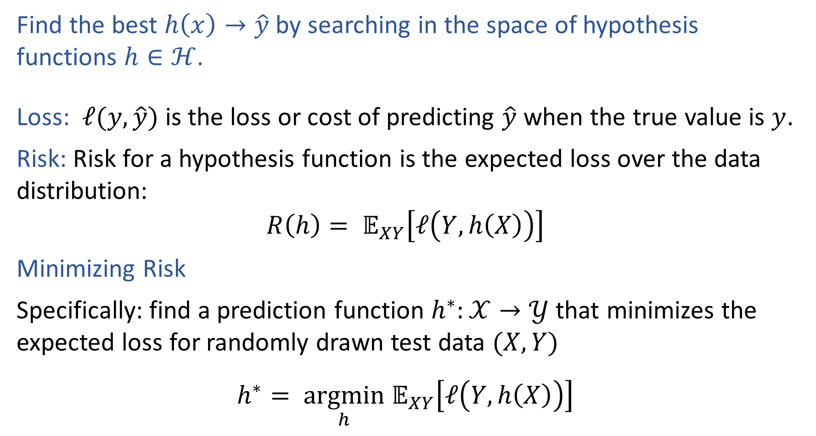
Pre-reading: Optimization Formulation
Find the best $h\left(x\right)→\hat{y}$ by searching in the space of hypothesis functions $h∈ℋ$.
Loss: $ℓ(y, \hat{y})$ is the loss or cost of predicting $\hat{y}$ when the true value is $y$.
Risk: Risk for a hypothesis function is the expected loss over the data distribution:
$$R\left(h\right)= 𝔼_{XY}\left[ℓ\left(Y, h\left(X\right)\right)\right]$$
Minimizing Risk
Specifically: find a prediction function $h^{∗}:𝒳→𝒴$ that minimizes the expected loss for randomly drawn test data $(X, Y)$
$$h^{∗}= \underset{h}{argmin} 𝔼_{XY}\left[ℓ\left(Y, h\left(X\right)\right)\right]$$

Slide 3

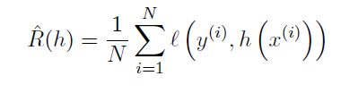


Pre-reading: Empirical Risk Minimization
Risk
Empirical Risk
Empirical Risk Minimization

Slide 4

Pre-reading: Loss Functions
$$h^{∗}= \underset{h}{argmin} 𝔼_{XY}\left[L\left(Y, h\left(X\right)\right)\right]$$
Loss function:
$L:𝒴×𝒴→ℝ$
Classification:
Two-class, 0,1 loss
Two-class, arbitrary loss
False positives and false negatives:

Slide 5
Poll (unused)
For a healthcare classification problem where:
Y=0 represents a negative test for cancer (healthy)
Y=1 represents a positive test for cancer (sick)
Which two-class loss value should be highest?
True negative
False negative
False positive
True positive

Slide 6
Poll (unused)
Does our decision tree algorithm (recursively finding the best attribute to split on a each node) find a hypothesis that minimizes empirical risk for zero-one loss?
Yes, always
Yes, but only when splitting with error rate
Yes, but only when splitting with mutual information
No

Slide 7
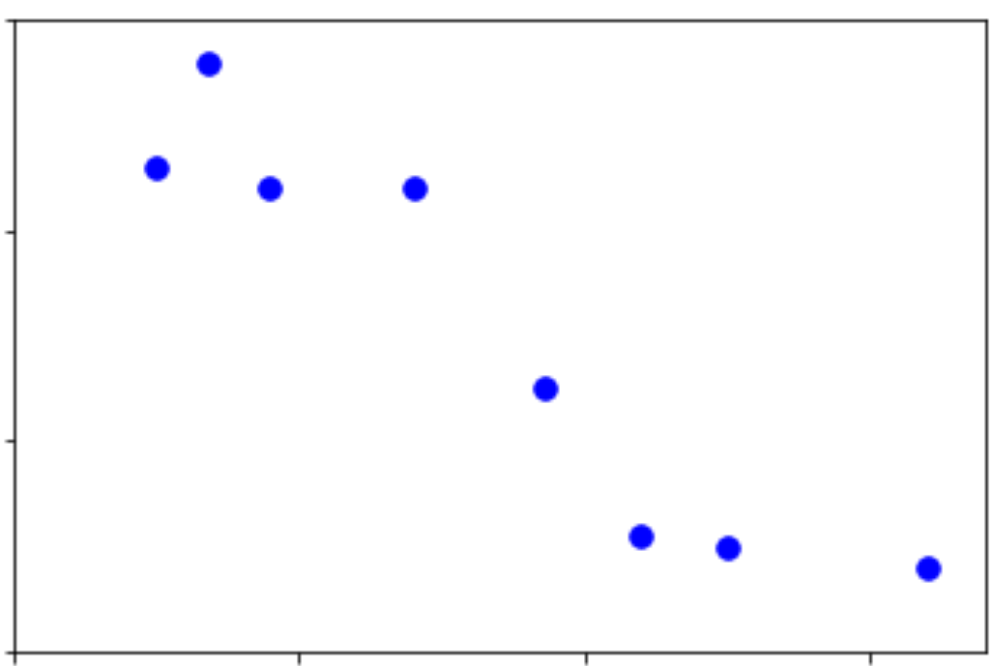
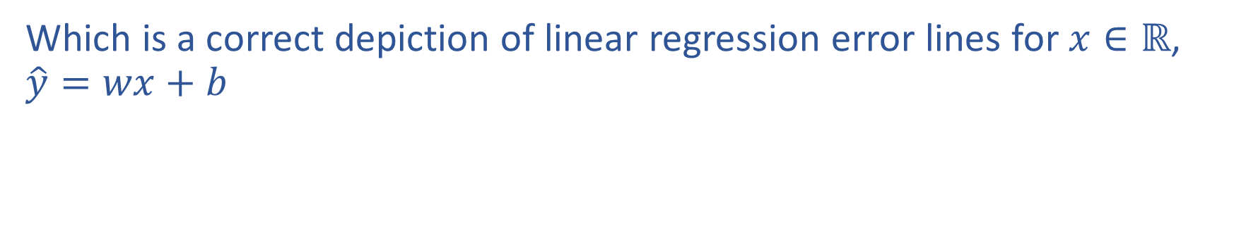
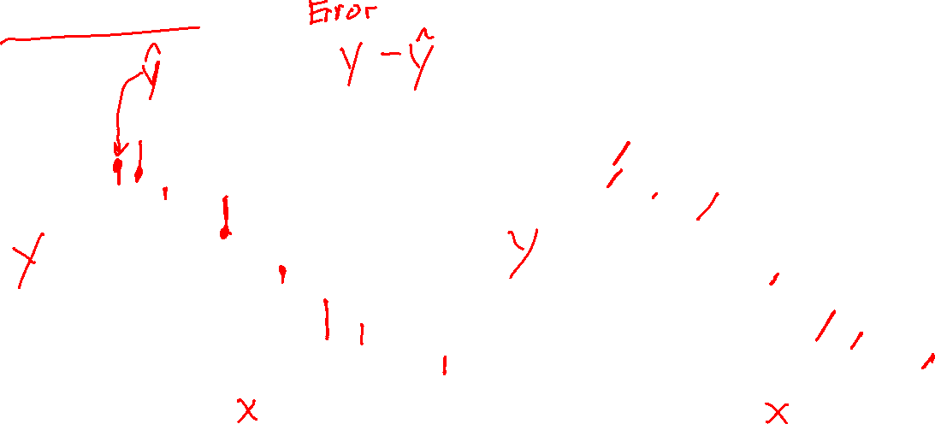
Poll 1
Which is a correct depiction of linear regression error lines for $x∈ℝ$, $\hat{y}=wx+b$
A
B

Slide 8
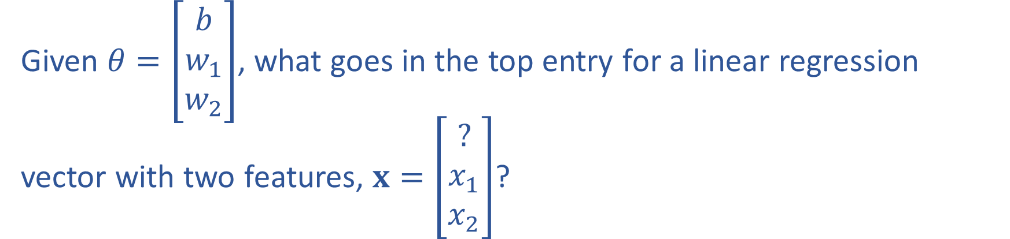
Poll 2
Given $θ=\left[\begin{matrix}b \\ w_{1} \\ w_{2}\end{matrix}\right]$, what goes in the top entry for a linear regression vector with two features, $x=\left[\begin{matrix}? \\ x_{1} \\ x_{2}\end{matrix}\right]$?

Slide 9
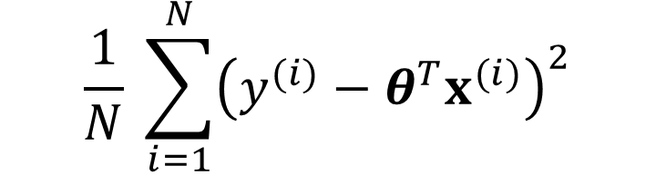
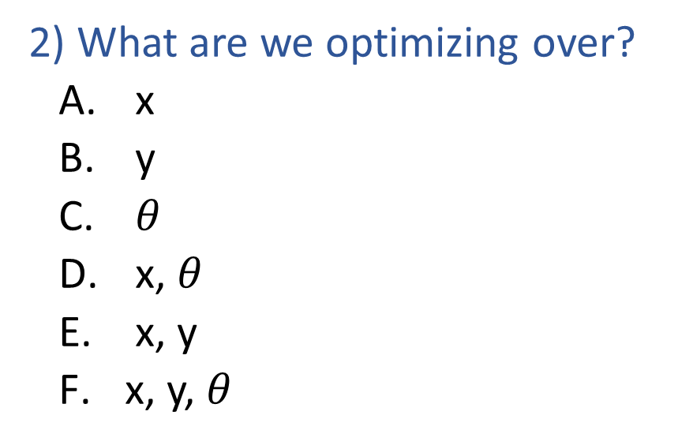
Poll 3: Two questions (unused)
Fill in the blanks: Linear regession optimization
$$\frac{1}{N} \sum_{i=1}^{N}{{\left(y^{(i)}−θ^{T}x^{(i)}\right)}^{2}}$$
_1) min/max/argmin/argmax?_
__2) ?__
1) What type of optimization?
min
max
argmin
argmax
2) What are we optimizing over?
x
y
$θ$
x, $θ$
x, y
x, y, $θ$

Slide 10
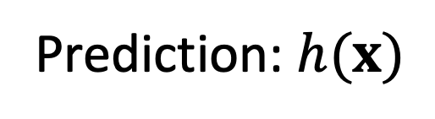


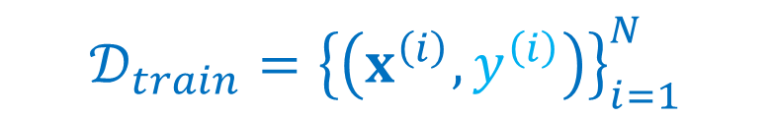

Machine Learning
Using (training) data to learn a model that we’ll later use for prediction
Training Data
Input and Measured Output
Model
Structure and Parameters, $θ$
Training
$$𝒟_{train}={\left\{\left(x^{\left(i\right)},y^{\left(i\right)}\right)\right\}}_{i=1}^{N}$$
Prediction: $h(x)$
Input
Predicted
Output
Model
$$x^{(new)}$$
$${\hat{y}}^{(new)}$$

Slide 11
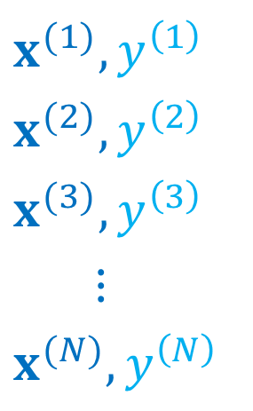
Machine Learning
Using (training) data to learn a model that we’ll later use for prediction
Training Data
$$x^{(1)},y^{\left(1\right)}$$
$$x^{(2)},y^{\left(2\right)}$$
$$x^{(3)},y^{\left(3\right)}$$
$$⋮$$
$$x^{(N)},y^{\left(N\right)}$$
Model
Structure and Parameters, $θ$
Training
Prediction: $h(x)$
Input
Predicted
Output
Model
$$x^{(new)}$$
$${\hat{y}}^{(new)}$$

Slide 12
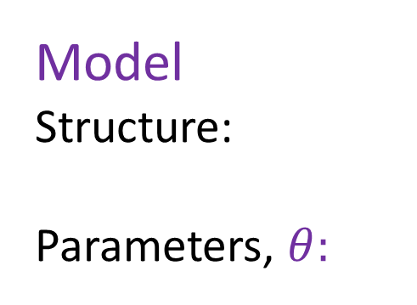
Machine Learning
Using (training) data to learn a model that we’ll later use for prediction
Training Data
$$x^{(1)},y^{\left(1\right)}$$
$$x^{(2)},y^{\left(2\right)}$$
$$x^{(3)},y^{\left(3\right)}$$
$$⋮$$
$$x^{(N)},y^{\left(N\right)}$$
Model
Structure:
Parameters, $θ:$
Training
Prediction: $h(x)$
Input
Predicted
Output
$$x^{(new)}$$
$${\hat{y}}^{(new)}$$

Slide 13
Machine Learning
Using (training) data to learn a model that we’ll later use for prediction
Training Data
$$x^{(1)},y^{\left(1\right)}$$
$$x^{(2)},y^{\left(2\right)}$$
$$x^{(3)},y^{\left(3\right)}$$
$$⋮$$
$$x^{(N)},y^{\left(N\right)}$$
Model
Structure and Parameters, $θ$
Training
Prediction: $h(x)$
Input
Predicted
Output
$$x^{(new)}$$
$${\hat{y}}^{(new)}$$

Slide 14
Machine Learning
Using (training) data to learn a model that we’ll later use for prediction
Training Data
$$x^{(1)},y^{\left(1\right)}$$
$$x^{(2)},y^{\left(2\right)}$$
$$x^{(3)},y^{\left(3\right)}$$
$$⋮$$
$$x^{(N)},y^{\left(N\right)}$$
Model
Structure and Parameters, $θ$
Training
Prediction: $h(x)$
Input
Predicted
Output
$$x^{(new)}$$
$${\hat{y}}^{(new)}$$

Slide 15
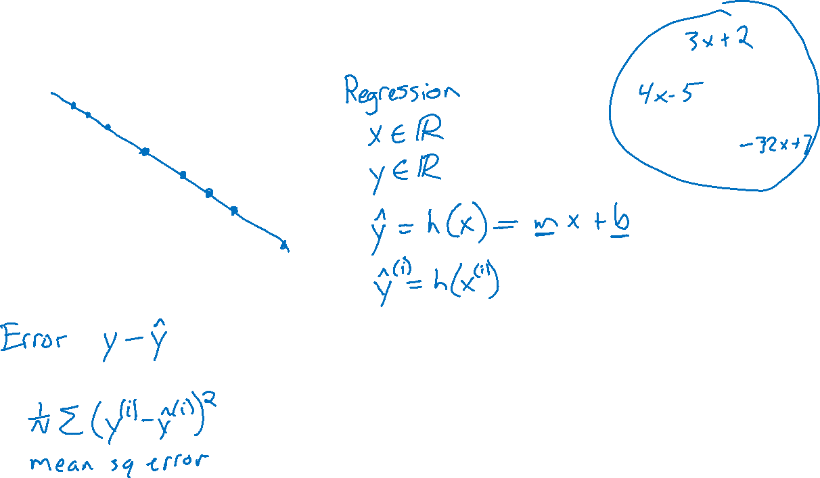
Linear Regression
Output y
Input x

Slide 16
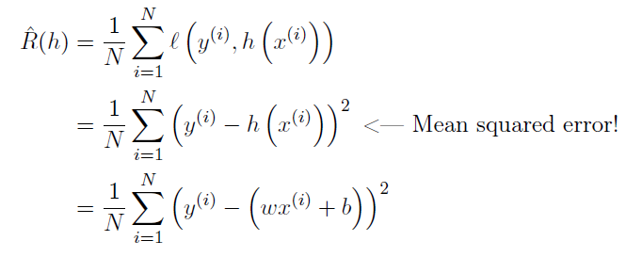
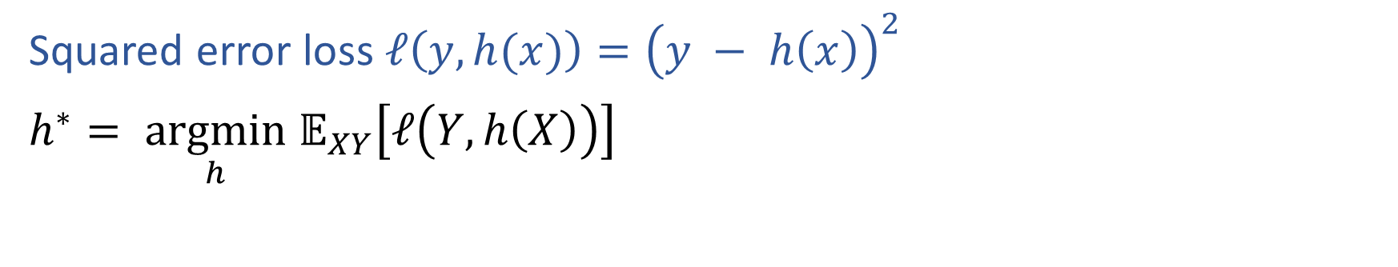
Risk in Regression
Squared error loss $ℓ\left(y, h(x)\right)={\left(y − h\left(x\right)\right)}^{2}$
$h^{∗}= \underset{h}{argmin} 𝔼_{XY}\left[ℓ\left(Y, h\left(X\right)\right)\right]$

Slide 17
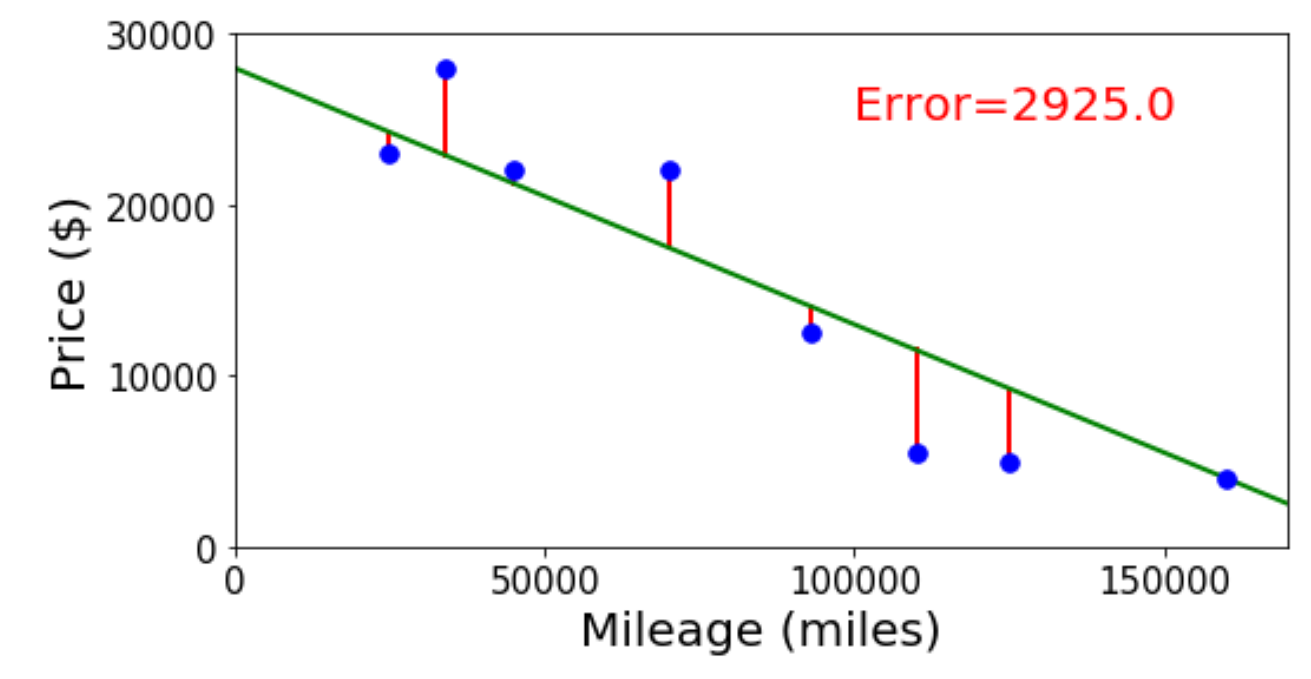
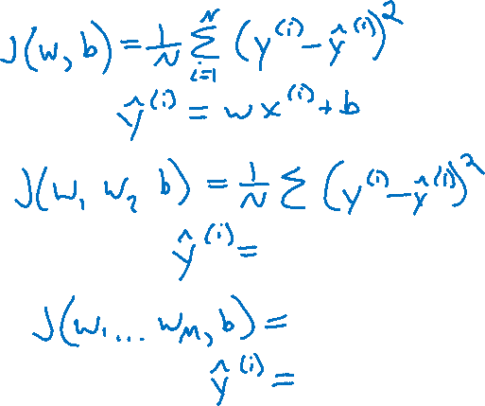
Linear Regression Optimzation
Finding the parameter values that minimize the mean squared error objective function

Slide 18
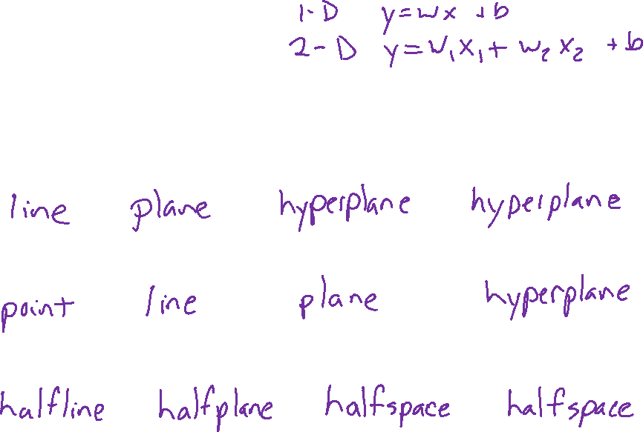





Linear in Higher Dimensions
What are these linear shapes called for 1-D, 2-D, 3-D, M-D input?
$$x∈ℝ$$
$$x∈ℝ^{2}$$
$$x∈ℝ^{3}$$
$$x∈ℝ^{M}$$
$y=w^{T}x+b$
$w^{T}x+b=0$
$w^{T}x+b≥0$

Slide 19

Linear Regression Optimzation
Finding the parameter values that minimize the mean squared error objective function

Slide 20
Contructing the Design Matrix

Slide 21


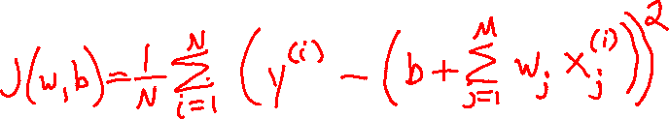
Linear Algebra Formulation
Constructing the design matrix

Slide 22
Linear Algebra Formulation
Constructing the design matrix
Species | Sepal Length | Sepal Width | Petal Length | Petal Width
0 | 4.3 | 3.0 | 1.1 | 0.1
0 | 4.9 | 3.6 | 1.4 | 0.1
0 | 5.3 | 3.7 | 1.5 | 0.2
1 | 4.9 | 2.4 | 3.3 | 1.0
1 | 5.7 | 2.8 | 4.1 | 1.3
1 | 6.3 | 3.3 | 4.7 | 1.6
2 | 5.9 | 3.0 | 5.1 | 1.8

Slide 23
Linear Algebra Formulation
Constructing the design matrix
Species
0
0
0
1
1
1
2
Sepal Length | Sepal Width | Petal Length | Petal Width
4.3 | 3.0 | 1.1 | 0.1
4.9 | 3.6 | 1.4 | 0.1
5.3 | 3.7 | 1.5 | 0.2
4.9 | 2.4 | 3.3 | 1.0
5.7 | 2.8 | 4.1 | 1.3
6.3 | 3.3 | 4.7 | 1.6
5.9 | 3.0 | 5.1 | 1.8

Slide 24

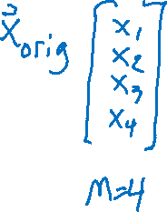
Linear Algebra Formulation
Constructing the design matrix
Species
0
0
0
1
1
1
2
(account for bias) | Sepal Length | Sepal Width | Petal Length | Petal Width
1 | 4.3 | 3.0 | 1.1 | 0.1
1 | 4.9 | 3.6 | 1.4 | 0.1
1 | 5.3 | 3.7 | 1.5 | 0.2
1 | 4.9 | 2.4 | 3.3 | 1.0
1 | 5.7 | 2.8 | 4.1 | 1.3
1 | 6.3 | 3.3 | 4.7 | 1.6
1 | 5.9 | 3.0 | 5.1 | 1.8

Slide 25
Linear Algebra Formulation
Constructing the design matrix

Slide 26
Linear Regression
System of Equations

Slide 27
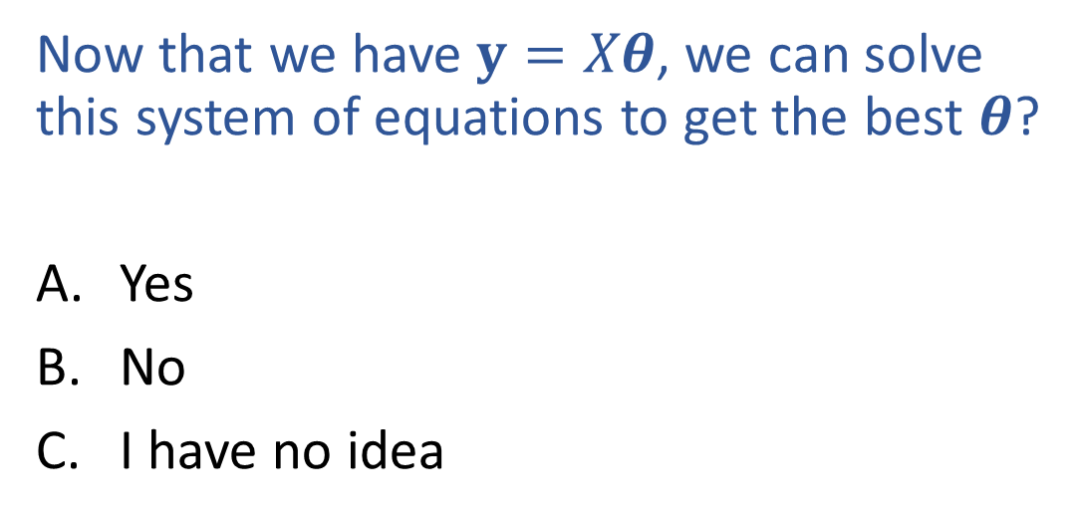
Poll 4 (unused)
Now that we have $y=Xθ$, we can solve this system of equations to get the best $θ$?
Yes
No
I have no idea

Slide 28
Linear Regression
Number of solutions?
Output y
Input x

Slide 29
Linear Regression
Linear algebra formulation

Slide 30
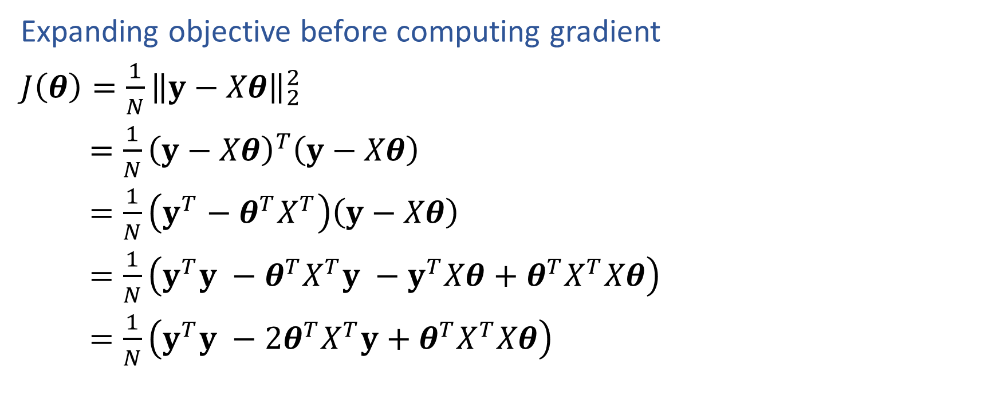

Linear Regression
Expanding objective before computing gradient
$J\left(θ\right)=\frac{1}{N}{\left\|y−Xθ\right\|}_{2}^{2}$
$=\frac{1}{N}{\left(y−Xθ\right)}^{T}\left(y−Xθ\right)$
$=\frac{1}{N}\left(y^{T}−θ^{T}X^{T}\right)\left(y−Xθ\right)$
$=\frac{1}{N}\left(y^{T}y −θ^{T}X^{T}y −y^{T}Xθ+θ^{T}X^{T}Xθ\right)$
$=\frac{1}{N}\left(y^{T}y −2θ^{T}X^{T}y+θ^{T}X^{T}Xθ\right)$

Slide 31
Linear Regression
$$J\left(w, b\right)=\frac{1}{2}\left[{\left(y^{(1)}−\left(wx^{(1)}+b\right)\right)}^{2}+{\left(y^{(2)}−\left(wx^{(2)}+b\right)\right)}^{2}\right]$$
Optimizing the objective
b
y
w
x

Slide 32
Poll 5
$$J\left(w, b\right)=\frac{1}{2}\left[{\left(y^{(1)}−\left(wx^{(1)}+b\right)\right)}^{2}+{\left(y^{(2)}−\left(wx^{(2)}+b\right)\right)}^{2}\right]$$
For fixed data and fixed slope, w, what shape do we get by plotting MSE objective vs intercept, b?
Line
Plane
Half-plane
Convex parabola (U-shape)
Concave parabola (up-side-down U)
None of the above
y
x

Slide 33
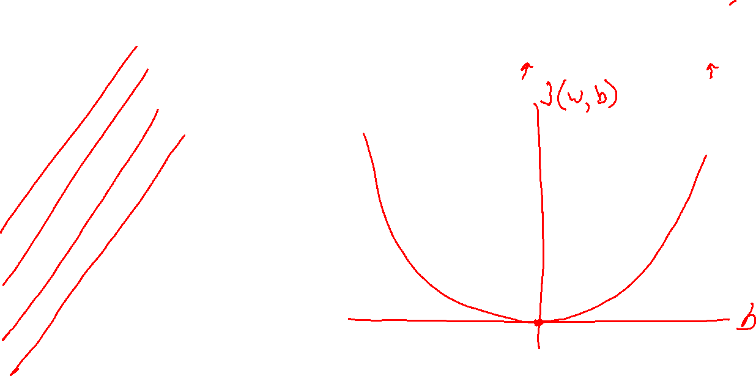
Linear Regression
$$J\left(w, b\right)=\frac{1}{2}\left[{\left(y^{(1)}−\left(wx^{(1)}+b\right)\right)}^{2}+{\left(y^{(2)}−\left(wx^{(2)}+b\right)\right)}^{2}\right]$$
Optimizing the objective
y
x

Slide 34
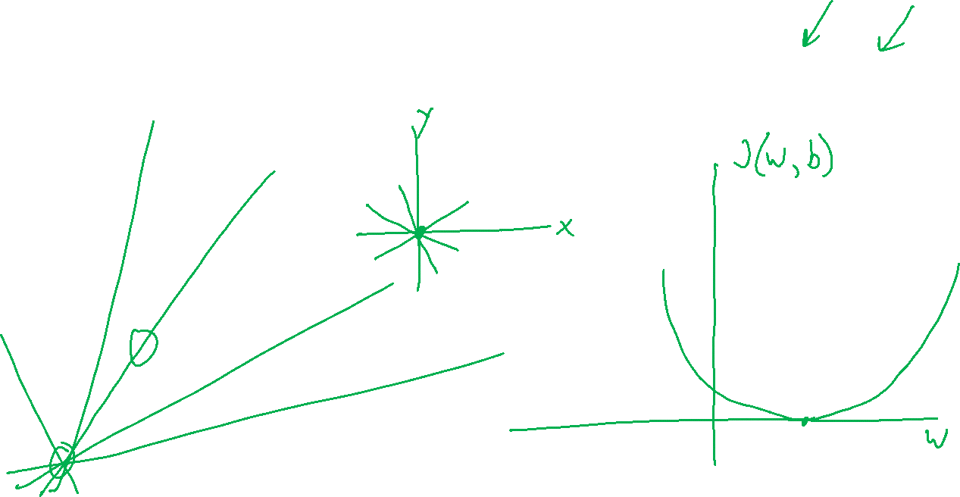
Linear Regression
$$J\left(w, b\right)=\frac{1}{2}\left[{\left(y^{(1)}−\left(wx^{(1)}+b\right)\right)}^{2}+{\left(y^{(2)}−\left(wx^{(2)}+b\right)\right)}^{2}\right]$$
Optimizing the objective
y
x

Slide 35

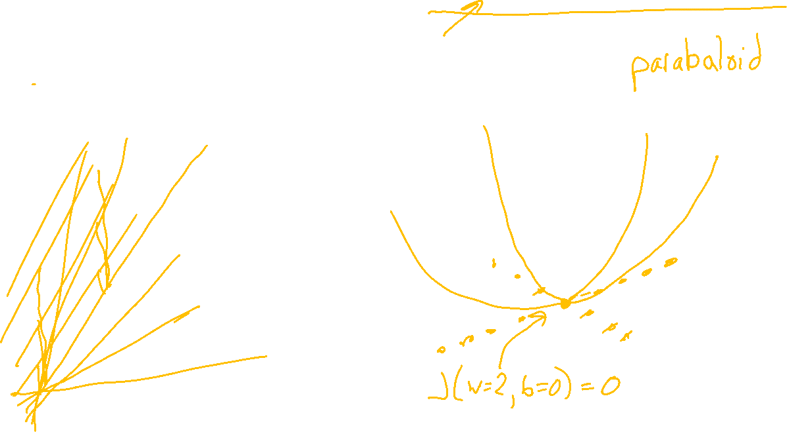
Linear Regression
$$J\left(w, b\right)=\frac{1}{2}\left[{\left(y^{(1)}−\left(wx^{(1)}+b\right)\right)}^{2}+{\left(y^{(2)}−\left(wx^{(2)}+b\right)\right)}^{2}\right]$$
What shape is the obejective function when we consider both parameters w and b?
$$J\left(w, b\right)$$
y
b
w
x

Slide 36
Linear Regression
$$J\left(w, b\right)=\frac{1}{2}\left[{\left(y^{(1)}−\left(wx^{(1)}+b\right)\right)}^{2}+{\left(y^{(2)}−\left(wx^{(2)}+b\right)\right)}^{2}\right]$$
What shape is the obejective function when we consider both parameters w and b?
$$J\left(w, b\right)$$
y
b
w
x

Slide 37
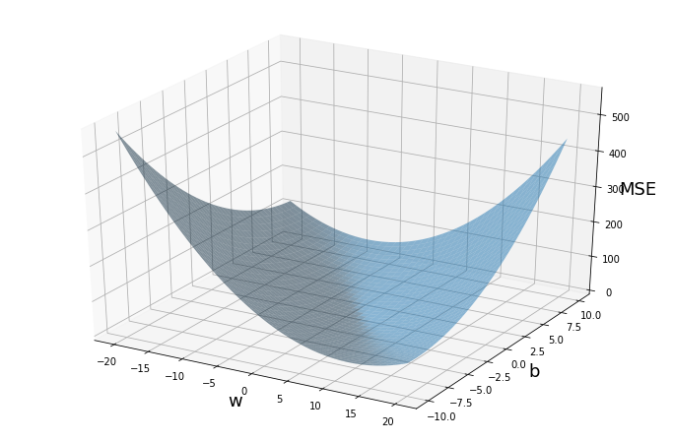
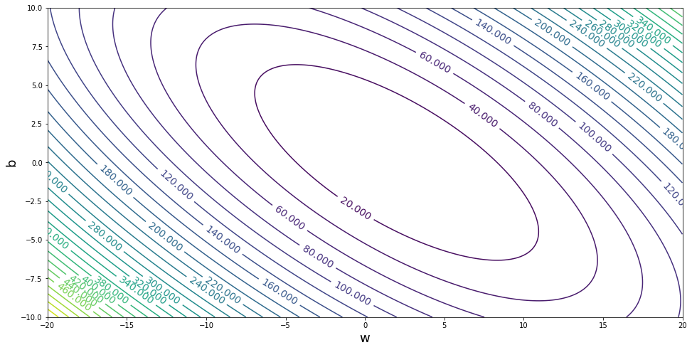
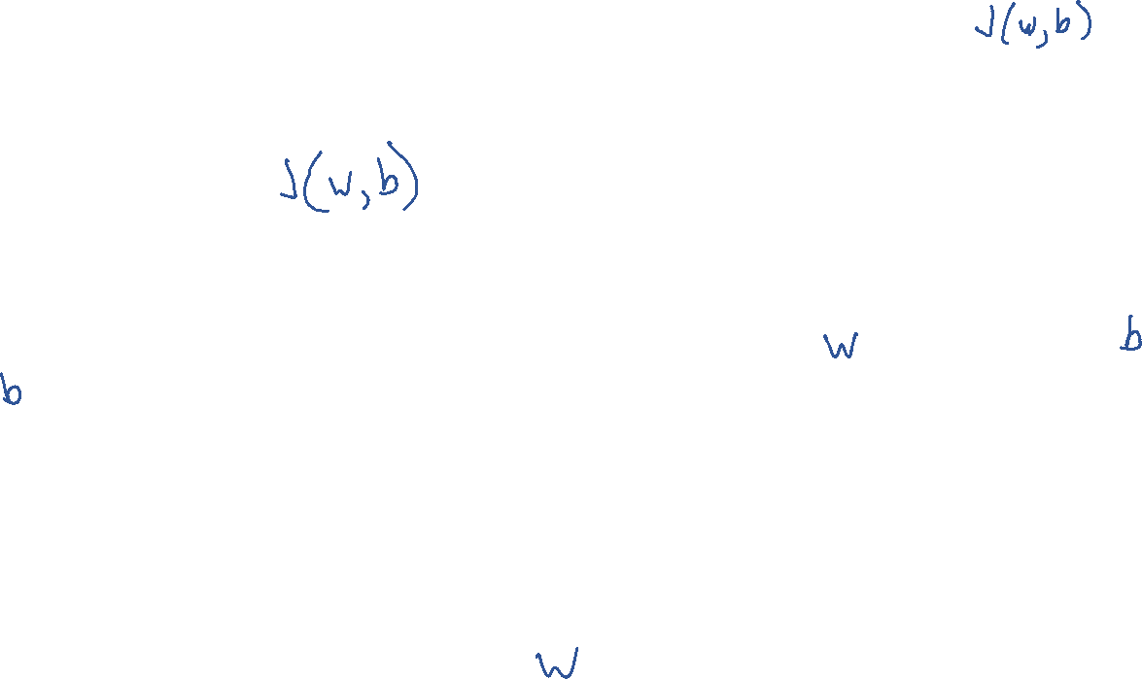
Linear Regression
Optimizing the objective

Slide 38
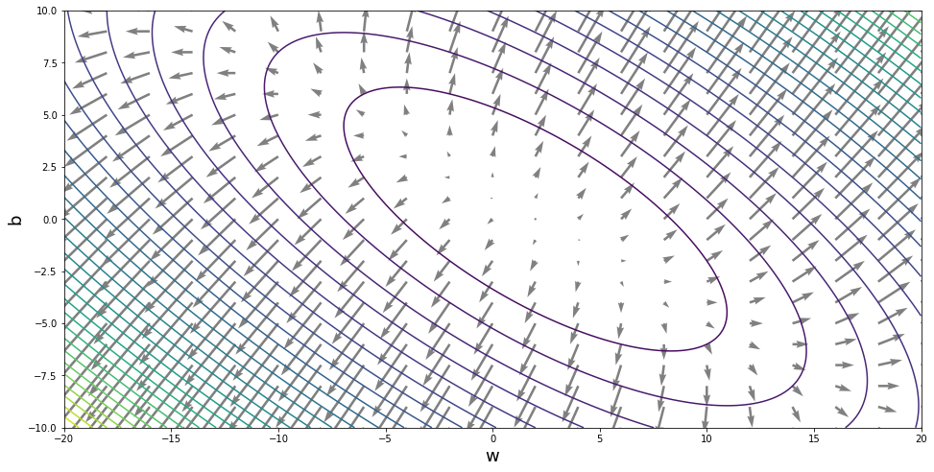
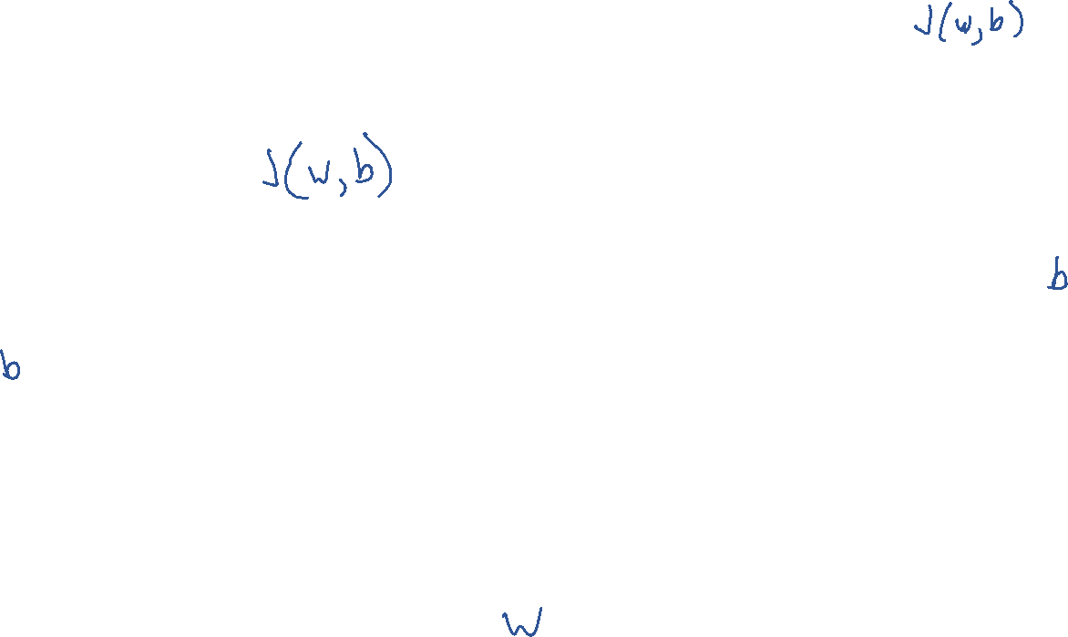
Optimization
Gradients

Slide 39
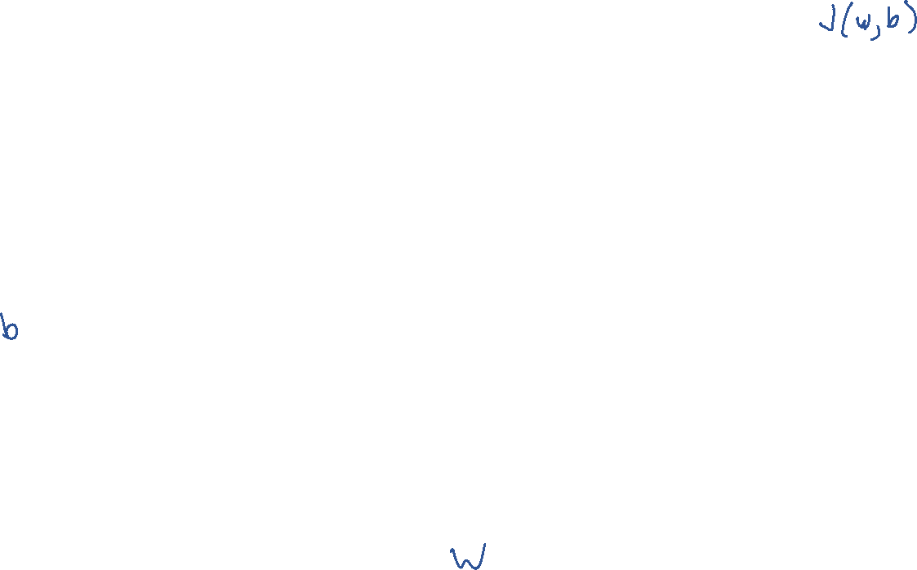
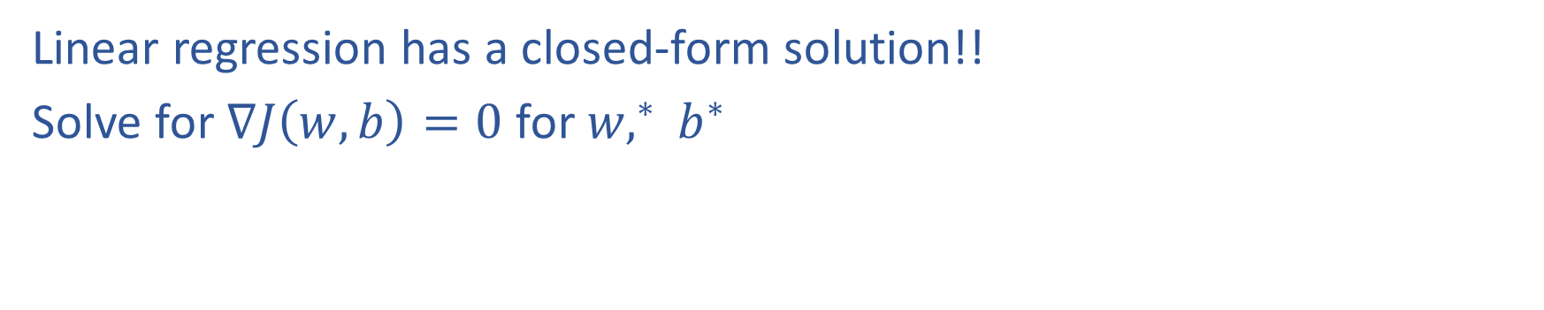
Optimization
Linear regression has a closed-form solution!!
Solve for $∇J\left(w,b\right)=0$ for $w,^{∗} b^{∗}$

Slide 40
Optimization
$$J\left(w, b\right)=\frac{1}{2}\left[{\left(y^{(1)}−\left(wx^{(1)}+b\right)\right)}^{2}+{\left(y^{(2)}−\left(wx^{(2)}+b\right)\right)}^{2}\right]$$
Gradients

Slide 41
Calculus Time-out
Partial derivatives

Slide 42
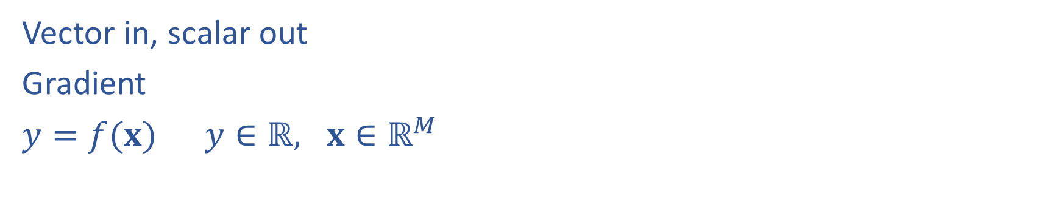
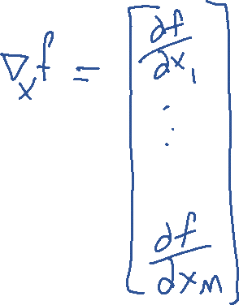
Calculus with Linear Algebra
Vector in, scalar out
Gradient
$y=f(x)$ $y∈ℝ, x∈ℝ^{M}$

Slide 43
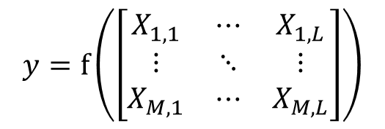

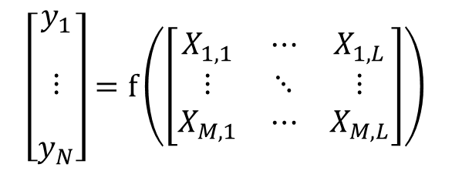
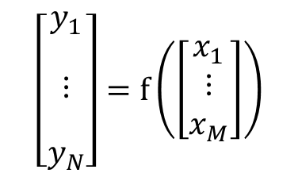
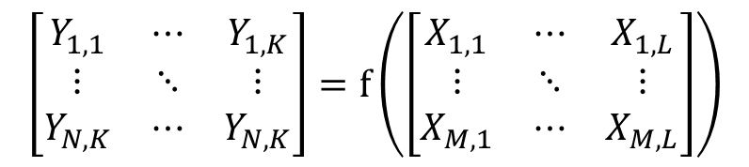
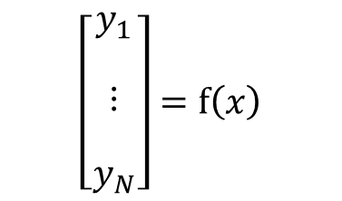
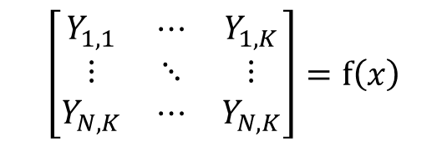

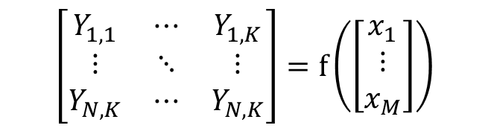
Calculus with Linear Algebra
Functions with linear algebra
$$y=f\left(\left[\begin{matrix}x_{1} \\ ⋮ \\ x_{M}\end{matrix}\right]\right)$$
$$y=f\left(\left[\begin{matrix}X_{1,1} & ⋯ & X_{1,L} \\ ⋮ & ⋱ & ⋮ \\ X_{M,1} & ⋯ & X_{M,L}\end{matrix}\right]\right)$$
$$y=f\left(x\right)$$
$$\left[\begin{matrix}\begin{aligned}y_{1} \\ \end{aligned} \\ \begin{aligned}⋮ \\ \end{aligned} \\ y_{N}\end{matrix}\right]=f\left(x\right)$$
$$\left[\begin{matrix}\begin{aligned}y_{1} \\ \end{aligned} \\ \begin{aligned}⋮ \\ \end{aligned} \\ y_{N}\end{matrix}\right]=f\left(\left[\begin{matrix}x_{1} \\ ⋮ \\ x_{M}\end{matrix}\right]\right)$$
$$\left[\begin{matrix}\begin{aligned}y_{1} \\ \end{aligned} \\ \begin{aligned}⋮ \\ \end{aligned} \\ y_{N}\end{matrix}\right]=f\left(\left[\begin{matrix}X_{1,1} & ⋯ & X_{1,L} \\ ⋮ & ⋱ & ⋮ \\ X_{M,1} & ⋯ & X_{M,L}\end{matrix}\right]\right)$$
$$\left[\begin{matrix}Y_{1,1} & ⋯ & Y_{1,K} \\ ⋮ & ⋱ & ⋮ \\ Y_{N,K} & ⋯ & Y_{N,K}\end{matrix}\right]=f\left(x\right)$$
$$\left[\begin{matrix}Y_{1,1} & ⋯ & Y_{1,K} \\ ⋮ & ⋱ & ⋮ \\ Y_{N,K} & ⋯ & Y_{N,K}\end{matrix}\right]=f\left(\left[\begin{matrix}x_{1} \\ ⋮ \\ x_{M}\end{matrix}\right]\right)$$
$$\left[\begin{matrix}Y_{1,1} & ⋯ & Y_{1,K} \\ ⋮ & ⋱ & ⋮ \\ Y_{N,K} & ⋯ & Y_{N,K}\end{matrix}\right]=f\left(\left[\begin{matrix}X_{1,1} & ⋯ & X_{1,L} \\ ⋮ & ⋱ & ⋮ \\ X_{M,1} & ⋯ & X_{M,L}\end{matrix}\right]\right)$$

Slide 44
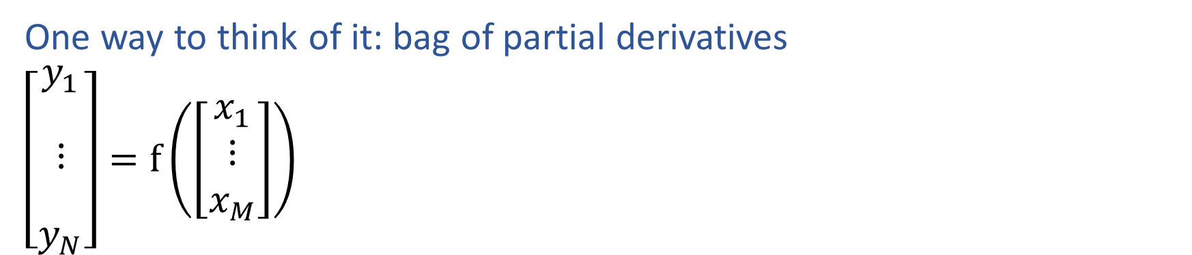
Calculus with Linear Algebra
One way to think of it: bag of partial derivatives
$\left[\begin{matrix}\begin{aligned}y_{1} \\ \end{aligned} \\ \begin{aligned}⋮ \\ \end{aligned} \\ y_{N}\end{matrix}\right]=f\left(\left[\begin{matrix}x_{1} \\ ⋮ \\ x_{M}\end{matrix}\right]\right)$

Slide 45
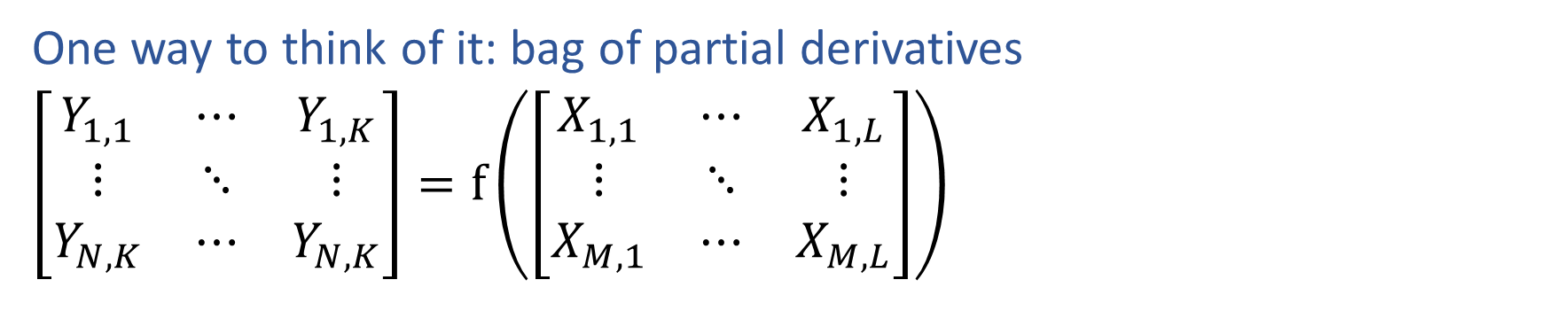
Calculus with Linear Algebra
One way to think of it: bag of partial derivatives
$\left[\begin{matrix}Y_{1,1} & ⋯ & Y_{1,K} \\ ⋮ & ⋱ & ⋮ \\ Y_{N,K} & ⋯ & Y_{N,K}\end{matrix}\right]=f\left(\left[\begin{matrix}X_{1,1} & ⋯ & X_{1,L} \\ ⋮ & ⋱ & ⋮ \\ X_{M,1} & ⋯ & X_{M,L}\end{matrix}\right]\right)$

Slide 46
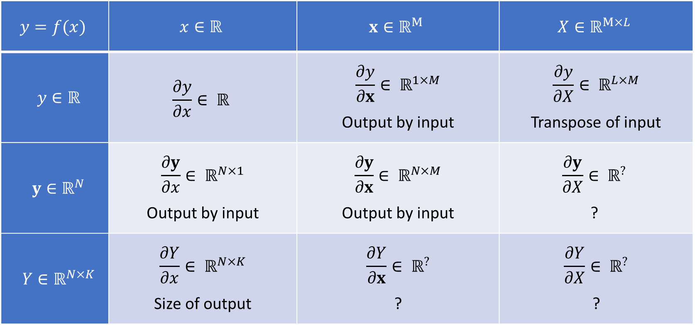
Numerator Layout
$$y=f(x)$$ | $$x∈ℝ$$ | $$x∈ℝ^{M}$$ | $$X∈ℝ^{M×L}$$
$y∈ℝ$ | $$\frac{∂y}{∂x}∈ ℝ$$ | $$\frac{∂y}{∂x}∈ ℝ^{1×M}$$ Output by input | $$\frac{∂y}{∂X}∈ ℝ^{L×M}$$ Transpose of input
$y∈ℝ^{N}$ | $$\frac{∂y}{∂x}∈ ℝ^{N×1}$$ Output by input | $$\frac{∂y}{∂x}∈ ℝ^{N×M}$$ Output by input | $$\frac{∂y}{∂X}∈ ℝ^{?}$$ ?
$Y∈ℝ^{N×K}$ | $$\frac{∂Y}{∂x}∈ ℝ^{N×K}$$ Size of output | $$\frac{∂Y}{∂x}∈ ℝ^{?}$$ ? | $$\frac{∂Y}{∂X}∈ ℝ^{?}$$ ?

Slide 47

Denominator Layout
$$y=f(x)$$ | $$x∈ℝ$$ | $$x∈ℝ^{M}$$ | $$X∈ℝ^{M×L}$$
$y∈ℝ$ | $$\frac{∂y}{∂x}∈ ℝ$$ | $$\frac{∂y}{∂x}∈ ℝ^{M×1}$$ Input by output | $$\frac{∂y}{∂X}∈ ℝ^{M×L}$$ Size of input
$y∈ℝ^{N}$ | $$\frac{∂y}{∂x}∈ ℝ^{1×N}$$ Input by output | $$\frac{∂y}{∂x}∈ ℝ^{M×N}$$ Input by output | $$\frac{∂y}{∂X}∈ ℝ^{?}$$ ?
$Y∈ℝ^{N×K}$ | $$\frac{∂Y}{∂x}∈ ℝ^{K×N}$$ Transpose of output | $$\frac{∂Y}{∂x}∈ ℝ^{?}$$ ? | $$\frac{∂Y}{∂X}∈ ℝ^{?}$$ ?

Slide 48
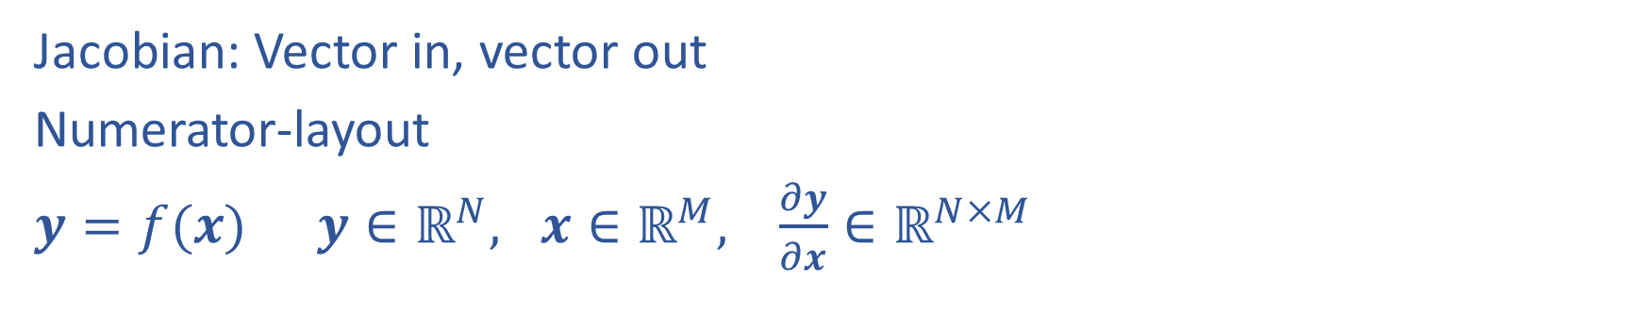
Calculus with Linear Algebra
Jacobian: Vector in, vector out
Numerator-layout
$y=f(x)$ $y∈ℝ^{N}, x∈ℝ^{M}, \frac{∂y}{∂x}∈ℝ^{N×M}$

Slide 49
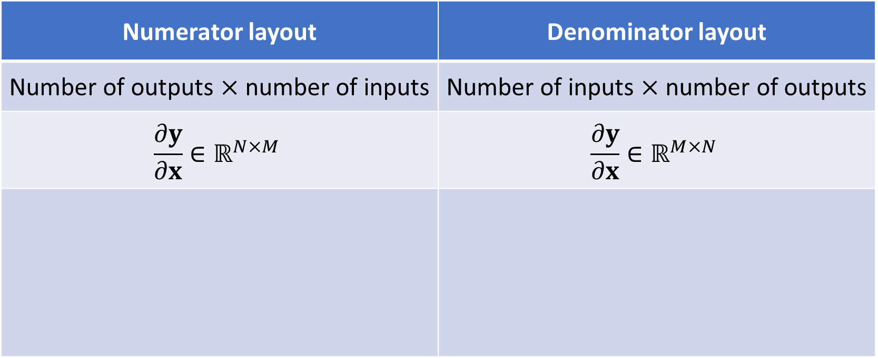


Calculus with Linear Algebra
$$\left[\begin{matrix}\begin{aligned}y_{1} \\ \end{aligned} \\ \begin{aligned}⋮ \\ \end{aligned} \\ y_{N}\end{matrix}\right]=f\left(\left[\begin{matrix}x_{1} \\ ⋮ \\ x_{M}\end{matrix}\right]\right)$$
Numerator-layout vs denominator-layout
Vector in, vector out
$y=f(x)$ $y∈ℝ^{N}, x∈ℝ^{M}$ (assume $N>M$ for illustrative purposes)
Numerator layout | Denominator layout
Number of outputs $×$ number of inputs | Number of inputs $×$ number of outputs
$$\frac{∂y}{∂x}∈ℝ^{N×M}$$ | $$\frac{∂y}{∂x}∈ℝ^{M×N}$$

Slide 50


Calculus with Linear Algebra
$$y=f\left(\left[\begin{matrix}x_{1} \\ ⋮ \\ x_{M}\end{matrix}\right]\right)$$
Vector in, scalar out
Numerator-layout
$y=f(x)$ $y∈ℝ, x∈ℝ^{M}, \frac{∂y}{∂x}∈ℝ^{1×M}$

Slide 51


Calculus with Linear Algebra
$$y=f\left(\left[\begin{matrix}x_{1} \\ ⋮ \\ x_{M}\end{matrix}\right]\right)$$
Numerator-layout vs denominator-layout
Vector in, scalar out
$y=f(x)$ $y∈ℝ, x∈ℝ^{M}$
Numerator layout | Denominator layout
Number of outputs $×$ number of inputs | Number of inputs $×$ number of outputs
$$\frac{∂y}{∂x}∈ℝ^{1×M}$$ | $$\frac{∂y}{∂x}∈ℝ^{M×1}$$

Slide 52


Calculus with Linear Algebra
$$\left[\begin{matrix}\begin{aligned}y_{1} \\ \end{aligned} \\ \begin{aligned}⋮ \\ \end{aligned} \\ y_{N}\end{matrix}\right]=f\left(x\right)$$
Scalar in, vector out
Numerator-layout
$y=f(x)$ $y∈ℝ^{N}, x∈ℝ, \frac{∂y}{∂x}∈ℝ^{N×1}$

Slide 53

Calculus with Linear Algebra
$$y=f\left(\left[\begin{matrix}x_{1} \\ ⋮ \\ x_{M}\end{matrix}\right]\right)$$
Gradient: Vector in, scalar out
Transpose of numerator-layout
$y=f(x)$ $y∈ℝ, x∈ℝ^{M}, \frac{∂y}{∂x}∈ℝ^{1×M}, ∇_{x}f∈ℝ^{M×1}$

Slide 54


Calculus with Linear Algebra
$$y=f\left(\left[\begin{matrix}X_{1,1} & ⋯ & X_{1,L} \\ ⋮ & ⋱ & ⋮ \\ X_{M,1} & ⋯ & X_{M,L}\end{matrix}\right]\right)$$
Matrix in, scalar out
Numerator layout: Transpose of matrix dimensions
Denominator layout: Keep same dimensions as matrix
$y=f(X)$ $y∈ℝ, X∈ℝ^{N×M}, \frac{∂y}{∂X}∈ℝ^{N×M}$ (denominator layout)

Slide 55

Exercise
Suppose we have a function that takes in a vector and squares each element individually, returning another vector, $y=f\left(x\right)$.
$f\left(\left[\begin{aligned}x_{1} \\ x_{2} \\ x_{3}\end{aligned}\right]\right)→\left[\begin{aligned}x_{1}^{2} \\ x_{2}^{2} \\ x_{3}^{2}\end{aligned}\right]$ Example: $f\left(\left[\begin{aligned}7 \\ 3 \\ 5\end{aligned}\right]\right)→\left[\begin{aligned}49 \\ 9 \\ 25\end{aligned}\right]$
What is $∂y/∂x$? (use numerator layout)

Slide 56

Derivatives of Functions with Respect to Vectors

Slide 57
Numerator Layout
$$y=f(x)$$ | $$x∈ℝ$$ | $$x∈ℝ^{M}$$ | $$X∈ℝ^{M×L}$$
$y∈ℝ$ | $$\frac{∂y}{∂x}∈ ℝ$$ | $$\frac{∂y}{∂x}∈ ℝ^{1×M}$$ Output by input | $$\frac{∂y}{∂X}∈ ℝ^{L×M}$$ Transpose of input
$y∈ℝ^{N}$ | $$\frac{∂y}{∂x}∈ ℝ^{N×1}$$ Output by input | $$\frac{∂y}{∂x}∈ ℝ^{N×M}$$ Output by input | $$\frac{∂y}{∂X}∈ ℝ^{?}$$ ?
$Y∈ℝ^{N×K}$ | $$\frac{∂Y}{∂x}∈ ℝ^{N×K}$$ Size of output | $$\frac{∂Y}{∂x}∈ ℝ^{?}$$ ? | $$\frac{∂Y}{∂X}∈ ℝ^{?}$$ ?

Slide 58
Denominator Layout
$$y=f(x)$$ | $$x∈ℝ$$ | $$x∈ℝ^{M}$$ | $$X∈ℝ^{M×L}$$
$y∈ℝ$ | $$\frac{∂y}{∂x}∈ ℝ$$ | $$\frac{∂y}{∂x}∈ ℝ^{M×1}$$ Input by output | $$\frac{∂y}{∂X}∈ ℝ^{M×L}$$ Size of input
$y∈ℝ^{N}$ | $$\frac{∂y}{∂x}∈ ℝ^{1×N}$$ Input by output | $$\frac{∂y}{∂x}∈ ℝ^{M×N}$$ Input by output | $$\frac{∂y}{∂X}∈ ℝ^{?}$$ ?
$Y∈ℝ^{N×K}$ | $$\frac{∂Y}{∂x}∈ ℝ^{K×N}$$ Transpose of output | $$\frac{∂Y}{∂x}∈ ℝ^{?}$$ ? | $$\frac{∂Y}{∂X}∈ ℝ^{?}$$ ?

Slide 59
Linear Regression
Closed-form Solution

Slide 60



Linear Regression
Methods for optimizing the objective
Closed-form solution
$$J(w,b)$$
$$b$$
$$w$$

Slide 61
Linear Regression
Expanding objective before computing gradient
$J\left(θ\right)=\frac{1}{N}{\left\|y−Xθ\right\|}_{2}^{2}$
$=\frac{1}{N}{\left(y−Xθ\right)}^{T}\left(y−Xθ\right)$
$=\frac{1}{N}\left(y^{T}−θ^{T}X^{T}\right)\left(y−Xθ\right)$
$=\frac{1}{N}\left(y^{T}y −θ^{T}X^{T}y −y^{T}Xθ+θ^{T}X^{T}Xθ\right)$
$=\frac{1}{N}\left(y^{T}y −2θ^{T}X^{T}y+θ^{T}X^{T}Xθ\right)$

Slide 62



Linear Regression
$\frac{∂z^{T}u}{∂z}=u$
-- or --
$\frac{∂z^{T}u}{∂z} =u^{T}$
Gradient of objective with respect to parameters
$J\left(θ\right)=\frac{1}{N}{\left\|y−Xθ\right\|}_{2}^{2}$
$=\frac{1}{N}\left(y^{T}y −2θ^{T}X^{T}y+θ^{T}X^{T}Xθ\right)$
$∇J\left(θ\right)=\frac{1}{N}$
$\frac{∂z^{T}Az}{∂z}=\left(A+A^{T}\right)z$
-- or --
$\frac{∂z^{T}Az}{∂z}=z^{T}\left(A+A^{T}\right)$

Slide 63

Linear Regression
$\frac{∂z^{T}u}{∂z}=u$
-- or --
$\frac{∂z^{T}u}{∂z} =u^{T}$
Gradient of objective with respect to parameters
$J\left(θ\right)=\frac{1}{N}{\left\|y−Xθ\right\|}_{2}^{2}$
$=\frac{1}{N}\left(y^{T}y −2θ^{T}X^{T}y+θ^{T}X^{T}Xθ\right)$
$∇J\left(θ\right)=\frac{1}{N}\left(0 −2X^{T}y+2θ^{T}X^{T}X\right)$
$\frac{∂z^{T}Az}{∂z}=\left(A+A^{T}\right)z$
-- or --
$\frac{∂z^{T}Az}{∂z}=z^{T}\left(A+A^{T}\right)$

Slide 64

Linear Regression
$\frac{∂z^{T}u}{∂z}=u$
-- or --
$\frac{∂z^{T}u}{∂z} =u^{T}$
Gradient of objective with respect to parameters
$J\left(θ\right)=\frac{1}{N}{\left\|y−Xθ\right\|}_{2}^{2}$
$=\frac{1}{N}\left(y^{T}y −2θ^{T}X^{T}y+θ^{T}X^{T}Xθ\right)$
$∇J\left(θ\right)=\frac{1}{N}\left(0 −2X^{T}y+2θ^{T}X^{T}X\right)$
$=\frac{1}{N}\left(0 −2X^{T}y+2X^{T}Xθ\right)$
$\frac{∂z^{T}Az}{∂z}=\left(A+A^{T}\right)z$
-- or --
$\frac{∂z^{T}Az}{∂z}=z^{T}\left(A+A^{T}\right)$

Slide 65

Linear Regression
$\frac{∂z^{T}u}{∂z}=u$
-- or --
$\frac{∂z^{T}u}{∂z} =u^{T}$
Gradient of objective with respect to parameters
$J\left(θ\right)=\frac{1}{N}{\left\|y−Xθ\right\|}_{2}^{2}$
$=\frac{1}{N}\left(y^{T}y −2θ^{T}X^{T}y+θ^{T}X^{T}Xθ\right)$
$∇J\left(θ\right)=\frac{1}{N}\left(0 −2X^{T}y+2θ^{T}X^{T}X\right)$
$=\frac{1}{N}\left(0 −2X^{T}y+2X^{T}Xθ\right)$
$=\frac{2}{N}\left(−X^{T}y+X^{T}Xθ\right)$
$\frac{∂z^{T}Az}{∂z}=\left(A+A^{T}\right)z$
-- or --
$\frac{∂z^{T}Az}{∂z}=z^{T}\left(A+A^{T}\right)$

Slide 66

Linear Regression
Closed-form solution
$∇J\left(θ\right)=\frac{2}{N}\left(−X^{T}y+X^{T}Xθ\right)$

Slide 67

Linear Regression
Number of solutions

Slide 68

A Note on Matrix Rank
Underlying dimensionality of the data

Slide 69
Linear Regression
Gradient Descent

Slide 70




Linear Regression
Demos to optimize the objective
Linear model optimization
regression_interactive.ipynb
Blind version
regression_blind_interactive.ipynb

Slide 71
Poll 6 (unused)
Open blind optimization on course website
Mess with sliders to find best model
What's the best RMSE that you got?
What's are the corresponding best parameters?

Slide 72
Linear Regression
Methods for optimizing the objective
Closed-form solution
Grid search
Random search
Gradient descent
Stochastic gradient descent (SGD)
Minibatch SGD
$$J(w,b)$$
$$b$$
$$w$$

Slide 73
Optimization
Gradients

Slide 74

Optimization
Gradient descent
Hyperparameter:
learning rate $α$ (or sometimes $γ$, $η$)
While not converged
Compute gradient: $∇J={\left[\frac{∂J}{∂w},\frac{∂J}{∂b}\right]}^{⊤}$
Update parameters
$w←w −α\frac{∂J}{∂w}$
$b ←b −α\frac{∂J}{∂b}$

Slide 75
Linear Regression
Methods for optimizing the objective
Closed-form solution
Grid search
Random search
Gradient descent
Stochastic gradient descent (SGD)
Minibatch SGD
$$J(w,b)$$
$$b$$
$$w$$

Slide 76
Linear Regression Gradient Descent
What happens in gradient descent when we have N=1,000,000 training points?
Output y
Input x

Slide 77



Gradient Descent
Batch -> Mini-batch -> Stochastic
Basically, just a difference in how many training points are each time we compute a gradient (and then take a step with that gradient
(Batch) GD
Effective batch size = $N$
Mini-batch SGD
Batch size = $B$, e.g., $B=10$
SGD
Effective batch size = $1$

Slide 78

(Batch) Gradient Descent
—
M
Slide credit: CMU MLD Matt Gormley

Slide 79

Stochastic Gradient Descent (SGD)
We need a per-example objective:
Slide credit: CMU MLD Matt Gormley

Slide 80




(Batch) Gradient Descent
Optimizing the objective using all points (just two in this example)
y
$$J\left(w, b\right)=\frac{1}{2}\left[{\left(y^{(1)}−\left(wx^{(1)}+b\right)\right)}^{2}+{\left(y^{(2)}−\left(wx^{(2)}+b\right)\right)}^{2}\right]$$
$$J\left(w, b\right)=\frac{1}{2}\left[{ J}^{(1)}\left(w, b\right) + J^{(2)}\left(w, b\right) \right]$$
$$J^{(1)}\left(w, b\right)={\left(y^{(1)}−\left(wx^{(1)}+b\right)\right)}^{2}$$
$$J^{(2)}\left(w, b\right)={\left(y^{(2)}−\left(wx^{(2)}+b\right)\right)}^{2}$$
x

Slide 81



(Batch) Gradient Descent
$$J\left(w, b\right)=\frac{1}{2}\left[{ J}^{(1)}\left(w, b\right) + J^{(2)}\left(w, b\right) \right]$$

Slide 82





Stochastic Gradient Descent
Optimizing the objective for one point at a time
y
$$J\left(w, b\right)=\frac{1}{2}\left[{ J}^{(1)}\left(w, b\right) + J^{(2)}\left(w, b\right) \right]$$
$$J^{(1)}\left(w, b\right)={\left(y^{(1)}−\left(wx^{(1)}+b\right)\right)}^{2}$$
$$J^{(2)}\left(w, b\right)={\left(y^{(2)}−\left(wx^{(2)}+b\right)\right)}^{2}$$
x

Slide 83



Stochastic Gradient Descent
$$J^{(1)}\left(w, b\right)={\left(y^{(1)}−\left(wx^{(1)}+b\right)\right)}^{2}$$

Slide 84




Stochastic Gradient Descent
Optimizing the objective for one point at a time
y
$$J\left(w, b\right)=\frac{1}{2}\left[{ J}^{(1)}\left(w, b\right) + J^{(2)}\left(w, b\right) \right]$$
$$J^{(1)}\left(w, b\right)={\left(y^{(1)}−\left(wx^{(1)}+b\right)\right)}^{2}$$
$$J^{(2)}\left(w, b\right)={\left(y^{(2)}−\left(wx^{(2)}+b\right)\right)}^{2}$$
x

Slide 85




Stochastic Gradient Descent
$$J^{(2)}\left(w, b\right)={\left(y^{(2)}−\left(wx^{(2)}+b\right)\right)}^{2}$$

Slide 86

Stochastic Gradient Descent
Optimizing the objective for one point at a time
y
$$J\left(w, b\right)=\frac{1}{2}\left[{ J}^{(1)}\left(w, b\right) + J^{(2)}\left(w, b\right) \right]$$
$$J^{(1)}\left(w, b\right)={\left(y^{(1)}−\left(wx^{(1)}+b\right)\right)}^{2}$$
$$J^{(2)}\left(w, b\right)={\left(y^{(2)}−\left(wx^{(2)}+b\right)\right)}^{2}$$
x

Slide 87

Stochastic Gradient Descent
$$J^{(1)}\left(w, b\right)={\left(y^{(1)}−\left(wx^{(1)}+b\right)\right)}^{2}$$

Slide 88
Stochastic Gradient Descent (SGD)
We need a per-example objective:
Slide credit: CMU MLD Matt Gormley

Slide 89
Stochastic Gradient Descent (SGD)
In practice, it is common to implement SGD using sampling without replacement (i.e. shuffle({1,2,…N}), even though most of the theory is for sampling with replacement (i.e. Uniform({1,2,…N}).
We need a per-example objective:
Slide credit: CMU MLD Matt Gormley

Slide 90
Gradient Descent
Batch -> Mini-batch -> Stochastic
Basically, just a difference in how many training points are each time we compute a gradient (and then take a step with that gradient
(Batch) GD
Effective batch size = $N$
Mini-batch SGD
Batch size = $B$, e.g., $B=10$
SGD
Effective batch size = $1$

Slide 91

Convergence Curves
Def: an epoch is a single pass through the training data
For GD, only one update per epoch
For SGD, N updates per epoch N = (# train examples)
Gradient Descent
SGD
Closed-form (normal eq.s)
SGD reduces MSE much more rapidly than GD
For GD / SGD, training MSE is initially large due to uninformed initialization
Slide credit: CMU MLD Matt Gormley and Eric P. Xing

