Slide 1

10-315
Introduction to ML
K-Nearest Neighbor and
Model Selection
Instructor: Pat Virtue

Slide 2
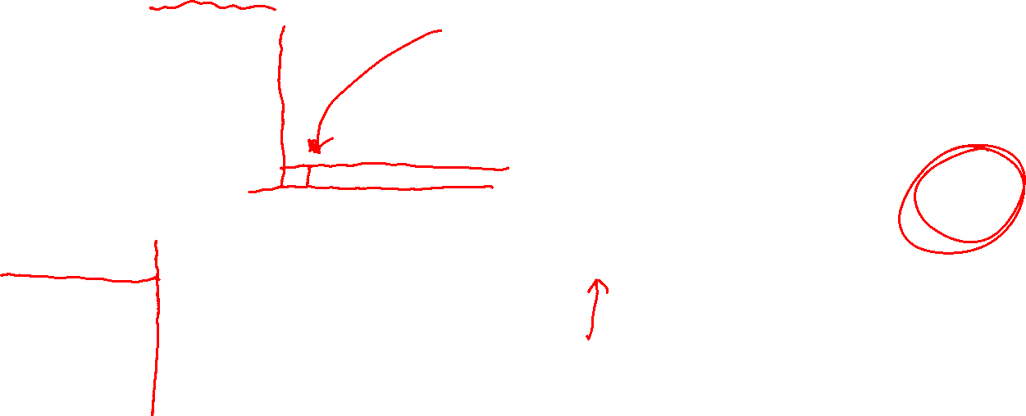

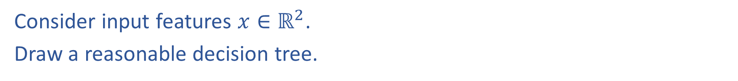
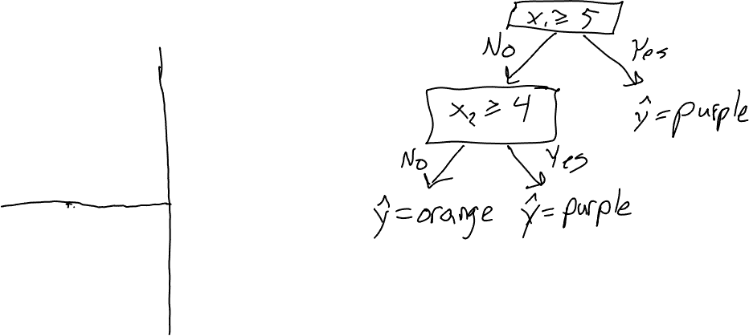

Reminder: Decision Tree Worksheet
Consider input features $x∈ℝ^{2}$.
Draw a reasonable decision tree.
$$x_{2}$$
10
5
$$x_{1}$$
5
10

Slide 3

Poll 1
Decision tree generalization
Which of the following generalize best to unseen examples?
Small tree with low training accuracy
Large tree with low training accuracy
Small tree with high training accuracy
Large tree with high training accuracy

Slide 4
Poll 1
Decision tree generalization
Which of the following generalize best to unseen examples?
Small tree with low training accuracy
Large tree with low training accuracy
Small tree with high training accuracy
Large tree with high training accuracy

Slide 5
Poll 2
True or False:
For any dataset, you can find a decision tree that can perfectly classify the training data.

Slide 6
Underfitting and Overfitting
Overfitting occurs when model:
  is too complex
  fits noise or “outliers” in the training dataset as opposed to the actual pattern of interest
  doesn’t have enough inductive bias pushing it to generalize
Underfitting occurs when model:
  is too simple
  can’t capture the actual pattern of interest in the training dataset
  has too much inductive bias
Slide credit: CMU MLD Henry Chai

Slide 7

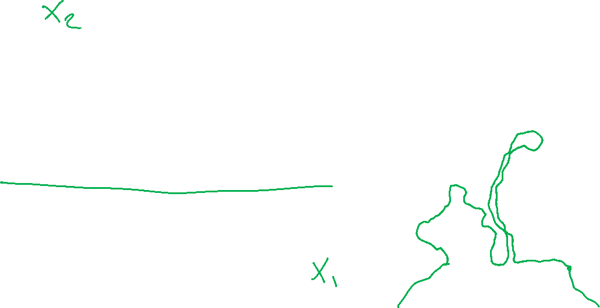



Underfitting and Overfitting: Classification
Underfitting
Overfitting
$$x_{2}$$
$$x_{2}$$
10
10
5
5
$$x_{1}$$
$$x_{1}$$
5
10
5
10

Slide 8
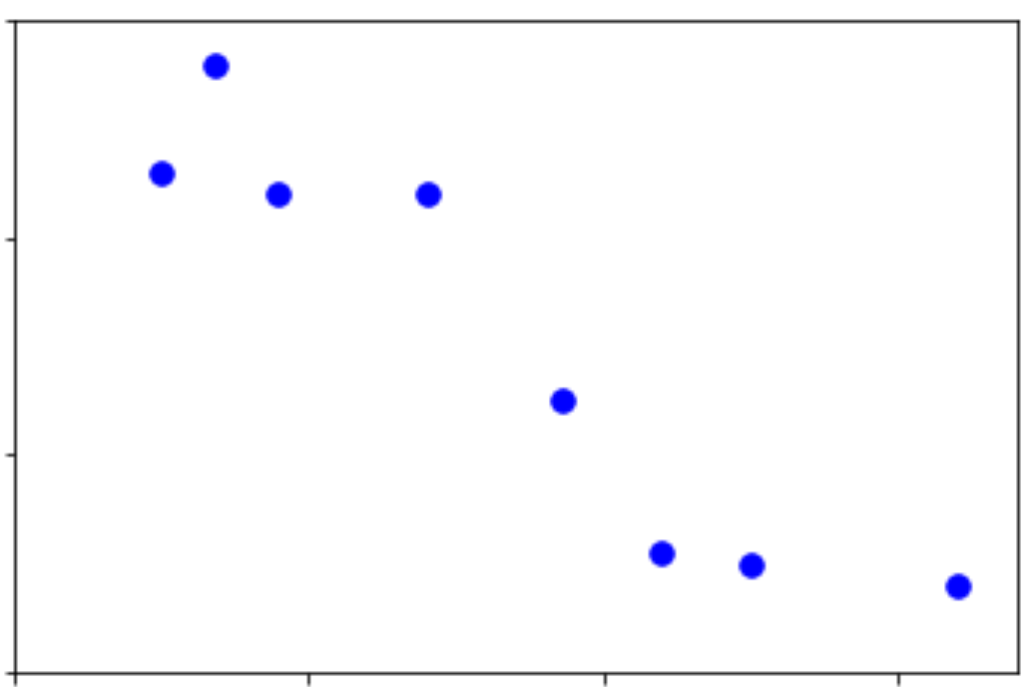
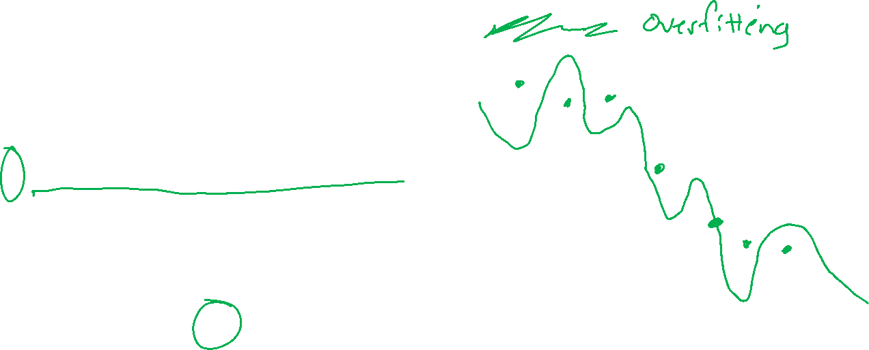
Underfitting and Overfitting: Regression
Underfitting
Classification
y
y
x1
x1

Slide 9
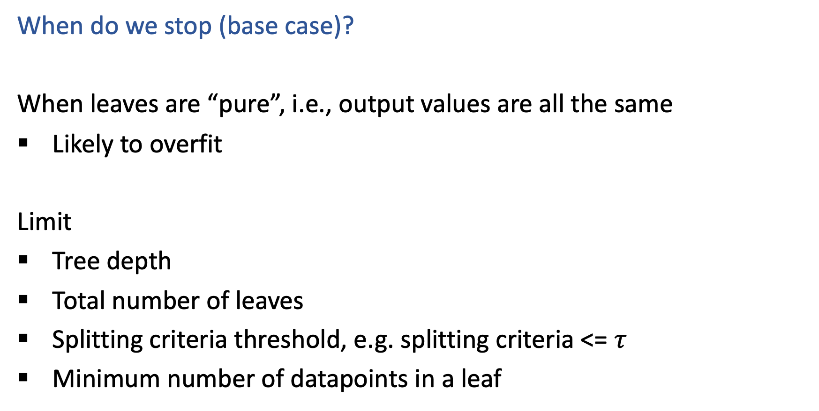

Decision Trees
When do we stop (base case)?
When leaves are “pure”, i.e., output values are all the same
Likely to overfit
Limit
Tree depth
Total number of leaves
Splitting criteria threshold, e.g. splitting criteria <= $τ$
Minimum number of datapoints in a leaf

Slide 10
But how do we choose all of those limits?!?
Answer: Model selection
Model selection is the process to choose the “best” among a set of (trained) models

Slide 11
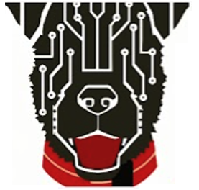
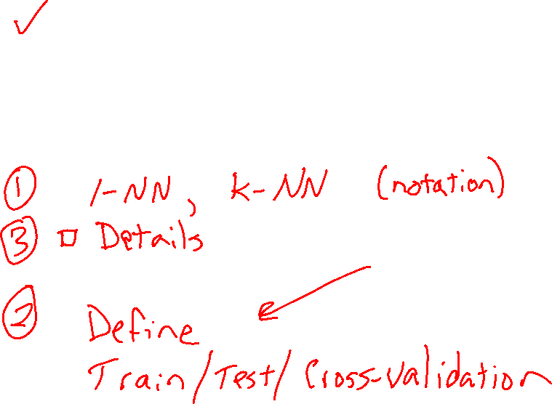
Today
Underfitting and Overfitting
Decision Tree stopping criteria
Classification and regression examples
k-Nearest Neighbor
Model Selection

Slide 12
K-Nearest Neighbor

Slide 13
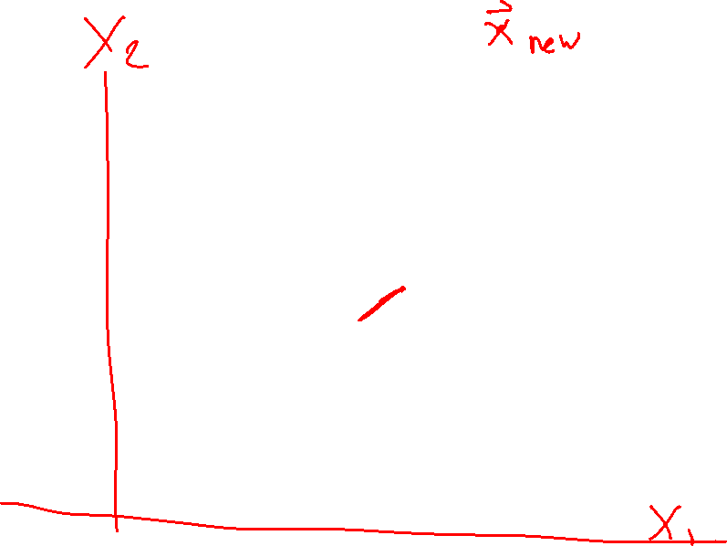
Nearest Neighbor Classifier
Test subject
Whales
Seals
Sharks

Slide 14
Nearest Neighbor Classifier
Test subject
Whales
Seals
Sharks

Slide 15
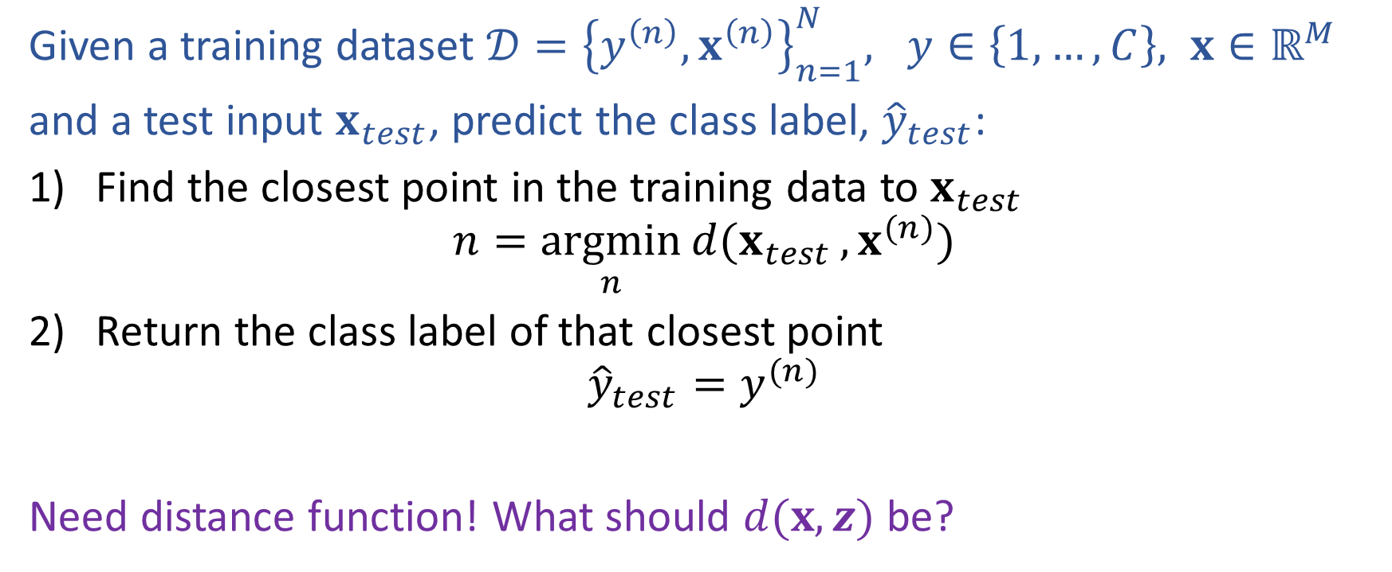
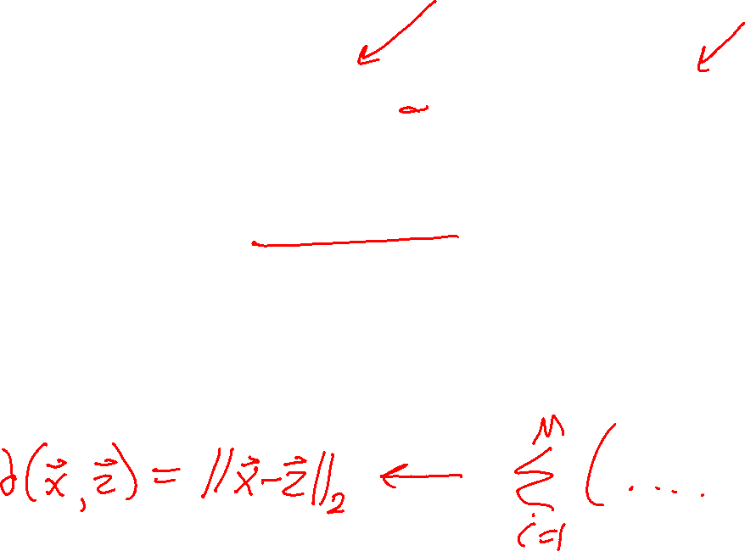
Nearest Neighbor Classification
Given a training dataset $𝒟={\left\{y^{\left(n\right)}, x^{\left(n\right)}\right\}}_{n=1}^{N}, y∈\left\{1,…,C\right\}, x∈ℝ^{M}$
and a test input $x_{test}$, predict the class label, ${\hat{y}}_{test}$:
Find the closest point in the training data to $x_{test}$
$$n=\underset{n}{argmin}{d(x_{test}}, x^{(n)})$$
Return the class label of that closest point
$${\hat{y}}_{test}=y^{(n)}$$
Need distance function! What should $d(x, z)$ be?

Slide 16
Fisher Iris Dataset
Fisher (1936) used 150 measurements of flowers from 3 different species: Iris setosa (0), Iris virginica (1), Iris versicolor (2) collected by Anderson (1936)
Species | Sepal Length | Sepal Width | Petal Length | Petal Width
0 | 4.3 | 3.0 | 1.1 | 0.1
0 | 4.9 | 3.6 | 1.4 | 0.1
0 | 5.3 | 3.7 | 1.5 | 0.2
1 | 4.9 | 2.4 | 3.3 | 1.0
1 | 5.7 | 2.8 | 4.1 | 1.3
1 | 6.3 | 3.3 | 4.7 | 1.6
1 | 6.7 | 3.0 | 5.0 | 1.7
Full dataset: https://en.wikipedia.org/wiki/Iris_flower_data_set

Slide 17

Fisher Iris Dataset
Fisher (1936) used 150 measurements of flowers from 3 different species: Iris setosa (0), Iris virginica (1), Iris versicolor (2) collected by Anderson (1936)
Species | Sepal Length | Sepal Width
0 | 4.3 | 3.0
0 | 4.9 | 3.6
0 | 5.3 | 3.7
1 | 4.9 | 2.4
1 | 5.7 | 2.8
1 | 6.3 | 3.3
1 | 6.7 | 3.0
Deleted two of the four features, so that input space is 2D
Full dataset: https://en.wikipedia.org/wiki/Iris_flower_data_set

Slide 18
Nearest Neighbor on Fisher Iris Data
Slide credit: CMU MLD Matt Gormley

Slide 19
Nearest Neighbor on Fisher Iris Data
Slide credit: CMU MLD Matt Gormley

Slide 20
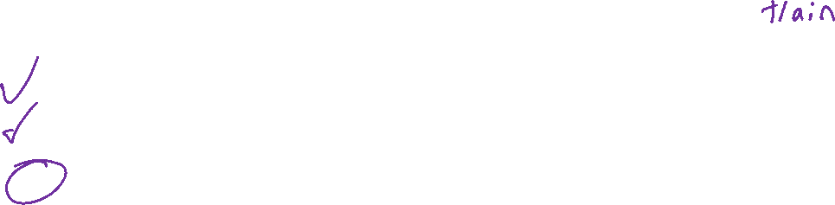
Poll 3
Which methods can achieve zero training error on this dataset?
Decision trees
1-Nearest Neighbor
Both
Neither
If zero error, draw the decision boundary.
Otherwise, why not?
x₂
x₁

Slide 21
Poll 3
Which methods can achieve zero training error on this dataset?
Decision trees
1-Nearest Neighbor
Both
Neither
If zero error, draw the decision boundary.
Otherwise, why not?
x₂
x₁

Slide 22
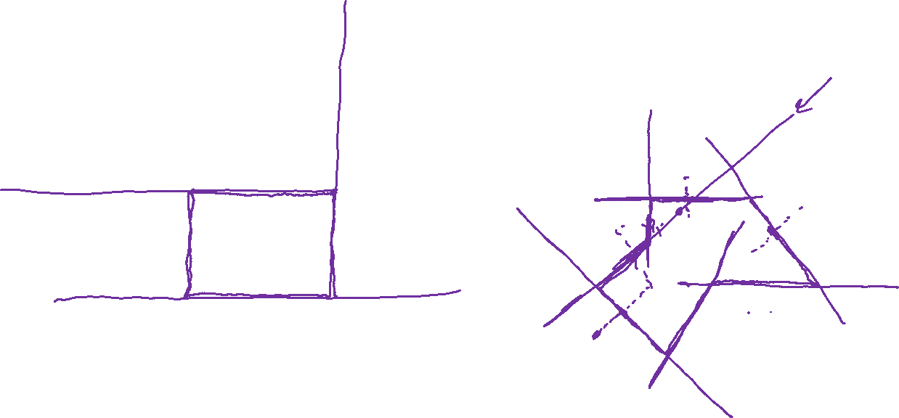
Decision Boundaries
Decision tree
Nearest neighbor
x₂
x₂
x₁
x₁

Slide 23
Decision Boundaries
Decision tree
Nearest neighbor
x₂
x₂
x₁
x₁

Slide 24
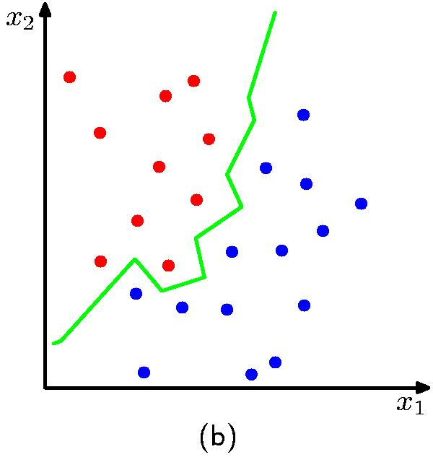
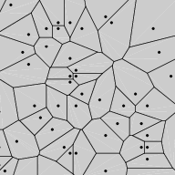
Nearest Neighbor Decision Boundary
1-nearest neighbor classifier decision boundary
Voronoi Diagram
K = 1

Slide 25
Poll 4
1-nearest neighbor will likely:
Overfit
Underfit
Neither (it’s a great learner!)

Slide 26
Poll 4
1-Nearest neighbor will likely:
Overfit
Underfit
Neither (it’s a great learner!)

Slide 27
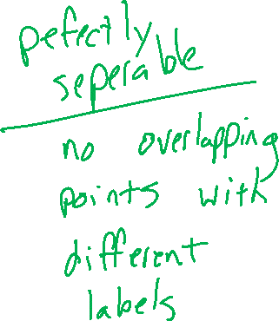
Nearest Neighbor on Fisher Iris Data
Slide credit: CMU MLD Matt Gormley

Slide 28
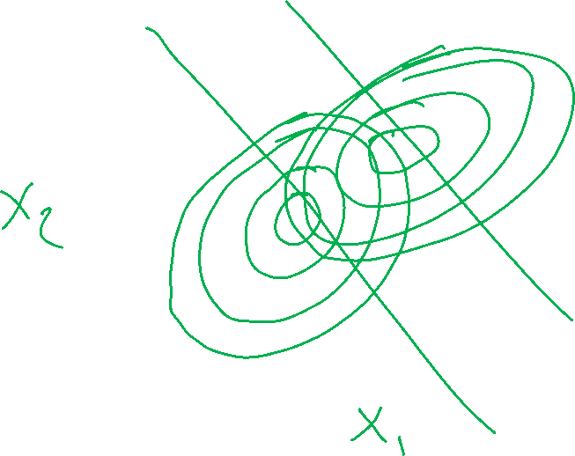
Nearest Neighbor on Gaussian Data
Slide credit: CMU MLD Matt Gormley

Slide 29
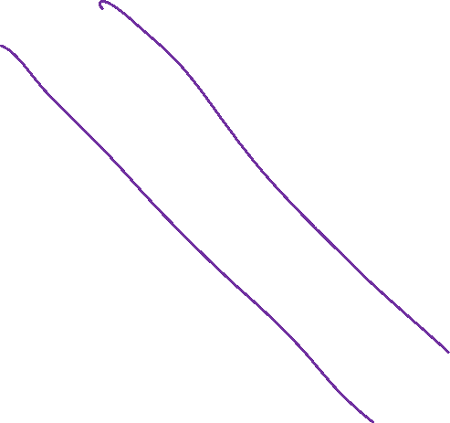
Nearest Neighbor on Gaussian Data
Slide credit: CMU MLD Matt Gormley

Slide 30
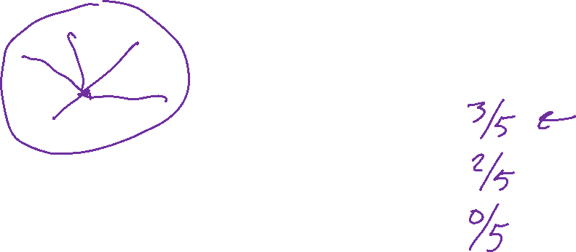
kNN classifier (k=5)
Test subject
Whales
Seals
Sharks

Slide 31
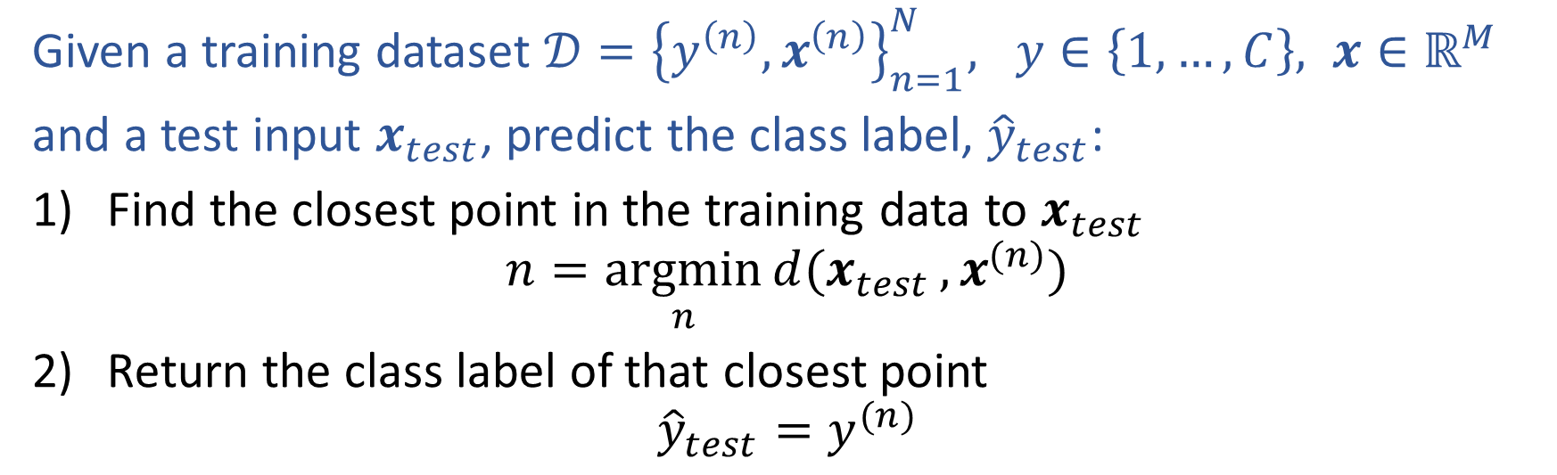
Nearest Neighbor Classification
Given a training dataset $𝒟={\left\{y^{\left(n\right)}, x^{\left(n\right)}\right\}}_{n=1}^{N}, y∈\left\{1,…,C\right\}, x∈ℝ^{M}$
and a test input $x_{test}$, predict the class label, ${\hat{y}}_{test}$:
Find the closest point in the training data to $x_{test}$
$$n=\underset{n}{argmin}{d(x_{test}}, x^{(n)})$$
Return the class label of that closest point
$${\hat{y}}_{test}=y^{(n)}$$

Slide 32
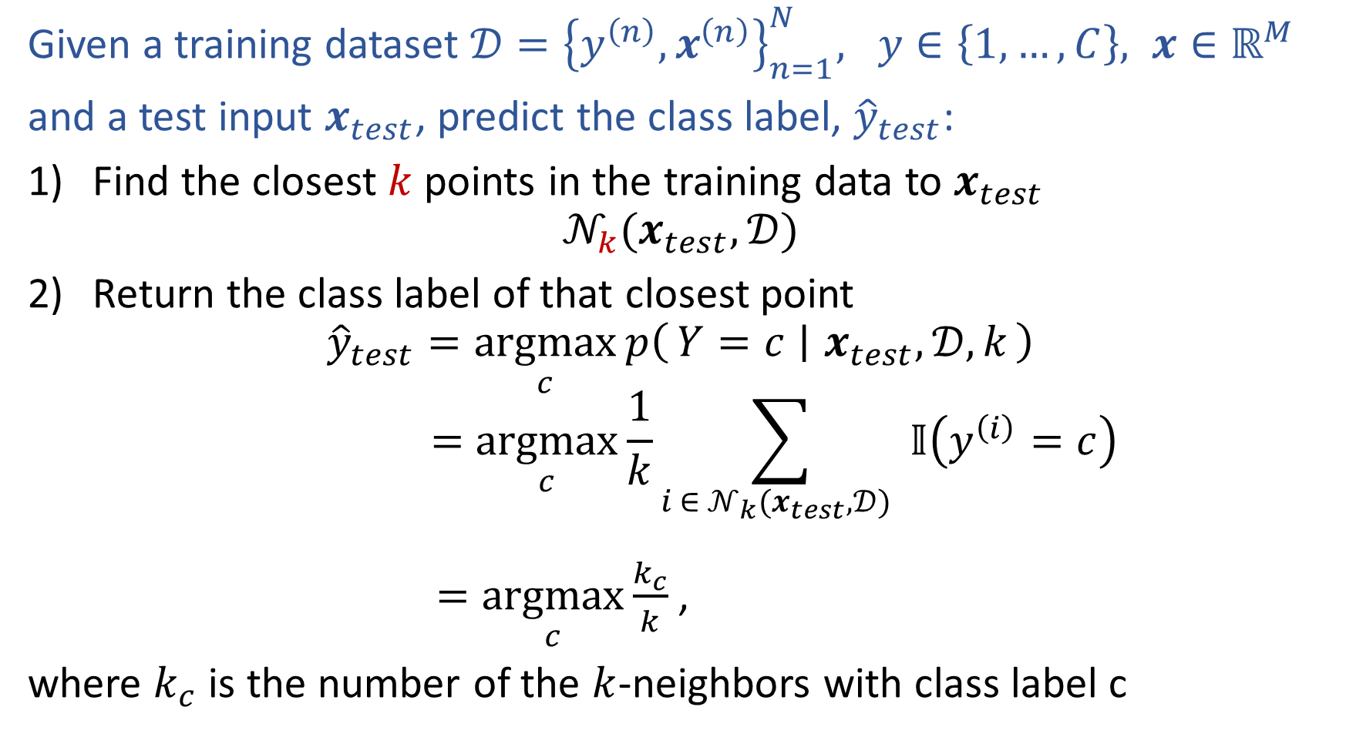
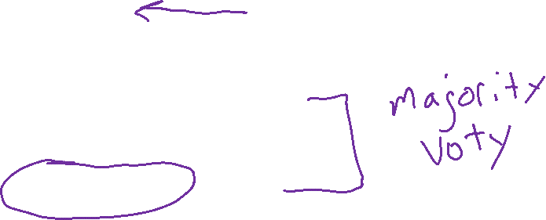
k-Nearest Neighbor Classification
Given a training dataset $𝒟={\left\{y^{\left(n\right)}, x^{\left(n\right)}\right\}}_{n=1}^{N}, y∈\left\{1,…,C\right\}, x∈ℝ^{M}$
and a test input $x_{test}$, predict the class label, ${\hat{y}}_{test}$:
Find the closest $k$ points in the training data to $x_{test}$
$$𝒩_{k}(x_{test},𝒟)$$
Return the class label of that closest point
$${\hat{y}}_{test}=\underset{c}{argmax}{p\left(Y=c ∣ x_{test},𝒟, k\right)}$$
$$=\underset{c}{argmax}{\frac{1}{k}\sum_{i ∈ 𝒩_{k}(x_{test},𝒟) }{𝕀\left(y^{\left(i\right)}=c\right)}}$$
$=\underset{c}{argmax}{\frac{k_{c}}{k}}$,
where $k_{c}$ is the number of the $k$-neighbors with class label c

Slide 33
1-Nearest Neighbor (kNN) classifier
Sports
Whales
Seals
Science
Sharks
Arts

Slide 34
2-Nearest Neighbor (kNN) classifier
Sports
Whales
Seals
Science
Sharks
Arts

Slide 35
3-Nearest Neighbor (kNN) classifier
Sports
Whales
Seals
Science
Sharks
Arts

Slide 36
5-Nearest Neighbor (kNN) classifier
Sports
Whales
Seals
Science
Sharks
Arts

Slide 37
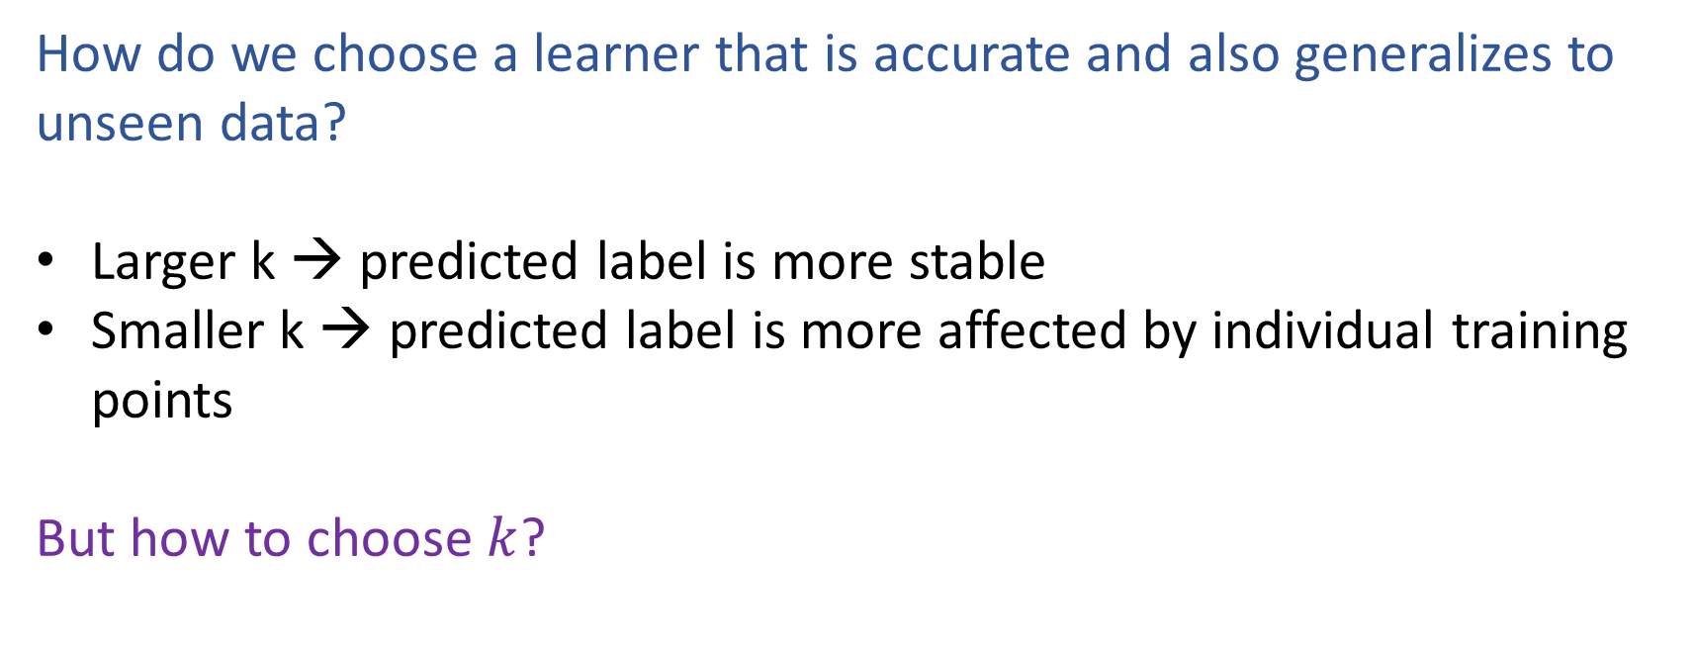
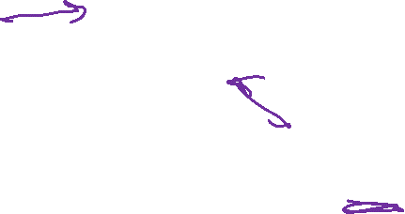
What is the best k?
How do we choose a learner that is accurate and also generalizes to unseen data?
Larger k → predicted label is more stable
Smaller k → predicted label is more affected by individual training points
But how to choose $k$?

Slide 38

k-NN on Fisher Iris Data
Special Case: Nearest Neighbor
Slide credit: CMU MLD Matt Gormley

Slide 39
k-NN on Fisher Iris Data
Slide credit: CMU MLD Matt Gormley

Slide 40
k-NN on Fisher Iris Data
Slide credit: CMU MLD Matt Gormley

Slide 41
k-NN on Fisher Iris Data
Slide credit: CMU MLD Matt Gormley

Slide 42
k-NN on Fisher Iris Data
Slide credit: CMU MLD Matt Gormley

Slide 43
k-NN on Fisher Iris Data
Slide credit: CMU MLD Matt Gormley

Slide 44
k-NN on Fisher Iris Data
Special Case: Majority Vote
Slide credit: CMU MLD Matt Gormley

Slide 45
K-NN Details

Slide 46
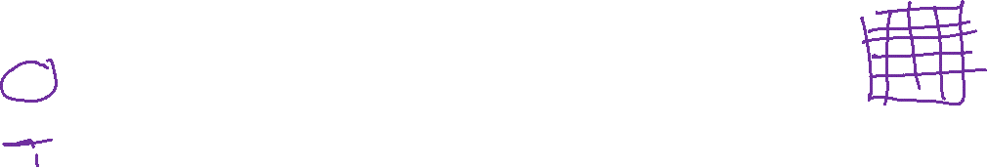
k-NN: Details
The inductive bias of a machine learning algorithm is the principal by which it generalizes to unseen examples
Inductive Bias:
  Close points should have similar labels
  All dimensions are created equally!
Slide credit: CMU MLD Matt Gormley

Slide 47
k-NN: Details
Inductive Bias:
  Close points should have similar labels
  All dimensions are created equally!
Example: two features for k-NN
big problem: feature scale could dramatically influence classification results
length (cm)
length (cm)
Slide credit: CMU MLD Matt Gormley
width (cm)
width (m)

Slide 48
k-NN: Details
Computational Efficiency:
Suppose we have N training examples, and each one has M features
Computational complexity for the special case where k=1:
Slide credit: CMU MLD Matt Gormley
Notes:
https://www.ri.cmu.edu/pub_files/pub1/moore_andrew_1991_1/moore_andrew_1991_1.pdf

Slide 49
Poll 5: Two questions (train) and (predict)
Suppose we have N training examples, and each one has M features
Computational complexity for the special case where k=1:
O(1)
O(log N)
O(log M)
O(log NM)
O(N)
O(M)
O(NM)
O(N^2)
O(N^2M)

Slide 50
Poll 5 : Two questions (train) and (predict)
Suppose we have N training examples, and each one has M features
Computational complexity for the special case where k=1:
O(1)
O(log N)
O(log M)
O(log NM)
O(N)
O(M)
O(NM)
O(N^2)
O(N^2M)

Slide 51
k-NN: Details
Computational Efficiency:
Suppose we have N training examples, and each one has M features
Computational complexity for the special case where k=1:
Task | Naive | k-d Tree
Train | O(1) | ~ O(M N log N)
Predict (one test example) | O(MN) | ~ O(2^{M} log N) on average
Problem: Very fast for small M, but very slow for large M
In practice: use stochastic approximations (very fast, and empirically often as good)
Slide credit: CMU MLD Matt Gormley
Notes:
https://www.ri.cmu.edu/pub_files/pub1/moore_andrew_1991_1/moore_andrew_1991_1.pdf

Slide 52
k-NN: Details
Computational Efficiency:
Suppose we have N training examples, and each one has M features
Computational complexity for the special case where k=1:
Task | Naive | k-d Tree
Train | O(1) | ~ O(M N log N)
Predict (one test example) | O(MN) | ~ O(2^{M} log N) on average
Problem: Very fast for small M, but very slow for large M
In practice: use stochastic approximations (very fast, and empirically often as good)
Slide credit: CMU MLD Matt Gormley
Notes:
https://www.ri.cmu.edu/pub_files/pub1/moore_andrew_1991_1/moore_andrew_1991_1.pdf

Slide 53
Model Selection

Slide 54
Model Selection
WARNING:
In some sense, our discussion of model selection is premature.
The models we have considered thus far are fairly simple.
The models and the many decisions available to the data scientist wielding them will grow to be much more complex than what we’ve seen so far.
Slide credit: CMU MLD Matt Gormley

Slide 55
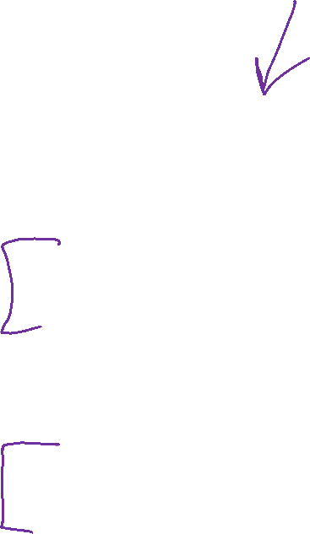
Model Selection
Statistics
Machine Learning
Def: a model defines the data generation process (i.e. a set or family of parametric probability distributions)
Def: model parameters are the values that give rise to a particular probability distribution in the model family
Def: learning (aka. estimation) is the process of finding the parameters that best fit the data
Def: hyperparameters are the parameters of a prior distribution over parameters
Def: (loosely) a model defines the hypothesis space over which learning performs its search
Def: model parameters are the numeric values or structure selected by the learning algorithm that give rise to a hypothesis
Def: the learning algorithm defines the data-driven search over the hypothesis space (i.e. search for good parameters)
Def: hyperparameters are the tunable aspects of the model, that the learning algorithm does not select
Slide credit: CMU MLD Matt Gormley

Slide 56
Model Selection
Example: Decision Tree
Machine Learning
model = set of all possible trees, possibly restricted by some hyperparameters (e.g. max depth)
parameters = structure of a specific decision tree
learning algorithm = ID3, CART, etc.
hyperparameters = max-depth, threshold for splitting criterion, etc.
Def: (loosely) a model defines the hypothesis space over which learning performs its search
Def: model parameters are the numeric values or structure selected by the learning algorithm that give rise to a hypothesis
Def: the learning algorithm defines the data-driven search over the hypothesis space (i.e. search for good parameters)
Def: hyperparameters are the tunable aspects of the model, that the learning algorithm does not select
Slide credit: CMU MLD Matt Gormley

Slide 57
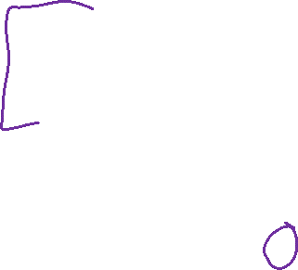
Model Selection
Example: k-Nearest Neighbors
Machine Learning
model = set of all possible nearest neighbors classifiers
parameters = none
(KNN is an instance-based or non-parametric method)
learning algorithm = for naïve setting, just storing the data
hyperparameters = k, the number of neighbors to consider
Def: (loosely) a model defines the hypothesis space over which learning performs its search
Def: model parameters are the numeric values or structure selected by the learning algorithm that give rise to a hypothesis
Def: the learning algorithm defines the data-driven search over the hypothesis space (i.e. search for good parameters)
Def: hyperparameters are the tunable aspects of the model, that the learning algorithm does not select
Slide credit: CMU MLD Matt Gormley

Slide 58
Model Selection
Statistics
Machine Learning
Def: a model defines the data generation process (i.e. a set or family of parametric probability distributions)
Def: model parameters are the values that give rise to a particular probability distribution in the model family
Def: learning (aka. estimation) is the process of finding the parameters that best fit the data
Def: hyperparameters are the parameters of a prior distribution over parameters
Def: (loosely) a model defines the hypothesis space over which learning performs its search
Def: model parameters are the numeric values or structure selected by the learning algorithm that give rise to a hypothesis
Def: the learning algorithm defines the data-driven search over the hypothesis space (i.e. search for good parameters)
Def: hyperparameters are the tunable aspects of the model, that the learning algorithm does not select
If “learning” is all about picking the best parameters how do we pick the best hyperparameters?
Slide credit: CMU MLD Matt Gormley

Slide 59
Model Selection
Two very similar definitions:
  Def: model selection is the process by which we choose the “best” model from among a set of candidates
  Def: hyperparameter optimization is the process by which we choose the “best” hyperparameters from among a set of candidates (could be called a special case of model selection)
Both assume access to a function capable of measuring the quality of a model
Both are typically done “outside” the main training algorithm --- typically training is treated as a black box
Slide credit: CMU MLD Matt Gormley

Slide 60
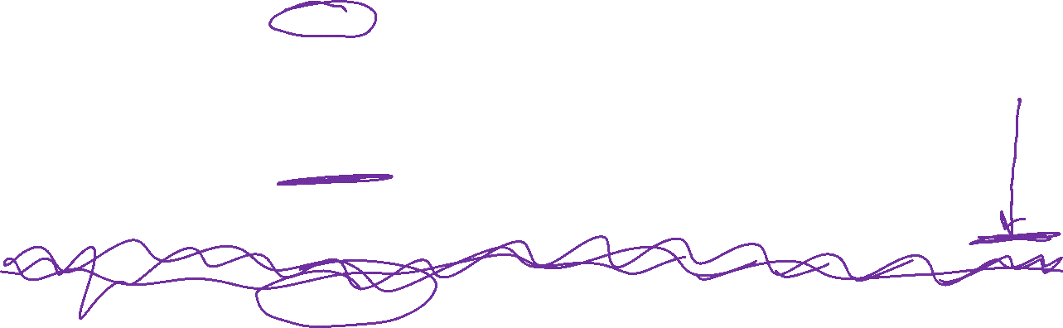
Experimental Design
 | Input | Output | Notes
Training | training dataset hyperparameters | best model parameters | We pick the best model parameters by learning on the training dataset for a fixed set of hyperparameters
Hyperparameter Optimization | training dataset validation dataset | best hyperparameters | We pick the best hyperparameters by learning on the training data and evaluating error on the validation error
Testing | test dataset hypothesis (i.e. fixed model parameters) | test error | We evaluate a hypothesis corresponding to a decision rule with fixed model parameters on a test dataset to obtain test error
Slide credit: CMU MLD Matt Gormley

Slide 61
Special Cases of k-NN
k=1: Nearest Neighbor
k=N: Majority Vote
Slide credit: CMU MLD Matt Gormley

Slide 62
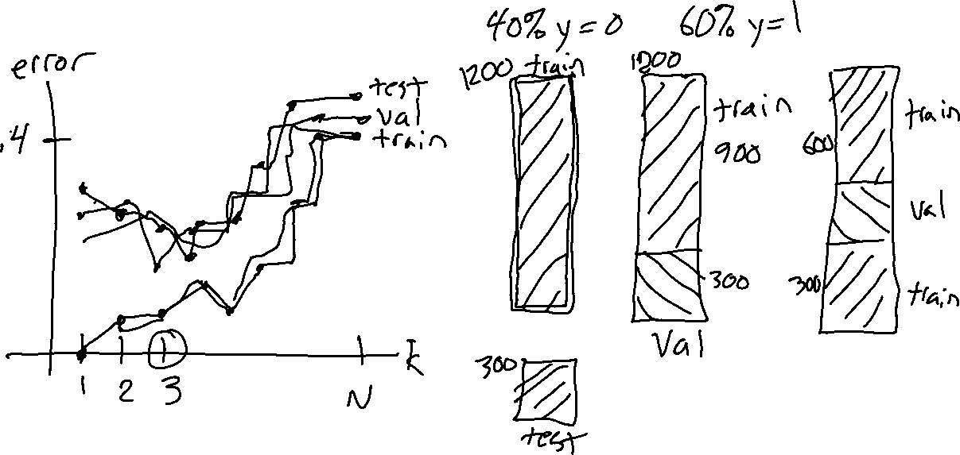
Example of Hyperparameter Optimization
Choosing k for k-NN
Slide credit: CMU MLD Matt Gormley

Slide 63
Example of Hyperparameter Optimization
Choosing k for k-NN
Slide credit: CMU MLD Matt Gormley

Slide 64
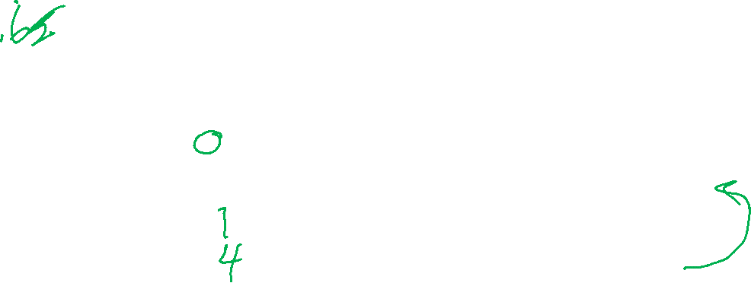
Example of Hyperparameter Optimization
Choosing k for k-NN
Slide credit: CMU MLD Matt Gormley

Slide 65
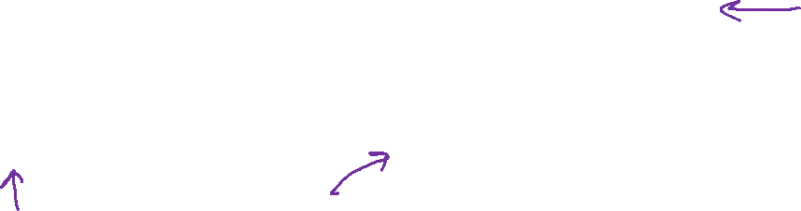
Example of Hyperparameter Optimization
Choosing k for k-NN
Slide credit: CMU MLD Matt Gormley

Slide 66
Example of Hyperparameter Optimization
Choosing k for k-NN
Slide credit: CMU MLD Matt Gormley

Slide 67
k-NN: Choosing k
Fisher Iris Data: varying the value of k
Slide credit: CMU MLD Matt Gormley

Slide 68
k-NN: Choosing k
Gaussian Data: varying the value of k
Slide credit: CMU MLD Matt Gormley

Slide 69
Cross-validation
Why do we need cross-validation?
  Choose hyperparameters
  Choose technique
  Help make any choices beyond our parameters
But now, we have another choice to make!
  How do we split training and validation?
Trade-offs
  More held-out data, better meaning behind validation numbers
  More held-out data, less data to train on!

Slide 70
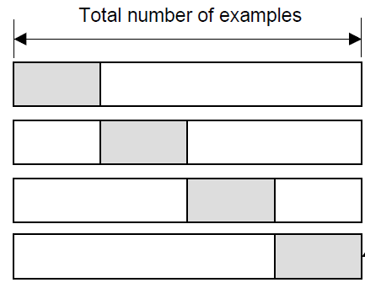
Cross-validation
K-fold cross-validation
Create K-fold partition of the dataset.
Do K runs: train using K-1 partitions and calculate validation error on remaining partition (rotating validation partition on each run).
Report average validation error
training
validation
Run 1
Run 2
Run K
Slide credit: CMU MLD Aarti Singh
TexPoint fonts used in EMF.
Read the TexPoint manual before you delete this box.: AAAAAAA

Slide 71
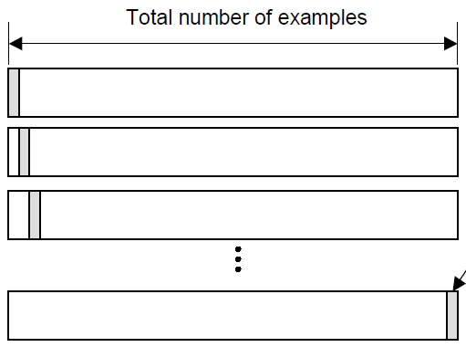
Cross-validation
Leave-one-out (LOO) cross-validation
Special case of K-fold with K=N partitions
Equivalently, train on N-1 samples and validate on only one sample per run for N runs
training
validation
Run 1
Run 2
Run K
Slide credit: CMU MLD Aarti Singh
TexPoint fonts used in EMF.
Read the TexPoint manual before you delete this box.: AAAAAAA

Slide 72
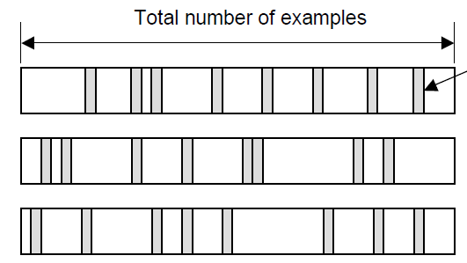
Cross-validation
Random subsampling
Randomly subsample a fixed fraction αN (0< α <1) of the dataset for validation.
Compute validation error with remaining data as training data.
Repeat K times
Report average validation error
training
validation
Run 1
Run 2
Run K
Slide credit: CMU MLD Aarti Singh
TexPoint fonts used in EMF.
Read the TexPoint manual before you delete this box.: AAAAAAA

Slide 73
Poll 6
Say you are choosing amongst 7 discrete values of a decision tree mutual information threshold, and you want to do K=5-fold cross-validation.
How many times do I have to train my model?
  1
  5
  7
  12
  35
  5⁷
Notes:
0

Slide 74
Poll 6
Say you are choosing amongst 7 discrete values of a decision tree mutual information threshold, and you want to do K=5-fold cross-validation.
How many times do I have to train my model?
  1
  5
  7
  12
  35
  5⁷
Notes:
0

Slide 75
Model Selection
WARNING (again):
  This section is only scratching the surface!
  Lots of methods for hyperparameter optimization: (to talk about later)
    Grid search
    Random search
    Bayesian optimization
    Graduate-student descent
    …
Main Takeaway:
  Model selection / hyperparameter optimization is just another form of learning
Slide credit: CMU MLD Matt Gormley

