Slide 1

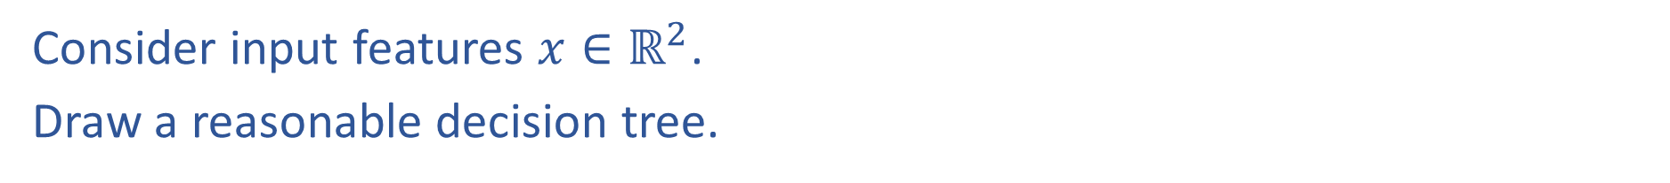
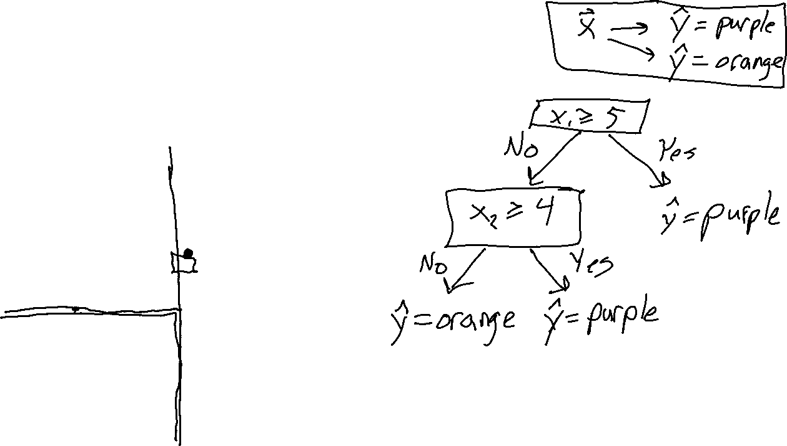

Warm-up as you walk in: Worksheet
Consider input features $x∈ℝ^{2}$.
Draw a reasonable decision tree.
$$x_{2}$$
10
5
$$x_{1}$$
5
10

Slide 2

10-315 Introduction to ML Decision Trees
Instructor: Pat Virtue

Slide 3
Decision Tree
Fetal
Position
Medical Prediction
(Oversimplified example)
Vertex
Abnormal
Breech
Fetal
Distress
C-section
C-section
No
Yes
Previous
C-section
C-section
No
Yes
Natural
C-section

Slide 4

Reminder: Machine Learning Problem Formulation
Three components <T,P,E>:
Task, T
Performance measure, P
Experience, E
Definition of learning:
A computer program learns if its performance at tasks in T, as measured by P, improves with experience E
Definition from (Mitchell, 1997)

Slide 5
Decision Trees
Why are we talking about decision trees?
Minimal prereqs: Doesn't rely on a ton of linear algebra, probability, or calc.
So we can focus on some important ML concepts and notation, including model selection, overfitting/underfitting
Explainability
Decision trees can be incredibly useful as they can more easily be interpreted and altered by humans than other ML algorithms
Basis of very powerful set of techniques: Random Forests
Random forests train many simple decision trees (ML topic: ensemble learning)
While powerful, random forests unfortunately have poor explainablility

Slide 6
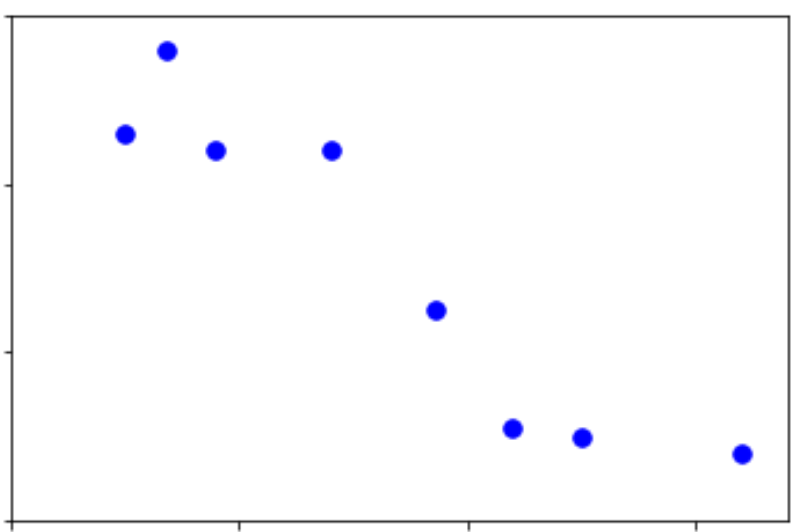
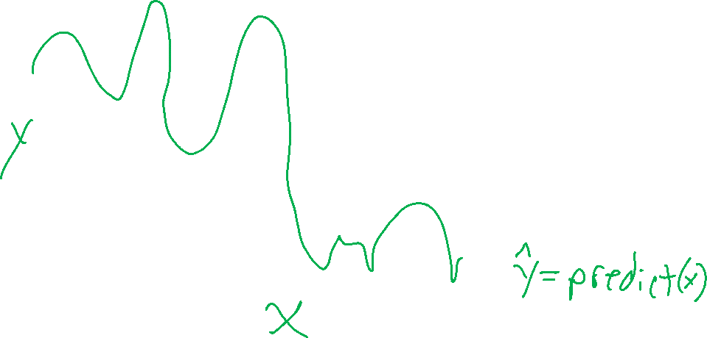
Regression Model
Regression: learning a model to predict a numerical output (but not numbers that just represent categories, that would be classification)
Model

Slide 7
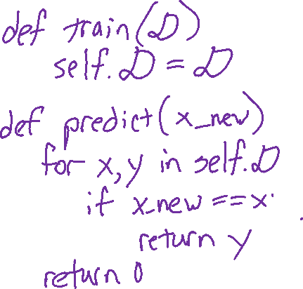
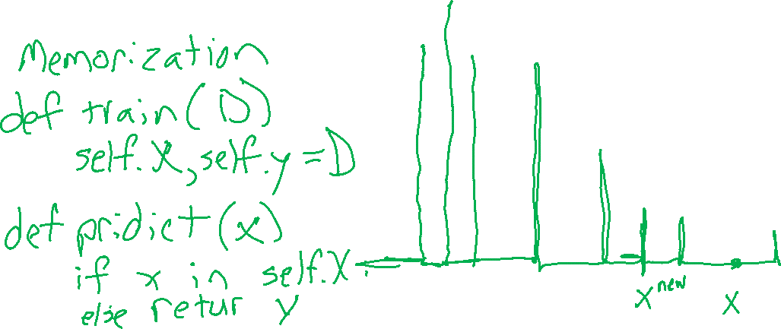
Regression Model
Regression: learning a model to predict a numerical output (but not numbers that just represent categories, that would be classification)
Model: Memorization

Slide 8
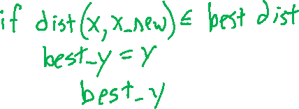

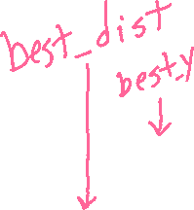
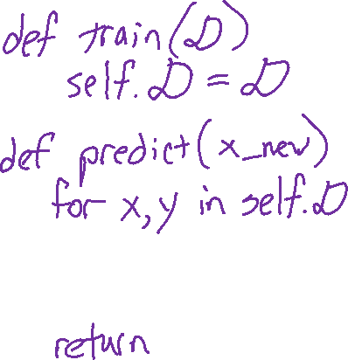
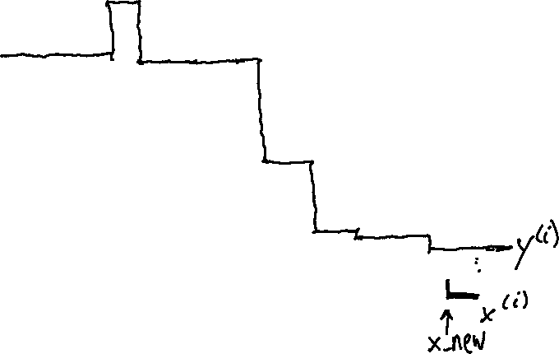
Regression Model
Regression: learning a model to predict a numerical output (but not numbers that just represent categories, that would be classification)
Model: Nearest neighbor

Slide 9
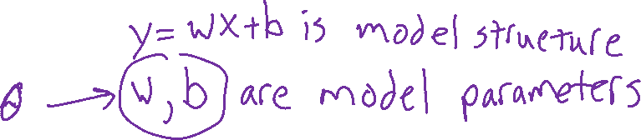
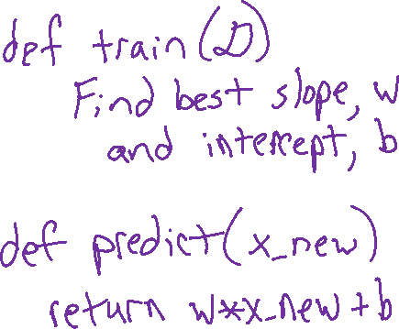
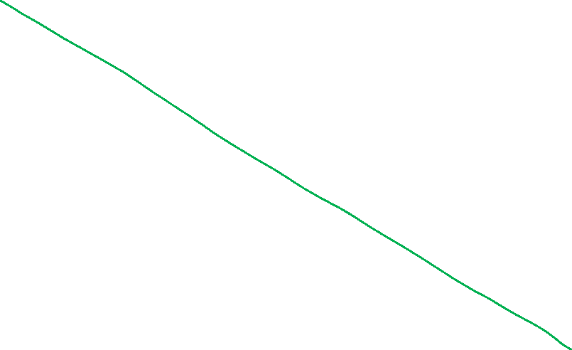
Regression Model
Regression: learning a model to predict a numerical output (but not numbers that just represent categories, that would be classification)
Model: Linear

Slide 10
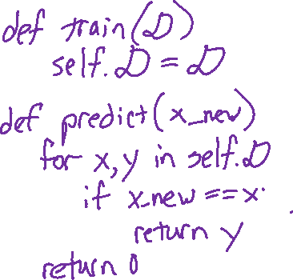
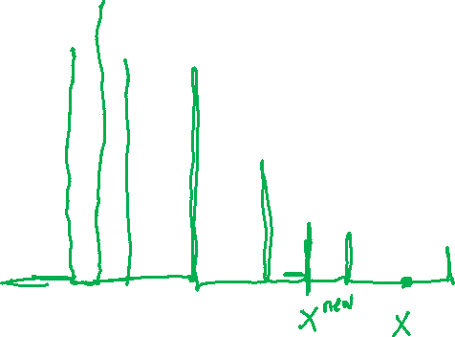
Poll 1
Does the memorization algorithm learn?
Yes
No
I have no clue
Slide credit: CMU MLD Matt Gormley

Slide 11
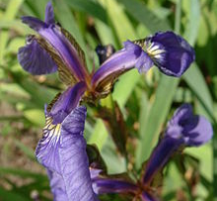
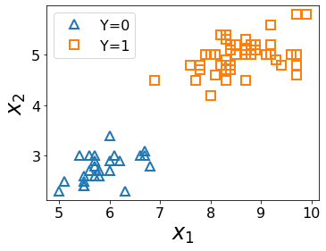
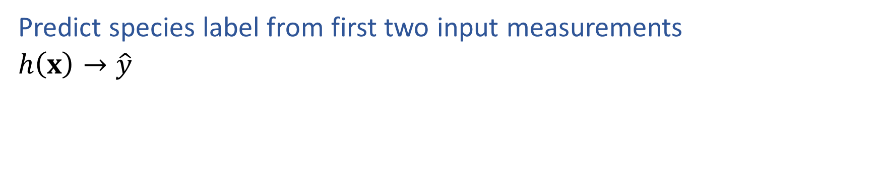
ML Task: Classification
Predict species label from first two input measurements
$h\left(x\right)→\hat{y}$
Species | Sepal Length | Sepal Width
0 | 4.3 | 3.0
0 | 4.9 | 3.6
0 | 5.3 | 3.7
1 | 4.9 | 2.4
1 | 5.7 | 2.8
1 | 6.3 | 3.3
Images and full dataset: https://en.wikipedia.org/wiki/Iris_flower_data_set

Slide 12

Problem Formulation
$x={\left[\begin{aligned}x_{1} \\ x_{2} \\ x_{3}\end{aligned}\right]=\left[x_{1},x_{2}, x_{3}\right]}^{T}$
$x_{1}∈\{Vertex, Breech, Abn\}$
$x_{2}∈\{Y,N\}$
$x_{3}∈\{Y,N\}$
$y∈\{Csection, Natural\}$
$\hat{y}=h(x)$
Medical Prediction
$y$ $x_{1} x_{2}$ $x_{3}$
Outcome | Fetal Position | Fetal Distress | Previous C-sec
Natural | Vertex | N | N
C-section | Breech | N | N
Natural | Vertex | Y | Y
C-section | Vertex | N | Y
Natural | Abnormal | N | N

Slide 13
Decision Tree
Fetal
Position
Medical Prediction
(Oversimplified example)
Vertex
Abnormal
Breech
Fetal
Distress
C-section
C-section
No
Yes
Previous
C-section
C-section
No
Yes
Natural
C-section

Slide 14
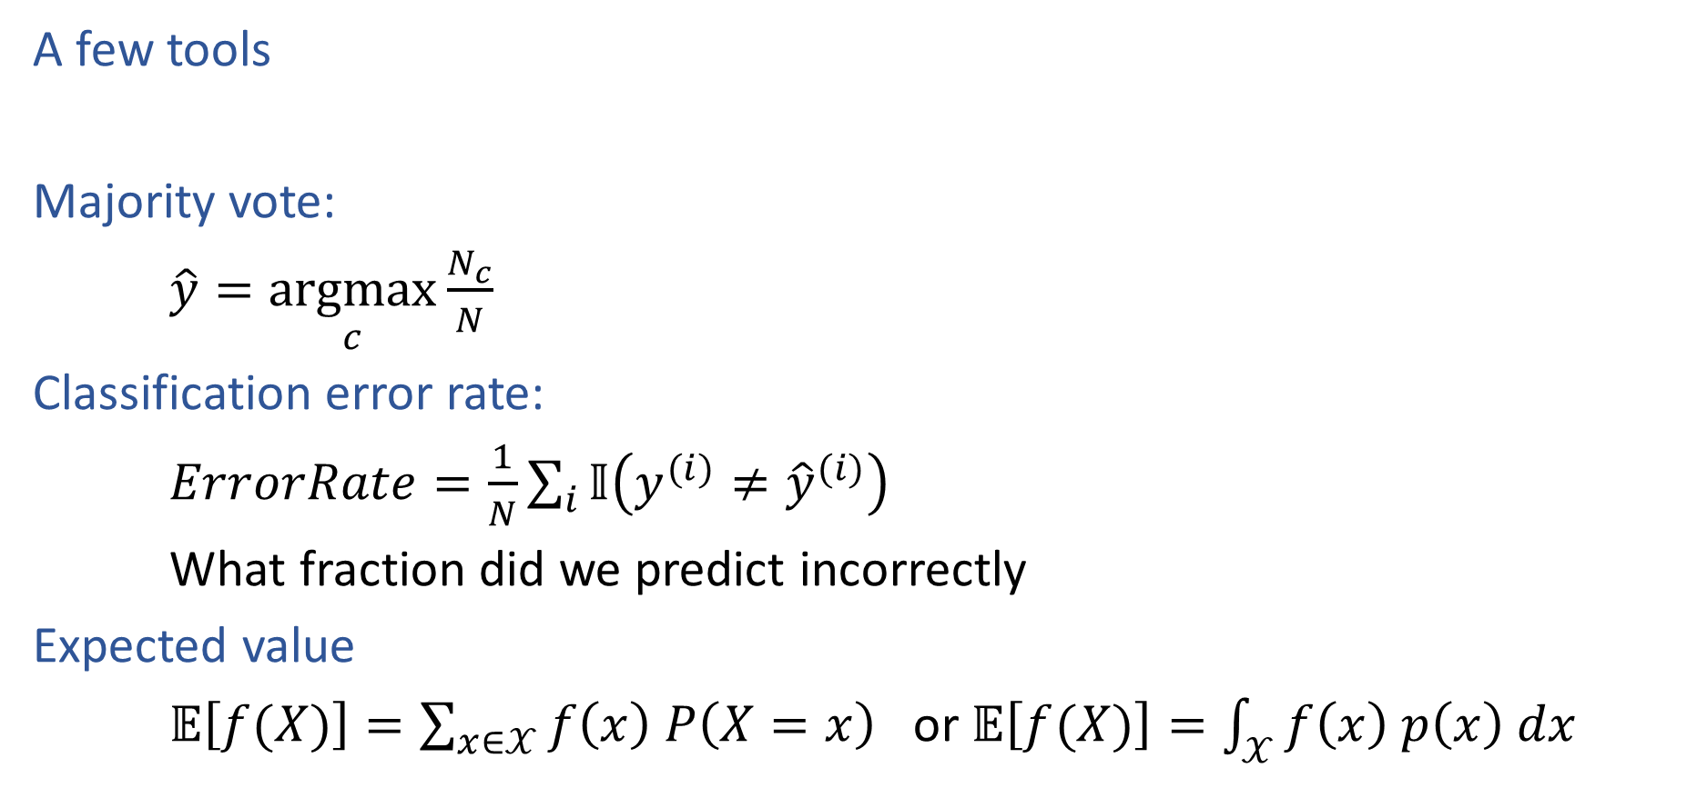
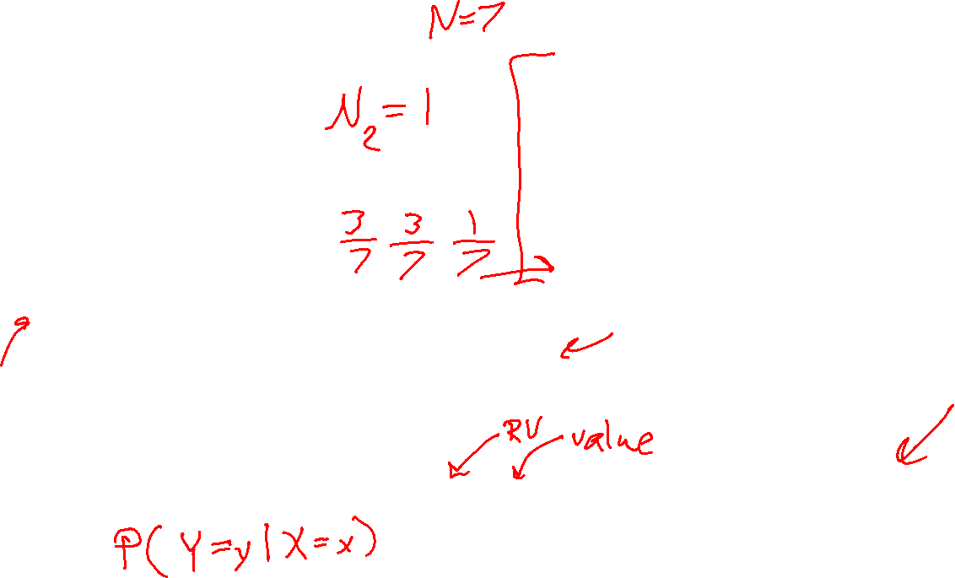
Decision Trees
Species | Sepal Length | Sepal Width | Petal Length | Petal Width
0 | 4.3 | 3.0 | 1.1 | 0.1
0 | 4.9 | 3.6 | 1.4 | 0.1
0 | 5.3 | 3.7 | 1.5 | 0.2
1 | 4.9 | 2.4 | 3.3 | 1.0
1 | 5.7 | 2.8 | 4.1 | 1.3
1 | 6.3 | 3.3 | 4.7 | 1.6
2 | 5.9 | 3.0 | 5.1 | 1.8
A few tools
Majority vote:
$\hat{y}=\underset{c}{argmax}{\frac{N_{c}}{N}}$
Classification error rate:
$ErrorRate=\frac{1}{N}\sum_{i}{𝕀\left(y^{(i)}≠{\hat{y}}^{(i)}\right)}$
What fraction did we predict incorrectly
Expected value
$𝔼\left[f(X)\right]=\sum_{x∈𝒳}{f\left(x\right) P\left(X=x\right)}$ or $𝔼\left[f(X)\right]=\int_{𝒳}{f\left(x\right) p\left(x\right) dx}$

Slide 15
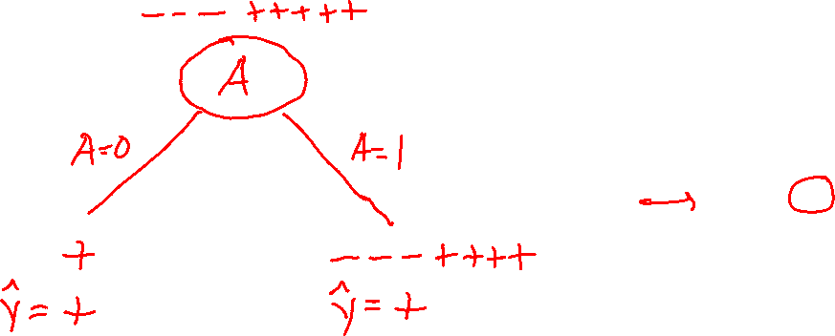
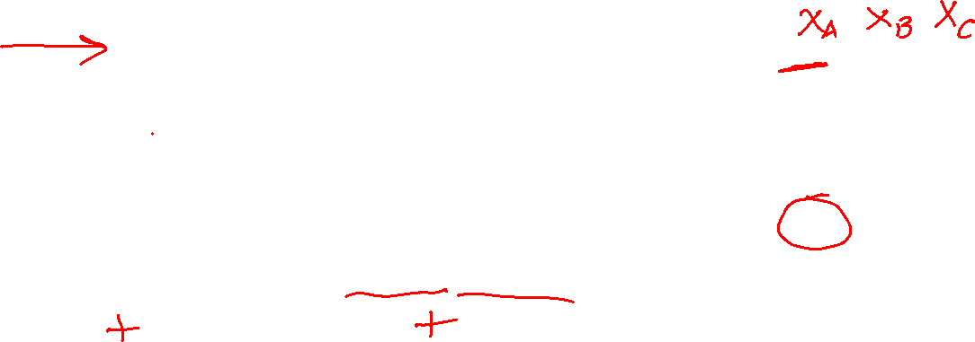
Decision Stumps
Split data based on a single attribute
Majority vote at leaves
Dataset: Output Y, Attributes A, B, C
Y | A | B | C
- | 1 | 0 | 0
- | 1 | 0 | 1
- | 1 | 0 | o
+ | 0 | 0 | 1
+ | 1 | 1 | 0
+ | 1 | 1 | 1
+ | 1 | 1 | 0
+ | 1 | 1 | 1
Slide credit: CMU MLD Matt Gormley

Slide 16
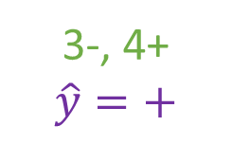
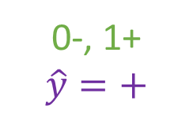
Decision Stumps
Split data based on a single attribute
Majority vote at leaves
Dataset: Output Y, Attributes A, B, C
Y | A | B | C
- | 1 | 0 | 0
- | 1 | 0 | 1
- | 1 | 0 | o
+ | 0 | 0 | 1
+ | 1 | 1 | 0
+ | 1 | 1 | 1
+ | 1 | 1 | 0
+ | 1 | 1 | 1
3-, 5+
A
A=0
A=1
0-, 1+
$$\hat{y}=+$$
3-, 4+
$$\hat{y}=+$$
Error: ( 0 + 3 ) / 8
= 3/8
Slide credit: CMU MLD Matt Gormley

Slide 17
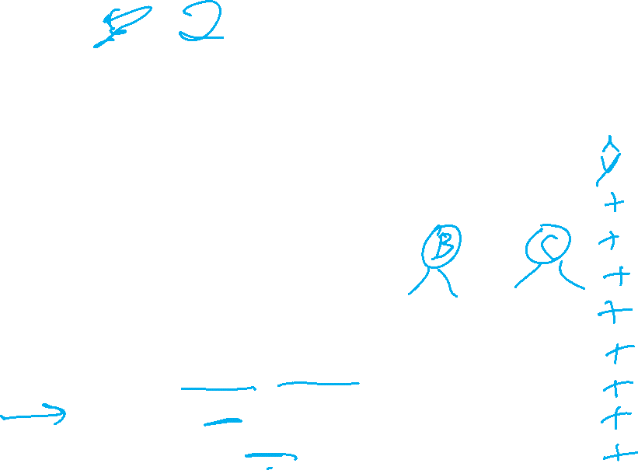
Poll 2
Splitting on which attribute {A, B, C} creates a decision stump with the lowest training error?
Dataset: Output Y, Attributes A, B, C
Y | A | B | C
- | 1 | 0 | 0
- | 1 | 0 | 1
- | 1 | 0 | o
+ | 0 | 0 | 1
+ | 1 | 1 | 0
+ | 1 | 1 | 1
+ | 1 | 1 | 0
+ | 1 | 1 | 1
3-, 5+
A
A=0
A=1
0-, 1+
$$\hat{y}=+$$
3-, 4+
$$\hat{y}=+$$
Error: ( 0 + 3 ) / 8
= 3/8
Slide credit: CMU MLD Matt Gormley

Slide 18
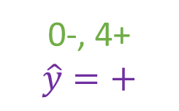
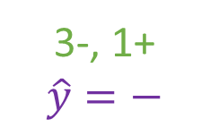

Poll 2
Splitting on which attribute {A, B, C} creates a decision stump with the lowest training error?
Answer: B
Dataset: Output Y, Attributes A, B, C
Y | A | B | C
- | 1 | 0 | 0
- | 1 | 0 | 1
- | 1 | 0 | o
+ | 0 | 0 | 1
+ | 1 | 1 | 0
+ | 1 | 1 | 1
+ | 1 | 1 | 0
+ | 1 | 1 | 1
3-, 5+
B
B=0
B=1
3-, 1+
$$\hat{y}=−$$
0-, 4+
$$\hat{y}=+$$
Error: ( 1 + 0 ) / 8
= 1/8
Slide credit: CMU MLD Matt Gormley

Slide 19
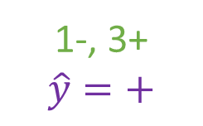
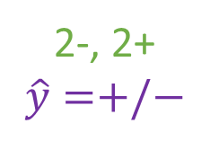
Poll 2
Splitting on which attribute {A, B, C} creates a decision stump with the lowest training error?
Answer: B
Dataset: Output Y, Attributes A, B, C
Y | A | B | C
- | 1 | 0 | 0
- | 1 | 0 | 1
- | 1 | 0 | o
+ | 0 | 0 | 1
+ | 1 | 1 | 0
+ | 1 | 1 | 1
+ | 1 | 1 | 0
+ | 1 | 1 | 1
3-, 5+
C
C=0
C=1
2-, 2+
$$\hat{y}=+/−$$
1-, 3+
$$\hat{y}=+$$
Error: ( 2 + 1 ) / 8
= 3/8
Slide credit: CMU MLD Matt Gormley

Slide 20
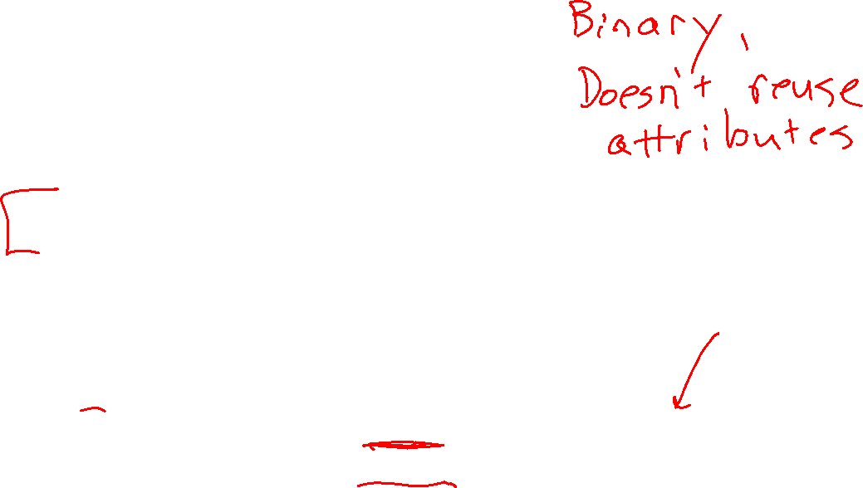
Building a Decision Tree
Function BuildTree(D, Attributes)
# D: dataset at current node
# Attributes : current set of attributes
# TODO Base Case
else
# Internal node
X ⇐ bestAttribute(D, Attributes)
LeftNode = BuildTree(D(X=1), Attributes \ {X})
RightNode = BuildTree(D(X=0), Attributes \ {X})
end
end

Slide 21
Poll 3
Dataset: Output Y, Attributes A, B, C
Which of the following trees would be learned by the decision tree learning algorithm using “error rate” as the splitting criterion?
(Assume ties are broken alphabetically.)
Y | A | B | C
+ | 0 | 0 | 0
+ | 0 | 0 | 1
- | 0 | 1 | 0
+ | 0 | 1 | 1
- | 1 | 0 | 0
- | 1 | 0 | 1
- | 1 | 1 | 0
+ | 1 | 1 | 1
1
A
2
A
3
A
0
1
0
1
0
1
C
C
B
C
B
B
0
1
0
1
0
1
0
1
0
1
0
1
+
-
-
+
+
-
-
+
+
C
-
C
0
1
0
1
4
C
5
B
-
+
-
+
0
1
0
1
6
B
B
A
A
C
0
1
0
1
0
1
0
1
0
1
A
A
+
-
-
+
+
-
-
+
0
1
0
1
+
-
C
C
0
1
0
1
+
-
-
+
Slide credit: CMU MLD Matt Gormley

Slide 22
Poll 3
Dataset: Output Y, Attributes A, B, C
Which of the following trees would be learned by the the decision tree learning algorithm using “error rate” as the splitting criterion?
(Assume ties are broken alphabetically.)
Y | A | B | C
+ | 0 | 0 | 0
+ | 0 | 0 | 1
- | 0 | 1 | 0
+ | 0 | 1 | 1
- | 1 | 0 | 0
- | 1 | 0 | 1
- | 1 | 1 | 0
+ | 1 | 1 | 1
1
A
2
A
3
A
0
1
0
1
0
1
C
C
B
C
B
B
0
1
0
1
0
1
0
1
0
1
0
1
+
-
-
+
+
-
-
+
+
C
-
C
0
1
0
1
4
C
5
B
-
+
-
+
0
1
0
1
6
B
B
A
A
C
0
1
0
1
0
1
0
1
0
1
A
A
+
-
-
+
+
-
-
+
0
1
0
1
+
-
C
C
0
1
0
1
+
-
-
+
Slide credit: CMU MLD Matt Gormley

Slide 23
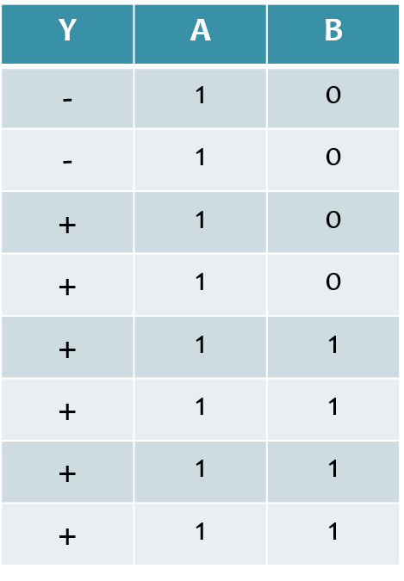
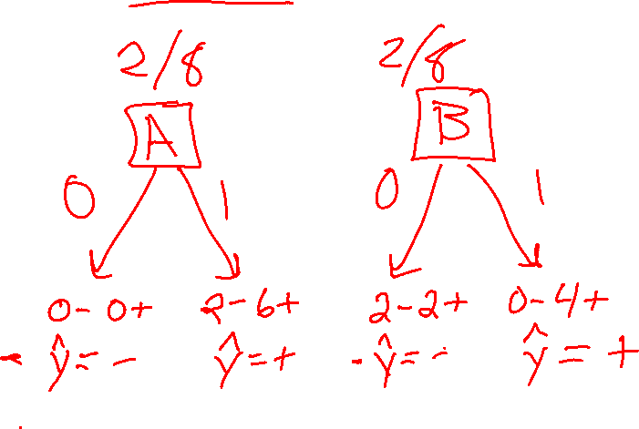
Poll 4
Dataset: Output Y, Attributes A and B
How many errors do each of the two decision stumps make on the training set?
Slide credit: CMU MLD Matt Gormley

Slide 24
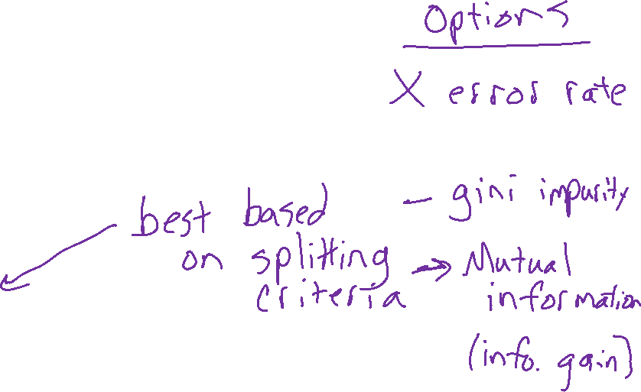
Building a Decision Tree
Function BuildTree(D, Attributes)
# D: dataset at current node
# Attributes : current set of attributes
# TODO Base Case
else
# Internal node
X ⇐ bestAttribute(D, Attributes)
LeftNode = BuildTree(D(X=1), Attributes \ {X})
RightNode = BuildTree(D(X=0), Attributes \ {X})
end
end

Slide 25
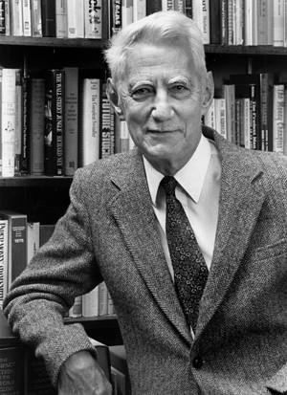
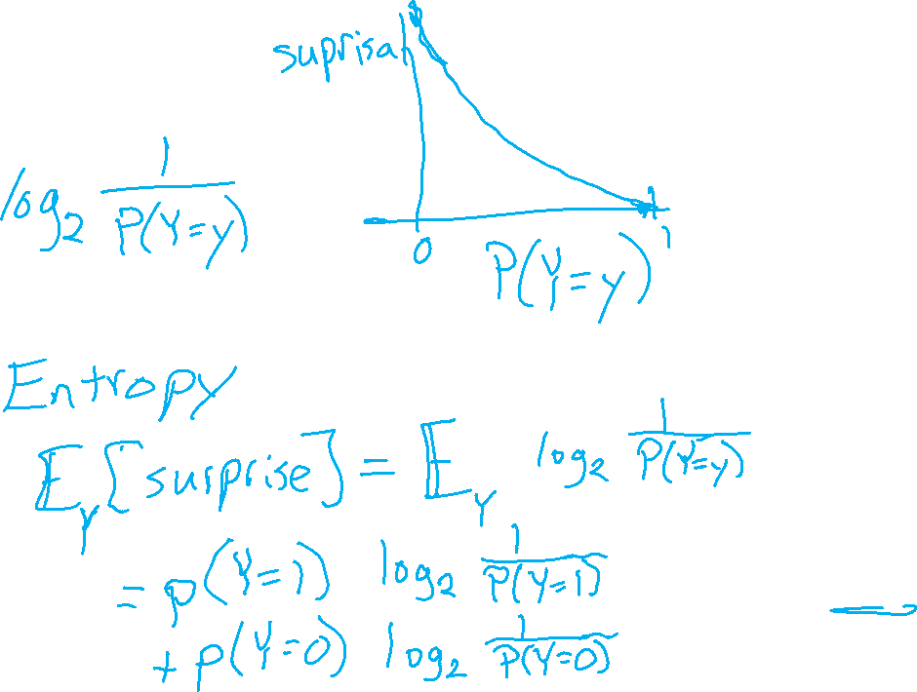
Entropy
Surprisal
Claude Shannon (1916 – 2001), most of the work was done in Bell labs

Slide 26
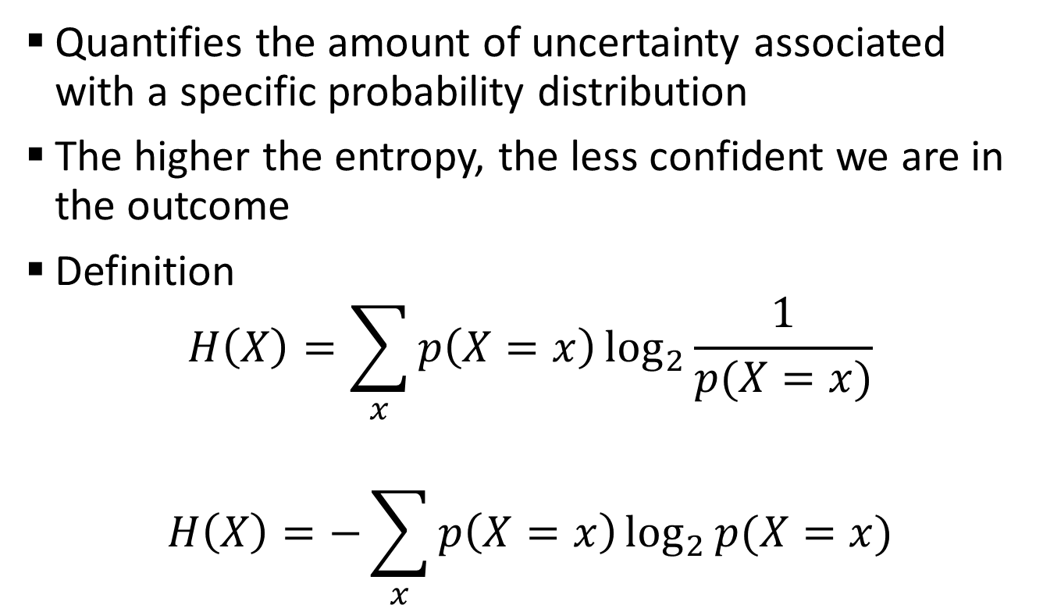
Entropy
Quantifies the amount of uncertainty associated with a specific probability distribution
The higher the entropy, the less confident we are in the outcome
Definition
$$H\left(X\right)=\sum_{x}{p\left(X=x\right)\log_{2}{\frac{1}{p(X=x)}}}$$
$$H\left(X\right)=−\sum_{x}{p\left(X=x\right)\log_{2}{p(X=x)}}$$
Claude Shannon (1916 – 2001), most of the work was done in Bell labs

Slide 27
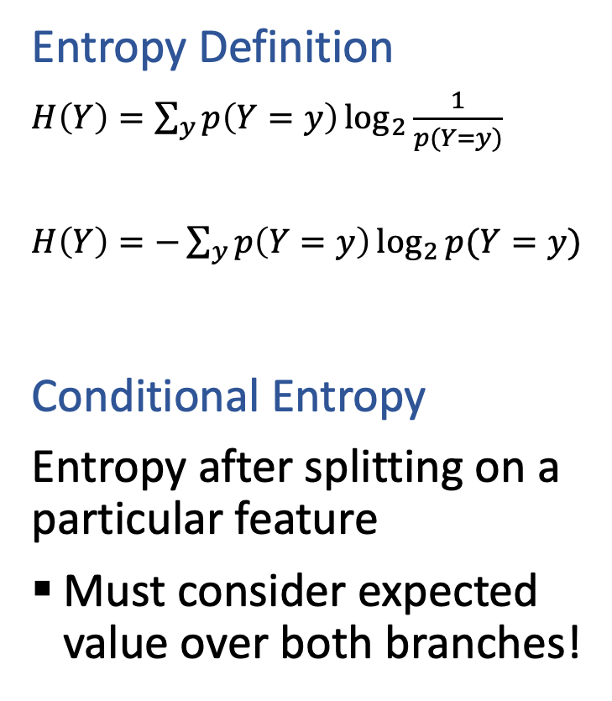
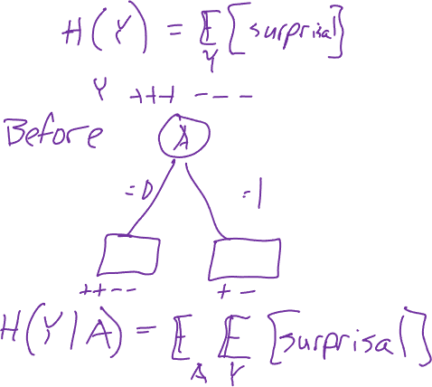
Conditional Entropy
Entropy Definition
$H\left(Y\right)=\sum_{y}{p\left(Y=y\right)\log_{2}{\frac{1}{p(Y=y)}}}$
$H\left(Y\right)=−\sum_{y}{p\left(Y=y\right)\log_{2}{p(Y=y)}}$
Conditional Entropy
Entropy after splitting on a particular feature
Must consider expected value over both branches!

Slide 28

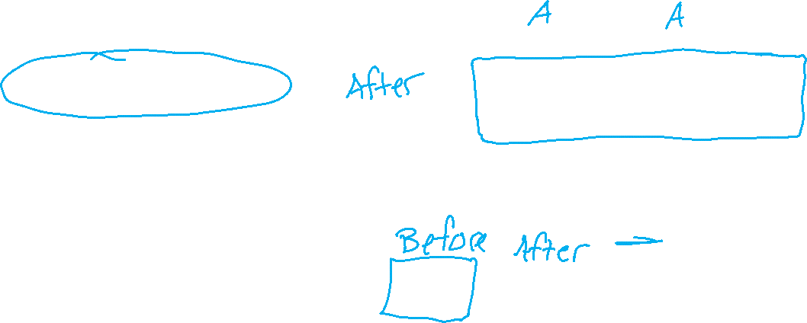
Conditional Entropy
Entropy Definition
$H\left(Y\right)=\sum_{y}{p\left(Y=y\right)\log_{2}{\frac{1}{p(Y=y)}}}$
$H\left(Y\right)=−\sum_{y}{p\left(Y=y\right)\log_{2}{p(Y=y)}}$
Conditional Entropy
Entropy after splitting on a particular feature
Must consider expected value over both branches!

Slide 29
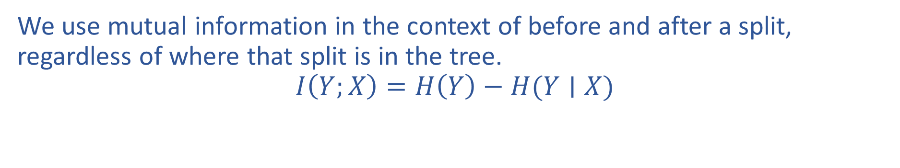
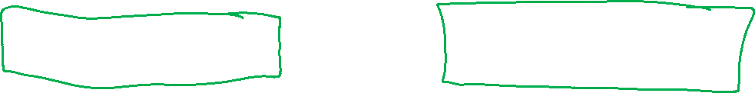
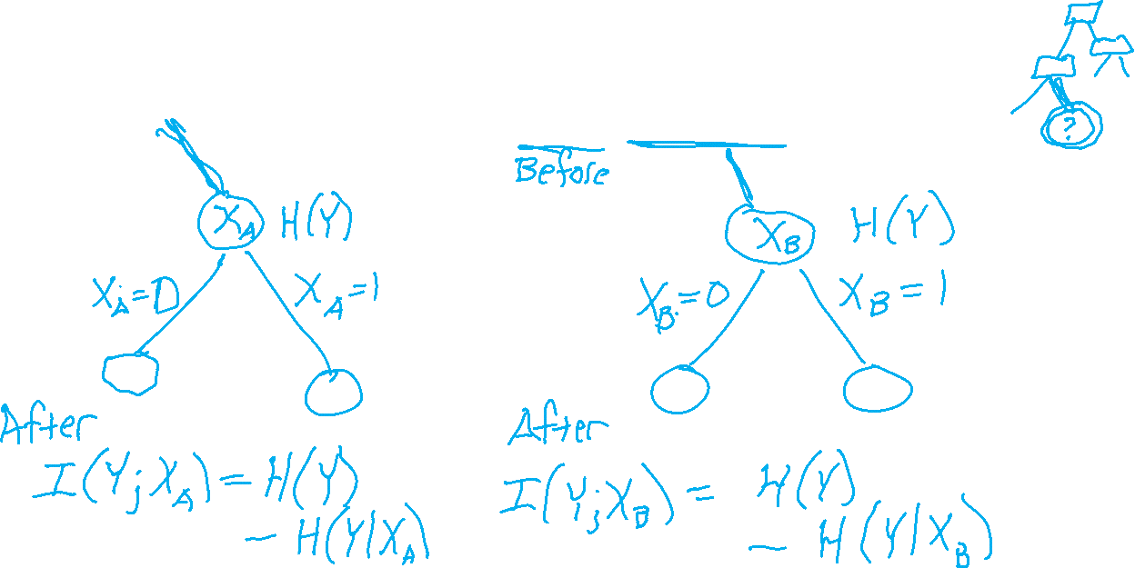
Mutual Information Notation
We use mutual information in the context of before and after a split, regardless of where that split is in the tree.
$$I\left(Y;X\right)=H\left(Y\right)−H(Y∣X)$$

Slide 30

Mutual Information
Slide credit: CMU MLD Matt Gormley
Notes:
In the preamble: \usepackage[fleqn]{amsmath}
Entropy:
\begin{align*} H(Y) = - \sum_{y \in \Yc} P(Y=y) \log_2 P(Y=y) \end{align*}
Specific Conditional Entropy:
\begin{align*} H(Y \mid X=x) = - \sum_{y \in \Yc} P(Y=y \mid X=x) \log_2 P(Y=y \mid X=x) \end{align*}
Conditional Entropy:
\begin{align*} H(Y \mid X) = \sum_{x \in \Xc} P(X=x) H(Y \mid X=x) \end{align*}
Mutual Information:
\begin{align*} I(Y; X) = H(Y) - H(Y|X) = H(X) - H(X|Y) \end{align*}

Slide 31
Mutual Information
Slide credit: CMU MLD Matt Gormley
For a decision tree, we can use mutual information of the output class Y and some attribute X on which to split as a splitting criterion
Given a dataset D of training examples, we can estimate the required probabilities as…
Notes:
In the preamble: \usepackage[fleqn]{amsmath}
Entropy:
\begin{align*} H(Y) = - \sum_{y \in \Yc} P(Y=y) \log_2 P(Y=y) \end{align*}
Specific Conditional Entropy:
\begin{align*} H(Y \mid X=x) = - \sum_{y \in \Yc} P(Y=y \mid X=x) \log_2 P(Y=y \mid X=x) \end{align*}
Conditional Entropy:
\begin{align*} H(Y \mid X) = \sum_{x \in \Xc} P(X=x) H(Y \mid X=x) \end{align*}
Mutual Information:
\begin{align*} I(Y; X) = H(Y) - H(Y|X) = H(X) - H(X|Y) \end{align*}

Slide 32
Mutual Information
Entropy measures the expected # of bits to code one random draw from X.
For a decision tree, we want to reduce the entropy of the random variable we are trying to predict!
Slide credit: CMU MLD Matt Gormley
For a decision tree, we can use mutual information of the output class Y and some attribute X on which to split as a splitting criterion
Given a dataset D of training examples, we can estimate the required probabilities as…
Conditional entropy is the expected value of specific conditional entropy E_{P(X=x)}[H(Y | X = x)]
Informally, we say that mutual information is a measure of the following: If we know X, how much does this reduce our uncertainty about Y?
Notes:
In the preamble: \usepackage[fleqn]{amsmath}
Entropy:
\begin{align*} H(Y) = - \sum_{y \in \Yc} P(Y=y) \log_2 P(Y=y) \end{align*}
Specific Conditional Entropy:
\begin{align*} H(Y \mid X=x) = - \sum_{y \in \Yc} P(Y=y \mid X=x) \log_2 P(Y=y \mid X=x) \end{align*}
Conditional Entropy:
\begin{align*} H(Y \mid X) = \sum_{x \in \Xc} P(X=x) H(Y \mid X=x) \end{align*}
Mutual Information:
\begin{align*} I(Y; X) = H(Y) - H(Y|X) = H(X) - H(X|Y) \end{align*}

Slide 33
Splitting with Mutual Information
Which attribute {A, B} would mutual information select for the next split?
A
B
A or B (tie)
I don’t know
Dataset: Output Y, Attributes A and B

Slide 34
Decision Tree Learning Example
Y | A | B
- | 1 | 0
- | 1 | 0
+ | 1 | 0
+ | 1 | 0
+ | 1 | 1
+ | 1 | 1
+ | 1 | 1
+ | 1 | 1
Slide credit: CMU MLD Matt Gormley

Slide 35
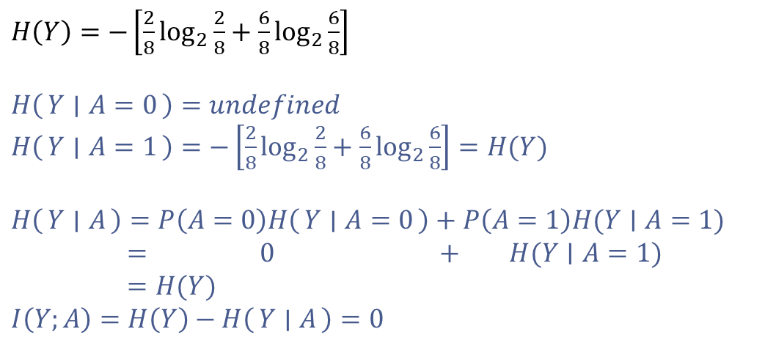
Decision Tree Learning Example
Y | A | B
- | 1 | 0
- | 1 | 0
+ | 1 | 0
+ | 1 | 0
+ | 1 | 1
+ | 1 | 1
+ | 1 | 1
+ | 1 | 1
$H\left(Y\right)=−\left[\frac{2}{8}\log_{2}{\frac{2}{8}}+\frac{6}{8}\log_{2}{\frac{6}{8}}\right]$
$H\left(Y ∣ A=0\right)=undefined$
$H\left(Y ∣ A=1\right)=−\left[\frac{2}{8}\log_{2}{\frac{2}{8}}+\frac{6}{8}\log_{2}{\frac{6}{8}}\right]=H(Y)$
$H\left(Y ∣ A\right)=P\left(A=0\right)H\left(Y ∣ A=0\right)+P\left(A=1\right)H(Y∣A=1)$
$= 0 + H(Y∣A=1)$
$=H(Y)$
$I\left(Y;A\right)=H\left(Y\right)−H\left(Y ∣ A\right)=0$
[2-, 6+]
A
A=0
A=1
[0-, 0+]
P(A=0) = 0
[2-, 6+]
P(A=1)=1
Slide credit: CMU MLD Matt Gormley

Slide 36
Decision Tree Learning Example
Y | A | B
- | 1 | 0
- | 1 | 0
+ | 1 | 0
+ | 1 | 0
+ | 1 | 1
+ | 1 | 1
+ | 1 | 1
+ | 1 | 1
[2-, 6+]
B
B=0
B=1
[2-, 2+]
P(B=0)=4/8
[0-, 4+]
P(B=1)=4/8
Slide credit: CMU MLD Matt Gormley

Slide 37
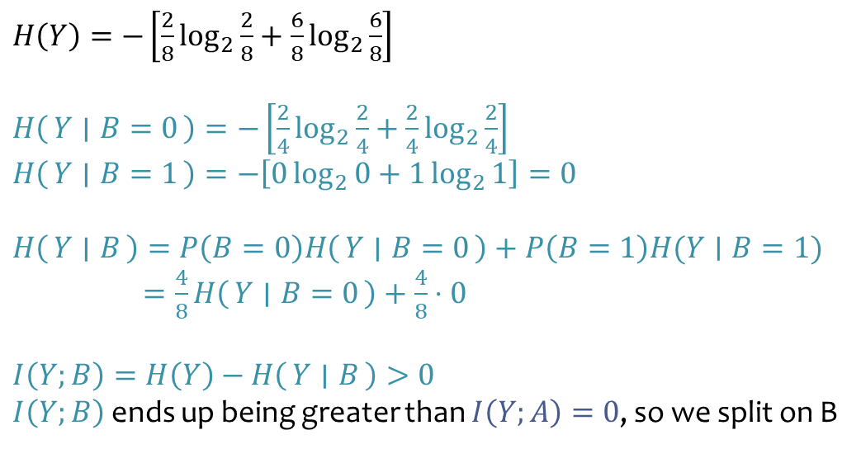
Decision Tree Learning Example
Y | A | B
- | 1 | 0
- | 1 | 0
+ | 1 | 0
+ | 1 | 0
+ | 1 | 1
+ | 1 | 1
+ | 1 | 1
+ | 1 | 1
$H\left(Y\right)=−\left[\frac{2}{8}\log_{2}{\frac{2}{8}}+\frac{6}{8}\log_{2}{\frac{6}{8}}\right]$
$H\left(Y ∣ B=0\right)=−\left[\frac{2}{4}\log_{2}{\frac{2}{4}}+\frac{2}{4}\log_{2}{\frac{2}{4}}\right]$
$H\left(Y ∣ B=1\right)=−\left[0\log_{2}{0}+1\log_{2}{1}\right]=0$
$H\left(Y ∣ B\right)=P\left(B=0\right)H\left(Y ∣ B=0\right)+P\left(B=1\right)H(Y∣B=1)$
$=\frac{4}{8}H\left(Y ∣ B=0\right)+\frac{4}{8}⋅0$
$I\left(Y;B\right)=H\left(Y\right)−H\left(Y ∣ B\right)>0$ $I\left(Y;B\right)$ ends up being greater than $I\left(Y;A\right)=0$, so we split on B
[2-, 6+]
B
B=0
B=1
[2-, 2+]
P(B=0)=4/8
[0-, 4+]
P(B=1)=4/8
Slide credit: CMU MLD Matt Gormley

Slide 38
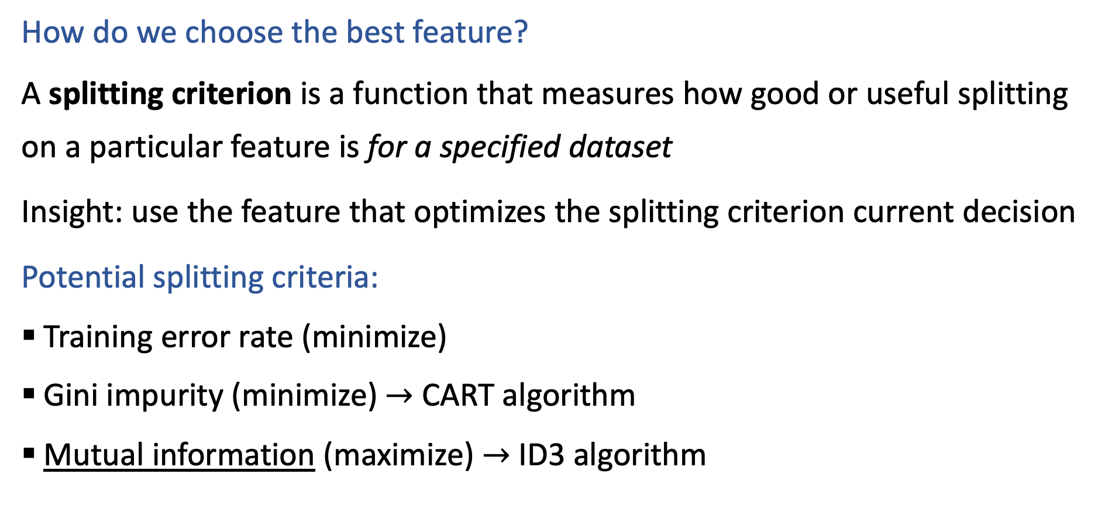

Building a Decision Tree
How do we choose the best feature?
A splitting criterion is a function that measures how good or useful splitting on a particular feature is for a specified dataset
Insight: use the feature that optimizes the splitting criterion current decision
Potential splitting criteria:
Training error rate (minimize)
Gini impurity (minimize) $→$ CART algorithm
Mutual information (maximize) $→$ ID3 algorithm
Slide credit: CMU MLD Henry Chai

Slide 39
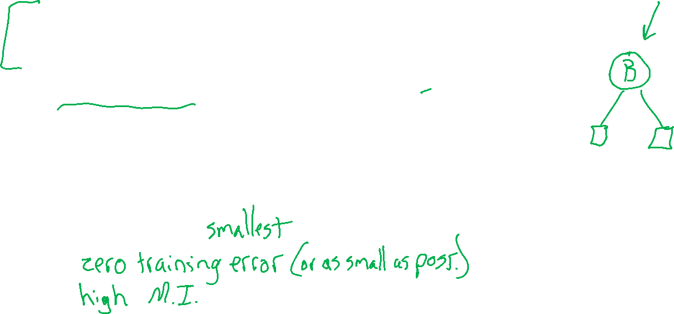
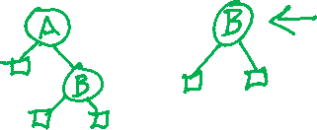
Why bother with splitting criteria at all?
Occam’s razor: try to find the “simplest” (e.g., smallest decision tree) classifier that explains the training dataset
The inductive bias of a machine learning algorithm is the principal by which it generalizes to unseen examples
What is the inductive bias of the ID3 algorithm i.e., decision tree learning with mutual information maximization as the splitting criterion?
Try to find the tree that achieves with features at the top
Slide credit: CMU MLD Henry Chai

Slide 40
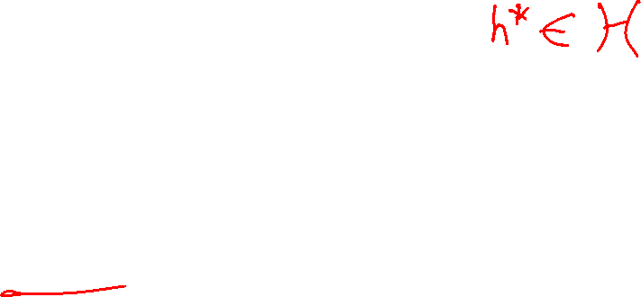
Are decision trees algorithms optimal?
Well, what do we mean by optimal?
Considering all possible decision trees (i.e., trees splitting on one feature per node),
will the ID3 algorithm (each split maximizes mutual information; stopping when mutual information is zero)…
produce the smallest decision tree that has lowest classification training error?
No, they aren’t optimal
Decision trees are greedy algorithms, i.e., they make the best local decision without considering longer term possibilities.
Better trees are possible, but it takes too long to search all combinations

Slide 41

Decision Trees: Pros & Cons
Pros
Interpretable
Efficient (computational cost and storage)
Can be used for classification and regression tasks
Compatible with categorical and real-valued features
Cons
Greedy: each split only considers the immediate impact
Not guaranteed to find the smallest (fewest number of splits) tree that achieves a training error rate of 0.
Liable to overfit!
Slide credit: CMU MLD Henry Chai

