Slide 1

10-315 Machine Learning Problem Formulation
Instructor: Pat Virtue

Slide 2
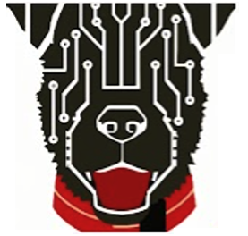

Today
Autoencoder (Aliens) (previous slides)
Features
ML Problem Formulation
Task input and output
Task, Performance, Experience
Data and notation
Examples: Iris Classification and Car Price Regression
ML Training and Models
Linear
Memorization
Nearest Neighbor

Slide 3
ML Problem Formulation

Slide 4
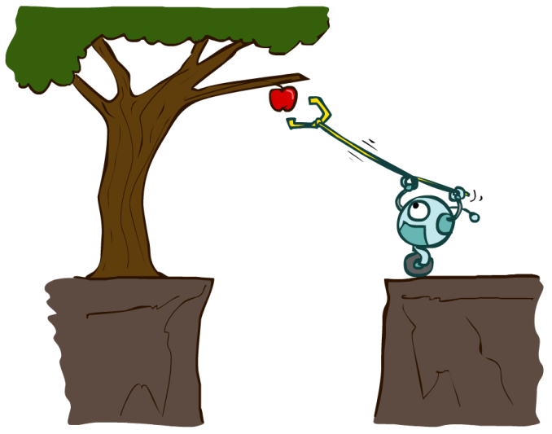
Agents
An agent is an entity that perceives and acts.
Actions can have an effect on the environment.
The specific sensors and actuators affect what the agent is capable of perceiving and what actions it is capable of taking
Sensors
Percepts
Agent
Environment
?
Actuators
Actions
Slide credit: ai.berkeley.edu

Slide 5
Agent: Simple Input/Output Task
Agent
Input
?
Predicted
Output

Slide 6
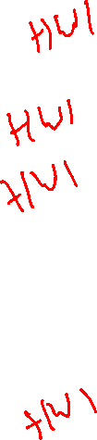
Task Input and Output
Input
Task
Output
Petal measurements
Time of day
Image
Image
Text
???
Iris classification
Traffic prediction
Image classification
Image denoising
Text to image generation
Face generation
Category
Traffic Volume
Category
Image
Image
Image

Slide 7
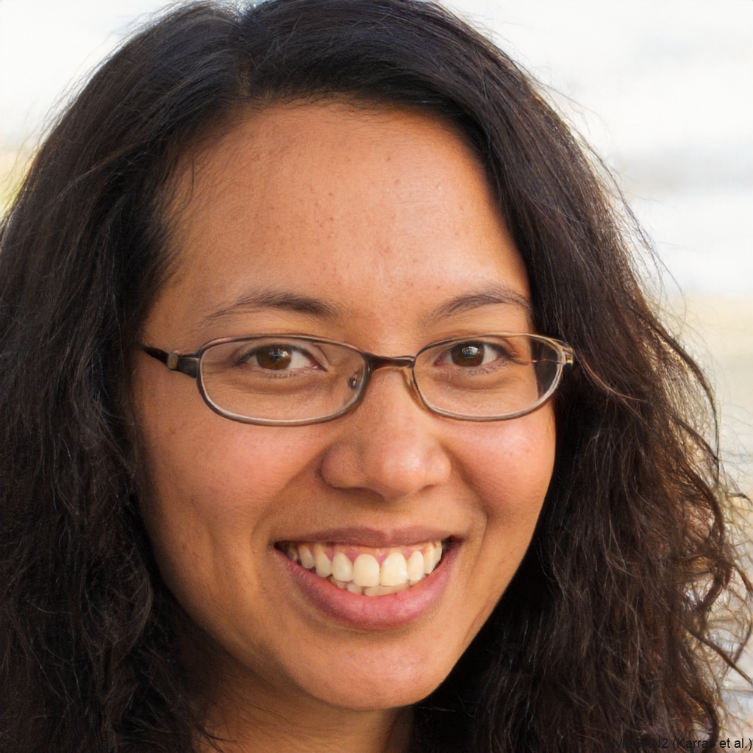
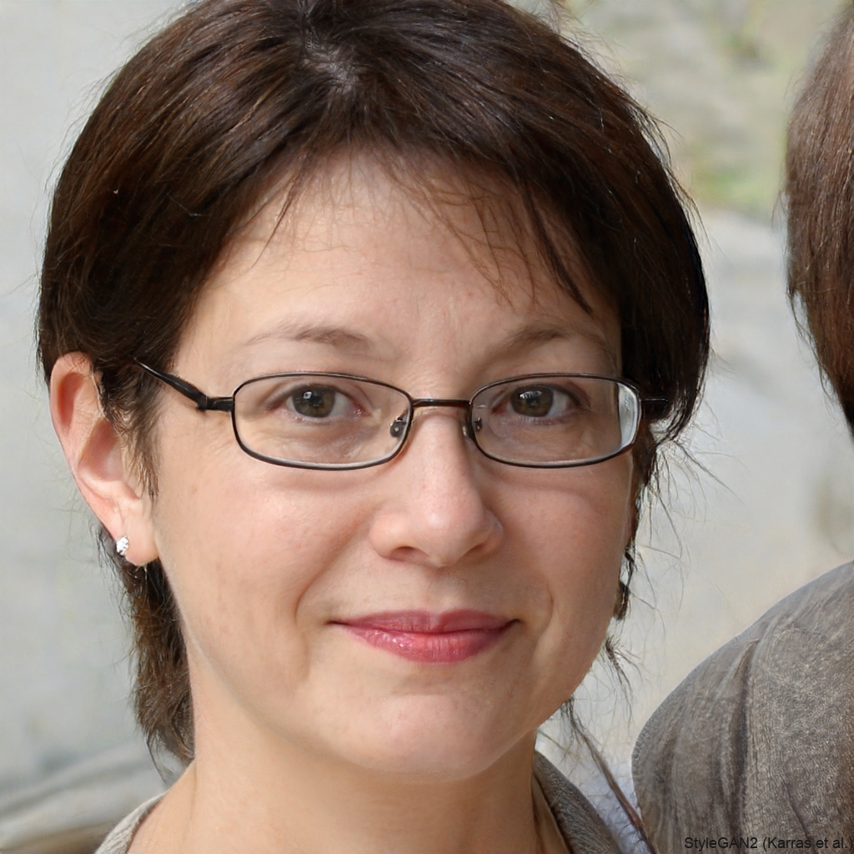
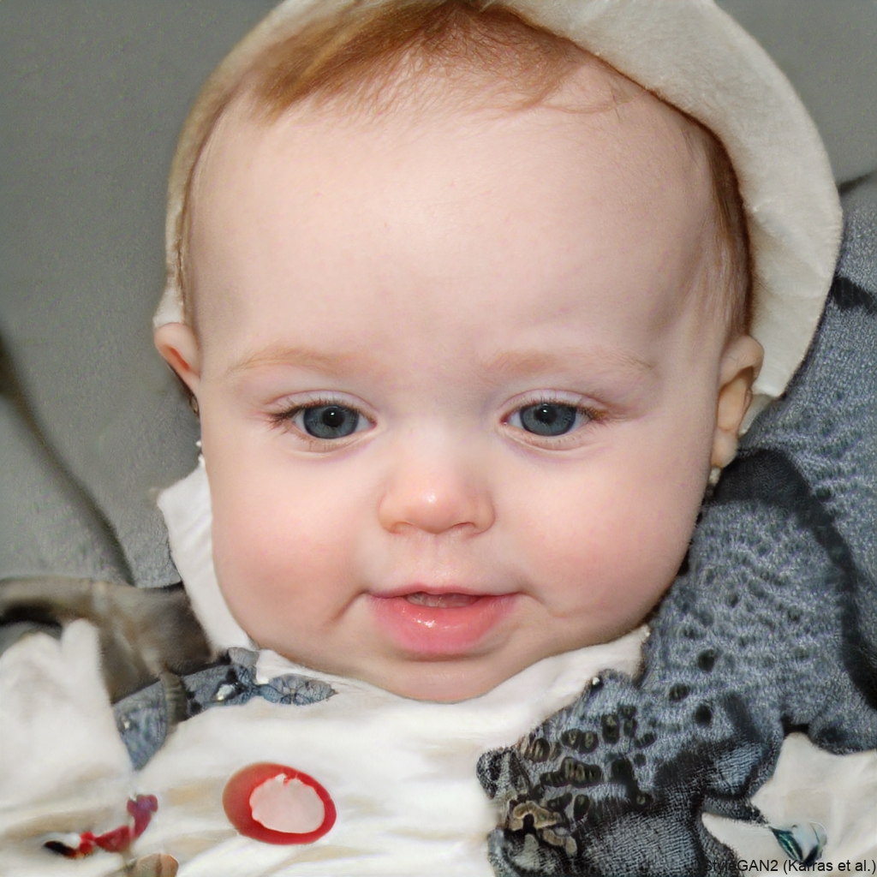
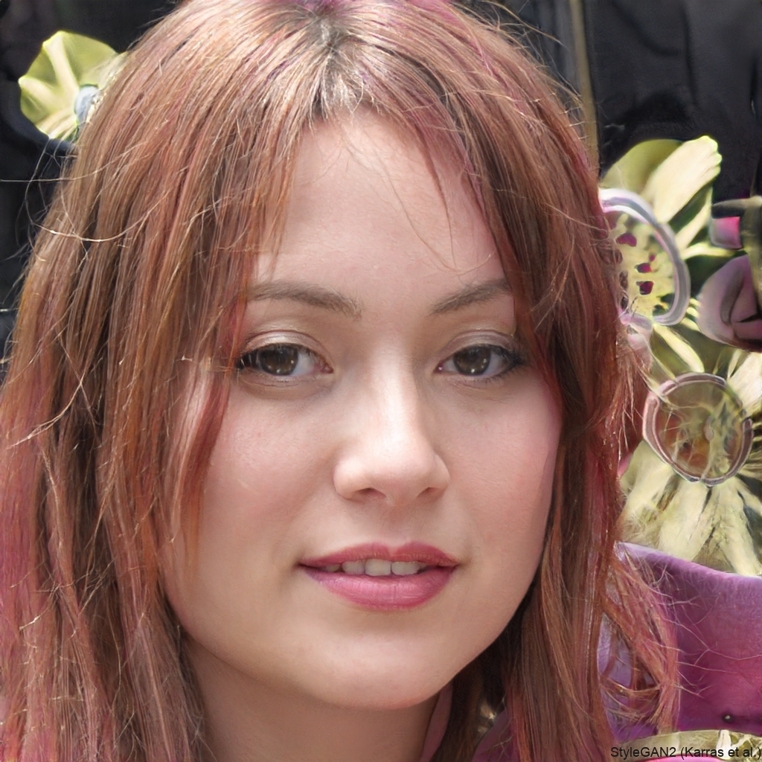
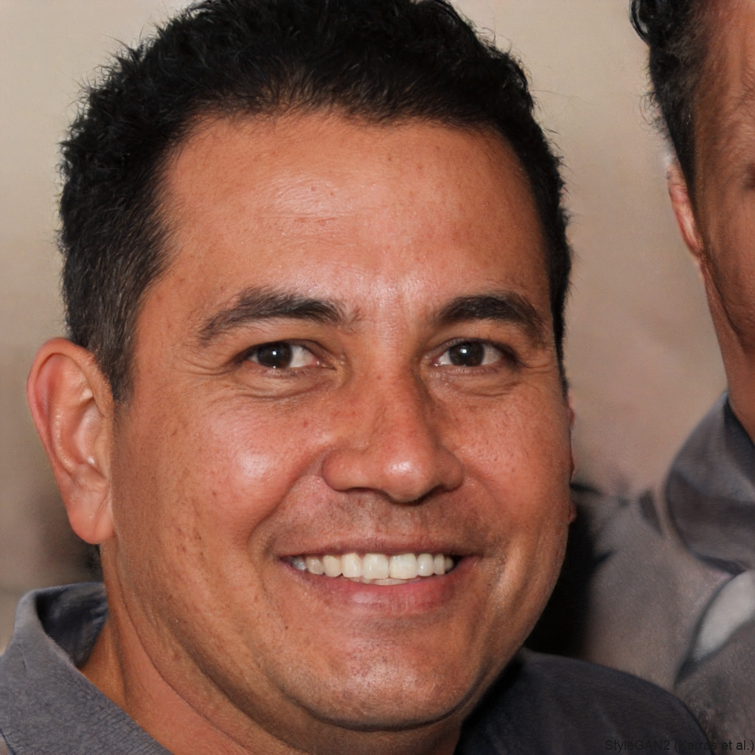
Task: Face Generation
https://thispersondoesnotexist.com/

Slide 8

Machine Learning Problem Formulation
Three components <T,P,E>:
Task, T
Performance measure, P
Experience, E
Definition of learning:
A computer program learns if its performance at tasks in T, as measured by P, improves with experience E
Definition from (Mitchell, 1997)

Slide 9
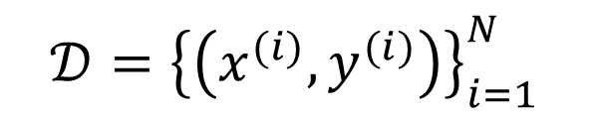
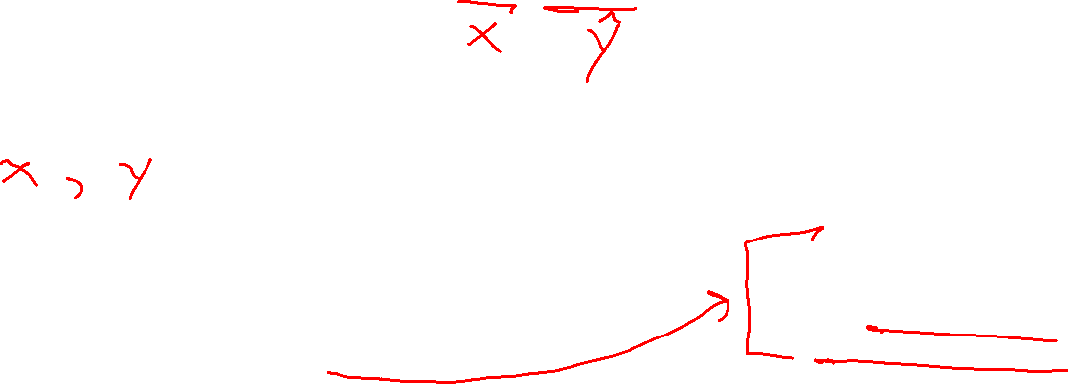

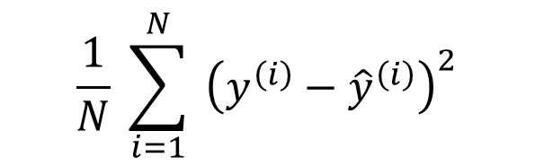
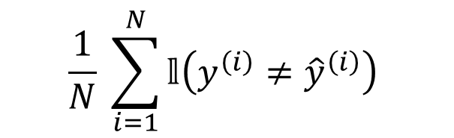
Machine Learning Problem Formulation
Notation
Task
Formalize the task as a mapping from input to output
Experience
Data! Task experience examples will usually be pairs: (input, measured output)
Performance measure
Objective function that gives a single numerical value representing how well the system performs for a given dataset
Classification: error rate
Regression: mean squared error
$$h\left(x\right)→\hat{y}$$
$$𝒟={\left\{\left(x^{(i)},y^{(i)}\right)\right\}}_{i=1}^{N}$$
$$\frac{1}{N} \sum_{i=1}^{N}{𝕝\left(y^{\left(i\right)}≠{\hat{y}}^{\left(i\right)}\right)}$$
$$\frac{1}{N} \sum_{i=1}^{N}{ {\left(y^{\left(i\right)}−{\hat{y}}^{\left(i\right)}\right)}^{2}}$$
Slide: CMU ML, Tom Mitchel and Roni Rosenfeld

Slide 10
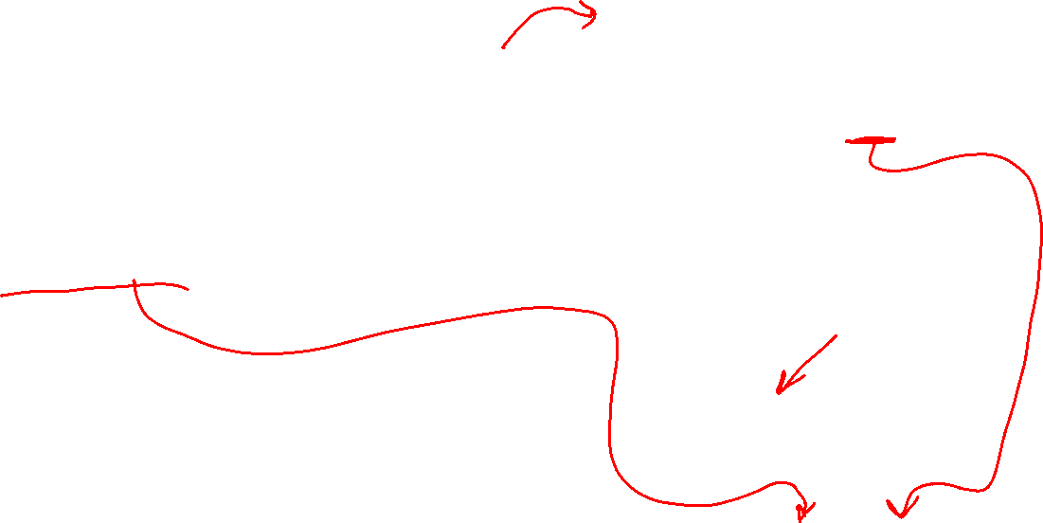
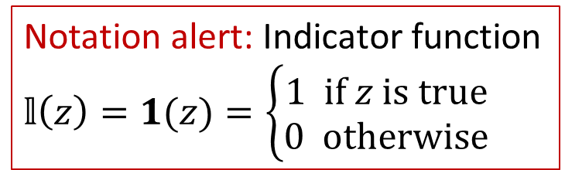
ML Problem Formulation
Notation alert: Indicator function
$𝕝\left(z\right)=1(z)=\left\{\begin{aligned}1 if z is true \\ 0 otherwise\end{aligned}\right.$
Task
Formalize the task as a mapping from input to output
Experience
Data! Task experience examples will usually be pairs: (input, measured output)
Performance measure
Objective function that gives a single numerical value representing how well the system performs for a given dataset
Classification: error rate
Regression: mean squared error
$$h\left(x\right)→\hat{y}$$
$$𝒟={\left\{\left(x^{(i)},y^{(i)}\right)\right\}}_{i=1}^{N}$$
$$\frac{1}{N} \sum_{i=1}^{N}{𝕝\left(y^{\left(i\right)}≠{\hat{y}}^{\left(i\right)}\right)}$$
$$\frac{1}{N} \sum_{i=1}^{N}{ {\left(y^{\left(i\right)}−{\hat{y}}^{\left(i\right)}\right)}^{2}}$$
Slide: CMU ML, Tom Mitchel and Roni Rosenfeld

Slide 11
Experience: Data and Notation

Slide 12
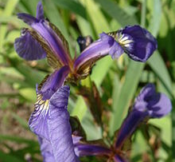
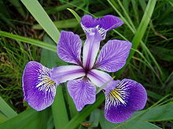
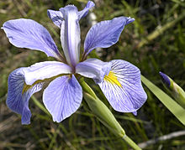

Example Dataset: Fisher Iris Dataset
Fisher (1936) used 150 measurements of flowers from 3 different species: Iris setosa (0), Iris virginica (1), Iris versicolor (2) collected by Anderson (1936)
Species | Sepal Length | Sepal Width | Petal Length | Petal Width
0 | 4.3 | 3.0 | 1.1 | 0.1
0 | 4.9 | 3.6 | 1.4 | 0.1
0 | 5.3 | 3.7 | 1.5 | 0.2
1 | 4.9 | 2.4 | 3.3 | 1.0
1 | 5.7 | 2.8 | 4.1 | 1.3
1 | 6.3 | 3.3 | 4.7 | 1.6
2 | 5.9 | 3.0 | 5.1 | 1.8
Images and full dataset: https://en.wikipedia.org/wiki/Iris_flower_data_set

Slide 13
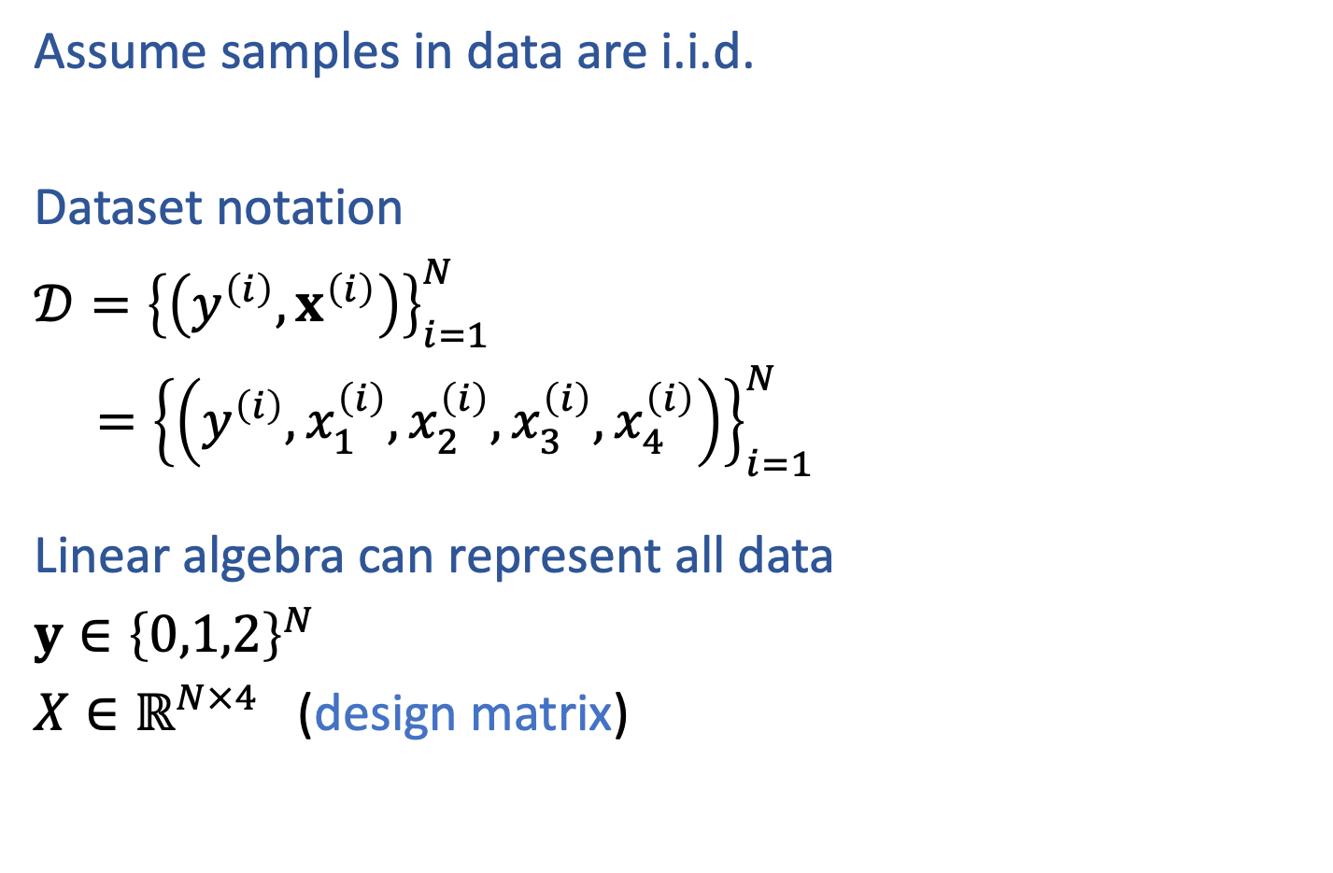
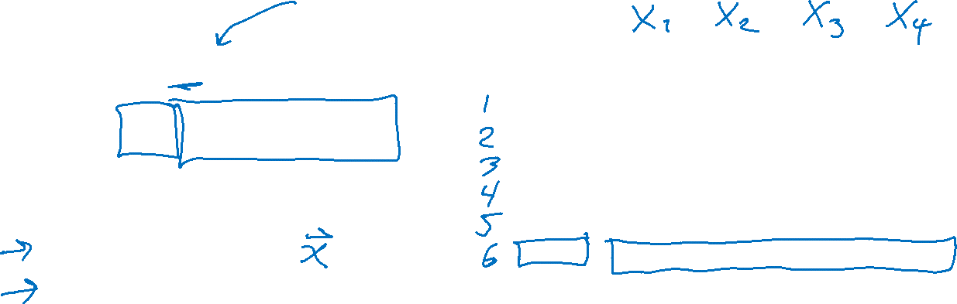
Example Dataset: Fisher Iris Dataset
from sklearn import datasets
iris = datasets.load_iris()
X = iris.data
y = iris.target
Assume samples in data are i.i.d.
Dataset notation
$𝒟={\left\{\left(y^{\left(i\right)}, x^{\left(i\right)}\right)\right\}}_{i=1}^{N}$
$={\left\{\left(y^{\left(i\right)}, x_{1}^{\left(i\right)},x_{2}^{\left(i\right)},x_{3}^{\left(i\right)},x_{4}^{\left(i\right)}\right)\right\}}_{i=1}^{N}$
Linear algebra can represent all data
$y∈{\left\{0,1,2\right\}}^{N}$
$X∈ℝ^{N×4}$ (design matrix)
Species | Sepal Length | Sepal Width | Petal Length | Petal Width
0 | 4.3 | 3.0 | 1.1 | 0.1
0 | 4.9 | 3.6 | 1.4 | 0.1
0 | 5.3 | 3.7 | 1.5 | 0.2
1 | 4.9 | 2.4 | 3.3 | 1.0
1 | 5.7 | 2.8 | 4.1 | 1.3
1 | 6.3 | 3.3 | 4.7 | 1.6
2 | 5.9 | 3.0 | 5.1 | 1.8
Images and full dataset: https://en.wikipedia.org/wiki/Iris_flower_data_set

Slide 14
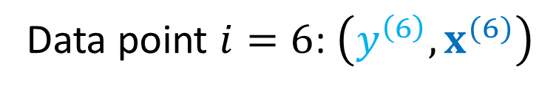

Example Dataset: Fisher Iris Dataset
from sklearn import datasets
iris = datasets.load_iris()
X = iris.data
y = iris.target
Assume samples in data are i.i.d.
Dataset notation
$𝒟={\left\{\left(y^{\left(i\right)}, x^{\left(i\right)}\right)\right\}}_{i=1}^{N}$
$={\left\{\left(y^{\left(i\right)}, x_{1}^{\left(i\right)},x_{2}^{\left(i\right)},x_{3}^{\left(i\right)},x_{4}^{\left(i\right)}\right)\right\}}_{i=1}^{N}$
Species | Sepal Length | Sepal Width | Petal Length | Petal Width
0 | 4.3 | 3.0 | 1.1 | 0.1
0 | 4.9 | 3.6 | 1.4 | 0.1
0 | 5.3 | 3.7 | 1.5 | 0.2
1 | 4.9 | 2.4 | 3.3 | 1.0
1 | 5.7 | 2.8 | 4.1 | 1.3
1 | 6.3 | 3.3 | 4.7 | 1.6
2 | 5.9 | 3.0 | 5.1 | 1.8
Data point $i=6$: $\left(y^{\left(6\right)},x^{(6)}\right)$
Images and full dataset: https://en.wikipedia.org/wiki/Iris_flower_data_set

Slide 15


Example Dataset: Fisher Iris Dataset
from sklearn import datasets
iris = datasets.load_iris()
X = iris.data
y = iris.target
Assume samples in data are i.i.d.
Dataset notation
$𝒟={\left\{\left(y^{\left(i\right)}, x^{\left(i\right)}\right)\right\}}_{i=1}^{N}$
$={\left\{\left(y^{\left(i\right)}, x_{1}^{\left(i\right)},x_{2}^{\left(i\right)},x_{3}^{\left(i\right)},x_{4}^{\left(i\right)}\right)\right\}}_{i=1}^{N}$
Linear algebra can represent all data
$y∈{\left\{0,1,2\right\}}^{N}$
$X∈ℝ^{N×4}$ (design matrix)
Species | Sepal Length | Sepal Width | Petal Length | Petal Width
0 | 4.3 | 3.0 | 1.1 | 0.1
0 | 4.9 | 3.6 | 1.4 | 0.1
0 | 5.3 | 3.7 | 1.5 | 0.2
1 | 4.9 | 2.4 | 3.3 | 1.0
1 | 5.7 | 2.8 | 4.1 | 1.3
1 | 6.3 | 3.3 | 4.7 | 1.6
2 | 5.9 | 3.0 | 5.1 | 1.8
Images and full dataset: https://en.wikipedia.org/wiki/Iris_flower_data_set

Slide 16
Task: Classification

Slide 17
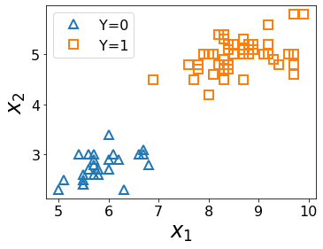
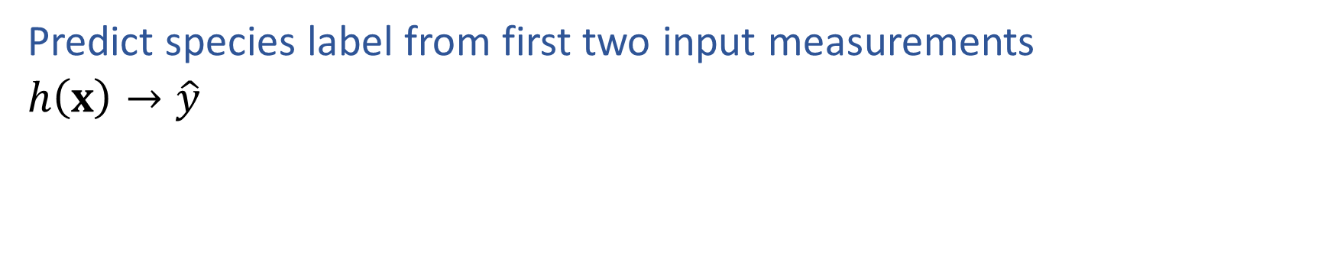
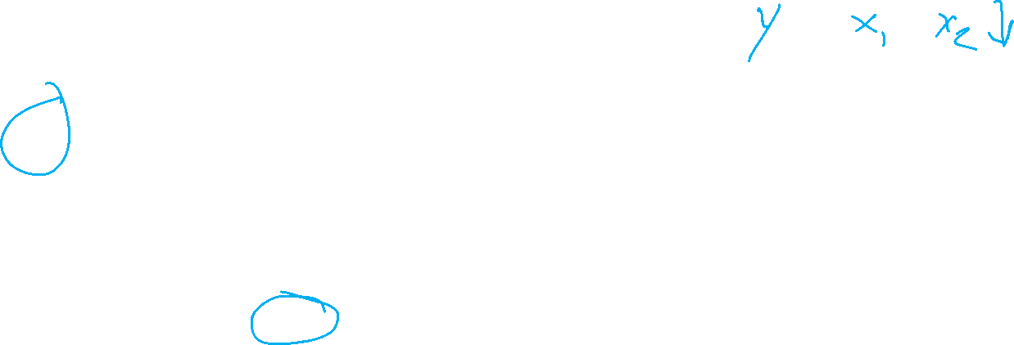
ML Task: Classification
Predict species label from first two input measurements
$h\left(x\right)→\hat{y}$
Species | Sepal Length | Sepal Width
0 | 4.3 | 3.0
0 | 4.9 | 3.6
0 | 5.3 | 3.7
1 | 4.9 | 2.4
1 | 5.7 | 2.8
1 | 6.3 | 3.3
Images and full dataset: https://en.wikipedia.org/wiki/Iris_flower_data_set

Slide 18
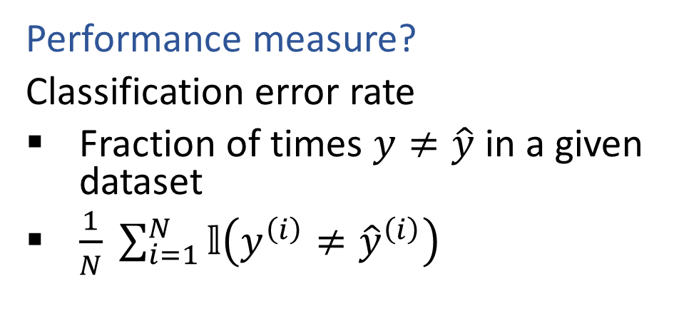



Classification
Notation alert: Indicator function
$𝕝\left(z\right)=1(z)=\left\{\begin{aligned}1 if z is true \\ 0 otherwise\end{aligned}\right.$
Iris data example
$𝒟={\left\{\left( x^{\left(i\right)},y^{\left(i\right)}\right)\right\}}_{i=1}^{N}$, where $x^{(i)}∈ℝ^{4}$, $y^{(i)}∈\{0, 1, 2\}$
Predict species label from input measurements
$h\left(x\right)→\hat{y}$
Species | Sepal Length | Sepal Width | Petal Length | Petal Width
0 | 4.3 | 3.0 | 1.1 | 0.1
0 | 4.9 | 3.6 | 1.4 | 0.1
0 | 5.3 | 3.7 | 1.5 | 0.2
1 | 4.9 | 2.4 | 3.3 | 1.0
1 | 5.7 | 2.8 | 4.1 | 1.3
1 | 6.3 | 3.3 | 4.7 | 1.6
2 | 5.9 | 3.0 | 5.1 | 1.8
Performance measure?
Classification error rate
Fraction of times $y≠\hat{y}$ in a given dataset
$\frac{1}{N} \sum_{i=1}^{N}{𝕝\left(y^{\left(i\right)}≠{\hat{y}}^{\left(i\right)}\right)}$
Images and full dataset: https://en.wikipedia.org/wiki/Iris_flower_data_set

Slide 19
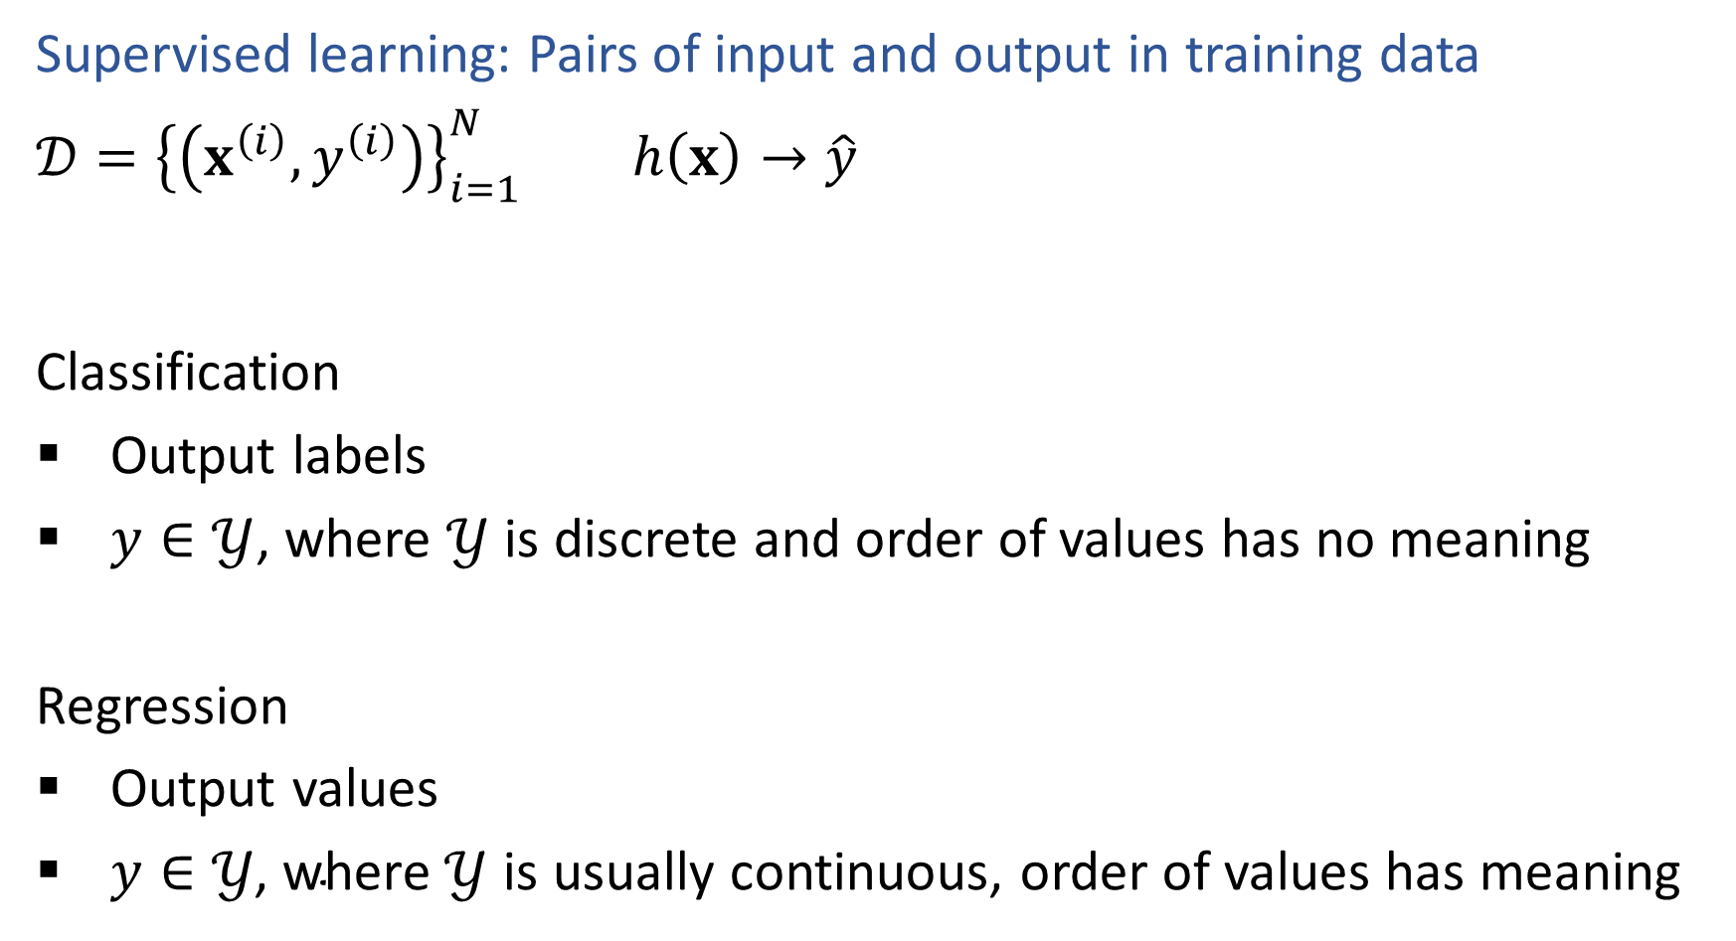

ML Tasks
Supervised learning: Pairs of input and output in training data
$𝒟={\left\{\left(x^{\left(i\right)},y^{\left(i\right)}\right)\right\}}_{i=1}^{N}$ $h\left(x\right)→\hat{y}$
Classification
Output labels
$y∈𝒴$, where $𝒴$ is discrete and order of values has no meaning
Regression
Output values
$y∈𝒴\text{, }\text{where} 𝒴$ is usually continuous, order of values has meaning

Slide 20
Unsupervised Tasks

Slide 21
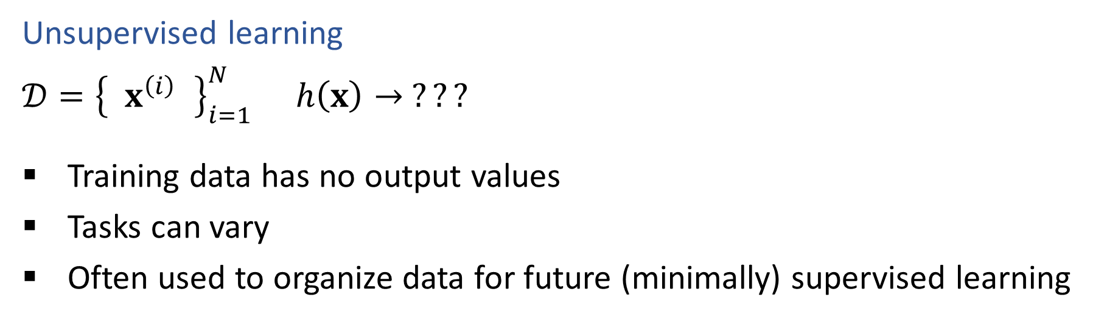
ML Tasks
Unsupervised learning
$𝒟={\left\{ x^{\left(i\right) }\right\}}_{i=1}^{N}$ $h\left(x\right)→ ???$
Training data has no output values
Tasks can vary
Often used to organize data for future (minimally) supervised learning

Slide 22
Task: Face Generation
https://thispersondoesnotexist.com/

Slide 23
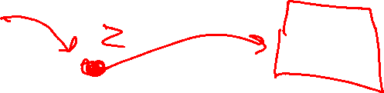

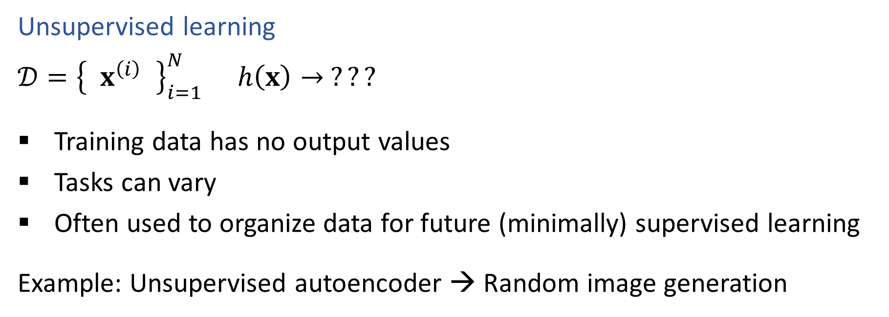
ML Tasks
Unsupervised learning
$𝒟={\left\{ x^{\left(i\right) }\right\}}_{i=1}^{N}$ $h\left(x\right)→ ???$
Training data has no output values
Tasks can vary
Often used to organize data for future (minimally) supervised learning
Example: Unsupervised autoencoder → Random image generation
$$x → h\left(x\right) → \hat{x}$$
$$x → f\left(x\right) →z→ g\left(z\right) → \hat{x}$$
$$z→ g\left(z\right) → \hat{x}$$

Slide 24
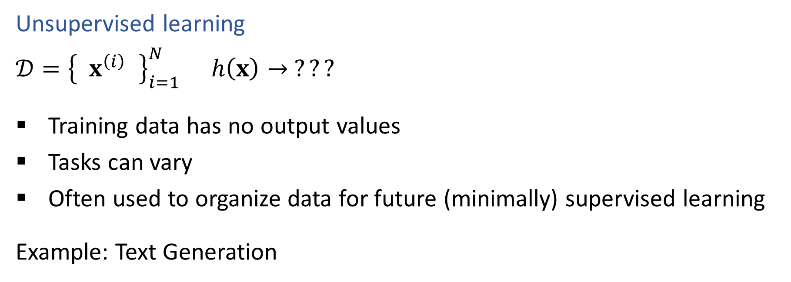
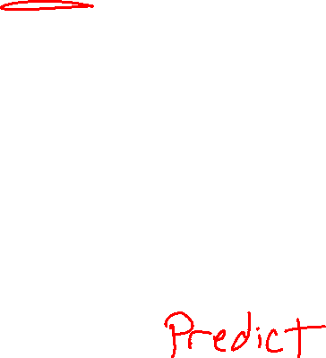
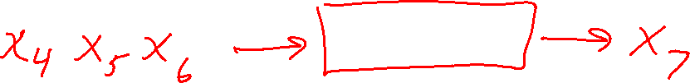
ML Tasks
Unsupervised learning
$𝒟={\left\{ x^{\left(i\right) }\right\}}_{i=1}^{N}$ $h\left(x\right)→ ???$
Training data has no output values
Tasks can vary
Often used to organize data for future (minimally) supervised learning
Example: Text Generation

Slide 25
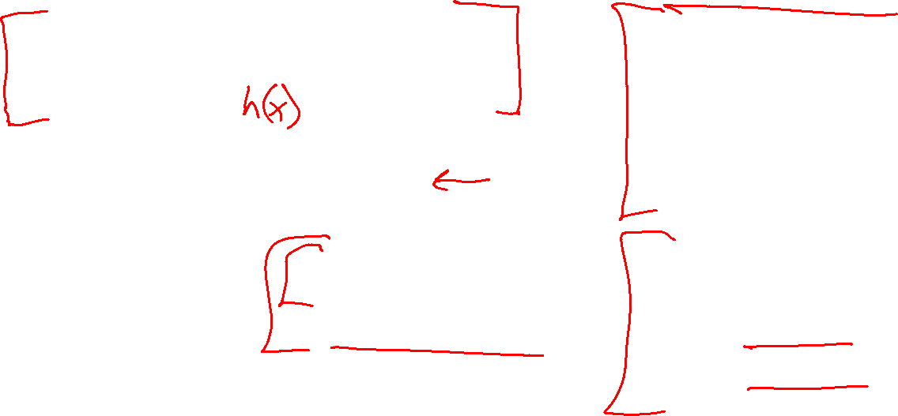
Vocab pause
Experience/Data
Input
Input feature
Measurement
Attribute
Output
Target
Class/category/label
True output
Measured output
Predicted output
Supervised
Unsupervised
Performance Measure
Objective function
Classification
Error rate
Accuracy rate
Regression
Mean squared error
Task
Prediction
Inference
Hypothesis function
Classification
Regression
Training
Model
Model structure
Model parameters

Slide 26
Training and ML Models

Slide 27
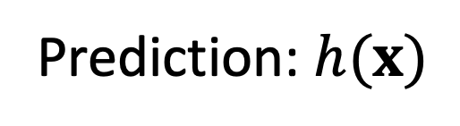


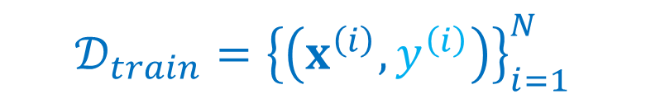

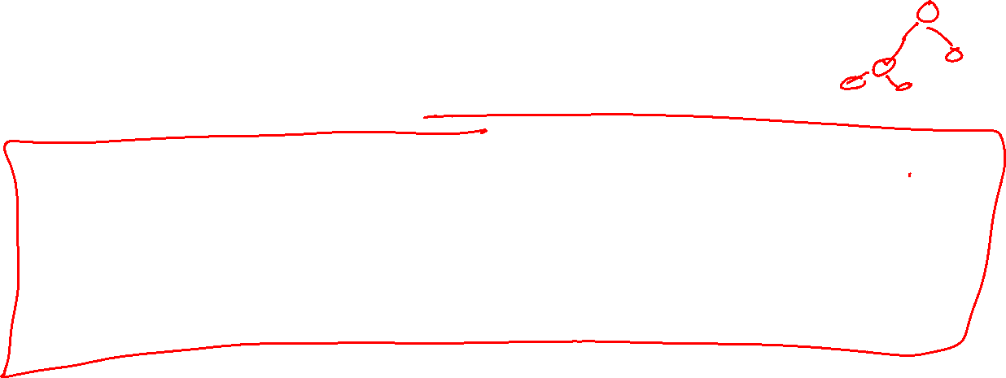
Machine Learning
Using (training) data to learn a model that we’ll later use for prediction
Training Data
Input and Measured Output
Model
Structure and Parameters, $θ$
Training
$$𝒟_{train}={\left\{\left(x^{\left(i\right)},y^{\left(i\right)}\right)\right\}}_{i=1}^{N}$$
Prediction: $h(x)$
Input
Predicted
Output
Model
$$x^{(new)}$$
$${\hat{y}}^{(new)}$$

Slide 28
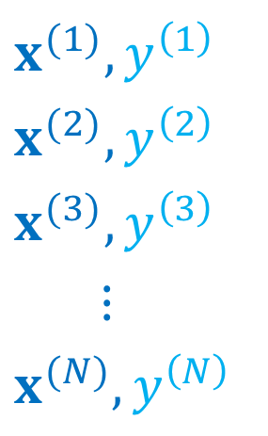
Machine Learning
Using (training) data to learn a model that we’ll later use for prediction
Training Data
$$x^{(1)},y^{\left(1\right)}$$
$$x^{(2)},y^{\left(2\right)}$$
$$x^{(3)},y^{\left(3\right)}$$
$$⋮$$
$$x^{(N)},y^{\left(N\right)}$$
Model
Structure and Parameters, $θ$
Training
Prediction: $h(x)$
Input
Predicted
Output
Model
$$x^{(new)}$$
$${\hat{y}}^{(new)}$$

Slide 29
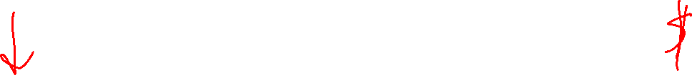
Task: Car Price Prediction
Regression: learning a model to predict a numerical output (but not numbers that just represent categories, that would be classification)
Example
Trying to see how much I should sell my car for.
Prediction
Input
Model
Predicted
Output

Slide 30
Task: Car Price Prediction
Regression: learning a model to predict a numerical output (but not numbers that just represent categories, that would be classification)
What input features should we use?
Prediction
Input
Model
Predicted
Output

Slide 31
Poll 2
Regression: learning a model to predict a numerical output (but not numbers that just represent categories, that would be classification)
What input features should we use?
Prediction
Input
Model
Predicted
Output

Slide 32
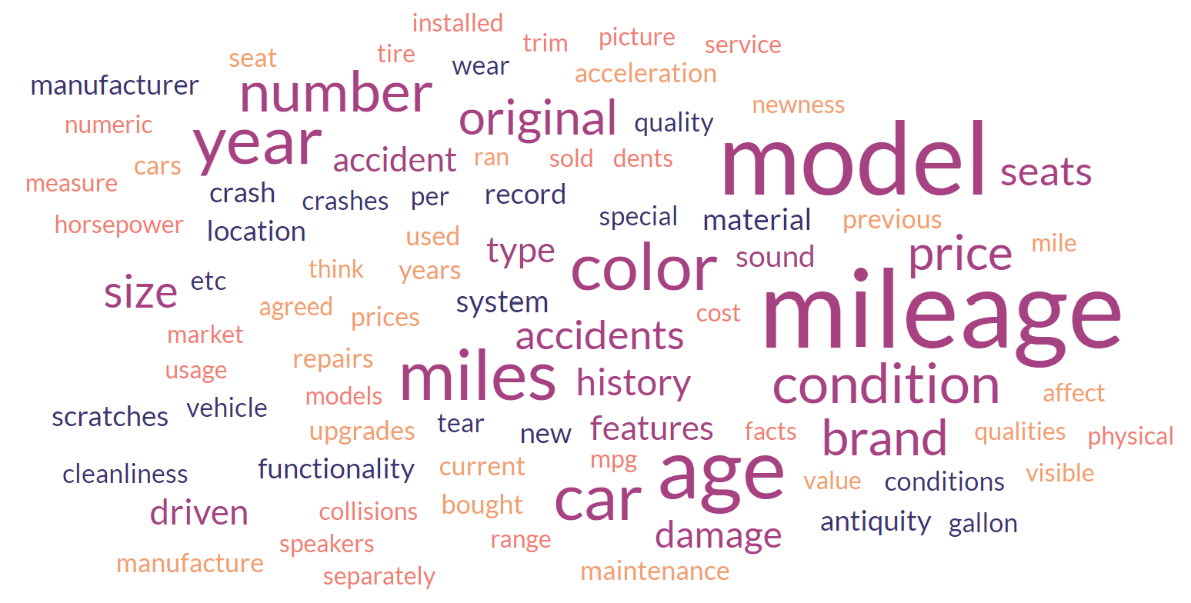
Poll 2
Regression: learning a model to predict a numerical output (but not numbers that just represent categories, that would be classification)
What input features should we use?

Slide 33
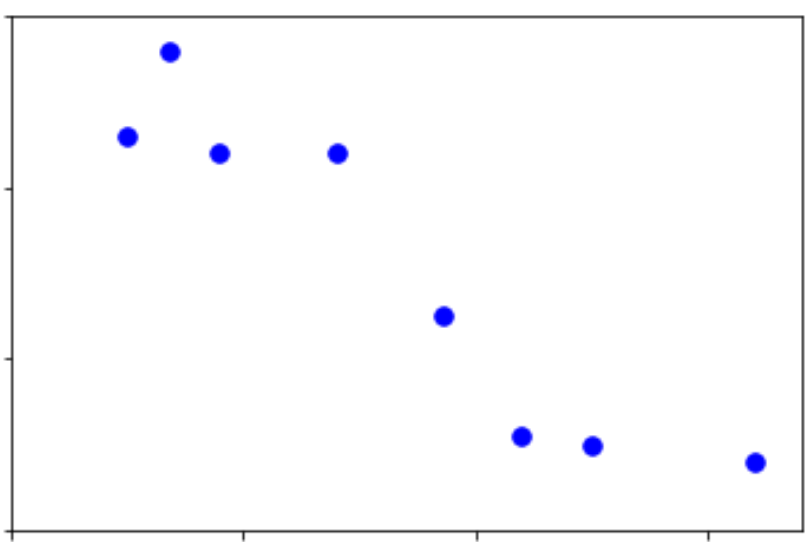
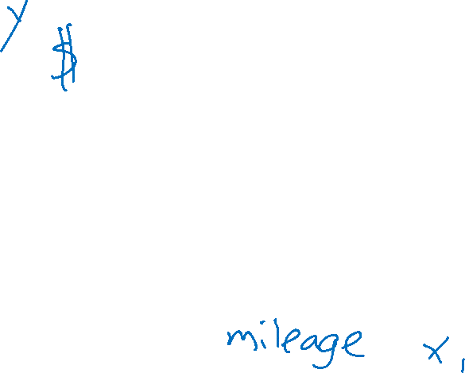
Regression
Regression: learning a model to predict a numerical output (but not numbers that just represent categories, that would be classification)
Example
Trying to see how much I should sell my car for. Looking up data from car websites, I find the mileage for a set of cars and the selling price for each car.

Slide 34
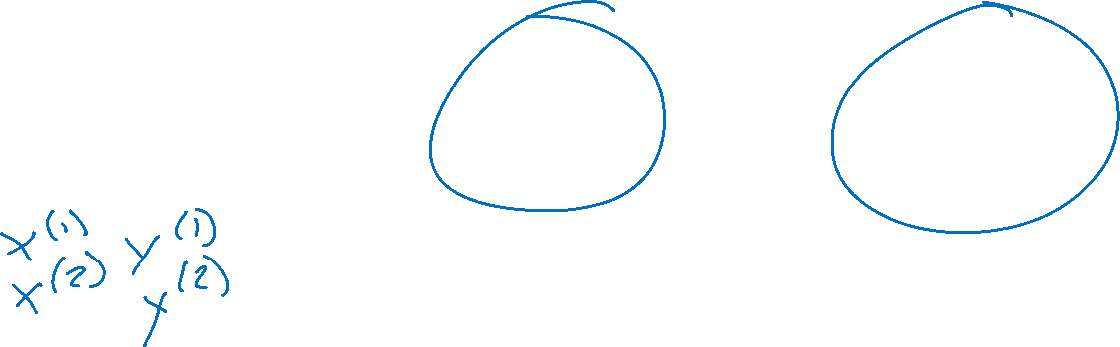
Machine Learning
Using (training) data to learn a model that we’ll later use for prediction
Training Data
Input and Measured Output
Model
Structure and Parameters
Training
Prediction
Input
Model
Predicted
Output

Slide 35
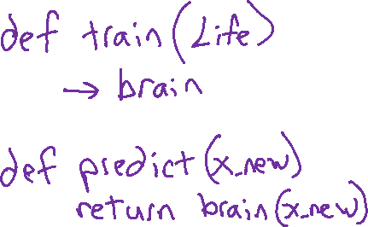
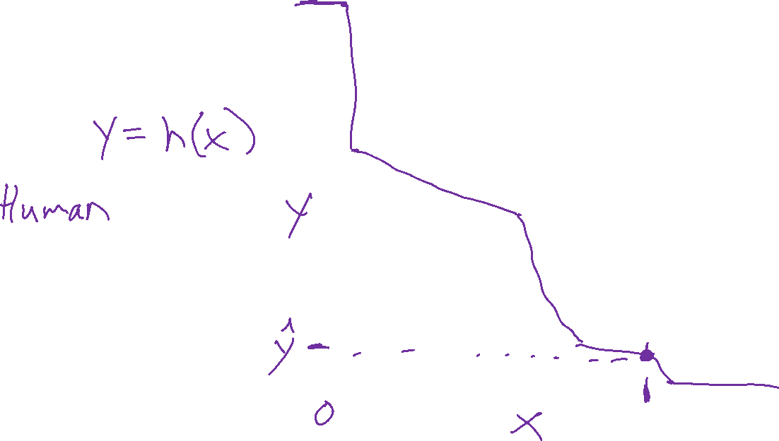
Regression Model
Regression: learning a model to predict a numerical output (but not numbers that just represent categories, that would be classification)
Model?

Slide 36
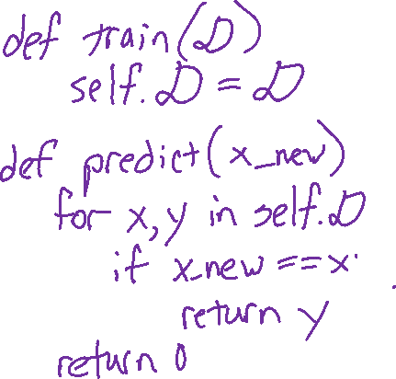
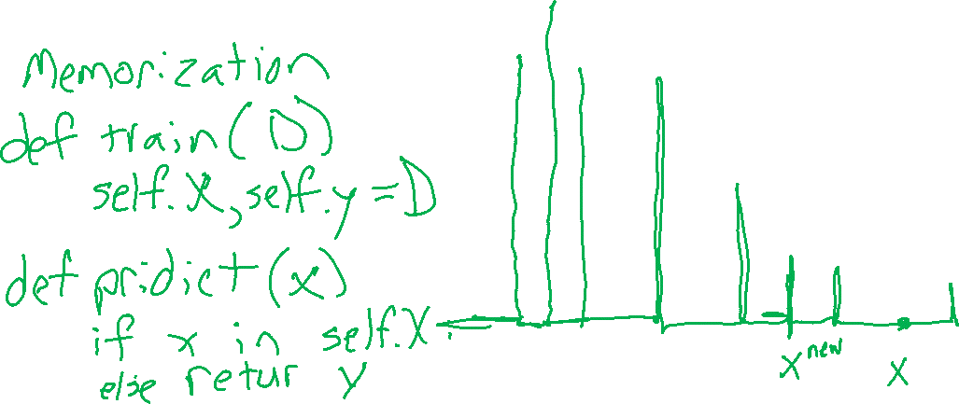
Regression Model
Regression: learning a model to predict a numerical output (but not numbers that just represent categories, that would be classification)
Model: Memorization

Slide 37
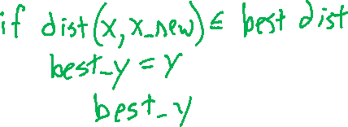



Regression Model
Regression: learning a model to predict a numerical output (but not numbers that just represent categories, that would be classification)
Model: Nearest neighbor

Slide 38



Regression Model
Regression: learning a model to predict a numerical output (but not numbers that just represent categories, that would be classification)
Model: Linear

Slide 39

Regression Model
Regression: learning a model to predict a numerical output (but not numbers that just represent categories, that would be classification)
Model?

