Slide 1
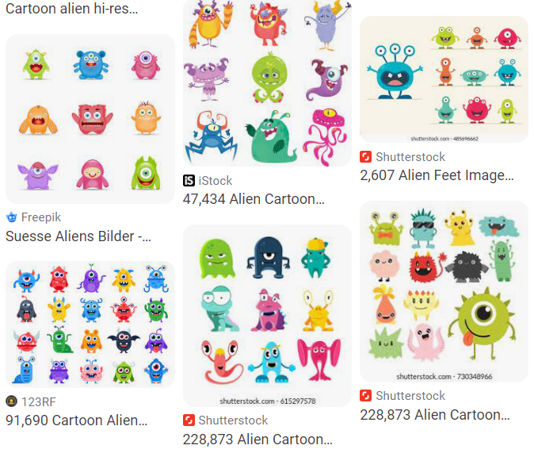
As you walk in
Welcome!
Help draw some aliens for our dataset today!
Grab a sharpie and some sticky notes
Just stick figures, nothing quite this fancy →

Slide 2
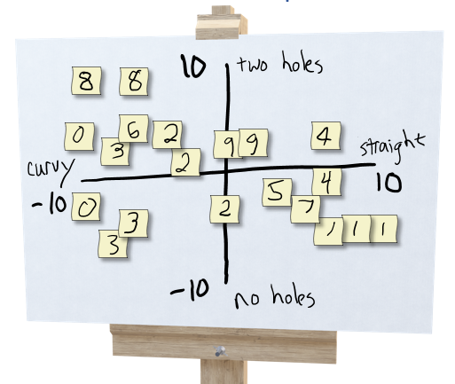
Exercise: Human-defined Feature Space
Try to organize data on a 2-D coordinate plot
to win the following game:
Select three students: A, B, C
Student A draws a new alien and hands it to student B
Student B thinks about where to plot it and comes up with a 2-D coordinate, (x, y)
Student C looks at the coordinate and the plot (but not the drawing from A) and draws a new alien

Slide 3

10-315 Introduction to ML
Instructor: Pat Virtue

Slide 4
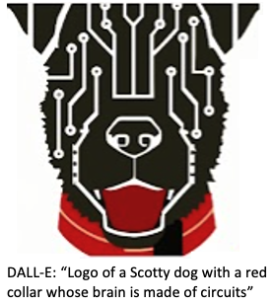
Today
Aliens
Course team
What is AI and ML?
ML framework
Example ML models
Autoencoder (Aliens)
Piazza and website for course info

Slide 5

Course Information
Website: https://www.cs.cmu.edu/~10315
Communication:
piazza.com
E-mail Joshmin if piazza doesn’t work:
joshminr@andrew.cmu.edu
Important posts coming soon!
Office Hours
Jupyter notebooks
Recitation (Fri)
Pre-reading (due Sun)
HW0
HW1

Slide 6

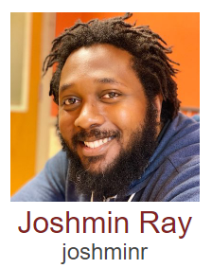
Course Team
Instructor
Education Associate
Best way to contact Pat:
Post on Piazza (private post as needed)
Just grab an OH appointment slot
Email Joshmin, joshminr@andrew.cmu.edu, for any:
Exceptions, extensions, etc
Any course logistics

Slide 7
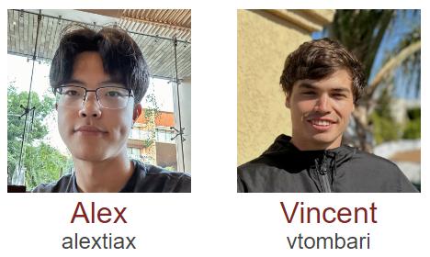
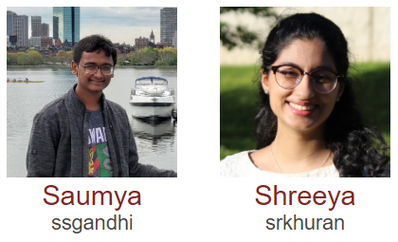
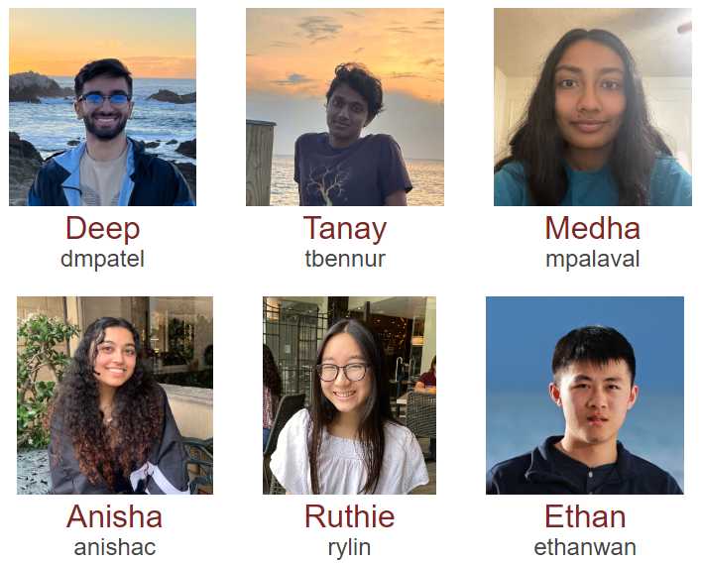
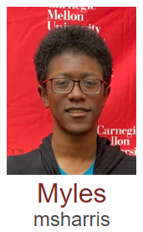
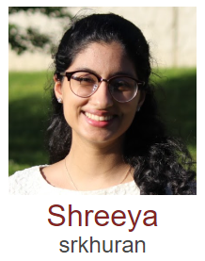
Course Team
Teaching Assistants

Slide 8
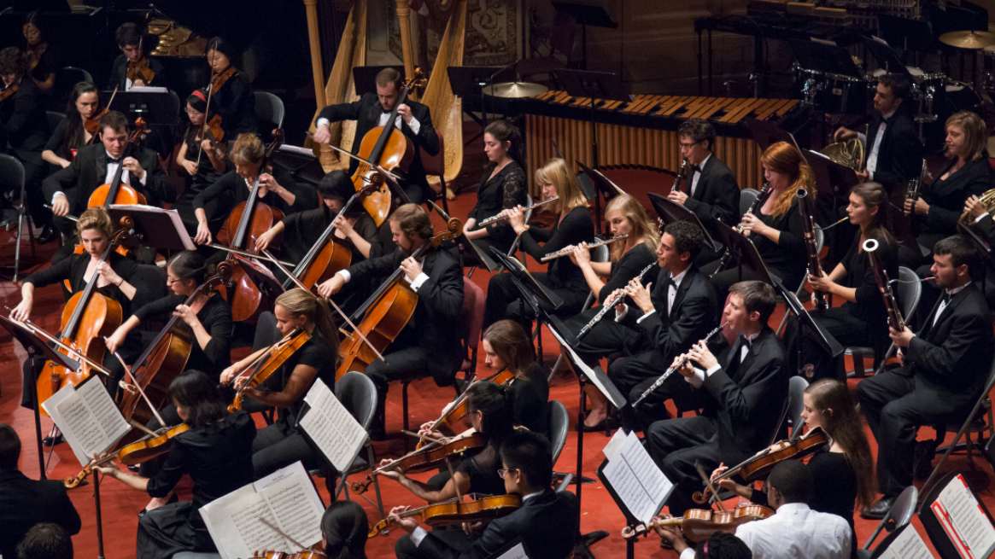
Course Team
Students!!

Slide 9
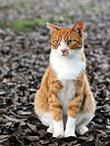
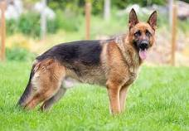

"Poll"
Which of these are artificial?
Which of these are more intelligent?

Slide 10
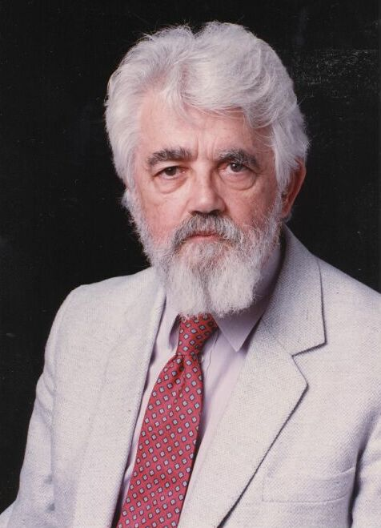
AI Definition by John McCarthy
What is artificial intelligence
It is the science and engineering of making intelligent machines, especially intelligent computer programs
What is intelligence
Intelligence is the computational part of the ability to achieve goals in the world
http://www-formal.stanford.edu/jmc/whatisai/whatisai.html

Slide 11
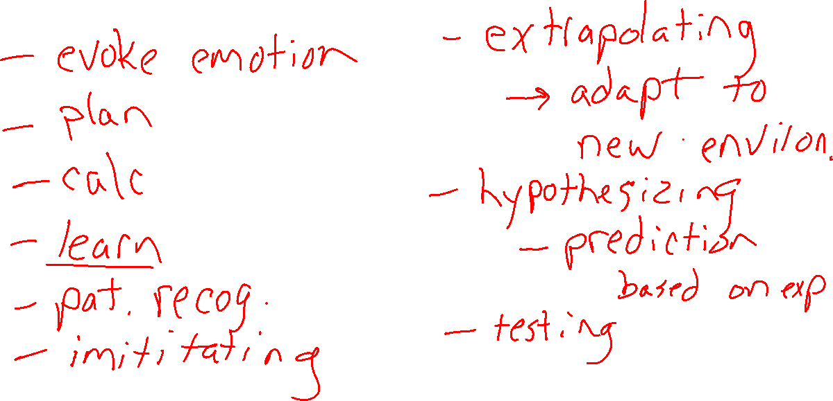
Attributes of Intelligence

Slide 12
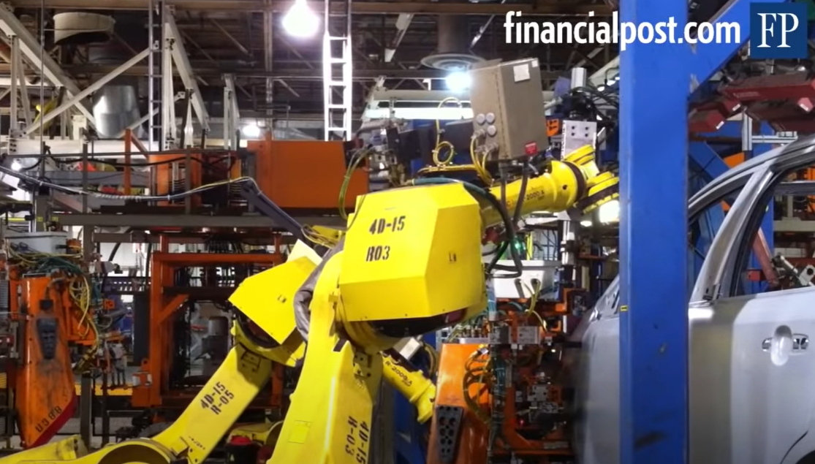
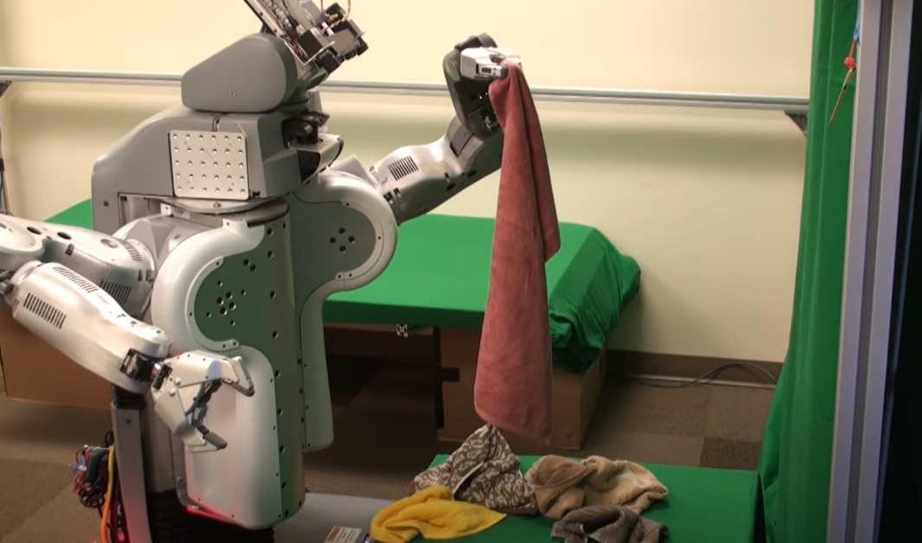
"Poll" Turn to your neighbor
Which of these more intelligent?
Robot that assemble cars in factory
Robot that fold clothes

Slide 13
Intelligence and Uncertainty
Uncertainty can have lots of sources, including anything we attribute to random chance
Hidden information
Cards in another player’s hand
Noise
Sensor noise
Way to complicated to model
Leaves blowing in the wind
Infinite number of possible configurations
More possibilities than any computer can compute in a reasonable time
Tic-tac-toe → Checkers → Chess

Slide 14
AI Definition by John McCarthy
What is artificial intelligence
It is the science and engineering of making intelligent machines, especially intelligent computer programs
What is intelligence
Intelligence is the computational part of the ability to achieve goals in the world
http://www-formal.stanford.edu/jmc/whatisai/whatisai.html

Slide 15


AI Definition (Pat's Version)
What is intelligence
Intelligence is the ability to perform well on a task that involves uncertainty
Intelligence is not binary
How well an agent performs and how much uncertainty is involved will determine how intelligent we consider the agent to be

Slide 16
Artificial Intelligence vs Machine Learning?
Artificial Intelligence
Machine Learning
Deep Learning

Slide 17
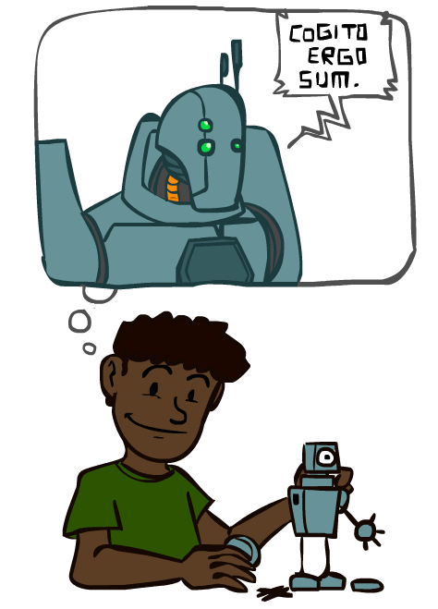
A Brief History of AI
Images: ai.berkeley.edu

Slide 18
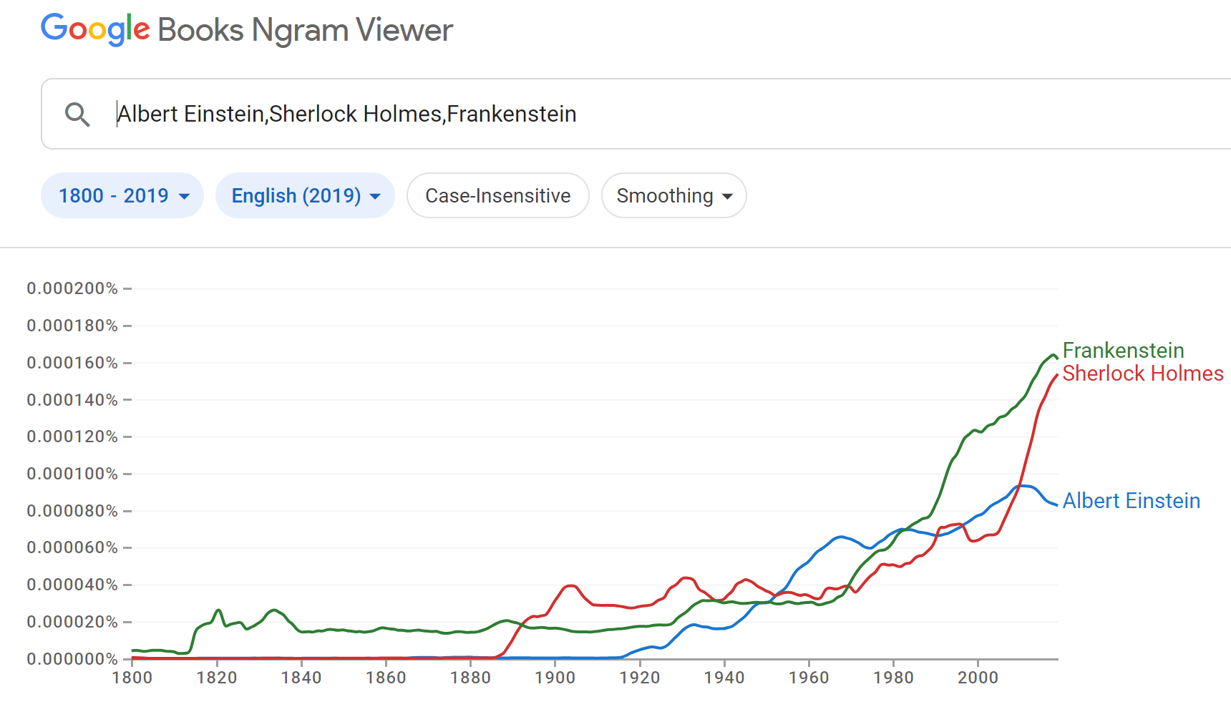
A Brief History of AI: Via Google N-grams Viewer
https://books.google.com/ngrams
https://books.google.com/ngrams

Slide 19
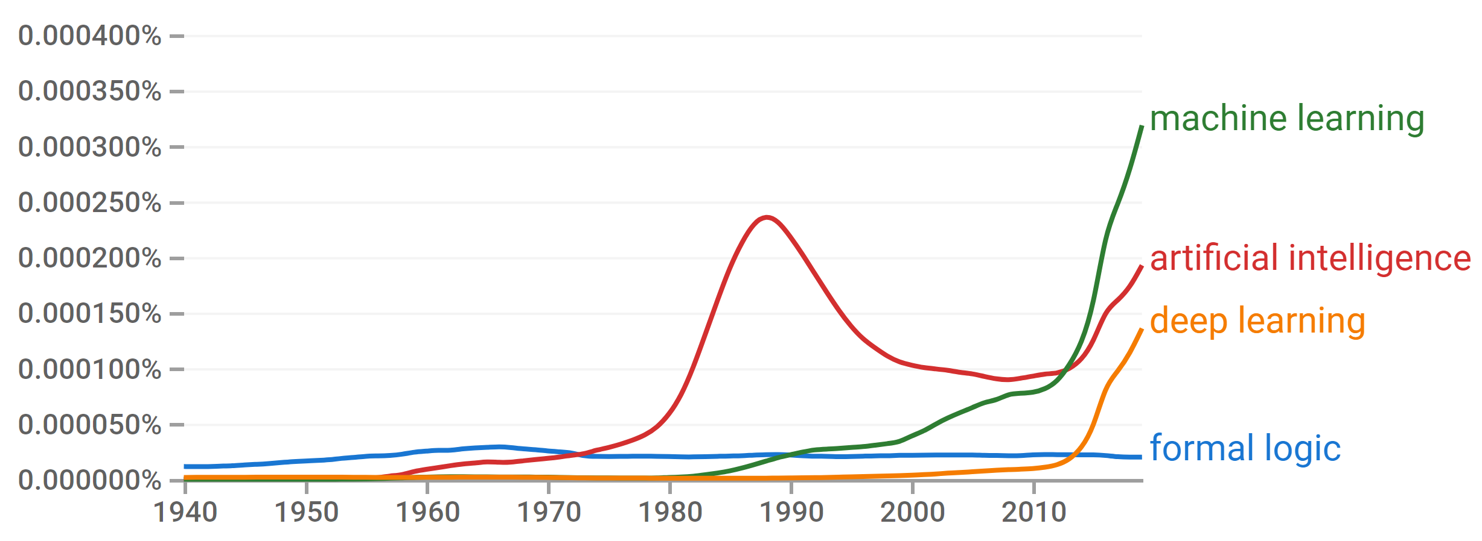

A Brief History of AI
Knowledge Based
Systems
1970-1990
Statistical Approaches
1990-
Deep Learning Era
2012-
Generative AI Era
2023-
AI
Excitement!
1950-1970
https://books.google.com/ngrams

Slide 20
A Brief History of AI
1940-1950: Early days
1943: McCulloch & Pitts: Boolean circuit model of brain
1950: Turing's “Computing Machinery and Intelligence”
1950—70: Excitement: Look, Ma, no hands!
1950s: Early AI programs, including Samuel's checkers program, Newell & Simon's Logic Theorist, Gelernter's Geometry Engine
1956: Dartmouth meeting: “Artificial Intelligence” adopted
1970—90: Knowledge-based approaches
1969—79: Early development of knowledge-based systems
1980—88: Expert systems industry booms
1988—93: Expert systems industry busts: “AI Winter”
1990—: Statistical approaches
Resurgence of probability, focus on uncertainty
General increase in technical depth
Agents and learning systems… “AI Spring”?
2012—: Deep learning
2012: ImageNet & AlexNet
2023—: Generative AI
2023: ChatGPT
Images: ai.berkeley.edu
Notes:
Million dollar computer with less computation than your phone
MT was

Slide 21
What is ML?
Domain of Interest
Computer Science
Computer Science
Machine Learning
Optimization
Optimization
Statistics
Statistics
Linear Algebra
Linear Algebra
Probability
Probability
Calculus
Calculus
Measure Theory

Slide 22
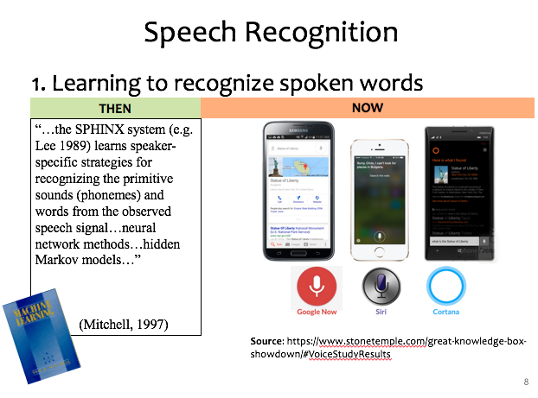
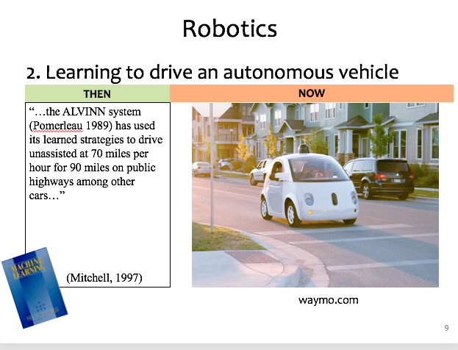
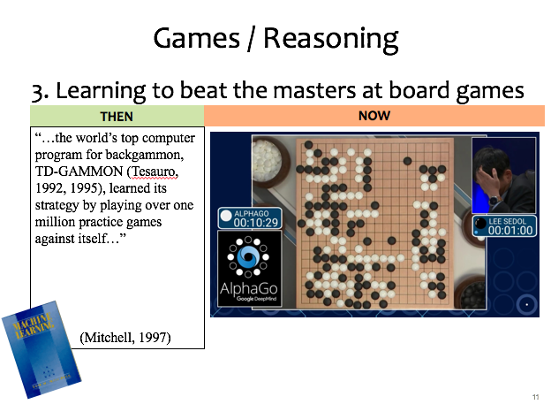
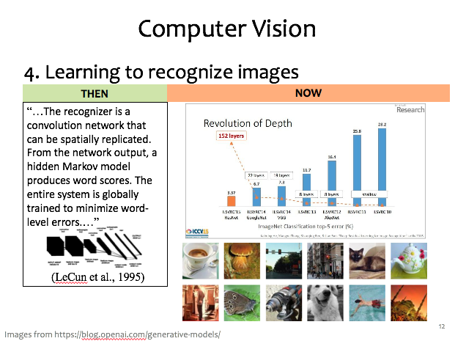
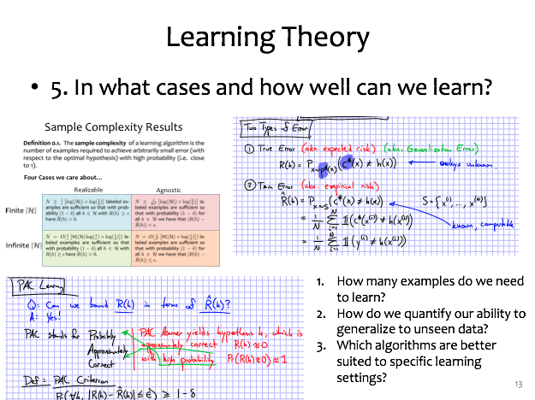

ML Applications?

Slide 23
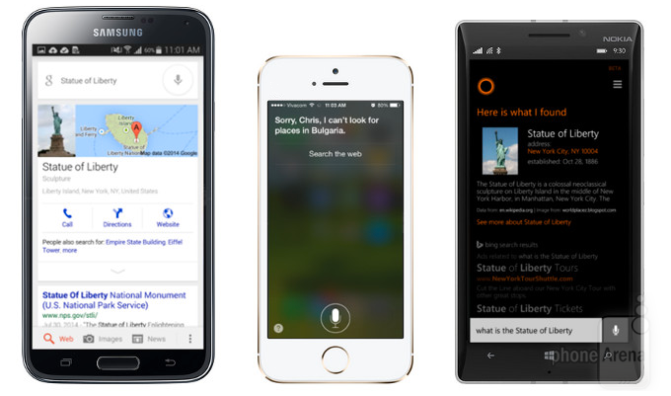

Speech Recognition
1. Learning to recognize spoken words
THEN
NOW
“…the SPHINX system (e.g. Lee 1989) learns speaker-specific strategies for recognizing the primitive sounds (phonemes) and words from the observed speech signal…neural network methods…hidden Markov models…”
(Mitchell, 1997)
Source: https://www.stonetemple.com/great-knowledge-box- showdown/#VoiceStudyResults
Slide credit: CMU MLD Matt Gormley

Slide 24
Robotics
2. Learning to drive an autonomous vehicle
NOW
THEN
NOW
“…the ALVINN system (Pomerleau 1989) has used its learned strategies to drive unassisted at 70 miles per hour for 90 miles on public highways among other cars…”
(Mitchell, 1997)
https://www.geek.com/wp-content/uploads/2016/03/uber.jpg
waymo.com
Slide credit: CMU MLD Matt Gormley
Notes:
This a Google self-driving car; it looks really cute and friendly.
But these things weigh a *ton* and there is a person sitting inside this thing!
So this machine needs to know a lot about its environment, what actions to take, or policy to follow.
If a person were to enter the crosswalk, it would need to know how to slow down, or that person would learn a very uncomfortable lesson about physics

Slide 25
Games / Reasoning
3. Learning to beat the masters at board games
THEN
NOW
“…the world’s top computer program for backgammon, TD-GAMMON (Tesauro, 1992, 1995), learned its strategy by playing over one million practice games against itself…”
(Mitchell, 1997)
Slide credit: CMU MLD Matt Gormley

Slide 26
Computer Vision
4. Learning to recognize images
THEN
NOW
“…The recognizer is a convolution network that can be spatially replicated. From the network output, a hidden Markov model produces word scores. The entire system is globally trained to minimize word-level errors.…”
(LeCun et al., 1995)
Slide credit: CMU MLD Matt Gormley
Images from https://blog.openai.com/generative-models/

Slide 27
Learning Theory
5. In what cases and how well can we learn?
Slide credit: CMU MLD Matt Gormley
How many examples do we need to learn?
How do we quantify our ability to generalize to unseen data?
Which algorithms are better suited to specific learning settings?

Slide 28

Machine Learning and Statistics
Statistics is also about learning from data
Statistics has been around from much longer!
What’s the difference?
Until the mid 1990s:
Statistics:
A branch of mathematics
Emphasized rigor, correctness, provable properties (“is it correct?”)
Was not very concerned with scaling
Machine Learning:
A branch of Computer Science / AI
Focus on heuristics, making things work in practice (“does it work?”)
Not much awareness of statistical theory
Slide: CMU ML, Roni Rosenfeld

Slide 29
As you walk in
Welcome!
Help draw some aliens for our dataset today!
See table up front
Just stick figures, nothing quite this fancy →

Slide 30
Exercise: Human-defined Feature Space
Try to organize data on a 2-D coordinate plot
to win the following game:
Select three students: A, B, C
Student A draws a new alien and hands it to student B
Student B thinks about where to plot it and comes up with a 2-D coordinate, (x, y)
Student C looks at the coordinate and the plot (but not the drawing from A) and draws a new alien

Slide 31




Exercise: Human-defined Feature Space
Step1: Write a bunch of example data on sticky notes

Slide 32

Exercise: Human-defined Feature Space
Step2: In groups, try to organize data on a 2-D coordinate plot
Optional: label the extreme ends of both coordinate axes

Slide 33
Exercise: Human-defined Feature Space
Step2: In groups, try to organize data on a 2-D coordinate plot
Optional: label the extreme ends of both coordinate axes

Slide 34
Exercise: Human-defined Feature Space
Step 3: Prediction!
Select three students: A,B,C
Student A draws a new digit and hands it to student B
Student B thinks about where to plot it and comes up with a 2-D coordinate, (x, y)
Student C looks at the coordinate and the plot (but not the drawing from A) and predicts the digit, 0-9

Slide 35
Exercise: Human-defined Feature Space
Step 4: Creation!
Select three students: A,B,C
Student A draws a new digit and hands it to student B
Student B thinks about where to plot it and comes up with a 2-D coordinate, (x, y)
Student C looks at the coordinate and the plot (but not the drawing from A) and draws a new digit

Slide 36
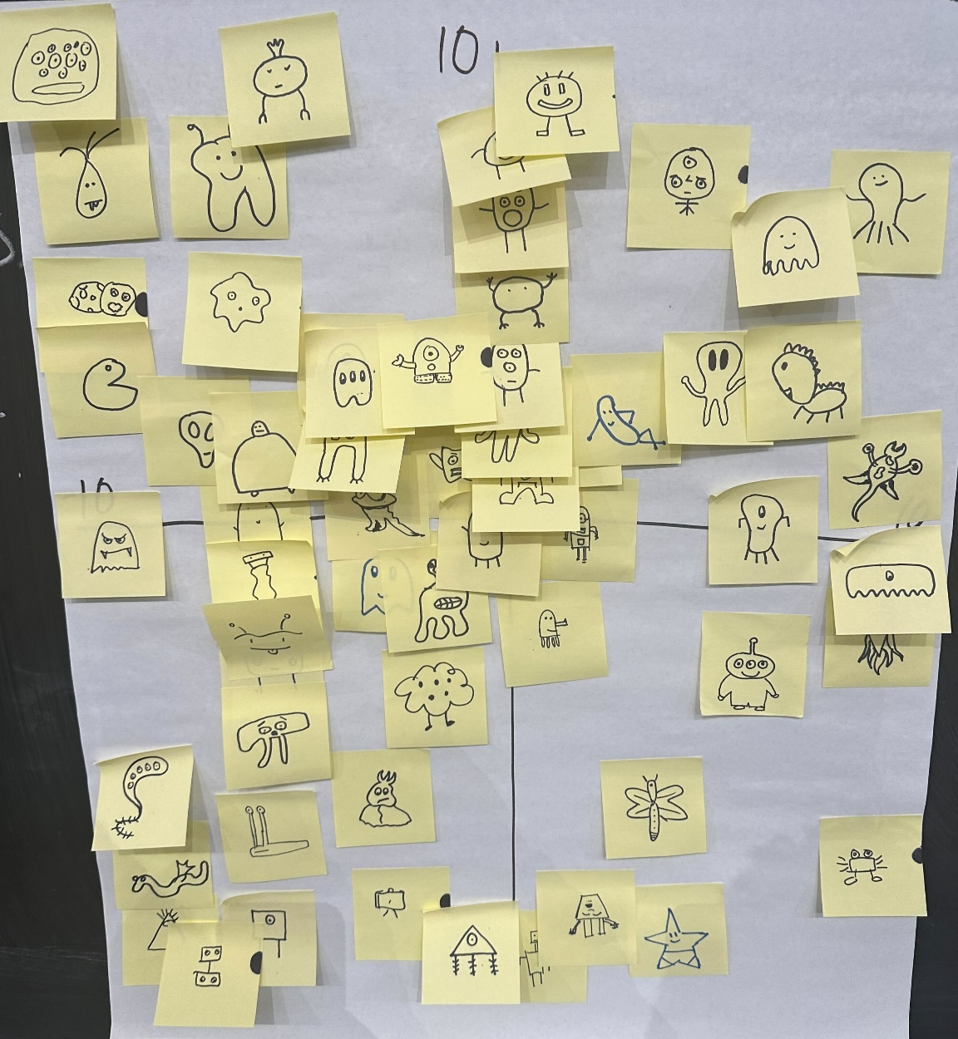
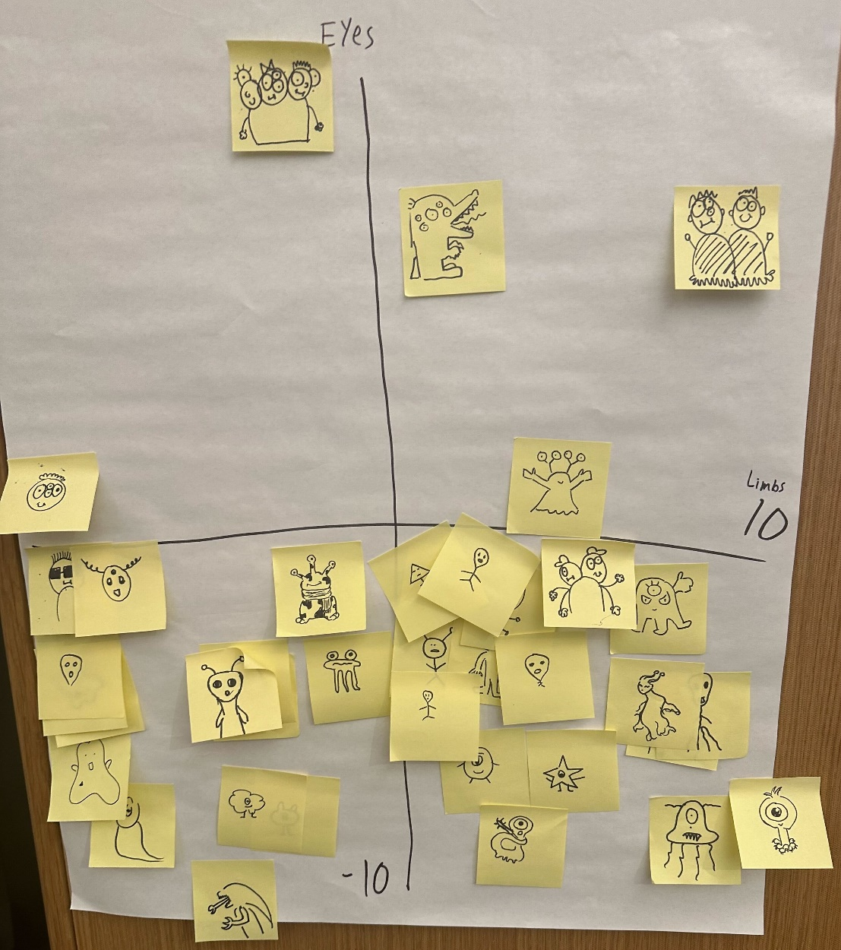
Exercise: Human-defined Feature Space

Slide 37
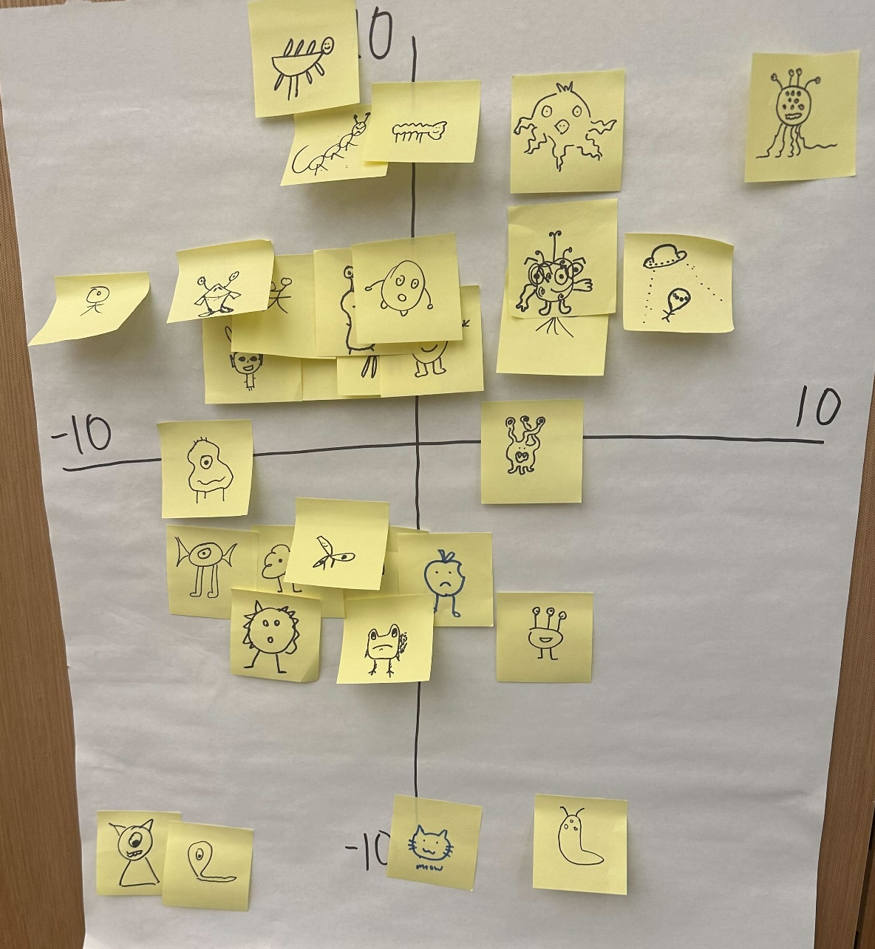
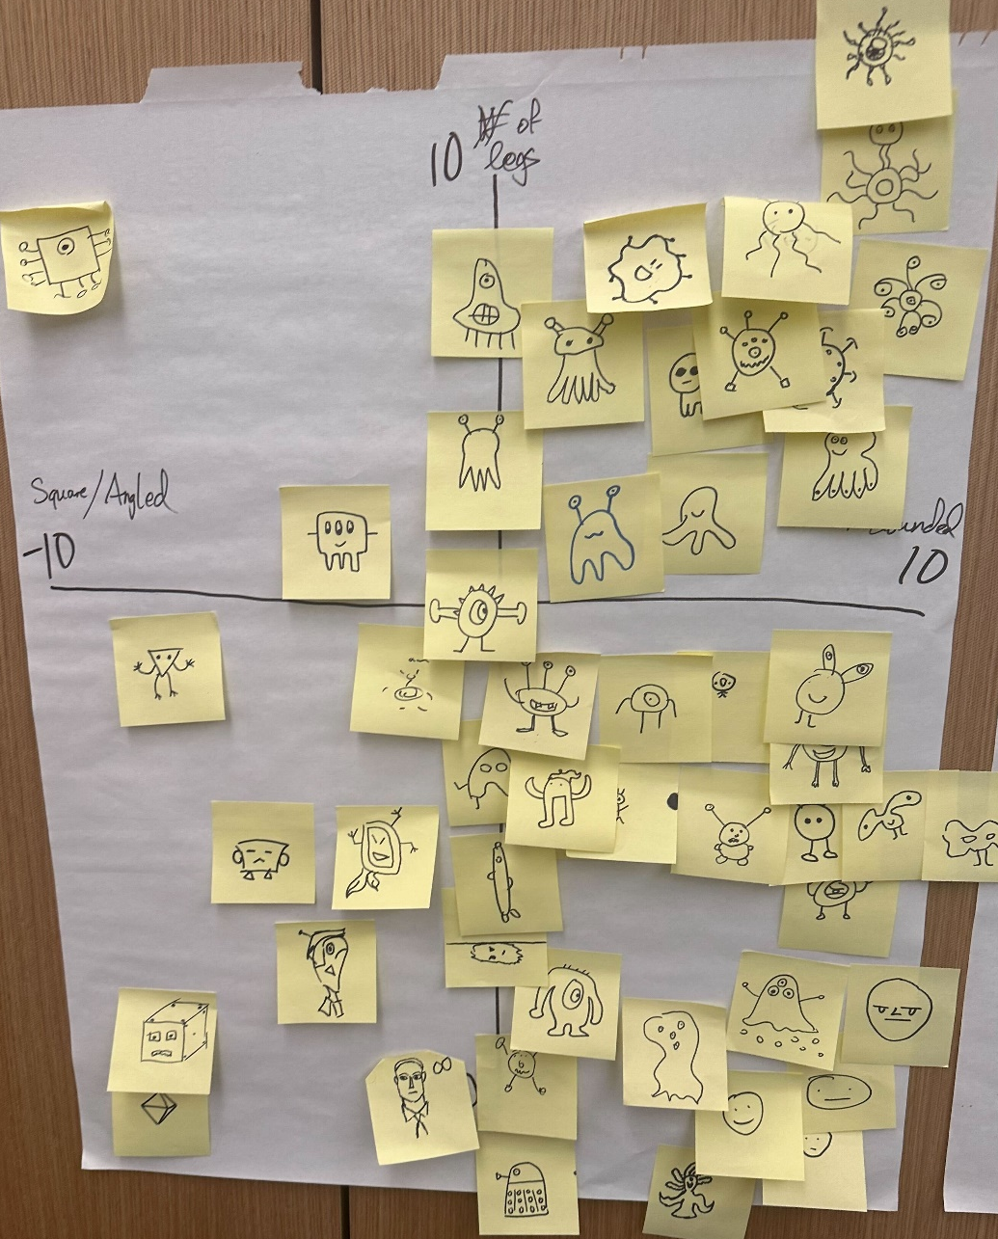
Exercise: Human-defined Feature Space

Slide 38
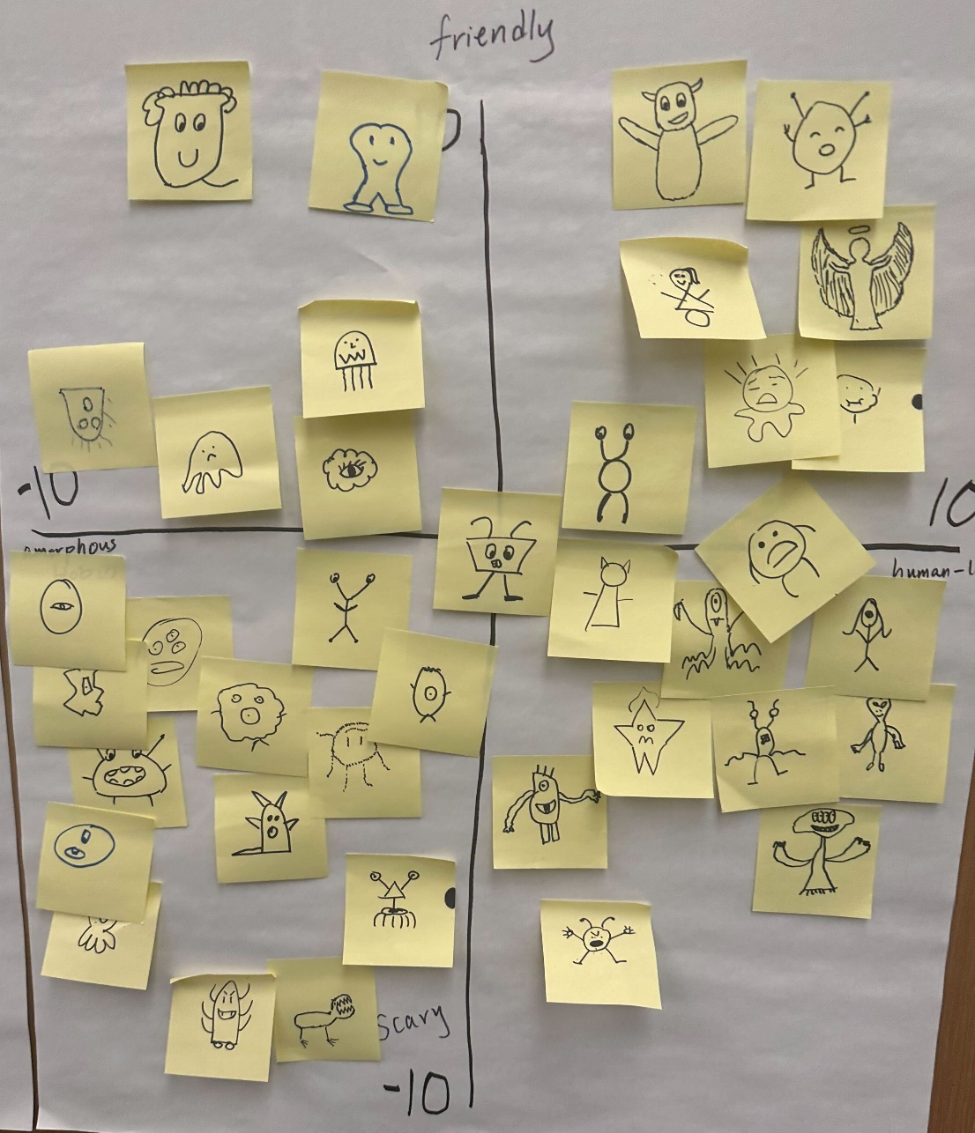
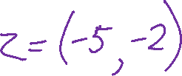
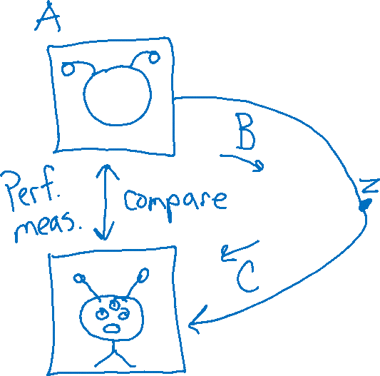
Exercise: Human-defined Feature Space

Slide 39
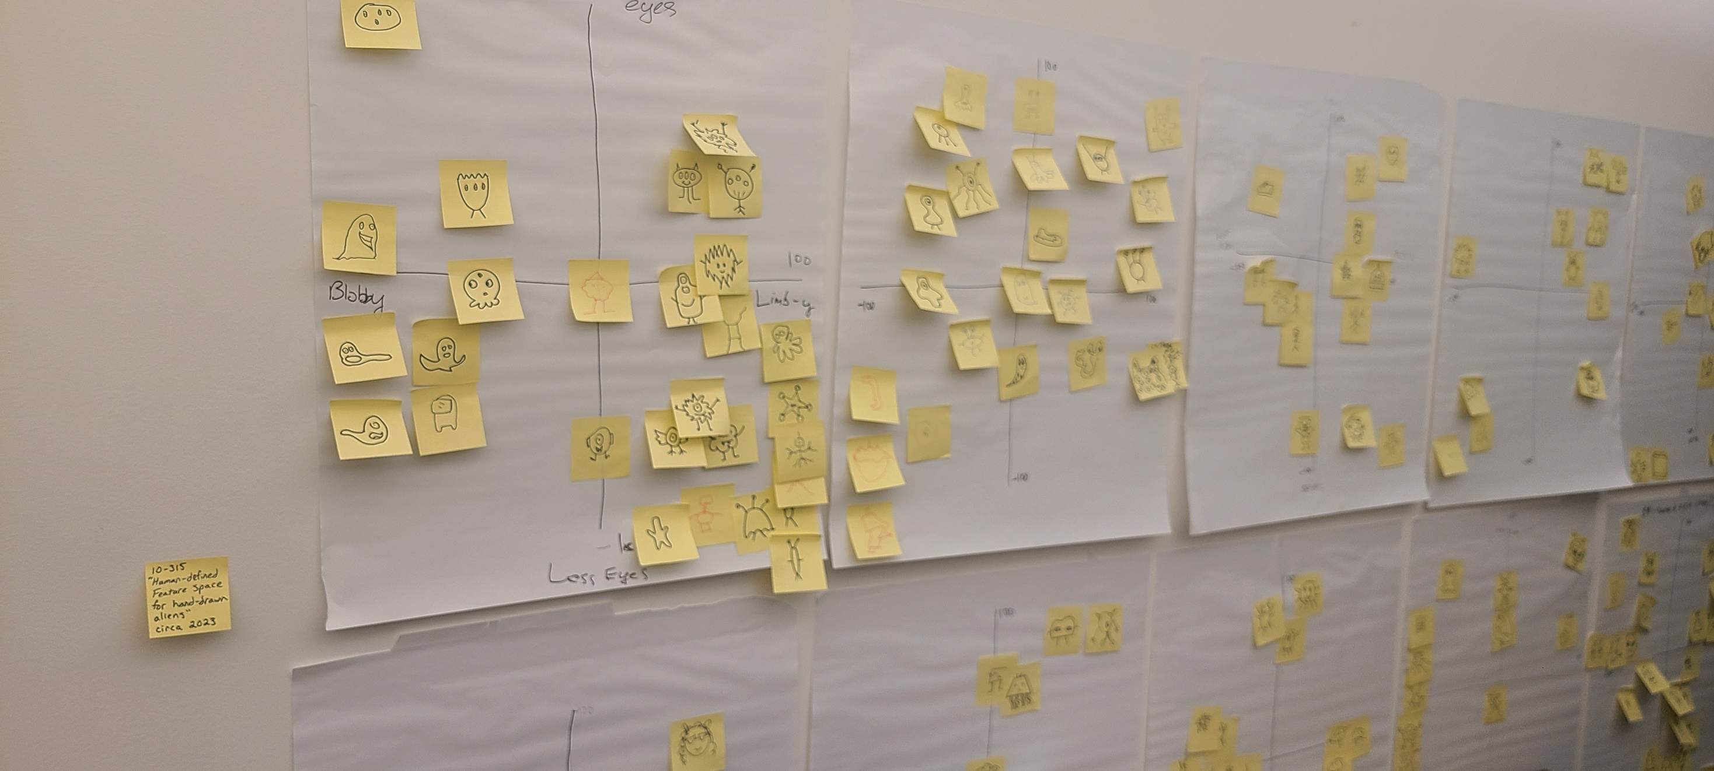
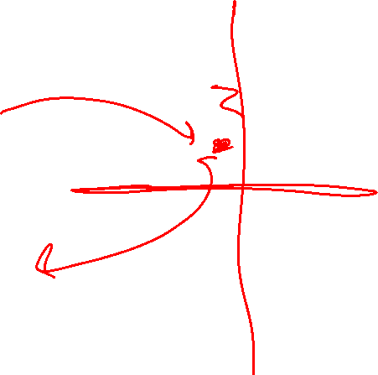

Exercise: Human-defined Feature Space

Slide 40
Poll 1
What features did you use?

Slide 41
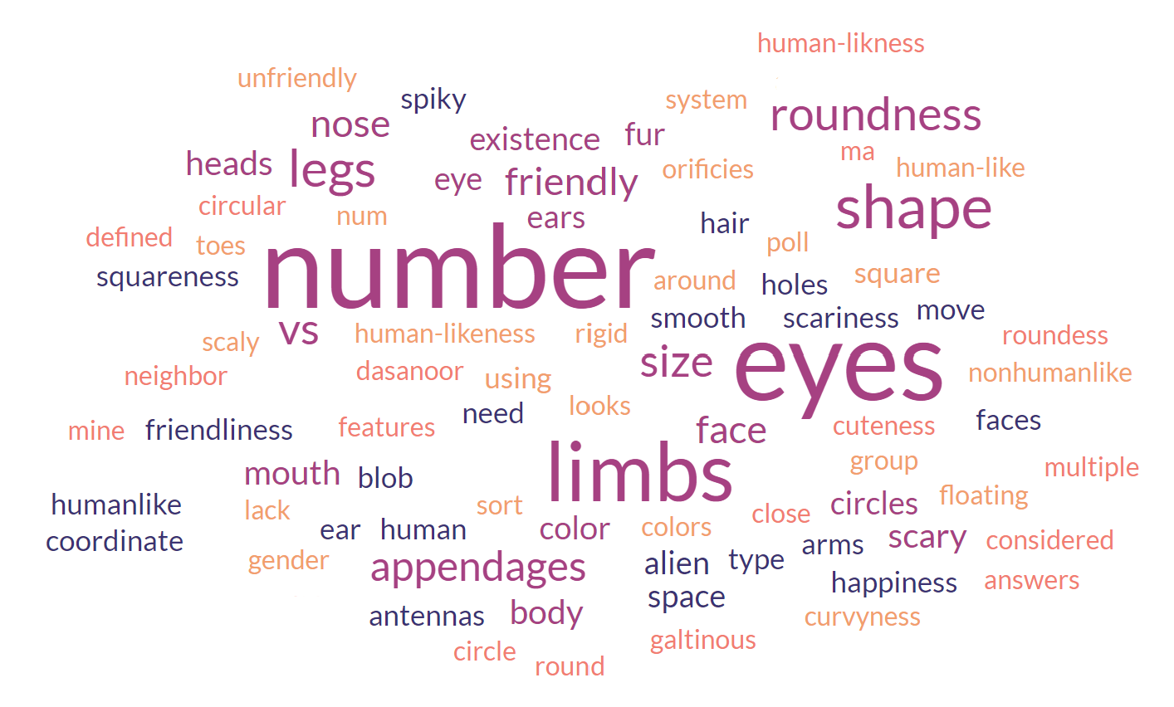
Poll 1
What features did you use?

Slide 42
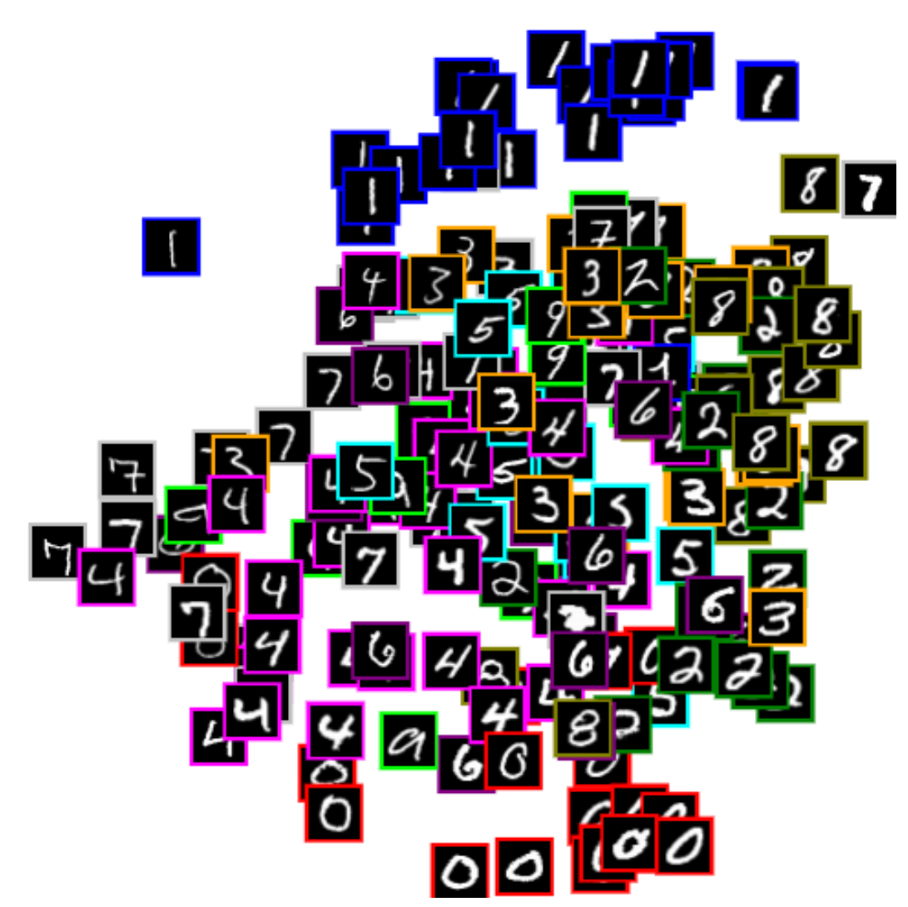


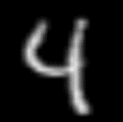


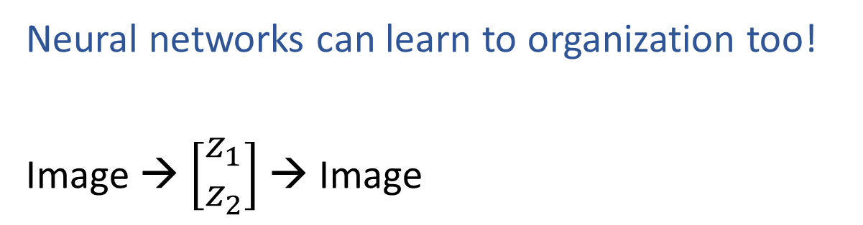
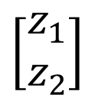
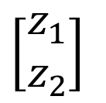
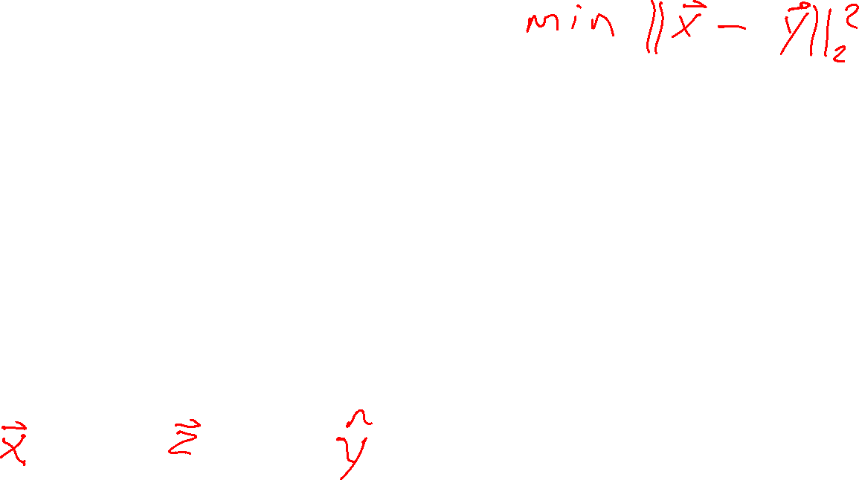
Learning to Organize Data
Neural networks can learn to organization too!
Image → $\left[\begin{aligned}z_{1} \\ z_{2}\end{aligned}\right]$ → Image
$$z_{2}$$
Net
Net
$$\left[\begin{aligned}z_{1} \\ z_{2}\end{aligned}\right]$$
Net
Net
$$\left[\begin{aligned}z_{1} \\ z_{2}\end{aligned}\right]$$
$$z_{1}$$
https://cs.stanford.edu/people/karpathy/convnetjs/demo/autoencoder.html

Slide 43

Digit Autoencoder
Demo: Using a learned feature space

Slide 44
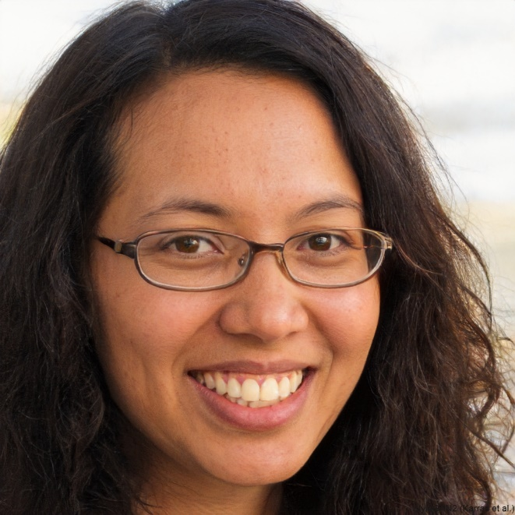
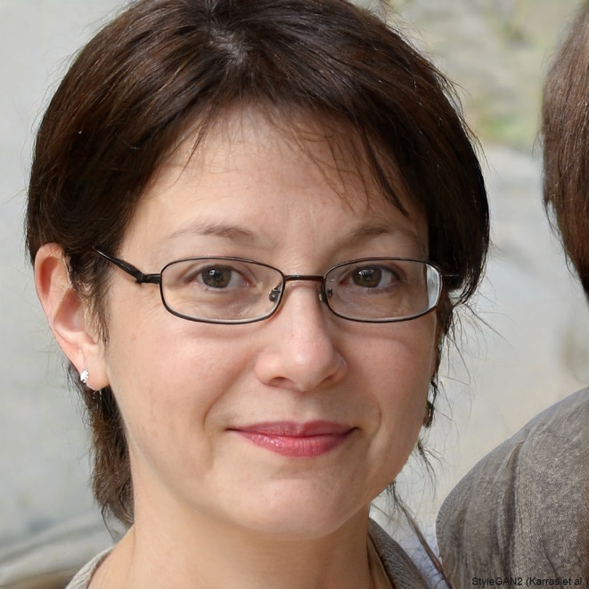
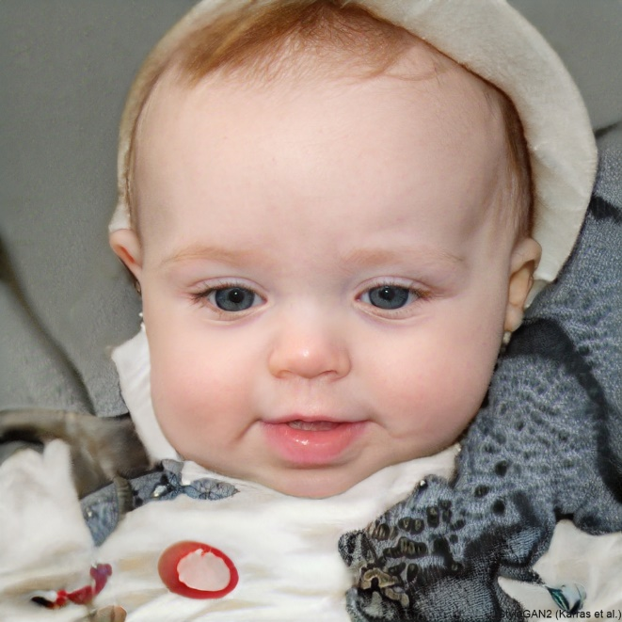
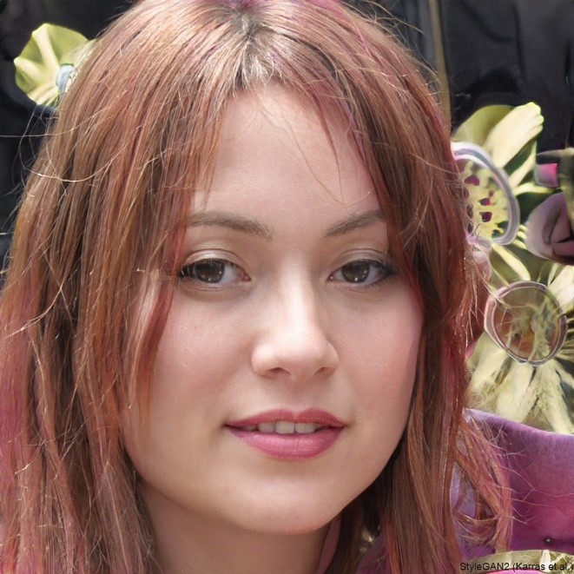

Task: Face Generation
https://thispersondoesnotexist.com/

Slide 45
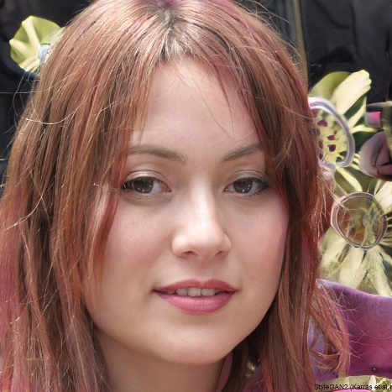

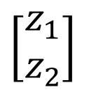
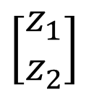
Task: Face Generation
https://thispersondoesnotexist.com/
Random
Net
$$\left[\begin{aligned}z_{1} \\ z_{2}\end{aligned}\right]$$
Random
$$\left[\begin{aligned}z_{1} \\ z_{2}\end{aligned}\right]$$
Net

Slide 46
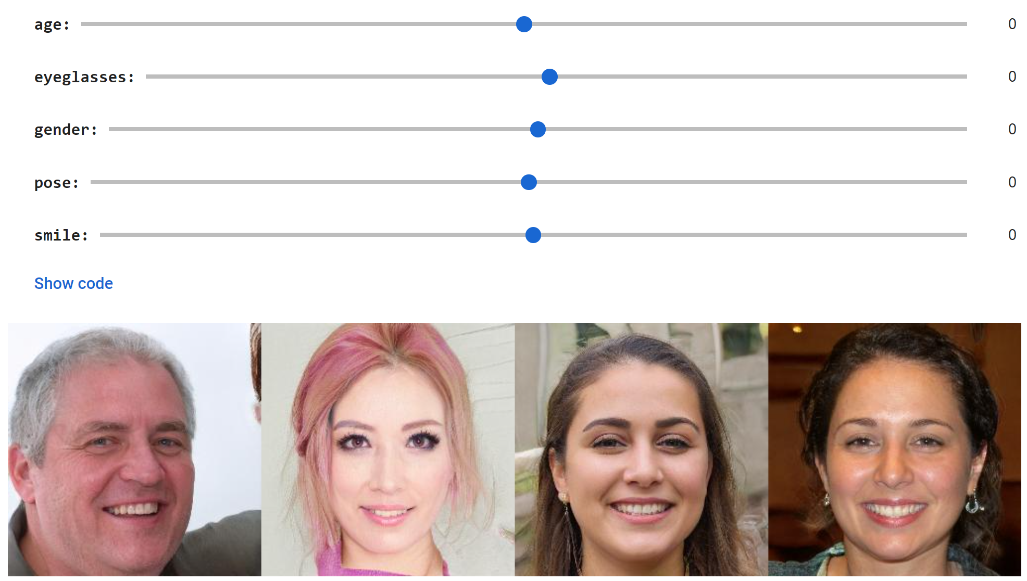
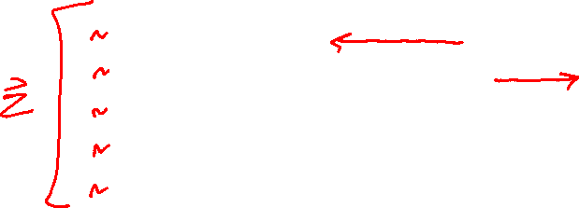
Face GAN Slider Demo
https://github.com/genforce/interfacegan
https://colab.research.google.com/github/genforce/interfacegan/blob/master/docs/InterFaceGAN.ipynb

Slide 47



Face GAN Slider Demo
https://github.com/genforce/interfacegan
https://colab.research.google.com/github/genforce/interfacegan/blob/master/docs/InterFaceGAN.ipynb

Slide 48


Listen Learner
Chris Harrison, CMU
https://chrisharrison.net/index.php/Research/ListenLearner

Slide 49

Dimensionality Reduction with Deep Learning
Hinton, Geoffrey E., and Ruslan R. Salakhutdinov.
"Reducing the dimensionality of data with neural networks.”
Science 313.5786 (2006): 504-507.

Slide 50


Digit Autoencoder
https://cs.stanford.edu/people/karpathy/convnetjs/demo/autoencoder.html
Layer 1
Layer 2
Layer 4
Layer 5
Layer 6
Input
28x28 = 784 pixels
Layer 3
50 neurons
50 neurons
784 neurons
50 neurons
50 neurons
2 neurons
Autoencoder network

Slide 51

Digit Autoencoder
Math for autoencoder model
Linear layer
ReLU layer
Tanh layer

