Slide 1


10-315
Introduction to ML
ML Applications in Practice
Instructor: Pat Virtue

Slide 2
Outline
ML Applications in Practice
Model design challenge
ML model cards
Deep learning toolkits (PyTorch)
Next time
Neural networks applications for images
Neural networks applications for language

Slide 3
Model Design

Slide 4

Reminder: Machine Learning Tasks
Using (training) data to learn a model that we’ll later use for prediction
Training Data
Model
Training
Prediction
Model
Input
Predicted
Output

Slide 5
Training Input
Training Output
Model
Training
Training
Training Error
Prediction
Training Input
Training Output Predicted
Training Output (Measured)
Model
Prediction
Testing Input
Testing Output Predicted
Testing Output (Measured)
Model
Testing
Testing Error

Slide 6

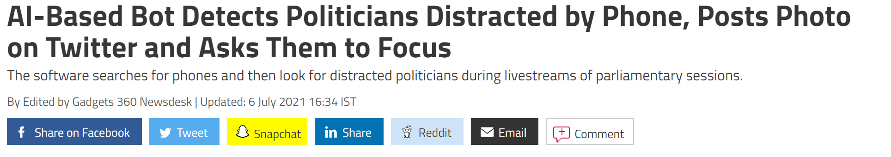
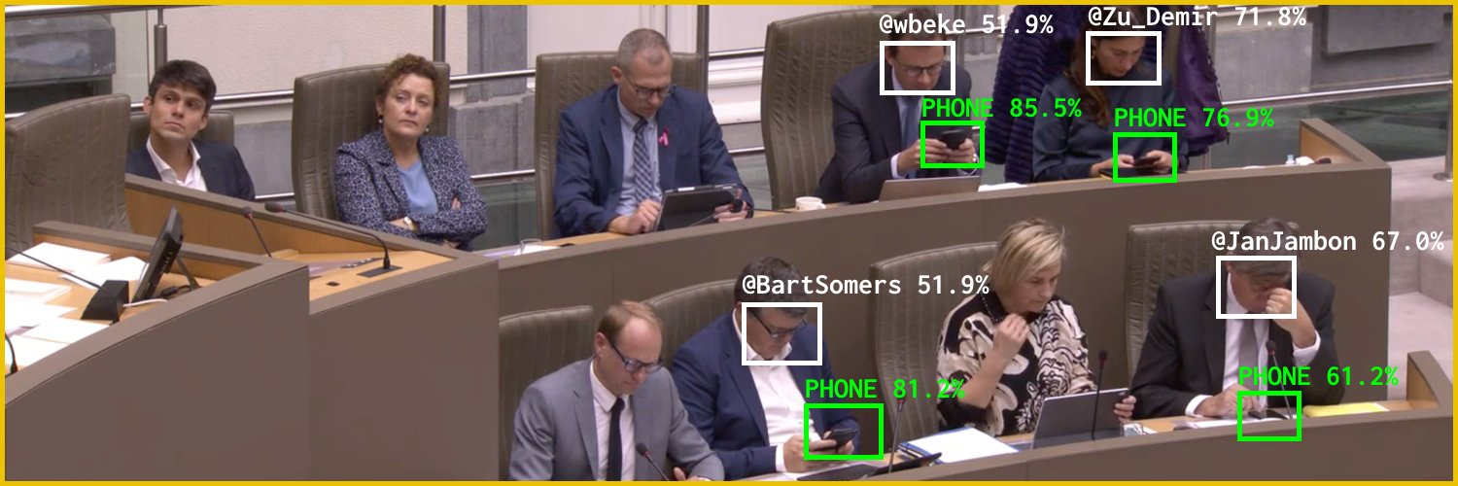
AI in the News
News:
https://gadgets.ndtv.com/social-networking/news/flemish-scrollers-ai-ml-bot-tool-software-belgium-politicians-distracted-phone-detect-troll-twitter-2480493
Source: Twitter @Flemish Scroller

Slide 7
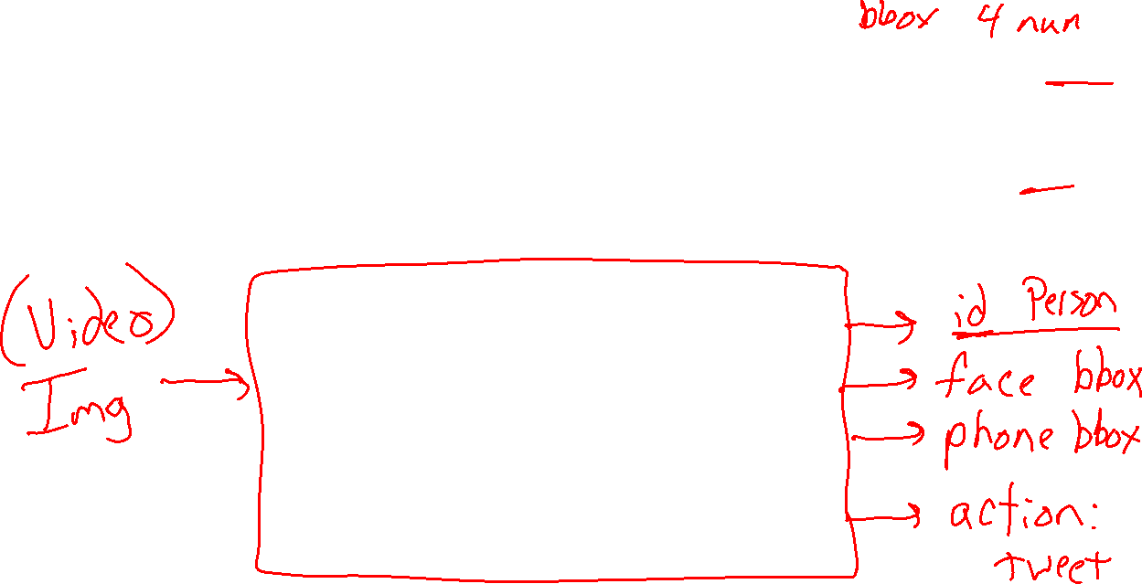
ML App Design
Distracted Politician Detection
What is the input/output for the task?
Image credit: Twitter @Flemish Scroller

Slide 8
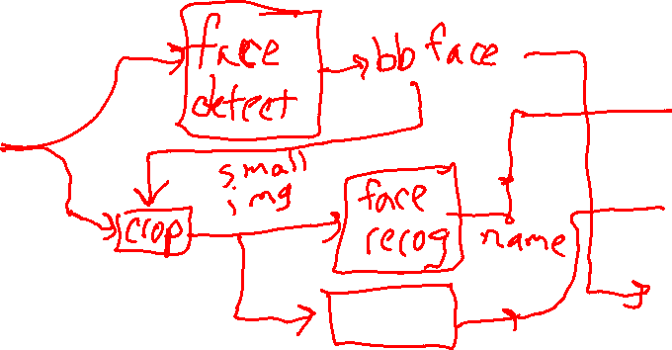
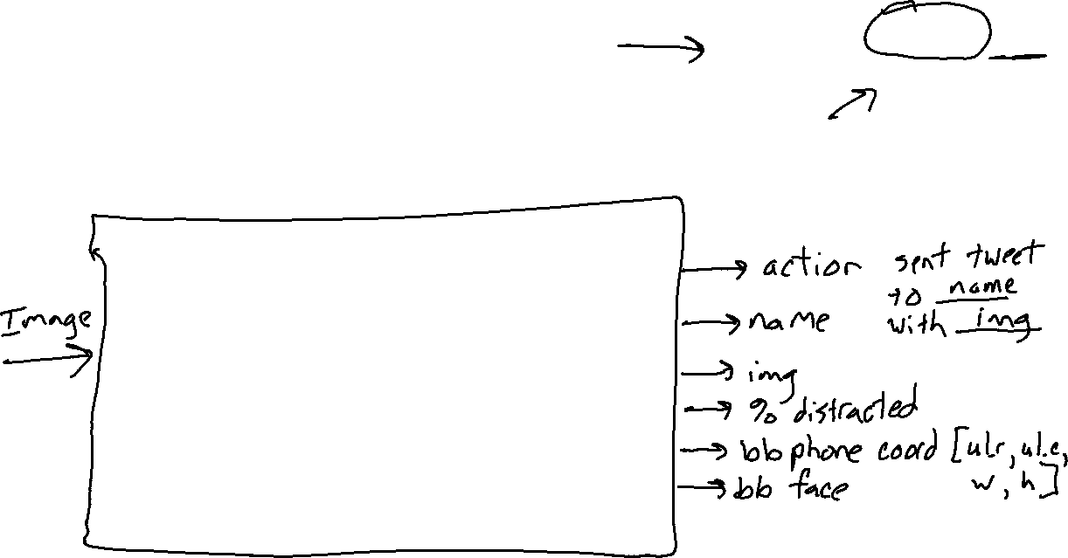
Input/Output
Distracted Politician Detection
Design the app by connecting smaller input/output ML Tasks
Image credit: Twitter @Flemish Scroller

Slide 9

Input/Output
Distracted Politician Detection
What is the input/output for the task?
What is the performance measure?
What training data do we need?
What is the intended use?
What could go wrong?
Image credit: Twitter @Flemish Scroller

Slide 10
ML Model Cards

Slide 11
ML Model Cards
Mitchell, Margaret, et al.
"Model cards for model reporting.“
Proceedings of the conference on fairness, accountability, and transparency. 2019.

Slide 12
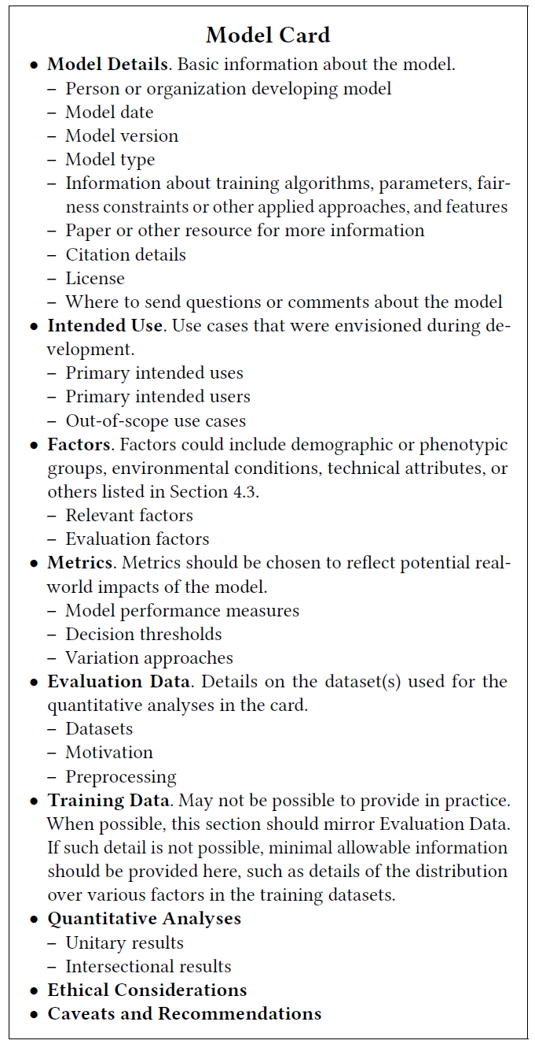

ML Model Cards

Slide 13
Exercise: ML Model Hunt
Search the web to find the model card for a real-world model

Slide 14
Neural Network Toolkits
Pytorch

Slide 15
Network Network Toolkits
Pytorch in this course
Already used behind the scenes in HW1
HW7 transfer learning and exploration
Mini-project if you want

Slide 16
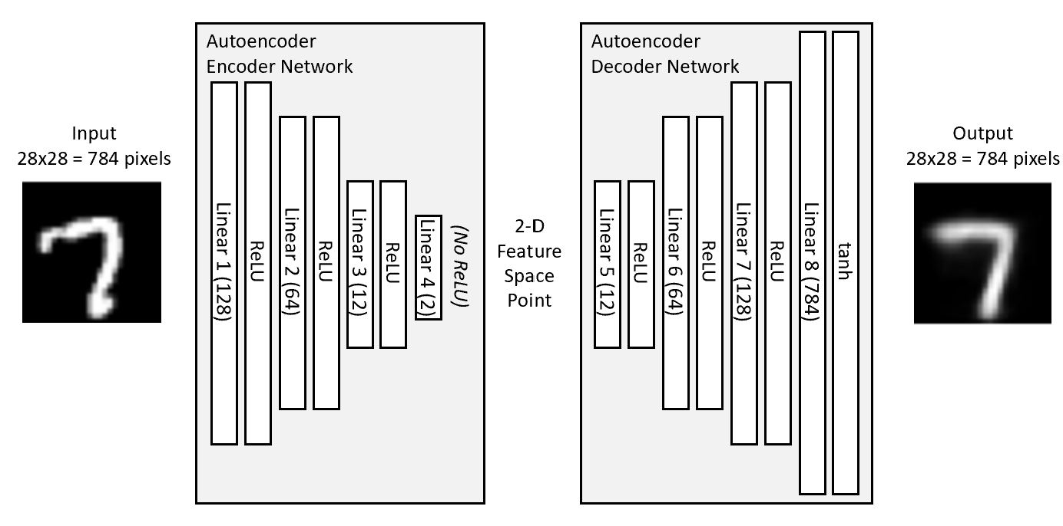
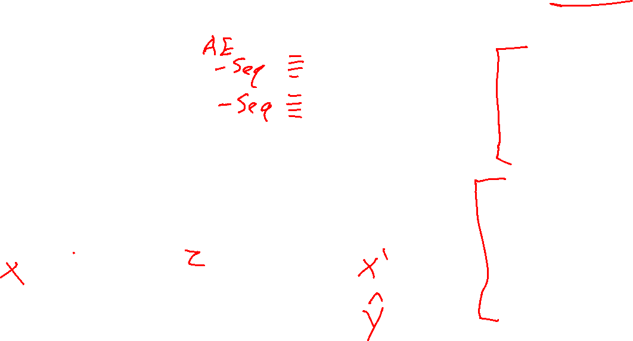
Pytorch for HW1 Networks
class autoencoder(nn.Module):
def __init__(self, bottleneck=2):
super().__init__()
self.encoder = nn.Sequential(
nn.Linear(28 * 28, 128),
nn.ReLU(True),
nn.Linear(128, 64),
nn.ReLU(True),
nn.Linear(64, 12),
nn.ReLU(True),
# nn.Linear(12, 2))
nn.Linear(12, bottleneck))
self.decoder = nn.Sequential(
# nn.Linear(2, 12),
nn.Linear(bottleneck, 12),
nn.ReLU(True),
nn.Linear(12, 64),
nn.ReLU(True),
nn.Linear(64, 128),
nn.ReLU(True),
nn.Linear(128, 28 * 28),
nn.Tanh())
def forward(self, x):
x = self.encoder(x)
x = self.decoder(x)
return x
Autoencoder
Source: https://github.com/L1aoXingyu/pytorch-beginner/blob/master/08-AutoEncoder/simple_autoencoder.py

Slide 17
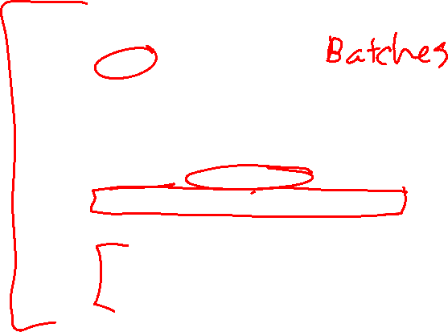
Pytorch for HW1 Networks
class autoencoder(nn.Module):
def __init__(self, bottleneck=2):
super().__init__()
self.encoder = nn.Sequential(
nn.Linear(28 * 28, 128),
nn.ReLU(True),
nn.Linear(128, 64),
nn.ReLU(True),
nn.Linear(64, 12),
nn.ReLU(True),
# nn.Linear(12, 2))
nn.Linear(12, bottleneck))
self.decoder = nn.Sequential(
# nn.Linear(2, 12),
nn.Linear(bottleneck, 12),
nn.ReLU(True),
nn.Linear(12, 64),
nn.ReLU(True),
nn.Linear(64, 128),
nn.ReLU(True),
nn.Linear(128, 28 * 28),
nn.Tanh())
def forward(self, x):
x = self.encoder(x)
x = self.decoder(x)
return x
Autoencoder
for epoch in range(num_epochs):
for data in dataloader:
img, _ = data
img = img.view(img.size(0), -1)
if torch.cuda.is_available():
img = img.cuda()
# ===================forward=====================
output = model(img)
loss = criterion(output, img)
# ===================backward====================
optimizer.zero_grad()
loss.backward()
optimizer.step()
Source: https://github.com/L1aoXingyu/pytorch-beginner/blob/master/08-AutoEncoder/simple_autoencoder.py

Slide 18
Pytorch for HW1 Networks
Autoencoder
class MiniImageCSVDataset:
def __init__(self, csv_filename, has_labels=True, header=0):
df = pd.read_csv(csv_filename, header=header)
data = df.values
if has_labels:
self.data = data[:, 1:]
self.labels = data[:, 0]
else:
self.data = data
self.labels = None
self.data = self.data.astype('float32')
self.data = self.data / 255
def __len__(self):
return len(self.data)
def __getitem__(self, idx):
if self.labels is not None:
return self.data[idx], self.labels[idx]
else:
return self.data[idx]
for epoch in range(num_epochs):
for data in dataloader:
img, _ = data
img = img.view(img.size(0), -1)
if torch.cuda.is_available():
img = img.cuda()
# ===================forward=====================
output = model(img)
loss = criterion(output, img)
# ===================backward====================
optimizer.zero_grad()
loss.backward()
optimizer.step()

Slide 19
Network Network Toolkits
More PyTorch to come in recitation (and HW7)!

