Slide 1

10-315
Introduction to ML
Probabilistic Models:
MAP
Instructor: Pat Virtue

Slide 2
Announcements
Probability
Come get help this week
Project
First step: groups of 3
See piazza for details
Polls
Still working on WiFi
    Please avoid non-315 bandwith
Mid-semester adjustment
    6 free polls: (denominator is currently 22 rather than 28)
Peer Instruction

Slide 3
Plan
Today
MLE → MAP
Wed and next Mon
Neural net applications (image, language)
Next Wed
Back to probability
Discriminative → Generative
    Naïve Bayes
    Discriminant Analysis
Combining MAP and Generative

Slide 4
Where are we?

Slide 5
Empirical Risk Minimization vs MLE/MAP
We seem to be redoing a lot of work? ...well, we are. But there is a reason

Slide 6
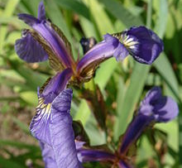
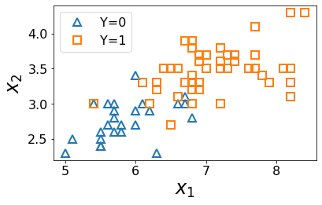
Why Probabilistic Models?
Iris Data

Slide 7
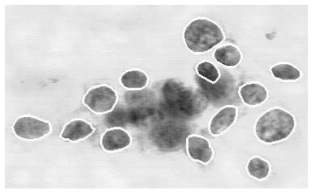
Why Probabilistic Models?
Breast Cancer Diagnosis

Slide 8
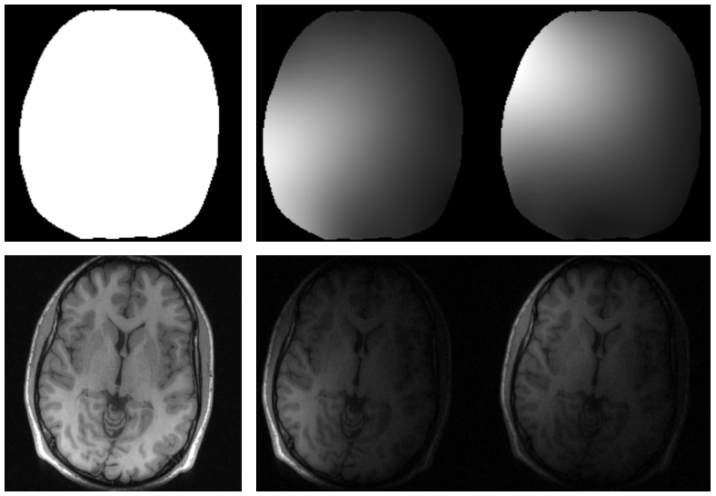
Why Probabilistic Models?
MRI Image Reconstruction

Slide 9
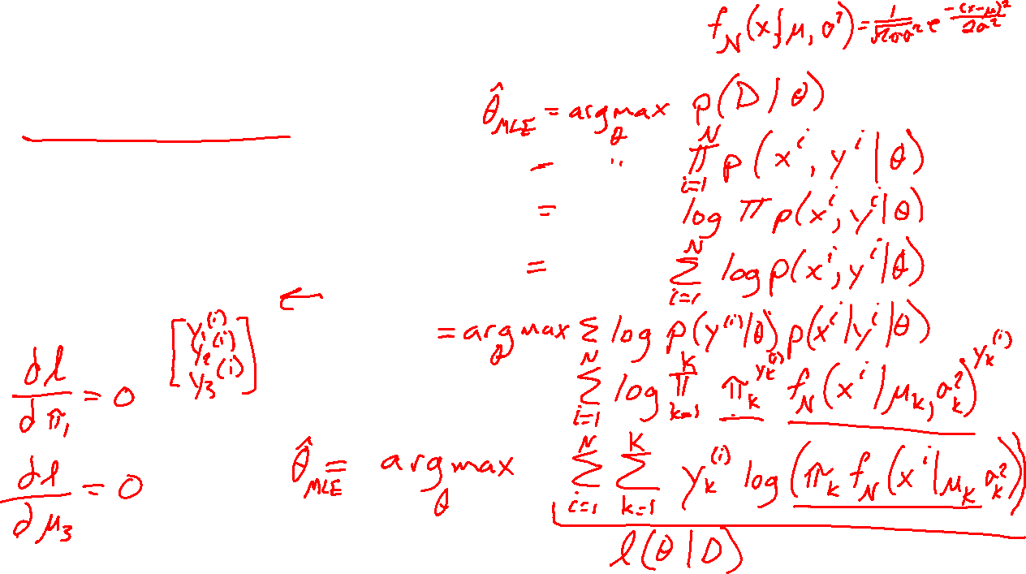
Categorical Gaussian Generative Model
PREVIEW
Estimating parameters
$Y \sim Categorical\left(π_{1},π_{2},π_{3}\right)$
$X_{Y=k} \sim 𝒩(μ_{k},σ_{k}^{2})$.
$𝒟={\left\{x^{\left(i\right)}, y^{\left(i\right)}\right\}}_{i=1}^{N}$

Slide 10
ML Applications of Bayes Rule

Slide 11
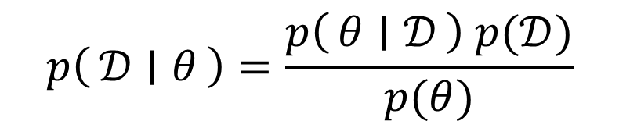
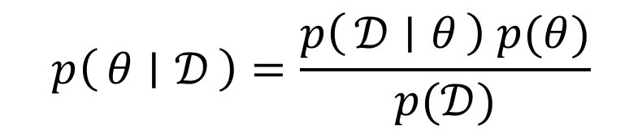
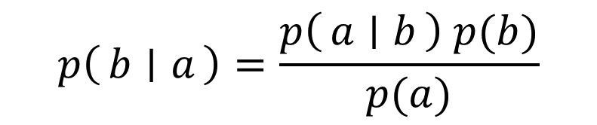
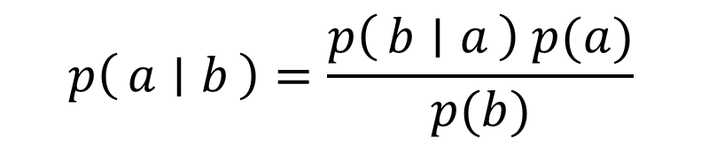
Bayes Rule
$$p\left(a ∣ b\right)=\frac{p\left(b ∣ a\right) p(a)}{p(b)}$$
$$p\left(b ∣ a\right)=\frac{p\left(a ∣ b\right) p(b)}{p(a)}$$
$$p\left(θ ∣ 𝒟\right)=\frac{p\left(𝒟 ∣ θ\right) p(θ)}{p(𝒟)}$$
$$p\left(𝒟 ∣ θ\right)=\frac{p\left(θ ∣ 𝒟\right) p(𝒟)}{p(θ)}$$

Slide 12
Poll 1
Which of these terms is the likelihood?
Select all that apply
A
B
C
E
F
G
$$p\left(θ ∣ 𝒟\right)=\frac{p\left(𝒟 ∣ θ\right) p(θ)}{p(𝒟)}$$
$$p\left(𝒟 ∣ θ\right)=\frac{p\left(θ ∣ 𝒟\right) p(𝒟)}{p(θ)}$$
D
H

Slide 13
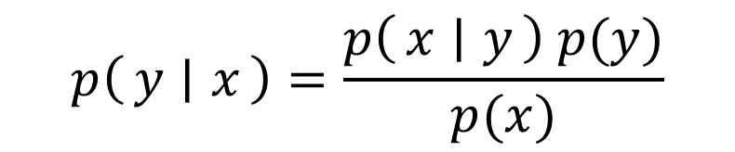
Poll
Which of these terms is the likelihood?
Select all that apply
A
B
C
E
F
G
$$p\left(θ ∣ 𝒟\right)=\frac{p\left(𝒟 ∣ θ\right) p(θ)}{p(𝒟)}$$
$$p\left(y ∣ x\right)=\frac{p\left(x ∣ y\right) p(y)}{p(x)}$$
D
H

Slide 14
Bayes Rule
Terminology
Posterior Likelihood Prior
$$p\left(θ ∣ 𝒟\right)=\frac{p\left(𝒟 ∣ θ\right) p(θ)}{p(𝒟)}$$

Slide 15
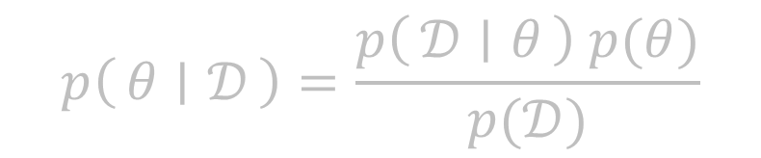
Bayes Rule
Terminology
Posterior Likelihood Prior
Posterior Class conditional Class prior
Conditional likelihood
$$p\left(θ ∣ 𝒟\right)=\frac{p\left(𝒟 ∣ θ\right) p(θ)}{p(𝒟)}$$
$$p\left(y ∣ x\right)=\frac{p\left(x ∣ y\right) p(y)}{p(x)}$$

Slide 16
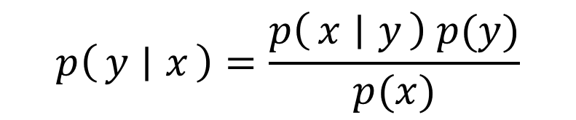
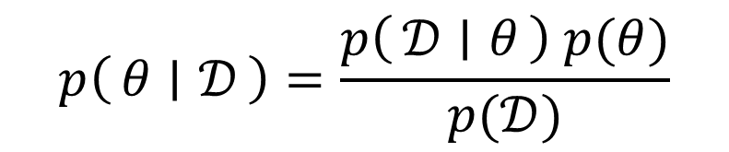

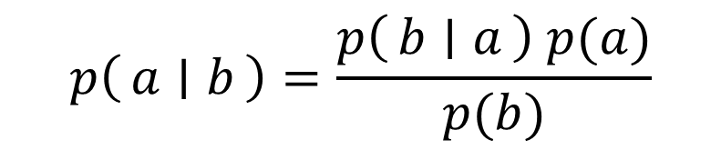
Two Applications of Bayes Rule
$$p\left(a ∣ b\right)=\frac{p\left(b ∣ a\right) p(a)}{p(b)}$$
$$p\left(θ ∣ 𝒟\right)=\frac{p\left(𝒟 ∣ θ\right) p(θ)}{p(𝒟)}$$
$$p\left(y ∣ x\right)=\frac{p\left(x ∣ y\right) p(y)}{p(x)}$$

Slide 17
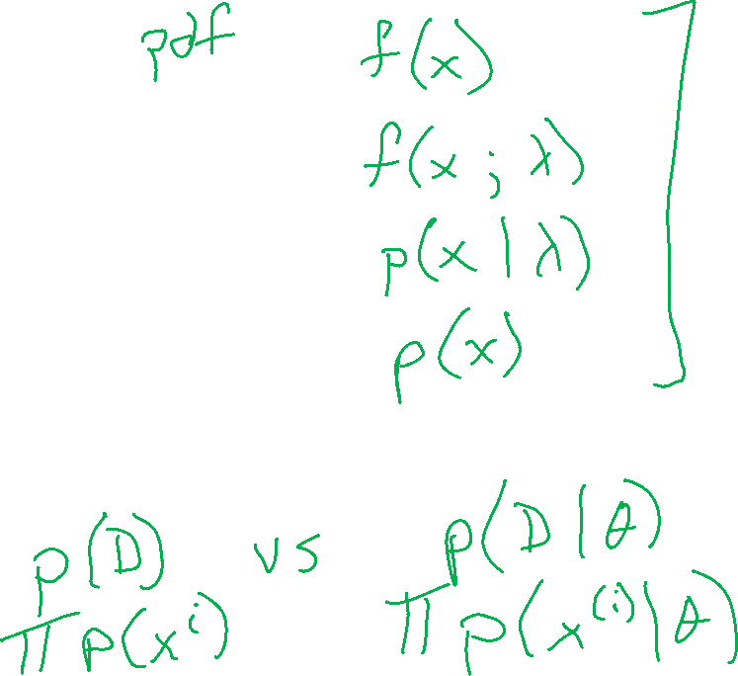
MLE and MAP

Slide 18


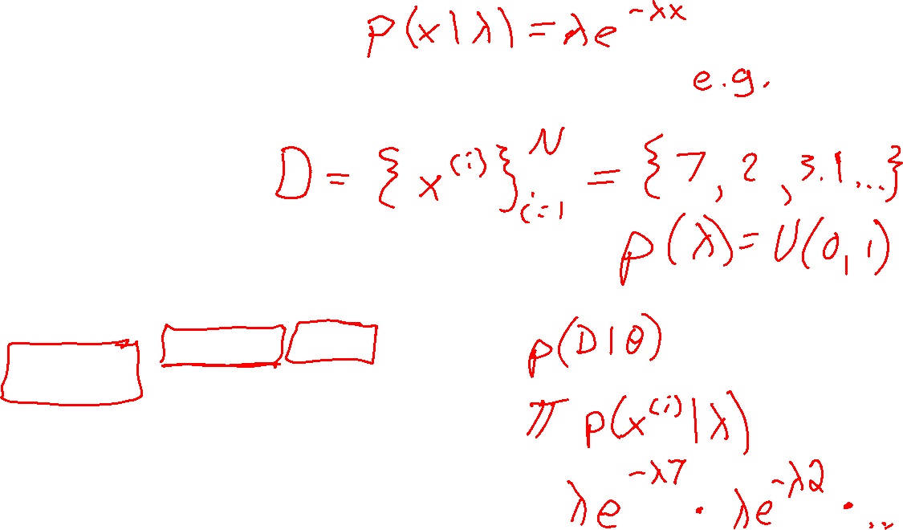
Poll 2
Where do we plug in the pdf, e.g., $f\left(x\right)=λe^{−λx}$
A
B
C
$$p\left(θ ∣ 𝒟\right)=\frac{p\left(𝒟 ∣ θ\right) p(θ)}{p(𝒟)}$$
D

Slide 19
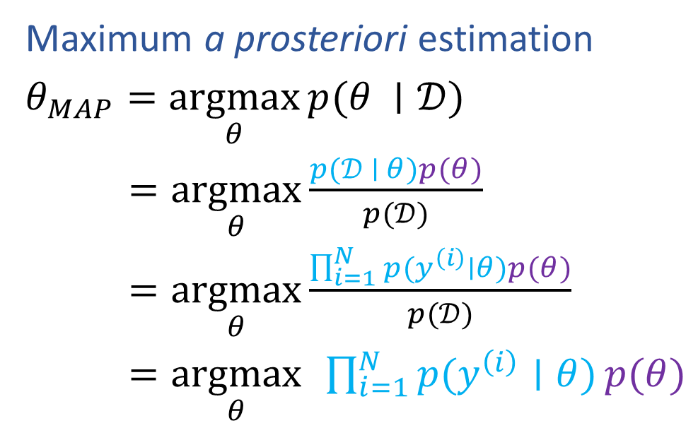
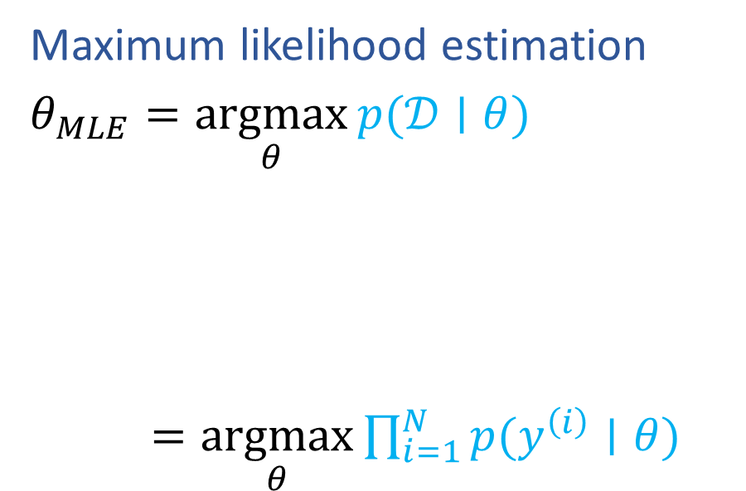
MLE and MAP
Maximum likelihood estimation
$θ_{MLE}=\underset{θ}{argmax}{p(𝒟∣θ)}$
$=\underset{θ}{argmax}{\prod_{i=1}^{N}{p(y^{\left(i\right)}∣θ)}}$
Maximum a prosteriori estimation
$θ_{MAP}=\underset{θ}{argmax}{p(θ ∣𝒟)}$
$=\underset{θ}{argmax}{\frac{p(𝒟 ∣ θ)p(θ)}{p(𝒟)}}$
$=\underset{θ}{argmax}{\frac{\prod_{i=1}^{N}{p(y^{\left(i\right)}∣θ)}p(θ)}{p(𝒟)}}$
$=\underset{θ}{argmax}{ }\prod_{i=1}^{N}{p(y^{\left(i\right)}∣θ)}p(θ)$

Slide 20
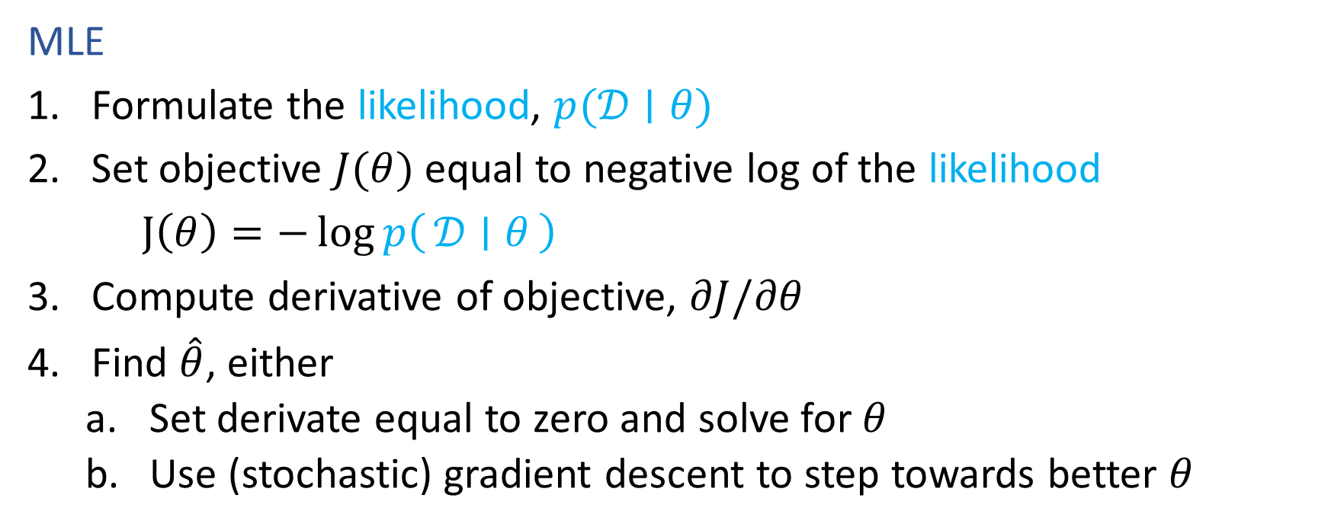
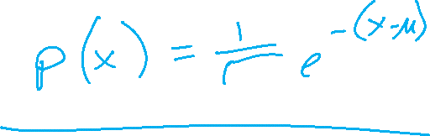
Recipe for Estimation
MLE
Formulate the likelihood, $p(𝒟∣θ)$
Set objective $J(θ)$ equal to negative log of the likelihood
$J\left(θ\right)=−\log{p\left(𝒟 ∣ θ\right)}$
Compute derivative of objective, $∂J/∂θ$
Find $\hat{θ}$, either
    Set derivate equal to zero and solve for $θ$
    Use (stochastic) gradient descent to step towards better $θ$

Slide 21
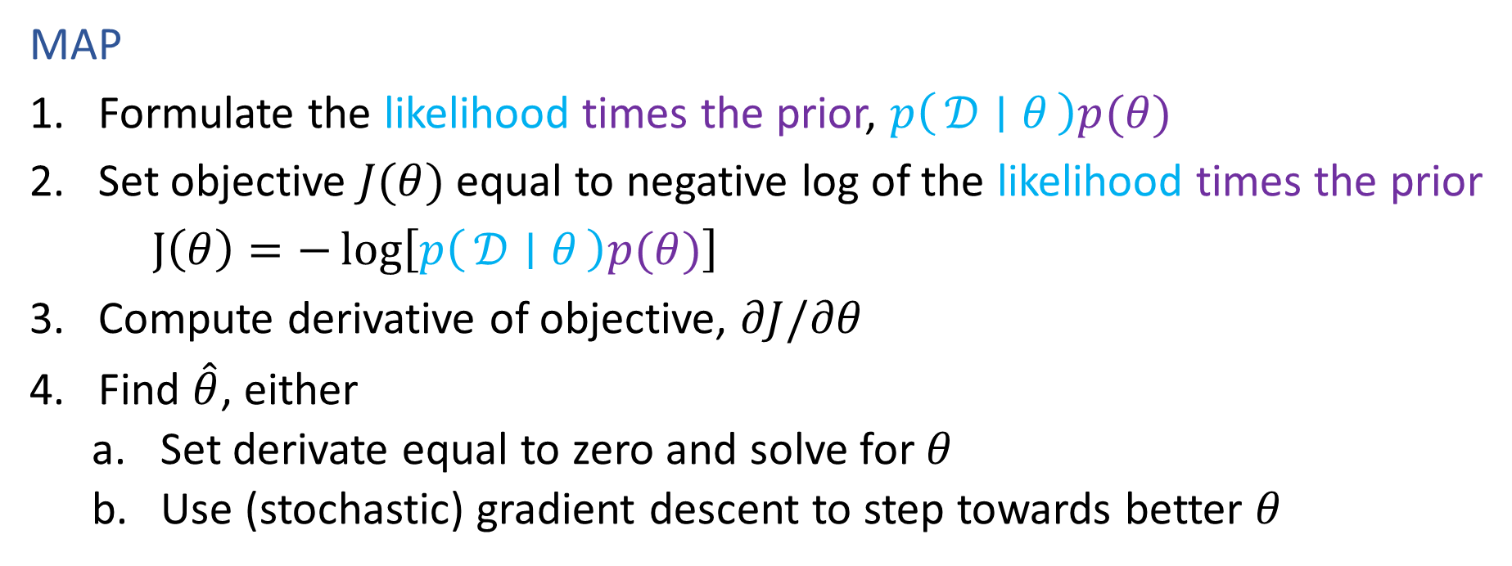
Recipe for Estimation
MAP
Formulate the likelihood times the prior, $p\left(𝒟 ∣ θ\right)p(θ)$
Set objective $J(θ)$ equal to negative log of the likelihood times the prior
$J\left(θ\right)=−\log\left[p\left(𝒟 ∣ θ\right)p(θ)\right]$
Compute derivative of objective, $∂J/∂θ$
Find $\hat{θ}$, either
    Set derivate equal to zero and solve for $θ$
    Use (stochastic) gradient descent to step towards better $θ$

Slide 22
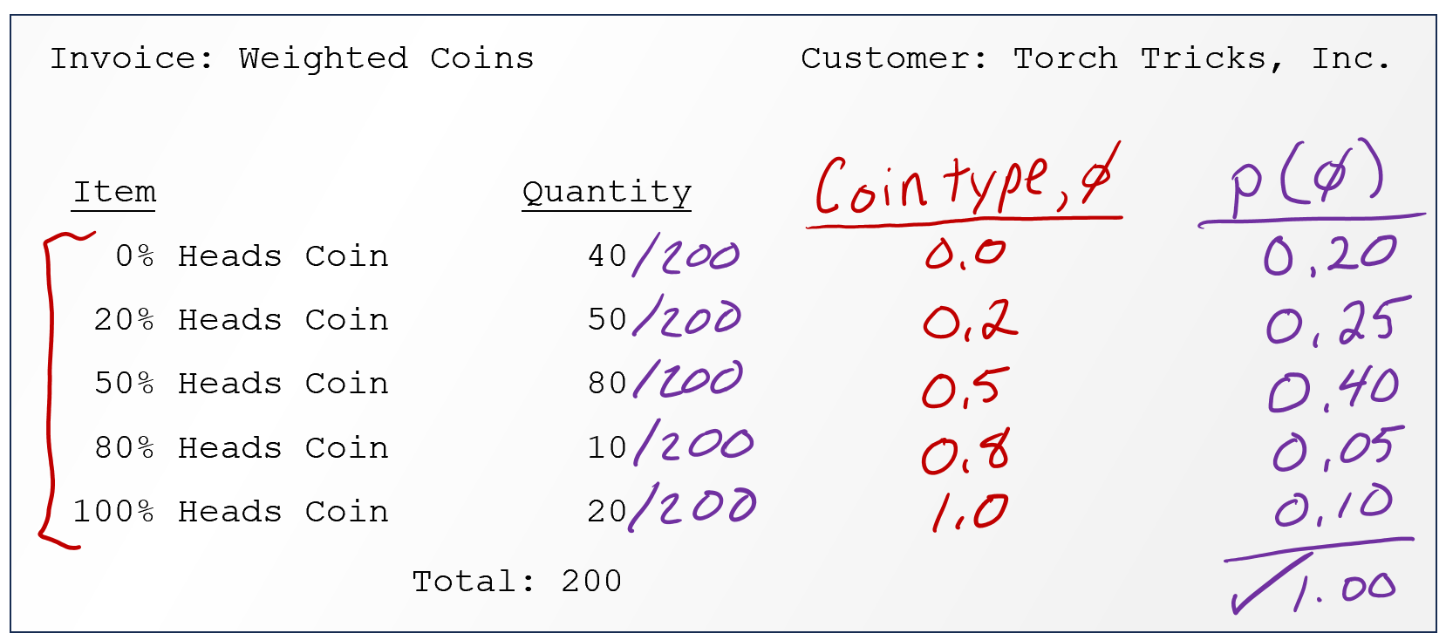

Coin Flipping Example
Trick coin from pre-reading
Initially: no information about the coin, so we just default to a uniform belief about the Bernoulli parameter $φ$

Slide 23
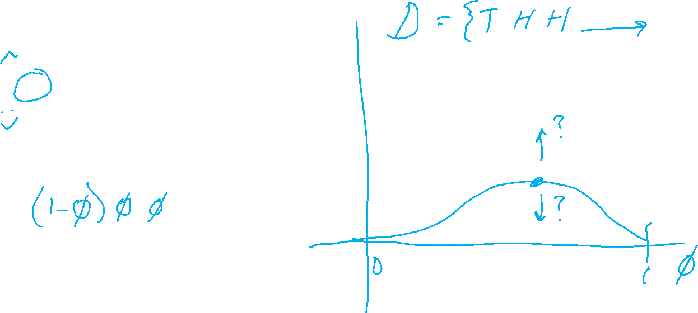
Poll 3
As we collect more and more data (more coin flips), will the peak of the likelihood curve increase or decrease?
Increase
Decrease
I have no idea

Slide 24
Coin Flipping Example
Trick coin from pre-reading
Suppose we discover information about the distribution of trick coin types? How can we use this information both before and after flipping coins?

Slide 25
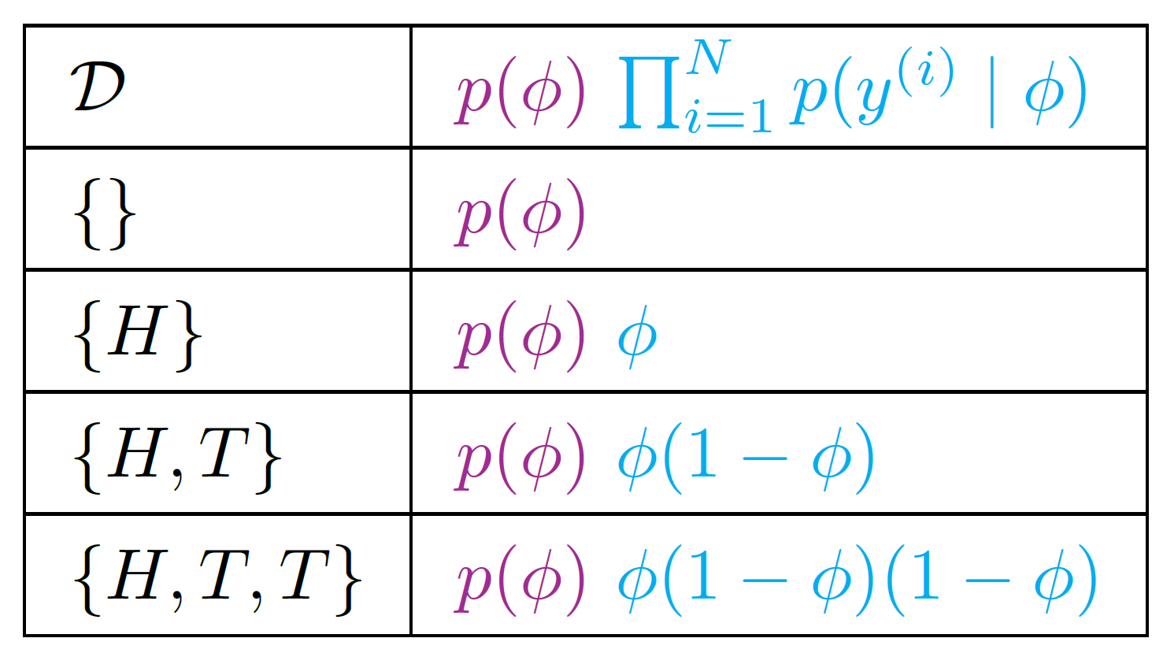
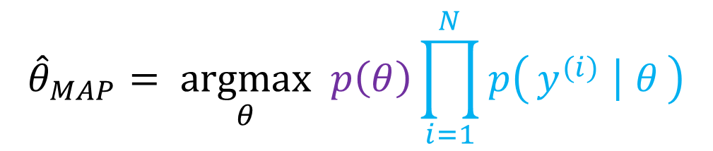
Coin Flipping Example
$${\hat{θ}}_{MAP}= \underset{θ}{argmax} p\left(θ\right)\prod_{i=1}^{N}{p\left(y^{(i)} ∣ θ\right)}$$
Trick coin from pre-reading
Suppose we discover information about the distribution of trick coin types? How can we use this information both before and after flipping coins?

Slide 26

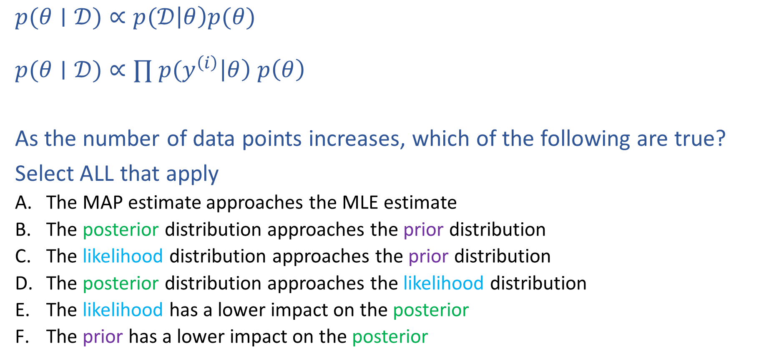
Poll 5
$$posterior∝likelihood⋅prior$$
$p(θ∣𝒟)∝p(𝒟\left|θ\right)p(θ)$
$p(θ∣𝒟)∝∏ p(y^{\left(i\right)}\left|θ\right) p\left(θ\right)$
As the number of data points increases, which of the following are true?
Select ALL that apply
  The MAP estimate approaches the MLE estimate
  The posterior distribution approaches the prior distribution
  The likelihood distribution approaches the prior distribution
  The posterior distribution approaches the likelihood distribution
  The likelihood has a lower impact on the posterior
  The prior has a lower impact on the posterior

Slide 27
Poll 5
$$posterior∝likelihood⋅prior$$
$p(θ∣𝒟)∝p(𝒟\left|θ\right)p(θ)$
$p(θ∣𝒟)∝∏ p(y^{\left(i\right)}\left|θ\right) p\left(θ\right)$
As the number of data points increases, which of the following are true?
Select ALL that apply
  The MAP estimate approaches the MLE estimate
  The posterior distribution approaches the prior distribution
  The likelihood distribution approaches the prior distribution
  The posterior distribution approaches the likelihood distribution
  The likelihood has a lower impact on the posterior
  The prior has a lower impact on the posterior

Slide 28
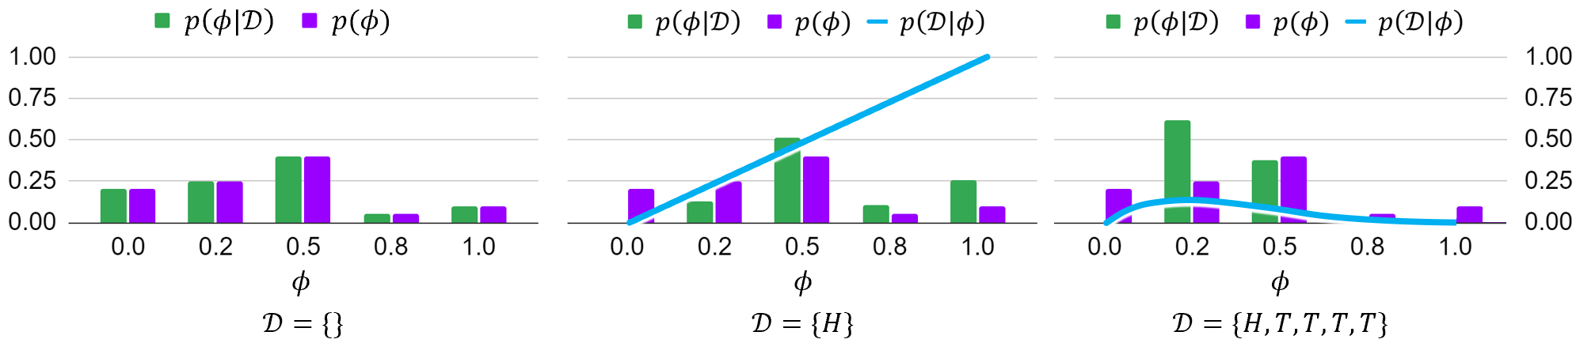


MAP as Data Increases
Given the ordered sequence of coin flip outcomes:
$$p\left(𝒟 ∣ φ\right) p(φ)=\prod_{i}^{N}{p\left(y^{\left(i\right)} ∣ φ\right) p\left(φ\right)} = φ^{N_{y=1}}{\left(1−φ\right)}^{N_{y=0}} p(φ)$$
What happens as we flip more coins?
$N=0: 𝒟=\{\}$

Slide 29

MAP as Data Increases
Given the ordered sequence of coin flip outcomes:
$$p\left(𝒟 ∣ φ\right) p(φ)=\prod_{i}^{N}{p\left(y^{\left(i\right)} ∣ φ\right) p\left(φ\right)} = φ^{N_{y=1}}{\left(1−φ\right)}^{N_{y=0}} p(φ)$$
What happens as we flip more coins?
$N=0: 𝒟=\{H\}$

Slide 30

MAP as Data Increases
Given the ordered sequence of coin flip outcomes:
$$p\left(𝒟 ∣ φ\right) p(φ)=\prod_{i}^{N}{p\left(y^{\left(i\right)} ∣ φ\right) p\left(φ\right)} = φ^{N_{y=1}}{\left(1−φ\right)}^{N_{y=0}} p(φ)$$
What happens as we flip more coins?
$N=0: 𝒟=\{H,T,T,T,T\}$

Slide 31

Prior Distributions for MAP
If the prior $p(θ)$ is uniform, then MLE and MAP are the same!
$$p\left(𝒟 ∣ φ\right) p(φ)=\prod_{i}^{N}{p\left(y^{\left(i\right)} ∣ φ\right) p\left(φ\right)} = φ^{N_{y=1}}{\left(1−φ\right)}^{N_{y=0}} p(φ)$$
https://www.desmos.com/calculator/kr7m2m6cf7

Slide 32
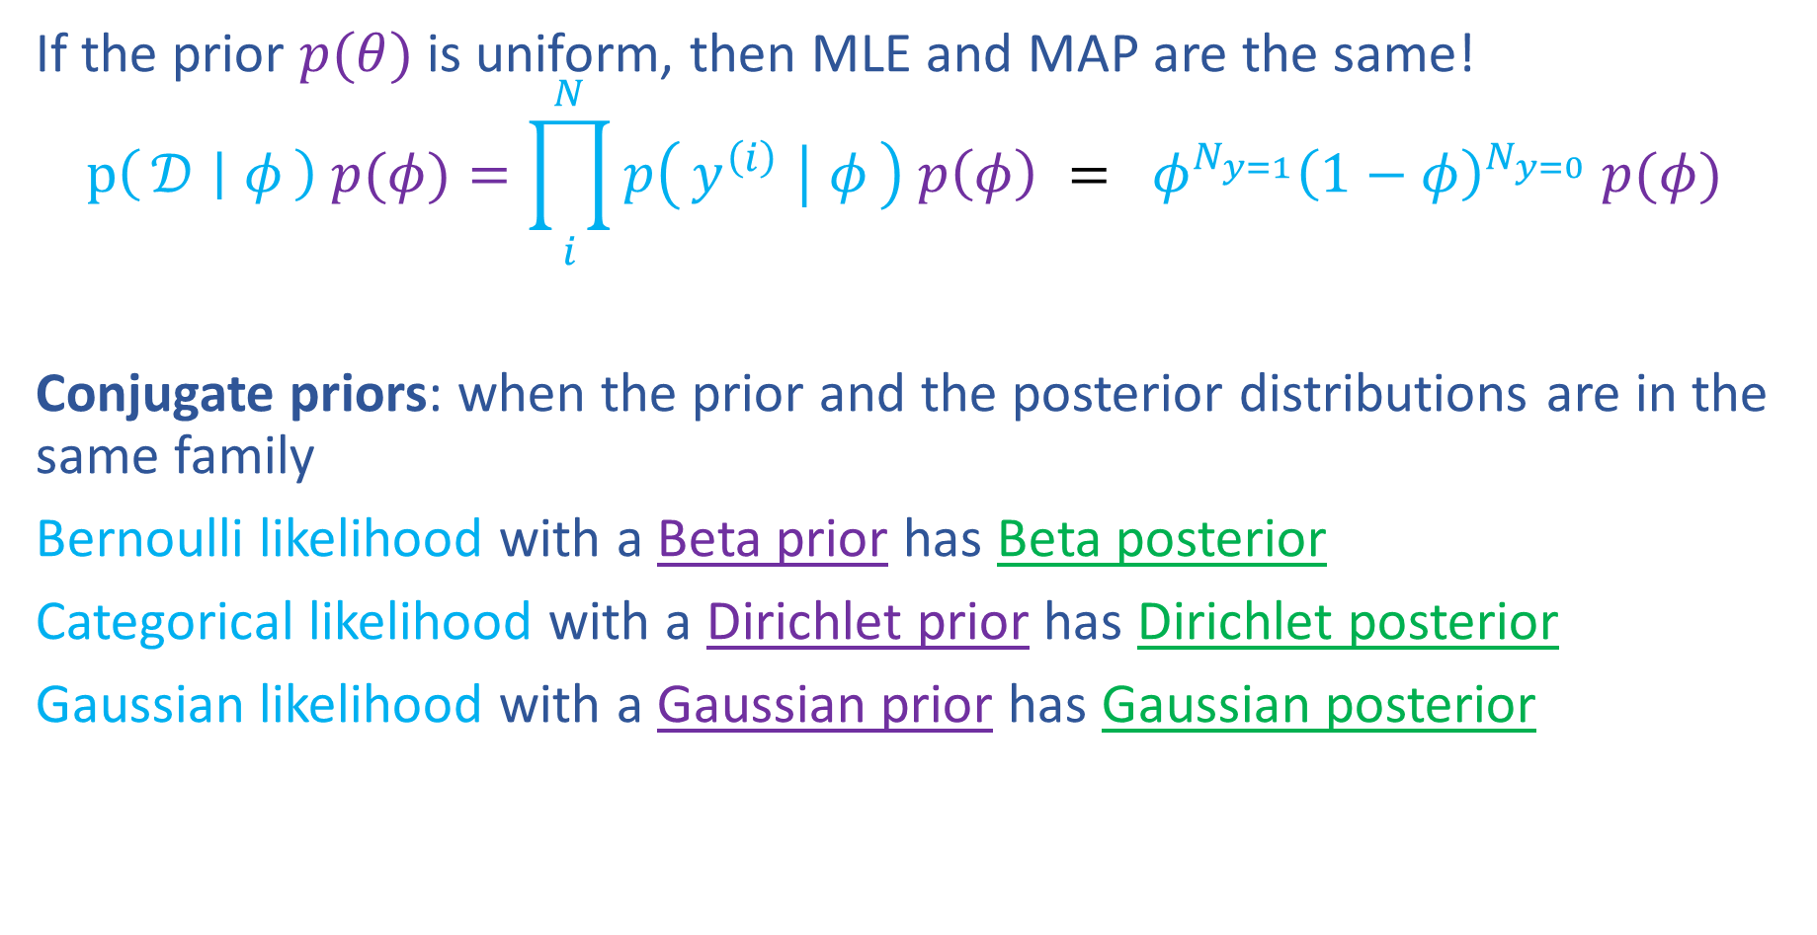

Prior Distributions for MAP
If the prior $p(θ)$ is uniform, then MLE and MAP are the same!
$$p\left(𝒟 ∣ φ\right) p(φ)=\prod_{i}^{N}{p\left(y^{\left(i\right)} ∣ φ\right) p\left(φ\right)} = φ^{N_{y=1}}{\left(1−φ\right)}^{N_{y=0}} p(φ)$$
Conjugate priors: when the prior and the posterior distributions are in the same family
Bernoulli likelihood with a Beta prior has Beta posterior
Categorical likelihood with a Dirichlet prior has Dirichlet posterior
Gaussian likelihood with a Gaussian prior has Gaussian posterior
https://www.desmos.com/calculator/kr7m2m6cf7

Slide 33
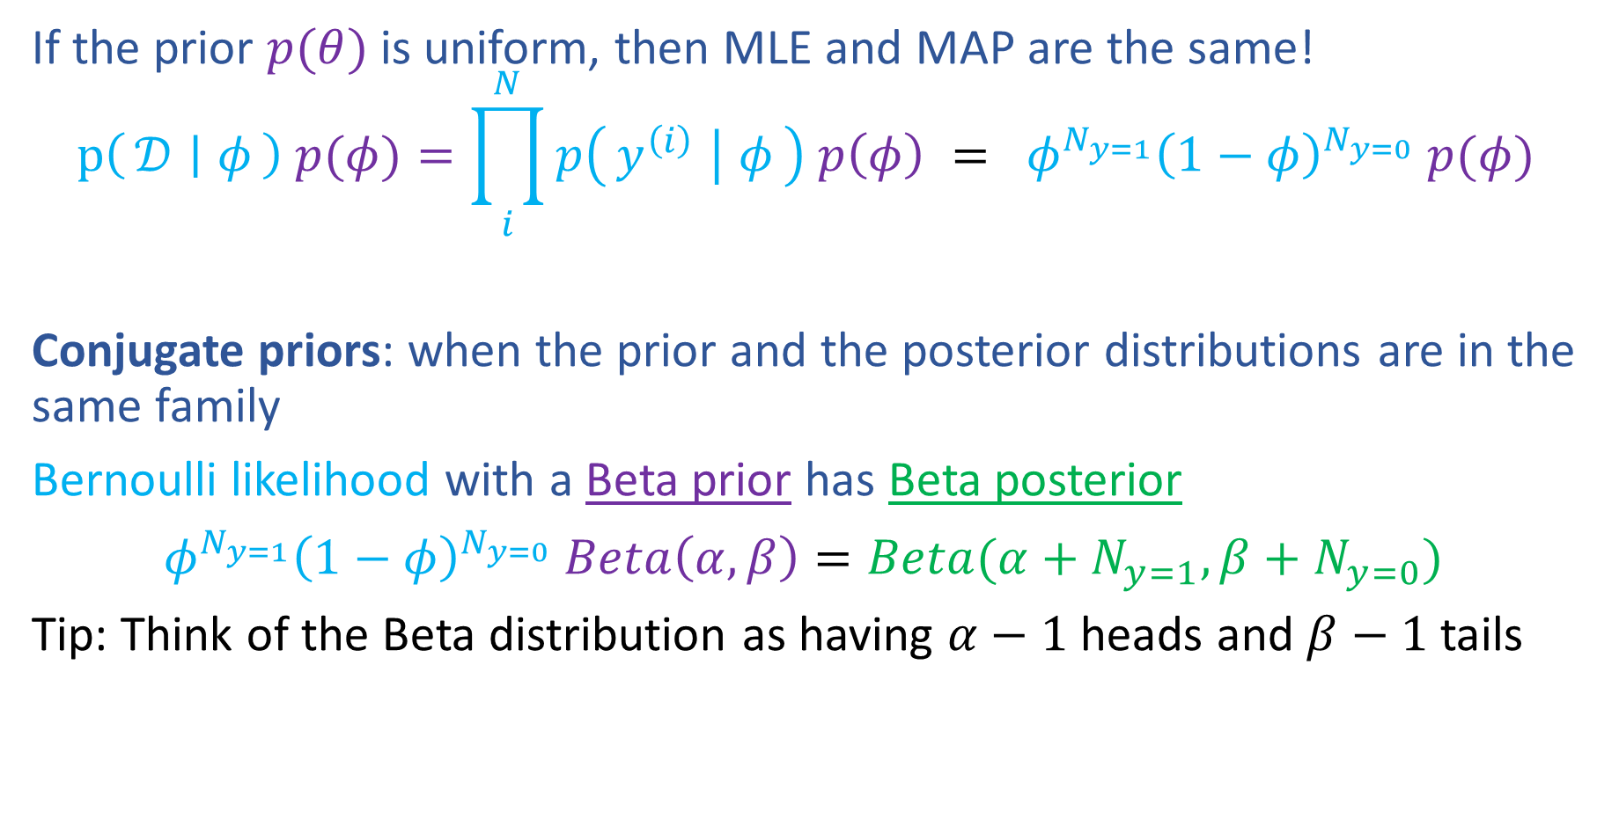

Prior Distributions for MAP
If the prior $p(θ)$ is uniform, then MLE and MAP are the same!
$$p\left(𝒟 ∣ φ\right) p(φ)=\prod_{i}^{N}{p\left(y^{\left(i\right)} ∣ φ\right) p\left(φ\right)} = φ^{N_{y=1}}{\left(1−φ\right)}^{N_{y=0}} p(φ)$$
Conjugate priors: when the prior and the posterior distributions are in the same family
Bernoulli likelihood with a Beta prior has Beta posterior
$φ^{N_{y=1}}{\left(1−φ\right)}^{N_{y=0}} Beta\left(α,β\right)=Beta(α+N_{y=1},β+N_{y=0})$
Tip: Think of the Beta distribution as having $α−1$ heads and $β−1$ tails
https://www.desmos.com/calculator/kr7m2m6cf7

Slide 34


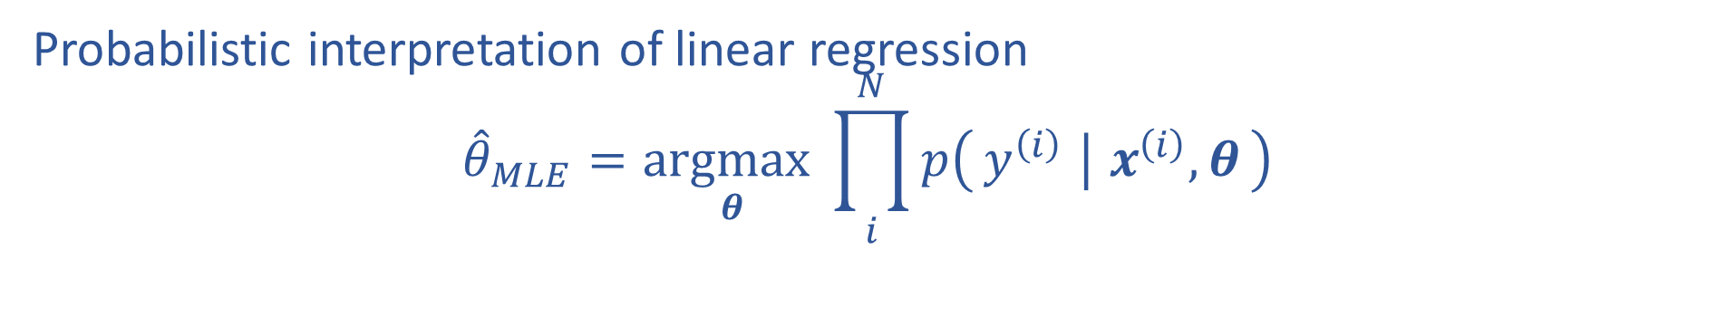
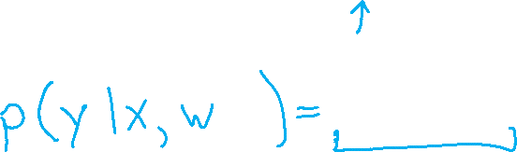

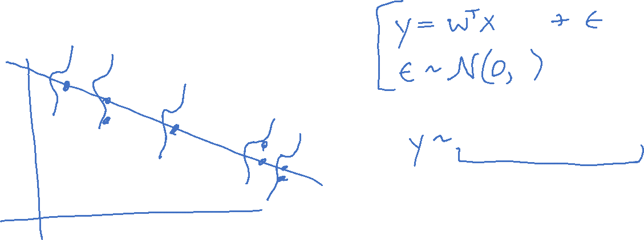
M(C)LE for Linear Regression
Probabilistic interpretation of linear regression
$${\hat{θ}}_{MLE}=\underset{θ}{argmax}\prod_{i}^{N}{p\left(y^{\left(i\right)} ∣ x^{\left(i\right)}, θ\right)}$$

Slide 35
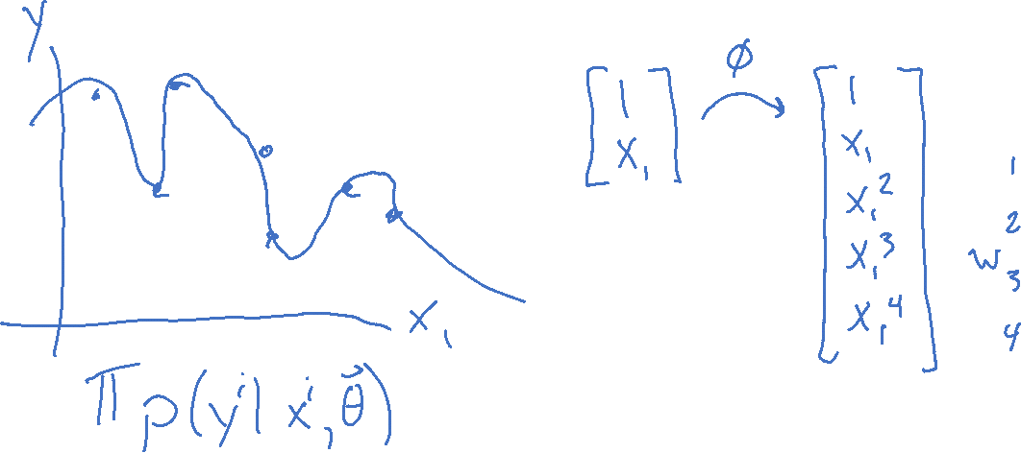
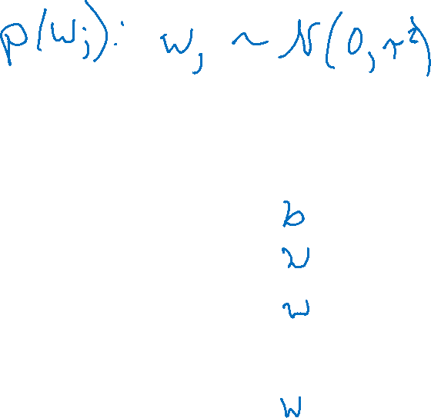
MAP for Linear Regression
What assumptions are we making about our parameters?

Slide 36
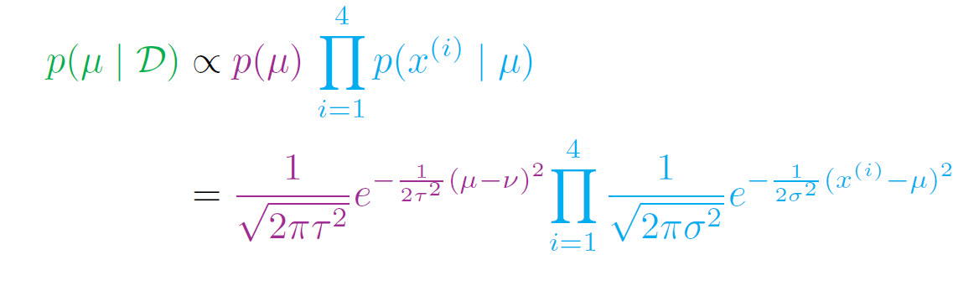
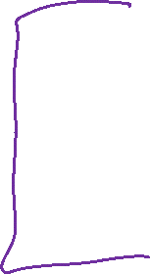
MAP for Linear Regression
Recall prereading example of Gausssian prior for Gaussian likelihood
Linear Regression with Gaussian prior on weights

Slide 37
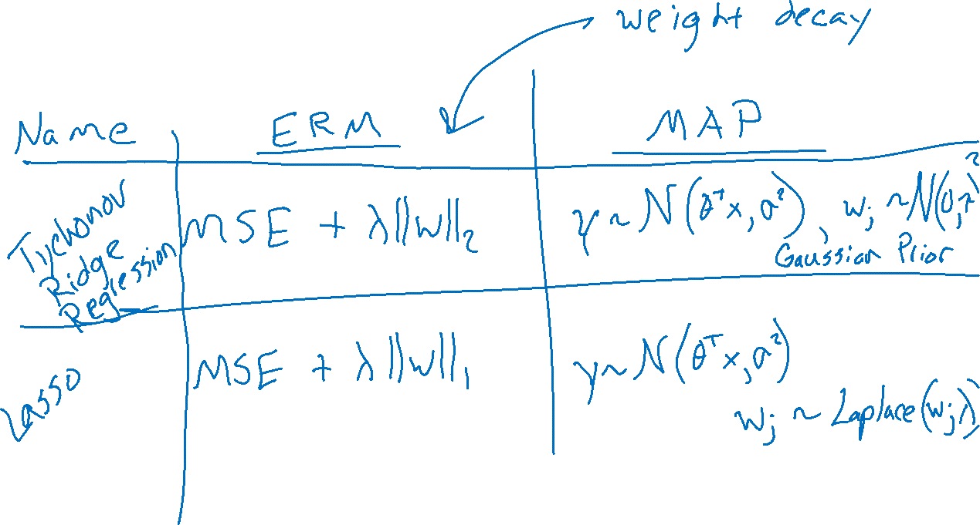
Regularization and MAP
Linear Regression

Slide 38
Discriminative and Generative
Sneak peek

Slide 39
Two Applications of Bayes Rule
$$p\left(a ∣ b\right)=\frac{p\left(b ∣ a\right) p(a)}{p(b)}$$
$$p\left(θ ∣ 𝒟\right)=\frac{p\left(𝒟 ∣ θ\right) p(θ)}{p(𝒟)}$$
$$p\left(y ∣ x\right)=\frac{p\left(x ∣ y\right) p(y)}{p(x)}$$

