Slide 1


10-315 Introduction to ML MLE and Probabilistic Formulation of Machine Learning
Instructor: Pat Virtue

Slide 2
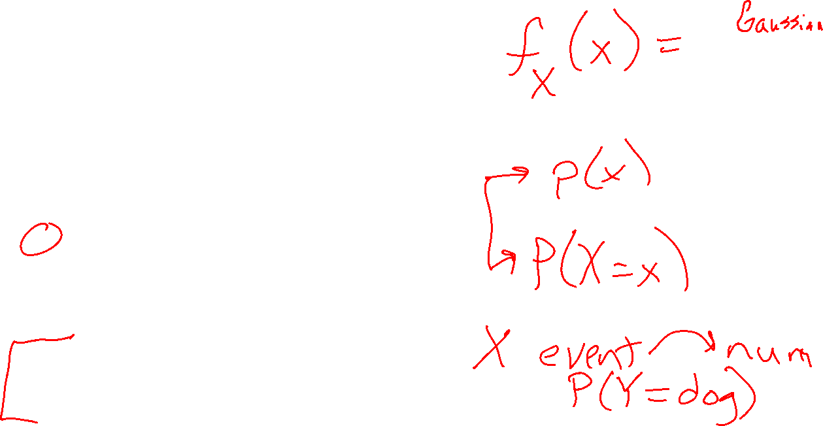
Logistics
Exam
Wed in class, see Piazza for details
Coming this week
Probability Primer
MAP Pre-reading
Mini project info
Today
Wrap-up regularization (for now)
MLE
Maximum likelihood estimation
Probabilistic formulation of linear and logistic regression

Slide 3
Poll 1
Course feedback link on Piazza
Are you finished with the course feedback form?
Yes
No
Still working on it

Slide 4
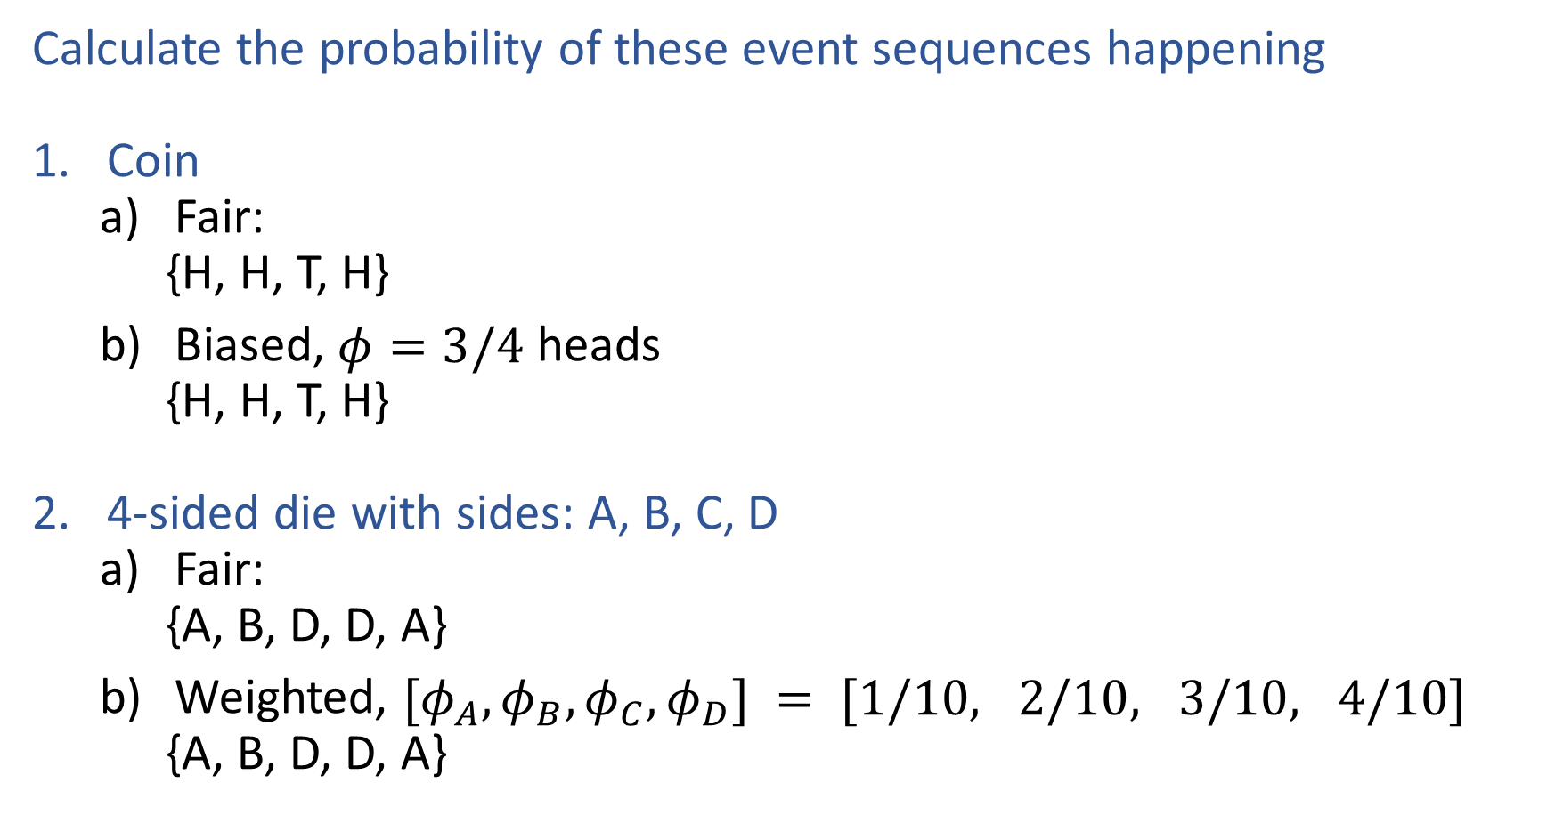
Exercises
Calculate the probability of these event sequences happening
Coin
Fair:
{H, H, T, H}
Biased, $φ=3/4$ heads
{H, H, T, H}
4-sided die with sides: A, B, C, D
Fair:
{A, B, D, D, A}
Weighted, $[φ_{A}, φ_{B},φ_{C}, φ_{D}] = [1/10, 2/10, 3/10, 4/10]$
{A, B, D, D, A}

Slide 5
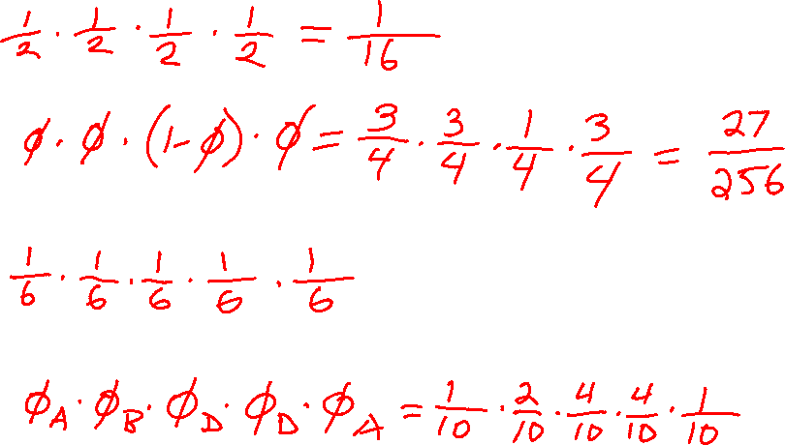
Exercises
Calculate the probability of these event sequences happening
Coin
Fair:
{H, H, T, H}
Biased, $φ=3/4$ heads
{H, H, T, H}
4-sided die with sides: A, B, C, D
Fair:
{A, B, D, D, A}
Weighted, $[φ_{A}, φ_{B},φ_{C}, φ_{D}] = [1/10, 2/10, 3/10, 4/10]$
{A, B, D, D, A}

Slide 6
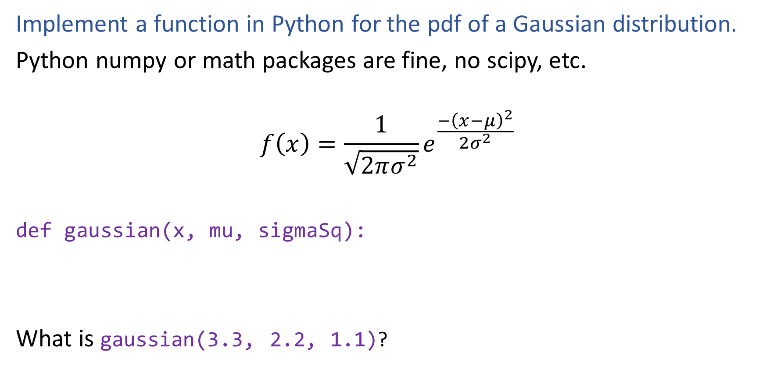

Poll 2
Implement a function in Python for the pdf of a Gaussian distribution.
Python numpy or math packages are fine, no scipy, etc.
$$f\left(x\right)=\frac{1}{\sqrt{2πσ^{2}}}e^{\frac{−{\left(x−μ\right)}^{2}}{2σ^{2}}}$$
def gaussian(x, mu, sigmaSq):
What is gaussian(3.3, 2.2, 1.1)?

Slide 7

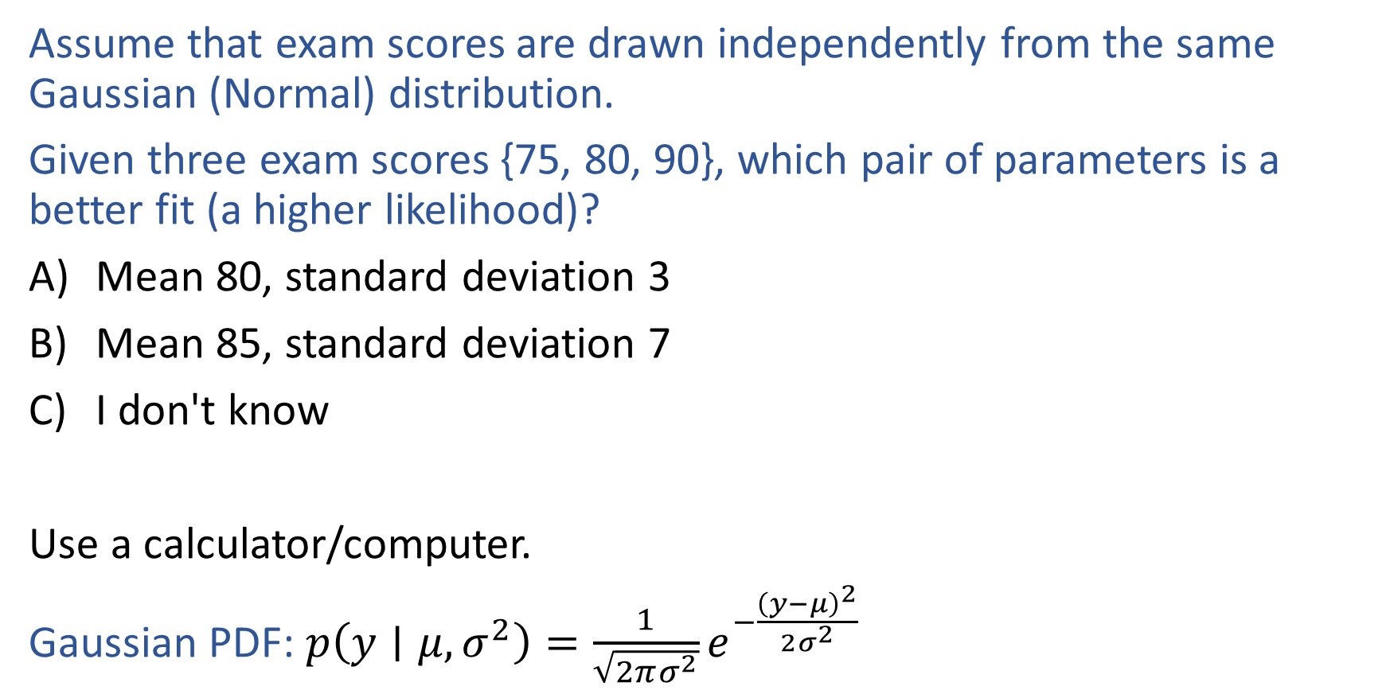

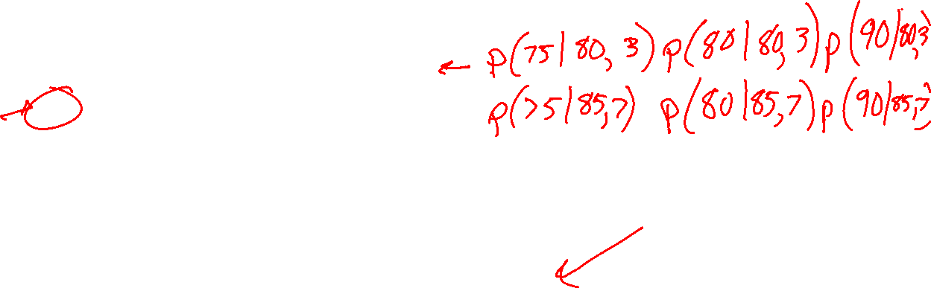
Poll 3
Assume that exam scores are drawn independently from the same Gaussian (Normal) distribution.
Given three exam scores {75, 80, 90}, which pair of parameters is a better fit (a higher likelihood)?
Mean 80, standard deviation 3
Mean 85, standard deviation 7
I don't know
Use a calculator/computer.
Gaussian PDF: $p\left(y∣μ, σ^{2}\right)=\frac{1}{\sqrt{2πσ^{2}}}e^{−\frac{{\left(y−μ\right)}^{2}}{2σ^{2}}}$

Slide 8

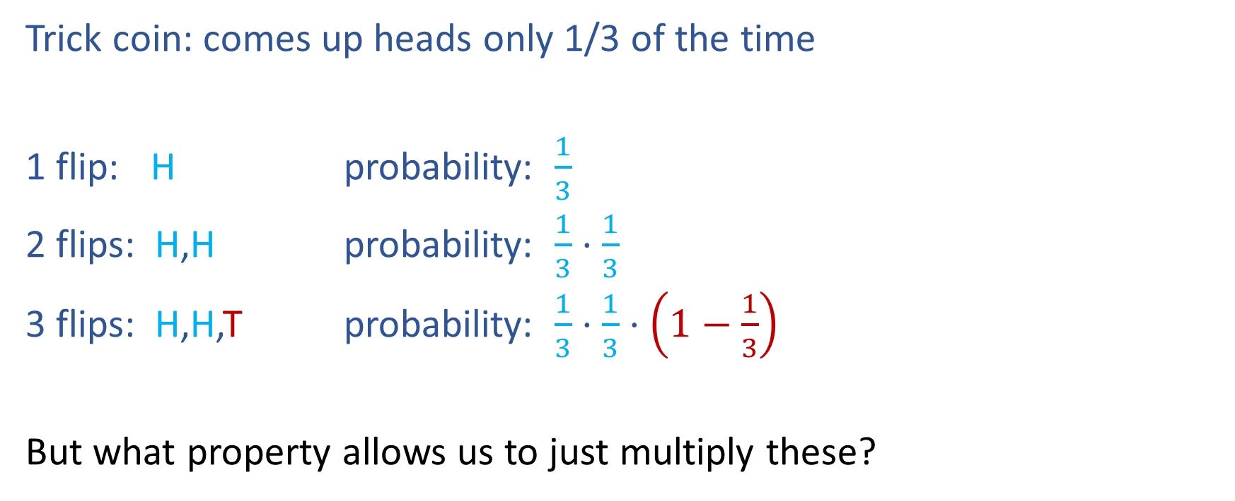
Poll 4
Trick coin: comes up heads only 1/3 of the time
1 flip: H probability: $\frac{1}{3}$
2 flips: H,H probability: $\frac{1}{3}⋅\frac{1}{3}$
3 flips: H,H,T probability: $\frac{1}{3}⋅\frac{1}{3}⋅\left(1−\frac{1}{3}\right)$
But what property allows us to just multiply these?

Slide 9

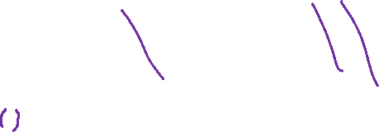

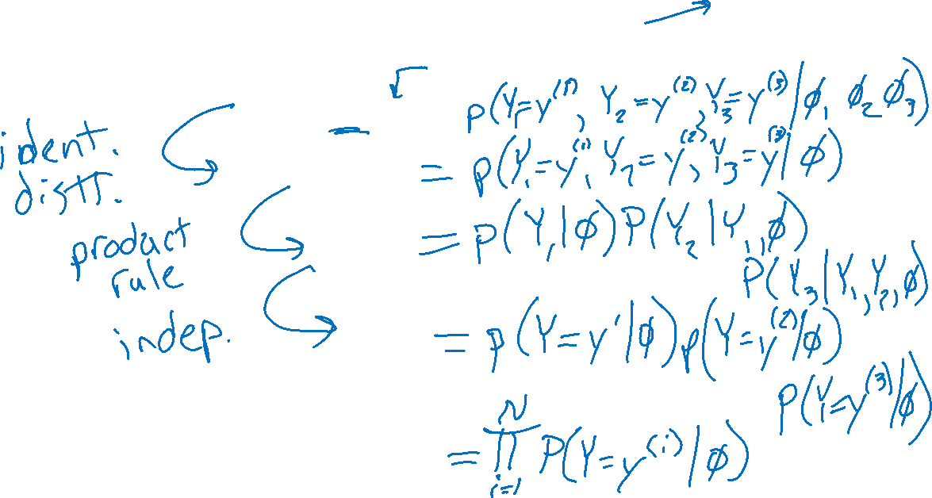

Poll 5
$𝒟=\left\{y^{\left(1\right)}, y^{\left(2\right)},y^{\left(3\right)}\right\}$
$$Y∼Bern\left(φ\right)$$
Which of these is the correct labeling of these properties?
$$p\left(𝒟 ∣ θ\right)=$$

Slide 10
Likelihood
Pre-reading

Slide 11

Likelihood
Likelihood: The probability (or density) of random variable $Y$ taking on value $y$ given the distribution parameters, $θ$.

Slide 12
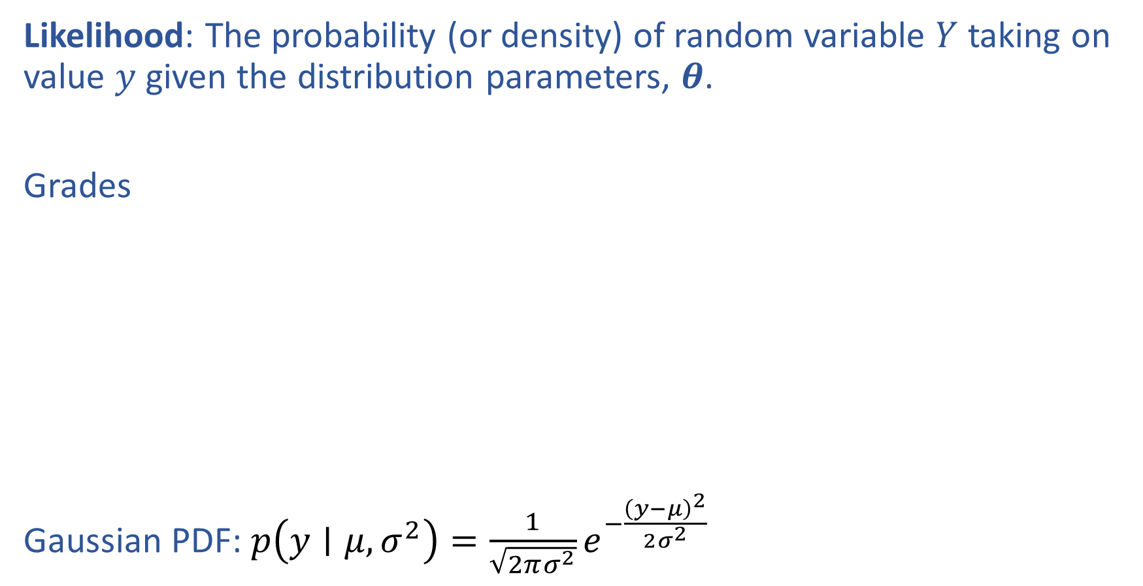
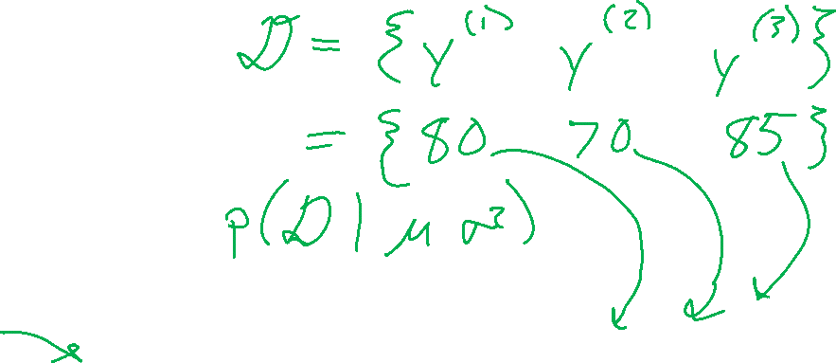
Likelihood
Likelihood: The probability (or density) of random variable $Y$ taking on value $y$ given the distribution parameters, $θ$.
Grades
Gaussian PDF: $p\left(y∣μ, σ^{2}\right)=\frac{1}{\sqrt{2πσ^{2}}}e^{−\frac{{\left(y−μ\right)}^{2}}{2σ^{2}}}$

Slide 13
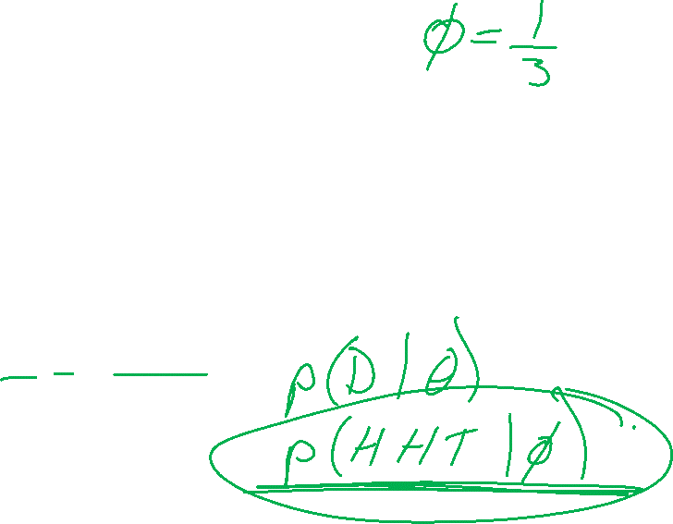
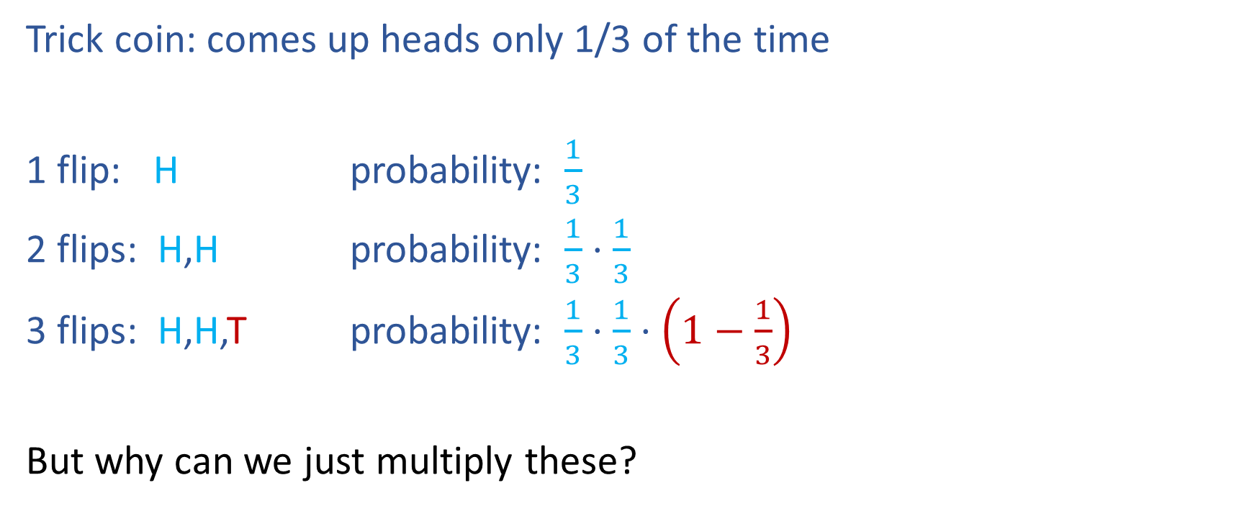
Likelihood
Trick coin: comes up heads only 1/3 of the time
1 flip: H probability: $\frac{1}{3}$
2 flips: H,H probability: $\frac{1}{3}⋅\frac{1}{3}$
3 flips: H,H,T probability: $\frac{1}{3}⋅\frac{1}{3}⋅\left(1−\frac{1}{3}\right)$
But why can we just multiply these?

Slide 14
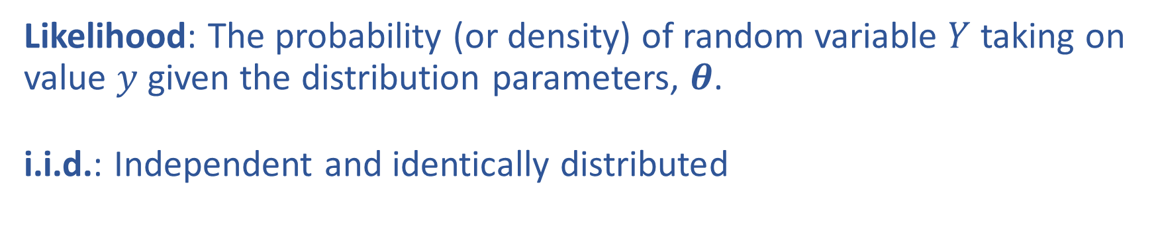
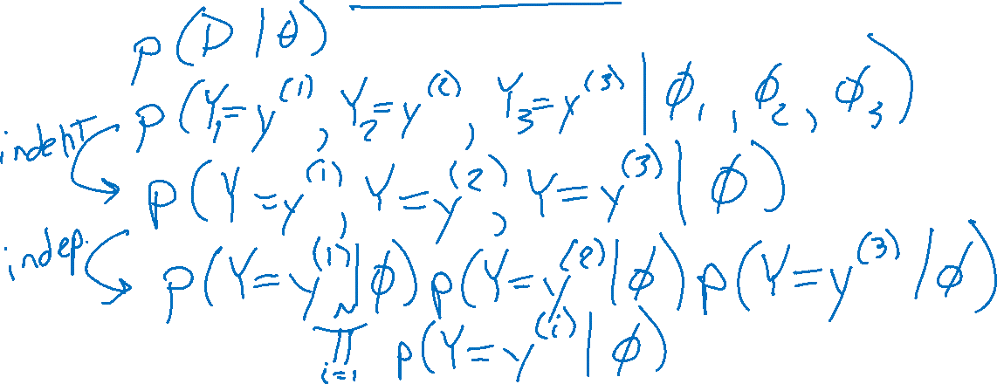
Likelihood and i.i.d
Likelihood: The probability (or density) of random variable $Y$ taking on value $y$ given the distribution parameters, $θ$.
i.i.d.: Independent and identically distributed

Slide 15
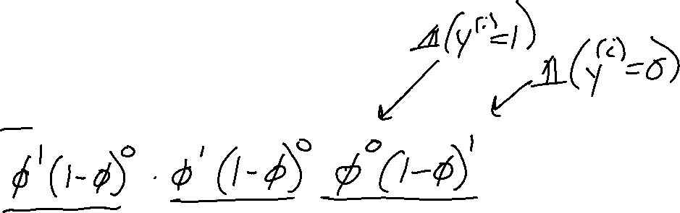
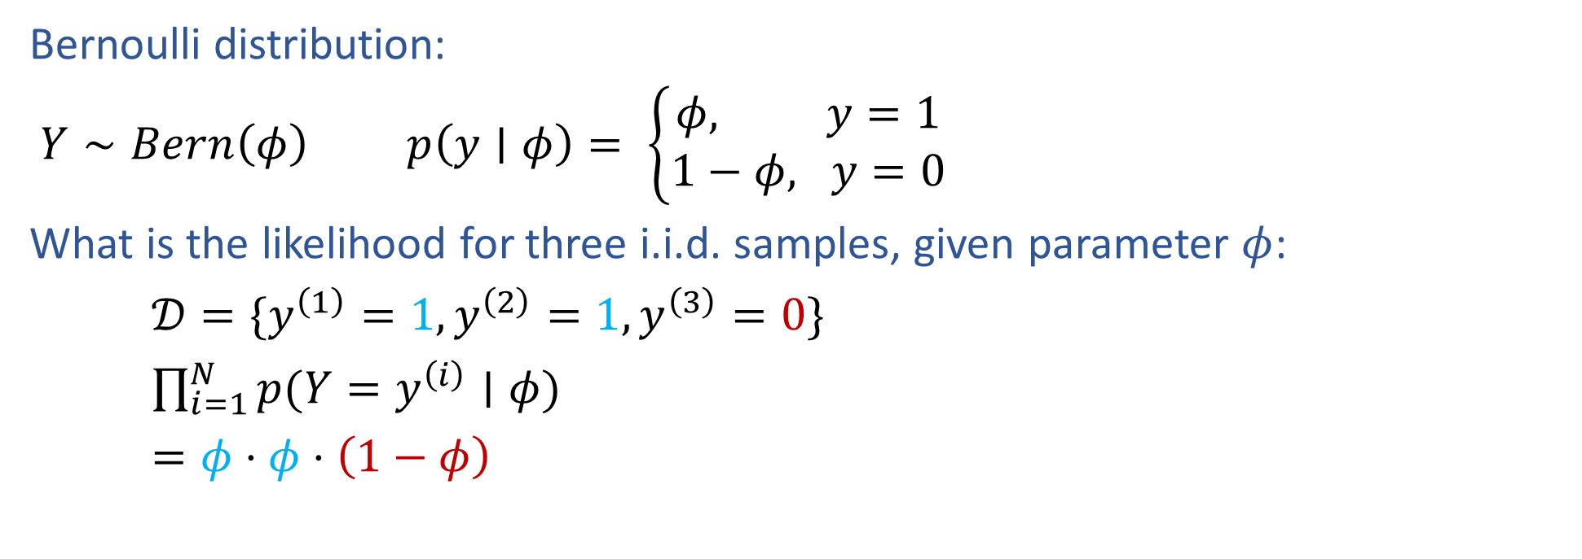
Bernoulli Likelihood
Bernoulli distribution:
$Y∼Bern\left(φ\right)$ $p\left(y∣φ\right)= \left\{\begin{aligned}φ, y=1 \\ 1−φ, y=0\end{aligned}\right.$
What is the likelihood for three i.i.d. samples, given parameter $φ$:
$𝒟=\{y^{\left(1\right)}=1, y^{\left(2\right)}=1,y^{\left(3\right)}=0\}$
$\prod_{i=1}^{N}{p(Y=y^{\left(i\right)}∣φ)}$
$=φ⋅φ⋅\left(1−φ\right)$

Slide 16
MLE
Maximum likelihood estimation

Slide 17
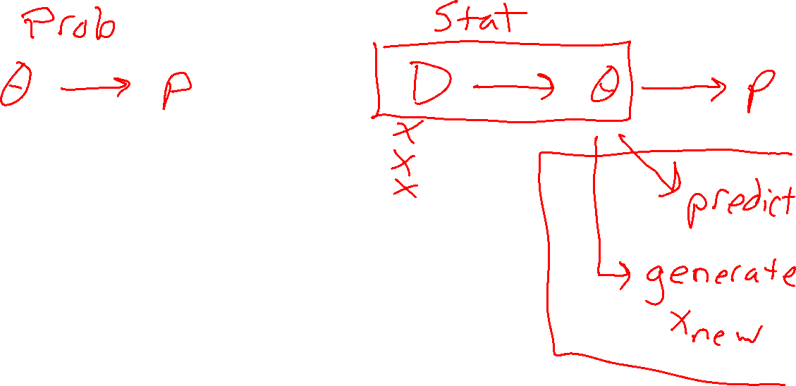
From Probability to Statistics

Slide 18
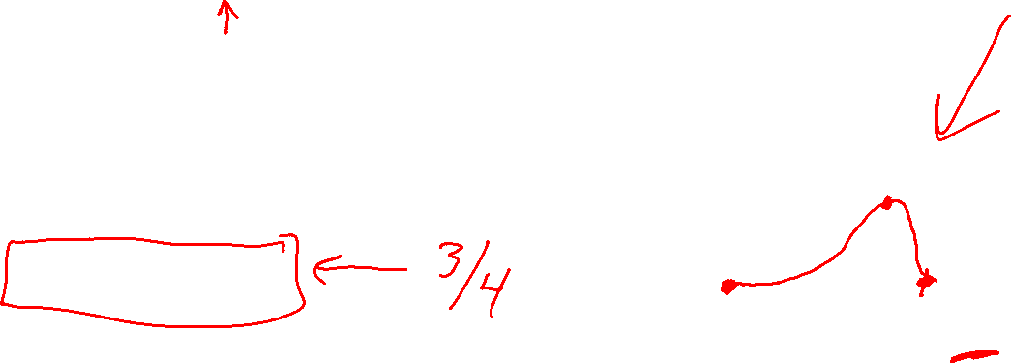
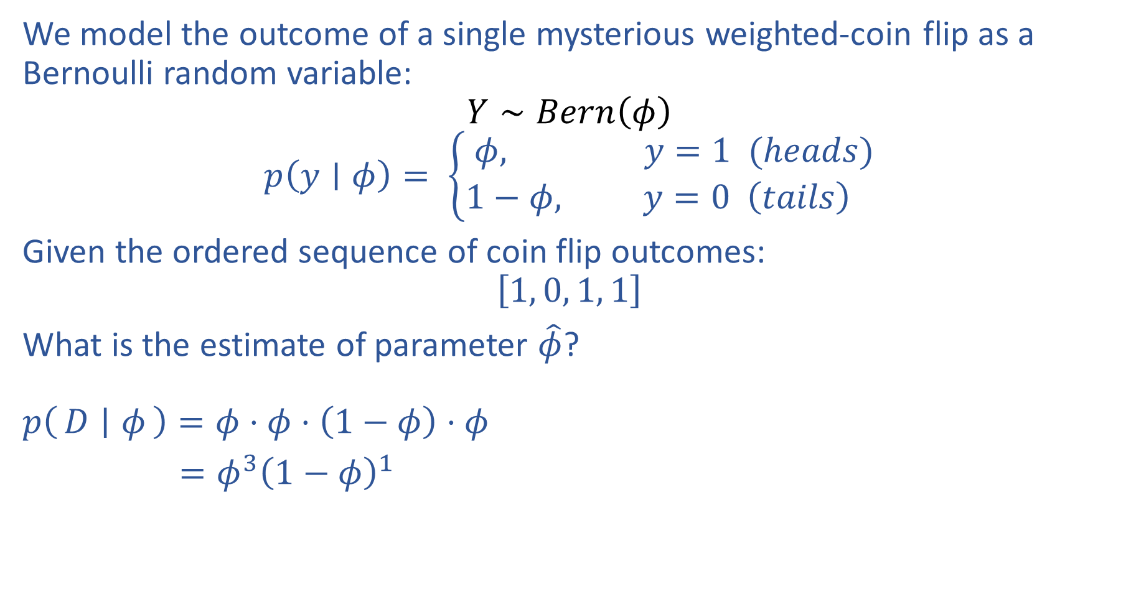
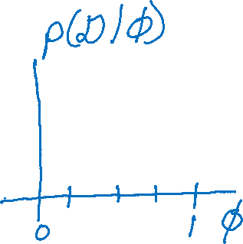
Estimating Parameters with Likelihood
We model the outcome of a single mysterious weighted-coin flip as a Bernoulli random variable:
$$Y∼Bern\left(φ\right)$$
$$p\left(y∣φ\right)= \left\{\begin{aligned}φ, y=1 (heads) \\ 1−φ, y=0 \left(tails\right) \end{aligned}\right.$$
Given the ordered sequence of coin flip outcomes:
$$\left[1, 0, 1, 1\right]$$
What is the estimate of parameter $\hat{φ}$?
$p\left(D ∣ φ\right)=φ⋅φ⋅\left(1−φ\right)⋅φ$
$=φ^{3}{\left(1−φ\right)}^{1}$
https://www.desmos.com/calculator/kr7m2m6cf7

Slide 19
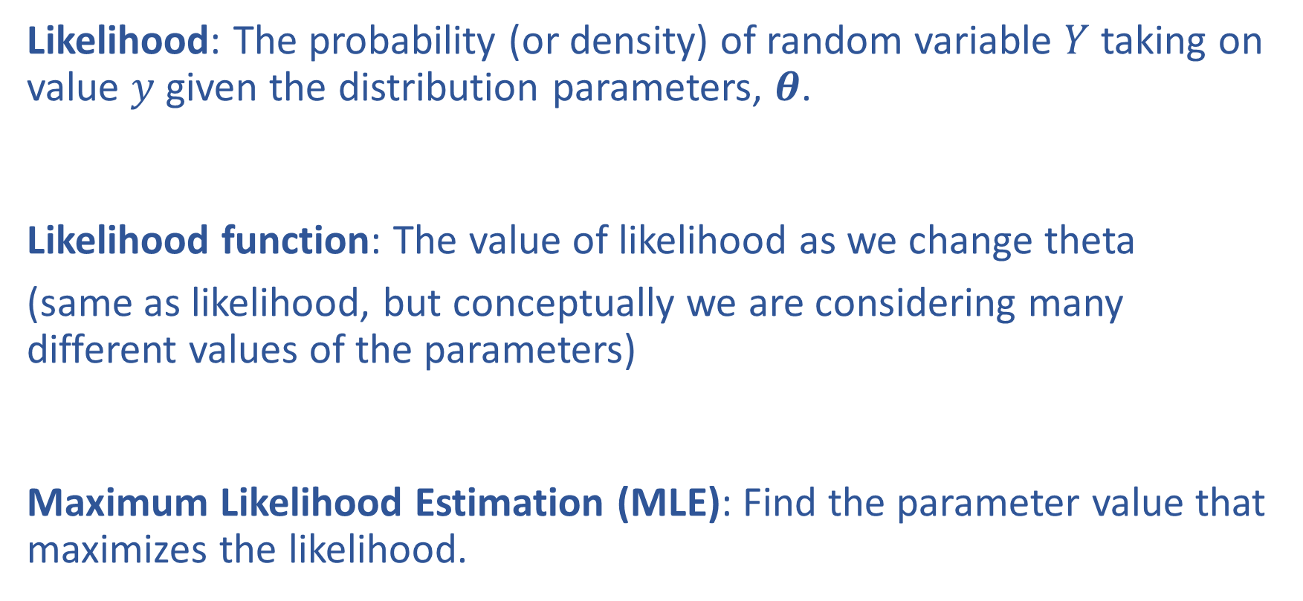
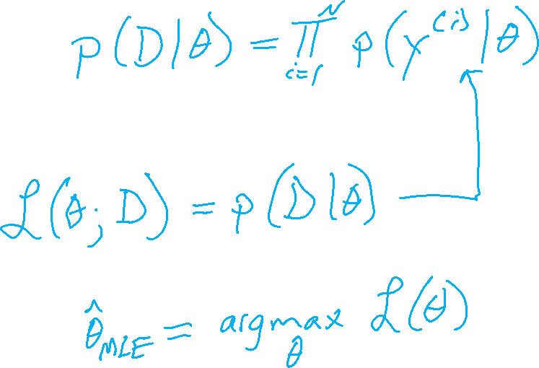
Likelihood and Maximum Likelihood Estimation
Likelihood: The probability (or density) of random variable $Y$ taking on value $y$ given the distribution parameters, $θ$.
Likelihood function: The value of likelihood as we change theta
(same as likelihood, but conceptually we are considering many different values of the parameters)
Maximum Likelihood Estimation (MLE): Find the parameter value that maximizes the likelihood.

Slide 20
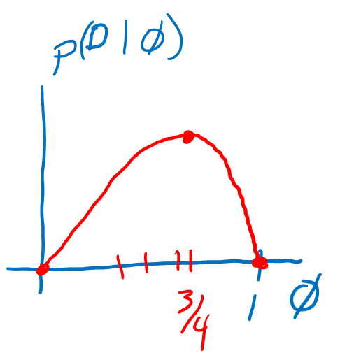


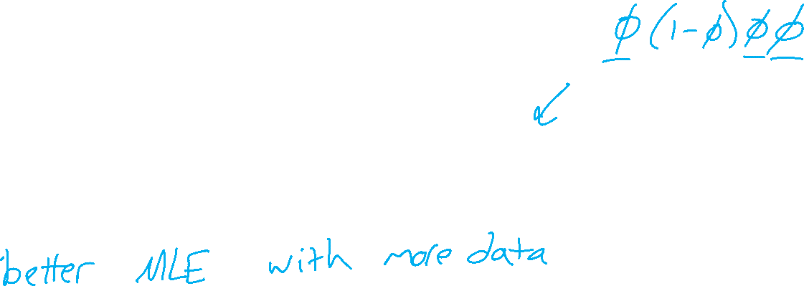
MLE as Data Increases
Given the ordered sequence of coin flip outcomes:
$$\left[1, 0, 1, 1\right]$$
$$p(𝒟∣φ)=\prod_{i}^{N}{p\left(y^{\left(i\right)} ∣ φ\right)} = φ^{N_{y=1}}{\left(1−φ\right)}^{N_{y=0}}$$
What happens as we flip more coins?
https://www.desmos.com/calculator/kr7m2m6cf7

Slide 21
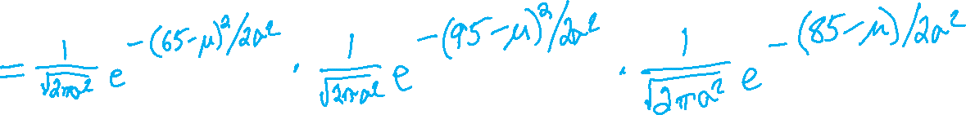
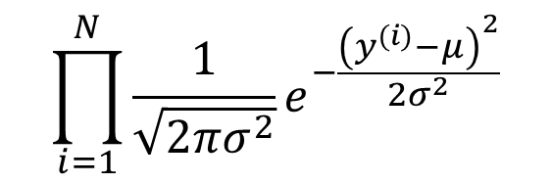
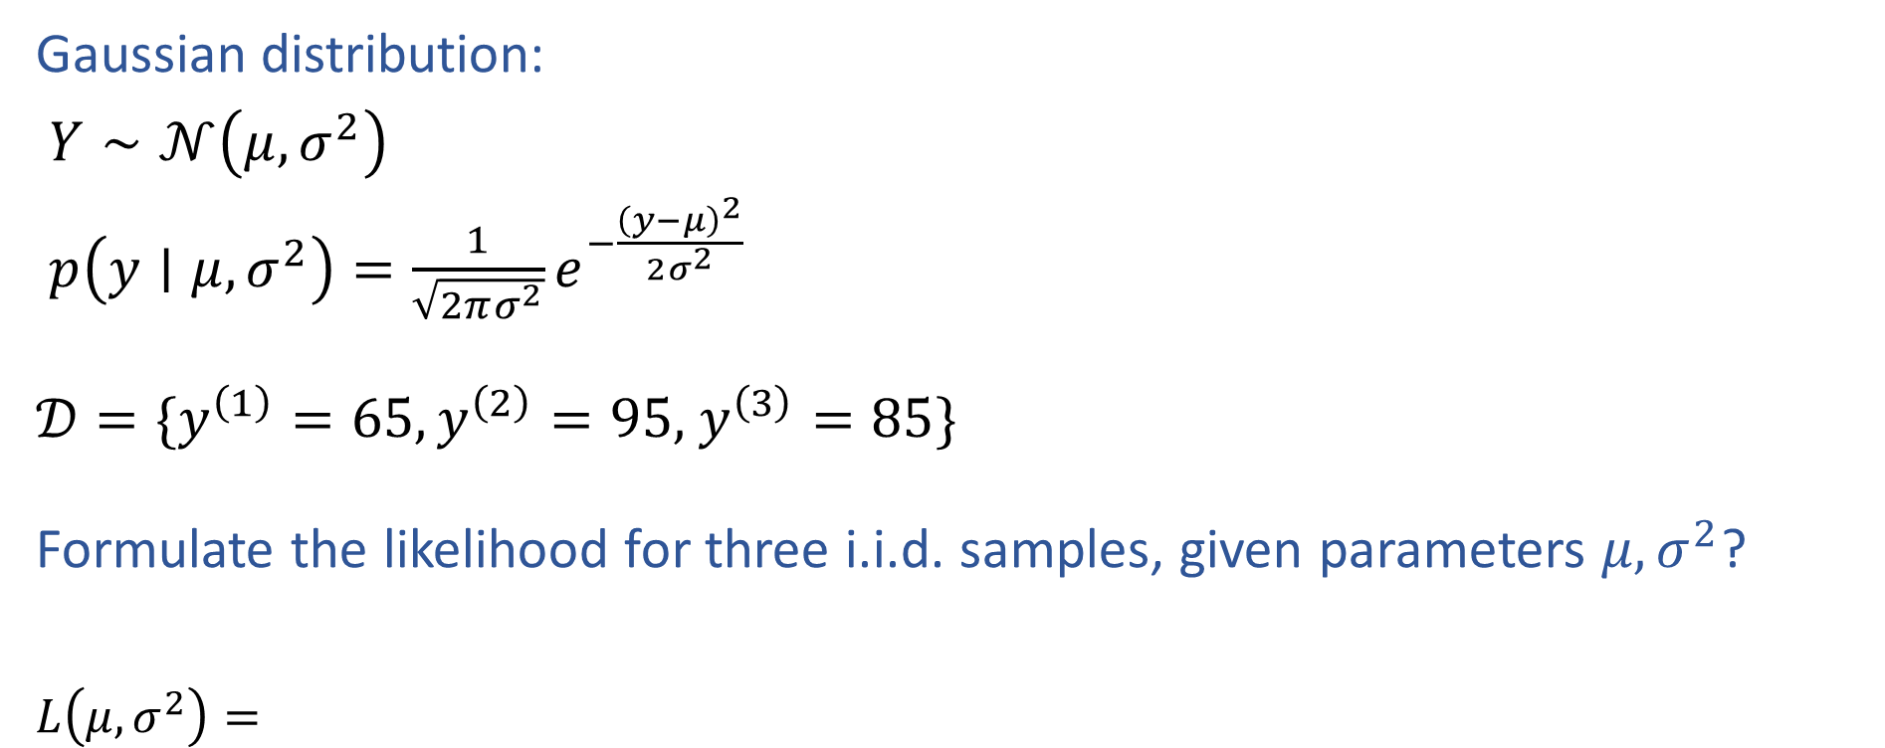
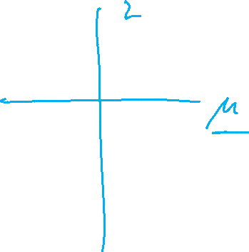
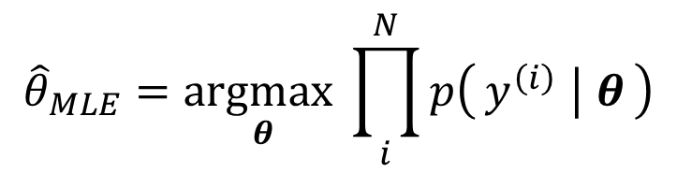
MLE for Gaussian
Gaussian distribution:
$Y∼𝒩\left(μ, σ^{2}\right)$
$p\left(y∣μ, σ^{2}\right)=\frac{1}{\sqrt{2πσ^{2}}}e^{−\frac{{\left(y−μ\right)}^{2}}{2σ^{2}}}$
$𝒟=\{y^{\left(1\right)}=65,y^{\left(2\right)}=95,$ $y^{\left(3\right)}=85\}$
Formulate the likelihood for three i.i.d. samples, given parameters $μ, σ^{2}$?
$L\left(μ, σ^{2}\right)=$
$$\prod_{i=1}^{N}{\frac{1}{\sqrt{2πσ^{2}}}e^{−\frac{{\left(y^{(i)}−μ\right)}^{2}}{2σ^{2}}}}$$
$${\hat{θ}}_{MLE}=\underset{θ}{argmax}\prod_{i}^{N}{p\left(y^{\left(i\right)} ∣ θ\right)}$$

Slide 22
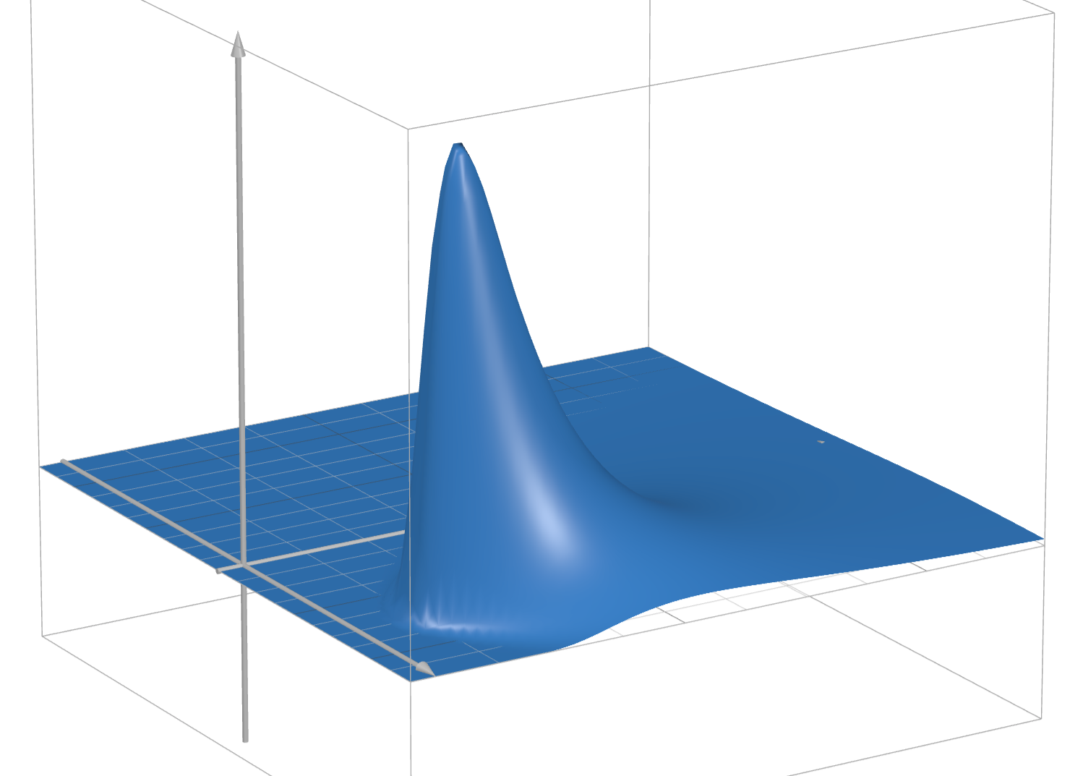

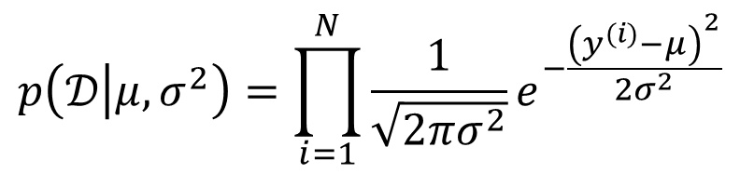
MLE for Gaussian
Assume that exam scores are drawn independently from the same Gaussian (Normal) distribution.
Given three exam scores 2, 3, 4, which pair of parameters is the best fit (the highest likelihood)?
$$p\left(𝒟 | μ, σ^{2}\right)=\prod_{i=1}^{N}{\frac{1}{\sqrt{2πσ^{2}}}e^{−\frac{{\left(y^{(i)}−μ\right)}^{2}}{2σ^{2}}}}$$
https://www.desmos.com/3d/988327bd26

Slide 23

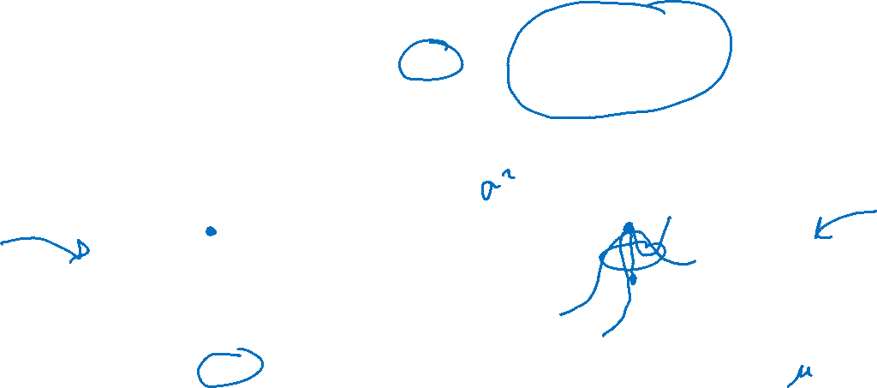
MLE
Principle of Maximum Likelihood Estimation:
Choose the parameters that maximize the likelihood of the data.
Maximum Likelihood Estimate (MLE)
θ₂
θ^{MLE}
L(θ)
L(θ₁, θ₂)
θ^{MLE}
θ₁
Slide credit: CMU MLD Matt Gormley

Slide 24
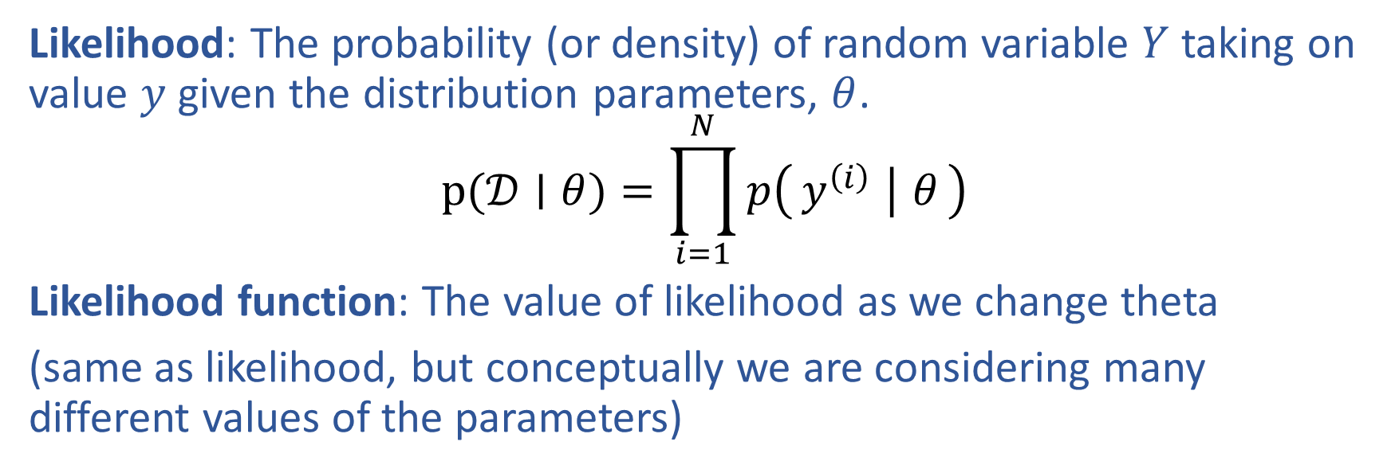
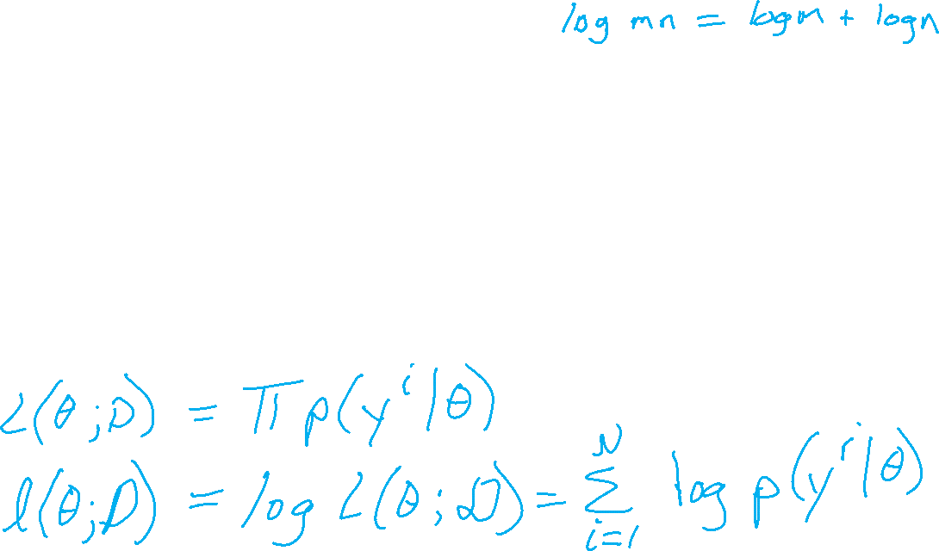
Likelihood and Log Likelihood
Likelihood: The probability (or density) of random variable $Y$ taking on value $y$ given the distribution parameters, $θ$.
$$p(𝒟∣θ)=\prod_{i=1}^{N}{p\left(y^{\left(i\right)} ∣ θ\right)}$$
Likelihood function: The value of likelihood as we change theta
(same as likelihood, but conceptually we are considering many different values of the parameters)

Slide 25
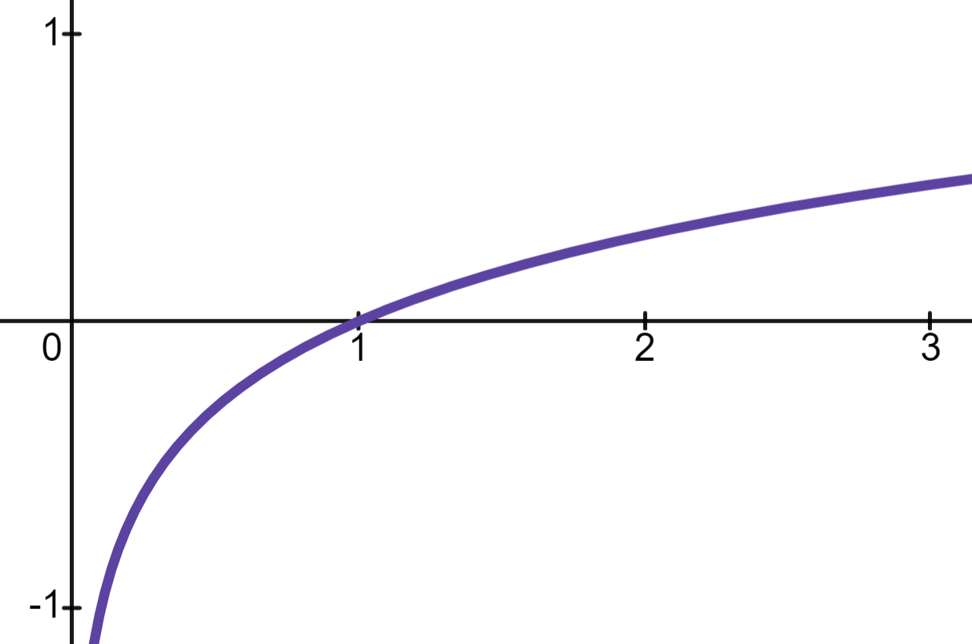
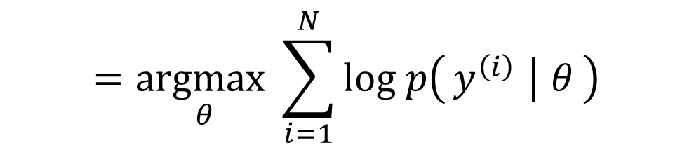
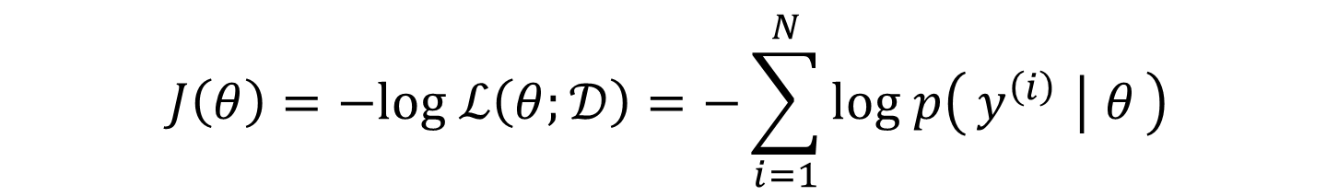
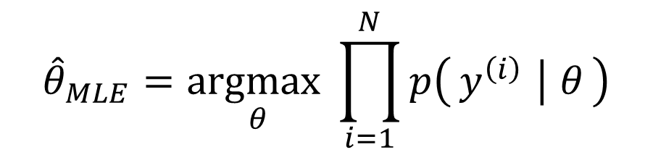
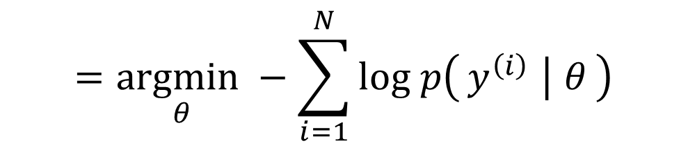



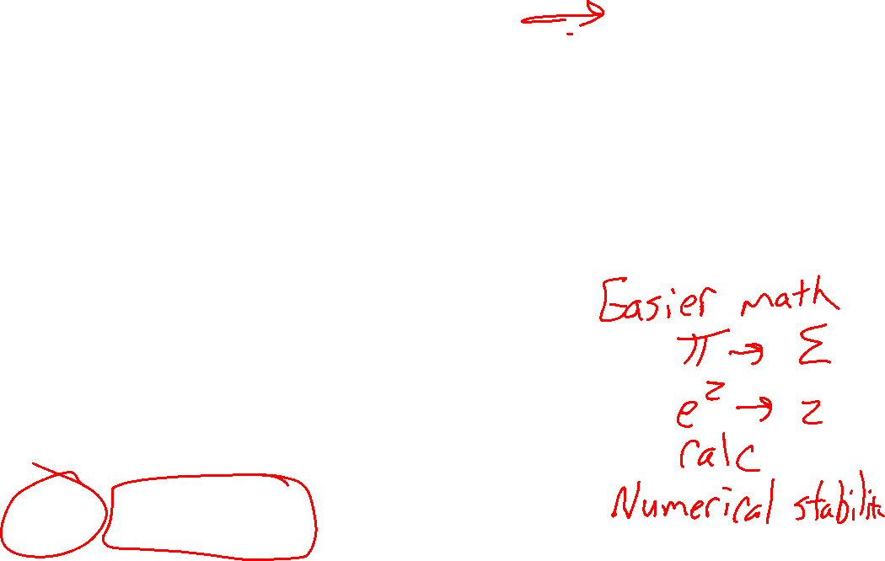
MLE Objective
Log is monotonic:
If $a < b$
then $\log{a}<\log{b}$
Updating our objective: Minimize neg. log likelihood
$${\hat{θ}}_{MLE}=\underset{θ}{argmax}\prod_{i=1}^{N}{p\left(y^{\left(i\right)} ∣ θ\right)}$$
$$=\underset{θ}{argmax}\sum_{i=1}^{N}{log p\left(y^{\left(i\right)} ∣ θ\right)}$$
$$=\underset{θ}{argmin}−\sum_{i=1}^{N}{log p\left(y^{\left(i\right)} ∣ θ\right)}$$
$$J\left(θ\right)=−log ℒ\left(θ;𝒟\right)=−\sum_{i=1}^{N}{log p\left(y^{\left(i\right)} ∣ θ\right)}$$
Minimize

Slide 26



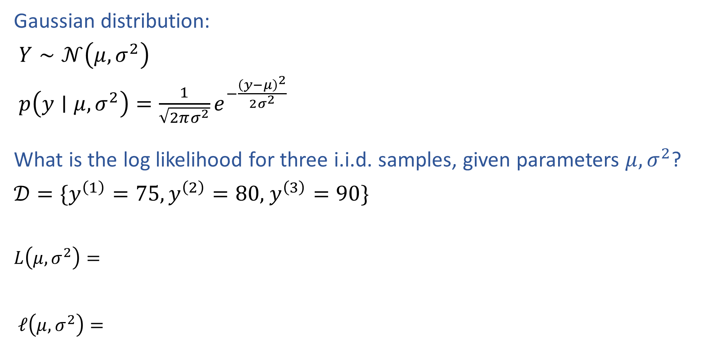
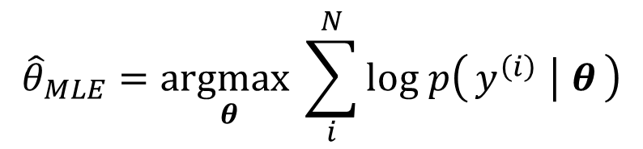

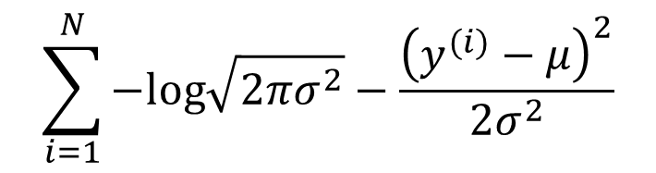

MLE for Gaussian
Gaussian distribution:
$Y∼𝒩\left(μ, σ^{2}\right)$
$p\left(y∣μ, σ^{2}\right)=\frac{1}{\sqrt{2πσ^{2}}}e^{−\frac{{\left(y−μ\right)}^{2}}{2σ^{2}}}$
What is the log likelihood for three i.i.d. samples, given parameters $μ, σ^{2}$?
$𝒟=\{y^{\left(1\right)}=75,y^{\left(2\right)}=80,$ $y^{\left(3\right)}=90\}$
$L\left(μ, σ^{2}\right)=$
$ℓ\left(μ, σ^{2}\right)=$
$$\prod_{i=1}^{N}{\frac{1}{\sqrt{2πσ^{2}}}e^{−\frac{{\left(y^{(i)}−μ\right)}^{2}}{2σ^{2}}}}$$
$${\hat{θ}}_{MLE}=\underset{θ}{argmax}\prod_{i}^{N}{p\left(y^{\left(i\right)} ∣ θ\right)}$$
$$\sum_{i=1}^{N}{−log\sqrt{2πσ^{2}}−\frac{{\left(y^{(i)}−μ\right)}^{2}}{2σ^{2}}}$$
$${\hat{θ}}_{MLE}=\underset{θ}{argmax}\sum_{i}^{N}{log p\left(y^{\left(i\right)} ∣ θ\right)}$$

Slide 27
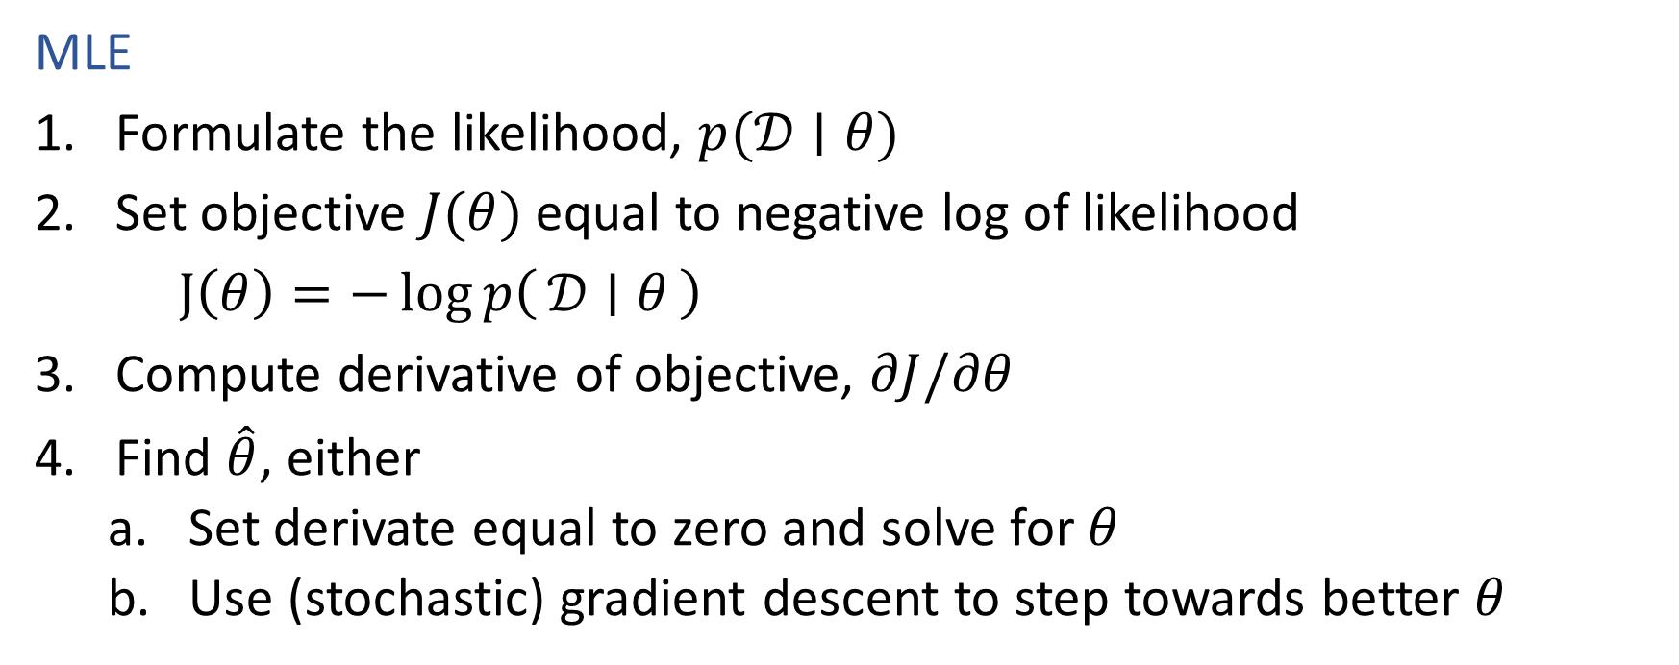
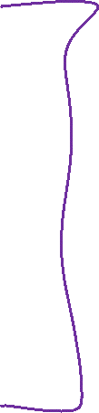
Recipe for Estimation
MLE
Formulate the likelihood, $p(𝒟∣θ)$
Set objective $J(θ)$ equal to negative log of likelihood
$J\left(θ\right)=−\log{p\left(𝒟 ∣ θ\right)}$
Compute derivative of objective, $∂J/∂θ$
Find $\hat{θ}$, either
Set derivate equal to zero and solve for $θ$
Use (stochastic) gradient descent to step towards better $θ$

Slide 28
Probabilistic Formulation for ML
MLE for Linear and Logistic Regression

Slide 29
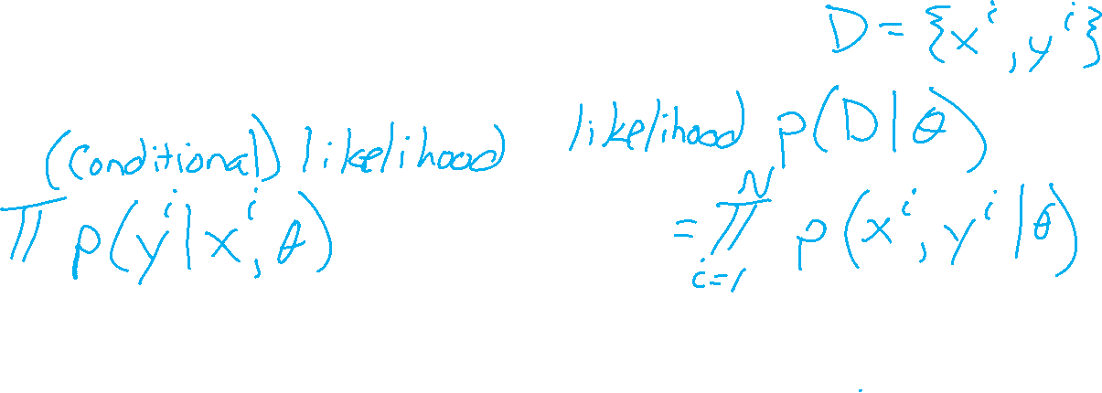
Using Statistics for Machine Learning
Likelihood vs conditional likelihood

Slide 30
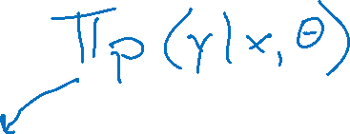
Recipe for Estimation
MLE
Formulate the likelihood, $p(𝒟∣θ)$
Set objective $J(θ)$ equal to negative log of likelihood
$J\left(θ\right)=−\log{p\left(𝒟 ∣ θ\right)}$
Compute derivative of objective, $∂J/∂θ$
Find $\hat{θ}$, either
Set derivate equal to zero and solve for $θ$
Use (stochastic) gradient descent to step towards better $θ$

Slide 31



M(C)LE for Logistic Regression
Learn to predict if a patient has cancer ($Y=1$) or not ($Y=0$) given the input of just one test results, $X_{A}$ and $X_{B}$
$${\hat{θ}}_{MLE}=\underset{θ}{argmax}\prod_{i}^{N}{{\frac{1}{1+{e^{−θ^{T}x}}^{\left(i\right)}}}^{𝕀\left(y^{\left(i\right)}=1\right)}{\left(1−\frac{1}{1+{e^{−θ^{T}x}}^{\left(i\right)}}\right)}^{𝕀\left(y^{(i)}=0\right)}}$$

Slide 32

M(C)LE for Logistic Regression
Learn to predict if a patient has cancer ($Y=1$) or not ($Y=0$) given the input of just one test results, $X_{A}$ and $X_{B}$
$${\hat{θ}}_{MLE}=\underset{θ}{argmax}\prod_{i}^{N}{p\left(y^{\left(i\right)} ∣ x^{\left(i\right)}, θ\right)}$$

Slide 33


M(C)LE for Multi-class Logistic Regression
Learn to predict if probability of output belonging to class $k$, $Y_{k}$ , given input $X$, $P(Y_{k}=1∣X, θ_{1}, …, θ_{K})$
$${\hat{Θ}}_{MLE}=\underset{Θ}{argmax}\prod_{i}^{N}{\prod_{k}^{K}{{\frac{{e^{θ_{k}^{T}x}}^{\left(i\right)}}{\sum_{l=1}^{K}{{e^{θ_{l}^{T}x}}^{\left(i\right)}}}}^{𝕀\left(y_{k}^{\left(i\right)}=1\right)}}}$$

Slide 34


M(C)LE for Multi-class Logistic Regression
Learn to predict if probability of output belonging to class $k$, $Y_{k}$ , given input $X$, $P(Y_{k}=1∣X, θ_{1}, …, θ_{K})$
$$ℒ\left(Θ;𝒟\right)=\prod_{i}^{N}{\prod_{k}^{K}{{\frac{{e^{θ_{k}^{T}x}}^{\left(i\right)}}{\sum_{l=1}^{K}{{e^{θ_{l}^{T}x}}^{\left(i\right)}}}}^{𝕀\left(y_{k}^{\left(i\right)}=1\right)}}}$$

Slide 35





M(C)LE for Linear Regression
$$f\left(z;μ,σ\right)=\frac{1}{\sqrt{2πσ^{2}}}e^{\frac{−{\left(x−μ\right)}^{2}}{2σ^{2}}}$$
Probabilistic interpretation of linear regression
$${\hat{θ}}_{MLE}=\underset{θ}{argmax}\prod_{i}^{N}{p\left(y^{\left(i\right)} ∣ x^{\left(i\right)}, θ\right)}$$

Slide 36











M(C)LE for Linear Regression
$$f\left(z\right)=\frac{1}{\sqrt{2πσ^{2}}}e^{\frac{−{\left(z−μ\right)}^{2}}{2σ^{2}}}$$
Probabilistic interpretation of linear regression
$$\prod_{i=1}^{N}{\frac{1}{\sqrt{2πσ^{2}}}e^{−\frac{{\left(z^{(i)}−μ\right)}^{2}}{2σ^{2}}}}$$
$$ℒ\left(θ;𝒟\right)=\prod_{i}^{N}{p\left(y^{\left(i\right)} ∣ x^{\left(i\right)}, θ\right)}$$
$$\sum_{i=1}^{N}{−log\sqrt{2πσ^{2}}−\frac{{\left(z^{(i)}−μ\right)}^{2}}{2σ^{2}}}$$

Slide 37
Additional Slides

Slide 38
Probability Primer

Slide 39
Probability Vocab
Outcomes
Sample space
Events
Probability
Random variable
Discrete random variable
Continuous random variable
Probability mass function
Probability density function
Parameters

Slide 40






Example
Random variable for spinach or no spinach
Random variable
Distribution
Sample space
Values
Probabilities or Densities
Icons: CC, https://openclipart.org/detail/296791/pizza-slice

Slide 41



Example
Random variable for spinach or no spinach
Random variable
Distribution
Sample space
Values
Probabilities or Densities
Icons: CC, https://openclipart.org/detail/296791/pizza-slice

Slide 42


Example
Random variable for topping type with
three categories: none, non-meat, meat
Random variable
Distribution
Sample space
Values
Probabilities or Densities
Icons: CC, https://openclipart.org/detail/296791/pizza-slice

Slide 43
Example
Random variable for topping type with
three categories: none, non-meat, meat
Random variable
Distribution
Sample space
Values
Probabilities or Densities
Icons: CC, https://openclipart.org/detail/296791/pizza-slice

Slide 44

Example
Random variable for number of heads after two flips of a fair coin
Random variable
Distribution
Sample space
Values
Probabilities or Densities
Icons: CC, https://openclipart.org/detail/296791/pizza-slice

Slide 45


Example
Random variable for number of heads after two flips of a biased coin that lands heads 75%
Random variable
Distribution
Sample space
Values
Probabilities or Densities
Icons: CC, https://openclipart.org/detail/296791/pizza-slice

Slide 46

Example
Random variable for cat in picture or not
Random variable
Distribution
Sample space
Values
Probabilities or Densities
Icons: CC, https://openclipart.org/detail/296791/pizza-slice

Slide 47

Example
Random variable for animal species in picture assuming one animal picture and available species: dog, cat, pig
Random variable
Distribution
Sample space
Values
Probabilities or Densities
Icons: CC, https://openclipart.org/detail/296791/pizza-slice

Slide 48

Example
Random variable for height of student
Random variable
Distribution
Sample space
Values
Probabilities or Densities
Icons: CC, https://openclipart.org/detail/296791/pizza-slice

Slide 49


Probability Vocab
Outcomes
Sample space
Events
Probability
Random variable
Discrete random variable
Continuous random variable
Probability mass function
Probability density function
Parameters

Slide 50

Example Discrete Distributions
Bernoulli
Categorical
Binomial
Multinomial
Uniform

Slide 51

Example Continuous Distributions
Gaussian
Beta
Laplace

Slide 52

Probability Vocab
Marginal
Joint
Conditional

Slide 53


Notation
Dataset
Parameters, generically $θ$
$p(𝒟 | θ)$, $p(𝒟 ; θ)$
Random variables
Capital
Values
lower case
Random variable: function that maps events to values
Y is rand variable that maps the event of a coin toss being heads to value one and the event of a coin toss being tails to zero
$P(Y=1 | φ)= 3/4$, where $φ =3/4$
$P(Y=1)=3/4$
Sometimes even
$P(Y=heads) =3/4$

Slide 54
Probability Toolbox
Algebra
Three axioms of probability
Theorem of total probability
Definition of conditional probability
Product rule
Bayes’ theorem
Chain rule
Independence
Conditional independence

Slide 55





Probability Tools Summary
Adding to the toolbox
Definition of conditional probability
Chain Rule
Bayes’ theorem
Chain Rule…
$$P\left(A | B\right)=\frac{P\left(A, B\right)}{P(B)}$$
$$P(A,B)=P\left(A | B\right)P(B)$$
$$P\left(B | A\right)=\frac{P\left(A | B\right)P(B)}{P(A)}$$
$$P(A_{1},…A_{N})=P(A_{1})\sum_{i=2}^{N}{P(A_{i}∣A_{i−1})}$$

