Slide 1

10-315 Introduction to ML Neural Networks
Instructor: Pat Virtue

Slide 2
Outline
Last time: Neural Networks
Three-neuron network + optimization
Neural network structure (adding more neurons)
Forward pass and Backpropagation (scalar version)
Today: Neural Networks
Calculus: multi-variate chain rule
Backpropagation (vector version)
Optimization intuition (sliders)
Neural Network Properties and Intuition

Slide 3

















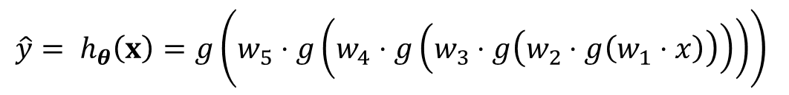






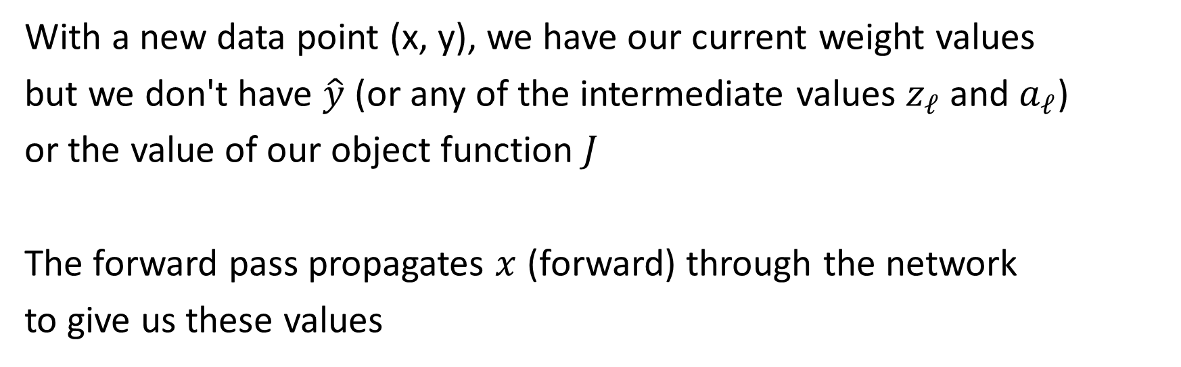






Forward Pass
$$\hat{y}= h_{θ}\left(x\right)=g\left(w_{5}⋅g\left(w_{4}⋅g\left(w_{3}⋅g\left(w_{2}⋅g\left(w_{1}⋅x\right)\right)\right)\right)\right)$$
Width 1 deep network (no bias) (dumb but will help with calculus)
$$y$$
$$x$$
$$z1$$
$$a1$$
$$z2$$
$$a2$$
$$z3$$
$$a3$$
$$z4$$
$$a4$$
$$z5$$
$$a5=\hat{y}$$
$$J$$
$$f$$
$$g$$
$$f$$
$$g$$
$$f$$
$$g$$
$$f$$
$$g$$
$$f$$
$$g$$
$$ℓ$$
$$w1$$
$$w2$$
$$w3$$
$$w4$$
$$w5$$
With a new data point (x, y), we have our current weight values
but we don't have $\hat{y}$ (or any of the intermediate values $z_{ℓ}$ and $a_{ℓ}$)
or the value of our object function $J$
The forward pass propagates $x$ (forward) through the network
to give us these values

Slide 4








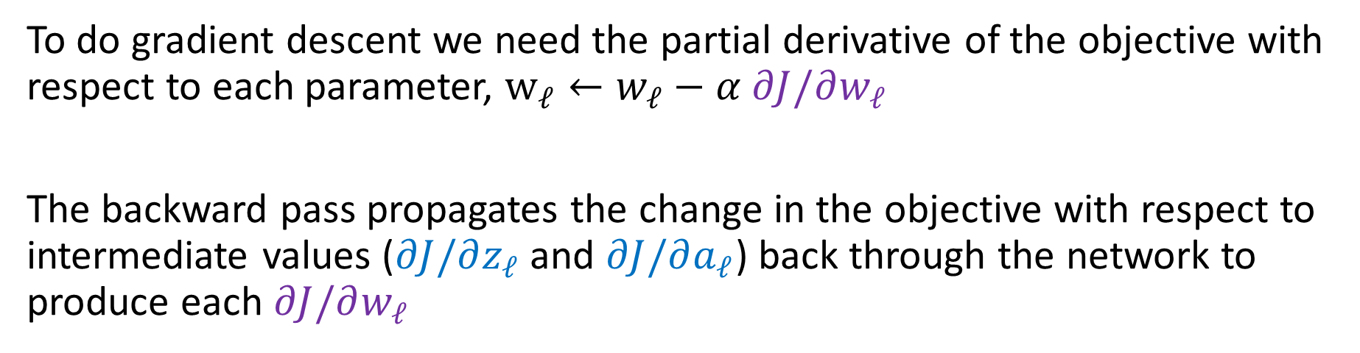







Backpropagation
$$\hat{y}= h_{θ}\left(x\right)=g\left(w_{5}⋅g\left(w_{4}⋅g\left(w_{3}⋅g\left(w_{2}⋅g\left(w_{1}⋅x\right)\right)\right)\right)\right)$$
Width 1 deep network (no bias) (dumb but will help with calculus)
$$\frac{∂J}{∂z_{1}}$$
$$\frac{∂J}{∂a_{1}}$$
$$\frac{∂J}{∂z_{2}}$$
$$\frac{∂J}{∂a_{2}}$$
$$\frac{∂J}{∂z_{3}}$$
$$\frac{∂J}{∂a_{3}}$$
$$\frac{∂J}{∂z_{4}}$$
$$\frac{∂J}{∂a_{4}}$$
$$\frac{∂J}{∂z_{5}}$$
$$\frac{∂J}{∂\hat{y}}$$
$$y$$
$$x$$
$$z1$$
$$a1$$
$$z2$$
$$a2$$
$$z3$$
$$a3$$
$$z4$$
$$a4$$
$$z5$$
$$a5=\hat{y}$$
$$J$$
$$f$$
$$g$$
$$f$$
$$g$$
$$f$$
$$g$$
$$f$$
$$g$$
$$f$$
$$g$$
$$ℓ$$
$$w1$$
$$w2$$
$$w3$$
$$w4$$
$$w5$$
$$\frac{∂J}{∂w_{1}}$$
$$\frac{∂J}{∂w_{2}}$$
$$\frac{∂J}{∂w_{3}}$$
$$\frac{∂J}{∂w_{4}}$$
$$\frac{∂J}{∂w_{5}}$$
To do gradient descent we need the partial derivative of the objective with respect to each parameter, $w_{ℓ}←w_{ℓ}−α ∂J/∂w_{ℓ}$
The backward pass propagates the change in the objective with respect to intermediate values ($∂J/∂z_{ℓ}$ and $∂J/∂a_{ℓ}$) back through the network to produce each $∂J/∂w_{ℓ}$

Slide 5
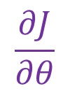

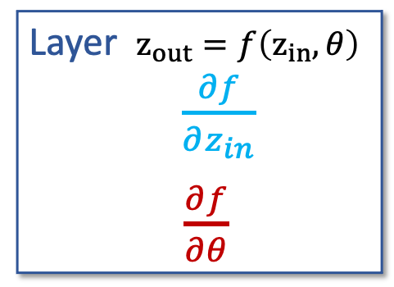



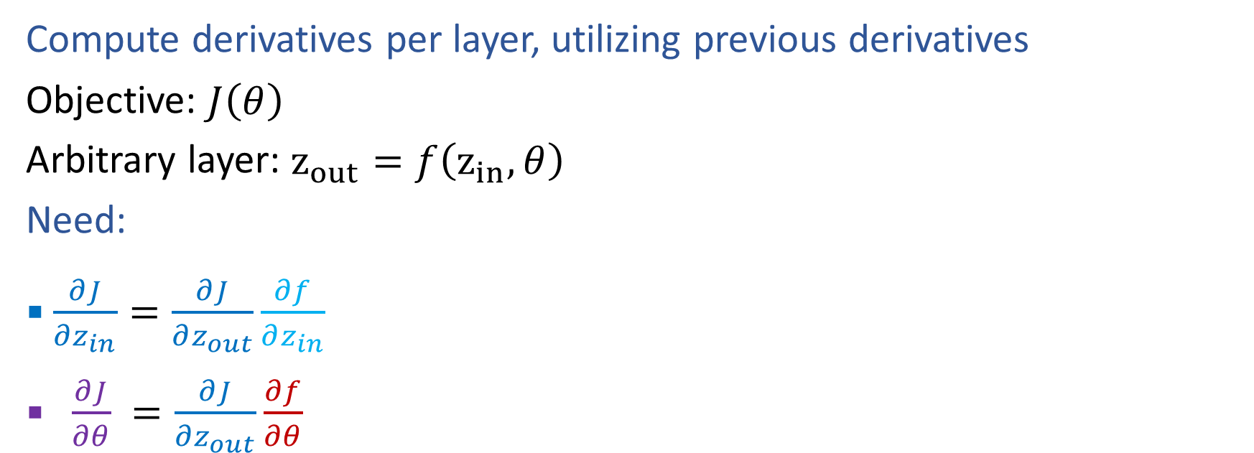

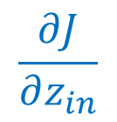




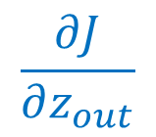


Generic Layer Implementation (so-far)
Compute derivatives per layer, utilizing previous derivatives
Objective: $J\left(θ\right)$
Arbitrary layer: $z_{out}=f\left(z_{in}, θ\right)$
Need:
$\frac{∂J}{∂z_{in}}=\frac{∂J}{∂z_{out}}\frac{∂f}{∂z_{in}}$
$\frac{∂J}{∂θ} =\frac{∂J}{∂z_{out}}\frac{∂f}{∂θ}$
$$zin$$
$$zout$$
$$J$$
$$f$$
$$θ$$
$$z_{in}$$
Layer $z_{out}=f\left(z_{in}, θ\right)$
$\frac{∂f}{∂z_{in}}$
$\frac{∂f}{∂θ}$
$$z_{out}$$
$$\frac{∂J}{∂z_{in}}$$
$$\frac{∂J}{∂z_{out}}$$
$$θ$$
$$\frac{∂J}{∂θ}$$

Slide 6












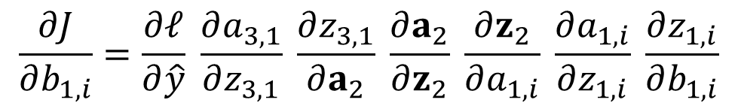





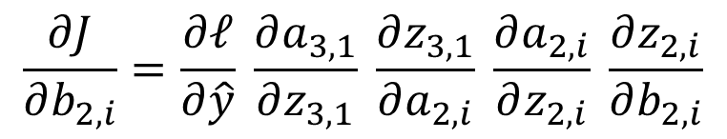







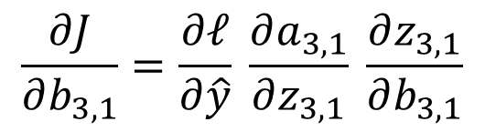







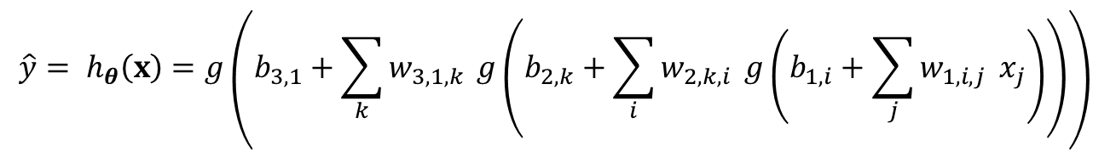





Optimization
$$\hat{y}= h_{θ}\left(x\right)=g\left(b_{3,1}+\sum_{k}{w_{3,1,k}} g\left(b_{2,k}+\sum_{i}{w_{2,k,i}} g\left(b_{1,i}+\sum_{j}{w_{1,i,j}} x_{j}\right)\right)\right)$$
Tons of repeated partial derivatives
$$z11$$
$$a11$$
$$x1$$
$$f$$
$$g$$
$$b11$$
$$z21$$
$$a21$$
$$f$$
$$g$$
$$z12$$
$$a12$$
$$b21$$
$$z31$$
$$\hat{y}$$
$$J$$
$$x2$$
$$f$$
$$g$$
$$f$$
$$g$$
$$ℓ$$
$$b12$$
$$z22$$
$$a22$$
$$b31$$
$$f$$
$$g$$
$$y$$
$$z13$$
$$a13$$
$$b22$$
$$\frac{∂J}{∂b_{3,1}}=\frac{∂ℓ}{∂\hat{y}} \frac{∂a_{3,1}}{∂z_{3,1}} \frac{∂z_{3,1}}{∂b_{3,1}}$$
$$x3$$
$$f$$
$$g$$
$$b13$$
$$\frac{∂J}{∂b_{2,i}}=\frac{∂ℓ}{∂\hat{y}} \frac{∂a_{3,1}}{∂z_{3,1}} \frac{∂z_{3,1}}{∂a_{2,i}} \frac{∂a_{2,i}}{∂z_{2,i}} \frac{∂z_{2,i}}{∂b_{2,i}}$$
$$\frac{∂J}{∂b_{1,i}}=\frac{∂ℓ}{∂\hat{y}} \frac{∂a_{3,1}}{∂z_{3,1}} \frac{∂z_{3,1}}{∂a_{2}} \frac{∂a_{2}}{∂z_{2}} \frac{∂z_{2}}{∂a_{1,i}} \frac{∂a_{1,i}}{∂z_{1,i}} \frac{∂z_{1,i}}{∂b_{1,i}}$$

Slide 7











Optimization
$$\hat{y}= h_{θ}\left(x\right)=g\left(b_{3,1}+\sum_{k}{w_{3,1,k}} g\left(b_{2,k}+\sum_{i}{w_{2,k,i}} g\left(b_{1,i}+\sum_{j}{w_{1,i,j}} x_{j}\right)\right)\right)$$
Tons of repeated partial derivatives
$$z11$$
$$a11$$
$$x1$$
$$f$$
$$g$$
$$b11$$
$$z21$$
$$a21$$
$$f$$
$$g$$
$$z12$$
$$a12$$
$$b21$$
$$z31$$
$$\hat{y}$$
$$J$$
$$x2$$
$$f$$
$$g$$
$$f$$
$$g$$
$$ℓ$$
$$b12$$
$$z22$$
$$a22$$
$$b31$$
$$f$$
$$g$$
$$y$$
$$z13$$
$$a13$$
$$b22$$
$$\frac{∂J}{∂b_{3,1}}=\frac{∂ℓ}{∂\hat{y}} \frac{∂a_{3,1}}{∂z_{3,1}} \frac{∂z_{3,1}}{∂b_{3,1}}$$
$$x3$$
$$f$$
$$g$$
$$b13$$
$$\frac{∂J}{∂b_{2,i}}=\frac{∂ℓ}{∂\hat{y}} \frac{∂a_{3,1}}{∂z_{3,1}} \frac{∂z_{3,1}}{∂a_{2,i}} \frac{∂a_{2,i}}{∂z_{2,i}} \frac{∂z_{2,i}}{∂b_{2,i}}$$
$$\frac{∂J}{∂b_{1,i}}=\frac{∂ℓ}{∂\hat{y}} \frac{∂a_{3,1}}{∂z_{3,1}} \frac{∂z_{3,1}}{∂a_{2}} \frac{∂a_{2}}{∂z_{2}} \frac{∂z_{2}}{∂a_{1,i}} \frac{∂a_{1,i}}{∂z_{1,i}} \frac{∂z_{1,i}}{∂b_{1,i}}$$

Slide 8
Calculus Time-out

Slide 9
Multivariate-chain rule

Slide 10
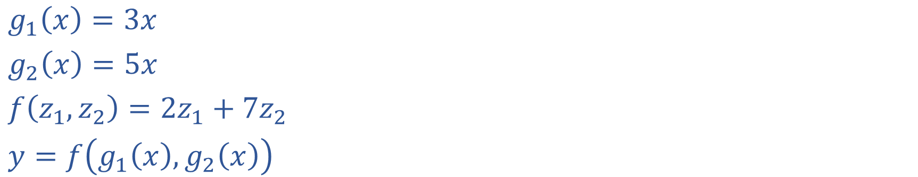
Multivariable Chain Rule
$g_{1}\left(x\right)=3x$
$g_{2}\left(x\right)=5x$
$f\left(z_{1}, z_{2}\right)={2z}_{1}+{7z}_{2}$
$y=f\left(g_{1}\left(x\right),g_{2}\left(x\right)\right)$

Slide 11
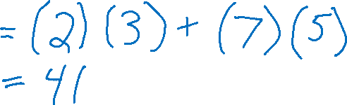
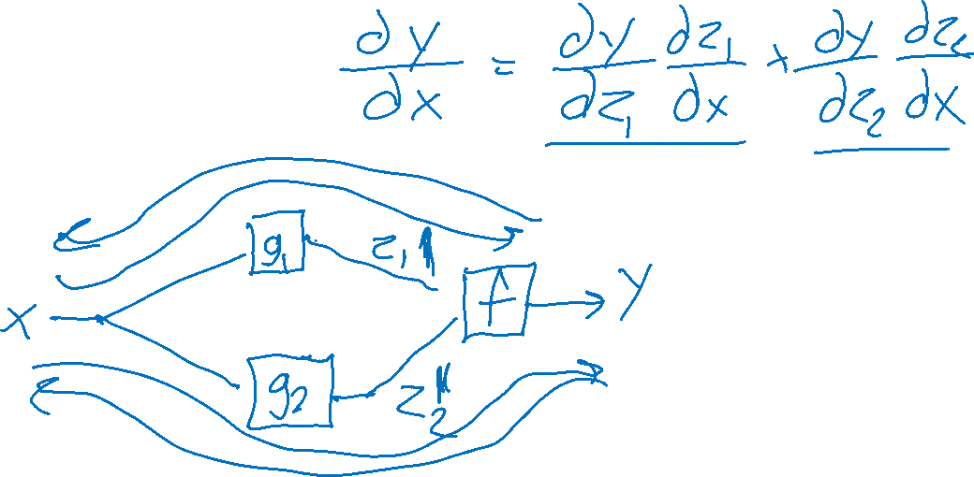
Multivariable Chain Rule
$g_{1}\left(x\right)=3x$
$g_{2}\left(x\right)=5x$
$f\left(z_{1}, z_{2}\right)={2z}_{1}+{7z}_{2}$
$y=f\left(g_{1}\left(x\right),g_{2}\left(x\right)\right)$

Slide 12
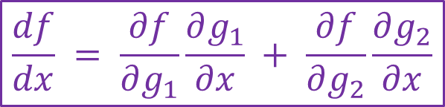
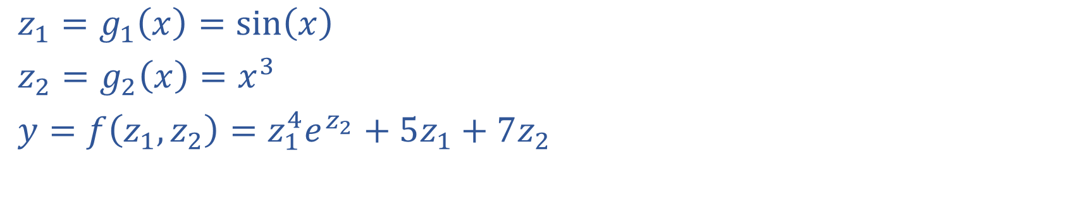
Exercise: Multivariable Chain Rule
$$\frac{df}{dx} = \frac{∂f}{∂g_{1}}\frac{∂g_{1}}{∂x} + \frac{∂f}{∂g_{2}}\frac{∂g_{2}}{∂x}$$
$z_{1}=g_{1}\left(x\right)=sin\left(x\right)$
$z_{2}=g_{2}\left(x\right)=x^{3}$
$y=f\left(z_{1}, z_{2}\right)=z_{1}^{4}e^{z_{2}}+5z_{1}+7z_{2}$

Slide 13
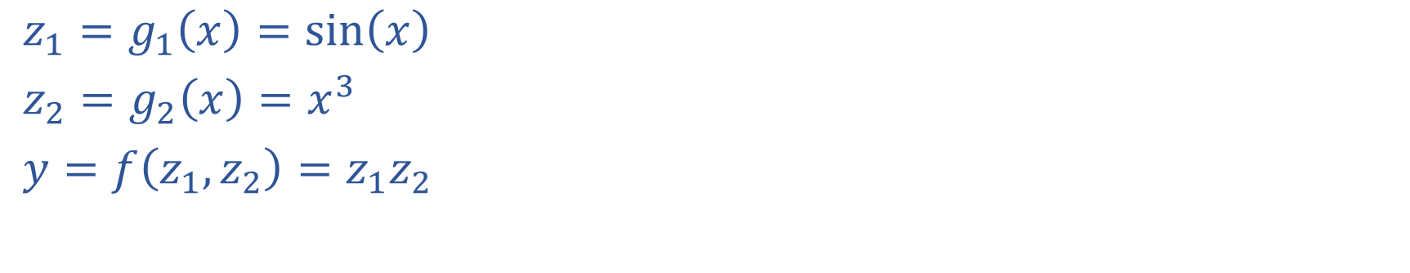
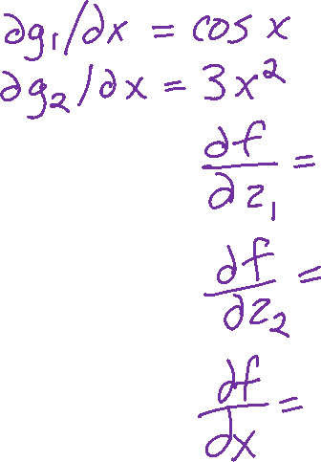
Multivariable Chain Rule
$$\frac{df}{dx} = \frac{∂f}{∂g_{1}}\frac{∂g_{1}}{∂x} + \frac{∂f}{∂g_{2}}\frac{∂g_{2}}{∂x}$$
$z_{1}=g_{1}\left(x\right)=sin\left(x\right)$
$z_{2}=g_{2}\left(x\right)=x^{3}$
$y=f\left(z_{1}, z_{2}\right)=z_{1}z_{2}$

Slide 14
Calculus Chain Rule
Scalar:
$y=f\left(z\right)$
$z=g\left(x\right)$
$\frac{dy}{dx}=\frac{dy}{dz}\frac{dz}{dx}$
Multivariate:
$y=f\left(z\right)$
$z=g\left(x\right)$
$\frac{dy}{dx}=\sum_{j}{\frac{∂y}{∂z_{j}}\frac{∂z_{j}}{∂x}}$
Multivariate:
$y=f\left(z\right)$
$z=g\left(x\right)$
$\frac{dy_{i}}{dx_{k}}=\sum_{j}{\frac{∂y_{i}}{∂z_{j}}\frac{∂z_{j}}{∂x_{k}}}$

Slide 15
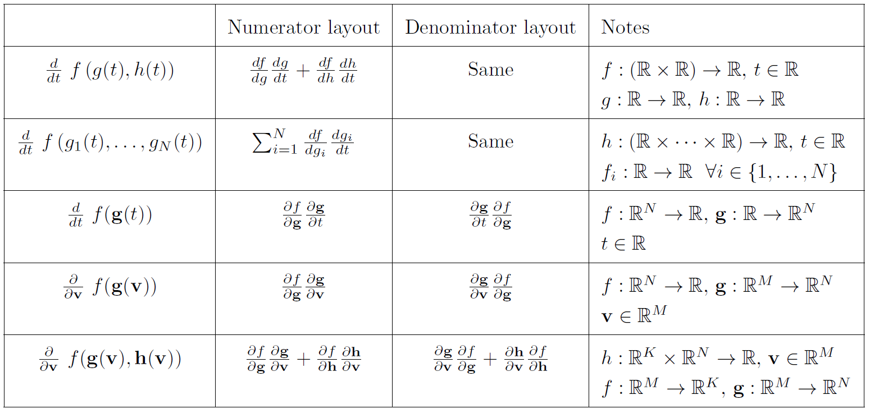
Multivariable Chain Rule

Slide 16
Backpropagation (vector version)

Slide 17
Network Optimization
$$\frac{∂J}{∂w_{E}}=\frac{∂J}{∂z_{4}}\frac{∂z_{4}}{∂w_{E}}$$
$$\frac{∂J}{∂w_{D}}=\frac{∂J}{∂z_{4}}\frac{∂z_{4}}{∂w_{D}}$$
$$\frac{∂J}{∂z_{3}}=\frac{∂J}{∂z_{4}}\frac{∂z_{4}}{∂z_{3}}$$
$$\frac{∂J}{∂z_{2}}=\frac{∂J}{∂z_{4}}\frac{∂z_{4}}{∂z_{2}}$$
$$\frac{∂J}{∂w_{C}}=\frac{∂J}{∂z_{3}}\frac{∂z_{3}}{∂w_{C}}$$
$$\frac{∂J}{∂w_{B}}=\frac{∂J}{∂z_{2}}\frac{∂z_{2}}{∂w_{B}}$$
$$\frac{∂J}{∂z_{1}}=\frac{∂J}{∂z_{2}}\frac{∂z_{2}}{∂z_{1}}+ \frac{∂J}{∂z_{3}}\frac{∂z_{3}}{∂z_{1}}$$
$$\frac{∂J}{∂w_{A}}=\frac{∂J}{∂z_{1}}\frac{∂z_{1}}{∂w_{A}}$$
$J\left(w\right)=z_{4}$
${z_{4}=f}_{4}\left(w_{D}, w_{E}, z_{2},z_{3}\right)$
$z_{3}=f_{3}\left(w_{C}, z_{1}\right)$
$z_{2}=f_{2}\left(w_{B}, z_{1}\right)$
$z_{1}=f_{1}\left(w_{A}, x\right)$
Need multivariate chain rule!
$$z_{2}$$
$$f_{2}$$
$$z_{1}$$
$$z_{4}$$
$$x$$
$$f_{1}$$
$$f_{4}$$
$$z_{3}$$
$$f_{3}$$

Slide 18

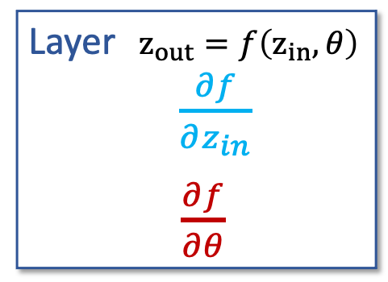

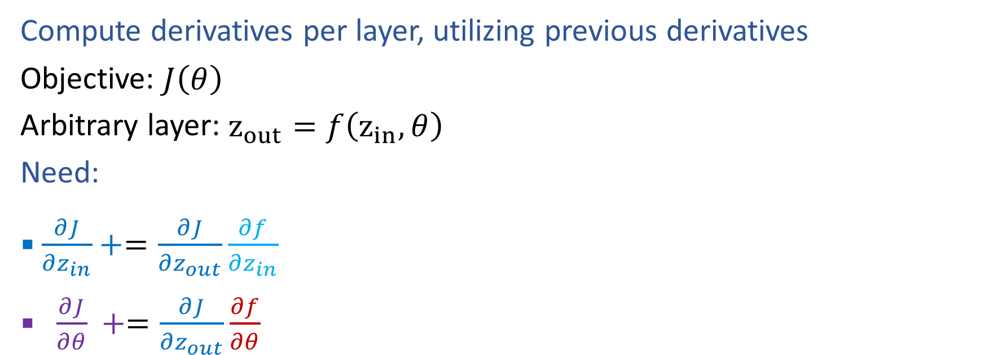




Generic Layer Implementation (updated)
Compute derivatives per layer, utilizing previous derivatives
Objective: $J\left(θ\right)$
Arbitrary layer: $z_{out}=f\left(z_{in}, θ\right)$
Need:
$\frac{∂J}{∂z_{in}}+=\frac{∂J}{∂z_{out}}\frac{∂f}{∂z_{in}}$
$\frac{∂J}{∂θ} +=\frac{∂J}{∂z_{out}}\frac{∂f}{∂θ}$
$$zout$$
$$zin$$
$$J$$
$$f$$
$$θ$$
$$z_{in}$$
Layer $z_{out}=f\left(z_{in}, θ\right)$
$\frac{∂f}{∂z_{in}}$
$\frac{∂f}{∂θ}$
$$z_{out}$$
$$\frac{∂J}{∂z_{in}}$$
$$\frac{∂J}{∂z_{out}}$$
$$θ$$
$$\frac{∂J}{∂θ}$$

Slide 19
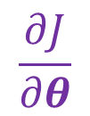

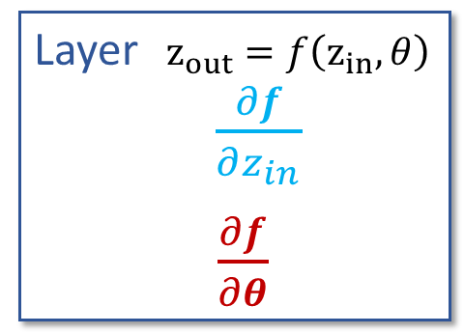





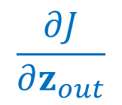


Generic Layer Implementation (vector output version)
Compute derivatives per layer, utilizing previous derivatives
Objective: $J\left(θ\right)$
Arbitrary layer: $z_{out}=f\left(z_{in}, θ\right)$
Need:
$\frac{∂J}{∂z_{in}}=$
$\frac{∂J}{∂θ_{j}} =$
$$zin$$
$$zout∈ℝ^{K}$$
$$J$$
$$f$$
$$θ∈ℝ^{M}$$
$$z_{in}$$
Layer $z_{out}=f\left(z_{in}, θ\right)$
$\frac{∂f}{∂z_{in}}$
$\frac{∂f}{∂θ}$
$$z_{out}$$
$$\frac{∂J}{∂z_{in}}$$
$$\frac{∂J}{∂z_{out}}$$
$$θ$$
$$\frac{∂J}{∂θ}$$

Slide 20

Generic Layer Implementation (vector output version)
Compute derivatives per layer, utilizing previous derivatives
Objective: $J\left(θ\right)$
Arbitrary layer: $z_{out}=f\left(z_{in}, θ\right)$
Need:
$\frac{∂J}{∂z_{in}}=\sum_{k}{\frac{∂J}{∂z_{out,k}}\frac{∂z_{out,k}}{∂z_{in}}}$
$\frac{∂J}{∂θ_{j}} =\sum_{k}{\frac{∂J}{∂z_{out,k}}\frac{∂f}{∂θ_{j}}}$
$$zin$$
$$zout∈ℝ^{K}$$
$$J$$
$$f$$
$$θ∈ℝ^{M}$$
$$z_{in}$$
Layer $z_{out}=f\left(z_{in}, θ\right)$
$\frac{∂f}{∂z_{in}}$
$\frac{∂f}{∂θ}$
$$z_{out}$$
$$\frac{∂J}{∂z_{in}}$$
$$\frac{∂J}{∂z_{out}}$$
$$θ$$
$$\frac{∂J}{∂θ}$$

Slide 21
Optimization
$$\hat{y}= h_{θ}\left(x\right)=g\left(b_{3,1}+\sum_{k}{w_{3,1,k}} g\left(b_{2,k}+\sum_{i}{w_{2,k,i}} g\left(b_{1,i}+\sum_{j}{w_{1,i,j}} x_{j}\right)\right)\right)$$
Where do we need chain rule?
$$z11$$
$$a11$$
$$x1$$
$$f$$
$$g$$
$$b11$$
$$z21$$
$$a21$$
$$f$$
$$g$$
$$z12$$
$$a12$$
$$b21$$
$$z31$$
$$\hat{y}$$
$$J$$
$$x2$$
$$f$$
$$g$$
$$f$$
$$g$$
$$ℓ$$
$$b12$$
$$z22$$
$$a22$$
$$b31$$
$$f$$
$$g$$
$$y$$
$$z13$$
$$a13$$
$$b22$$
$$\frac{∂J}{∂b_{3,1}}=\frac{∂ℓ}{∂\hat{y}} \frac{∂a_{3,1}}{∂z_{3,1}} \frac{∂z_{3,1}}{∂b_{3,1}}$$
$$x3$$
$$f$$
$$g$$
$$b13$$
$$\frac{∂J}{∂b_{2,i}}=\frac{∂ℓ}{∂\hat{y}} \frac{∂a_{3,1}}{∂z_{3,1}} \frac{∂z_{3,1}}{∂a_{2,i}} \frac{∂a_{2,i}}{∂z_{2,i}} \frac{∂z_{2,i}}{∂b_{2,i}}$$
$$\frac{∂J}{∂b_{1,i}}=\frac{∂ℓ}{∂\hat{y}} \frac{∂a_{3,1}}{∂z_{3,1}} \frac{∂z_{3,1}}{∂a_{2}} \frac{∂a_{2}}{∂z_{2}} \frac{∂z_{2}}{∂a_{1,i}} \frac{∂a_{1,i}}{∂z_{1,i}} \frac{∂z_{1,i}}{∂b_{1,i}}$$

Slide 22



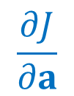


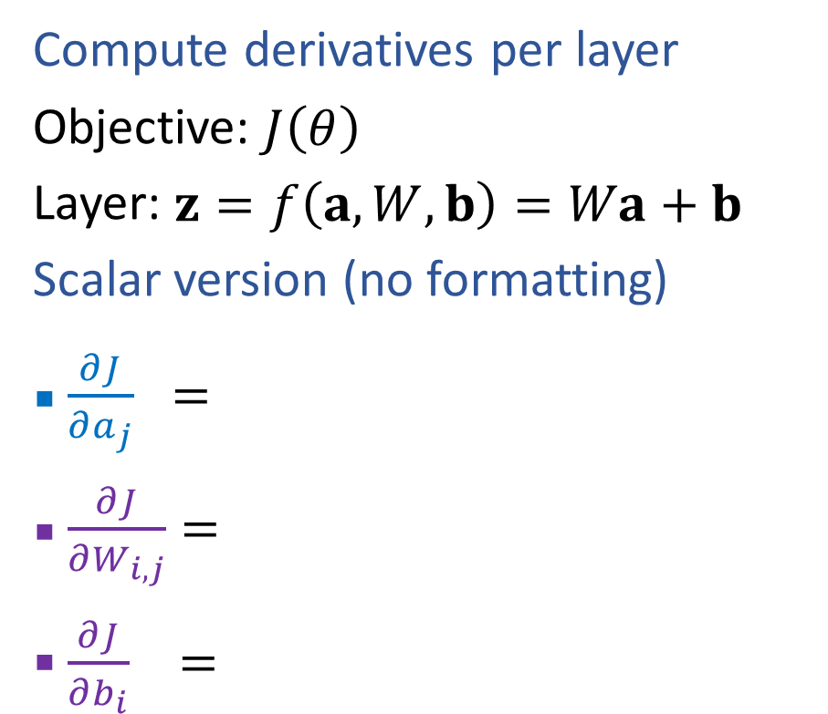






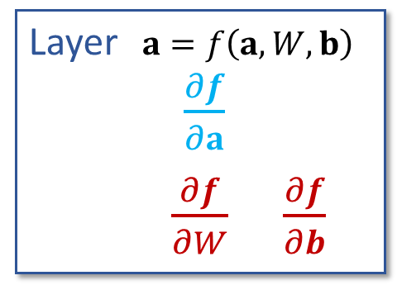
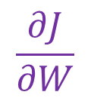

Linear Layer Implementation
$$a∈ℝ^{M}$$
$$z∈ℝ^{K}$$
$$J$$
$$f$$
$$W∈ℝ^{K×M}, b∈ℝ^{K}$$
Compute derivatives per layer
Objective: $J\left(θ\right)$
Layer: $z=f\left(a, W,b\right)=Wa+b$
Scalar version (no formatting)
$\frac{∂J}{∂a_{j}} =$
$\frac{∂J}{∂W_{i,j}}=$
$\frac{∂J}{∂b_{i}} =$
$$a$$
Layer $a=f\left(a, W,b\right)$
$\frac{∂f}{∂a}$
$\frac{∂f}{∂W}$ $\frac{∂f}{∂b}$
$$z$$
$$\frac{∂J}{∂a}$$
$$\frac{∂J}{∂z}$$
$$W b$$
$$\frac{∂J}{∂W}$$
$$\frac{∂J}{∂b}$$
$$z=Wa+b$$
$z_{k}=b_{k}+\sum_{j}{W_{k,j}a_{j}}$

Slide 23
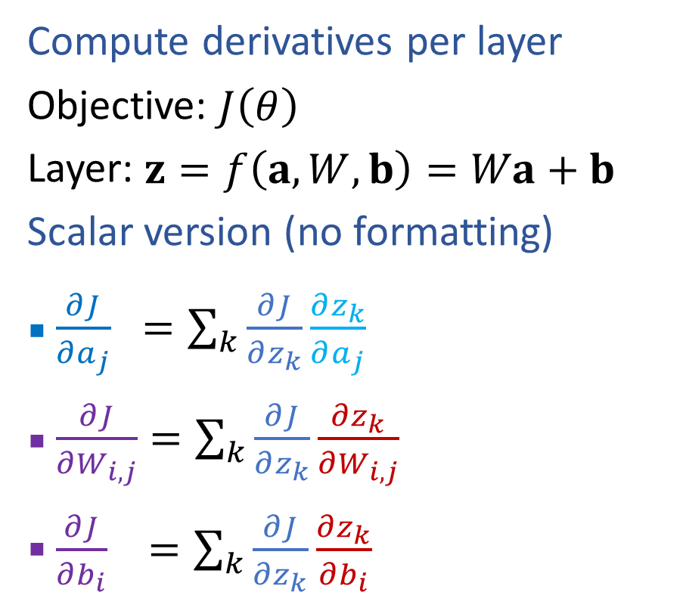
Linear Layer Implementation
$$a∈ℝ^{M}$$
$$z∈ℝ^{K}$$
$$J$$
$$f$$
$$W∈ℝ^{K×M}, b∈ℝ^{K}$$
Compute derivatives per layer
Objective: $J\left(θ\right)$
Layer: $z=f\left(a, W,b\right)=Wa+b$
Scalar version (no formatting)
$\frac{∂J}{∂a_{j}} =\sum_{k}{\frac{∂J}{∂z_{k}}}\frac{∂z_{k}}{∂a_{j}}$
$\frac{∂J}{∂W_{i,j}}=\sum_{k}{\frac{∂J}{∂z_{k}}}\frac{∂z_{k}}{∂W_{i,j}}$
$\frac{∂J}{∂b_{i}} =\sum_{k}{\frac{∂J}{∂z_{k}}}\frac{∂z_{k}}{∂b_{i}}$
$$a$$
Layer $a=f\left(a, W,b\right)$
$\frac{∂f}{∂a}$
$\frac{∂f}{∂W}$ $\frac{∂f}{∂b}$
$$z$$
$$\frac{∂J}{∂a}$$
$$\frac{∂J}{∂z}$$
$$W b$$
$$\frac{∂J}{∂W}$$
$$\frac{∂J}{∂b}$$
$$z=Wa+b$$
$z_{k}=b_{k}+\sum_{j}{W_{k,j}a_{j}}$

Slide 24
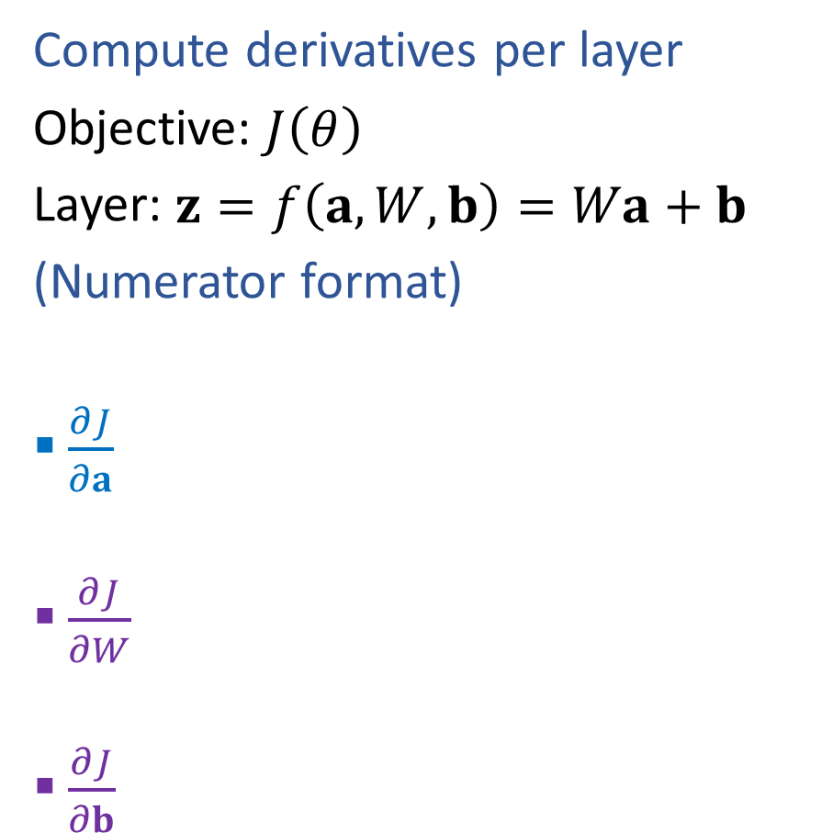


Linear Layer Implementation
$$a∈ℝ^{M}$$
$$z∈ℝ^{K}$$
$$J$$
$$f$$
$$W∈ℝ^{K×M}, b∈ℝ^{K}$$
Compute derivatives per layer
Objective: $J\left(θ\right)$
Layer: $z=f\left(a, W,b\right)=Wa+b$
(Numerator format)
$\frac{∂J}{∂a}$
$\frac{∂J}{∂W}$
$\frac{∂J}{∂b}$
$$a$$
Layer $z=f\left(a, W,b\right)$
$\frac{∂f}{∂a}$
$\frac{∂f}{∂W}$ $\frac{∂f}{∂b}$
$$z$$
$$\frac{∂J}{∂a}$$
$$\frac{∂J}{∂z}$$
$$W b$$
$$\frac{∂J}{∂W}$$
$$\frac{∂J}{∂b}$$

Slide 25





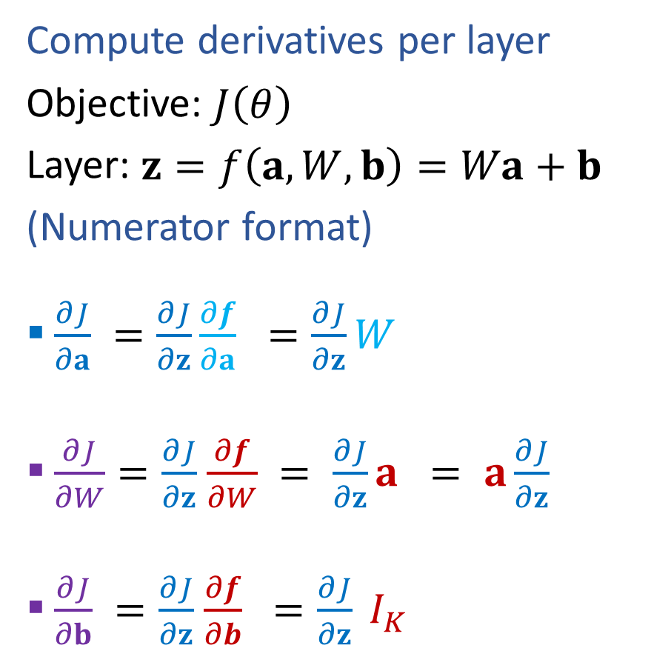












Linear Layer Implementation
$$a∈ℝ^{M}$$
$$z∈ℝ^{K}$$
$$J$$
$$f$$
$$W∈ℝ^{K×M}, b∈ℝ^{K}$$
Compute derivatives per layer
Objective: $J\left(θ\right)$
Layer: $z=f\left(a, W,b\right)=Wa+b$
(Numerator format)
$\frac{∂J}{∂a} =\frac{∂J}{∂z}\frac{∂f}{∂a} =\frac{∂J}{∂z}W$
$\frac{∂J}{∂W}=\frac{∂J}{∂z}$ $\frac{∂f}{∂W} = \frac{∂J}{∂z}a = a\frac{∂J}{∂z}$
$\frac{∂J}{∂b} =\frac{∂J}{∂z}$ $\frac{∂f}{∂b} =\frac{∂J}{∂z} I_{K}$
$$a$$
Layer $z=f\left(a, W,b\right)$
$\frac{∂f}{∂a}$
$\frac{∂f}{∂W}$ $\frac{∂f}{∂b}$
$$z$$
$$\frac{∂J}{∂a}$$
$$\frac{∂J}{∂z}$$
$$[1×M]$$
$$[1×K]$$
$$[K×M]$$
$$[1×K]$$
$$[K×M]$$
Fixed dimensions to be outer product
Broken!
$$[M×K]$$
$$[1×K]$$
$$[ ? × ?]$$
$$[1×K]$$
$$[M×1]$$
$$[M×1]$$
$$[1×K]$$
$$W b$$
$$\frac{∂J}{∂W}$$
$$\frac{∂J}{∂b}$$
$$[1×M]$$
$$[1×K]$$
$$[K×K]$$
$$[1×K]$$
$$[K×K]$$

Slide 26
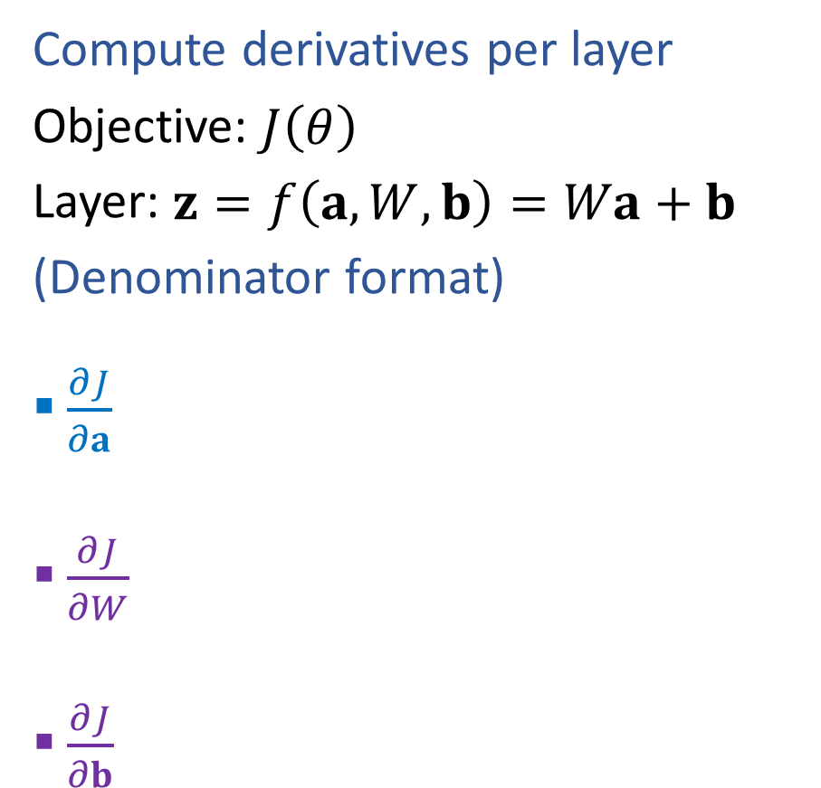
Linear Layer Implementation
$$a∈ℝ^{M}$$
$$z∈ℝ^{K}$$
$$J$$
$$f$$
$$W∈ℝ^{K×M}, b∈ℝ^{K}$$
Compute derivatives per layer
Objective: $J\left(θ\right)$
Layer: $z=f\left(a, W,b\right)=Wa+b$
(Denominator format)
$\frac{∂J}{∂a}$
$\frac{∂J}{∂W}$
$\frac{∂J}{∂b}$
$$a$$
Layer $z=f\left(a, W,b\right)$
$\frac{∂f}{∂a}$
$\frac{∂f}{∂W}$ $\frac{∂f}{∂b}$
$$z$$
$$\frac{∂J}{∂a}$$
$$\frac{∂J}{∂z}$$
$$W b$$
$$\frac{∂J}{∂W}$$
$$\frac{∂J}{∂b}$$

Slide 27





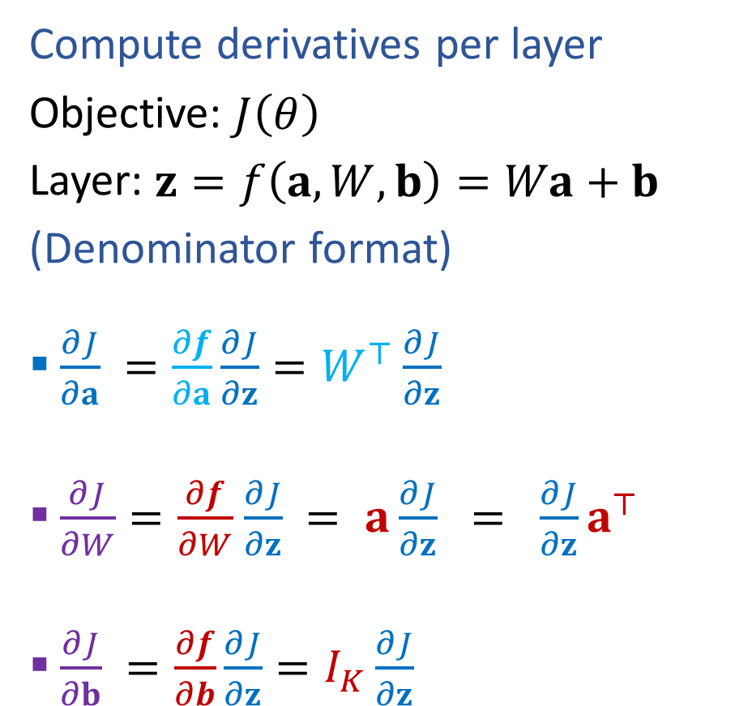












Linear Layer Implementation
$$a∈ℝ^{M}$$
$$z∈ℝ^{K}$$
$$J$$
$$f$$
$$W∈ℝ^{K×M}, b∈ℝ^{K}$$
Compute derivatives per layer
Objective: $J\left(θ\right)$
Layer: $z=f\left(a, W,b\right)=Wa+b$
(Denominator format)
$\frac{∂J}{∂a} =\frac{∂f}{∂a}\frac{∂J}{∂z}=W^{⊤}\frac{∂J}{∂z}$
$\frac{∂J}{∂W}=\frac{∂f}{∂W}$ $\frac{∂J}{∂z} = a\frac{∂J}{∂z} = \frac{∂J}{∂z}a^{⊤}$
$\frac{∂J}{∂b} =\frac{∂f}{∂b}\frac{∂J}{∂z}=I_{K}\frac{∂J}{∂z}$
$$a$$
Layer $z=f\left(a, W,b\right)$
$\frac{∂f}{∂a}$
$\frac{∂f}{∂W}$ $\frac{∂f}{∂b}$
$$z$$
$$\frac{∂J}{∂a}$$
$$\frac{∂J}{∂z}$$
$$[M×1]$$
$$[M×K]$$
$$[K×1]$$
$$[M×K]$$
$$[K×1]$$
Fixed dimensions to be outer product
Broken!
$$[K×M]$$
$$[ ? × ? ]$$
$$[K×1]$$
$$[M×1]$$
$$[K×1]$$
$$[K×1]$$
$$[1×M]$$
$$W b$$
$$\frac{∂J}{∂W}$$
$$\frac{∂J}{∂b}$$
$$[M×1]$$
$$[K×K]$$
$$[K×1]$$
$$[K×K]$$
$$[K×1]$$

Slide 28
Optimization Intuition

Slide 29
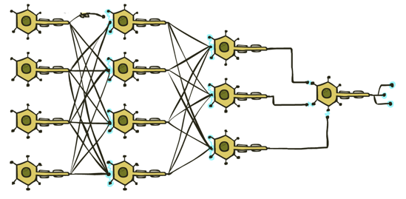
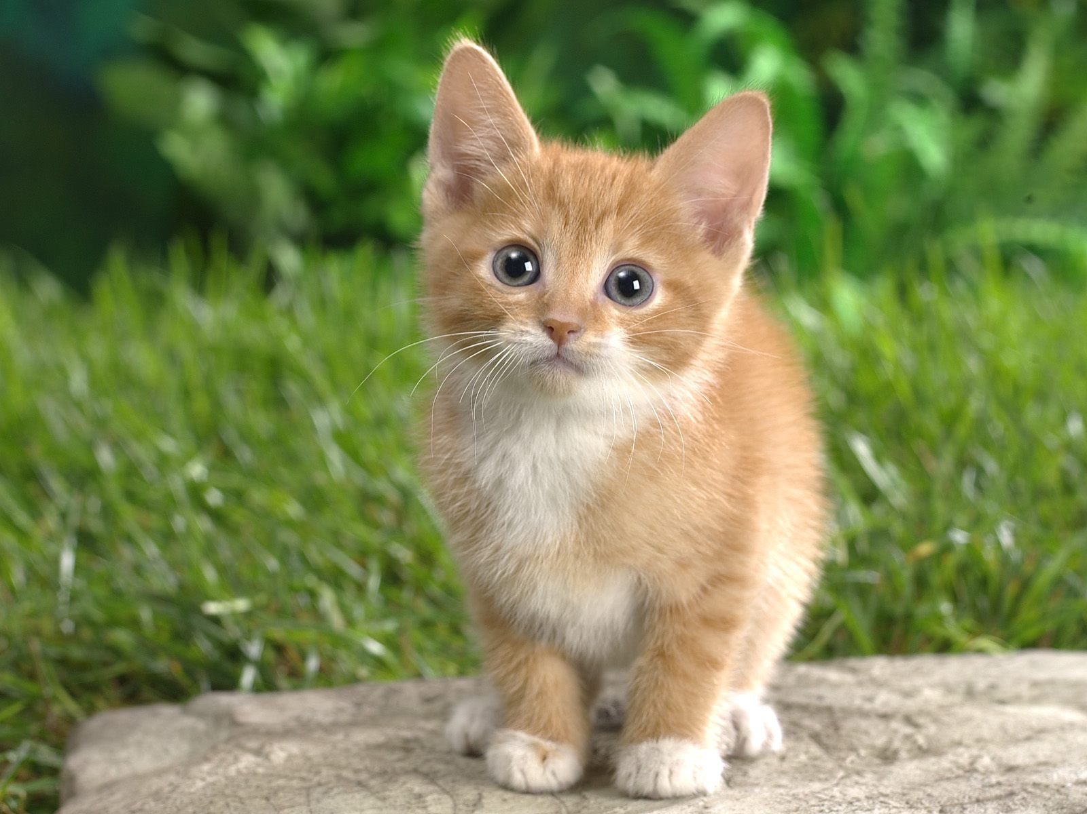


Neural Networks
Output
Signal
Many layers of neurons, millions of parameters
$$\hat{y}$$
Input Signal
DOG
CAT
TREE
CAR
SKY

Slide 30
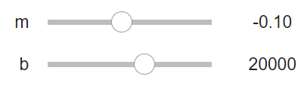
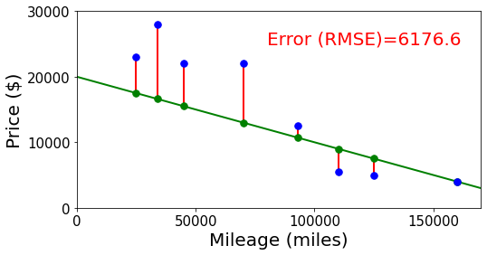
Neural Networks
Building on optimization for linear and logistic regression
Selling my car

Slide 31
Neural Networks
Output
Signal
Many layers of neurons, millions of parameters
$$\hat{y}$$
Input Signal
DOG
CAT
TREE
CAR
SKY

Slide 32






Neural Networks
Output
Signal
Many layers of neurons, millions of parameters
$$\hat{y}$$
$$y$$
Input Signal
DOG
CAT
TREE
CAR
SKY
$$0$$
$$1$$
$$0$$
$$0$$
$$0$$

Slide 33
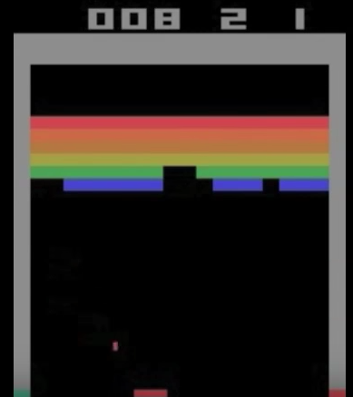
Neural Networks
Output
Signal
Many layers of neurons, millions of parameters
$$\hat{y}$$
Input Signal
LEFT
RIGHT
UP
DOWN
BUTTON

Slide 34
Outline
Last time: Neural Networks
Three-neuron network + optimization
Neural network structure (adding more neurons)
Forward pass and Backpropagation (scalar version)
Today: Neural Networks
Calculus: multi-variate chain rule
Backpropagation (vector version)
Optimization intuition (sliders)
Neural Network Properties and Intuition

Slide 35
Neural Network Properties

Slide 36
Neural Networks Properties
Practical considerations
Large number of neurons
Danger for overfitting
Modeling assumptions vs data assumptions trade-off
Gradient descent can easily get stuck local optima
What if there are no non-linear activations?
A deep neural network with only linear layers can be reduced to an exactly equivalent single linear layer
Universal Approximation Theorem:
A two-layer neural network with a sufficient number of neurons can approximate any continuous function to any desired accuracy.

Slide 37
Neural Networks Properties
Non-linearity
Fitting complex functions
Fitting any! function (universal approximation theorem)
Overfitting

Slide 38
Neural Network Properties
Non-linearity

Slide 39
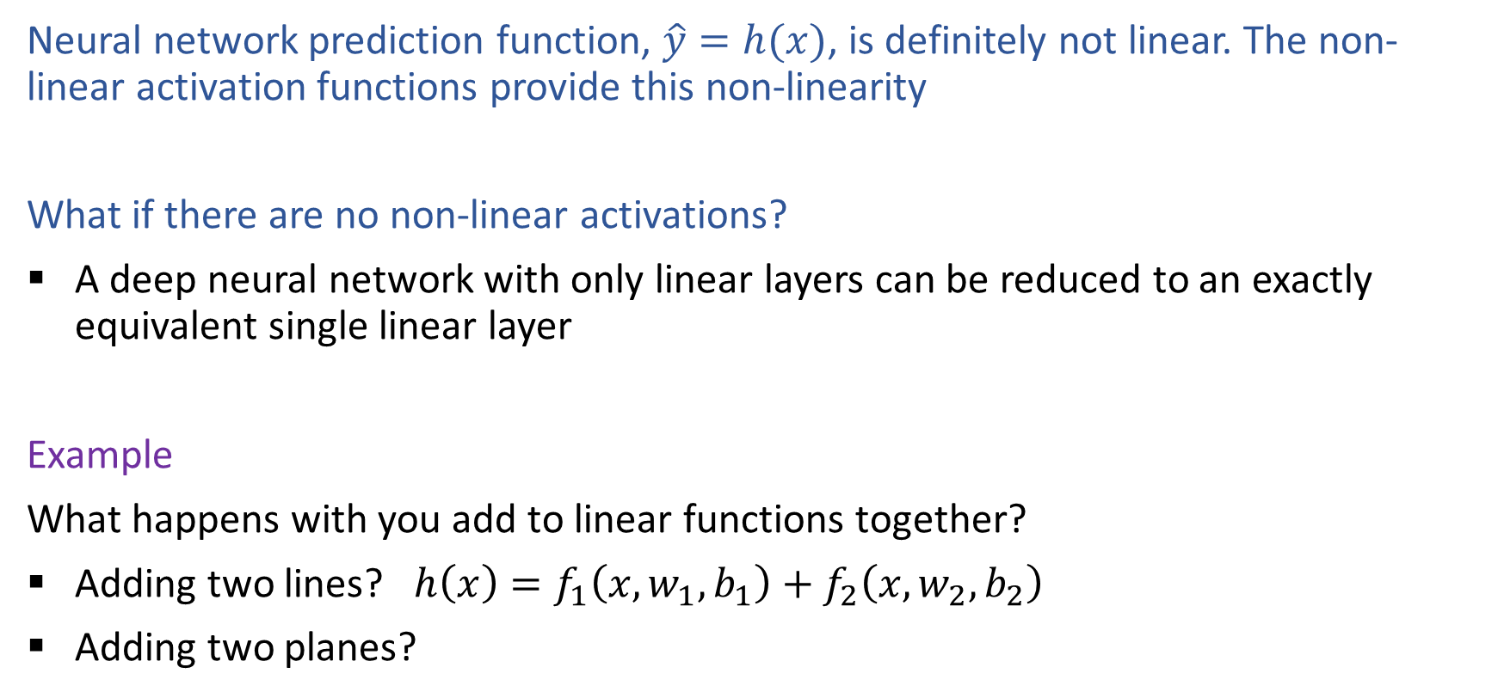
Non-linearity
Neural network prediction function, $\hat{y}=h(x)$, is definitely not linear. The non-linear activation functions provide this non-linearity
What if there are no non-linear activations?
A deep neural network with only linear layers can be reduced to an exactly equivalent single linear layer
Example
What happens with you add to linear functions together?
Adding two lines? $h\left(x\right)=f_{1}\left(x, w_{1},b_{1}\right)+f_{2}\left(x, w_{2}, b_{2}\right)$
Adding two planes?

Slide 40
Objective Function is Not Convex
Objective function for… | Convex? | Closed-form solution?
Linear regression
Logistic regression
Neural networks

Slide 41
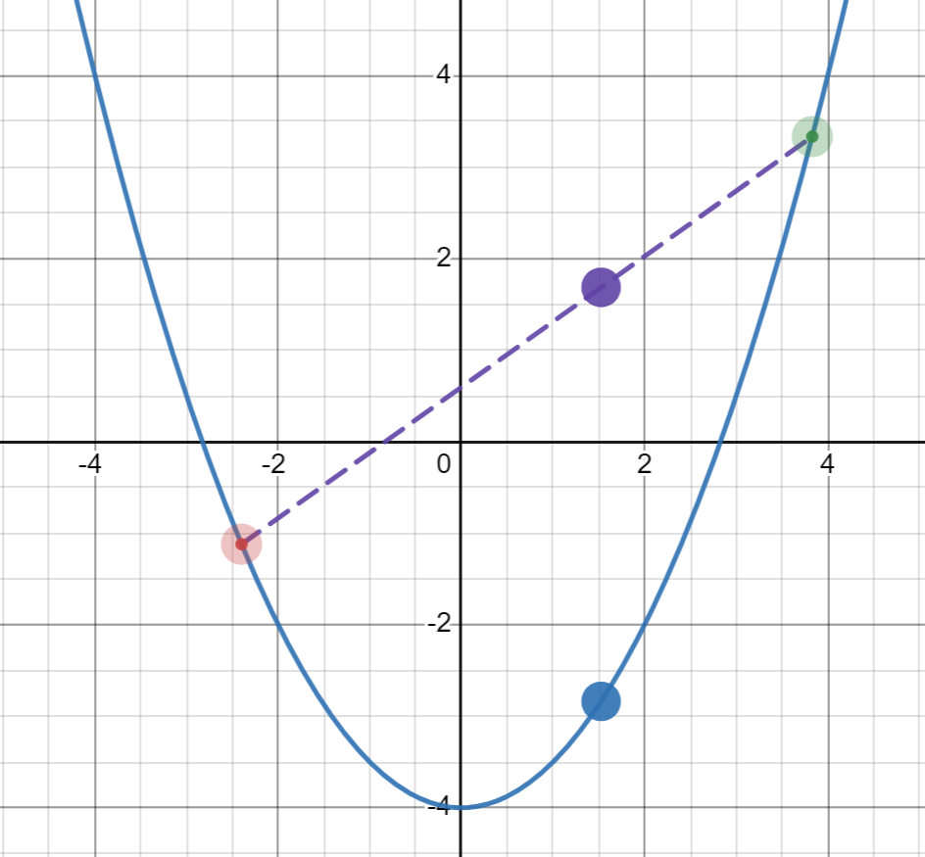

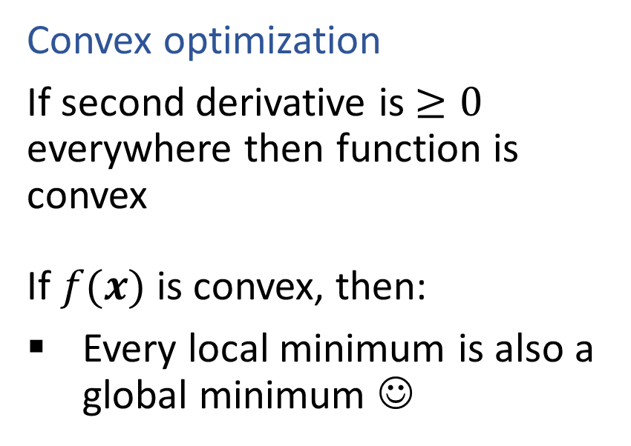
Optimization
Convex function
If $f(x)$ is convex, then:
$f\left(αx+\left(1−α\right)z\right)≤αf\left(x\right)+\left(1−α\right)f\left(z\right)$ $∀ 0≤α≤1$
Convex optimization
If second derivative is $≥0$ everywhere then function is convex
If $f(x)$ is convex, then:
Every local minimum is also a global minimum ☺

Slide 42
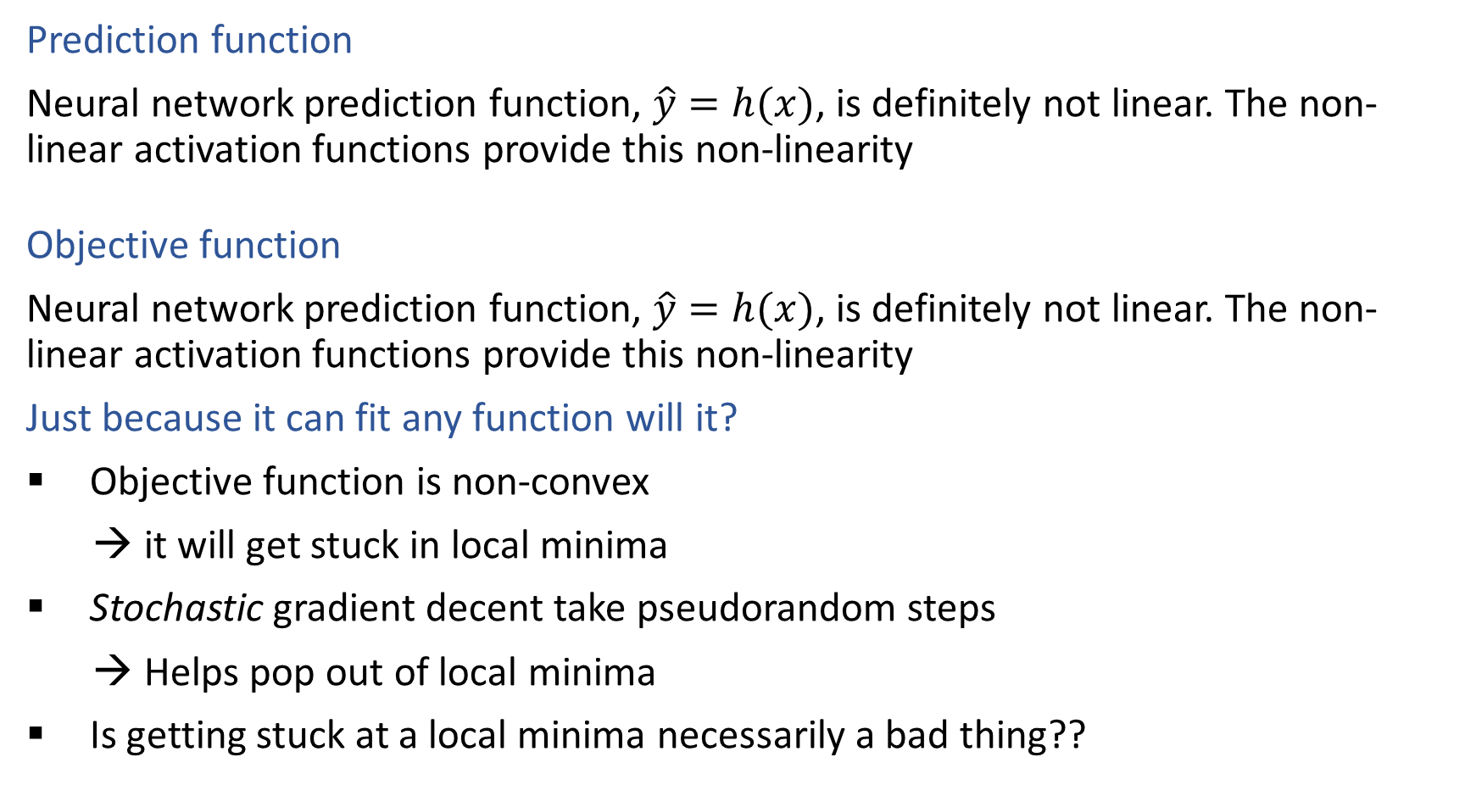
Non-linearity
Prediction function
Neural network prediction function, $\hat{y}=h(x)$, is definitely not linear. The non-linear activation functions provide this non-linearity
Objective function
Neural network prediction function, $\hat{y}=h(x)$, is definitely not linear. The non-linear activation functions provide this non-linearity
Just because it can fit any function will it?
Objective function is non-convex
→ it will get stuck in local minima
Stochastic gradient decent take pseudorandom steps
→ Helps pop out of local minima
Is getting stuck at a local minima necessarily a bad thing??

Slide 43
Neural Network Properties
Fitting complex functions (with 1-D input)

Slide 44
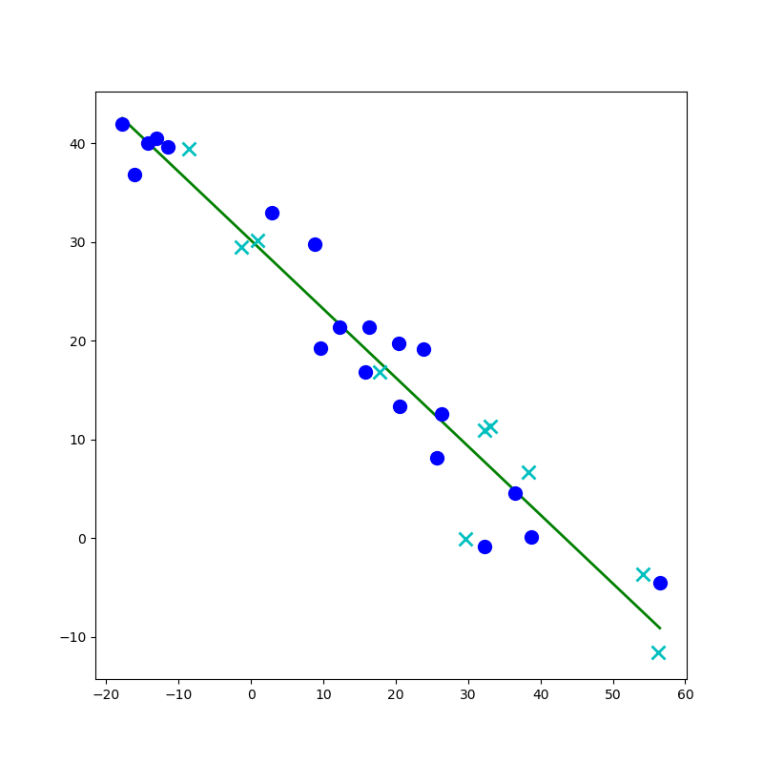
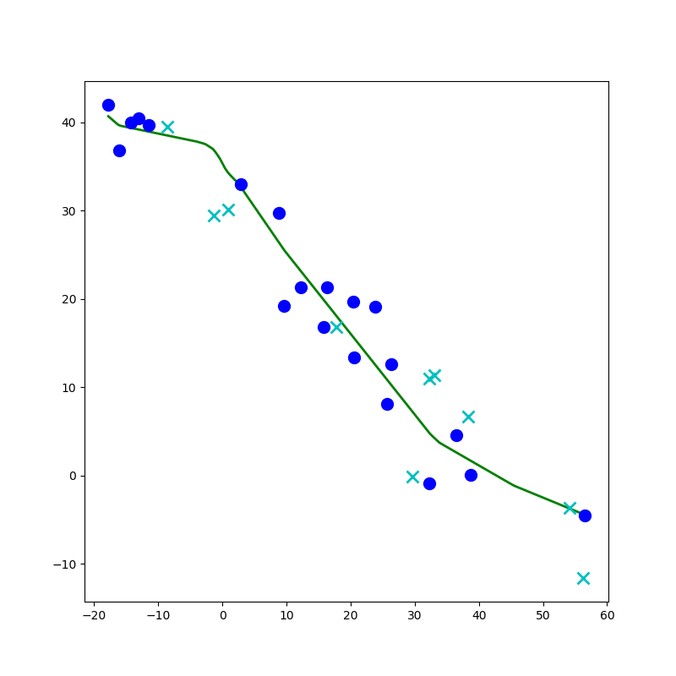
Network to Approximate a 1-D Function

Slide 45
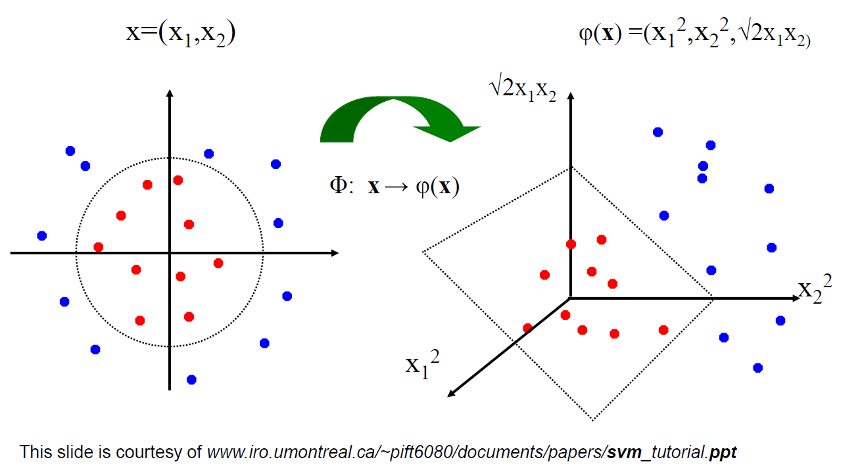
Linear Classifiers for Nonlinear Data
Linear classifiers have linear decision boundaries
Feature mapping can convert nonlinear data to higher dimensions
Today, instead of choosing a feature mapping function, we’ll use neural networks to learn nonlinear decision boundaries.
We’ll quickly shift this to doing nonlinear regression too!

Slide 46
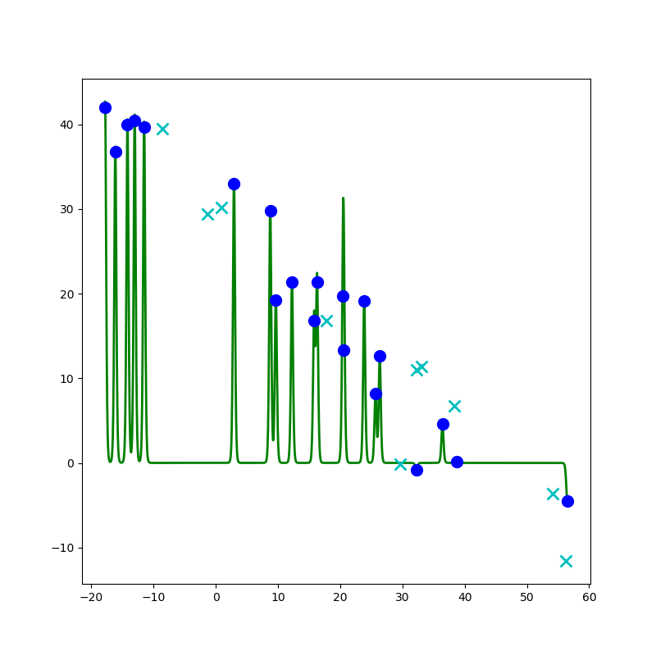
Network to Approximate a 1-D Function

Slide 47
Network to Approximate a 1-D Function
Design a network to approximate this function using:
Linear, Sigmoid, Step, or ReLU

Slide 48
Network to Approximate a 1-D Function

Slide 49
Neural Network Properties
Fitting complex functions (with 2-D input)

Slide 50



Classification Design Challenge
$$h_{A}\left(x\right)=sign\left(w_{A}^{T}x+b_{A}\right)$$
$$h_{B}\left(x\right)=sign\left(w_{B}^{T}x+b_{B}\right)$$
$$h_{C}\left(x\right)=sign\left(w_{C}^{T}x+b_{C}\right)$$
How could you configure three specific perceptrons to classify this data?
$$x2$$
$$x1$$

Slide 51





Perceptron
$$sign\left(z\right)= \left\{\begin{aligned}1, if z≥0 \\ −1, if z<0\end{aligned}\right.$$
Classification: Hard threshold on linear model
$$h\left(x\right)=sign\left(w^{T}x+b\right)$$

Slide 52

Perceptron History
Frank Rosenblatt, 1957

Slide 53




Exercise
$h\left(x\right)=sign\left(w^{T}x+b\right)$
$sign\left(z\right)= \left\{\begin{aligned}1, if z≥0 \\ −1, if z<0\end{aligned}\right.$
Which of the following perceptron parameters will perfectly classify this data?
$w=\left[\begin{aligned}1 \\ 1\end{aligned}\right], b=0$
$w=\left[\begin{aligned}−1 \\ 1\end{aligned}\right], b=0$
$w=\left[\begin{aligned}1 \\ −1\end{aligned}\right], b=0$
$w=\left[\begin{aligned}−1 \\ −1\end{aligned}\right], b=0$
None of the above
$$x2$$
$$x1$$

Slide 54
Poll
$h\left(x\right)=sign\left(w^{T}x+b\right)$
$sign\left(z\right)= \left\{\begin{aligned}1, if z≥0 \\ −1, if z<0\end{aligned}\right.$
Which of the following perceptron parameters will perfectly classify this data?
$w=\left[\begin{aligned}1 \\ 1\end{aligned}\right], b=0$
$w=\left[\begin{aligned}−1 \\ 1\end{aligned}\right], b=0$
$w=\left[\begin{aligned}1 \\ −1\end{aligned}\right], b=0$
$w=\left[\begin{aligned}−1 \\ −1\end{aligned}\right], b=0$
None of the above
$$x2$$
$$x1$$

Slide 55




Poll
$$h_{C}\left(z\right)=sign\left(w_{C}^{T}z+b_{C}\right)$$
$sign\left(x\right)= \left\{\begin{aligned}1, if x≥0 \\ −1, if x<0\end{aligned}\right.$
Which of the following parameters of $h_{C}\left(z\right)$ will perfectly classify this data?
$w_{C}=\left[\begin{aligned}1 \\ 1\end{aligned}\right], b_{C}=0$
$w_{C}=\left[\begin{aligned}1 \\ 1\end{aligned}\right], b_{C}=1$
$w_{C}=\left[\begin{aligned}1 \\ 1\end{aligned}\right], b_{C}=−1$
None of the above
$$z2$$
$$z1$$

Slide 56
Classification Design Challenge
$$h_{A}\left(x\right)=sign\left(w_{A}^{T}x+b_{A}\right)$$
$$h_{B}\left(x\right)=sign\left(w_{B}^{T}x+b_{B}\right)$$
$$h_{C}\left(x\right)=sign\left(w_{C}^{T}x+b_{C}\right)$$
How could you configure three specific perceptrons to classify this data?
$$x2$$
$$x1$$

Slide 57

Network to Approximate Binary Classification
https://playground.tensorflow.org/#activation=sigmoid

Slide 58

Network to Approximate Binary Classification
Approximate arbitrary decision boundary
https://cs.stanford.edu/people/karpathy/convnetjs/demo/classify2d.html

Slide 59


Network to Approximate Binary Classification
Approximate arbitrary decision boundary
https://cs.stanford.edu/people/karpathy/convnetjs/demo/classify2d.html

Slide 60
Network to Approximate Binary Classification
Approximate arbitrary decision boundary
https://cs.stanford.edu/people/karpathy/convnetjs/demo/classify2d.html

Slide 61
Neural Network Properties
(Over?) Fitting any function

Slide 62
Neural Networks Properties
Universal Approximation Theorem
A two-layer neural network with a sufficient number of neurons can approximate any continuous function to any desired accuracy
Reminder
Just because it can fit any function will it?
Objective function is non-convex
→ it will get stuck in local minima
Stochastic gradient decent take pseudorandom steps
→ Helps pop out of local minima
Is getting stuck at a local minima necessarily a bad thing??

Slide 63
Network to Approximate a 1-D Function

Slide 64
Debugging Overfitting and Underfitting
Underfitting (check this first!)
Evidence: poor training loss (and poor validation loss)
Note: Compare with human performance as a baseline, i.e., make sure the task isn't impossible for a human (with unlimited resources)
Try: Adding more capacity to network (wider or deeper)
But how do we choose a new network structure?
Overfitting
Evidence: good training loss, but poor validation loss
Evidence: really large parameter values
Try: Regularization (we'll learn about this soon!)
Try: Adding more data

Slide 65
Network to Approximate a 1-D Function

Slide 66
Summary: Neural Networks Properties
Practical considerations
Large number of neurons
Danger for overfitting
Modeling assumptions vs data assumptions trade-off
Gradient descent can easily get stuck local optima
What if there are no non-linear activations?
A deep neural network with only linear layers can be reduced to an exactly equivalent single linear layer
Universal Approximation Theorem:
A two-layer neural network with a sufficient number of neurons can approximate any continuous function to any desired accuracy.

