Slide 1

10-315 Introduction to ML Neural Networks
Instructor: Pat Virtue

Slide 2
Poll 1
Logistic regression for 28x28=784 pixel hand-written digit images into 10 classes:
How many parameters (including bias terms)?
10
10+784
10*784
10*784 + 10
10*784 + 784

Slide 3
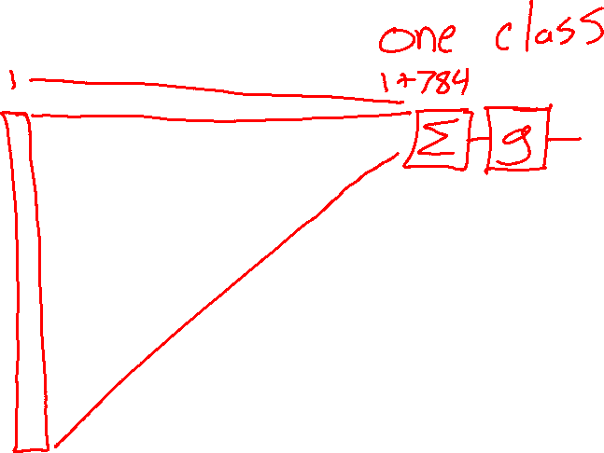

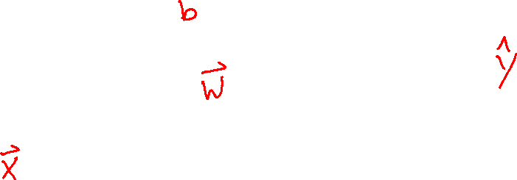
Poll 1
Logistic regression for 28x28=784 pixel hand-written digit images into 10 classes:
How many parameters (including bias terms)?
10
10+784
10*784
10*784 + 10
10*784 + 784

Slide 4

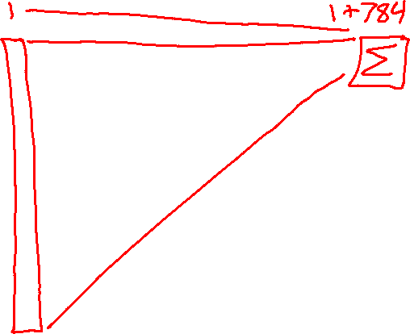



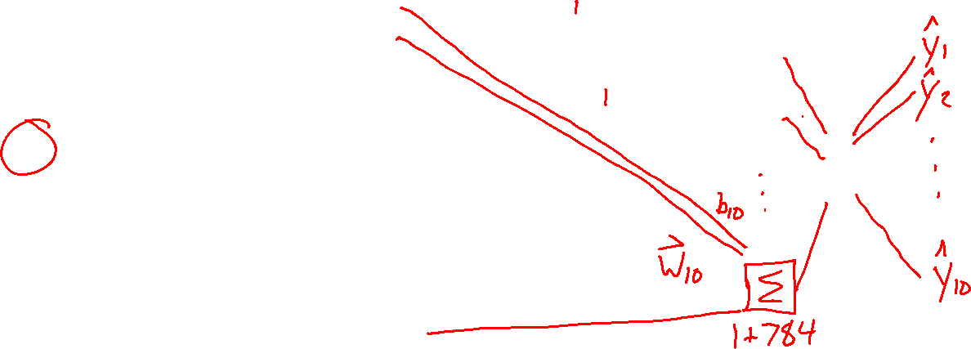
Poll 1
Logistic regression for 28x28=784 pixel hand-written digit images into 10 classes:
How many parameters (including bias terms)?
10
10+784
10*784
10*784 + 10
10*784 + 784

Slide 5


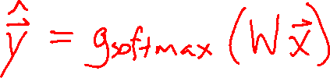
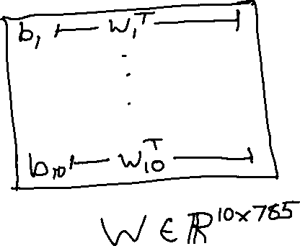
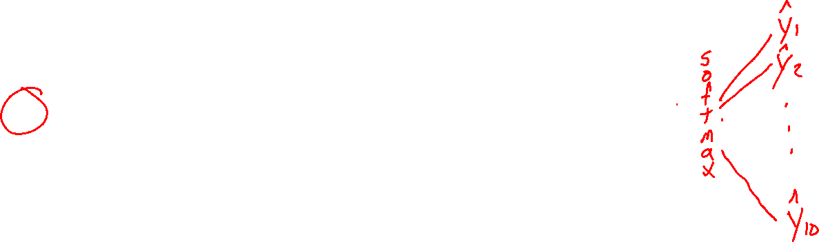
Poll 1
Logistic regression for 28x28=784 pixel hand-written digit images into 10 classes:
How many parameters (including bias terms)?
10
10+784
10*784
10*784 + 10
10*784 + 784

Slide 6
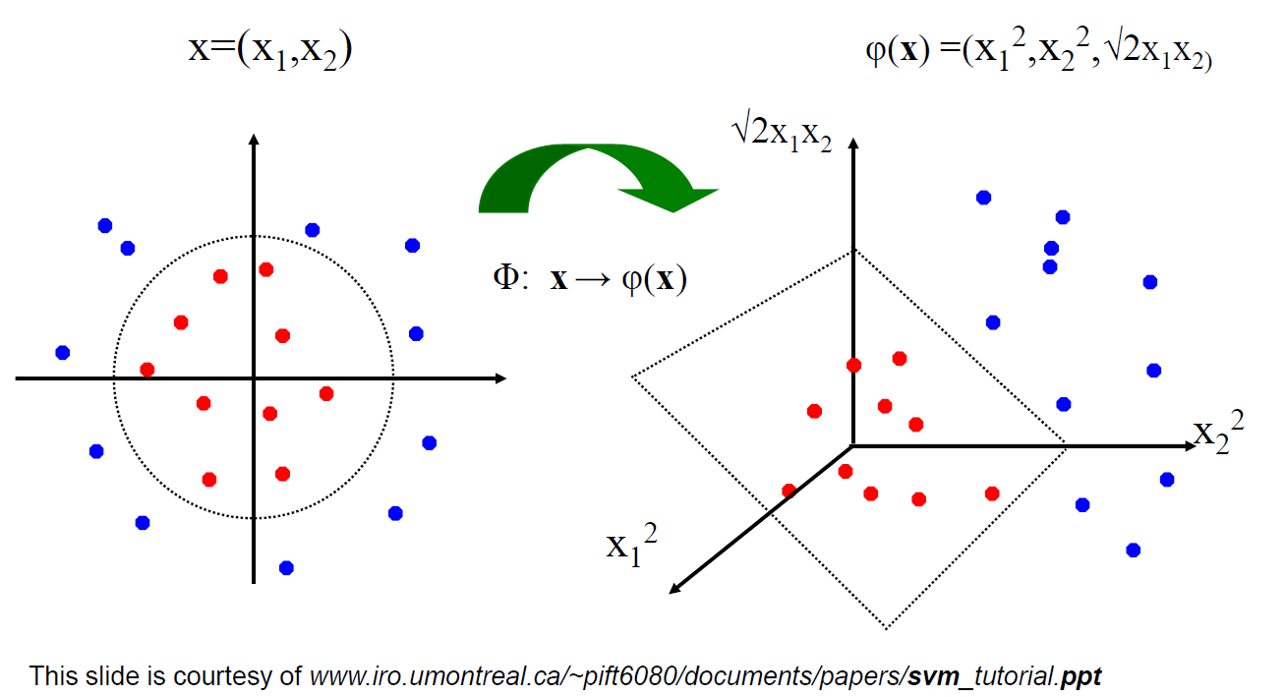
Linear Classifiers for Nonlinear Data
Linear classifiers have linear decision boundaries
Feature mapping can convert nonlinear data to higher dimensions
Today, instead of choosing a feature mapping function, we’ll use neural networks to learn nonlinear decision boundaries.
We’ll quickly shift this to doing nonlinear regression too!

Slide 7
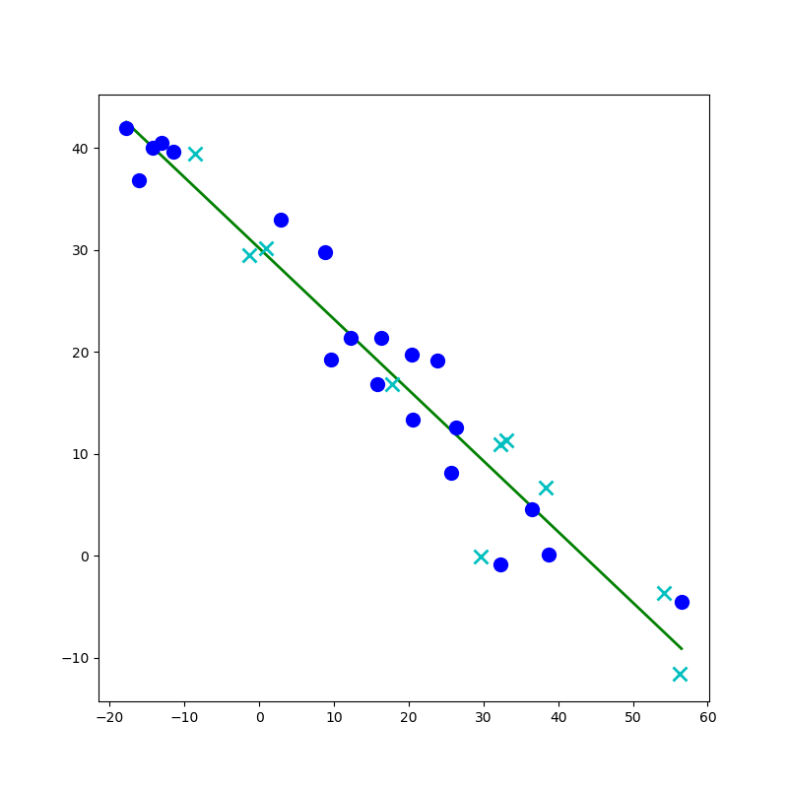
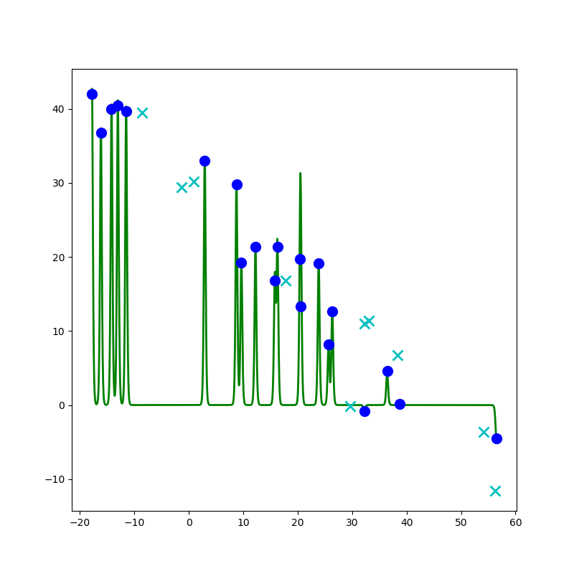
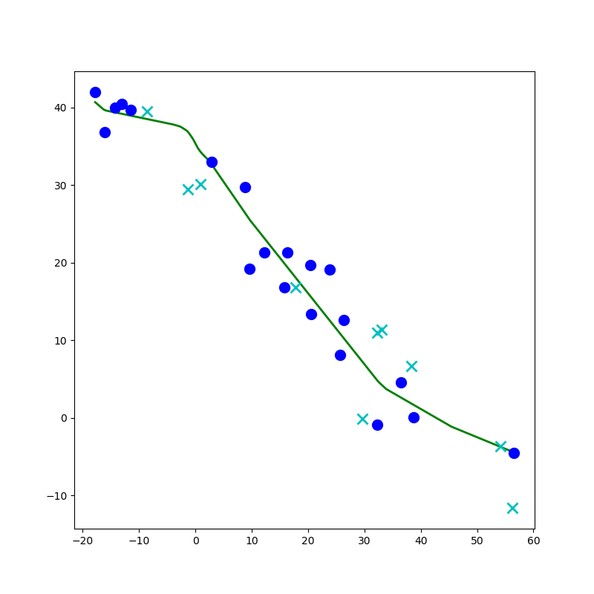
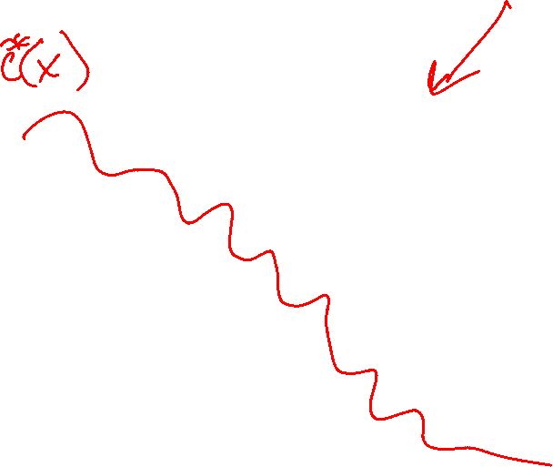
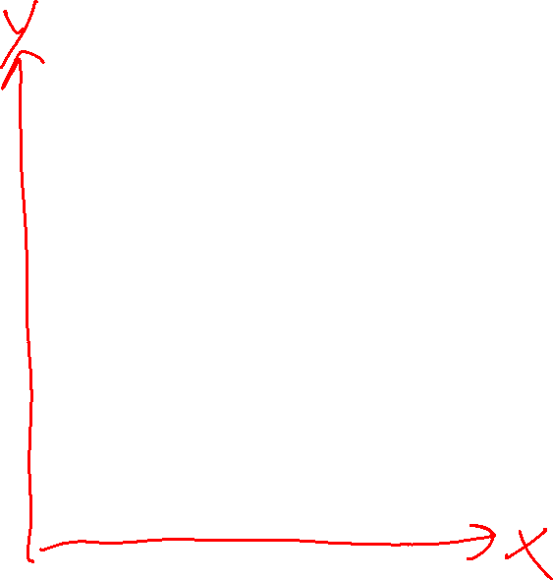
Network to Approximate a 1-D Function

Slide 8
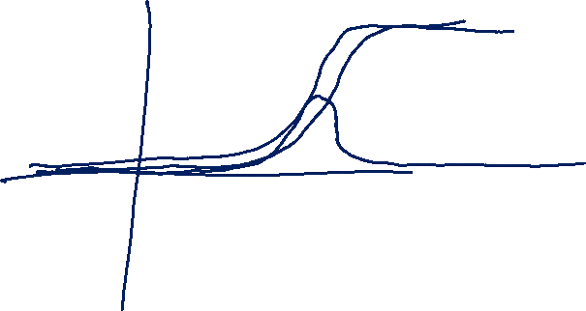
Network to Approximate a 1-D Function
Design a network to approximate this function using:
Linear, Sigmoid, Step, or ReLU

Slide 9
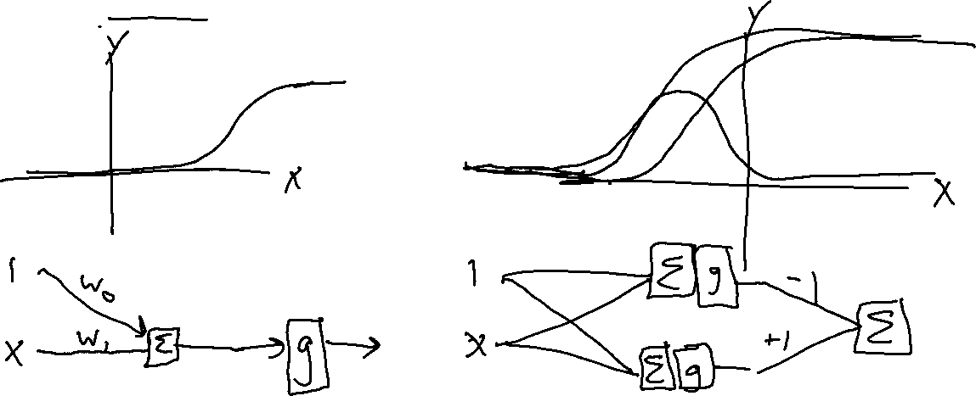


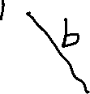
Network to Approximate a 1-D Function
Design a network to approximate this function using:
Linear, Sigmoid, Step, or ReLU

Slide 10


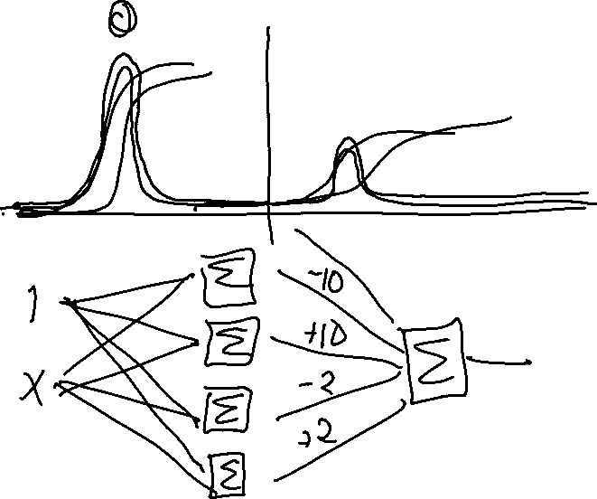
Network to Approximate a 1-D Function

Slide 11
Network to Approximate a 1-D Function

Slide 12
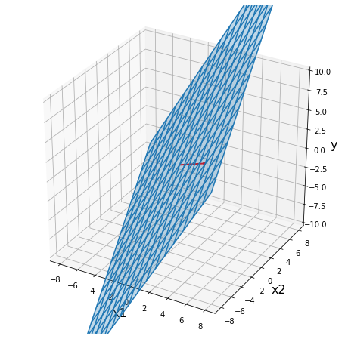
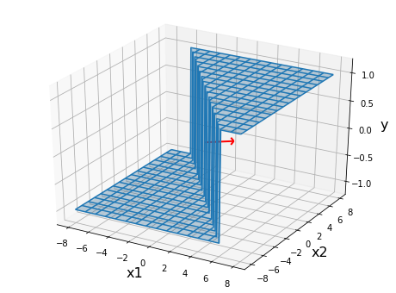
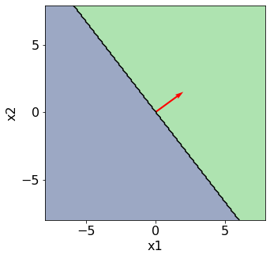
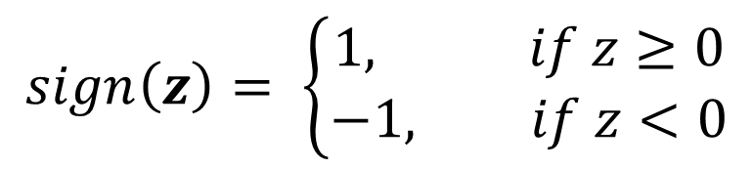

Perceptron
$$sign\left(z\right)= \left\{\begin{aligned}1, if z≥0 \\ −1, if z<0\end{aligned}\right.$$
Classification: Hard threshold on linear model
$$h\left(x\right)=sign\left(w^{T}x+b\right)$$

Slide 13
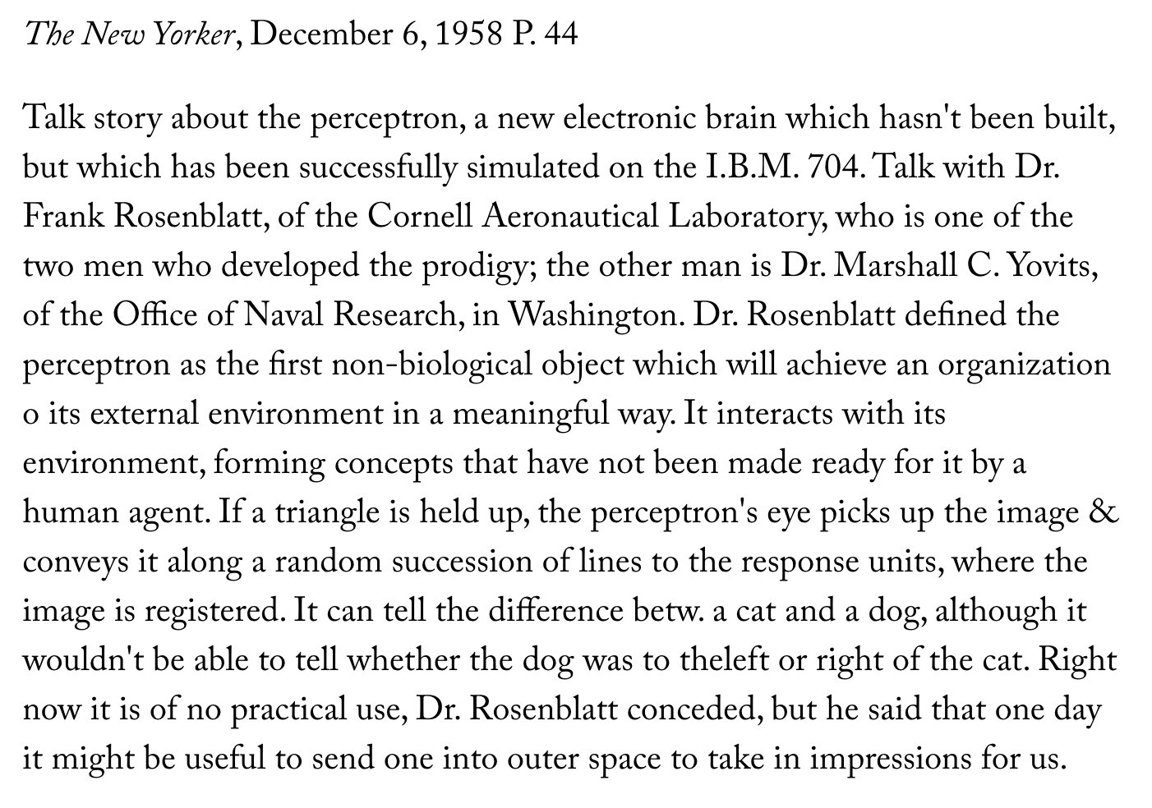
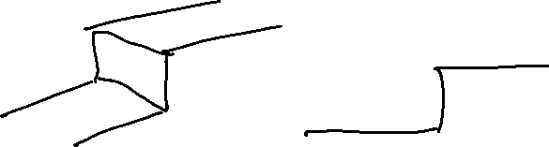
Perceptron History
Frank Rosenblatt, 1957

Slide 14

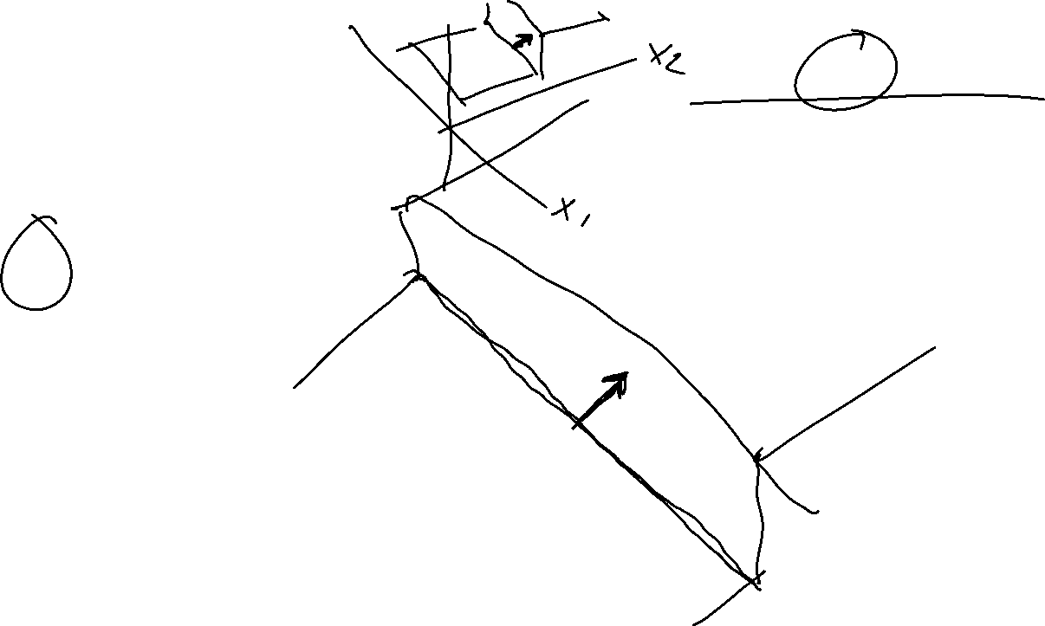
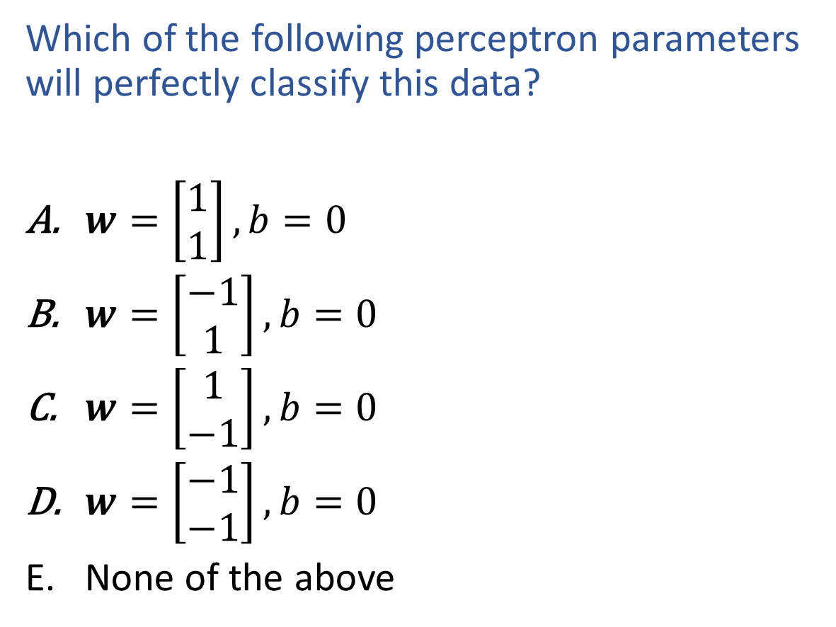
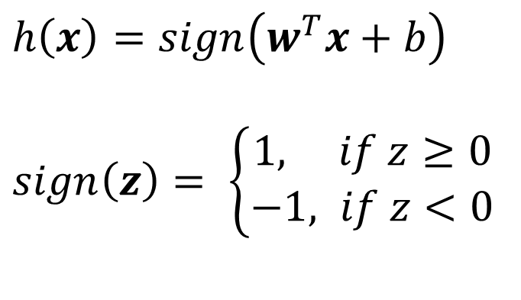

Exercise
$h\left(x\right)=sign\left(w^{T}x+b\right)$
$sign\left(z\right)= \left\{\begin{aligned}1, if z≥0 \\ −1, if z<0\end{aligned}\right.$
Which of the following perceptron parameters will perfectly classify this data?
$w=\left[\begin{aligned}1 \\ 1\end{aligned}\right], b=0$
$w=\left[\begin{aligned}−1 \\ 1\end{aligned}\right], b=0$
$w=\left[\begin{aligned}1 \\ −1\end{aligned}\right], b=0$
$w=\left[\begin{aligned}−1 \\ −1\end{aligned}\right], b=0$
None of the above
$$x2$$
$$x1$$

Slide 15
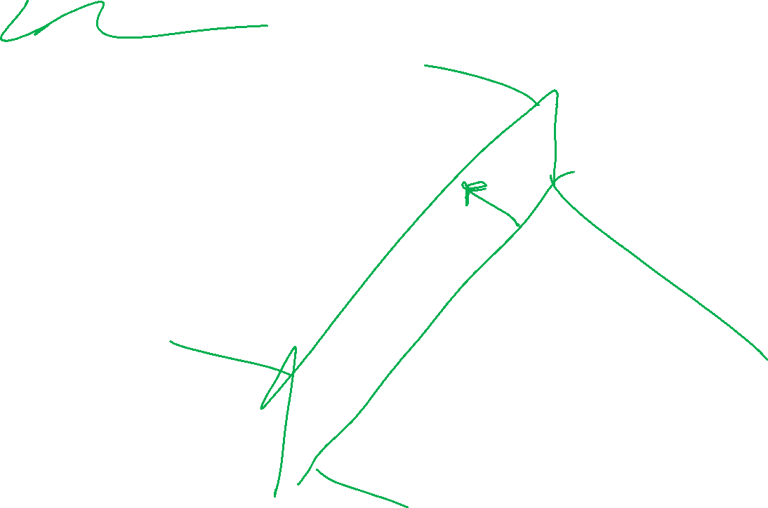
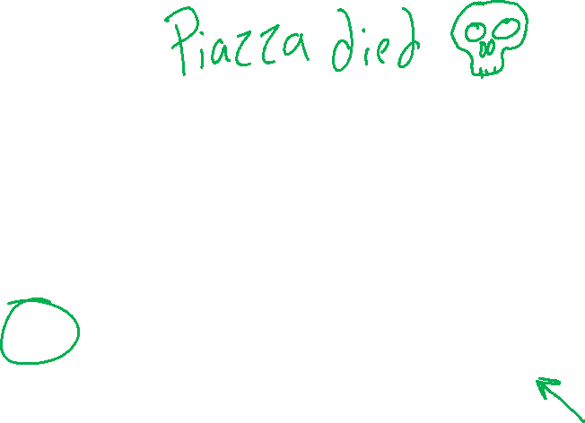
Poll 2
$h\left(x\right)=sign\left(w^{T}x+b\right)$
$sign\left(z\right)= \left\{\begin{aligned}1, if z≥0 \\ −1, if z<0\end{aligned}\right.$
Which of the following perceptron parameters will perfectly classify this data?
$w=\left[\begin{aligned}1 \\ 1\end{aligned}\right], b=0$
$w=\left[\begin{aligned}−1 \\ 1\end{aligned}\right], b=0$
$w=\left[\begin{aligned}1 \\ −1\end{aligned}\right], b=0$
$w=\left[\begin{aligned}−1 \\ −1\end{aligned}\right], b=0$
None of the above
$$x2$$
$$x1$$

Slide 16

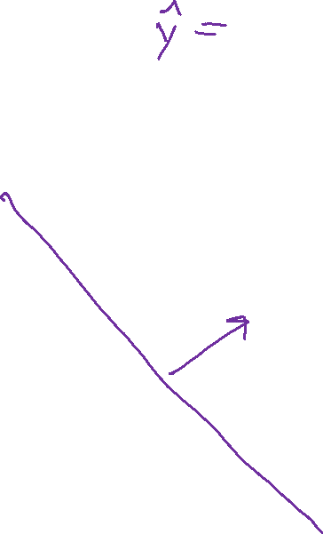
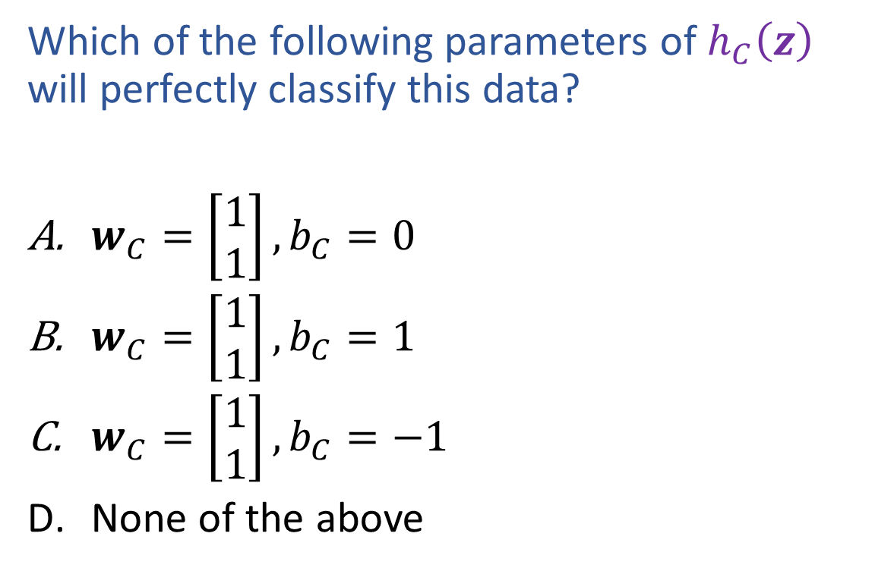
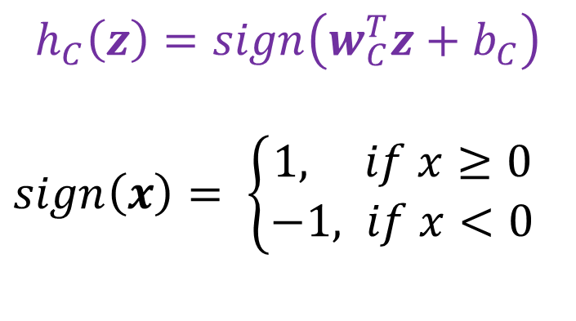

Poll 3
$$h_{C}\left(z\right)=sign\left(w_{C}^{T}z+b_{C}\right)$$
$sign\left(x\right)= \left\{\begin{aligned}1, if x≥0 \\ −1, if x<0\end{aligned}\right.$
Which of the following parameters of $h_{C}\left(z\right)$ will perfectly classify this data?
$w_{C}=\left[\begin{aligned}1 \\ 1\end{aligned}\right], b_{C}=0$
$w_{C}=\left[\begin{aligned}1 \\ 1\end{aligned}\right], b_{C}=1$
$w_{C}=\left[\begin{aligned}1 \\ 1\end{aligned}\right], b_{C}=−1$
None of the above
$$z2$$
$$z1$$

Slide 17
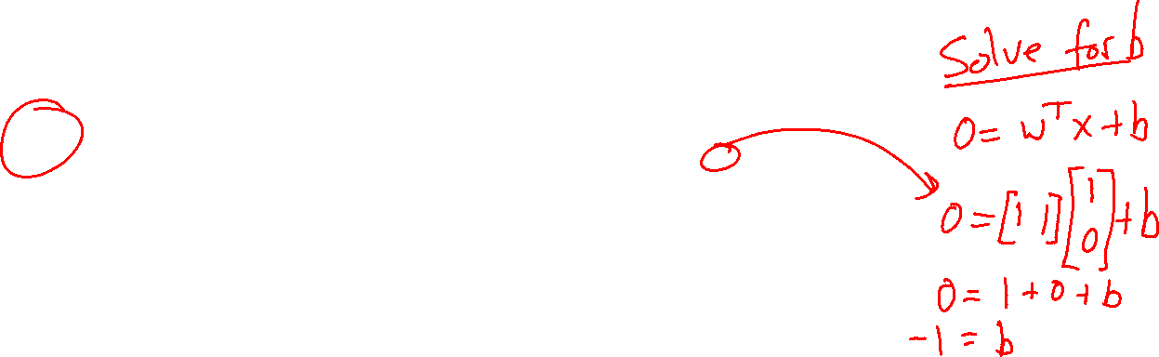
Poll 3
$$h_{C}\left(z\right)=sign\left(w_{C}^{T}z+b_{C}\right)$$
$sign\left(x\right)= \left\{\begin{aligned}1, if x≥0 \\ −1, if x<0\end{aligned}\right.$
Which of the following parameters of $h_{C}\left(z\right)$ will perfectly classify this data?
$w_{C}=\left[\begin{aligned}1 \\ 1\end{aligned}\right], b_{C}=0$
$w_{C}=\left[\begin{aligned}1 \\ 1\end{aligned}\right], b_{C}=1$
$w_{C}=\left[\begin{aligned}1 \\ 1\end{aligned}\right], b_{C}=−1$
None of the above
$$z2$$
$$z1$$

Slide 18


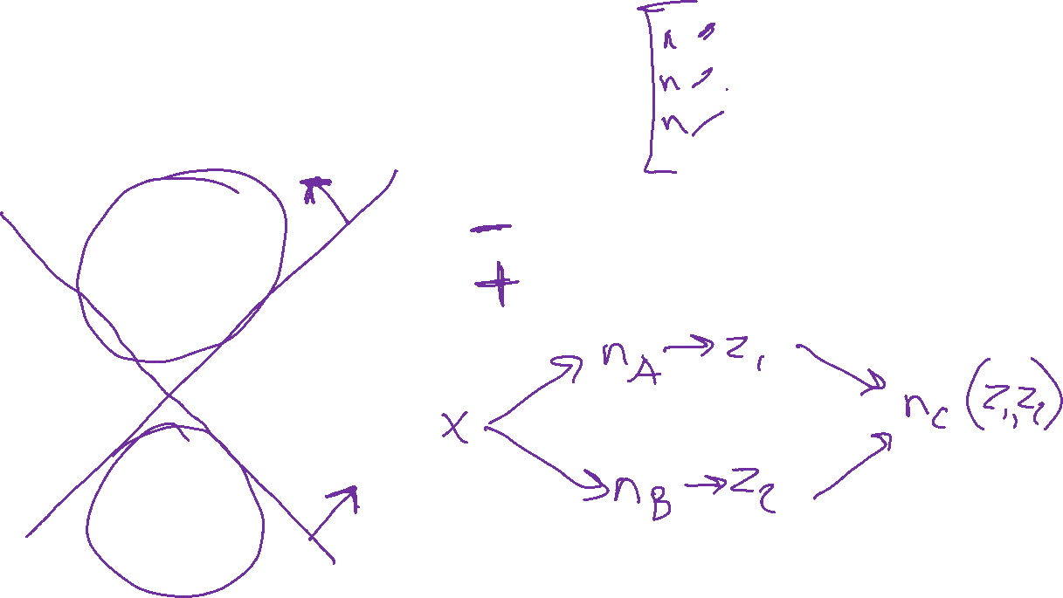
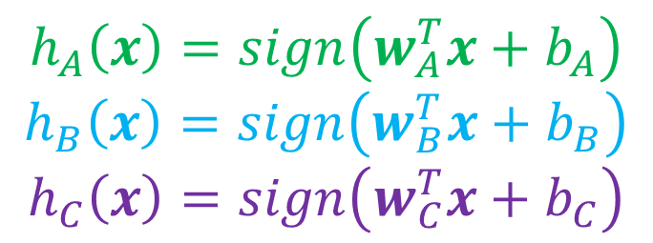
Classification Design Challenge
$$h_{A}\left(x\right)=sign\left(w_{A}^{T}x+b_{A}\right)$$
$$h_{B}\left(x\right)=sign\left(w_{B}^{T}x+b_{B}\right)$$
$$h_{C}\left(x\right)=sign\left(w_{C}^{T}x+b_{C}\right)$$
How could you configure three specific perceptrons to classify this data?
$$x2$$
$$x1$$

Slide 19
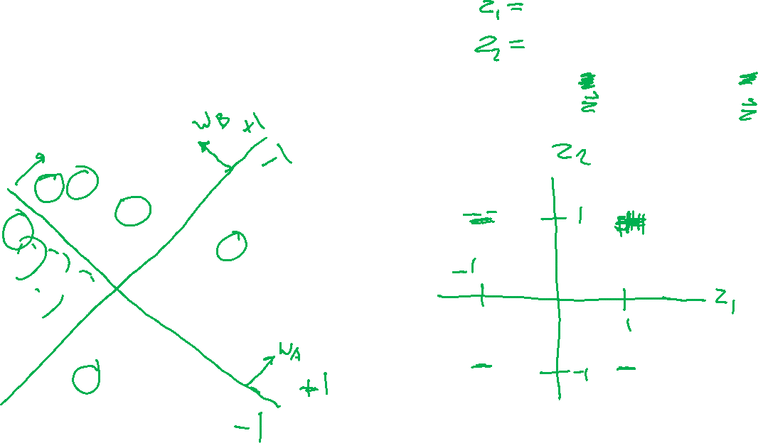
Classification Design Challenge
$$h_{A}\left(x\right)=sign\left(w_{A}^{T}x+b_{A}\right)$$
$$h_{B}\left(x\right)=sign\left(w_{B}^{T}x+b_{B}\right)$$
$$h_{C}\left(x\right)=sign\left(w_{C}^{T}x+b_{C}\right)$$
How could you configure three specific perceptrons to classify this data?
$$x2$$
$$x1$$

Slide 20
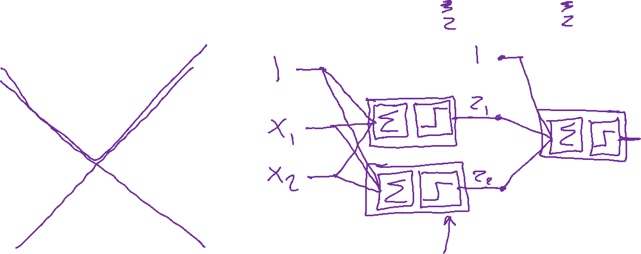
Classification Design Challenge
$$h_{A}\left(x\right)=sign\left(w_{A}^{T}x+b_{A}\right)$$
$$h_{B}\left(x\right)=sign\left(w_{B}^{T}x+b_{B}\right)$$
$$h_{C}\left(x\right)=sign\left(w_{C}^{T}x+b_{C}\right)$$
How could you configure three specific perceptrons to classify this data?
$$x2$$
$$x1$$

Slide 21
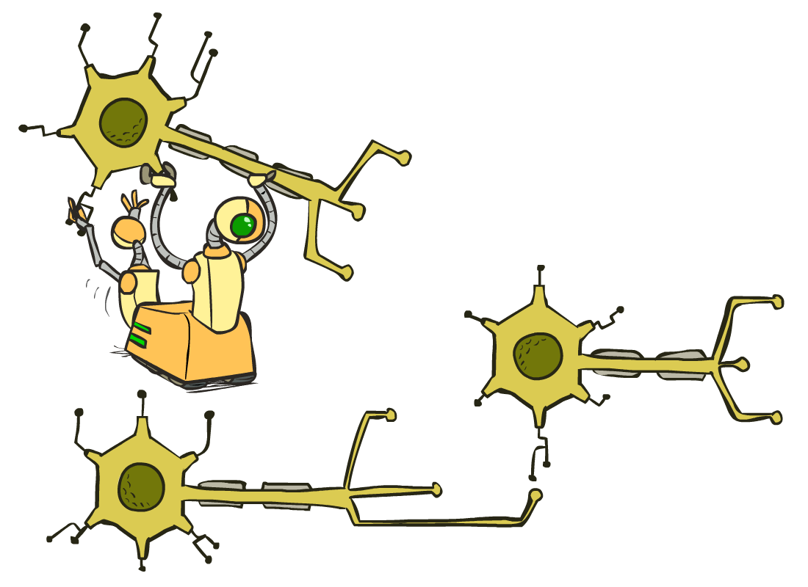
Multilayer Perceptrons
A multilayer perceptron is a feedforward neural network with at least one hidden layer (nodes that are neither inputs nor outputs)
MLPs with enough hidden nodes can represent any function
Slide from UC Berkeley AI

Slide 22
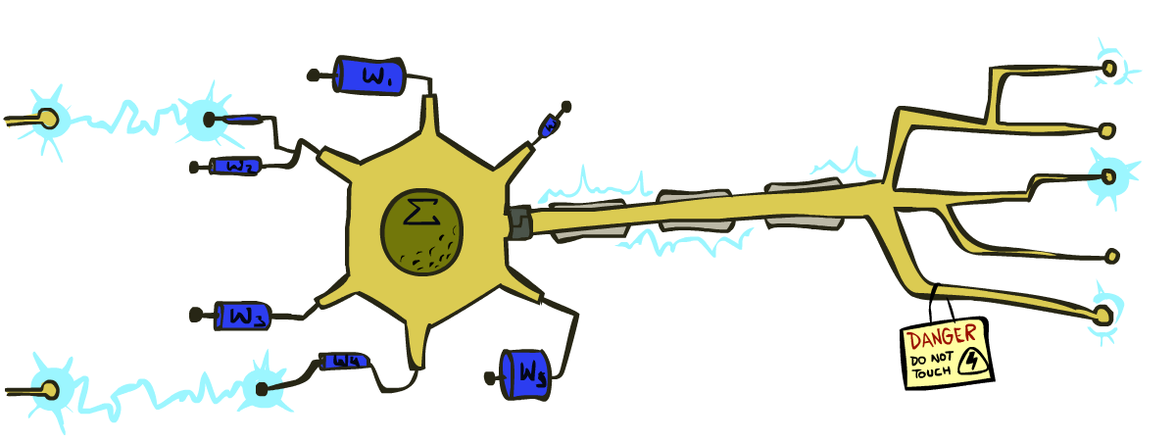
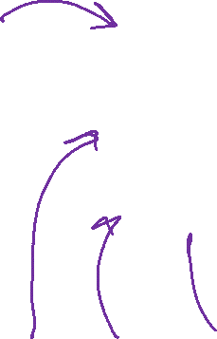
Very Loose Inspiration: Human Neurons
Slide from UC Berkeley AI

Slide 23


Simple Model of a Neuron (McCulloch & Pitts, 1943)
Inputs a_{i} come from the output of node i to this node j (or from “outside”)
Each input link has a weight w_{i,j}
There is an additional fixed input a₀ with bias weight w_{0,j}
The total input is in_{j} = Σ_{i} w_{i,j} a_{i}
The output is a_{j} = g(in_{j}) = g(Σ_{i} w_{i,j} a_{i}) = g(w.a)
Slide from UC Berkeley AI
Notes:
fix notation: x, a, h, etc, explain bias

Slide 24
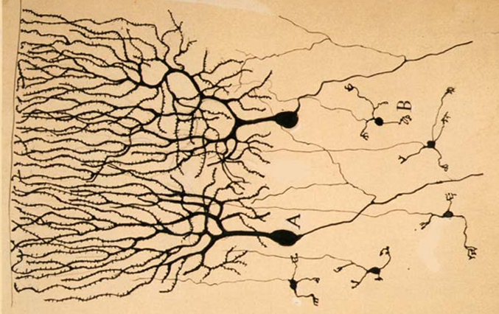
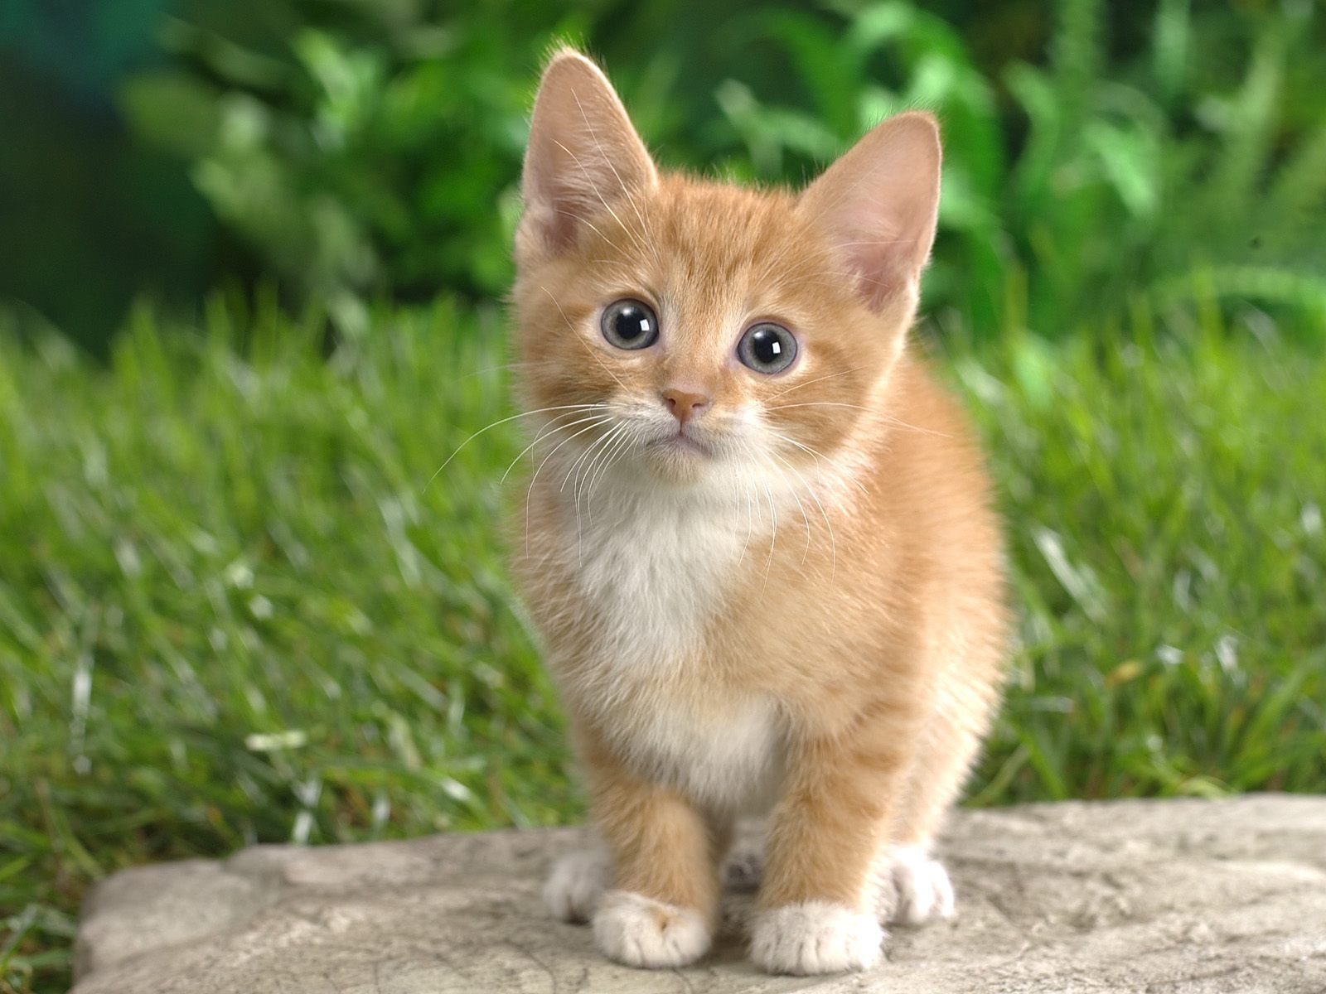

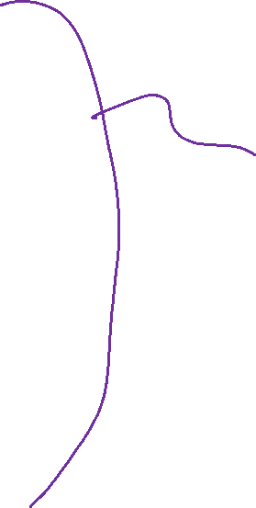
Neural Networks
Inspired by actual human brain
Output
Signal
Input Signal
DOG
CAT
TREE
CAR
SKY
Image: https://en.wikipedia.org/wiki/Neuron

Slide 25
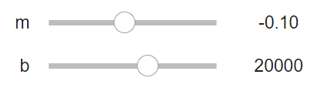
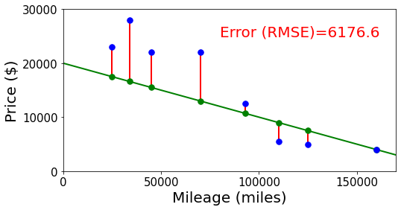
Neural Networks
Building on optimization for linear and logistic regression
Selling my car

Slide 26
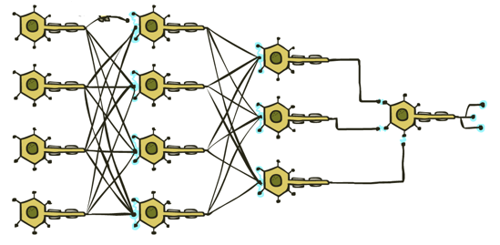



Neural Networks
Output
Signal
Many layers of neurons, millions of parameters
$$\hat{y}$$
Input Signal
DOG
CAT
TREE
CAR
SKY

Slide 27








Neural Networks
Output
Signal
Many layers of neurons, millions of parameters
$$\hat{y}$$
$$y$$
Input Signal
DOG
CAT
TREE
CAR
SKY
$$0$$
$$1$$
$$0$$
$$0$$
$$0$$

Slide 28

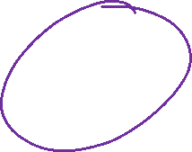
Neural Networks
Output
Signal
Many layers of neurons, millions of parameters
$$\hat{y}$$
Input Signal
LEFT
RIGHT
UP
DOWN
BUTTON

Slide 29

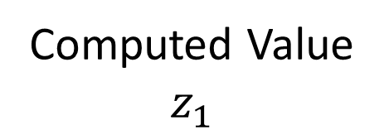

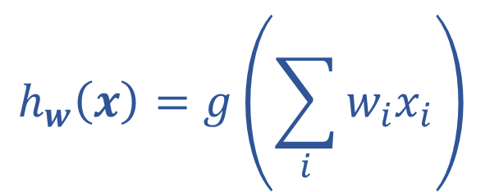
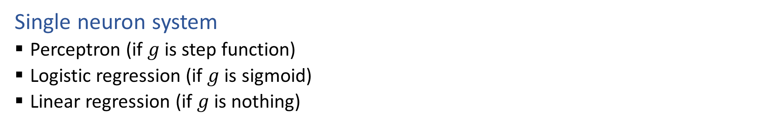
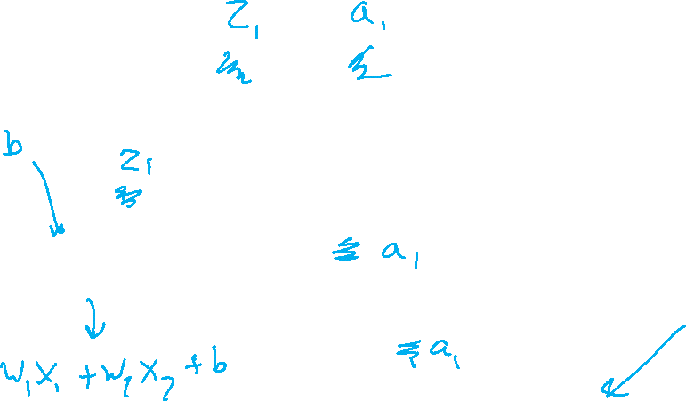







Single Neuron
Single neuron system
Perceptron (if $g$ is step function)
Logistic regression (if $g$ is sigmoid)
Linear regression (if $g$ is nothing)
$$x1$$
$$w1$$
Computed Value
$$z_{1}$$
True Label
$$y$$
$$∑$$
$$g$$
$$x2$$
$$h_{w}\left(x\right)=z_{1}$$
$$w2$$
$$h_{w}\left(x\right)=g\left(\sum_{i}{w_{i}x_{i}}\right)$$

Slide 30





Activation Functions
It would be really helpful to have a g(z) that was nicely differentiable
Hard threshold: $g\left(z\right)=\left\{\begin{aligned}1 z≥0 \\ 0 z<0\end{aligned}\right.$ $\frac{dg}{dz}= \left\{\begin{aligned}0 z≥0 \\ 0 z<0\end{aligned}\right.$
Sigmoid: $g\left(z\right)=\frac{1}{1+e^{−z}}$ $\frac{dg}{dz}=g\left(z\right)\left(1−g\left(z\right)\right)$
(Softmax)
ReLU: $g\left(z\right)= max(0,z)$ $\frac{dg}{dz}= \left\{\begin{aligned}1 z≥0 \\ 0 z<0\end{aligned}\right.$
$$z$$
$$z$$
$$z$$

Slide 31


Optimizing
How do we find the “best” set of weights?
$$h_{w}\left(x\right)=g\left(\sum_{j}{w_{j}x_{j}}\right)$$

Slide 32

Loss Functions
Regression
Squared error: $ℓ\left(y, \hat{y}\right)={\left(y−\hat{y}\right)}^{2}$
Classification
Cross entropy: $ℓ\left(y, \hat{y}\right)=−\sum_{k}{ y_{k}\log{{\hat{y}}_{k}}}$

Slide 33
Multilayer Perceptrons
A multilayer perceptron is a feedforward neural network with at least one hidden layer (nodes that are neither inputs nor outputs)
MLPs with enough hidden nodes can represent any function
Slide from UC Berkeley AI

Slide 34







































Neural Network Equations
$$z11$$
$$w111$$
$$z21$$
$$x1$$
$$∑$$
$$g$$
$$w211$$
$$w112$$
$$w113$$
$$w212$$
$$z31$$
$$∑$$
$$g$$
$$w311$$
$$w121$$
$$w221$$
$$z12$$
$$z22$$
$$z41$$
$$x2$$
$$∑$$
$$g$$
$$∑$$
$$g$$
$$w123$$
$$w221$$
$$z32$$
$$w321$$
$$w131$$
$$∑$$
$$g$$
$$z13$$
$$z23$$
$$w232$$
$$x3$$
$$∑$$
$$g$$
w₁₃₃
$$h_{w}\left(x\right)=z_{4,1}$$
$z_{1,1}=x_{1}$
$z_{4,1}=g\left(\sum_{i}{w_{3,i,1} z_{3,i}}\right)$
$$h_{w}\left(x\right)=g\left(\sum_{k}{w_{3,k,1}} g\left(\sum_{j}{w_{2,j,k}} g\left(\sum_{i}{w_{1,i,j}} x_{i}\right)\right)\right)$$
$z_{3,1}=g\left(\sum_{i}{w_{2,i,1} z_{2,i}}\right)$
$z_{d,1}=g\left(\sum_{i}{w_{d−1,i,1} z_{d−1,i}}\right)$

Slide 35

Optimizing
How do we find the “best” set of weights?
$$h_{w}\left(x\right)=g\left(\sum_{k}{w_{3,k,1}} g\left(\sum_{j}{w_{2,j,k}} g\left(\sum_{i}{w_{1,i,j}} x_{i}\right)\right)\right)$$

Slide 36


Optimizing
How do we find the “best” set of weights?
$$h_{w}\left(x\right)=g\left(\sum_{k}{w_{3,k,1}} g\left(\sum_{j}{w_{2,j,k}} g\left(\sum_{i}{w_{1,i,j}} x_{i}\right)\right)\right)$$

Slide 37

Neural Network Equations
$$z11$$
$$w111$$
$$z21$$
$$x1$$
$$∑$$
$$g$$
$$w211$$
$$w112$$
$$w113$$
$$w212$$
$$z31$$
$$∑$$
$$g$$
$$w311$$
$$w121$$
$$w221$$
$$z12$$
$$z22$$
$$z41$$
$$x2$$
$$∑$$
$$g$$
$$∑$$
$$g$$
$$w123$$
$$w221$$
$$z32$$
$$w321$$
$$w131$$
$$∑$$
$$g$$
$$z13$$
$$z23$$
$$w232$$
$$x3$$
$$∑$$
$$g$$
w₁₃₃
How do we describe this network?
input neuron (node) loss
hidden layer
output layer

Slide 38
Network Optimization Details

Slide 39



Reminder: Calculus Chain Rule (scalar version)
$$y=f\left(z\right)$$
$$z=g\left(x\right)$$
$$\frac{dy}{dx}=\frac{dy}{dz}\frac{dz}{dx}$$

Slide 40


Network Optimization
$J\left(w\right)=z_{3}$
$z_{3}=f_{3}(w_{3}, z_{2})$
$z_{2}=f_{2}\left(w_{2}, z_{1}\right)$
$z_{1}=f_{1}\left(w_{1}, x\right)$

Slide 41




Network Optimization: Forward then Backwards
$J\left(w\right)=z_{3}$
$z_{3}=f_{3}(w_{3}, z_{2})$
$z_{2}=f_{2}\left(w_{2}, z_{1}\right)$
$z_{1}=f_{1}\left(w_{1}, x\right)$
$\frac{∂J}{∂w_{3}}=\frac{∂J}{∂z_{3}}\frac{∂z_{3}}{∂w_{3}}$
$\frac{∂J}{∂w_{2}}=\frac{∂J}{∂z_{3}}\frac{∂z_{3}}{∂z_{2}}\frac{∂z_{2}}{∂w_{2}}$
$\frac{∂J}{∂w_{1}}=\frac{∂J}{∂z_{3}}\frac{∂z_{3}}{∂z_{2}}\frac{∂z_{2}}{∂z_{1}}\frac{∂z_{1}}{∂w_{1}}$
Lots of repeated calculations

Slide 42



Network Optimization: Layer Implementation
$J\left(w\right)=z_{3}$
$z_{3}=f_{3}(w_{3}, z_{2})$
$z_{2}=f_{2}\left(w_{2}, z_{1}\right)$
$z_{1}=f_{1}\left(w_{1}, x\right)$
$\frac{∂J}{∂w_{3}}=\frac{∂J}{∂z_{3}}\frac{∂z_{3}}{∂w_{3}}$
$\frac{∂J}{∂w_{2}}=\frac{∂J}{∂z_{3}}\frac{∂z_{3}}{∂z_{2}}\frac{∂z_{2}}{∂w_{2}}$
$\frac{∂J}{∂w_{1}}=\frac{∂J}{∂z_{3}}\frac{∂z_{3}}{∂z_{2}}\frac{∂z_{2}}{∂z_{1}}\frac{∂z_{1}}{∂w_{1}}$
Lots of repeated calculations

Slide 43



Backpropagation (so-far)
Compute derivatives per layer, utilizing previous derivatives
Objective: $J\left(w\right)$
Arbitrary layer: $y=f\left(x, w\right)$
Need:
$\frac{∂J}{∂x}=\frac{∂J}{∂y}\frac{∂y}{∂x}$
$\frac{∂J}{∂w}=\frac{∂J}{∂y}\frac{∂y}{∂w}$
$$x$$
Layer $y=f\left(x, w\right)$
$\frac{∂y}{∂x}$
$\frac{∂y}{∂w}$
$$y$$
$$\frac{∂J}{∂x}$$
$$\frac{∂J}{∂y}$$
$$w$$
$$\frac{∂J}{∂w}$$

Slide 44



Previous Exercise
Suppose we have a function that takes in a vector and squares each element individually, returning another vector, $y=f\left(x\right)$.
$f\left(\left[\begin{aligned}x_{1} \\ x_{2} \\ x_{3}\end{aligned}\right]\right)→\left[\begin{aligned}x_{1}^{2} \\ x_{2}^{2} \\ x_{3}^{2}\end{aligned}\right]$ Example: $f\left(\left[\begin{aligned}7 \\ 3 \\ 5\end{aligned}\right]\right)→\left[\begin{aligned}49 \\ 9 \\ 25\end{aligned}\right]$
What is $∂y/∂x$? (use numerator layout)

Slide 45


Exercise
Prove $\frac{∂}{∂v}v^{T}Av=\left(A^{T}+A\right)v$ for $v∈ℝ^{2}$ and $A∈ℝ^{2×2}$
$f\left(v\right)=v^{T}Av$ $v=\left[\begin{matrix}v_{1} \\ v_{2}\end{matrix}\right]$ $A=\left[\begin{matrix}A_{1,1} & A_{1,2} \\ A_{2,1} & A_{2,2}\end{matrix}\right]$
Prove $\frac{∂f}{∂v}=$ $\left(A^{T}+A\right)v$
Hint: Start by expanding $Av$ and then expanding $v^{T}Av$, i.e., write $f(v_{1},v_{2})$ in terms of scalars $v_{1}, v_{2}, A_{1,1}, A_{1,2}, A_{2,1}, A_{2,2}$
Hint: Write out scalar partial derivatives, $\frac{∂f}{∂v_{1}}$ and $\frac{∂f}{∂v_{2}}$
Hint: Work both top-down and bottom-up, i.e., also expand $\left(A^{T}+A\right)v$, so you can see where you are going.

Slide 46

Derivatives of Functions with Respect to Vectors

Slide 47
Calculus
Multivariable Chain Rule

Slide 48


Multivariable Chain Rule
$g_{1}\left(x\right)=3x$
$g_{2}\left(x\right)=5x$
$f\left(z_{1}, z_{2}\right)={2z}_{1}+{7z}_{2}$
$y=f\left(g_{1}\left(x\right),g_{2}\left(x\right)\right)$

Slide 49



Multivariable Chain Rule
$g_{1}\left(x\right)=3x$
$g_{2}\left(x\right)=5x$
$f\left(z_{1}, z_{2}\right)={2z}_{1}+{7z}_{2}$
$y=f\left(g_{1}\left(x\right),g_{2}\left(x\right)\right)$

Slide 50


Exercise: Multivariable Chain Rule
$$\frac{df}{dx} = \frac{∂f}{∂g_{1}}\frac{∂g_{1}}{∂x} + \frac{∂f}{∂g_{1}}\frac{∂g_{2}}{∂x}$$
$z_{1}=g_{1}\left(x\right)=sin\left(x\right)$
$z_{2}=g_{2}\left(x\right)=x^{3}$
$y=f\left(z_{1}, z_{2}\right)=z_{1}^{4}e^{z_{2}}+5z_{1}+7z_{2}$

Slide 51


Multivariable Chain Rule
$$\frac{df}{dx} = \frac{∂f}{∂g_{1}}\frac{∂g_{1}}{∂x} + \frac{∂f}{∂g_{1}}\frac{∂g_{2}}{∂x}$$
$z_{1}=g_{1}\left(x\right)=sin\left(x\right)$
$z_{2}=g_{2}\left(x\right)=x^{3}$
$y=f\left(z_{1}, z_{2}\right)=z_{1}z_{2}$

Slide 52



Calculus Chain Rule
Scalar:
$y=f\left(z\right)$
$z=g\left(x\right)$
$\frac{dy}{dx}=\frac{dy}{dz}\frac{dz}{dx}$
Multivariate:
$y=f\left(z\right)$
$z=g\left(x\right)$
$\frac{dy}{dx}=\sum_{j}{\frac{∂y}{∂z_{j}}\frac{∂z_{j}}{∂x}}$
Multivariate:
$y=f\left(z\right)$
$z=g\left(x\right)$
$\frac{dy_{i}}{dx_{k}}=\sum_{j}{\frac{∂y_{i}}{∂z_{j}}\frac{∂z_{j}}{∂x_{k}}}$

Slide 53


Multivariable Chain Rule

Slide 54


Poll 4 (not used)
Assume numerator layout:
Num outputs $×$ Num inputs
$y=f\left(z\right)$ $y∈ℝ, z∈ℝ^{N}, x∈ℝ$
$z=g\left(x\right)$
$\frac{∂y}{∂x}=…$
$\frac{∂y}{∂z}\frac{∂z}{∂x}$
${\left(\frac{∂y}{∂z}\right)}^{T}\frac{∂z}{∂x}$
$\frac{∂y}{∂z}{\left(\frac{∂z}{∂x}\right)}^{T}$
${\left(\frac{∂y}{∂z}\right)}^{T}{\left(\frac{∂z}{∂x}\right)}^{T}$
None of the above

Slide 55

Poll 4 (not used)
Assume numerator layout:
Num outputs $×$ Num inputs
$y=f\left(z\right)$ $y∈ℝ, z∈ℝ^{N}, x∈ℝ$
$z=g\left(x\right)$
$\frac{∂y}{∂x}=…$
$\frac{∂y}{∂z}\frac{∂z}{∂x}$
${\left(\frac{∂y}{∂z}\right)}^{T}\frac{∂z}{∂x}$
$\frac{∂y}{∂z}{\left(\frac{∂z}{∂x}\right)}^{T}$
${\left(\frac{∂y}{∂z}\right)}^{T}{\left(\frac{∂z}{∂x}\right)}^{T}$
None of the above

Slide 56
Poll 4 (not used)
Assume numerator layout:
Num outputs $×$ Num inputs
$y=f\left(z\right)$ $y∈ℝ, z∈ℝ^{N}, x∈ℝ$
$z=g\left(x\right)$
$\frac{∂y}{∂x}=…$
$\frac{∂y}{∂z}\frac{∂z}{∂x}$
${\left(\frac{∂y}{∂z}\right)}^{T}\frac{∂z}{∂x}$
$\frac{∂y}{∂z}{\left(\frac{∂z}{∂x}\right)}^{T}$
${\left(\frac{∂y}{∂z}\right)}^{T}{\left(\frac{∂z}{∂x}\right)}^{T}$
None of the above

Slide 57

Poll 5 (not used)
Assume numerator layout:
Num outputs $×$ Num inputs
$y=f\left(z\right)$
$z=g\left(x\right)$
$\frac{∂y}{∂x}=…$
$\frac{∂y}{∂z}\frac{∂z}{∂x}$
${\left(\frac{∂y}{∂z}\right)}^{T}\frac{∂z}{∂x}$
$\frac{∂y}{∂z}{\left(\frac{∂z}{∂x}\right)}^{T}$
${\left(\frac{∂y}{∂z}\right)}^{T}{\left(\frac{∂z}{∂x}\right)}^{T}$
None of the above

Slide 58



Poll 5 (not used)
Assume numerator layout:
Num outputs $×$ Num inputs
$y=f\left(z\right)$ $y∈ℝ, z∈ℝ^{N}, x∈ℝ^{M}$
$z=g\left(x\right)$
$\frac{∂y}{∂x}=…$
$\frac{∂y}{∂z}\frac{∂z}{∂x}$
${\left(\frac{∂y}{∂z}\right)}^{T}\frac{∂z}{∂x}$
$\frac{∂y}{∂z}{\left(\frac{∂z}{∂x}\right)}^{T}$
${\left(\frac{∂y}{∂z}\right)}^{T}{\left(\frac{∂z}{∂x}\right)}^{T}$
None of the above

Slide 59
Poll 5 (not used)
Assume numerator layout:
Num outputs $×$ Num inputs
$y=f\left(z\right)$
$z=g\left(x\right)$
$\frac{∂y}{∂x}=…$
$\frac{∂y}{∂z}\frac{∂z}{∂x}$
${\left(\frac{∂y}{∂z}\right)}^{T}\frac{∂z}{∂x}$
$\frac{∂y}{∂z}{\left(\frac{∂z}{∂x}\right)}^{T}$
${\left(\frac{∂y}{∂z}\right)}^{T}{\left(\frac{∂z}{∂x}\right)}^{T}$
None of the above

Slide 60
Network Optimization
$J\left(w\right)=z_{4}$
${z_{4}=f}_{4}\left(w_{D}, w_{E}, z_{2},z_{3}\right)$
$z_{3}=f_{3}\left(w_{C}, z_{1}\right)$
$z_{2}=f_{2}\left(w_{B}, z_{1}\right)$
$z_{1}=f_{1}\left(w_{A}, x\right)$
Need multivariate chain rule!

Slide 61


Network Optimization
$$\frac{∂J}{∂w_{E}}=\frac{∂J}{∂z_{4}}\frac{∂z_{4}}{∂w_{E}}$$
$$\frac{∂J}{∂w_{D}}=\frac{∂J}{∂z_{4}}\frac{∂z_{4}}{∂w_{D}}$$
$$\frac{∂J}{∂z_{3}}=\frac{∂J}{∂z_{4}}\frac{∂z_{4}}{∂z_{3}}$$
$$\frac{∂J}{∂z_{2}}=\frac{∂J}{∂z_{4}}\frac{∂z_{4}}{∂z_{2}}$$
$$\frac{∂J}{∂w_{C}}=\frac{∂J}{∂z_{3}}\frac{∂z_{3}}{∂w_{C}}$$
$$\frac{∂J}{∂w_{B}}=\frac{∂J}{∂z_{2}}\frac{∂z_{2}}{∂w_{B}}$$
$$\frac{∂J}{∂z_{1}}=\frac{∂J}{∂z_{2}}\frac{∂z_{2}}{∂z_{1}}+ \frac{∂J}{∂z_{3}}\frac{∂z_{3}}{∂z_{1}}$$
$$\frac{∂J}{∂w_{A}}=\frac{∂J}{∂z_{1}}\frac{∂z_{1}}{∂w_{A}}$$
$J\left(w\right)=z_{4}$
${z_{4}=f}_{4}\left(w_{D}, w_{E}, z_{2},z_{3}\right)$
$z_{3}=f_{3}\left(w_{C}, z_{1}\right)$
$z_{2}=f_{2}\left(w_{B}, z_{1}\right)$
$z_{1}=f_{1}\left(w_{A}, x\right)$
Need multivariate chain rule!
$$z_{2}$$
$$f_{2}$$
$$z_{1}$$
$$z_{4}$$
$$x$$
$$f_{1}$$
$$f_{4}$$
$$z_{3}$$
$$f_{3}$$

Slide 62

Backpropagation (updated)
Compute derivatives per layer, utilizing previous derivatives
Objective: $J\left(w\right)$
Arbitrary layer: $y=f\left(x, w\right)$
Init:
$\frac{∂J}{∂x}=0$
$\frac{∂J}{∂w}=0$
Compute:
$\frac{∂J}{∂x}+=\frac{∂J}{∂y}\frac{∂y}{∂x}$
$\frac{∂J}{∂w}+=\frac{∂J}{∂y}\frac{∂y}{∂w}$
$$x$$
Layer $y=f\left(x, w\right)$
$\frac{∂y}{∂x}$
$\frac{∂y}{∂w}$
$$y$$
$$\frac{∂J}{∂x}$$
$$\frac{∂J}{∂y}$$
$$w$$
$$\frac{∂J}{∂w}$$

Slide 63













Neural Network Implementation
Which pieces to we treat as functions?
$$z11$$
$$w111$$
$$z21$$
$$x1$$
$$∑$$
$$g$$
$$w211$$
$$w112$$
$$w113$$
$$w212$$
$$z31$$
$$∑$$
$$g$$
$$w311$$
$$w121$$
$$w221$$
$$z12$$
$$z22$$
$$z41$$
$$x2$$
$$∑$$
$$g$$
$$∑$$
$$g$$
$$w123$$
$$w221$$
$$z32$$
$$w321$$
$$w131$$
$$∑$$
$$g$$
$$z13$$
$$z23$$
$$w232$$
$$x3$$
$$∑$$
$$g$$
w₁₃₃

Slide 64
Neural Network Properties

Slide 65


Neural Networks Properties
Practical considerations
Large number of neurons
Danger for overfitting
Modelling assumptions vs data assumptions trade-off
Gradient descent can easily get stuck local optima
What if there are no non-linear activations?
A deep neural network with only linear layers can be reduced to an exactly equivalent single linear layer
Universal Approximation Theorem:
A two-layer neural network with a sufficient number of neurons can approximate any continuous function to any desired accuracy.

Slide 66
Classification Design Challenge
$$h_{A}\left(x\right)=sign\left(w_{A}^{T}x+b_{A}\right)$$
$$h_{B}\left(x\right)=sign\left(w_{B}^{T}x+b_{B}\right)$$
$$h_{C}\left(x\right)=sign\left(w_{C}^{T}x+b_{C}\right)$$
How could you configure three specific perceptrons to classify this data?
$$x2$$
$$x1$$

Slide 67


Network to Approximate Binary Classification
https://playground.tensorflow.org/#activation=sigmoid

Slide 68

Network to Approximate Binary Classification
Approximate arbitrary decision boundary
https://cs.stanford.edu/people/karpathy/convnetjs/demo/classify2d.html

Slide 69


Network to Approximate Binary Classification
Approximate arbitrary decision boundary
https://cs.stanford.edu/people/karpathy/convnetjs/demo/classify2d.html

Slide 70
Network to Approximate Binary Classification
Approximate arbitrary decision boundary
https://cs.stanford.edu/people/karpathy/convnetjs/demo/classify2d.html

Slide 71
Network to Approximate a 1-D Function

Slide 72
Network to Approximate a 1-D Function

Slide 73

Objective Function is Not Convex
Objective function for… | Convex? | Closed-form solution?
Linear regression
Logistic regression
Neural networks

Slide 74

Optimization
Linear function
If $f(x)$ is linear, then:
$f\left(x+z\right)=f\left(x\right)+f\left(z\right)$
$f\left(αx\right)=αf\left(x\right) ∀α$
$f\left(αx+\left(1−α\right)z\right)=αf\left(x\right)+\left(1−α\right)f\left(z\right) ∀α$

Slide 75


Optimization
Linear function
If $f(x)$ is linear, then:
$f\left(x+z\right)=f\left(x\right)+f\left(z\right)$
$f\left(αx\right)=αf\left(x\right) ∀α$
$f\left(αx+\left(1−α\right)z\right)=αf\left(x\right)+\left(1−α\right)f\left(z\right) ∀α$

Slide 76


Optimization
Convex function
If $f(x)$ is convex, then:
$f\left(αx+\left(1−α\right)z\right)≤αf\left(x\right)+\left(1−α\right)f\left(z\right) ∀ 0≤α≤1$

Slide 77


Optimization
Convex function
If $f(x)$ is convex, then:
$f\left(αx+\left(1−α\right)z\right)≤αf\left(x\right)+\left(1−α\right)f\left(z\right)$ $∀ 0≤α≤1$
Demo on Desmos

Slide 78

Optimization
Convex function
If $f(x)$ is convex, then:
$f\left(αx+\left(1−α\right)z\right)≤αf\left(x\right)+\left(1−α\right)f\left(z\right) ∀ 0≤α≤1$
Convex optimization
If second derivative is $≥0$ everywhere then function is convex
If $f(x)$ is convex, then:
Every local minimum is also a global minimum ☺

