Slide 1

10-315 Introduction to ML Neural Networks
Instructor: Pat Virtue

Slide 2
Poll 1
Logistic regression for 28x28=784 pixel hand-written digit images into 10 classes:
How many parameters (including bias terms)?
10
10+784
10*784
10*784 + 10
10*784 + 784

Slide 3
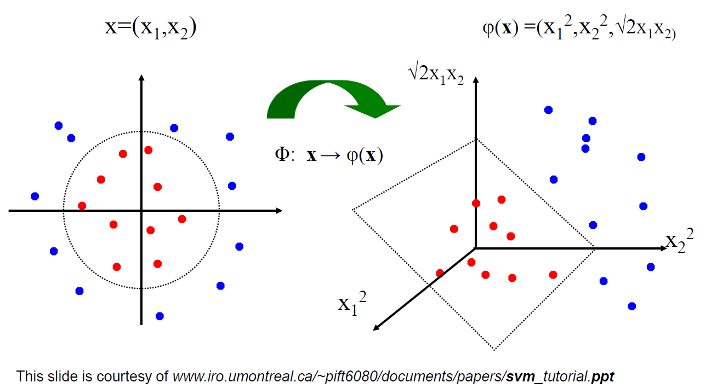
Linear Classifiers for Nonlinear Data
Linear classifiers have linear decision boundaries
Feature mapping can convert nonlinear data to higher dimensions
Today, instead of choosing a feature mapping function, we’ll use neural networks to learn nonlinear decision boundaries.
We’ll quickly shift this to doing nonlinear regression too!

Slide 4
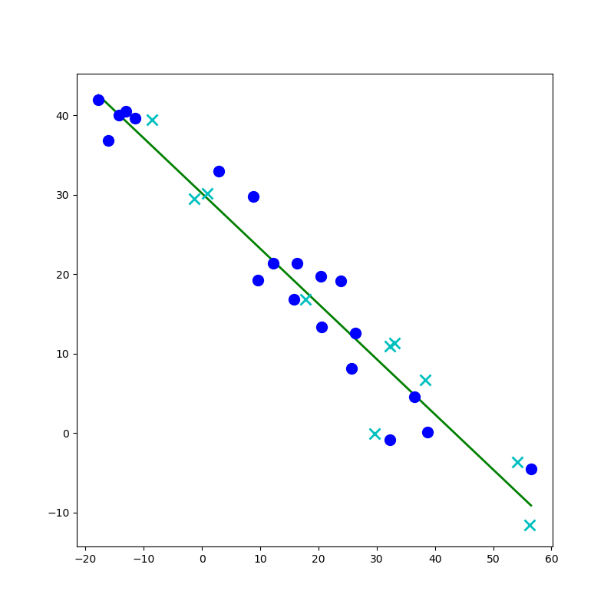
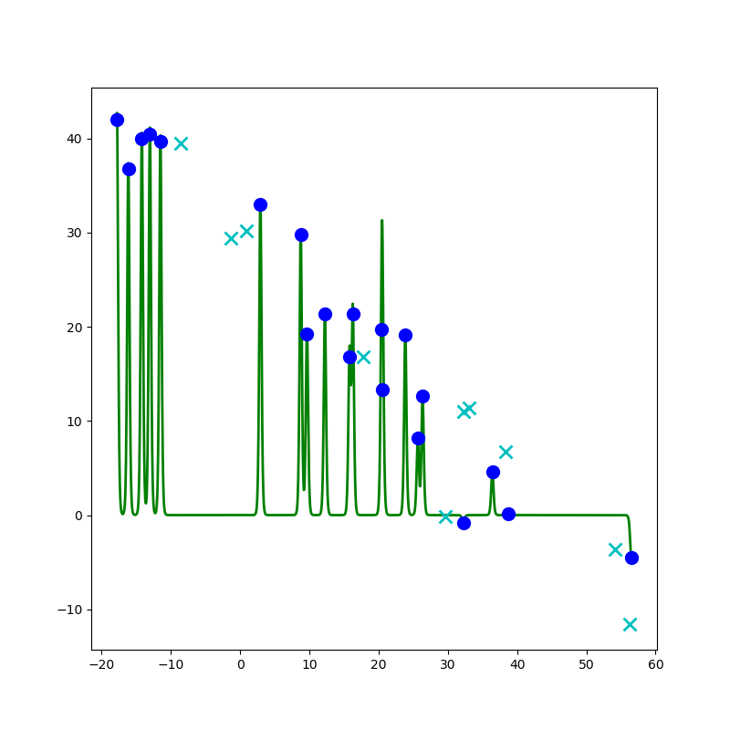
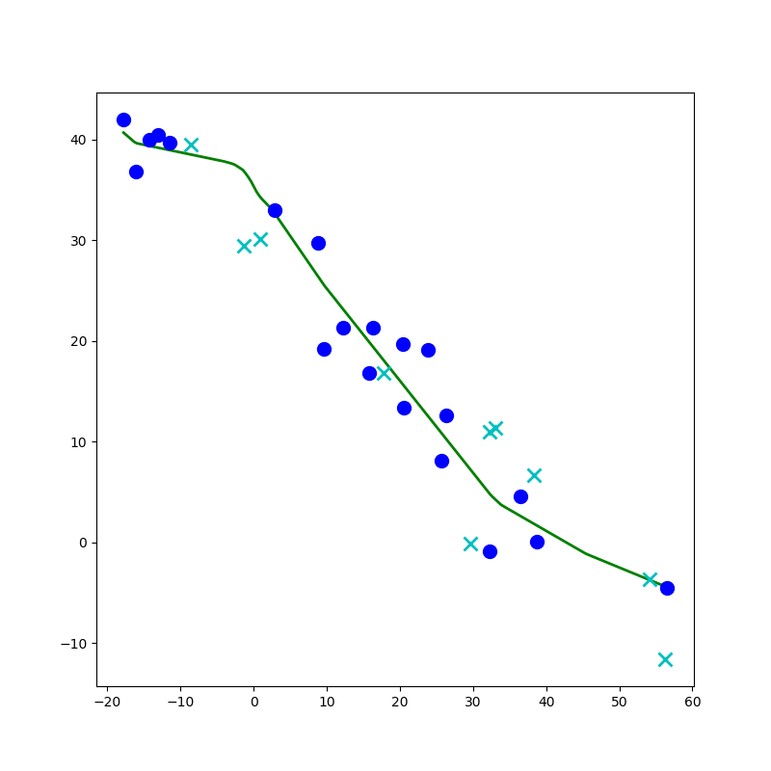
Network to Approximate a 1-D Function

Slide 5
Network to Approximate a 1-D Function
Design a network to approximate this function using:
Linear, Sigmoid, Step, or ReLU

Slide 6
Network to Approximate a 1-D Function
Design a network to approximate this function using:
Linear, Sigmoid, Step, or ReLU

Slide 7
Network to Approximate a 1-D Function

Slide 8
Network to Approximate a 1-D Function

Slide 9
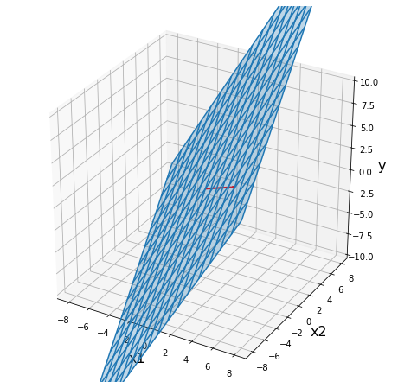
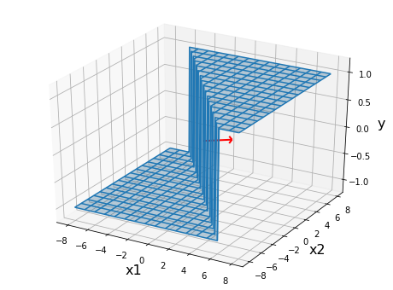
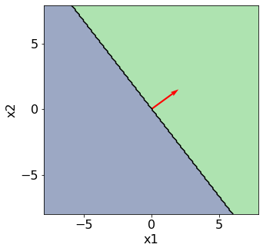
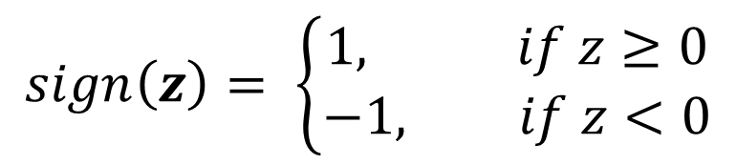

Perceptron
$$sign\left(z\right)= \left\{\begin{aligned}1, if z≥0 \\ −1, if z<0\end{aligned}\right.$$
Classification: Hard threshold on linear model
$$h\left(x\right)=sign\left(w^{T}x+b\right)$$

Slide 10
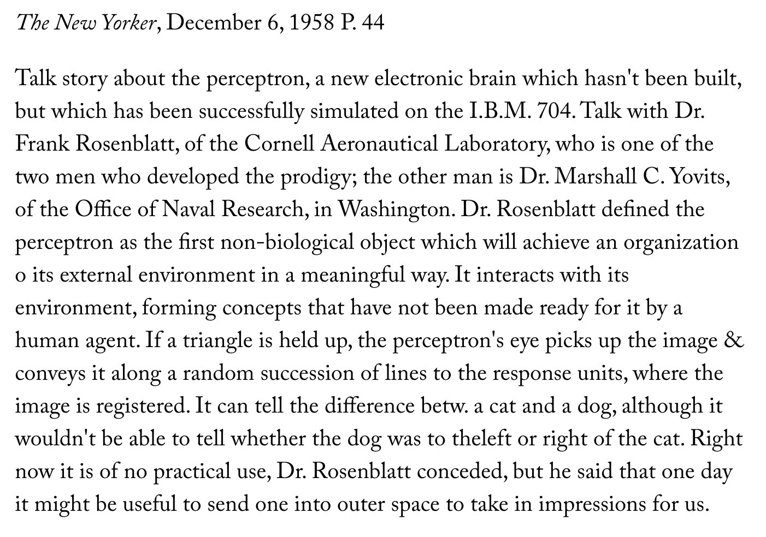
Perceptron History
Frank Rosenblatt, 1957

Slide 11

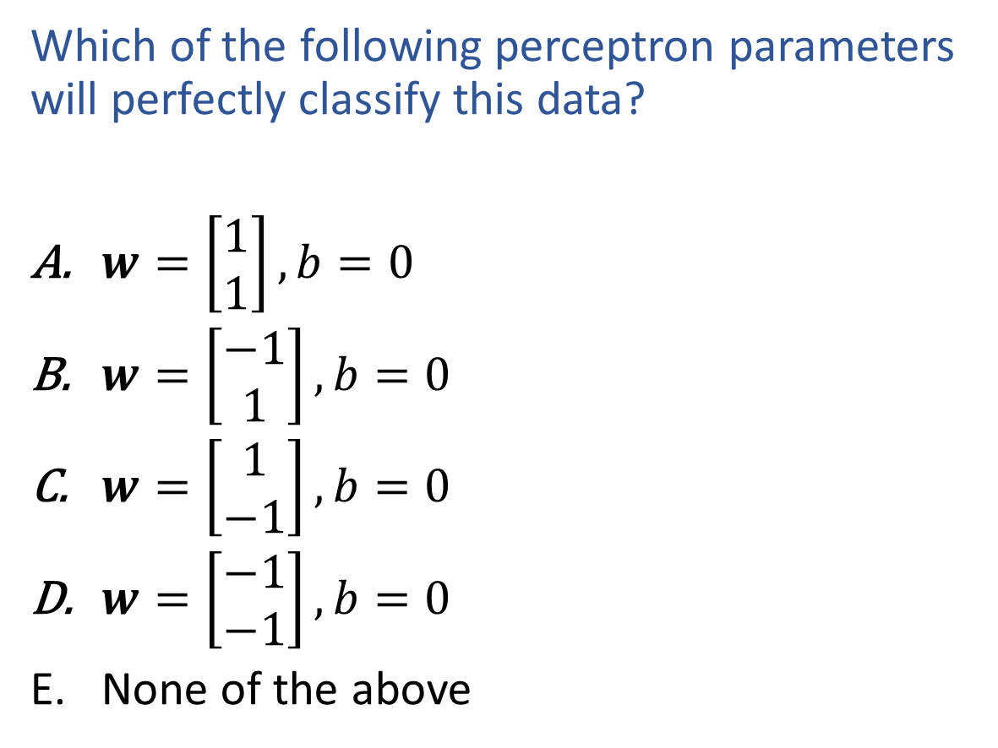
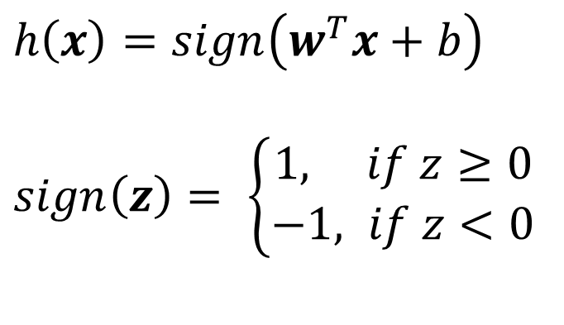

Exercise
$h\left(x\right)=sign\left(w^{T}x+b\right)$
$sign\left(z\right)= \left\{\begin{aligned}1, if z≥0 \\ −1, if z<0\end{aligned}\right.$
Which of the following perceptron parameters will perfectly classify this data?
$w=\left[\begin{aligned}1 \\ 1\end{aligned}\right], b=0$
$w=\left[\begin{aligned}−1 \\ 1\end{aligned}\right], b=0$
$w=\left[\begin{aligned}1 \\ −1\end{aligned}\right], b=0$
$w=\left[\begin{aligned}−1 \\ −1\end{aligned}\right], b=0$
None of the above
$$x2$$
$$x1$$

Slide 12
Poll 2
$h\left(x\right)=sign\left(w^{T}x+b\right)$
$sign\left(z\right)= \left\{\begin{aligned}1, if z≥0 \\ −1, if z<0\end{aligned}\right.$
Which of the following perceptron parameters will perfectly classify this data?
$w=\left[\begin{aligned}1 \\ 1\end{aligned}\right], b=0$
$w=\left[\begin{aligned}−1 \\ 1\end{aligned}\right], b=0$
$w=\left[\begin{aligned}1 \\ −1\end{aligned}\right], b=0$
$w=\left[\begin{aligned}−1 \\ −1\end{aligned}\right], b=0$
None of the above
$$x2$$
$$x1$$

Slide 13

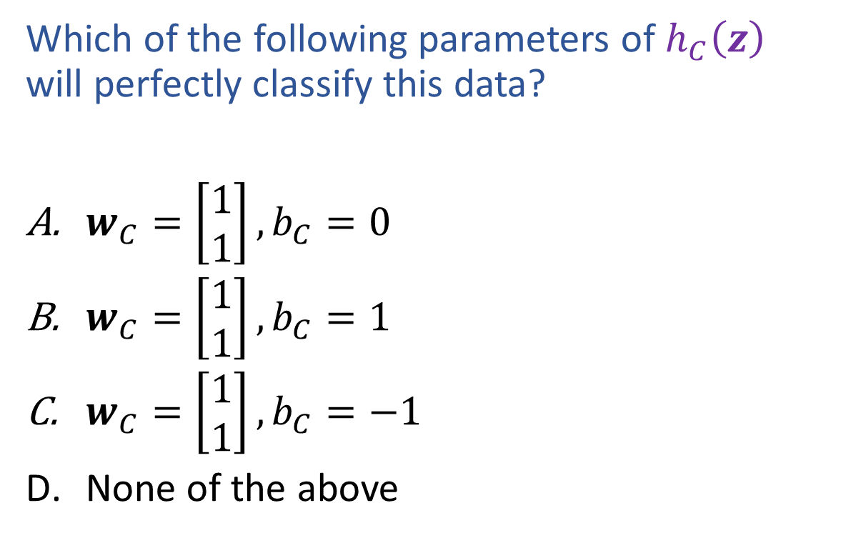
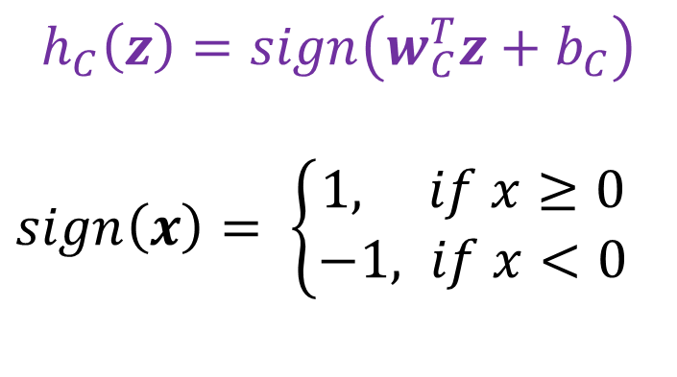

Poll 3
$$h_{C}\left(z\right)=sign\left(w_{C}^{T}z+b_{C}\right)$$
$sign\left(x\right)= \left\{\begin{aligned}1, if x≥0 \\ −1, if x<0\end{aligned}\right.$
Which of the following parameters of $h_{C}\left(z\right)$ will perfectly classify this data?
$w_{C}=\left[\begin{aligned}1 \\ 1\end{aligned}\right], b_{C}=0$
$w_{C}=\left[\begin{aligned}1 \\ 1\end{aligned}\right], b_{C}=1$
$w_{C}=\left[\begin{aligned}1 \\ 1\end{aligned}\right], b_{C}=−1$
None of the above
$$z2$$
$$z1$$

Slide 14


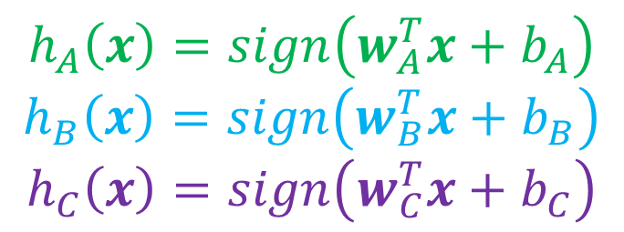
Classification Design Challenge
$$h_{A}\left(x\right)=sign\left(w_{A}^{T}x+b_{A}\right)$$
$$h_{B}\left(x\right)=sign\left(w_{B}^{T}x+b_{B}\right)$$
$$h_{C}\left(x\right)=sign\left(w_{C}^{T}x+b_{C}\right)$$
How could you configure three specific perceptrons to classify this data?
$$x2$$
$$x1$$

Slide 15
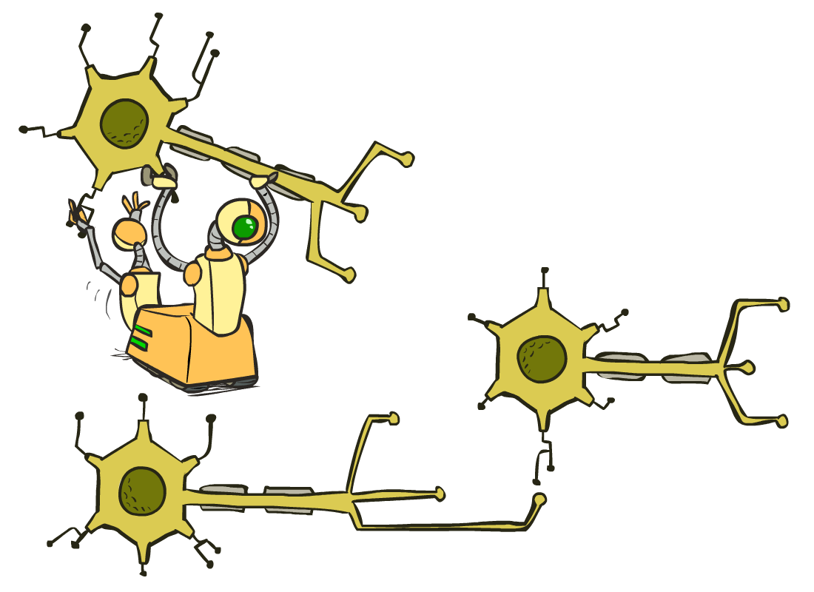
Multilayer Perceptrons
A multilayer perceptron is a feedforward neural network with at least one hidden layer (nodes that are neither inputs nor outputs)
MLPs with enough hidden nodes can represent any function
Slide from UC Berkeley AI

Slide 16
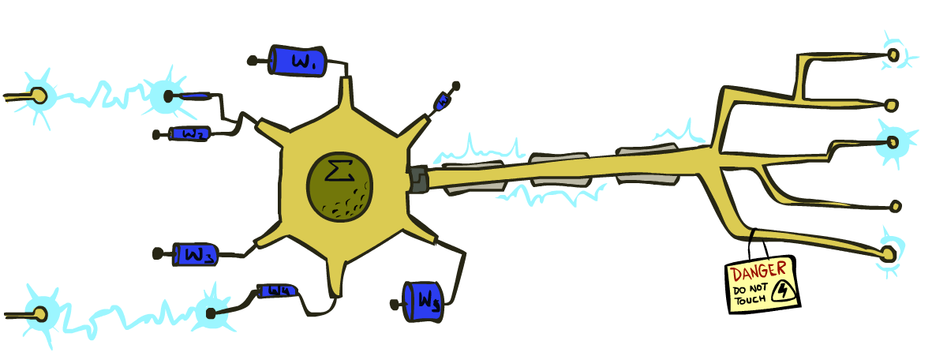
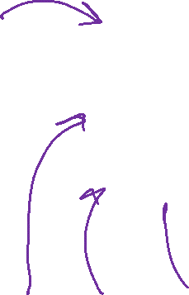
Very Loose Inspiration: Human Neurons
Slide from UC Berkeley AI

Slide 17
Simple Model of a Neuron (McCulloch & Pitts, 1943)
Inputs a_{i} come from the output of node i to this node j (or from “outside”)
Each input link has a weight w_{i,j}
There is an additional fixed input a₀ with bias weight w_{0,j}
The total input is in_{j} = Σ_{i} w_{i,j} a_{i}
The output is a_{j} = g(in_{j}) = g(Σ_{i} w_{i,j} a_{i}) = g(w.a)
Slide from UC Berkeley AI
Notes:
fix notation: x, a, h, etc, explain bias

Slide 18
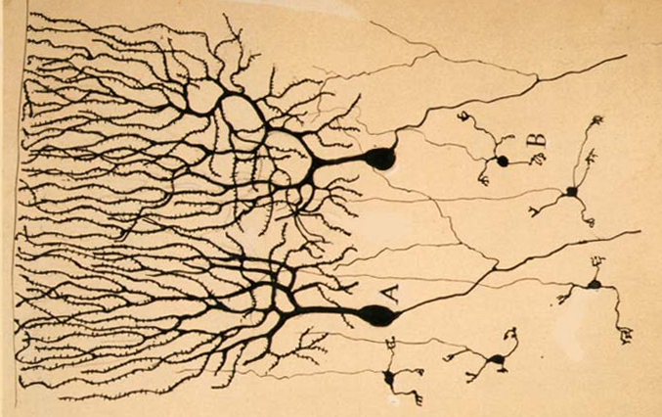

Neural Networks
Inspired by actual human brain
Output
Signal
Input Signal
DOG
CAT
TREE
CAR
SKY
Image: https://en.wikipedia.org/wiki/Neuron

Slide 19
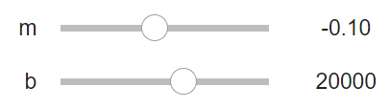
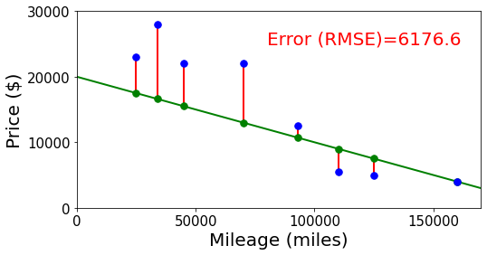
Neural Networks
Building on optimization for linear and logistic regression
Selling my car

Slide 20
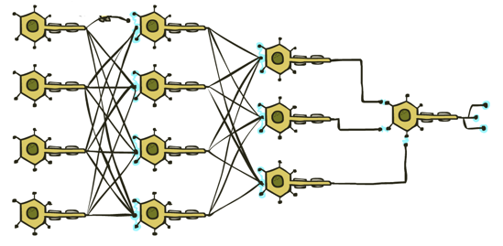


Neural Networks
Output
Signal
Many layers of neurons, millions of parameters
$$\hat{y}$$
Input Signal
DOG
CAT
TREE
CAR
SKY

Slide 21






Neural Networks
Output
Signal
Many layers of neurons, millions of parameters
$$\hat{y}$$
$$y$$
Input Signal
DOG
CAT
TREE
CAR
SKY
$$0$$
$$1$$
$$0$$
$$0$$
$$0$$

Slide 22

Neural Networks
Output
Signal
Many layers of neurons, millions of parameters
$$\hat{y}$$
Input Signal
LEFT
RIGHT
UP
DOWN
BUTTON

Slide 23

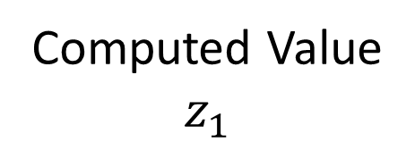

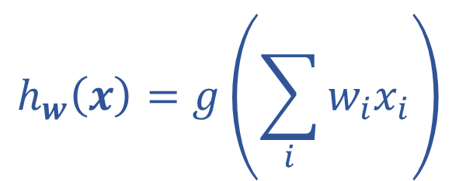
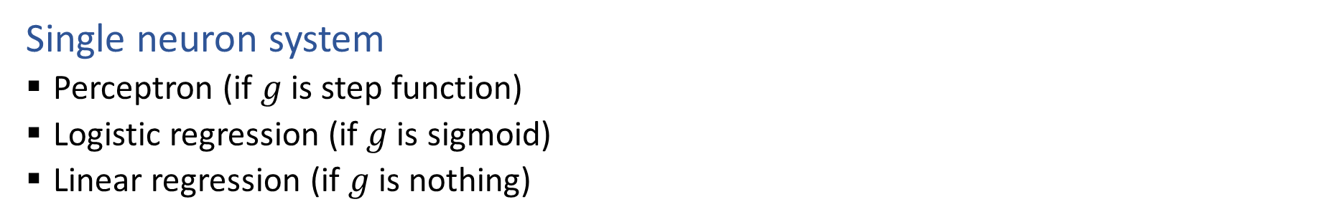






Single Neuron
Single neuron system
Perceptron (if $g$ is step function)
Logistic regression (if $g$ is sigmoid)
Linear regression (if $g$ is nothing)
$$x1$$
$$w1$$
Computed Value
$$z_{1}$$
True Label
$$y$$
$$∑$$
$$g$$
$$x2$$
$$h_{w}\left(x\right)=z_{1}$$
$$w2$$
$$h_{w}\left(x\right)=g\left(\sum_{i}{w_{i}x_{i}}\right)$$

Slide 24

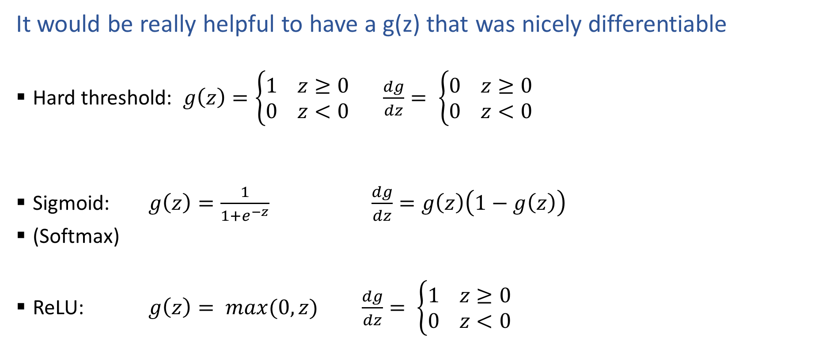


Activation Functions
It would be really helpful to have a g(z) that was nicely differentiable
Hard threshold: $g\left(z\right)=\left\{\begin{aligned}1 z≥0 \\ 0 z<0\end{aligned}\right.$ $\frac{dg}{dz}= \left\{\begin{aligned}0 z≥0 \\ 0 z<0\end{aligned}\right.$
Sigmoid: $g\left(z\right)=\frac{1}{1+e^{−z}}$ $\frac{dg}{dz}=g\left(z\right)\left(1−g\left(z\right)\right)$
(Softmax)
ReLU: $g\left(z\right)= max(0,z)$ $\frac{dg}{dz}= \left\{\begin{aligned}1 z≥0 \\ 0 z<0\end{aligned}\right.$
$$z$$
$$z$$
$$z$$

Slide 25
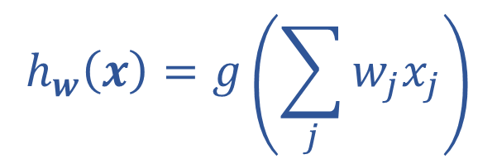
Optimizing
How do we find the “best” set of weights?
$$h_{w}\left(x\right)=g\left(\sum_{j}{w_{j}x_{j}}\right)$$

Slide 26

Loss Functions
Regression
Squared error: $ℓ\left(y, \hat{y}\right)={\left(y−\hat{y}\right)}^{2}$
Classification
Cross entropy: $ℓ\left(y, \hat{y}\right)=−\sum_{k}{ y_{k}\log{{\hat{y}}_{k}}}$

Slide 27
Multilayer Perceptrons
A multilayer perceptron is a feedforward neural network with at least one hidden layer (nodes that are neither inputs nor outputs)
MLPs with enough hidden nodes can represent any function
Slide from UC Berkeley AI

Slide 28












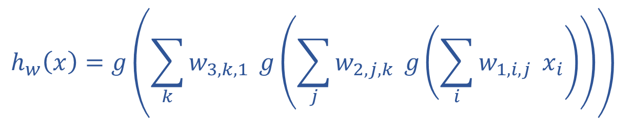
























Neural Network Equations
$$z11$$
$$w111$$
$$z21$$
$$x1$$
$$∑$$
$$g$$
$$w211$$
$$w112$$
$$w113$$
$$w212$$
$$z31$$
$$∑$$
$$g$$
$$w311$$
$$w121$$
$$w221$$
$$z12$$
$$z22$$
$$z41$$
$$x2$$
$$∑$$
$$g$$
$$∑$$
$$g$$
$$w123$$
$$w221$$
$$z32$$
$$w321$$
$$w131$$
$$∑$$
$$g$$
$$z13$$
$$z23$$
$$w232$$
$$x3$$
$$∑$$
$$g$$
w₁₃₃
$$h_{w}\left(x\right)=z_{4,1}$$
$z_{1,1}=x_{1}$
$z_{4,1}=g\left(\sum_{i}{w_{3,i,1} z_{3,i}}\right)$
$$h_{w}\left(x\right)=g\left(\sum_{k}{w_{3,k,1}} g\left(\sum_{j}{w_{2,j,k}} g\left(\sum_{i}{w_{1,i,j}} x_{i}\right)\right)\right)$$
$z_{3,1}=g\left(\sum_{i}{w_{2,i,1} z_{2,i}}\right)$
$z_{d,1}=g\left(\sum_{i}{w_{d−1,i,1} z_{d−1,i}}\right)$

Slide 29
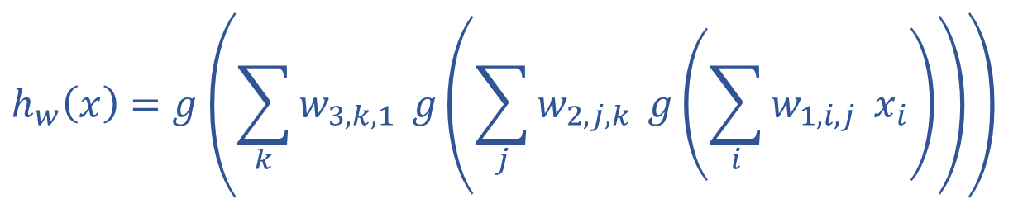
Optimizing
How do we find the “best” set of weights?
$$h_{w}\left(x\right)=g\left(\sum_{k}{w_{3,k,1}} g\left(\sum_{j}{w_{2,j,k}} g\left(\sum_{i}{w_{1,i,j}} x_{i}\right)\right)\right)$$

Slide 30
Optimizing
How do we find the “best” set of weights?
$$h_{w}\left(x\right)=g\left(\sum_{k}{w_{3,k,1}} g\left(\sum_{j}{w_{2,j,k}} g\left(\sum_{i}{w_{1,i,j}} x_{i}\right)\right)\right)$$

Slide 31
Neural Network Equations
$$z11$$
$$w111$$
$$z21$$
$$x1$$
$$∑$$
$$g$$
$$w211$$
$$w112$$
$$w113$$
$$w212$$
$$z31$$
$$∑$$
$$g$$
$$w311$$
$$w121$$
$$w221$$
$$z12$$
$$z22$$
$$z41$$
$$x2$$
$$∑$$
$$g$$
$$∑$$
$$g$$
$$w123$$
$$w221$$
$$z32$$
$$w321$$
$$w131$$
$$∑$$
$$g$$
$$z13$$
$$z23$$
$$w232$$
$$x3$$
$$∑$$
$$g$$
w₁₃₃
How do we describe this network?
input neuron (node) loss
hidden layer
output layer

Slide 32
Network Optimization Details

Slide 33
Reminder: Calculus Chain Rule (scalar version)
$$y=f\left(z\right)$$
$$z=g\left(x\right)$$
$$\frac{dy}{dx}=\frac{dy}{dz}\frac{dz}{dx}$$

Slide 34
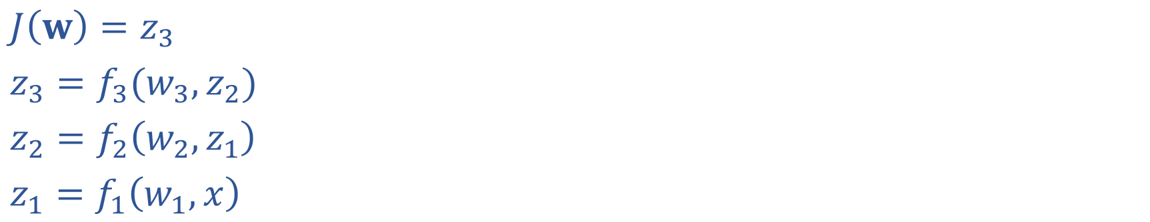
Network Optimization
$J\left(w\right)=z_{3}$
$z_{3}=f_{3}(w_{3}, z_{2})$
$z_{2}=f_{2}\left(w_{2}, z_{1}\right)$
$z_{1}=f_{1}\left(w_{1}, x\right)$

Slide 35
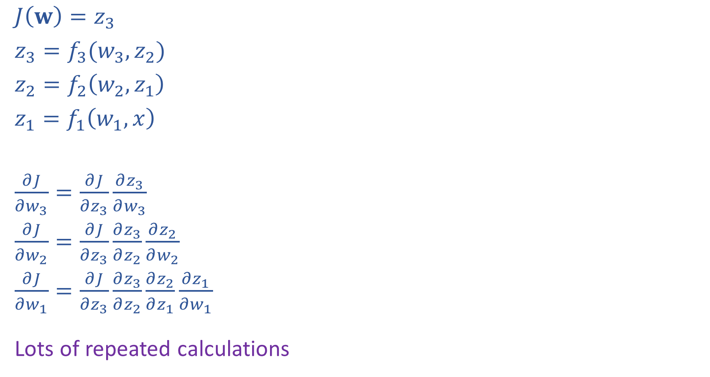
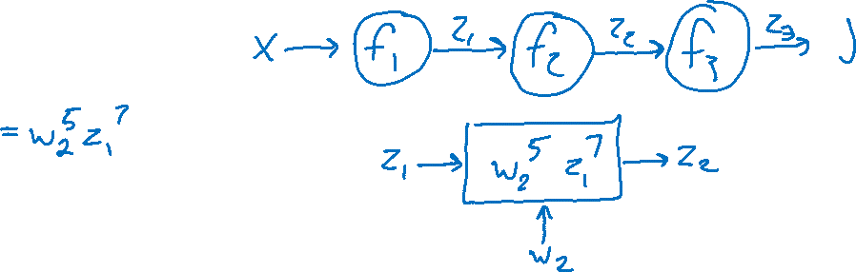
Network Optimization: Forward then Backwards
$J\left(w\right)=z_{3}$
$z_{3}=f_{3}(w_{3}, z_{2})$
$z_{2}=f_{2}\left(w_{2}, z_{1}\right)$
$z_{1}=f_{1}\left(w_{1}, x\right)$
$\frac{∂J}{∂w_{3}}=\frac{∂J}{∂z_{3}}\frac{∂z_{3}}{∂w_{3}}$
$\frac{∂J}{∂w_{2}}=\frac{∂J}{∂z_{3}}\frac{∂z_{3}}{∂z_{2}}\frac{∂z_{2}}{∂w_{2}}$
$\frac{∂J}{∂w_{1}}=\frac{∂J}{∂z_{3}}\frac{∂z_{3}}{∂z_{2}}\frac{∂z_{2}}{∂z_{1}}\frac{∂z_{1}}{∂w_{1}}$
Lots of repeated calculations

Slide 36
Network Optimization: Layer Implementation
$J\left(w\right)=z_{3}$
$z_{3}=f_{3}(w_{3}, z_{2})$
$z_{2}=f_{2}\left(w_{2}, z_{1}\right)$
$z_{1}=f_{1}\left(w_{1}, x\right)$
$\frac{∂J}{∂w_{3}}=\frac{∂J}{∂z_{3}}\frac{∂z_{3}}{∂w_{3}}$
$\frac{∂J}{∂w_{2}}=\frac{∂J}{∂z_{3}}\frac{∂z_{3}}{∂z_{2}}\frac{∂z_{2}}{∂w_{2}}$
$\frac{∂J}{∂w_{1}}=\frac{∂J}{∂z_{3}}\frac{∂z_{3}}{∂z_{2}}\frac{∂z_{2}}{∂z_{1}}\frac{∂z_{1}}{∂w_{1}}$
Lots of repeated calculations

Slide 37

Backpropagation (so-far)
Compute derivatives per layer, utilizing previous derivatives
Objective: $J\left(w\right)$
Arbitrary layer: $y=f\left(x, w\right)$
Need:
$\frac{∂J}{∂x}=\frac{∂J}{∂y}\frac{∂y}{∂x}$
$\frac{∂J}{∂w}=\frac{∂J}{∂y}\frac{∂y}{∂w}$
$$x$$
Layer $y=f\left(x, w\right)$
$\frac{∂y}{∂x}$
$\frac{∂y}{∂w}$
$$y$$
$$\frac{∂J}{∂x}$$
$$\frac{∂J}{∂y}$$
$$w$$
$$\frac{∂J}{∂w}$$

Slide 38
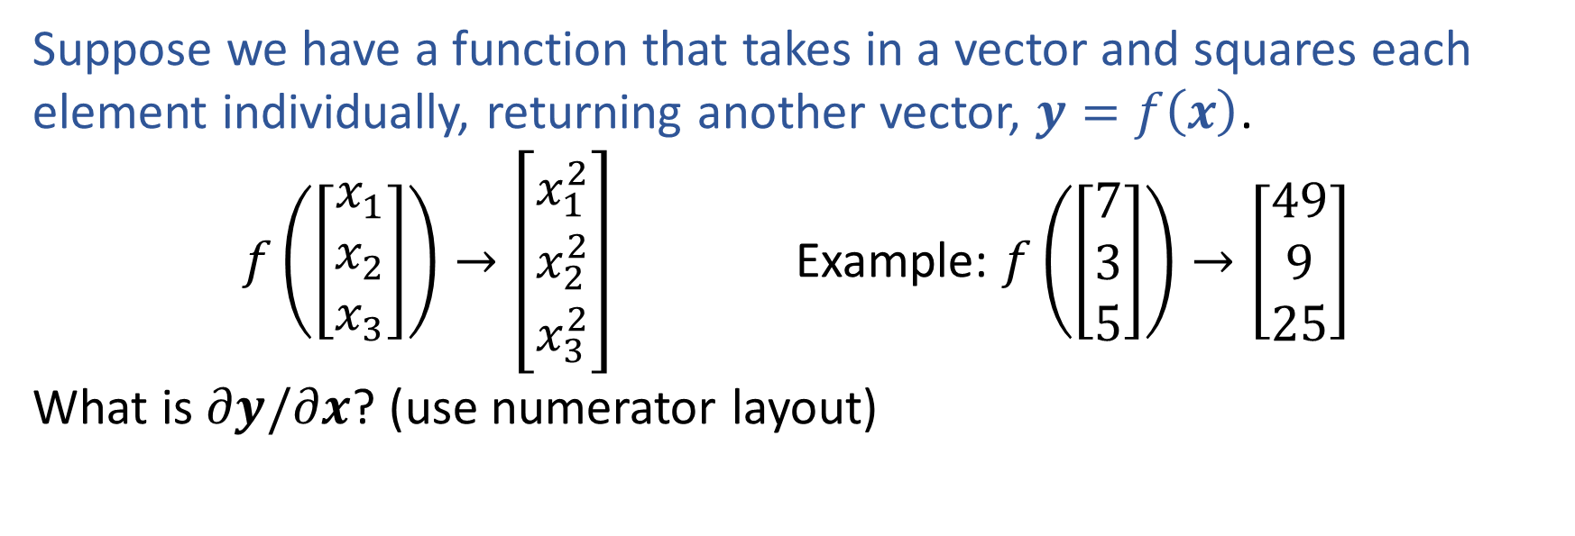
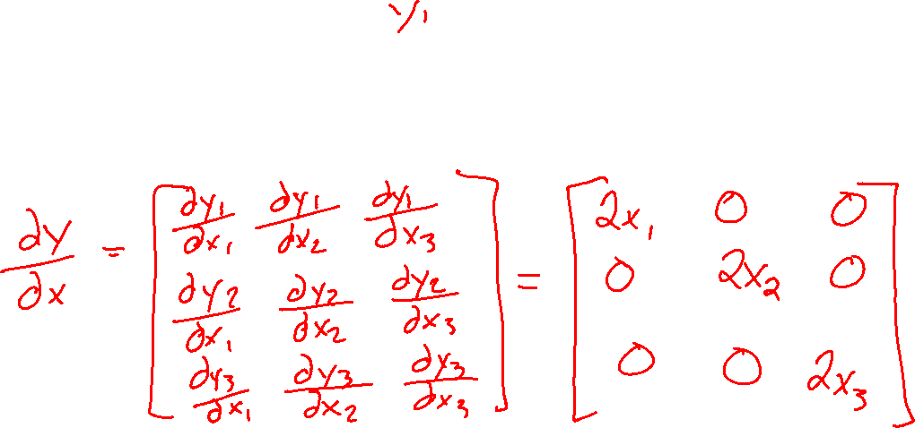
Previous Exercise
Suppose we have a function that takes in a vector and squares each element individually, returning another vector, $y=f\left(x\right)$.
$f\left(\left[\begin{aligned}x_{1} \\ x_{2} \\ x_{3}\end{aligned}\right]\right)→\left[\begin{aligned}x_{1}^{2} \\ x_{2}^{2} \\ x_{3}^{2}\end{aligned}\right]$ Example: $f\left(\left[\begin{aligned}7 \\ 3 \\ 5\end{aligned}\right]\right)→\left[\begin{aligned}49 \\ 9 \\ 25\end{aligned}\right]$
What is $∂y/∂x$? (use numerator layout)

Slide 39
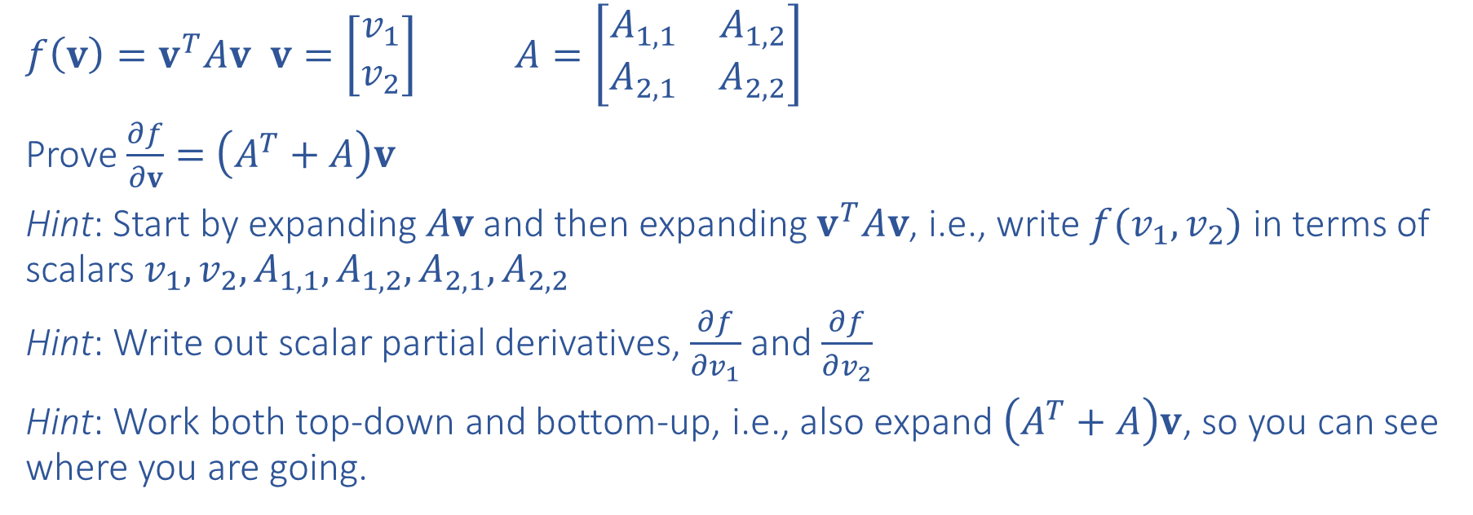
Exercise
Prove $\frac{∂}{∂v}v^{T}Av=\left(A^{T}+A\right)v$ for $v∈ℝ^{2}$ and $A∈ℝ^{2×2}$
$f\left(v\right)=v^{T}Av$ $v=\left[\begin{matrix}v_{1} \\ v_{2}\end{matrix}\right]$ $A=\left[\begin{matrix}A_{1,1} & A_{1,2} \\ A_{2,1} & A_{2,2}\end{matrix}\right]$
Prove $\frac{∂f}{∂v}=$ $\left(A^{T}+A\right)v$
Hint: Start by expanding $Av$ and then expanding $v^{T}Av$, i.e., write $f(v_{1},v_{2})$ in terms of scalars $v_{1}, v_{2}, A_{1,1}, A_{1,2}, A_{2,1}, A_{2,2}$
Hint: Write out scalar partial derivatives, $\frac{∂f}{∂v_{1}}$ and $\frac{∂f}{∂v_{2}}$
Hint: Work both top-down and bottom-up, i.e., also expand $\left(A^{T}+A\right)v$, so you can see where you are going.

Slide 40
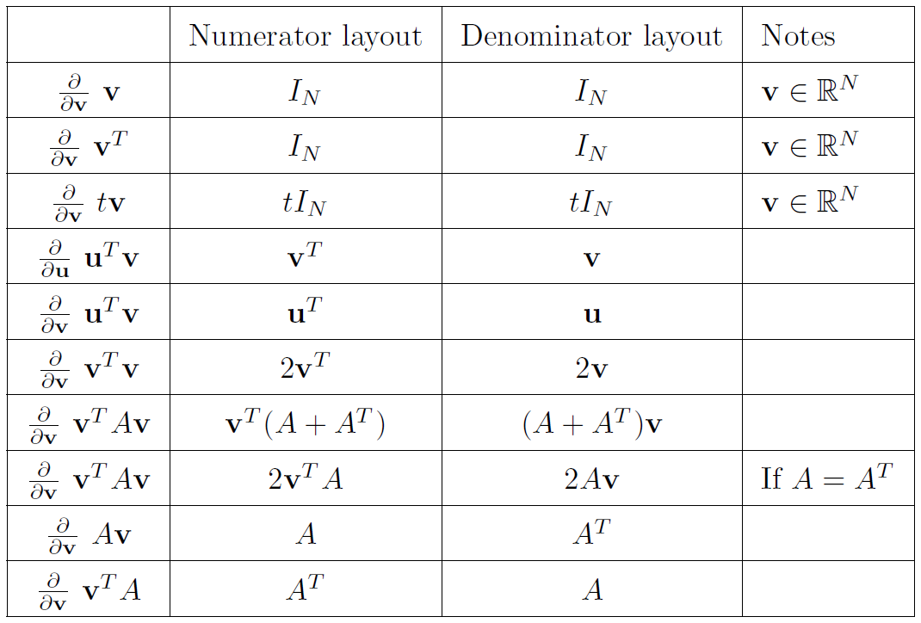
Derivatives of Functions with Respect to Vectors

Slide 41
Calculus
Multivariable Chain Rule

Slide 42
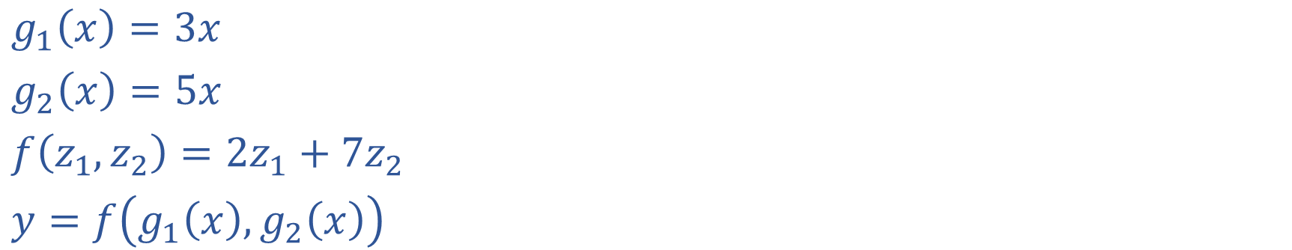
Multivariable Chain Rule
$g_{1}\left(x\right)=3x$
$g_{2}\left(x\right)=5x$
$f\left(z_{1}, z_{2}\right)={2z}_{1}+{7z}_{2}$
$y=f\left(g_{1}\left(x\right),g_{2}\left(x\right)\right)$

Slide 43
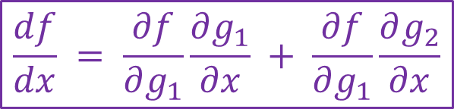
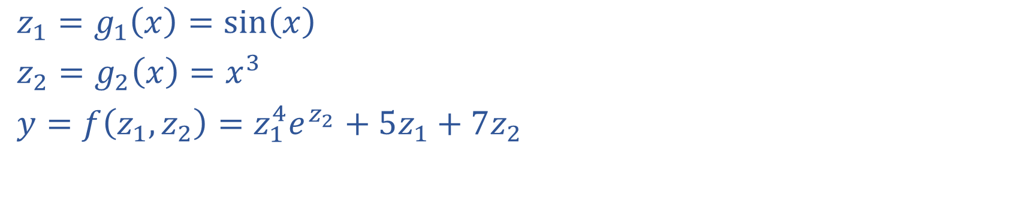
Exercise: Multivariable Chain Rule
$$\frac{df}{dx} = \frac{∂f}{∂g_{1}}\frac{∂g_{1}}{∂x} + \frac{∂f}{∂g_{1}}\frac{∂g_{2}}{∂x}$$
$z_{1}=g_{1}\left(x\right)=sin\left(x\right)$
$z_{2}=g_{2}\left(x\right)=x^{3}$
$y=f\left(z_{1}, z_{2}\right)=z_{1}^{4}e^{z_{2}}+5z_{1}+7z_{2}$

Slide 44
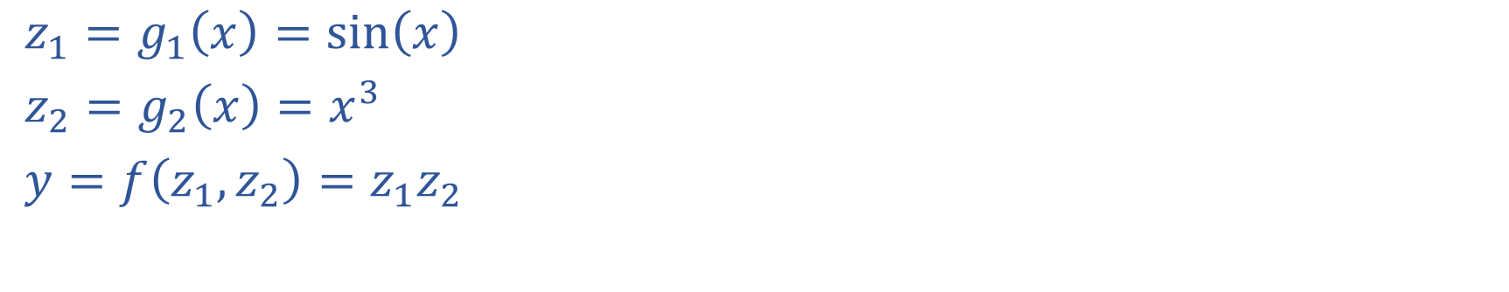
Multivariable Chain Rule
$$\frac{df}{dx} = \frac{∂f}{∂g_{1}}\frac{∂g_{1}}{∂x} + \frac{∂f}{∂g_{1}}\frac{∂g_{2}}{∂x}$$
$z_{1}=g_{1}\left(x\right)=sin\left(x\right)$
$z_{2}=g_{2}\left(x\right)=x^{3}$
$y=f\left(z_{1}, z_{2}\right)=z_{1}z_{2}$

Slide 45
Calculus Chain Rule
Scalar:
$y=f\left(z\right)$
$z=g\left(x\right)$
$\frac{dy}{dx}=\frac{dy}{dz}\frac{dz}{dx}$
Multivariate:
$y=f\left(z\right)$
$z=g\left(x\right)$
$\frac{dy}{dx}=\sum_{j}{\frac{∂y}{∂z_{j}}\frac{∂z_{j}}{∂x}}$
Multivariate:
$y=f\left(z\right)$
$z=g\left(x\right)$
$\frac{dy_{i}}{dx_{k}}=\sum_{j}{\frac{∂y_{i}}{∂z_{j}}\frac{∂z_{j}}{∂x_{k}}}$

Slide 46
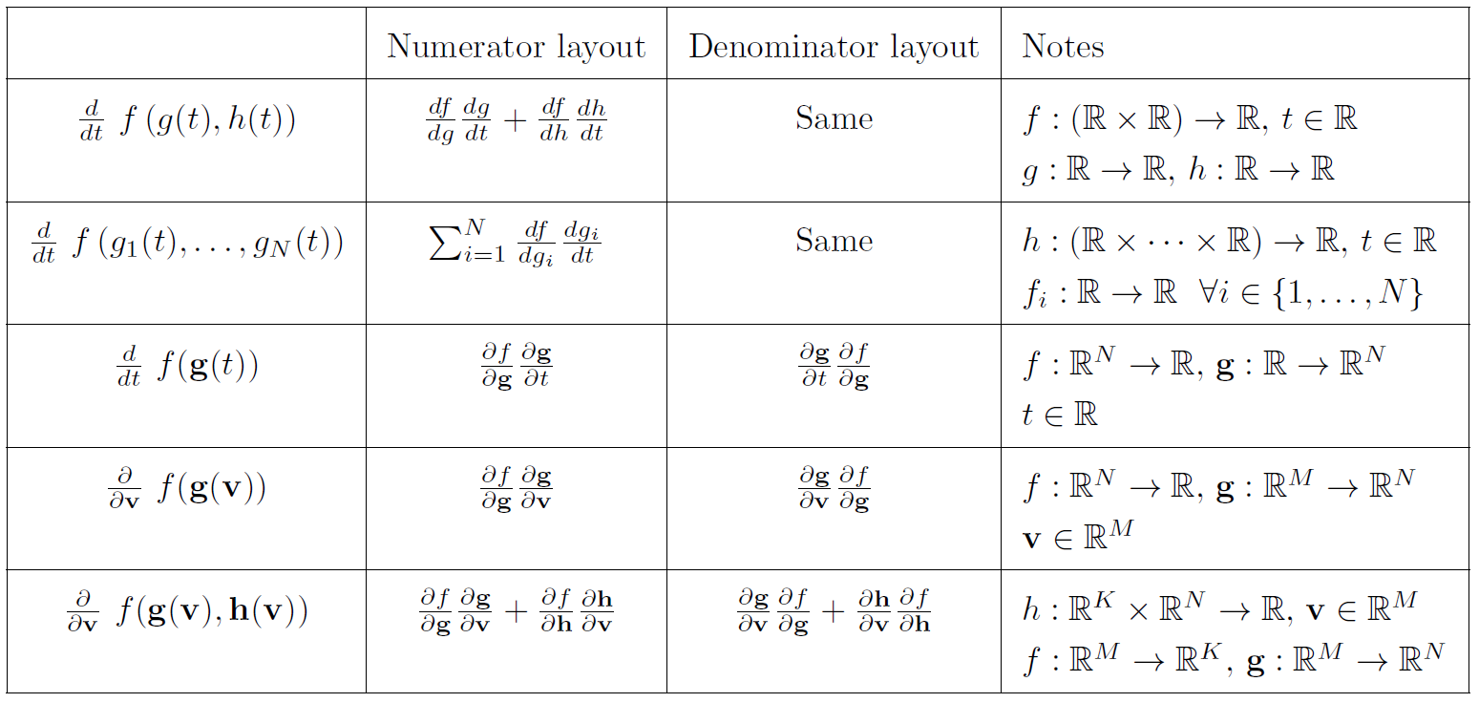
Multivariable Chain Rule

Slide 47

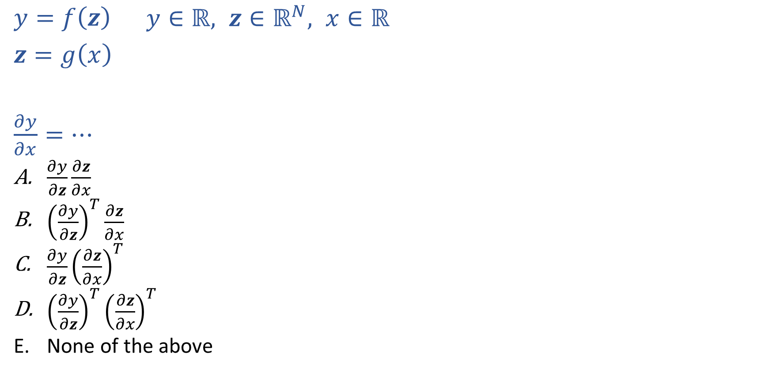
Poll 4
Assume numerator layout:
Num outputs $×$ Num inputs
$y=f\left(z\right)$ $y∈ℝ, z∈ℝ^{N}, x∈ℝ$
$z=g\left(x\right)$
$\frac{∂y}{∂x}=…$
$\frac{∂y}{∂z}\frac{∂z}{∂x}$
${\left(\frac{∂y}{∂z}\right)}^{T}\frac{∂z}{∂x}$
$\frac{∂y}{∂z}{\left(\frac{∂z}{∂x}\right)}^{T}$
${\left(\frac{∂y}{∂z}\right)}^{T}{\left(\frac{∂z}{∂x}\right)}^{T}$
None of the above

Slide 48
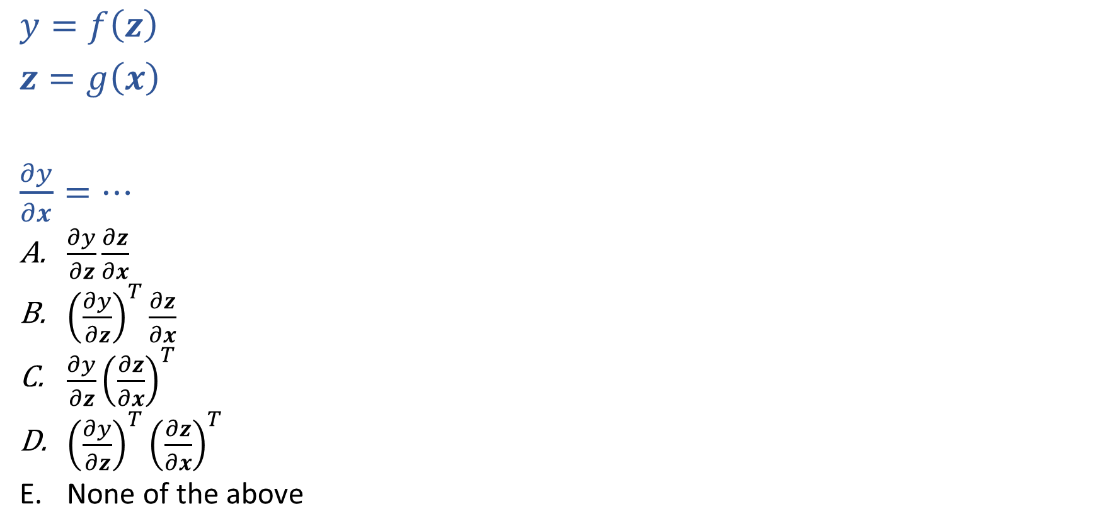
Poll 5
Assume numerator layout:
Num outputs $×$ Num inputs
$y=f\left(z\right)$
$z=g\left(x\right)$
$\frac{∂y}{∂x}=…$
$\frac{∂y}{∂z}\frac{∂z}{∂x}$
${\left(\frac{∂y}{∂z}\right)}^{T}\frac{∂z}{∂x}$
$\frac{∂y}{∂z}{\left(\frac{∂z}{∂x}\right)}^{T}$
${\left(\frac{∂y}{∂z}\right)}^{T}{\left(\frac{∂z}{∂x}\right)}^{T}$
None of the above

Slide 49
Network Optimization
$J\left(w\right)=z_{4}$
${z_{4}=f}_{4}\left(w_{D}, w_{E}, z_{2},z_{3}\right)$
$z_{3}=f_{3}\left(w_{C}, z_{1}\right)$
$z_{2}=f_{2}\left(w_{B}, z_{1}\right)$
$z_{1}=f_{1}\left(w_{A}, x\right)$
Need multivariate chain rule!

Slide 50

Network Optimization
$$\frac{∂J}{∂w_{E}}=\frac{∂J}{∂z_{4}}\frac{∂z_{4}}{∂w_{E}}$$
$$\frac{∂J}{∂w_{D}}=\frac{∂J}{∂z_{4}}\frac{∂z_{4}}{∂w_{D}}$$
$$\frac{∂J}{∂z_{3}}=\frac{∂J}{∂z_{4}}\frac{∂z_{4}}{∂z_{3}}$$
$$\frac{∂J}{∂z_{2}}=\frac{∂J}{∂z_{4}}\frac{∂z_{4}}{∂z_{2}}$$
$$\frac{∂J}{∂w_{C}}=\frac{∂J}{∂z_{3}}\frac{∂z_{3}}{∂w_{C}}$$
$$\frac{∂J}{∂w_{B}}=\frac{∂J}{∂z_{2}}\frac{∂z_{2}}{∂w_{B}}$$
$$\frac{∂J}{∂z_{1}}=\frac{∂J}{∂z_{2}}\frac{∂z_{2}}{∂z_{1}}+ \frac{∂J}{∂z_{3}}\frac{∂z_{3}}{∂z_{1}}$$
$$\frac{∂J}{∂w_{A}}=\frac{∂J}{∂z_{1}}\frac{∂z_{1}}{∂w_{A}}$$
$J\left(w\right)=z_{4}$
${z_{4}=f}_{4}\left(w_{D}, w_{E}, z_{2},z_{3}\right)$
$z_{3}=f_{3}\left(w_{C}, z_{1}\right)$
$z_{2}=f_{2}\left(w_{B}, z_{1}\right)$
$z_{1}=f_{1}\left(w_{A}, x\right)$
Need multivariate chain rule!
$$z_{2}$$
$$f_{2}$$
$$z_{1}$$
$$z_{4}$$
$$x$$
$$f_{1}$$
$$f_{4}$$
$$z_{3}$$
$$f_{3}$$

Slide 51
Backpropagation (updated)
Compute derivatives per layer, utilizing previous derivatives
Objective: $J\left(w\right)$
Arbitrary layer: $y=f\left(x, w\right)$
Init:
$\frac{∂J}{∂x}=0$
$\frac{∂J}{∂w}=0$
Compute:
$\frac{∂J}{∂x}+=\frac{∂J}{∂y}\frac{∂y}{∂x}$
$\frac{∂J}{∂w}+=\frac{∂J}{∂y}\frac{∂y}{∂w}$
$$x$$
Layer $y=f\left(x, w\right)$
$\frac{∂y}{∂x}$
$\frac{∂y}{∂w}$
$$y$$
$$\frac{∂J}{∂x}$$
$$\frac{∂J}{∂y}$$
$$w$$
$$\frac{∂J}{∂w}$$

Slide 52












Neural Network Implementation
Which pieces to we treat as functions?
$$z11$$
$$w111$$
$$z21$$
$$x1$$
$$∑$$
$$g$$
$$w211$$
$$w112$$
$$w113$$
$$w212$$
$$z31$$
$$∑$$
$$g$$
$$w311$$
$$w121$$
$$w221$$
$$z12$$
$$z22$$
$$z41$$
$$x2$$
$$∑$$
$$g$$
$$∑$$
$$g$$
$$w123$$
$$w221$$
$$z32$$
$$w321$$
$$w131$$
$$∑$$
$$g$$
$$z13$$
$$z23$$
$$w232$$
$$x3$$
$$∑$$
$$g$$
w₁₃₃

Slide 53
Neural Network Properties

Slide 54
Neural Networks Properties
Practical considerations
Large number of neurons
Danger for overfitting
Modelling assumptions vs data assumptions trade-off
Gradient descent can easily get stuck local optima
What if there are no non-linear activations?
A deep neural network with only linear layers can be reduced to an exactly equivalent single linear layer
Universal Approximation Theorem:
A two-layer neural network with a sufficient number of neurons can approximate any continuous function to any desired accuracy.

Slide 55
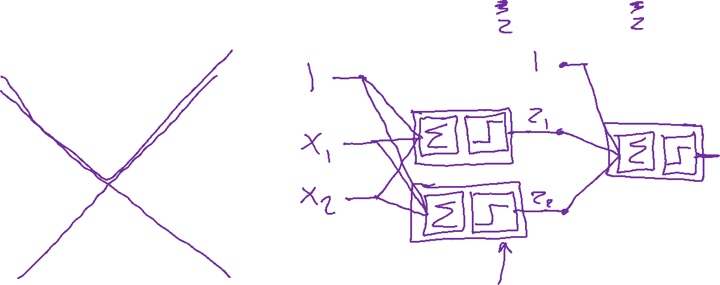
Classification Design Challenge
$$h_{A}\left(x\right)=sign\left(w_{A}^{T}x+b_{A}\right)$$
$$h_{B}\left(x\right)=sign\left(w_{B}^{T}x+b_{B}\right)$$
$$h_{C}\left(x\right)=sign\left(w_{C}^{T}x+b_{C}\right)$$
How could you configure three specific perceptrons to classify this data?
$$x2$$
$$x1$$

Slide 56
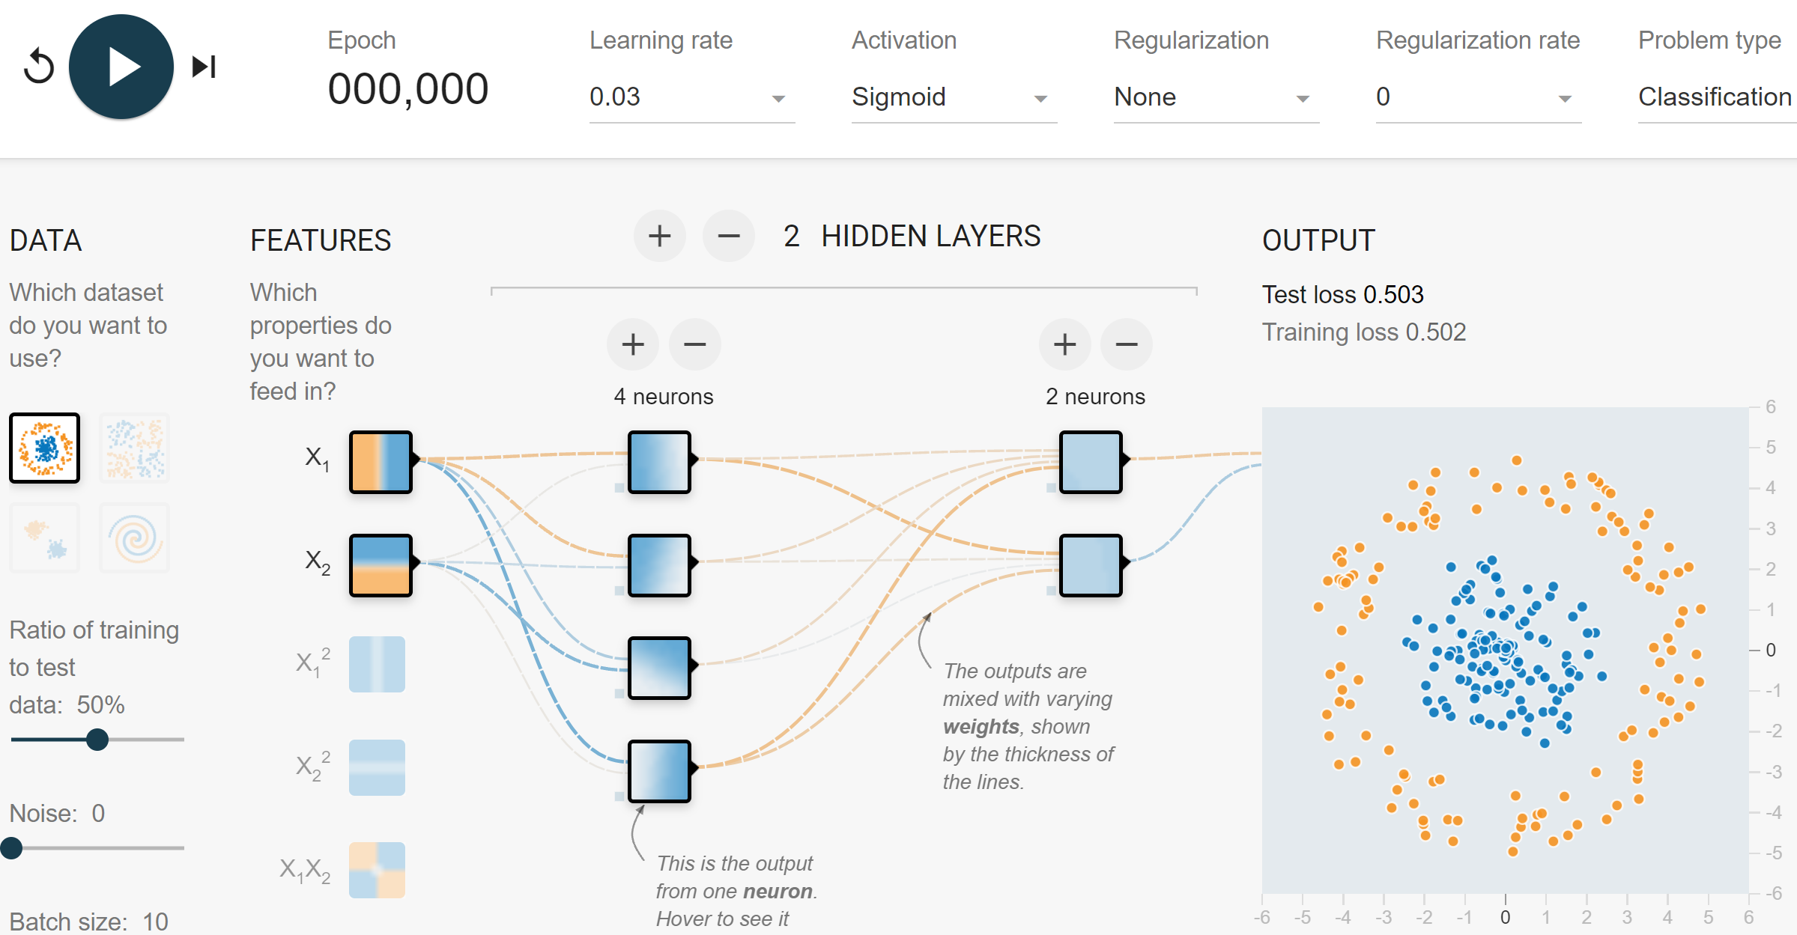
Network to Approximate Binary Classification
https://playground.tensorflow.org/#activation=sigmoid

Slide 57
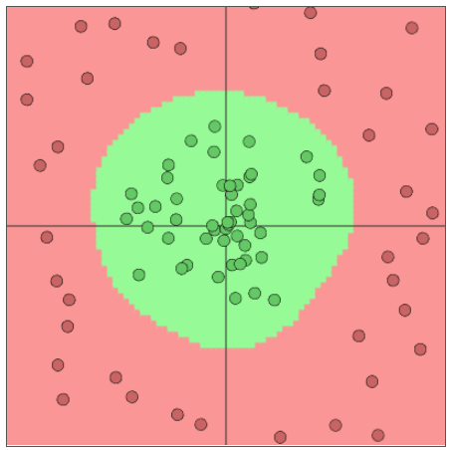
Network to Approximate Binary Classification
Approximate arbitrary decision boundary
https://cs.stanford.edu/people/karpathy/convnetjs/demo/classify2d.html

Slide 58
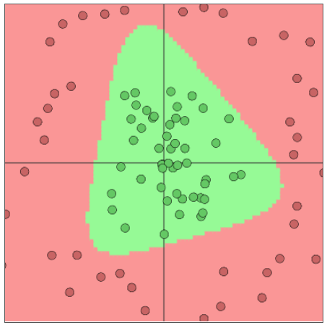
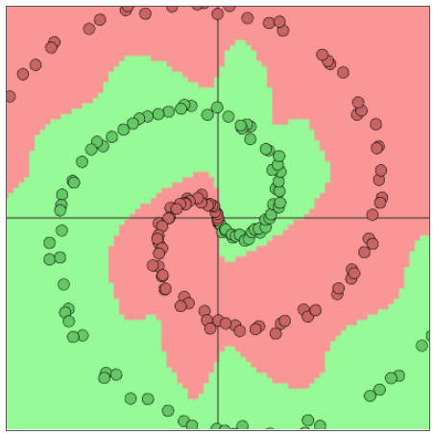
Network to Approximate Binary Classification
Approximate arbitrary decision boundary
https://cs.stanford.edu/people/karpathy/convnetjs/demo/classify2d.html

Slide 59
Network to Approximate Binary Classification
Approximate arbitrary decision boundary
https://cs.stanford.edu/people/karpathy/convnetjs/demo/classify2d.html

Slide 60
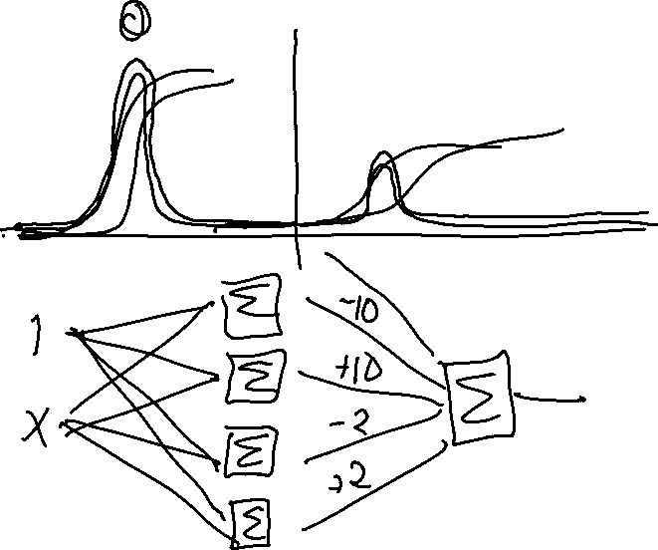
Network to Approximate a 1-D Function

Slide 61
Network to Approximate a 1-D Function

Slide 62
Objective Function is Not Convex
Objective function for… | Convex? | Closed-form solution?
Linear regression
Logistic regression
Neural networks

Slide 63

Optimization
Linear function
If $f(x)$ is linear, then:
$f\left(x+z\right)=f\left(x\right)+f\left(z\right)$
$f\left(αx\right)=αf\left(x\right) ∀α$
$f\left(αx+\left(1−α\right)z\right)=αf\left(x\right)+\left(1−α\right)f\left(z\right) ∀α$

Slide 64
Optimization
Linear function
If $f(x)$ is linear, then:
$f\left(x+z\right)=f\left(x\right)+f\left(z\right)$
$f\left(αx\right)=αf\left(x\right) ∀α$
$f\left(αx+\left(1−α\right)z\right)=αf\left(x\right)+\left(1−α\right)f\left(z\right) ∀α$

Slide 65

Optimization
Convex function
If $f(x)$ is convex, then:
$f\left(αx+\left(1−α\right)z\right)≤αf\left(x\right)+\left(1−α\right)f\left(z\right) ∀ 0≤α≤1$

Slide 66


Optimization
Convex function
If $f(x)$ is convex, then:
$f\left(αx+\left(1−α\right)z\right)≤αf\left(x\right)+\left(1−α\right)f\left(z\right)$ $∀ 0≤α≤1$
Demo on Desmos

Slide 67

Optimization
Convex function
If $f(x)$ is convex, then:
$f\left(αx+\left(1−α\right)z\right)≤αf\left(x\right)+\left(1−α\right)f\left(z\right) ∀ 0≤α≤1$
Convex optimization
If second derivative is $≥0$ everywhere then function is convex
If $f(x)$ is convex, then:
Every local minimum is also a global minimum ☺

