Slide 1

10-315 Introduction to ML Feature Engineering
Instructor: Pat Virtue

Slide 2
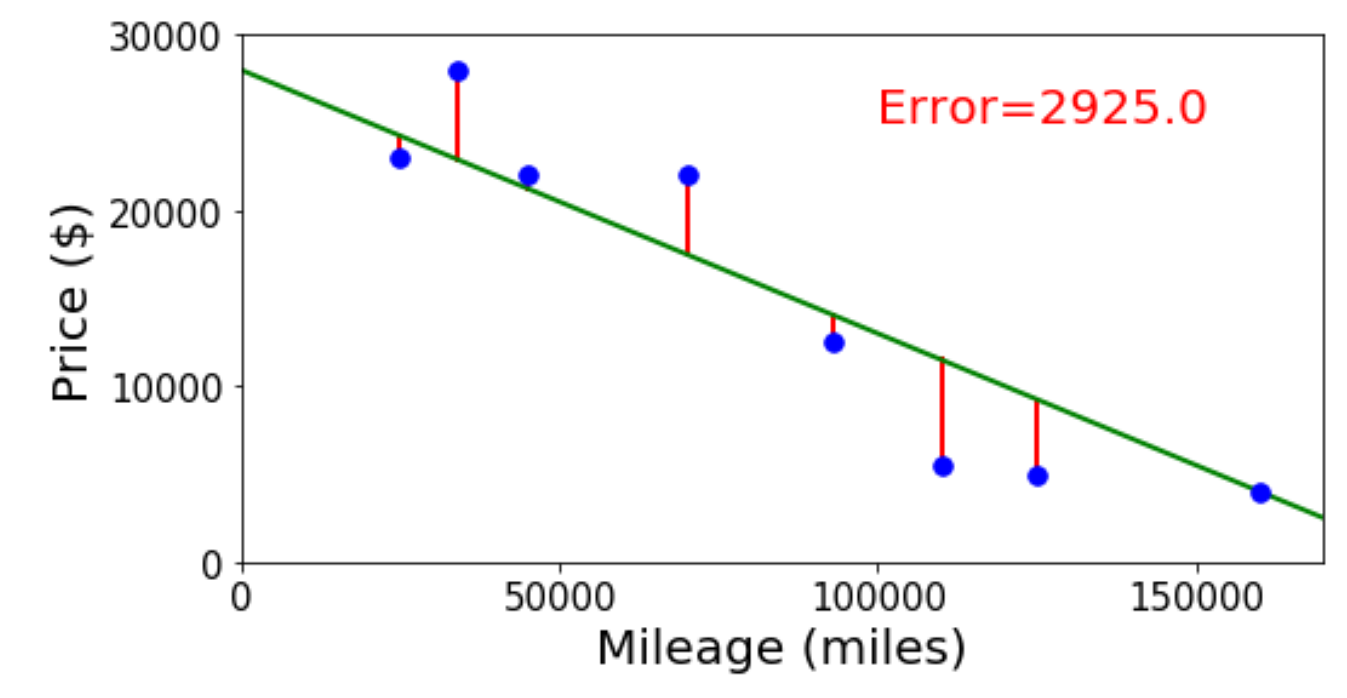

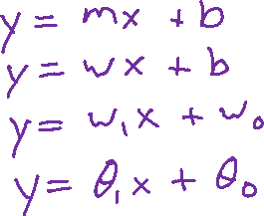
Previous Poll
Linear regression. What is linear about it?
Select all that apply.
Always fits a linear (or affine) shape to the data
Linear objective function with respect to the input
Linear objective function with respect to the parameters
None of the above

Slide 3
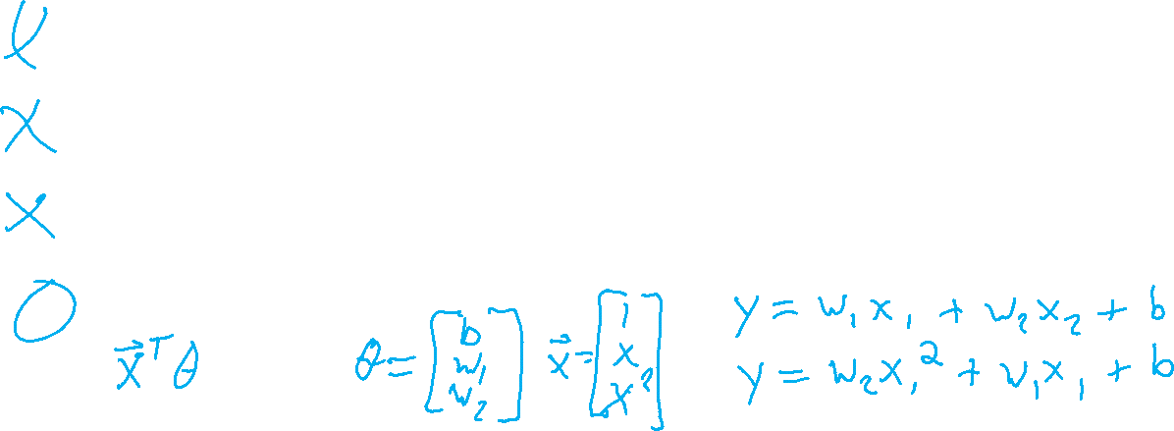
Previous Poll
Linear regression. What is linear about it?
Select all that apply.
Always fits a linear (or affine) shape to the data
Linear objective function with respect to the input
Linear objective function with respect to the parameters
None of the above

Slide 4
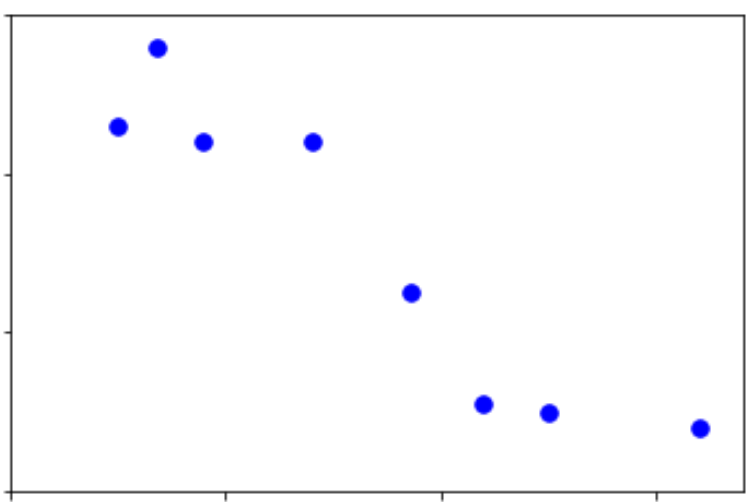

Linear Data
Regression on simple linear dataset
Output y
Input x

Slide 5
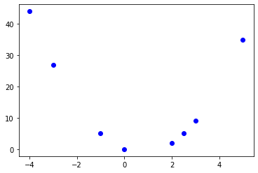
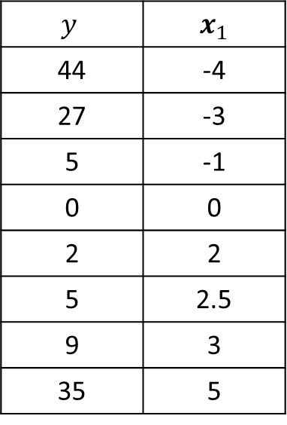
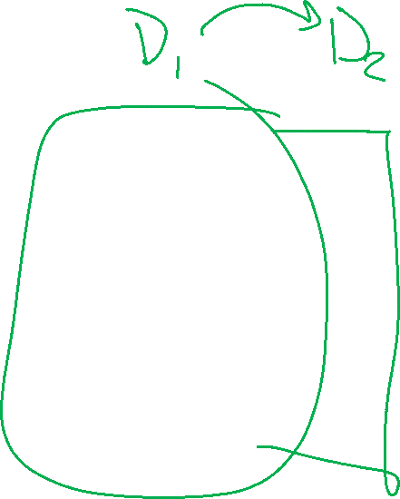
Non-linear Data
Linear regression on polynomial data?
$$y$$ | $x_{1}$
44 | -4
27 | -3
5 | -1
0 | 0
2 | 2
5 | 2.5
9 | 3
35 | 5
Output y
Input x

Slide 6
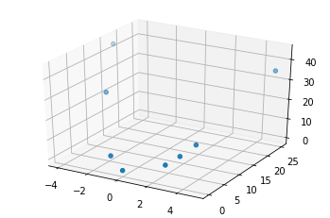
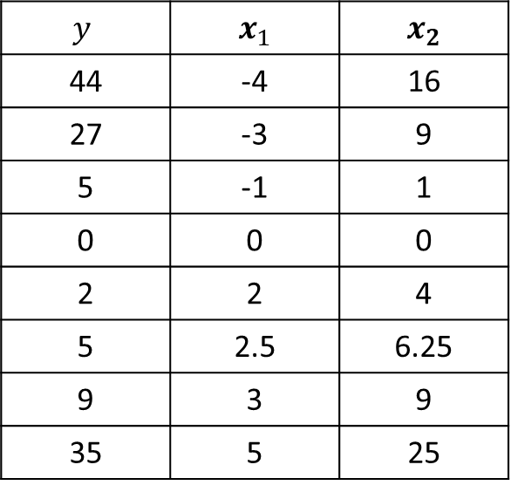
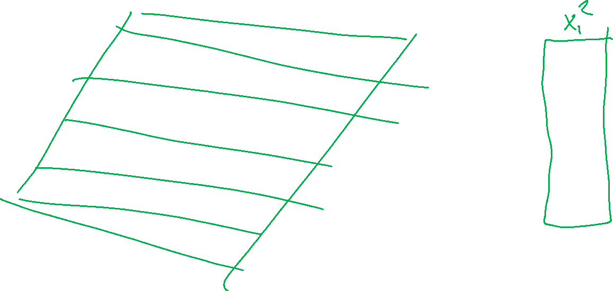
Non-linear Data
Regression on simple linear dataset
$$y$$ | $x_{1}$ | $x_{2}$
44 | -4 | 16
27 | -3 | 9
5 | -1 | 1
0 | 0 | 0
2 | 2 | 4
5 | 2.5 | 6.25
9 | 3 | 9
35 | 5 | 25

Slide 7
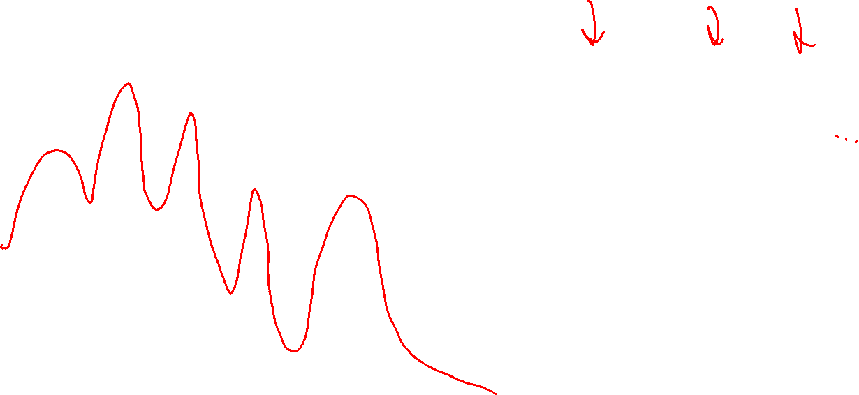
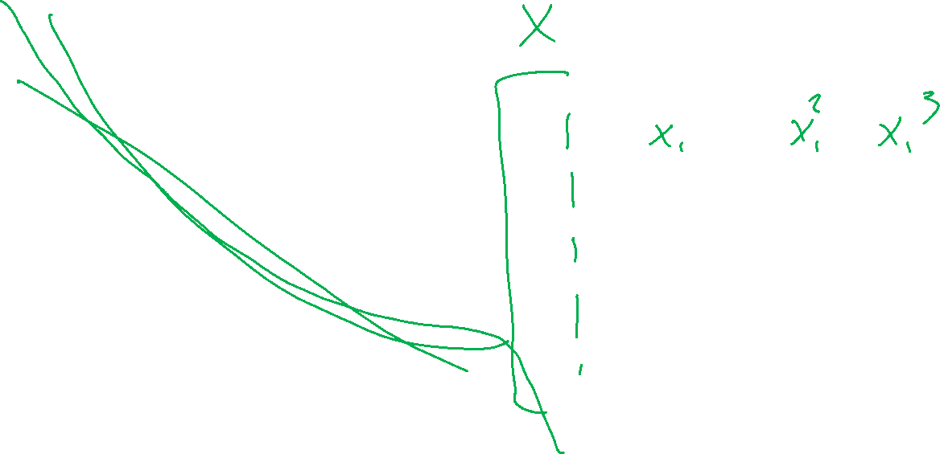
Non-linear Data
Polynomial feature map for linear regression
Output y
Input x

Slide 8
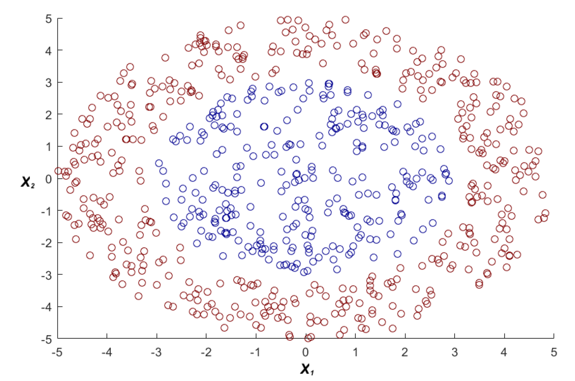

Non-linear Data
Polynomial feature map for linear classification
https://www.youtube.com/watch?v=3liCbRZPrZA

Slide 9
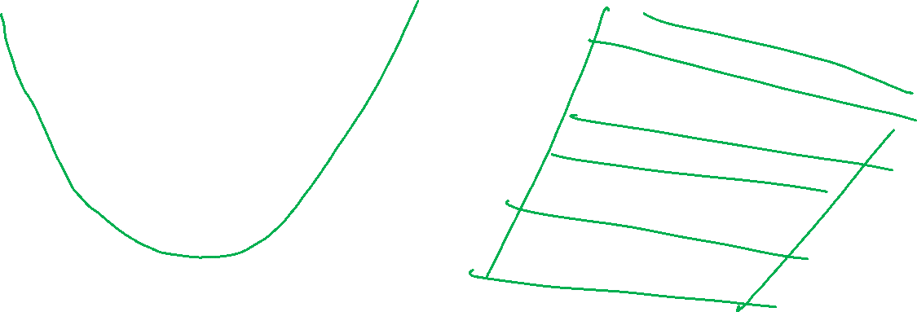
Feature Maps
Two ways to think about it

Slide 10
Example: Linear Regression
Goal: Learn y = w^{T} f(x) + b
where f(.) is a polynomial basis function
y | x
2.0 | 1.2
1.3 | 1.7
0.1 | 2.7
1.1 | 1.9
y
Slide credit: CMU MLD Matt Gormley
true “unknown” target function is linear with negative slope and gaussian noise
x

Slide 11
Example: Linear Regression
Goal: Learn y = w^{T} f(x) + b
where f(.) is a polynomial basis function
y | x
2.0 | 1.2
1.3 | 1.7
0.1 | 2.7
1.1 | 1.9
y
Slide credit: CMU MLD Matt Gormley
true “unknown” target function is linear with negative slope and gaussian noise
x

Slide 12
Example: Linear Regression
Goal: Learn y = w^{T} f(x) + b
where f(.) is a polynomial basis function
y | x | x²
2.0 | 1.2 | (1.2)²
1.3 | 1.7 | (1.7)²
0.1 | 2.7 | (2.7)²
1.1 | 1.9 | (1.9)²
y
Slide credit: CMU MLD Matt Gormley
true “unknown” target function is linear with negative slope and gaussian noise
x

Slide 13
Example: Linear Regression
Goal: Learn y = w^{T} f(x) + b
where f(.) is a polynomial basis function
y | x | x² | x³
2.0 | 1.2 | (1.2)² | (1.2)³
1.3 | 1.7 | (1.7)² | (1.7)³
0.1 | 2.7 | (2.7)² | (2.7)³
1.1 | 1.9 | (1.9)² | (1.9)³
y
Slide credit: CMU MLD Matt Gormley
true “unknown” target function is linear with negative slope and gaussian noise
x

Slide 14
Example: Linear Regression
Goal: Learn y = w^{T} f(x) + b
where f(.) is a polynomial basis function
y | x | x² | … | x⁵
2.0 | 1.2 | (1.2)² | … | (1.2)⁵
1.3 | 1.7 | (1.7)² | … | (1.7)⁵
0.1 | 2.7 | (2.7)² | … | (2.7)⁵
1.1 | 1.9 | (1.9)² | … | (1.9)⁵
y
Slide credit: CMU MLD Matt Gormley
true “unknown” target function is linear with negative slope and gaussian noise
x

Slide 15

Example: Linear Regression
Goal: Learn y = w^{T} f(x) + b
where f(.) is a polynomial basis function
y | x | x² | … | x⁸
2.0 | 1.2 | (1.2)² | … | (1.2)⁸
1.3 | 1.7 | (1.7)² | … | (1.7)⁸
0.1 | 2.7 | (2.7)² | … | (2.7)⁸
1.1 | 1.9 | (1.9)² | … | (1.9)⁸
y
Slide credit: CMU MLD Matt Gormley
true “unknown” target function is linear with negative slope and gaussian noise
x

Slide 16

Example: Linear Regression
Goal: Learn y = w^{T} f(x) + b
where f(.) is a polynomial basis function
y | x | x² | … | x⁹
2.0 | 1.2 | (1.2)² | … | (1.2)⁹
1.3 | 1.7 | (1.7)² | … | (1.7)⁹
0.1 | 2.7 | (2.7)² | … | (2.7)⁹
1.1 | 1.9 | (1.9)² | … | (1.9)⁹
y
Slide credit: CMU MLD Matt Gormley
true “unknown” target function is linear with negative slope and gaussian noise
x

Slide 17
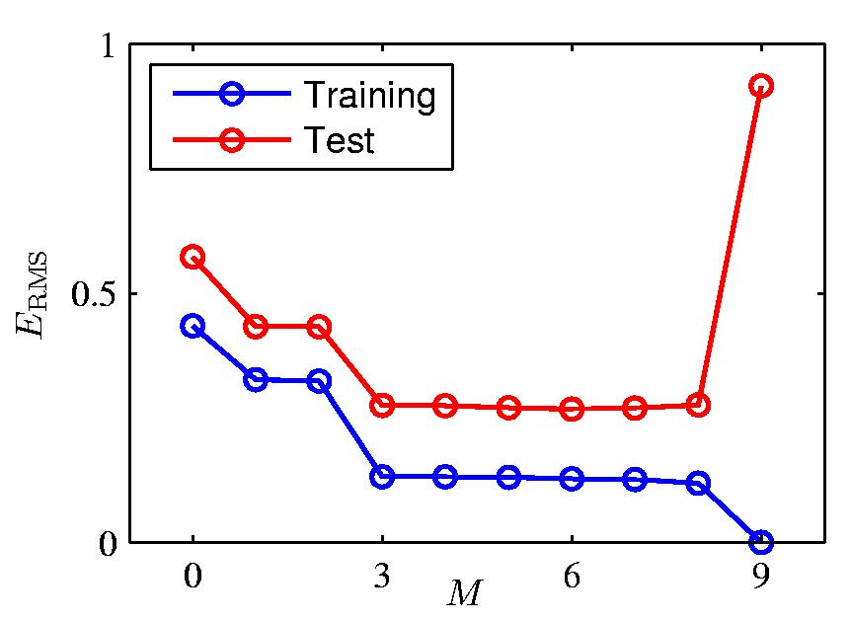
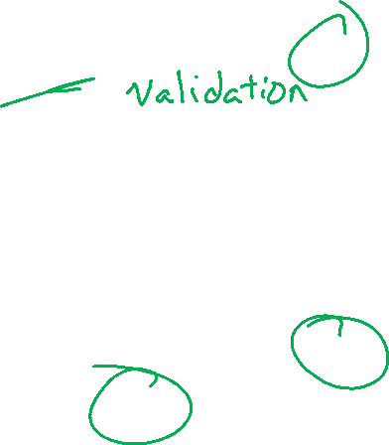
Over-fitting
Slide credit: CMU MLD William Cohen

Slide 18
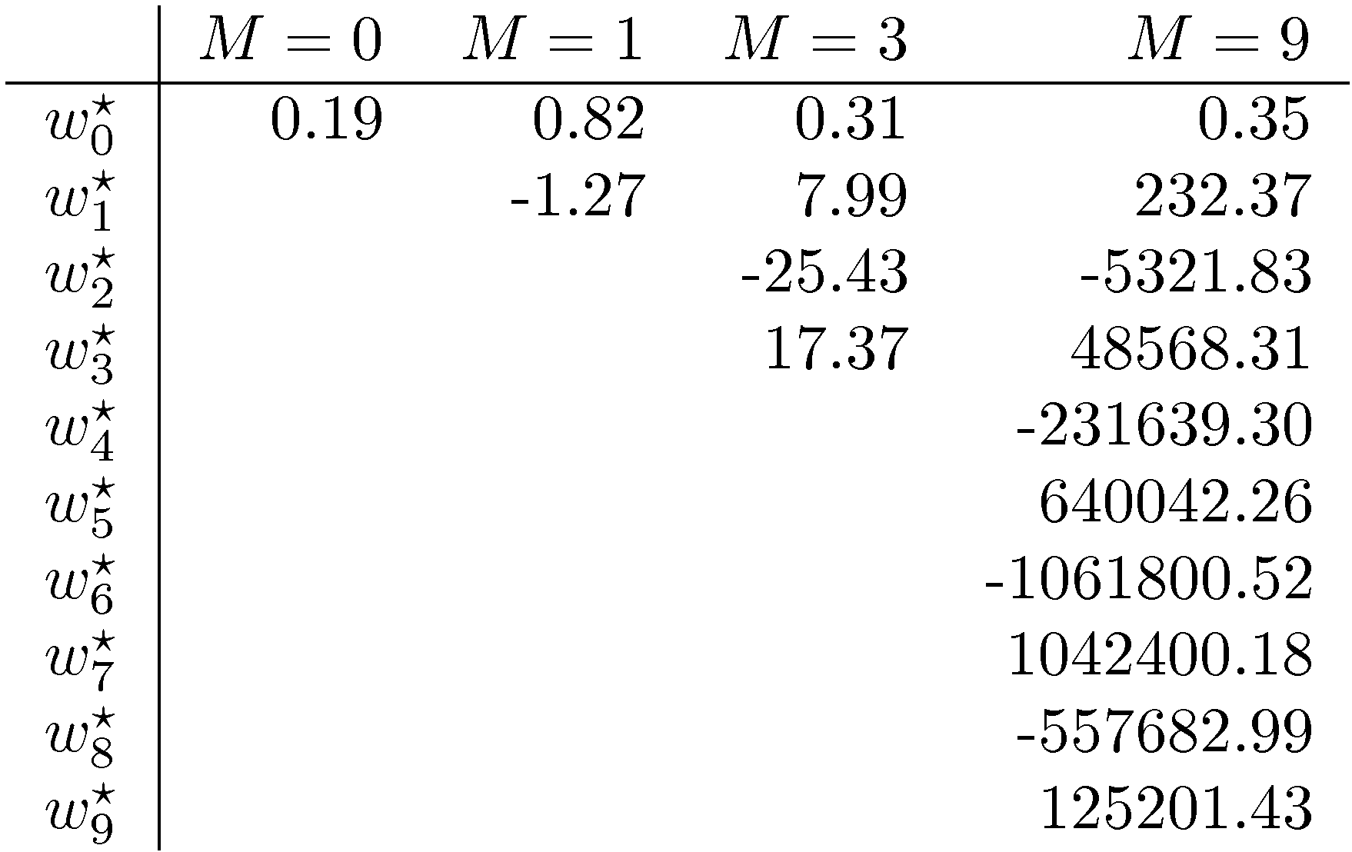

Polynomial Coefficients
Slide credit: CMU MLD William Cohen

Slide 19
Example: Linear Regression
With just N = 10 points we overfit!
But with N = 100 points, the overfitting (mostly) disappears
Takeaway: more data helps prevent overfitting
Goal: Learn y = w^{T} f(x) + b
where f(.) is a polynomial basis function
i | y | x | … | x⁹
1 | 2.0 | 1.2 | … | (1.2)⁹
2 | 1.3 | 1.7 | … | (1.7)⁹
… | … | … | … | …
10 | 1.1 | 1.9 | … | (1.9)⁹
y
Slide credit: CMU MLD Matt Gormley
x

Slide 20

Example: Linear Regression
With just N = 10 points we overfit!
But with N = 100 points, the overfitting (mostly) disappears
Takeaway: more data helps prevent overfitting
Goal: Learn y = w^{T} f(x) + b
where f(.) is a polynomial basis function
i | y | x | … | x⁹
1 | 2.0 | 1.2 | … | (1.2)⁹
2 | 1.3 | 1.7 | … | (1.7)⁹
3 | 0.1 | 2.7 | … | (2.7)⁹
4 | 1.1 | 1.9 | … | (1.9)⁹
… | … | … | … | …
… | … | … | … | …
… | … | … | … | …
98 | … | … | … | …
99 | … | … | … | …
100 | 0.9 | 1.5 | … | (1.5)⁹
y
Slide credit: CMU MLD Matt Gormley
true “unknown” target function is linear with negative slope and gaussian noise
x

Slide 21
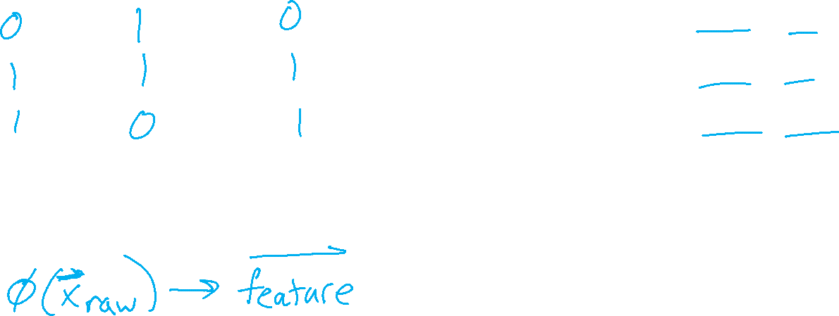
How Do We Deal with Real-world Problems
Politician Voting Classification

Slide 22
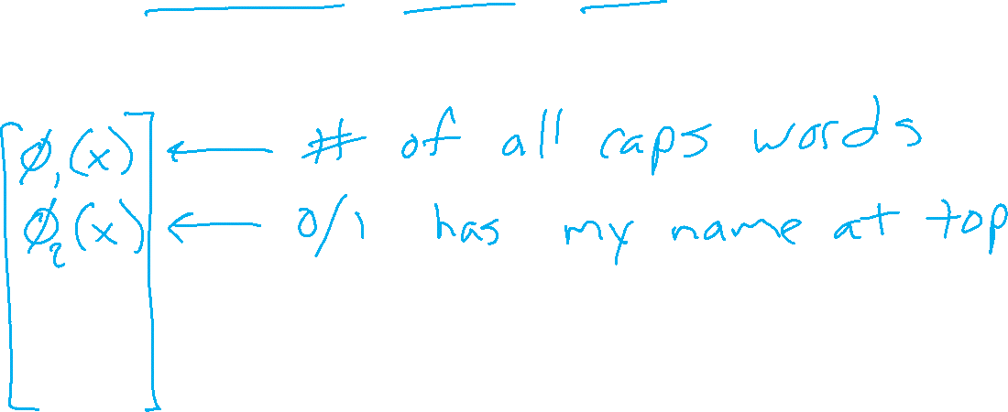
How Do We Deal with Real-world Problems
SPAM Classification

Slide 23
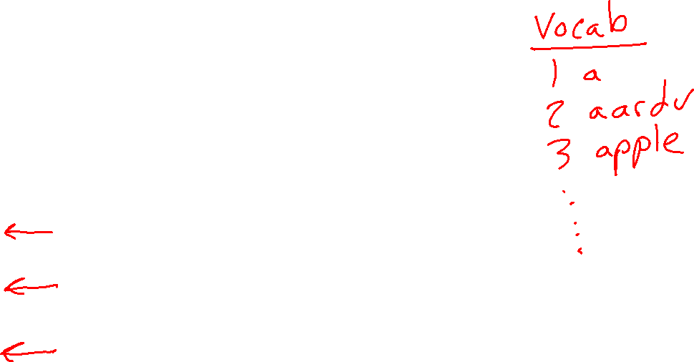
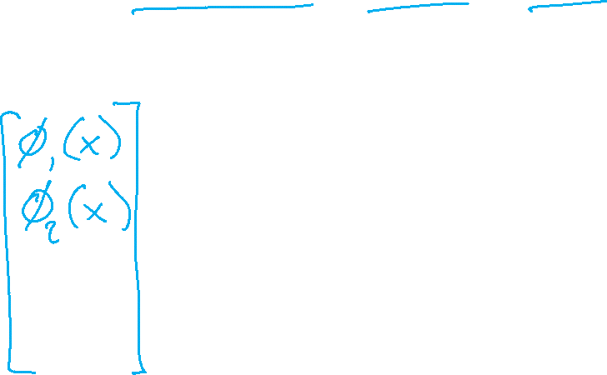
How Do We Deal with Real-world Problems
SPAM Classification

Slide 24
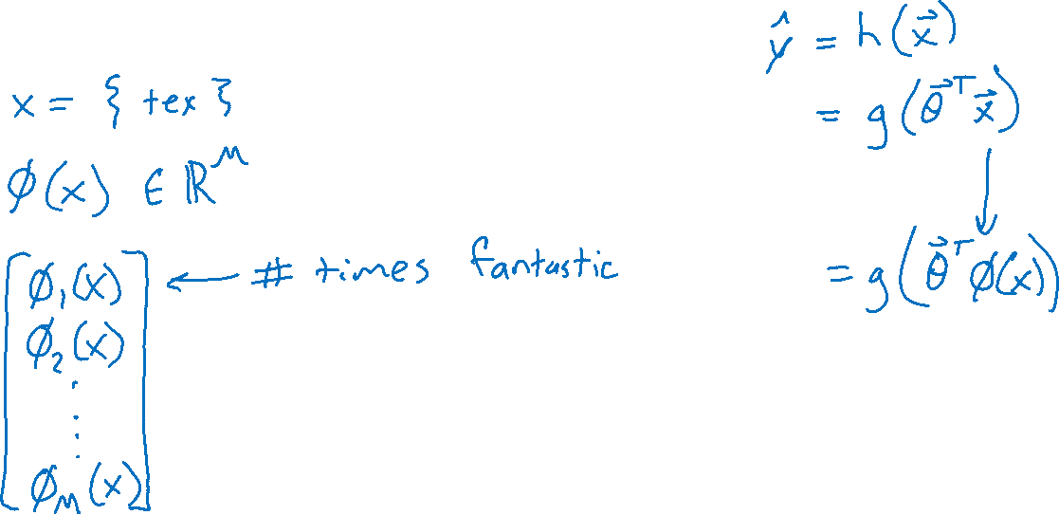
How Do We Deal with Real-world Problems
Predicting Rating from Written Movie Review

Slide 25
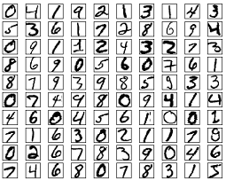

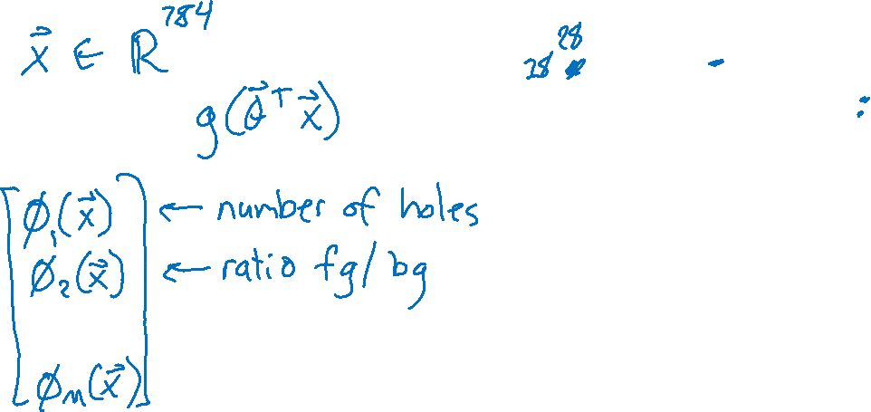
How Do We Deal with Real-world Problems
Images: Handwritten Digits

Slide 26
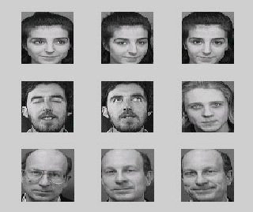

How Do We Deal with Real-world Problems
Images: Face Recognition

Slide 27
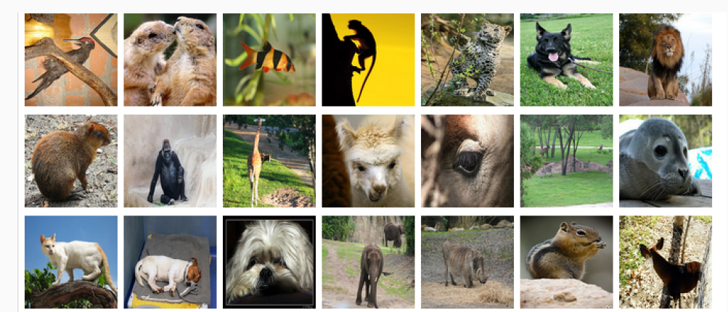
How Do We Deal with Real-world Problems
Images: Animal Classification
Image: ImageNet

Slide 28
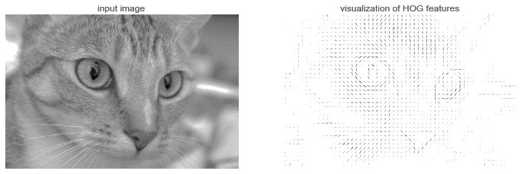
How Do We Deal with Real-world Problems
Images: Animal Classification
Image: https://jakevdp.github.io/PythonDataScienceHandbook/05.14-image-features.html

Slide 29
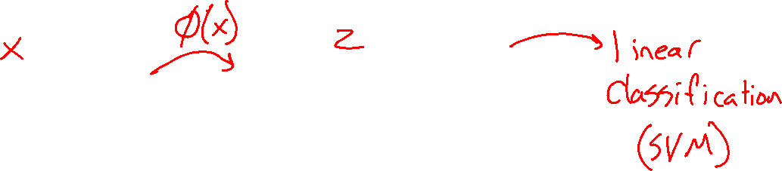
How Do We Deal with Real-world Problems
Preview: Neural Networks
Image: https://jakevdp.github.io/PythonDataScienceHandbook/05.14-image-features.html

Slide 30
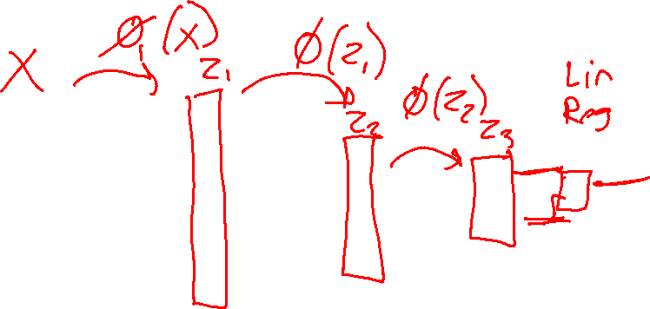
How Do We Deal with Real-world Problems
Preview: Neural Networks
Image: https://jakevdp.github.io/PythonDataScienceHandbook/05.14-image-features.html

Slide 31
How Do We Deal with Real-world Problems
Politician Voting Classification

Slide 32
How Do We Deal with Real-world Problems
SPAM Classification

Slide 33
How Do We Deal with Real-world Problems
Predicting Rating from Written Movie Review

Slide 34
How Do We Deal with Real-world Problems
Images: Handwritten Digits

Slide 35

How Do We Deal with Real-world Problems
Images: Face Recognition

Slide 36
How Do We Deal with Real-world Problems
Images: Animal Classification
Image: ImageNet

Slide 37
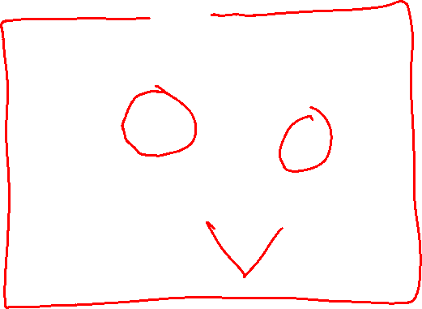
How Do We Deal with Real-world Problems
Images: Animal Classification
Image: https://jakevdp.github.io/PythonDataScienceHandbook/05.14-image-features.html

Slide 38
How Do We Deal with Real-world Problems
Preview: Neural Networks
Image: https://jakevdp.github.io/PythonDataScienceHandbook/05.14-image-features.html

Slide 39
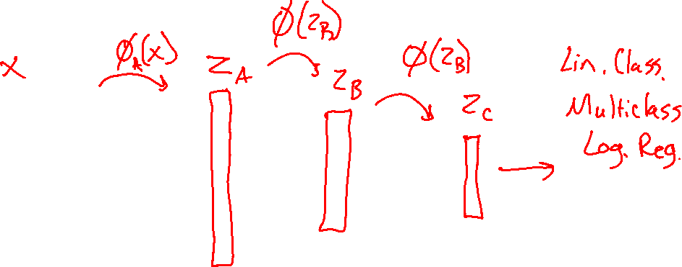
How Do We Deal with Real-world Problems
Preview: Neural Networks
Image: https://jakevdp.github.io/PythonDataScienceHandbook/05.14-image-features.html

