Slide 1
Plan
Cool stuff
Expectation-Maximization algorithm
    Gaussian mixture models for clustering
Kernels
    Linear regression
    Support vector machines
Duality
    Support vector machines

Slide 2

Course Update
Sun | Mon | Tue | Wed | Thu | Fri | Sat
2 | 3 | 4 | 5 HW8 Proj | 6 | 7 | 8
9 HW8 | 10 HW9 HW10 | 11 | 12 | 13 | 14 | 15
16 | 17 HW9 | 18 | 19 Prop | 20 | 21 | 22 HW10
23 | 24 | 25 | 26 MT2 | 27 | 28 | 29
30 | 1 | 2 | 3 | 4 | 5 Proj | 6
Current Plan (updated)
HW 8 (online)
Mini-project proposal
HW 9 (online)
HW 10 (written/prog)
Midterm 2
Mini-project

Slide 3
Poll 1
How many people are currently in your mini-project group, including yourself?
0 (don’t choose this; it doesn’t make sense)
1 (haven’t started looking)
1 (started looking)
2 (haven’t started looking)
2 (started looking)
3
4
5+

Slide 4

10-315
Introduction to ML
Gaussian Mixture Models and Expectation Maximization
Instructor: Pat Virtue

Slide 5
(One) bad case for K-means
Clusters may overlap
Some clusters may be “wider” than others
Clusters may not be linearly separable
Slide credit: CMU MLD Aarti Singh
TexPoint fonts used in EMF.
Read the TexPoint manual before you delete this box.: AAAAAAAAA

Slide 6
(One) bad case for K-means
Clusters may overlap
Some clusters may be “wider” than others
Clusters may not be linearly separable
Slide credit: CMU MLD Aarti Singh
TexPoint fonts used in EMF.
Read the TexPoint manual before you delete this box.: AAAAAAAAA

Slide 7
Partitioning Algorithms
K-means
  hard assignment: each object belongs to only one cluster
Mixture modeling
  soft assignment: probability that an object belongs to a cluster
  Generative approach
Slide credit: CMU MLD Aarti Singh

Slide 8
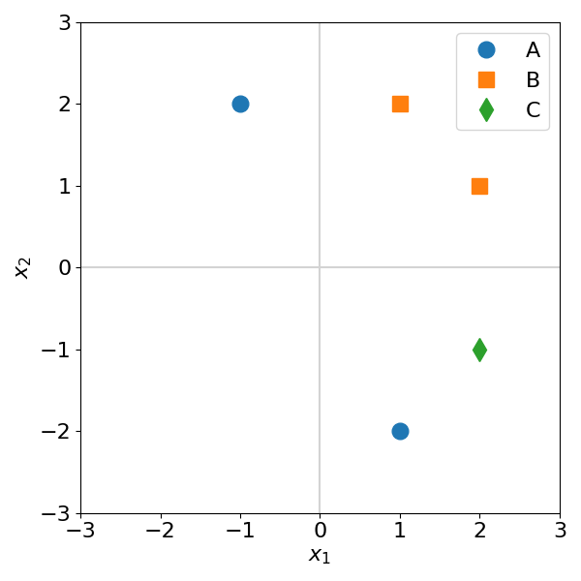
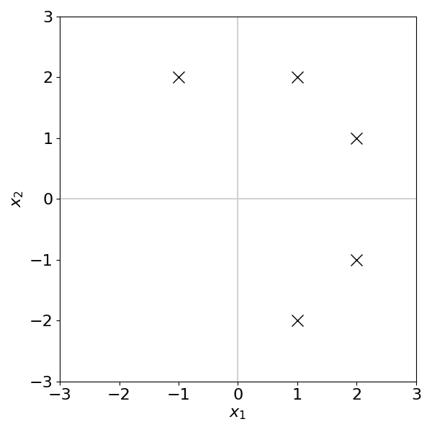
Generative Models: Supervised vs Unsupervised
Discriminant analysis vs Gaussian mixture models

Slide 9
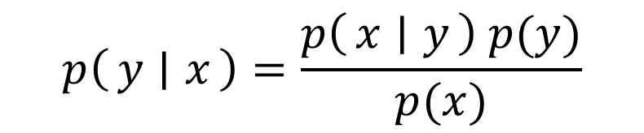
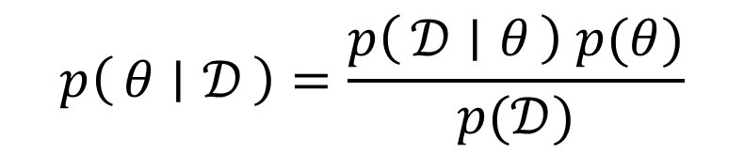
Poll 2
Which of these terms is the likelihood?
Select all that apply
A
B
C
E
F
G
$$p\left(θ ∣ 𝒟\right)=\frac{p\left(𝒟 ∣ θ\right) p(θ)}{p(𝒟)}$$
$$p\left(y ∣ x\right)=\frac{p\left(x ∣ y\right) p(y)}{p(x)}$$
D
H

Slide 10
Generative Models: Supervised vs Unsupervised
Discriminant analysis vs Gaussian mixture models

Slide 11
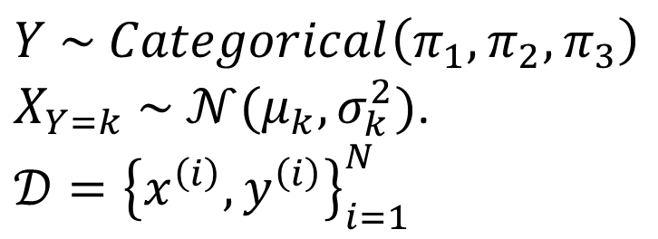
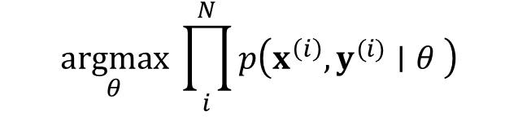
Generative Model: Supervised
MLE: Discriminant analysis
$Y \sim Categorical\left(π_{1},π_{2},π_{3}\right)$
$X_{Y=k} \sim 𝒩(μ_{k},σ_{k}^{2})$.
$𝒟={\left\{x^{\left(i\right)}, y^{\left(i\right)}\right\}}_{i=1}^{N}$
$$\underset{θ}{argmax}{ \prod_{i}^{N}{p\left(x^{\left(i\right)},y^{(i)}∣θ \right)}}$$

Slide 12
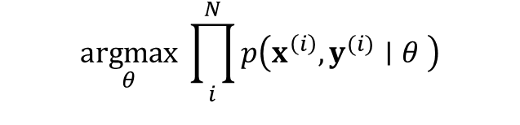
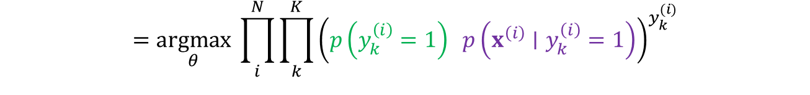
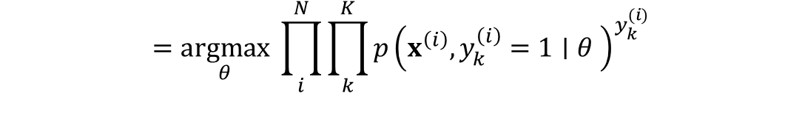
Generative Model: Supervised
MLE: Discriminant analysis
$Y \sim Categorical\left(π_{1},π_{2},π_{3}\right)$
$X_{Y=k} \sim 𝒩(μ_{k},σ_{k}^{2})$.
$𝒟={\left\{x^{\left(i\right)}, y^{\left(i\right)}\right\}}_{i=1}^{N}$
$$\underset{θ}{argmax}{ \prod_{i}^{N}{p\left(x^{\left(i\right)},y^{(i)}∣θ \right)}}$$
$$=\underset{θ}{argmax}{ \prod_{i}^{N}{\prod_{k}^{K}{p{\left(x^{\left(i\right)},y_{k}^{\left(i\right)}=1∣θ \right)}^{y_{k}^{(i)}}}}}$$
$$=\underset{θ}{argmax}{ \prod_{i}^{N}{\prod_{k}^{K}{{\left(p\left(y_{k}^{\left(i\right)}=1\right) p\left(x^{\left(i\right)}∣y_{k}^{\left(i\right)}=1\right)\right)}^{y_{k}^{(i)}}}}}$$
$$=\underset{θ}{argmax}{ \prod_{i}^{N}{\prod_{k}^{K}{{\left(π_{k} {\left|Σ_{k}\right|}^{−\frac{1}{2}} e^{−\frac{1}{2}{\left(x^{\left(i\right)}−μ_{k}\right)}^{T}Σ_{k}^{−1}\left(x^{\left(i\right)}−μ_{k}\right)}\right)}^{y_{k}^{(i)}}}}}$$
$$=\underset{θ}{argmax}{ log\prod_{i}^{N}{\prod_{k}^{K}{{\left(π_{k} {\left|Σ_{k}\right|}^{−\frac{1}{2}} e^{−\frac{1}{2}{\left(x^{\left(i\right)}−μ_{k}\right)}^{T}Σ_{k}^{−1}\left(x^{\left(i\right)}−μ_{k}\right)}\right)}^{y_{k}^{(i)}}}}}$$
$$=\underset{θ}{argmax}{ \sum_{i}^{N}{\sum_{k}^{k}{y_{k}^{(i)} log }}\left(π_{k} {\left|Σ_{k}\right|}^{−\frac{1}{2}} e^{−\frac{1}{2}{\left(x^{\left(i\right)}−μ_{k}\right)}^{T}Σ_{k}^{−1}\left(x^{\left(i\right)}−μ_{k}\right)}\right)}$$

Slide 13
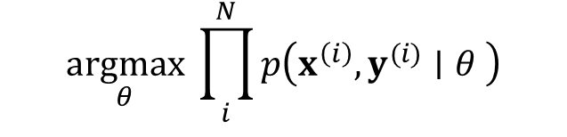
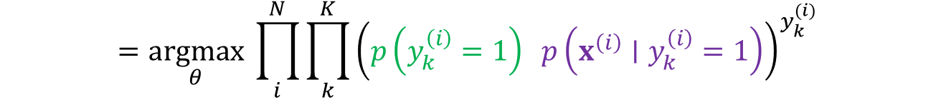
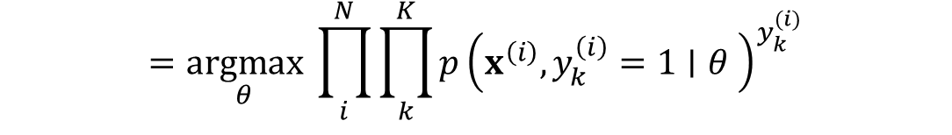
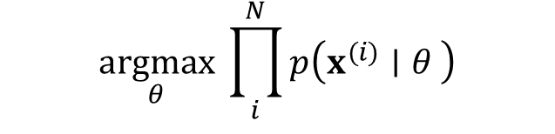
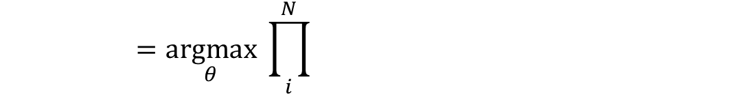
Generative Models: Supervised vs Unsupervised
Discriminant analysis vs Gaussian mixture models
$$\underset{θ}{argmax}{ \prod_{i}^{N}{p\left(x^{\left(i\right)},y^{(i)}∣θ \right)}}$$
$$\underset{θ}{argmax}{ \prod_{i}^{N}{p\left(x^{(i)}∣θ \right)}}$$
$$=\underset{θ}{argmax}{ \prod_{i}^{N}{\prod_{k}^{K}{p{\left(x^{\left(i\right)},y_{k}^{\left(i\right)}=1∣θ \right)}^{y_{k}^{(i)}}}}}$$
$$=\underset{θ}{argmax}{ \prod_{i}^{N}{ }}$$
$$=\underset{θ}{argmax}{ \prod_{i}^{N}{\prod_{k}^{K}{{\left(p\left(y_{k}^{\left(i\right)}=1\right) p\left(x^{\left(i\right)}∣y_{k}^{\left(i\right)}=1\right)\right)}^{y_{k}^{(i)}}}}}$$

Slide 14
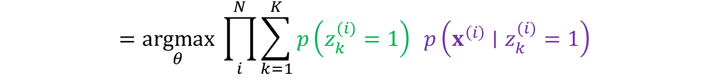
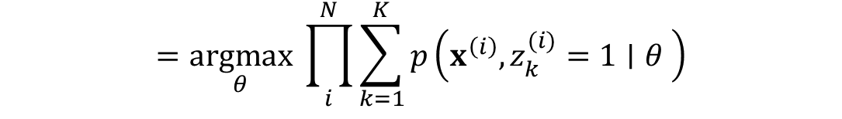
Generative Models: Supervised vs Unsupervised
Discriminant analysis vs Gaussian mixture models
$$\underset{θ}{argmax}{ \prod_{i}^{N}{p\left(x^{\left(i\right)},y^{(i)}∣θ \right)}}$$
$$\underset{θ}{argmax}{ \prod_{i}^{N}{p\left(x^{(i)}∣θ \right)}}$$
$$=\underset{θ}{argmax}{ \prod_{i}^{N}{\prod_{k}^{K}{p{\left(x^{\left(i\right)},y_{k}^{\left(i\right)}=1∣θ \right)}^{y_{k}^{(i)}}}}}$$
$$=\underset{θ}{argmax}{ \prod_{i}^{N}{\sum_{k=1}^{K}{p\left(x^{\left(i\right)},z_{k}^{(i)}=1∣θ \right)}}}$$
$$=\underset{θ}{argmax}{ \prod_{i}^{N}{\prod_{k}^{K}{{\left(p\left(y_{k}^{\left(i\right)}=1\right) p\left(x^{\left(i\right)}∣y_{k}^{\left(i\right)}=1\right)\right)}^{y_{k}^{(i)}}}}}$$
$$=\underset{θ}{argmax}{ \prod_{i}^{N}{\sum_{k=1}^{K}{p\left(z_{k}^{(i)}=1\right) p\left(x^{\left(i\right)}∣z_{k}^{(i)}=1\right)}}}$$

Slide 15
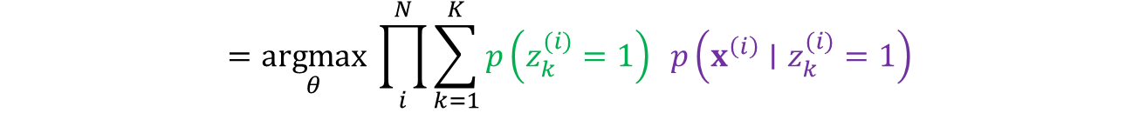
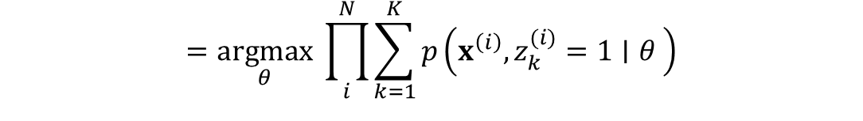
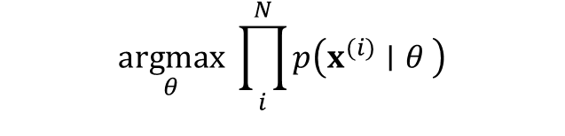
Generative Models: Supervised vs Unsupervised
Discriminant analysis vs Gaussian mixture models
$$\underset{θ}{argmax}{ \prod_{i}^{N}{p\left(x^{\left(i\right)},y^{(i)}∣θ \right)}}$$
$$\underset{θ}{argmax}{ \prod_{i}^{N}{p\left(x^{(i)}∣θ \right)}}$$
$$=\underset{θ}{argmax}{ \prod_{i}^{N}{\prod_{k}^{K}{p{\left(x^{\left(i\right)},y_{k}^{\left(i\right)}=1∣θ \right)}^{y_{k}^{(i)}}}}}$$
$$=\underset{θ}{argmax}{ \prod_{i}^{N}{\sum_{k=1}^{K}{p\left(x^{\left(i\right)},z_{k}^{(i)}=1∣θ \right)}}}$$
$$=\underset{θ}{argmax}{ \prod_{i}^{N}{\prod_{k}^{K}{{\left(p\left(y_{k}^{\left(i\right)}=1\right) p\left(x^{\left(i\right)}∣y_{k}^{\left(i\right)}=1\right)\right)}^{y_{k}^{(i)}}}}}$$
$$=\underset{θ}{argmax}{ \prod_{i}^{N}{\sum_{k=1}^{K}{p\left(z_{k}^{(i)}=1\right) p\left(x^{\left(i\right)}∣z_{k}^{(i)}=1\right)}}}$$
$$=\underset{θ}{argmax}{ \prod_{i}^{N}{\prod_{k}^{K}{{\left(π_{k} {\left|Σ_{k}\right|}^{−\frac{1}{2}} e^{−\frac{1}{2}{\left(x^{\left(i\right)}−μ_{k}\right)}^{T}Σ_{k}^{−1}\left(x^{\left(i\right)}−μ_{k}\right)}\right)}^{y_{k}^{(i)}}}}}$$
$$=\underset{θ}{argmax}{ \prod_{i}^{N}{\sum_{k=1}^{K}{ π_{k} {\left|Σ_{k}\right|}^{−\frac{1}{2}} e^{−\frac{1}{2}{\left(x^{(i)}−μ_{k}\right)}^{T}Σ_{k}^{−1}\left(x^{(i)}−μ_{k}\right)}}}}$$
$$=\underset{θ}{argmax}{ log\prod_{i}^{N}{\prod_{k}^{K}{{\left(π_{k} {\left|Σ_{k}\right|}^{−\frac{1}{2}} e^{−\frac{1}{2}{\left(x^{\left(i\right)}−μ_{k}\right)}^{T}Σ_{k}^{−1}\left(x^{\left(i\right)}−μ_{k}\right)}\right)}^{y_{k}^{(i)}}}}}$$
$$=\underset{θ}{argmax}{ log\prod_{i}^{N}{\sum_{k=1}^{K}{ π_{k} {\left|Σ_{k}\right|}^{−\frac{1}{2}} e^{−\frac{1}{2}{\left(x^{(i)}−μ_{k}\right)}^{T}Σ_{k}^{−1}\left(x^{(i)}−μ_{k}\right)}}}}$$
$$=\underset{θ}{argmax}{ \sum_{i}^{N}{\sum_{k}^{k}{y_{k}^{(i)} log }}\left(π_{k} {\left|Σ_{k}\right|}^{−\frac{1}{2}} e^{−\frac{1}{2}{\left(x^{\left(i\right)}−μ_{k}\right)}^{T}Σ_{k}^{−1}\left(x^{\left(i\right)}−μ_{k}\right)}\right)}$$
$$=\underset{θ}{argmax}{ \sum_{i}^{N}{log}\sum_{k=1}^{K}{ π_{k} {\left|Σ_{k}\right|}^{−\frac{1}{2}} e^{−\frac{1}{2}{\left(x^{(i)}−μ_{k}\right)}^{T}Σ_{k}^{−1}\left(x^{(i)}−μ_{k}\right)}}}$$

Slide 16
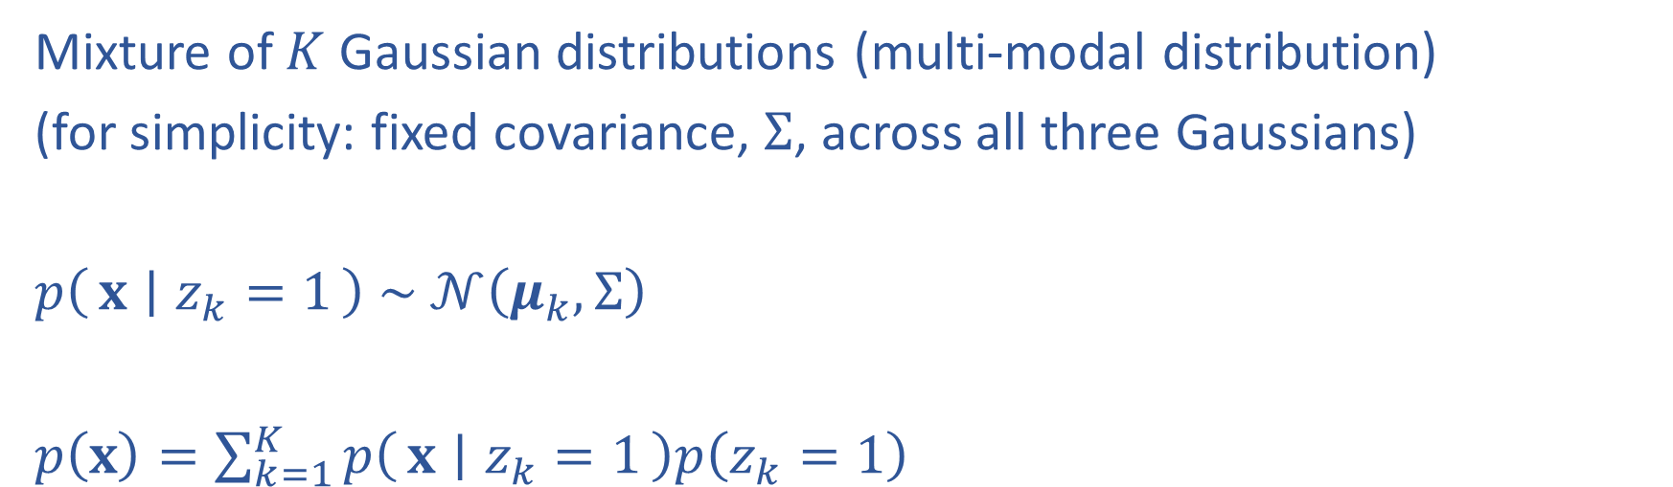



Gaussian Mixture Model
Mixture of $K$ Gaussian distributions (multi-modal distribution)
(for simplicity: fixed covariance, $Σ$, across all three Gaussians)
$p\left(x ∣ z_{k}=1\right) \sim 𝒩\left(μ_{k}, Σ\right)$
$p\left(x\right)=\sum_{k=1}^{K}{p\left(x ∣ z_{k}=1\right)p\left(z_{k}=1\right)}$
$$μ_{2}$$
$$μ_{1}$$
Mixture
component
Mixture
proportion
$$μ_{3}$$

Slide 17
Gaussian Mixture Model
Mixture of $K$ Gaussian distributions (multi-modal distribution)
(for simplicity: fixed covariance, $Σ$, across all three Gaussians)
$p\left(x ∣ z_{k}=1\right) \sim 𝒩\left(μ_{k}, Σ\right)$
$p\left(x\right)=\sum_{k=1}^{K}{p\left(x ∣ z_{k}=1\right)p\left(z_{k}=1\right)}$
$$μ_{2}$$
$$μ_{1}$$
Mixture
component
Mixture
proportion
$$μ_{3}$$

Slide 18
(One) bad case for K-means
Clusters may overlap
Some clusters may be “wider” than others
Clusters may not be linearly separable
Slide credit: CMU MLD Aarti Singh
TexPoint fonts used in EMF.
Read the TexPoint manual before you delete this box.: AAAAAAAAA

Slide 19



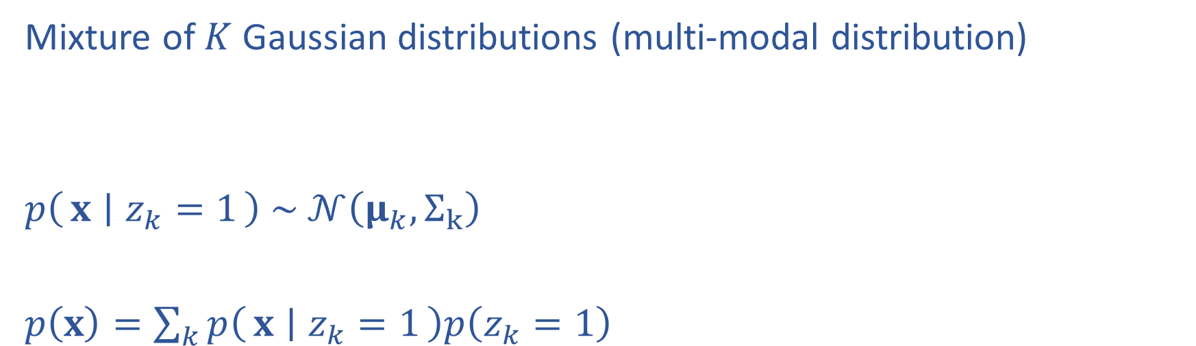



Gaussian Mixture Model
Mixture of $K$ Gaussian distributions (multi-modal distribution)
$p\left(x ∣ z_{k}=1\right) \sim 𝒩\left(μ_{k}, Σ_{k}\right)$
$p\left(x\right)=\sum_{k}{p\left(x ∣ z_{k}=1\right)p\left(z_{k}=1\right)}$
$$Σ_{2}$$
$$Σ_{1}$$
$$μ_{2}$$
$$μ_{1}$$
$$μ_{3}$$
$$Σ_{3}$$

Slide 20
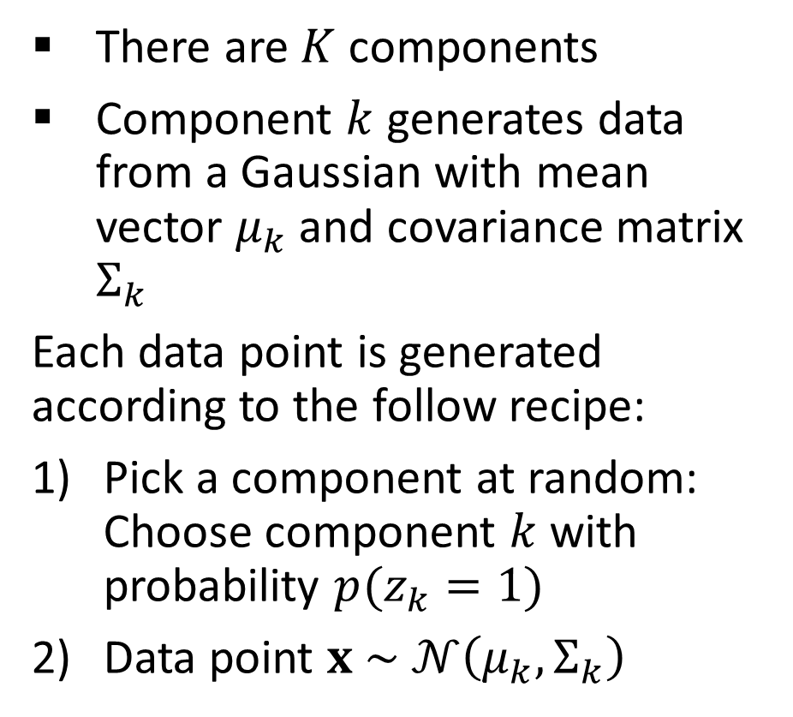
Gaussian Mixture Model
Mixture of $K$ Gaussian distributions (multi-modal distribution)
There are $K$ components
Component $k$ generates data from a Gaussian with mean vector $μ_{k}$ and covariance matrix $Σ_{k}$
Each data point is generated according to the follow recipe:
Pick a component at random: Choose component $k$ with probability $p(z_{k}=1)$
Data point $x \sim 𝒩\left(μ_{k}, Σ_{k}\right)$
$$Σ_{2}$$
$$Σ_{1}$$
$$μ_{2}$$
$$μ_{1}$$
$$μ_{3}$$
$$Σ_{3}$$

Slide 21



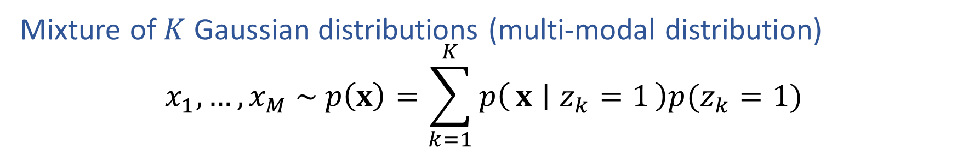



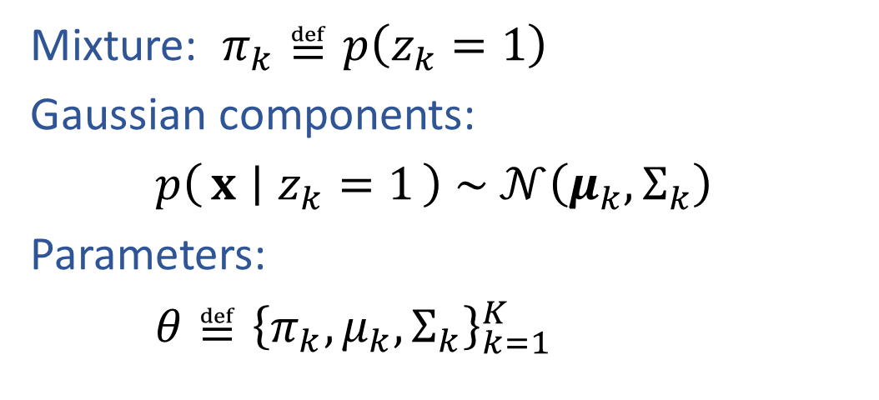

Learning General GMM
Mixture of $K$ Gaussian distributions (multi-modal distribution)
$$x_{1},…, x_{M} \sim p\left(x\right)=\sum_{k=1}^{K}{p\left(x ∣ z_{k}=1\right)p(z_{k}=1)}$$
$$Σ_{2}$$
Mixture: $π_{k}≝p\left(z_{k}=1\right)$
Gaussian components:
$p\left(x ∣ z_{k}=1\right) \sim 𝒩\left(μ_{k}, Σ_{k}\right)$
Parameters:
$θ≝{\left\{π_{k}, μ_{k}, Σ_{k}\right\}}_{k=1}^{K}$
$$Σ_{1}$$
$$μ_{2}$$
$$μ_{1}$$
$$μ_{3}$$
$$Σ_{3}$$
How to estimate parameters? Can we do MLE even without labels $z$?

Slide 22
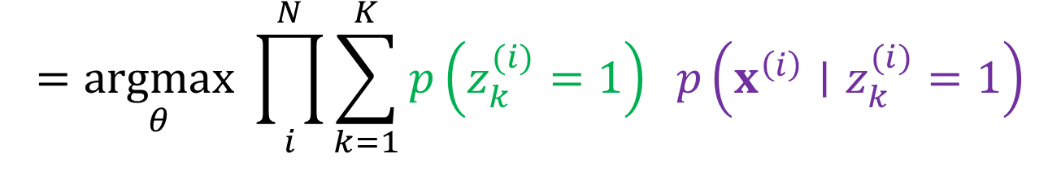
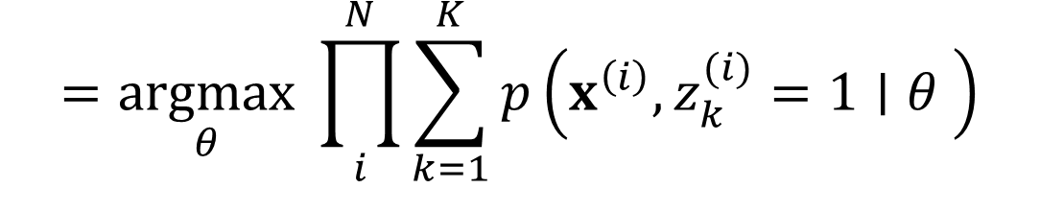

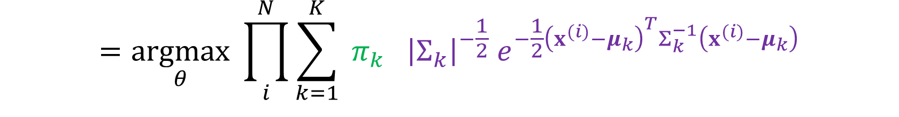
Learning General GMM
Maximize marginal likelihood:
$$\underset{θ}{argmax}{ \prod_{i}^{N}{p\left(x^{(i)}∣θ \right)}}$$
$$=\underset{θ}{argmax}{ \prod_{i}^{N}{\sum_{k=1}^{K}{p\left(x^{\left(i\right)},z_{k}^{(i)}=1∣θ \right)}}}$$
$$=\underset{θ}{argmax}{ \prod_{i}^{N}{\sum_{k=1}^{K}{p\left(z_{k}^{(i)}=1\right) p\left(x^{\left(i\right)}∣z_{k}^{(i)}=1\right)}}}$$
$$=\underset{θ}{argmax}{ \prod_{i}^{N}{\sum_{k=1}^{K}{ π_{k} {\left|Σ_{k}\right|}^{−\frac{1}{2}} e^{−\frac{1}{2}{\left(x^{(i)}−μ_{k}\right)}^{T}Σ_{k}^{−1}\left(x^{(i)}−μ_{k}\right)}}}}$$

Slide 23

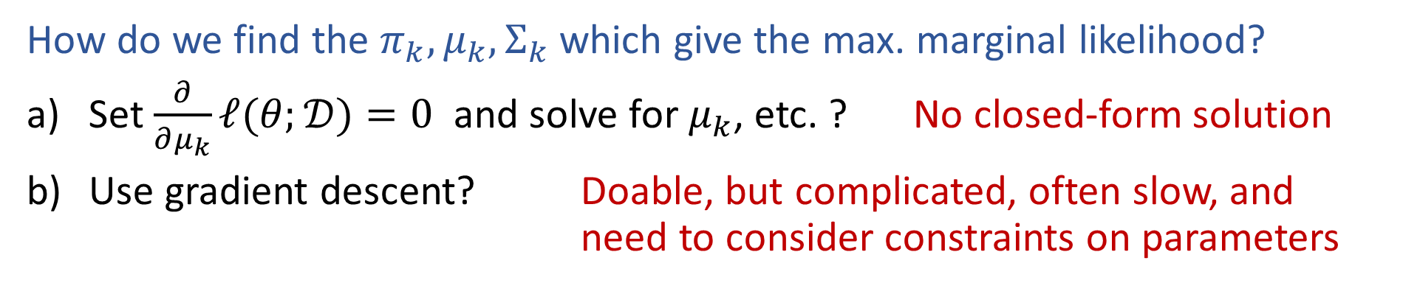
Learning General GMM
Maximize marginal likelihood:
$$\underset{θ}{argmax}{ \prod_{i}^{N}{p\left(x^{(i)}∣θ \right)}}$$
$$=\underset{θ}{argmax}{ \prod_{i}^{N}{\sum_{k=1}^{K}{ π_{k} {\left|Σ_{k}\right|}^{−\frac{1}{2}} e^{−\frac{1}{2}{\left(x^{(i)}−μ_{k}\right)}^{T}Σ_{k}^{−1}\left(x^{(i)}−μ_{k}\right)}}}}$$
How do we find the $π_{k}, μ_{k}, Σ_{k}$ which give the max. marginal likelihood?
Set $\frac{∂}{∂μ_{k}}ℓ(θ;𝒟)=0$ and solve for $μ_{k}$, etc. ? No closed-form solution
Use gradient descent? Doable, but complicated, often slow, and need to consider constraints on parameters

Slide 24
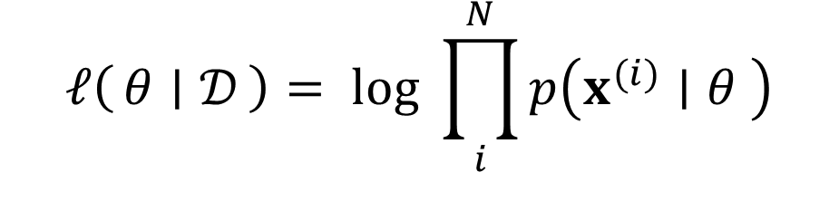
Log (Marginal) Likelihood for Missing Data
Marginalize over missing data, $z^{(i)}$
$$ℓ\left(θ ∣ 𝒟\right)= log{ \prod_{i}^{N}{p\left(x^{(i)}∣θ \right)}}$$

Slide 25

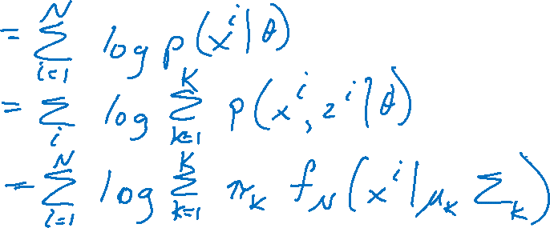
Log (Marginal) Likelihood for Missing Data
Marginalize over missing data, $z^{(i)}$
$$ℓ\left(θ ∣ 𝒟\right)= log{ \prod_{i}^{N}{p\left(x^{(i)}∣θ \right)}}$$

Slide 26
Gradient Learning for mixture models
We can learn mixture densities using gradient descent on the log likelihood. The gradients are quite interesting:
In other words, the gradient is the responsibility weighted sum of the individual log likelihood gradients.
Can pass this to a conjugate gradient routine.

Slide 27
Parameter Constraints
Often we have constraints on the parameters, e.g. Σ_{k}π_{k} = 1, Σ being symmetric positive definite (hence Σ_{ii} > 0).
We can use constrained optimization, or we can reparameterize in terms of unconstrained values.
  For normalized weights, use the softmax transform:
  For covariance matrices, use the Cholesky decomposition:
    where A is upper diagonal with positive diagonal:
    the parameters γ_{i}, λ_{i}, η_{ij} ∈ R are unconstrained.
  Use chain rule to compute

Slide 28
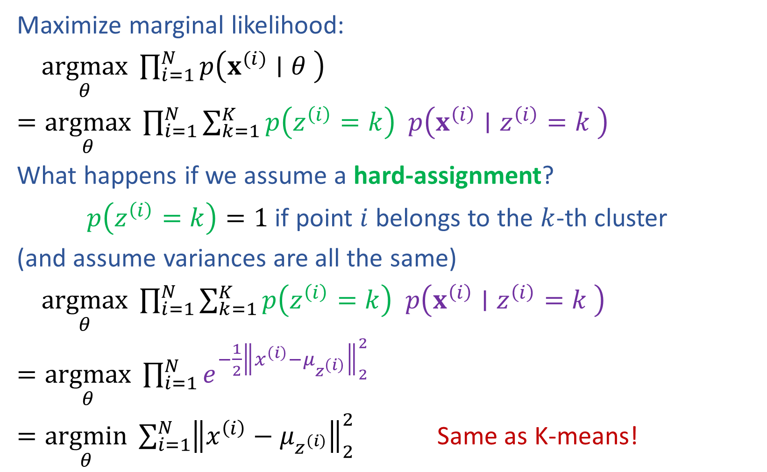
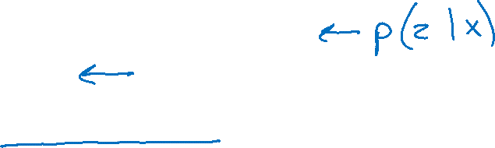
GMM vs K-means
Maximize marginal likelihood:
$\underset{θ}{argmax}{ \prod_{i=1}^{N}{p\left(x^{(i)}∣θ \right)}}$
$=\underset{θ}{argmax}{ \prod_{i=1}^{N}{\sum_{k=1}^{K}{p\left(z^{\left(i\right)}=k\right) p\left(x^{\left(i\right)}∣z^{\left(i\right)}=k \right)}}}$
What happens if we assume a hard-assignment?
$p\left(z^{\left(i\right)}=k\right)=1$ if point $i$ belongs to the $k$-th cluster
(and assume variances are all the same)
$\underset{θ}{argmax}{ \prod_{i=1}^{N}{\sum_{k=1}^{K}{p\left(z^{\left(i\right)}=k\right) p\left(x^{\left(i\right)}∣z^{\left(i\right)}=k \right)}}}$
$=\underset{θ}{argmax}{ \prod_{i=1}^{N}{e^{−\frac{1}{2}{\left\|x^{\left(i\right)}−μ_{z^{\left(i\right)}}\right\|}_{2}^{2}}}}$
$=\underset{θ}{argmin}{ \sum_{i=1}^{N}{{\left\|x^{\left(i\right)}−μ_{z^{\left(i\right)}}\right\|}_{2}^{2}}}$ Same as K-means!

Slide 29
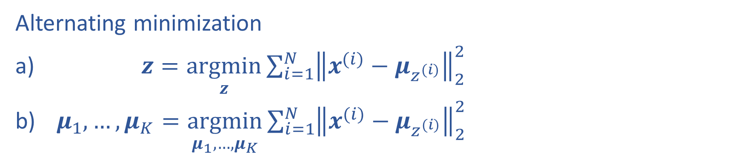
K-means Optimization
Alternating minimization
$z=\underset{z}{argmin}\sum_{i=1}^{N}{{\left\|x^{(i)}−μ_{z^{(i)}}\right\|}_{2}^{2}}$
$μ_{1}, …, μ_{K}=\underset{μ_{1}, …, μ_{K}}{argmin}\sum_{i=1}^{N}{{\left\|x^{(i)}−μ_{z^{(i)}}\right\|}_{2}^{2}}$

Slide 30
Expectation-Maximization for GMM

Slide 31
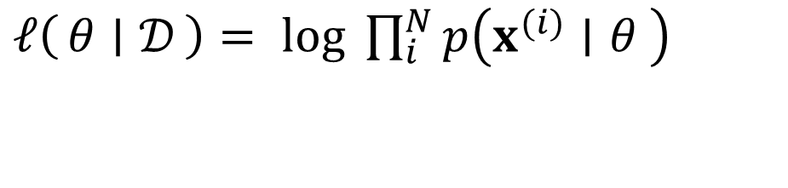
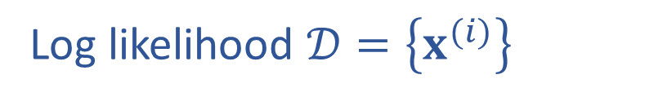
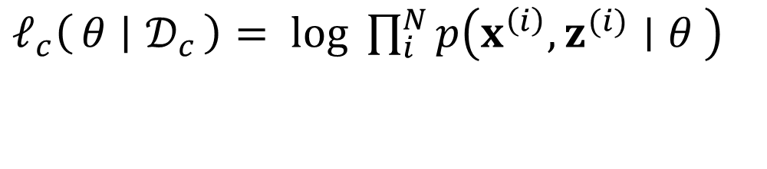
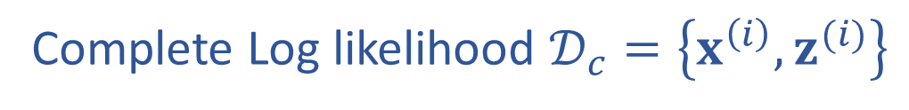
Log Likelihood vs Complete Log Likelihood
Log likelihood $𝒟=\left\{x^{(i)}\right\}$
Complete Log likelihood $𝒟_{c}=\left\{x^{\left(i\right)},z^{(i)}\right\}$
$ℓ\left(θ ∣ 𝒟\right)= log{ \prod_{i}^{N}{p\left(x^{(i)}∣θ \right)}}$
$ℓ_{c}\left(θ ∣ 𝒟_{c}\right)= log{ \prod_{i}^{N}{p\left(x^{\left(i\right)},z^{(i)}∣θ \right)}}$

Slide 32
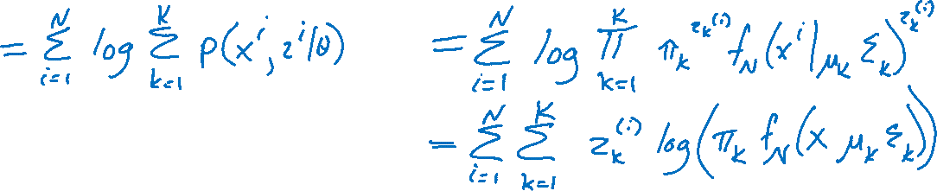
Log Likelihood vs Complete Log Likelihood
Log likelihood $𝒟=\left\{x^{(i)}\right\}$
Complete Log likelihood $𝒟_{c}=\left\{x^{\left(i\right)},z^{(i)}\right\}$
$ℓ\left(θ ∣ 𝒟\right)= log{ \prod_{i}^{N}{p\left(x^{(i)}∣θ \right)}}$
$ℓ_{c}\left(θ ∣ 𝒟_{c}\right)= log{ \prod_{i}^{N}{p\left(x^{\left(i\right)},z^{(i)}∣θ \right)}}$

Slide 33
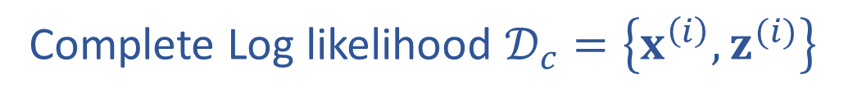
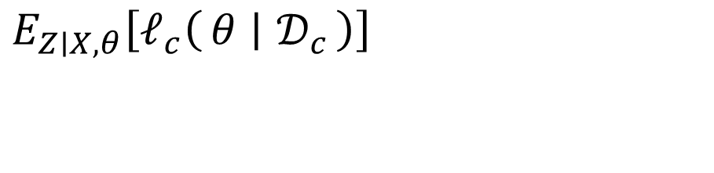
Expected Value of Complete Log Likelihood
Replace know value of z with
Complete Log likelihood $𝒟_{c}=\left\{x^{\left(i\right)},z^{(i)}\right\}$
$E_{Z∣X, θ}\left[ℓ_{c}\left(θ ∣ 𝒟_{c}\right)\right]$
$ℓ_{c}\left(θ ∣ 𝒟_{c}\right)= log{ \prod_{i}^{N}{p\left(x^{\left(i\right)},z^{(i)}∣θ \right)}}$

Slide 34
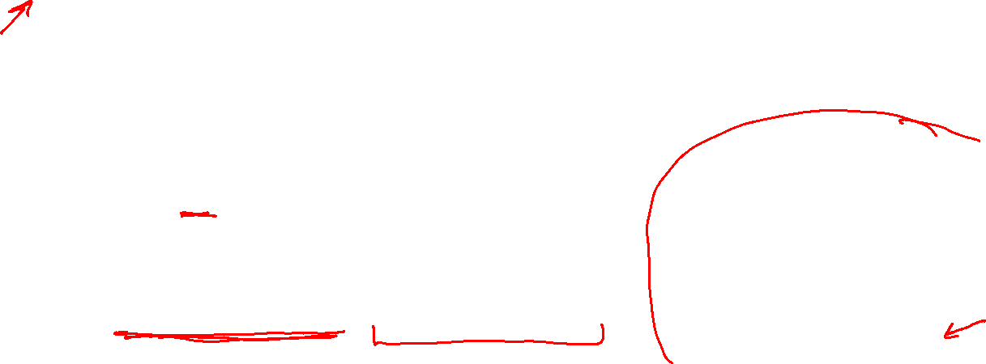
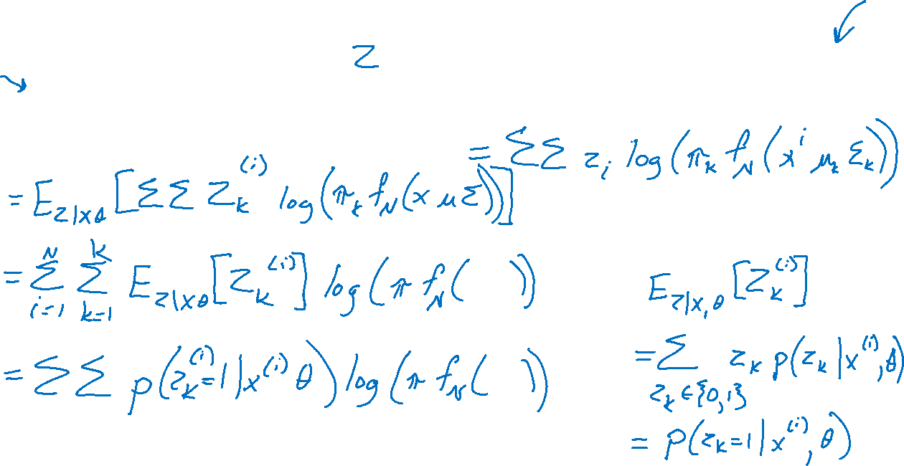
Expected Value of Complete Log Likelihood
Replace know value of z with
Complete Log likelihood $𝒟_{c}=\left\{x^{\left(i\right)},z^{(i)}\right\}$
$E_{Z∣X, θ}\left[ℓ_{c}\left(θ ∣ 𝒟_{c}\right)\right]$
$ℓ_{c}\left(θ ∣ 𝒟_{c}\right)= log{ \prod_{i}^{N}{p\left(x^{\left(i\right)},z^{(i)}∣θ \right)}}$

Slide 35
Notes on EM
EM is an optimization strategy for objective functions that can be interpreted as likelihoods in the presence of missing data.
It is much simpler than gradient methods:
  No need to choose step size.
  Enforces constraints.
  Calls inference and fully observed learning as subroutines.
EM is an Iterative algorithm with two linked steps:
  E-step: fill-in hidden values using inference, p(z|x, θ^{t}).
  M-step: update parameters t+1 using standard MLE/MAP method applied to completed data
This procedure monotonically improves (or leaves it unchanged). Thus, it always converges to a local optimum of the likelihood.

Slide 36
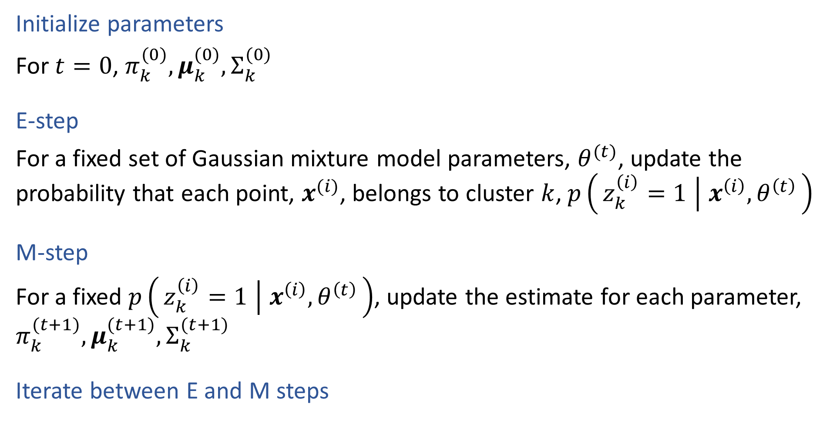
EM for GMMS
Initialize parameters
For $t=0$, $π_{k}^{(0)}, μ_{k}^{(0)}, Σ_{k}^{(0)}$
E-step
For a fixed set of Gaussian mixture model parameters, $θ^{(t)}$, update the probability that each point, $x^{(i)}$, belongs to cluster $k$, $p\left(z_{k}^{\left(i\right)}=1 ∣ x^{\left(i\right)}, θ^{\left(t\right)}\right)$
M-step
For a fixed $p\left(z_{k}^{\left(i\right)}=1 ∣ x^{\left(i\right)}, θ^{\left(t\right)}\right)$, update the estimate for each parameter, $π_{k}^{(t+1)}, μ_{k}^{(t+1)}, Σ_{k}^{(t+1)}$
Iterate between E and M steps

Slide 37
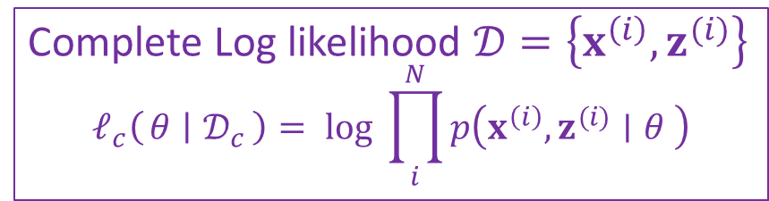

EM for GMMS
Complete Log likelihood $𝒟=\left\{x^{\left(i\right)},z^{(i)}\right\}$
$$ℓ_{c}\left(θ ∣ 𝒟_{c}\right)= log{ \prod_{i}^{N}{p\left(x^{\left(i\right)},z^{(i)}∣θ \right)}}$$
E-step
$E_{Z∣X, θ^{(t)}}\left[Z_{k}^{(i)}\right]=p\left(z_{k}^{\left(i\right)}=1 ∣ x^{\left(i\right)}, θ^{\left(t\right)}\right)$
M-step
$π_{k}^{(t+1)}$
$μ_{k}^{(t+1)} ={argmax}_{θ} E_{Z∣X, θ^{(t)}}\left[ℓ_{c}\left(θ ∣ 𝒟_{c}\right)\right]$
$Σ_{k}^{(t+1)}$

Slide 38
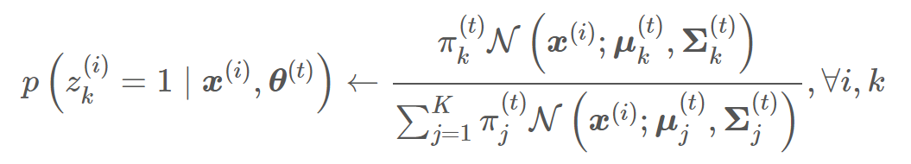
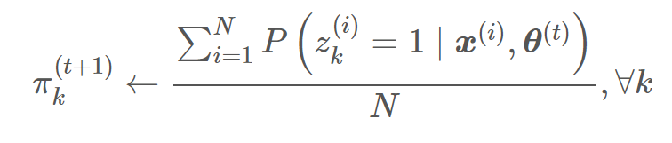
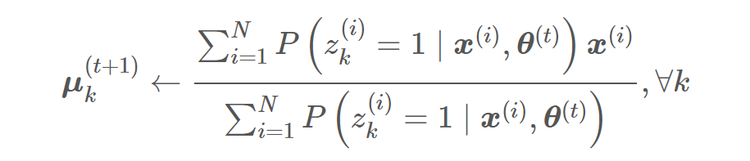
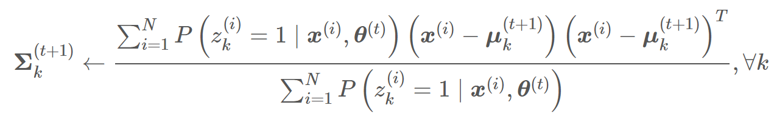
EM for GMMS
E-step
M-step

Slide 39


EM for GMMs: Example
Σ₂
Σ₃
μ₂
μ₁
μ₃
Σ₁
P($z_{2}$ = 1 |x_{j},μ₁,μ₂,μ₃,Σ₁,Σ₂,Σ₃,$π$₁, $π$₂, $π$₃)

Slide 40

After 1st iteration

Slide 41

After 2nd iteration

Slide 42

After 3rd iteration

Slide 43

After 4th iteration

Slide 44

After 5th iteration

Slide 45

After 6th iteration

Slide 46

After 20th iteration

Slide 47
Gaussian Mixture Model
Mixture of $K$ Gaussian distributions (multi-modal distribution)
$p\left(x ∣ z_{k}=1\right) \sim 𝒩\left(μ_{k}, Σ_{k}\right)$
$p\left(x\right)=\sum_{k}{p\left(x ∣ z_{k}=1\right)p\left(z_{k}=1\right)}$
$$Σ_{2}$$
$$Σ_{1}$$
$$μ_{2}$$
$$μ_{1}$$
Mixture
component
Mixture
proportion
$$μ_{3}$$
$$Σ_{3}$$

Slide 48
General EM Algorithm

Slide 49
Theory underlying EM
What are we doing?
Recall that according to MLE, we intend to learn the model parameter that would have maximize the likelihood of the data.
But we do not observe z, so computing
is difficult!
What shall we do?

Slide 50
Complete & Incomplete Log Likelihoods
Complete log likelihood
  Let X denote the observable variable(s), and Z denote the latent variable(s).
  If Z could be observed, then
  Usually, optimizing l_{c}() given both z and x is straightforward (c.f. MLE for fully observed models).
  Recalled that in this case the objective for, e.g., MLE, decomposes into a sum of factors, the parameter for each factor can be estimated separately.
  But given that Z is not observed, l_{c}() is a random quantity, cannot be maximized directly.
Incomplete log likelihood
  With z unobserved, our objective becomes the log of a marginal probability:
  This objective won't decouple

Slide 51


Expected Complete Log Likelihood
For any distribution q(z), define expected complete log likelihood:
    A deterministic function of θ
    Linear in l_{c}() --- inherit its factorizabiility
    Does maximizing this surrogate yield a maximizer of the likelihood?
Jensen’s inequality

Slide 52


Lower Bounds and Free Energy
For fixed data x, define a functional called the free energy:
The EM algorithm is coordinate-ascent on F :
  E-step:
  M-step:

Slide 53

E-step: maximization of expected l_{c} w.r.t. q
Claim:
  This is the posterior distribution over the latent variables given the data and the parameters. Often we need this at test time anyway (e.g. to perform classification).
Proof (easy): this setting attains the bound l(θ;x)≥F(q,θ )
Can also show this result using variational calculus or the fact that

Slide 54
E-step ≡ plug in posterior expectation of latent variables
Without loss of generality: assume that p(x,z|θ) is a generalized exponential family distribution:
  Special cases: if p(X|Z) are GLIMs, then
The expected complete log likelihood under is

Slide 55

M-step: maximization of expected l_{c} w.r.t. θ
Note that the free energy breaks into two terms:
  The first term is the expected complete log likelihood (energy) and the second term, which does not depend on θ, is the entropy.
Thus, in the M-step, maximizing with respect to θ for fixed q we only need to consider the first term:
  Under optimal q^{t+1}, this is equivalent to solving a standard MLE of fully observed model p(x,z|θ), with the sufficient statistics involving z replaced by their expectations w.r.t. p(z|x,θ).

Slide 56




Convergence of EM
Marginal
Likelihood function
F($q^{t+1}$, $θ^{t+1}$)
Sequence of EM lower bound F-functions
EM monotonically converges to a local maximum of likelihood !
TexPoint fonts used in EMF.
Read the TexPoint manual before you delete this box.: AAAAAAAAA

Slide 57
EM & Local Maxima
Typical likelihood function
Different sequence of EM lower bound
F-functions depending on initialization
Use multiple, randomized initializations in practice
TexPoint fonts used in EMF.
Read the TexPoint manual before you delete this box.: AAAAAAAAA

Slide 58
Summary: EM Algorithm
A way of maximizing likelihood function for latent variable models. Finds MLE of parameters when the original (hard) problem can be broken up into two (easy) pieces:
  Estimate some “missing” or “unobserved” data from observed data and current parameters.
  Using this “complete” data, find the maximum likelihood parameter estimates.
Alternate between filling in the latent variables using the best guess (posterior) and updating the parameters based on this guess:
  E-step:
  M-step:
In the M-step we optimize a lower bound on the likelihood. In the E-step we close the gap, making bound=likelihood.

Slide 59
A Report Card for EM
Some good things about EM:
  no learning rate (step-size) parameter
  enforces parameter constraints
  very fast for low dimensions
  each iteration guaranteed to improve likelihood
Some bad things about EM:
  can get stuck in local minima
  can be slower than conjugate gradient (especially near convergence)
  requires expensive inference step
  is a maximum likelihood/MAP method

