Slide 1
Announcements
Struggling?
Don’t struggle alone
Come talk to Pat
    OH
    1-on-1 appointment calendar
    Private message on Piazza with set of times to meet

Slide 2
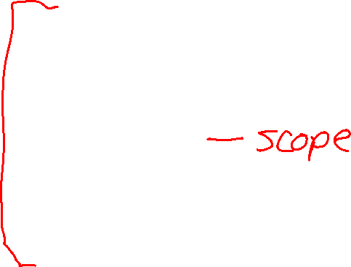
Announcements
Assignments
HW5
    Fri, 2/24, 11:59 pm
Midterm
Wed, 3/1, in-class
Details will be coming on Piazza
    Logistics
    Learning objectives for Midterm 1 topics
    Review session
    Practice exam problems

Slide 3
Announcements
Struggling?
Don’t struggle alone
Come talk to Pat
    OH
    1-on-1 appointment calendar
    Private message on Piazza with set of times to meet

Slide 4

Plan
Today
Wrap-up neural nets (for now)
Regularization
    Make sure they aren’t too powerful ☺

Slide 5
Wrap up Neural Nets
Switch to neural nets slides

Slide 6

10-315
Introduction to ML
Regularization
Instructor: Pat Virtue

Slide 7
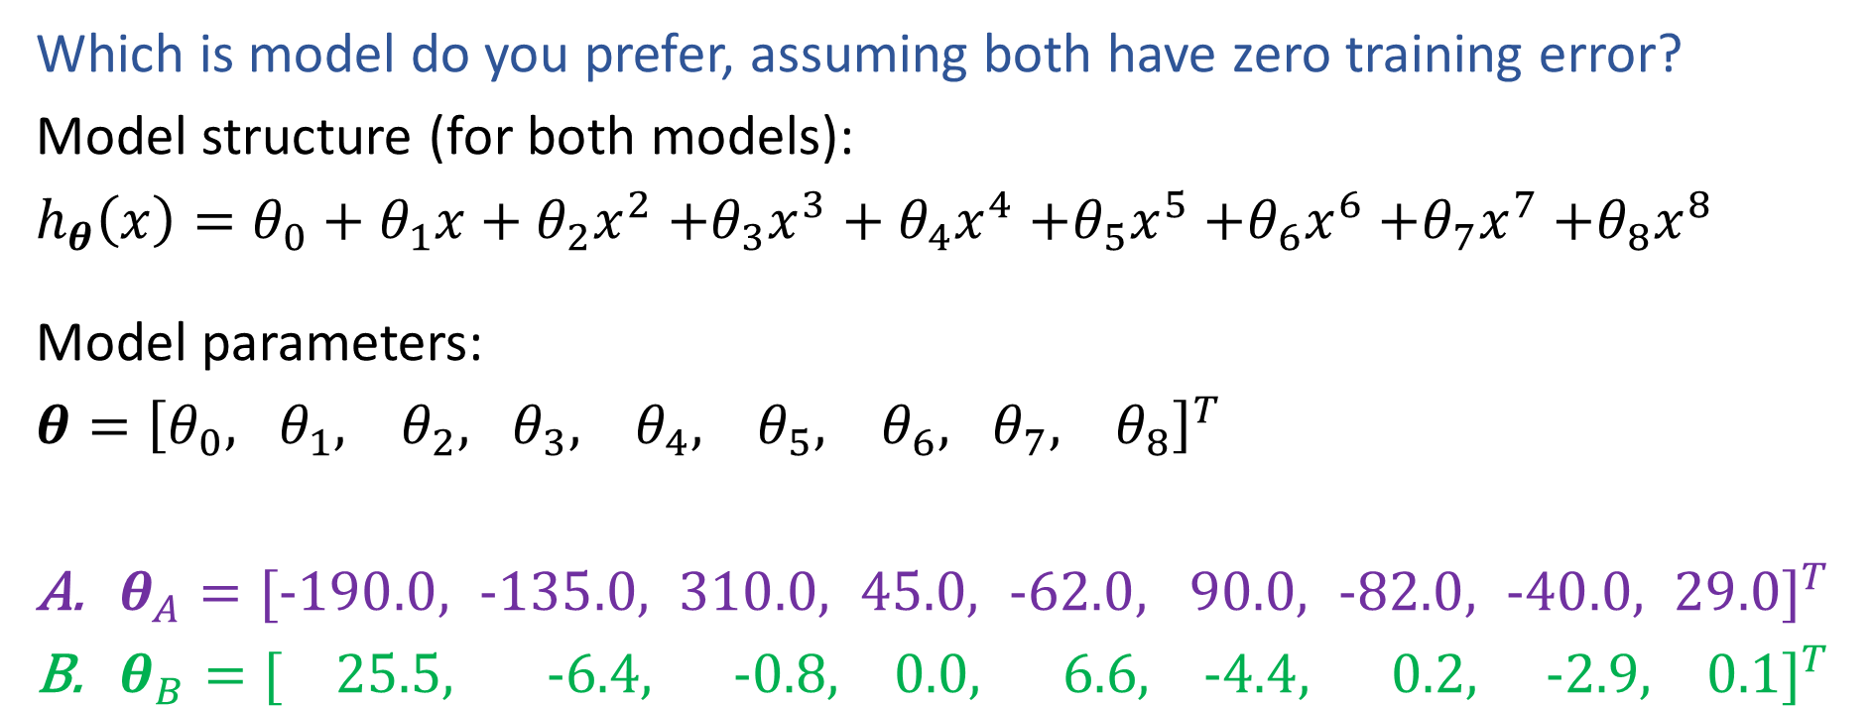
Poll 1
Which is model do you prefer, assuming both have zero training error?
Model structure (for both models):
$h_{θ}\left(x\right)=θ_{0}+θ_{1}x+θ_{2}x^{2}$ $+θ_{3}x^{3}+θ_{4}x^{4}$ $+θ_{5}x^{5}$ $+θ_{6}x^{6}$ $+θ_{7}x^{7}$ $+θ_{8}x^{8}$
Model parameters:
$θ={\left[θ_{0}, θ_{1}, θ_{2}, θ_{3}, θ_{4}, θ_{5}, θ_{6}, θ_{7}, θ_{8}\right]}^{T}$
$θ_{A}={[−190.0, −135.0, 310.0, 45.0, −62.0, 90.0, −82.0, −40.0, 29.0]}^{T}$
$θ_{B}={[ 25.5, −6.4, −0.8, 0.0, 6.6, −4.4, 0.2, −2.9, 0.1]}^{T}$

Slide 8
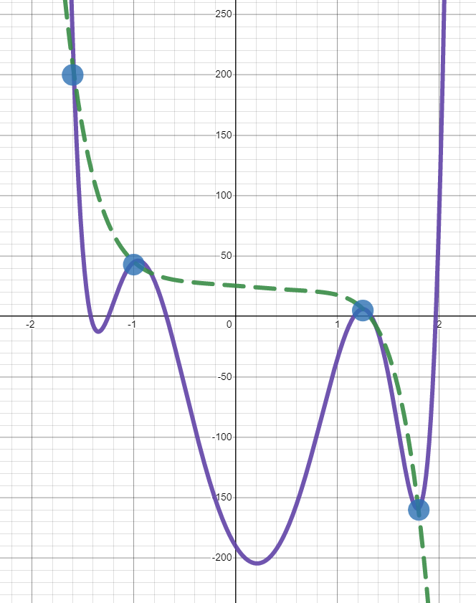
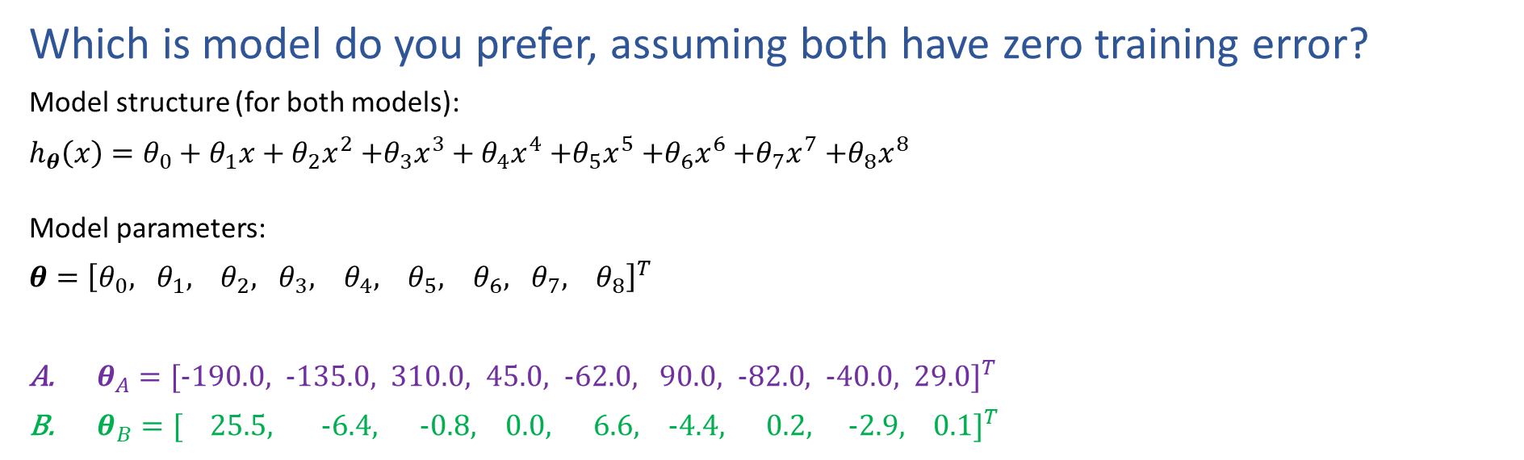
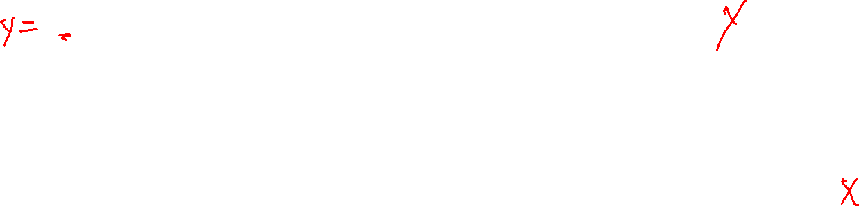
Poll 1
Which is model do you prefer, assuming both have zero training error?
Model structure (for both models):
$h_{θ}\left(x\right)=θ_{0}+θ_{1}x+θ_{2}x^{2}$ $+θ_{3}x^{3}+θ_{4}x^{4}$ $+θ_{5}x^{5}$ $+θ_{6}x^{6}$ $+θ_{7}x^{7}$ $+θ_{8}x^{8}$
Model parameters:
$θ={\left[θ_{0}, θ_{1}, θ_{2}, θ_{3}, θ_{4}, θ_{5}, θ_{6}, θ_{7}, θ_{8}\right]}^{T}$
$θ_{A}={[−190.0, −135.0, 310.0, 45.0, −62.0, 90.0, −82.0, −40.0, 29.0]}^{T}$
$θ_{B}={[ 25.5, −6.4, −0.8, 0.0, 6.6, −4.4, 0.2, −2.9, 0.1]}^{T}$

Slide 9
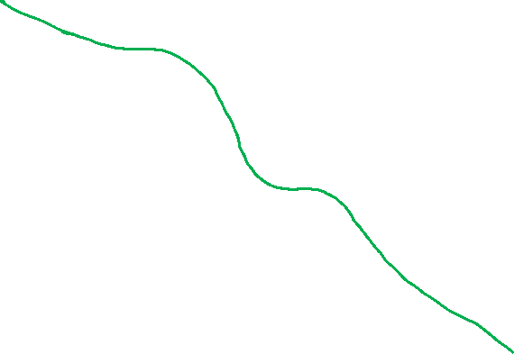
Example: Linear Regression
Goal: Learn y = w^{T} f(x) + b
where f(.) is a polynomial basis function
y | x | x² | … | x⁹
2.0 | 1.2 | (1.2)² | … | (1.2)⁹
1.3 | 1.7 | (1.7)² | … | (1.7)⁹
0.1 | 2.7 | (2.7)² | … | (2.7)⁹
1.1 | 1.9 | (1.9)² | … | (1.9)⁹
y
Slide credit: CMU MLD Matt Gormley
true “unknown” target function is linear with negative slope and gaussian noise
x

Slide 10
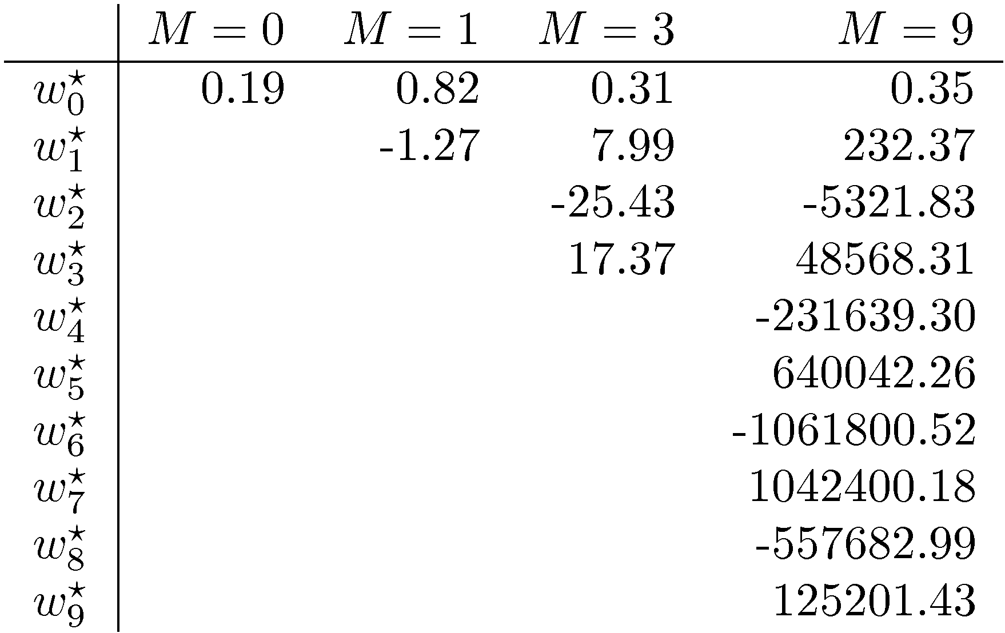
Symptoms of Overfitting
Slide credit: CMU MLD William Cohen

Slide 11
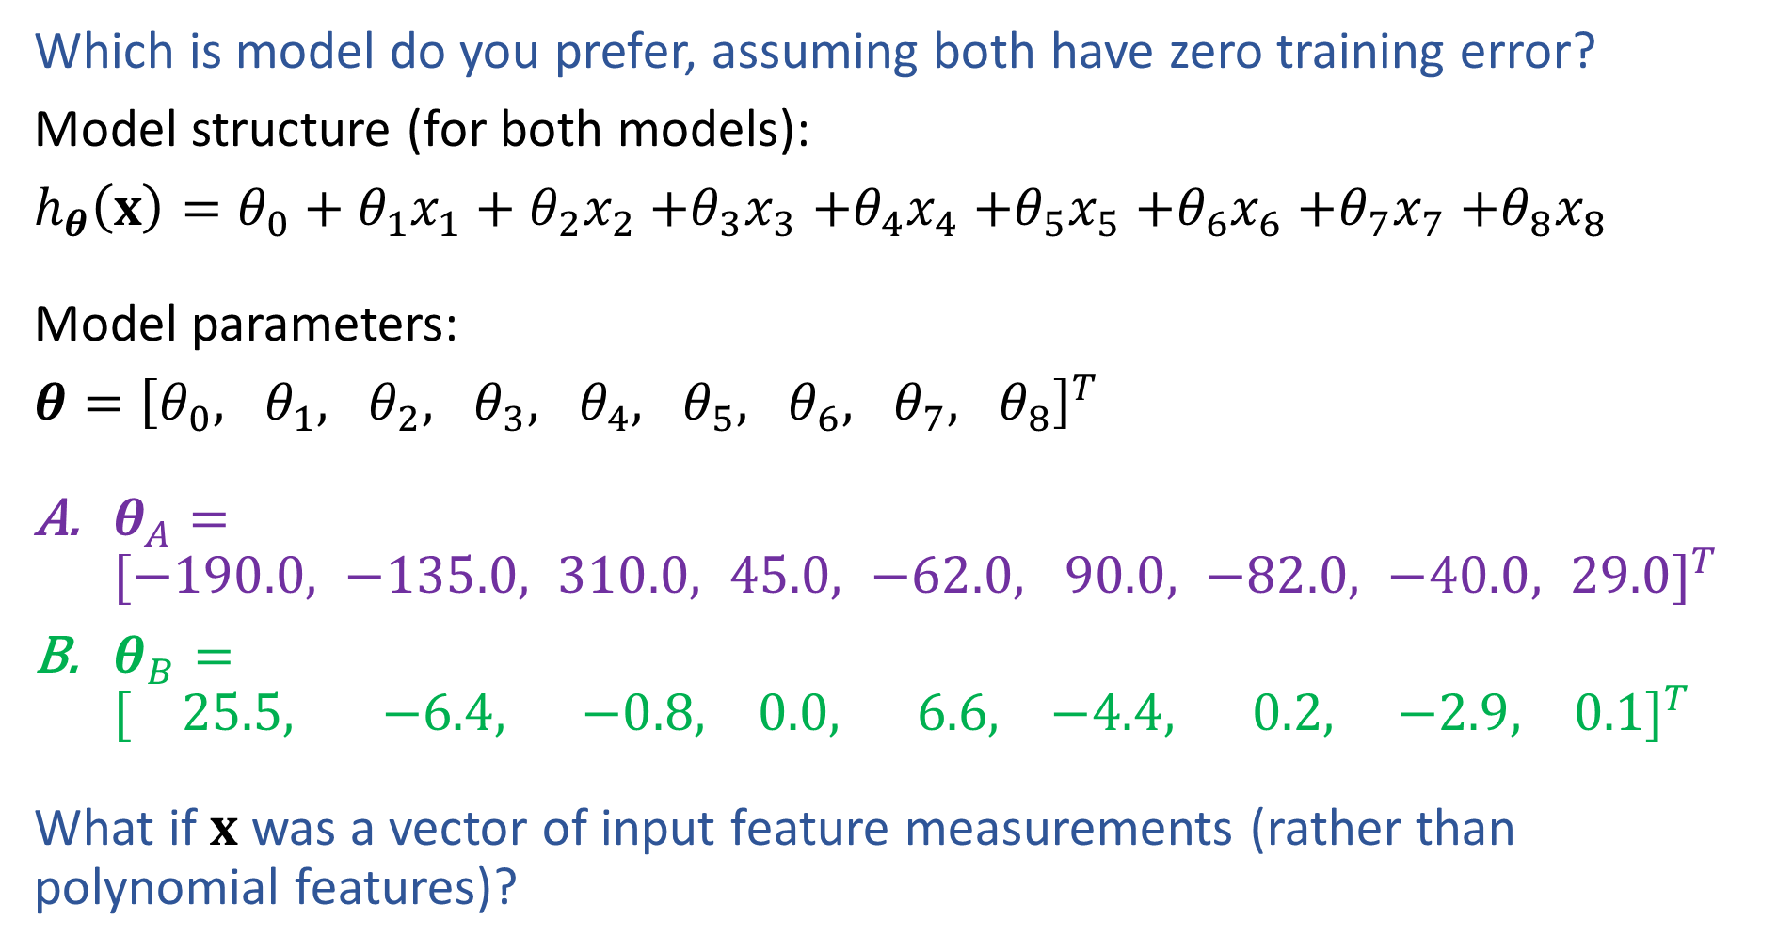

Model Preference
Which is model do you prefer, assuming both have zero training error?
Model structure (for both models):
$h_{θ}\left(x\right)=θ_{0}+θ_{1}x_{1}+θ_{2}x_{2}$ $+θ_{3}x_{3}$ $+θ_{4}x_{4}$ $+θ_{5}x_{5}$ $+θ_{6}x_{6}$ $+θ_{7}x_{7}$ $+θ_{8}x_{8}$
Model parameters:
$θ={\left[θ_{0}, θ_{1}, θ_{2}, θ_{3}, θ_{4}, θ_{5}, θ_{6}, θ_{7}, θ_{8}\right]}^{T}$
$θ_{A}={[−190.0, −135.0, 310.0, 45.0, −62.0, 90.0, −82.0, −40.0, 29.0]}^{T}$
$θ_{B}={[ 25.5, −6.4, −0.8, 0.0, 6.6, −4.4, 0.2, −2.9, 0.1]}^{T}$
What if $x$ was a vector of input feature measurements (rather than polynomial features)?

Slide 12
Motivation: Regularization
Example: Stock Prices
Suppose we wish to predict Google’s stock price at time t+1
What features should we use?
(putting all computational concerns aside)
  Stock prices of all other stocks at times t, t-1, t-2, …, t - k
  Mentions of Google with positive / negative sentiment words in all newspapers and social media outlets
Do we believe that all of these features are going to be useful?
Slide credit: CMU MLD Matt Gormley

Slide 13
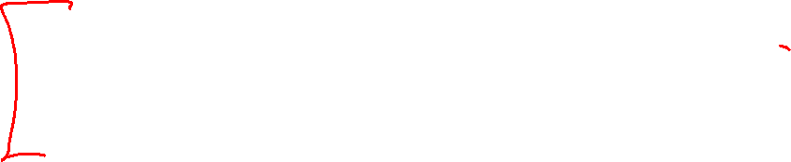
Overfitting
Definition: The problem of overfitting is when the model captures the noise in the training data instead of the underlying structure
Overfitting can occur in all the models we’ve seen so far:
  Decision Trees (e.g. when tree is too deep)
  K-NN (e.g. when k is small)
  Linear Regression (e.g. with nonlinear features or extraneous features)
  Logistic Regression (e.g. with nonlinear features or extraneous features)
  Neural networks
Slide credit: CMU MLD Matt Gormley

Slide 14
Motivation: Regularization
Occam’s Razor: prefer the simplest hypothesis
What does it mean for a hypothesis (or model) to be simple?
  small number of features (model selection)
  small number of “important” features (shrinkage)
Slide credit: CMU MLD Matt Gormley

Slide 15
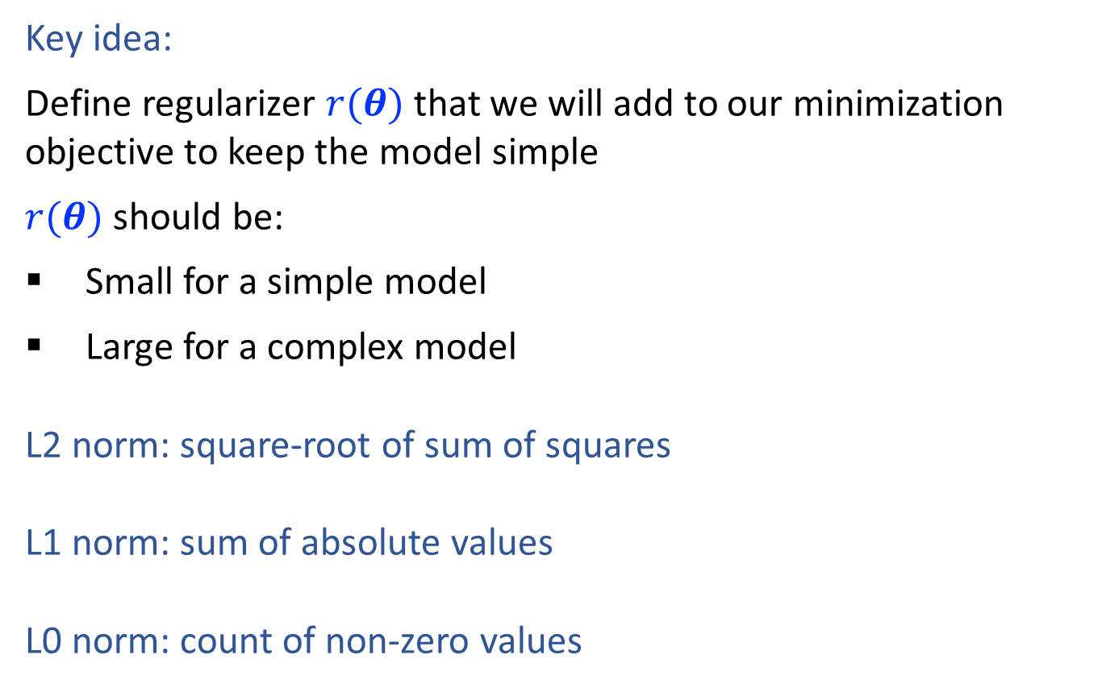
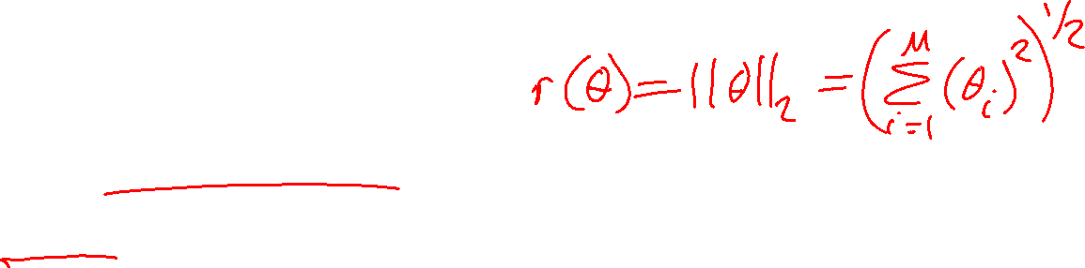
Regularization
Key idea:
Define regularizer $r(θ)$ that we will add to our minimization objective to keep the model simple
$r(θ)$ should be:
Small for a simple model
Large for a complex model
L2 norm: square-root of sum of squares
L1 norm: sum of absolute values
L0 norm: count of non-zero values
Slide credit: CMU MLD Matt Gormley

Slide 16

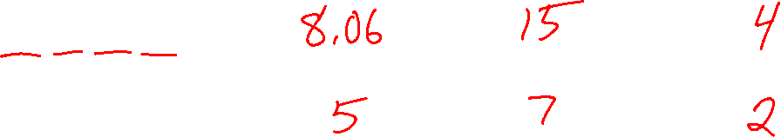
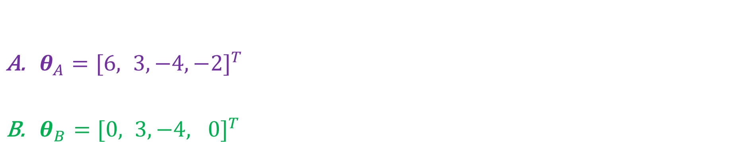


Regularization
$${\left\|θ\right\|}_{2}$$
$${\left\|θ\right\|}_{1}$$
$${\left\|θ\right\|}_{0}$$
$θ_{A}={[6, 3, −4, −2]}^{T}$
$θ_{B}={[0, 3, −4, 0]}^{T}$

Slide 17
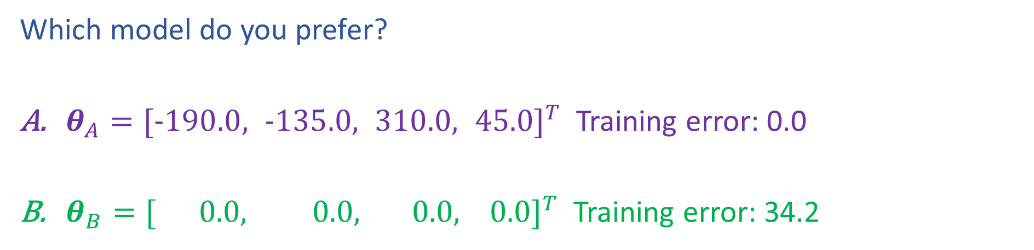
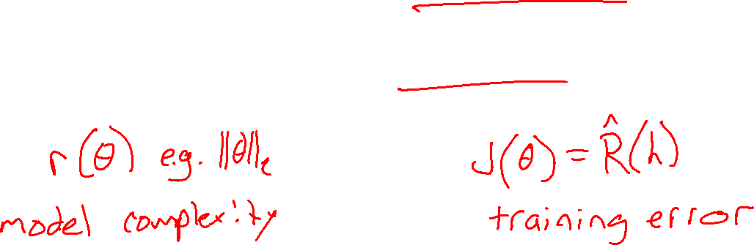
Poll 2
Which model do you prefer?
$θ_{A}={[−190.0, −135.0, 310.0, 45.0]}^{T}$ Training error: 0.0
$θ_{B}={[ 0.0, 0.0, 0.0, 0.0]}^{T}$ Training error: 34.2

Slide 18
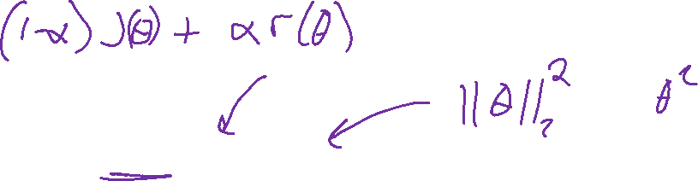
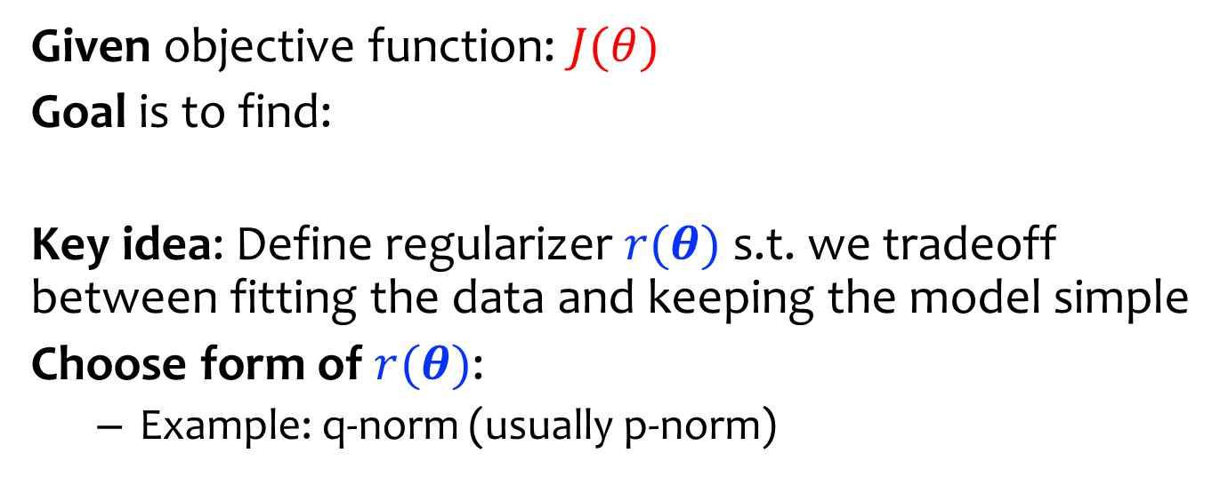
Regularization
Given objective function: $J(θ)$
Goal is to find:
Key idea: Define regularizer $r(θ)$ s.t. we tradeoff between fitting the data and keeping the model simple
Choose form of $r(θ)$:
  Example: q-norm (usually p-norm)
Slide credit: CMU MLD Matt Gormley

Slide 19
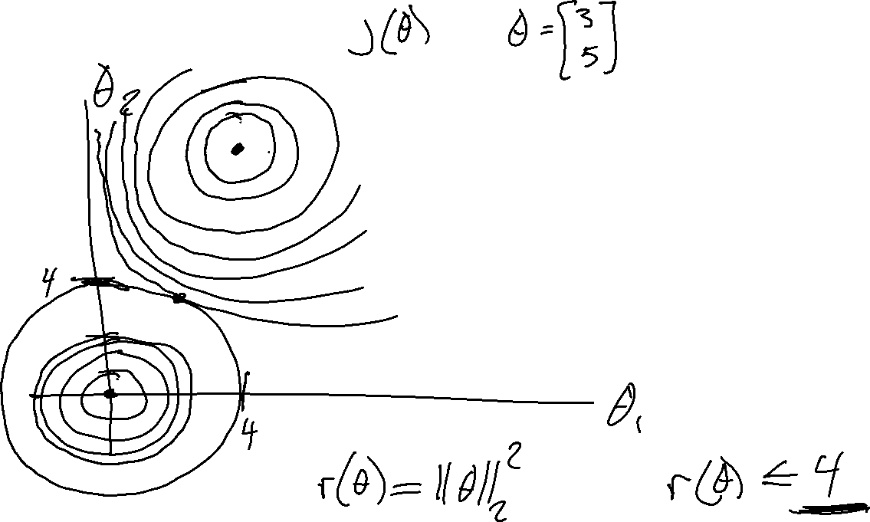
Regularization

Slide 20
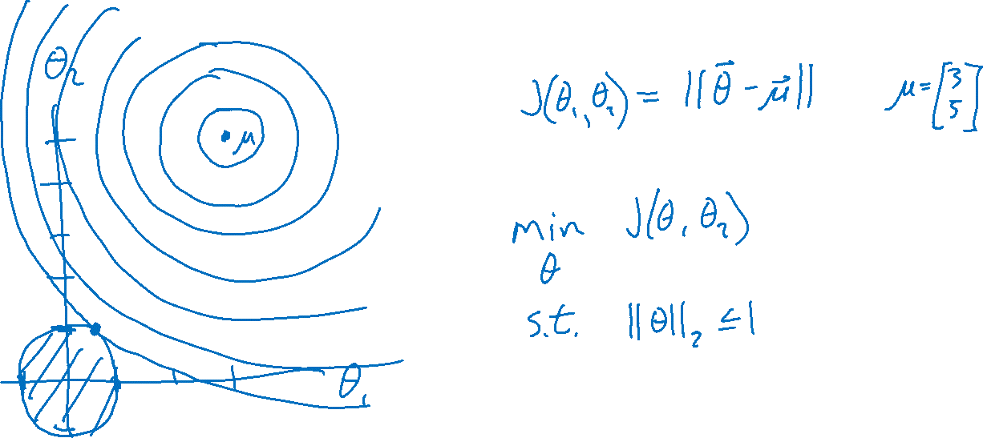
Regularization

Slide 21

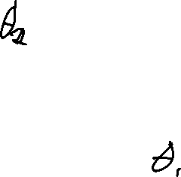
Poll 3
Question:
Suppose we are minimizing J’(θ) where
As λ increases, the minimum of J’(θ) will…
  …move towards the midpoint between J’(θ) and r(θ)
  …move towards the minimum of J(θ)
  …move towards the minimum of r(θ)
  …move towards a theta vector of positive infinities
  …move towards a theta vector of negative infinities
  …stay the same
Slide credit: CMU MLD Matt Gormley

Slide 22
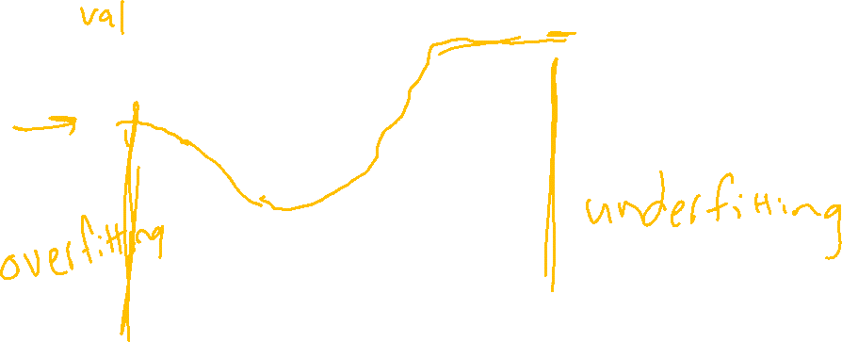
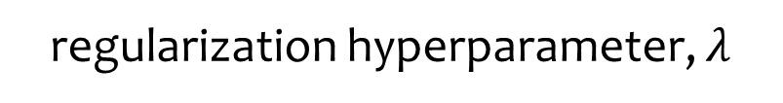
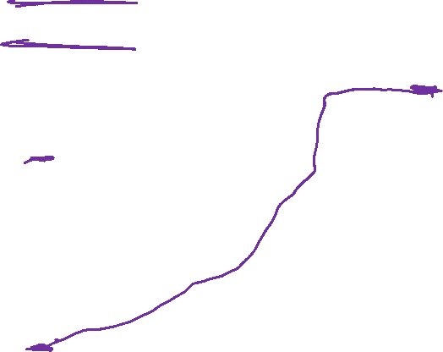
Regularization Exercise
In-class Exercise
Plot train error vs. regularization hyperparameter (cartoon)
Plot test error vs . regularization hyperparameter (cartoon)
error
Slide credit: CMU MLD Matt Gormley
regularization hyperparameter, $λ$

Slide 23

Poll 4
Question:
Suppose we are minimizing J’(θ) where
As we increase λ from zero, the validation error will…
  …increase
  …decrease
  …first increase, then decrease
  …first decrease, then increase
  …stay the same
Slide credit: CMU MLD Matt Gormley

Slide 24
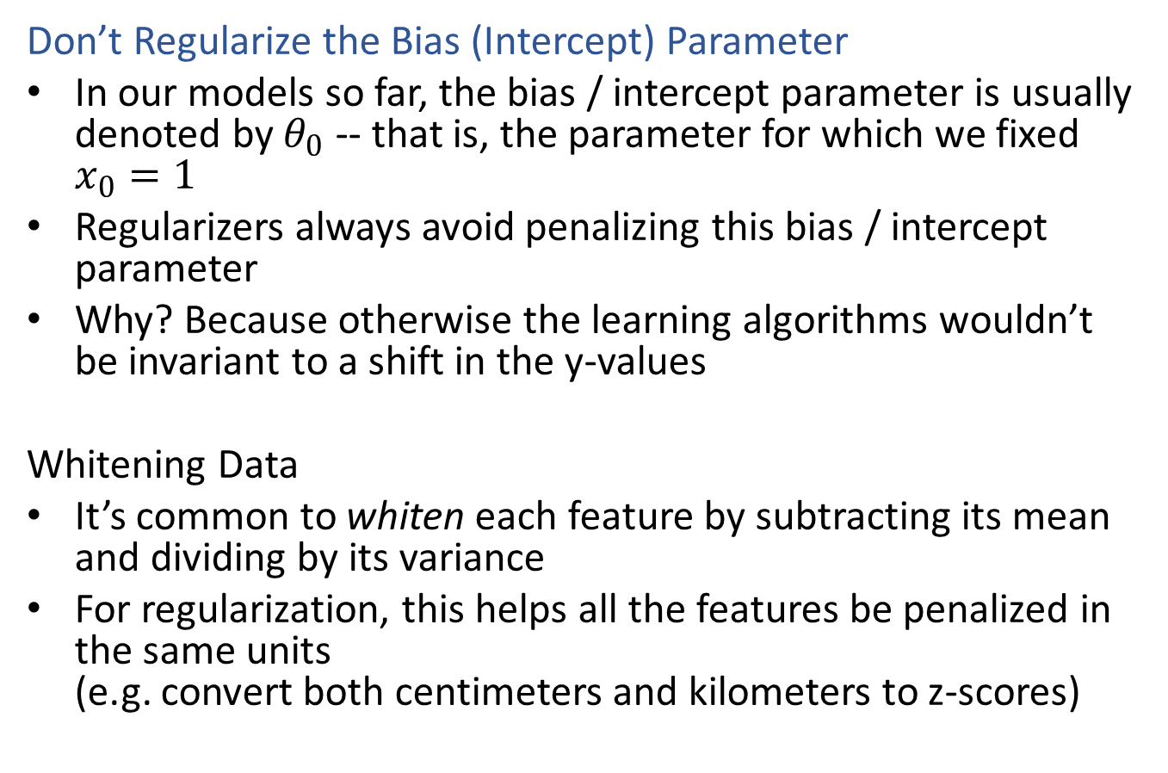

Regularization
Don’t Regularize the Bias (Intercept) Parameter
In our models so far, the bias / intercept parameter is usually denoted by $θ_{0}$ -- that is, the parameter for which we fixed $x_{0}=1$
Regularizers always avoid penalizing this bias / intercept parameter
Why? Because otherwise the learning algorithms wouldn’t be invariant to a shift in the y-values
Whitening Data
It’s common to whiten each feature by subtracting its mean and dividing by its variance
For regularization, this helps all the features be penalized in the same units
(e.g. convert both centimeters and kilometers to z-scores)
Slide credit: CMU MLD Matt Gormley

Slide 25
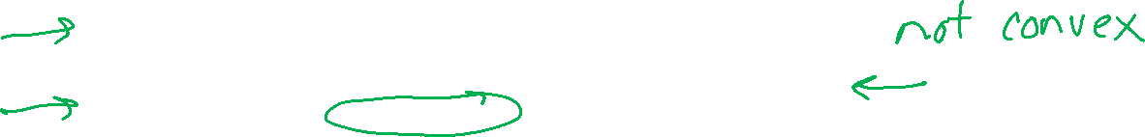
Regularization
Given objective function: $J(θ)$
Goal is to find:
Key idea: Define regularizer $r(θ)$ s.t. we tradeoff between fitting the data and keeping the model simple
Choose form of $r(θ)$:
  Example: q-norm (usually p-norm)
Slide credit: CMU MLD Matt Gormley

Slide 26
Regularization

Slide 27
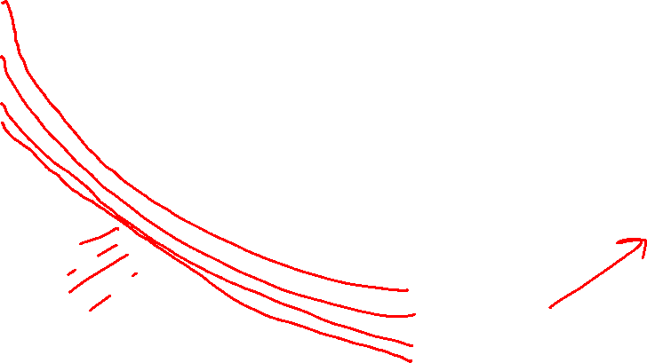
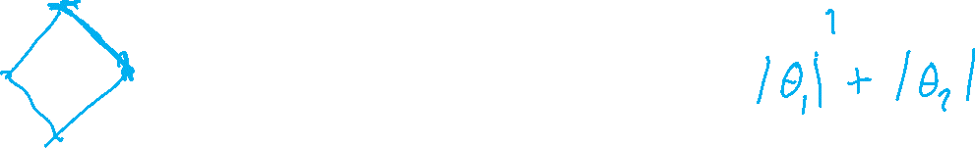
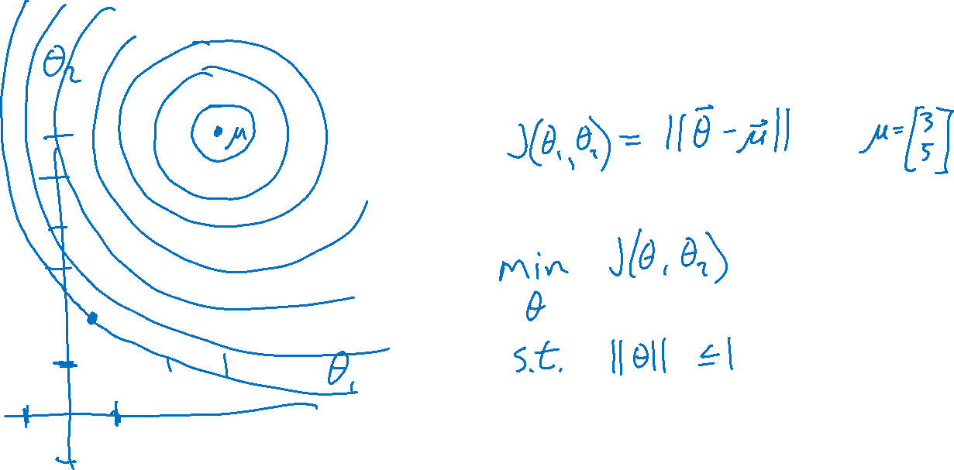
Regularization

Slide 28
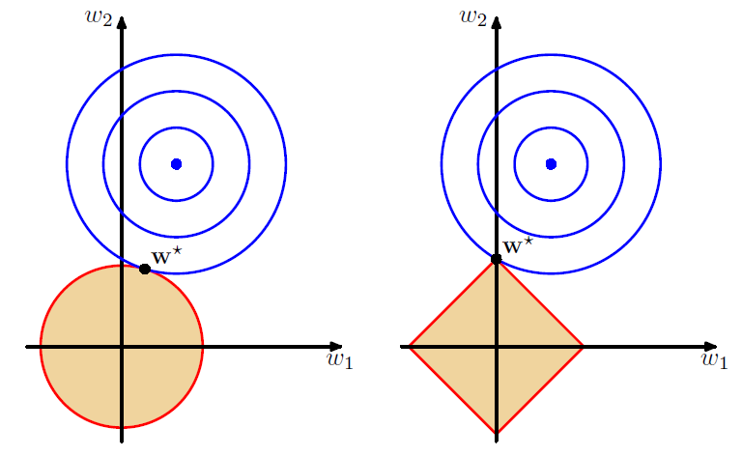
L2 vs L1 Regularization
Combine original objective with penalty on parameters
Figures: Bishop, Ch 3.1.4

Slide 29
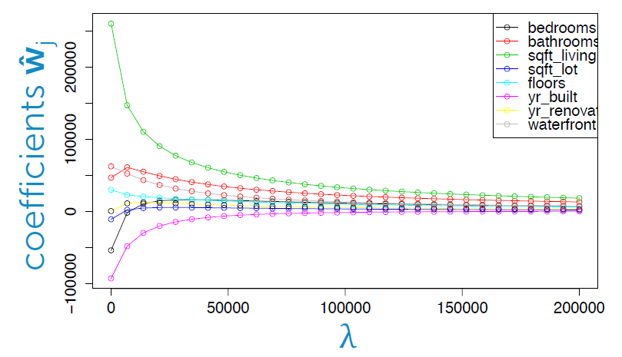
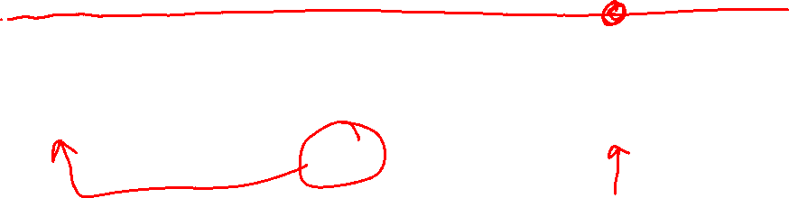
L2 vs L1: Housing Price Example
Predict housing price from several features
Figure: Emily Fox, University of Washington

Slide 30
L2 vs L1: Housing Price Example
Predict housing price from several features
Figure: Emily Fox, University of Washington

Slide 31
L2 vs L1: Housing Price Example
Predict housing price from several features
Figure: Emily Fox, University of Washington

Slide 32
L2 vs L1: Housing Price Example
Predict housing price from several features
Figure: Emily Fox, University of Washington

Slide 33
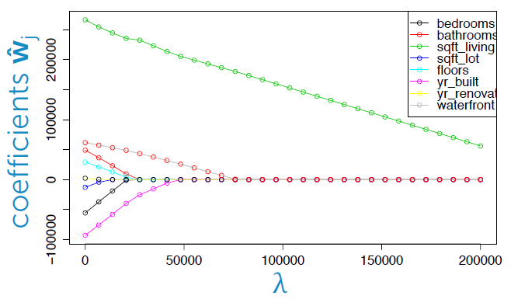

L2 vs L1: Housing Price Example
Predict housing price from several features
Figure: Emily Fox, University of Washington

Slide 34
L2 vs L1: Housing Price Example
Predict housing price from several features
Figure: Emily Fox, University of Washington

Slide 35
L2 vs L1: Housing Price Example
Predict housing price from several features
Figure: Emily Fox, University of Washington

Slide 36
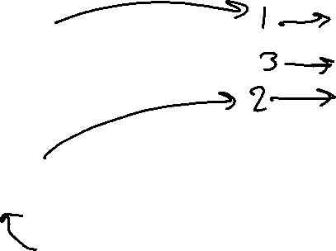
L2 vs L1: Housing Price Example
Predict housing price from several features
Figure: Emily Fox, University of Washington

Slide 37
L2 vs L1: Housing Price Example
Predict housing price from several features
Figure: Emily Fox, University of Washington

Slide 38
Regularization as MAP
L1 and L2 regularization can be interpreted as maximum a-posteriori (MAP) estimation of the parameters
To be discussed later in the course…
Slide credit: CMU MLD Matt Gormley

Slide 39
Optimization

Slide 40
Takeaways
Nonlinear basis functions allow linear models (e.g. Linear Regression, Logistic Regression) to capture nonlinear aspects of the original input
Nonlinear features require no changes to the model (i.e. just preprocessing)
Regularization helps to avoid overfitting
(Regularization and MAP estimation are equivalent for appropriately chosen priors)
Slide credit: CMU MLD Matt Gormley

Slide 41
Feature Engineering / Regularization Objectives
You should be able to…
Engineer appropriate features for a new task
Use feature selection techniques to identify and remove irrelevant features
Identify when a model is overfitting
Add a regularizer to an existing objective in order to combat overfitting
Convert linearly inseparable dataset to a linearly separable dataset in higher dimensions
Describe feature engineering in common application areas

Slide 42
Additional Slides

Slide 43
Logistic Regression with Nonlinear Features
Jupyter notebook demo

Slide 44
Example: Logistic Regression
For this example, we construct nonlinear features (i.e. feature engineering)
Specifically, we add polynomials up to order 9 of the two original features x₁ and x₂
Thus our classifier is linear in the high-dimensional feature space, but the decision boundary is nonlinear when visualized in low-dimensions (i.e. the original two dimensions)
Training Data
Test
Data
Slide credit: CMU MLD Matt Gormley

Slide 45
Example: Logistic Regression
error
lambda
Slide credit: CMU MLD Matt Gormley

Slide 46

Example: Logistic Regression
Slide credit: CMU MLD Matt Gormley

Slide 47
Example: Logistic Regression
Slide credit: CMU MLD Matt Gormley

Slide 48
Example: Logistic Regression
Slide credit: CMU MLD Matt Gormley

Slide 49
Example: Logistic Regression
Slide credit: CMU MLD Matt Gormley

Slide 50
Example: Logistic Regression
Slide credit: CMU MLD Matt Gormley

Slide 51
Example: Logistic Regression
Slide credit: CMU MLD Matt Gormley

Slide 52
Example: Logistic Regression
Slide credit: CMU MLD Matt Gormley

Slide 53
Example: Logistic Regression
Slide credit: CMU MLD Matt Gormley

Slide 54
Example: Logistic Regression
Slide credit: CMU MLD Matt Gormley

Slide 55
Example: Logistic Regression
Slide credit: CMU MLD Matt Gormley

Slide 56
Example: Logistic Regression
Slide credit: CMU MLD Matt Gormley

Slide 57

Example: Logistic Regression
Slide credit: CMU MLD Matt Gormley

Slide 58
Example: Logistic Regression
Slide credit: CMU MLD Matt Gormley

Slide 59
Example: Logistic Regression
error
lambda
Slide credit: CMU MLD Matt Gormley

