Slide 1
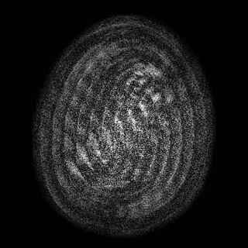
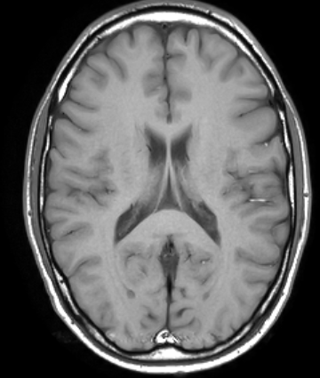
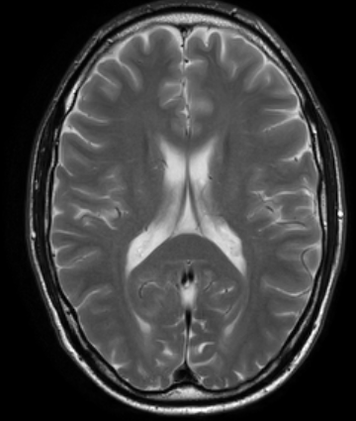
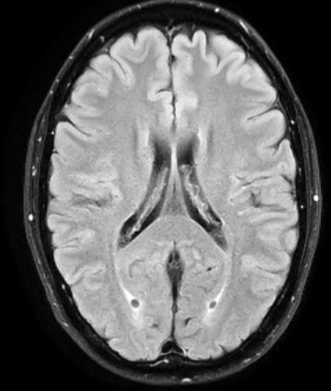
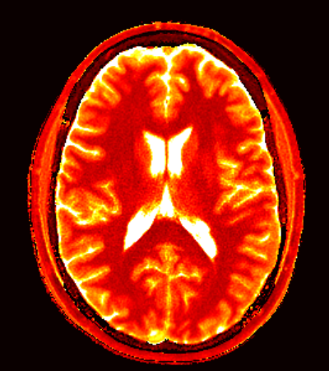
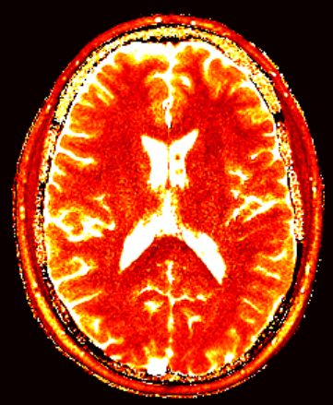
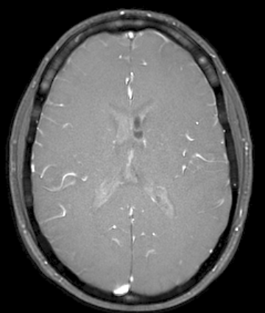
MR Fingerprinting and Contrast-weighted Images
MRF
T1w
T2w
FLAIR
4 min.
3 min.
1 min.
6 min.
T1
T2
PD
1

Slide 2
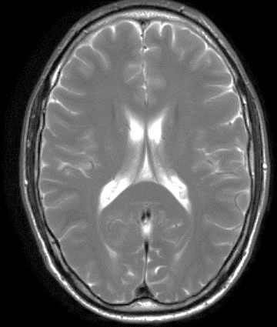
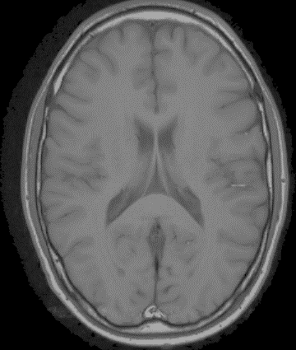
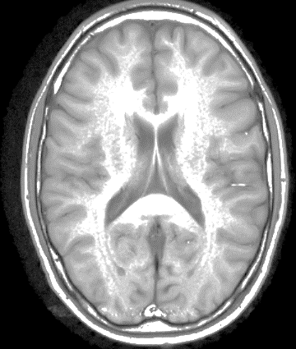

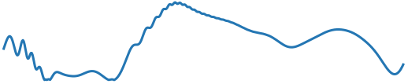
MR Fingerprinting
0
250
500
Time Index

Slide 3
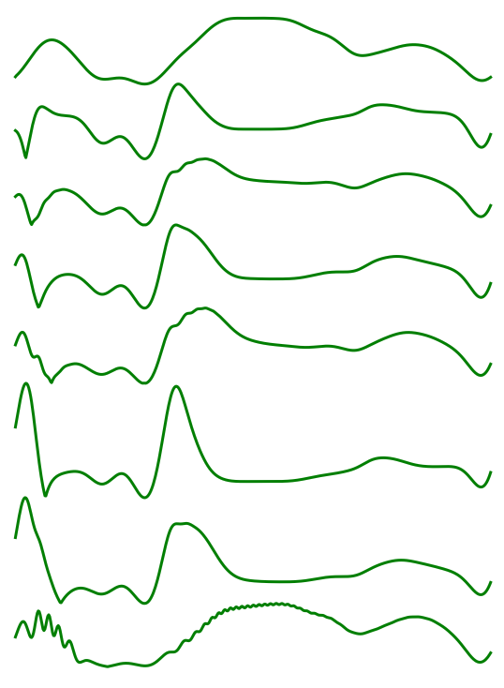
MR Fingerprinting
(T1, T2)
Dictionary Signal
(2960, 1920)
(2200, 64)
(1700, 18)
(1260, 148)
(900, 52)
0
250
500
T1
T2
(640, 128)
T1, T2 = (900, 52)
(350, 14)
(4, 2)

Slide 4
MR Fingerprinting
Ma, Dan, et al. "Magnetic Resonance Fingerprinting." Nature 495.7440 (2013): 187-192.
Virtue, Patrick, X. Yu Stella, and Michael Lustig. "Better than real: Complex-valued neural nets for MRI fingerprinting." 2017 IEEE International Conference on Image Processing (ICIP). IEEE, 2017.
MRI Noise
Macovski, Albert. "Noise in MRI." Magnetic Resonance in Medicine 36.3 (1996): 494-497.

