Slide 1

Announcements
Assignments:
HW4
    Release delayed to tomorrow
    Due date delayed to Thu, 2/20, 11:59 pm
Midterm Conflicts
See Piazza post

Slide 2
Plan
Last time
Wrap up MLE vs MAP
Intro to Naïve Bayes
Today
MLE vs MAP
Naïve Bayes Assumptions
Naïve Bayes MLE
Naïve Bayes MAP
Generative Models

Slide 3
Introduction to
Machine Learning
Generative Models
Instructor: Pat Virtue

Slide 4
SPAM Detection Handout

Slide 5
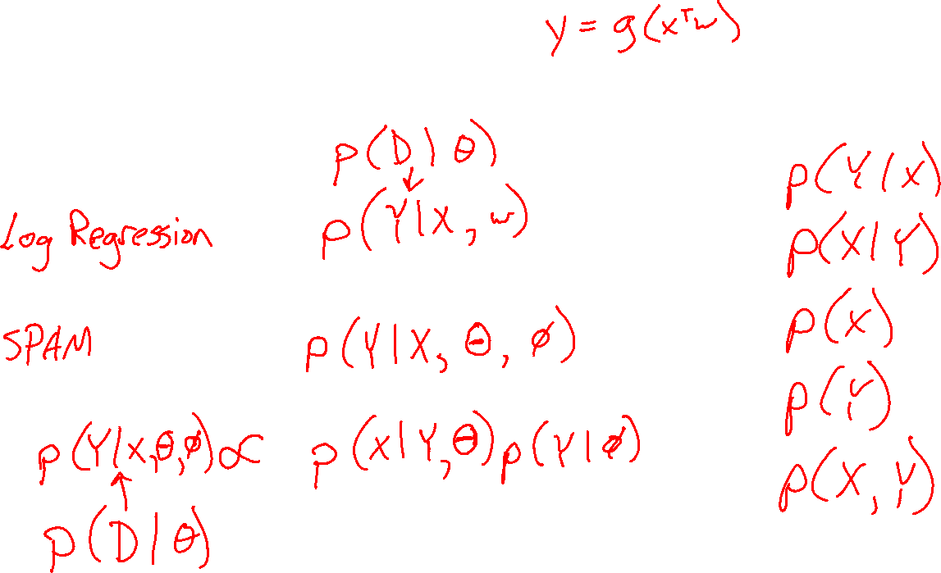
Previous Piazza Poll
What method were we using to estimate parameters in our Naïve Bayes handout?

Slide 6
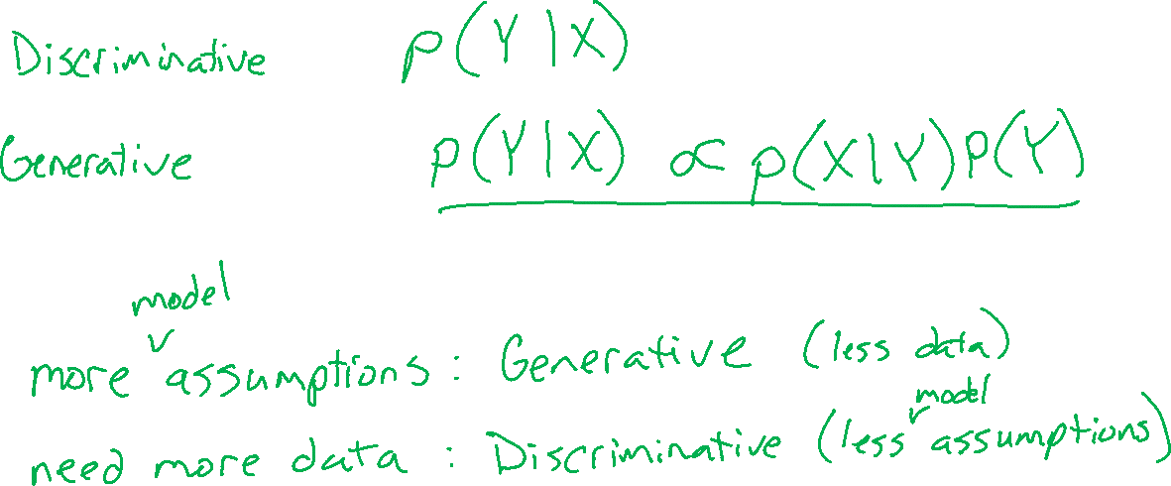
Generative vs Discriminative

Slide 7
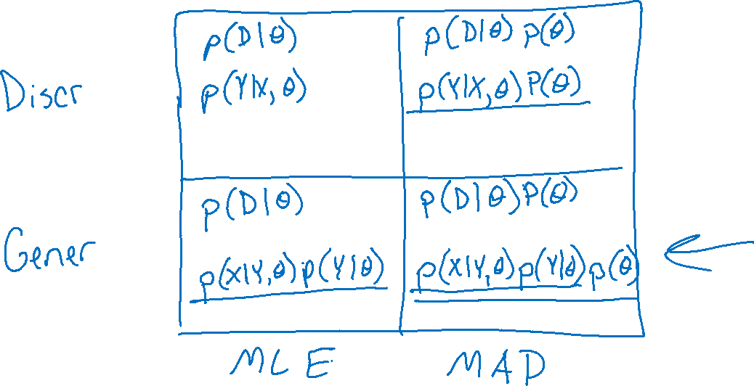
MLE vs MAP vs Generative vs Discriminative

Slide 8
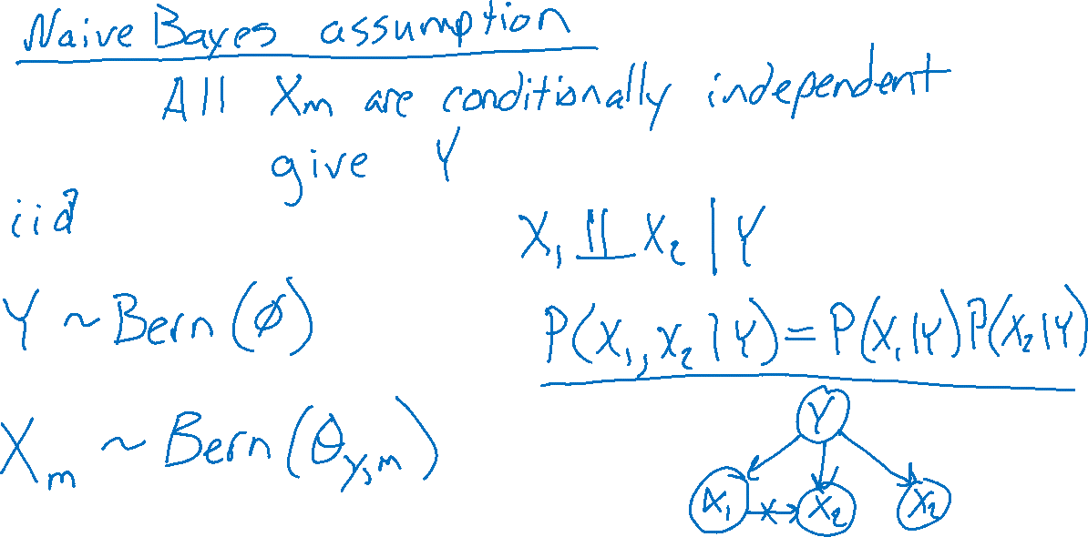
SPAM Detection Data and Assumptions

Slide 9
Naïve Bayes MLE
Whiteboard

Slide 10

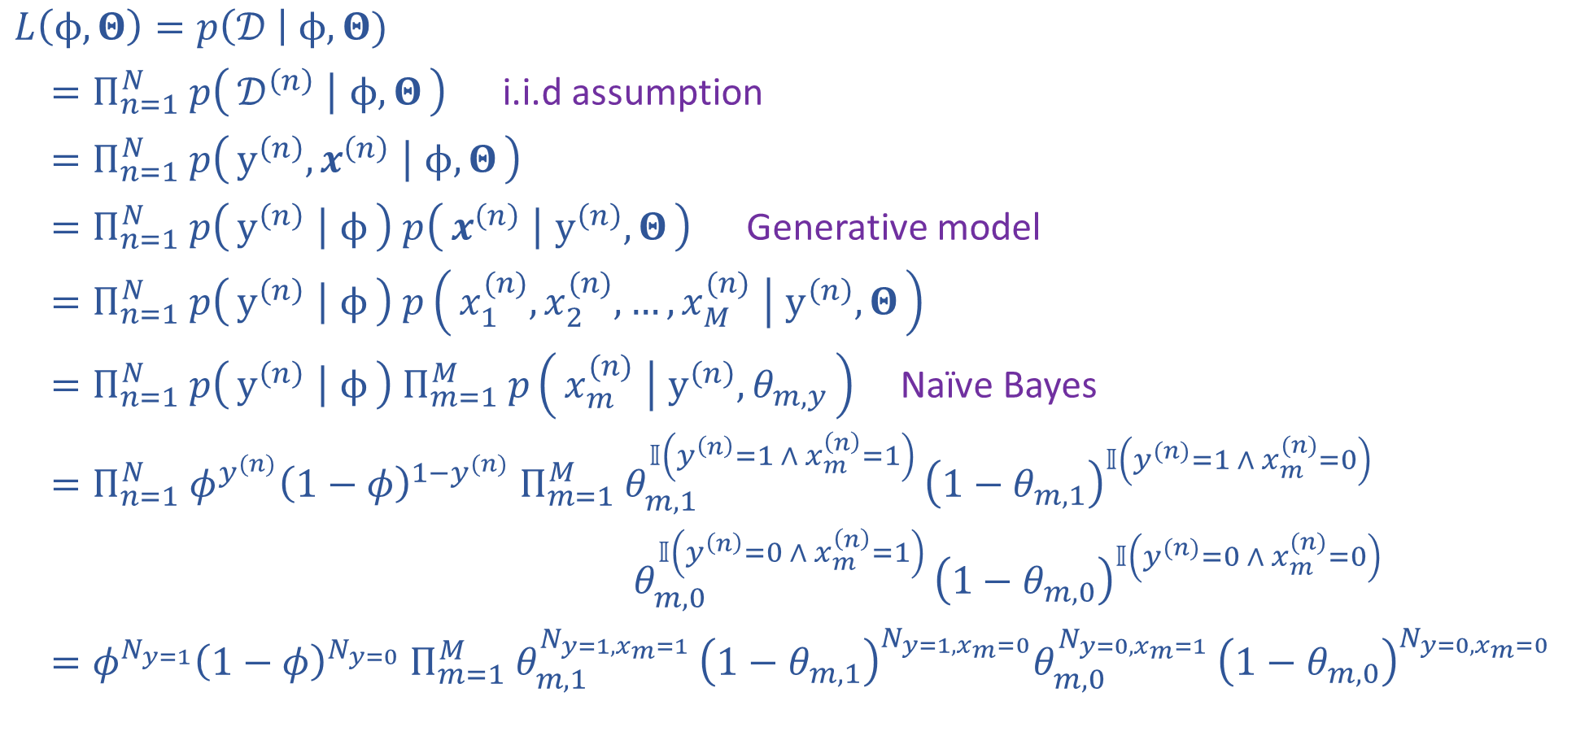
Naïve Bayes MLE
$𝒟={\left\{y^{\left(n\right)}, x^{(n)}\right\}}_{n=1}^{N}$
$y^{(n)}∈\{0,1\}$
$x^{(n)}∈{\left\{0,1\right\}}^{M}$
$φ∈[0,1]$
$Θ∈{\left[0,1\right]}^{Mx2}$
$L\left(ϕ, Θ\right)=p\left(𝒟 \right| ϕ, Θ)$
$=Π_{n=1}^{N} p\left(𝒟^{\left(n\right)} ∣ ϕ, Θ\right)$ i.i.d assumption
$=Π_{n=1}^{N} p\left(y^{\left(n\right)}, x^{\left(n\right)} ∣ ϕ, Θ\right)$
$=Π_{n=1}^{N} p\left(y^{\left(n\right)} ∣ ϕ\right) p\left(x^{\left(n\right)} ∣ y^{\left(n\right)}, Θ\right)$ Generative model
$=Π_{n=1}^{N} p\left(y^{\left(n\right)} ∣ ϕ\right) p\left(x_{1}^{(n)},x_{2}^{(n)},…,x_{M}^{(n)} ∣ y^{\left(n\right)}, Θ\right)$
$=Π_{n=1}^{N} p\left(y^{\left(n\right)} ∣ ϕ\right) Π_{m=1}^{M} p\left(x_{m}^{(n)} ∣ y^{\left(n\right)}, θ_{m,y}\right)$ Naïve Bayes
$=Π_{n=1}^{N} φ^{y^{(n)}}{\left(1−φ\right)}^{1−y^{(n)}} Π_{m=1}^{M} θ_{m,1}^{𝕀\left(y^{\left(n\right)}=1 ∧ x_{m}^{\left(n\right)}=1\right) }{\left(1−θ_{m,1}\right)}^{𝕀\left(y^{(n)}=1 ∧ x_{m}^{(n)}=0\right)}$
$θ_{m,0}^{𝕀\left(y^{\left(n\right)}=0 ∧ x_{m}^{\left(n\right)}=1\right) }{\left(1−θ_{m,0}\right)}^{𝕀\left(y^{(n)}=0 ∧ x_{m}^{(n)}=0\right)}$
$=φ^{N_{y=1}}{\left(1−φ\right)}^{N_{y=0}} Π_{m=1}^{M} θ_{m,1}^{N_{y=1,x_{m}=1} }{\left(1−θ_{m,1}\right)}^{N_{y=1,x_{m}=0}}θ_{m,0}^{N_{y=0,x_{m}=1} }{\left(1−θ_{m,0}\right)}^{N_{y=0,x_{m}=0}}$

Slide 11
Naïve Bayes MAP
Laplace Smoothing

Slide 12
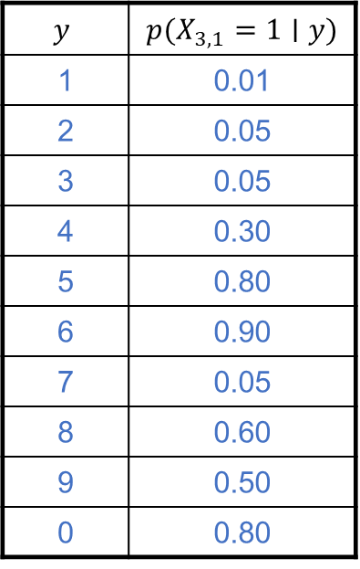
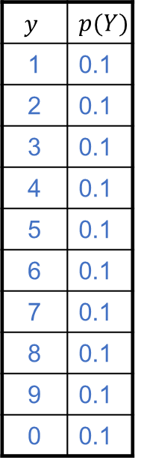
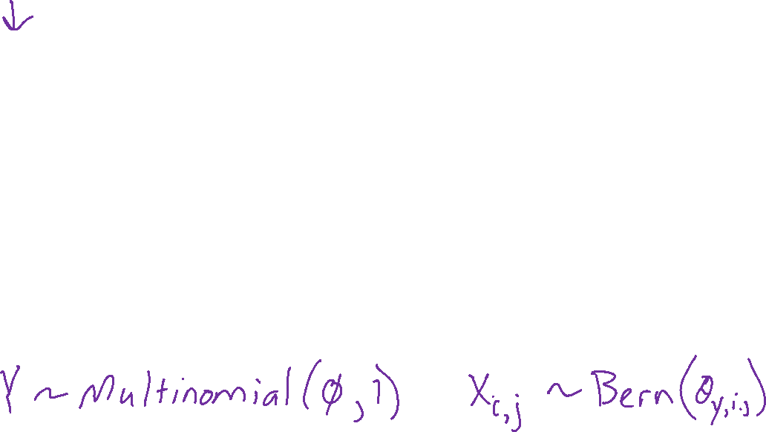
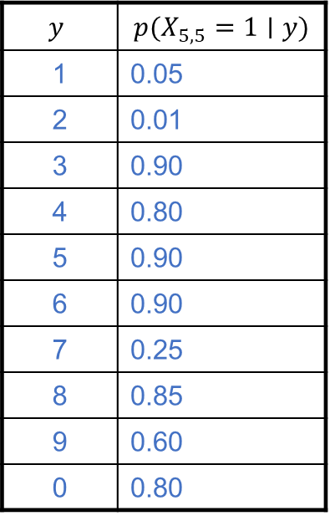
Naïve Bayes for Digits
$$y$$ | $$p(Y)$$
1 | 0.1
2 | 0.1
3 | 0.1
4 | 0.1
5 | 0.1
6 | 0.1
7 | 0.1
8 | 0.1
9 | 0.1
0 | 0.1
$$y$$ | $$p(X_{3,1}=1∣y)$$
1 | 0.01
2 | 0.05
3 | 0.05
4 | 0.30
5 | 0.80
6 | 0.90
7 | 0.05
8 | 0.60
9 | 0.50
0 | 0.80
$$y$$ | $$p(X_{5,5}=1∣y)$$
1 | 0.05
2 | 0.01
3 | 0.90
4 | 0.80
5 | 0.90
6 | 0.90
7 | 0.25
8 | 0.85
9 | 0.60
0 | 0.80

Slide 13
Generative Models with Continuous Features
Bernoulli class distribution with Gaussian class-conditional distribution

