Slide 1
Announcements
Assignments:
HW3
Due Tomorrow, 2/11, 11:59 pm
HW4
Plan to release tomorrow
Due Tue, 2/18, 11:59 pm

Slide 2
Plan
Last time
Linear regression with regularization
MLE vs MAP
Today
Wrap up MLE vs MAP
Intro to Naïve Bayes

Slide 3
Ridge Regression
Linear regression with $ℓ_{2}$ penalty on weights
$J\left(w\right)=\frac{1}{2}{\left\|y−Xw\right\|}_{2}^{2}+\frac{1}{2}λ{\left\|w\right\|}_{2}^{2}$
${=\frac{1}{2}[y}^{T}y −{2w}^{T}X^{T}y+w^{T}X^{T}Xw+λw^{T}w]$
Compute gradient
$∇J\left(w\right)={−X}^{T}y+X^{T}Xw+λw$
Closed form solution:
${−X}^{T}y+X^{T}Xw+λw=0$
$X^{T}Xw+λw= X^{T}y$
${(X}^{T}X+ λ)w= X^{T}y$ Not quite $\left(A+7\right)z≠Az+7z$
${(X}^{T}X+ λI)w= X^{T}y$
$w={\left(X^{T}X+ λI\right)}^{−1}X^{T}y$
A robust solution to make $X^{T}X$ invertible

Slide 4
MLE and MAP

Slide 5
Probabilistic Ridge Regression
Linear regression with Gaussian prior on weights

Slide 6
Previous Poll
Given the optimization of our new objective:
$$\hat{w}=\min_{w}{ {\left\|y−Xw\right\|}_{2}^{2} + λ{\left\|w\right\|}_{2}^{2}}$$
Select ALL that are true:
As $λ→0$, $\hat{w}→$ point $A$
As $λ→0$, $\hat{w}→$ point $B$
As $λ→∞$, $\hat{w}→$ point $A$
As $λ→∞$, $\hat{w}→$ point $B$
None of the above
I have no clue

Slide 7
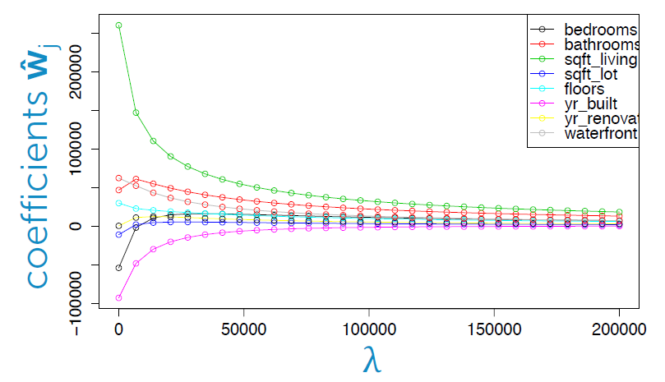
Housing Price Example
Predict housing price from several features
Figure: Emily Fox, University of Washington

Slide 8
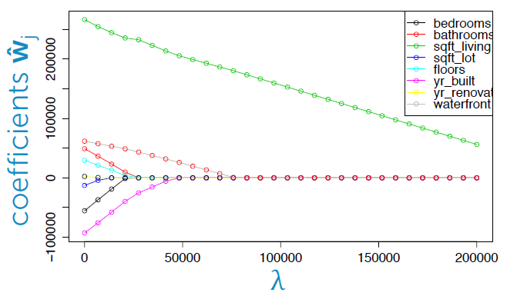
Housing Price Example
Predict housing price from several features
Figure: Emily Fox, University of Washington

Slide 9
Regularization
Combine original objective with penalty on parameters
$ℓ_{2}, ℓ_{1},ℓ_{0}$ norms

Slide 10
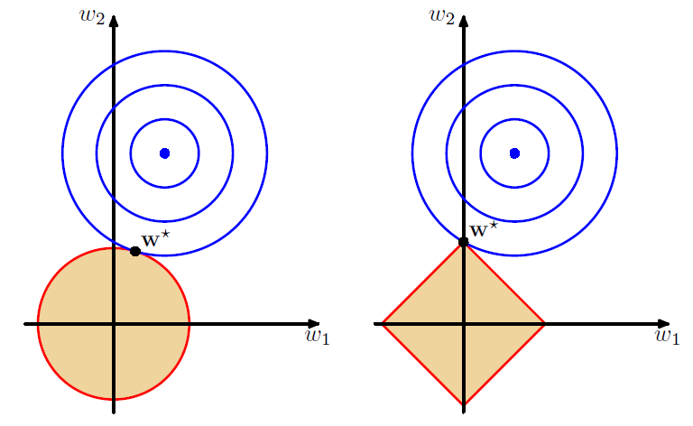
Regularization
Combine original objective with penalty on parameters
Figures: Bishop, Ch 3.1.4

Slide 11
LASSO
Linear regression with $ℓ_{1}$ penalty on weights

Slide 12
LASSO
Linear regression with $ℓ_{1}$ penalty on weights
$J\left(w\right)=\frac{1}{2}{\left\|y−Xw\right\|}_{2}^{2}+\frac{1}{2}λ{\left\|w\right\|}_{1}$
${=\frac{1}{2}[y}^{T}y −{2w}^{T}X^{T}y+w^{T}X^{T}Xw+\sum_{m}{\left|w_{m}\right|}]$
Probabilistic interpretation
Laplace prior on weights
$w∼Laplace(μ=0, b)$
$f\left(w ∣ b\right)=\frac{1}{2b}e^{\left(−\frac{|x|}{b}\right)}$

Slide 13
Introduction to Machine Learning
Naïve Bayes
Instructor: Pat Virtue

Slide 14
SPAM Detection Handout

Slide 15
Piazza Poll 1
What method were we using to estimate parameters in our Naïve Bayes handout?

Slide 16
SPAM Detection Data and Assumptions

Slide 17
Naïve Bayes Parameter Estimation

Slide 18
Naïve Bayes for Digits
1 | 0.1
2 | 0.1
3 | 0.1
4 | 0.1
5 | 0.1
6 | 0.1
7 | 0.1
8 | 0.1
9 | 0.1
0 | 0.1
1 | 0.01
2 | 0.05
3 | 0.05
4 | 0.30
5 | 0.80
6 | 0.90
7 | 0.05
8 | 0.60
9 | 0.50
0 | 0.80
1 | 0.05
2 | 0.01
3 | 0.90
4 | 0.80
5 | 0.90
6 | 0.90
7 | 0.25
8 | 0.85
9 | 0.60
0 | 0.80

Slide 19
Generative vs Discriminative

Slide 20
Laplace Smoothing

